Slide 1

The application of micro-beam X-ray fluorescence spectrometry (micro-XRF) in the study of the metal artefacts of four sanctuaries at Tegea, Arcadia, Greece
(10th-7th c. BCE)
Kladouri, N.K.

Slide 2
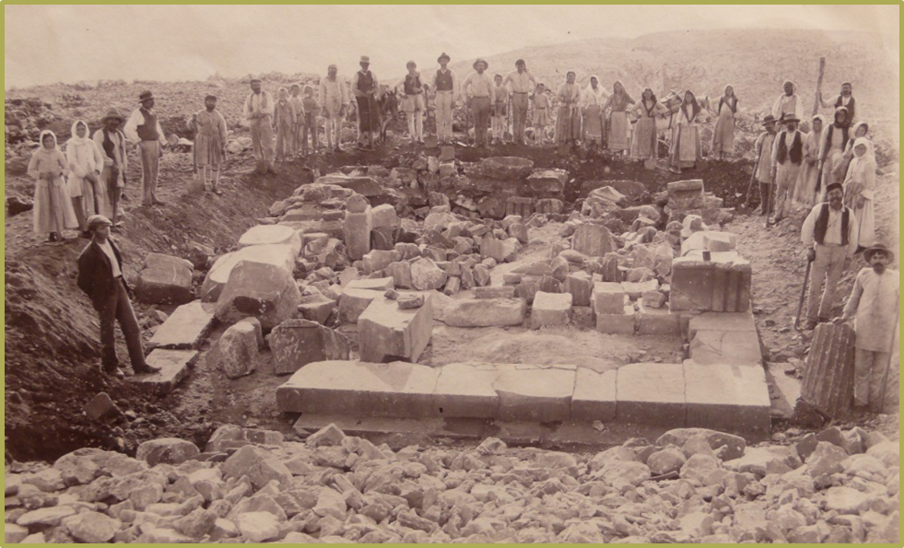
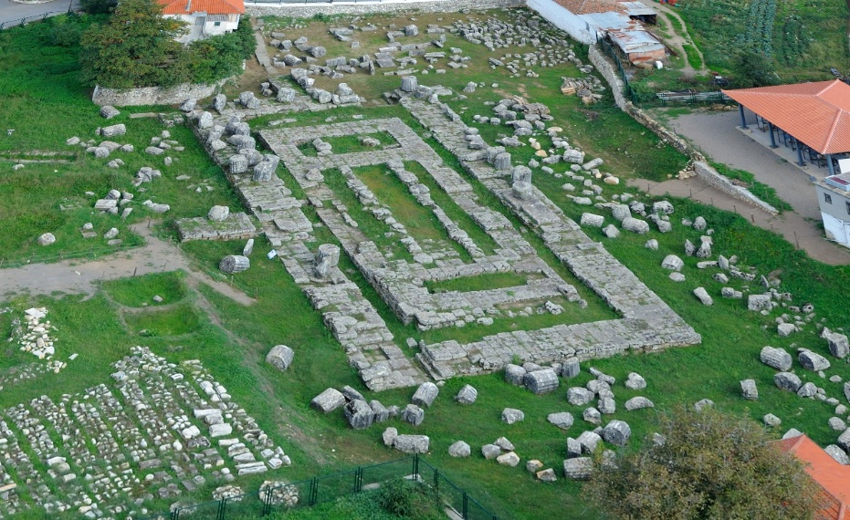
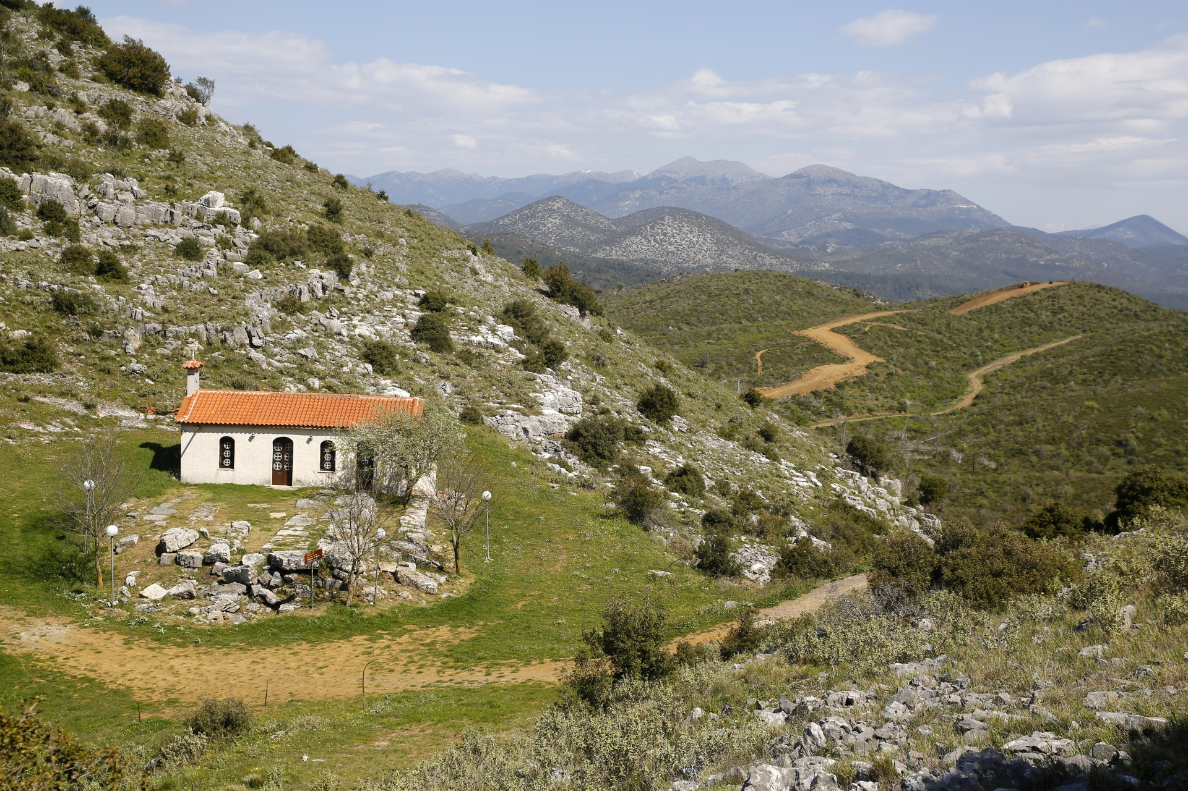
The archaeological context
Map showing the location of the sanctuaries at Tegea in central Peloponnese, Greece
The sanctuary of Artemis at Mavriki, in 1907
The sanctuary of Athena Alea
The sanctuary of Athena and Zeus at Vigla

Slide 3
Objectives
250 copper objects, of subsequent periods from the 10th to the 7th centuries, were analysed in order to document:
their metal alloying components
the metallurgical practices in each of the four sanctuaries
the chronological development of the metallurgical technology of the sanctuaries
the evaluation of the technological and typological characteristics of the objects
the characteristics of one or more possible workshops in the sanctuary of Alea

Slide 4
Archaeological samples
Photographs showing part of the sanctuaries’ objects

Slide 5
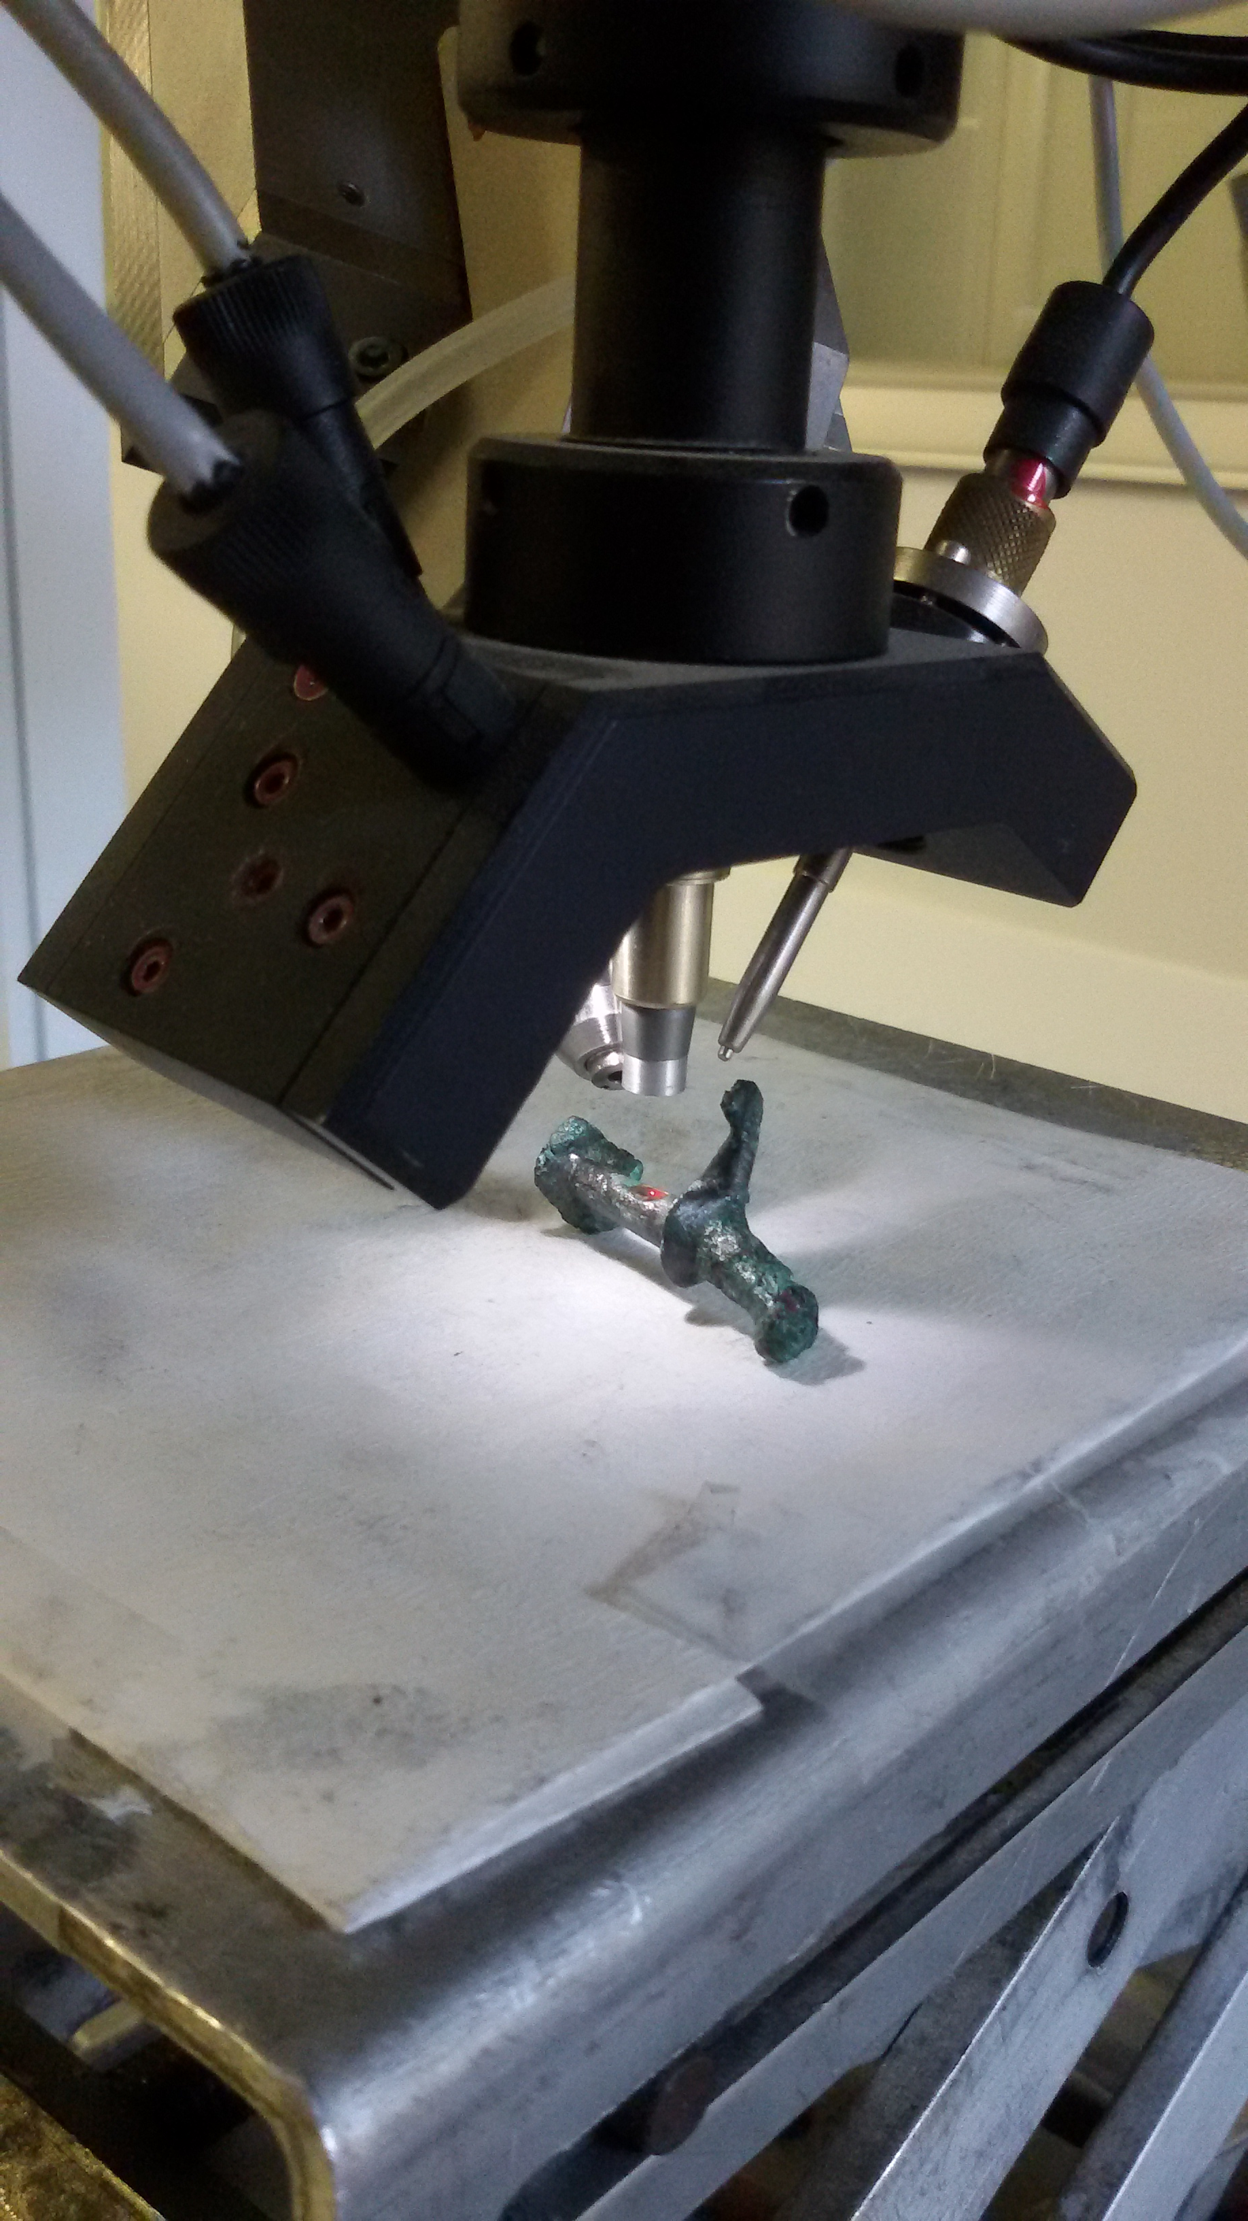
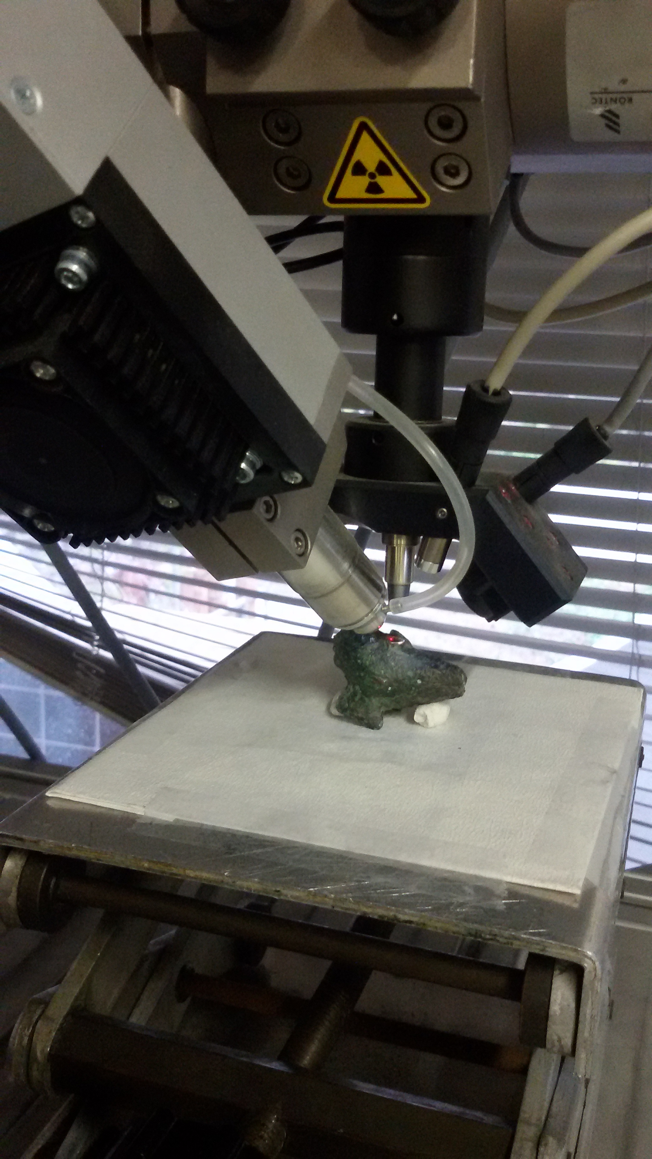
Experimental setup
Micro XRF: customized version of the micro XRF spectrometer Artax (Bruker-Nano).
Settings: filter Co-Ti-Pd, voltage 50kV, current 600μA, line scan mode, six measurements, 50 sec/100 μm step size.
Photograph showing the setup of the portable micro X-ray fluorescence spectrometer (μ-XRF) during the measurement of two bronze objects at the Institute of Nuclear and Particle Physics of the NCSR “Demokritos”, Athens.

Slide 6
Reference samples
MBH 39X 17868 AG
Element | Certified | Σ | Measured | Σ | Dev.%
Cu | 99.17 | 0 | 99.18 | 0 | -0.01
Sn | 0.103 | 0.003 | 0.163 | 0.016 | -58.5
Pb | 0.1040 | 0.002 | 0.09554 | 0.003 | 8.1
Zn | 0.1970 | 0.005 | 0.154 | 0.011 | 21.6
Fe | 0.1100 | 0.004 | 0.1020 | 0.002 | 7.3
Ni | 0.0222 | 0.0008 | <LoQ | - | -
Co | 0.0248 | 0.0005 | 0.02973 | 0.0013 | -19.9
Al | 0.0072 | 0.0011 | <LoQ | - | -
As | 0.0226 | 0.0005 | 0.01458 | 0.002 | 35.5
Mn | 0.0123 | 0.0005 | 0.01195 | 0.002 | 2.9
Sb | 0.0300 | 0.002 | <LoQ | - | -
P | 0.0510 | 0.003 | <LoQ | - | -
Bi | 0.0308 | 0.0009 | 0.02719 | 0.002 | 11.7
Cd | 0.0130 | 0.0004 | <LoQ | - | -
Ag | 0.0249 | 0.0008 | <LoQ | - | -
Au | 0.0101 | 0.0006 | 0.00973 | 0.002 | 3.7
Mg | 0.0085 | 0.0010 | <LoQ | - | -
S | 0.0220 | 0.002 | <LoQ | - | -
Se | 0.0133 | 0.0010 | 0.01632 | 0.0010 | -22.7
Te | 0.0206 | 0.0010 | <LoQ | - | -
In | 0.0076 | 0.0004 | <LoQ | - | -
Comparison of the elemental concentrations determined by means of the μ-XRF analysis (area scan mode, 110 measurements, 10 sec/100 μm step size) for the following reference copper alloys: BAM-374, NIST-1107 and ΜΒΗ 39X 17868 AG. For the BCR-691E a line scan was performed (six measurements, 50 sec/100 μm step size). The presented elemental concentrations are reported in % wt. and for each alloy the normalization condition to 100% was applied. Σ=relative error. Dev %=Deviation among measurements.
Reference sample / | BCR-691_{E} |  |  |  |  | NIST-1107 |  |  |  |  | BAM-374
Element% | Certified | Σ | Measured | Σ | Dev % | Certified | Σ | Measured | Σ | Dev % | Certified | Σ | Measured | Σ | Dev %
Cu | 92.4 | - | 91.8 | 0.06 | 0.66 | 61.2 | 0.074 | 61.1 | 0.02 | 0.1 | 92.22 | 0.05 | 92.3 | 0.04 | -0.1
Zn | 0.15 | 0.02 | 0.126 | 0.012 | 15.6 | 37.4 | 0.084 | 37.5 | 0.02 | -0.2 | - | - | - | - | -
As | 0.19 | 0.02 | 0.1924 | 0.004 | -1.3 | - | - | - | - | - | - | - | - | - | -
Sn | 7.0 | 0.6 | 7.70 | 0.09 | -10.0 | 1.07 | 0.015 | 1.13 | 0.02 | -5.9 | 7.6 | 0.13 | 7.67 | 0.05 | -0.9
Pb | 0.204 | 0.01 | 0.1945 | 0.005 | 4.6 | 0.19 | 0.0024 | 0.1354 | 0.003 | 28.7 | - | - | - | - | -
Fe | - | - | - | - | - | 0.04 | 0.0032 | 0.04030 | 0.002 | -0.7 | - | - | - | - | -
Ni | - | - | - | - | - | 0.09 | 0.0037 | 0.08491 | 0.002 | 5.7 | - | - | - | - | -
P | - | - | - | - | - | - | - | - | - | - | 0.17 | 0.008 | <LoQ | - | -

Slide 7
Micro-XRF spectra for AL4, AL8 and high purity copper foil Cu 41504

Slide 8
Results
Elemental concentration of the mean values of the elements detected on the objects with the micro-XRF method, normalized to 100% and expressed in % wt. σEl= % relative error due to the peak statistical uncertainty, LoQ=Limit of Quantification.
Element/ Sample | Cu% | σCu% | Sn% | σSn% | As % | σAs% | Pb% | σPb% | Fe % | σFe% | Co% | σCo% | Ni % | σNi% | Zn% | σZn% | Se% | σSe% | Sb % | σSb %
VG | 89.9 | 0.1 | 9.4 | 1.9 | 0.27 | 2.9 | 0.32 | 3.4 | 0.14 | 6.4 | 0.052 | 7.1 | 0.061 | 9.5 | 0.064 | 15.1 | LoQ | - | 0.39 | 10.8
MV | 93.4 | 0.1 | 5.8 | 2.1 | 0.23 | 3.1 | 0.54 | 3.5 | 0.17 | 4.5 | 0.039 | 6.9 | 0.11 | 5.4 | LoQ | - | LoQ | - | 0.37 | 10.0
ST | 92.4 | 0.1 | 6.1 | 3.9 | 0.25 | 3.9 | 1.1 | 2.4 | 0.22 | 4.4 | 0.044 | 6.2 | 0.11 | 8.1 | 0.84 | 6.4 | 0.008 | 14.7 | 0.33 | 11.6
AL | 90.4 | 0.1 | 8.7 | 1.5 | 0.21 | 3.7 | 0.38 | 3.2 | 0.25 | 4.4 | 0.045 | 7.8 | 0.19 | 7.2 | 0.055 | 13.4 | 0.18 | 10.2 | 0.28 | 13.0
Limit of Quantification (LoQ), expressed in ppm for several trace elements in copper-based alloys (for 300s)
Limit of quantification (LoQ)
Fe | 170
Co | 200
Ni | 300
Zn | 500
As | 750
Se | 70
Sb | 3000
Pb | 600
Bi | 1000

Slide 9
Classification
Classification of the copper alloy sample according to their chemical composition.
Alloy/ Sanctuary | Binary bronze | Unalloyed Cu | Leaded bronze
Alea | 97 | 3 | -
Ag. Sostis | 75 | 6 | 4
Vigla | 29 | 2 | -
Mavriki | 29 | 2 | 1
 | 93% | 5% | 2%

Slide 10
Major elements-Sn
Box plot of tin distribution in the sample for all sanctuaries

Slide 11
Trace elements-Pb & As
Histograms of lead (up) and arsenic (down) distribution in the sample for all sanctuaries
Micro-XRF spectra for pins AL15, AL18 and AL98 bearing different values of arsenic and lead. Lead on sample P15 is 3.5 wt% and As is 0.16 wt%. On sample P98 the value of As is 0.21 wt%, Pb is below quantification limits, whereas for sample P18 the values of Pb and As are 0.23 and 1.12 wt%, accordingly.
Notes:
Η περιεκτικότητα σε μόλυβδο στην συλλογή είναι <2% κ.β., (μη σκόπιμη προσθήκη). Σε δύο μόνο αντικείμενα ανιχνεύθηκε μόλυβδος 9% κ.β. Ανιχνεύτηκε περιορισμένη ποσότητα αρσενικού ως πιθανό αποτέλεσμα χρήσης πλούσιων σε αρσενικό μεταλλευμάτων

Slide 12
Trace elements- Fe, Co & Ni
Micro-XRF spectra for four objects, bearing different values of iron, nickel and cobalt.
Histograms of cobalt, nickel and iron distribution in the sample
Notes:
O σίδηρος και το νικέλιο είναι μη σκόπιμες προσθήκες, που σχετίζονται με τα μεταλλεύματα.

Slide 13
Minor & Trace elements
The mean values, the standard deviation, the range of values and the frequency of the trace elements detected on the sample through the micro-XRF method
Element | Mean value % | St. Dev. % | Range of values % | Median value % | Num. of objects
Fe | 0,19 | 0.041 | 0.016-1.1 | 0.14 | 225
Pb | 0,59 | 0.31 | 0.059-10.9 | 0.28 | 207
As | 0,24 | 0.14 | 0.24-1.1 | 0.17 | 182
Ni | 0,25 | 0.045 | 0.029-0.60 | 0.077 | 26
Co | 0,045 | 0.004 | 0.020-0.39 | 0.038 | 196

Slide 14
Conclusions
Results confirmed that
the assemblage consists of Cu-Sn binary alloys
the majority of the artefacts were made of bronze with an average tin content of approximately 7.5 wt%
there was major availability of tin
the relative concentration of the two main elements of the alloy was not correlated to object typology
fresh rather than scrap metal was used
there are indications for a local metallurgical technology, linked with the use of the sites as sanctuaries

Slide 15
Thank you for your attention

