Slide 1
SRS
(Scalable Readout System)
A DAQ System for MicroMegas Detectors
Blanas Vasilios
National Center for Scientific Research "Demokritos"

Slide 2
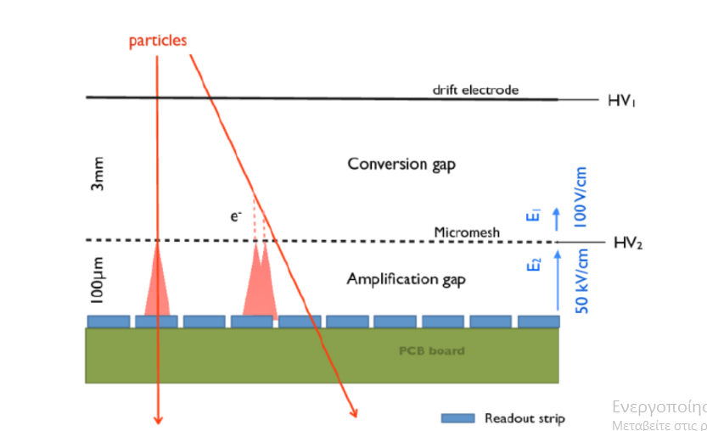
MicroMegas Working Principle

Slide 3
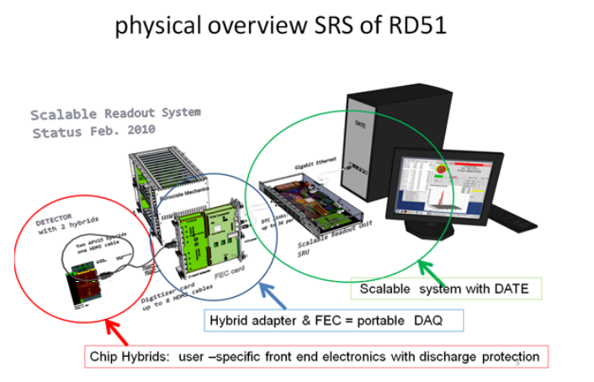
SRS

Slide 4
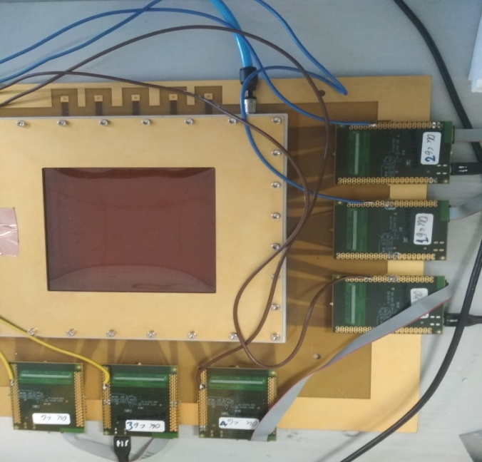
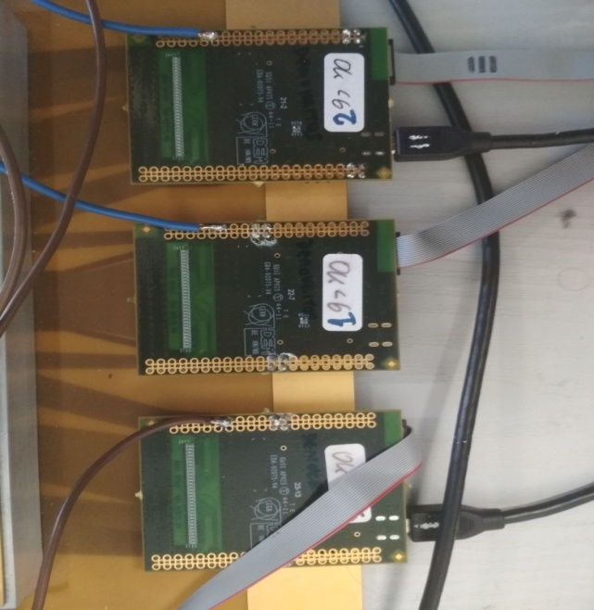
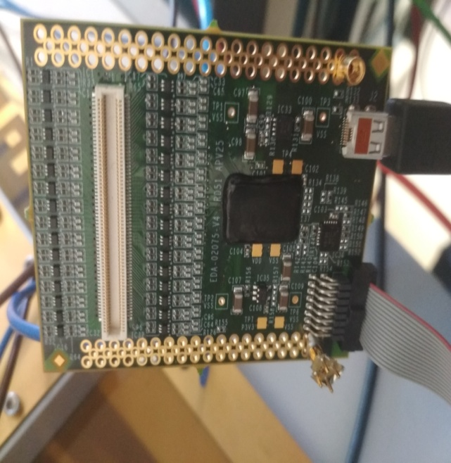
SRS and Micromegas Assembly

Slide 5
Requirements
common chip link interface for different readout chips
Scalability
Integration of commercial standards
Availability
Flexibility

Slide 6
Pros of SRS
Need of few channels
Large system, like an LHC experiment, use the same readout backends
Connectability with adapter cards

Slide 7

SRS Interface

Slide 8
Tasks
Command Interpretation & Adjustment
Mapping
Decoding
Grounding

Slide 9
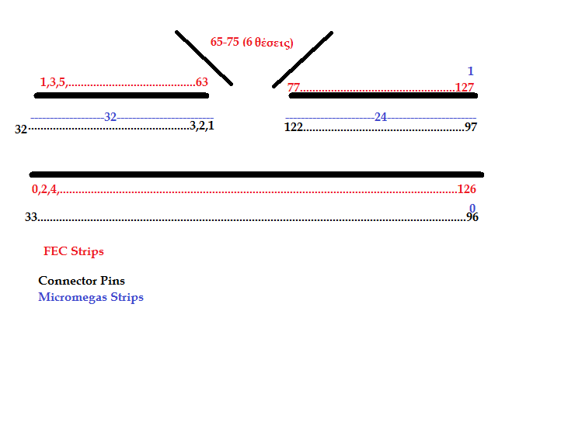
Mapping efforts

Slide 10
Objectives
Running Micromegas and observing cosmic ray(muons) in an environment of intense neutron flow.
Cosmic Stand will help to that

Slide 11
Bibliography
Kalamaris A.
Study of the microbulk technology for the MicroMegas
detector with mesh segmented in strips
SRS Slow Control Manual
RD51 Scalable Readout System

Slide 12
Thank you for your attention!

