Slide 1
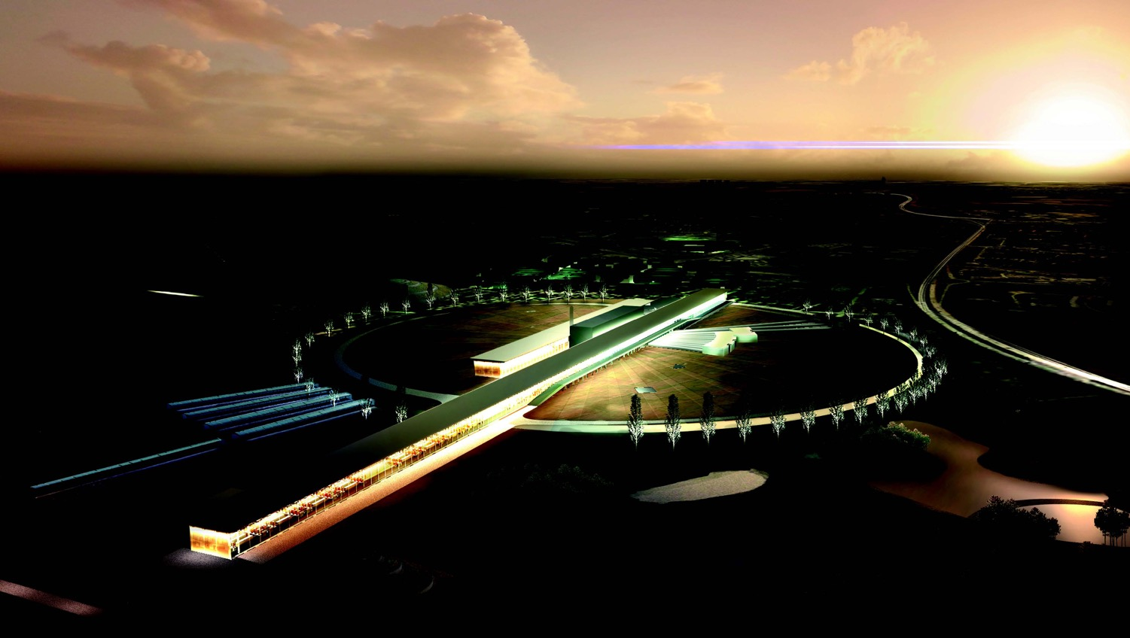


ESSnuSB design study for the ESS (European Spallation Source)
Neutrino Super beam
George Fanourakis
Institute of Nuclear & Particle Physics, NCSR Demokritos

Slide 2
Demokritos INPP ESSνSB team
George Fanourakis,
George Stavropoulos,
Theodoros Geralis,
Olga Zormpa
“This project has received funding from the European Union’s Horizon 2020 research and innovation programme under grant agreement No 777419”.
This project is supported by the COST Action CA15139 ``Combining forces for a novel European facility for neutrino-antineutrino symmetry-violation discovery'' (EuroNuNet).

Slide 3

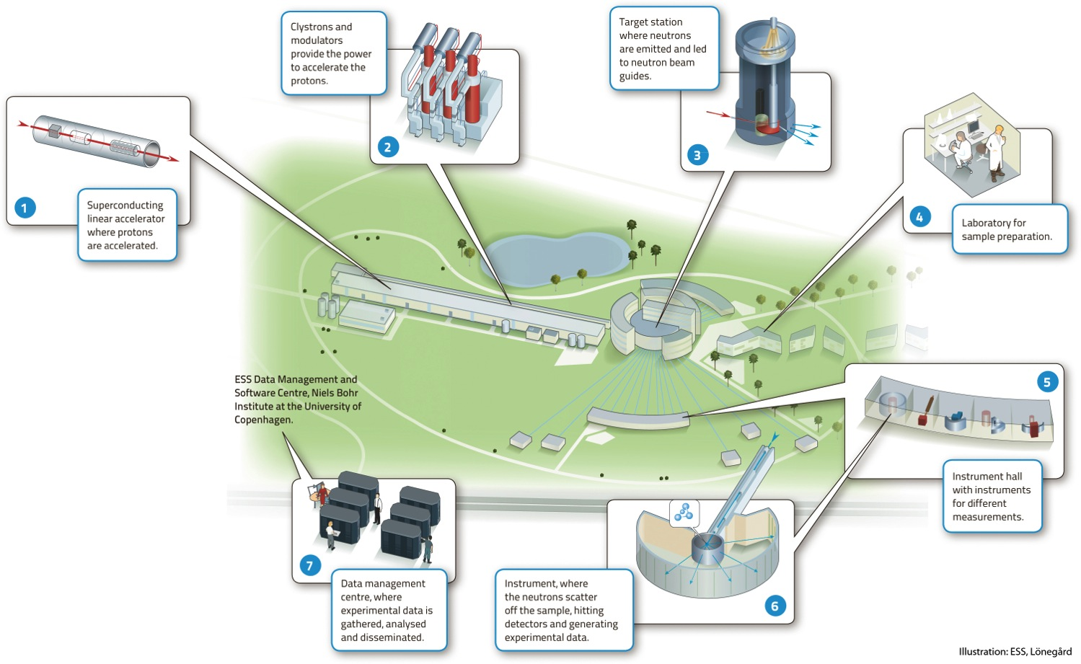
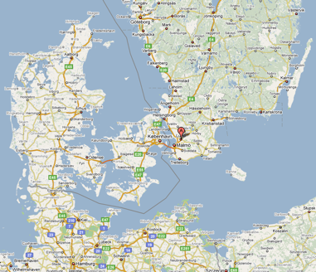
European Spallation Source (ESS)
Neutron facility
under construction phase
(~1.85 B€ facility)

Slide 4
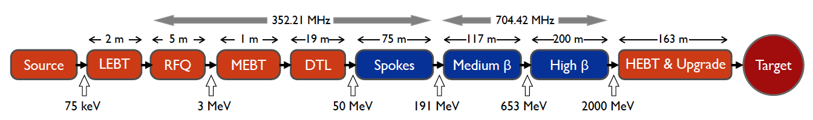
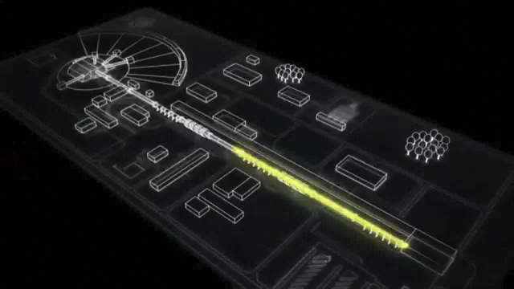
ESS proton linac
empty space for energy upgrades
The ESS will be a copious source of spallation neutrons.
5 MW average beam power.
125 MW peak power.
14 Hz repetition rate (2.86 ms pulse duration, 10¹⁵ protons).
Duty cycle 4%.
2.0 GeV protons
  up to 3.5 GeV with linac upgrades
>2.7x10²³ p.o.t/year.
8
x10¹⁴
ESS 5 MW
2015 design
7
λ = 1.5 Å
6
5
Brightness (n/cm²/s/sr/Å)
4
3
ESS 5 MW
2012 design (TDR)
Linac ready by 2023 (full power)
2
UK TS2
32 kW
SNS
1-2 MW
JPARC
0.3-1 MW
1
UK TS1
128 kW
ILL 57 MW
0
time (ms)
1
2
3
4

Slide 5
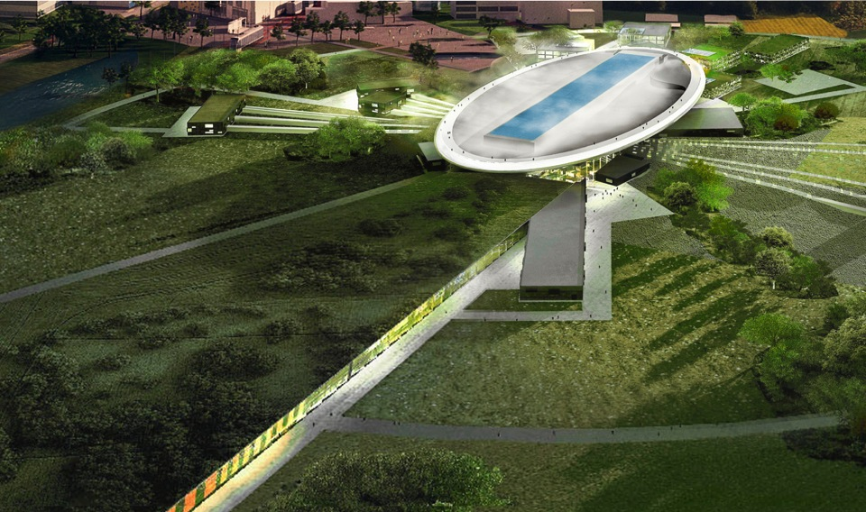
ESS schedule
2025
ESS construction complete
2014
Construction work starts on the site
2023
ESS starts
user program
2009
Decision: ESS will be built in Lund
2019
First neutrons on instruments
2012
ESS Design Update phase complete
2003
First European design effort of ESS completed

Slide 6
The European Spallation Source as High Intensity Neutrino Facility for the CP violation observation
ν

Slide 7

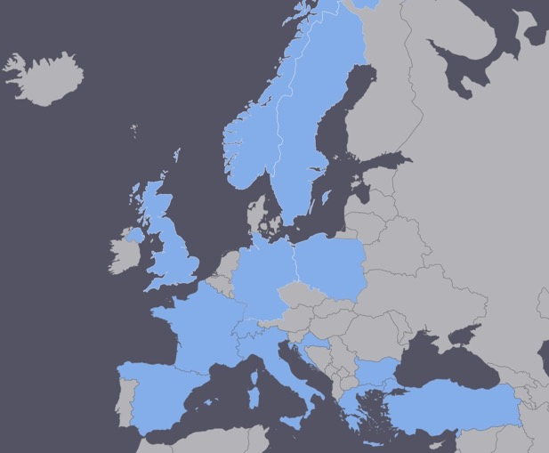
EuroNuNet
COST application for networking: CA15139 (2016-2020)
  EuroNuNet : Combining forces for a novel European facility for neutrino-antineutrino symmetry violation discovery (http://www.cost.eu/COST_Actions/ca/CA15139)
The members are countries which signed the Action MoU
  Major goals of EuroNuNet:
    to aggregate the community of neutrino physics in Europe to study a neutrino long baseline concept in a spirit of inclusiveness,
    to impact the priority list of High Energy Physics policy makers and of funding agencies to this new approach to the experimental discovery of leptonic CP violation.
  13 participating countries.
http://euronunet.in2p3.fr/

Slide 8
ESSνSB at the European level
A H2020 EU Design Study (Call INFRADEV-01-2017)
Title of Proposal: Discovery and measurement of leptonic CP violation using an intensive neutrino Super Beam generated with the exceptionally powerful ESS linear accelerator
Duration: 4 years
Total cost: 4.7 M€
Requested budget: 3 M€
15 participating institutes from
11 European countries including CERN and ESS
6 Work Packages
Approved end of August 2017
ESSνSB
BENE (2004-2008)
ISS (2005-2007)
EUROν (2008-2012)
LAGUNA (2008-2010)
LAGUNA-LBNO (2010-2014)
COST Action CA15139 (2015-2019)

Slide 9
Design Study ESSνSB
(2018-2021)
More information on:
http://essnusb.eu/
partners: IHEP, BNL, SCK•CEN, SNS, PSI, RAL

Slide 10
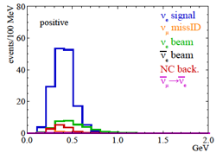
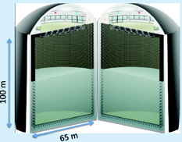
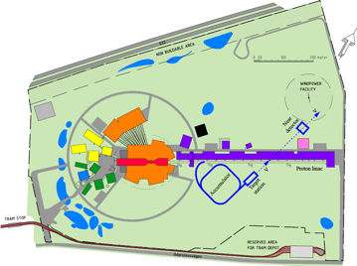
Possible ESSνSB schedule
(2nd generation neutrino Super Beam)
2021: End of ESSνSB Design Study, CDR and preliminary costing
2012: inception of the project
2016-2019: beginning of COST Action EuroNuNet
2018: beginning of ESSνSB Design Study (EU-H2020)
2022-2024: Preparatory Phase, TDR
2025-2026: Preconstruction Phase, International Agreement
2027-2034: Construction of the facility and detectors, including commissioning
2035-: Data taking
Nucl. Phys. B 885 (2014) 127

Slide 11
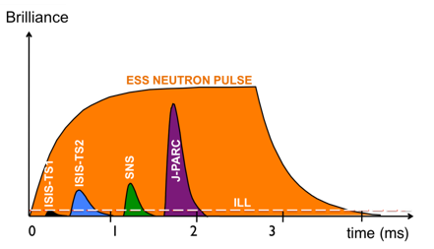
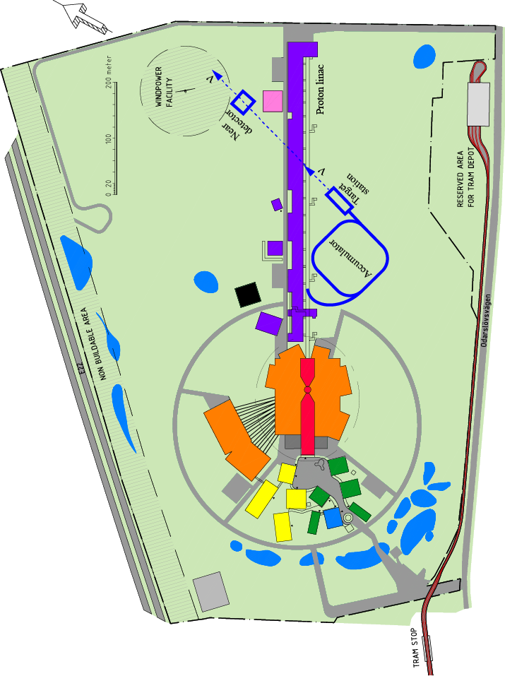
How to add a neutrino facility?
The neutron program must not be affected and if possible synergetic modifications.
Linac modifications: double the rate (14 Hz → 28 Hz), from 4% duty cycle to 8%.
Accumulator (C~400 m) needed to compress to few μs the 2.86 ms proton pulses, affordable by the magnetic horn (350 kA, power consumption, Joule effect)
  H⁻ source (instead of protons),
  space charge problems to be solved.
~300 MeV neutrinos.
Target station (studied in EUROν).
Underground detector (studied in LAGUNA).
Short pulses (~μs) will also allow DAR (decays at rest) experiments (as those proposed for SNS) using the neutron target.

Slide 12
Having access to a powerful proton beam…
What can we do with:
5 MW power
2 GeV energy
14 Hz repetition rate
10¹⁵ protons/pulse
>2.7x10²³ protons/year
proton beam
decay tunnel
p
hadrons
physics
π
ν
⨂B
target
hadronic collector
(focusing)
Detector
conventional neutrino (super) beam

Slide 13
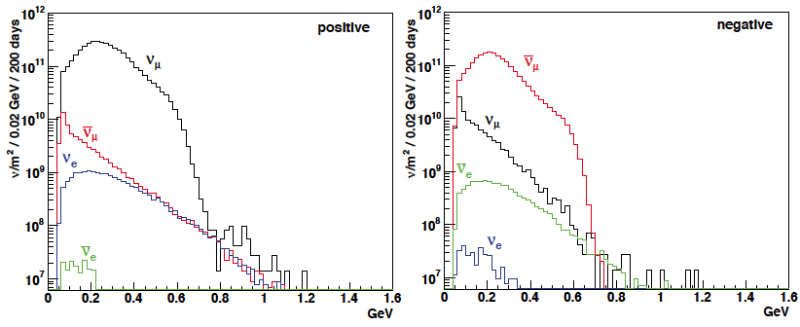
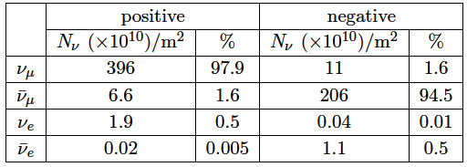
ESSνSB neutrinos energy distribution
(without optimisation)
neutrinos
anti-neutrinos
almost pure ν_{μ} beam
small ν_{e} contamination which could be used to measure ν_{e} cross-sections in a near detector
at 100 km from the target and per year (in absence of oscillations)
(Nucl. Phys. B 885 (2014) 127)

Slide 14
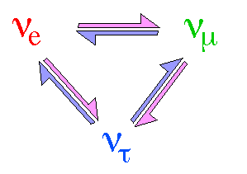

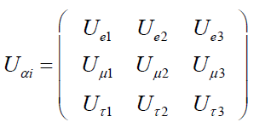

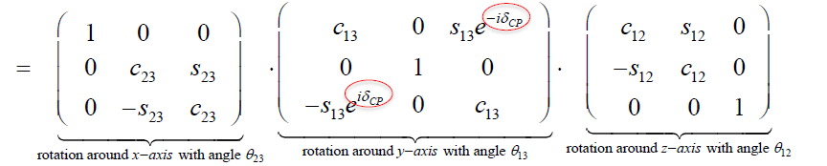
Neutrino Oscillations
Pontecorvo-Maki-Nakagawa-Sakata matrix
ν₃
well established now
θ₁₃
ν_{μ}
ν_{τ}
θ₂₃
θ₂₃
θ₁₂
ν₂
Usual parameterization
ν_{e}
ν₁
θ₁₂
θ₁₃
Atmospheric,
Accelerators oscillations
reactors, Accelerators oscillations
CP violation
Solar, Reactors oscillations
δCP for neutrinos
-δCP for anti-neutrinos
Notes:
θ12 and Δm21^2 were measured by solar neutrino experiments and a reactor neutrino experiment KamLAND. θ23 and |Δm32^2| were measured by atmospheric and accelerator neutrino experiments. The last unknown mixing angle θ13 was determined to be unexpectedly large by the DayaBay Reactor Neutrino Experiment, as well as other reactor neutrino experiments Double Chooz and RENO, and accelerator neutrino experiments T2K and MINOS. These measurements open a new era of neutrino experiments. The next generation neutrino oscillation experiments will focus on determining the sign of Δm32^2 (mass hierarchy), precisely measuring all oscillation parameters and searching for CP violation in the neutrino oscillation.

Slide 15








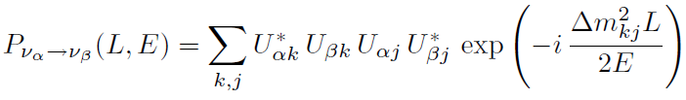
Transition Probability in vacuum
where
and
For utrarelativistic neutrinos t=L
the transition probabilities do not depend on the particle masses but on the squared mass differences

Slide 16
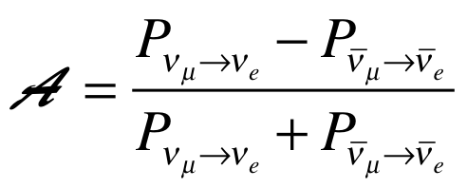
Oscillation probability
(neutrino beams)
"atmospheric"
"interference"
"solar"
matter effect
for antimatter: δ_{CP} →-δ_{CP} and a→-a
fake matter/antimatter asymetry due to matter effect
δ_{CP} dependence,
sizable matter effect for long baselines
Matter-antimatter asymmetry

Slide 17
Questions remaining
Despite the tremendous progress in our understanding of neutrino physics over the last years, many fundamental questions remain unsolved in the neutrino sector.
These questions include those of:
the absolute neutrino mass scale,
the Mass Hierarchy (MH), that is the sign of Δm²₃₁,
the possible Majorana character of the neutrino fields and of
the existence of leptonic CP violation parameterized by the phase angle δ_{CP}.
Focusing on the need of determining the phase angle δ_{CP}.
The CP violation observed in the quark sector does not justify the
Baryon Asymmetry of the Universe (BAU)
A measurement of δ_{CP} could provide very illuminating information on
the origin of the BAU

Slide 18
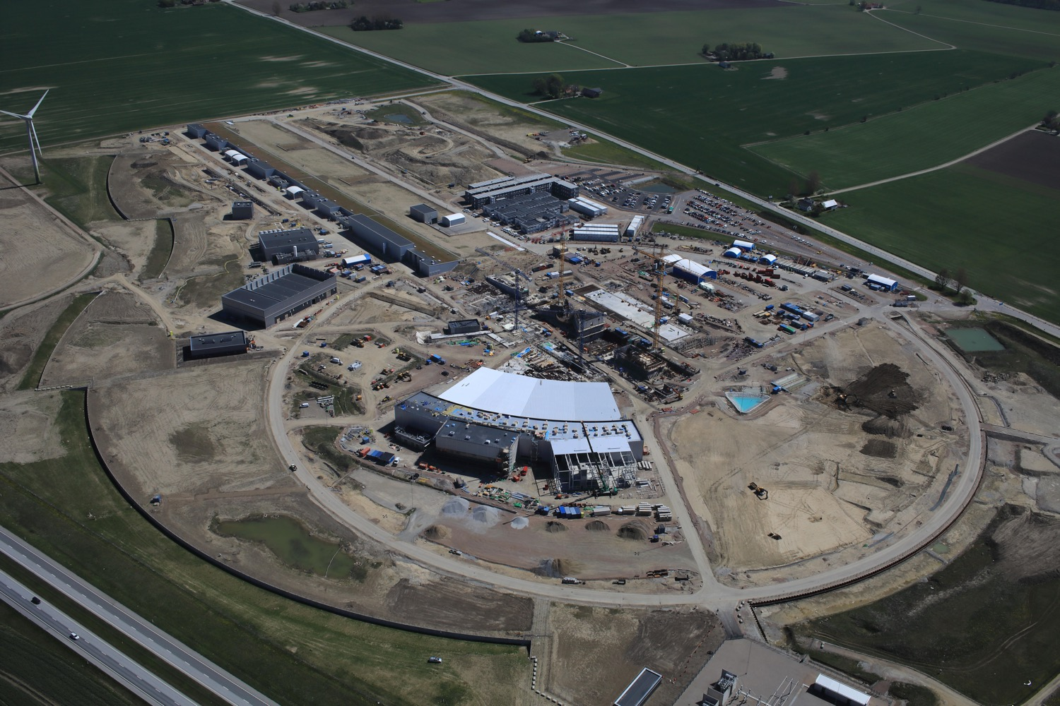
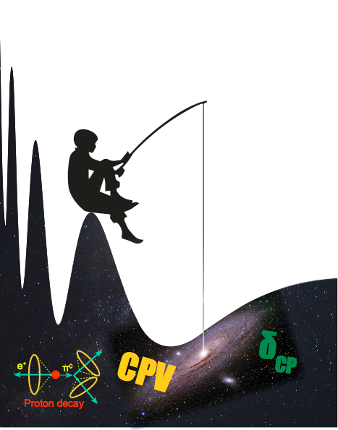
Use all this ESS linac power to go to the second oscillation maximum
but why?

Slide 19
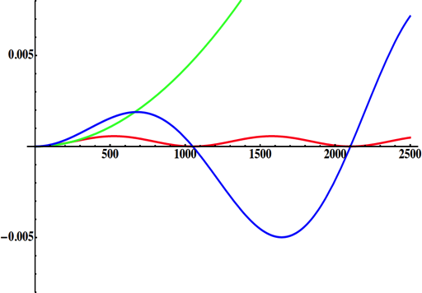
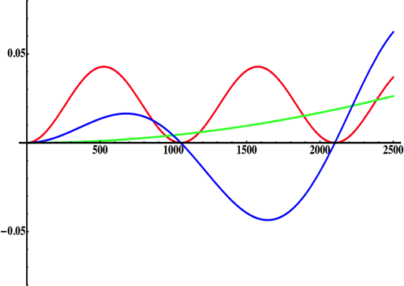
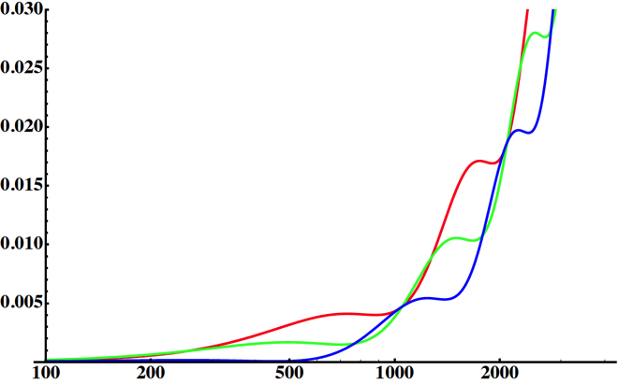
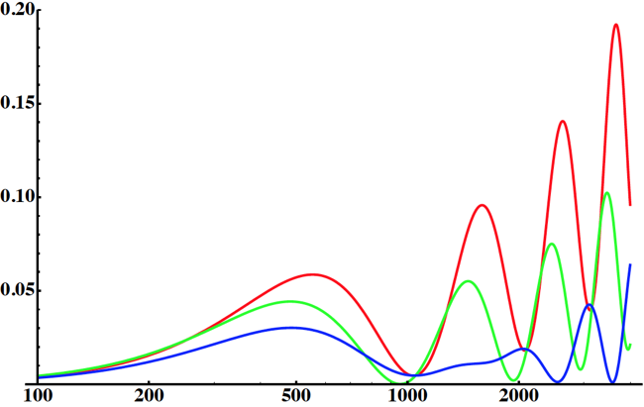
Neutrino Oscillations with "large" θ₁₃
solar
atmospheric
for "large" θ₁₃ 1st oscillation maximum is dominated by atmospheric term
for small θ₁₃ 1st oscillation maximum is better
atmospheric
solar
L/E
L/E
CP interference
(arXiv:1110.4583)
θ₁₃=1º
CP interference
θ₁₃=8.8º
solar
2nd oscillation maximum
P(ν_{μ}→ν_{e})
1st oscillation maximum
θ₁₃=1º
("small" θ₁₃)
δ_{CP}=-90
δ_{CP}=0
δ_{CP}=+90
θ₁₃=8.8º
("large" θ₁₃)
L/E
L/E
1st oscillation max.: A=0.3sinδ_{CP}
2nd oscillation max.: A=0.75sinδ_{CP}
more sensitivity at 2nd oscillation max.
(see arXiv:1310.5992 and arXiv:0710.0554)

Slide 20
Oscillations to be studied

Slide 21
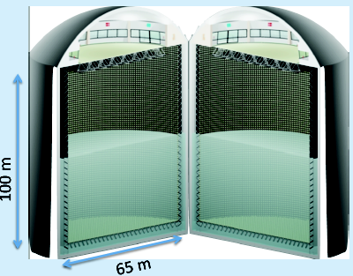
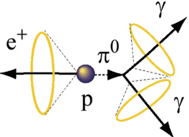
Can we go to the 2nd oscillation maximum using our proton beam?
Yes, if we place our far detector at around 500 km from the neutrino source.
MEMPHYS like Cherenkov detector
(MEgaton Mass PHYSics studied by LAGUNA)
(arXiv: hep-ex/0607026)
Neutrino Oscillations
Proton decay
Astroparticles
Understand the gravitational collapsing: galactic SN ν
  Supernovae "relics"
Solar Neutrinos
Atmospheric Neutrinos
New 20" PMTs with higher QE and cheaper (see JUNO), the detection efficiency will improve the detector performance keeping the price constant, not yet taken into account.
500 kt fiducial volume (~20xSuperK)
Readout: ~240k 8” PMTs
30% optical coverage

Slide 22
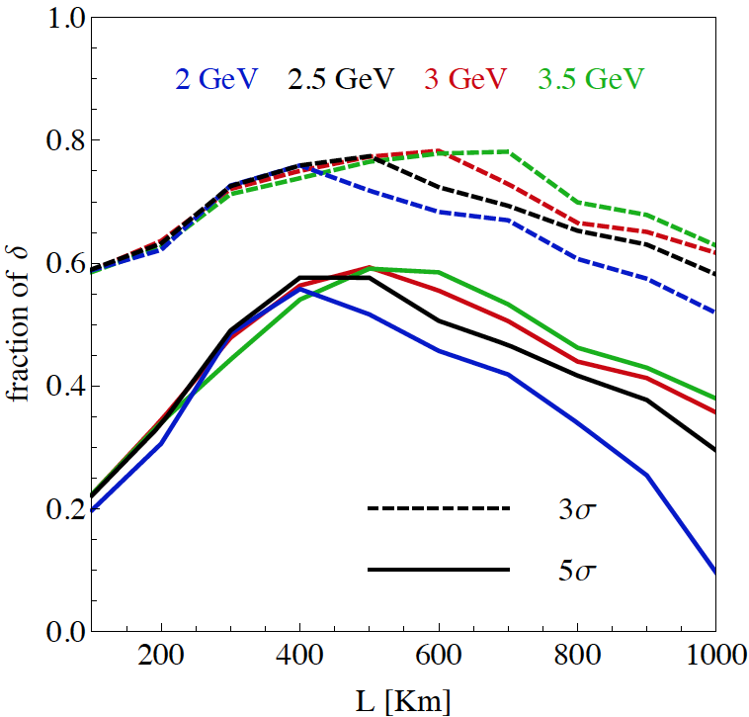
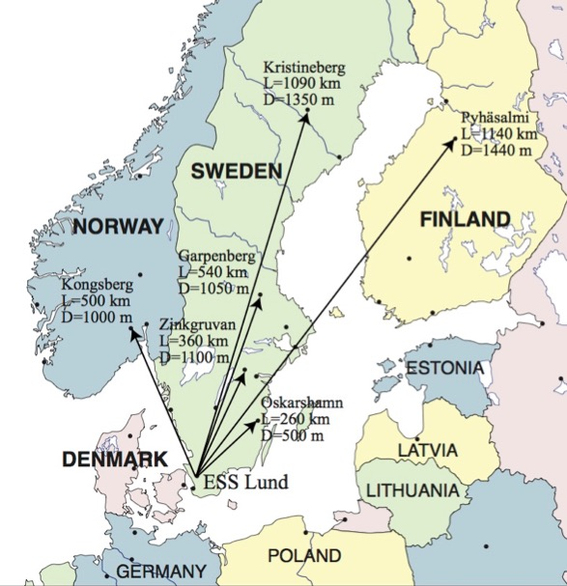
Which baseline?
CPV (Nucl. Phys. B 885 (2014) 127)
Garpenberg
Zinkgruvan
~60% δ_{CP} coverage at 5 σ C.L.
>75% δ_{CP} coverage at 3 σ C.L.
systematic errors: 5%/10% (signal/backg.)
Candidate active mines

Slide 23
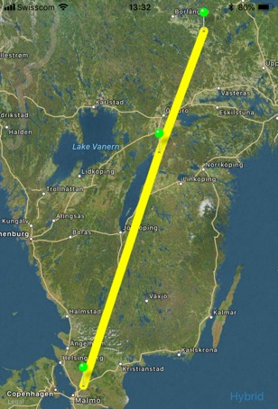
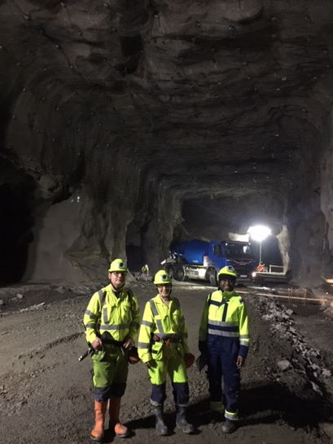
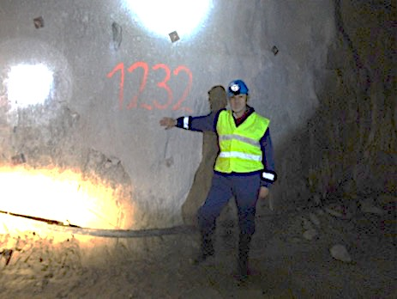
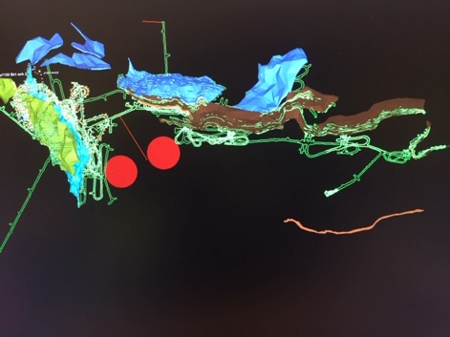
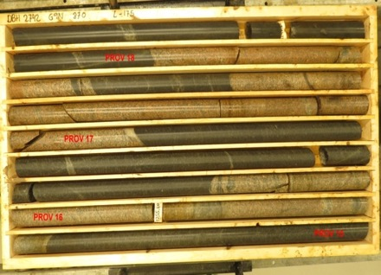
Candidate active mines
Garpenberg mine
  Distance from ESS Lund 540 km
  Depth 1200 m
  Truck access tunnel
Zinkgruvan mine
  Distance from ESS Lund 360 km
  Depth 1500 m
  Truck access tunnel
Garpenberg
(540 km)
Zinkgruvan
Zinkgruvan
(360 km)
Lund
possible location of MEMPHYS in
Zinkgruvan mine
Garpenberg
Granite drill cores

Slide 24
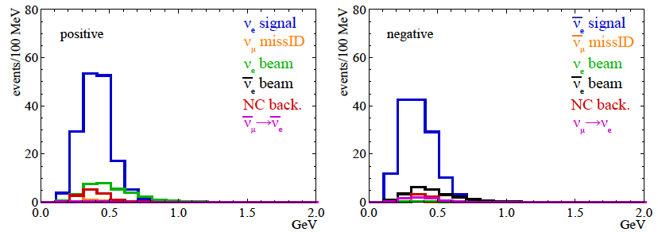
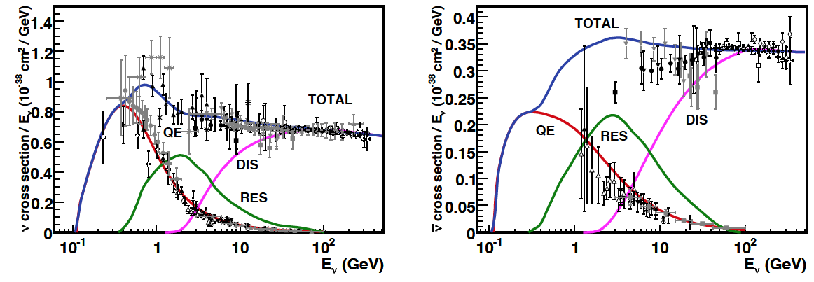
Neutrinos in the far detector
540 km (2 GeV), 10 years
neutrinos
anti-neutrinos
δ_{CP}=0
2 years
8 years
below ν_{τ} production, almost only QE events, not suffering too much by π⁰ background

Slide 25
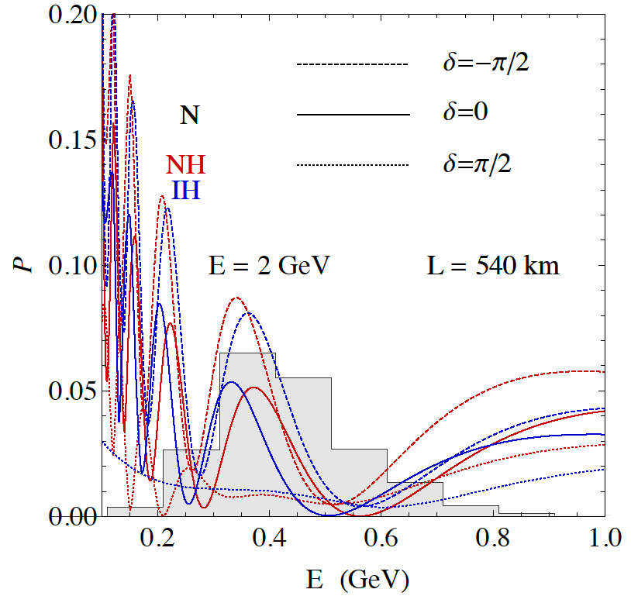
2nd Oscillation max. coverage
2nd oscillation max.
well covered by the ESS neutrino spectrum
1st oscillation max.

Slide 26
Physics Performance
540 km
little dependence on mass hierarchy,
δ_{CP} coverage at 5 σ C.L. up to 60%,
δ_{CP} accuracy down to 6° at 0° and 180° (absence of CPV for these two values),
not yet optimized facility,
5/10% systematic errors on signal/background.

Slide 27
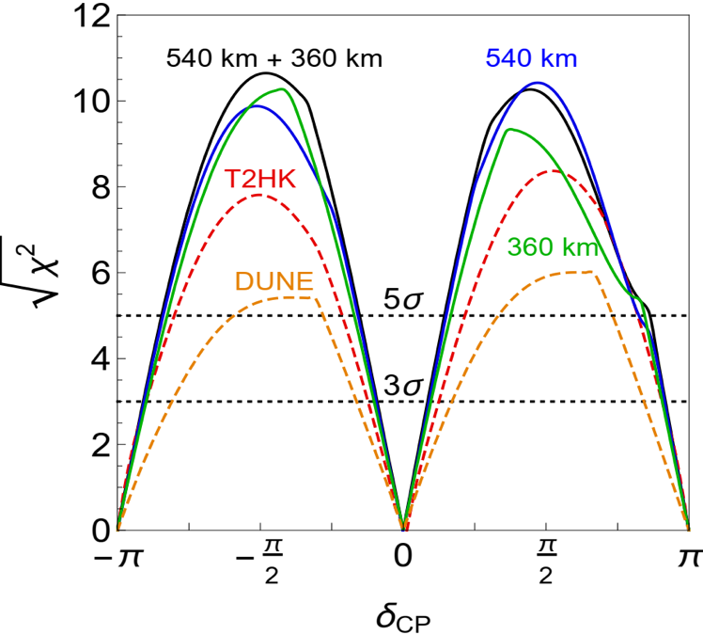
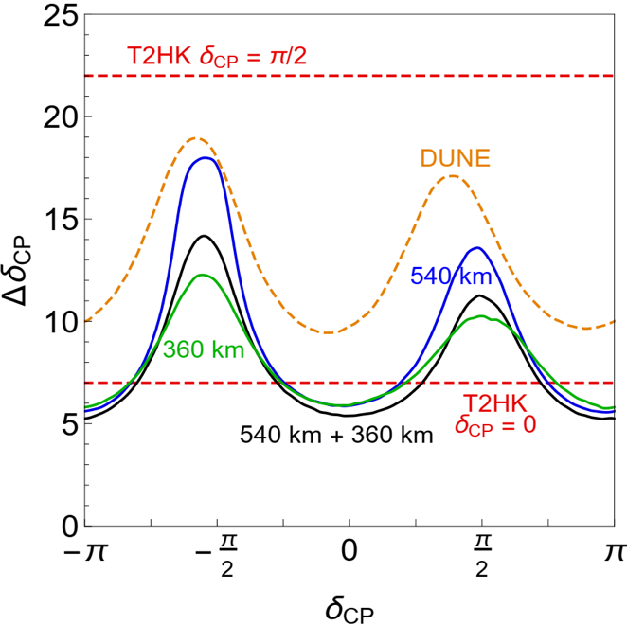
CPV performance comparison between ESSnuSB, DUNE and Hyper-K assuming 3% systematic errors for ESSnuSB in line with the other two.
ESSνSB 500 kt tank at 540 km.
ESSνSB 500 kt tank at 360 km.
(degrees)
ESSνSB 250 kt tank at 540 km
and 250 kt tank at 360 km.
See also: K. Chakraborty et al. / Nuclear Physics B 937 (2018) 303–332

Slide 28
Fraction of δ_{CP}
Garpenberg
(540 km)
(E. Martinez-Fernandez)
Zinkgruvan
(360 km)
Lund
2 active mines aligned…
these scenarios may be too optimistic for all facilities

Slide 29
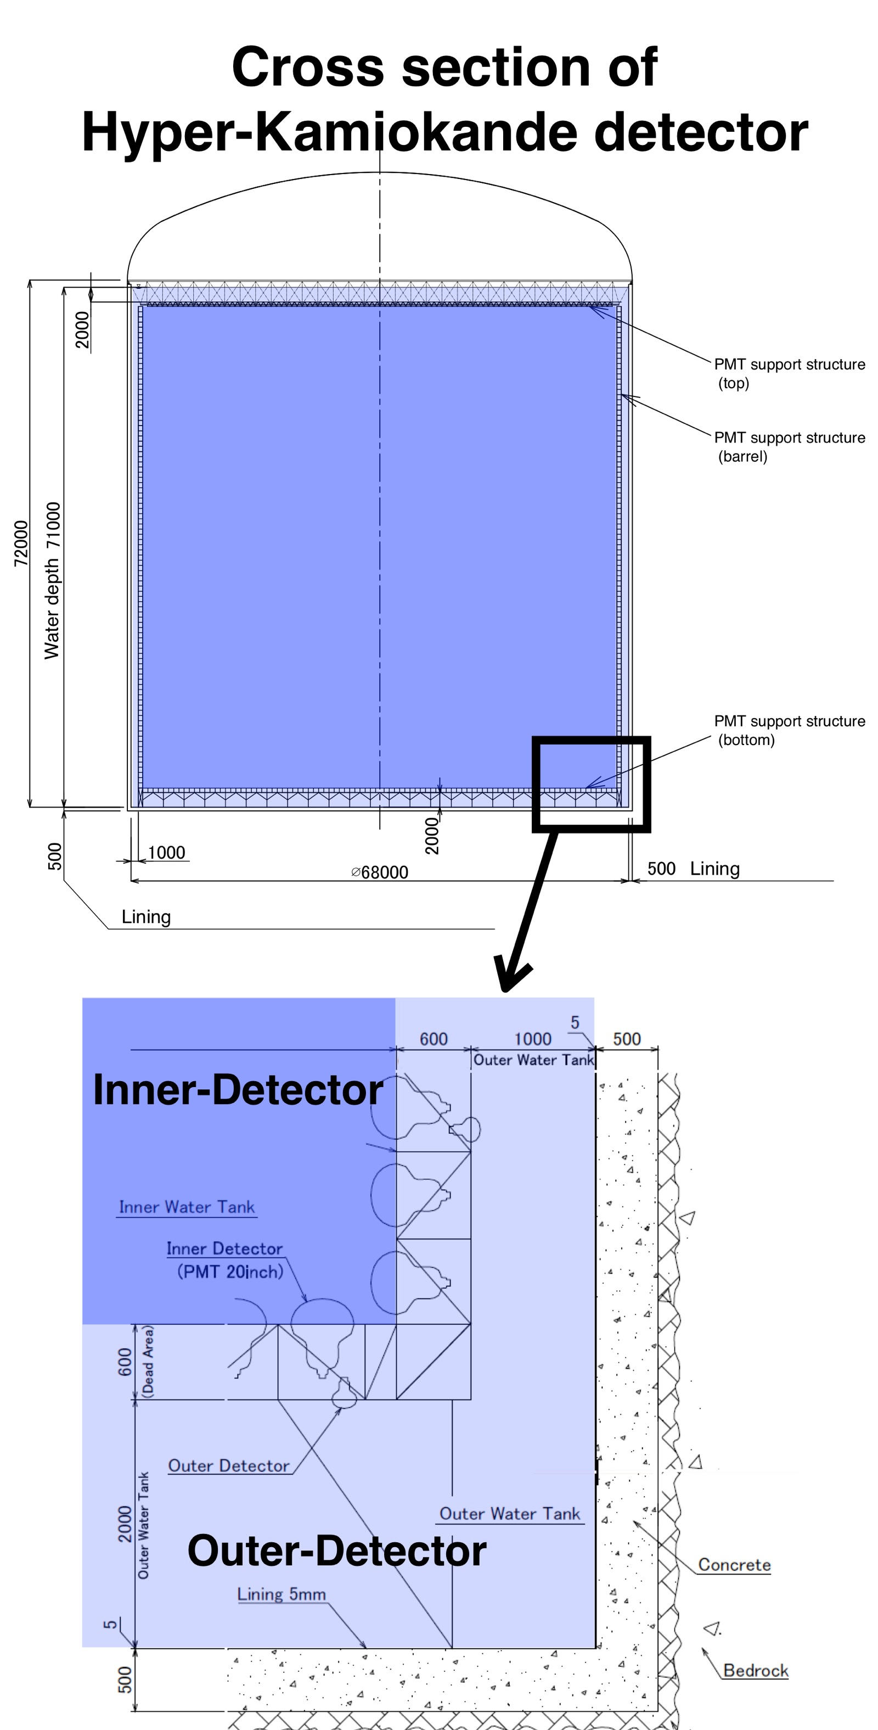
INPP in WP5 detector studies
Next talk by Olga Zormpa
“Study of far detector using WCSim
with HyperK geometry”
HyperK 260 kton water Cherenkov far detector. Equipped with 40000 photo sensors

Slide 30
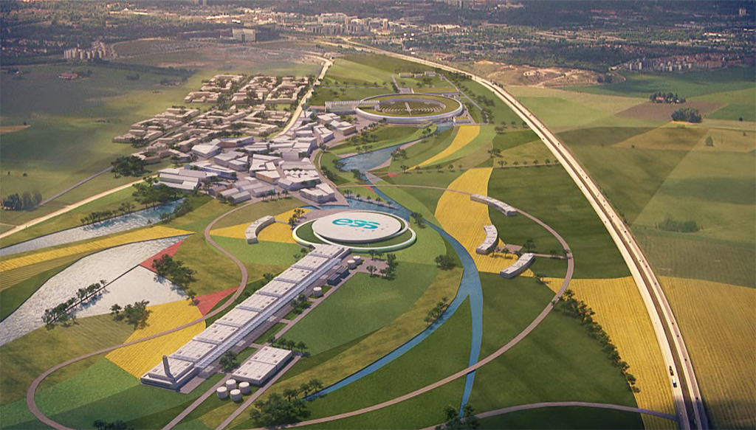
Conclusions
ESS will be the most powerful neutron facility for many applications.
ESS can also become a powerful neutrino facility with enough protons to go to the 2nd oscillation maximum and increase the CPV sensitivity.
CPV: 5 σ could be reached over 60% of δ_{CP} range by ESSνSB with large physics potential.
Large associated detectors have a rich astroparticle physics program.
The European Spallation Source Linac will be ready by 2025, upgrade decisions by this moment.
COST network project CA15139 and a EU-H2020 Design Study supports this project.
The INPP team is participating in the detector studies.

