Slide 1
MINOS AXENIDES
NCSR – DEMOKRITOS, INPP
THEORETICAL
HIGH ENERGY PHYSICS GROUP

Slide 2
Physics beyond the SMPP-
SU(3) x SU(2) xU(1)+ Gr (Einstein)
Strong CP– Axions in the Early-Late Universe
B,L violations –Baryogenesis (Leptogenesis induced)
Phase Transitions in the Early universe ( Guts-EW-QCD)
Inflation in the early & Late Universe
Modelling CDM and DE
Solitons in SUSY theories (Q-Balls)
Chaos ( Hamiltonian –Dissipative)
Stable Membrane Configurations ( M-theory)
Discrete Models in Classical and Q.M.

Slide 3
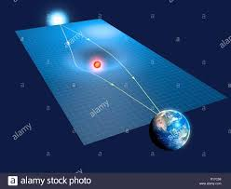
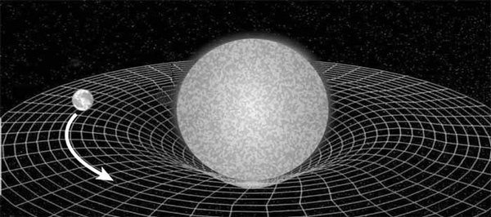
Einsteinian Gravitational Dynamics
Spacetime Curvature
moves Matter
Matter curves
Spacetime

Slide 4
Hierarchy of 4 fundamental Forces
(EW+QCD+ GR)
Gr much weaker
Mass and Energy are sources of attractive GR-attraction (inverse square) 40 order of magnitude weaker than EM-Coulomb’s
This is in juxtaposition to Coulomb’s Law of Force
Equal charges repel
Opposite charges attract
Charged Bulk matter in equilibrium neutralizes +’s with –’s
Massive distribution of matter is unstable against
gravitational collapse (Oppenheimer-Snyder)
Compact Stars ( e.g. Neutron Stars)
Black holes

Slide 5
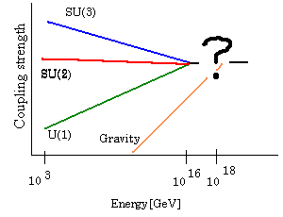
WHEN GRAVITY BECOMES STRONG?

Slide 6
PHYSICAL SCALES
Phys. Observable Universe
Spiral Galaxy (Milky Way)
Earth
Atoms
LHC—QUARKS-LEPTONS
Planck Scale

Slide 7
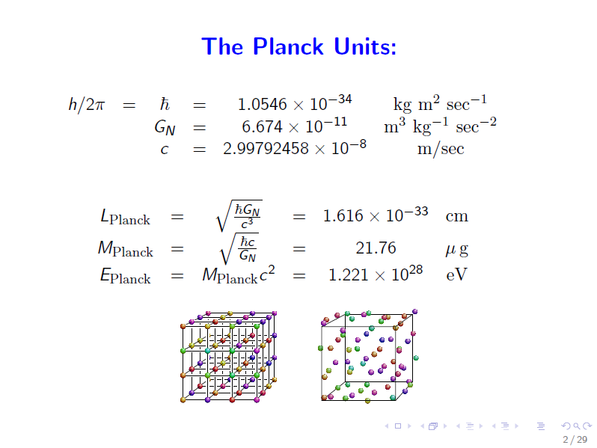

Slide 8
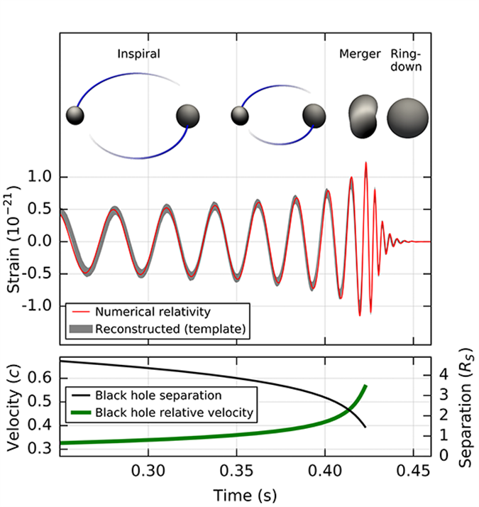
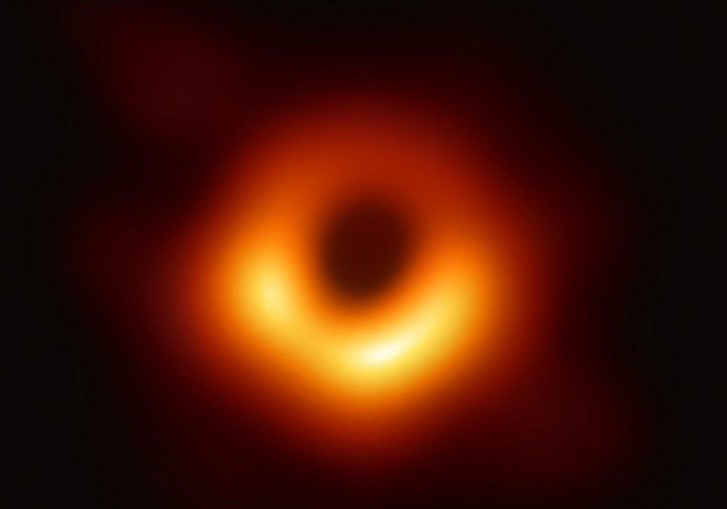
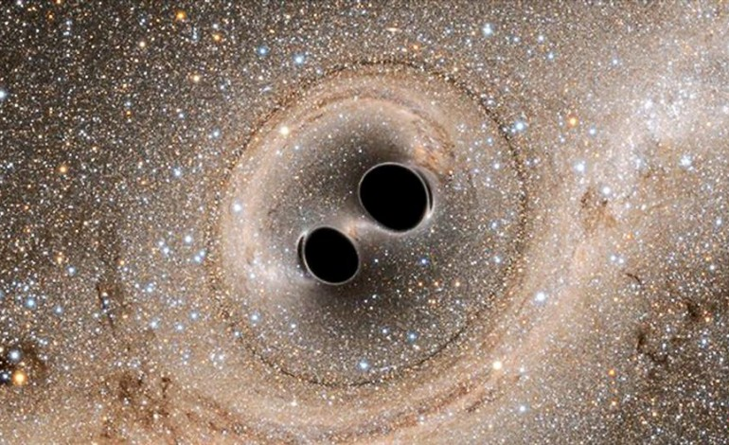
BH PHENOMENOLOGY
2-BLACK HOLE MERGER
EVENT HORIZON TELESCOPE
1st IMAGE ever

Slide 9

MEMBRANE PARADIGM : near Horizon region as a 2-DIM viscous fluid- possible dynamical system in M-theory. (see GL talk)

Slide 10
NOTABLE PROPERTIES OF BH-event horizons
NO HAIR ( M , Q , J )
COMPLEMENTARITY BETWEEN OBSERVERS –ONE AT INFINITY AND ONE FALLING THROUGH EVENT HORIZON
due to :
gravitational time dilation for infalling matter
gravitational redshift at the event horizon
HENCE for an observer at infinity the surface is the information storage for the BH (1 bit per planck area)

Slide 11
Planck scale physics → strong Q.Gr effects dominates---CRITICAL ISSUES
Strong HAWKING RADIATION for planck scale BHs
Entropy of BHs scales with its area
( Bekenstein –Hawking) –
Holographic thermodynamic system
T (Hawking temperature )
Qs---What are its microscopic dofs ( Strominger-Vafa) derived
It from D-branes AND String theory for extremal bhS ( Q=M)
what is the nature of spacetime ????

Slide 12
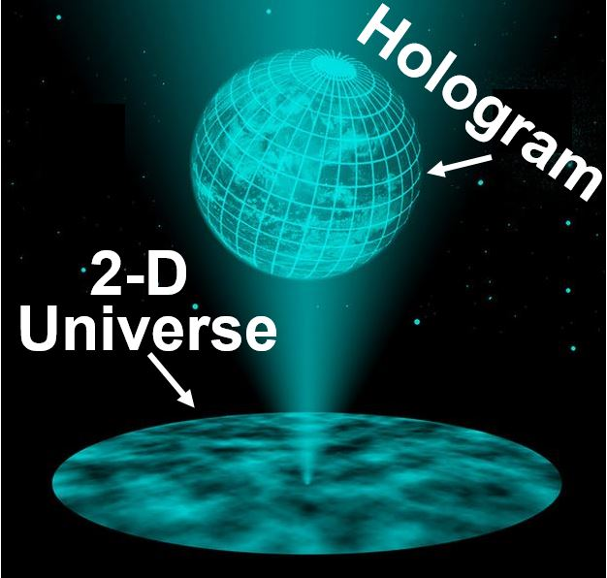
HOLOGRAPHY => INFORMATION OF A VOLUME IS ENCODED ON ITS SURFACE BOUNDARY

Slide 13
Breakdown of conceptual tools
Experimental Impasse for probing spacetime at Planck scale high energies PRODUCTION OF PLANCK MASS BHs
CONTINUUM LOCAL FIELD THEORIES OUT OF USE---BREAKDOWN OF LOCALITY -> INFINITE amount of info per Planck Volume
Perturbative Q.Gravity as well as perturbative String theories theory break down,
PEOPLE HAVE GIVEN UP THE CONTINUUM HYPOTHESIS ANS RESORT TO SPACETIME DIESCRETUM( Ambjorn-Lol et.al.-Lorentzian triangulations) ( Causal Sets-Sorkin)

Slide 14
A Discretized spacetime approach based on modular arithmetics
Fundamental Premises
Near Horizon Geometry of extremal BHs is ADS2
Finite BH- Entropy -> Finite dim. Hilbert Space of States ->
-> Finite Geometry of spacetime points ->
MODULAR ARITHMETIC SPACETIME DISCRETUM
Good properties---
Nonlocality
Chaotic Randomness
Quantum Entanglement for composite probes
ADS/CFT realization

Slide 15
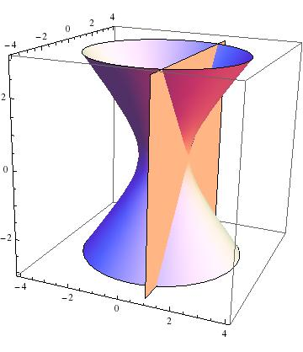

Slide 16
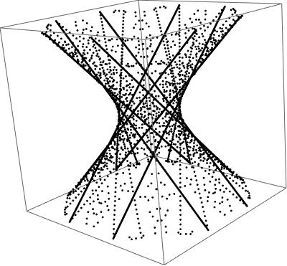

Slide 17
Modular discretization of the AdS2/CFT1 holography
Minos Axenides (Democritos Nucl. Res. Ctr.), E.G. Floratos (Democritos Nucl. Res. Ctr. & CERN & Athens U.), S. Nicolis (Tours U.). Jun 24, 2013. 31 pp.
Published in JHEP 1402 (2014) 109 .
Chaotic Information Processing by Extremal Black Holes
Minos Axenides (Democritos Nucl. Res. Ctr.), Emmanuel Floratos (Democritos Nucl. Res. Ctr. & Athens U.), Stam Nicolis (Fed. Denis Poisson, Tours & Tours U.). Apr 2, 2015. 7 pp.
Published in Int.J.Mod.Phys. D24 (2015) no.09, 1542012.
The arithmetic geometry of AdS2 and its continuum limit
Minos Axenides (Democritos Nucl. Res. Ctr.), Emmanuel Floratos (Athens U.), Stam Nicolis (Tours U., CNRS). Aug 19, 2019. 35 pp.
e-Print: arXiv:1908.06641

Slide 18
1EU + 6 national grants
# | Grant/Fellowship | Amount | Period | Scientist in charge
1 | CA16201: Unraveling new physics at the LHC through the precision frontier | 520 k€ | 2017-21 | C. Papadopoulos G. Savvidy
2 | HFRI E-12300: Holographic applications of quantum entanglement (HAPPEN) | 200 k€ | 2018-20 | G. Pastras M. Axenides
3 | IKY (postdoc fellows) | 26 k€ | 2017-19 | G. Pastras
4 | IKY (doctoral fellows) | 30 k€ | 2018-21 | D. Katsinis
5 | HFRI: Two-loop Amplitude Calculations Based on Intergrand Reduction | 32.4 k€ | 2019-22 | C. Papadopoulos D. Canko
6 | ΕΔΒΜ 103: Χαοτική Δυναμική και Μελανές Οπές στη Θεωρία BMN | 50 k€ | 2020-21 | E. Floratos M. Axenides
7 | ΕΔΒΜ 103: Μελέτη διορθώσεων ανώτερης τάξης στο πλαίσιο της Κβαντικής Χρωμοδυναμικής και εφαρμογές στα πειράματα Υψηλών Ενεργειών του LHC | 50 k€ | 2020-21 | C. Papadopoulos

Slide 19
BH-Info Paradox at a Crossroads

