Slide 1


Nuclear Astrophysics
&
Nuclear Data
Paraskevi (Vivian) Dimitriou
Institute of Nuclear and Particle Physics
National Center for Scientific Research “Demokritos”
Athens, Greece

Slide 2
Outline
Nuclear Astrophysics (CALIBRA WP.1.3)
Nuclear Data (CALIBRA WP.1.3;WP.1.5)
7th International Workshop on Compound-Nuclear Reactions and Related Topics (CNR*20) (CALIBRA WP.1.10)

Slide 3
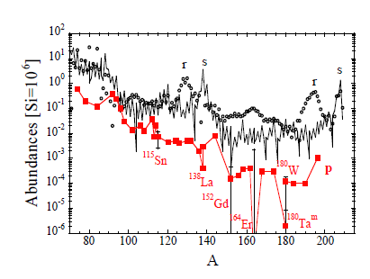
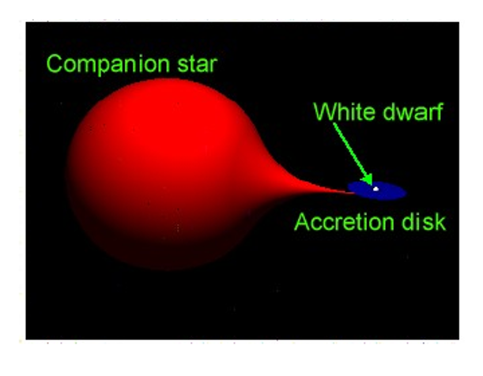
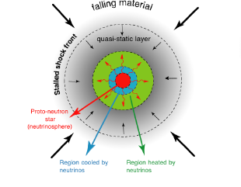
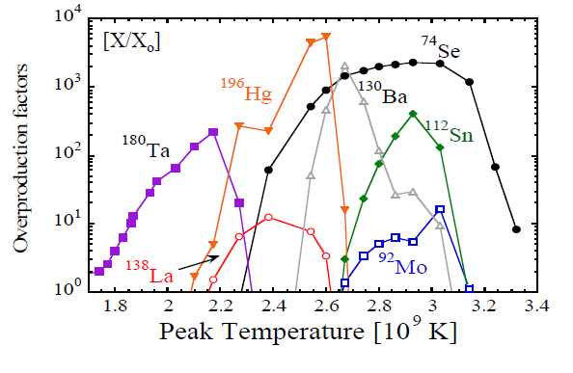
Nuclear Astrophysics
Astro-physics scenarios
Nuclear Physics
Elemental abundances in Universe

Slide 4
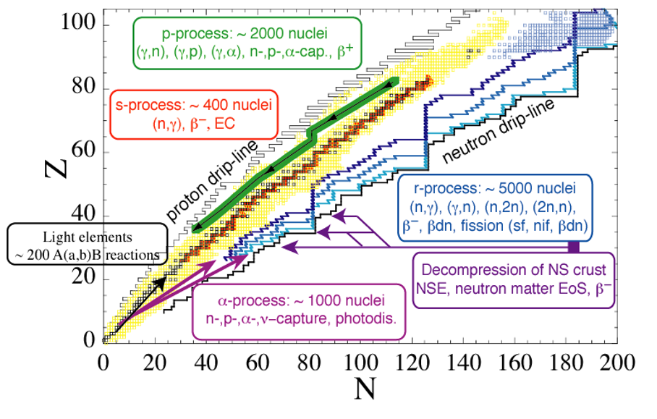
Nuclear Data Needs
Fusion reactions: CNO cycles

Slide 5
Nuclear Data for Astrophysics
One specific measurement will not affect directly the p-process abundances but could well have an impact on the global nuclear description (e.g α-OMP), hence on the nucleosynthesis
Consider all existing measurements of relevance for constraining the relevant reaction rates
Reproduce as well as possible all relevant observables within different theoretical frameworks (capture cross sections, E1 strength, NLD, ….)
Estimate uncertainties on reaction rates associated with the different theoretical frameworks and
study their impact on astrophysical predictions of the s-, r- and p-process abundances in different plausible scenarios
Define new experimental measurements that can reduce existing uncertainties.

Slide 6
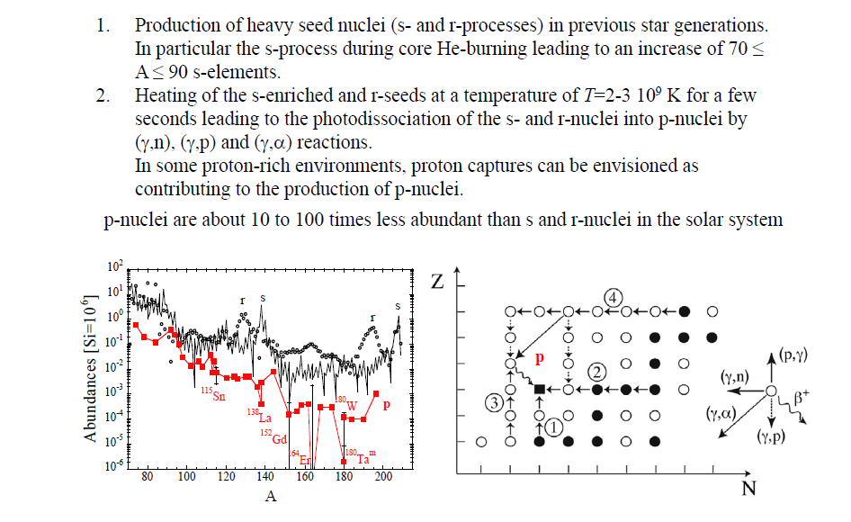
P nuclei: 35 neutron-deficient nuclei

Slide 7
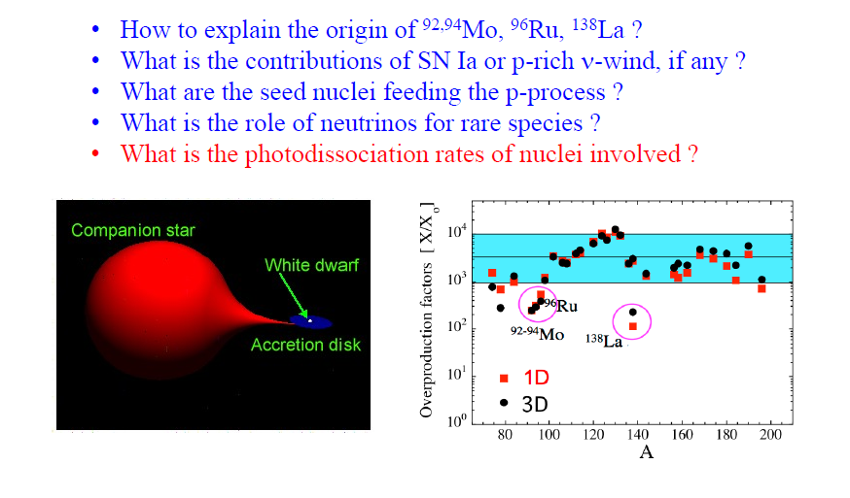
P process nucleosynthesis

Slide 8
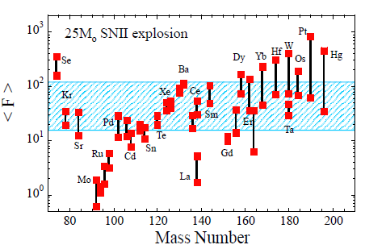
Impact of nuclear uncertainties
Major nuclear uncertainties in theoretical photo-disintegration rates:
  Global alpha-nucleus optical potential (A>150)
  GLOBAL nucleon-nucleus potential, NLD, γ-strength (light A<90 p-nuclides)
Nuclear measurements:
  p- and α-capture cross sections (new measurements at Demokritos, ATOMKI, Achen, etc)
  γ-strength function (new measurements at Konan Univ., Oslo, GSI, TUNL, Dresden) and new IAEA Photon Strength Function Database

Slide 9
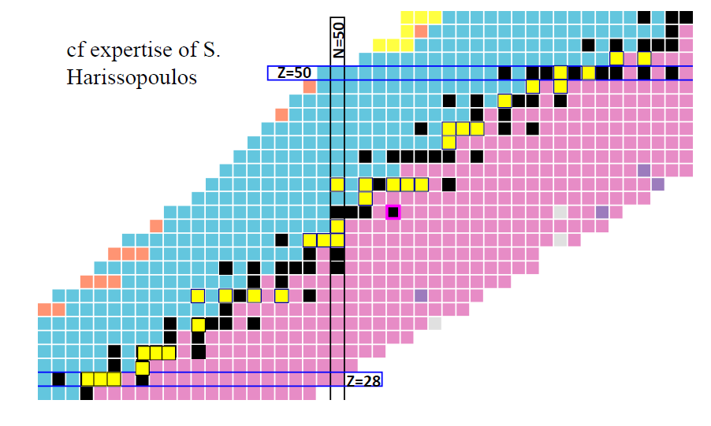
Project 1: P captures (p,γ)
New measurements at Demokritos (yellow boxes) (Harissopoulos, Foteinou, Axiotis, Lagogiannis, Spyrou et al.)
New improved p/n optical potentials based on global systematics
(Vagena, Dimitriou, Harissopoulos, Axiotis, Lagogiannis):

Slide 10
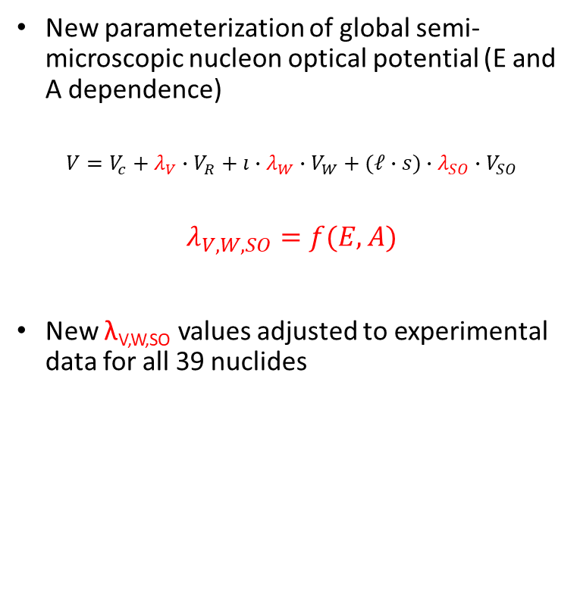
Improved nucleon OP based on systematics
All available experimental (p,γ) cross sections at astrophysically relevant energies retrieved
Criteria for using them in fitting procedure applied
Experimental uncertainties sorted (systematic, statistical)
39 nuclides; A=50-150
V-51; Cr-50, Cr-54; Fe-54, Fe-56, Fe-58; Co-59; Ni-58, Ni-60, Ni-61, Ni-62, Ni-64; Cu-63, Cu-65; Zn-67, Zn-68; Sr-84, Sr-86, Sr-88, Sr-87; Y-89; Zr-90, Zr-92; Mo-92, Mo-94, Mo-95, Mo-98; Ru-99; Pd-105; In-113; Sn-112, Sn-114, Sn-116; Sb-121; Ba-130; Ce-142; Sm-144, Sn-147; Gd-152
New parameterization of global semi-microscopic nucleon optical potential (E and A dependence)
$$V=V_{c}+λ_{V}∙V_{R}+ı∙λ_{W}∙V_{W}+(ℓ∙s)∙λ_{SO}∙V_{SO}$$
$$λ_{V,W,SO}=f(E,A)$$
New λ_{V,W,SO} values adjusted to experimental data for all 39 nuclides
Collaboration:
Vagena, Dimitriou, Axiotis, Harissopoulos, Lagogiannis: work ongoing

Slide 11
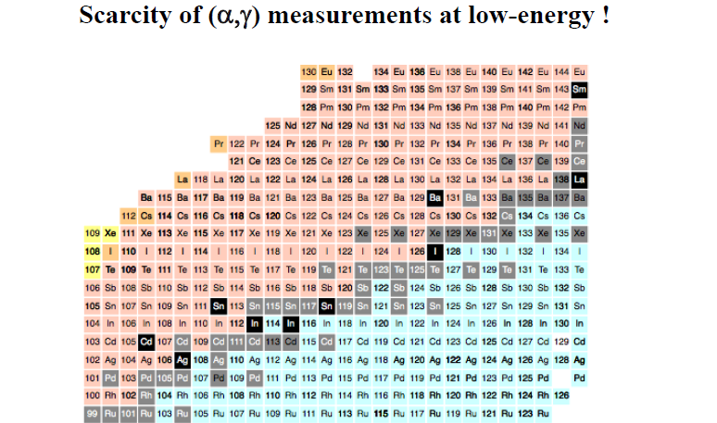
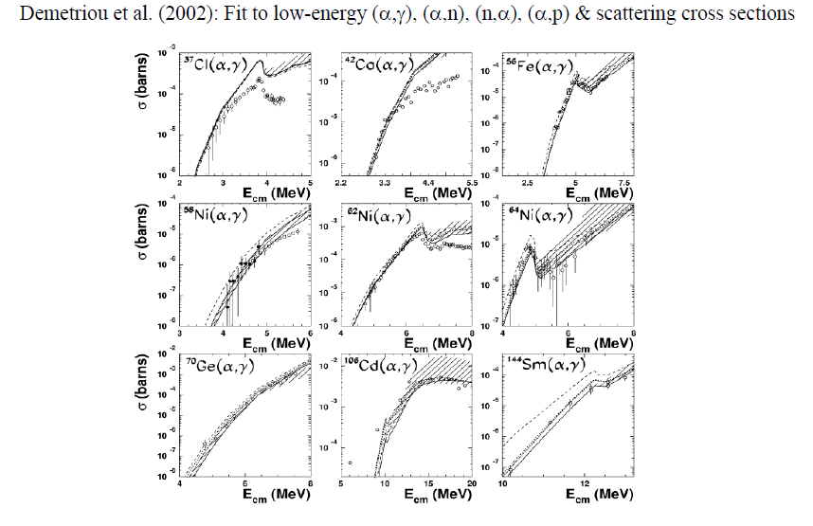
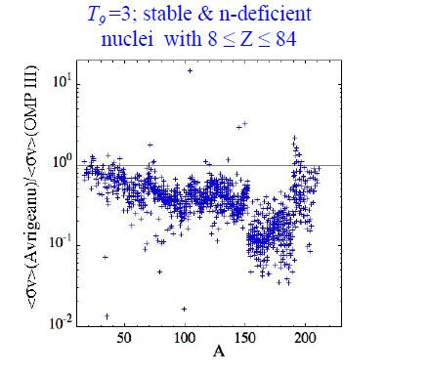
Project 2: Αlpha captures (α,γ)
Different global alpha-OPs: Dimitriou et al (2002), Avrigeanu et al (2014) fitted on available exp. Data at low energies

Slide 12
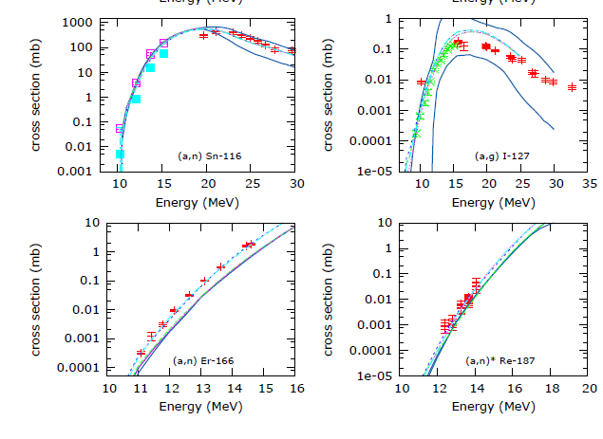
New improved global alpha OP with deformation
Discrepancies observed for rare-earth nuclei
Include deformation in the real double-folding potential
Global formula (r→R(β₂))
Study impact on p process nucleosynthesis simulations
Collaboration:
S. Goriely (Universite Libre de Bruxelles)
Project on Measurements of alpha-cross sections relevant to Nuclear Astrophysics (GANIL, Universite de Lyon, Universite Libre de Bruxelles, NCSR Demokritos)

Slide 13
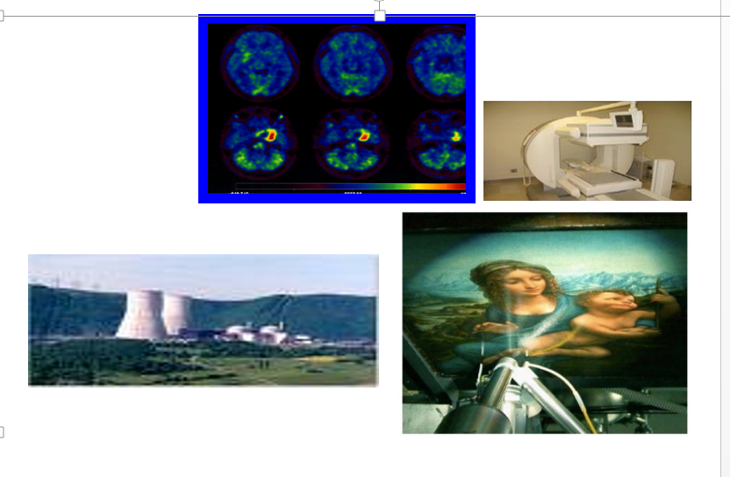
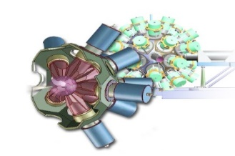
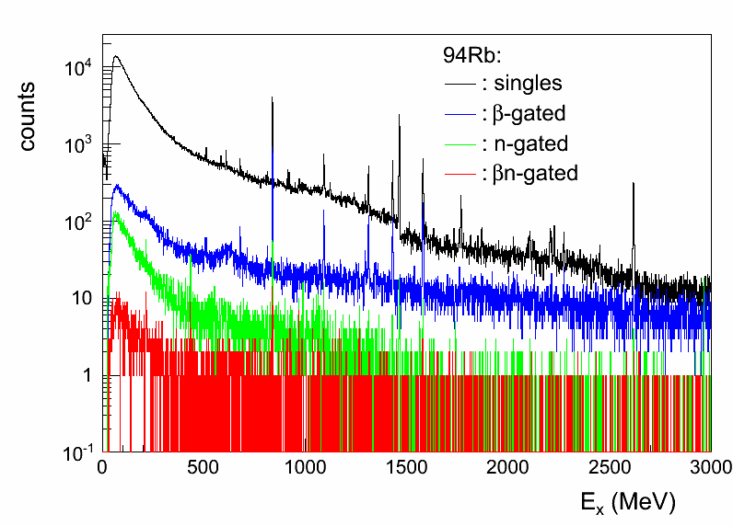
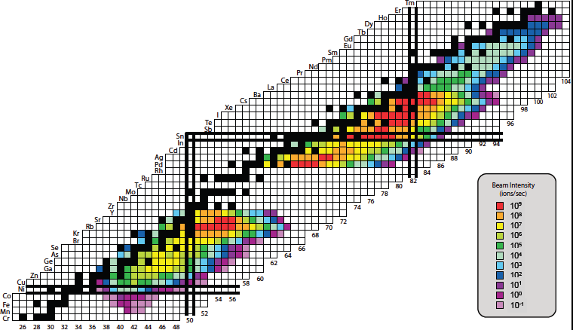
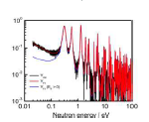
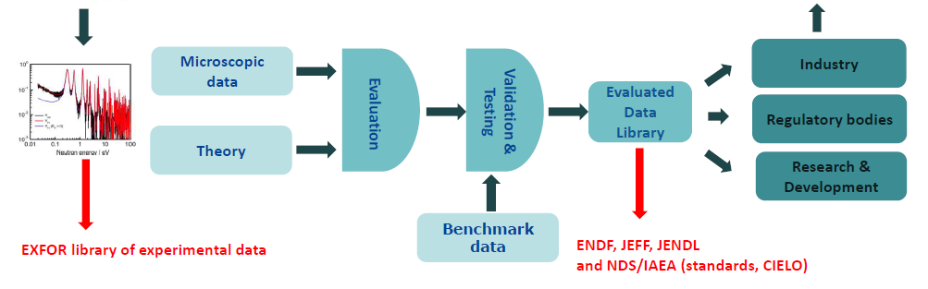
Nuclear data
Feedback, new data needs
XUNDL experimental structure data
EXFOR database of experimental cross sections
IBANDL library of IBA cross sections
ENSDF, NuDAT, LiveChart, MIRD

Slide 14
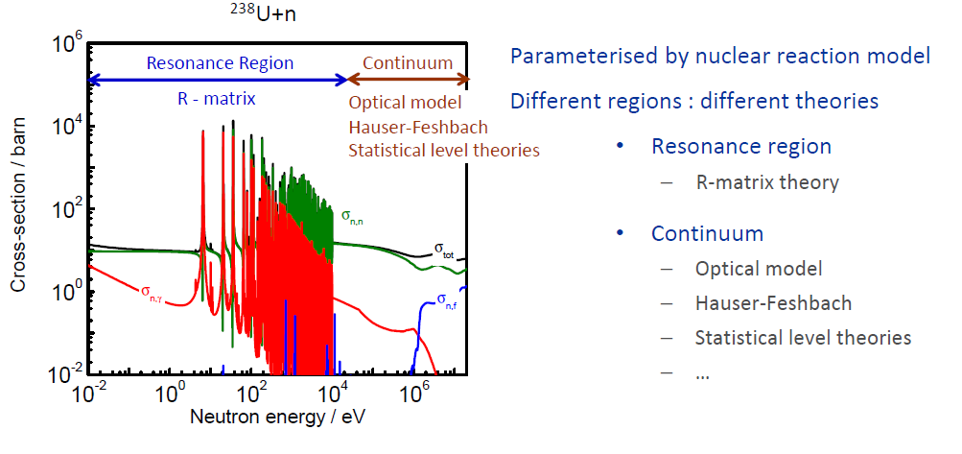
Project 1: Light-particle induced nuclear reactions

Slide 15
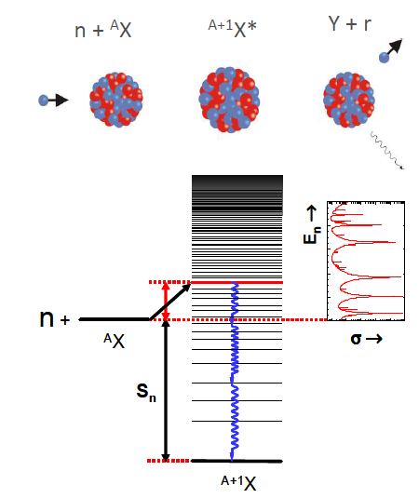
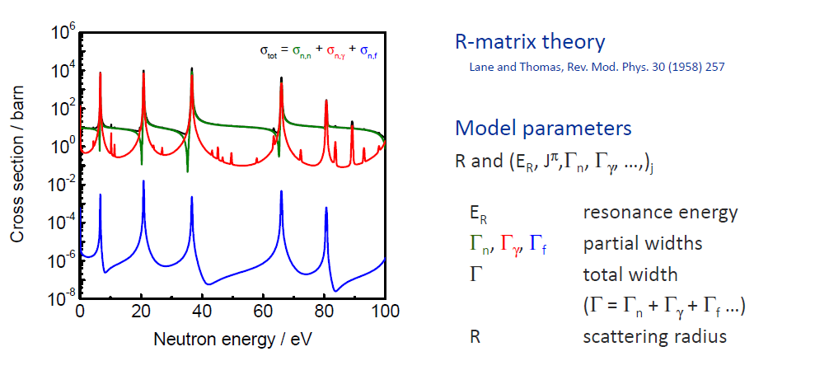
Compound nucleus –
Resonance region
Resonance parameters cannot be predicted by theory
Are adjusted to experimental data
Experimental data are required

Slide 16
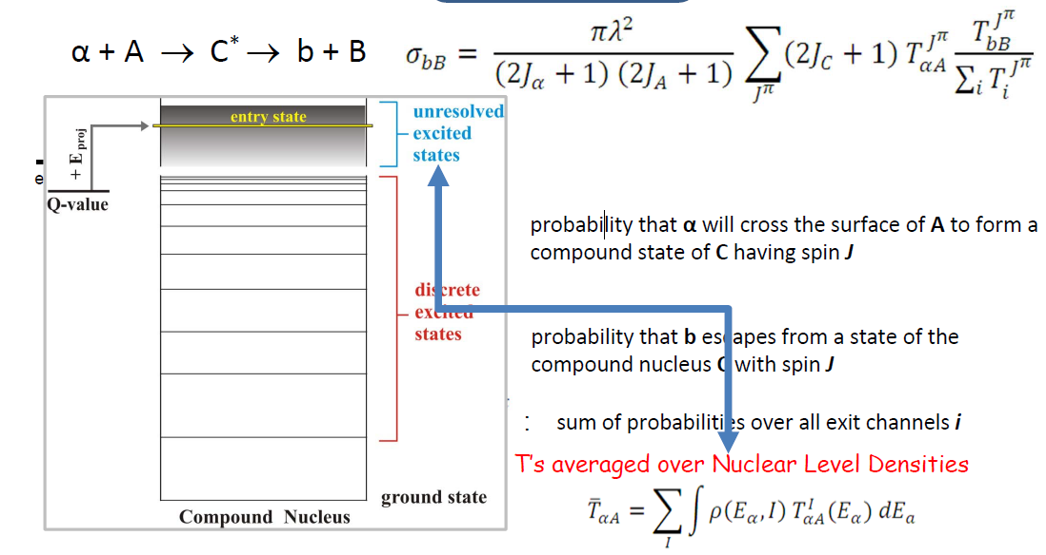
Compound nucleus reactions-continuum
Statistical Model,
Hauser-Feshbach
Particle-nucleus average potentials (optical potentials)
Nuclear level densities
Photon strength functions
ground-state properties (masses, deformations, level schemes)
Τ_{αΑ}
T_{bB}

Slide 17
Parameters per theory
RRR
R-matrix
Relevant for Ion Beam Analysis + Nuclear Astrophysics
Exp. data
Res. Param
E_{R,j}, Γ_{p,j}, Γ_{γ,j}, ℓ, R
Relevant for Nuclear Astrophysics
Level statistics+R, D₀, < Γ_{γ}>
URR
Hauser-Feshbach
Average Param.
OP, NLD, γSF
Exp. data
Exp. data

Slide 18
Evaluation of cross-sections
Critical assessment of experimental data and uncertainties (statistical, systematic)
Fit parameters to available experimental data (Bayesian inference)
Construct correlation matrices of uncertainties (covariances)
Fit resolved resonance region and statistical region separately – match at intersection
Produce output in well-defined format (evaluated library)

Slide 19
Evaluation of cross sections
Compound system Be-7: p+⁶Li, ⁴He+³He → (p,p), (p,alpha), (p, ³He), (p,γ), (³He,p), (³He,n), etc
Compound systems N-15, N-16: n+¹⁴N, n+¹⁵N → (n,tot), (n,n’), (n,γ),
Under the auspices of the International Atomic Energy Agency: International Nuclear Data
Evaluation Network on Light Elements
H. Leeb, Technisches Universitӓt Wien
Ian Thompson, Lawrence Livermore National Laboratory
Gerry Hale, Mark Paris, Los Alamos National Laboratory
Marco Pigni, Oak Ridge National Laboratory
James deBoer, Notre Dame University
Zhenpeng Chen, Tsinghua University
Satoshi Kunieda, Japan Atomic Energy Agency
Pierre Tamagno, CEA Cadarache

Slide 20
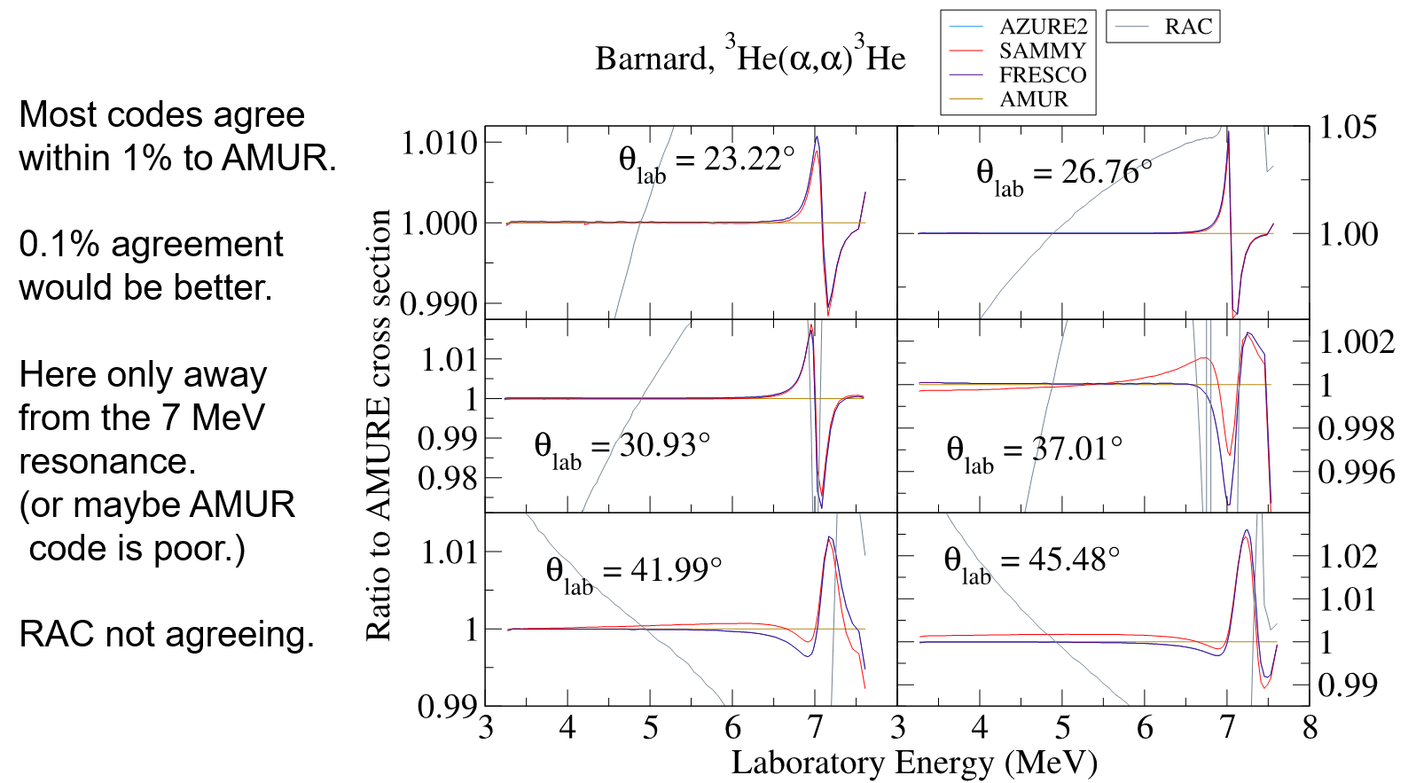
Step 1: Verification of R-matrix codes
Thompson, deBoer, Dimitriou, Chen et al, Eur. Phys. J. A (2019) 55:92

Slide 21
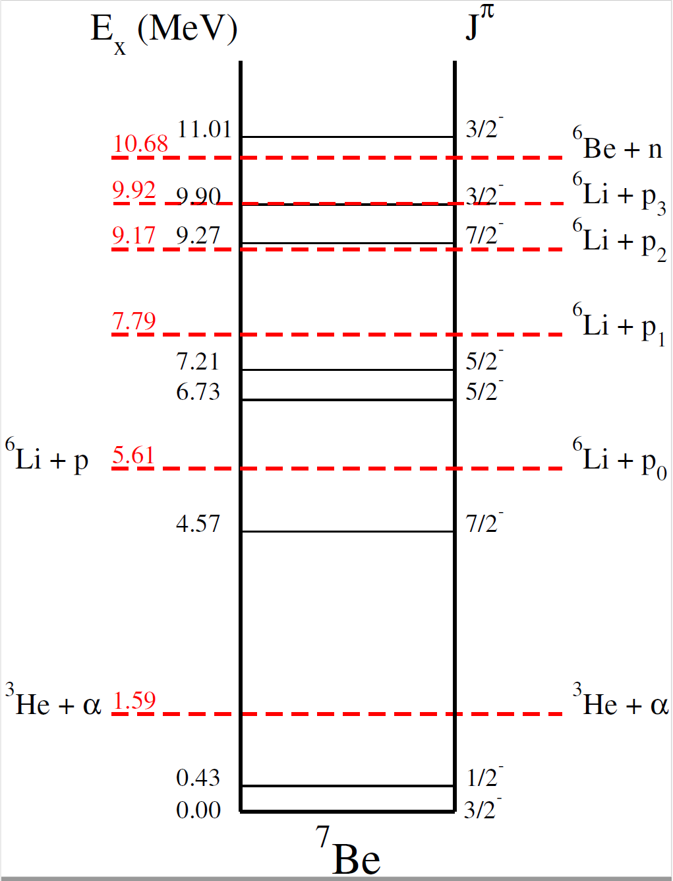
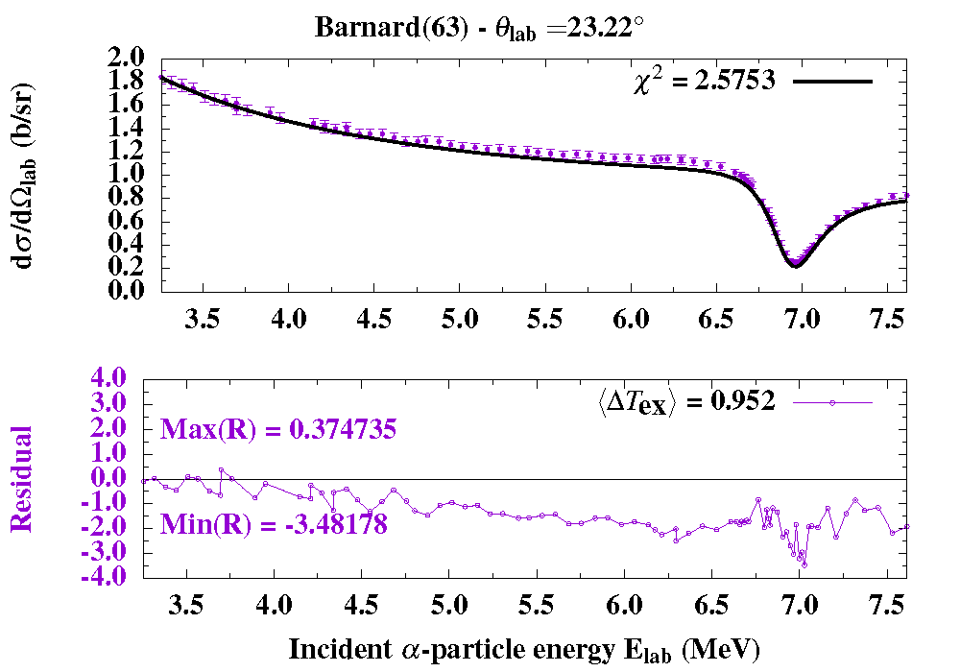
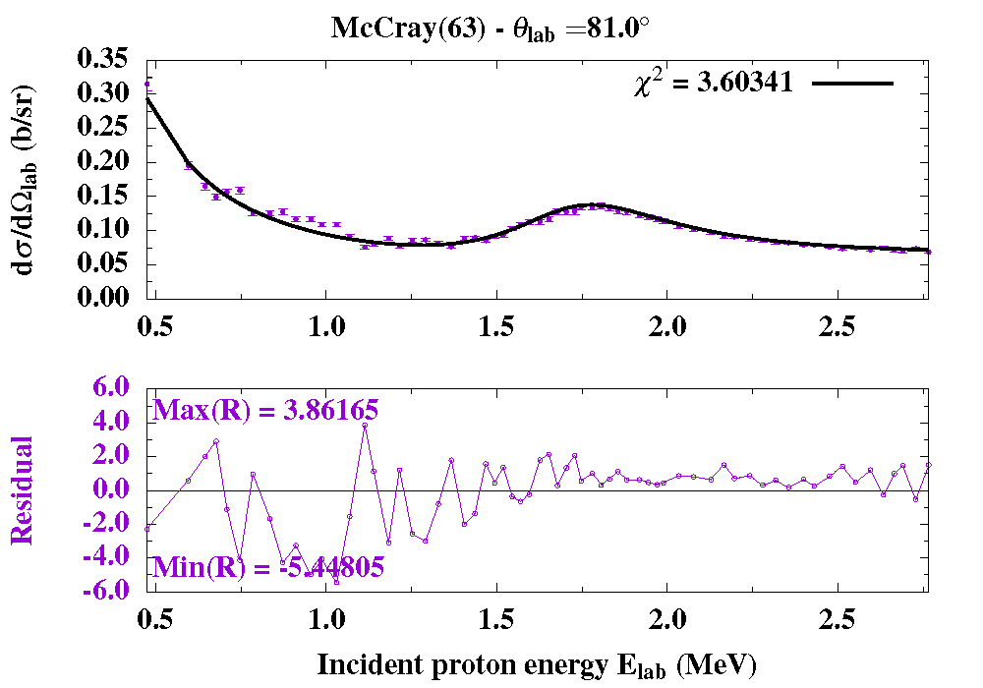
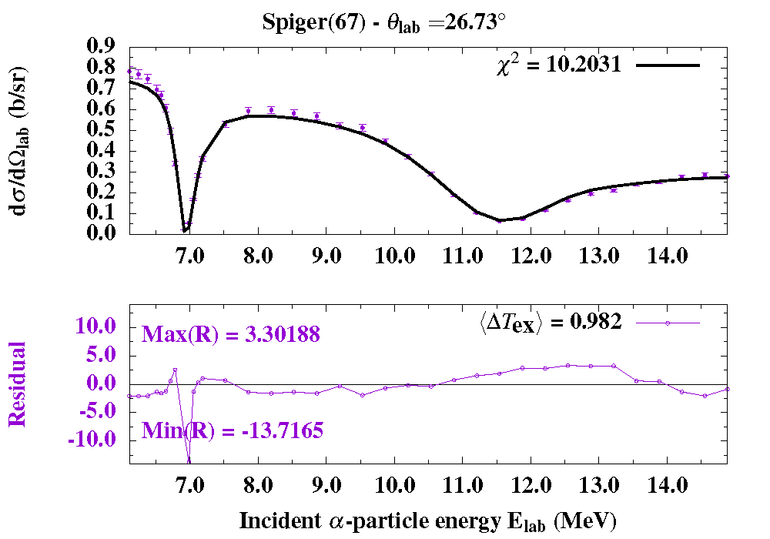
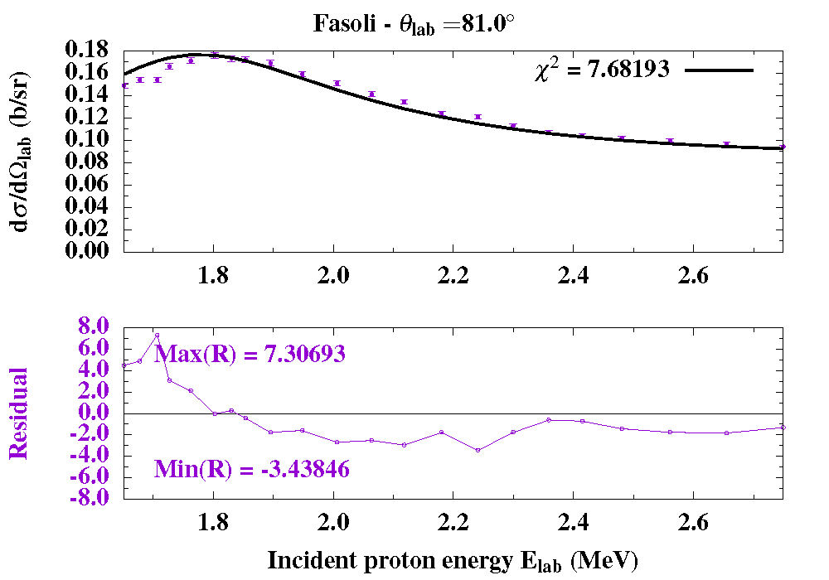
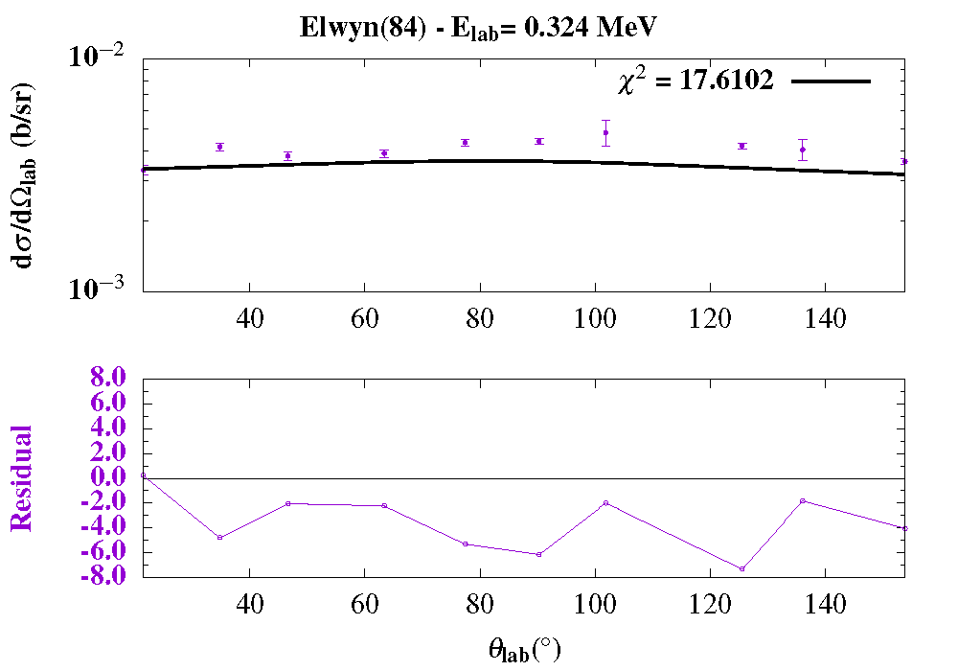
Step 2: Evaluation of Be-7
All channels and exp. data up to 20 MeV [SAMMY R-matix code]
First attempt: up to Ex=8 MeV-no correlation matrix (only statistical uncertainties)- χ²=6

Slide 22
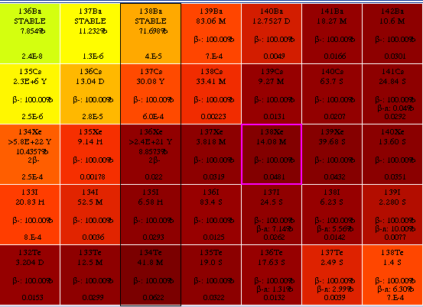
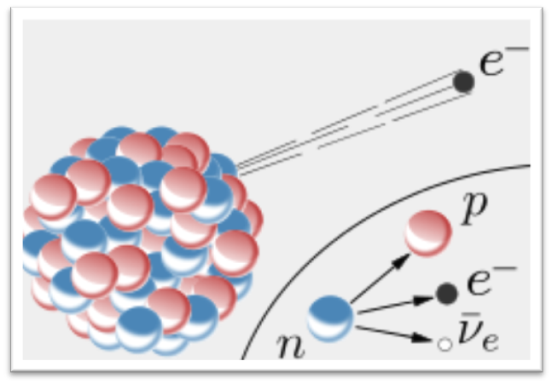
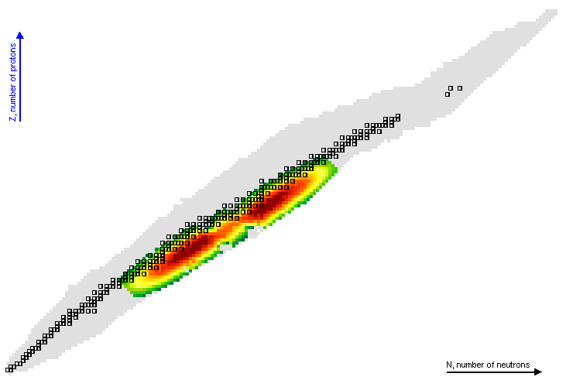
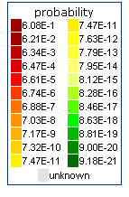
Decay Data: Fission Fragments
²³⁵U
More than 800 nuclides produced in the fission of ²³⁵U

Slide 23
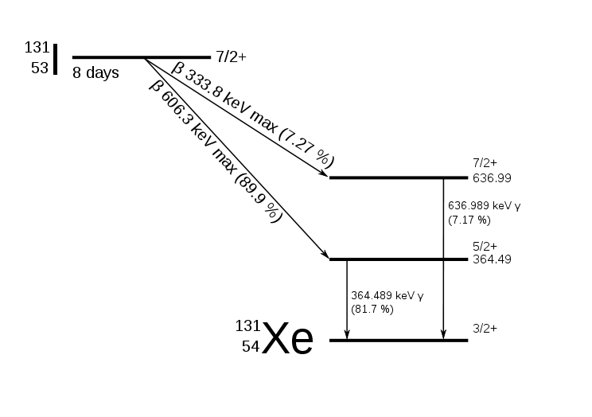
Decay radiation
Q_{β}
Electromagnetic (EM): I_{γ}, Ι_{x-ray}
Light Particle (LP)=I_{β-}, I_{ce}, I_{Auger}
Total Energy=EM+LP+E_{neutrino}= Q(β-)

Slide 24
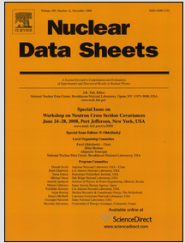
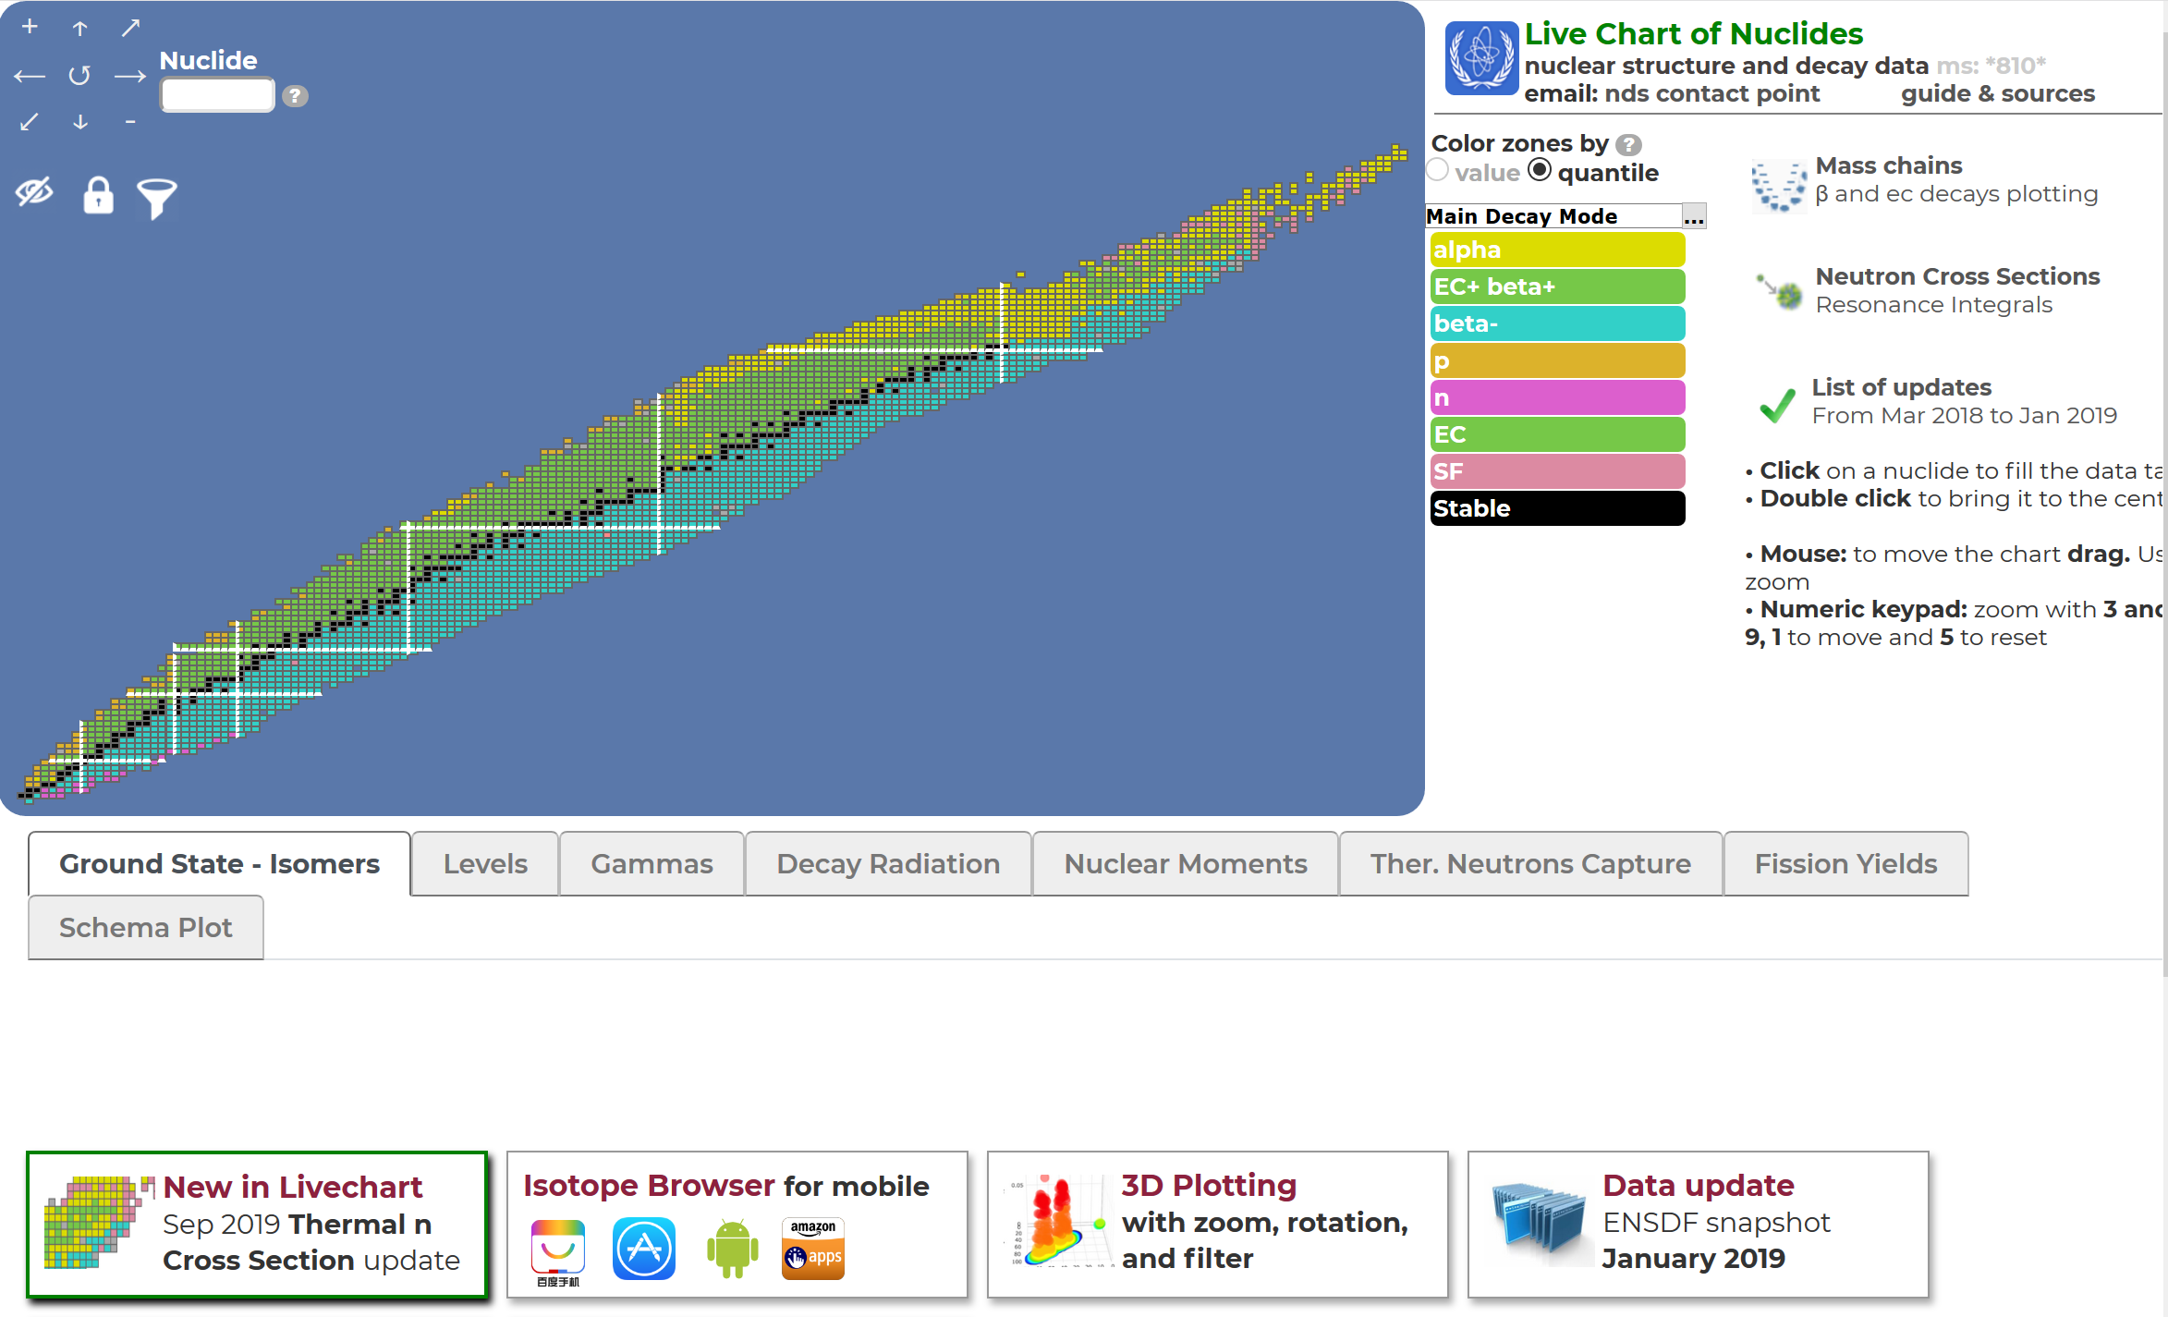
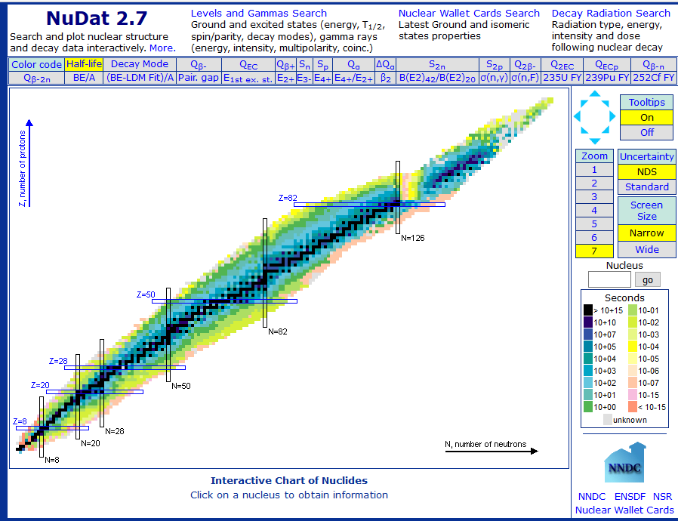
Evaluation of decay data
Critical assessment of all measurements and uncertainties
Averaging methods
Procedures, policies, analysis codes developed and used for the Evaluated Nuclear Structure Data File (ENSDF)

Slide 25
Project 2: Evaluation of decay data for monitoring applications
27 important fission products for monitoring nuclear explosions by analyzing air samples (CTBTO)
International Atomic Energy Agency project
Balraj Singh (McMaster University)
Jagdish Tuli (University of Berkeley)
Filip Kondev (Argonne National Laboratory)
Tibor Kibedi (Australian National University)
Alan Nichols (Surrey University)
Monica Galan (Spain)

Slide 26
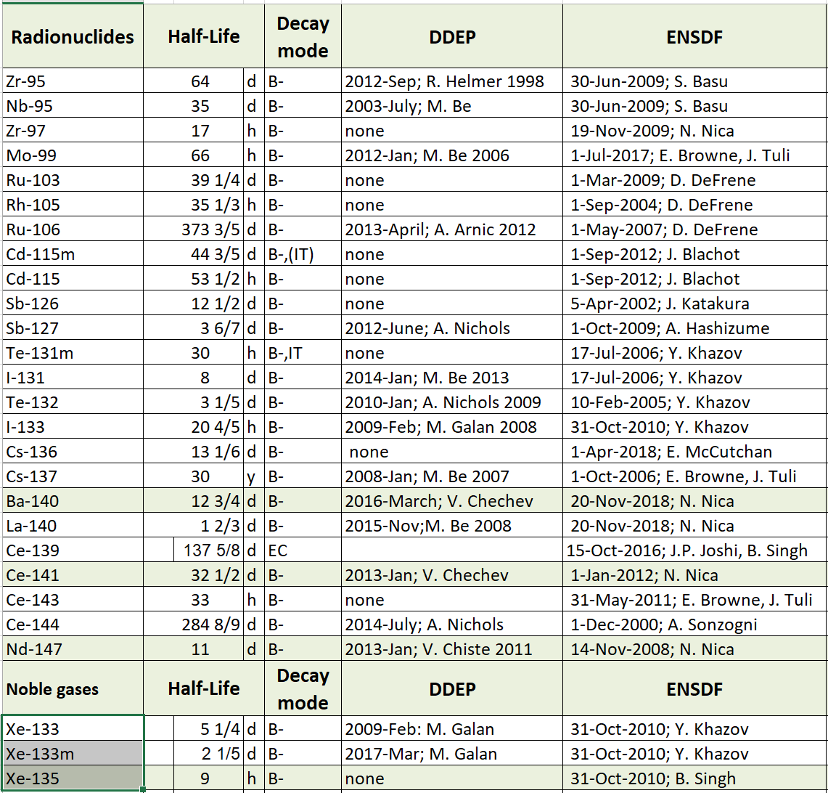

Slide 27

Series of international conferences: Yosemite National Park (2007), Bordeaux (2009), Prague (2011), Sao Paolo (2013), Tokyo (2015) and Berkeley (2018)
Topics:
  Nuclear reaction mechanisms (direct, compound, pre-equilibrium, other)
  Nuclear fission
  Statistical Hauser-Feshbach theory
  Surrogate methods
  Optical model
  Level densities and photon strength functions
  R-matrix theory and connecting resolved resonances with statistical regime
  Nuclear structure for nuclear reactions
  Measurements relevant to compound-nuclear reactions (direct and indirect)
  Nuclear data
  Applications in nuclear astrophysics, energy, medical physics etc.
  Experimental facilities
Venue: National Hellenic Research Foundation
Organised by INPP (CALIBRA) in collaboration with Los Alamos National Laboratory

Slide 28
Proceedings: peer-reviewed in EPJ Web of Conferences; topical issue in EPJ Nuclear Sciences & Technologies
1st circular released
Poster in preparation
website: http://www.inp.demokritos.gr/cnr2020
Local Organizing Committee
  Paraskevi Dimitriou (NCSR “Demokritos”) - Chair
  Michail Axiotis (NCSR “Demokritos”)
  Anastasia Georgiadou (LANL)
  Anastasios Lagoyannis (NCSR “Demokritos”)
  Eleni Vagena (NCSR “Demokritos”)

Slide 29
Summary
Nuclear models for reactions relevant to nuclear astrophysics: p process, r process, light elements
Nuclear data for basic science (astrophysics) and applications (Ion Beam Analysis, Energy, Medicine, Monitoring, etc)
Future:
  fission data (yields, cross sections) for nuclear astrophysics and applications
  Data Sciences (tools for nuclear data)
Thank you!

