Slide 1
Activities of the
Tandem Accelerator Lab
in 2019
Anastasios Lagoyannis
Tandem Accelerator Laboratory
Institute of Nuclear and Particle Physics
N.C.S.R. “Demokritos”

Slide 2
Future (in 2018)
CALIBRA is coming…
Upgrade of the TANDEM
New ion - sources
New set – ups
Re-arrangement of existing ones
Upgrade of the electronics
Cross section measurements
Nuclear Astrophysics related
Light elements deuteron induced reactions
Proton induced gamma – ray reactions
Applications
micro – beam carbon quantification in JET samples
Collaboration with INN
Proton – tagged PIGE
A. Lagoyannis
I.N.P.P. Annual Meeting
Thursday 14/11/19

Slide 3
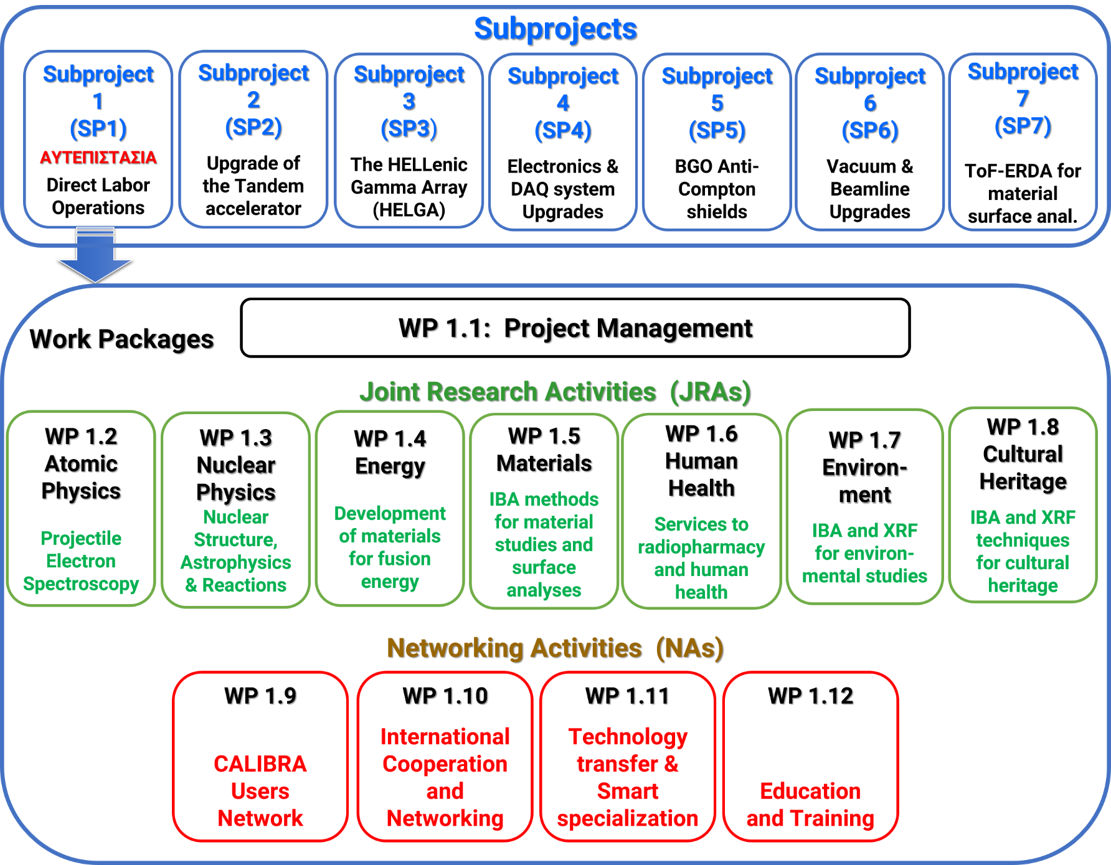
Calibra
SP2: Unseal the offer(s) on 15/11
SP3: Technical offer unsealed on 13/11
SP4: Tender finished. Contract signed. Delivery in February 2020
SP5: Depends on SP3
SP6: Technical offer(s) unsealed on 11/10
SP7: Tender was announced on 13/11
A. Lagoyannis
I.N.P.P. Annual Meeting
Thursday 14/11/19

Slide 4
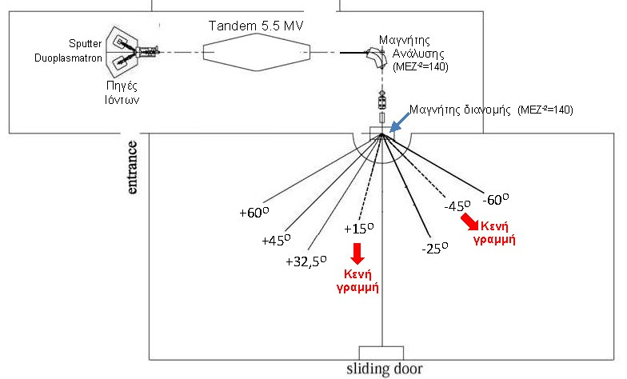
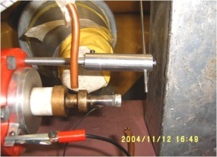
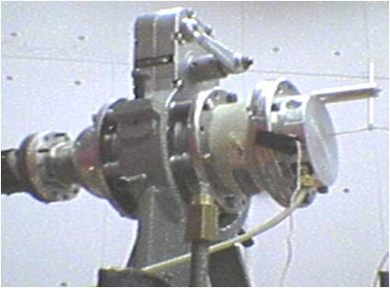
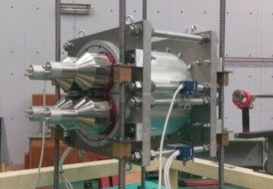
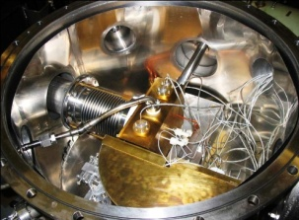
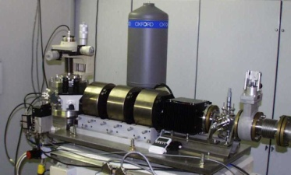
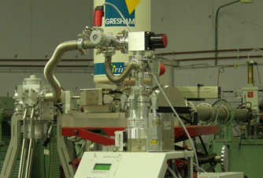
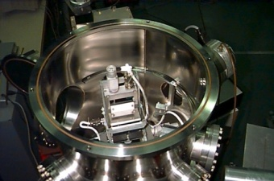
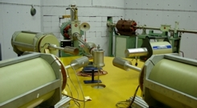
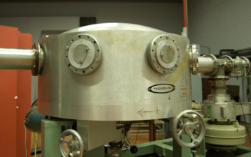
Tandem Layout
d-filled gas-cell
neutron irradiations
Tritiated Ti-target
(rotating)
γ - calorimetry
Atomic physics
μ-PIXE
Auger Spectrom.
multipurpose
scattering chamber
4 HPGe detect. array
Charged-particle induced X rays
RBS , NRA, ERDA …
γ - spectrometry
charged-part. irradiations
A. Lagoyannis
I.N.P.P. Annual Meeting
Thursday 14/11/19

Slide 5
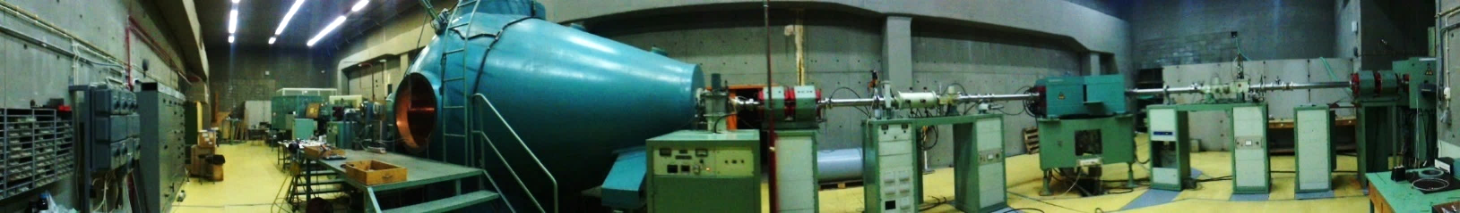
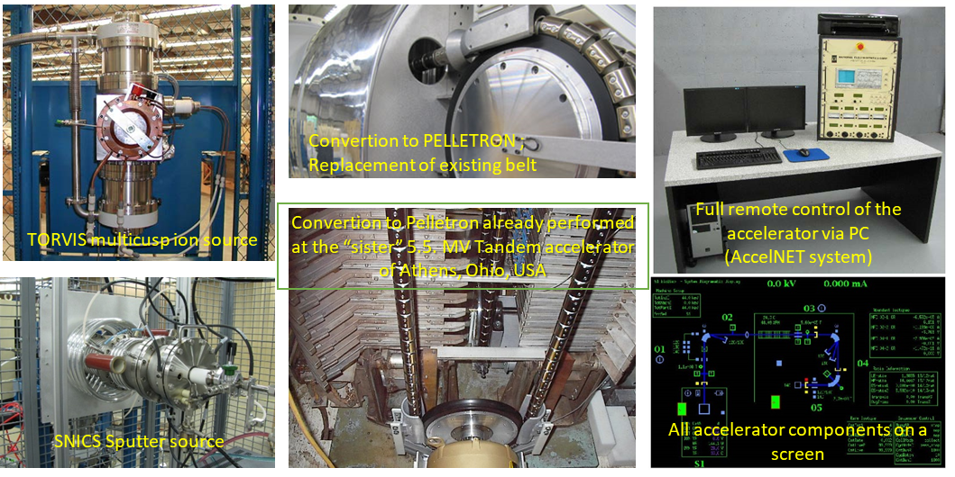
Tandem Upgrades – SP2
5.5 MV Tandem Accelerator
Tandem hall
A. Lagoyannis
I.N.P.P. Annual Meeting
Thursday 14/11/19

Slide 6
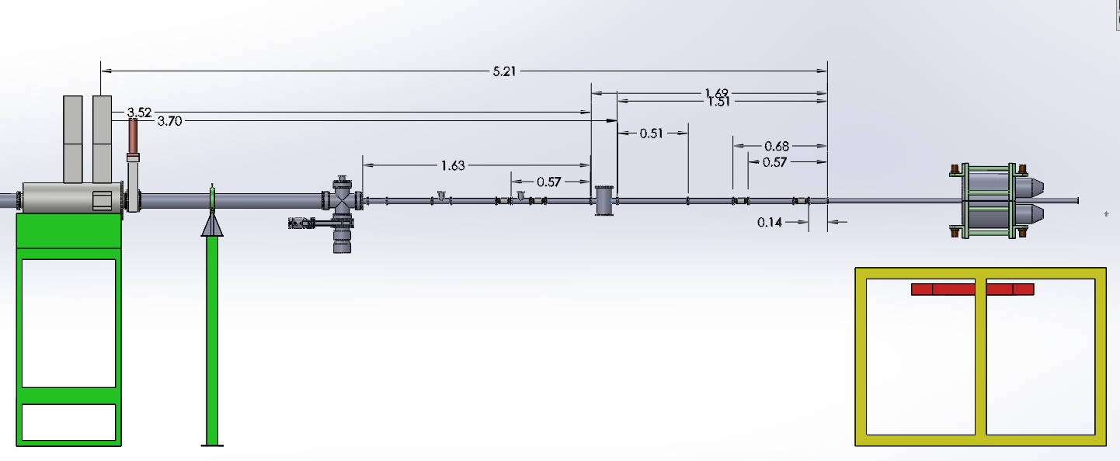
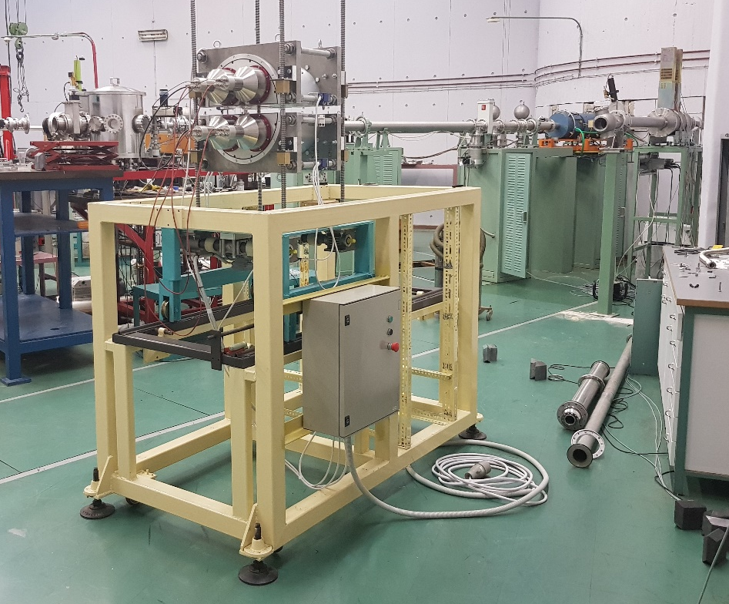
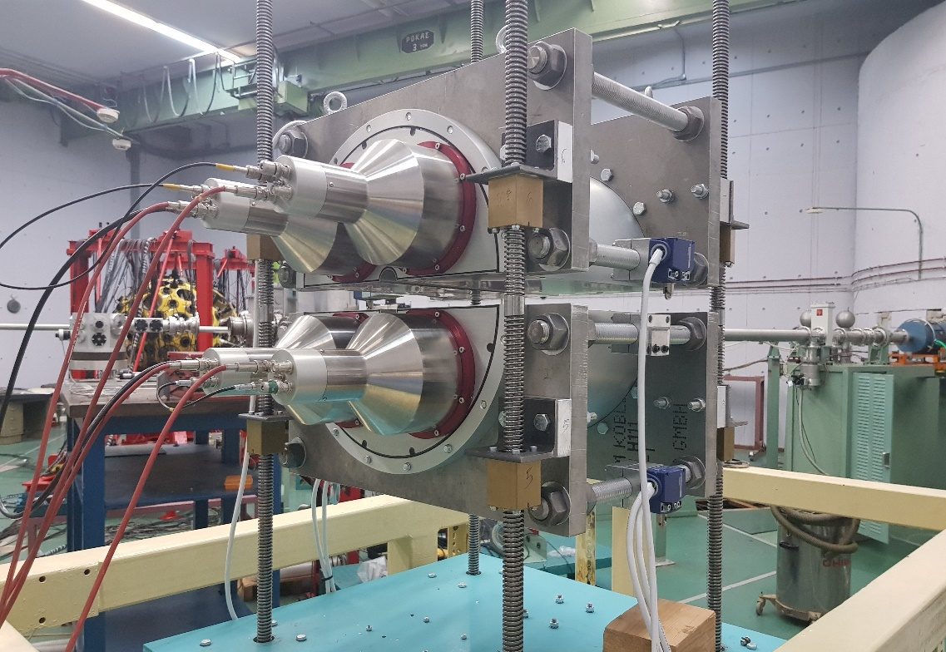
Tandem Upgrades
The R +15 beamline
Beam line extended – “Neoptolemos” transferred
A. Lagoyannis
I.N.P.P. Annual Meeting
Thursday 14/11/19

Slide 7
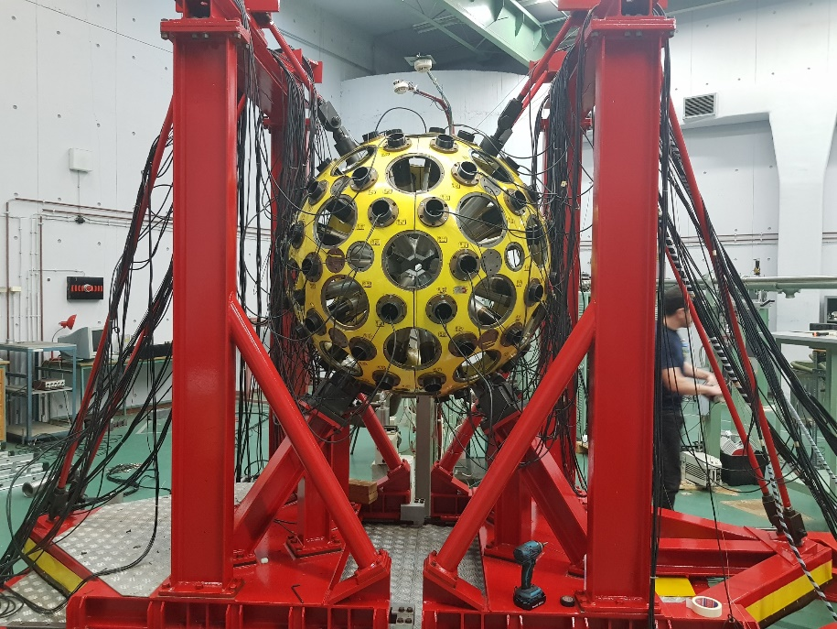
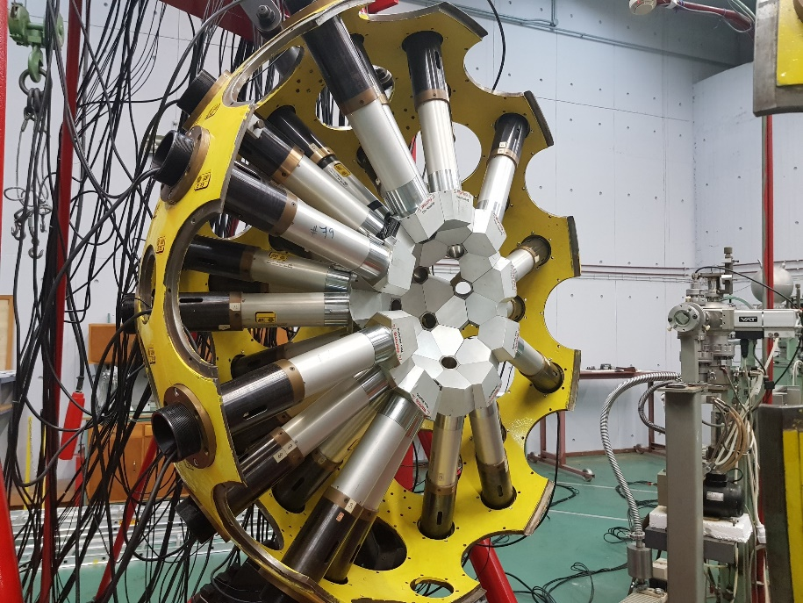
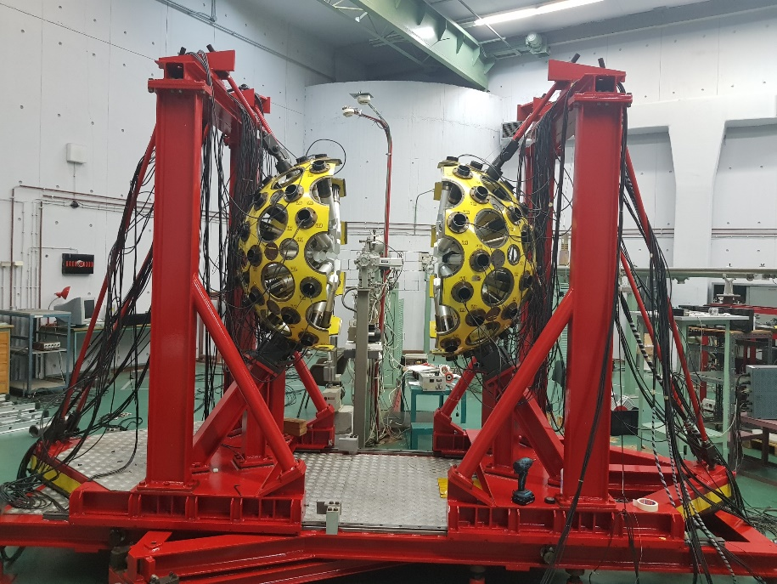
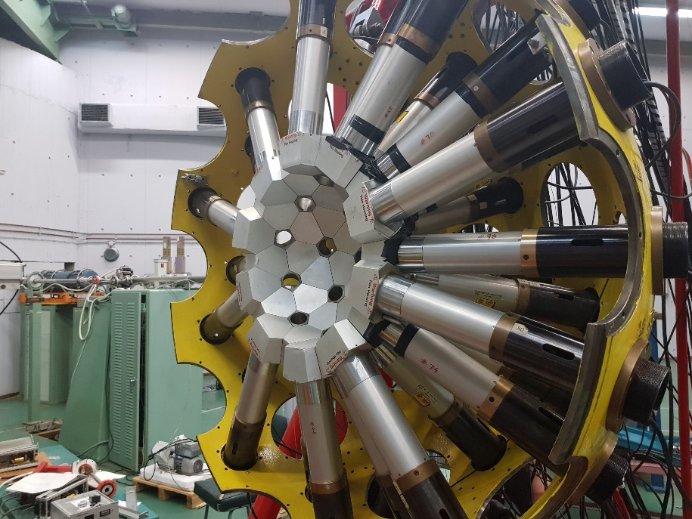
Tandem Upgrades
The R +60 beamline
GASPAR (electronics @ SP4)
A. Lagoyannis
I.N.P.P. Annual Meeting
Thursday 14/11/19

Slide 8
Tandem Layout
d-filled gas-cell
neutron irradiations
Tritiated Ti-target
(rotating)
GASPAR
μ-PIXE
Atomic physics
Auger Spectrom.
multipurpose
scattering chamber
4 HPGe detect. array
PIXE XRF
RBS , NRA, ERDA …
γ - calorimetry
γ - spectrometry
charged-part. irradiations
A. Lagoyannis
I.N.P.P. Annual Meeting
Thursday 14/11/19

Slide 9
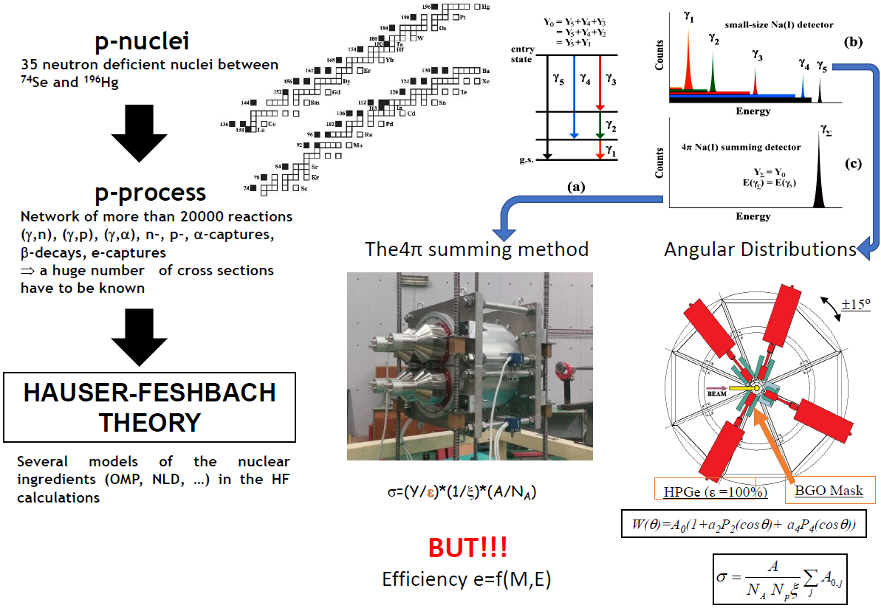
Nuclear Astrophysics Cross-Section Measurements
A. Lagoyannis
I.N.P.P. Annual Meeting
Thursday 14/11/19

Slide 10
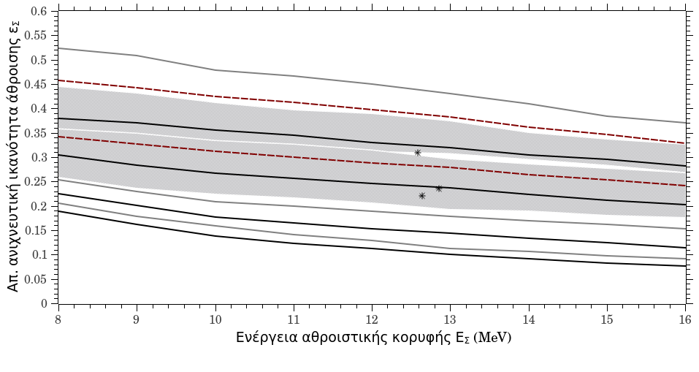
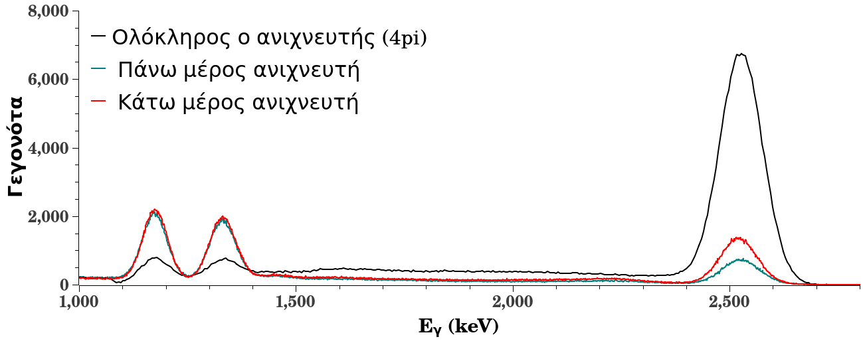
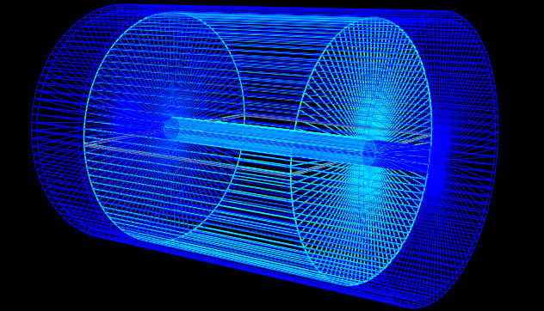
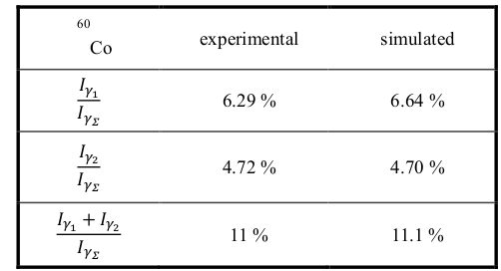
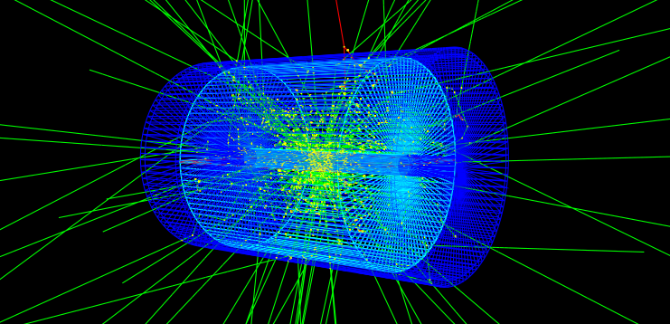
Simulated Efficiency for 4π Summing Method
E_{γΣ}=Ε_{γ1}+Ε_{γ2}=2505.7 keV
Μ=1
* ²⁷Al(p,γ)²⁸Si
<Μ>=1.5
E_{γ1}
E_{γ2}
Μ=2
<Μ>=2.5
¹³⁷Cs
<Μ>= 2.25
Μ=3
<Μ>= 3
Μ=4
<Μ>= 3.2
Μ=5
Μ=6
Μ=7
A. Lagoyannis
I.N.P.P. Annual Meeting
Thursday 14/11/19

Slide 11
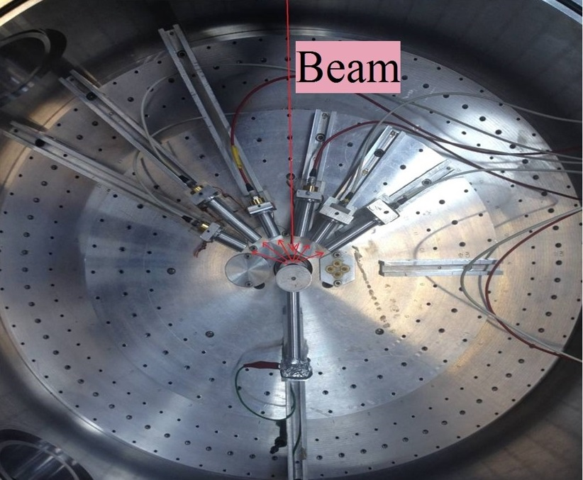
Differential Cross Section Measurement
Differential cross sections for EBS
^{nat}Mg(d,d₀) ^{natMg}
E_{d,lab} = 2700 – 4250 keV
Angles = 120º to 170º
Motor driven goniometer
Great angular accuracy (0.01 deg.)
Up to 4 targets
Water cooling available
Target : C + Mg + Au
A. Lagoyannis
I.N.P.P. Annual Meeting
Thursday 14/11/19

Slide 12
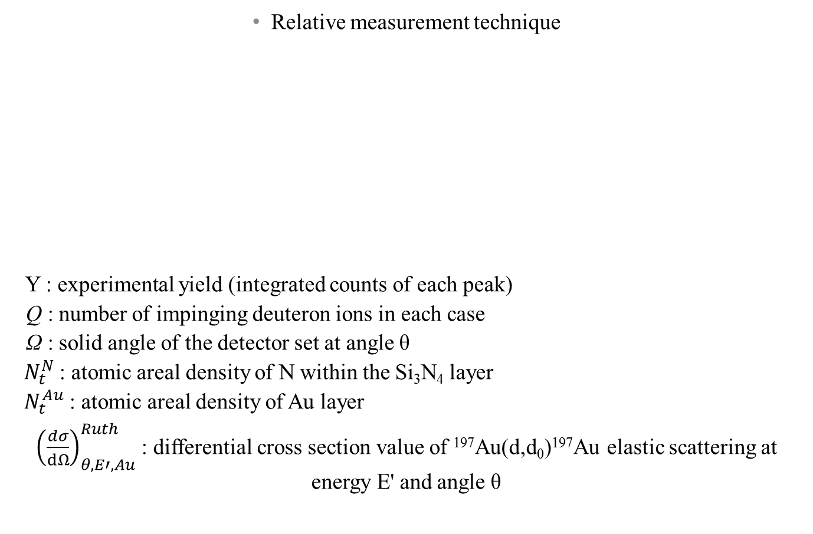
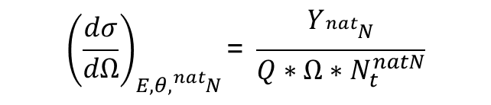
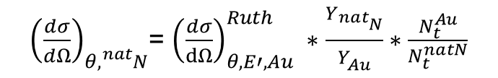
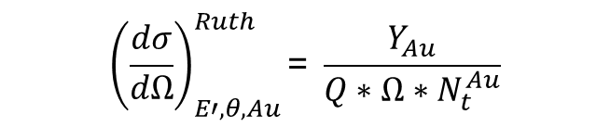
Differential Cross Section Measurement
p-EBS
Rutherford formula
SpectrW, Tv
A. Lagoyannis
I.N.P.P. Annual Meeting
Thursday 14/11/19

Slide 13
Differential CS Measurement - EBS
Total statistical uncertainty < 5% in all cases
A. Lagoyannis
I.N.P.P. Annual Meeting
Thursday 14/11/19

Slide 14
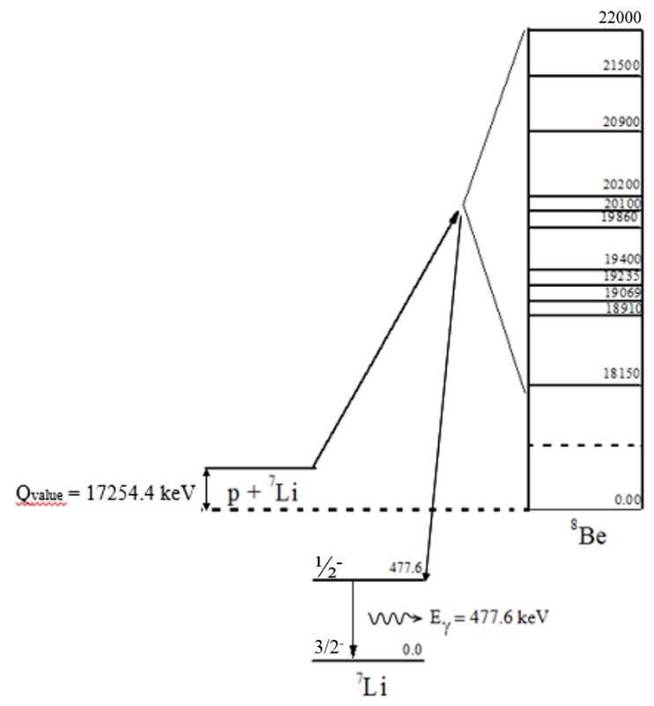
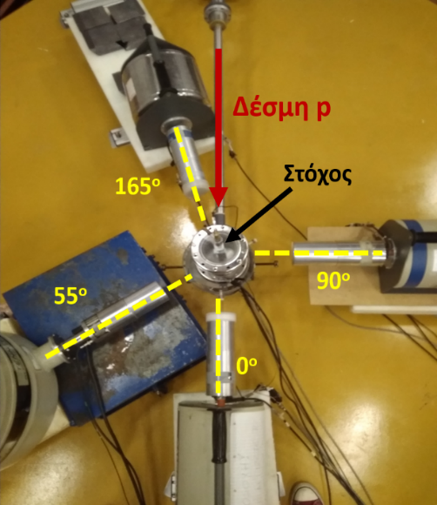
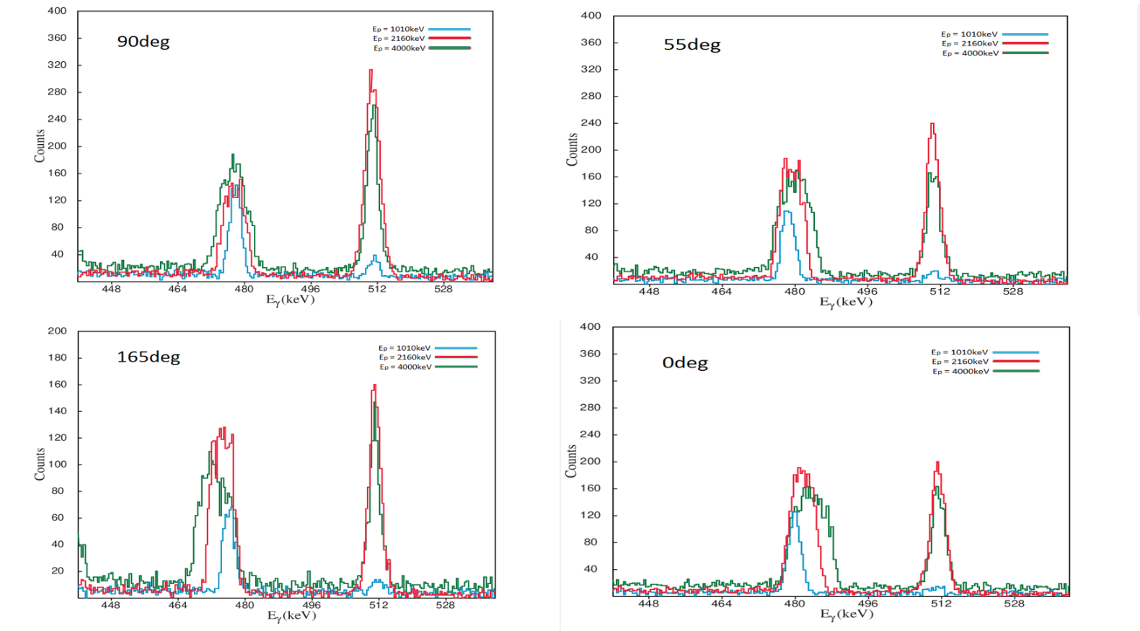
Differential CS Measurement - PIGE
Electronically controlled turntable
Initial angles: 0º – 55º – 90º ‐ 165º
4 HPGe detectors (2 – 18%, 1 – 10%, 1 – 50%)
placed between 25 and 30 cm from target
Air cooled target
A. Lagoyannis
I.N.P.P. Annual Meeting
Thursday 14/11/19

Slide 15
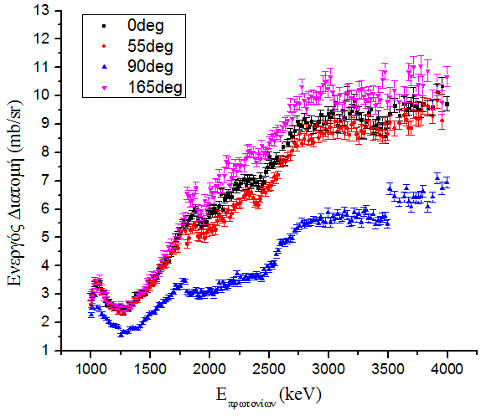
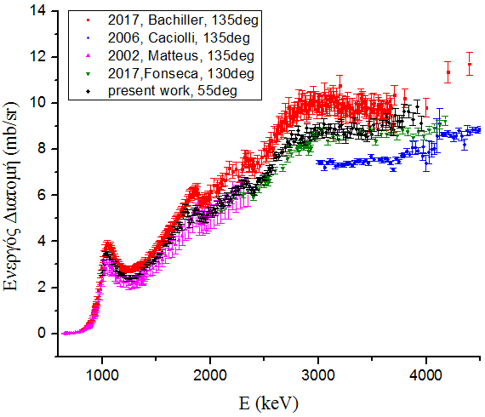
Differential CS Measurement - PIGE
⁷Li(p,p΄γ) ⁷Li
E_{p} = 2600 – 4050 keV
Angles = 0º - 55º - 90º - 165º
A. Lagoyannis
I.N.P.P. Annual Meeting
Thursday 14/11/19

Slide 16
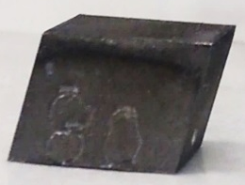
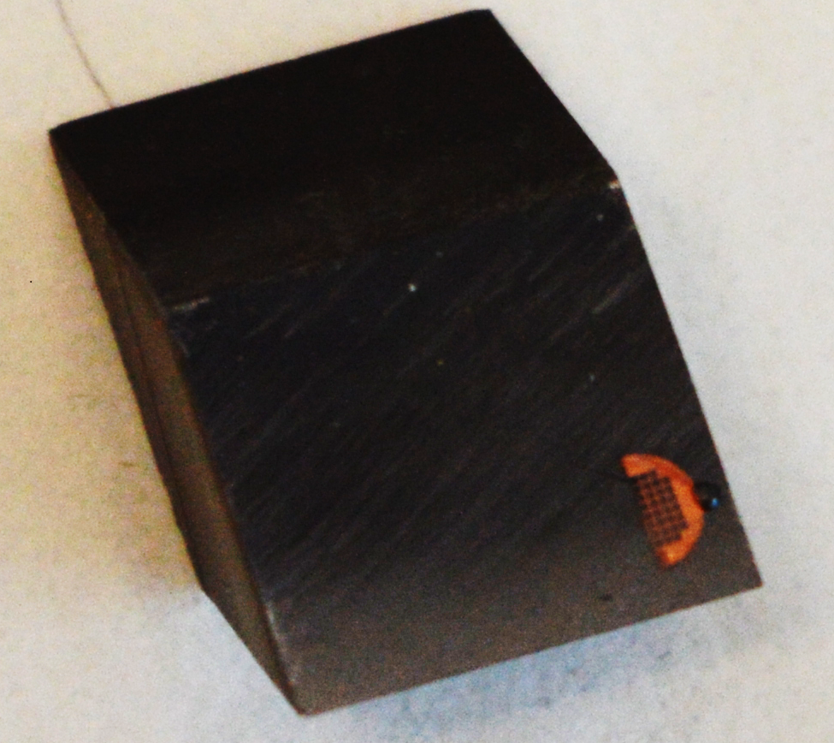
JET Measurements
ILW-1 Inner Wall Guard Limiter (IWGL) Wing
2B(C)2
IILW-1 Dump Plate (DP)
DP
IWGL
OPL
2XR10
4D14
Side D
Be (∼ 8 μm)
Surface
Experimental Setup
Measurements at Demokritos
1.35 MeV ²H milli-beam (for Carbon)
Ni (∼2 μm)
Side B
Be (Bulk)
Side A
Engraved number
Side C
Experimental Setup
Measurements at Ruder Boskovic Institute
3 MeV ³He micro-beam (for Deuteron)
8-14 mm
∼ 12 mm
∼ 12 mm
A. Lagoyannis
I.N.P.P. Annual Meeting
Thursday 14/11/19

Slide 17
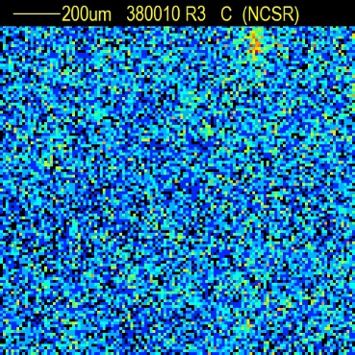
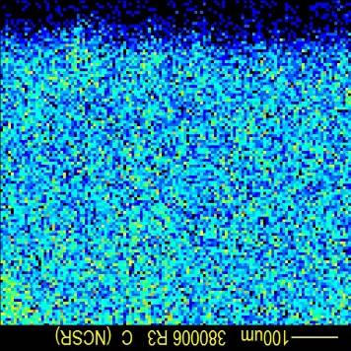
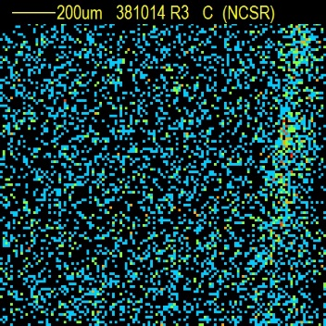
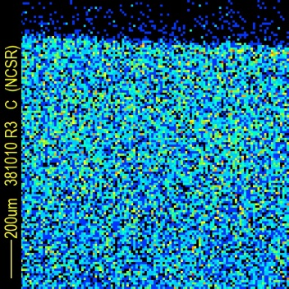
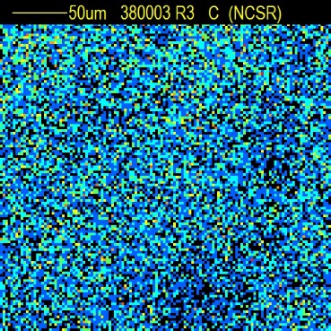
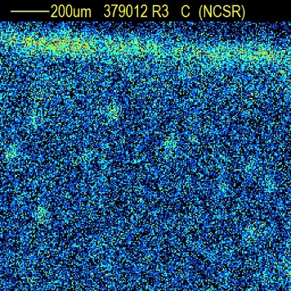
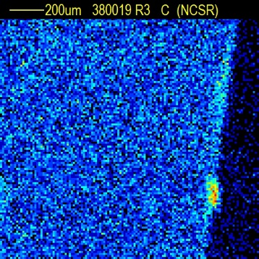
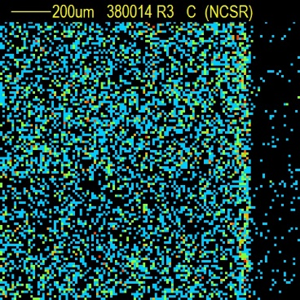
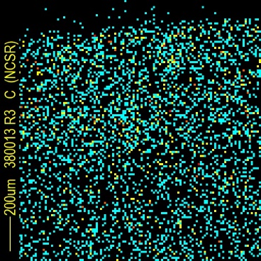
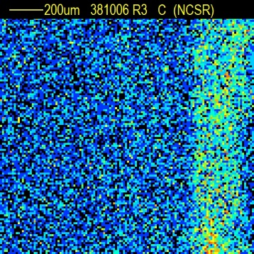
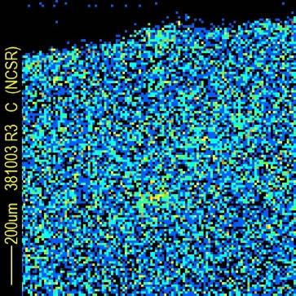
JET Measurements
IWGL (27)
IWGL (174)
Surface
Castellation
Surface
Castellation
Ion beam analysis using ²H microbeam of 1.35 MeV and spot size 50×50 μm²
DP (80)
IWGL (191)
OPL (120)
OPL (320)
In some surfaces & castellation sides carbon agglomerates of about 50-200 µm diameter are observed.
A. Lagoyannis
I.N.P.P. Annual Meeting
Thursday 14/11/19

Slide 18
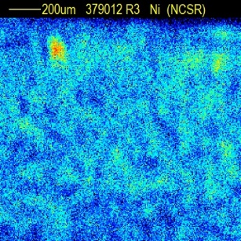










JET Measurements
ILW-1 DP
Ni
Be
C
W
200 μm
200 μm
200 μm
200 μm
ILW-1 IWGL CENTER
Ni
Be
C
W
500 μm
100 μm
100 μm
100 μm
100 μm
ILW-1 IWGL CENTER
Ni
Be
C
100 μm
100 μm
100 μm
100 μm
A. Lagoyannis
I.N.P.P. Annual Meeting
Thursday 14/11/19

Slide 19
Future
CALIBRA is here
Upgrade of the TANDEM vacuum system
Installation of digital electronics for GASPAR (and other setups)
Completion of the R-15 line to the Neoptolemos detector
Design of the new goniometric table
Cross section measurements
Characterization of the Neoptolemos detector with reactions
Test of GASPAR with reactions
Light elements deuteron induced reactions
Proton induced gamma – ray reactions
Applications
Upgrade of micro – beam setup for PIXE
Continue with JET measurements
Measurement of targets for University of York
Continue collaboration within the G4G ESA project
A. Lagoyannis
I.N.P.P. Annual Meeting
Thursday 14/11/19

