Slide 1
2018 UPDATE
BH Information Paradox at Crossroads
MINOS AXENIDES
Theoretical High Energy Physics
I.N.P.P.

Slide 2
Publications :
Multipole stability of spinning M2 branes in the classical limit of the Berenstein-Maldacena-Nastase matrix model
Minos Axenides , Emmanuel Floratos, Georgios Linardopoulos
Published in Phys.Rev. D97 (2018) no.12, 126019
The quantum cat map on the modular discretization of extremal black hole horizons
Minos Axenides (Democritos Nucl. Res. Ctr.), Emmanuel Floratos (Democritos Nucl. Res. Ctr. & Athens U.), Stam Nicolis (Fed. Denis Poisson, Tours).
Published in Eur.Phys.J. C78 (2018) no.5, 412

Slide 3
a sequel of previous works
Modular discretization of the AdS2/CFT1 holography
Minos Axenides (Democritos Nucl. Res. Ctr.), E.G. Floratos (Democritos Nucl. Res. Ctr. & CERN & Athens U.), S. Nicolis (Tours U.). Jun 24, 2013. 31 pp.
Published in JHEP 1402 (2014) 109 .
Chaotic Information Processing by Extremal Black Holes
Minos Axenides (Democritos Nucl. Res. Ctr.), Emmanuel Floratos (Democritos Nucl. Res. Ctr. & Athens U.), Stam Nicolis (Fed. Denis Poisson, Tours & Tours U.). Apr 2, 2015. 7 pp.
Published in Int.J.Mod.Phys. D24 (2015) no.09, 1542012.

Slide 4
BH-Info Paradox at a Crossroads

Slide 5
Dr G. Pastras -- IKY (2016-2018)
--- ELIDEK ( 2019-2022)
--- Quantum Entanglement and Gravity
--- QFT- Strings and Quantum Gravity

Slide 6
Teaching-Theses Supervision
Dimitris Katsinis - UoA- Ph.D candidate
“Quantum Entanglement and Gravity”
IKY schoraship award (3 yrs)
Papagrigoriou Evagelos – MSc- 15 June 2018
Thesis “ Entanglement Entropy in many Harmonic
Oscillator Systems and in Field Theories”
Dimitris Tridimas - UoA – Diplomatiki
“Integrable and Chaotic aspects of Henon-Heilles system”

Slide 7
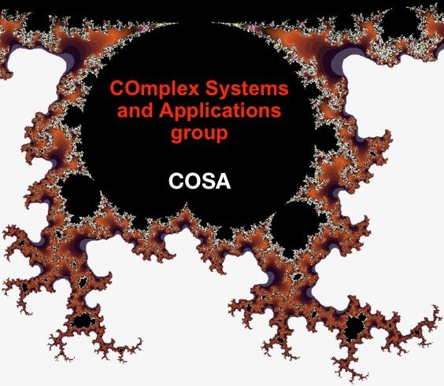
Cosa-Net-> Seminars-
NTUA-Demokritos course,
Summer School 2018

Slide 8
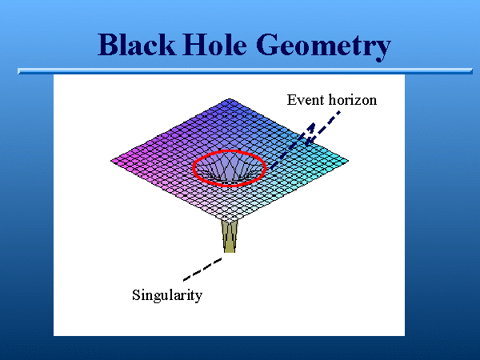
BH-Near Horizon Stretched Space-time

Slide 9
Few observations
Black holes are thermal
They have entropy[Bekenstein] S ( A/4)
They have temperature[Hawking] T ( 1/M)
Strong chaos underlies thermal behavior in ordinary systems
Possible connection between quantum black holes and chaos

Slide 10
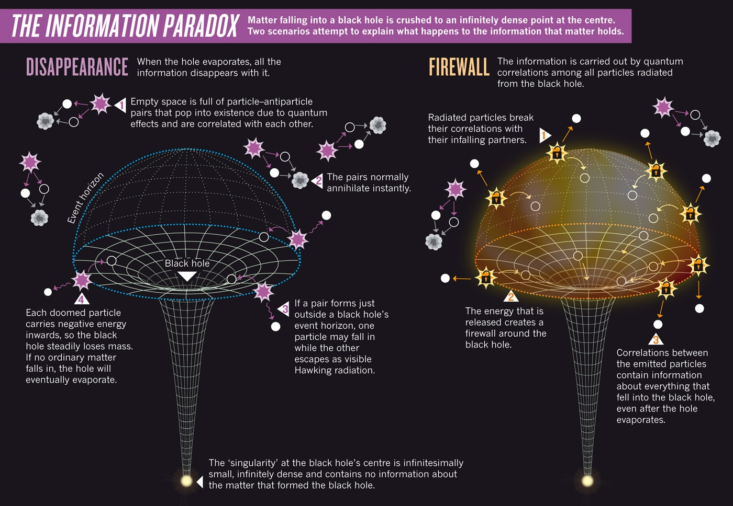
BH- INFO-PARADOX= PURE INCOMING STATES
MIXED OUTGOING STATES

Slide 11
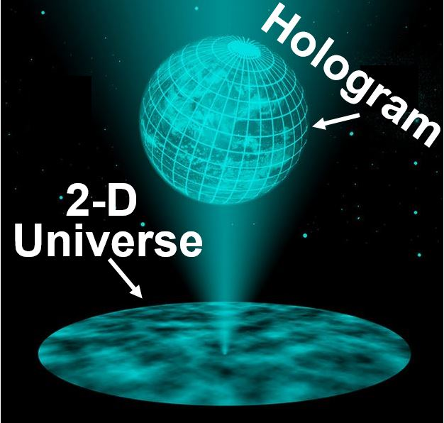
INFORMATION
OF A VOLUME IS ENCODED ON
ITS SURFACE BOUNDARY

Slide 12
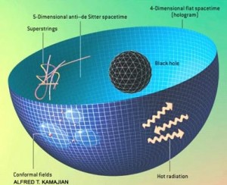
Holographic Universe—AdS/CFT
(‘t hooft-Susskind –Maldacena)

Slide 13
PROPOSAL
DISCRETE GEOMETRY IS
AN APPROPRIATE FRAMEWORK FOR THE
BH QUANTUM INFORMATION PARADOX
IN THE BH- NEAR HORIZON SPACETIME

Slide 14
ASSUMPTIONS
• FINITENES OF BH ENTROPY S ≈ A/4 ->
FINITE DIMENSIONAL HILBERT SPACE OF BH MICROSCOPIC STATES Dim[H]=Exp[S]
•FINITE DIMENSIONAL HILBERT SPACE -> DISCRETE AND FINITE SPACE-TIME
• THE SIMPLEST MODEL FOR SINGLE PARTICLE DYNAMICS A DISCRETE AND FINITE PHASE SPACE Z[N]XZ[N] Z[N]={0,1,2,3,..,N-1}
ALL INTEGERS MODULO N FOR N=PRIME INTEGER=p
GALOIS FIELD F[p] -> MODULAR ARITHMETICS

Slide 15
ARITHMETIC GEOMETRY
A MODEL FOR PLANCK SCALE SPACE-TIME
FOR NEAR HORIZON BH-SPACETIME
• MODULAR ARITHMETIC -> RANDOM POINT GEOMETRIES
• MODULAR DYNAMICS A= 2X2 MODULAR MATRICES IN SL[2,Z[N]] -> CHAOS AUTOMATIC
• FINITE DIMENSIONAL HILBERT SPACES
• FINITE QUANTUM MECHANICS AND QUANTUM FIELD THEORIES
• N=p^n, QUDITS OF INFORMATION,
• FINITE DIMENSIONAL UNITARY RANDOM EVOLUTION OPERATORS U[A]

Slide 16
CONCLUSIONS
DISCRETIZING AdS2 RADIAL AND TIME NEAR HORIZON GEOMETRY OF EXTREMAL BLACKHOLES AND AT THE SAME TIME PRESERVING THE ALGEBRAIC STRUCTURE OF THE ISOMETRIES NECESSARILY LEADS TO THE MOD[N] ARITHMETIC DISCRETIZATION
WITH HOLOGRAPHY AdS2[N]/CFT1[N],
We make IT QUANTUM THROUGH
FINITE QUANTUM MECHANICS

