Slide 1


Institute of
Nuclear & Particle Physics
fast Micromegas and dense Neutrinos
George Fanourakis
Institute of Nuclear & Particle Physics
N.C.S.R. “Demokritos”

Slide 2

Fast detectors: Motivation
PID techniques: Alternatives to RICH methods, J. Va’vra,
https://dx.doi.org/10.1016/j.nima.2017.02.075
High Luminosity Upgrade of LHC:
To resolve pile-up.
ATLAS/CMS simulations: ~140 vertices per crossing (σ_{t}~170ps).
Extra detector requirements:
20 ps timing + tracking info.
Large surface coverage.
Multi-pads for tracking.
Resistance to aging effects.

Slide 3
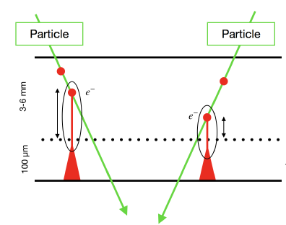
The standard Micromegas Detector
Cathode
HV1
Drift Conversion region
Radiation creates electrons, which drift to the mesh plane.
Mesh
HV2
Amplification region
Electrons go through the mesh and are amplified. The charge movement induces signals on the anode strips/pads.
Anode - Read out
Ground
Lukas Sohl
(master thesis)
Timing limitations
Conversion region too long: The electrons are created at different places
Diffusion effects: for a 3mm drift length → ~6 ns !

Slide 4
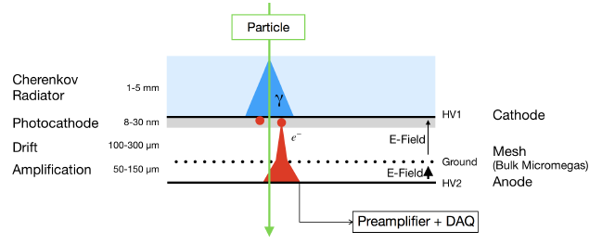
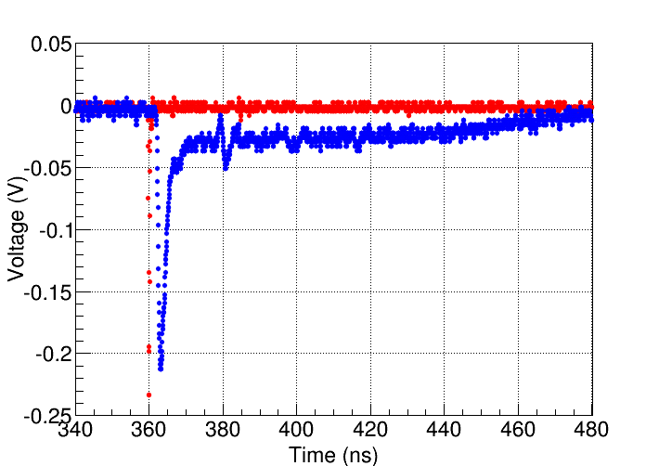
The Picosec detector
F.J. Iguaz (Saclay)
A particle produces Cerenkov radiation.
Photons produce electrons in the photocathode.
Electrons are amplified by a two stage Micromegas detector.
We observe a signal with two components:
  Fast: electron peak (~1 ns). → good timing
  Slow: ion tail (~100 ns).
MCP signal

Slide 5
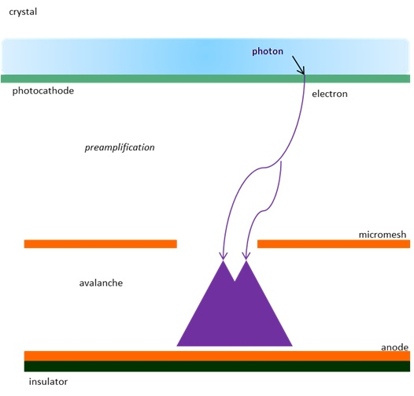
Many parameters to optimize
Crystal:
- Different Thicknesses of MgF2 (2,3,5mm)
- Different Materials
Photocathode:
1) CsI and different:
- producer (CERN, Saclay)
- thicknesses (11, 18, 25, 36nm)
- metallic interface (Al, Cr) &
thicknesses (Cr 3, 5.5nm)
2) Pure metallic
- Al(8nm), Cr (10,15,20nm)
- Diamond, B-doped Diamond, DLC
Gas Mixture:
- Compass gas
- CF4 + 10% C₂H₆
- Ne + 20% C₂H₆
Drift field
Micromegas:
- standard bulk
- bulk with 6 pillars
- thin mesh bulk
Resistive (different values)
microbulk
Operation voltages
Amplification field
E. Oliveri (CERN)

Slide 6
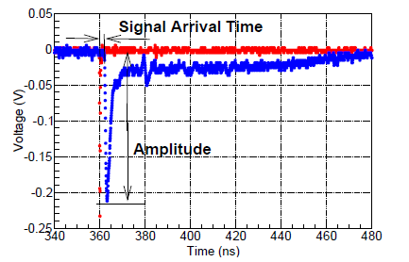
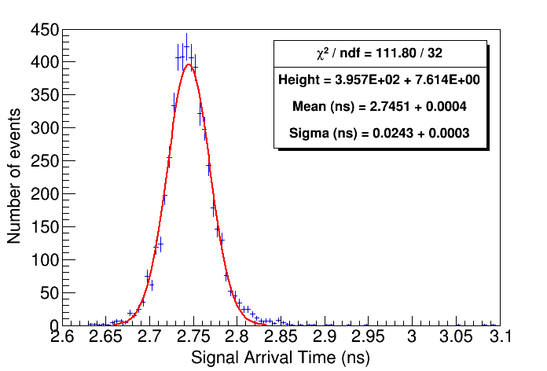
Reaching time resolution 24 ps !!!
σ_{TOF} = 24.3 ps
Single pad PICOSEC, active area: 1 cm diameter
Best result: 24 ps (bulk MM + Cr/CsI photocathode).
Optimum operation point: Anode +275V / Drift – 475V.
Nphe = 10.1 ± 0.7
Result repeated in two different beam campaigns.

Slide 7
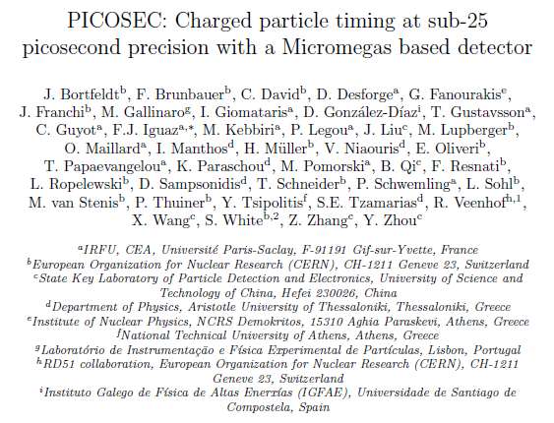
Nucl.Instrum.Meth. A903 (2018) 317-325

Slide 8
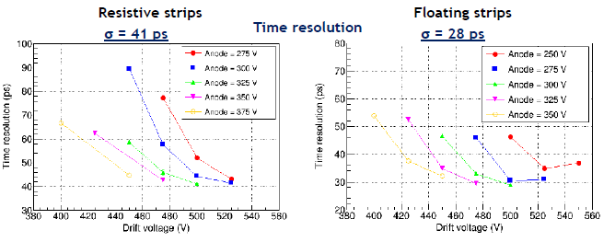
Testing resistive PICOSECs
Values not far from the bulk PICOSEC detector
Worked fine for hours of pion beam

Slide 9
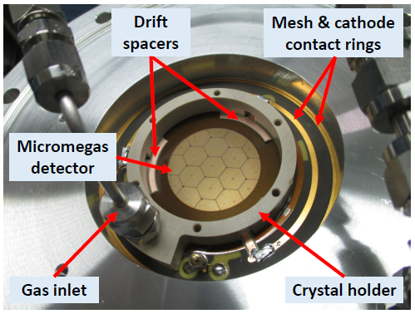
Expanding the active area: Multipad PICOSEC
19 hexagonal pads
36 mm diameter active area
tested successfully October 2018 (again!)

Slide 10
a Design Study
ESSνSB (ESSnuSB)
Study CP Violation in leptonic sector
(INPP) G. Fanourakis, Th. Geralis, G. Stavropoulos

Slide 11

Design Study ESSνSB (2018-2021)
Kick-off meeting in January 2018, Lund.
ESSνSB has already started engaging postdocs.
More information on:
http://essnusb.eu/
partners: IHEP, BNL, SCK•CEN, SNS, PSI, RAL

Slide 12
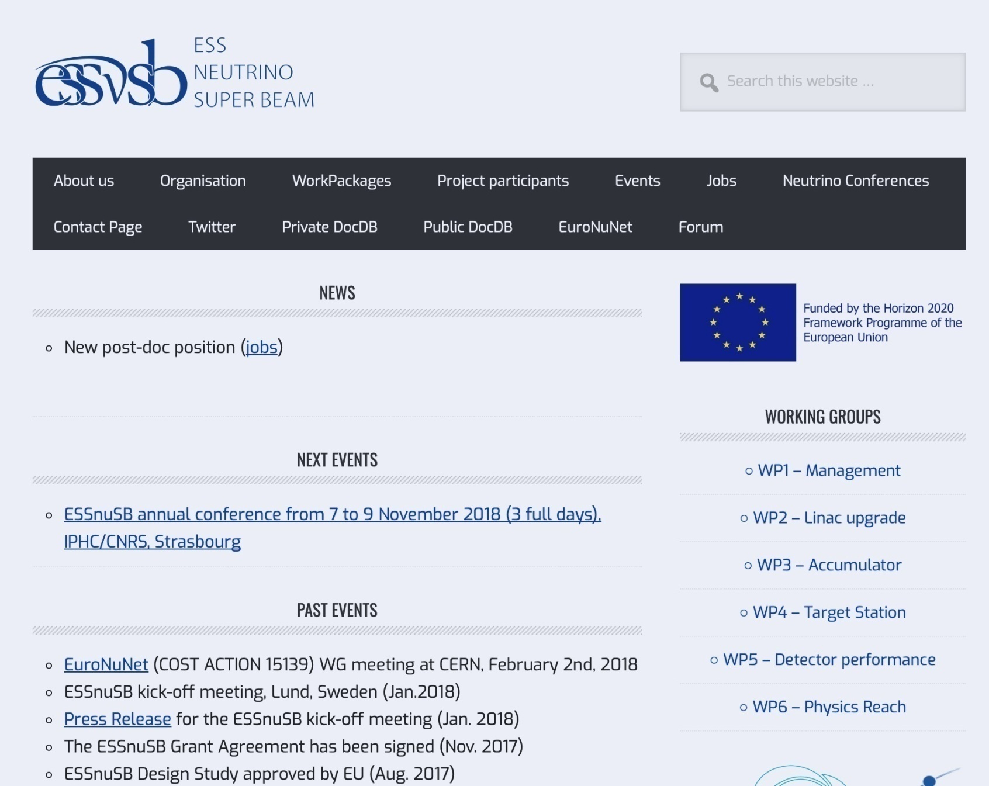
ESSnuSB web site

Slide 13
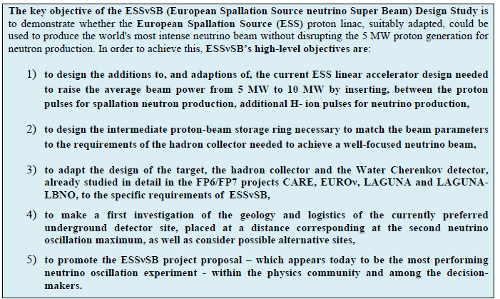
Objectives

Slide 14
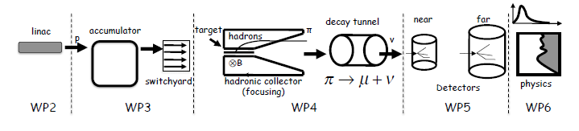
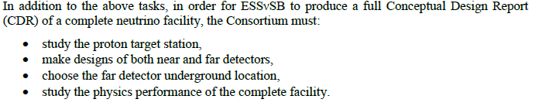
Some details
2 GeV protons
INPP
Introduce Micromegas tracking detectors
Investigate the ESSnuSB potential for studying NSI

Slide 15
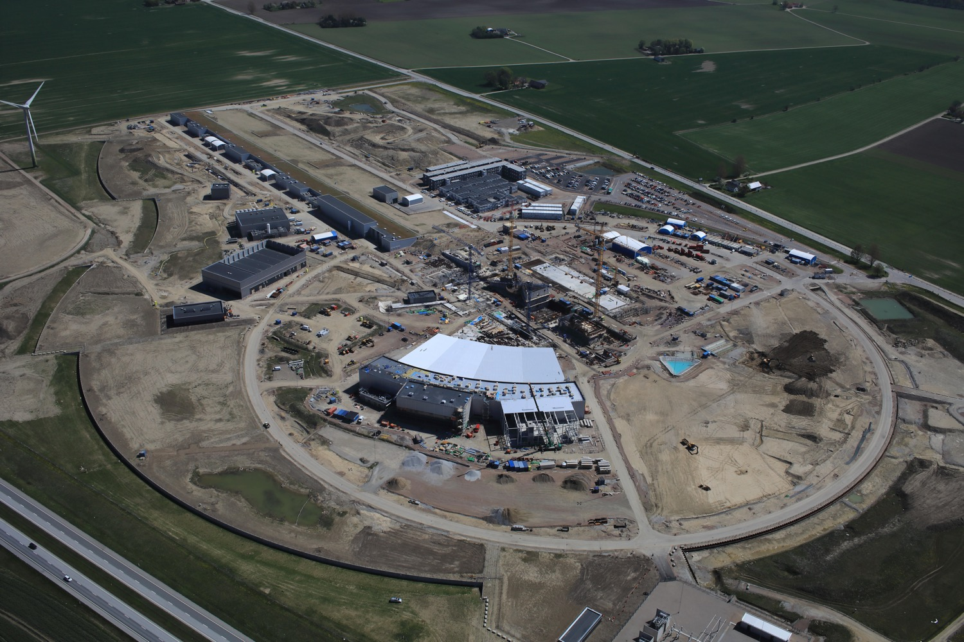
European Spallation Source
May 2018

Slide 16
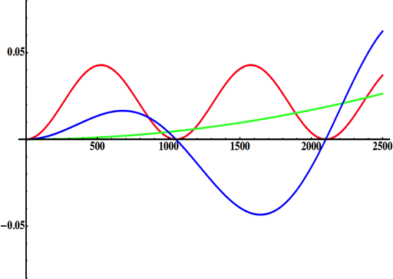
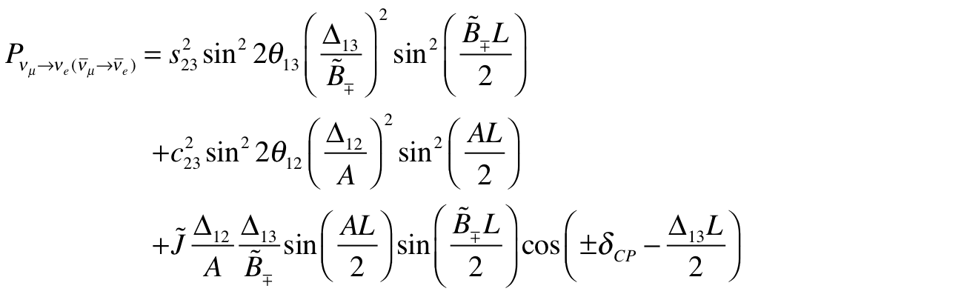
Going for the 2nd Oscillation Maximum
(arXiv:1110.4583)
atmospheric
atmospheric
solar
Non-CP terms
solar
L/E
interference
CP interference
CP violating
θ₁₃=8.8º
+…
for "large" θ₁₃ 1st oscillation maximum is dominated by atmospheric term
1st oscillation max.: A=0.3sinδ_{CP}
2nd oscillation max.: A=0.75sinδ_{CP}
2nd oscillation maximum
δ_{CP}=-90
δ_{CP}=0
δ_{CP}=+90
(see arXiv:1310.5992 and arXiv:0710.0554)
P(ν_{μ}→ν_{e})
θ₁₃=8.8º
("large" θ₁₃)
more sensitivity at 2nd oscillation max.
very intense neutrino beam needed
L/E

Slide 17
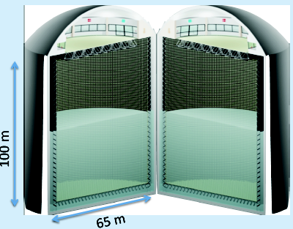
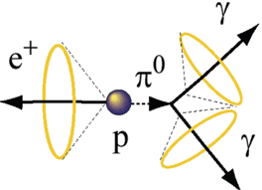
Can we obtain the 2nd Oscillation Maximum?
Yes, if we place our far detector at around 500 km from the neutrino source.
MEMPHYS like Cherenkov detector
(MEgaton Mass PHYSics studied by LAGUNA)
(arXiv: hep-ex/0607026)
Neutrino Oscillations
Proton decay
Astroparticles
Understand the gravitational collapsing: galactic SN ν
  Supernovae "relics"
Solar Neutrinos
Atmospheric Neutrinos
New 20" PMTs with higher QE and cheaper (see JUNO), the detection efficiency will improve the detector performance keeping the price constant, not yet taken into account.
500 kt fiducial volume (~20xSuperK)
Readout: ~240k 8” PMTs
30% optical coverage

Slide 18
Physics Performance
540 km
little dependence on mass hierarchy,
δ_{CP} coverage at 5 σ C.L. up to 60%,
δ_{CP} accuracy down to 6° at 0° and 180° (absence of CPV for these two values),
not yet optimized facility,
5/10% systematic errors on signal/background.

Slide 19
In combination with the other experiments
Apart from the fact that ESSνSB has the highest sensitivity for resolving CP among all the coming experiments (DUNE, T2HK and variations)
Nuclear Physics B 937 (2018) 303–332
ESSνSB + DUNE can resolve CP with a minimum 10σ sensitivity in 4-5 years !
ESSνSB + 2THK can resolve CP in 3 years !
ESSνSB + 2THK can resolve the Hierarchy by breaking the hierarchy-δ_{CP} degeneracies

