Slide 1
KM3NeT and Astroparticle Physics in INPP
Christos Markou
INPP, 13/12/2018

Slide 2
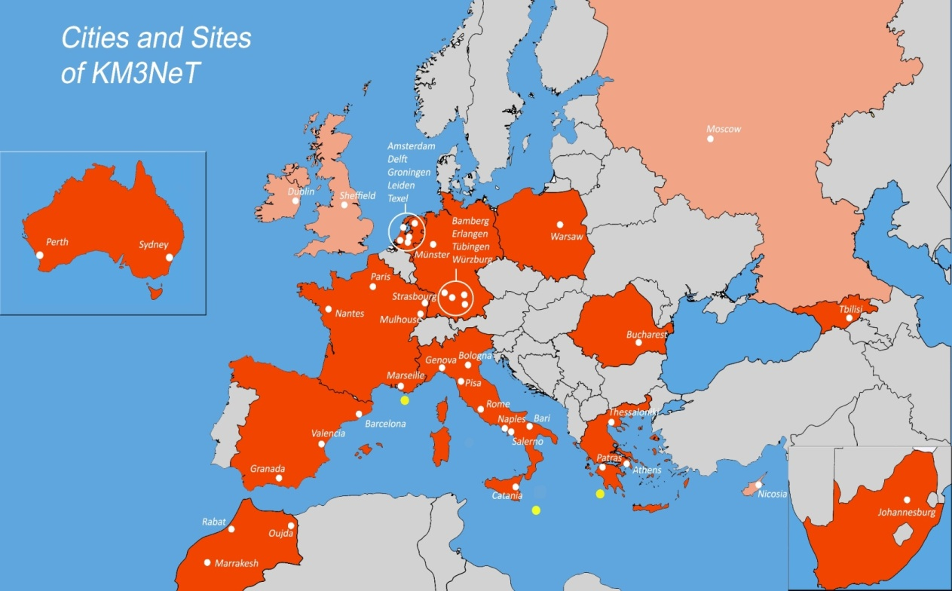
The KM3NeT collaboration
41 Institutions from 16 countries.
Distributed infrastructure in the Mediterranean sea, part of the ESFRI Roadmap.
3 Deployment sites, Toulon/FR, Sicily/IT, Pylos/GR. Infrastructure to be completed in phases.
Oscillation Research with Cosmics in the Abyss (ORCA)
Astroparticle Research with Cosmics in the Abyss (ARCA)

Slide 3
Where are we today
Finishing the construction, deployment and operation of the Phase 1 DUs.
Cable in French site completely replaced.
Three DUs to be installed in ORCA; sea operation starting on the 15/12/2018.
4 more DUs to be installed in January.
Sea operation in Italian site scheduled for January.
Phase 2 starting and overlapping with Phase 1.

Slide 4
The Astroparticle Physics group in INPP
People active in 2018:
CM, E. Tzamariudaki, A. Belias,
G. Androulakis, C. Bagatelas, P. Tsagli, S. Koutsoukos,
G. Kiskiras, A. Vougioukas, S. Bakou,
K. Pikounis, D. Tzanetatos, V. Panagopoulos, G. Polydeyki, A. Sinopoulou
D. Stavropoulos, T. Chadzistavrou, G. Zarpapis, G. Anagnostou, G. Anastasiou

Slide 5
Responsibilities of our members
CM: Chairman of the Institution Board since 10/2016
– re-elected for a second 2-year term,
RRB member
Publication committee member
E. Tzamariudaki: Management Team and Steering committee member,
Publication committee member,
Conference and Outreach committee member
G. Androulakis: QA/QC manager of KM3NeT,
Management Team and Steering committee member
C. Bagatelas: DOM integrator, responsible for the DOM lab.

Slide 6
Activities
Governance and Management
QA/QC
Construction
    DOM integration
    High pressure testing of deep sea components - single point failure items
    Calibration of electronics and sensors
Physics analyses and studies
Neutrino acoustic detection activities

Slide 7
KM3NeT INFRADEV
3 year coordination and support Horizon 2020 project (2017-2019)
INPP is involved in 7 out of 10 WPs, with coordination role in two of them.
E. Tzamariudaki is coordinating the Innovation and Technology transfer WP.
CM coordinates the WP on making KM3NeT a research facility with zero-carbon footprint.
Additional involvement in Legal entity, Outreach and communications, Open Data Access, Societal role and impact and User ports.

Slide 8
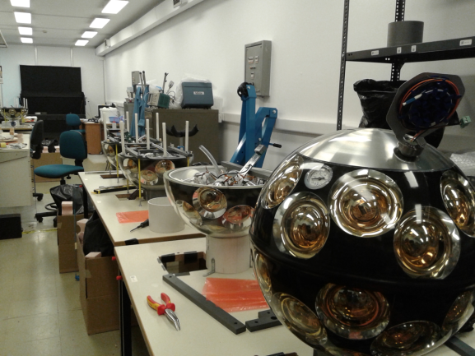
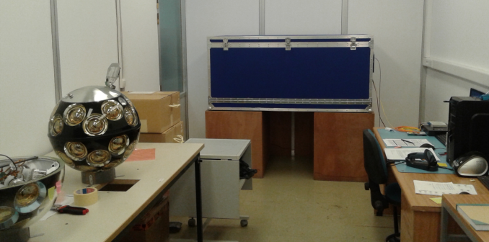
DOM integration site at Demokritos (C. Bagatelas, V. Tsagkli)
4 working benches (integration of 4 DOMs in parallel)
2 areas for preparation of DOM components
1 dark box for DOM testing and calibration
Storage place for 18 DOMs (1 DU)
1 DU (18 DOMs) ready to be deployed – 1st ARCA DU in 2019
1 DU under construction:
  14 DOMs out of 18 are ready.
DOM production rate: 18 DOMs (1 DU) in less than 2 months .

Slide 9
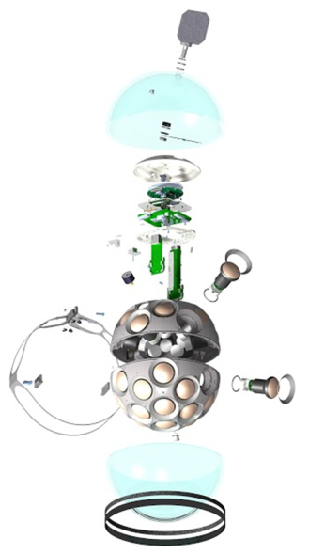
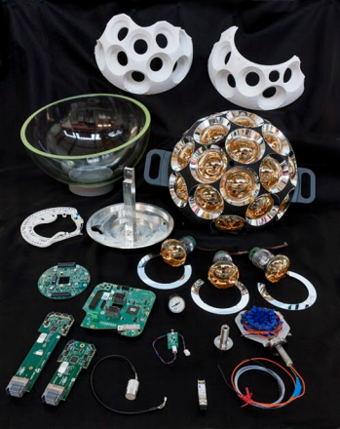
The KM3NeT DOM
Mechanical parts:
  Nautilus Vitrovex 17 ‘’ glass sphere
  Titanium penetrator for data and power
  Cooling mushroom
  Top and Bottom PMT support structures
  31 reflector rings
  Optical gel
  Titanium collar
Electronics:
  Central Logic Board (CLB)
  2 Octopus Boards
  Power Board
Optical parts:
  Single-mode laser transceiver (SFP)
  Add/drop filter
Sensors/instruments:
  31 3” inch PMTs + Base Boards
  Piezo acoustic sensor
  Temperature/humidity sensors
  Compass/accelerometer
  Nanobeacon LED
  Pressure gauge

Slide 10
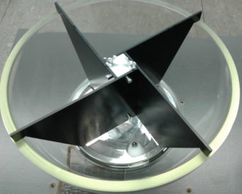
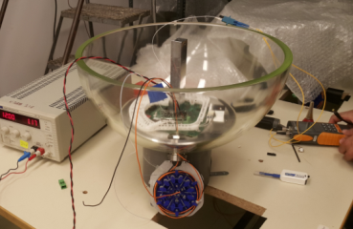
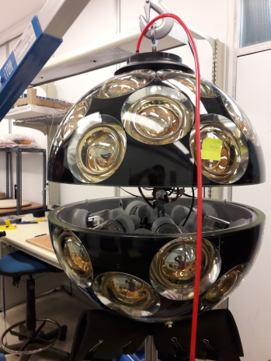
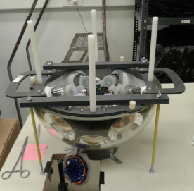
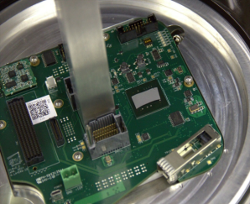
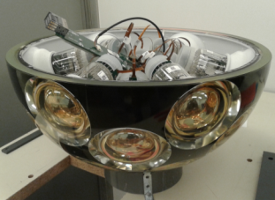
KM3NeT DOM integration

Slide 11
Physics Analyses of the APP group in INPP
High Energy Starting Events (HESE) Analysis K. Pikounis
maximise the discovery potential of KM3NeT/ARCA for a diffuse astrophysical neutrino flux
muons from high energy neutrino events interacting inside the detector volume and
contained showers
5σ discovery of the astrophysical neutrino flux with 50% (90)% probability in less than 0.5 (0.8) years
2 Internal Notes, presented in NEUTRINO 2018 (Poster) and in VLVnT 2018 (talk)
Analysis of KM3NeT/ARCA data
suppress the contribution of badly reconstructed events
neutrino candidates
A. Sinopoulou, D. Tzanetatos
assess the effect of sedimentation and biofouling D. Stavropoulos
data quality checks G. Zarpapis

Slide 12
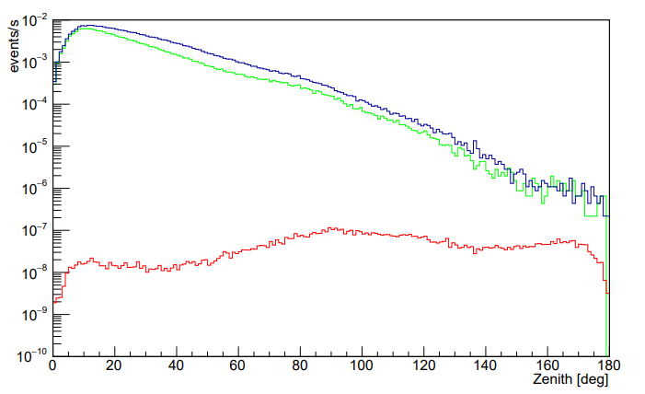
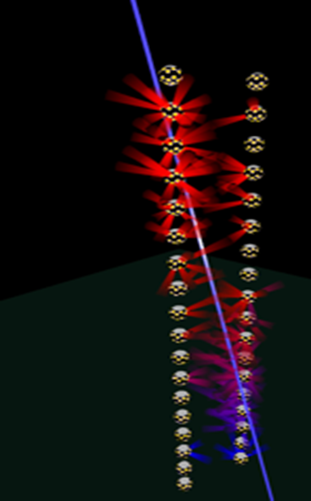
Data/MC comparisons and neutrino candidates – A. Sinopoulou
Analysis focusing on :
Cuts optimization for selecting well reconstructed events
Selection criteria to identify neutrino event candidates
A. Sinopoulou
KM3NeT/ARCA
2 DUs
Candidate public plot
Data
Atm. Muons
Atm. Neutrinos

Slide 13
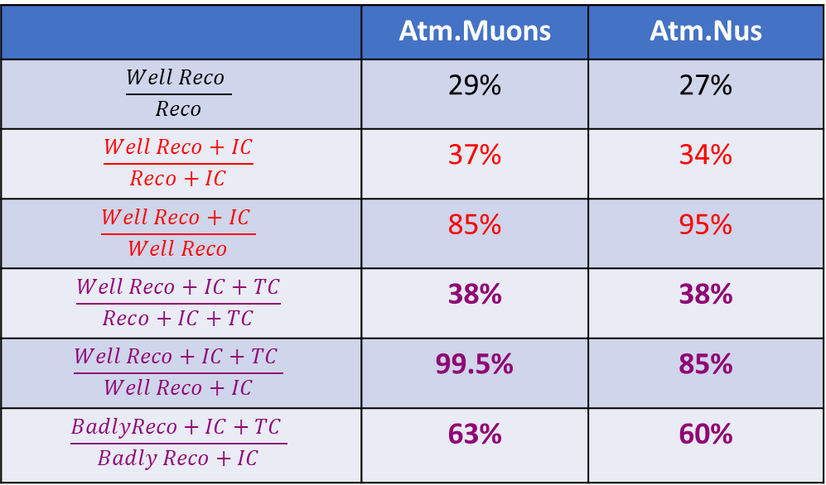
Current status – A. Sinopoulou
Introduced a first set of cuts for selecting
well reconstructed events (initial cuts - IC)
A second set of topological cuts (TC) is currently under investigation
A. Sinopoulou
 | Atm.Muons | Atm.Nus
$$\frac{Well Reco }{Reco}$$ | 29% | 27%
$$\frac{Well Reco+IC}{Reco+IC}$$ | 37% | 34%
$$\frac{Well Reco+IC }{Well Reco}$$ | 85% | 95%
$$\frac{Well Reco+IC+TC}{Reco+IC+TC}$$ | 38% | 38%
$$\frac{Well Reco+IC+TC }{Well Reco+IC}$$ | 99.5% | 85%
$$\frac{BadlyReco+IC+TC }{Badly Reco+IC}$$ | 63% | 60%
Really promising results:
a reduction of ~40% on the really badly reconstructed events
with an efficiency of 90% on the well reconstructed events

Slide 14
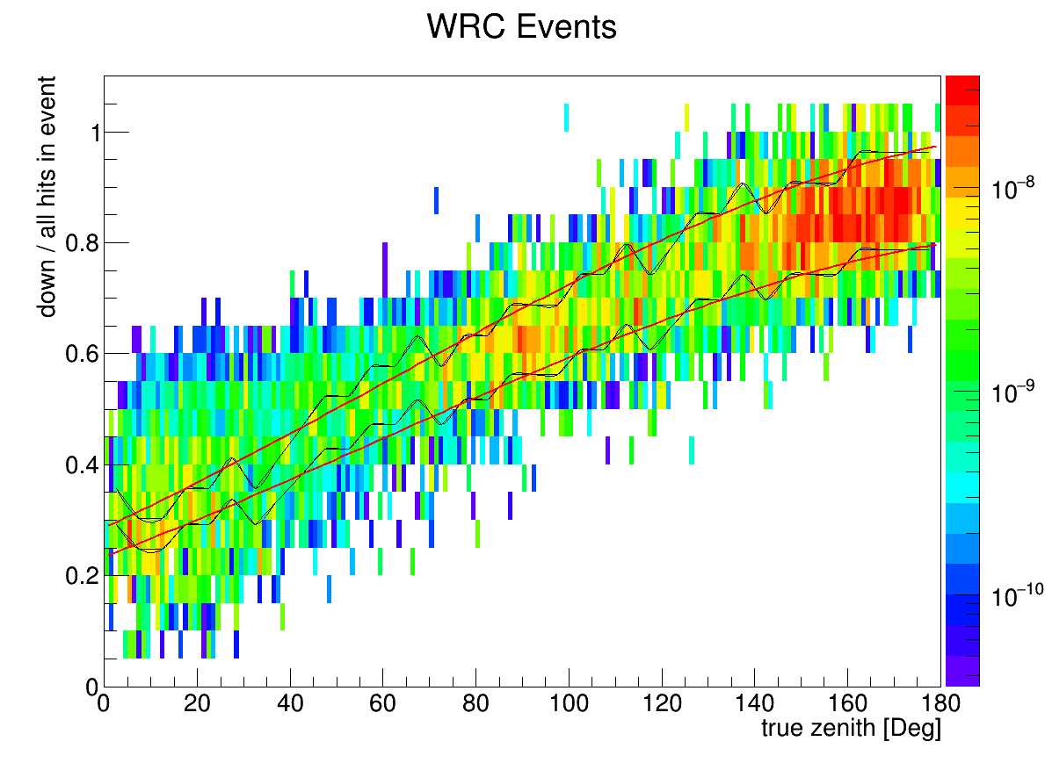

Simulated atmospheric νμ events – Reconstruction parameters
D. Tzanetatos
Analyse data for ARCA DU-2
Investigate variables based on kinematic proeties as a way to distinguish badly reconstructed events from well reconstructed and enhance the purity of the sample.
Event selection:
Require some first cut conditions to be consistent with Cherenkov cone geometry.
Y-axis:
X-axis: True zenith of the νμ track
Two reference lines at the at +- 10% of the median respectively
Cut: > 75 degs and below the lower line
or < 60 degs and above the upper line.
Preliminary Results:
Efficiency WRC(after cut)/WRC(before)=0.92
Quality WRC/RC(before cut)= 0.18 , WRC/RC(after cut)=0.58

Slide 15
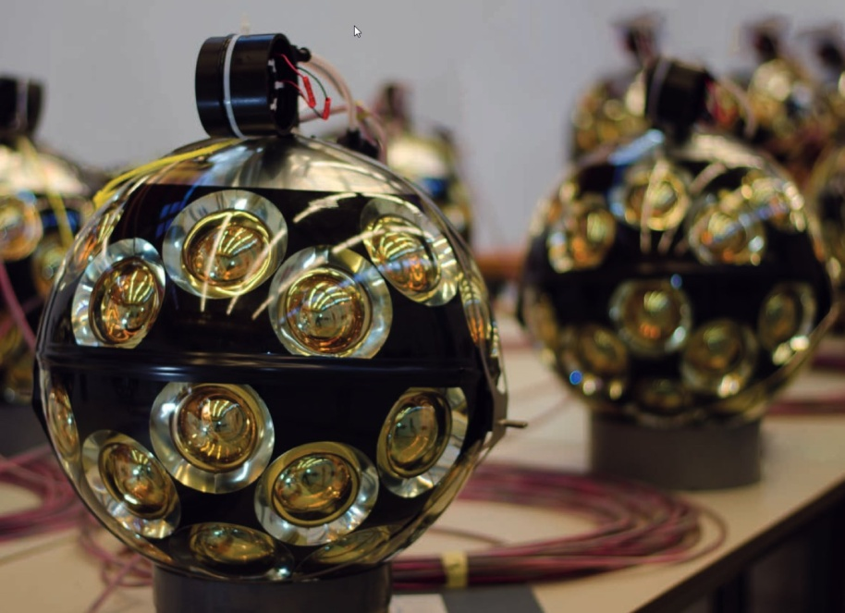
Using the ARCA data to investigate sedimentation and biofouling
Dimitris Stavropoulos - MSc Thesis
We can use the data from the 2 ARCA DUs deployed to perform studies of biofouling & sedimentation, which will both affect the detector efficiency
Biofouling is expected to affect the whole DOM surface
Sedimentation is expected to cause a decrease on upper hemisphere PMTs
Detailed studies are on-going
Comparison of upper/lower hemisphere rates between same floor DOMs
Depth dependence of the rate decrease
Comparison between intra-DOM PMTs with different directions

Slide 16
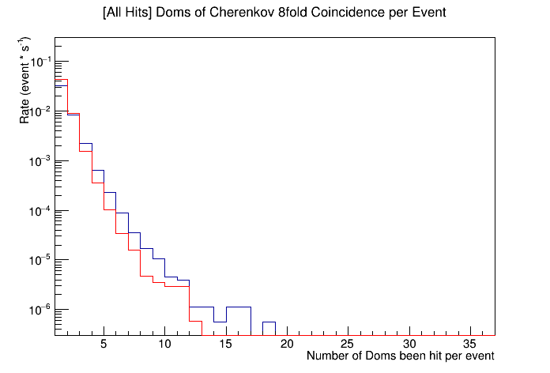
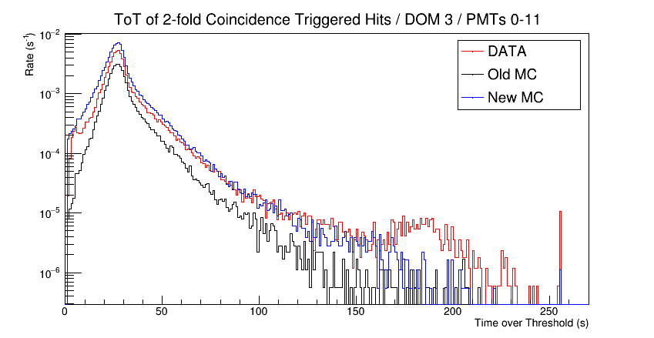
Data quality checks – G. Zarpapis
DATA
MC
Data and Monte-Carlo comparison to check the quality of the Data.
Rate for 8-fold coincidences as a function of the number of DOMs hit.
ToT (Time over Threshold) distributions for PMTs in the upper
hemisphere of the DOM. Data, old MC and new MC comparison.
(PMTs: 0-11 = upper hemisphere)

Slide 17
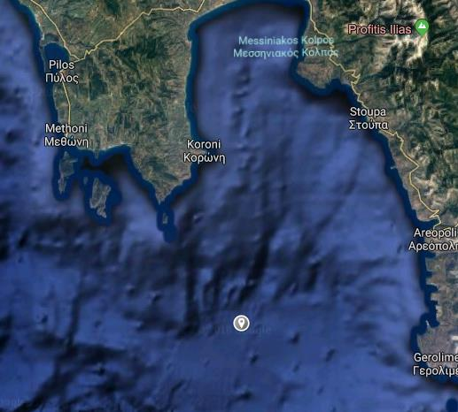
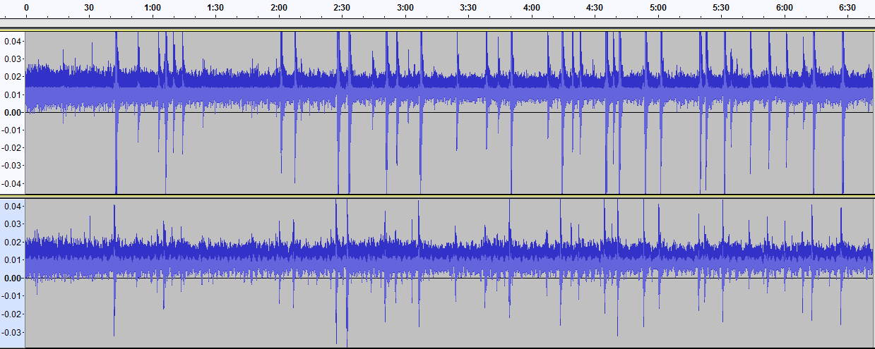
Acoustic detection of neutrinos
Deployed 2 hydrophones in 2/2018 at 1600 m depth to evaluate the acoustic load of the area.
1 month continuous recording
Data are used to tune algorithms and MC
Recorded sounds include ship traffic, environmental noises like rain, waves, wind, thunder, and marine life

Slide 18
Physics Analyses of the APP group in INPP
Acoustic Neutrino Detection
analysis of data collected by the 2 hydrophones deployed :
T. Chatzistavrou, V. Panagopoulos, G. Anastasiou
simulation studies to evaluate the potential of disentangling an acoustic signal coming from a VHE neutrino interaction : T. Chatzistavrou, V. Panagopoulos
analysis of KM3NeT acoustic data (piezos) : V. Panagopoulos, G. Polydefki
simulation studies towards an acoustic data trigger : V. Panagopoulos, G. Polydefki
Acoustic signal analysis and classification : Georgia Anagnostou

Slide 19
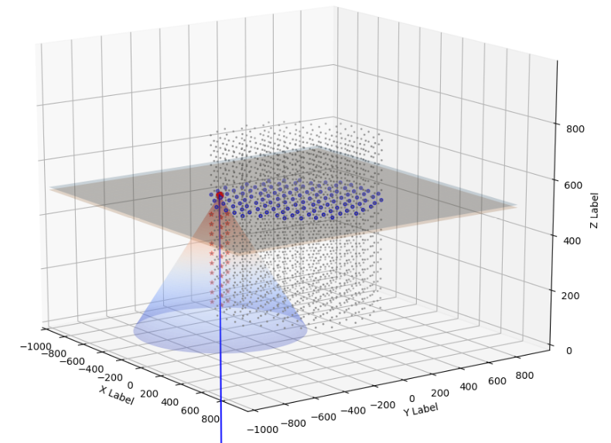
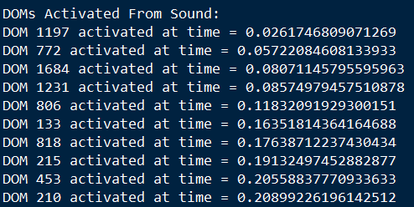
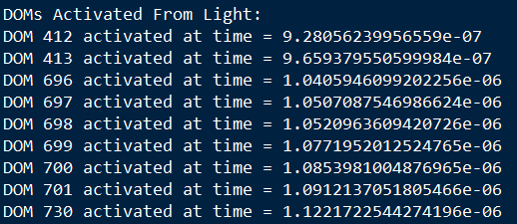
MC development of acoustic pulse propagation and detection,
V. Panagopoulos
MC simulation of UHE neutrinos as expected to be detected in KM3NeT with the current geometry

Slide 20
Evaluation of existing ORCA acoustic data, G. Polydefki
Using existing acoustic data from 1 ORCA string as an exercise to evaluate the sensitivity of current acoustic detector hardware.
Establish an optical trigger for the acoustic detectors.

Slide 21
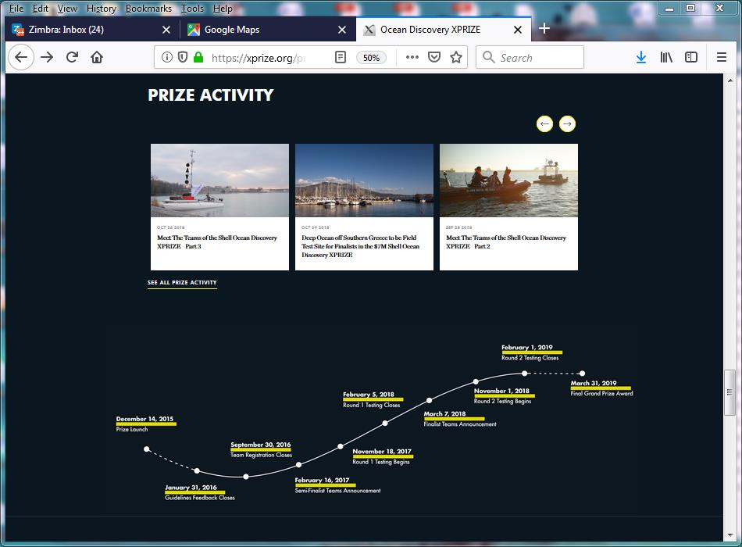
Latest developments
Xprize.org – Final round of the Shell Ocean discovery competition is currently happening off the coast of SW Peloponnese.
Mapping of the ocean floor down to 4.000m with an accuracy better than 5m over an area of 500Km² with autonomous systems over 24 hours.
Detailed maps extremely important for sound propagation measurements and studies.

Slide 22
Thank you
on behalf of the APP group of INPP

