Slide 1


INPP @ CMS
NCSR ‘Demokritos’, Institute of Nuclear & Particle Physics
Staff
G. Anagnostou,
G. Daskalakis,
A. Kyriakis,
D. Loukas*
* Institution Team Leader
Ph.D. Students
P. Asenov (ΕΛΙΔΕΚ),
P. Assiouras
G. Paspalaki
CMS Students
A. Papadopoulos
Engineers
I. Kazas (on cotract)
ACTIVITIES 2018
CONSTRUCTION
&
OPERATION
Test-Beams & Service work
New analysis techniques/algorithms
Physics Measurements
CMS Upgrade for Phase-II
PHYSICS MEASUREMENTS
INPP-CMS group have made significant contributions in several areas of physics that can be explored by CMS, like:
Standard Model (SM), Searches beyond SM, Supersymmetry, TOP, Higgs

Slide 2
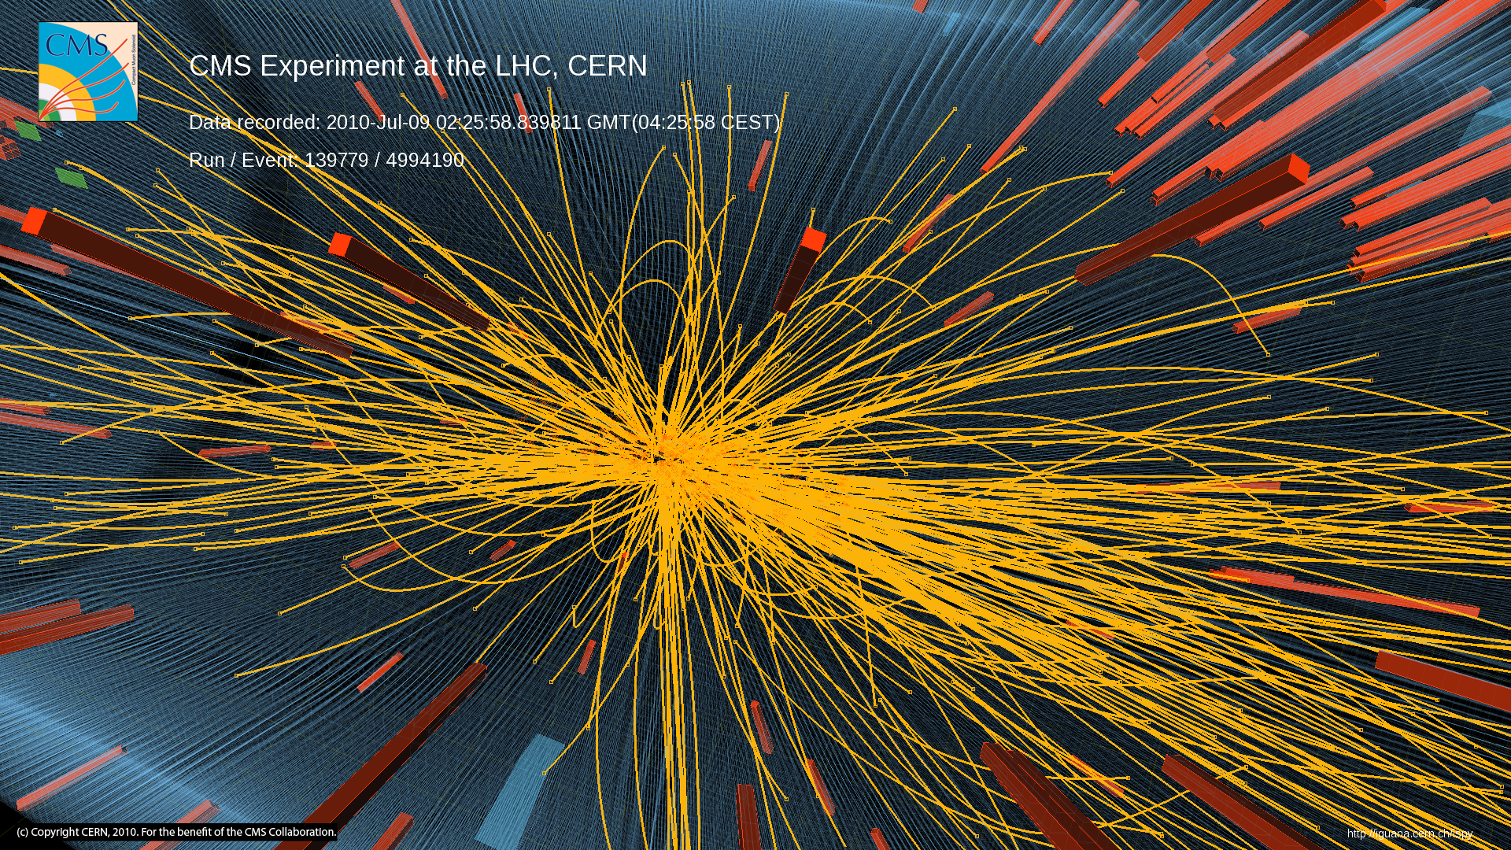


“Demokritos” Participation in CMS at CERN
One of the first
collisions in CMS
Can we identify those particles
and
do physics with them?
YES we CAN!

Slide 3
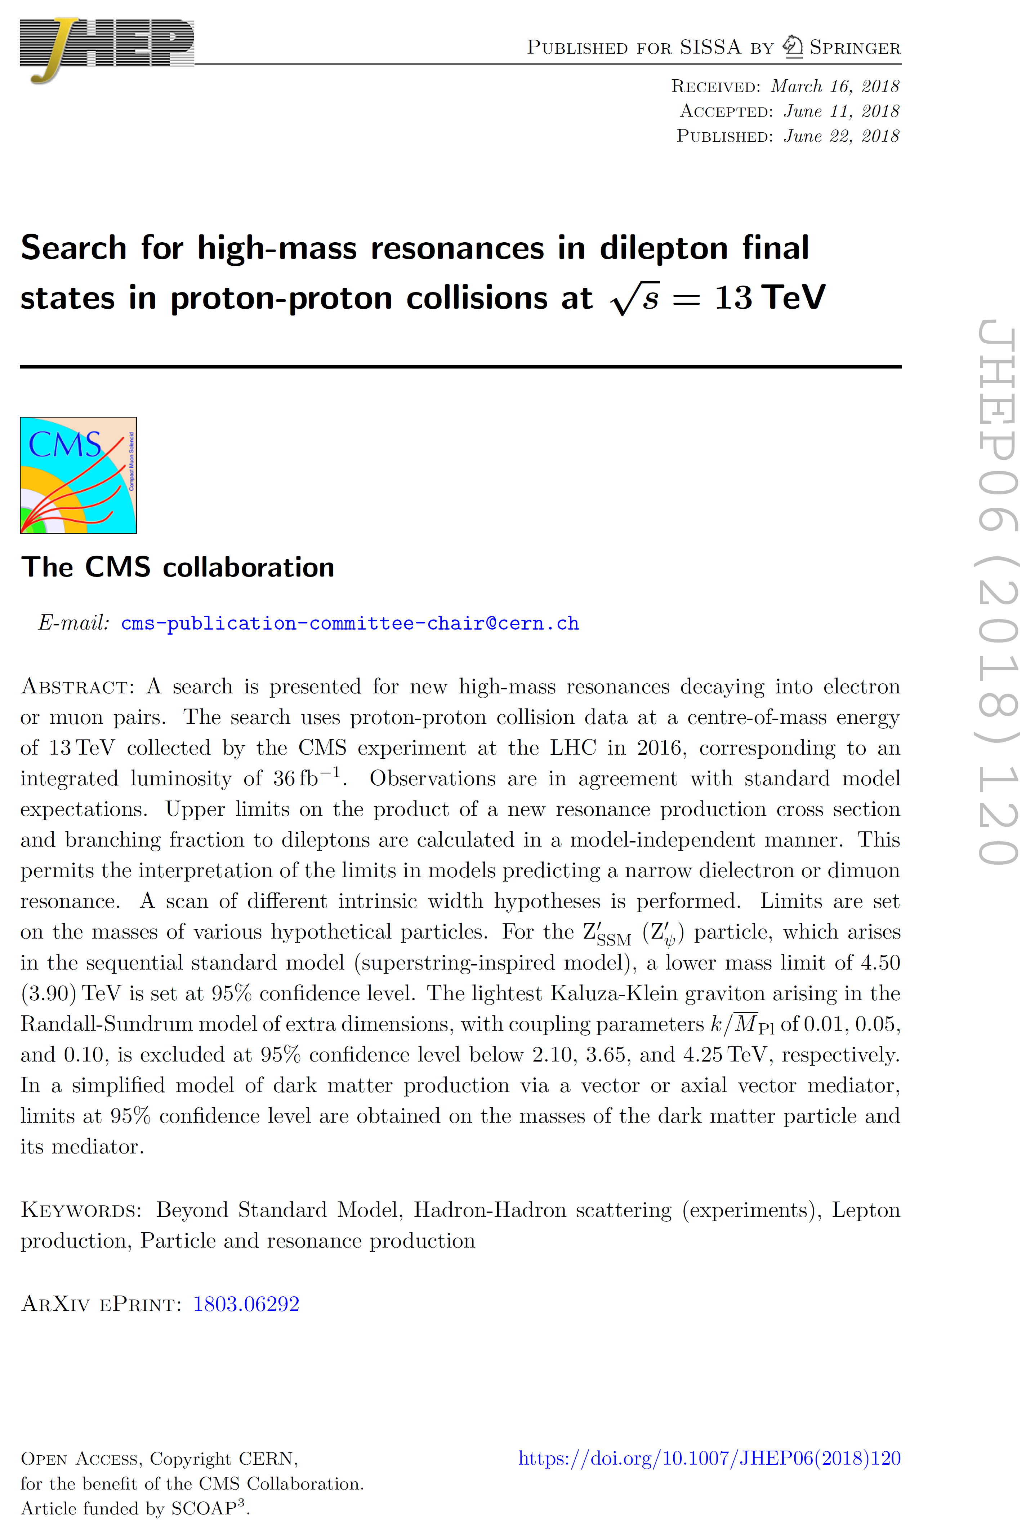
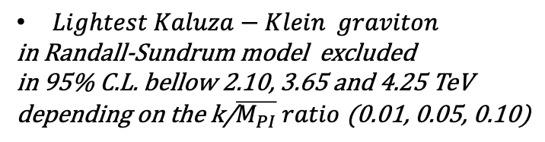

Z’→e⁺e⁻ , μ⁺μ⁻ Searches
22 June 2018 JHEP published the paper.
http://dx.doi.org/10.1007/JHEP06(2018)120
G. Daskalakis was the editor of the paper (EXO-16-047) from the electron side.
Several Institutes/Universities involved.
Focus on the full 2016 data sample ~ 36 fb⁻¹.
New limits on:
- U’ (1) models ( E₆, LR, GSM )
- Kaluza-Klein graviton (G_{KK}) excitations
- Dark matter mediators
Search for new high-mass resonamnces
decaying into e and μ pairs.
$Z_{SSM}^{’}$($Z_{ψ}^{,}$): lower mass limit at 4.50(3.90) TeV
$Lightest Kaluza−Klein graviton$
in Randall-Sundrum model excluded
in 95% C.L. bellow 2.10, 3.65 and 4.25 TeV
depending on the k/$\overline{M_{PI}} ratio$ (0.01, 0.05, 0.10)
3

Slide 4
Z’→e⁺e⁻ , μ⁺μ⁻ Searches
We analyzed the full 2017 data ( ~ 41 fb⁻¹).
Muons were not ready, so we published a Physics Analysis Summary (CMS PAS EXO-18-006) using only the ‘electron’ results.
We also provided a combination with the full 2016 data ( ~ 36 fb⁻¹ ).
FUTURE PLANS
- Quick results for the 2018 dataset
- Combine the 13 TeV data from all years (2016+2017+2018) for a legacy paper on
‘heavy narrow resonances’
dedicated to RUN2
4

Slide 5
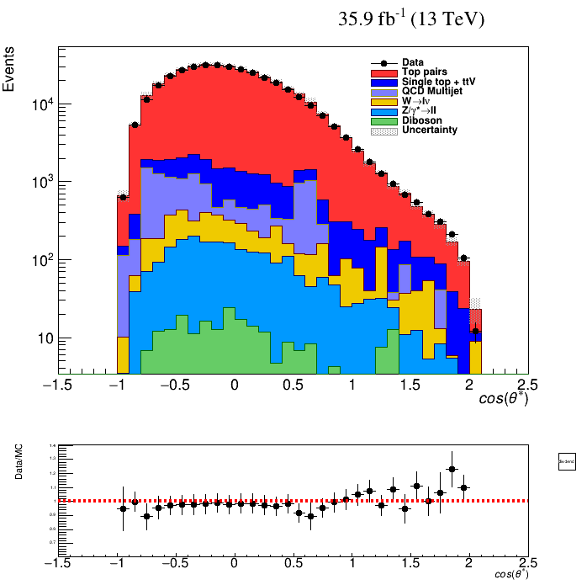
W helicity in l+jets @ 13 TeV
The W helicity fractions will be measured from the angular distribution of the cos(θ*).
cos(θ*) for the top ≡ the angle between the
down-type fermion momentum in the W rest frame and the W momentum in the top rest frame
The cos(θ*) dependency on the helicity fractions F_{0,L,R}
$\frac{1}{Γ}\frac{dΓ}{dcosθ }=\frac{3}{8}\left(1−cosθ\right)2FL+\frac{3}{8}\left(1+cosθ\right)2FR+\frac{3}{4}sin2θF0$ , θ ≡ θ*
SM values: F₀ = 0.6902, F_{L}=0.3089, F_{R}=0.0009
cos(θ*) distribution at Generator Level

Slide 6


W helicity in l+jets @ 13 TeV
… the team …
Mara Senghi Soares , Javier Brochero Cifuentes
Georgios Daskalakis , Georgios Anagnostou
+ PhD student funded from KRIPIS-II
We would like to measure the W boson helicity fractions from top quark decays in ttbar events at 13 TeV using lepton+jets .
Motivation:
The measurement is sensitive to the Wtb vertex structure;
new physics from anomalous Wtb couplings might appear.
Effort to improve (if possible) systematic uncertainties w.r.t. 7 & 8 TeV analyses
Common framework with the simultaneous l+jets & dilepton xsection measurement
CMS (8 TeV) ATLAS (8 TeV)
Phys. Lett. B 762 (2016) 512 Eur. Phys. J. C 77 (2017) 264
F₀ = 0.681 ± 0.012 (stat) ± 0.023 (syst), F₀ = 0.709 ± 0.019 (stat+syst),
F_{L} = 0.323 ± 0.008 (stat) ± 0.014 (syst), and F_{L} = 0.299 ± 0.015 (stat+syst), and
F_{R} = -0.004 ± 0.005 (stat) ± 0.014 (syst) F_{R} = -0.008 ± 0.014 (stat+syst)
6

Slide 7
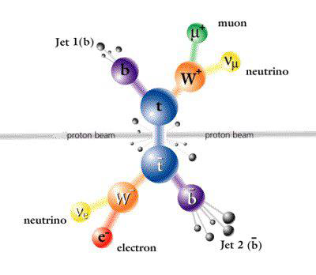
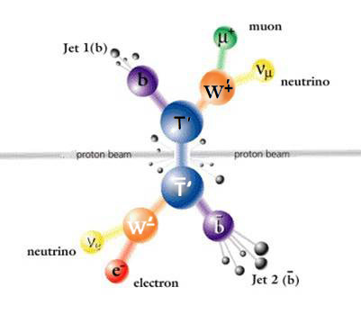
Searching in 2D mass space for final states with 2 invisible particles @ Run2
G.Anagnostou, G.Daskalakis
generic topology with 2 unknown particles
Searching simultaneously for both a heavy top partner T’ and a new gauge boson W’
Practically, searching for anything decaying like dilepton top pairs
7
Notes:
7
This includes the diffuse flux limit considering prompt flux for the conclcusion detector (I call it example detector here), you should at some point say what the moderate
Criterion (6 storeys) is, as all results are for this selection step.

Slide 8
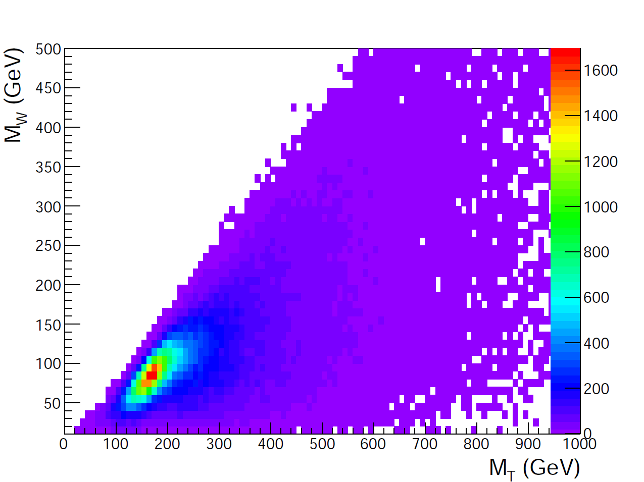
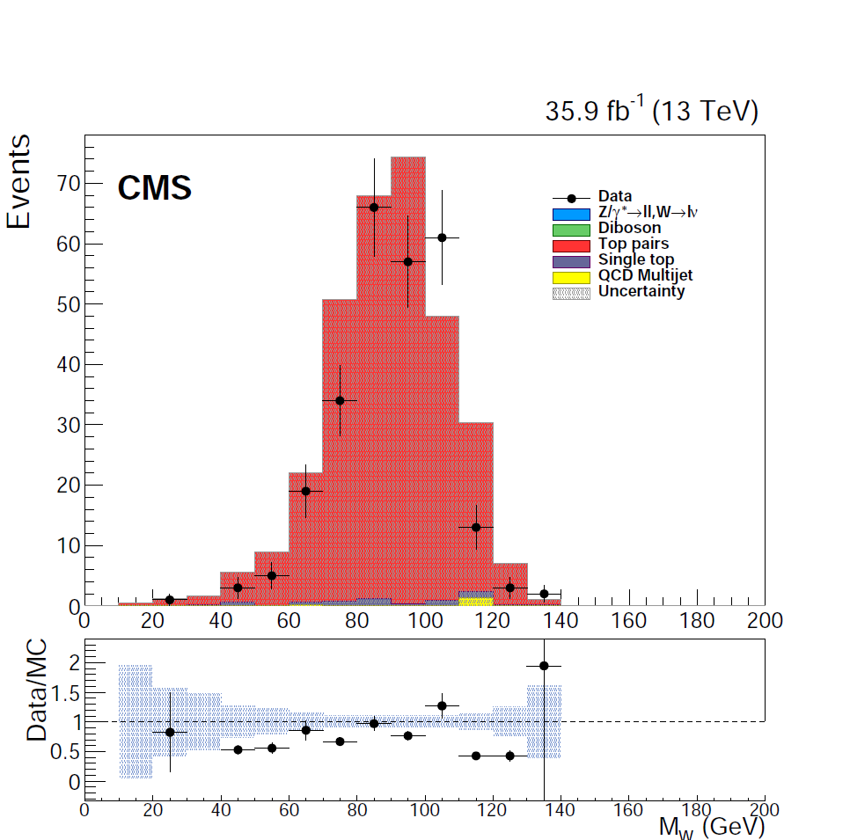
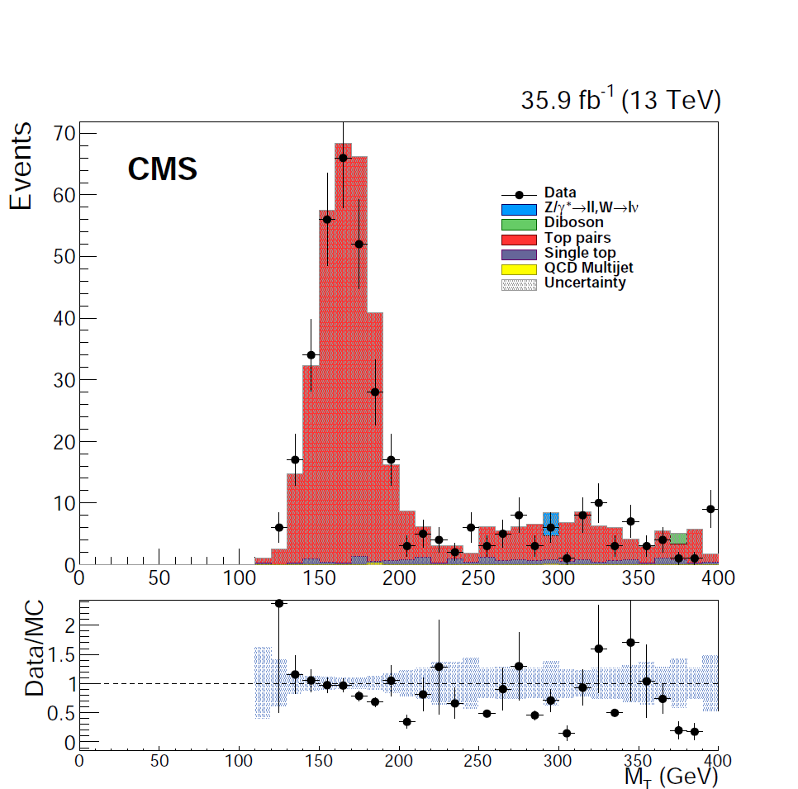
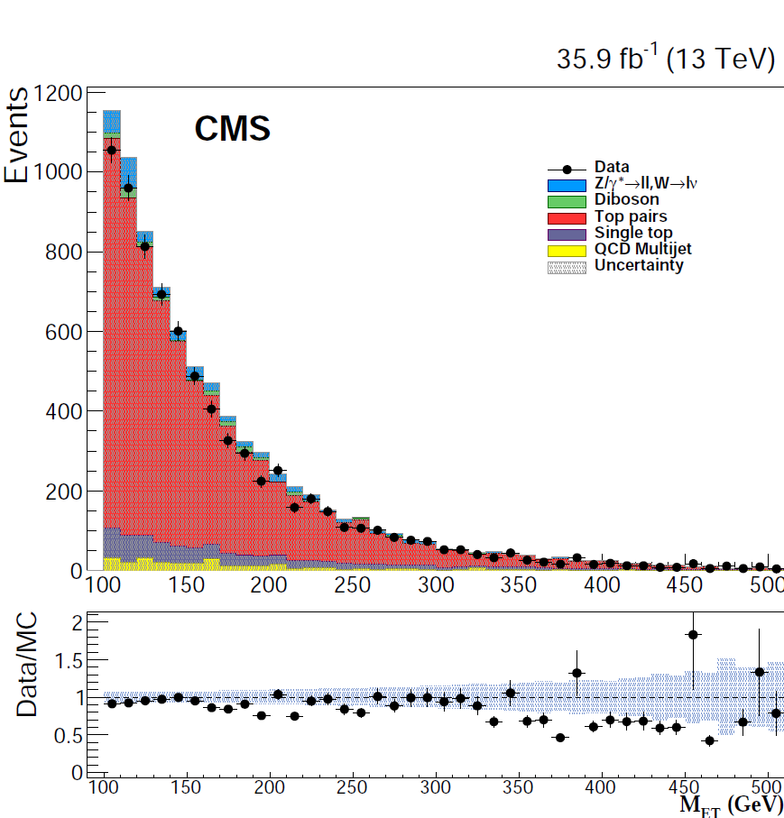
Run2 data analysis ongoing
8

Slide 9

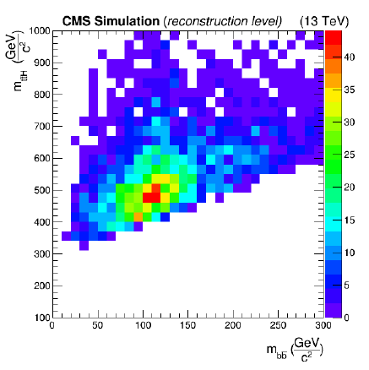
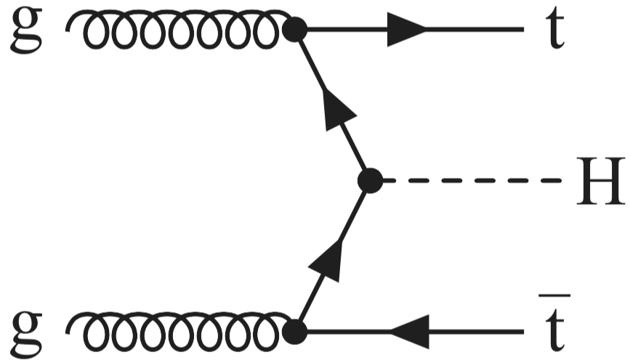
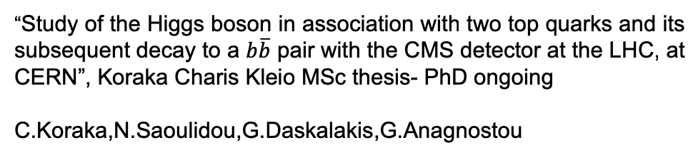
Application of the method to tt+Higgs
“Study of the Higgs boson in association with two top quarks and its subsequent decay to a $b\overline{b}$ pair with the CMS detector at the LHC, at CERN”, Koraka Charis Kleio MSc thesis- PhD ongoing
C.Koraka,N.Saoulidou,G.Daskalakis,G.Anagnostou
This is Higgs mass in bbar!
2D mass reconstruction for final states with 2 invisible particles method applied to another topology, top pairs + Higgs
This is the second one, after top pairs. How generic is it? To which topologies is it applicable?

Slide 10
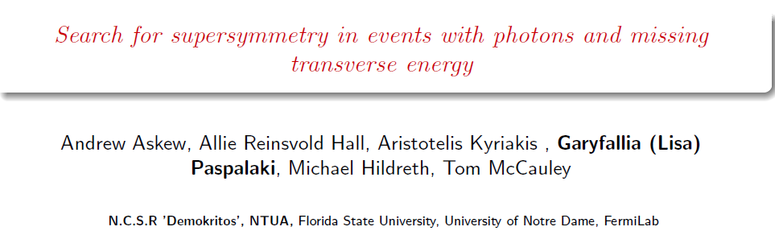
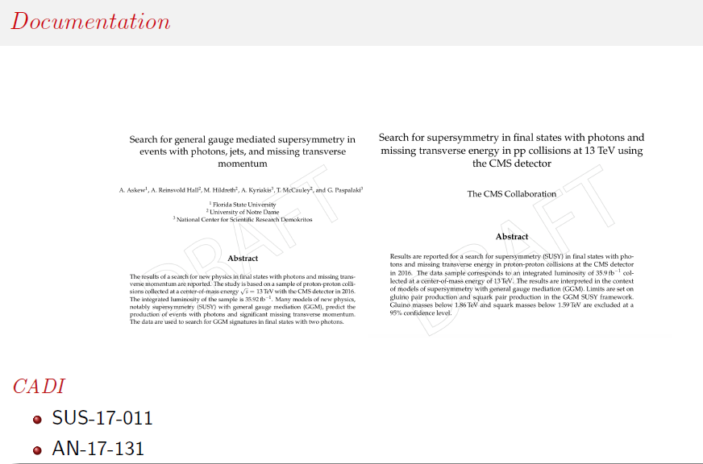
Detailed info in Lisa’s talk tomorow…

Slide 11

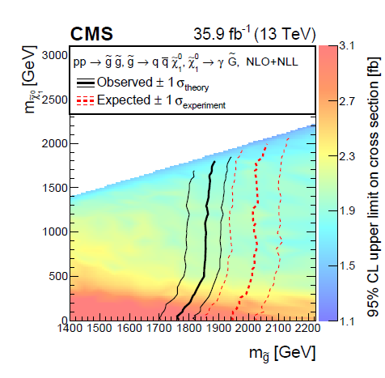
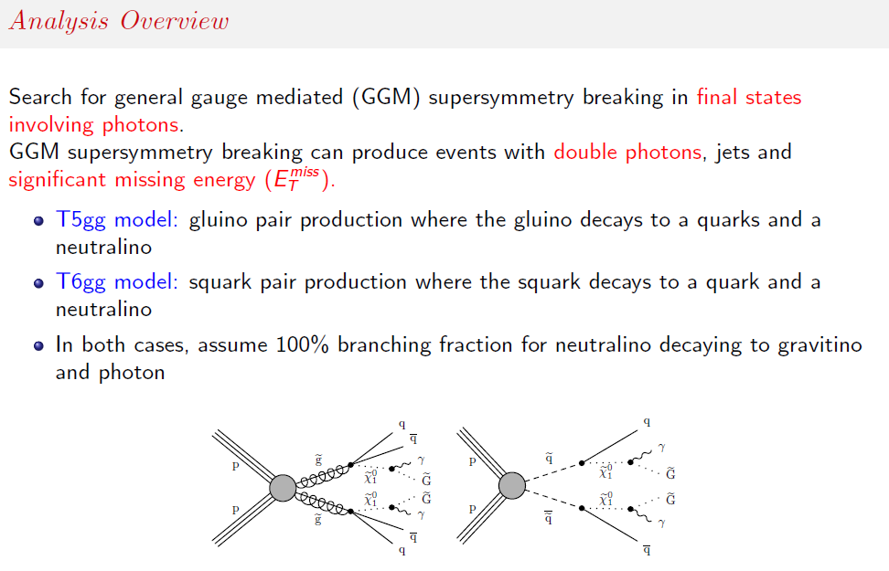
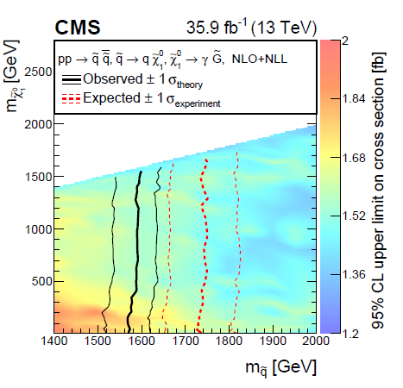
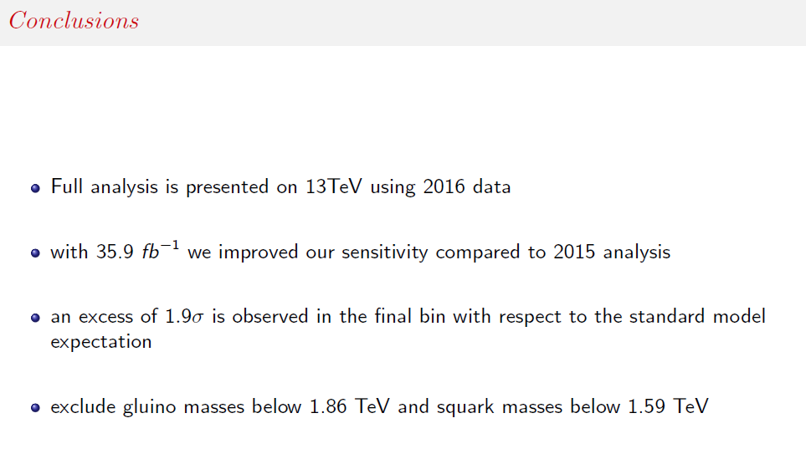

Slide 12
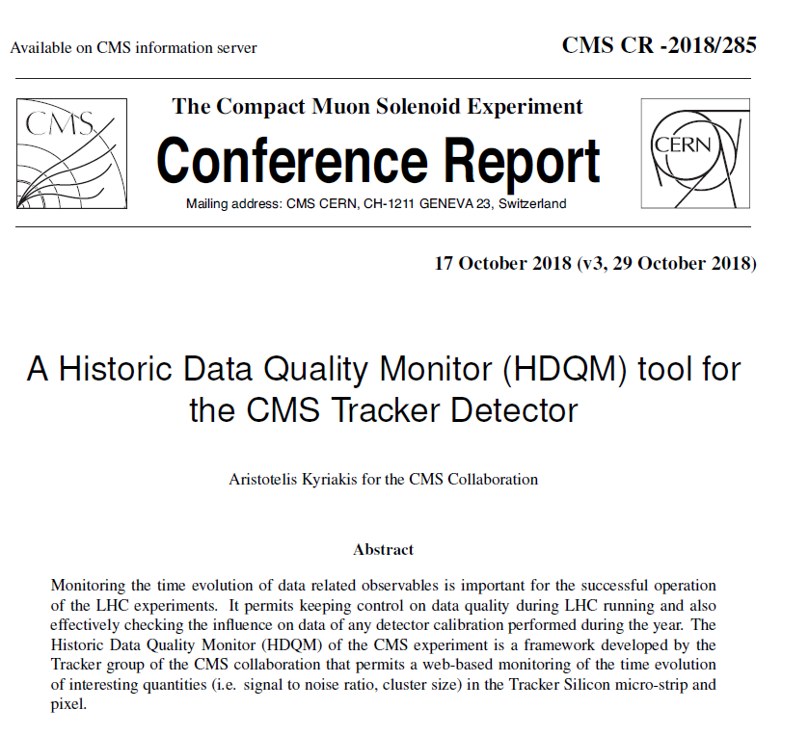
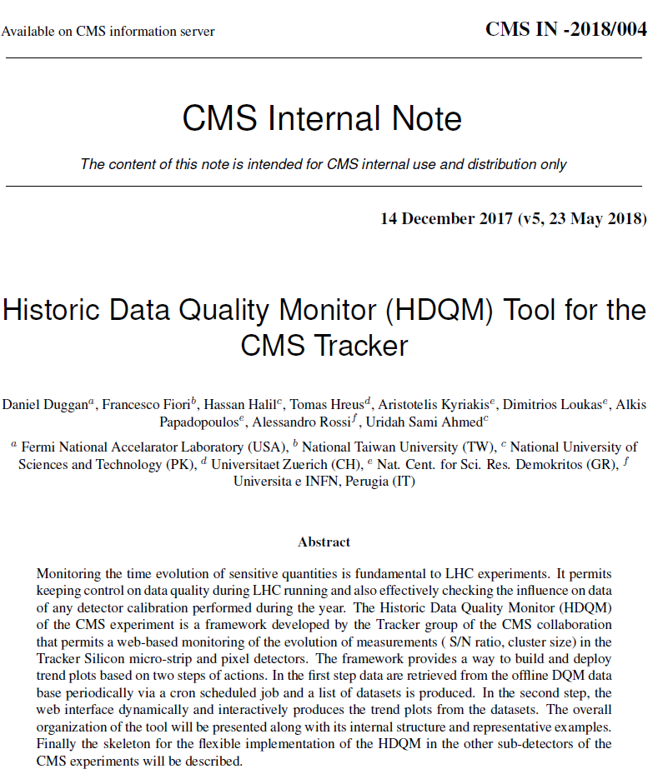
Historic Data Quality Monitor
The Historic Data Quality Monitor (HDQM) of the CMS experiment is a framework developed by the Tracker group of the CMS collaboration that permits a web-based monitoring of the time evolution of interesting quantities (i.e. signal to noise ratio, cluster size) in the Tracker Silicon micro-strip and pixel.
The tool run smoothly during 2018 data taking period and was documented as an internal note and also presented in CHEP2018, Sofia Bulgaria

Slide 13
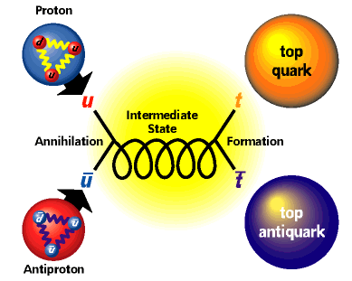
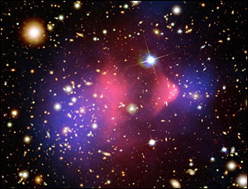

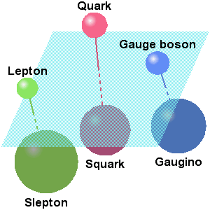
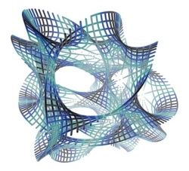
INPP @ CMS
The CMS Group of Demokritos has made marked contributions in the preparation of the experiment before data taking as well as in Physics measurements with the collected data at 7, 8 TeV. & 13 TeV( in progress)
Dark Matter
Standard
Model
SUSY
!!! UNEXPECTED!!!
Extra Dimensions
Over 800 physics publications in peer reviewed journals

Slide 14
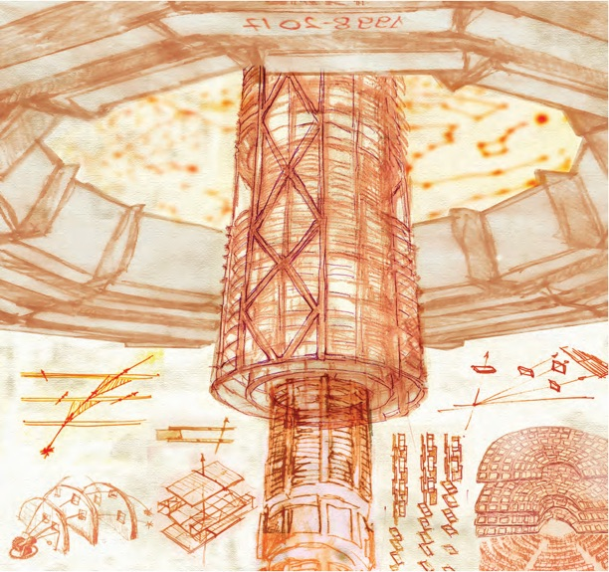
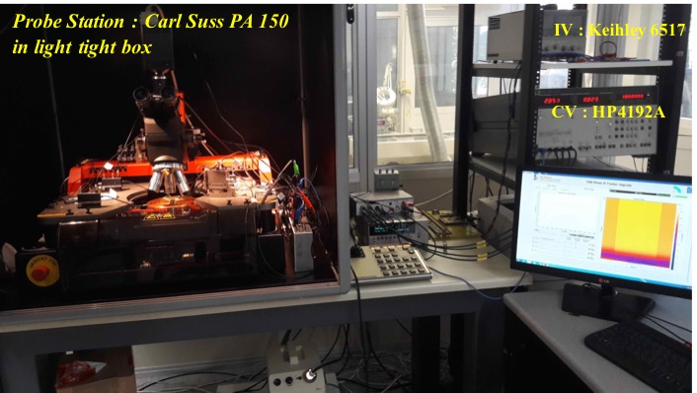
INPP @ CMS Upgrade
The Phase II CMS Tracker Upgrade :
10 years of R&D
Over 100 MCHF core cost
1.4 MCHF foreseen Greek contribution
INPP activities focused on
Sensor Quality Control
Process Quality Control
Pixel Electronics
Telescope & Beam Tests

Slide 15
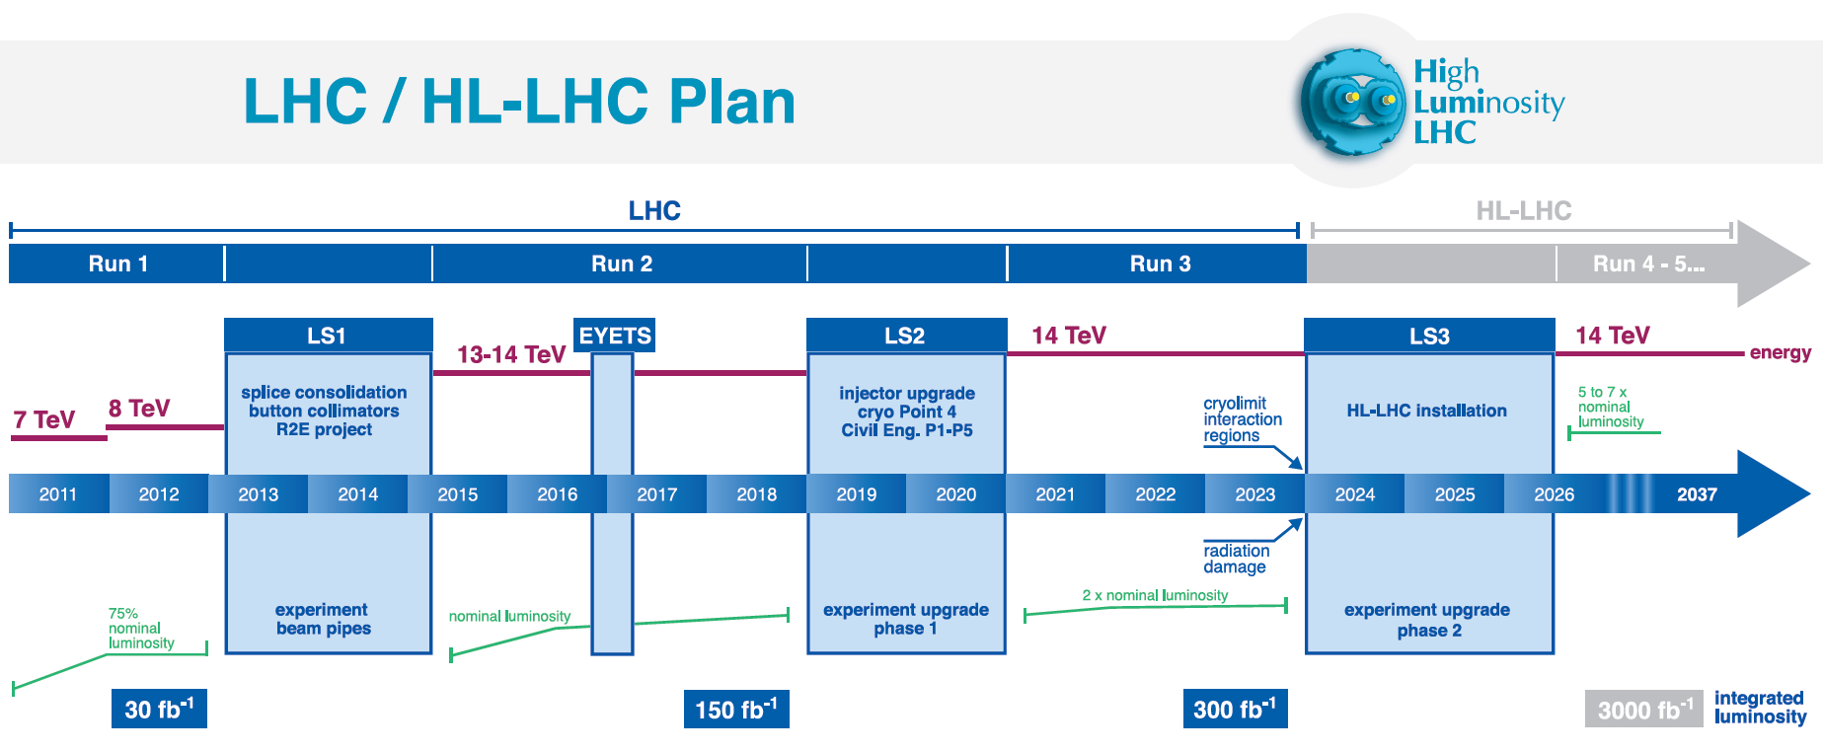
High Luminosity upgrade for the LHC : HL-LHC
Increase the Luminosity (rate of collisions) : from 300 fb⁻¹ to 3000 fb⁻¹

Slide 16
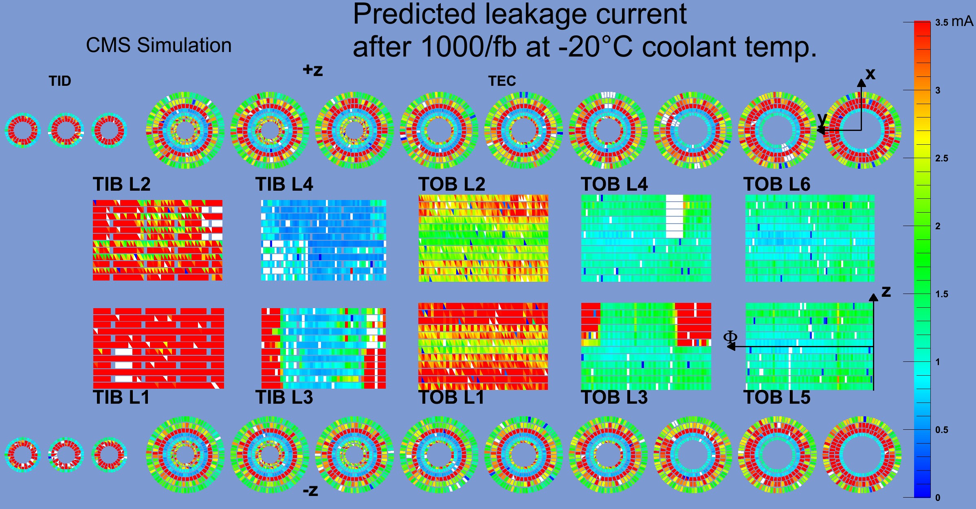
Challenges of HI-LHC to the Physics Reach of CMS
Radiation Damage
Total Tracker Replacement

Slide 17
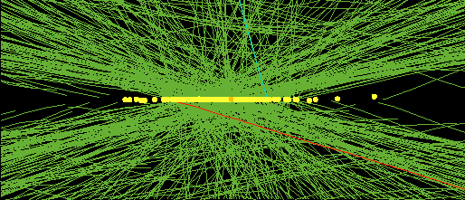
Challenges of HI-LHC to the Physics Reach of CMS
Hi Pileup
Mean number of pile ups in 2016 (L=1.5x10³⁴ cm⁻² s⁻¹ ) : 53
Mean number of pile ups in HI-LHC (L=5x10³⁴ cm⁻² s⁻¹ ) : 140
Mean number of pile ups in HI-LHC (L=7x10³⁴ cm⁻² s⁻ ) : 200
High pile up event with 78 reconstructed vertices

Slide 18

Upgrade Requirements for the Phase II Tracker
Total Tracker Replacement
Radiation Tolerance up to $\int{Ldt=3000 {fb}^{−1}}$
Flip from p_on_n sensors to n_on_p
Pile Up 140-200 , Occupancy < 1 %
Increase granularity
Longer Latency : from 3.2 μs to 12.5 μς
Increase front end buffer depth
Increase forward acceptance
Mostly through pixel extension
Improve CMS Trigger
Provide tracking info to L1
Improve resolution at low P_{t}
Reduce material
Improve resolution at high P_{t}
Increase granularity

Slide 19
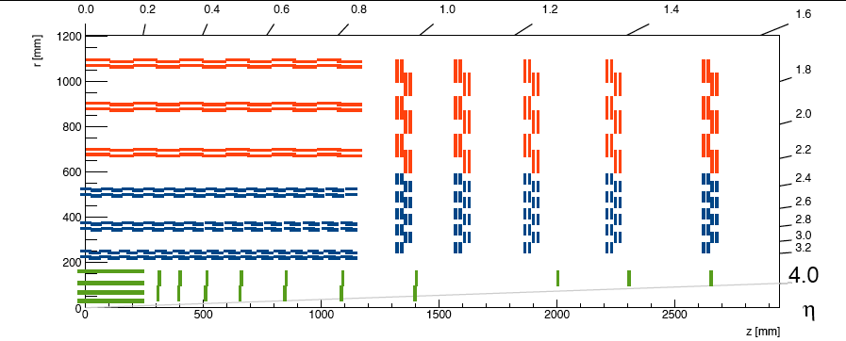
The New Tracker Geometry
Phase II Tracker layout
OUTER TRACKER
Red: Strip-Strip (2S) modules Blue: Pixel-Strip (PS) modules Green: pixel
200 μm thick sensors
Outer Tracker based on 2 type modules only
PIXEL DETECTORS
2S strip-strip double-layers
~8400 modules
~34M channels
~155m²
PS strip-strixel double-layers
~7000 modules
~230M channels
~62m²

Slide 20
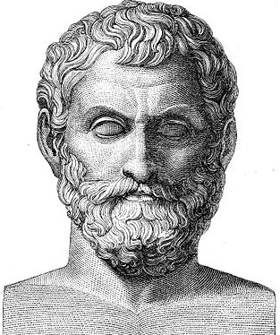
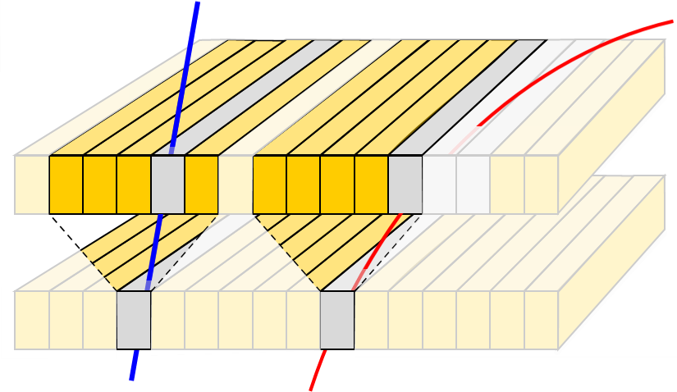
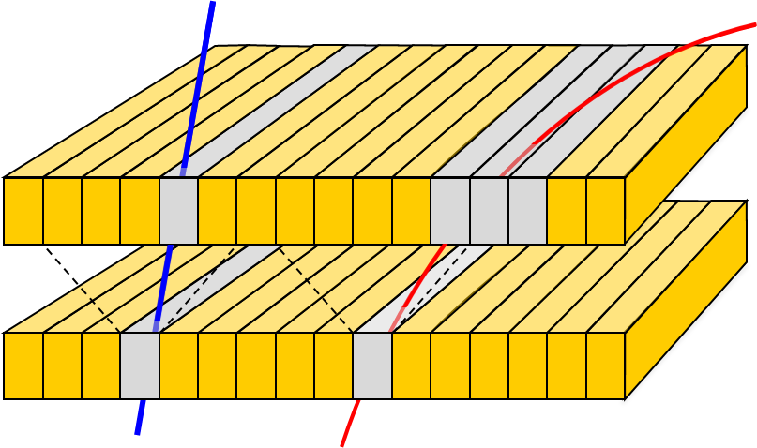
The New Tracker Geometry
Provide Tracker Info to L1
Pass → Stub
Fail
~2-4 mm
outer sensor
R
inner sensor
~200μm
φ
~100μm
  High-P_{T} tracks (stubs) can be identified if cluster centre in top layer lies within a search window in R-φ (rows)
  - P_{T} cut is given by: module radius (z), sensor separation and correlation window

Slide 21
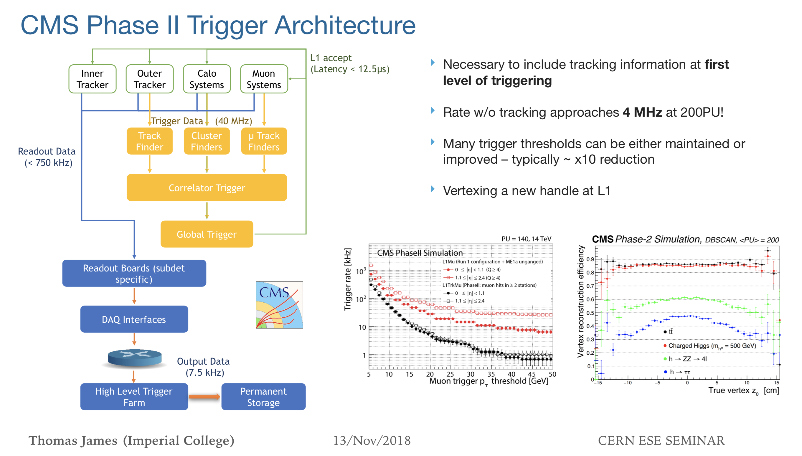
Trcaker in L1 Trigger

Slide 22
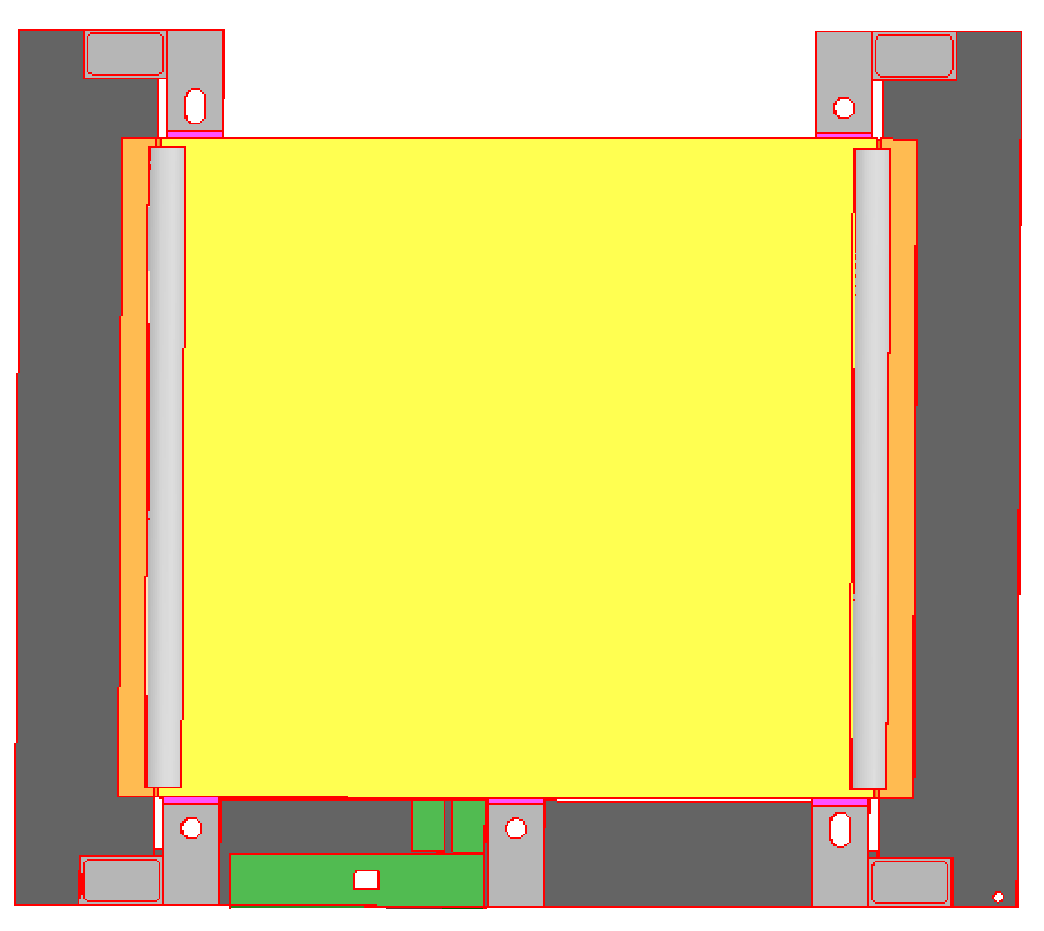
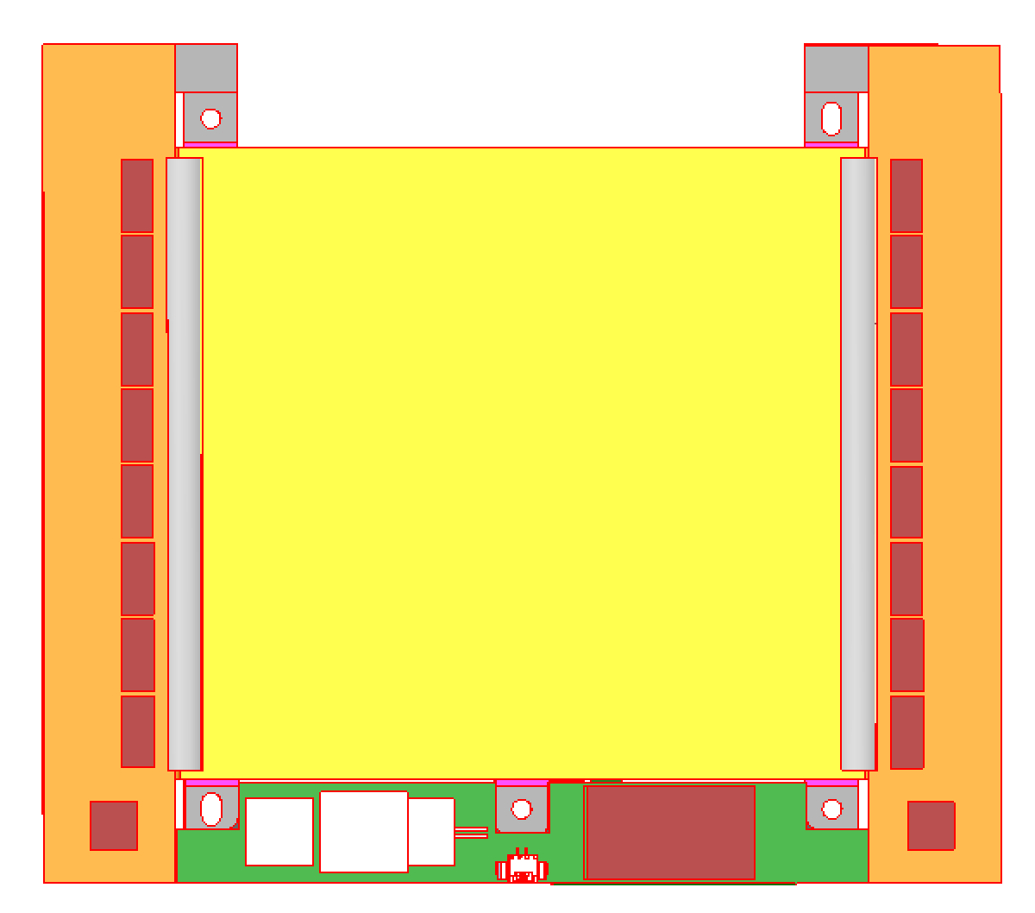
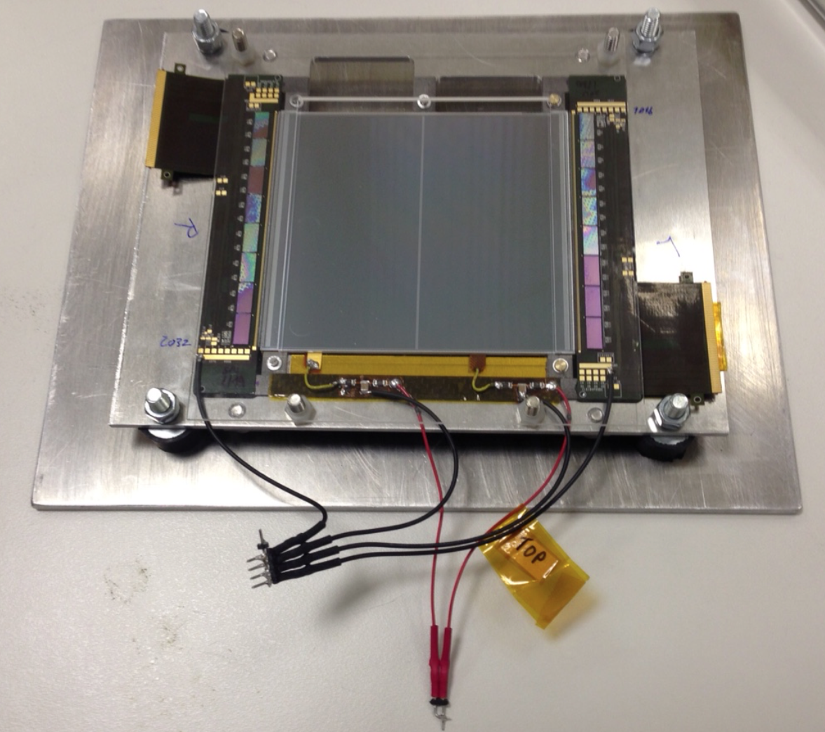
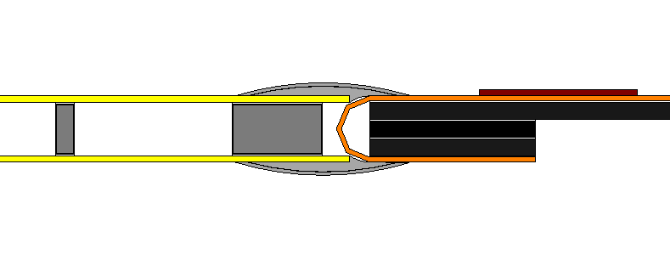
The 2S Module
2S P_{T} Module
Upper Layer
Lower Layer

Slide 23
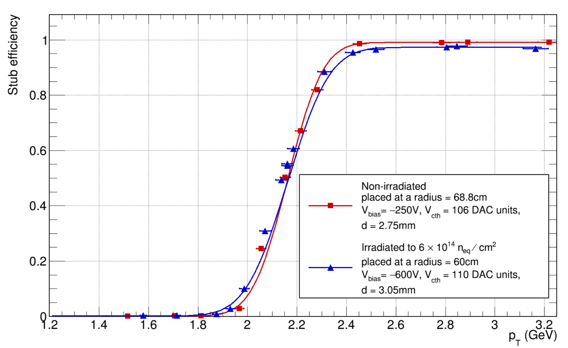
Beam test results
120 GeV/c pions

Slide 24
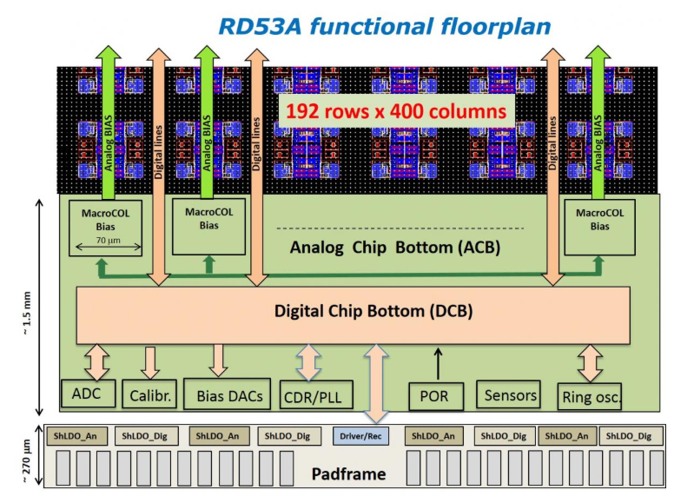
Inner-Tracker Pixel Chip
RD53A is large scale pixel chip demonstrator in 65nm CMOS technology which will form the basis for the production design for the ATLAS and CMS HL-LHC upgrades.
192 rows x 400 columns pixel matrix, 50um x 50um pixel size
Non-uniform design to test 3 different front-end flavors
Digital output of Time-over-Threshold value (ToT) & trigger stamp for each pixel
Extremely high hit rate and trigger capabilities (up to 3GHz/cm2)
Extremely high radiation levels (1Grad over 10 years)

Slide 25
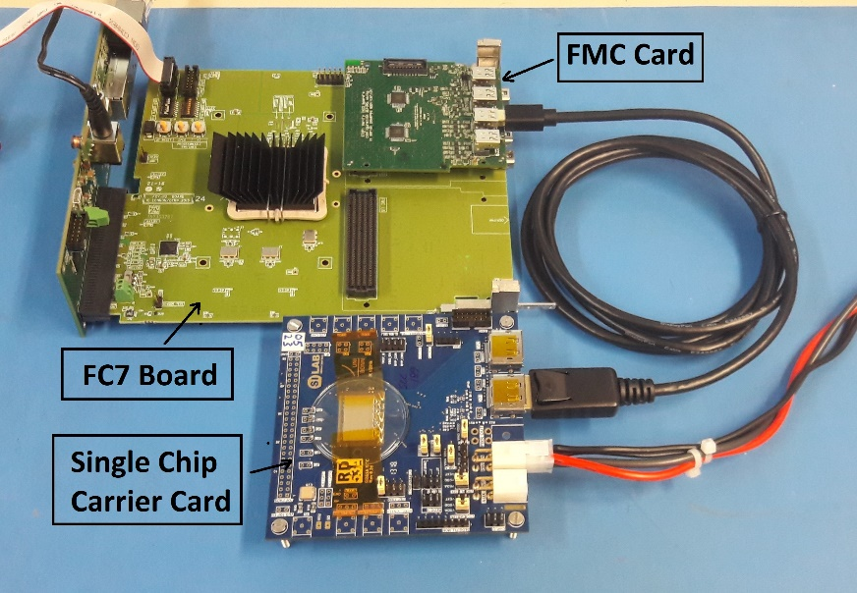
Inner-Tracker Pixel Chip
Inner-Tracker uDTC is a development based on FC7 board, to accommodate test systems for RD53A.
Key aspects of the firmware development:
  Communication with host PC via Gigabit Ethernet (IPBus protocol)
  Custom protocol for serial communication with the chips @ 160Mbps
  Xilinx-specific “Aurora” protocol for the readout-data from the chips @1.28Gbps
  Able to connect up to 8 chips on a single FPGA
Development started on June and the first version of the firmware is about to be released in the following weeks .

Slide 26
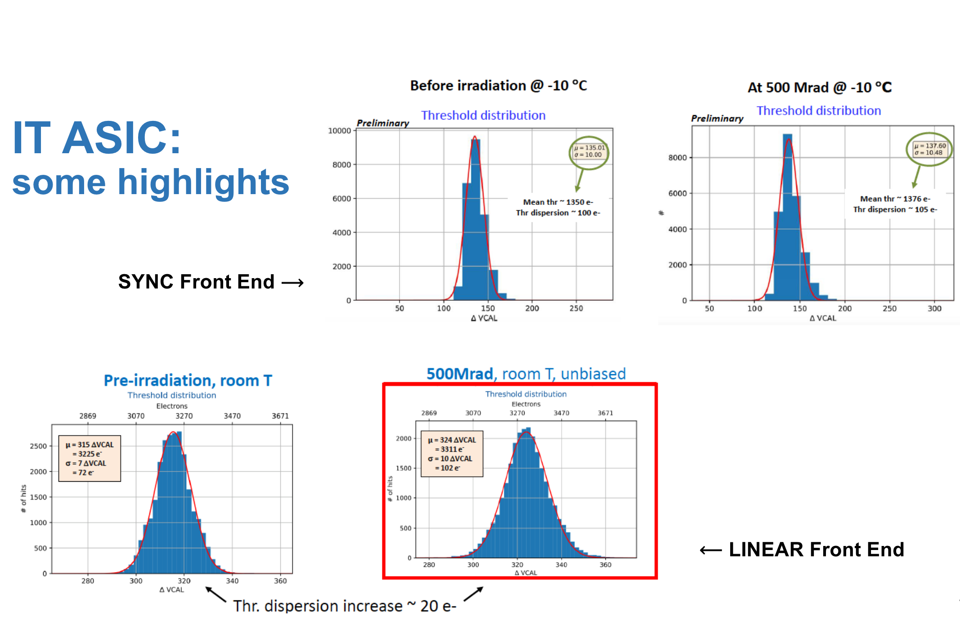
CMS TRACKER PHASE II IT ASIC: Some highlights

Slide 27




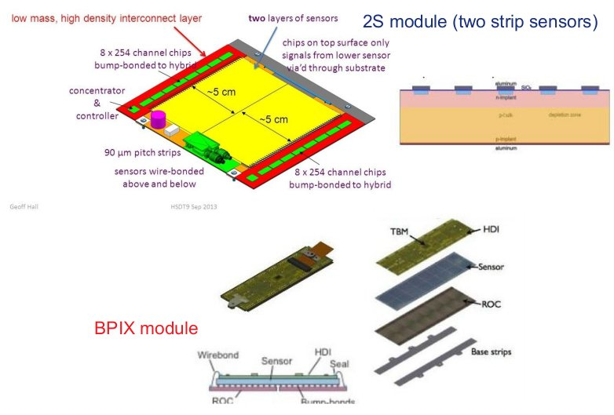
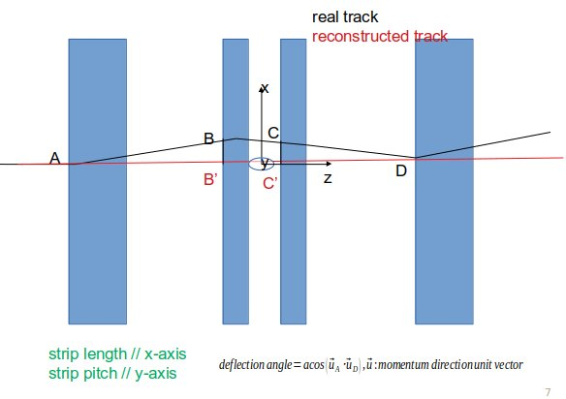
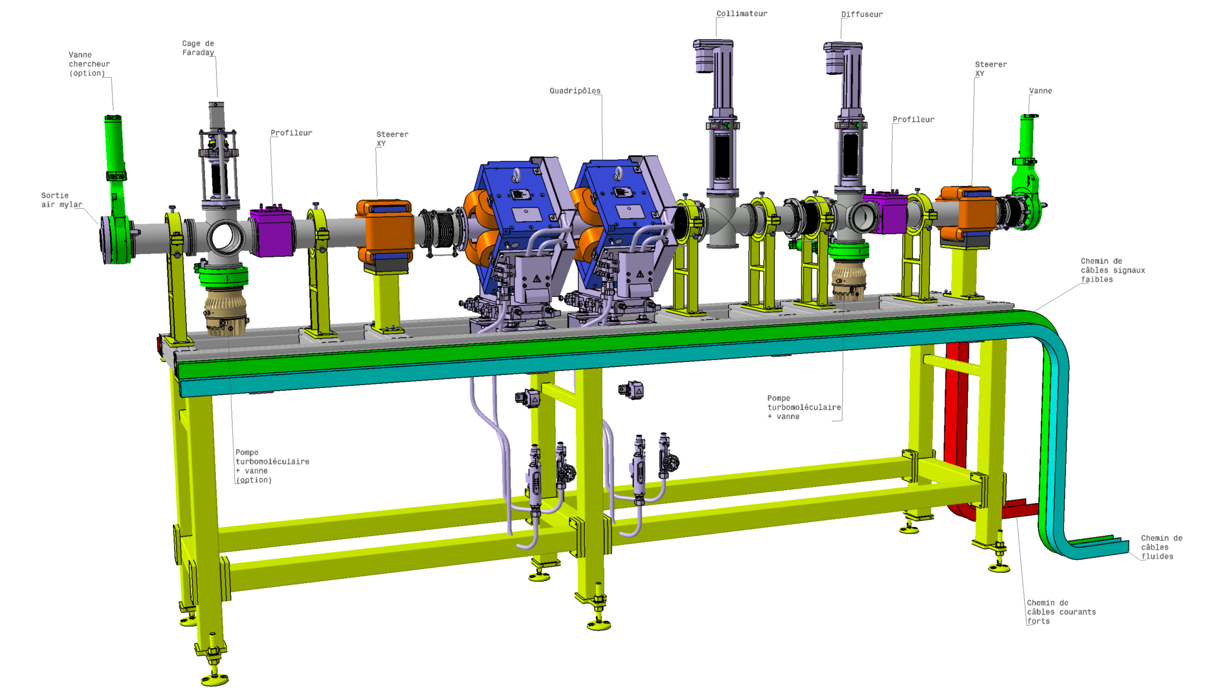
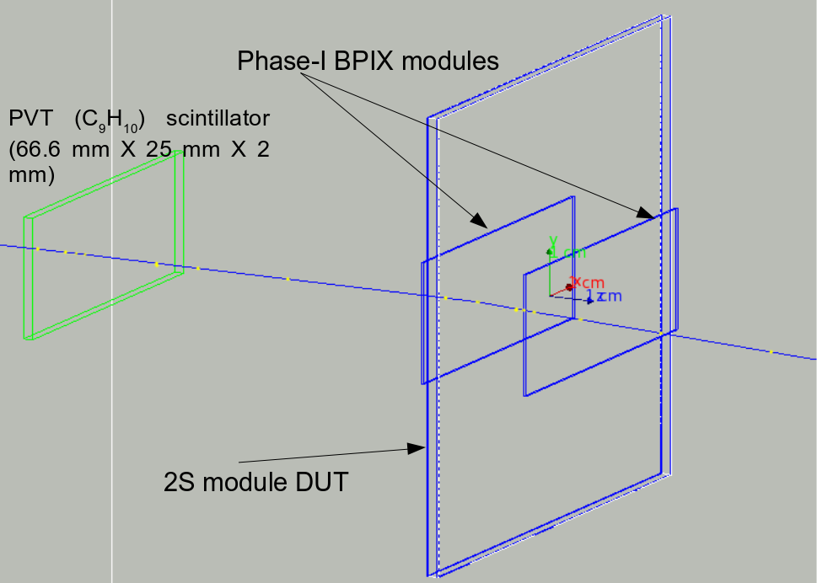
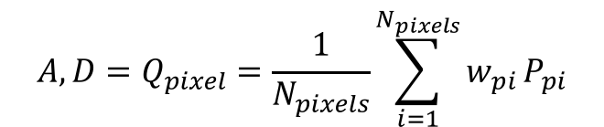
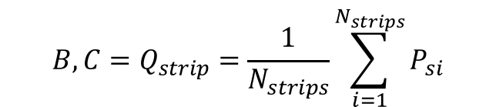
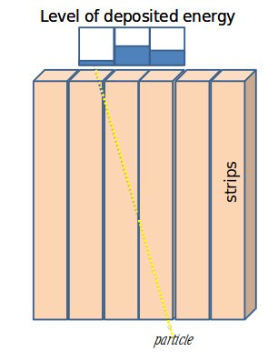



A Geant4 Study of Residuals and Hit Multiplicity in Silicon Strip Sensors for the CMS Phase-II Upgrade
Patrick Asenovª, Jérémy Andrea^{b}, Ulrich Goerlach^{b}, Dimitris Loukasª
a) Institute of Nuclear and Particle Physics (INPP), NCSR Demokritos, Aghia Paraskevi, Greece
b) Université de Strasbourg, CNRS, IPHC UMR 7178, F-67000 Strasbourg, France
Overview
  Upgrade of the LHC to the HL-LHC: up to 3000 fb-1 integrated luminosity [1]
  New silicon tracking devices, improved radiation hardness
  Test beams: study the performance of silicon sensors, also under irradiation
  A new beam line at cyclotron CYRCÉ (mid 2019, 25 MeV protons) at IPHC-Strasbourg: testing CMS tracker modules (performances and the DAQ system) with high rates of particles and for large energy depositions [2]
  Studying the new setup is critical: performing a Geant4 simulation of the interaction between a 25 MeV proton beam and the silicon sensors [3], [4]
25 MeV
2. The New CYRCÉ Beamline
Energy (fixed): 16-25 MeV; dispersion: ΔE = 100 keV
Particle: Protons
Intensities: max 10¹² p/s, min 10² p/s
Time micro-structure: 11.75 ns → 85.085 MHz, just about twice the nominal LHC bunch collision rate = 40 MHz [2]; a “kicker” could be used to have exactly 85.085 MHz/2.
6. Estimation of the Resolution of 2S Sensors
Impact points Q_{pixel} = A, D; Q_{strip} = B, C, where A, B, C, D defined above
Weight w_{pi} for each pixel with a hit = charge collected in the current pixel over the total charge collected in all pixels of the current module that have counted a hit in the current event; weight w_{s} for each strip with a hit = 1 over the total number of strips of the current sensor that have counted a hit in the current event (no charge info from CMS Binary Chip)
N_{pixels}: the total number of pixels with a hit in the current module, P_{pi}: the geometric center of the front surface (in the way of the beam) of the i-th pixel that has counted a hit; N_{strips}: the total number of strips with a hit in the current sensor, P_{si}: the geometric center of the front surface (in the way of the beam) of the i-th strip that has counted a hit
3. Simulated Geometry and Physics Processes
2S module DUT and Phase-I BPIX modules as part of the telescope [1]
25 MeV proton beam in z-direction. Origin: Center of World. Scintillator: z = -10 cm. Particle gun: (-1, 0, -20) cm
Run: 100000 events
Physics processes included in the simulation: 1) Ionizations, 2)Bremsstrahlung, 3) Pair production, 4) Annihilation, 5)Photoelectric effect, 6) γ production, 7) Compton scattering, 8) Rayleigh scattering, 9) Klein-Nishina model for the differential cross section [4]
25 MeV
25 MeV
y-residuals’ distribution is a superposition of two effects: discrete positions due to the signal from the strips (B and C positions), and continuous positions from the track extrapolation through the DUT (B’ and C’ positions). Multiple scattering accounting for the differences between B/C and B’/C’, respectively.
4. Energy Deposition in Silicon Sensors
Energy lost by primary protons: a) deposited energy in the material of the detectors; b) kinetic energy of secondary (newly created by physics processes) particles
25 MeV protons: stopped by about 3 mm of silicon (as expected from Bethe formula [5]) and deposit large amounts of energy [6]
Goal: To collect info regarding the deposited energy per sensor of DUT/pixel module
5σ noise threshold: at 5000 e⁻ for 2S strips and at 1000 e⁻ for pixels
For each event: stored energy in each strip/pixel, respectively, calculated; when dividing this energy by the energy required for a single electron-hole production in silicon (= 3.67 eV) charge collected in each strip/pixel (measured in electrons) obtained
If this charge exceeds the threshold of 5000/1000 electrons, for a strip/pixel respectively, we consider that we have got a hit in the examined strip/pixel in the current event
Reconstructed entrance position of 25 MeV protons in front pixel module:
7. Hit Multiplicities of Simulation Components
Hit multiplicity = the number of strips/pixels per sensor/module, respectively, with a hit in a single event (→ cluster size for strips)
For each of the sensors of the 2S module and the pixel modules of the telescope: hit multiplicity computed for a run of 100000 events
# of entries per bin
# of entries per bin
Energy deposited in silicon material and energy of secondaries for Sensor 1 for a 25 MeV primary track
# of entries per bin
# of entries per bin
Landau fit
50 GeV
25 MeV
Gaussian fit seems to be approximately good
# of entries per bin
# of entries per bin
Left: Energy stored in the volume of Sensor 1 from the passage of a proton (blue) and the amount of energy transformed to kinetic energy of newly produced secondaries due to the physics processes (red). Right: The sum of the above energies is equal to the total energy lost by the primary proton. A comparison is made between the 25 MeV beam of the beam line at IPHC and an MIP beam of 50 GeV protons (inset). On all the vertical axes: Number of entries for a run of 100000 events.
5. Multiple Scattering of Protons
A, B, C, D points defined as entrance points of primary protons in the first pixel module, the first 2S sensor, the second 2S sensor and the second pixel module, respectively; they all lie on the front surfaces of each compnent in the way of the beam
Geant4 returns the real (extrapolated) entrance positions
An attempt made to perform a local reconstruction: the reconstructed entrance points correspond to those that could be measured in reality
Simplifications made in the calculation of reconstructed entrance points to estimate the detector residuals
8. Outlook
Small deflection angle in the proposed telescope system (< 0.3 rad) for 25 MeV protons
Similar hit multiplicities for sensors regardless of energy
A novel simulation algorithm for the estimation of multiple scattering angles, residuals and energy deposition per strip/pixel for any test beam system and telescope containing pixel and strip sensors
This work has received financial support by the Hellenic Foundation for Research & Innovation.
References
[1] CMS collaboration, 2017 The phase-2 upgrade of the CMS tracker, CERN-LHCC-2017-009, CERN, Geneva Switzerland, [CMS-TDR-17-001]
[2] P. Marchand, A. Ouadi, M. Pellicioli, D. Brasse. Cyrcé, un cyclotron pour la recherche et l’enseignement en Alsace. L’Actualité Chimique, 2014, 386, 9-14.
[3] S. Agostinelli et. al., Geant4: A simulation toolkit, Nucl. Instrum. Meth. A, vol. 506, no. 3, pp. 250-303, 2003.
[4] Allison, John et al., Geant4 developments and applications - IEEE Trans.Nucl.Sci. 53 (2006) 270 SLAC-PUB-11870
[5] H. Bethe und J. Ashkin in "Experimental Nuclear Physics, ed. E. Segré, J. Wiley, New York, 1953, p. 253
[6] NISTIR 4999, Stopping Power and Range Tables

Slide 28


Construction Responsibilities
Responsibilities
table of electrical specifications for the sensors

Slide 29


Activities at INPP
Sensor Quality Control
$${ENC}^{2}=a\left\{\left(2eI_{d}+b\right)τ+c\frac{C^{2}}{τ}+dC^{2}\right\}$$

Slide 30


Upgrade Requierements for the Phase II Tracker

Slide 31


A complete 3D representation up to 1st metal layer

Slide 32
The MIDAS chip

Slide 33


Mesh

Slide 34


Back Biased Pixel : Response to mips
A mip liberates ~1.28 x 10⁻¹⁵ Cb in 100 um silicon
Impact point at 10 um
$$1.24 ×{10}^{−15}Cb (in 10 ns)$$
Impact point at 50 um
$$1.29 ×{10}^{−15}Cb (in 10 ns)$$

Slide 35





MIDAS Radiation Detector
MIDAS is highly miniaturized radiation detector for use in space applications.
Detecting Head consists of 40 HVCMOS ASICs (32 x 32) & The Neutron Monitor subsystem.
Evaluation Board and DAQ system has been designed and ASIC characterization is on the way.

Slide 36



MIDAS Radiation Detector
Neutron Monitor Subsystem uses pulse-shape discrimination to distinguish between events originated from neutron hits and events from gamma-rays.
Hardware:
  Plastic scintillator coupled with a Silicon Photomultiplier
  Transimpedance amplifier & Gated Integrator to process generated pulses
Firmware/Software:
  DAQ system with FPGA + USB uController.
  LabView-based GUI
1st Version successfully tested with neutron test beam @ TANDEM & CERF

