Slide 1
Review of the XRF laboratory activities within 2018
Vicky Kantarelou
INPP, NCSR “Demokritos”
kantarelou@inp.demokritos.gr

Slide 2
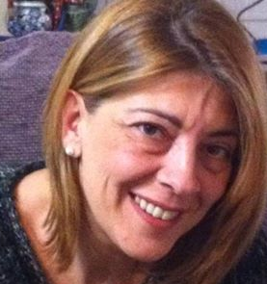
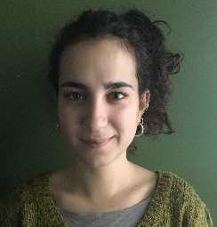
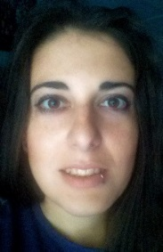
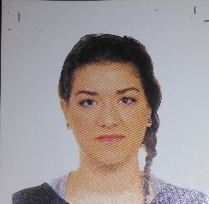
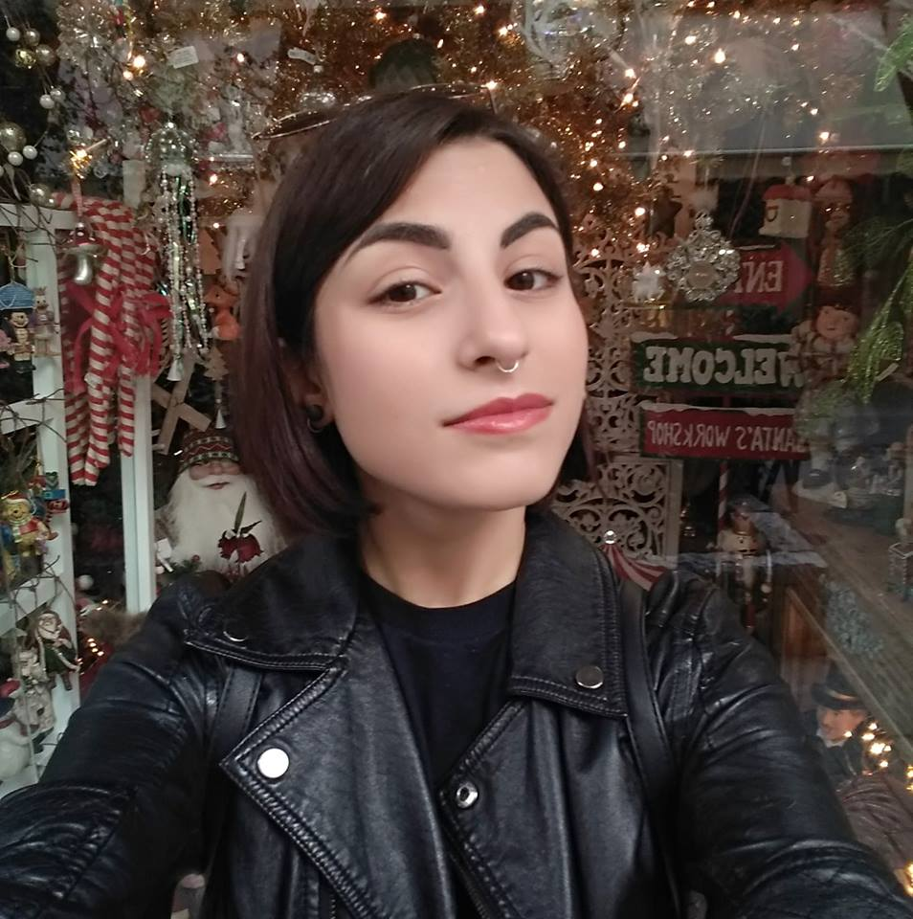
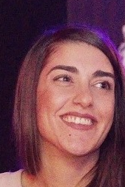
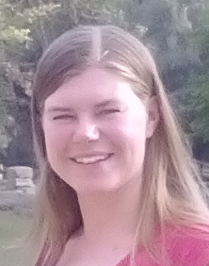
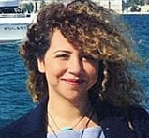
XRF Laboratory group 2018
Andreas Karydas, Researcher A
Vasiliki Kantarelou, Post Doc
Nelly Kladouri, PhD, University of Peloponnese
Eleni Kokiasmenou, MSc Diploma, AUTH
Dimitra Papadopoulou, MSc Diploma, AUTH
Sotiria Symewnidi, Diploma Work, NTUA
Savvina Fotiou, MSc, Diploma Work, CultTech
Kalliopi Tsampa, MSc, Diploma Work, NTUA
Rebecca Grethe, MSc, Diploma Work, CultTech
Fatima Azzahra Rakhami, Diploma Work, ENSICAEN
Maria Kontimpa, Intern

Slide 3
  Research Activities
Spin-off
Cultural Heritage
Cascade
X-ray
Knowledge, Technology
Transfer, Services
Study of fundamental interactions/parameters in X-ray spectrometry
X-ray
Fundamental
Parameters
Environment
Development of X-ray spectrometry methodologies & applications
XRF-Lab/ Tandem/Elettra
Resonant Raman
Scattering
Biomedicine
Improvement/ Development
of quantification models/approaches
Development of XRF Spectrometers for tailored applications
Advanced Materials

Slide 4
Scientific outcome (2018)
13 publications in peer –review journals
2 oral presentations in EXRS2018 and CHEMCH2018
4 poster presentations in EXRS2018 and CHEMCH2018
Education (2018)
Three (3) MSc diploma works were completed
Two (2) MSc diploma works will be defended within the next month
One (1) MSc diploma work is on progress
One (1) PhD candidate
One (1) intern thesis was completed

Slide 5
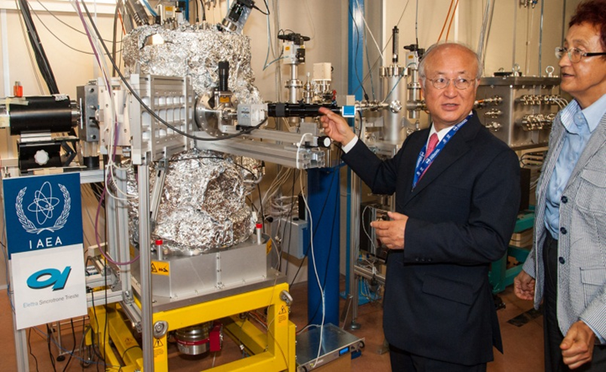
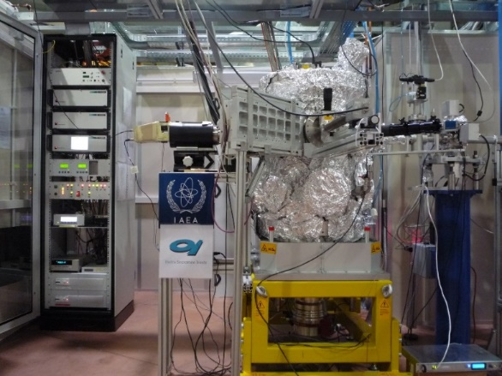
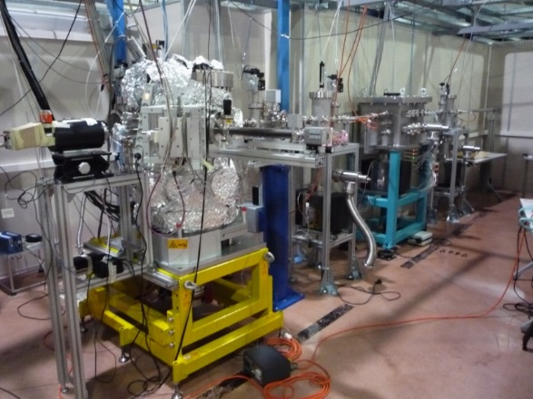
Research Activities @Elettra
IAEA Beamline end-station at Elettra Sincrotrone Trieste
2012-2016

Slide 6
  Fundamental interactions/X ray parameters @Elettra
  Projects – Collaborators
Ge L- X-ray Cascade Emission enhanced in the vicinity of the KL Resonant Raman Scattering
Measurement of X-ray FPs for Dy (Z=66)
Revisiting X-ray Fundamental parameters for Re (Z=75), Sn (Z=50) using SR
@ Elettra Sincrotrone Trieste, XRF Beamline
Dr. Mateusz Czyzycki, Elettra Sincrotrone Trieste
Prof. Sanjiv Puri, Department of Basic and Applied Sciences, Punjabi University, India
Dr. Matjaz Kavcic, Josef Stefan Institute, Slovenia
Dr. Charalambos Zarkadas, Malvern Panalytical, The Netherlands
Dr. Dimosthenis Sokaras, SLAC, SLAC National Accelerator Laboratory, US
Sotiria Symeonidou, ΣΕΜΦΕ, Diploma Student

Slide 7
Measurement Ge-L cross sections @Elettra
Secondary enhancement corrections were applied to account for:
Secondary fluorescence of Si-K to Ge-L, Ge-K to Ge-L when E_{inc}≥U_{K}(Ge)
Electron excitation of Ge-L photo-electrons
Electron excitation of Ge-K Auger electrons when E_{inc} ≥ U_{K}(Ge)

Slide 8
Air Pollution Studies @ Elettra

Slide 9
  Advanced Materials @ Elettra
Study of depth distribution of high energy implanted heavy ions in Silicon using Rutherford/Elastic Backscattering and Grazing Incidence X-ray Fluorescence
Prof. M. Kokkoris, National Technical University of Athens
Eleni Ntempou, PhD student NTUA

Slide 10
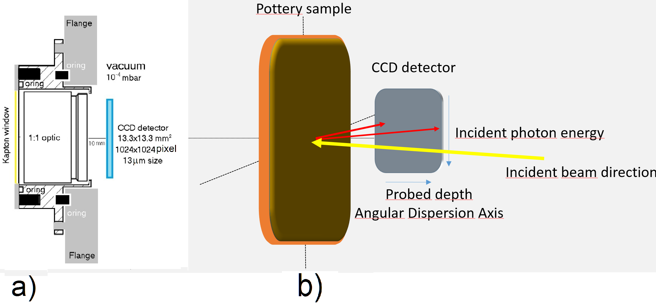
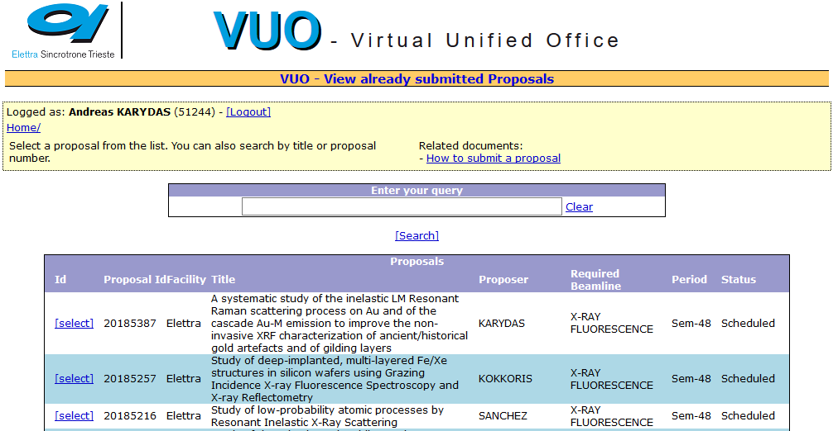
Accepted proposals @ Elettra (1st semester 2019)
Feasibility of depth resolved X-ray absorption spectroscopy by means of scanning- free grazing emission X-ray fluorescence, May 2018
A systematic study of the inelastic LM Resonant Raman scattering process on Au and of the cascade Au-M emission to improve the non-invasive XRF characterization of ancient/historical gold artefacts and of gilding layers, 20185387, by Dr. A. G. Karydas
Study of deep-implanted, multi-layered Fe/Xe structures in silicon wafers using Grazing Incidence X-ray Fluorescence Spectroscopy and X-ray Reflectometry, 20185257, by Prof. Mike Kokkoris
Study of low-probability atomic processes by Resonant Inelastic X-Ray Scattering, 20185216 by Prof. Jorge Sanchez

Slide 11
  Cultural Heritage: Research Projects – Collaborators
1) MA-XRF Imaging, P. Romano, C. Caliri, INFN-LNS, Catania & Istituto per i Beni Archeologici e Monumentali, CNR, Catania, Italy:
Development of MA-XRF quantification procedures
Polychromy of Roman wall-paintings,
S. Fotiou (MSc, CultTech)
PGM inclusions in Mycenaean gold,
S. Stocker (University of Cincinnati, USA), E. Konstantinidi (NAM), K. Tsampa (MSc, NTUA)

Slide 12
  Cultural Heritage: Research Projects – Collaborators
2) Evaluation of MC simulation code for XRF quantification purposes,
D. Papadopoulou (MSc, AUTH)
3) XRF analysis of Wall-Paintings from Nestor Palace
E. Kokiasmenou (MSc, AUTH), H. Brecoulaki (NHRF)
4) A technological study of bronze pins of Geometric period, from the sanctuary
of Athena alea at Tegea, N. Kladouri (PhD, UoP), V. Orfanou (AARHUS)
5) XRF analysis of daggers swords and other bronze funerary furnishings of the
Mycenaean period, E. Pappathoma (Museum of Vravrona)
6) XRF analysis of silver objects from Olympia, R. Grethe (MSc, CultTech)
7) XRF analysis on statues polychromy, H. Brecoulaki (NHRF)

Slide 13
  Cultural Heritage: In situ campaigns
Ancient Olympia museum, May 2018
Chora Archaeological Museum at Pylos, July 2018
INFN LNS Catania, September 2018
Kalymnos Archaeological Museum, October 2018
National Archaeological Museum, November 2018
Archaeological museum of Vravrona, December 2018

Slide 14
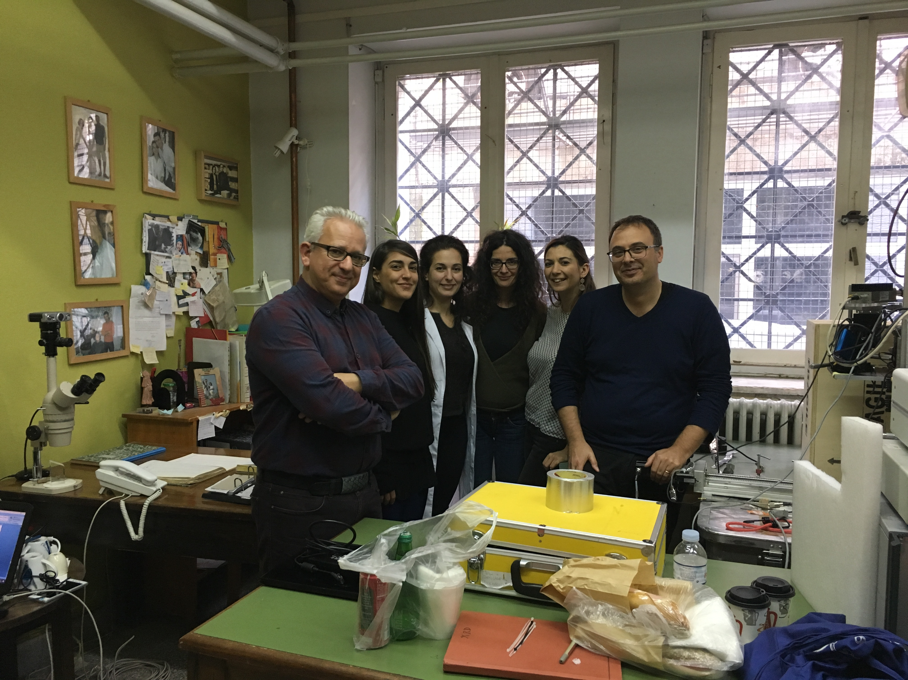
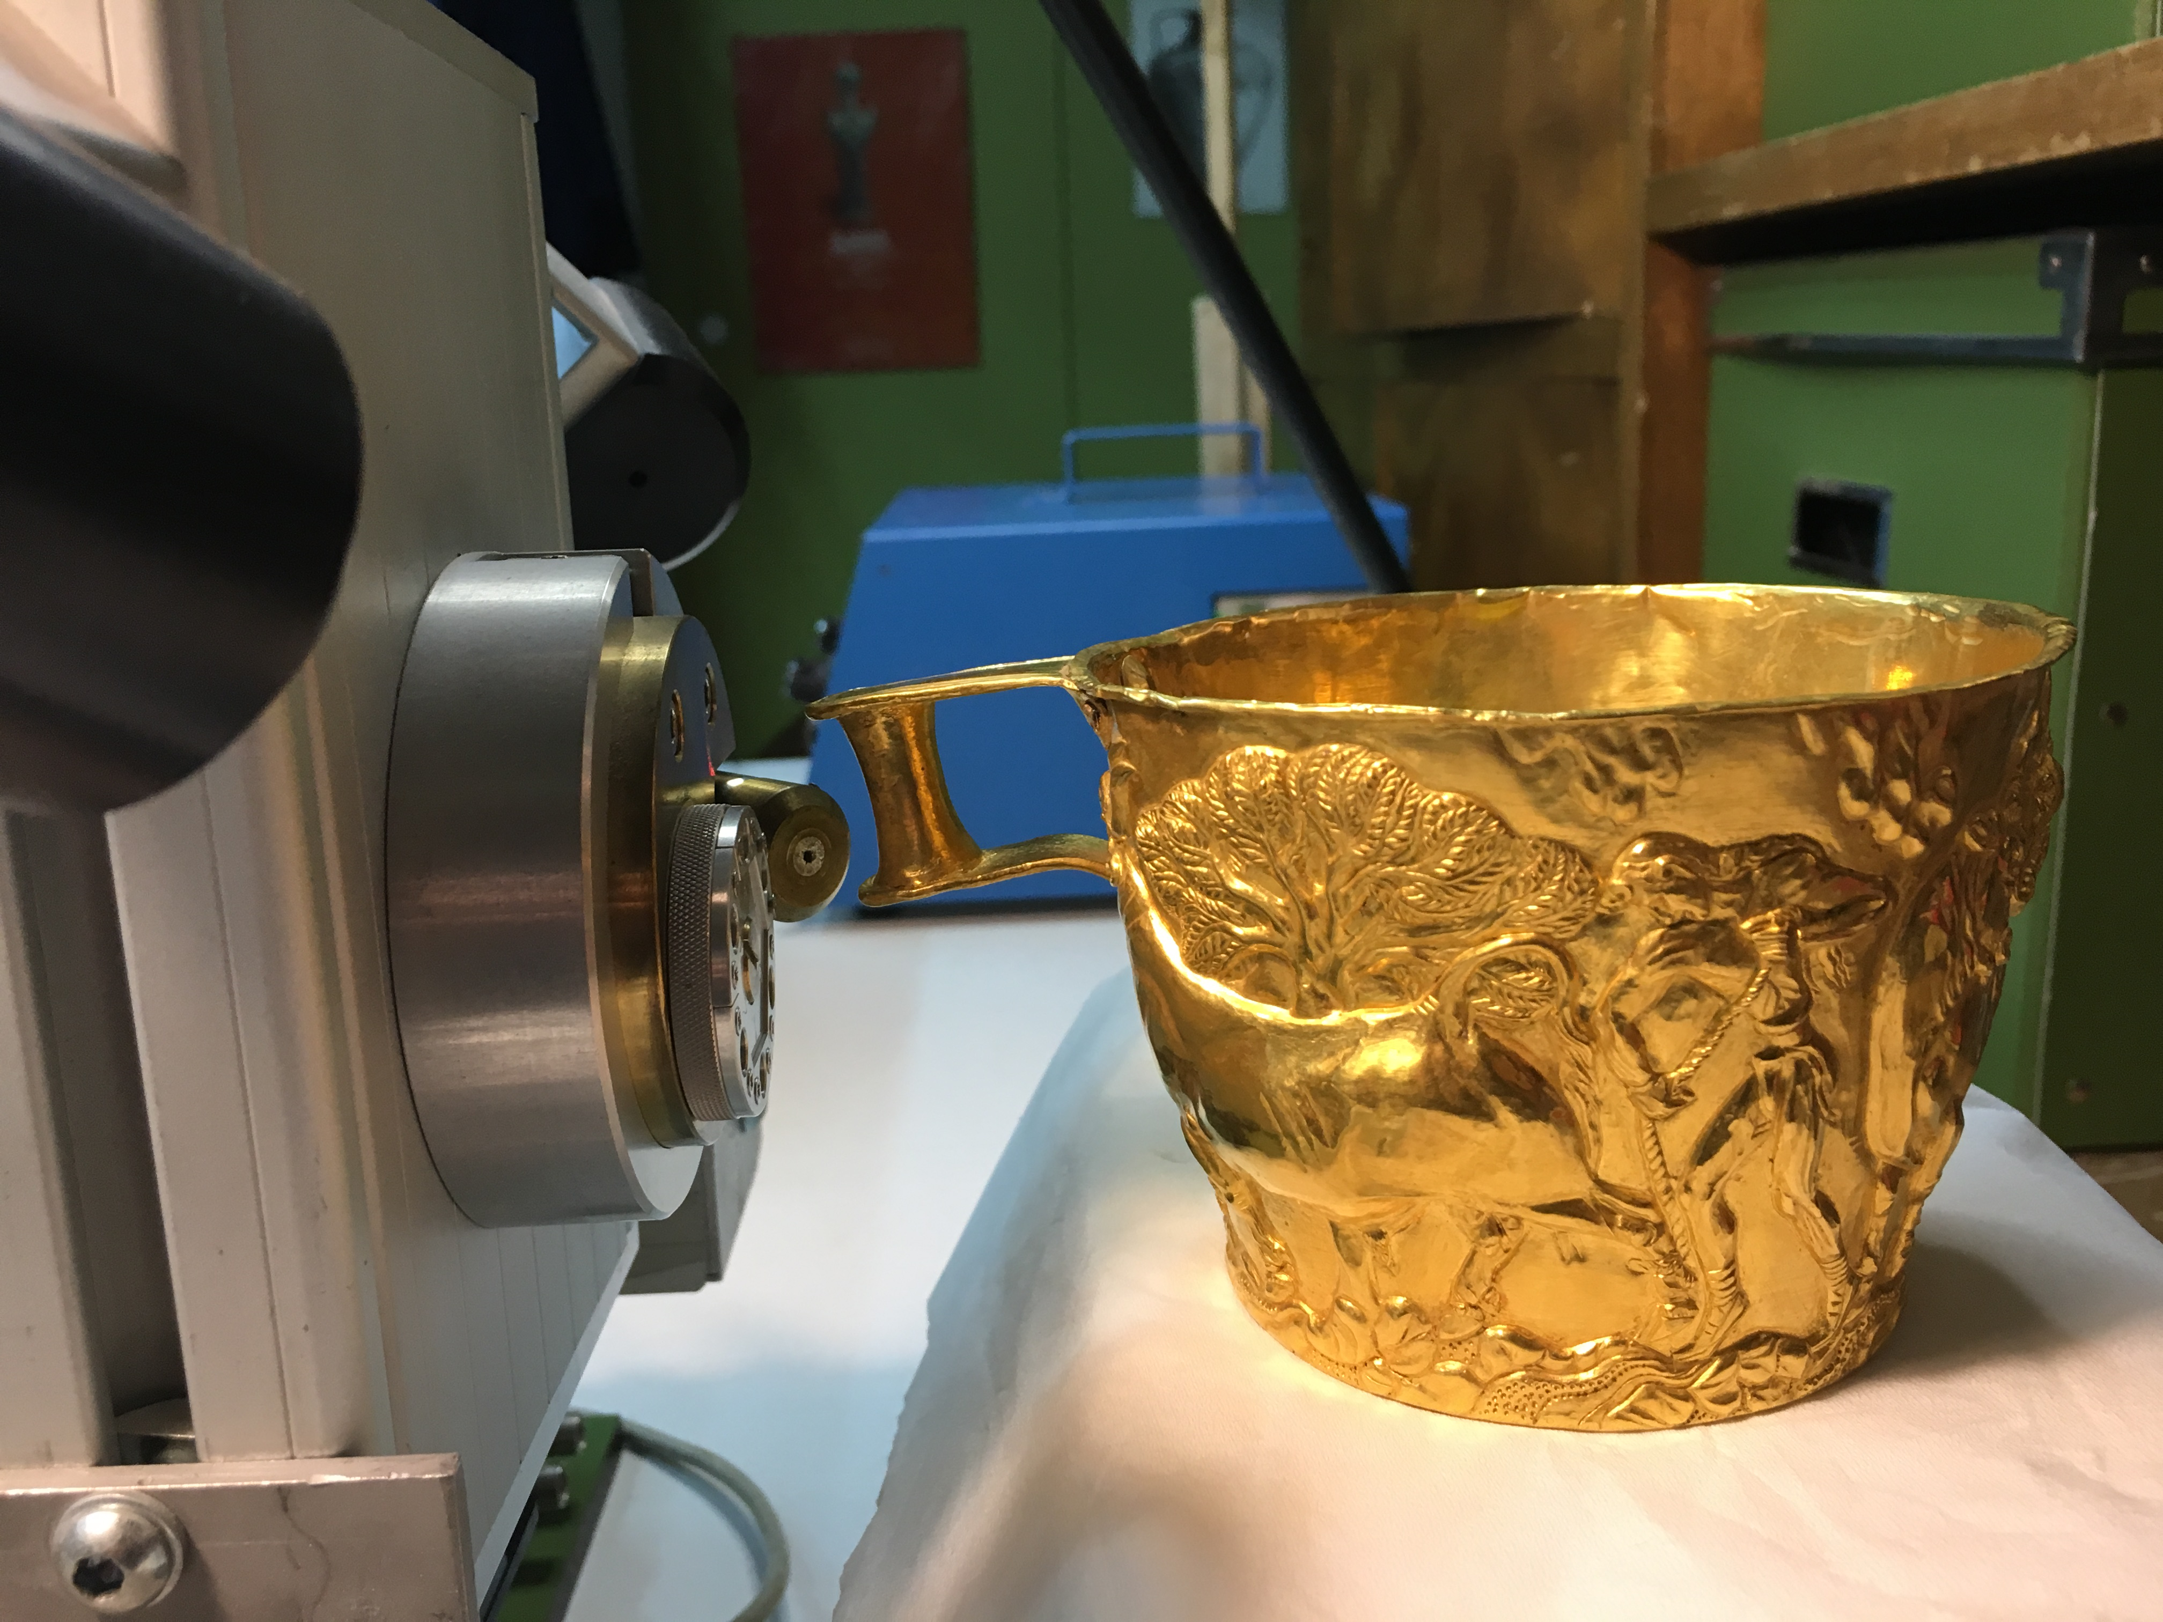
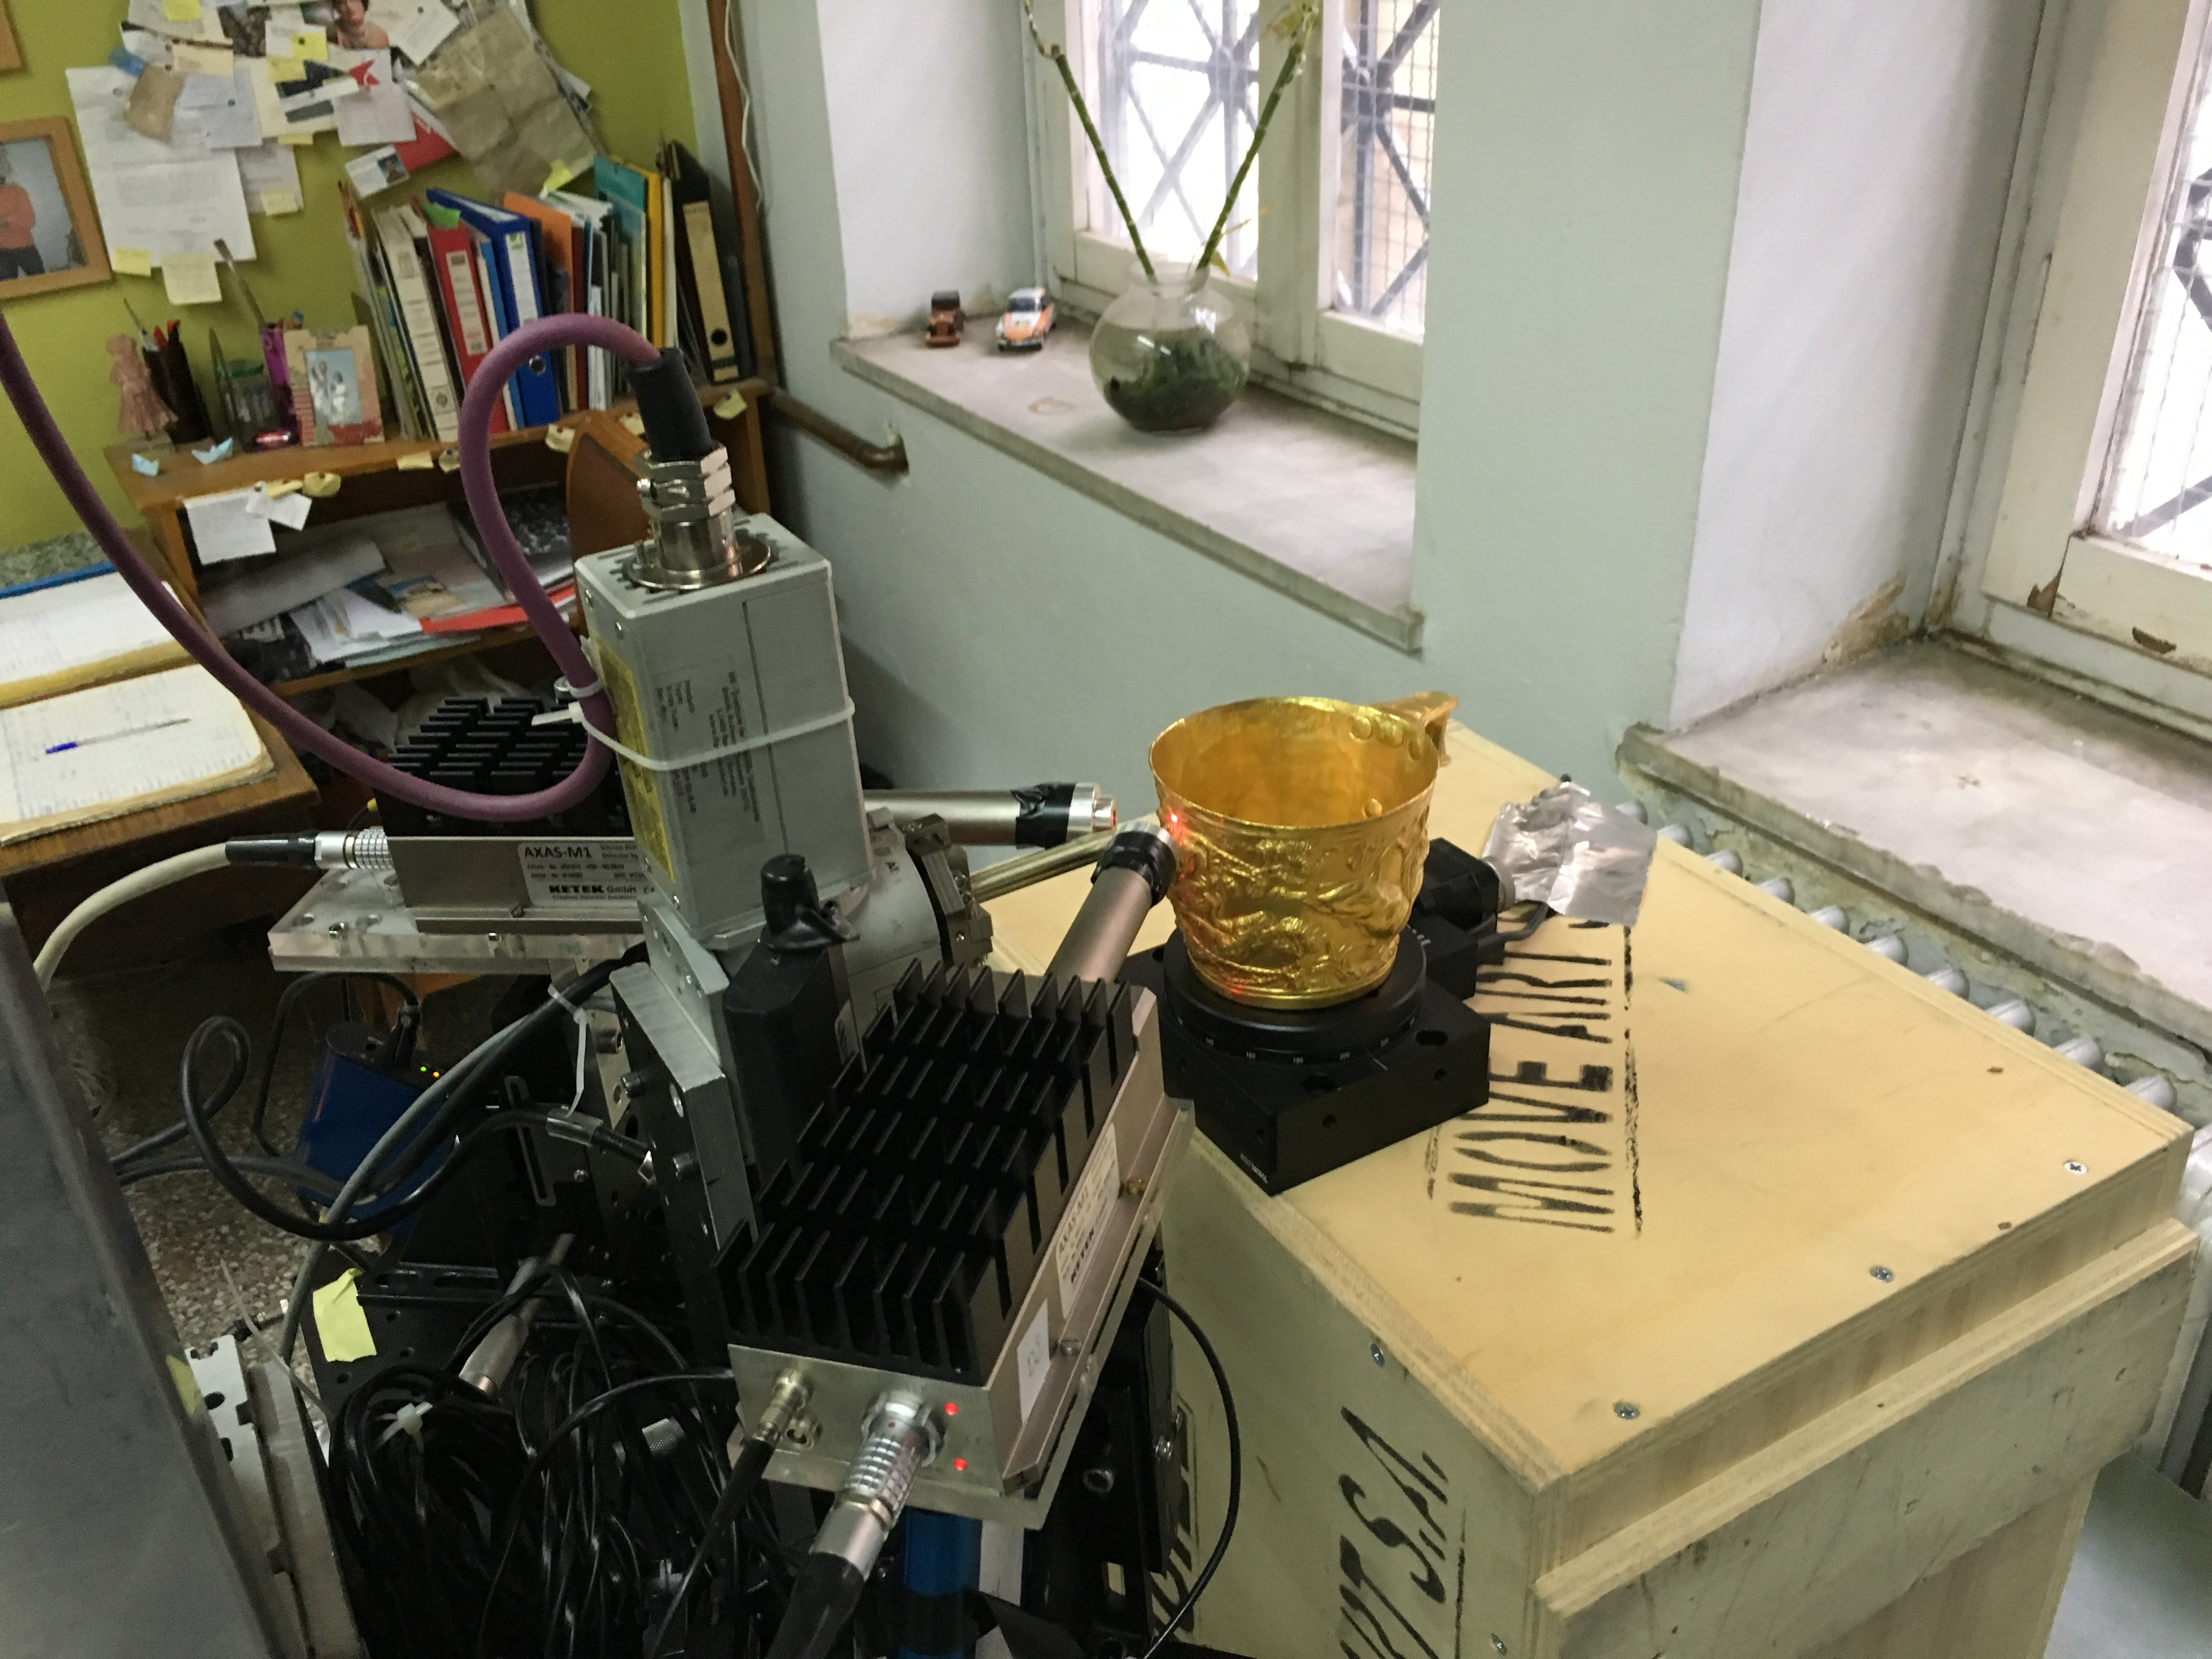
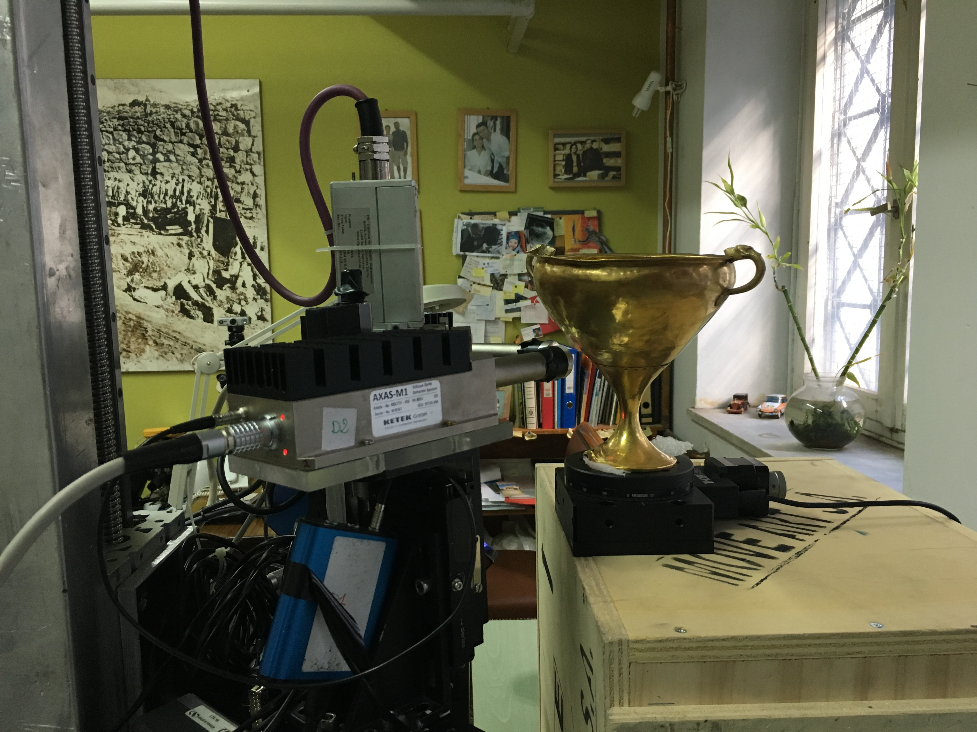
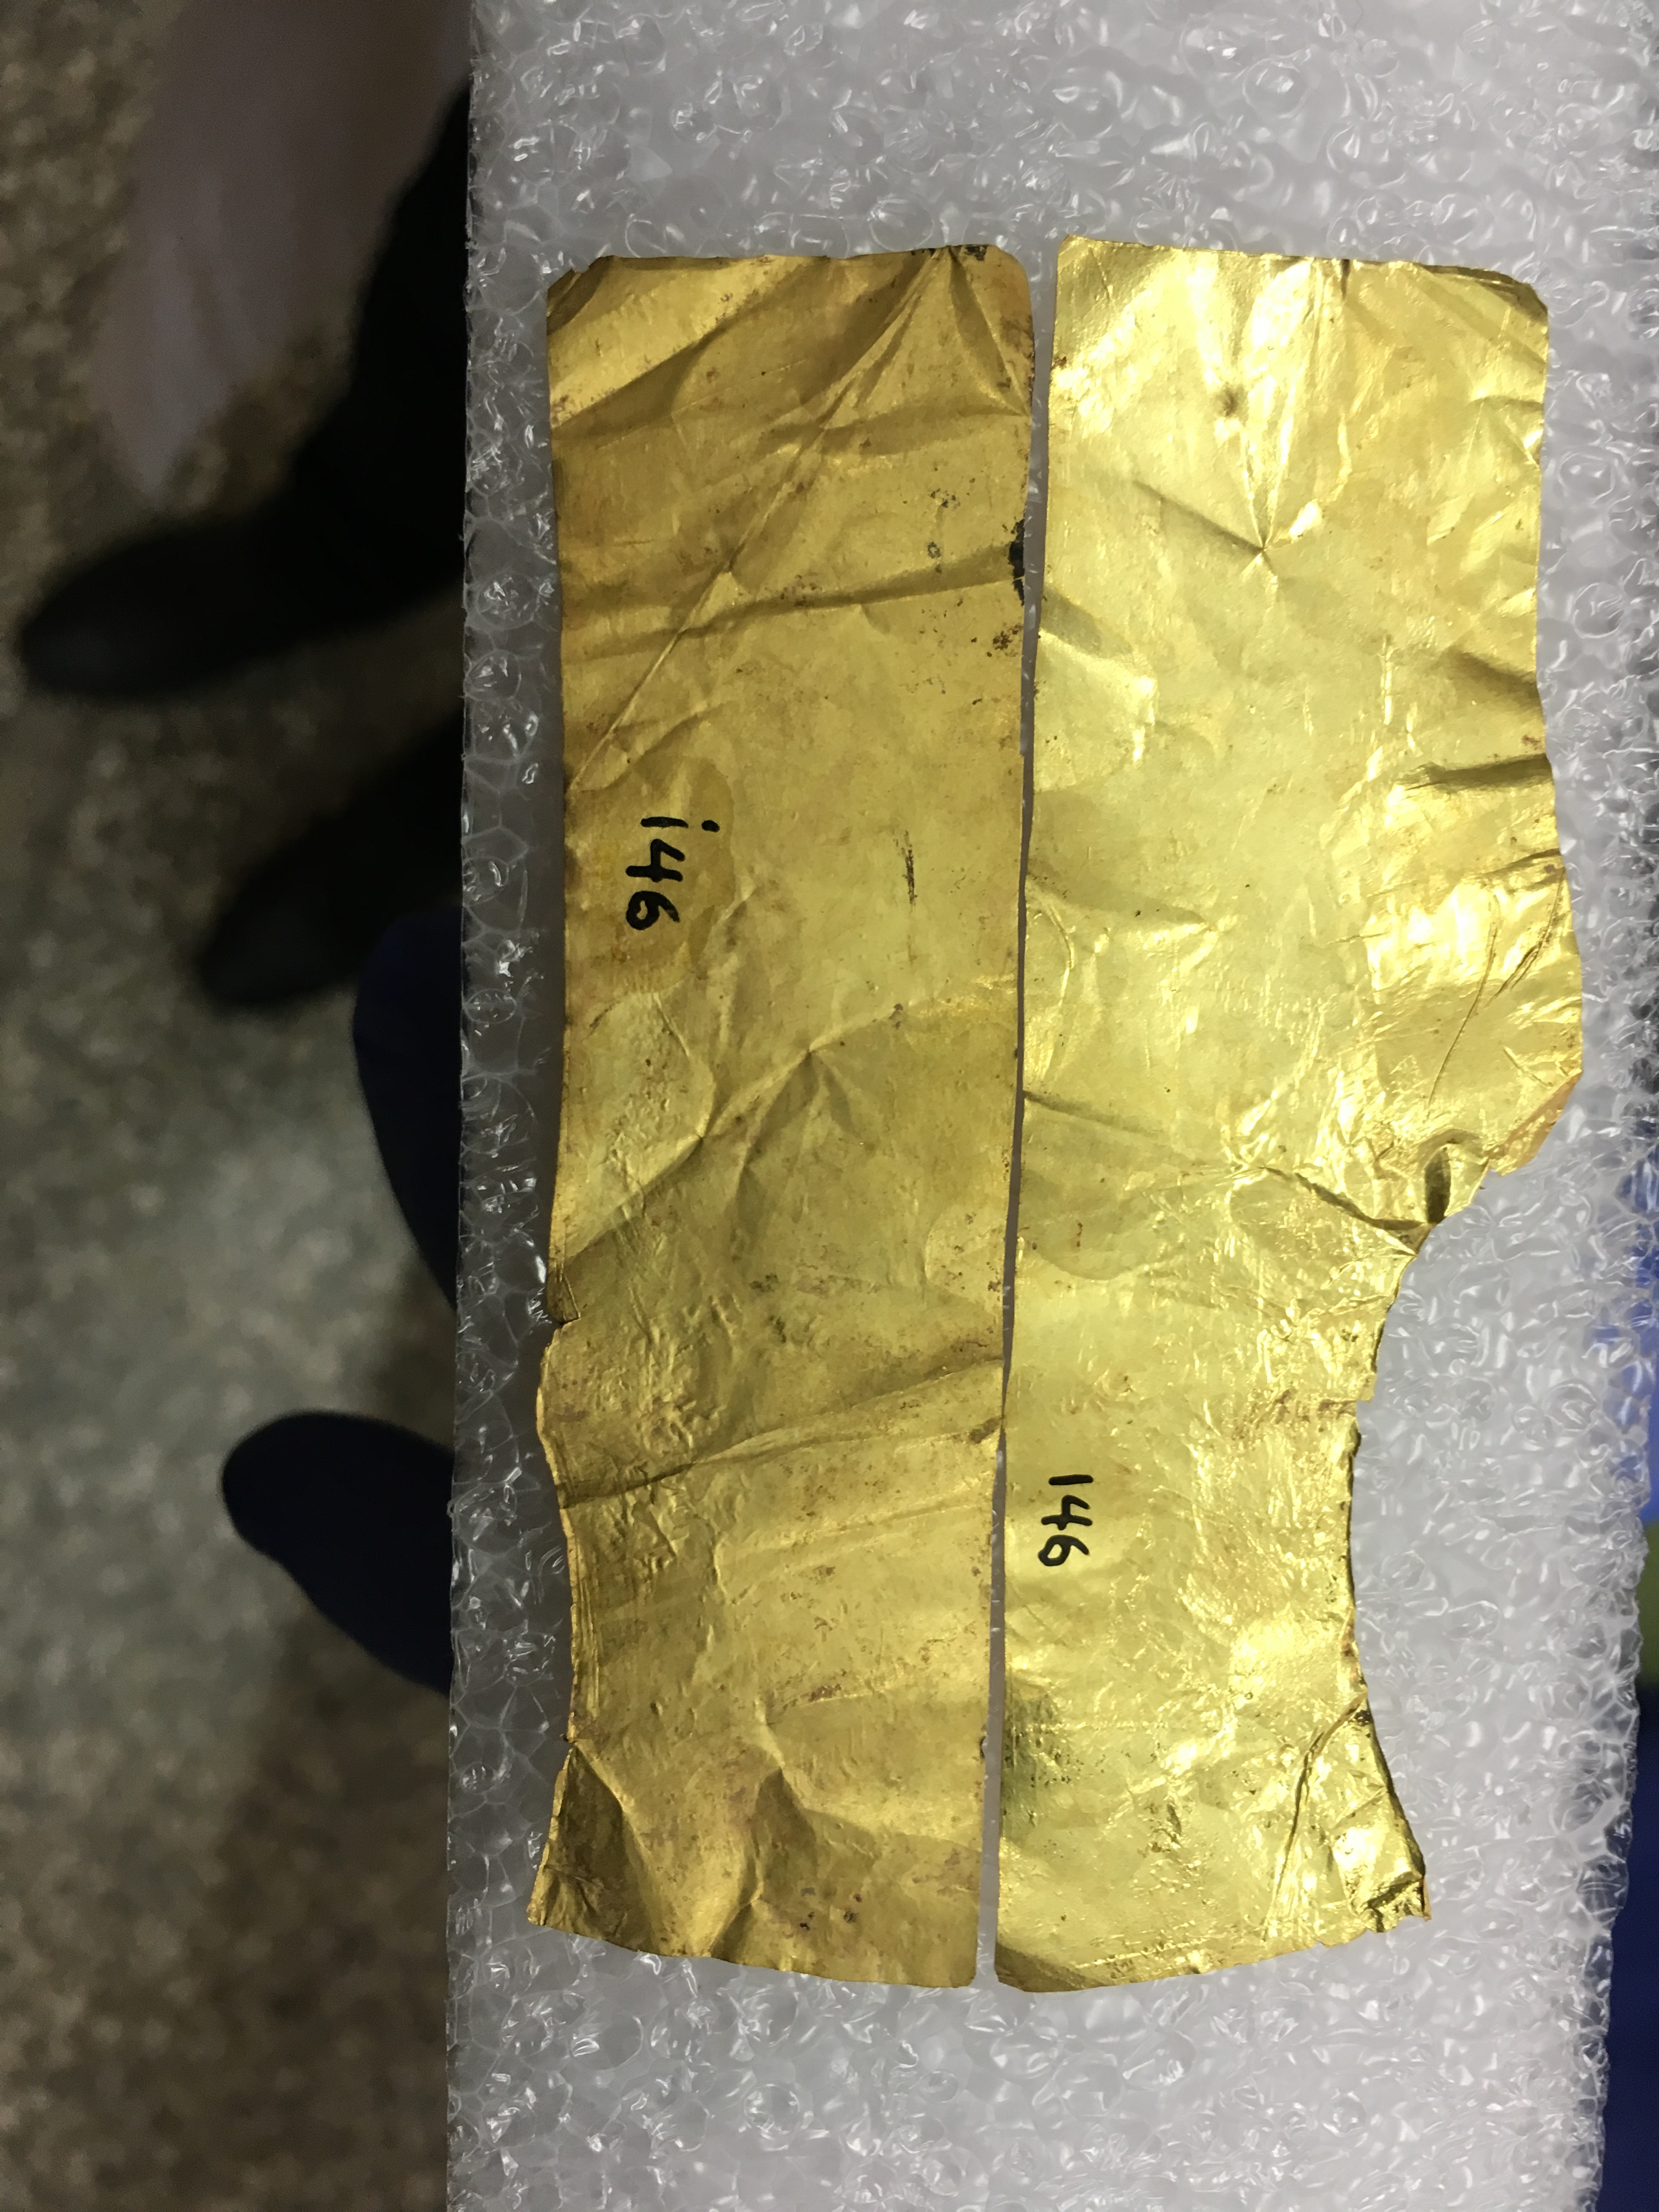
In search of PGM inclusions
(National Archaeological Museum , Nov2018)
Milli-XRF
MA-XRF

Slide 15
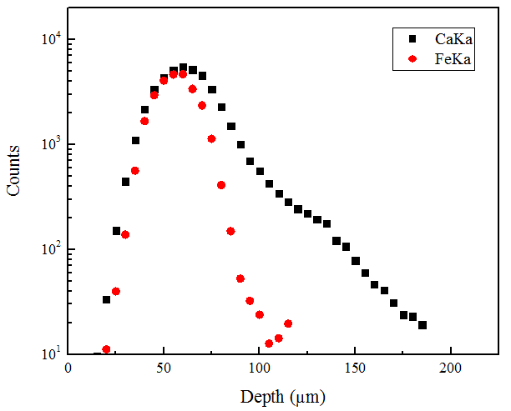
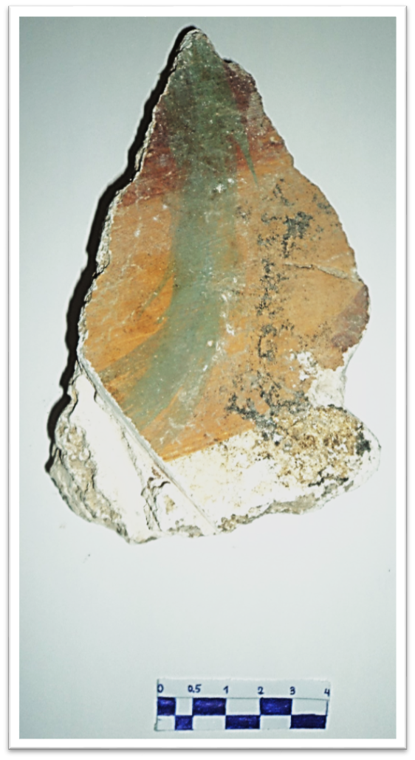
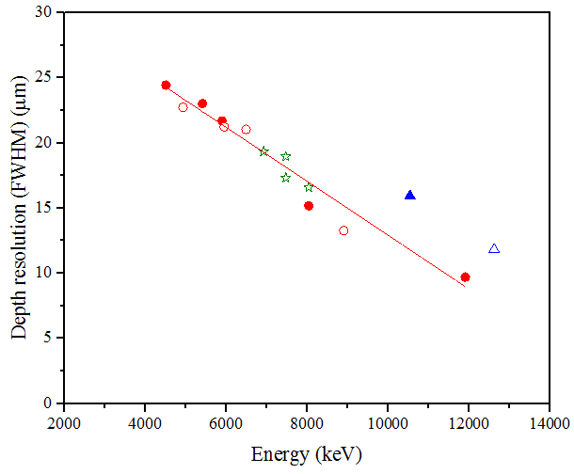
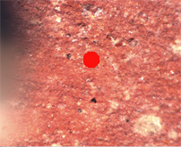
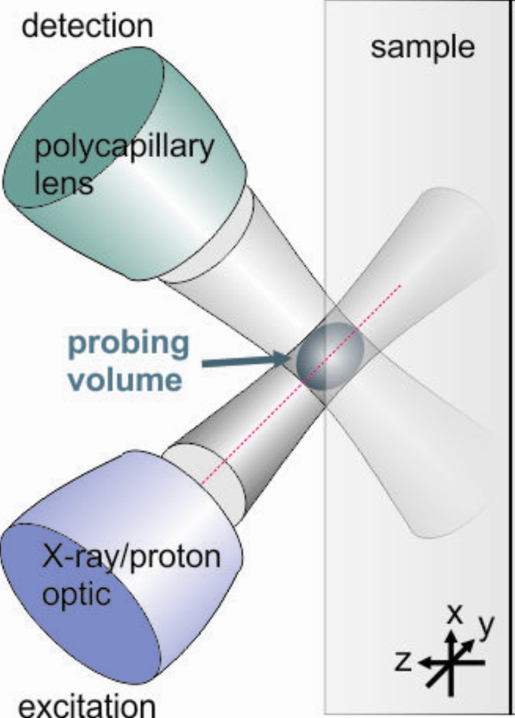
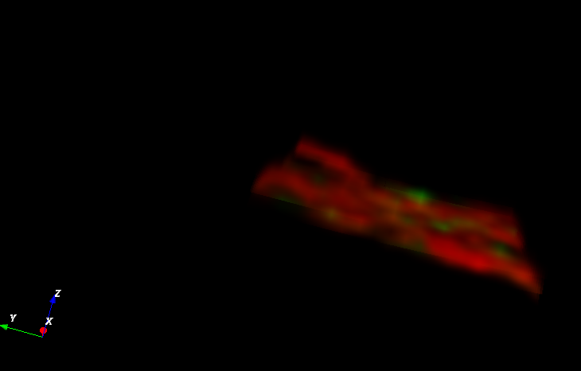
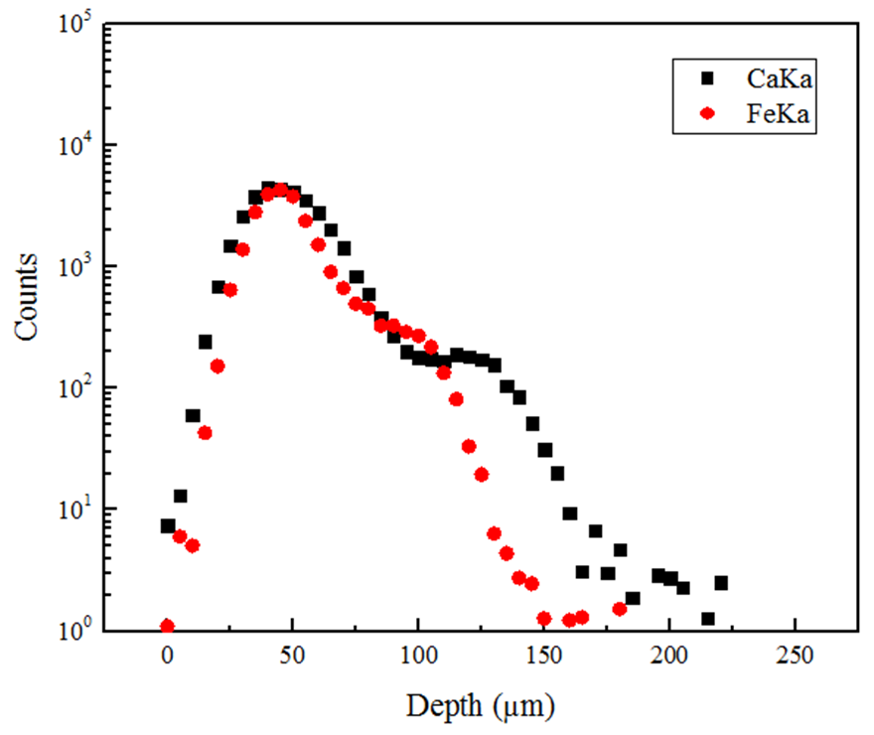
3D visualization of Roman wall-painting fragments
1D
3D
Fe is on the top of Ca
Fe
Ca
1D

Slide 16
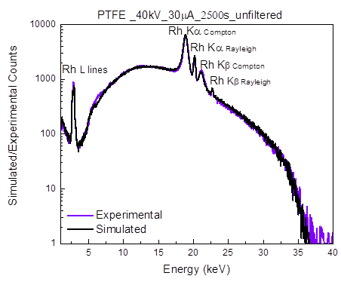
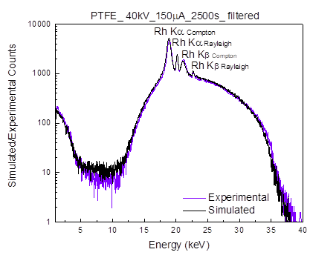
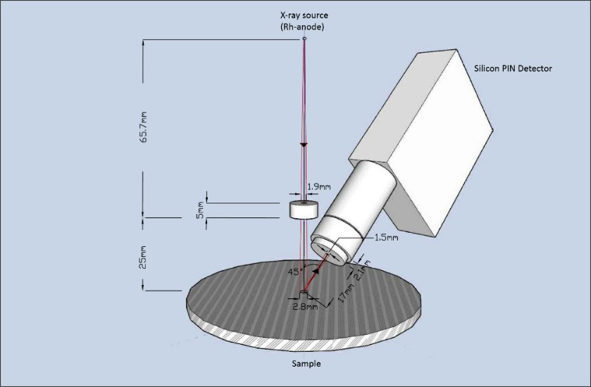
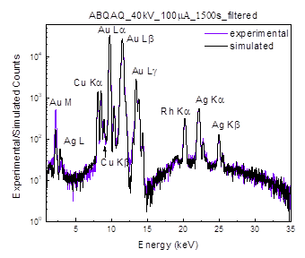
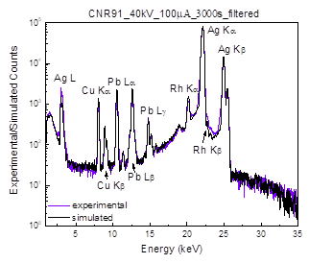
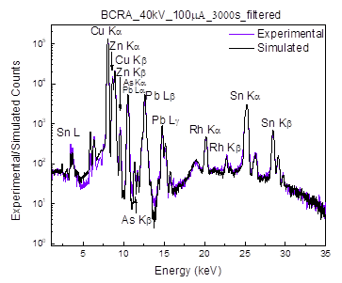
Evaluation of MC simulation code for XRF quantification

Slide 17
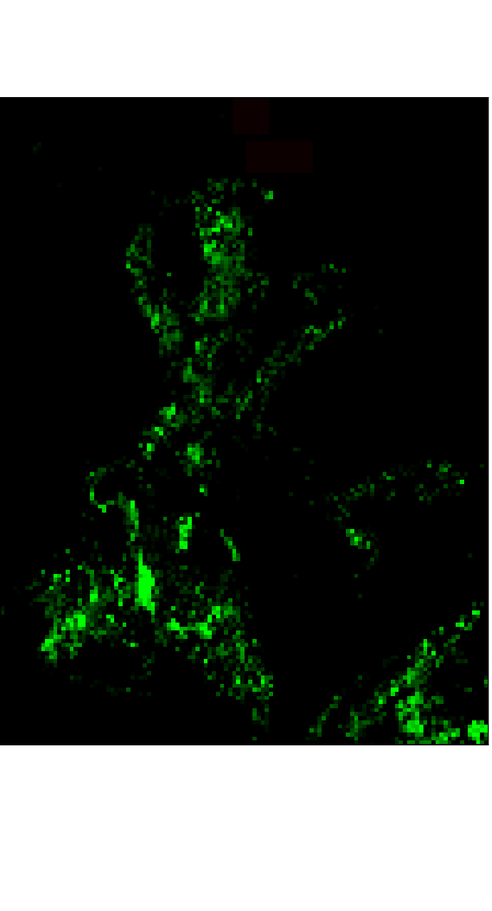
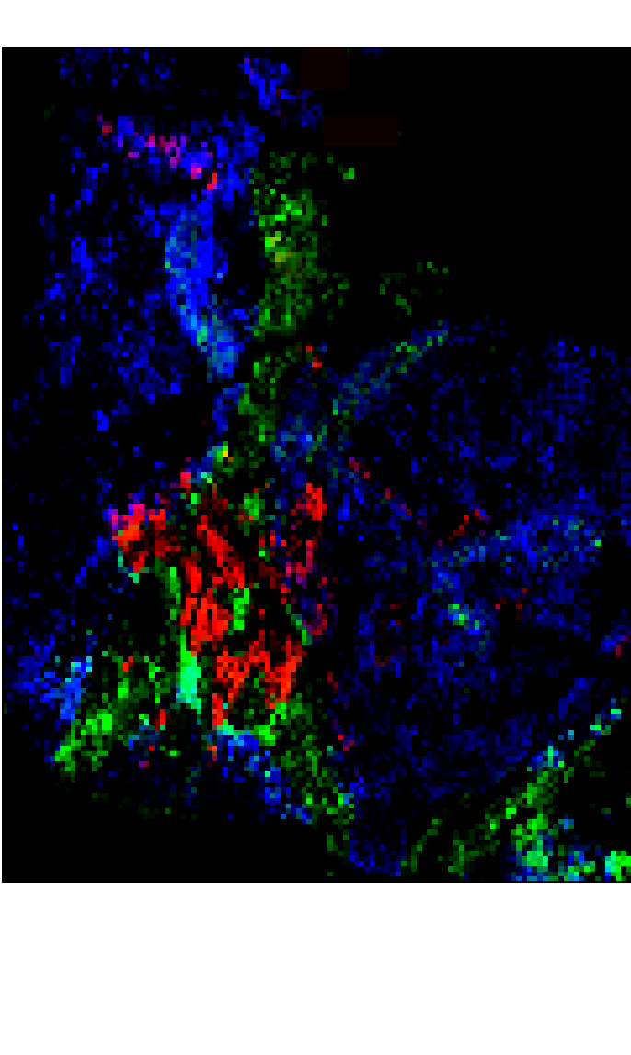
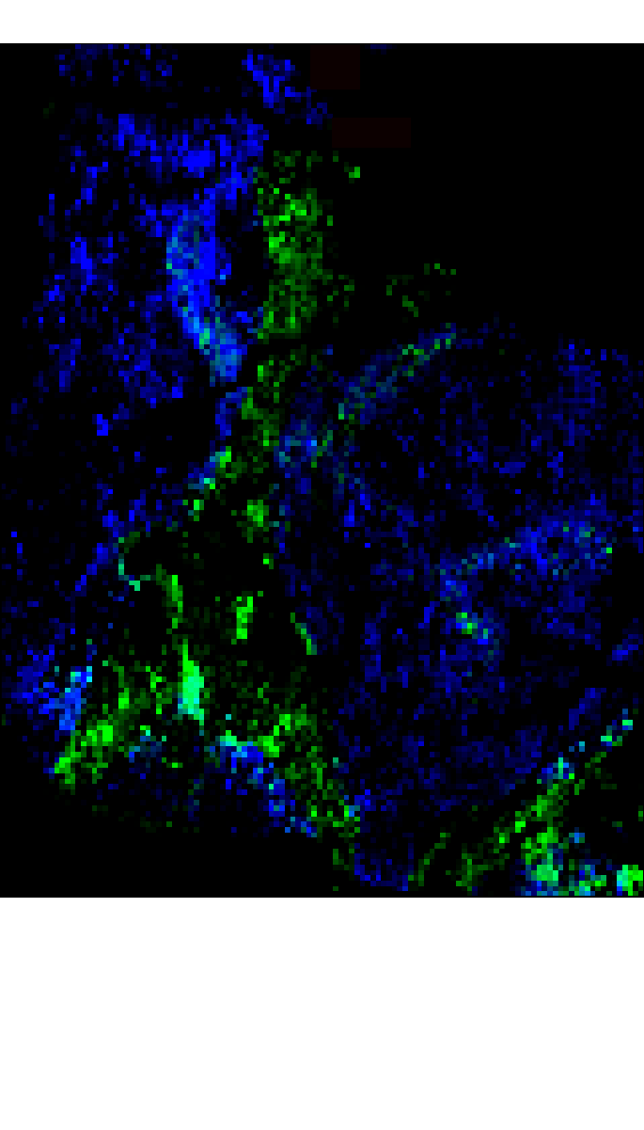
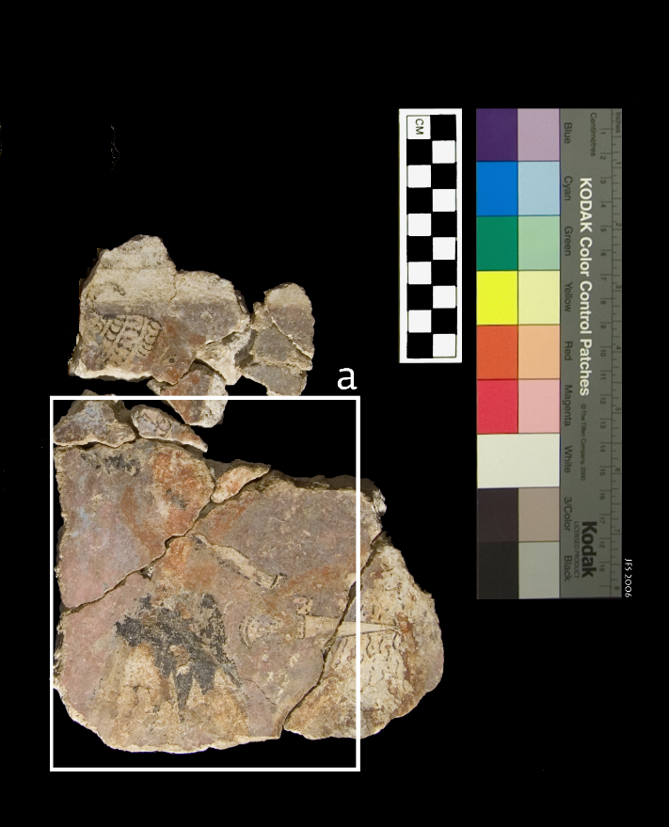
MA-XRF analysis of Wall-Paintings from Nestor Palace
IV
Inorganic pigments
Fe-Kα → Ochre
Cu-Kα → Egyptian blue
Mn-Kα → Pyrolusite

Slide 18
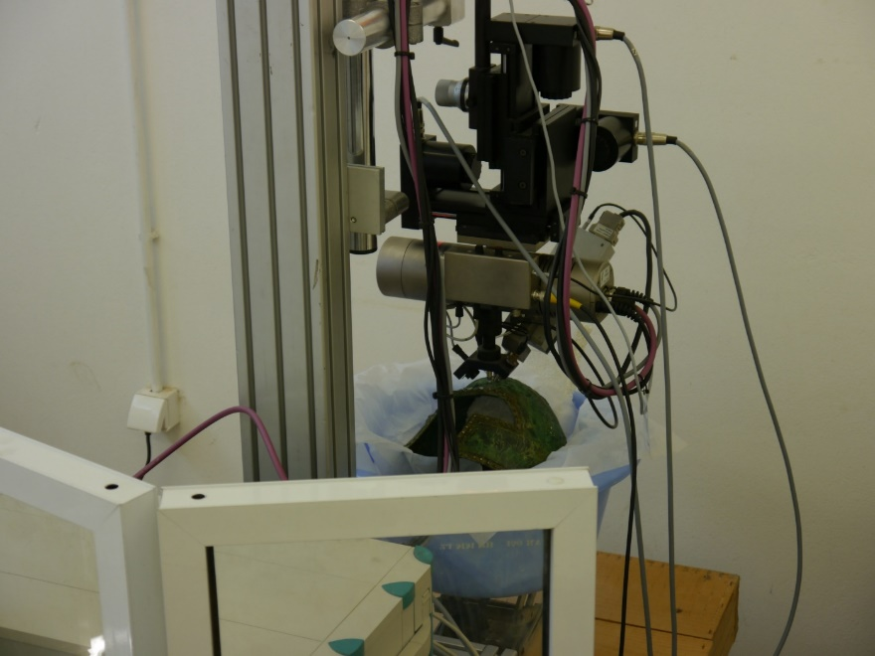
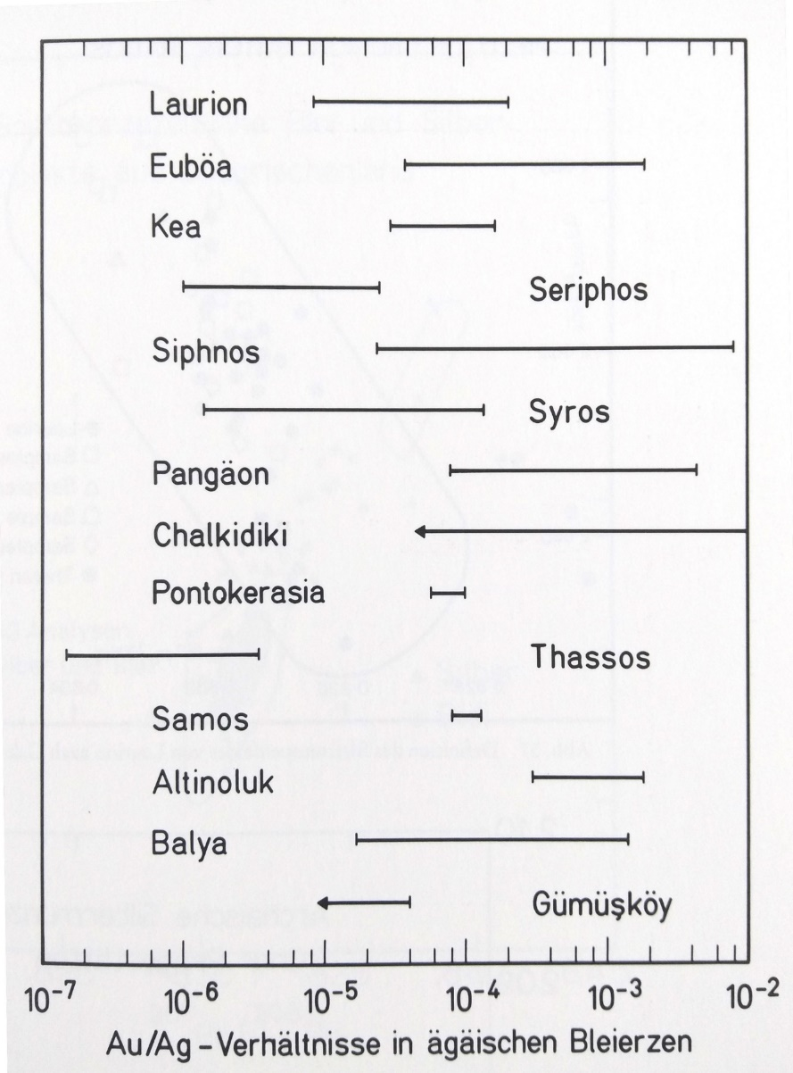
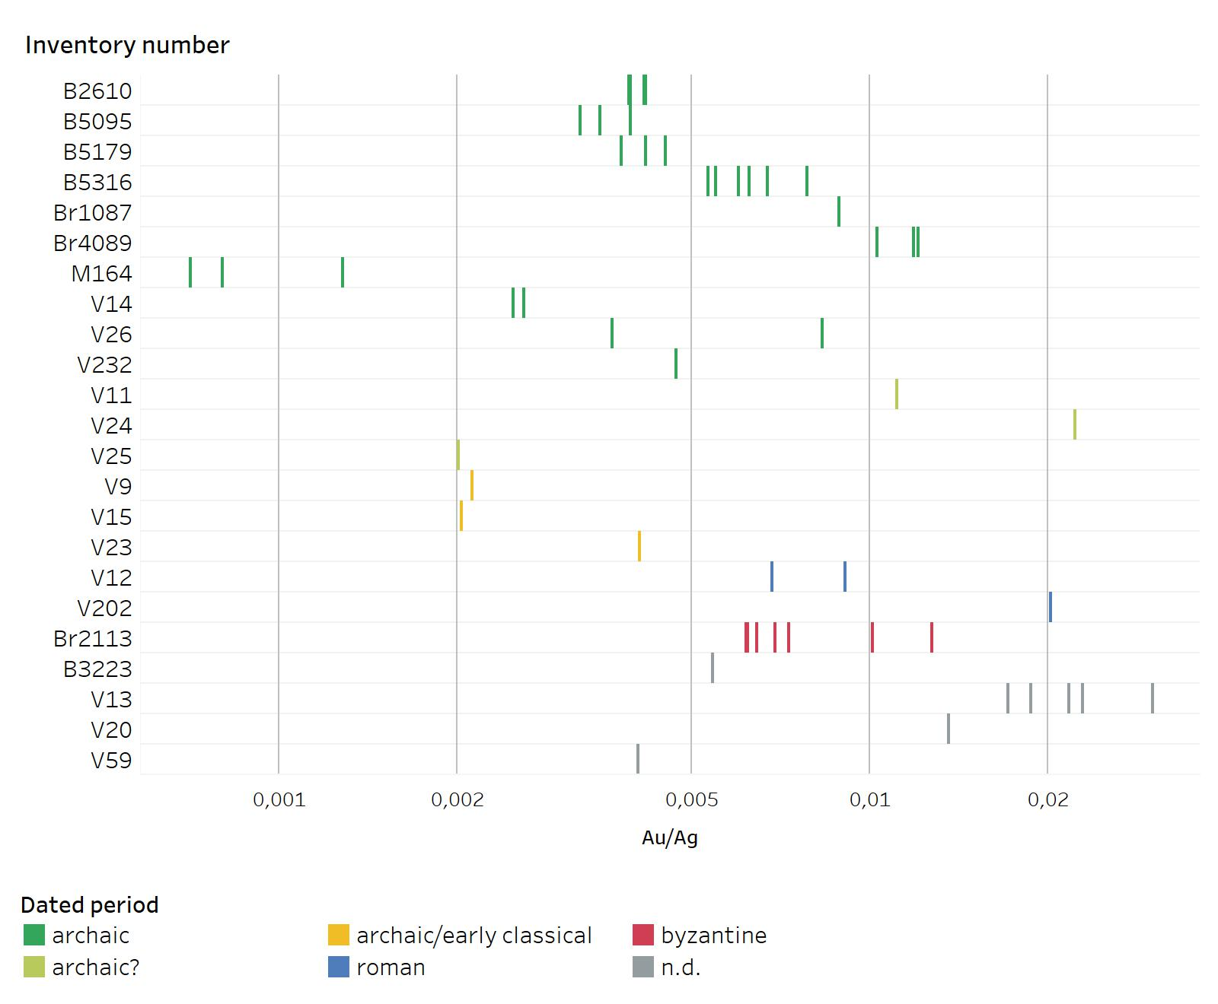
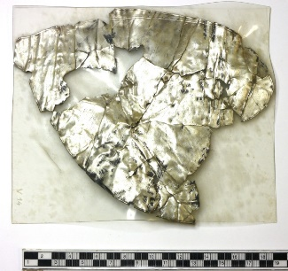
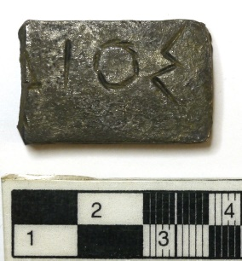
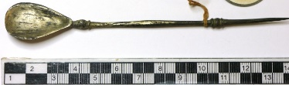
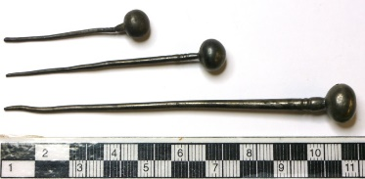
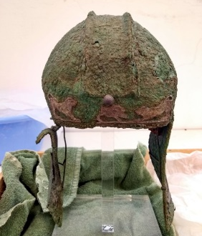
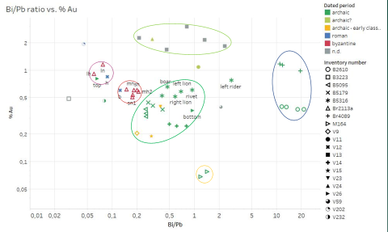
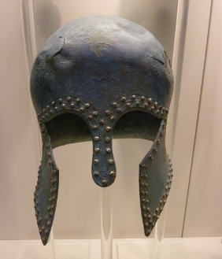
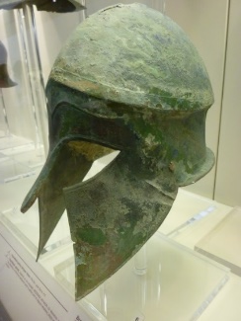
Silver artifacts, Olympia
27 objects made of silver, dating to different periods
Silver decorations on 9 helmets from the archaic period

Slide 19
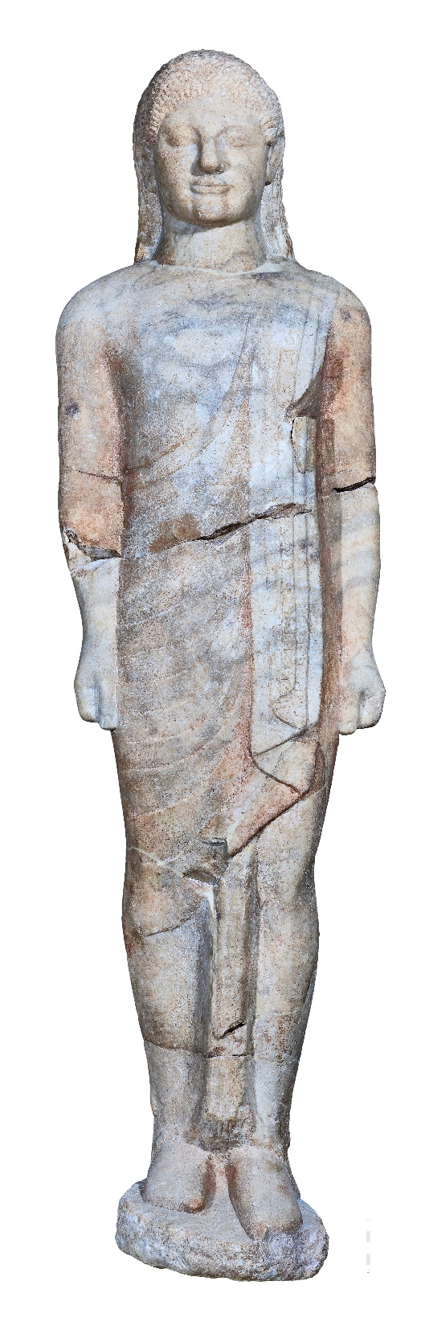
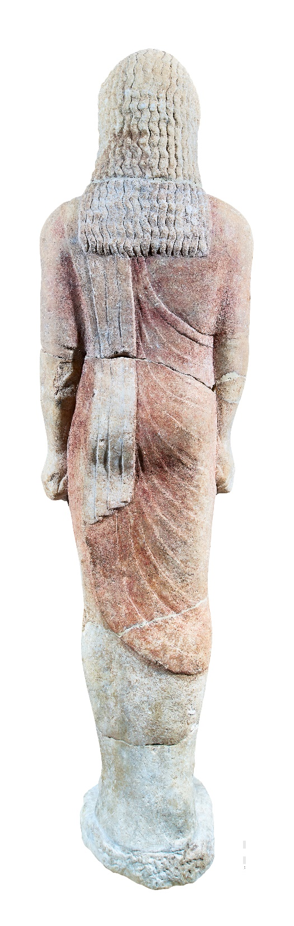
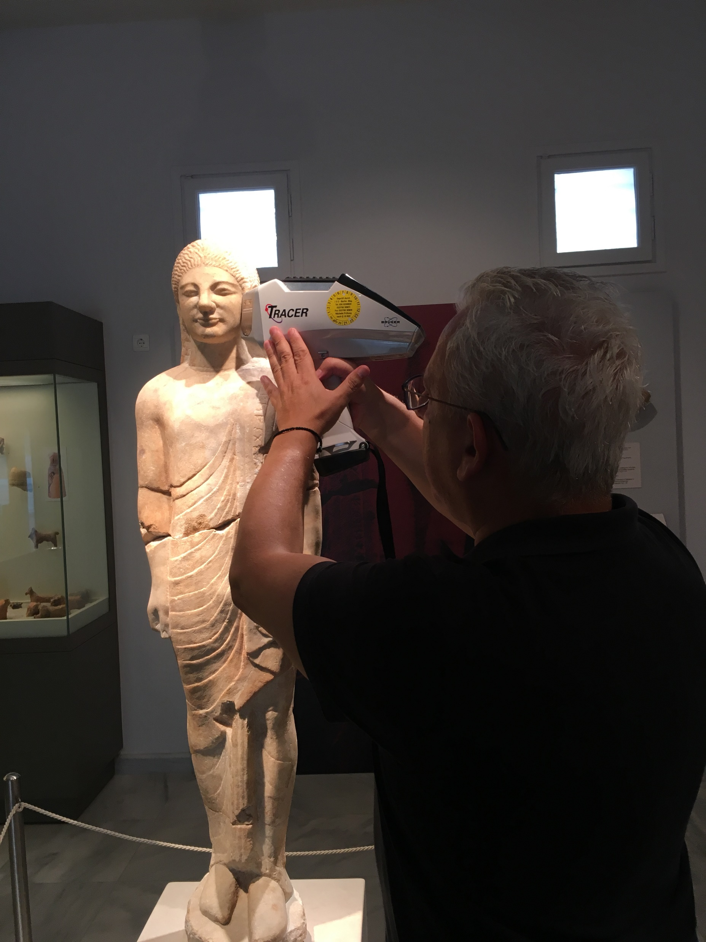
  In-situ HH-XRF on statue polychrome, Kalymnos Oct 2018
59
47
58
46
50
51
26
33/34
41
27
52
76
77
80
65
45
39
86
43
37
74
71
62
63
85
44
75
38
28
40
73
25
23
92
24
32
91
56
55
54
48
87
53
2 October: 20/10 no filter
3 October: 45/50/black filter (62-71)
45/10 blue filter (72-)
72
64
22

Slide 20
Characterization of a new Silicon Drift Detector

