Slide 1


Developments in 2D XRF analysis for Macro scale imaging of Cultural Heritage artefacts
Vasiliki Kantarelou, Claudia Caliri, Andreas Germanos Karydas and
Francesco Paolo Romano
Institute of Nuclear and Particle Physics, N.C.S.R. “Demokritos”
Laboratori Nazionali del Sud, INFN

Slide 2
Schematic representation of the various modes in XRF analysis
Milli XRF
Beam size ~ mm
Old Micro XRF
Beam size : 20-100 μm
2D
Max analyzed area
~10 x 10 mm²
Confocal XRF
Volume ~
20x20x20 μm³
3D
Macro area Micro XRF
Beam size : 20 μm-1 mm
2D
Analysis of 110 x 70 cm² in 4.3 h
with continuous scanning 100 mm/s

Slide 3
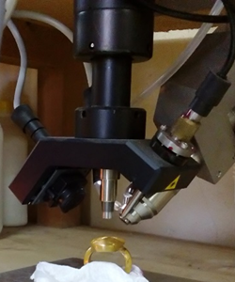
Micro-XRF spectrometer
A customized version of ArtTAX, (Bruker Nano GmbH)
X-ray Rh-anode tube (spot size 50×50 μm, max 50 kV, max 1 mA, 30 W maximum power consumption, Be window 0.2-mm thickness)
Polycapillary X-ray lens (IFG), focal distance 21.2 mm.
Silicon drift X-ray detector (10-mm²) with 146 eV FWHM at 10 kcps coupled with a digital signal processor.
Color CCD camera (×13), dimmable white LED, laser
Three stepping motors
Customized filter composed by
Ti (23.6 ± 0.2) μm and Co (17.7 ± 1.3) μm
Spatial resolution: 40 - 80 μm for characteristic X-rays between 22-8 keV, respectively.

Slide 4
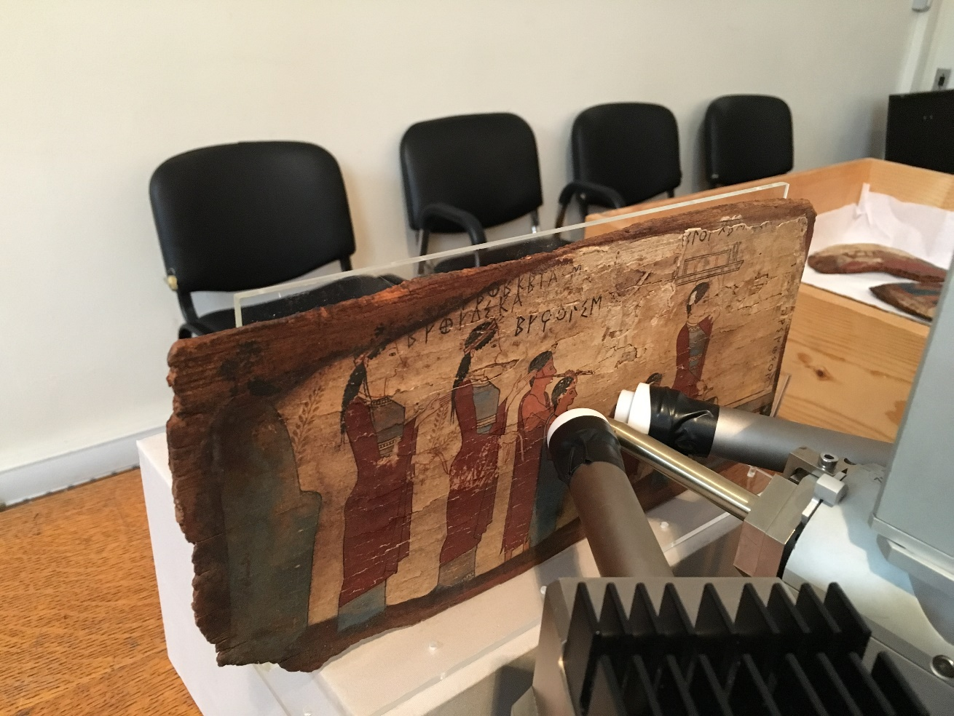
MA-XRF spectrometer
X-ray source: Rh target (by IFG)
Polycapillary optic with a focus size of 25 μm at 1cm (by IFG)
Two 50 mm² SDDs with 130 eV @ 5.9 keV (by KETEK)
Digital X-ray processors operated in time list event mode with 40 ns time resolution (by BrightSpec)

Slide 5

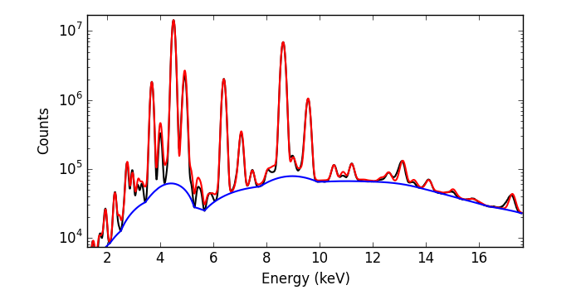
Real-time fitting of pixel XRF spectra
Scanning with a uniform continuous speed up to 100 mm/sec
X-ray spectra are obtained by packing data in pixels of dimension fixed by users. Pixel size can be changed dynamically during scanning
SDD 2
SDD 1
A Control Unit (CU) programmed under Real Time Linux is used to control all sensors in the scanner, to acquire data and elaborate X-ray spectra in a live mode
T₁₁ E₁₁
T₁₂ E₁₂
.
.
T_{1n} E_{1n}
T₂₁ E₂₁
T₂₂ E₂₂
.
.
T_{2n} E_{2n}
The continuous stream of X-ray events is elaborated by the
Control Unit as coming from a single detector
5300 fitted spectra per second
T₁₁ E₁₁
T₂₁ E₂₁
T₁₂ E₁₂
T₂₂ E₂₂
.
T_{1n} E_{1n}
T_{2n} E_{2n}

Slide 6
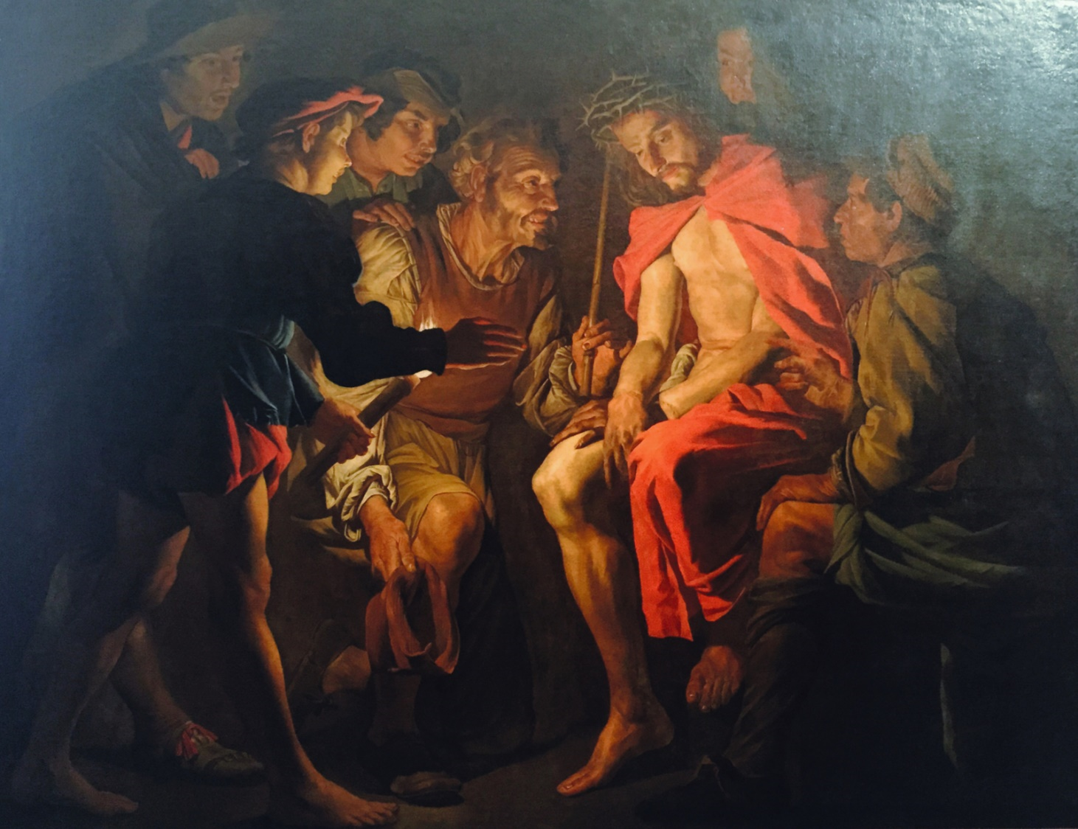
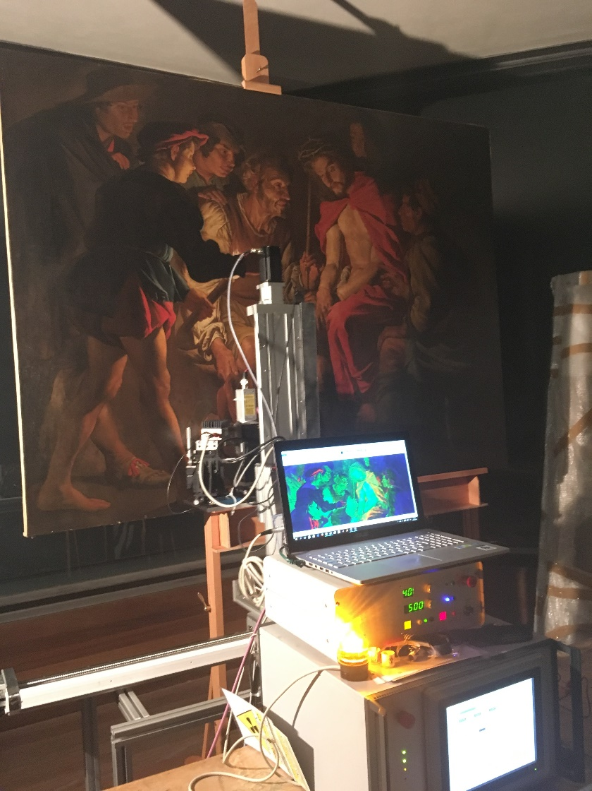
Fast MA-XRF scanning
Mocking of Christ, 1640 ca.,
Matthias Stomer (210x154 cm²)
Scanning speed @ 100 mm/sec
Elemental maps elaborated with 1 mm pixel size (equivalent to 10 ms dwell time)
Pixels: 3.2 Mega; Scanning time 9.5 h (including a full fitting of pixel spectra)

Slide 7
Micro-XRF quantification methodology
Glasses
Metals
Validation of the method using certified reference gold, bronze and silver alloy and glasses using the ratio of measured to certified concentration (Ki)
Determination of transmission efficiency using a set of thin and thick targets
V. Kantarelou and A.G. Karydas, XRS, 2016, 45, 85-91.

Slide 8
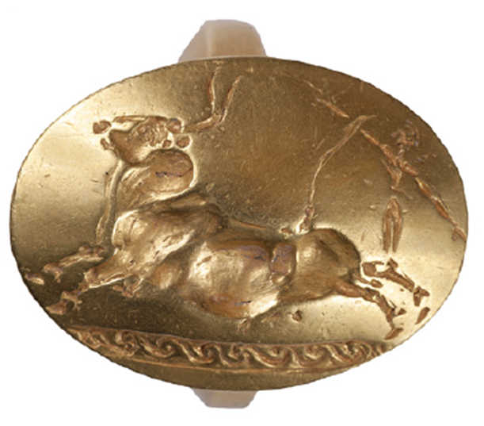
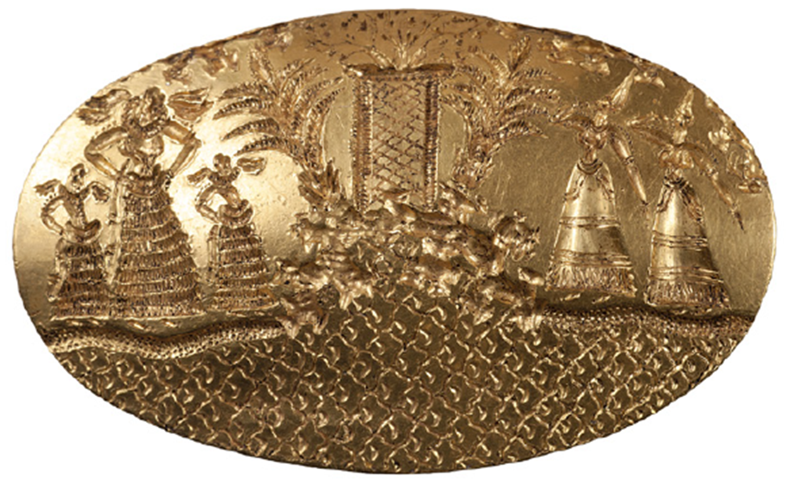
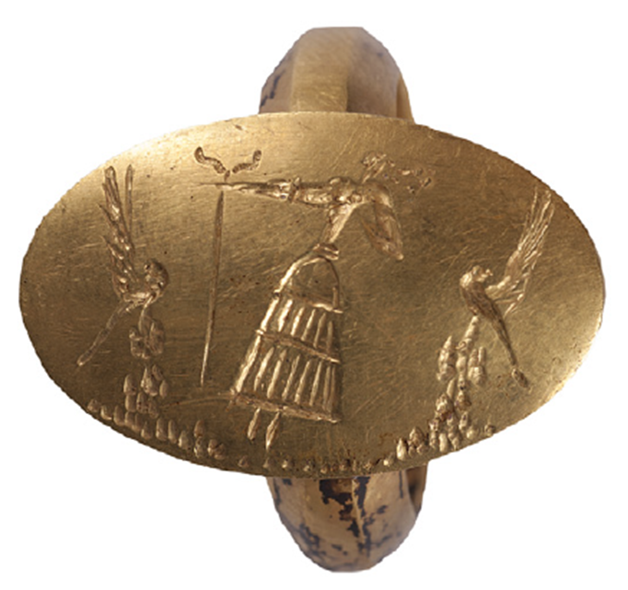
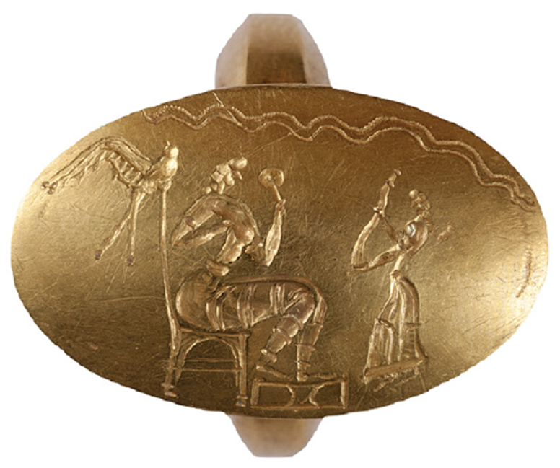
Micro-XRF application: Gold signet rings LBA
SN24-18
SN24-30
SN24-702
SN24-736
The rings were recovered in 2015 in the grave of the Griffin Warrior at the Palace of Nestor in Pylos by the archaeologists of the Cincinnati university.

Slide 9
Micro-XRF application: Gold signet rings LBA
Cu content is below 4 %
Use of native gold
Range of Au : 75 - 92.5 %
Range of Ag : 7.5 – 27.5 %

Slide 10
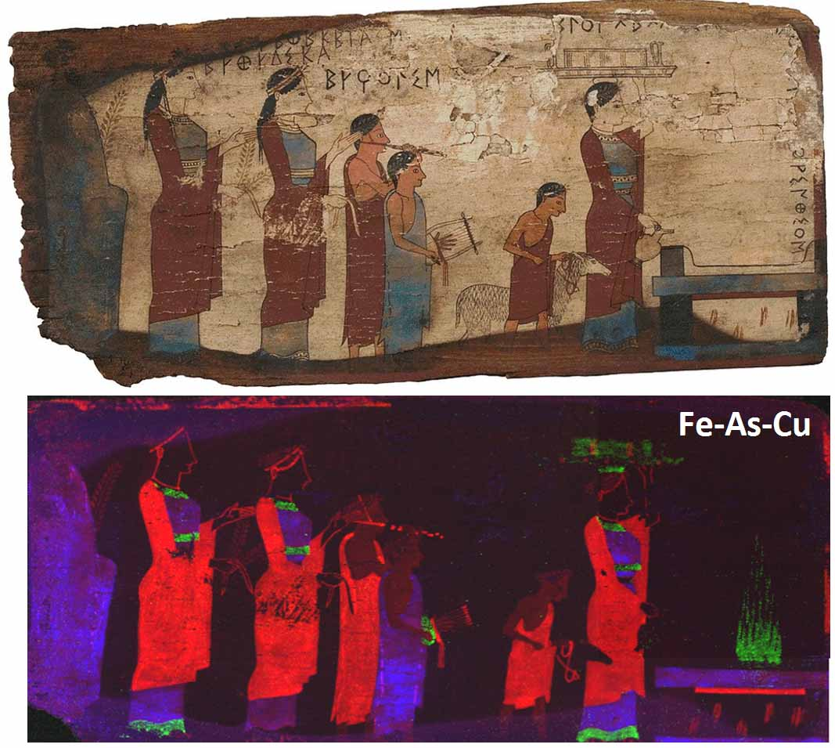
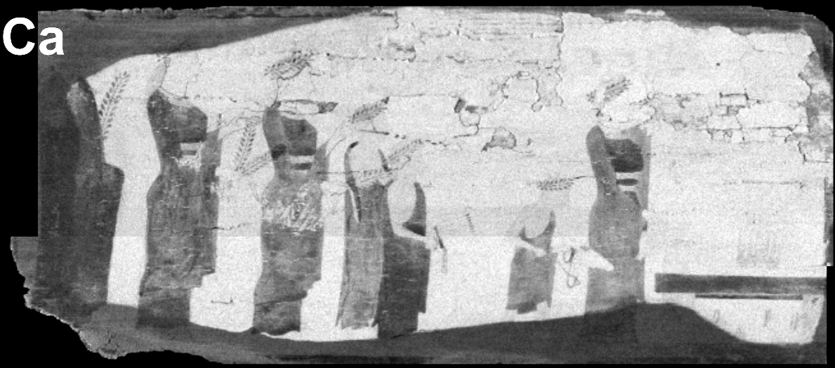
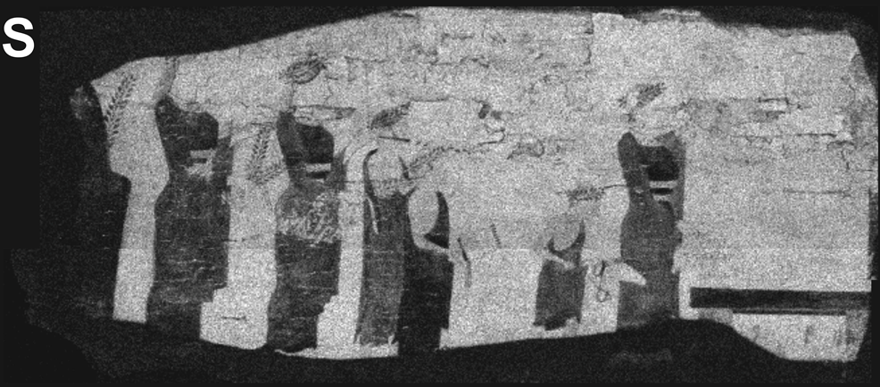
MA-XRF application: Pitsa wooden panels, Pinax A
MA-XRF mapping
White tone:
High intensity of an element
Grey tones:
Low intensity of an element
The white preparatory substrate is identified as gypsum (CaSO4) that must have been mixed with an organic binder, presumably animal glue, in order to give strength to the ground and fix it to the wooden surface

Slide 11
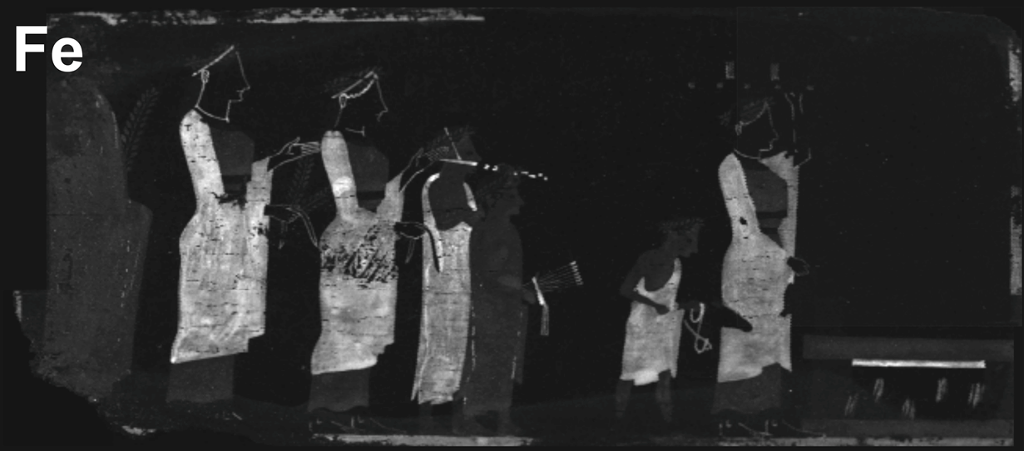
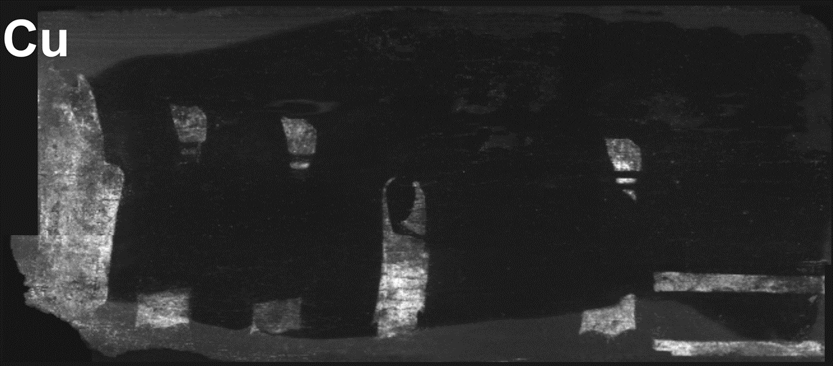
MA-XRF application : Pitsa wooden panels, Pinax A
Dark red of the chiton and himatia: Hematite (Fe2O3)
Men's’ skin:
Mixture of hematite and gypsum (CaSO4)
Blue of the himatia: Egyptian blue
CaCuSi₄O₁₀
Fe: Red
As: Green
Cu: Blue
16 November 2017
11

Slide 12
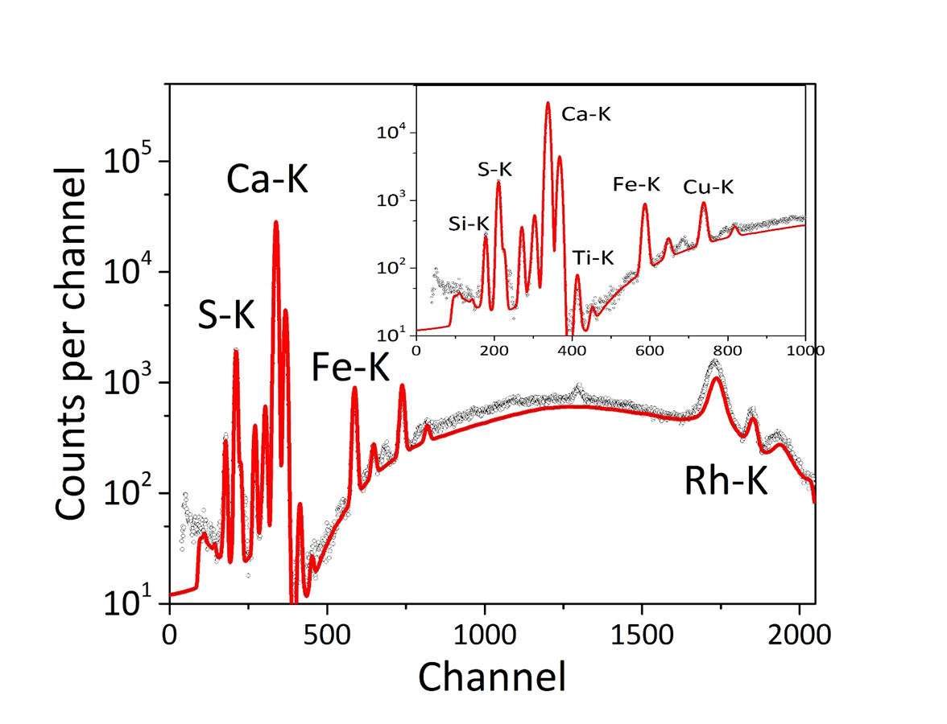
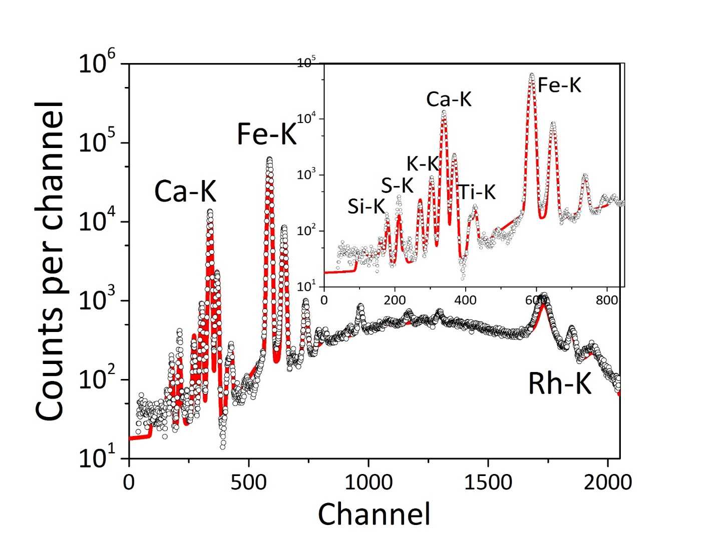
MA XRF Quantification: Pinax A
Gypsum
Ochre Layer
Gypsum: 75.2%, Binder: 21.4%
Lime: 1.8%, K₂O: 1.0%
Trace elements: Ti, Fe, Cu
Thickness ~ 10 μm
Ochre: 53.6%
Binder: 45%, Trace elements: Cu, As, Sr
Notes:
We performed a Monte Carlo simulation on the red ochre layer so we calculated the thickness of the layer as well as the concentration of the pigment (ochre) and the binder.

Slide 13
Future plans
Build our own Macro-XRF
Quantitative analysis of MA-XRF using Monte Carlo XMI-MSIM based simulations
Thank you for your attention !

