Slide 1
KM3NeT and Astroparticle Physics in INPP
Christos Markou
INPP, 15/11/2017

Slide 2
Our mission
KM3NeT is a research infrastructure housing the next generation neutrino telescopes.
Once completed, the telescopes will have detector volumes between megaton and several cubic kilometers of clear sea water.
Located in the deepest seas of the Mediterranean, KM3NeT will open a new window on our Universe, but also contribute to the research of the properties of the elusive neutrino particles.
With the ARCA telescope, KM3NeT scientists will search for neutrinos from distant astrophysical sources such as supernovae, gamma ray bursts or colliding stars.
The ORCA telescope is the instrument for studying neutrino properties exploiting neutrinos generated in the Earth's atmosphere.

Slide 3
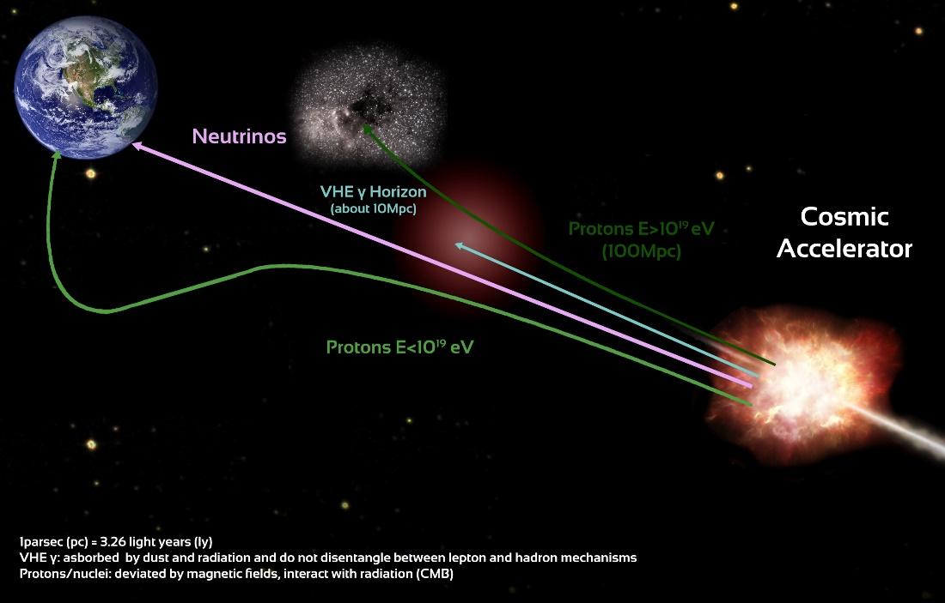

Exploring the high energy universe
Four Messengers
Photons | Cosmic rays
Neutrinos | Gravitational waves
Cosmic Rays: charged particles - protons/nuclei deviated by magnetic fields, absorbed on radiation
Photons (γ): neutral, absorbed on dust and radiation
Neutrinos: neutral, weakly interacting elementary particles propagate almost undisturbed through the universe from their production sites to the Earth
The wealth of information about the universe comes mostly from electromagnetic radiation (spanning from radio waves to gamma rays) and from cosmic rays (protons/nuclei) produced and accelerated by astrophysical objects (cosmic accelerators)
in a similar way to the production of photons, cosmic accelerators are expected to produce neutrinos
Neutrinos are ideal cosmic messengers
propagate directly from their sources to the Earth keeping direction and energy information
make it possible to explore astrophysical objects and the mechanisms which accelerate cosmic rays
Multi messenger analyses: insight to astronomical objects by associating independent measurements from different messengers which are stemming from the same event
(as for the Ligo/Virgo observation of GW170817)

Slide 4
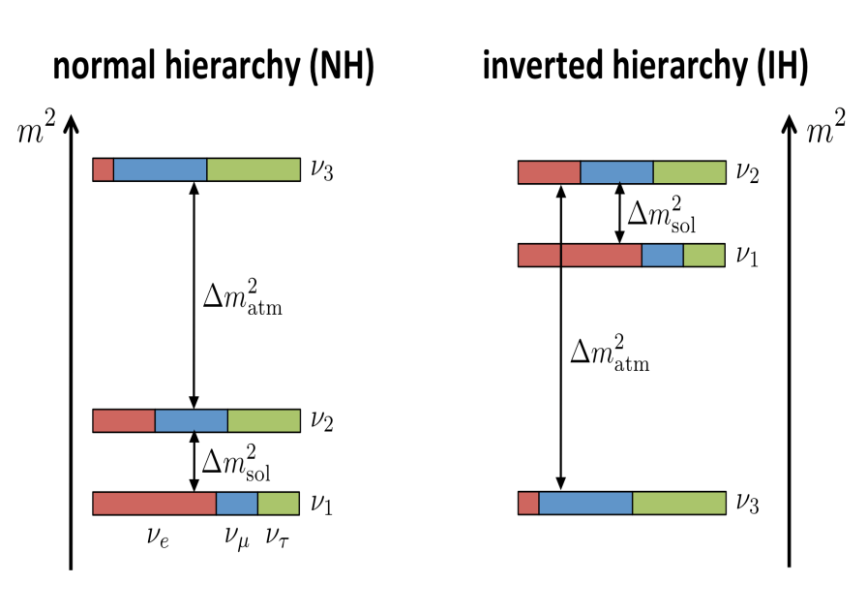
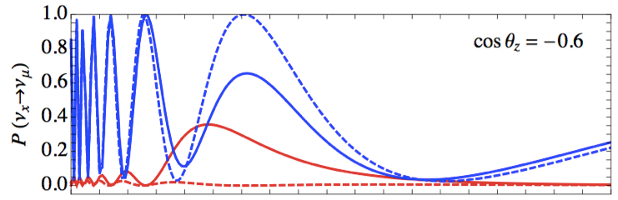
Neutrino Mass Hierarchy
During the past two decades important progress has been made on determining the fundamental properties of neutrinos, with the evidence for neutrino oscillations implying the existence of non-zero neutrino masses, being a major milestone for elementary particle physics.
The observed sizeable contribution of electron neutrinos to the third neutrino mass eigenstate has motivated subsequent searches for the remaining major unknowns in the neutrino sector, and in particular for the determination of the ordering of the neutrino mass eigenstates, which is of fundamental importance to constrain the theoretical models.
Measuring the neutrino mass hierarchy with atmospheric neutrinos:
a « free beam » of (ν_{e}, ν_{μ})
wide range of baselines (50 → 12800 km) and energies (GeV → PeV)
oscillation pattern distorted by Earth matter effects (hierarchy-dependent):
maximum difference IH vs NH at θ=130° (7645 km) and E_{ν} = 7 GeV
P(νμ → νμ) for θ=130º
νμ
νe
5
Eν [GeV]

Slide 5
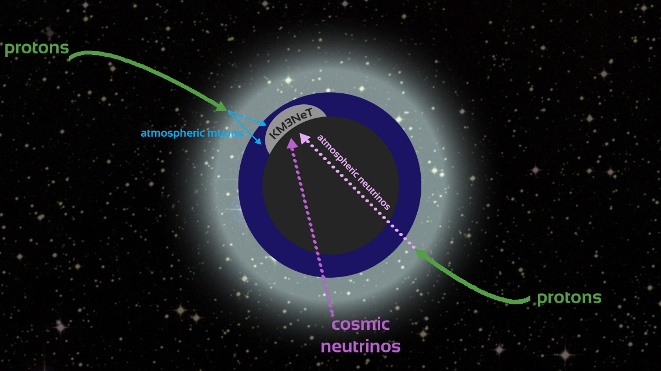
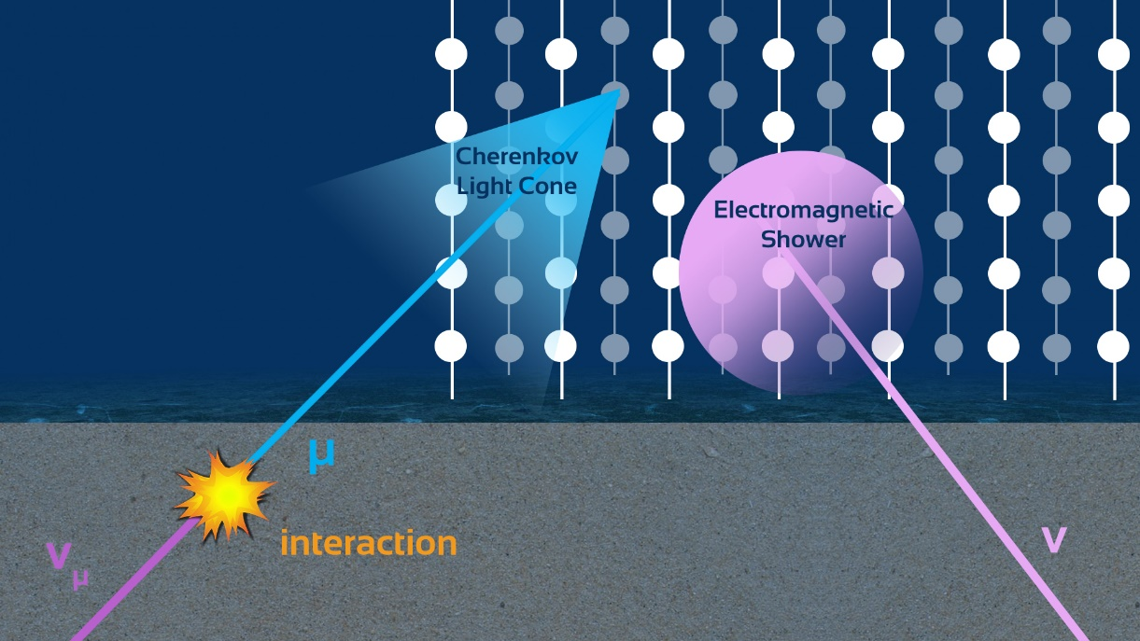
Detection principle
Neutrino interacts in the vicinity of the telescope
In seawater relativistic charged particles emerging from a neutrino interaction produce Cherenkov light
Thousands of optical sensors to be deployed at a depth of 3.5 km to detect this light
Density of optical sensors determines energy threshold
Deep sea water offers excellent direction resolution due to low scattering

Slide 6
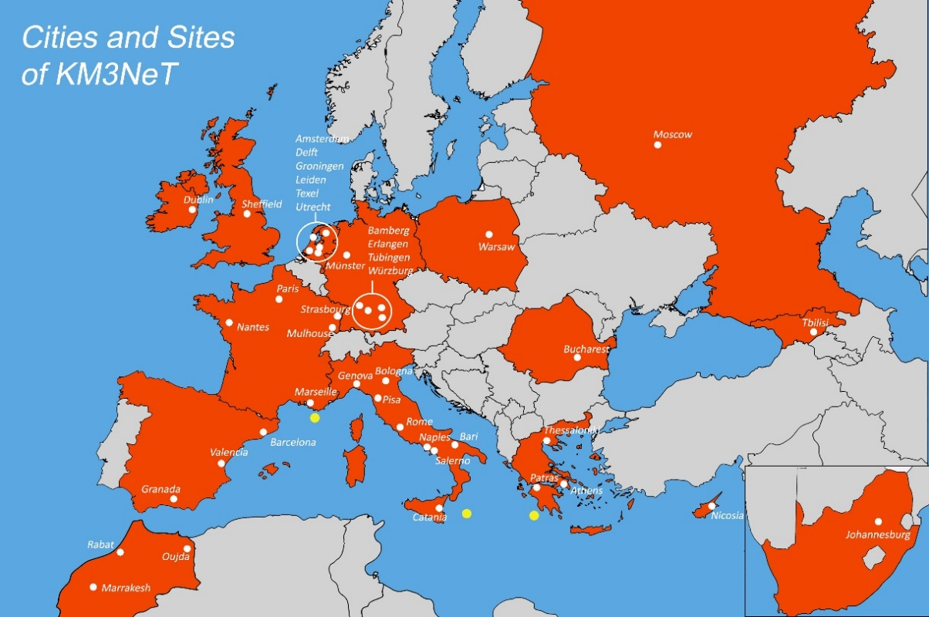
The KM3NeT collaboration
39 Institutions from 15 countries.
Distributed infrastructure in the Mediterranean sea, part of the ESFRI Roadmap.
3 Deployment sites, Toulon/FR, Sicily/IT, Pylos/GR. Infrastructure to be completed in phases.
Oscillation Research with Cosmics in the Abyss (ORCA)
Astroparticle Research with Cosmics in the Abyss (ARCA)

Slide 7
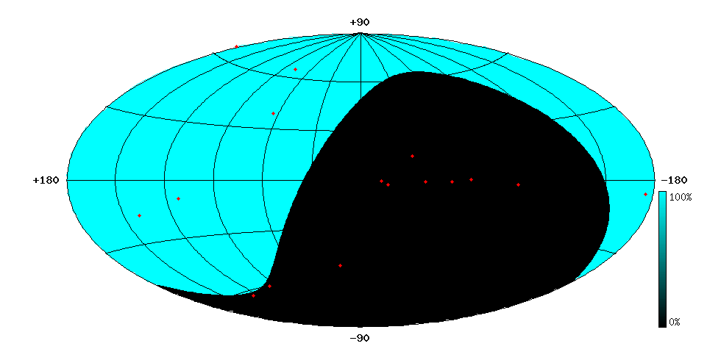
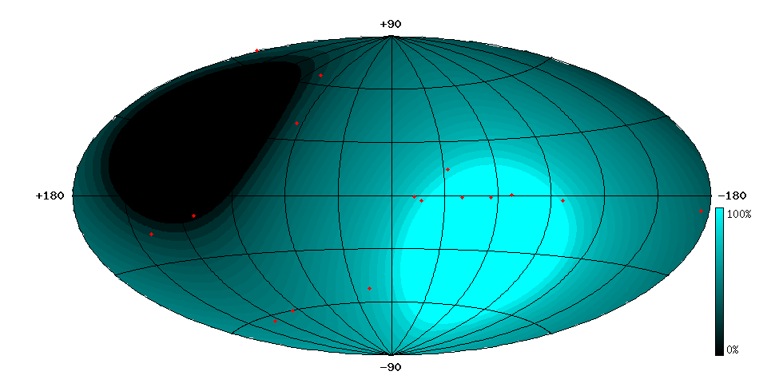
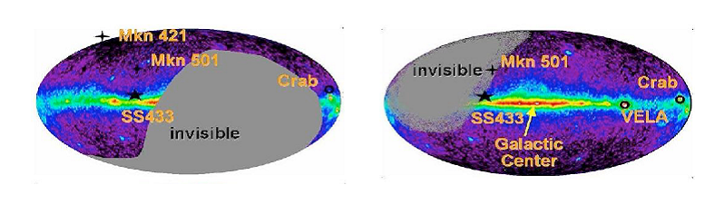
Complementarity with ICECUBE
South Pole Mediterranean Sea

Slide 8
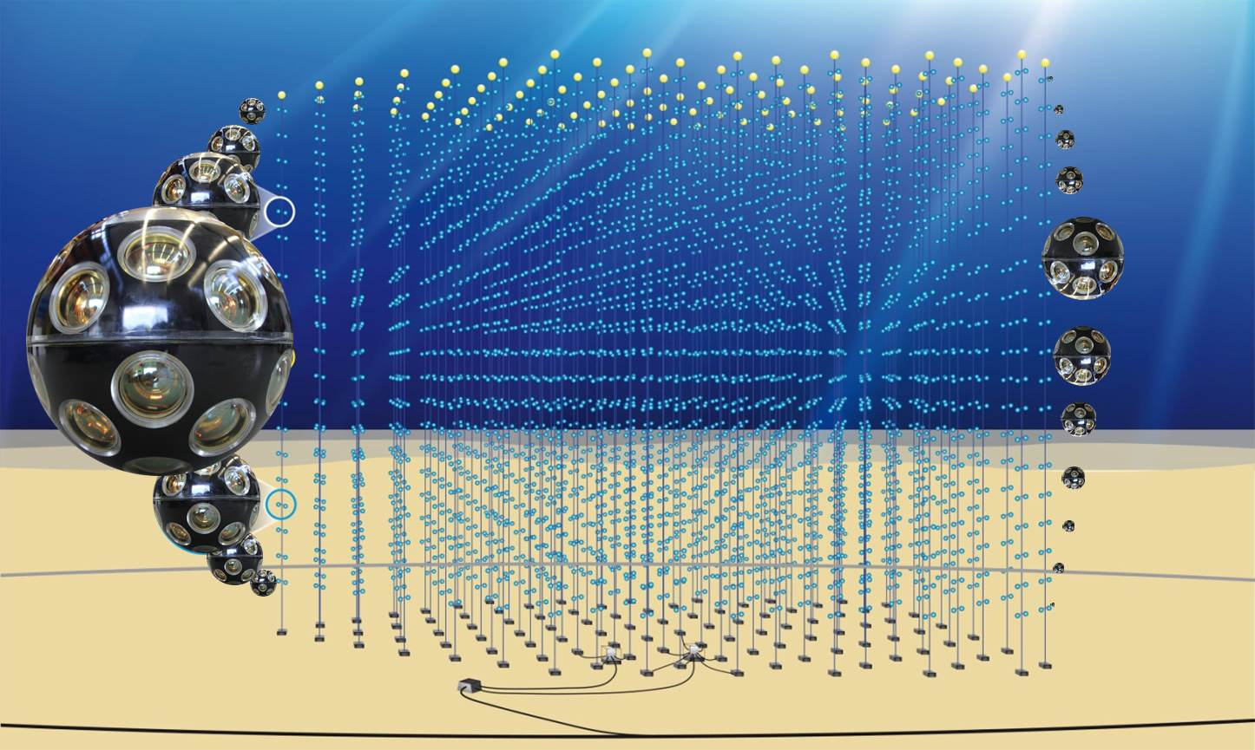
The Detector at a glance
Infrastructure:
Building blocks of 115 strings anchored to sea bottom;
18 equally spaced optical modules per string
(~1 km² footprint in ARCA configuration)
Multi-PMT digital optical modules
31 X 3” PMTs + expansion cones
Time synchronization
White rabbit
Optical data transmission
Base module with DWDM at string anchor
All data to shore concept
Filtering/Trigger on-shore in computer farm
+ nodes for long term high-bandwidth connection for Earth and Sea sciences
Optical data transmission

Slide 9
The KM3NeT Phased construction
Phase 3 Phase 2 Phase 1
 | 0,25 | Shore and deep-sea infrastucture at KM3NeT-Fr and KM3NeT-It 31 lines Proof & first results
 | 2 ARCA | Measurement of IceCube - like signal All-flavour neutrino astronomy
 | 1 ORCA | Neutrino mass hierarchy
 | 6, 2 Blocks in each site | Neutrino astronomy including Galactic sources

Slide 10
Where are we today
Working on the construction, deployment and operation of the Phase 1 DUs.
Two DUs installed in ARCA in 2016. Data taking for several months. Since April, a problem in a Junction Box requires an intervention.
One DU installed in ORCA, taking data since September, with full scale shifts.
More than half of the DOMs for Phase 1 have been constructed, with several DUs ready to be deployed.
Phase 2 starting and overlapping with Phase 1.
For 2018, the plan is to deploy 45 DUs in the two sites.

Slide 11
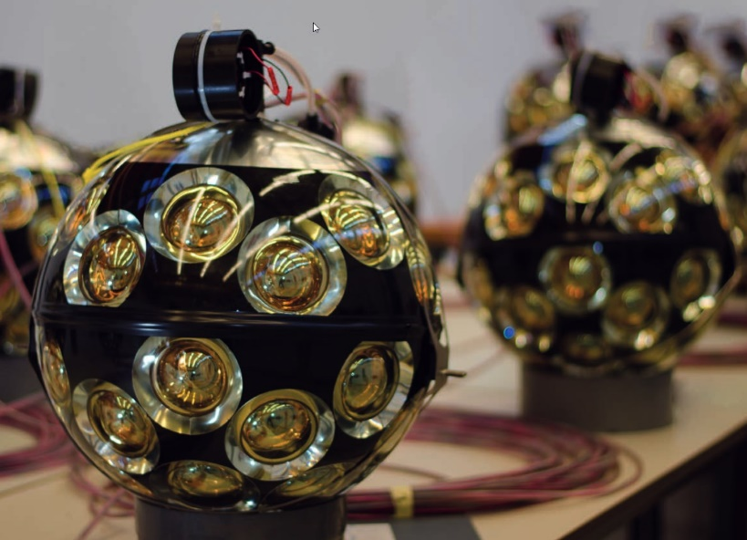
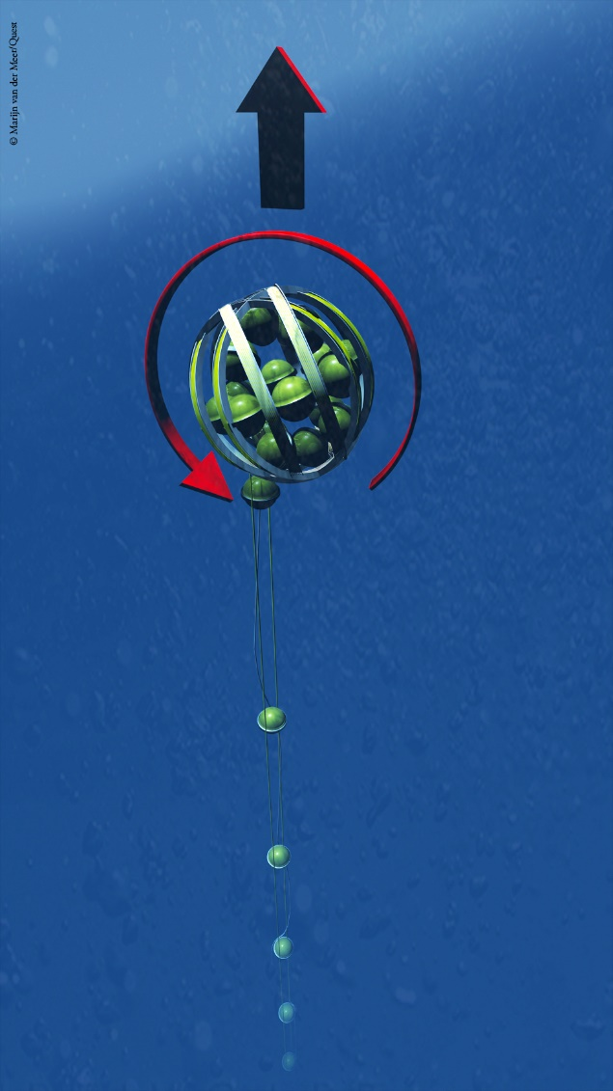
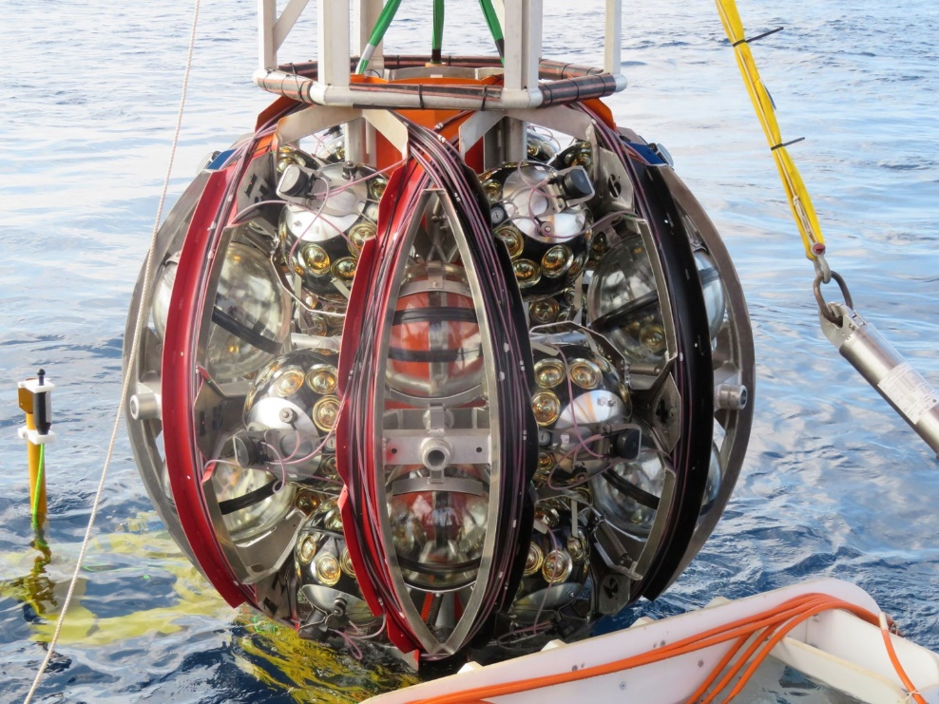
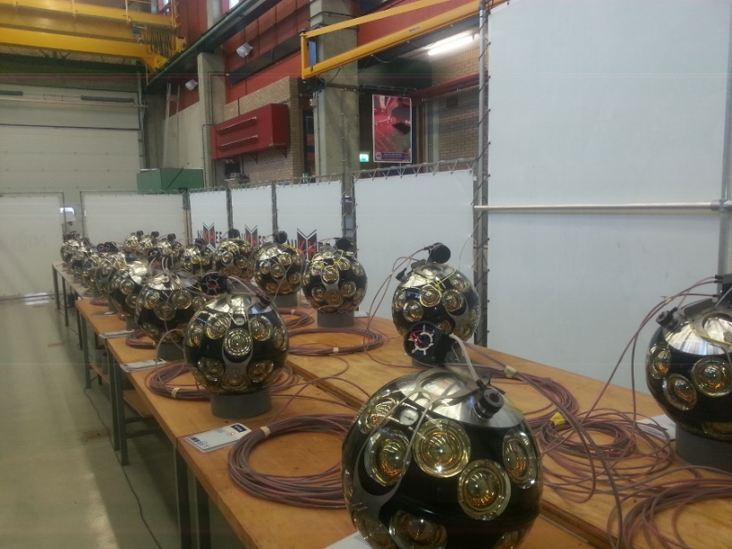
Some pics

Slide 12
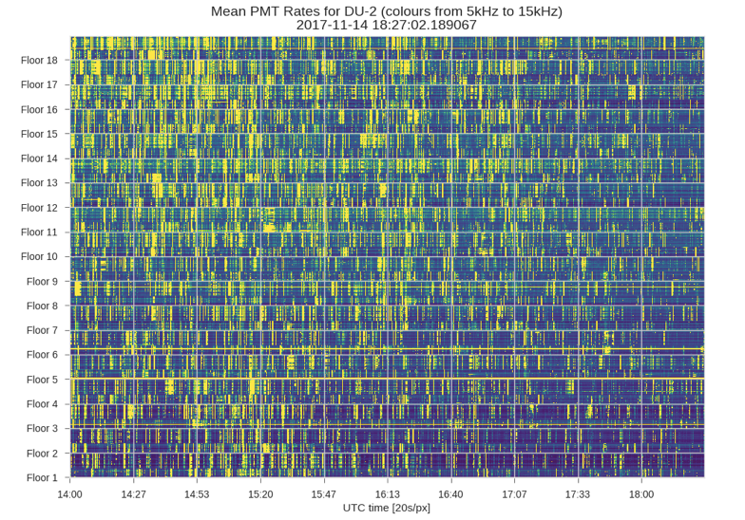
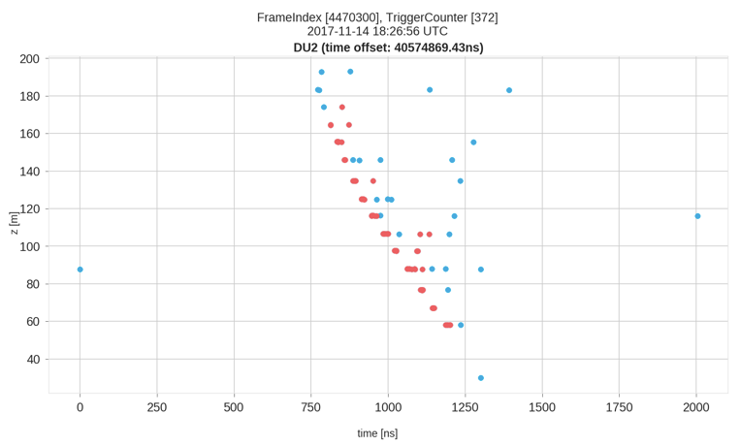
Data taking

Slide 13
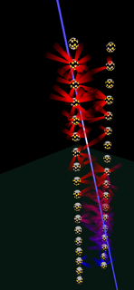
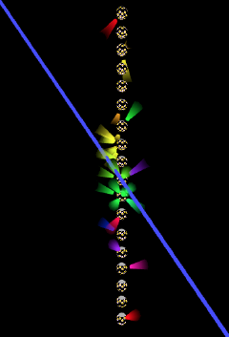
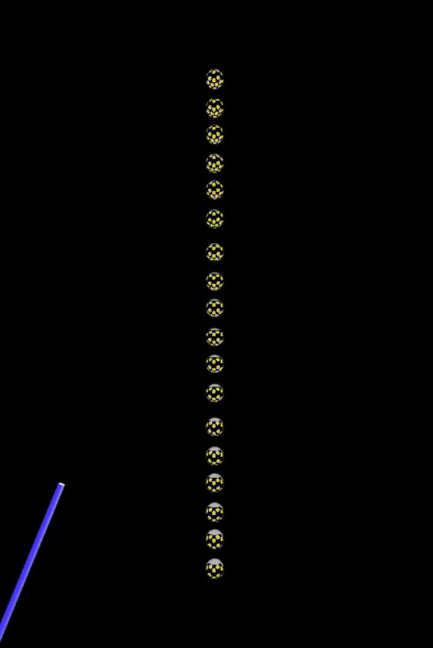
ARCA and ORCA events
An ARCA event
An ORCA event

Slide 14
The Astroparticle Physics group in INPP
Currently active:
CM, K. Tzamariudaki, T. Belias,
G. Androulakis, C. Bagatelas, P. Tsagli,
G. Kiskiras, A. Vougioukas, S. Bakou,
K. Pikounis, D. Tzanetatos, V. Panagopoulos, G. Polydeyki,
A. Sinopoulou, D. Stavropoulos, N. Mandilaras
Several other colleagues have contributed in the past, but are not active at the moment. We have also lost several good people due to lack of funding.

Slide 15
The Astroparticle Physics group in INPP
CM: Chairman of the Institution Board since 10/2016,
Publication committee member
K. Tzamariudaki: Publication committee member,
Conference and Outreach committee member
G. Androulakis: QA/QC manager of KM3NeT,
Management Team and Steering committee member
C. Bagatelas: DOM integrator, responsible for the DOM lab.

Slide 16
Activities
Governance and Management
QA/QC
Construction
    DOM integration (see talk by C. Bagatelas)
    High pressure testing of deep sea components - single point failure items
    Calibration of electronics and sensors
Shifts, data taking and analysis
Developments in White Rabbit technology
Physics analyses and studies (see next talks)

Slide 17
QA/QC activities
The multi-location production of KM3NeT requires a robust QA/QC system to ensure quality and traceability of products.
The QA/QC group of KM3NeT consists of 17 local quality supervisors; it is the largest working group of KM3NeT in terms of manpower. Demokritos, through Giorgos Androulakis, is the coordinator of the group.
The role of the quality manager (QM) is defined in the KM3NeT MoU:
    “The QM is appointed by the IB to coordinate and supervise the QA/QC procedures for the construction and operation of the KM3NeT RI. The QM shall monitor the conformity of the detector components at the production sites. The QM is explicitly invited to all meeting of the Project Management Team and those of the Project Steering Committee. The QM reports to the Collaboration, the IB and the RRB.”
Giorgos succeeded the old QM in Jan/2016, after a two months training period.
Soon after, he worked on reinforcing, modernizing and extending the scope of the older quality system, in order to be ready for the upcoming mass production.

Slide 18
QA/QC activities
In particular:
  The DCR (Design change request) and NCR (Non conformity report) treatment protocols are now faster and more effective.
  Whenever necessary, members of the quality group have been re-appointed.
  All members of the quality group are now certified internal auditors (ISO 9001:2015), after following a three days seminar organized @Demokritos.
  Giorgos is regularly performing production site inspections and participates/reports to all internal & external oversight committees.
  A Demokritos based (but KM3NeT funded) intern worked under Giorgos supervision on modernizing the quality system. It is now fully integrated with the KM3NeT central DB, as opposed to the older Excel-based quality reporting.
  The central DB has been significantly extended: it now contains all components, their location, NCRs of red tagged components, calibration files, test sheets etc.
  On-going effort for quality in documentation: classification & versioning.
QA/QC activities

Slide 19
KM3NeT INFRADEV
3 year coordination and support Horizon 2020 project (2017-2019)
INPP is involved in 7 out of 10 WPs, with coordination role in two of them.
K. Tzamariudaki is coordinating the Innovation and Technology transfer WP.
CM coordinates the WP on making KM3NeT a research facility with zero-carbon footprint.
Additional involvement in Legal entity, Outreach and communications, Open Data Access, Societal role and impact and User ports.

Slide 20
White Rabbit in KM3NeT – A. Belias
Provide scientific infrastructures with a control and nanosecond timing network.
Based on standard fiber-optic networking technologies.
Collaborative project initiated at CERN, academic institutions and industrial companies.
Open Hardware/Software ( http://www.ohwr.org/projects/wr-switch-sw/)
The KM3NeT network has thousands distributed underwater sensors (DOMs) and on shore the control and DAQ station (Shore-Station).
The amount of data received from the DOMs is quite big. However, the info sent from the Shore-Station is small; just Slow-Control & timing
400 Mbps expected from each DOM, 1Gbps must be enough to send information to the entire array of DOMs
Need accurate synchronization at nanosecond level across the whole array of DOMs.

Slide 21
White Rabbit in KM3NeT – A. Belias
White Rabbit (WR) & KM3NeT are not a perfect match:
  The standard WR uses bidirectional links, synchronization point to point and specific wavelengths.
  Customization of White Rabbit is needed for the KM3NeT requirements!
In the context of H2020 technology transfer WP:
Focus on White Rabbit technology in network switches
  Examine exisiting WR switch hardware to be used in KM3NeT.
  Extend WR technology to other switch architectures.
In cooperation with WR proponents in KM3NeT and external institutes CERN, GSI and industrial companies.

Slide 22
Publications - Theses
Completed in the last 3 years:
Ευαγγελία Δρακοπούλου (Ph.D): "Μέθοδος Υπολογισμού της Ενέργειας Μιονίων και Νετρίνων στο Τηλεσκόπιο KM3NeT"
Άννα Σινοπούλου (Διπλ.): "Μελέτη της δυνατότητας ανίχνευσης νετρίνων πολύ υψηλής ενέργειας με την πρωτότυπη
αυτόνομη ανιχνευτική συστοιχία GRBNeT"
Άννα Σινοπούλου (MSc) :"Μελέτη βελτιστοποίησης του ανιχνευτή KM3NeT για την ανίχνευση νετρίνων υψηλών ενεργειών"
Δημ. Σταυρόπουλος (Διπλ.):" Μελέτη εξάρτησης της συχνότητας ανίχνευσης ατμοσφαιρικών μιονίων από το θαλάσσιο βάθος με τον ανιχνευτή ARCA του υποβρύχιου τηλεσκοπίου νετρίνων KM3NeT"
Επισης 5 πρακτικές ασκήσεις προπτυχιακων φοιτητων.
4 Ph.D. theses are on going: K. Pikounis (finishing in 2018), D. Tzanetatos (2nd year), V. Panagopoulos (1st year), G. Polydeyki (1st year)
All results have been presented to KM3NeT collaboration and working group meetings, have been presented in conferences and published accordingly.
In 2015-2016, group members gave
12 conference talks, 3 posters, 8 papers in proceedings

Slide 23
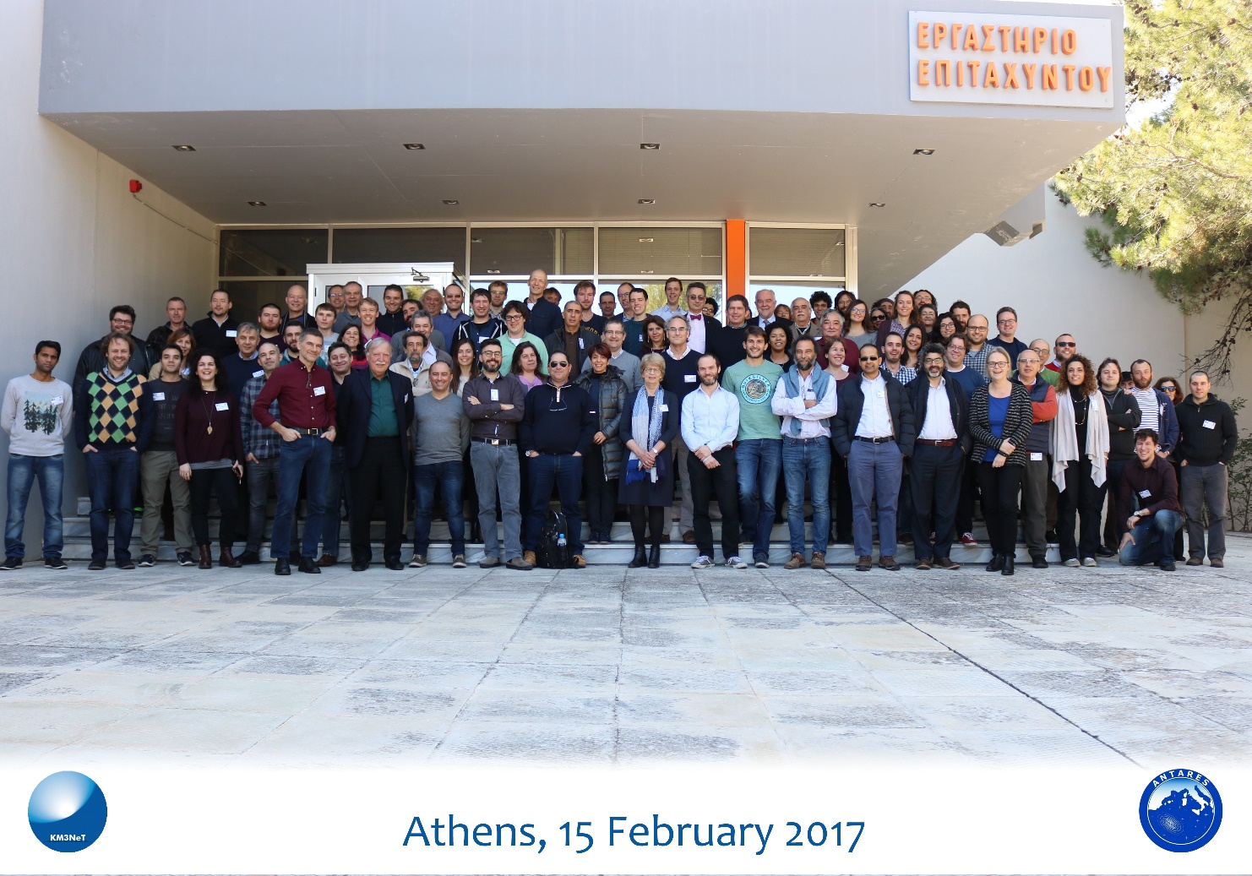
Meetings
We have hosted several meetings
Software meeting in November 2015
Collaboration meeting in February 2017
QA/QC certification workshop in September 2017
Earth and Sea Sciences workshop next December 2017

Slide 24
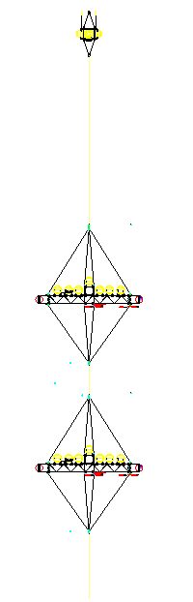
Field activites in Greece
GRBNeT – An autonomous detector for Neutrinos from
Gamma Ray Bursts
A project funded through the Thales initiative (2013-2015).
GRBNeT was a collaboration of INPP, UoA, HCMR
  C.M., A. Tzamariudaki, A. Belias, P. Rapidis, C. Bagatelas, K. Balasi,
  P. Damianos, G. Androulakis, K. Manolopoulos, E. Kappos, K. Pikounis,
  E. Drakopoulou, C. Filippidis, T. Michos, A. Vougioukas, Y. Kiskiras (INPP)
  E. Anasontzis, G. Voulgaris (UoA)
  H. Kontogiannis, S. Stavrakakis, V. Lykoussis (HCMR)

Slide 25
GRBNeT
Design and implementation of
Mechanical structure
Low power electronics
Autonomous power supply system
Trigger and DAQ system
The system was deployed in October 2015 at -3000 m off the coast of Pylos, and recovered in April 2017. It operated for several months before shutting down. Data on rates were measured and compared to older similar ones.
A publication on the design and the implementation is ready to be sent for publishing.
http://www.neutrinoburst.gr

Slide 26
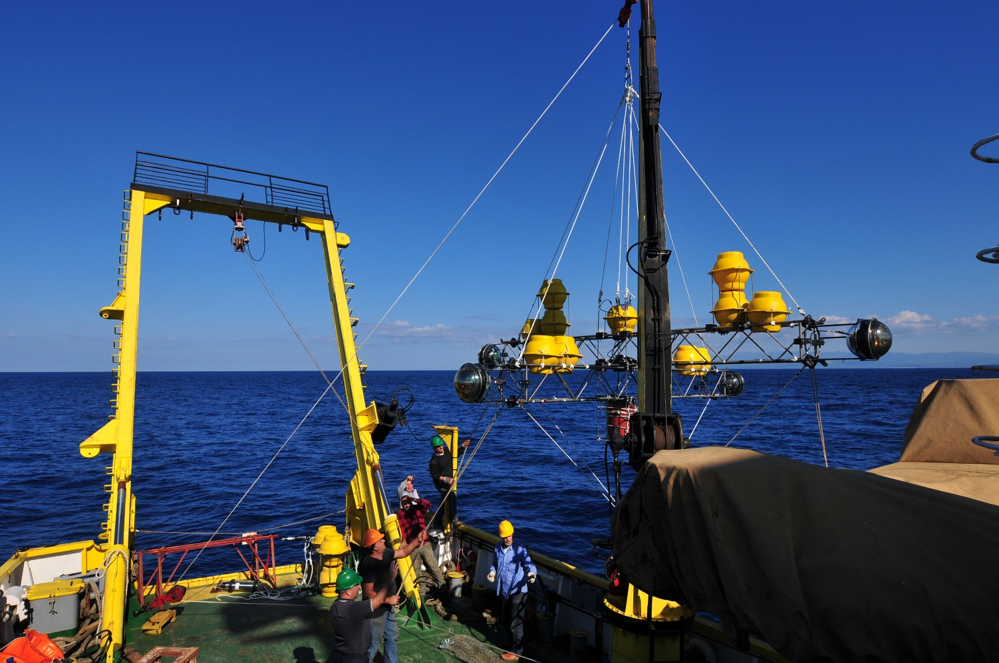
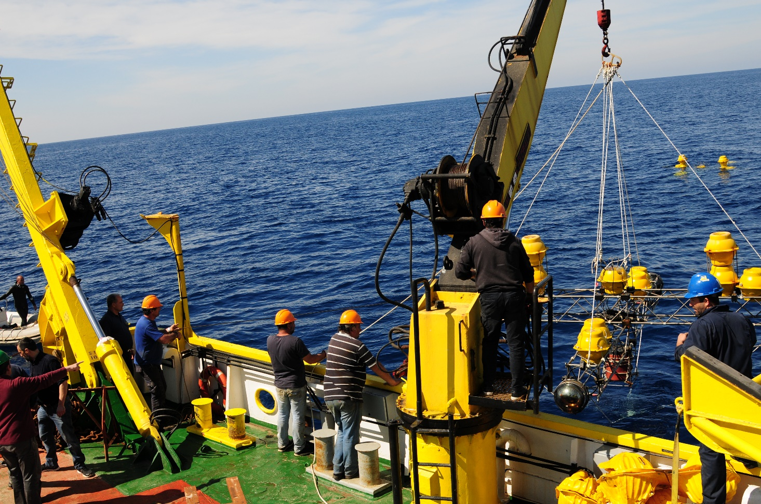
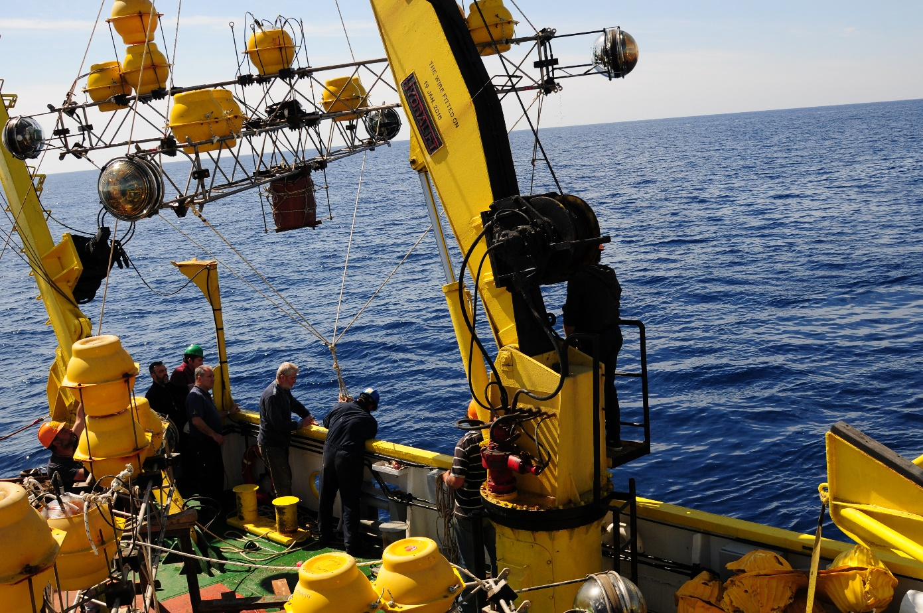
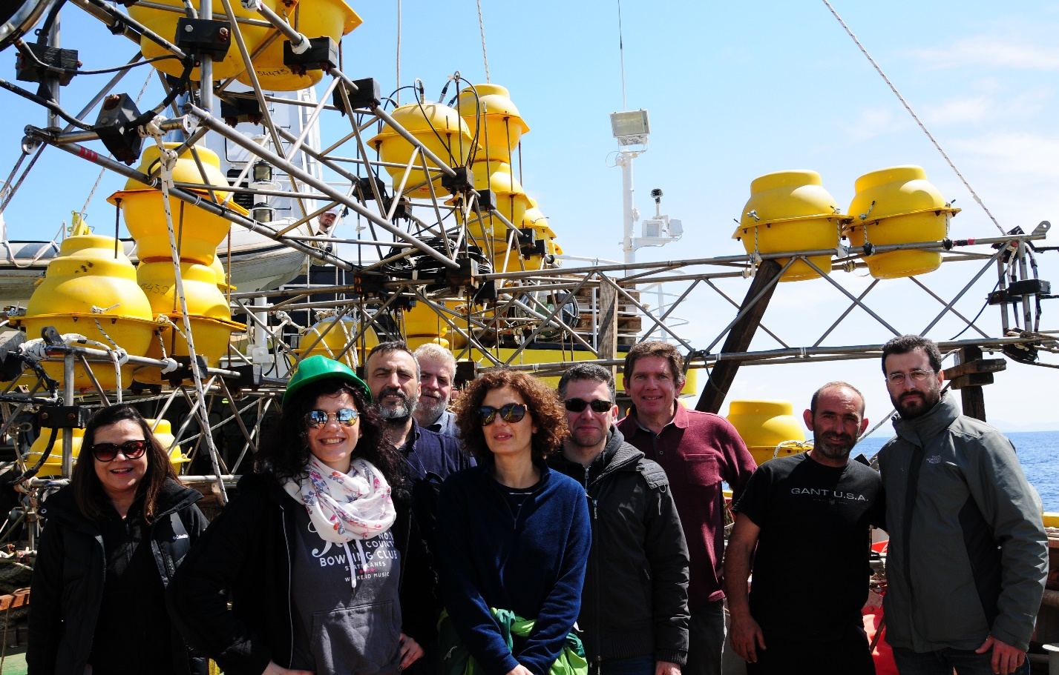

Slide 27
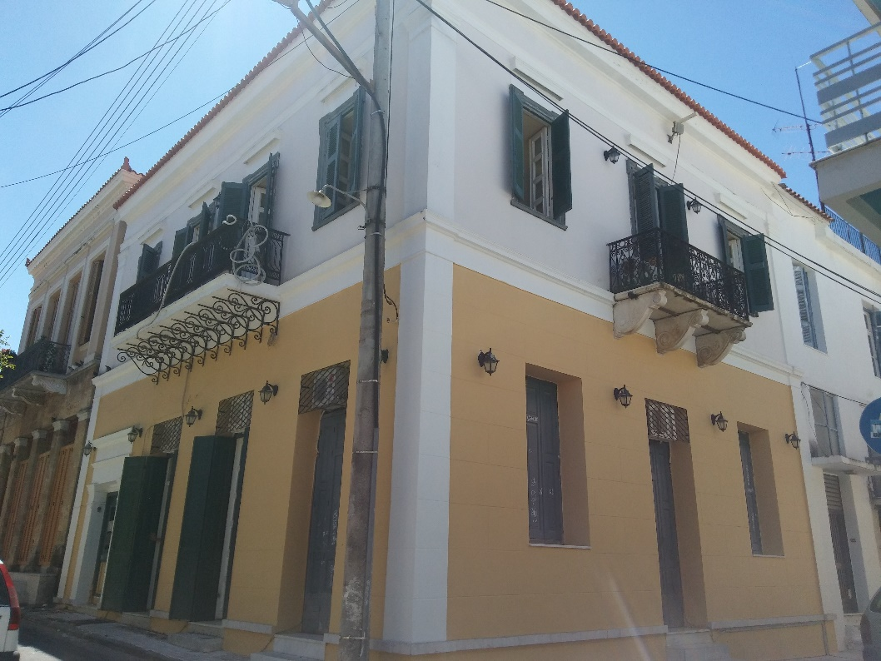
Pylos - Kalamata
Have to move out of Pylos at the latest in 2018.
MOU between NCSR D – Municipality of Kalamata (2015).
Will move to Zoumpouleio in 2018. In the meantime, we have established temporary headquarters in another building.
Office spaces, electronics lab, storage space
until the final move.
Have kept the workshop and storage in
Pylos.

Slide 28
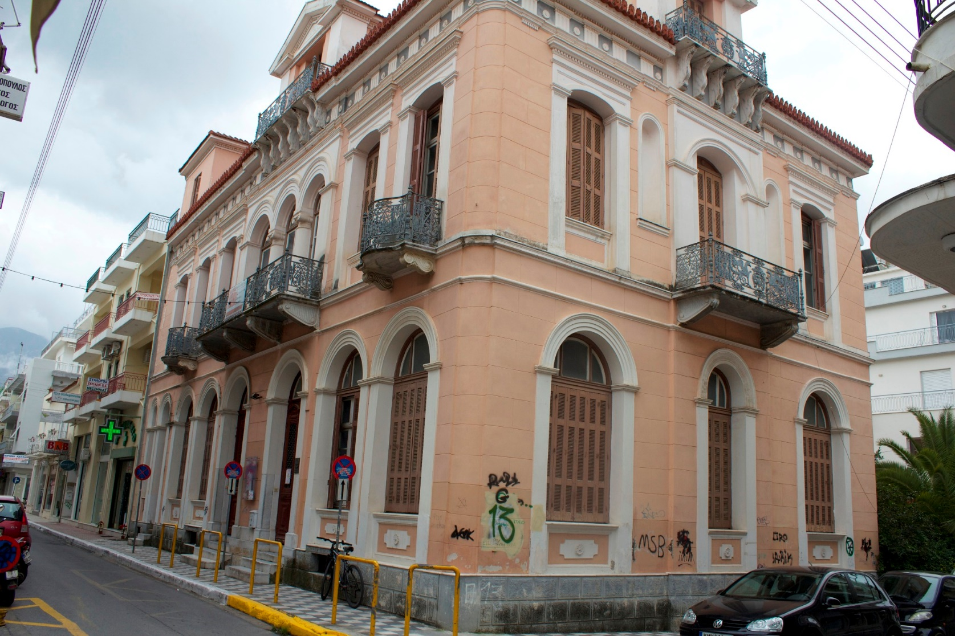
Kalamata – Our future home

Slide 29
What does the future hold?
We will continue our work on the construction, operation and data analysis for the ARCA and ORCA detectors.
The KM3NeT Phase 3 involves the Greek site, which means the establishment of sea bed network and detector infrastructure.
We are focusing on alternative detection methods which will allow the implementation of more cost effective designs aiming at the ultra-high energy part of the neutrino spectrum. This couples naturally with the ESS scope, so this can be the game changer in this effort. Huge collaborative potential!
First steps in this direction have already been made, with the deployment of background measurement acoustic detectors planned for later this month off the Peloponnese coast.

Slide 30
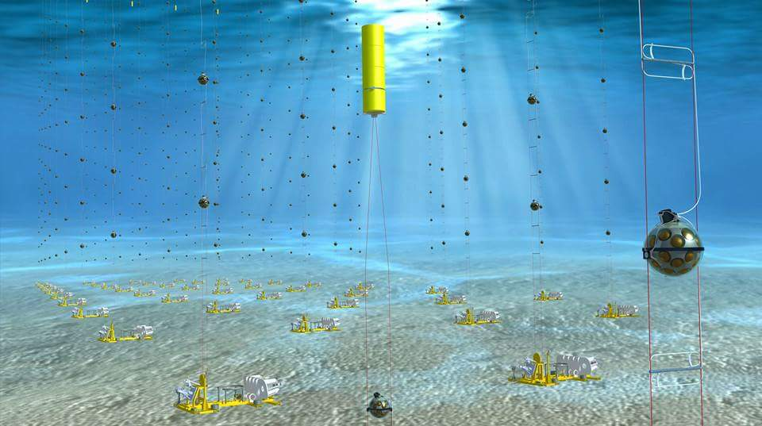
Thank you! And feel free to attend the December
ESS workshop.

