Slide 1


Development of the PiGreCo simulation code for material analysis using the PIGE technique
Department of Physics
School of Applied Mathematical
and Physical Sciences
National Technical University of Athens, Greece
Tandem Accelerator Laboratory
Institute of Nuclear and
Particle Physics
NCSR – “Demokritos”
Konstantinos Preketes-Sigalas

Slide 2
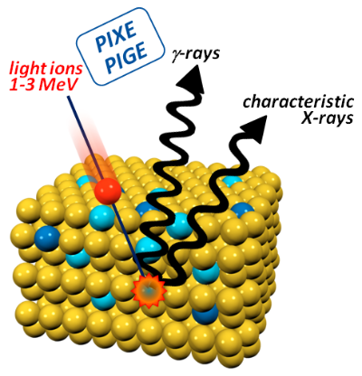


Introduction
PIGE (Particle Induced Gamma-ray Emission)
  Light-element (Li, B, F, Mg etc.) analysis of thick target
  Resonant-PIGE: depth profiling
Relative measurements: Need of several standards (stopping power)
→ Absolute (standard-less) measurements
→ Differential cross sections (IBANDL)
+ Simulation Code (integration of c.s.)

Slide 3
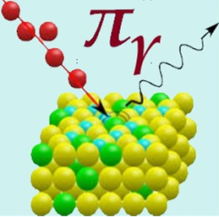
PiGreCo
(Particle Induced Gamma-Ray Emission COde)
Open-source code (Available in the scientific community via http://tandem.inp.demokritos.gr/pigreco/)
Programmed in C++ / Qt-5 libraries for GUI
Distributions for Windows/Linux/MacOS
Homogenous monolayer target
Stopping power:
  ZBL/SRIM compilations (elemental targets)
  Bragg’s rule (compound targets)
Straggling: Gaussian distribution – Bohr’s approximation
Cross sections: R33 format files → Compatibility with the IBANDL database

Slide 4
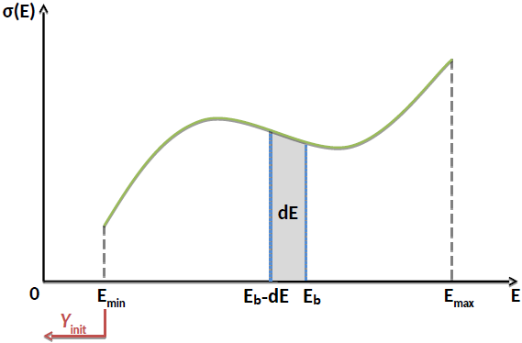

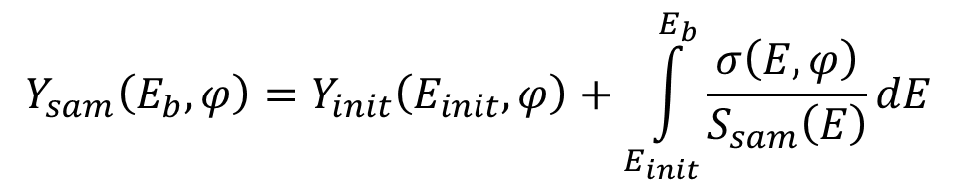
Yield calculation
Using standards: $Y_{sam}\left(E_{b},φ\right)≈Y_{std}\left(E_{b},φ\right)\frac{C_{sam}}{C_{std}}\frac{S_{std}(E^{′})}{S_{sam}(E^{′})}$ $\left(E^{′}→Y\left(E^{′}\right)=Y\left(E_{b}\right)/2\right)$
Standard-less measurements:
$$Y_{sam}\left(E_{b},φ\right)=Y_{init}\left(E_{init},φ\right)+\int_{E_{init}}^{E_{b}}{\frac{σ\left(E,φ\right)}{S_{sam}\left(E\right)}dE}$$
Target
≤dE
dE
dE
E_{b}
…
Beam
E_{b}-dE
E_{init}≥E_{min}
E_{b}-2dE

Slide 5
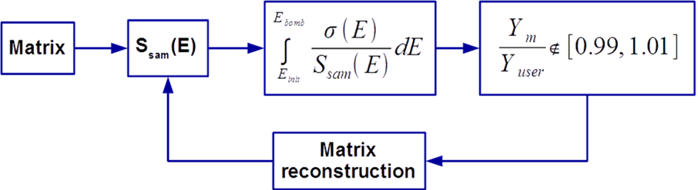
The algorithm
Initial composition - Target division
Stopping power calculation (S_{sam})
Yield calculation (Y_{m})
Comparison with experimental yield (Y_{user})
Reconstruction of the matrix

Slide 6

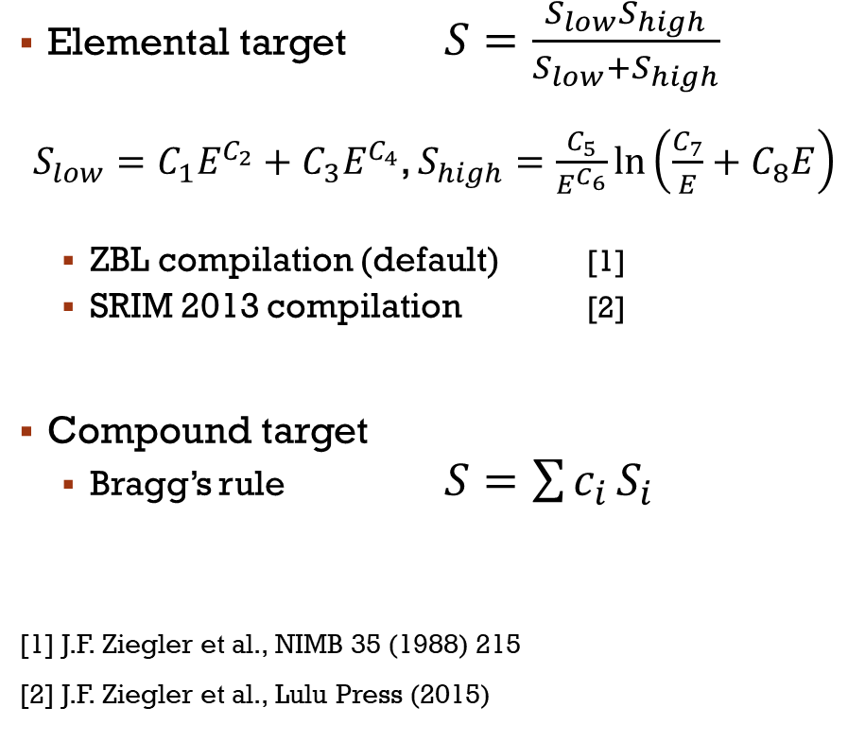
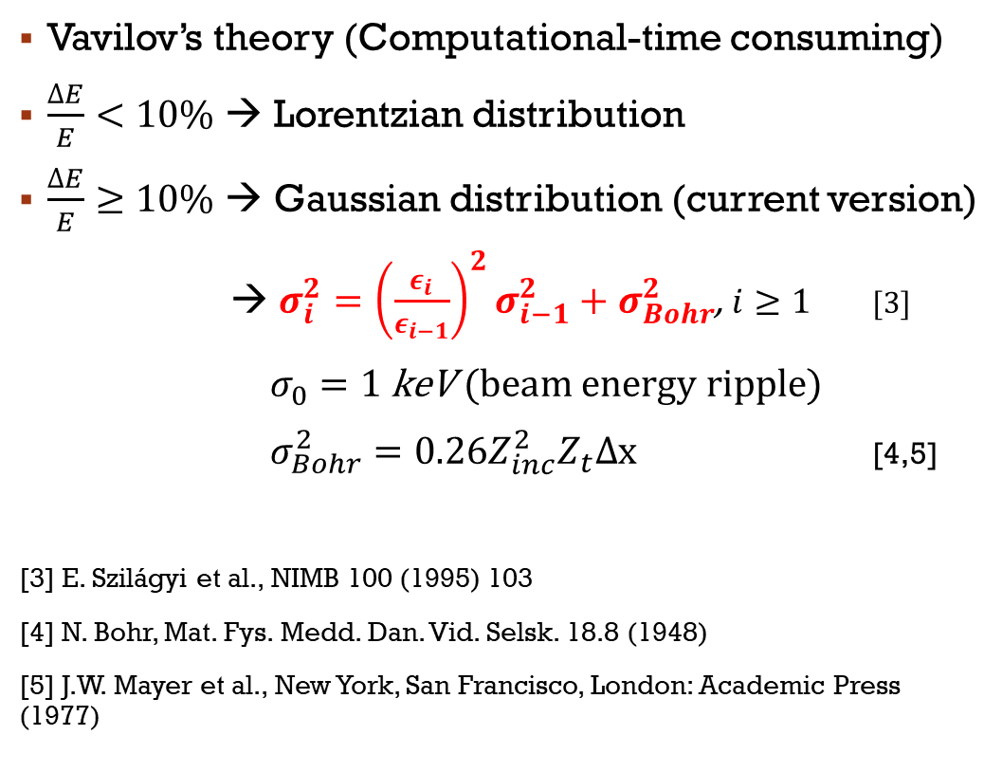
Stopping power
Straggling
Elemental target $S=\frac{S_{low}S_{high}}{S_{low}+S_{high}}$
$S_{low}=C_{1}E^{C_{2}}+C_{3}E^{C_{4}}$, $S_{high}=\frac{C_{5}}{E^{C_{6}}}\ln\left(\frac{C_{7}}{E}+C_{8}E\right)$
  ZBL compilation (default) [1]
  SRIM 2013 compilation [2]
Compound target
  Bragg’s rule $S=\sum{c_{i}}S_{i}$
[1] J.F. Ziegler et al., NIMB 35 (1988) 215
[2] J.F. Ziegler et al., Lulu Press (2015)
Vavilov’s theory (Computational-time consuming)
$\frac{ΔE}{E}<10\%$ → Lorentzian distribution
$\frac{ΔE}{E}≥10\%$ → Gaussian distribution (current version)
→ $σ_{i}^{2}={\left(\frac{ε_{i}}{ε_{i−1}}\right)}^{2}σ_{i−1}^{2}+σ_{Bohr}^{2}$, $i≥1$ [3]
$σ_{0}=1 \text{keV}$ (beam energy ripple)
$σ_{Bohr}^{2}=0.26Z_{inc}^{2}Z_{t}Δx$ [4,5]
[3] E. Szilágyi et al., NIMB 100 (1995) 103
[4] N. Bohr, Mat. Fys. Medd. Dan. Vid. Selsk. 18.8 (1948)
[5] J.W. Mayer et al., New York, San Francisco, London: Academic Press (1977)

Slide 7
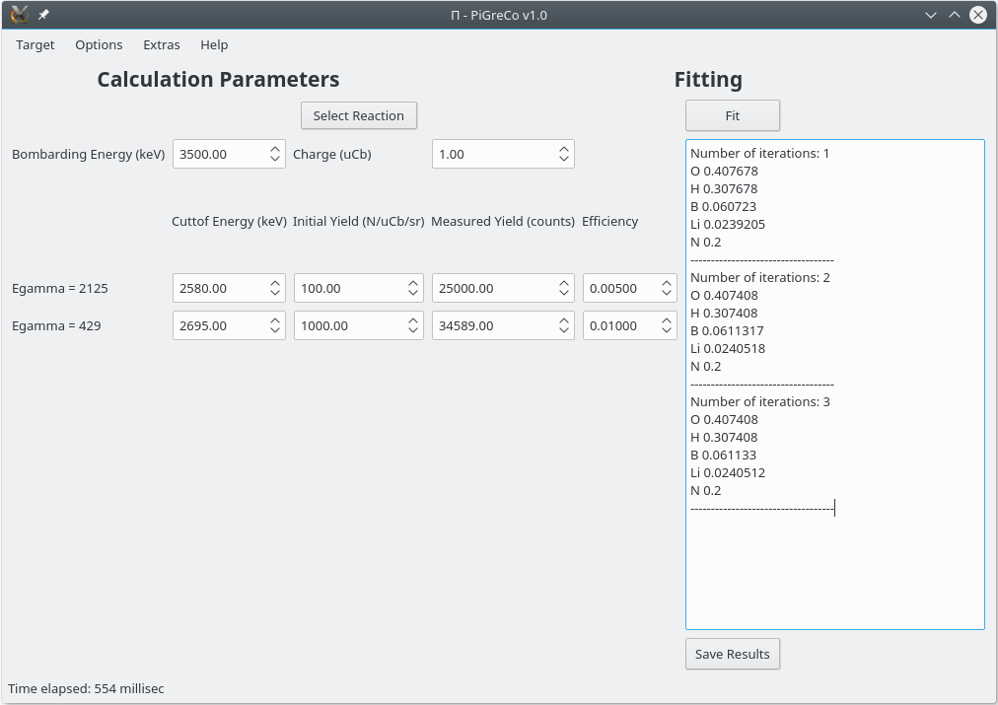
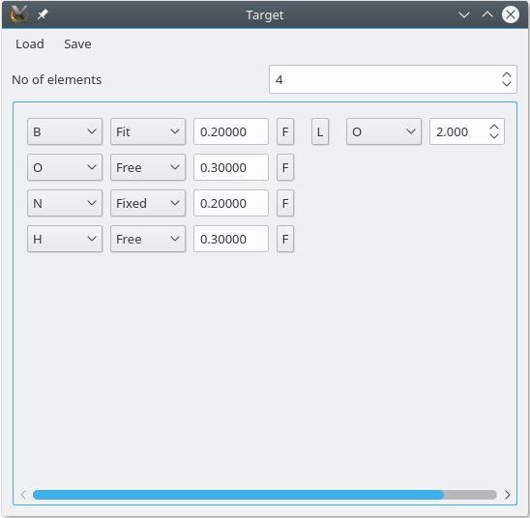
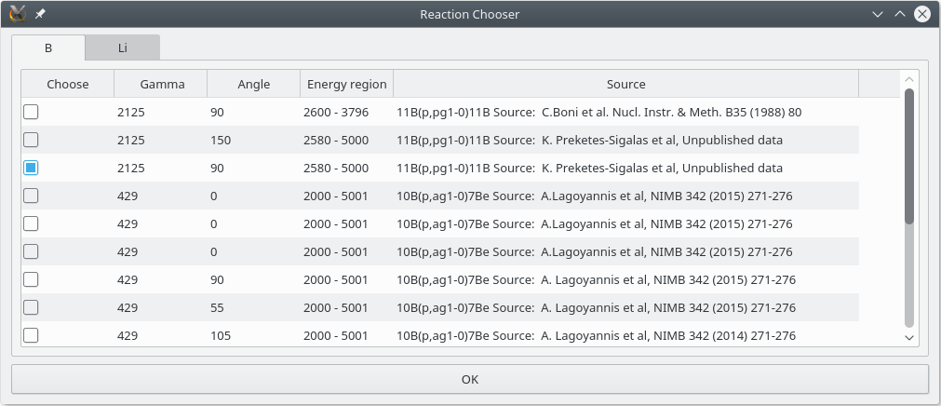
Layout

Slide 8
Fitting
Target division in dE layers (dE=5 keV by default)
Cross-section linear interpolation
Stopping-power calculation for each layer
Yield calculation for the 1st “Fit” element
Comparison with the respective experimental yield
Element concentration is changed accordingly
(Concentration of linked element)
Excess/lack concentration is equally distributed to the “Free” elements
Steps 3-8 for all “Fit” elements
Program stops:
  1% convergence for all “Fit” elements
  50 iterations for each “Fit” element

Slide 9
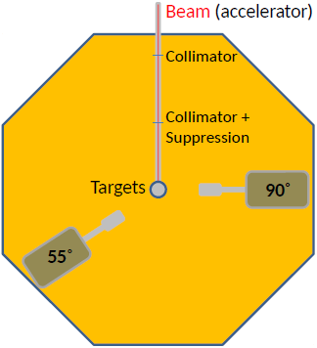
Code validation
Tandem Accelerator 5.5 MV Laboratory,
INPP, NCSR – “Demokritos”
2 standard samples
  Phosphate rock (NIST, SRM 120b)
  Multicomponent glass (NIST, SRM 1412)
E_{p}=1.5 – 4.0 MeV (variable steps)
θ_{lab}=55° and 90°

Slide 10
Validation results
Phosphate rock (“NIST 120b”) @ E_{p} = 4000 keV and θ_{lab} = 55°
Element | Reaction | E_{γ} (keV) | Cross section | Difference
Fluorine | ¹⁹F(p,p’γ₁₋₀)¹⁹F | 110 | Chiari et al. [1] | 2.3%
Sodium | ²³Na(p,p’γ₁₋₀)²³Na | 440 | Chiari et al. [1] | 4%
Multicomponent glass (“NIST 1412”) @ E_{p} = 3500 keV and θ_{lab} = 90°
Element | Reaction | E_{γ} (keV) | Cross section | Difference
Sodium | ²³Na(p,p’γ₁₋₀)²³Na | 440 | Chiari et al. [1] | 2.8%
Boron | ¹⁰B(p,p’γ₁₋₀)¹⁰B | 718 | Lagoyannis et al. [2] | 0.3%
Magnesium | ²⁵Mg(p,p’γ₂₋₁)²⁵Mg | 390 | Preketes et al. [3] | 1.9%
 | ²⁵Mg(p,p’γ₁₋₀)²⁵Mg | 585 | Preketes et al. [3] | 3%
 | ²⁵Mg(p,p’γ₂₋₀)²⁵Mg | 975 | Preketes et al. [3] | 4%
[1] M. Chiari et al., to be published, data retrieved from the IBANDL database
[2] A. Lagoyannis et al., NIMB 342 (2015) 271
[3] K. Preketes-Sigalas et al., NIMB 386 (2016) 4

Slide 11
Summary and Plans
PiGreCo (http://tandem.inp.demokritos.gr/pigreco/)
  Homogenous monolayer targets
  Compatibility with R33 format files from the IBANDL database
  User-friendly – Distributions for Windows/Linux/MacOS
Improvements
  User-supplied stopping powers
  Weight percentage Atomic percentage (current version)
  Depending on feedback (e-mail: preketes@inp.demokritos.gr)
Future plans:
  Cross-section errors
  Straggling: Lorentzian distribution
  Breit-Wigner formula for narrow-isolated resonances
  Multilayer targets (resonant PIGE) / ill-posed problem

Slide 12
Thank you for your attention!

Slide 13
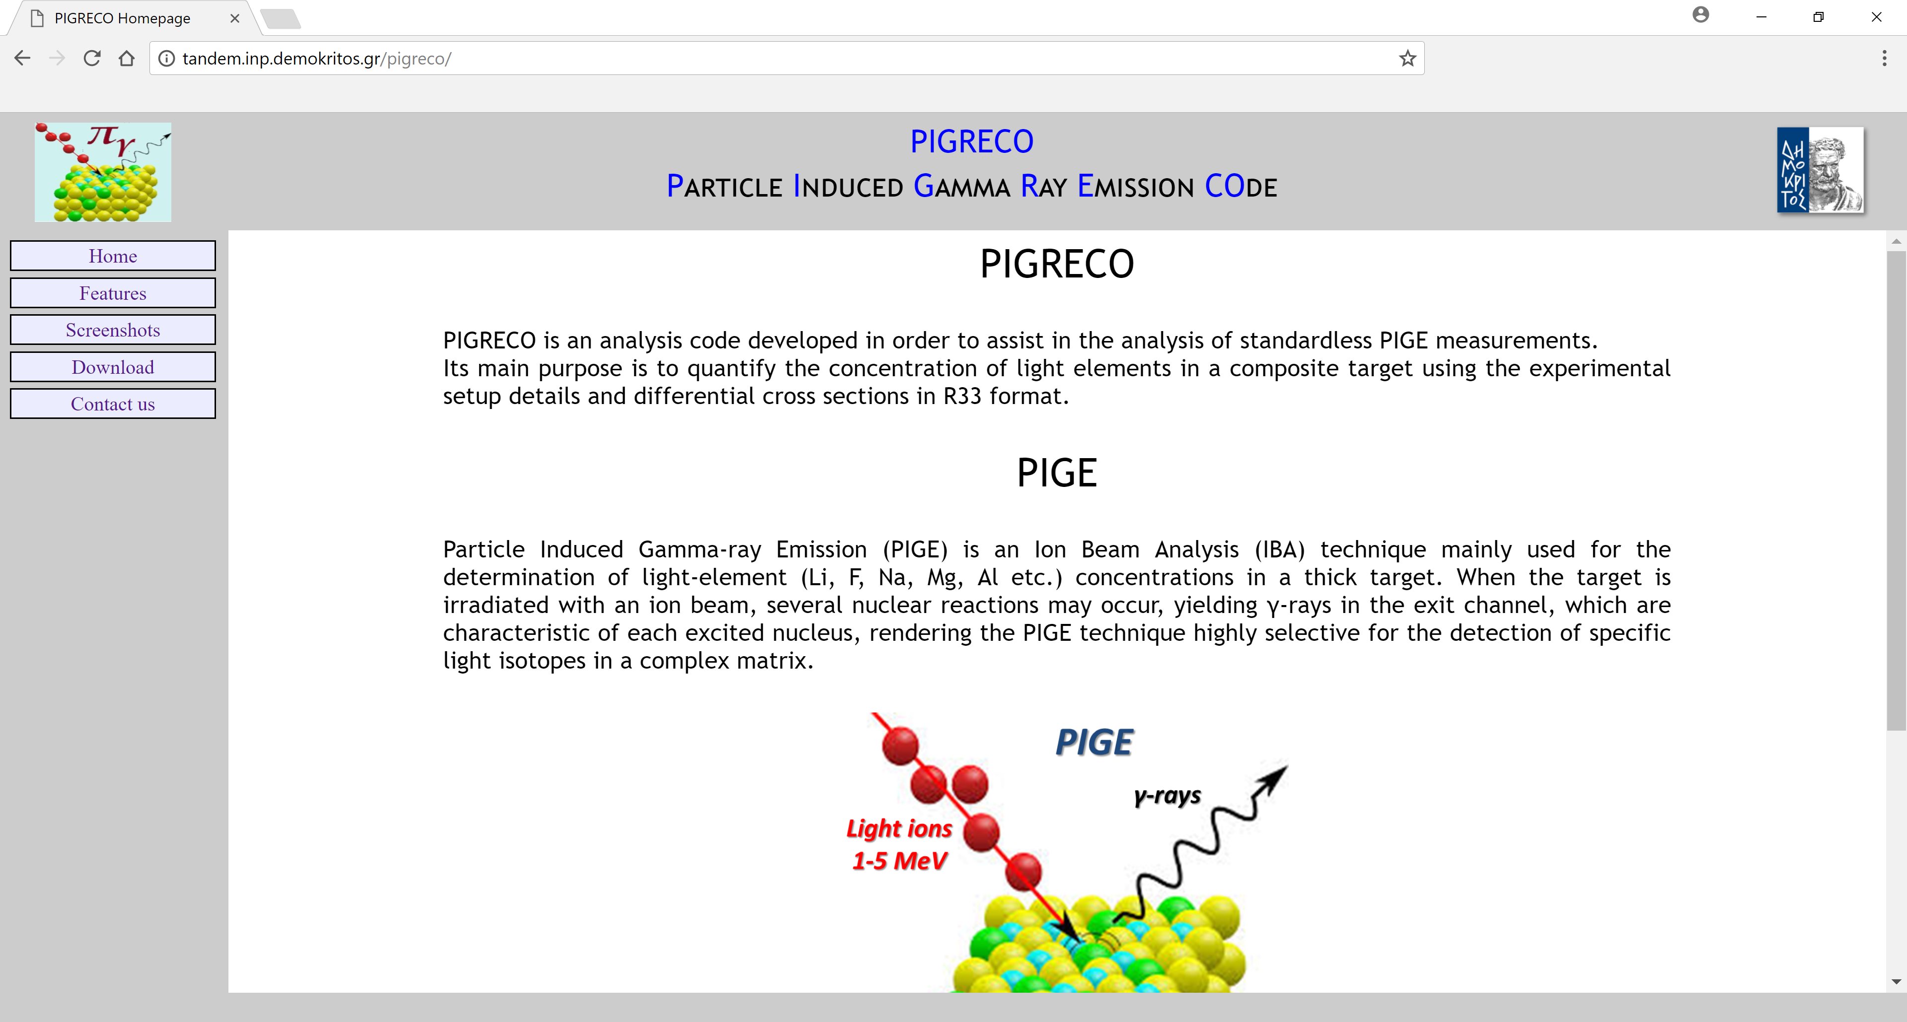
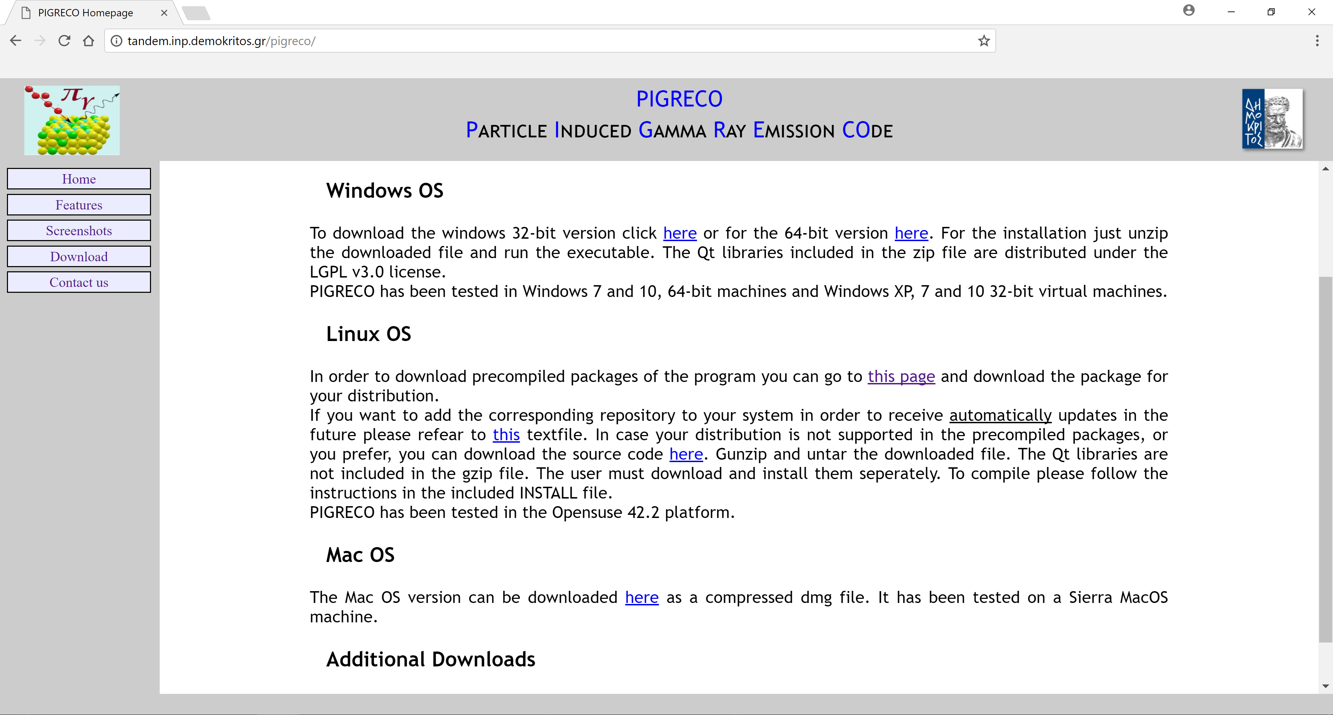
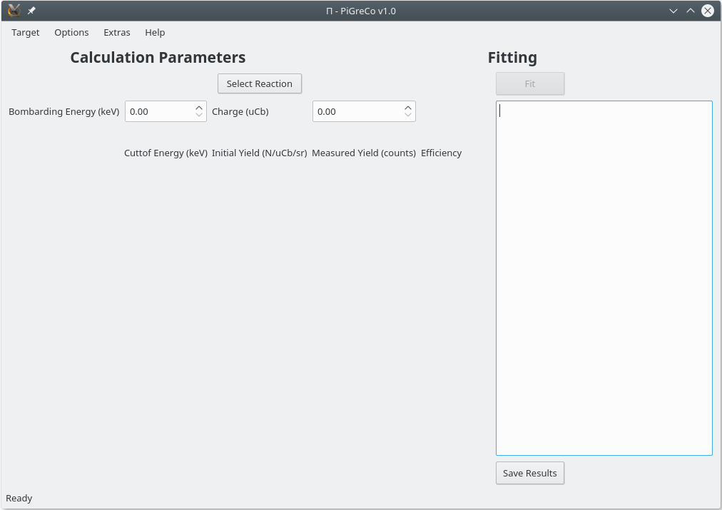
Layout…

Slide 14
Target window
Homogenous monolayer target
  # of elements
  Composition (elements + initial concentrations)
    Total concentration equal to 1
    For the last element concentration press “F” (Fill)
  Element “behavior”:
    Fit (at least 1 and up to 5)
    Free (at least 1): excess/lack concentration
    Fixed: NO change
          ONLY for stopping power
  Link a “Fit” with a “Free” element
    (e.g., B:O is 1:2 → O at least twice of B)
Extras: Load/Save

Slide 15
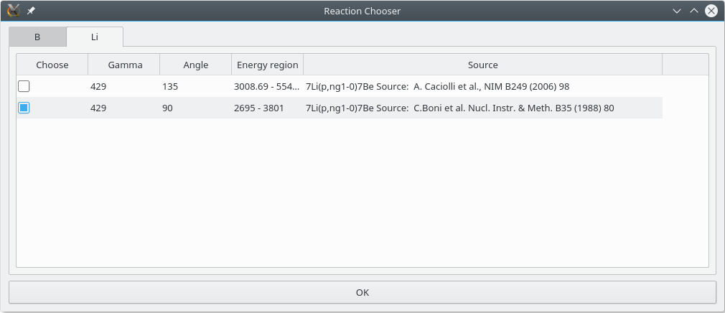
Reaction window
Cross sections: in subdirectory “R33Data”
One cross section for each “Fit” element (tabs)

Slide 16
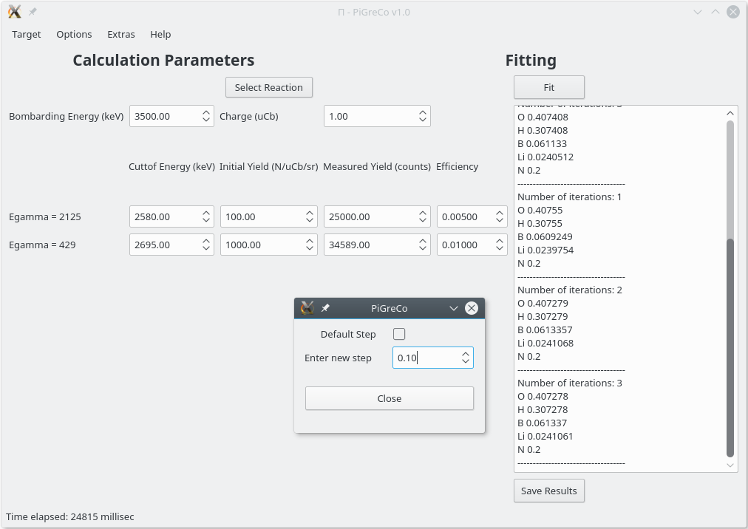
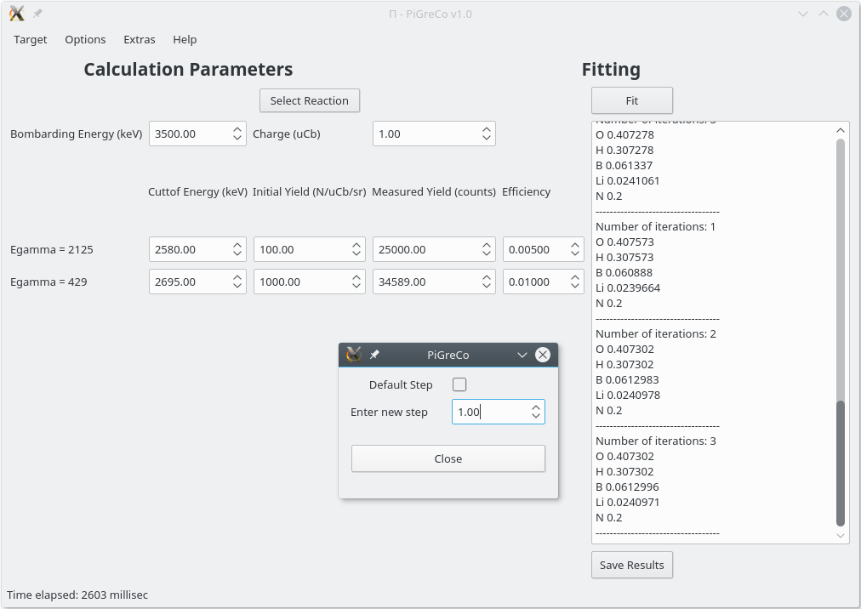
Main window

Slide 17
Validation results
Phosphate rock (“NIST 120b”) @ E_{p} = 4000 keV
Element | Reaction | E_{γ} (keV) | Initial yield (#/sr/μC) | Cross section | Difference
Fluorine | ¹⁹F(p,p’γ₁₋₀)¹⁹F | 110 | 5.1x10⁶ @ 2500 keV | Chiari et al. | 2.3%
Sodium | ²³Na(p,p’γ₁₋₀)²³Na | 440 | 6.01x10⁶ @ 2498 keV | Chiari et al. | 4%
Multicomponent glass (“NIST 1412”) @ E_{p} = 3500 keV
Element | Reaction | E_{γ} (keV) | Initial yield (#/sr/μC) | Cross section | Difference
Sodium | ²³Na(p,p’γ₁₋₀)²³Na | 440 | 6.01x10⁶ @ 2498 keV | Chiari et al. | 2.8%
Boron | ¹⁰B(p,p’γ₁₋₀)¹⁰B | 718 | 2.4x10⁴ @ 2002 keV | Lagoyannis et al. | 0.3%
Magnesium | ²⁵Mg(p,p’γ₂₋₁)²⁵Mg | 390 | 2.4x10⁴ @ 2400 keV | Preketes et al. | 1.9%
 | ²⁵Mg(p,p’γ₁₋₀)²⁵Mg | 585 | 8.5x10⁴ @ 2416.2 keV | Preketes et al. | 3%
 | ²⁵Mg(p,p’γ₂₋₀)²⁵Mg | 975 | 2.2x10⁴ @ 2400 keV | Preketes et al. | 4%

