Slide 1
Updated exploration of a Sigmoid Late-Physics model for Dark Energy with DES
Sebastián Rueda-Blanco
Universidad Nacional de Colombia, Observatorio Astronómico Nacional,
Advisor: Mario-A. Higuera-G.
Universidad Nacional de Colombia, Observatorio Astronómico Nacional,
Co-advisor: Camilo Delgado-Correal
Universidad Distrital FJC, IGAC, Energesis-Smart
Sergio Torres Arzayus
Cosmology and Astrophysics Department, International Center for Relativistic Astrophysics Network, Pescara, Italy

Slide 2

Introduction
Dynamic Dark Energy models are focused on describing accelerated expansion of the Universe by considering physics of the early universe, according to the CMB observations.
The Hubble tension is the discrepancy between the values of $H_{0}$ determined from
the magnitude-redshift relation and those derived from the Cosmic Microwave Background (CMB). In this work, we analyze Type Ia supernovae (SNe) data to constrain the dark energy EOS, given by $w=\frac{P}{ρ}$.
In order to alleviate the problem of calculate the expansion rate (Hubble tension), there are some examples of Dark Energy models focused on potential late-time physics, in which the estimation of $H_{0}$ implies using observational data.

Slide 3



Friedmann Equations for the Expansion rate (Hubble parameter)
$H^{2}=H_{0}^{2}\left[Ω_{k}{\left(1+z\right)}^{2}{+Ω}_{m}{\left(1+z\right)}^{3}{+Ω}_{r}{\left(1+z\right)}^{4}{+Ω}_{DE}f_{DE}\left(z\right)\right]$, (1)
Where $Ω_{x}$are the density parameters for curvature (k), matter (m), radiation (r) and
dark energy (Ʌ), respectively, and $f(z)$ is to be determined by the EOS,
$f_{DE}\left(z\right)=exp\left[\int_{0}^{z}{\frac{3(1+w(z′))}{1+z′}dz′}\right].$ (2)
Here, $w= \frac{P}{ρ}$ , where P is the pressure and ρ the density. The equation of state must
satisfy the conservation equation $\dot{ρ}+3H(ρ+P)=0$.
Flat geometry is considered: $Ω_{k}=0.$

Slide 4




Calculation of (2) : If $f_{DE}={\left(1+z\right)}^{3(1+w_{0})}$ at late times ($w_{0}=−1$ in $ɅCDM$ model), and $f_{DE}=1$ at early times (high redshift), we assume a behavior
Q$\left(z\right)=w_{0}− \frac{(1+w_{0})}{1+ e^{\frac{z_{a−z}}{r}}}$ (3)
$f_{DE}={(1+z)}^{3(1+Q)}$,
Sigmoid function (3) involves a smooth transition of $f_{DE}$ between the two regimes (early and late) taking place at a redshift $z_{a}$ with a transition rate 𝑟.

Slide 5
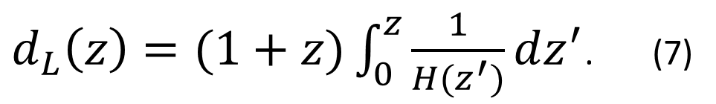
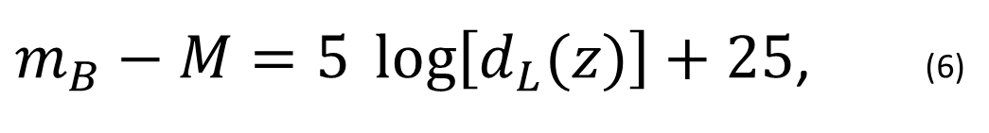
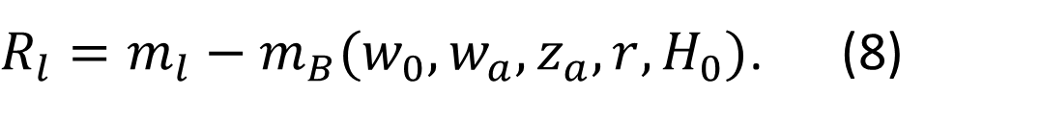

Distance modulus: magnitude-redshift relation by luminosity-distance:
$m_{B}−M=5 \log\left[d_{L}(z)\right]+25$, (6)
where
$d_{L}\left(z\right)=(1+z)\int_{0}^{z}{\frac{1}{H(z^{′})}dz^{′}}$. (7)
Fitting with the light curves: A $χ^{2}$test based on the apparent magnitude
values $m_{B}$: ${ χ}^{2}=R^{−1}C^{−1}R$, where
$R_{l}=m_{l}−m_{B}(w_{0},w_{a},z_{a},r,H_{0})$. (8)

Slide 6
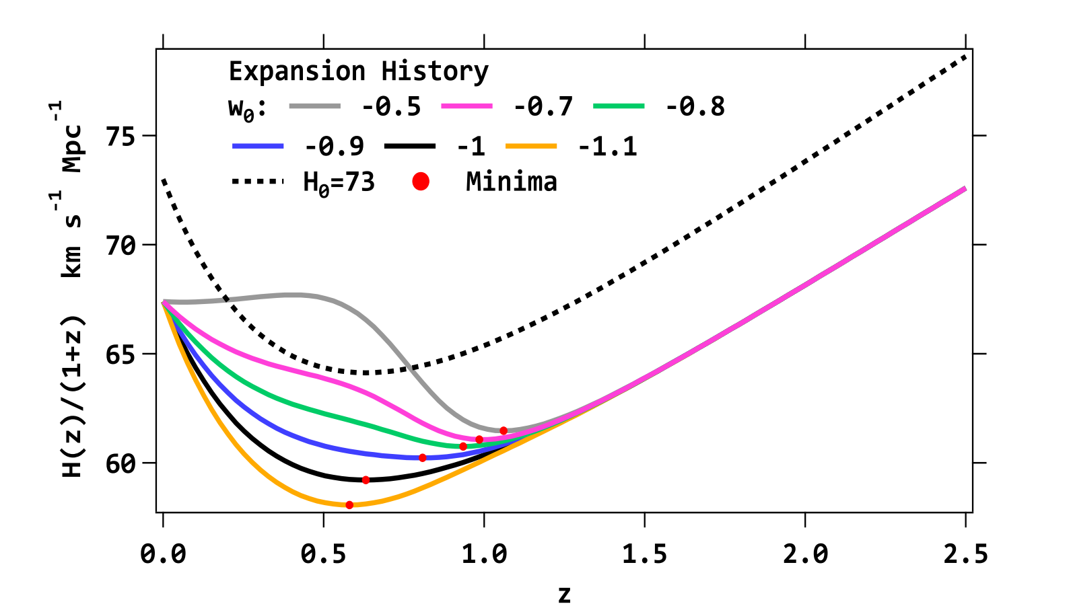
Expansion History Sigmoid Model

Slide 7
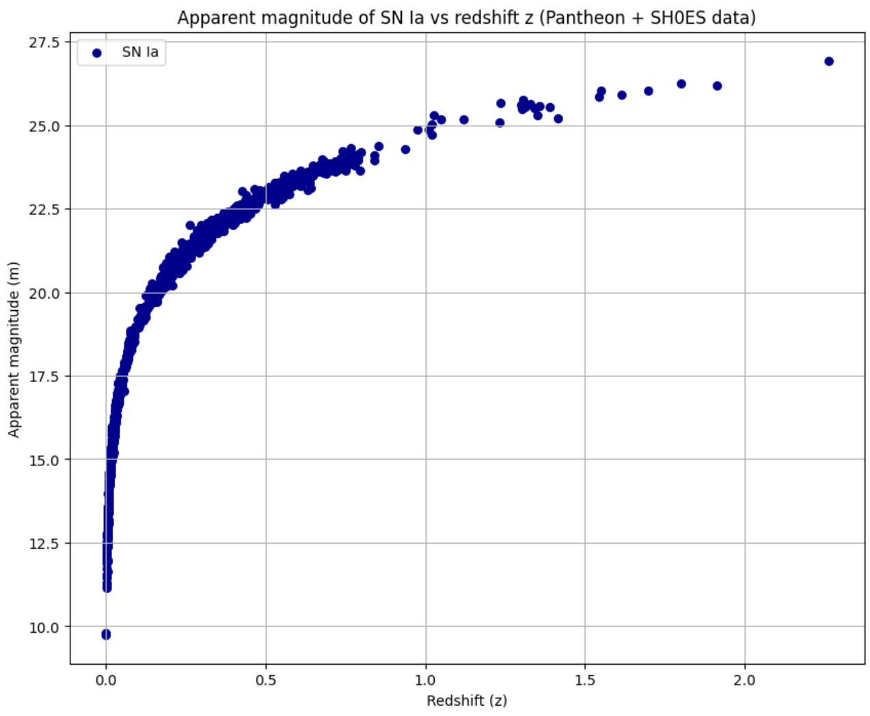
Apparent brightness vs redshift for the 1701 SN Ia of Pantheon+ SH0ES data.

Slide 8
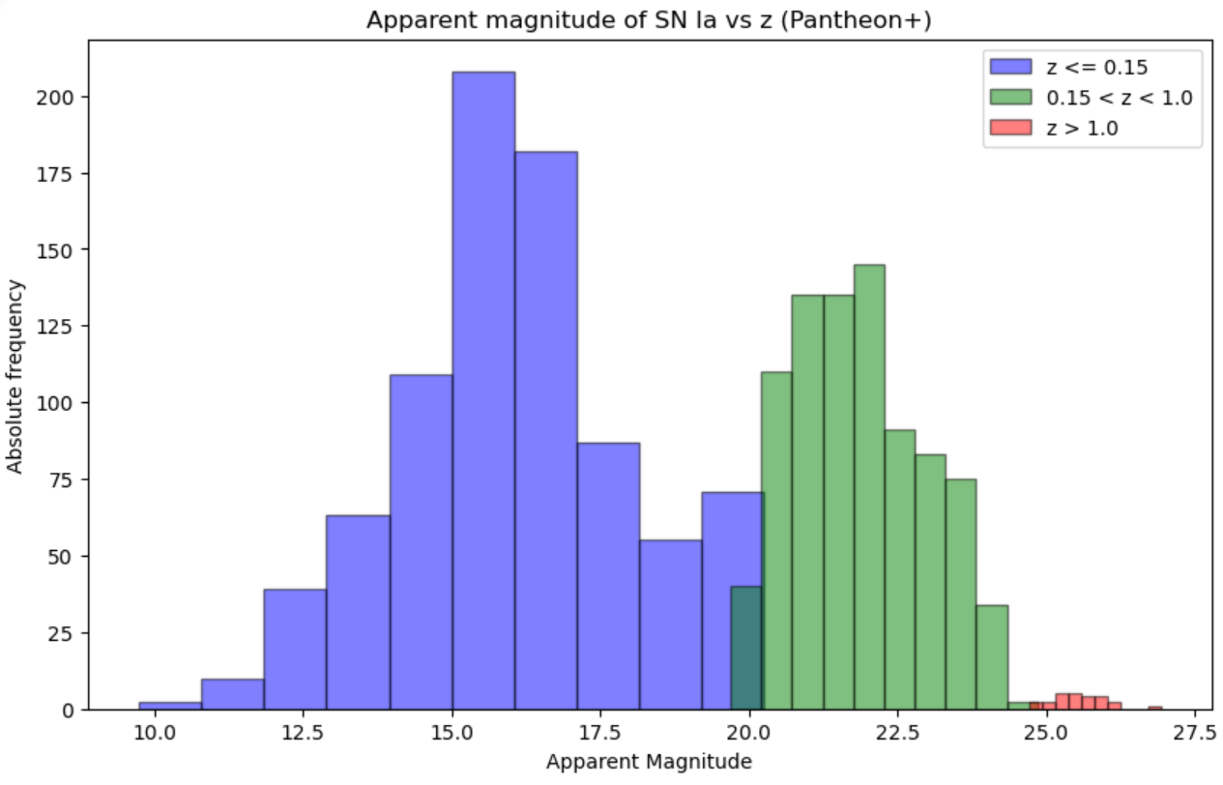
Histogram for SN Ia in Pantheon+ data, for different values of redshift and magnitude.

Slide 9
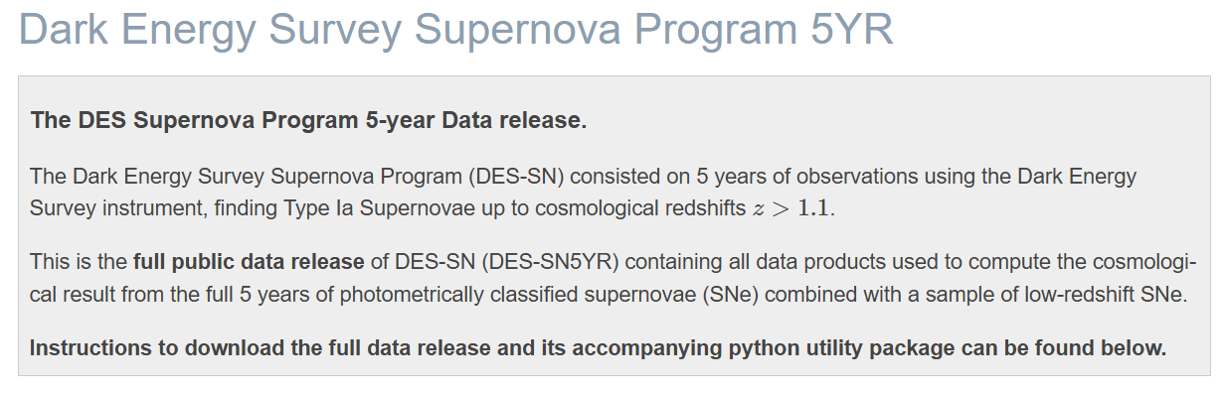

Slide 10
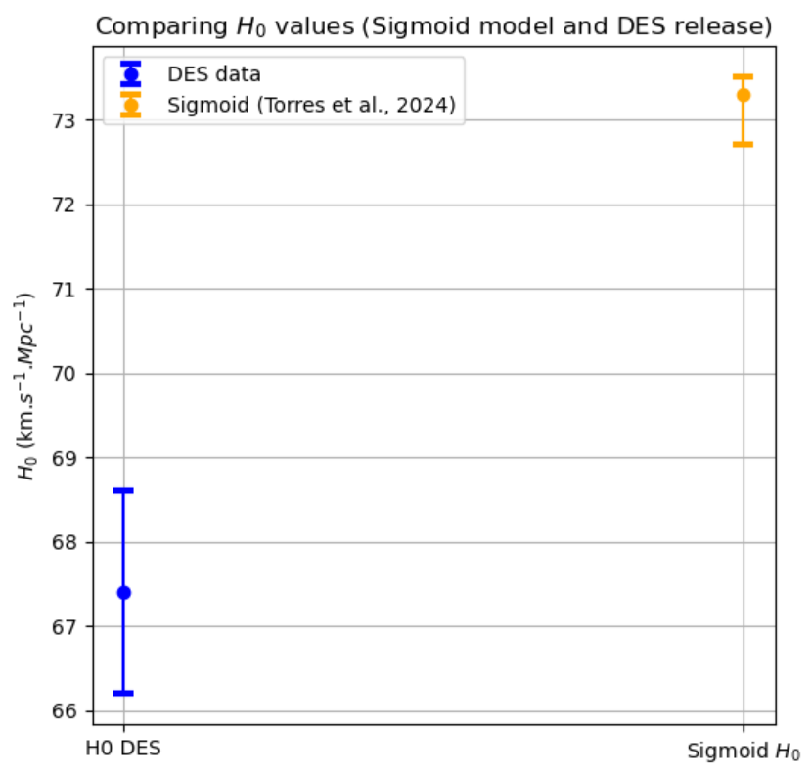
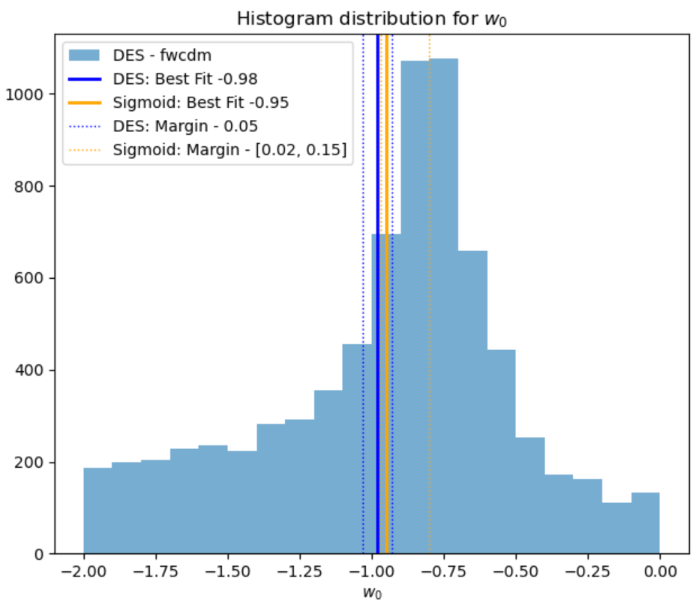

Slide 11
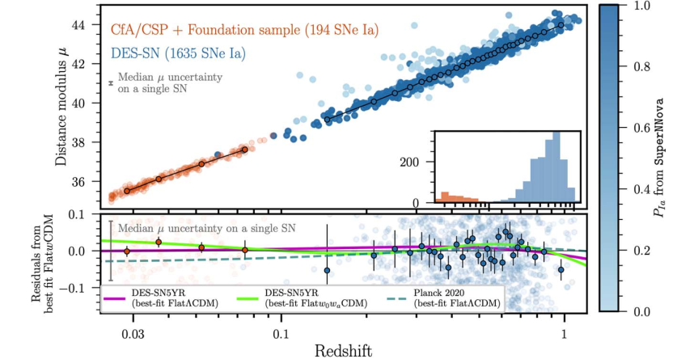
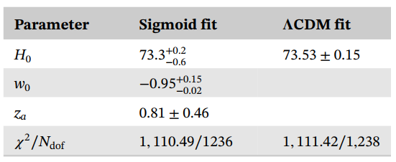
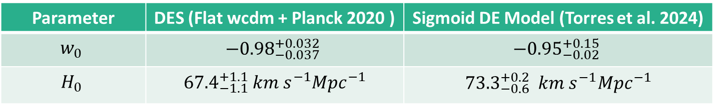
Parameter | DES (Flat wcdm + Planck 2020 ) | Sigmoid DE Model (Torres et al. 2024)
$$w_{0}$$ | $${−0.98}_{−0.037}^{+0.032}$$ | $${−0.95}_{−0.02}^{+0.15}$$
$$H_{0}$$ | ${67.4}_{−1.1}^{+1.1}$ $km s^{−1}Mpc^{−1}$ | ${73.3}_{−0.6}^{+0.2}$ $km s^{−1}Mpc^{−1}$
Results with Pantheon+SH0ES data
(Torres et al., 2024)
DES Collaboration:
Abbott et al., 2024

Slide 12
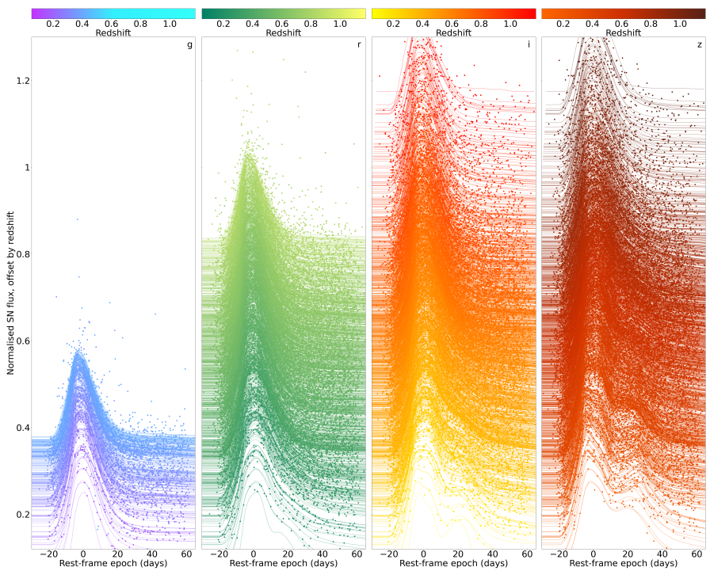
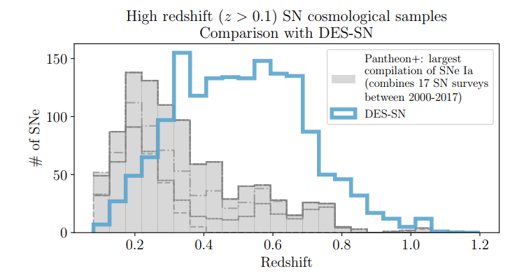
DES Collaboration: Abbott et al., 2024

Slide 13

The significant discrepancy between the $H_{0}$​ values in DES-SN5YR ($67.4±1.1$) and the sigmoidal model (${73.3}_{−0.6}^{+0.2}$)
reflects the well-known $H_{0}$​ ​tension. This has direct implications for our understanding of this cosmological problem.
Local Implication (Sigmoidal Model):
The sigmoidal model better fits local data, such as measurements from type Ia supernovae and Cepheid variables, which
tend to favor higher $H_{0}$​ values. This model suggests that there may be dynamic evolution in the properties of dark
energy, or that local supernovae data capture phenomena not explained by the standard model.
Global Implication (DES):
The ​ value in DES aligns more closely with estimates derived from the Cosmic Microwave Background (CMB), such as
those from the Planck satellite. If this discrepancy persists, it could indicate the need for new physics beyond the
standard model to reconcile local and global expansion scales.

Slide 14
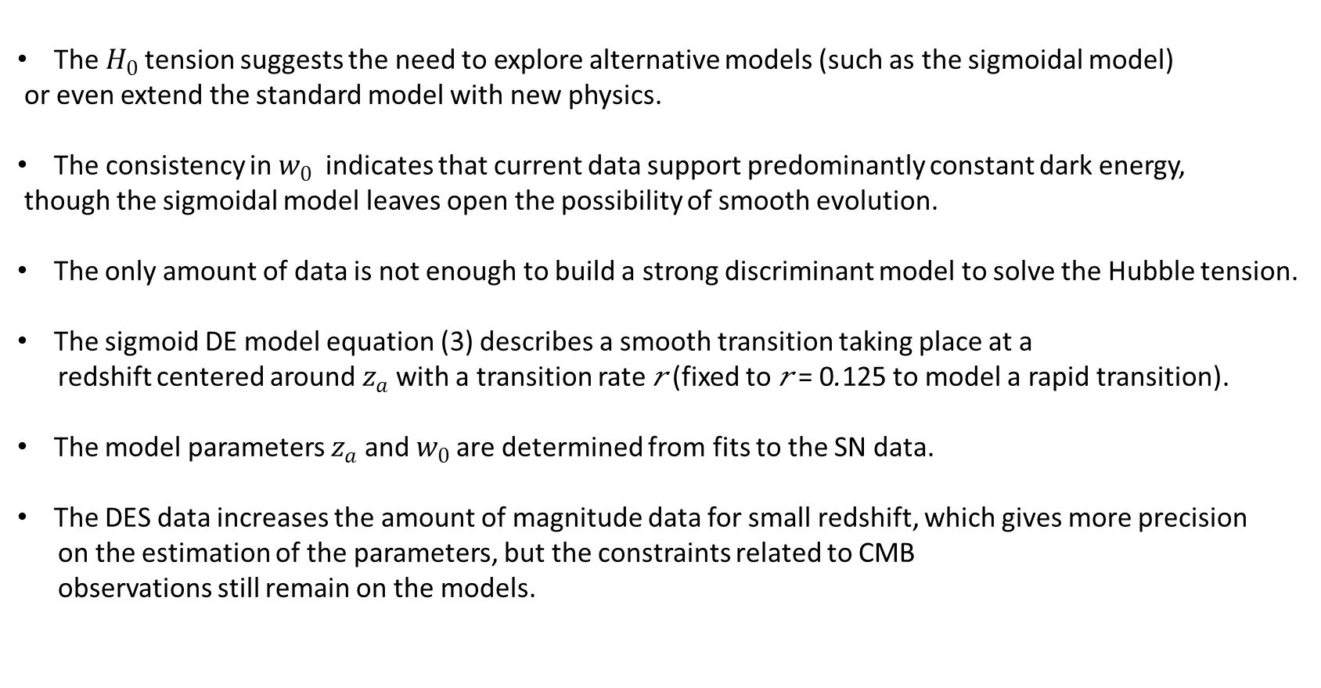
Conclusions
The $H_{0}$tension suggests the need to explore alternative models (such as the sigmoidal model)
or even extend the standard model with new physics.
The consistency in $w_{0}$​ indicates that current data support predominantly constant dark energy,
though the sigmoidal model leaves open the possibility of smooth evolution.
The only amount of data is not enough to build a strong discriminant model to solve the Hubble tension.
The sigmoid DE model equation (3) describes a smooth transition taking place at a
redshift centered around $z_{a}$with a transition rate 𝑟 (fixed to 𝑟 = 0.125 to model a rapid transition).
The model parameters $z_{a}$and $w_{0}$are determined from fits to the SN data.
The DES data increases the amount of magnitude data for small redshift, which gives more precision
on the estimation of the parameters, but the constraints related to CMB
observations still remain on the models.

Slide 15
References
Camilleri, et al., (2024) The Dark Energy Survey Supernova Program: An updated measurement of the Hubble constant using the Inverse Distance Ladder. arXiv: 2406.05049v1.
Torres, S. Dark energy constraints from Pantheon+ Ia supernovae data. Astrophysics and Space Sciences, 369, 1.
Torres-Arzayus, S., Delgado-Correal, C., Higuera-G, M. -A., & Rueda-Blanco, S. 2024, Astron. Nachr., 345,
Vicenzi, M et al. (2024) The Dark Energy Survey Supernova Program: Cosmological Analysis and Systematic Uncertainties. arXiv:2401.02945v2.
Adame, A. et al., (2024) DESI 2024 VI: Cosmological Constraints from the Measurements of Baryon Acoustic Oscillations. arXiv:2404.03002 .

Slide 16
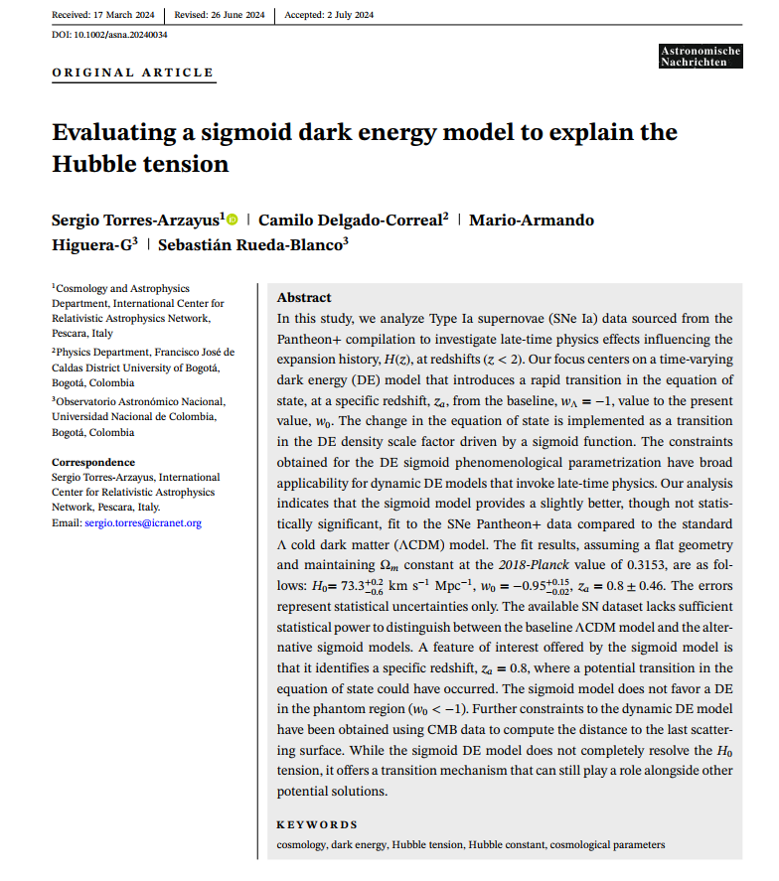

Original paper
https://doi.org/10.1002/asna.20240034

