Slide 1
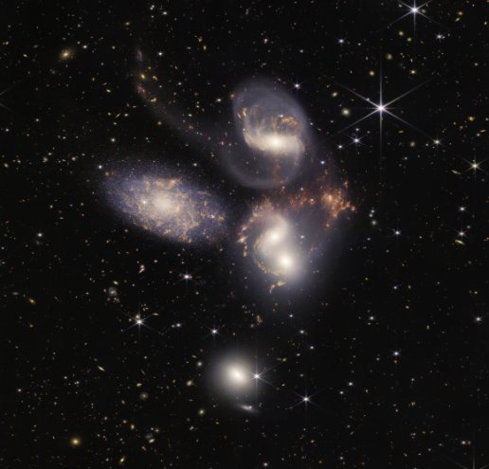


Fuzzy dark matter modeling of the dynamical behavior of nearby isolated dwarf galaxies.
Andrés Castillo
Collab: Andrés Bañares, Jorge Martin Camalich and Giuluiano Iorio

Slide 2
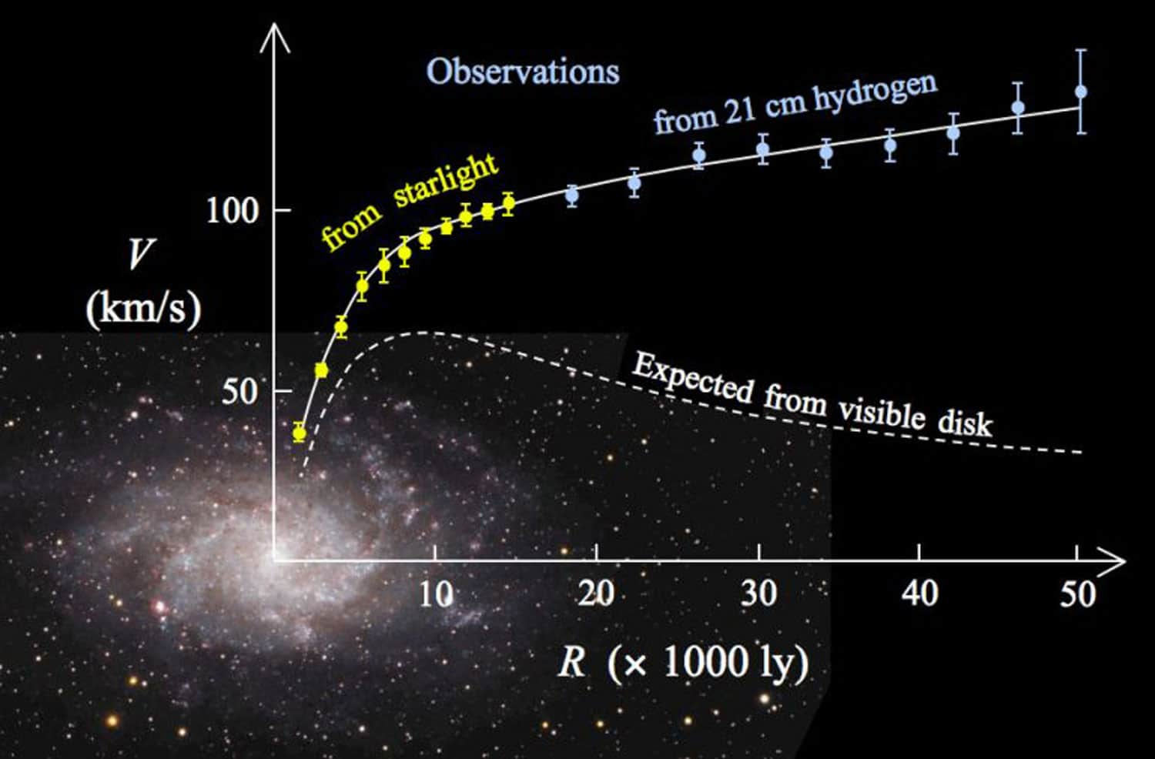
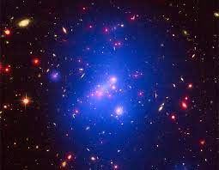
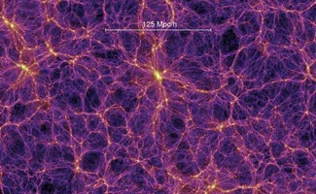
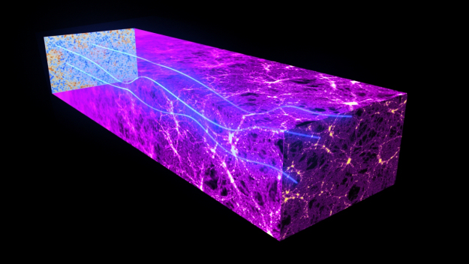
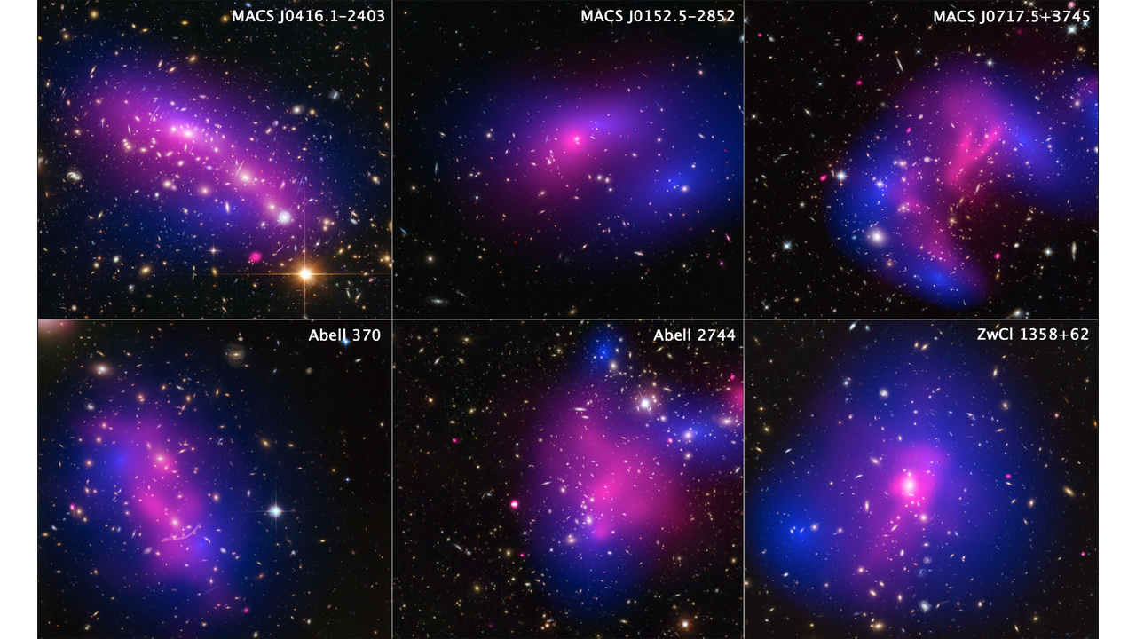
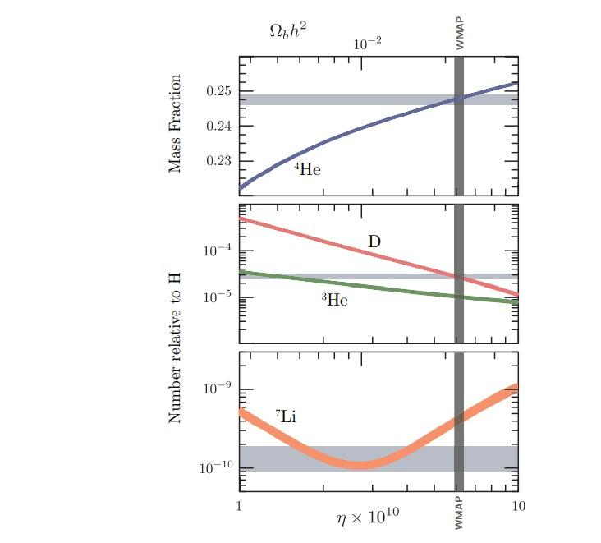
Evidences for dark matter
Galactic rotation curves
Clusters
CMB/LSS
BBN
Lensing
Cluster collision

Slide 3
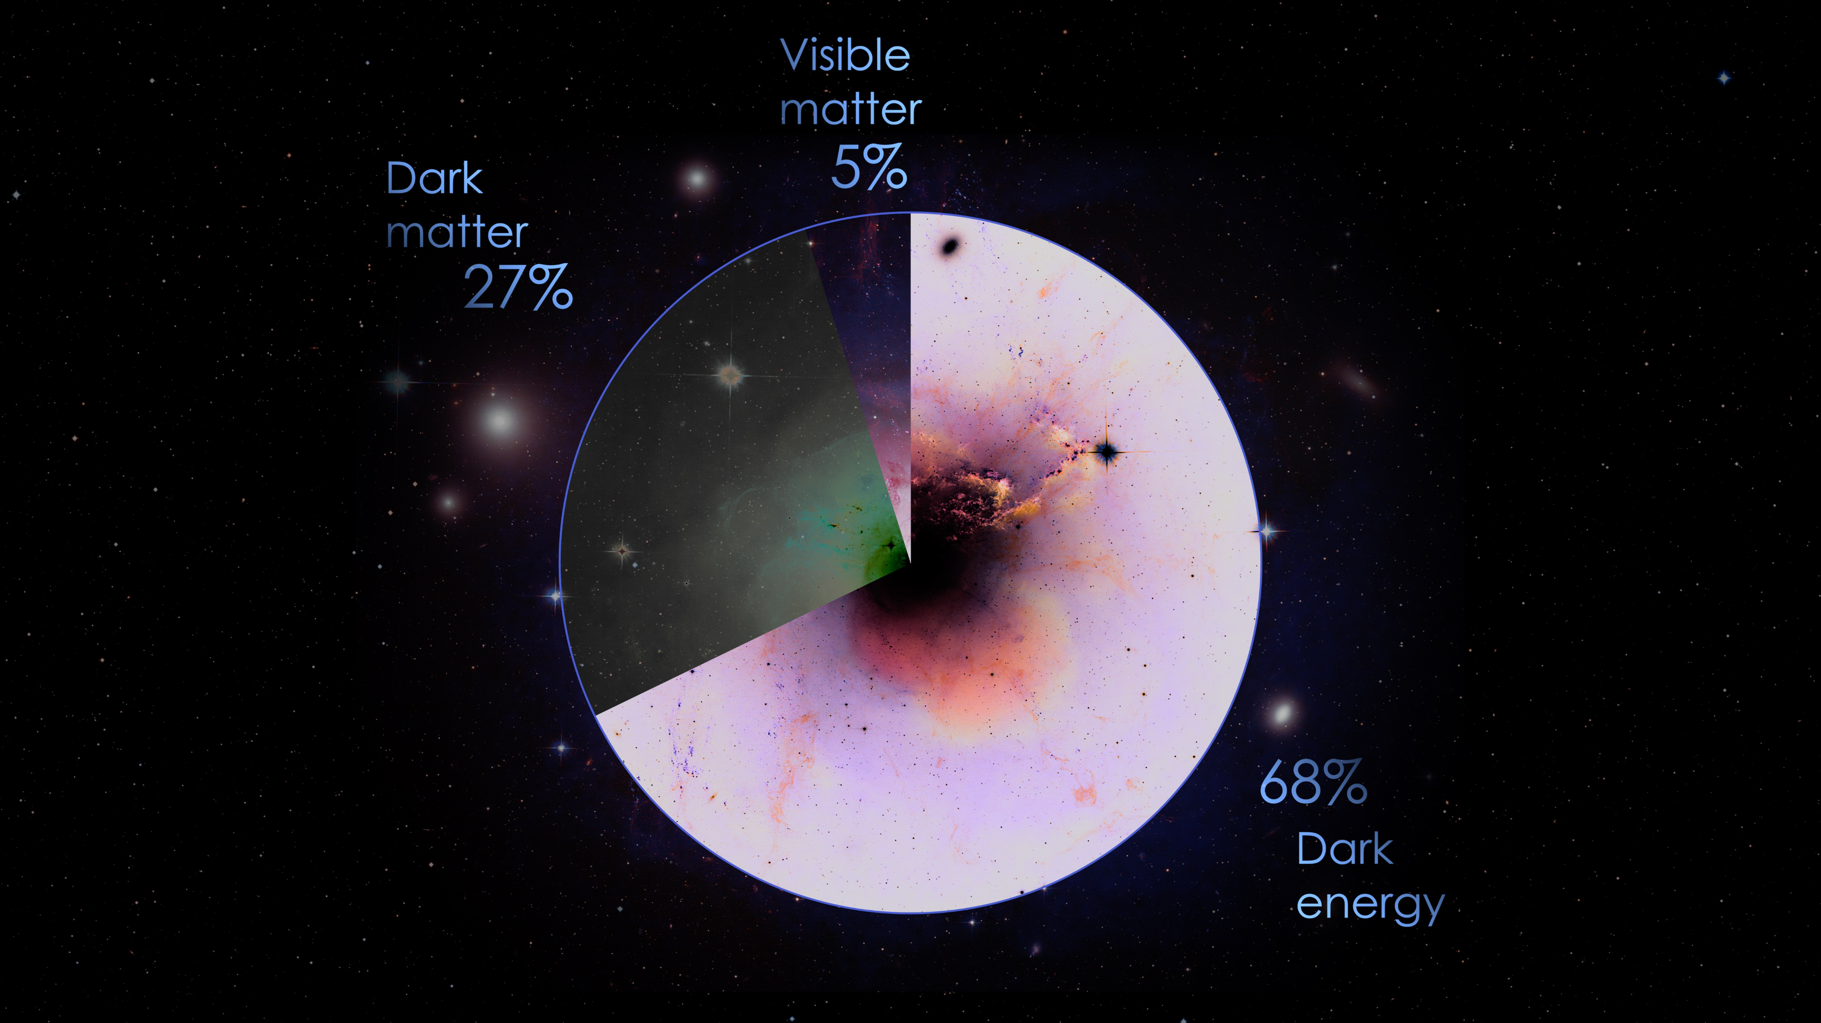
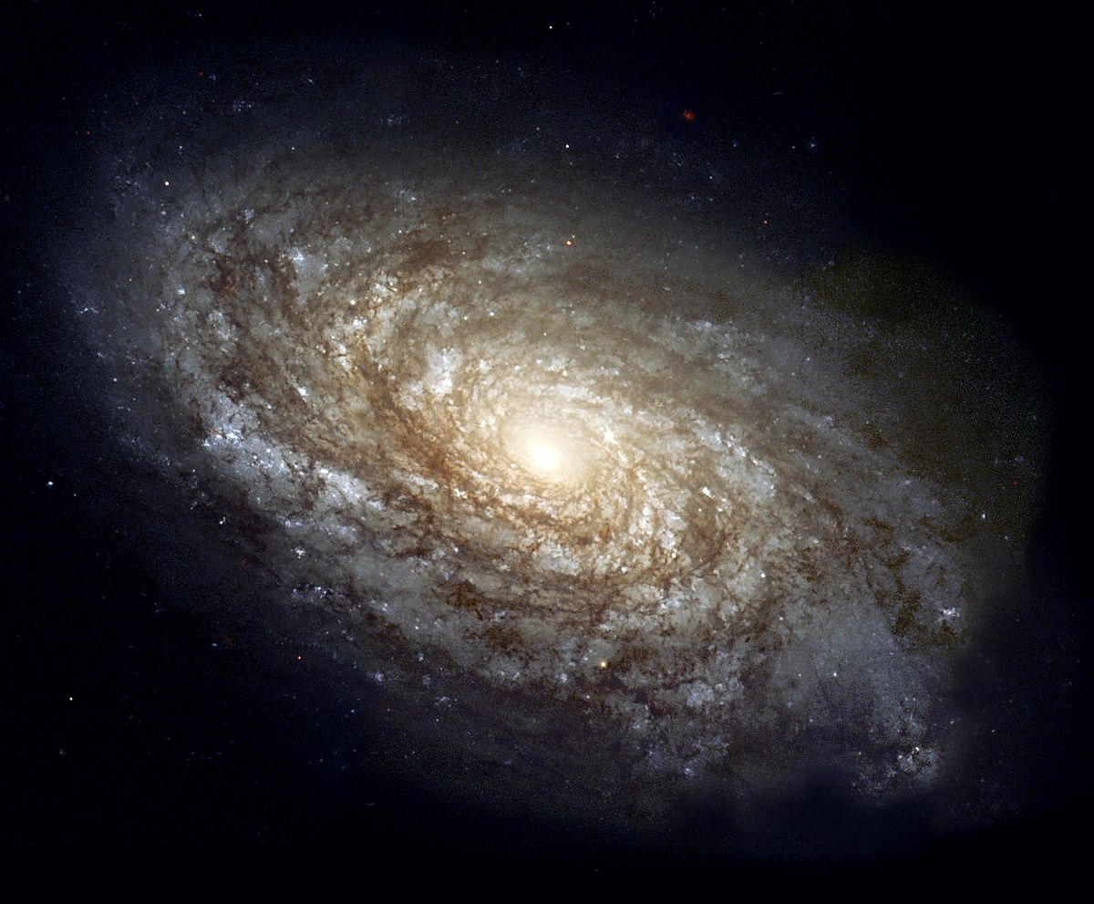
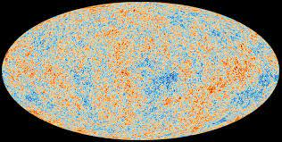
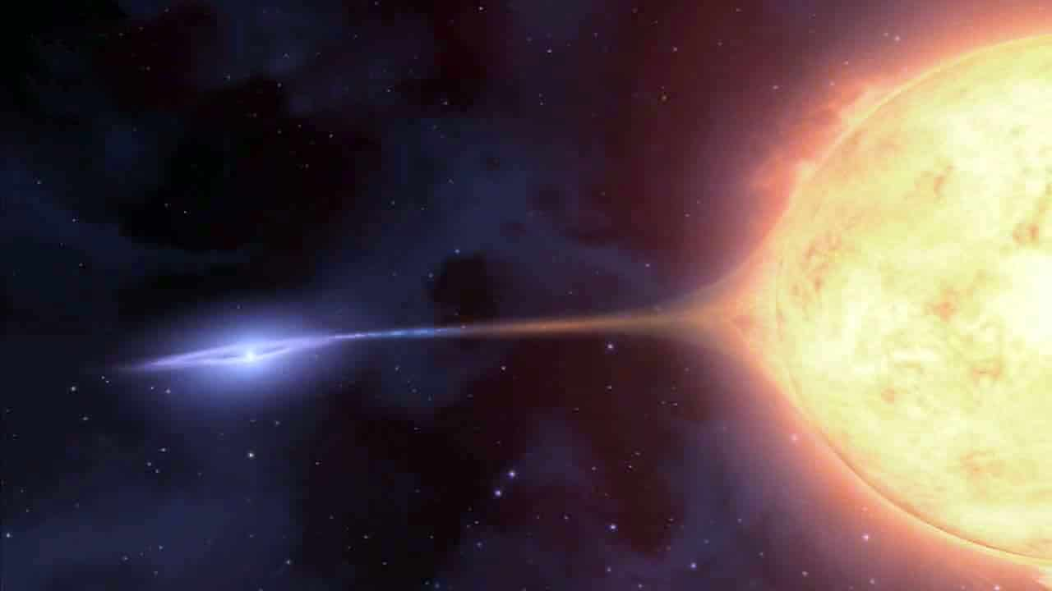
LCDM

Slide 4
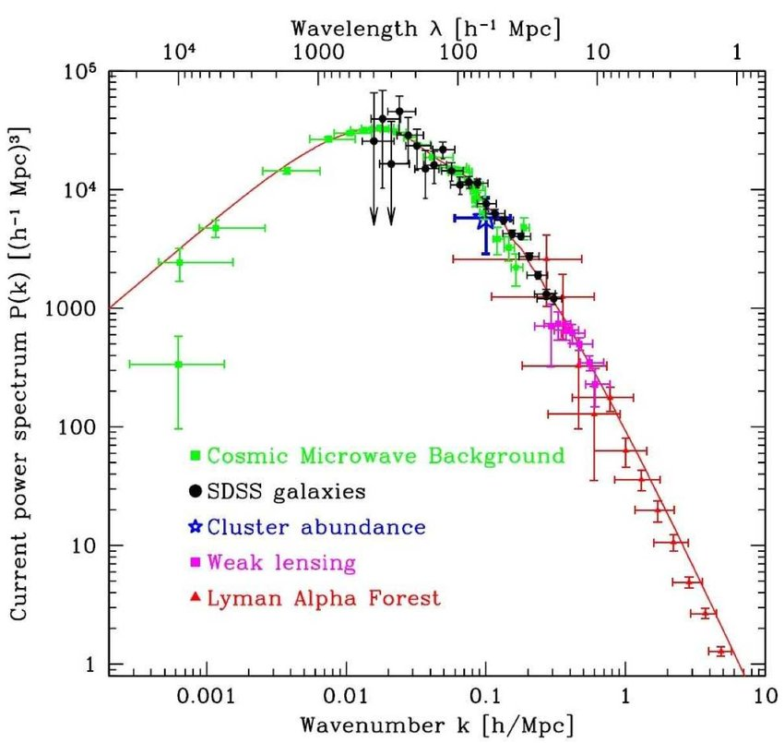
Cold dark matter
Cold: moves non-relativistic
Pressureless: gravitational attractive, cluster
Dark: (transparent): no/weakly electromagnetic interaction
Collisionless: no/weakly self-interaction or interaction with baryons
Abundance: amount of DM today known
@Based on E. Ferreira Talks

Slide 5
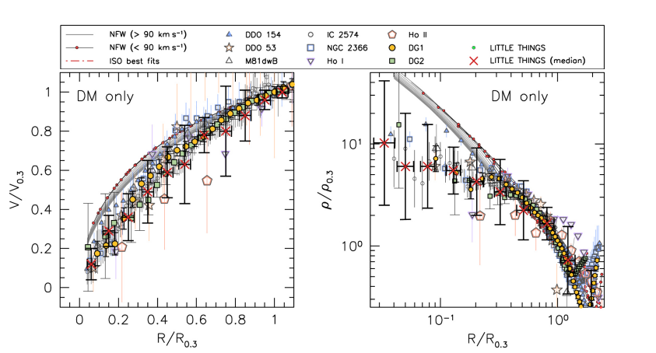
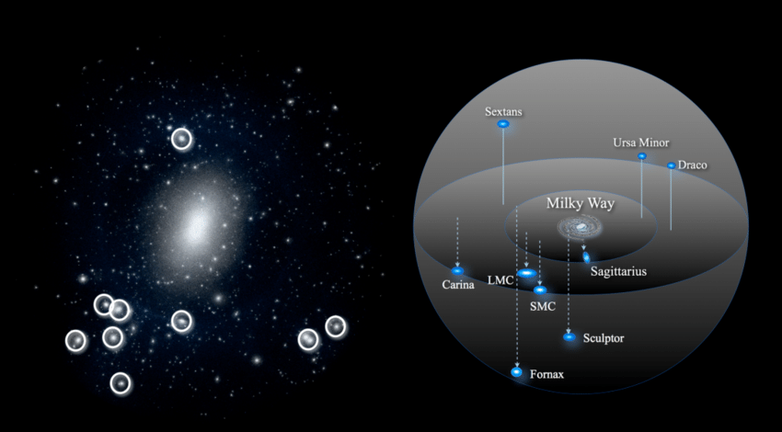
Small scale challenges
Cusp-core
Missing satellites
Oh et al (2011)
Bullock+17
"Observed dwarf galaxies show constant density cores at their centers, not high-density cusps (NFW)"
"LCDM predicts a much larger number of satellite subhalos in the local group (for MW and M31) than we observe"

Slide 6
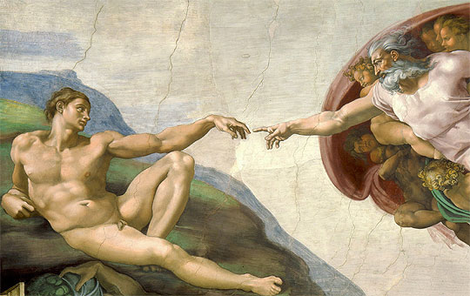
Cosmo & Astro
Fund. HEP

Slide 7
Fuzzy Dark Matter: Foundations

Slide 8
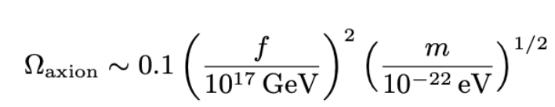
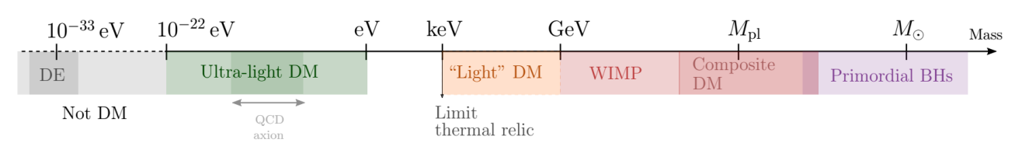
Axion-like Particles (ALPs)
Originally proposed to solve the strong CP problem in QCD
In the range ~ 10^-22 − 10^-21 eV predicted relic abundances are consistent with observed DM abundance

Slide 9
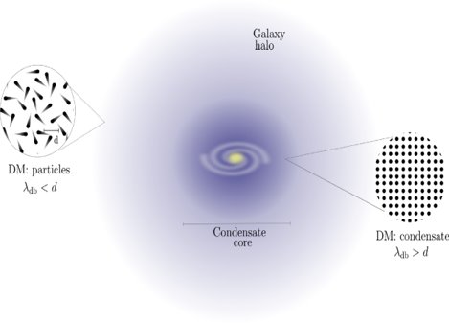
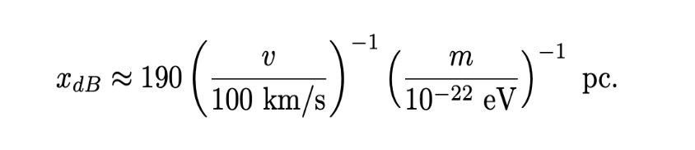
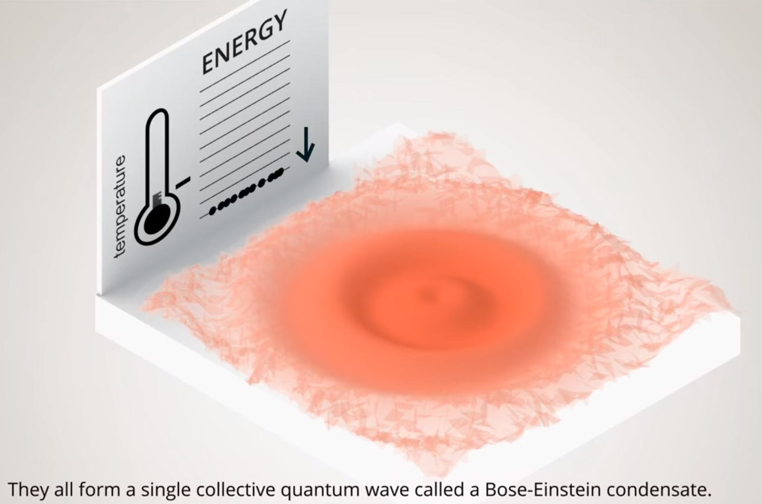
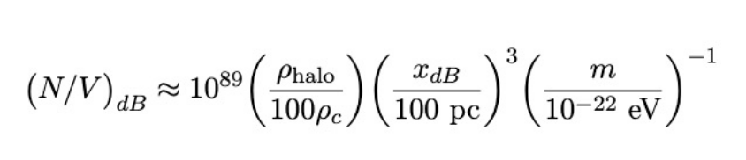
Wave like behavior
Ferreira+21
Low masses mean a high de Broglie wavelength
Hui+16 and Bar+18
Structure below the de Broglie wavelength is suppressed (wave-like behavior)
In the high-particle density limit, forming cored structures analogous to BECs

Slide 10
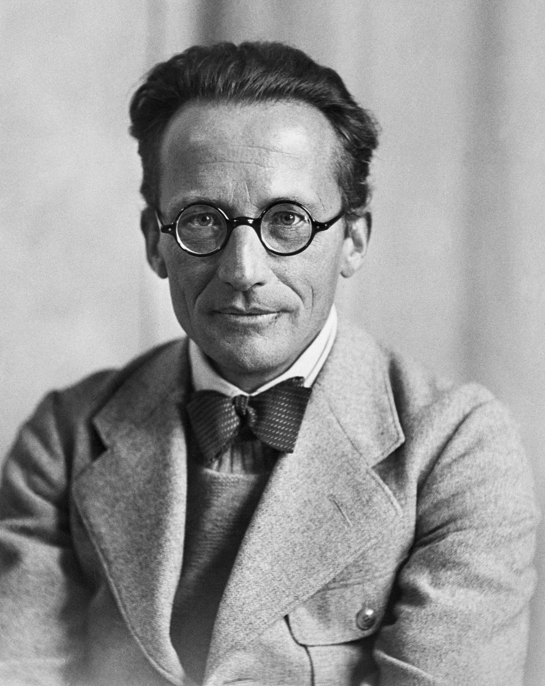
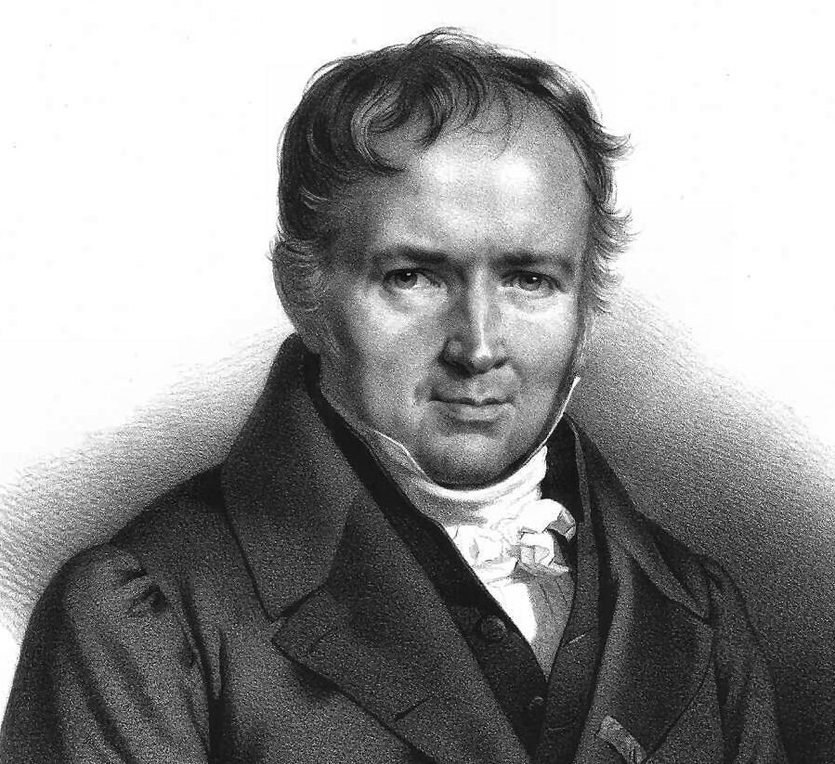
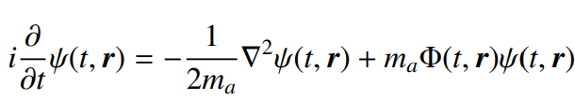

Schrodinger-Poisson Equation
Non-self-interactions
Slow variations in space and time, i.e.,

Slide 11
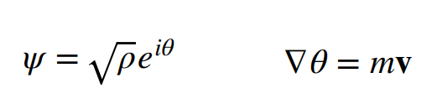
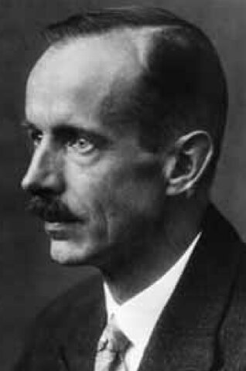
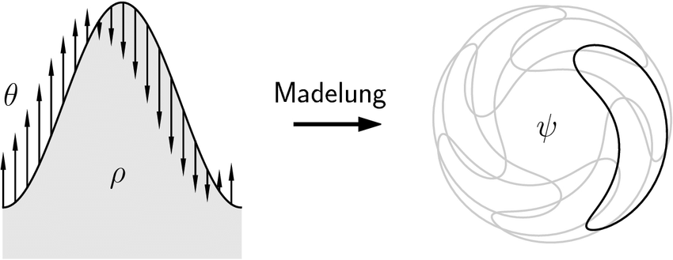
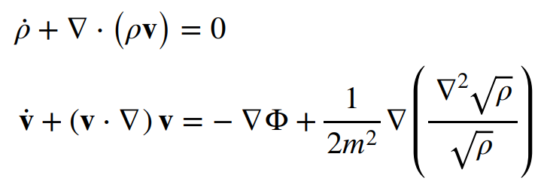
Madelung transformation
Classical fluid:
Quantum potential
Hui+16, Chavanis+11
Mass conservation
Quantum potential
Model recovers CDM for larger axion mass

Slide 12
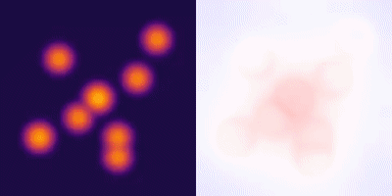
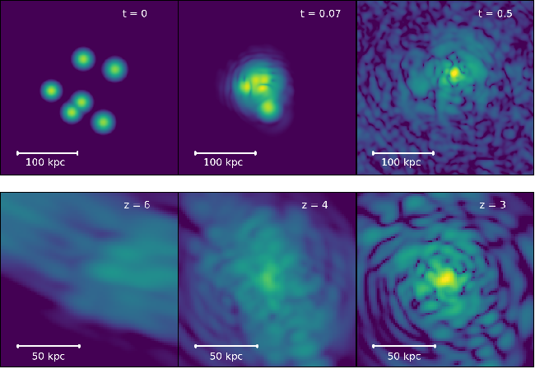
FDM simulations: Cores
Mocz+19
Chan+22

Slide 13
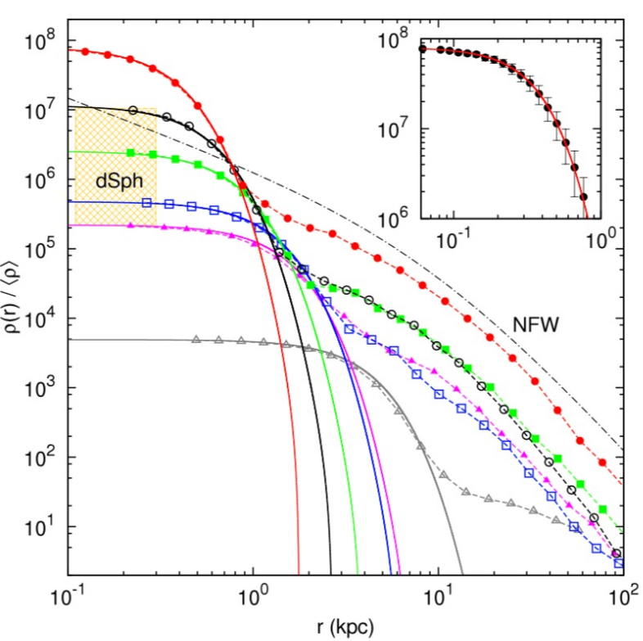
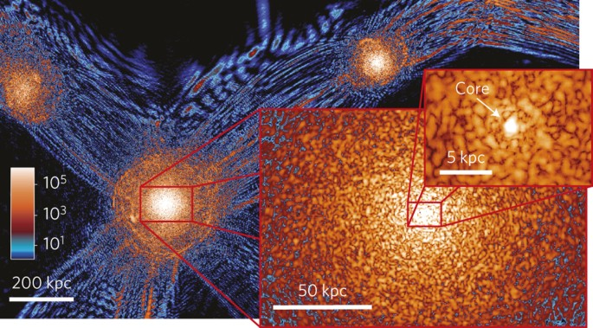
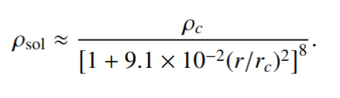
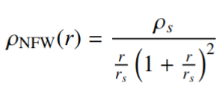
Schive+14
FDM simulations
Evolution of solitons in cosmological simulations
Cored structures with NFW evolved tails

Slide 14

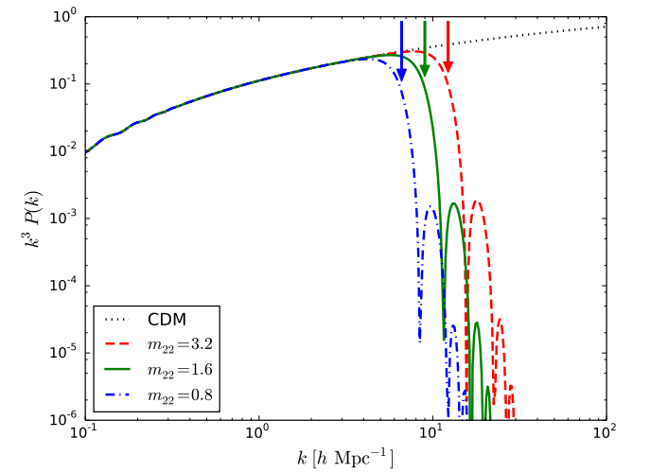
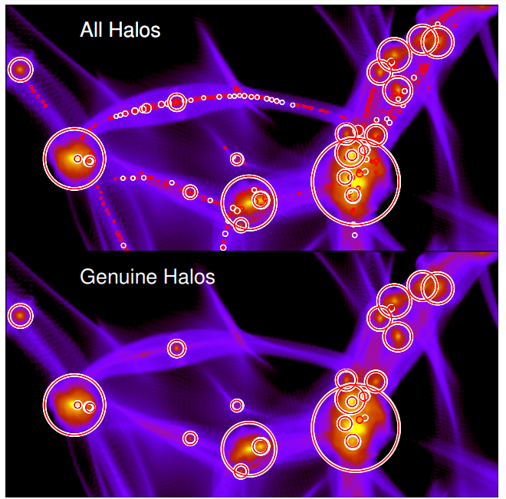
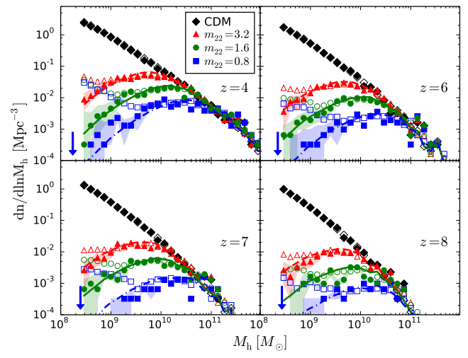
Halo mass function:
Schive+16

Slide 15
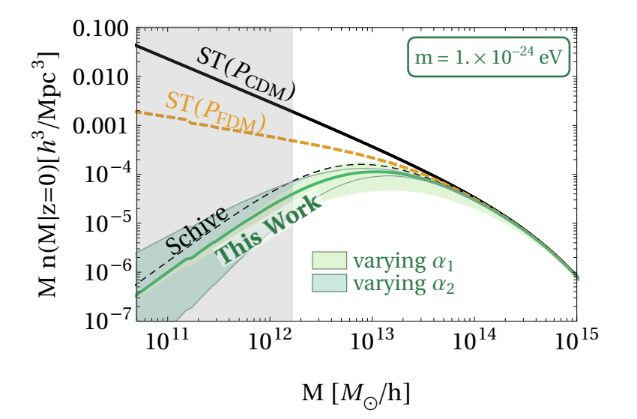
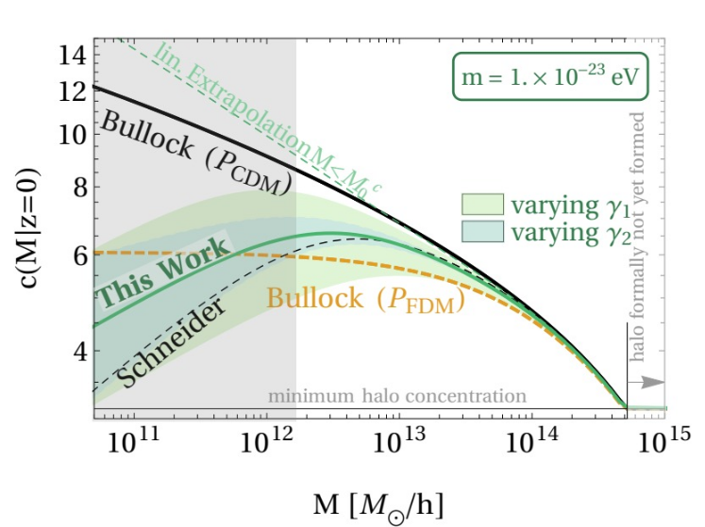
LCDM Challenges and ULDM:
Wave behavior causes core formation and suppression of the formation of
halos below a certain mass (due to power spectrum suppression)
This makes ULDM an attractive candidate to address small-scale structure
issues in LCDM (i.e. core-cusp problem and missing satellites)
Dentler+22

Slide 16
Searching for isolated dwarf galaxies

Slide 17
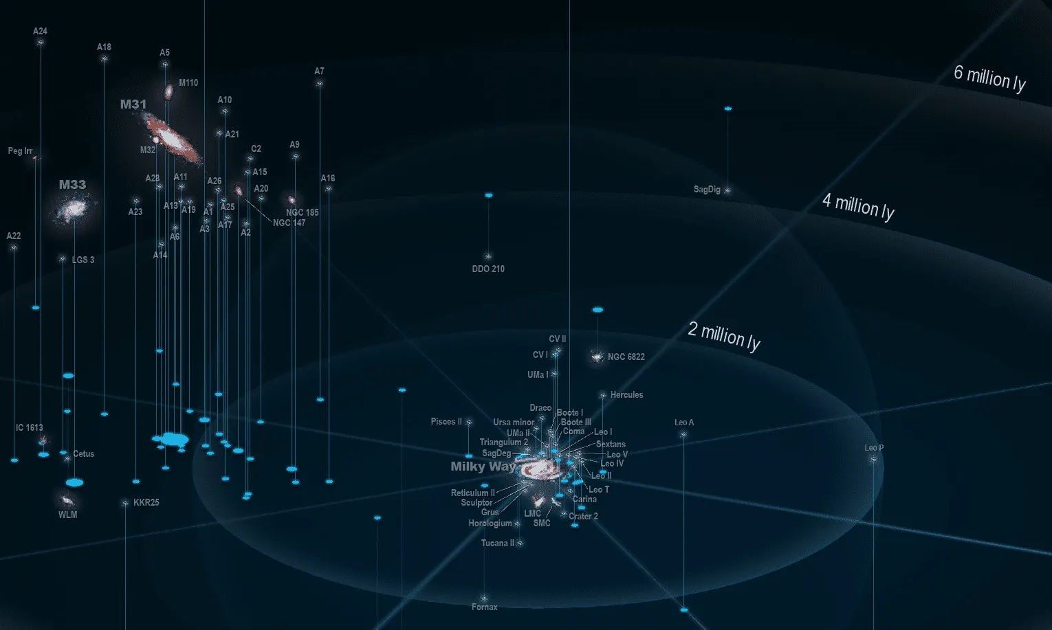
Isolated Dwarfs

Slide 18
Isolated Dwarfs

Slide 19
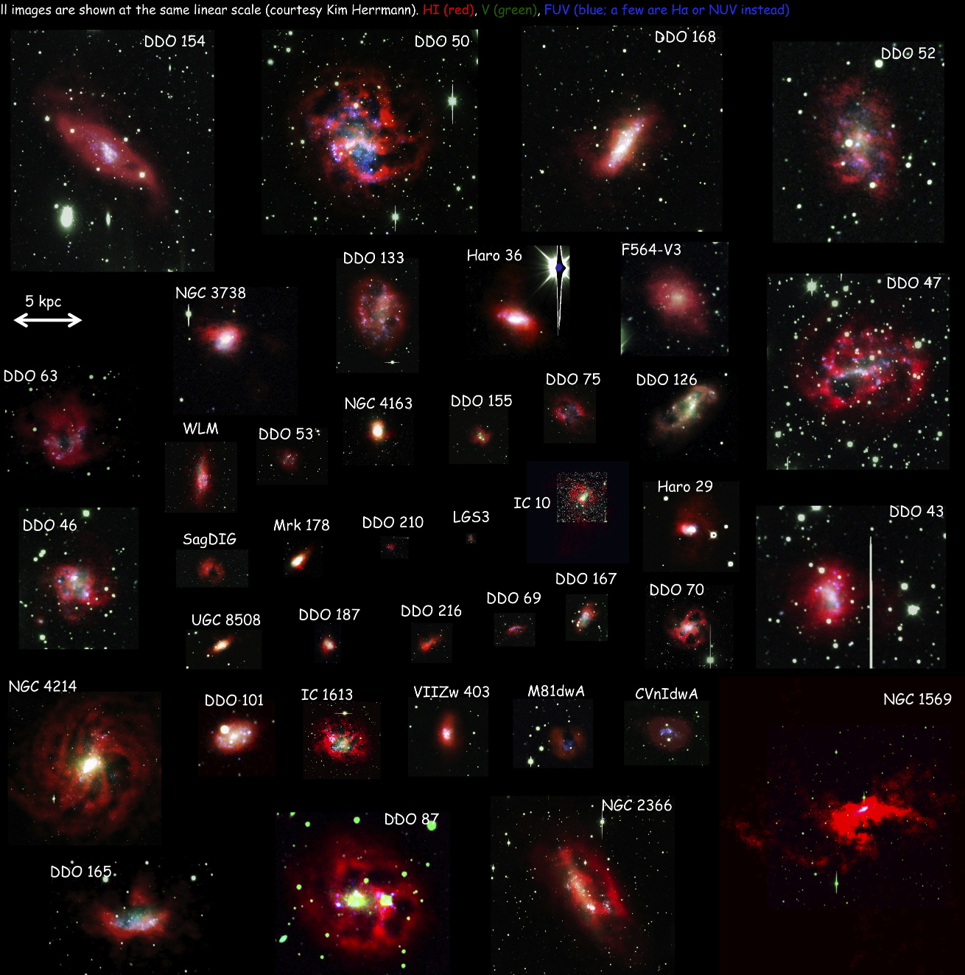

Slide 20
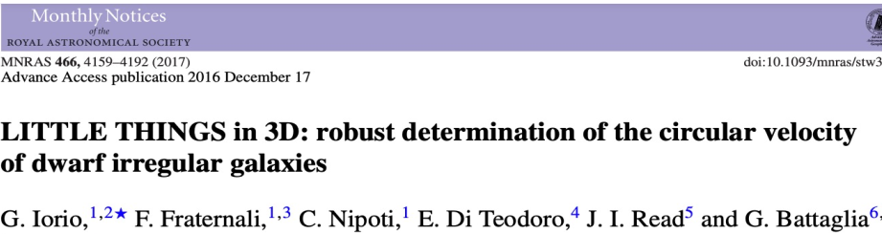
Probing FDM with LITTLE THINGS
Extensive analysis of RCs performed by Iorio et al (2016) on a select group of 14 high-quality isolated dwarf galaxies (with well resolved cores).
Robust determination of errors in distance and inclination
Characterized by being DM dominated with low total and stellar masses, making it especially sensitive to small-scale FDM physics

Slide 22
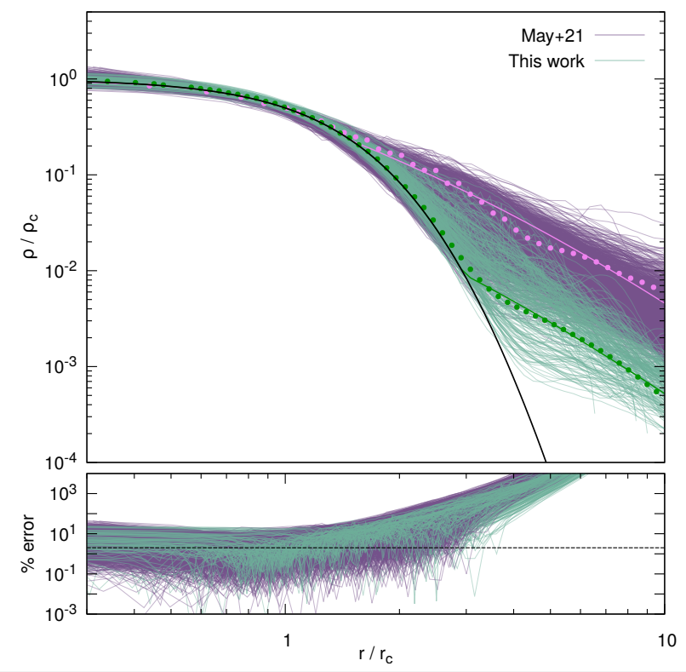
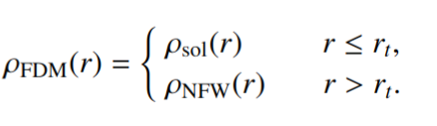
FDM: Mass model
We parametrize the DM profile with four variables: axion mass (𝑚a ), core mass (𝑀c ), concentration parameter (𝑐) and halo mass (𝑀v).
Chan+22

Slide 23
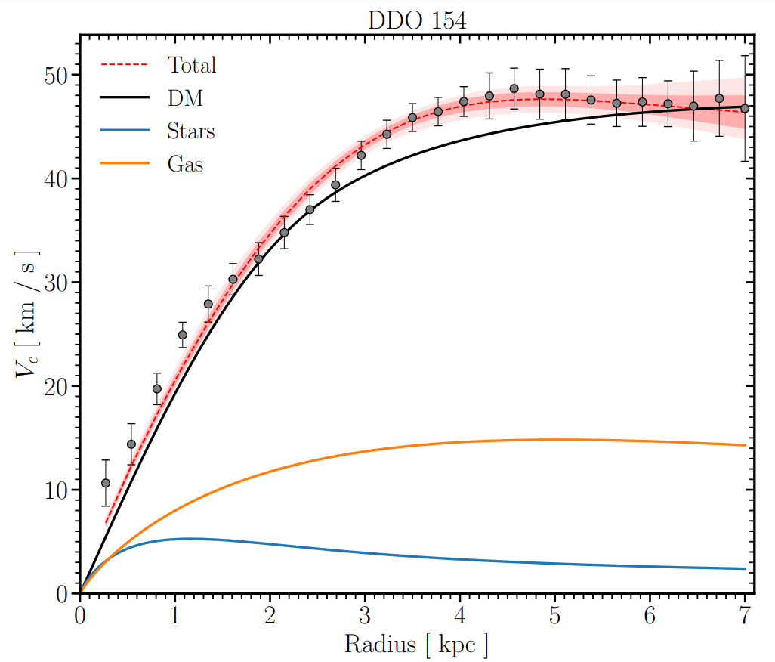
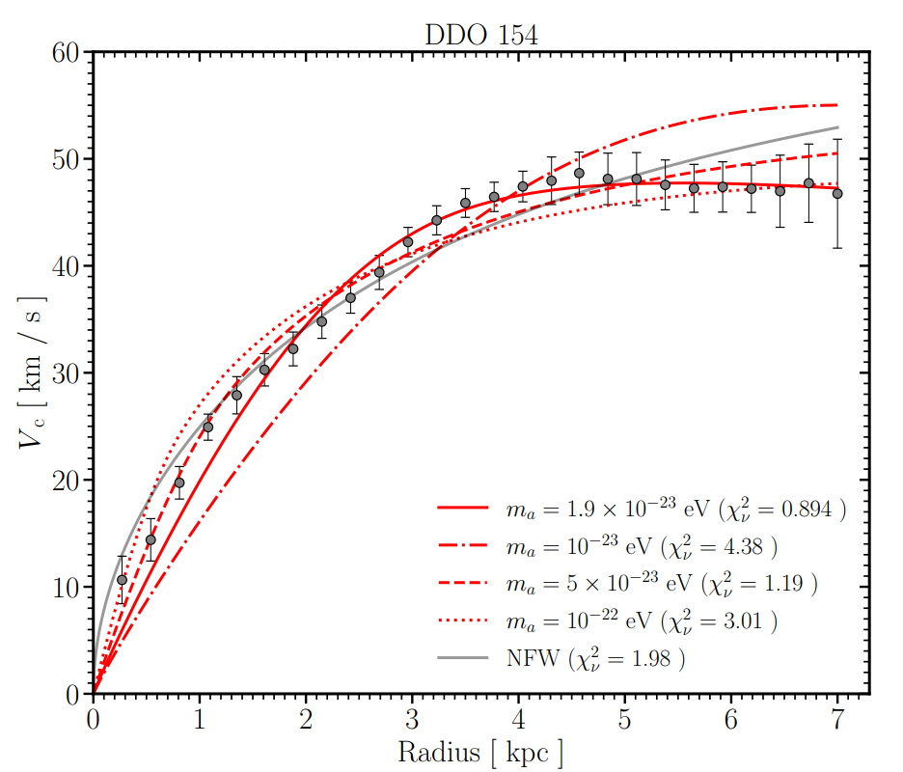


FDM: Rotation curves

Slide 24
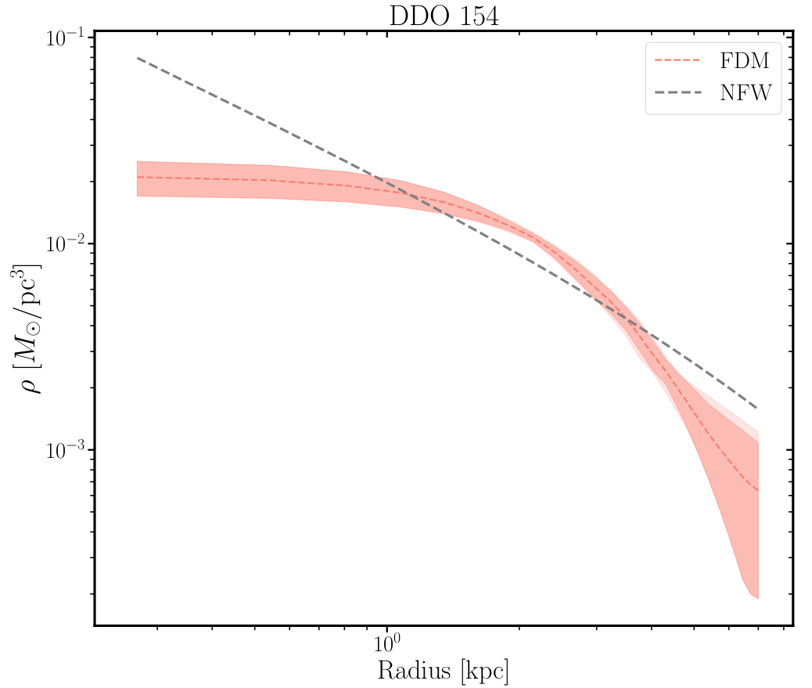
FDM: Density profile
Core radius
Tran. Radius
FDM component
rc
rt

Slide 25
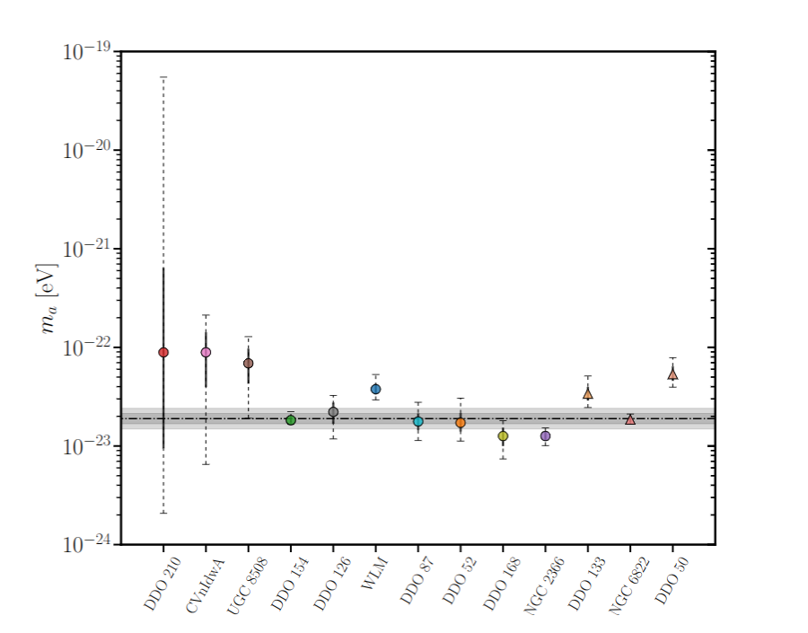
FDM: Mass axion universality
Rogues
Mass
Mass

Slide 26
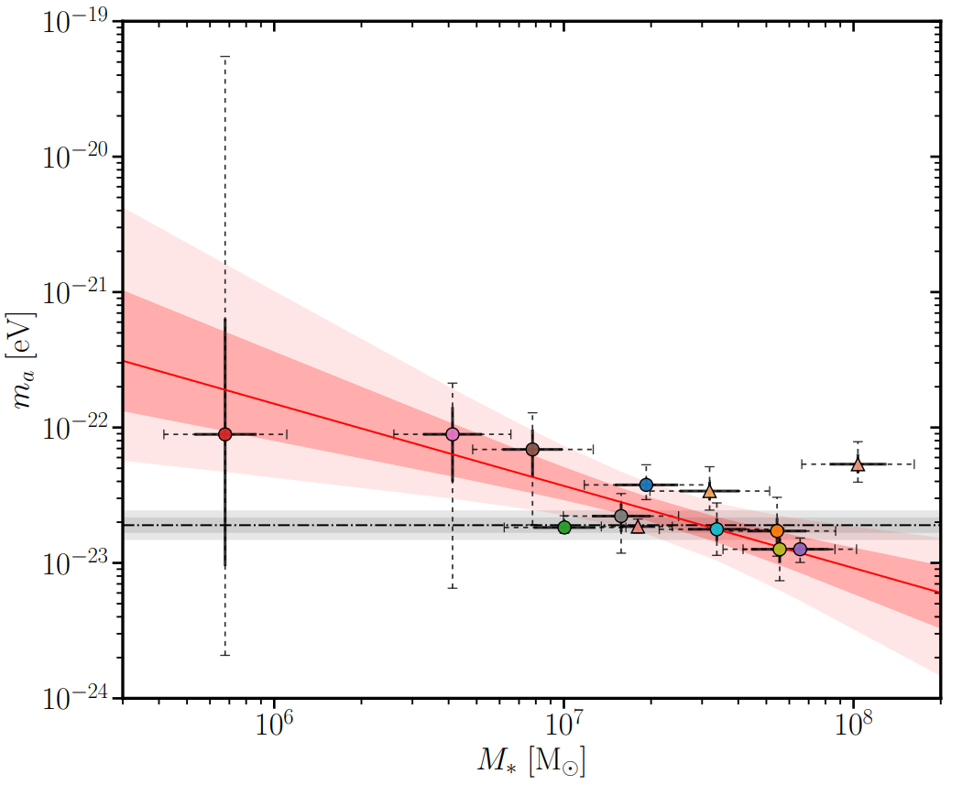


FDM: axion mass universality
An ∼ 3.3σ evidence of a correlation between the values of ma determined from RCs of the galaxies and the corresponding stellar mass.

Slide 27
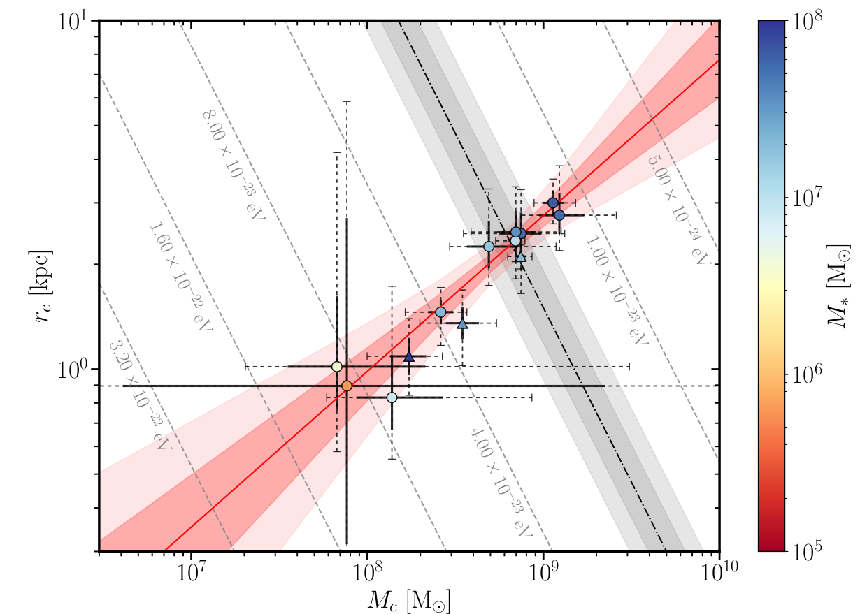
Core radius and mass
Ortoghonal correlation regarding the FDM prediction (significance larger than 5σ)

Slide 28
Number of haloes in local volume

Slide 29
Isolated Dwarfs

Slide 30

Number of haloes in the LV
116
3
Optimal fit

Slide 31
Number of haloes in the LV
116
¡Tension with the fits!
3
We can put a constraint
Optimal fit

Slide 32
Cosmo & Astro Constraints for FDM

Slide 33








Cosmo & Astro Constraints for FDM mass

Slide 34

Cosmo & Astro Constraints for FDM mass
Cosmology:
-Power spectrum suppression
Astrophysics:
-Black hole superradiance
-Heating
-Dynamical friction
-Jeans analysis
-Small scales suppression
@Exclusion (FDM is all DM )

Slide 35
Cosmo & Astro Constraints for FDM mass
Cosmology:
-Power spectrum suppression
Astrophysics:
-Black hole superradiance
-Heating
-Dynamical friction
-Jeans analysis
-Small scales suppression
@Exclusion (FDM is all DM )

Slide 36
Concluding remarks
The soliton+NFW model provides an excellent fit to the rotation curves of the LTs sample
A mild correlation of axion mass with the stellar mass of the galaxy with a significance of ∼ 3.3σ
rc − Mc relation the data shows a scaling that is almost orthogonal to the one predicted by FDM (>5σ)
Same galaxies we are studying would be excluded by the strong suppression in the linear power spectrum that is predicted for FDM with the mass 2 10^{-23} eV

Slide 37
Catch+22 problem FDM
"To replicate the core-like structures in dwarf galaxies by invoking a particle mass would imply a suppression of small-scale structure that is much too strong to be consistent with observations''.

Slide 38
Muchas gracias

Slide 39
Properties of the halo

Slide 40


Benchmark analysis

Slide 41

Inner slope
The most massive galaxies in the sample present cores which are consistent with those expected from baryonic feedback while the less massive ones.
Other present cores generally more extended (or flatter) than predicted by these processes.

Slide 42

Abundance matching
Galaxies with stellar low masses should be extremely rare which is clearly in plain contradiction with the posterior distributions of the very same fits.

Slide 43
Extra slides

Slide 44

Too big to fail
The more massive subhalos predicted by the simulations are too big to fail to form stars and galaxies

Slide 45







FDM Motivations
Isotropic and homogeneous expanding universe
Axion field starts to oscillate with a frequency equal to its mass
Co et al (2019)
Correct relic density: Misalignment Mechanism
Core-cusp problem
Large scale structure: CDM like behavior
Ho et al (2015)
Schive et al (2014)

Slide 46


Baryonic effects

Slide 47

Baryonic effects

Slide 48

Global fit for mass

Slide 49

Central density and core radius
Disagreeing with the prediction of FDM, with a significance larger than 3σ

Slide 50


NFW results

Slide 51
Cosmo & Astro Constraints for FDM mass
Influence of baryons: baryonic processes can change the density structure of their halo.
Universality of the core profile: FDM soliton profile might be too simplistic, could change for different systems (might also depend on baryons).
@Exclusion (FDM is all DM )

Slide 52
Cosmo & Astro Constraints for FDM mass
Core-mass relation: might need to be better understood. Diff. relations in diff. Simulations.
Challenge for the FDM model
@Exclusion (FDM is all DM )

