Slide 1
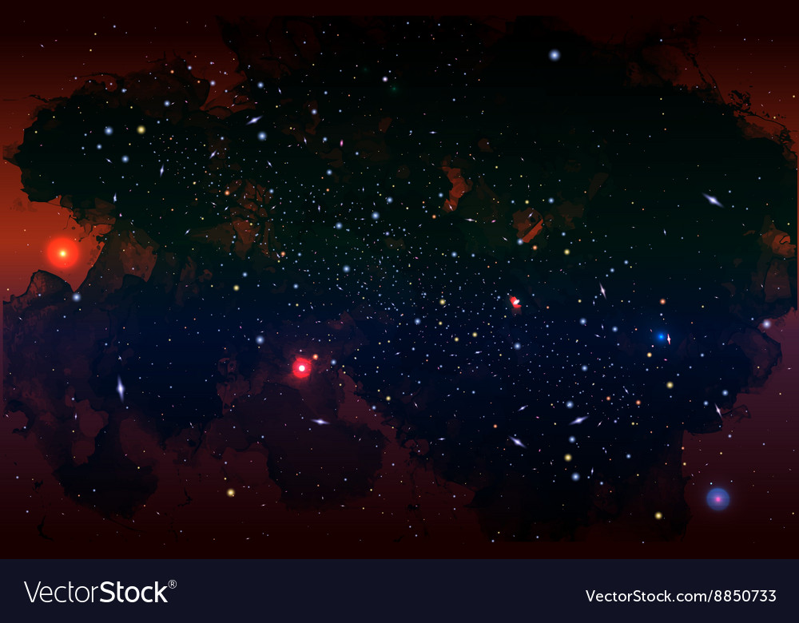



Machine Learning Unveils the Matter Power Spectrum of Modified Gravity
J. Bayron Orjuela- Quintana
Savvas Nesseris
Domenico Sapone
Notes:
Hello everyone. My name is Bayron, I'm a PhD student in Colombia, and I'm very grateful to have the opportunity to share with you my work on theoretical aspects of modified gravity theories in this Cosmology from Home 2023. This work is the fruit of collaboration with Professor Savvas Neseeris at Instituto de F\'isica Te\'orica in Madrid.
So, let's get start it. It is far known that the standard cosmological model is suffering by some theoretical and observational problems, and that modified gravity is one of the main platforms displayed to investigate alternative models.

Slide 2
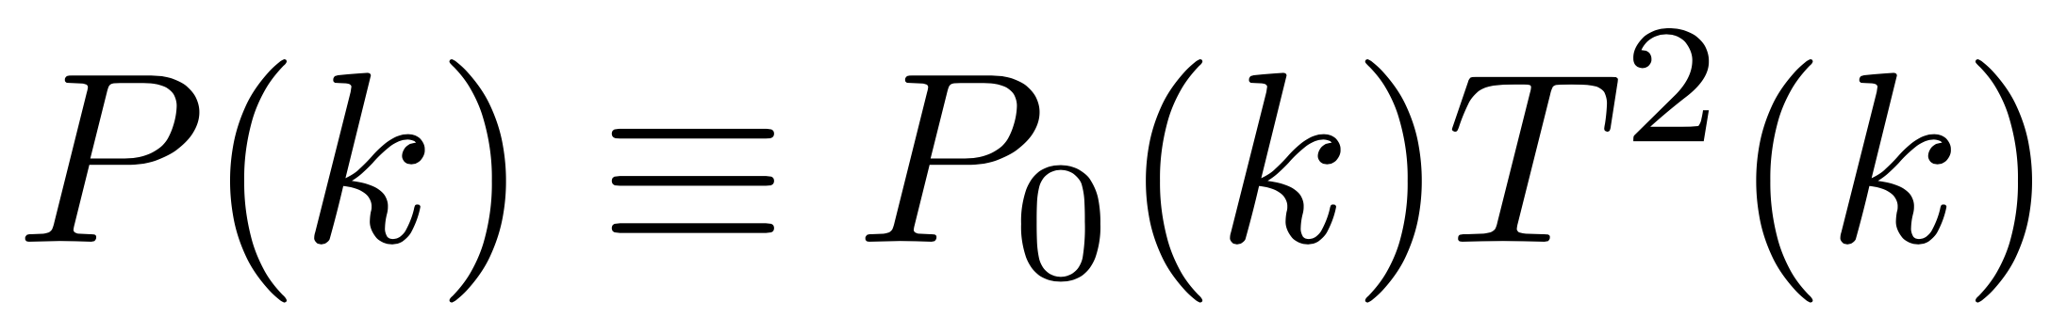
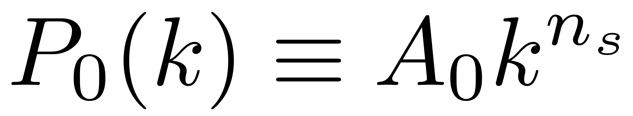
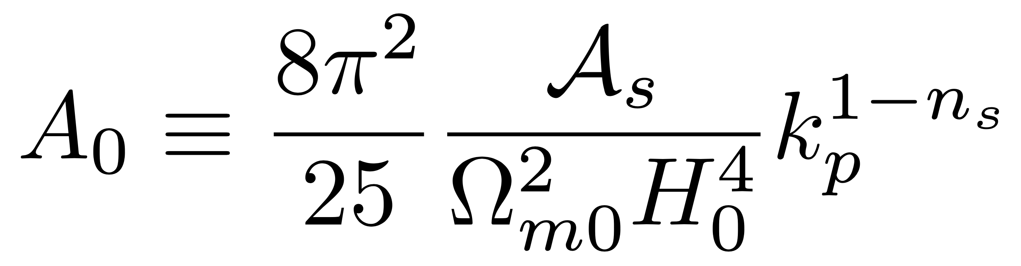
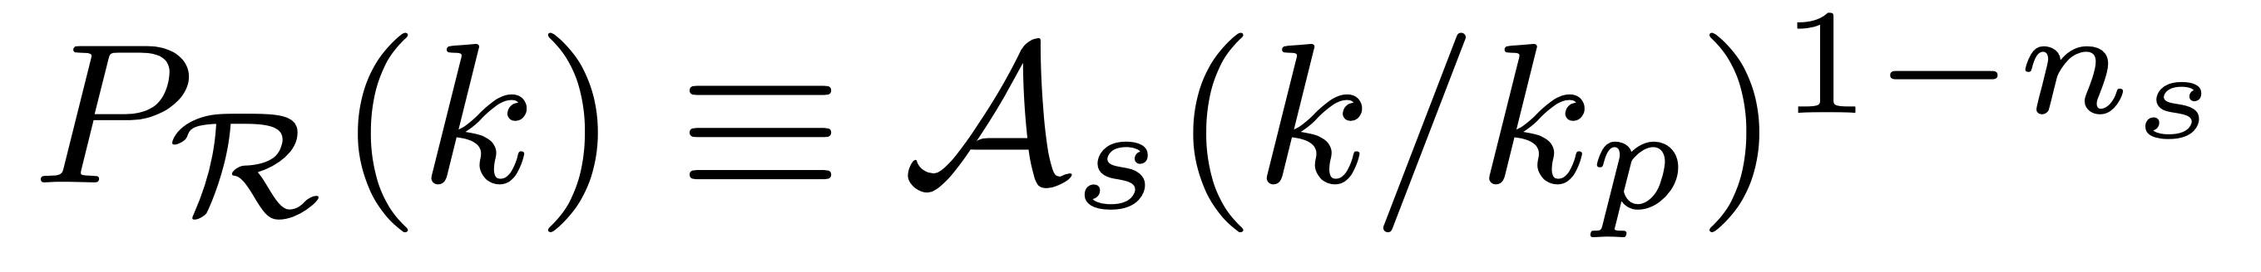
Matter Power Spectrum
Transfer Function
Z’eldovich Spectrum
For concordance model and sub-horizon modes
Primordial power spectrum
Notes:
However, there is a huge number of possibilities as you can see in this picture. Then, some theoretical strategies are required to understand the physics behind these theories. Here, for the sake of simplicity, I will focus in the tiny part of this map known as $f(R)$ theories, which are very representative among the plethora of modified gravity theories. We hope to extend the results I will show you to larger portions of this map.

Slide 3
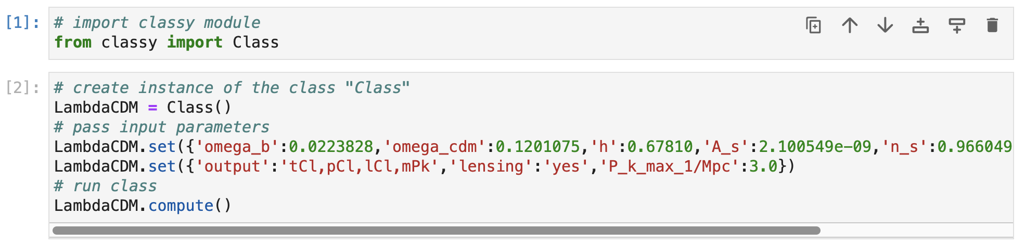
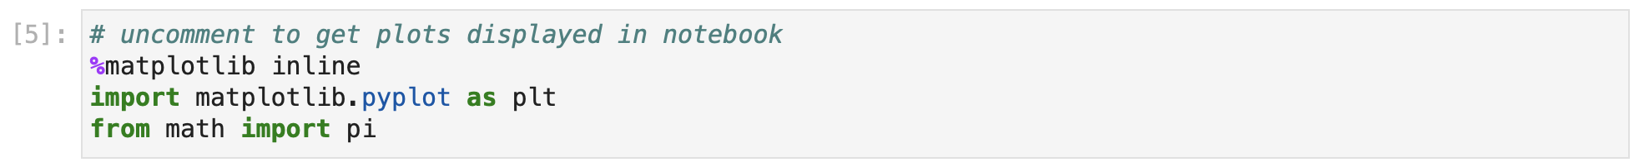
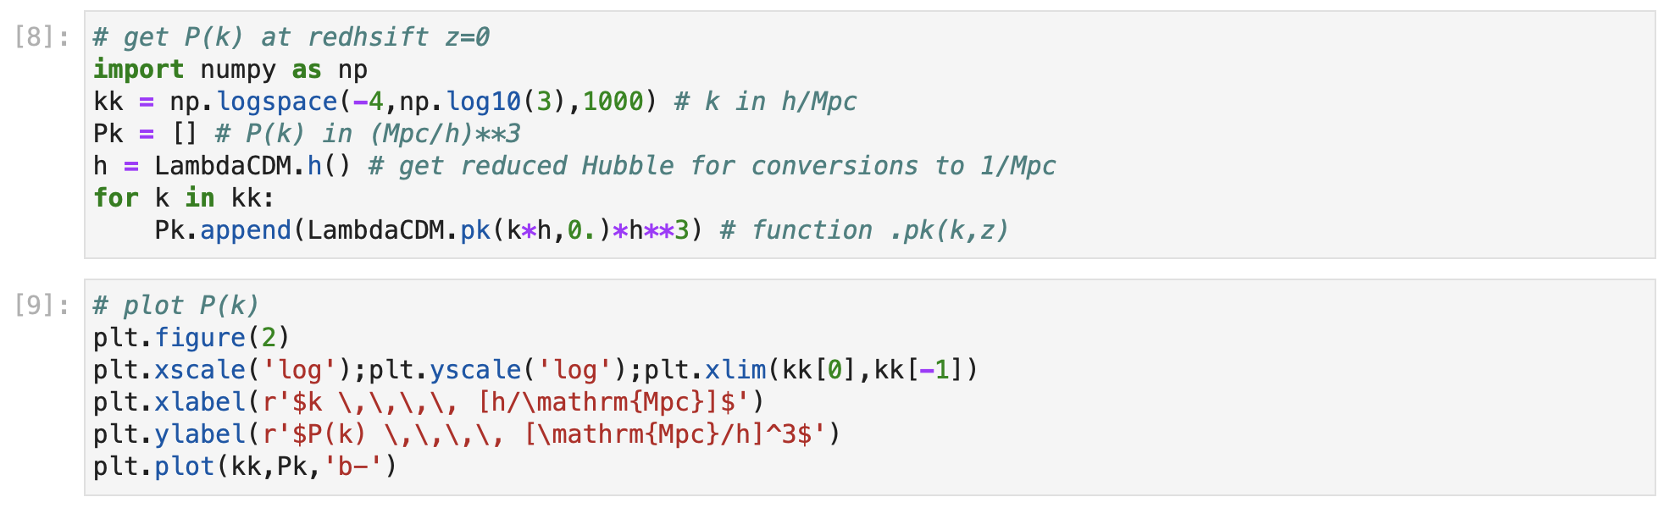
Numerical Computation
Using the Python wrapper of CLASS

Slide 4
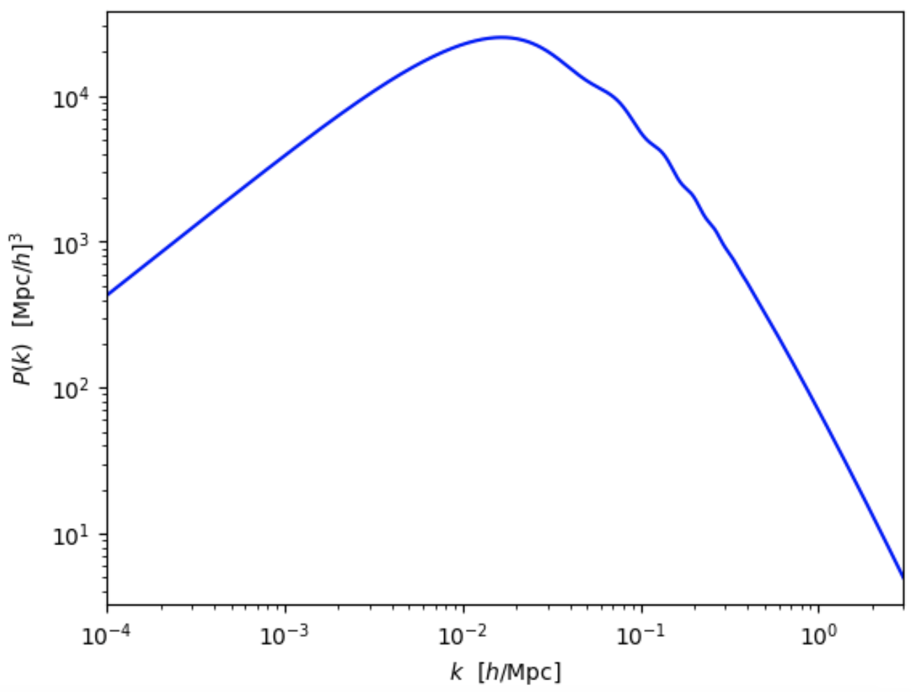

Slide 5
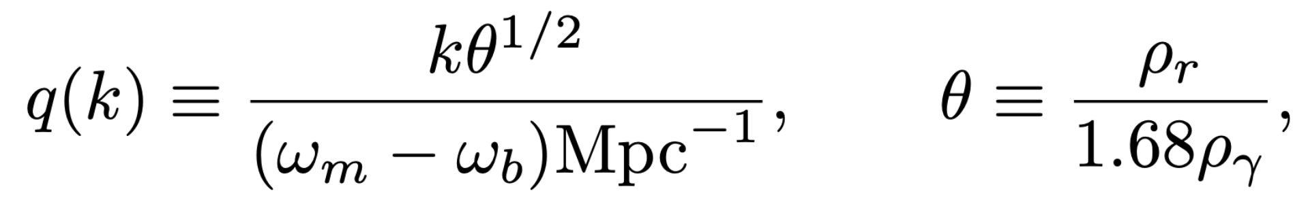
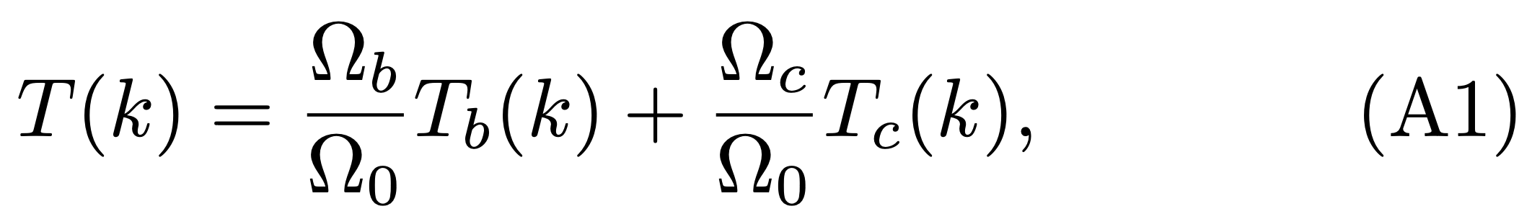

Fitting Functions: CDM
$Λ$
Bardeen-Bondi-Kaiser-Szlay Fitting Formula: Astrophys. J. 304 (1986) 15–61.
Too simplistic!
Eisenstein-Hu Fitting Formula: Astrophys. J. 496 (1998) 605, arXiv:astro-ph/9709112.
A lot of physics!

Slide 6
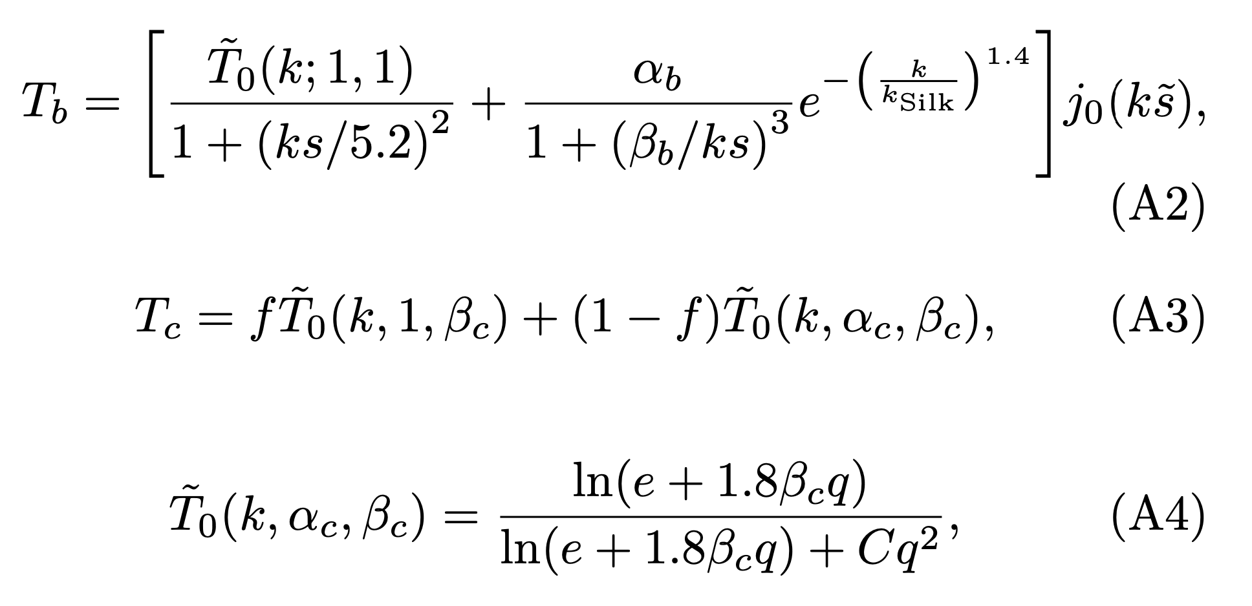
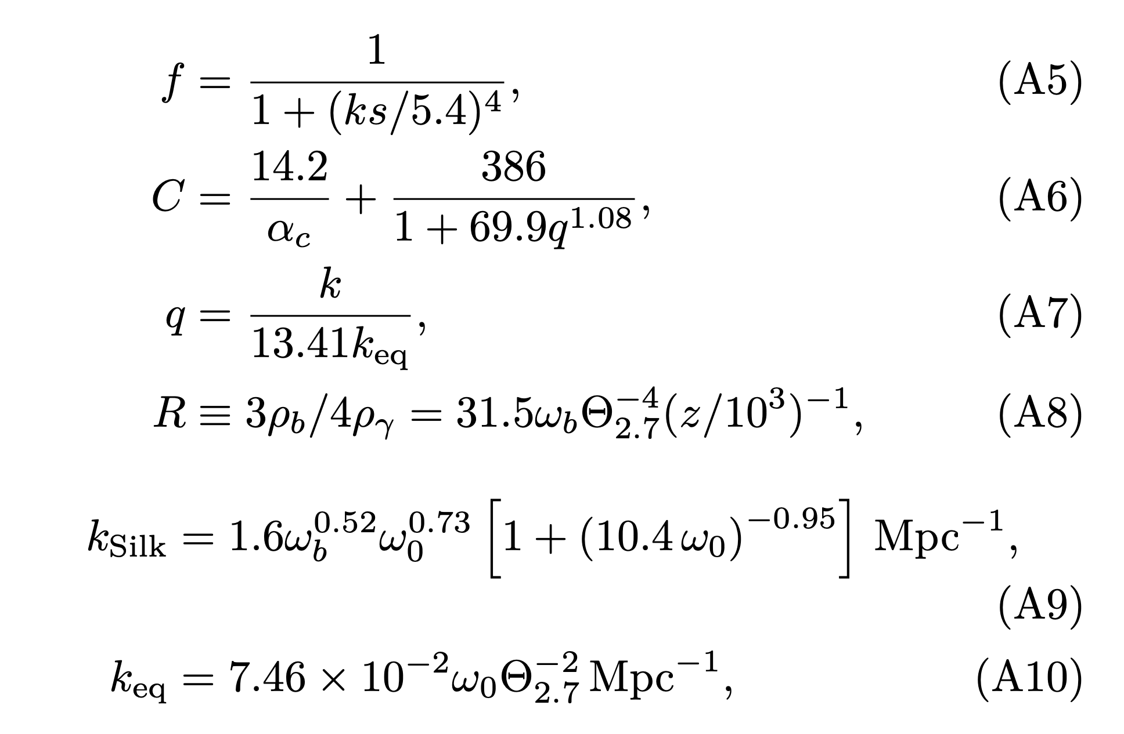

Slide 7
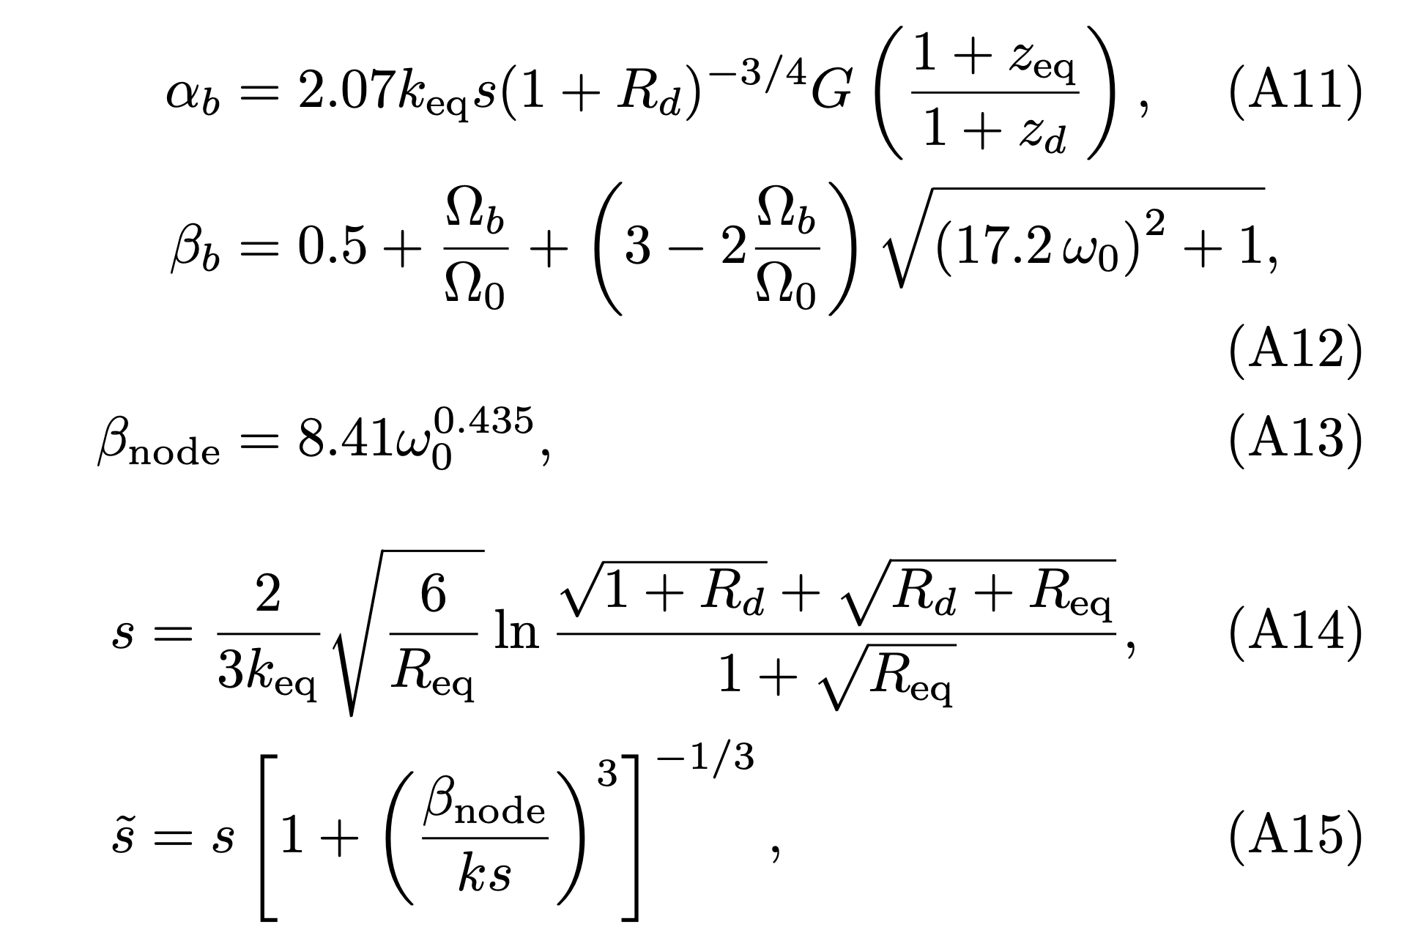
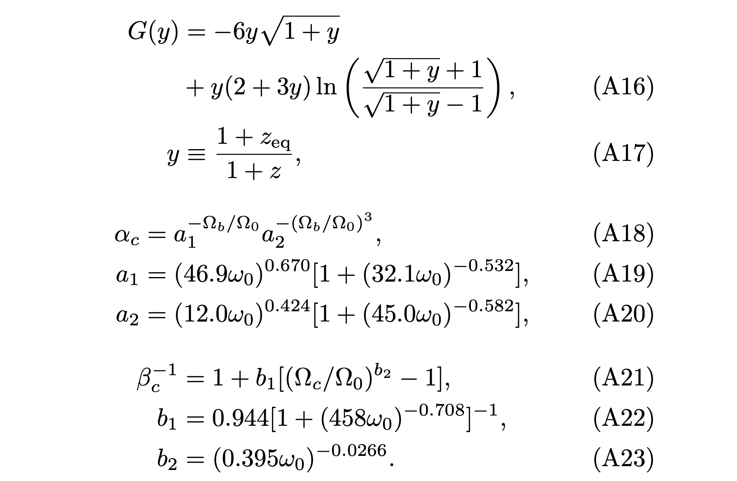

Slide 8
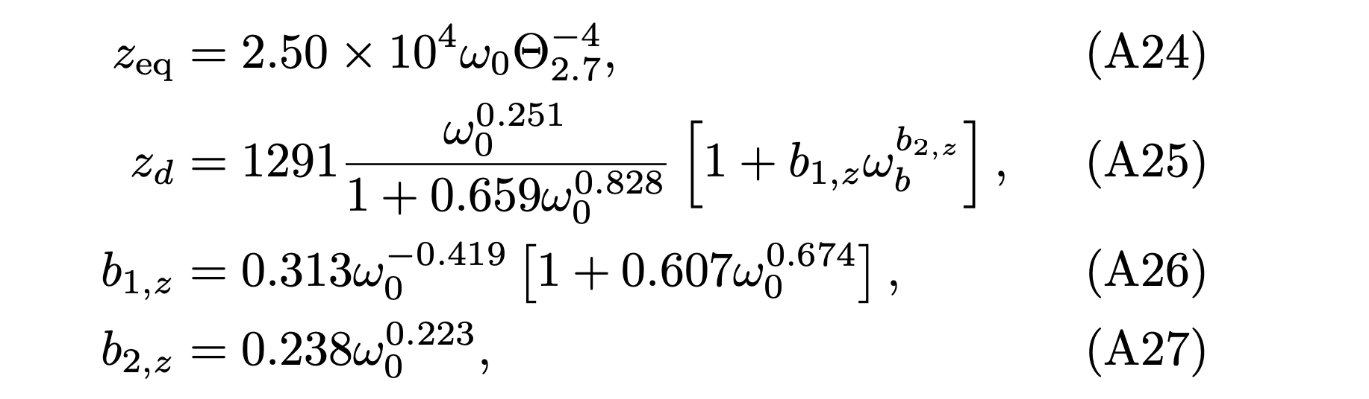
Too complicated!!!

Slide 9
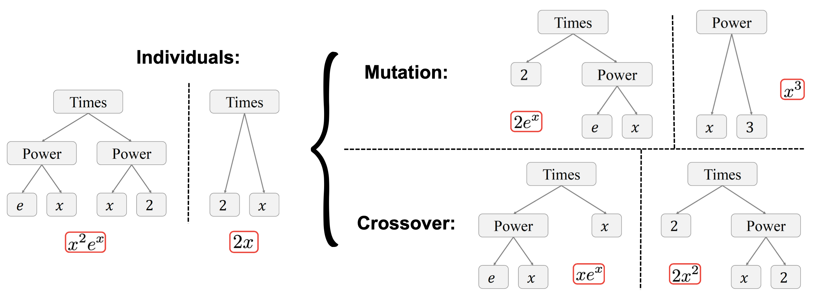
Genetic Algorithms
GOAL: To find a simpler formulation with similar or better accuracy

Slide 10
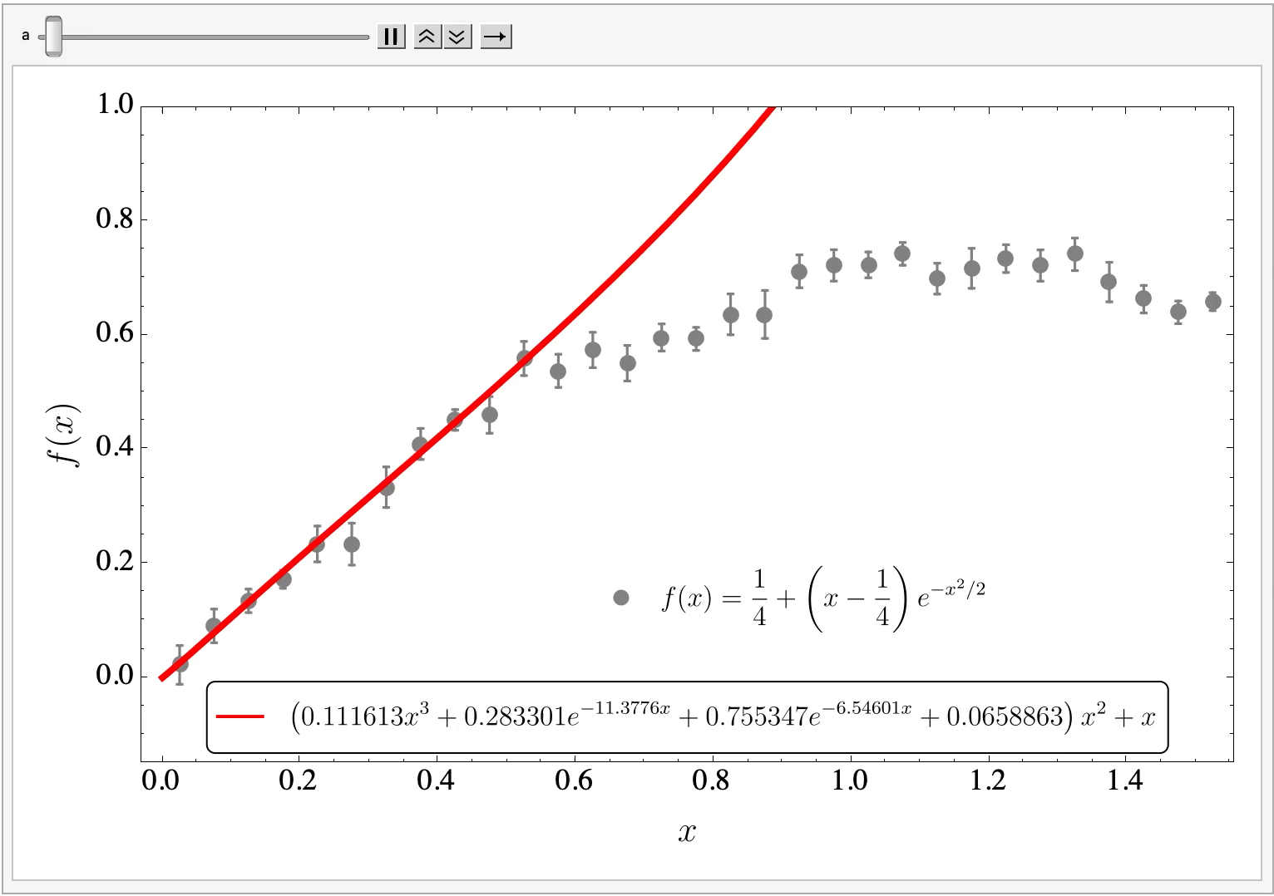
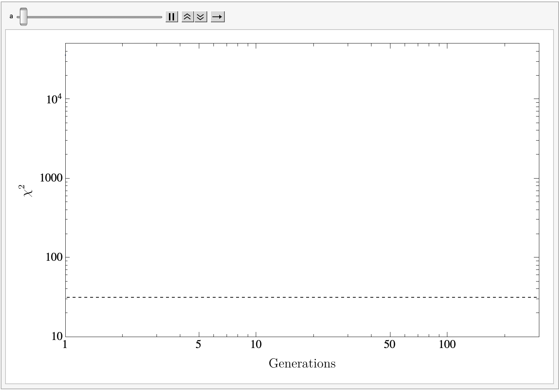

Slide 11
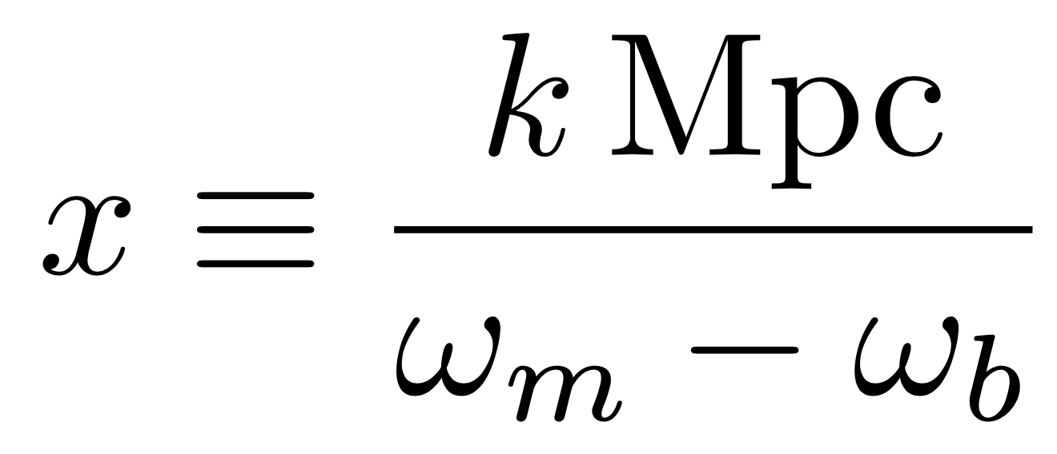
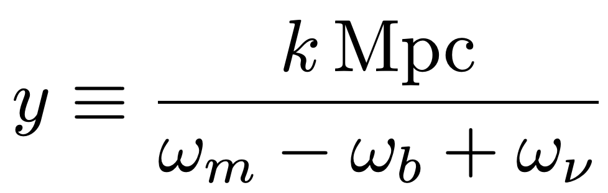

GA Fitting Function: CDM
$Λ$
Magic numbers?

Slide 12
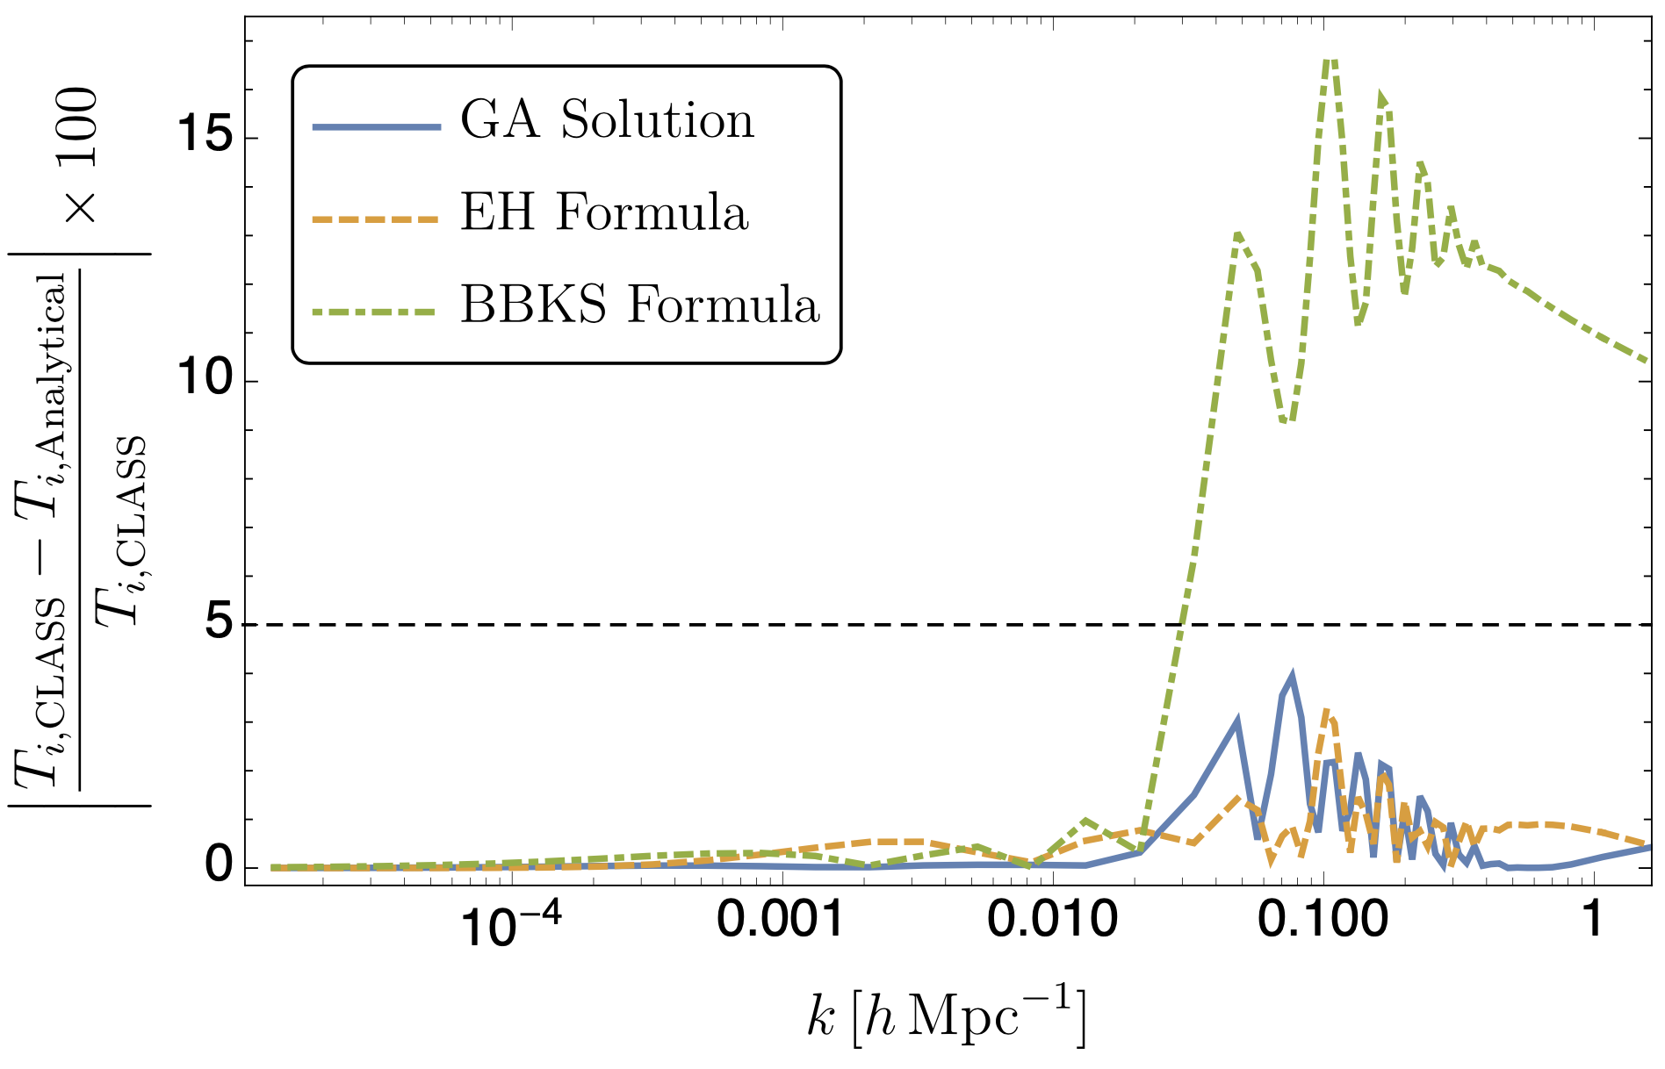
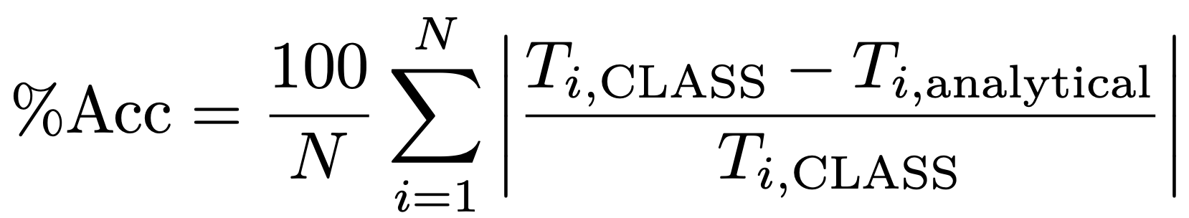
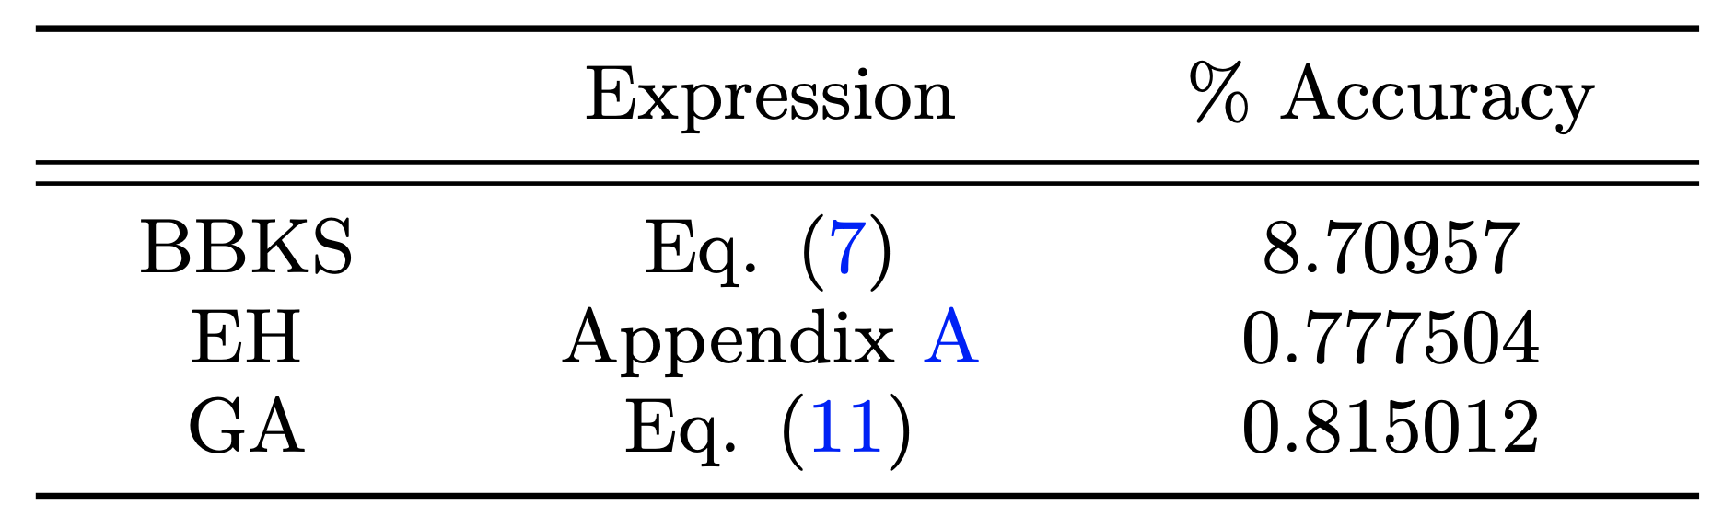
Performance

Slide 13
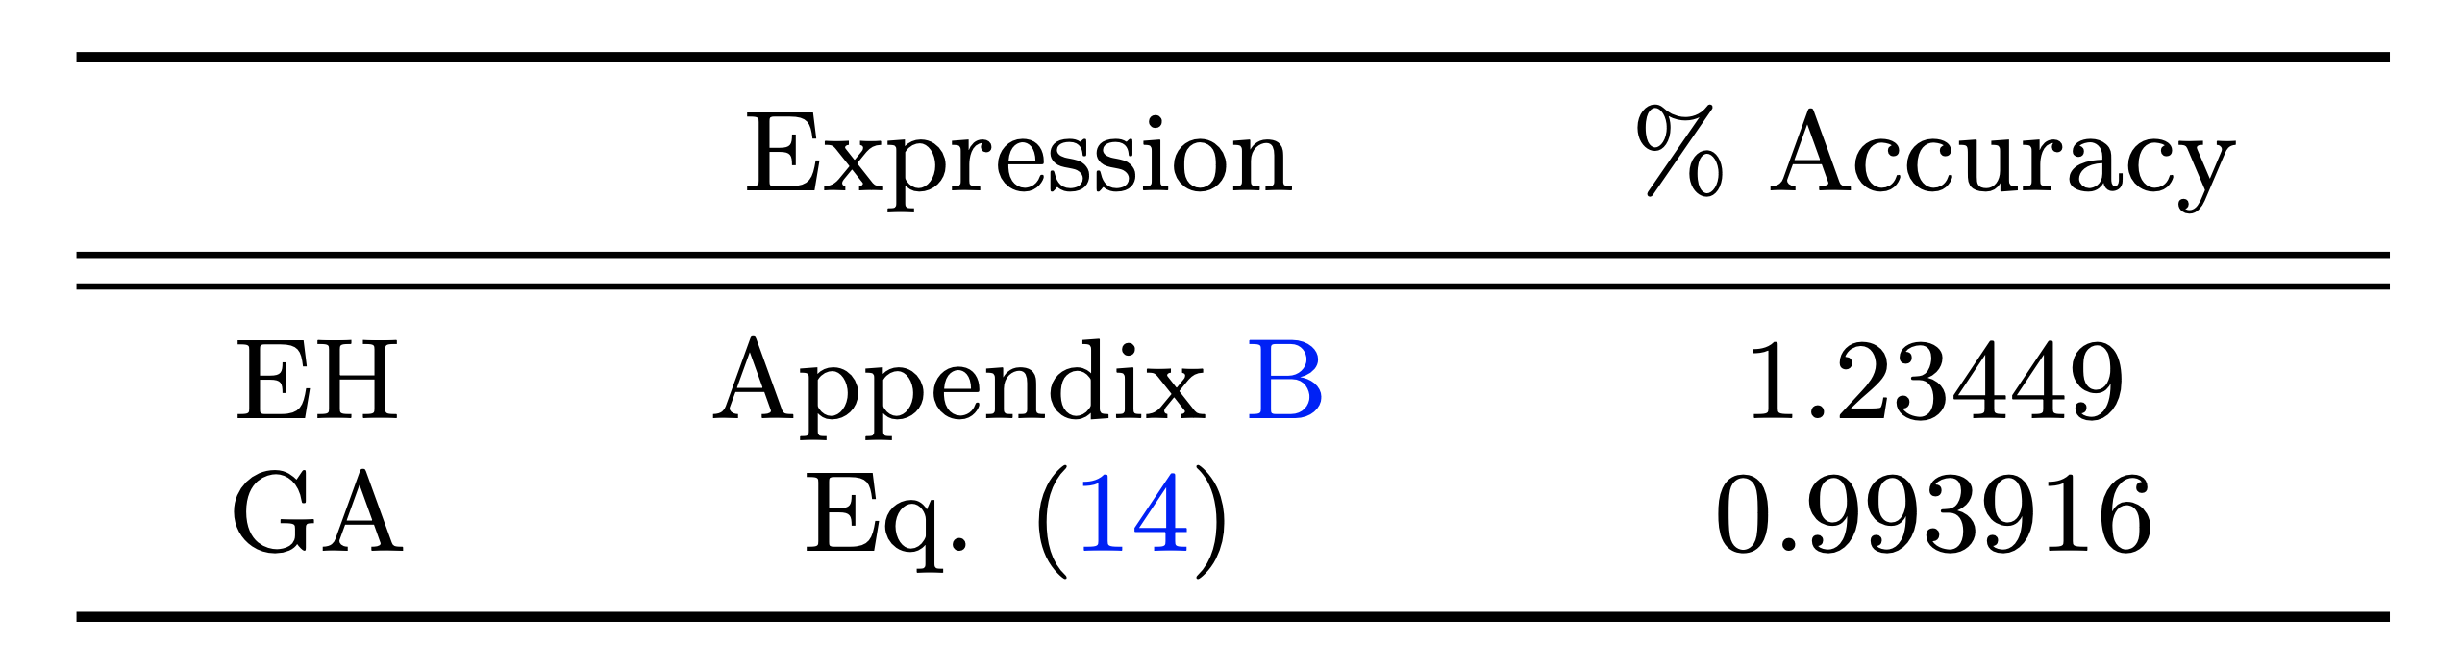
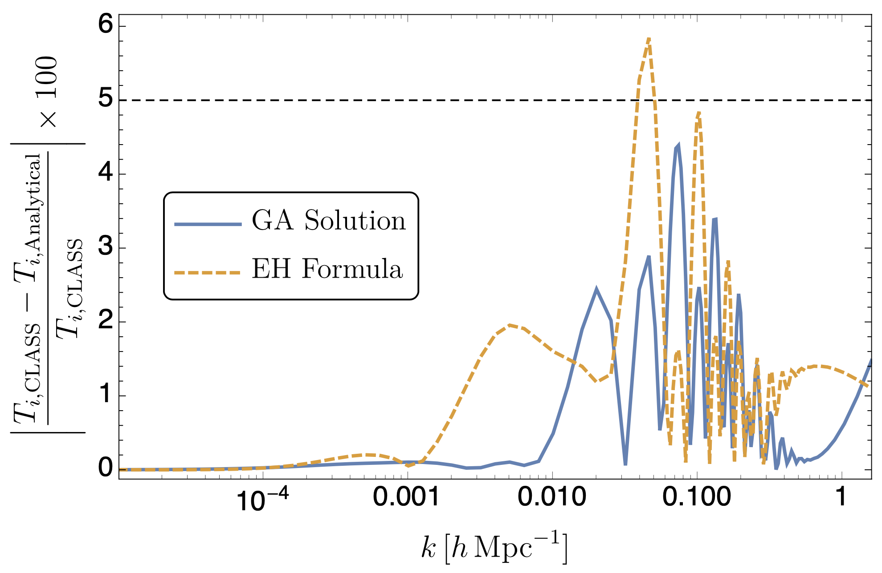

Slide 14
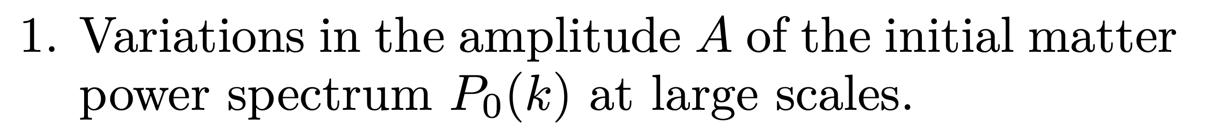
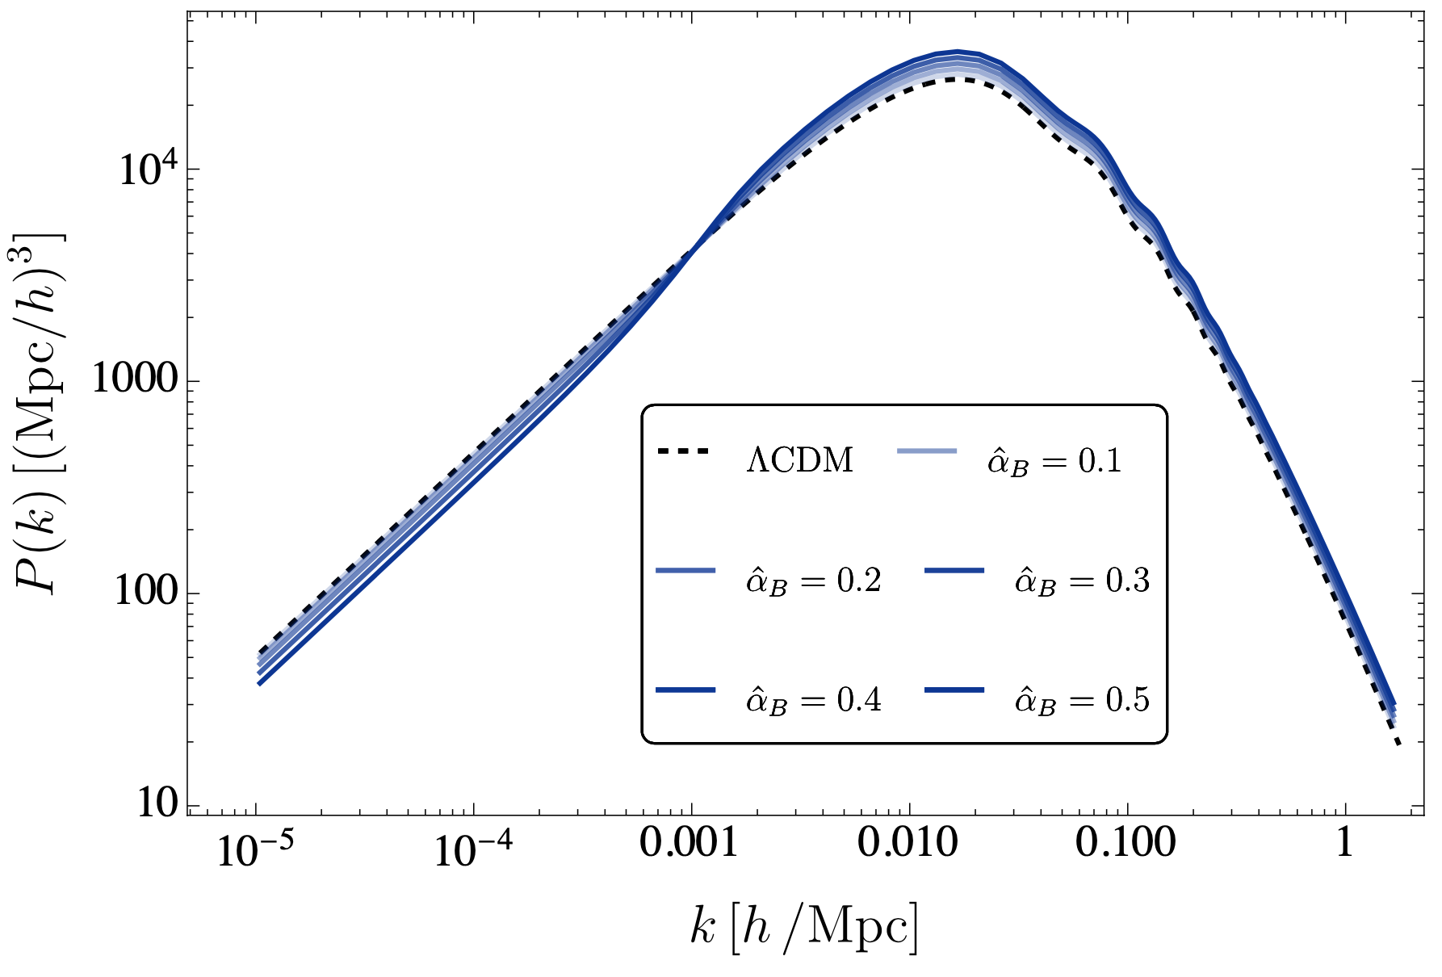
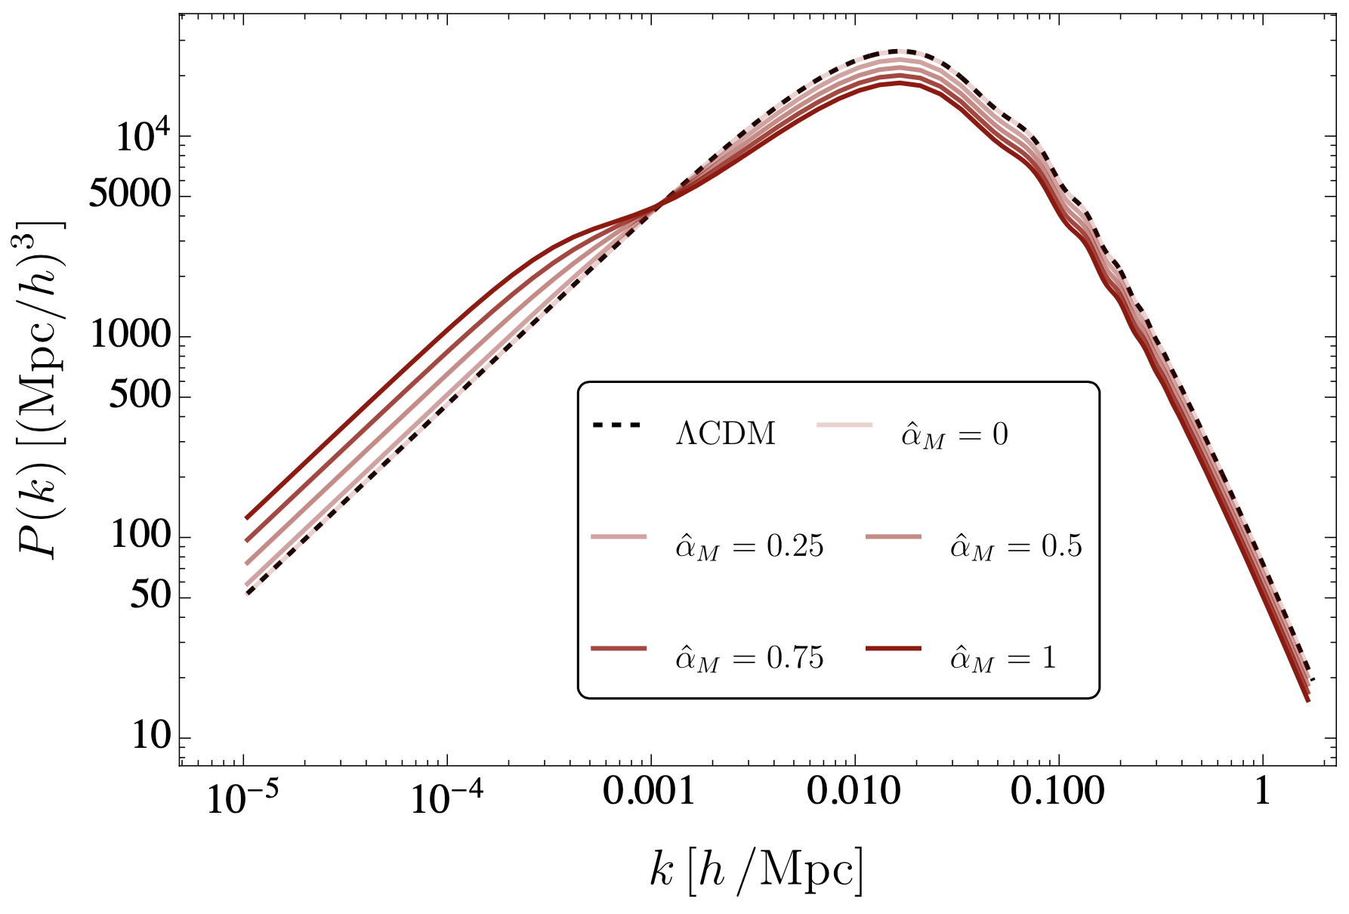
Effects of Modified Gravity

Slide 15
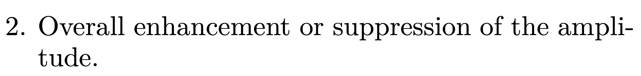
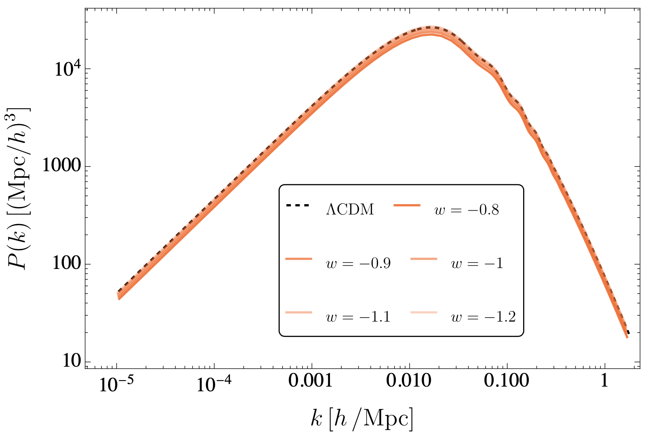

Slide 16
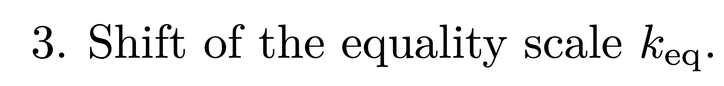
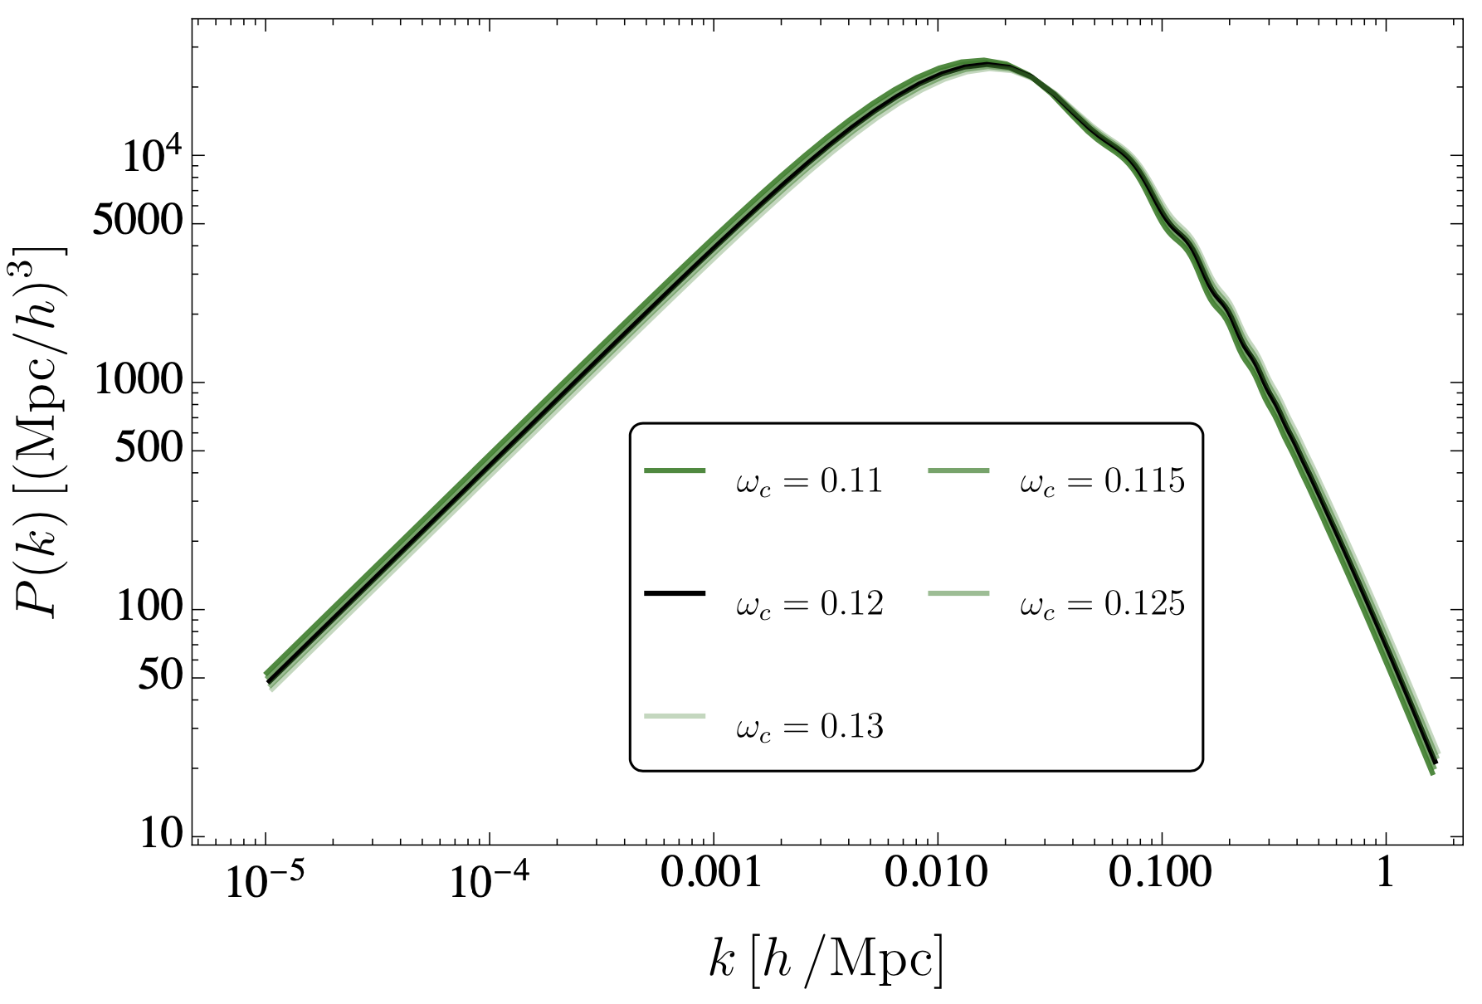

Slide 17
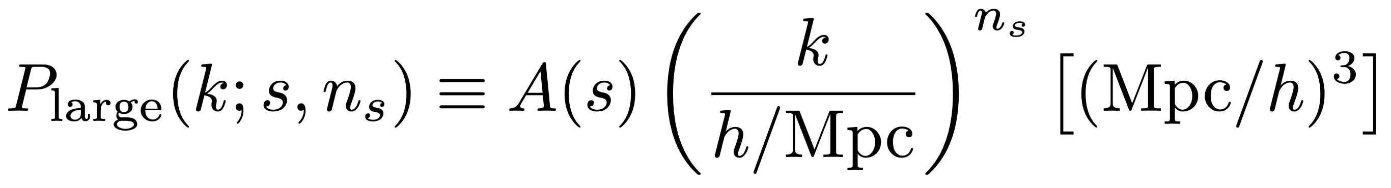
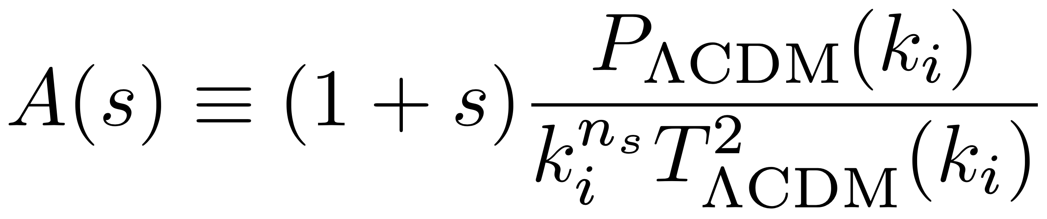
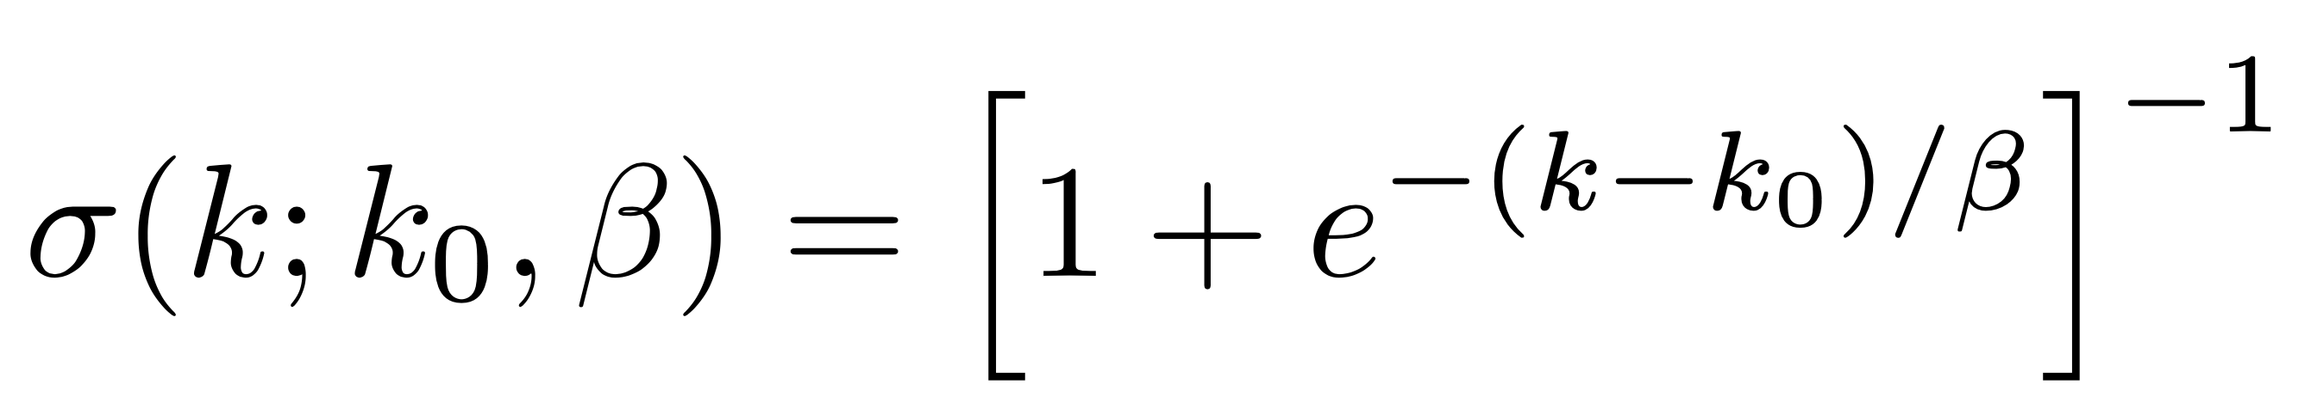
Magic Formula
Modification at large scales:
Modification at small scales:
Transition function between large and small scales:
The Magic Formula!

Slide 18
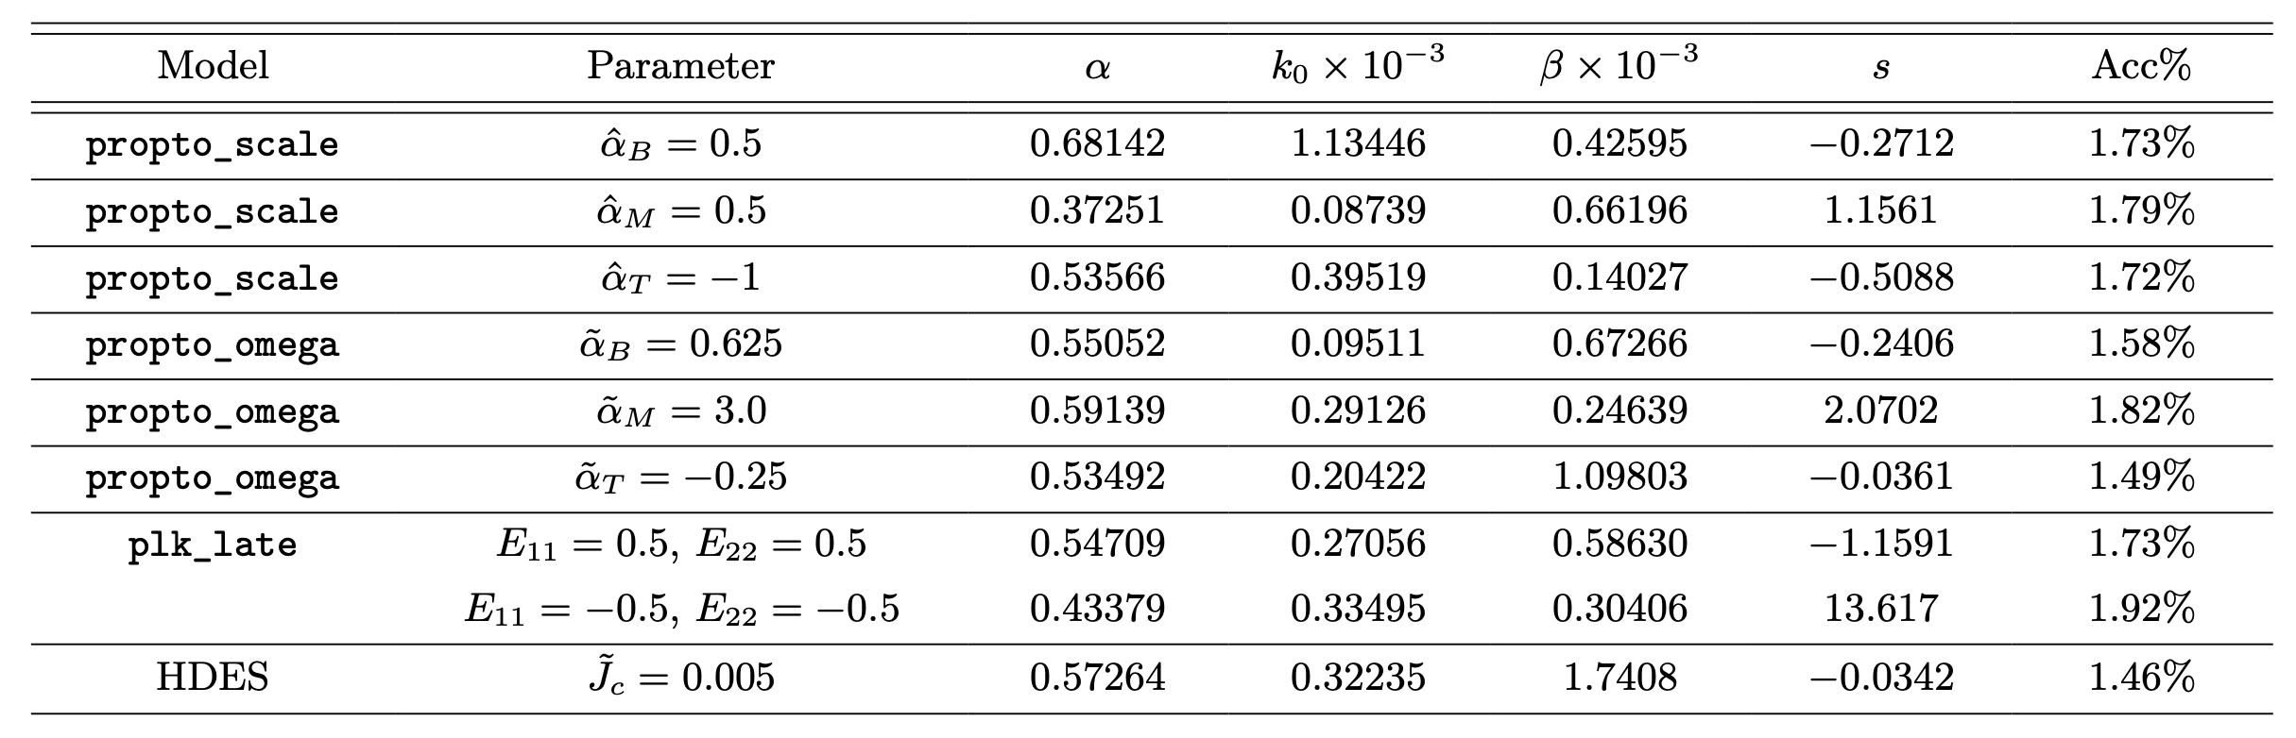
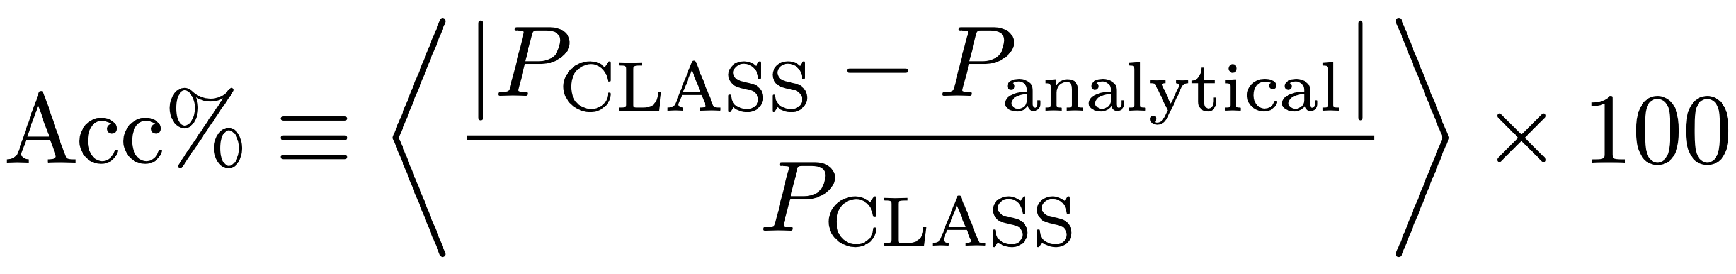
Performance

Slide 19
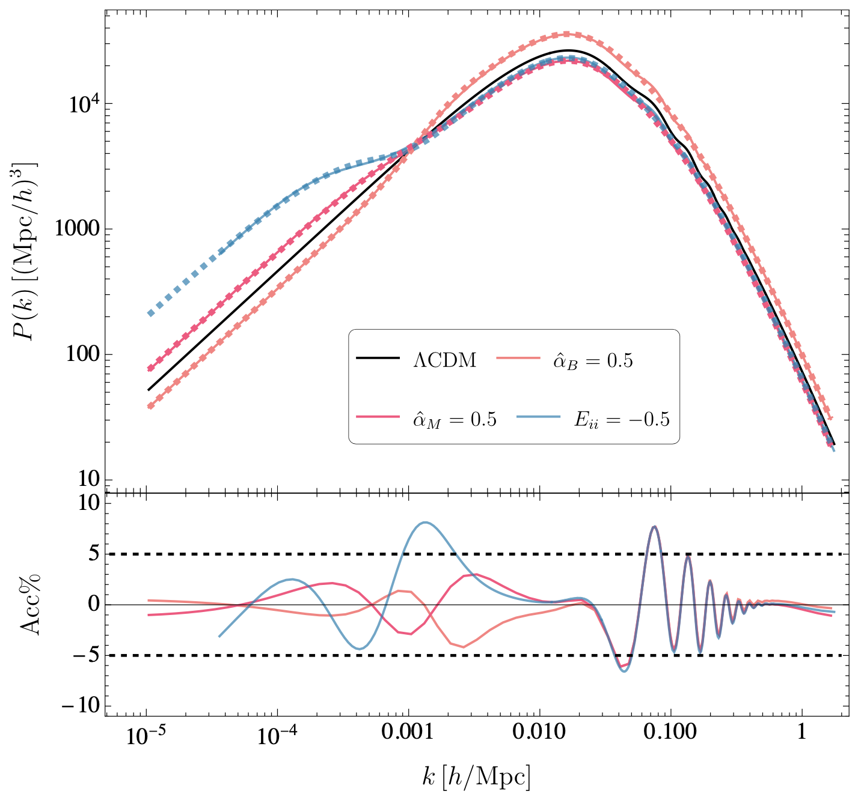

Slide 20
All posible MPS are covered!

Slide 21
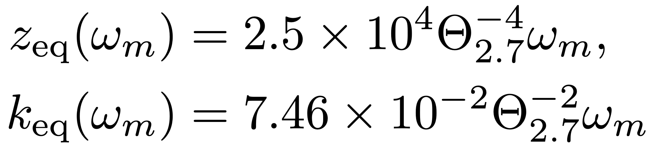
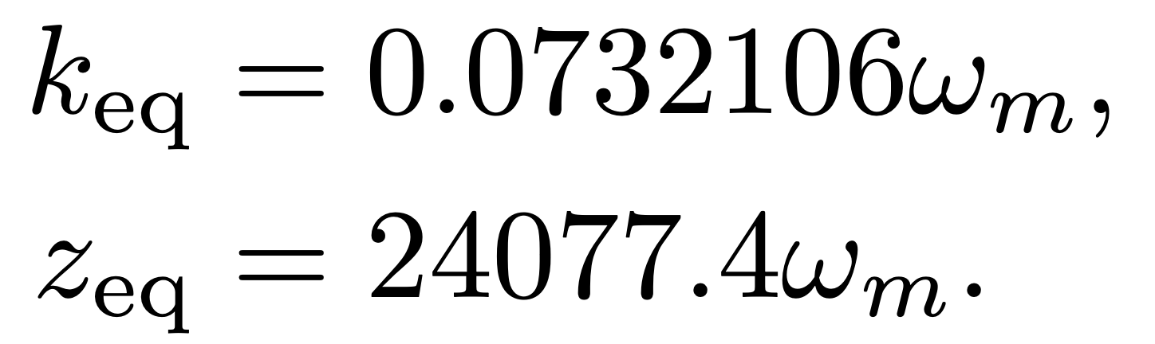
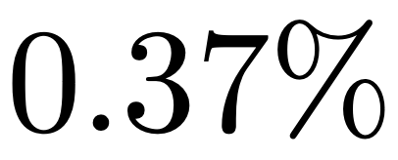
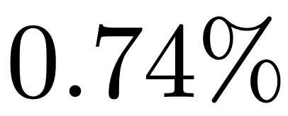
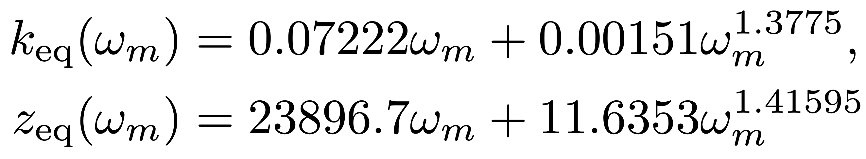
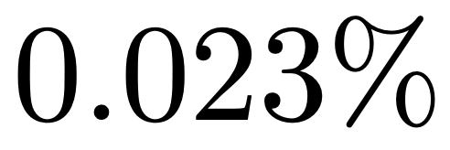
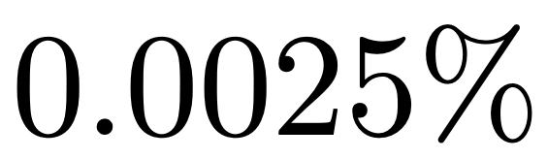
Bonus
Redshift and scale at Equality:

Slide 22
Take-Home Points
GAs are able to find simple and accurate analytical expressions for many interesting quantities in Cosmology
A general formula for the matter power spectrum of modified gravity!
Further details: 2211.06393 (Orjuela-Quintana & Nesseris)… Available on PRD
        2307.03643 (Orjuela-Quintana & Nesseris)… Soonly on PRD
Notes:
Well. In brief, the main goal of this work was to make transparent the application of an approximation scheme which is broadly used in Cosmology to study the dynamics of modified gravity theories. Some terms neglected in the standard approach are found but for the models analyzed they do not seem to be very relevant at the observational level. However, $f(R)$ is just an example and things promise to be different in other theories, such as Horndeski theories.

Slide 23
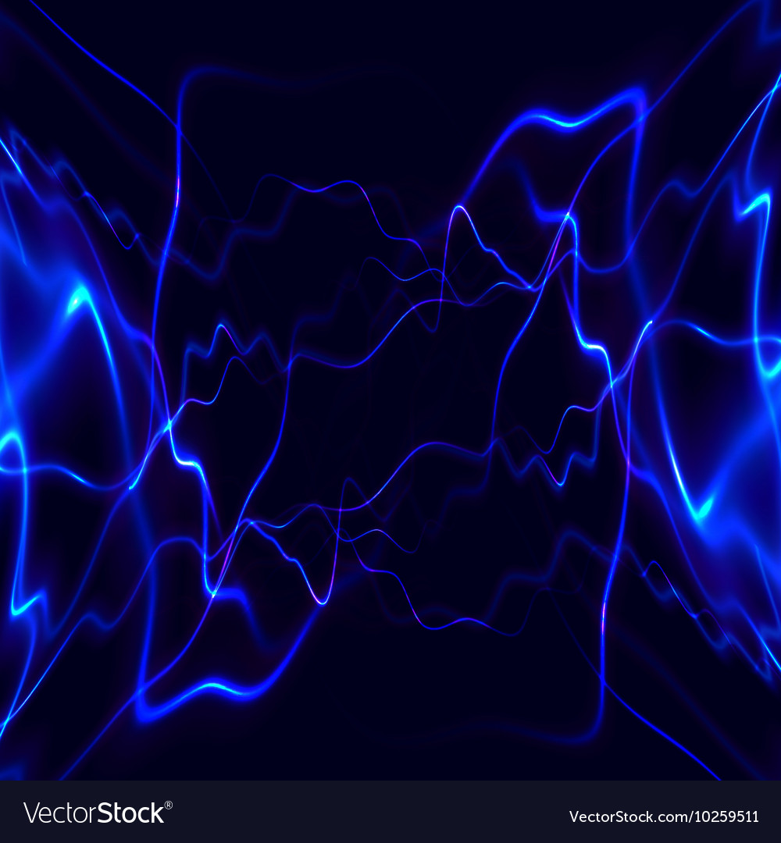


Thank you!
Notes:
I appreciate that you watched this video until the end, I will be very happy to discuss about any concern you have about this work. Thank you.

