Slide 1

Scaling Solutions in Generalized Proca Theory and its Cosmological Implications
Santiago García-Serna
J. Bayron Orjuela-Quintana
César A. Valenzuela-Toledo
Facultad de Ciencias Naturales y Exactas
Universidad del Valle
Santiago Garcia Serna
Universidad del Valle (2023)

Slide 2
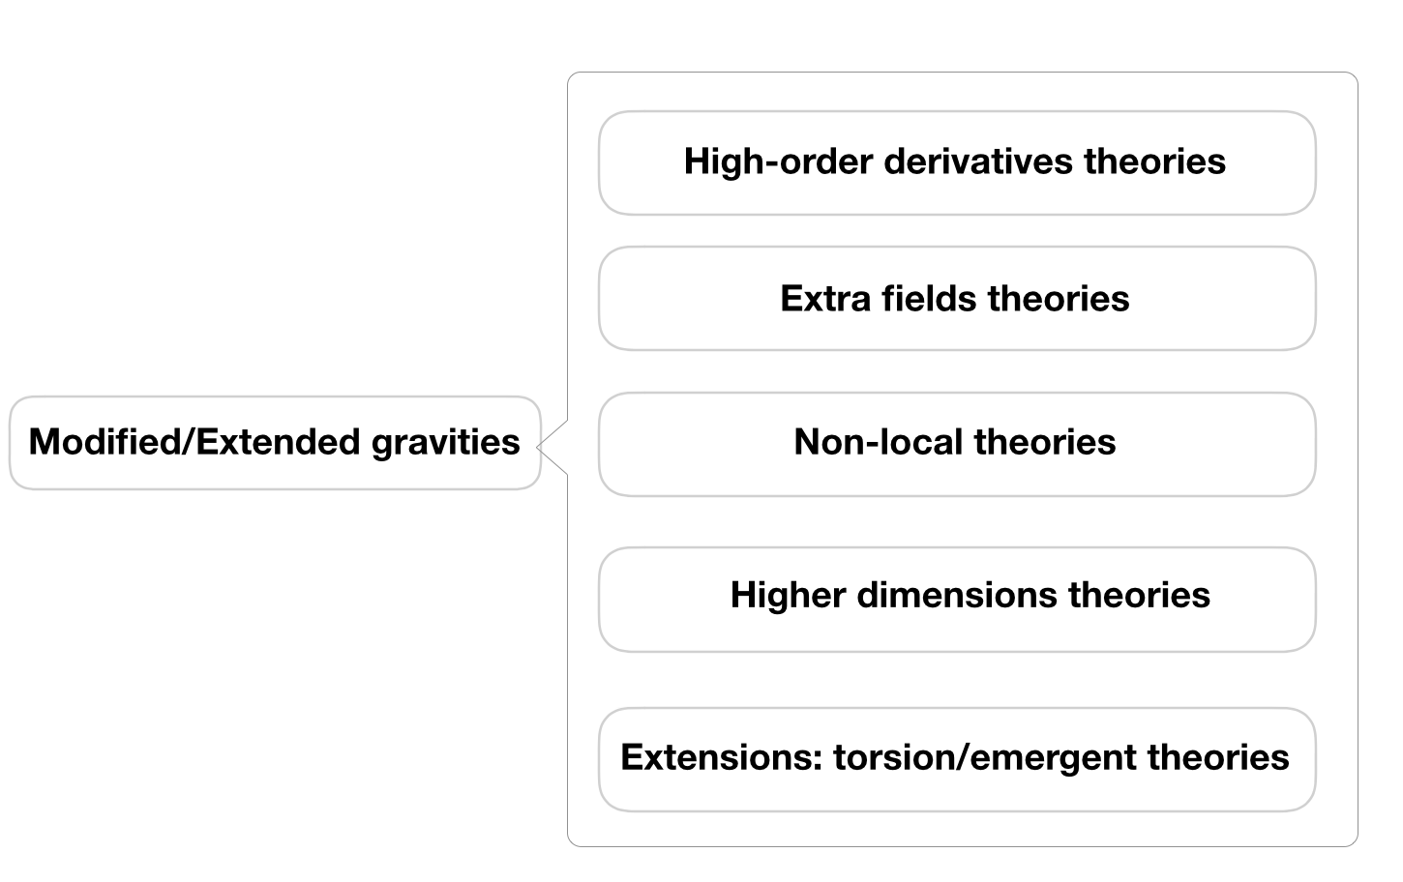
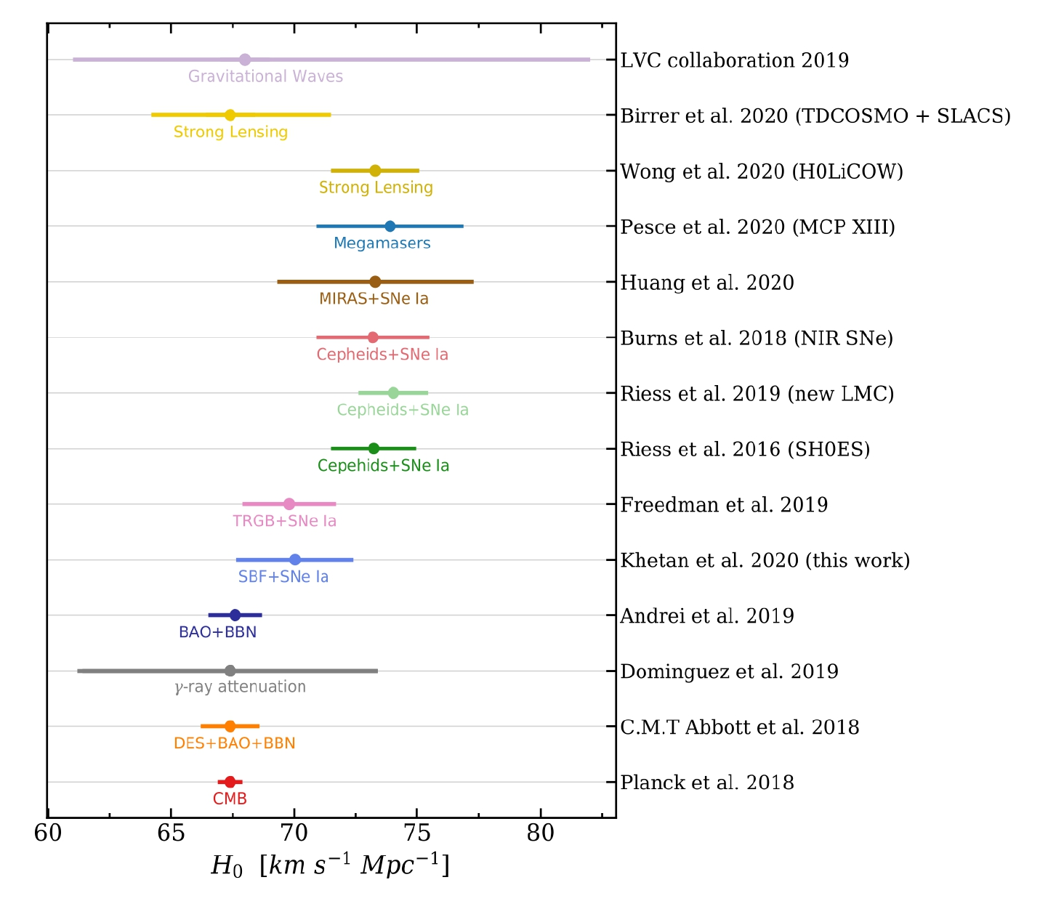
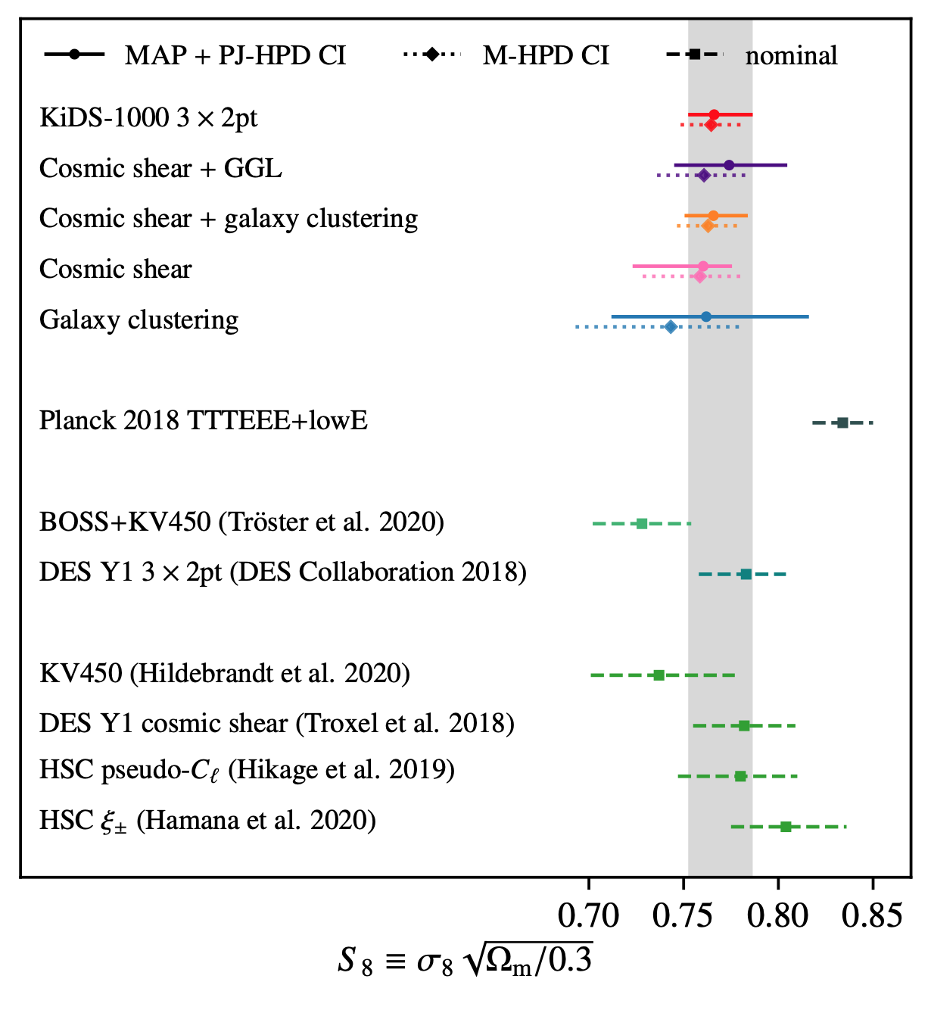
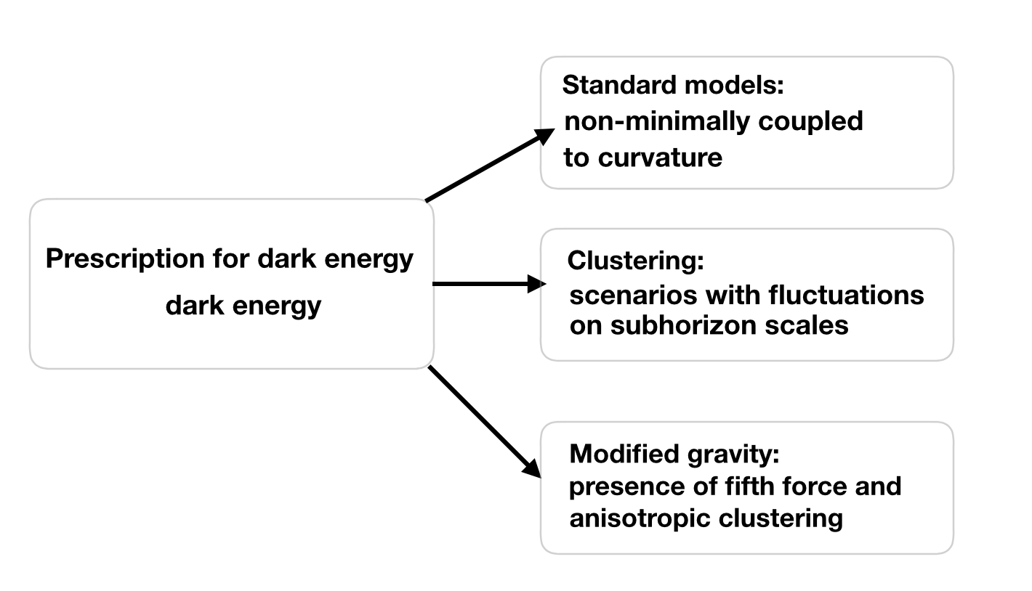
Motivation
arxiv.org/abs/2203.06142

Slide 3
Motivation
Dynamical Dark Energy
arXiv:1701.08165
arXiv:2201.09306
Interacting Dark Energy
arXiv:1910.09853
arXiv:Astro-ph/9908023.
Modified Gravity models
Horndeski theory (arXiv:1901.07183 )
What about the Generalized Proca theory coupled?

Slide 4
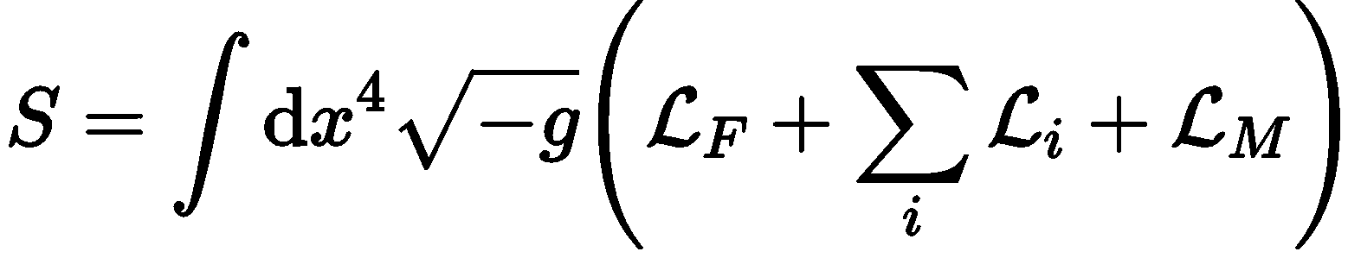
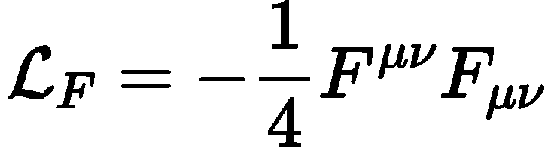
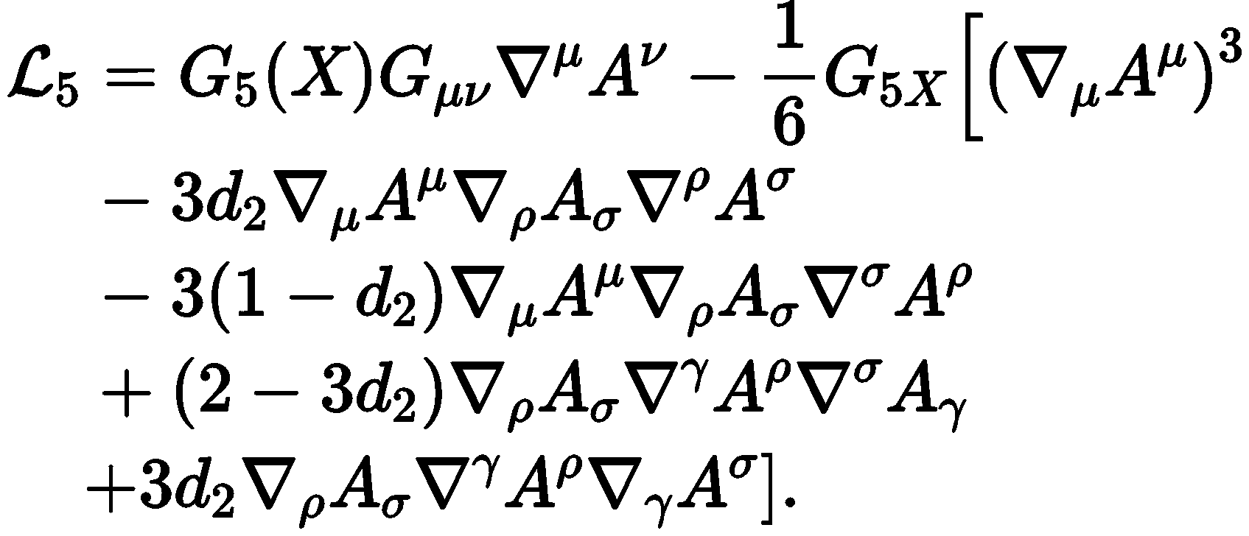
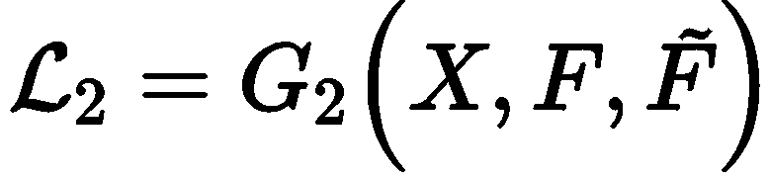
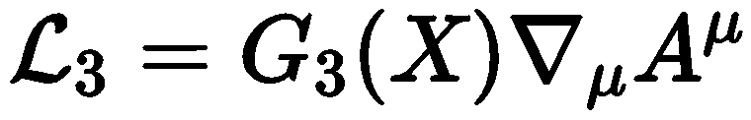
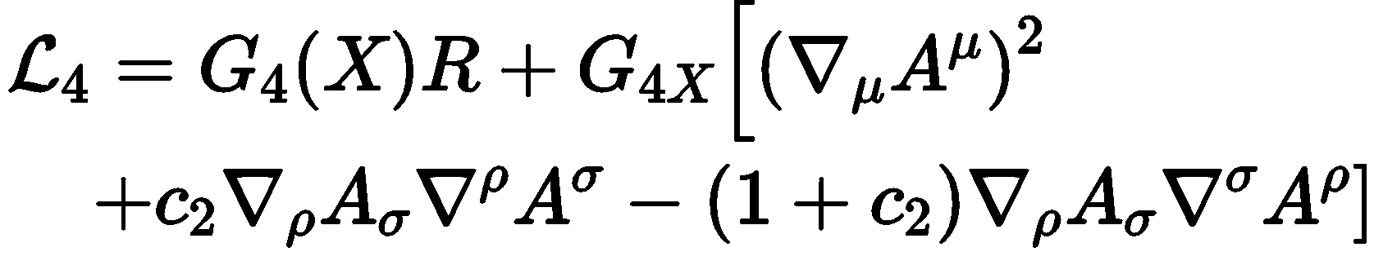
Generalized Proca Theory

Slide 5
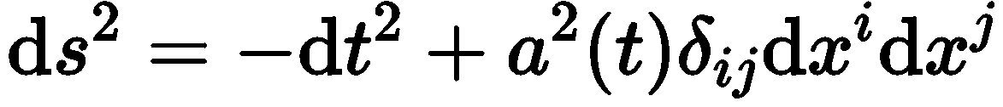
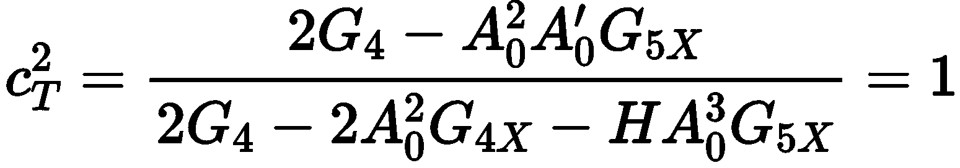
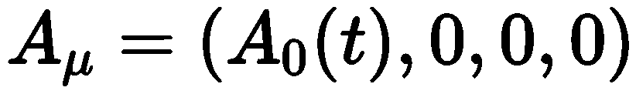
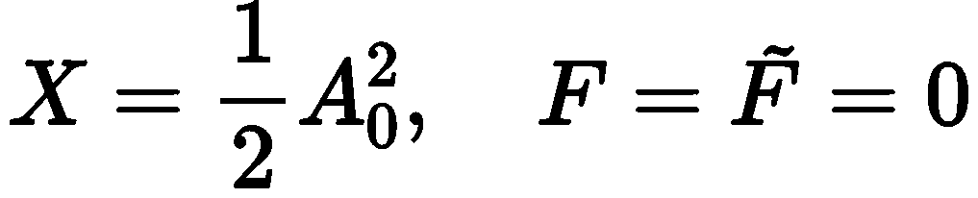
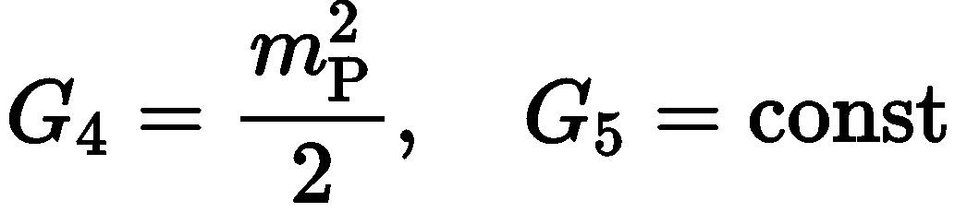

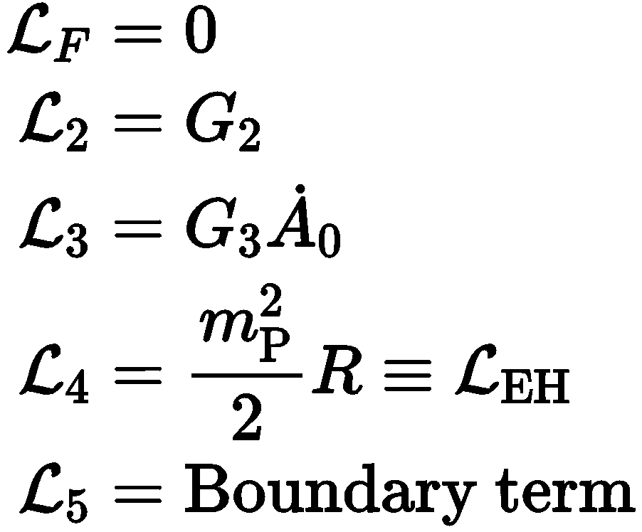
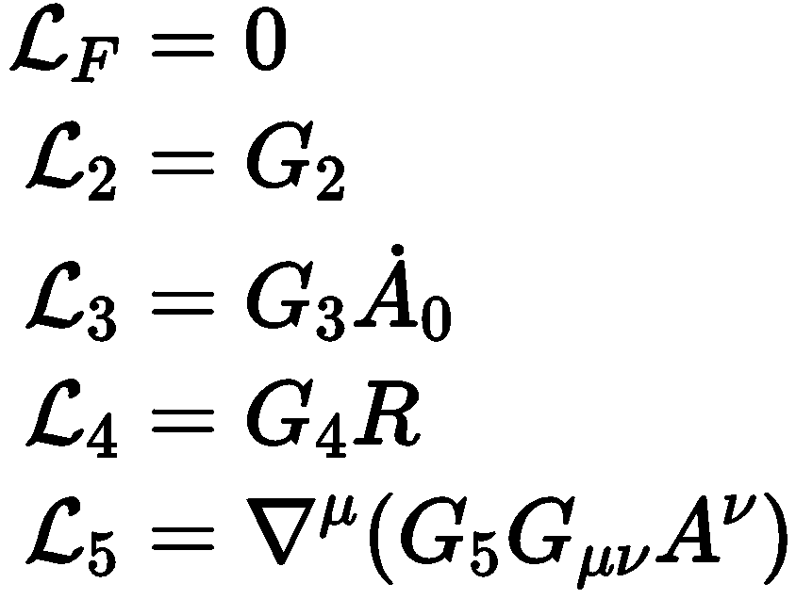
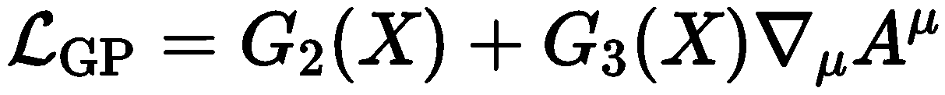
On the background of FLRW
Background
Tensor perturbations
arXiv:1603.05806

Slide 6




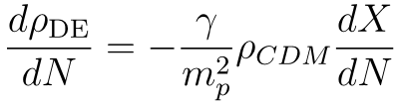
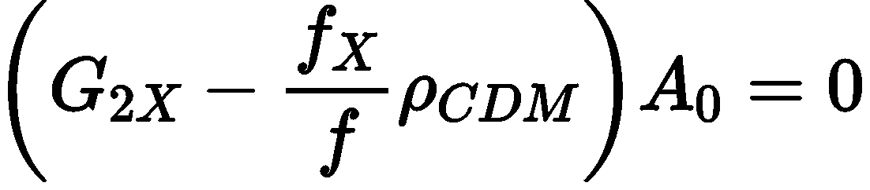
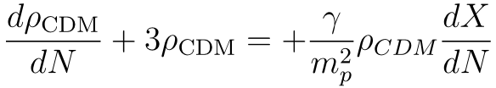

Generalized Proca theory coupled to Cold Dark Matter and Scaling Solution
Scaling condition
Case
Friedmann equations
Motion equation of
$$A_{0}$$

Slide 7

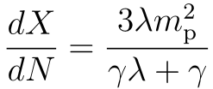
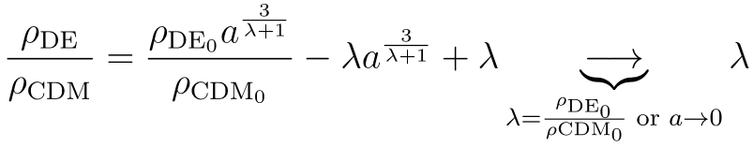
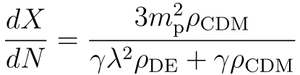

Motion equation of
$$A_{0}$$
Continuity equations of the all fluids.
During the scaling period

Slide 8
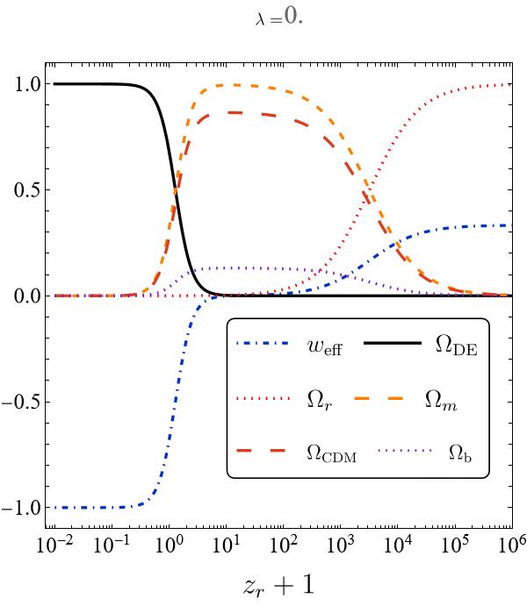
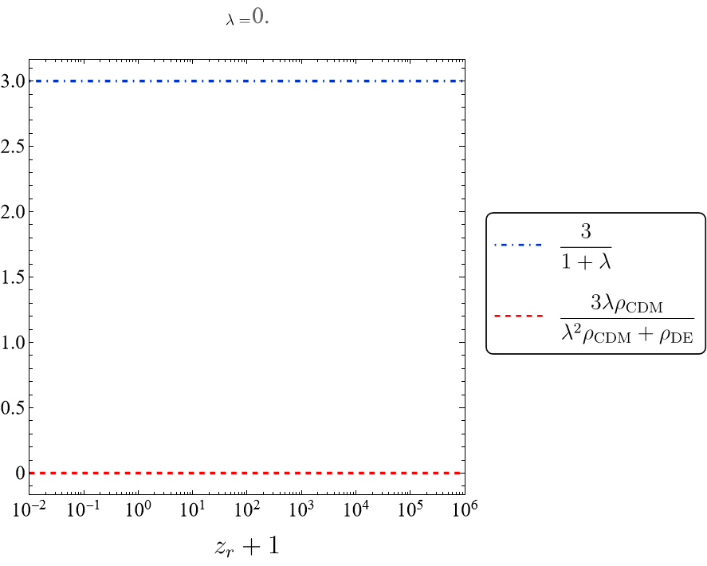
Evolution of the background

Slide 9

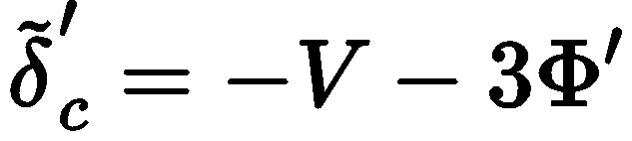

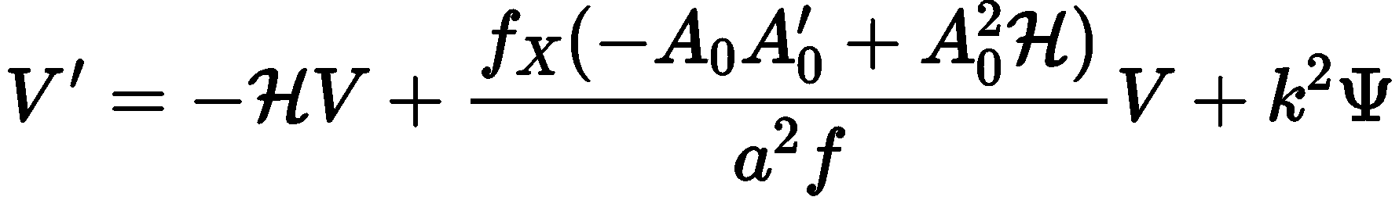
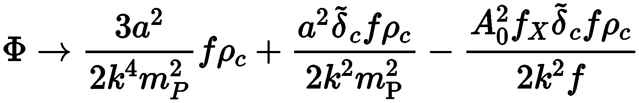
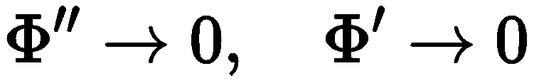
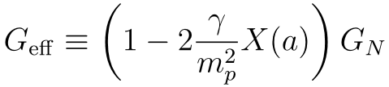
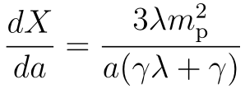
Linear perturbations
QSA-SHA approximation

Slide 10
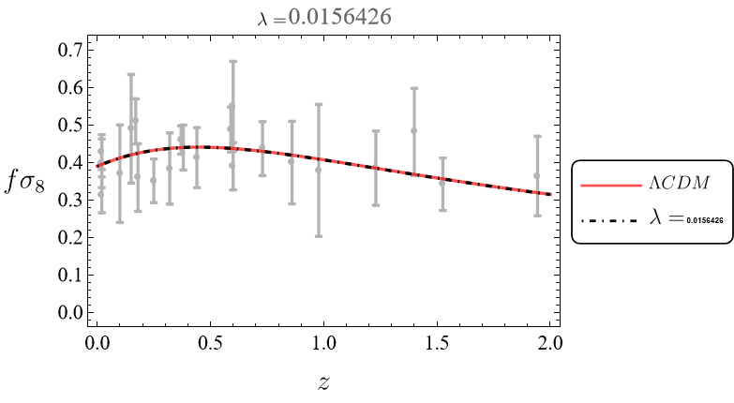


Evolution of the factor
$$fσ_{8}$$
We assumed

Slide 11
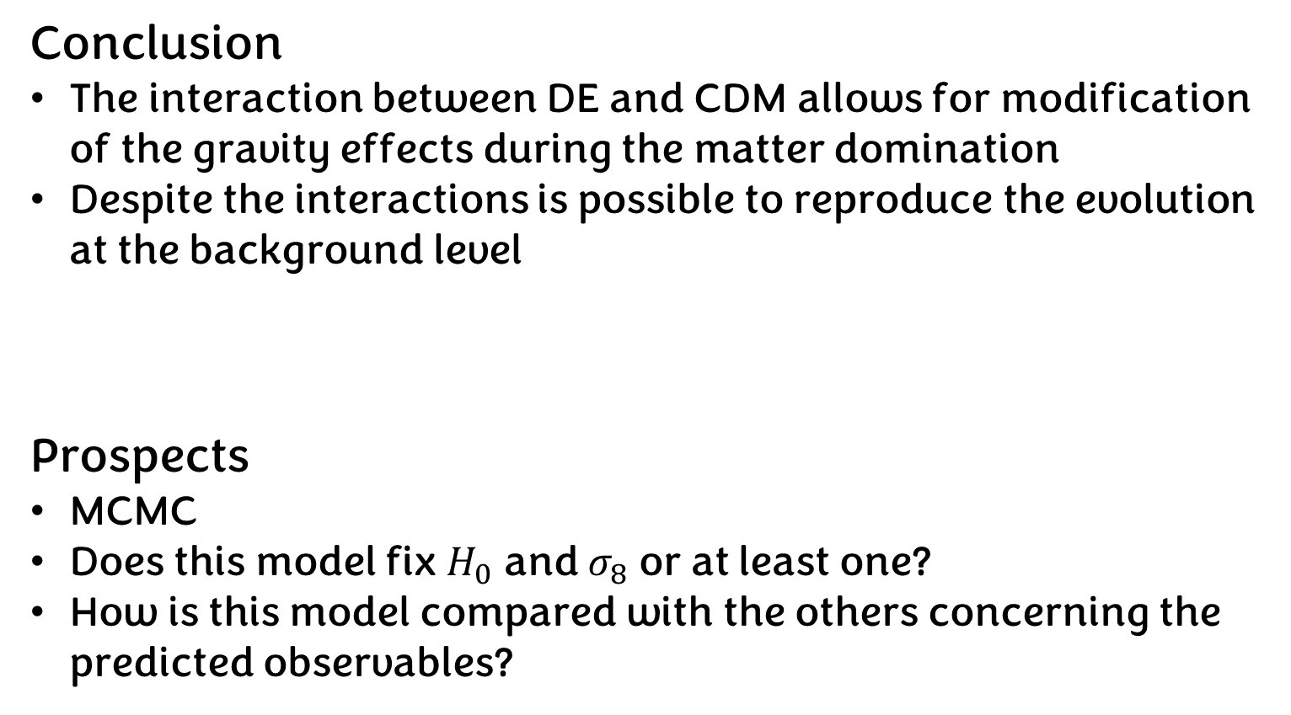
Conclusions and prospects
Conclusion
The interaction between DE and CDM allows for modification of the gravity effects during the matter domination
Despite the interactions is possible to reproduce the evolution at the background level
Prospects
MCMC
Does this model fix $H_{0}$ and $σ_{8}$ or at least one?
How is this model compared with the others concerning the predicted observables?

Slide 12


