Slide 1
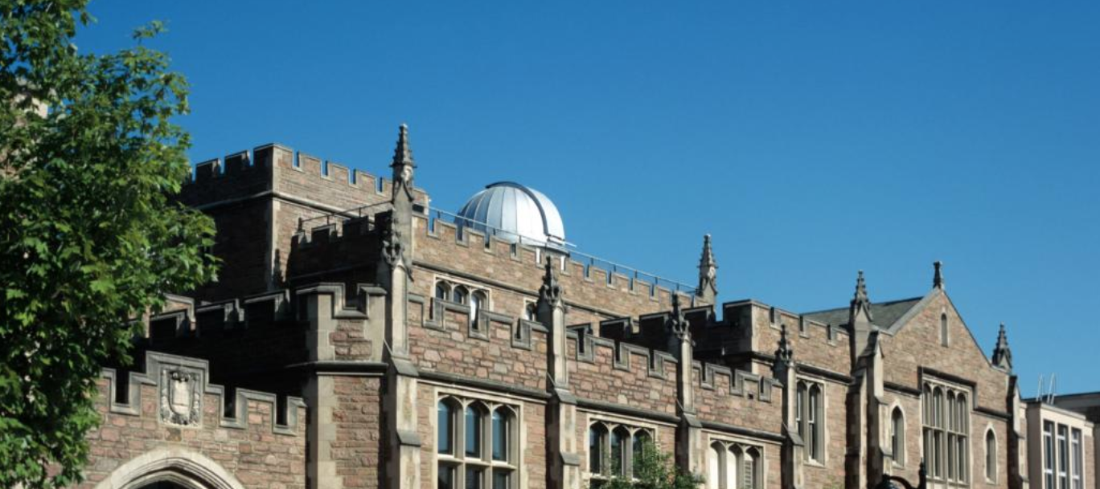


Information and Statistics for Nuclear Experiment and Theory (ISNET)
Welcome ISNET-9
Welcome!
Department of Physics and the McDonnell Center for the Space Sciences, Washington University in St. Louis

Slide 2
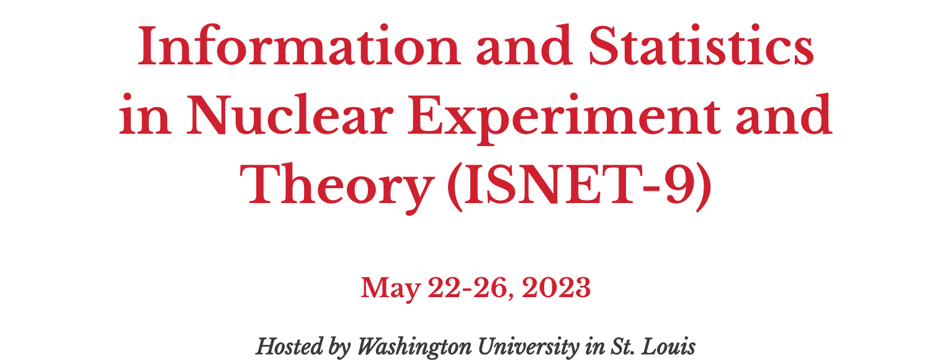
The mission of the Information and Statistics in Nuclear Experiment and Theory (ISNET) community is to encourage, facilitate, and develop the use of statistical and computational methodologies to enable nuclear physics to reach more quantitatively rigorous scientific conclusions. We do this by combining domain knowledge from the broad nuclear physics community with expertise in related fields of research, such as statistics, mathematics and computer science.
Welcome to remote participants: For 2023, ISNET-9 is a hybrid meeting. All talks will be delivered on-site, but sessions will also be broadcast via Zoom for remote participants.

Slide 3
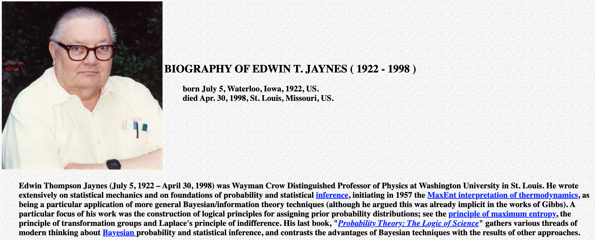
A bit of Washington University history in the area of Bayesian Inference
G. Larry Bretthorst, 1988, Bayesian Spectrum Analysis and Parameter Estimation, in Lecture Notes in Statistics 48, Springer-Verlag, New York: Bayesian spectrum analysis is still in its infancy. It was born when E. T. Jaynes derived the periodogram as a sufficient statistic for determining the spectrum of a time-sampled data set containing a single stationary frequency...

Slide 4


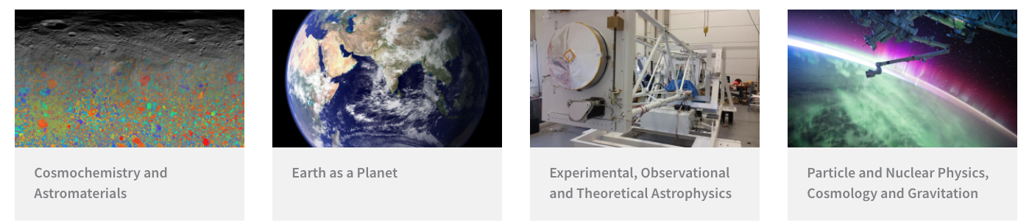
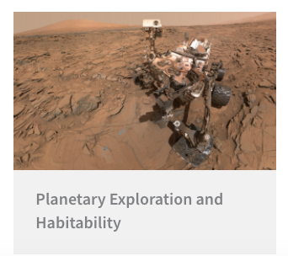

Slide 5
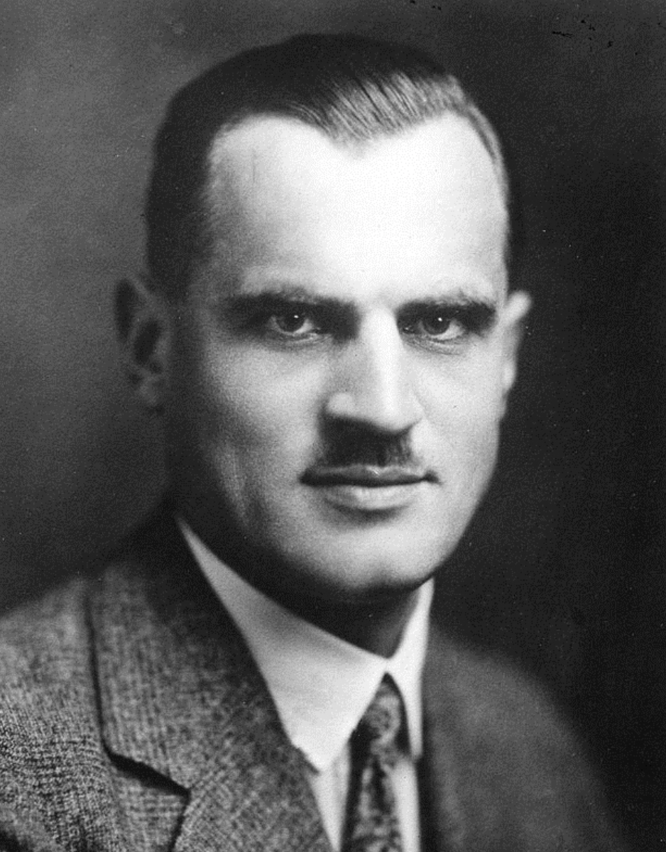
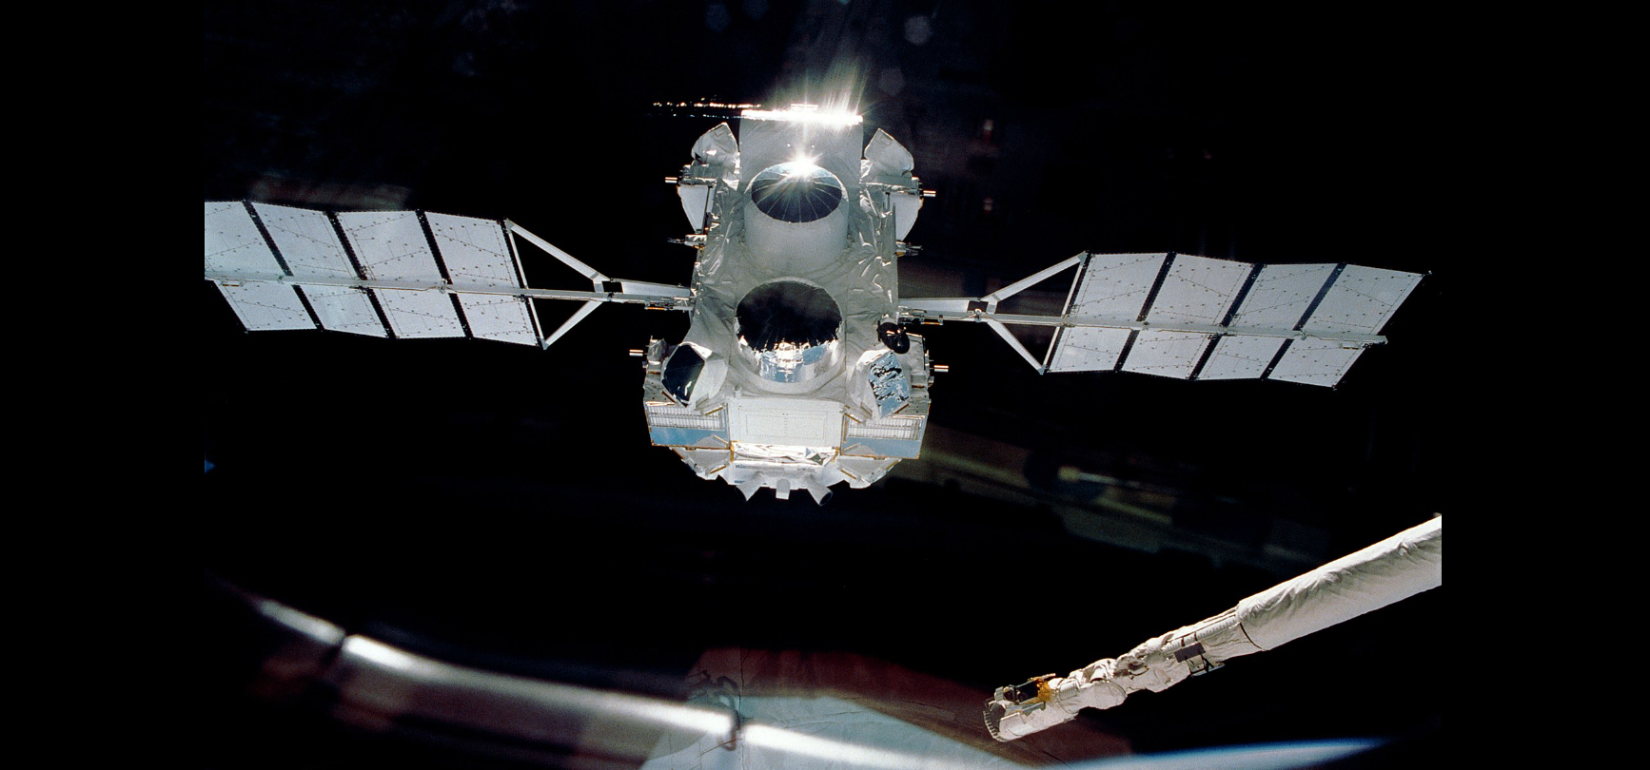
Another bit of Washington University history of interest
Arthur Holly Compton
Wayman Crow Professor of Physics and Department Head,
1920-1922
Nobel Prize in
Physics, 1927
Chancellor of
WashU 1946-1954
Directed the work resulting in the first atomic chain reaction
Discovered the Compton effect (1923) – demonstrated the particle nature of electro-magnetic radiation
The Compton Gamma Ray Observatory released into Earth orbit in 1991; NASA/Ken Cameron
Notes:
During his tenure, the university formally desegregated its undergraduate divisions, named its first female full professor, and enrolled a record number of students after wartime veterans returned to the United States

Slide 6
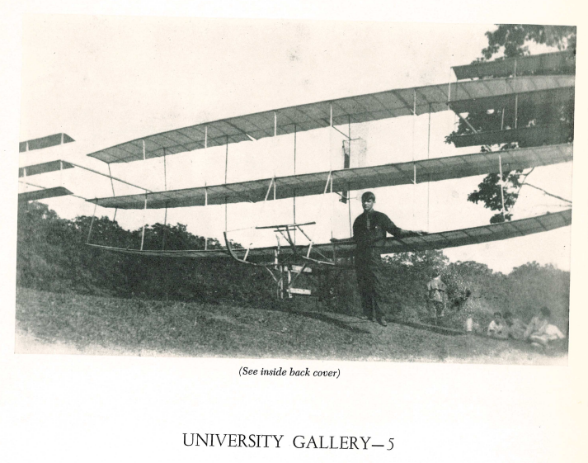
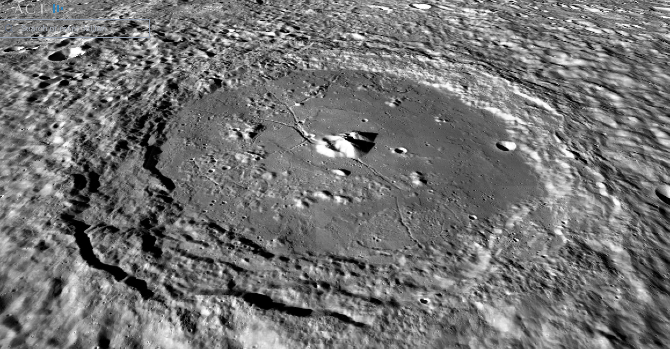
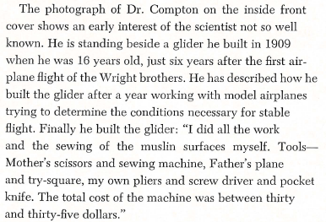
Another bit of Washington University history of interest
Arthur Holly Compton and his brother Karl were honored posthumously with the naming of a crater on the Moon. The only such crater named for brothers.
Compton with the glider he built, age 16

Slide 7
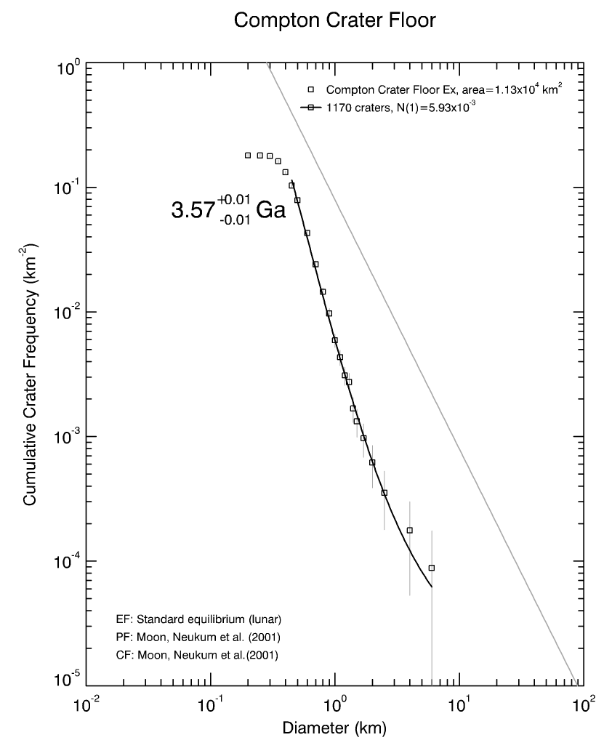
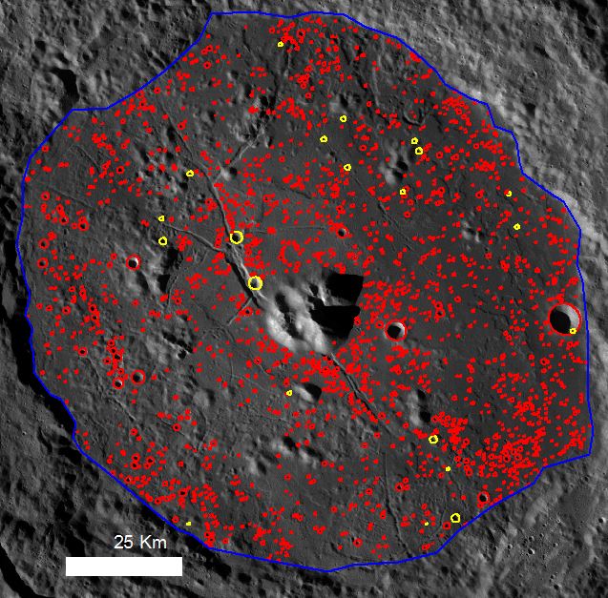
Improvements to this method are using Bayesian Inference
Determining the age of Compton Crater using crater size-frequency distribution analysis.. The most up-to-date methods make use of Poisson statistics and Bayesian inference.
Shirley, K., M. Zanetti, B. Jolliff, C. v. d. Bogert, and H. Hiesinger (2016) Crater size-frequency distribution measurements and age of the Compton-Belkovich Volcanic Complex. Icarus 273, 214-223.
2087 craters, 21 uncertain (yellow)
Model age fit to craters 450-6000 m in diameter

