Slide 1

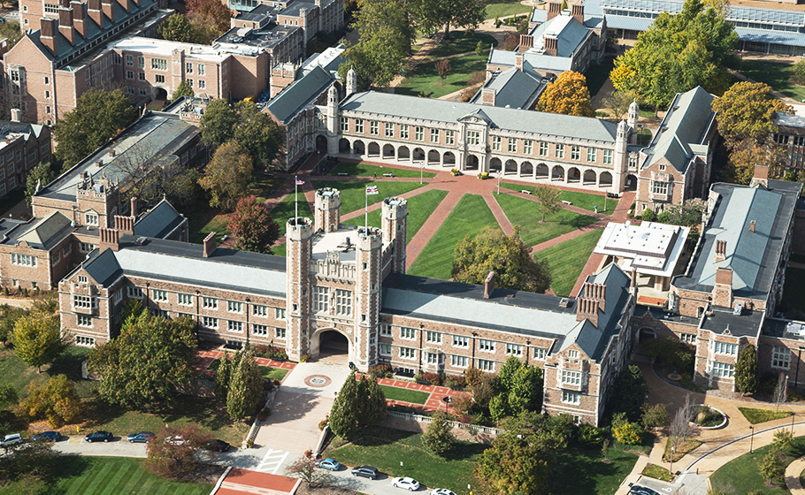
Welcome!

Slide 2

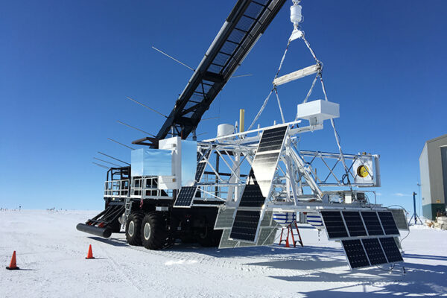
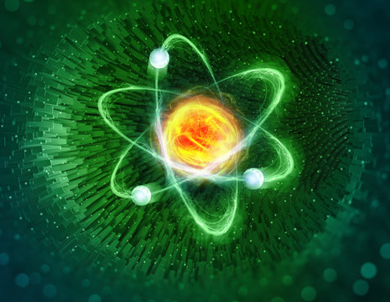
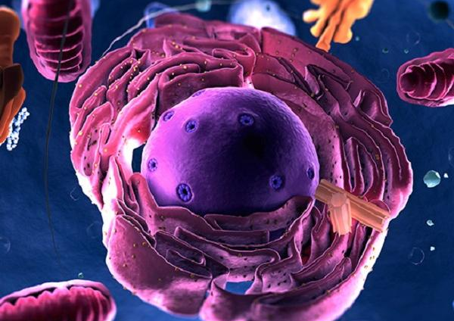
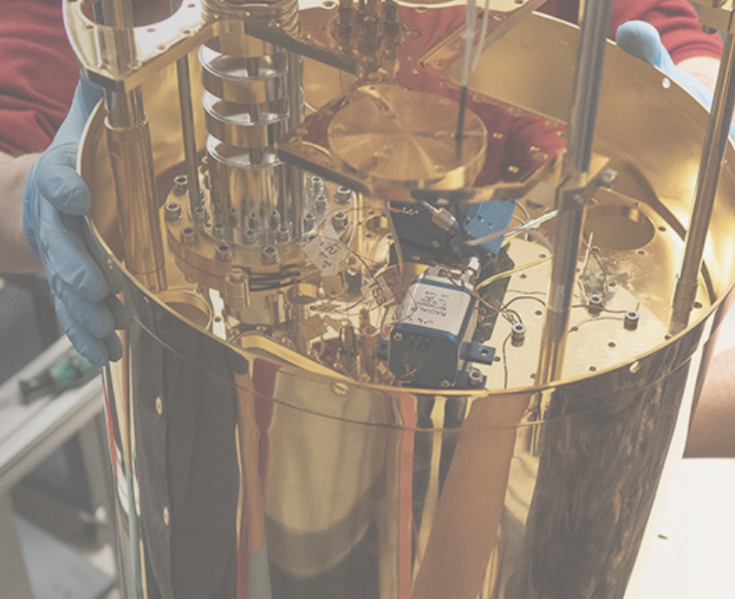
Astrophysics
Nuclear and Fundamental Physics
Biophysics
Center for
Quantum Leaps

Slide 3


Slide 4


Slide 5

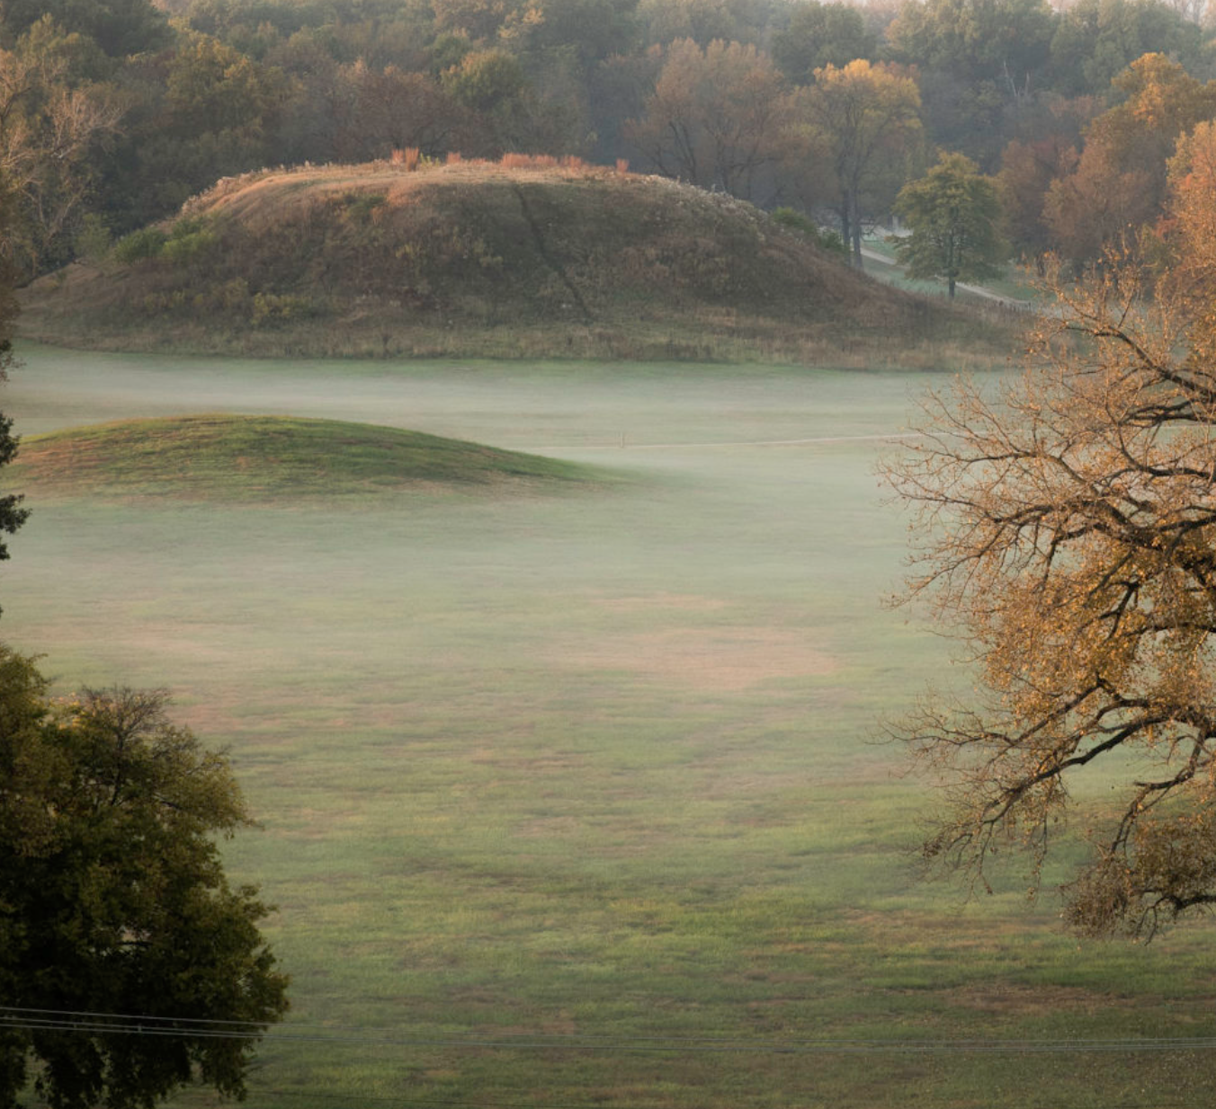

Slide 6
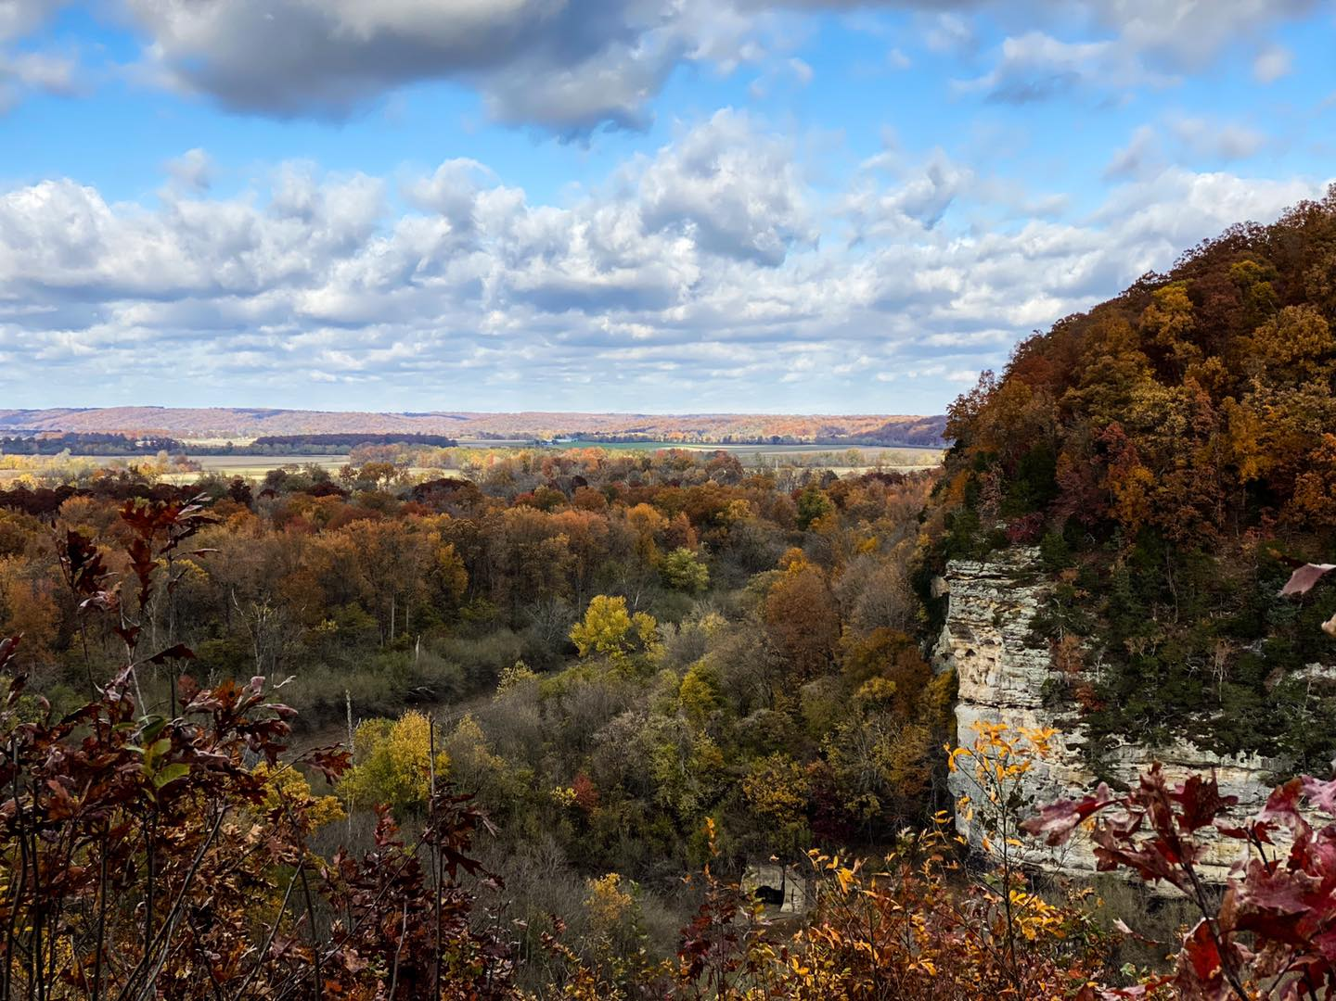

Little Grand Canyon

Slide 7
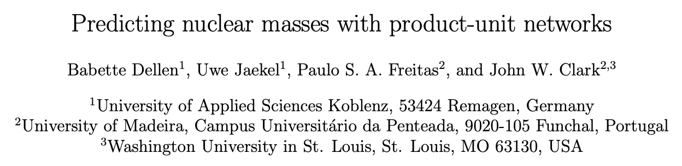
Department of Physics
John W. Clark
Wayman Crow Professor Emeritus of Physics
1955: B.S. Physics, University of Texas, Austin
1957: M.A. Physics, University of Texas, Austin
1959: PHD, Washington University in St. Louis (advisor: Eugene Feenberg)
1959-1963:
  NSF Postdoctoral Fellow at Princeton University (advisor: Eugene Wigner)
  Associate research scientist at the Martin Company, Denver
  NATO postdoctoral fellow at University of Birmingham and Saclay
1963: Joins the faculty at WashU
Awards
Fellow, American Physical Society
1965: Alfred P. Sloan Foundation Fellowship
1987: Eugene Feenberg Medal for Many-Body Physics
Research interests:
Quantum Many-body Theory
Danse-Matter Astrophysics
Neural Networks
Quantum Control
arXiv:2305.04675

