Slide 1
Predicting nuclear masses with product-unit networks
24.05.2023, Virtual Talk at ISNET, Washington University in St.Louis, MO, USA
Prof. Dr. Babette Dellen
Faculty of Mathematics and Technology,
RheinAhrCampus Remagen,
University of Applied Sciences Koblenz, Germany

Slide 2
How can we represent nonlinear functions and patterns?

Slide 5
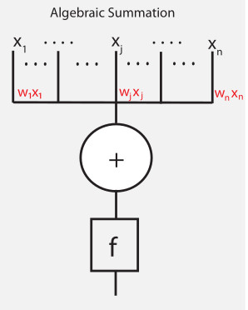
Perceptron
W. S. McCulloch and W. Pitts, “A logical calculus of the ideas immanent
in nervous activity,” Bulletin of Mathematical Biophysics, pp. 115–133,
vol. 5, 1943.
F. Rosenblatt, “The perceptron - a probabilistic model for information
storage and organization in the brain,” Psychological Review, vol. 65,
1958

Slide 6
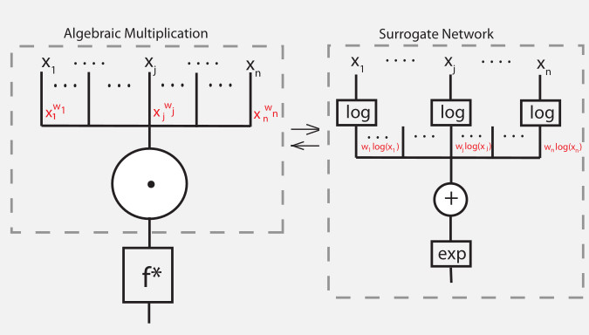
Product unit
Dellen et al., 2019, Leerink et al., 1995, Durbin & Rumelhart, 1989

Slide 7
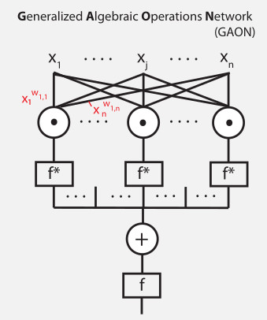
Product-unit network
B Dellen, U Jaekel, M Wolnitza, Function and Pattern Extrapolation with Product-Unit Networks, ICCS 2019

Slide 8
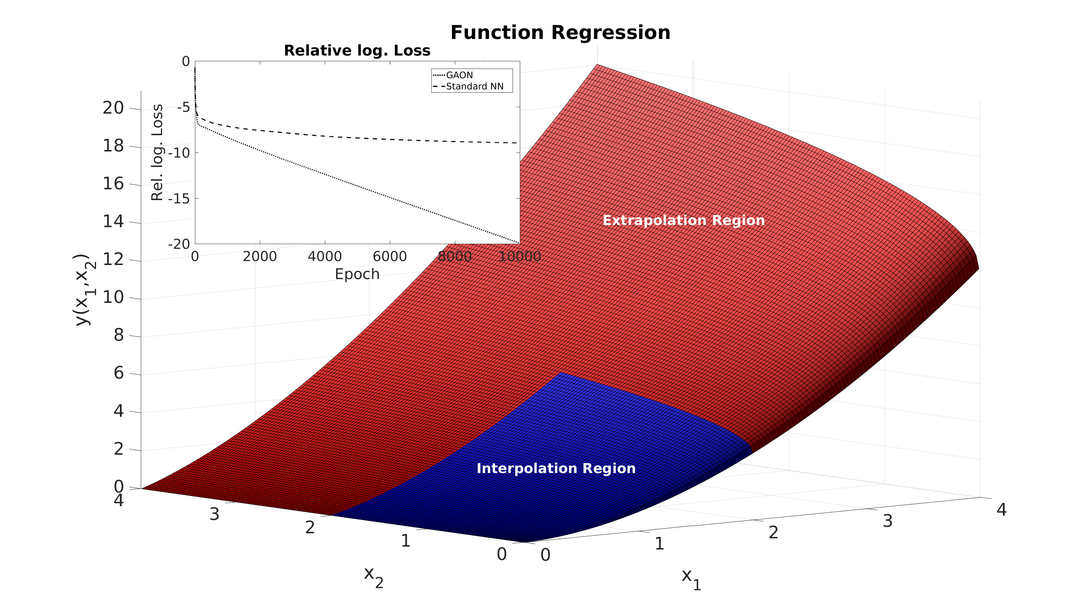
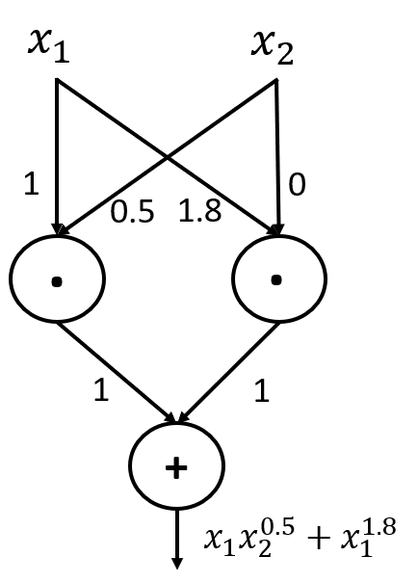
Function-regression task
B Dellen, U Jaekel, M Wolnitza, Function and Pattern Extrapolation with Product-Unit Networks, ICCS 2019

Slide 9
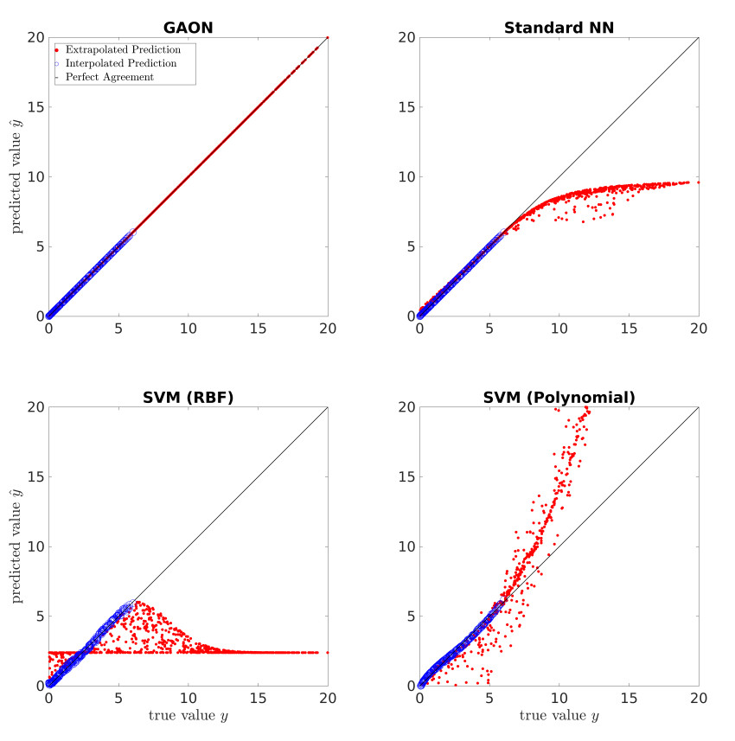
Function-regression task
B Dellen, U Jaekel, M Wolnitza, Function and Pattern Extrapolation with Product-Unit Networks, ICCS 2019

Slide 10
B Dellen, U Jaekel, M Wolnitza, Function and Pattern Extrapolation with Product-Unit Networks, ICCS 2019

Slide 11
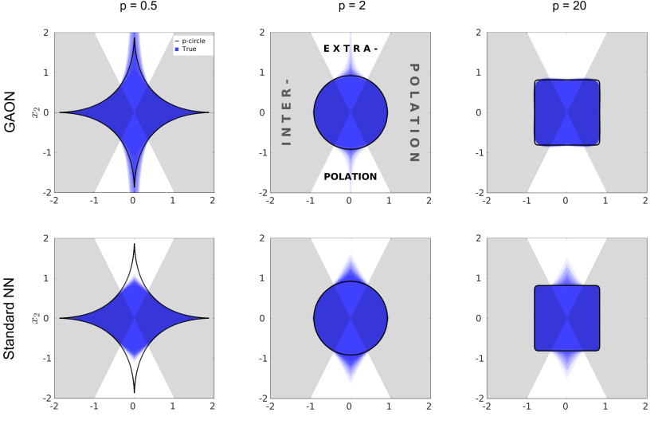
Classification task
B Dellen, U Jaekel, M Wolnitza, Function and Pattern Extrapolation with Product-Unit Networks, ICCS 2019

Slide 12
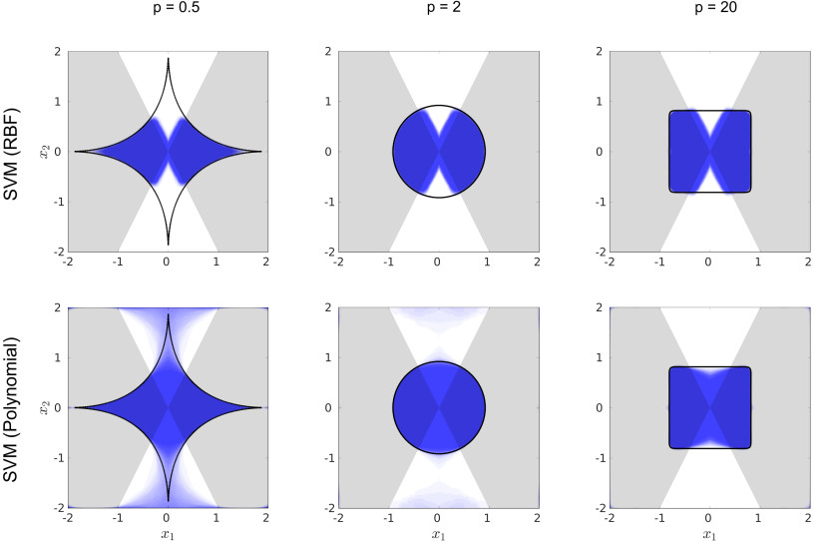
B Dellen, U Jaekel, M Wolnitza, Function and Pattern Extrapolation with Product-Unit Networks, ICCS 2019

Slide 13
B Dellen, U Jaekel, M Wolnitza, Function and Pattern Extrapolation with Product-Unit Networks, ICCS 2019

Slide 14
B Dellen, U Jaekel, M Wolnitza, Function and Pattern Extrapolation with Product-Unit Networks, ICCS 2019

Slide 15
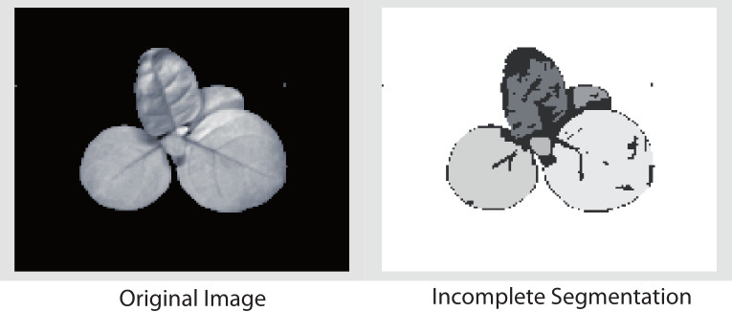
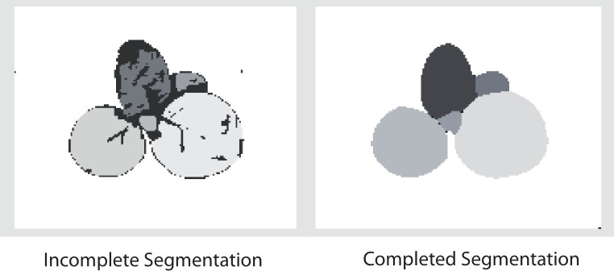
Label-completion task

Slide 16
Summary:
→ Model discovery?

Slide 17
Semi-empirical mass formula:
Source: https://en.wikipedia.org/wiki/Semi-empirical_mass_formula
C. F. von Weizsäcker. Zur Theorie der Kernmassen. Zeitschrift für Physik, 96:431–458, 1935.
Could a similar functional relationship be described and learned from mass data by a product-unit network?
Atomic mass evaluation:
Atomic masses are expressed as mass excess, i.e., the difference between atomic mass and the atomic number times the atomic mass unit, a quantity related to the nuclear binding energy.
M. Wang, W. Huang, F. Kondev, G. Audi, and S. Naimi. The ame 2020 atomic mass evaluation (ii). tables, graphs and references*. Chinese Physics C, 45(3):030003, 2021.

Slide 18
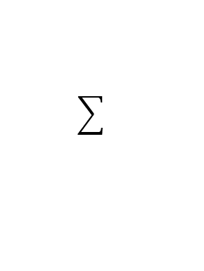
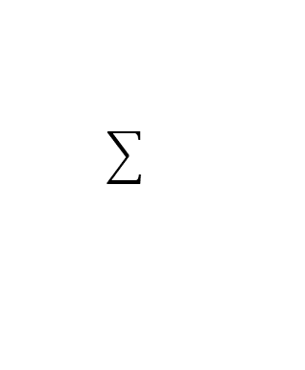
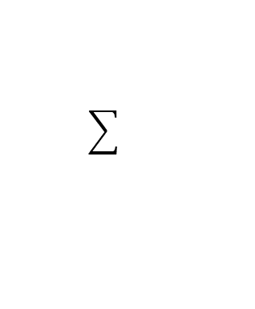
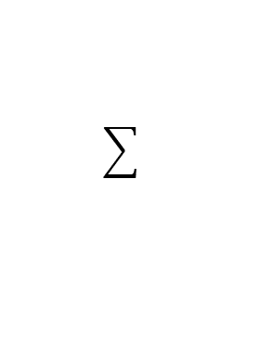
Real-valued product unit network (RPUN)
Z
N
LOG
LOG
. . .
. . .
. . .
50 PU
. . .
EXP
EXP
EXP
B Dellen, U Jaekel, PSA Freitas, JW Clark, Predicting nuclear masses with product unit networks
arXiv preprint arXiv:2305.04675, 2023

Slide 19
Exponents of N and Z of product units in exponent space
B Dellen, U Jaekel, PSA Freitas, JW Clark, Predicting nuclear masses with product unit networks arXiv preprint arXiv:2305.04675, 2023

Slide 20
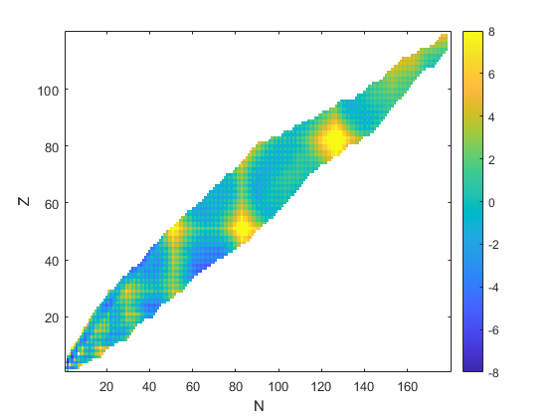
Mass difference of Prediction and true value of RPUN
B Dellen, U Jaekel, PSA Freitas, JW Clark, Predicting nuclear masses with product unit networks, arXiv preprint arXiv:2305.04675, 2023

Slide 21
Introducing further variables:
N
Z
N Odd and Even Parity
Z Odd and Even Parity
A Odd and Even Parity
Z Distance to closest magic number
N Distance to closest magic number

Slide 22


Complex-valued product unit network (CPUN):
Input layer
10
Loss function: ${\left(a−m\right)}^{2}+b^{2}$
Linear layer (complex weights)
20
Complex GAON
prediction uncertainty :=
Product-unit layer (complex weights)
40
Advantage:
No thresholds are required!
Linear output unit (complex weights)
10
B Dellen, U Jaekel, PSA Freitas, JW Clark, Predicting nuclear masses with product unit networks arXiv preprint arXiv:2305.04675, 2023
$$z=a+ib$$

Slide 23
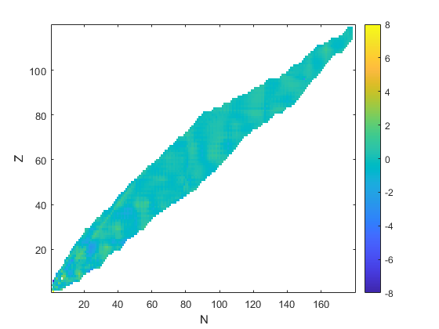
Experiment A: Comparison of RPUN and CPUN
RMS in MeV
B Dellen, U Jaekel, PSA Freitas, JW Clark, Predicting nuclear masses with product unit networks,
arXiv preprint, arXiv:2305.04675, 2023

Slide 24
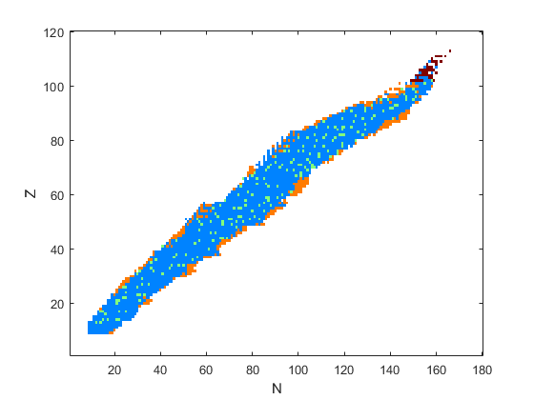
Data sets drawn from AME (Experiment C):
B Dellen, U Jaekel, PSA Freitas, JW Clark, Predicting nuclear masses with product unit networks
arXiv preprint arXiv:2305.04675, 2023

Slide 25
Neural networks with and without product units investigated in this work
B Dellen, U Jaekel, PSA Freitas, JW Clark, Predicting nuclear masses with product unit networks
arXiv preprint arXiv:2305.04675, 2023

Slide 26
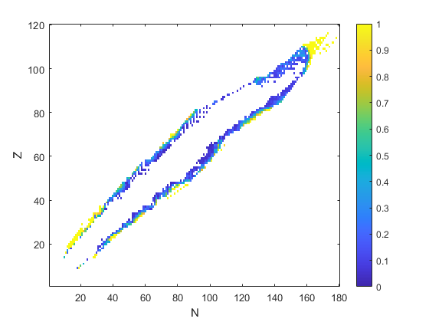
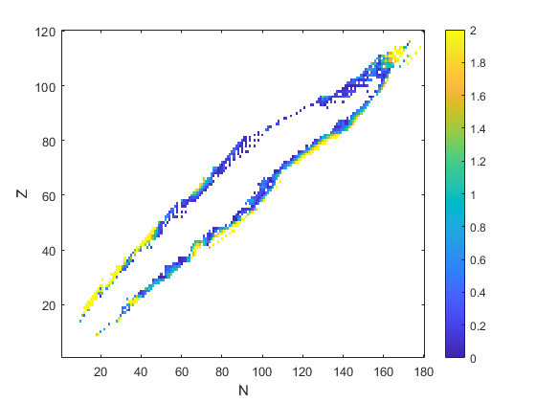
Prediction uncertainty:
Prediction error:

Slide 27
Vergleich der Netzwerke
RMS error in MeV
B Dellen, U Jaekel, PSA Freitas, JW Clark, Predicting nuclear masses with product unit networks
arXiv preprint arXiv:2305.04675, 2023

Slide 28
Summary:
Development of complex-valued product-unit networks
Application to inter- and exrapolation problems in nuclear mass prediction
Performance comparison of different network architectures with and without product units

Slide 29
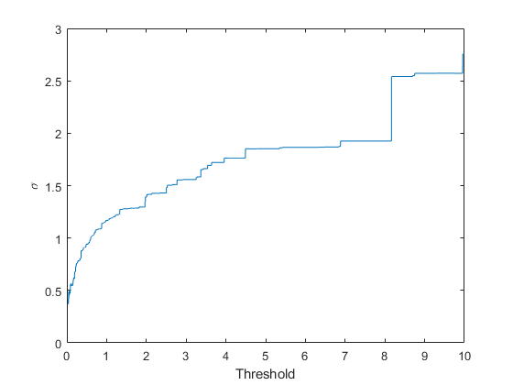
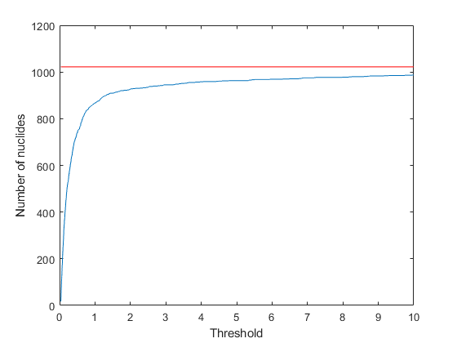
Experiment B:
Thresholding predicting uncertainty
B Dellen, U Jaekel, PSA Freitas, JW Clark, Predicting nuclear masses with product unit networks
arXiv preprint arXiv:2305.04675, 2023

Slide 30
Experiment B:
RMS error in MeV

Slide 31
https://www.nndc.bnl.gov/nudat3/

