Slide 1
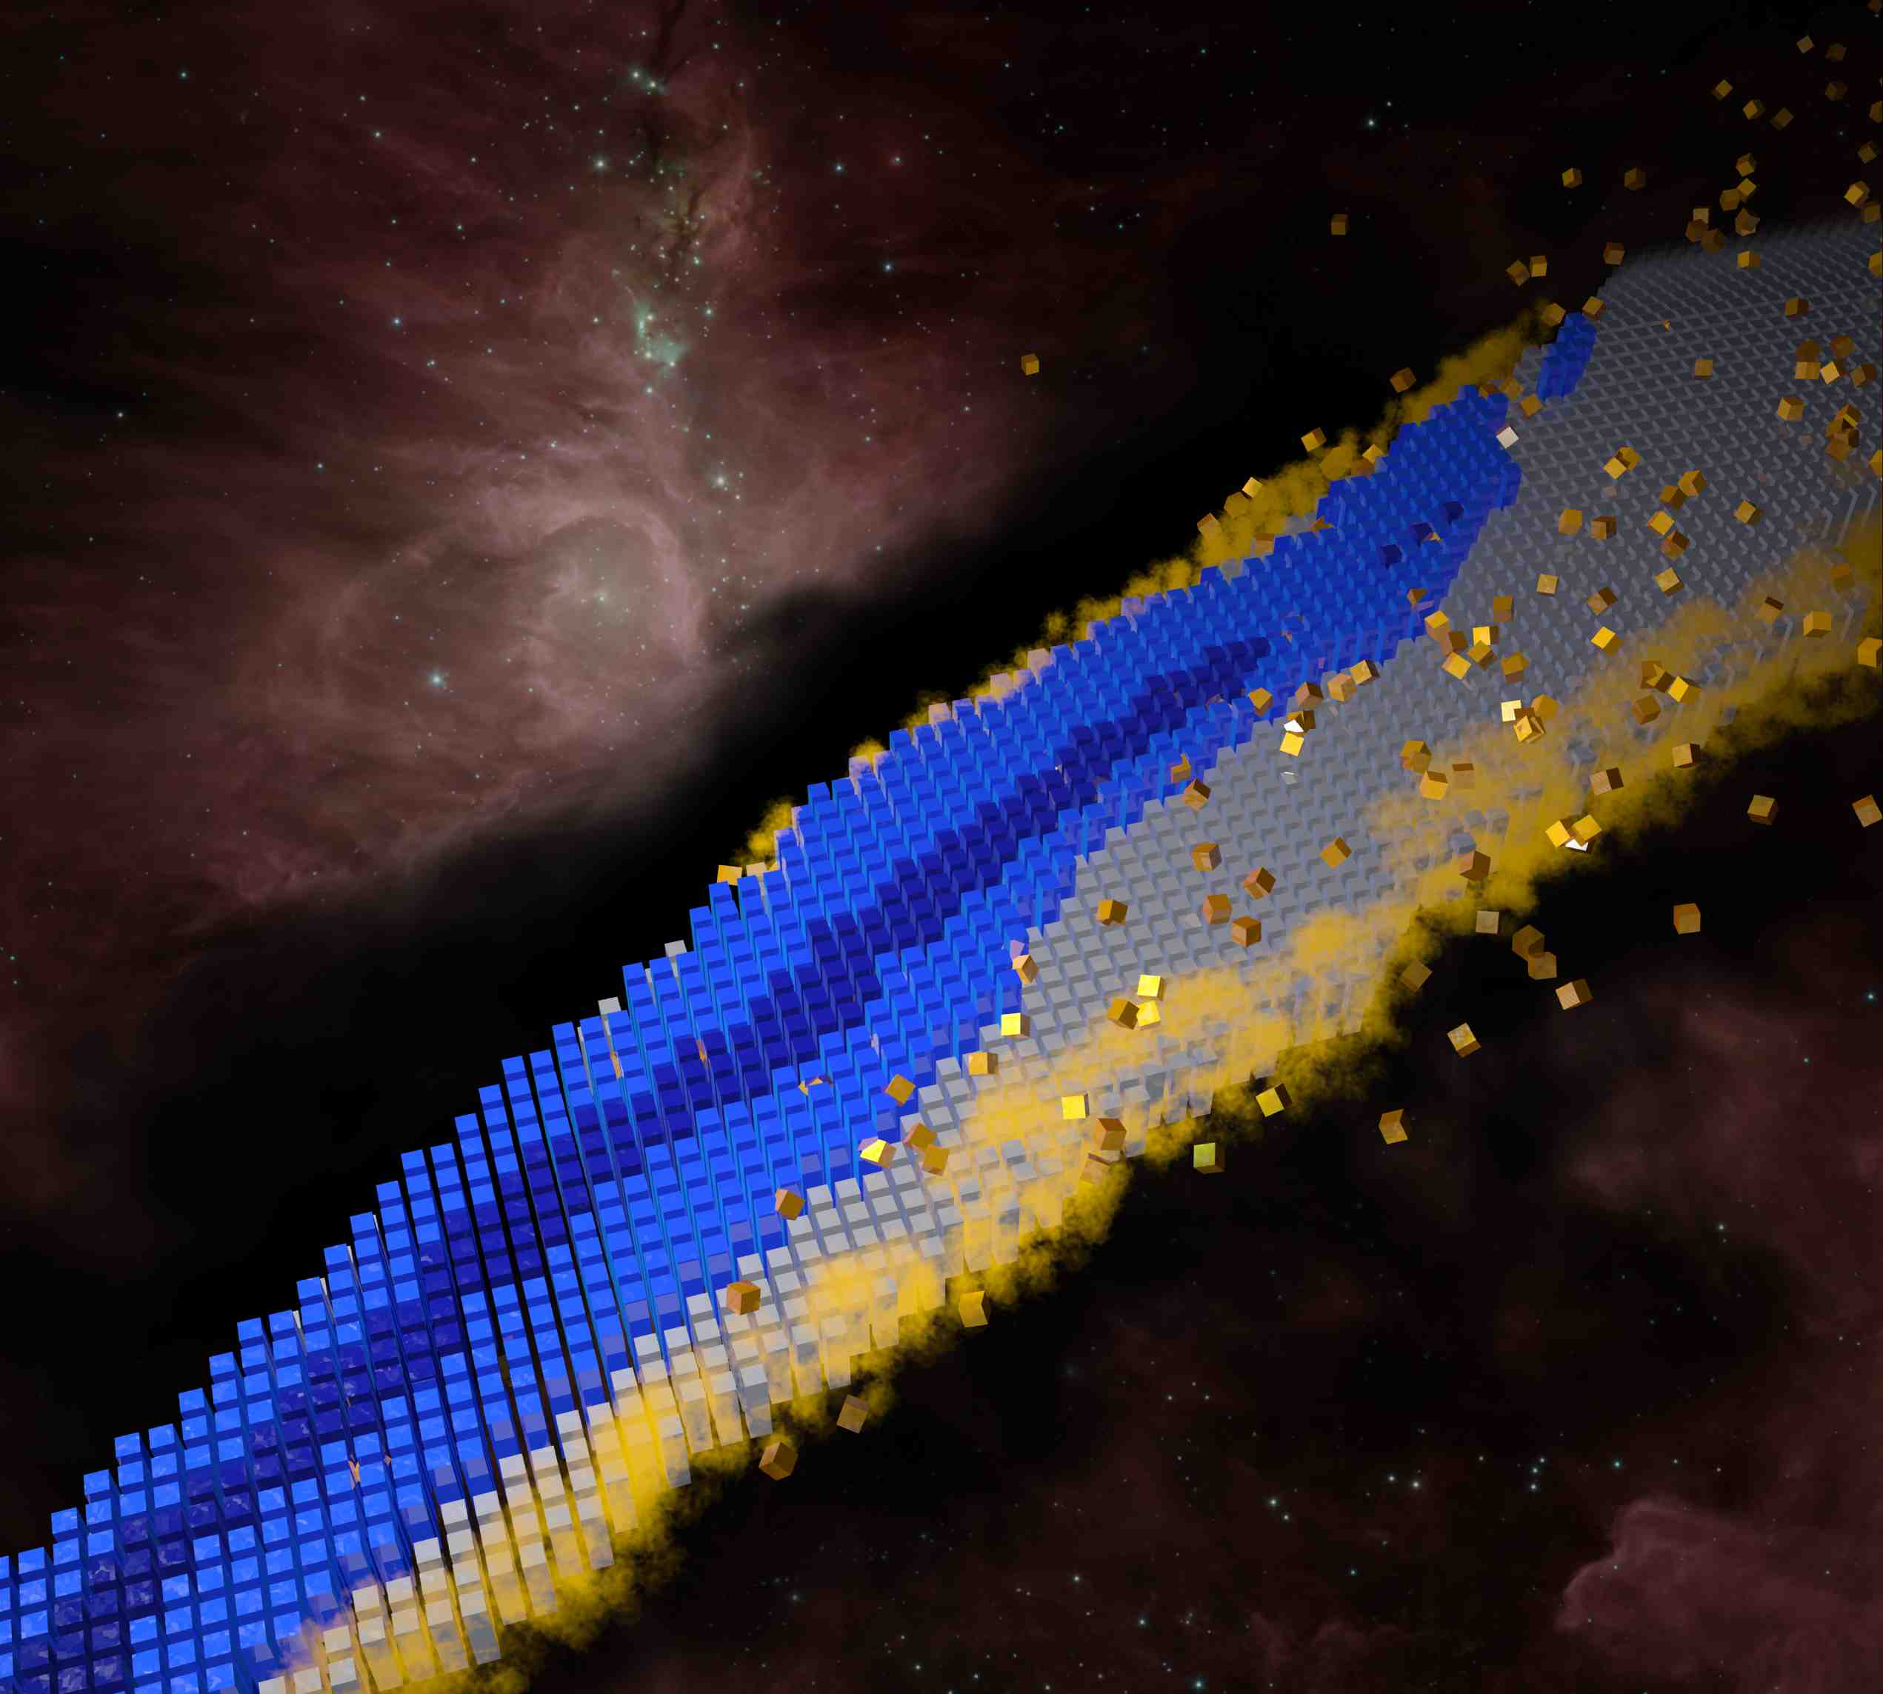
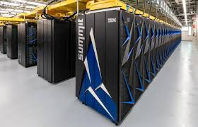
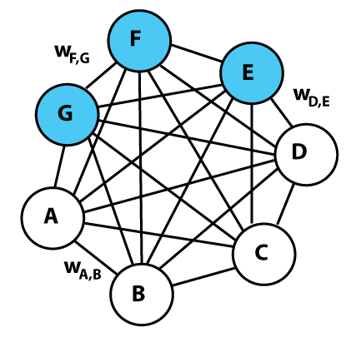
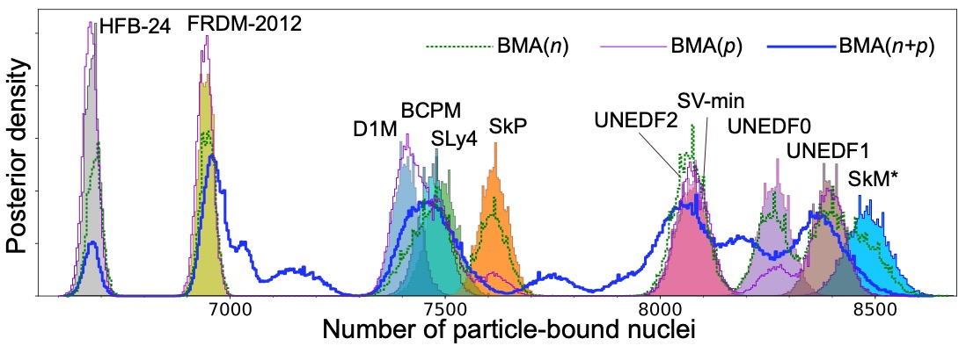
Machine Learning for nuclear structure theory
Witold Nazarewicz Michigan State University/FRIB
ISNET-9, Washington University in St. Louis, May 22-26, 2023
Preliminaries
Why?
How?
Examples of recent work
Perspectives
Notes:
Machine learning (automated processes that learn by example in order to classify, predict, discover, or generate new data)
Artificial intelligence (methods by which a computer makes decisions or discoveries that would usually require human intelligence)
https://towardsdatascience.com/no-machine-learning-is-not-just-glorified-statistics-26d3952234e3
https://towardsdatascience.com/the-actual-difference-between-statistics-and-machine-learning-64b49f07ea3
https://www.nature.com/articles/nmeth.4642
https://machinelearningmastery.com/relationship-between-applied-statistics-and-machine-learning/

Slide 2
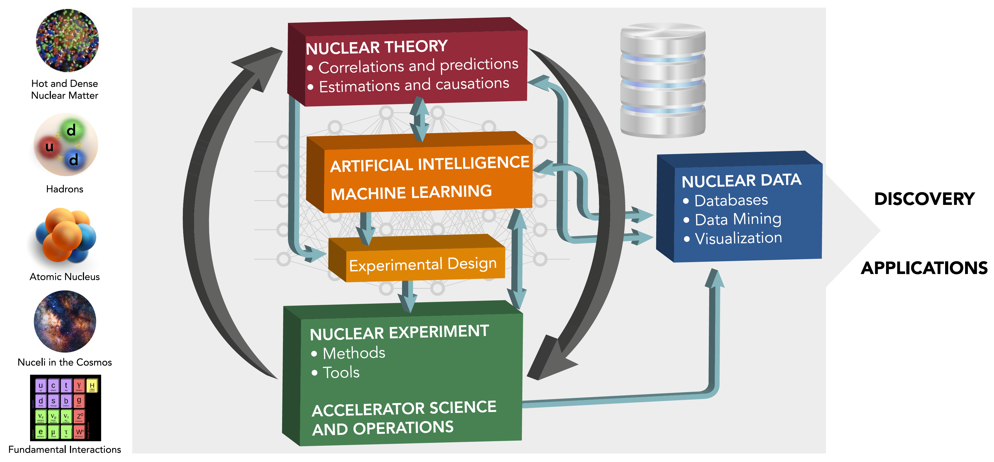
Machine learning and nuclear theory: big picture
Artificial Intelligence and Machine Learning in Nuclear Physics
A. Boehnlein et al., Rev. Mod. Phys. Rev. Mod. Phys. 94, 031003 (2022)
Many examples can be found there!
Highly interdisciplinary!
  Speeding-up the cycle of the scientific method through machine learning

Slide 3
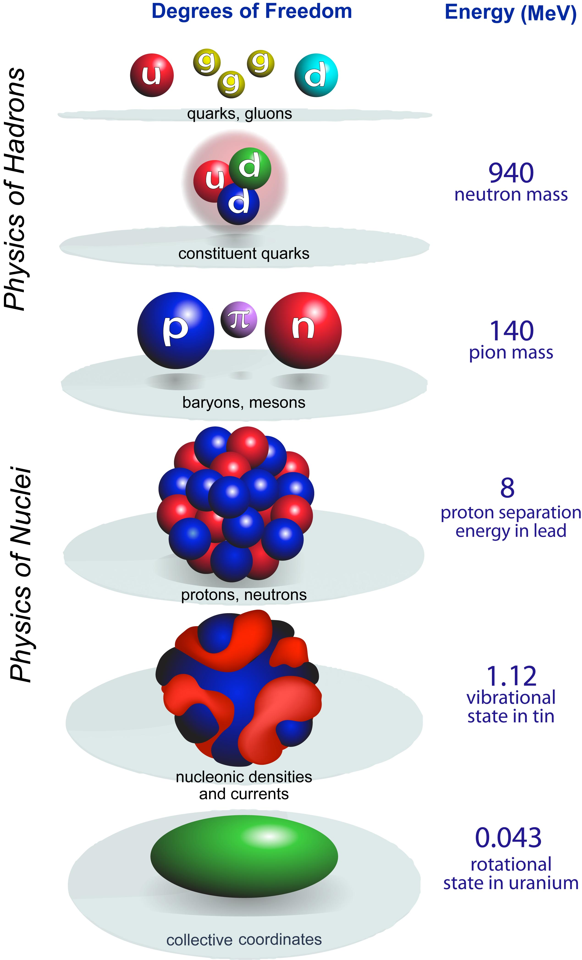
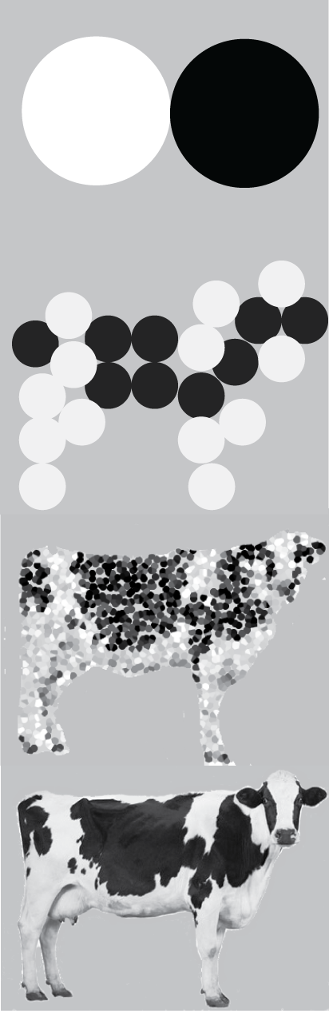
scale
separation
LQCD
quark
models
model emulators
A-body
coupled equations in 3A dimensions
Effective Field Theory
Resolution (depends on questions asked!)
model
CI
Hilbert-space truncations necessary
DFT
experiment
Resolution
collective
Notes:
All nuclear models are phenomenological but at different resolution
ultraviolet (continuum space, long distance) an infrared (momentum space, short distance) extrapolations

Slide 4
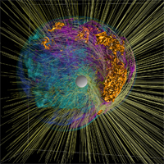
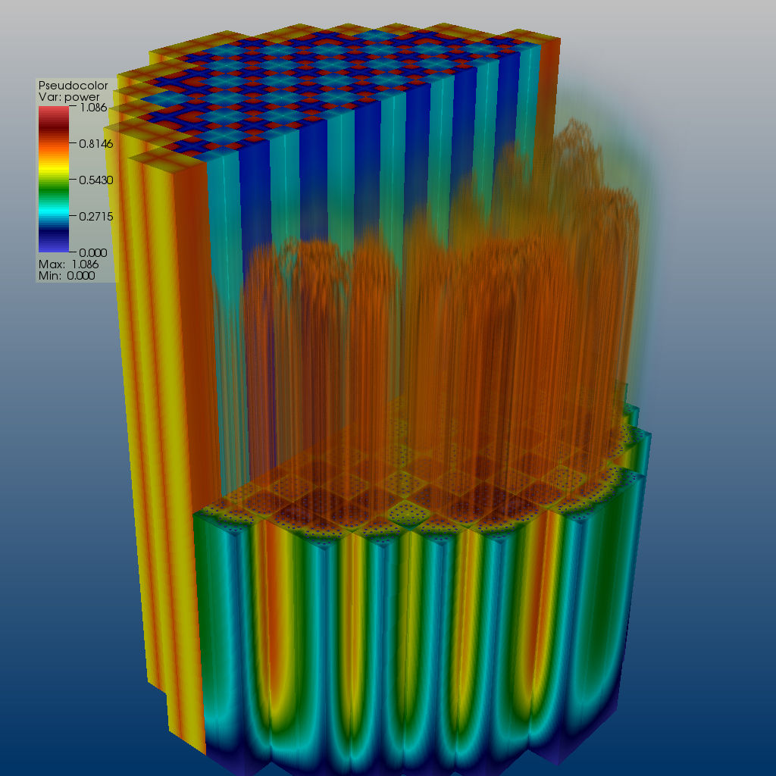
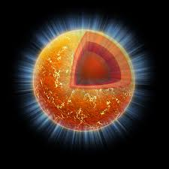

Machine learning & low-energy nuclear theory: Why?
ML tools can help us to speed up the scientific method cycle and hence facilitate discoveries
  Enabling fast emulation for big simulations
  Revealing the information content of measured observables w.r.t. theory
  Identifying crucial experimental data for better constraining theory
  Providing meaningful input to applications and planned measurements
ML tools can help us to reveal the structure of our models
  Parameter estimation with heterogeneous/multi-scale datasets
  Model reduction
ML tools can help us to provide predictive capability
  Theoretical results often involve ultraviolet and infrared extrapolations due to Hilbert-space truncations
  Uncertainty quantification essential
  Theoretical models are often applied to entirely new nuclear systems and conditions that are not accessible to experiment
Many applications represented at ISNET’23
Notes:
Infrared divergences arise from the propagator (large distances, small energy), whereas ultraviolet divergences appear from the upper limit of integration (short-distance physics).

Slide 5
Explosion of papers on machine learning in theoretical nuclear structure/reactions: Various techniques used
Neural Networks
  Bayesian, convolutional, feedforward, recurrent, Boltzmann machines
Bayesian Machine Learning
  Bayesian calibration, Bayesian model averaging & mixing, Bayesian experimental design
Clustering Methods
Ensemble Methods
  Random forests, bagging and voting methods, gradient boosting approaches
Dimensionality Reduction
  Principal component analysis, linear and generalized discriminant analysis, reduced basis methods
Classification and regression analysis
  Kernel methods, linear regression, support vector machines
…
Many techniques represented at ISNET’23

Slide 6
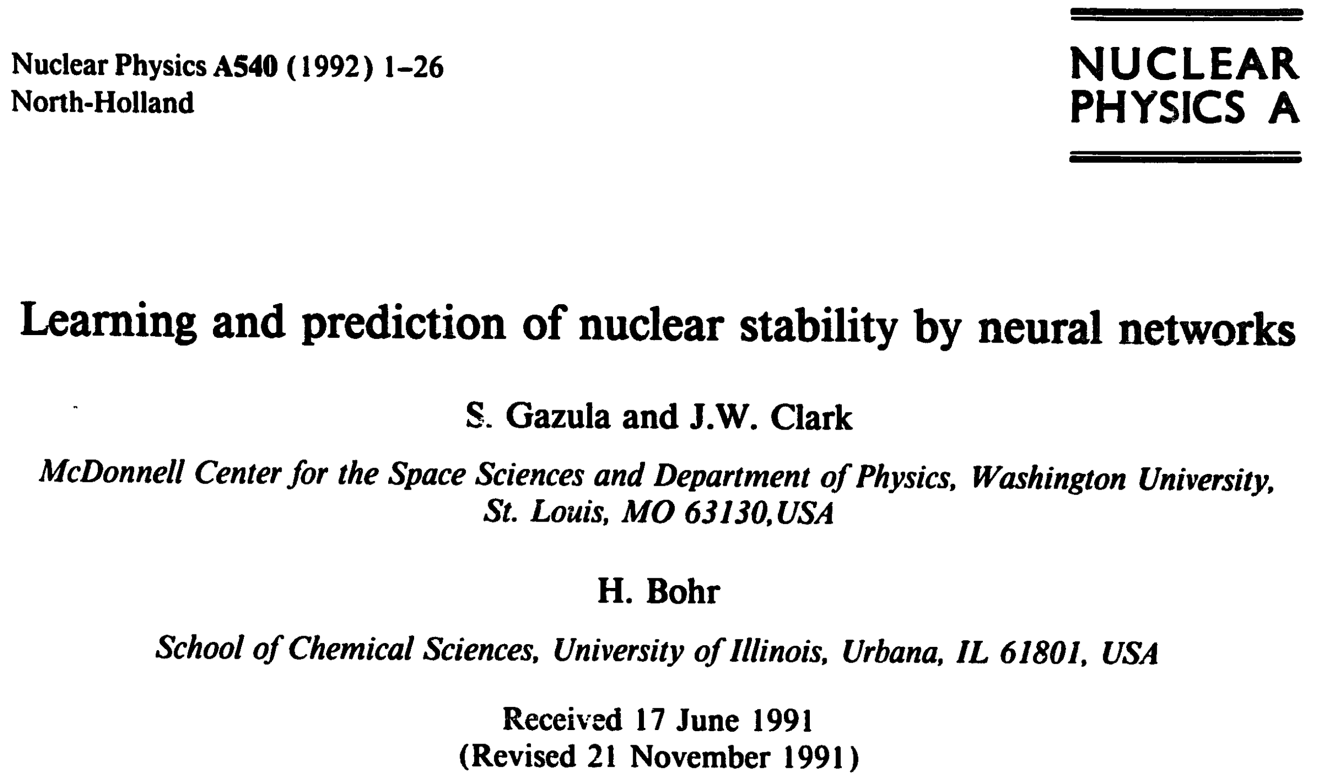
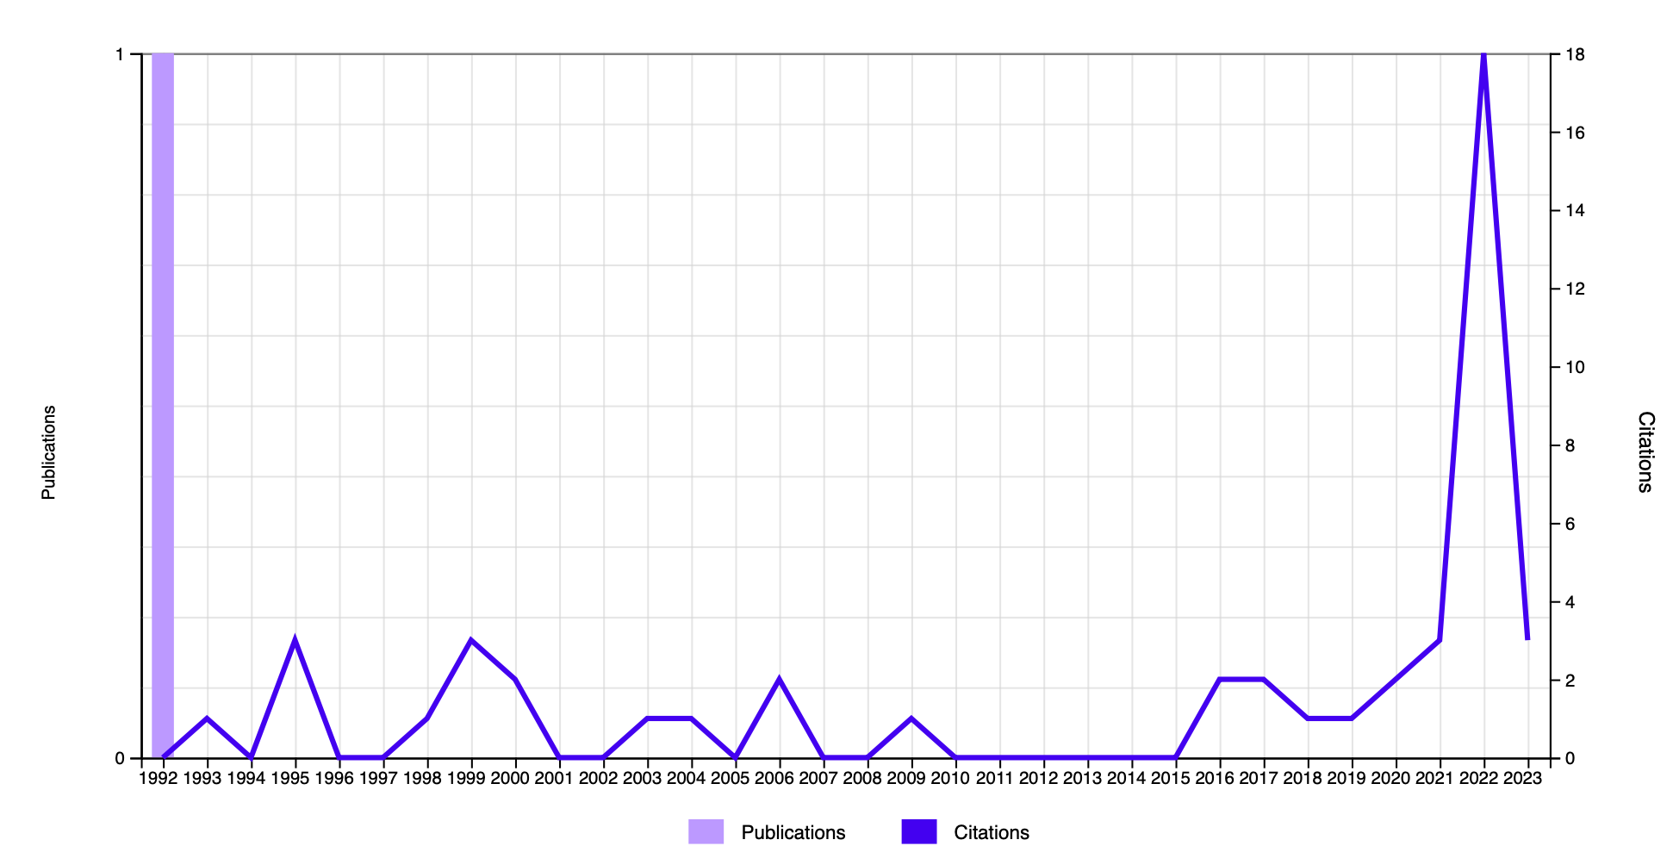
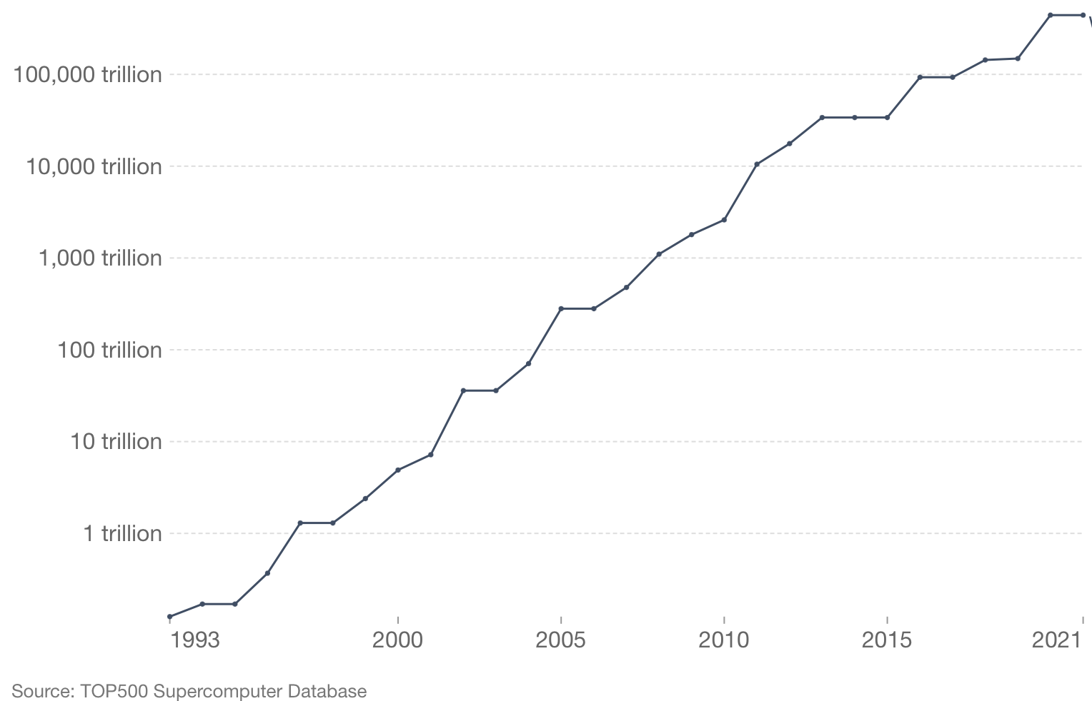
Early applications of neural networks: 1991-2006
The backpropagation learning algorithm is used to teach layered feedforward networks of model neurons the existing data on nuclear stability and atomic masses. Specific applications include (i) the construction of networks that decide stability, (ii) learning and prediction of nuclear mass excesses and (iii) analysis of the systematics of neutron separation energies. With suitable architecture and representation of input and output data, learning can be accomplished with high accuracy. Evidence is presented that these
>7 decades
DoE/Jlab
meeting
new adaptive computational systems can grasp essential regularities of nuclear physics including the valley of β-stability, the pairing effect and the existence of shell structure. Significant predictive ability is demonstrated, opening the prospect that neural networks may provide a valuable new tool for computing nuclear properties and, more broadly, for phenomenological description of complex many-body systems.
TensorFlow
PyTorch
Several applications of ML to various nuclear structure problems by Clark and his collaborators, including: nuclear systematics^{1,2}; backpropagation algorithm for training NN³; Nuclear mass systematics⁴; Global properties: Support Vector Machines⁵
¹Phys. Lett. B 300, 1 (1993); ²Neural Networks 8, 291 (1995); ³CPC 88, 1 (1995);
⁴Nucl. Phys. A 743, 222 (2004); ⁵IJMP B 20, 5015 (2006)
WN visits WUSL
Notes:
Henrik Bohr: grandson of Niels Bohr

Slide 7
Selected Examples

Slide 8
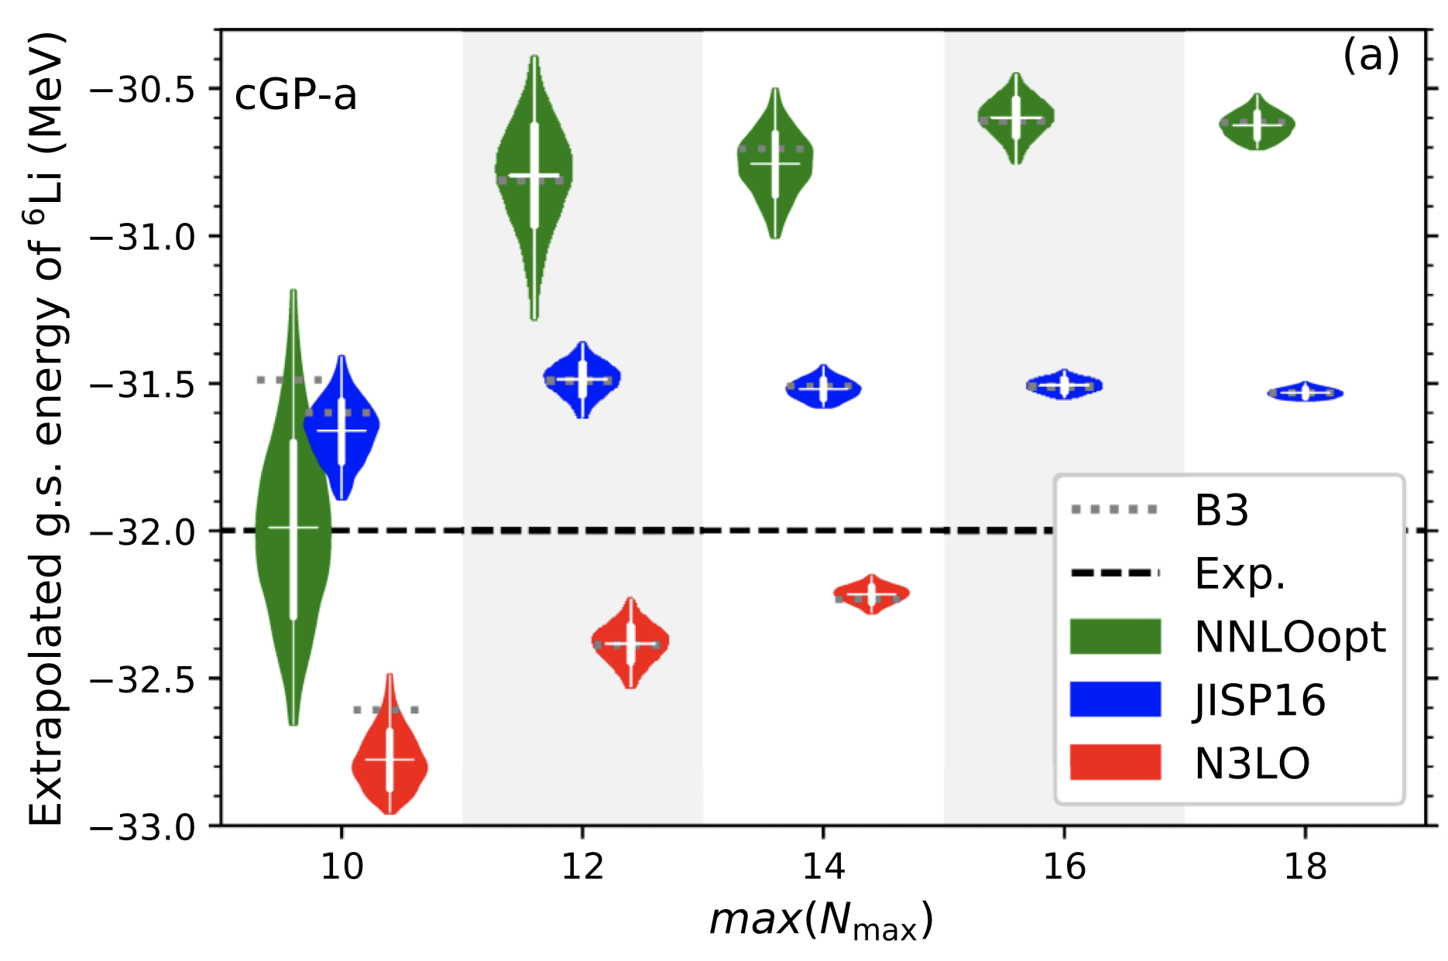
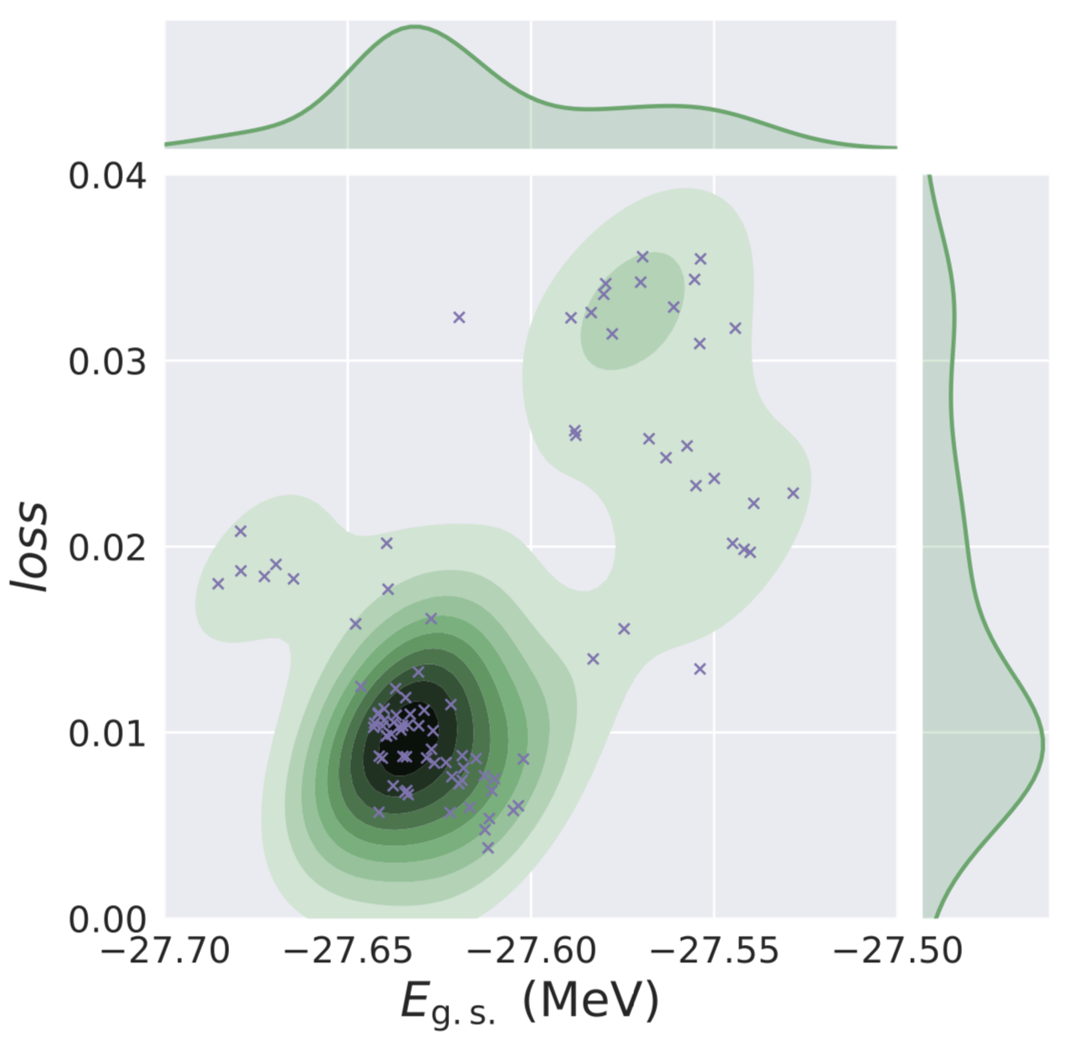
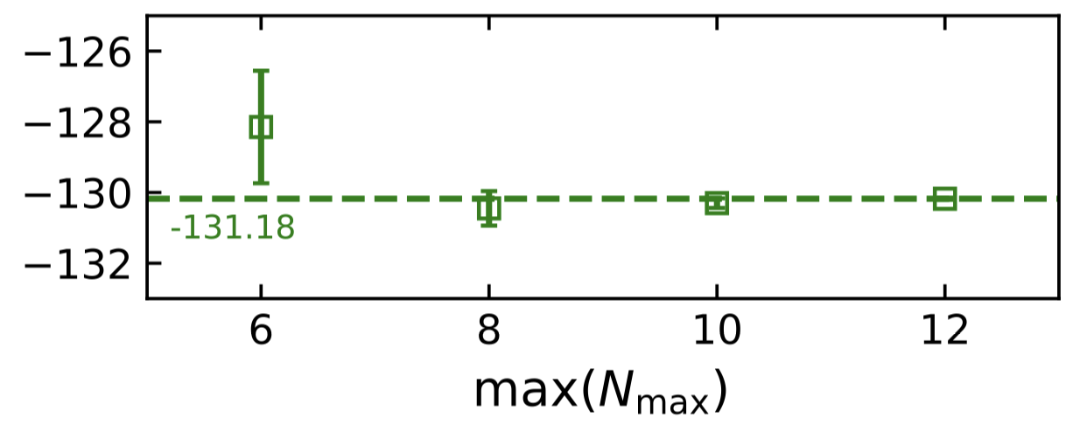
Hilbert-space extrapolations of A-body results with ANN
  Jiang et al. Phys. Rev. C 100, 054326 (2019)
  Yoshida, Phys. Rev. C 102, 024305 (2020)
⁴He with NCSM+NNLO_{opt}
Extrapolated ground-state energy of ⁶Li
¹⁶O with CC+NNLO_{opt}

Slide 9
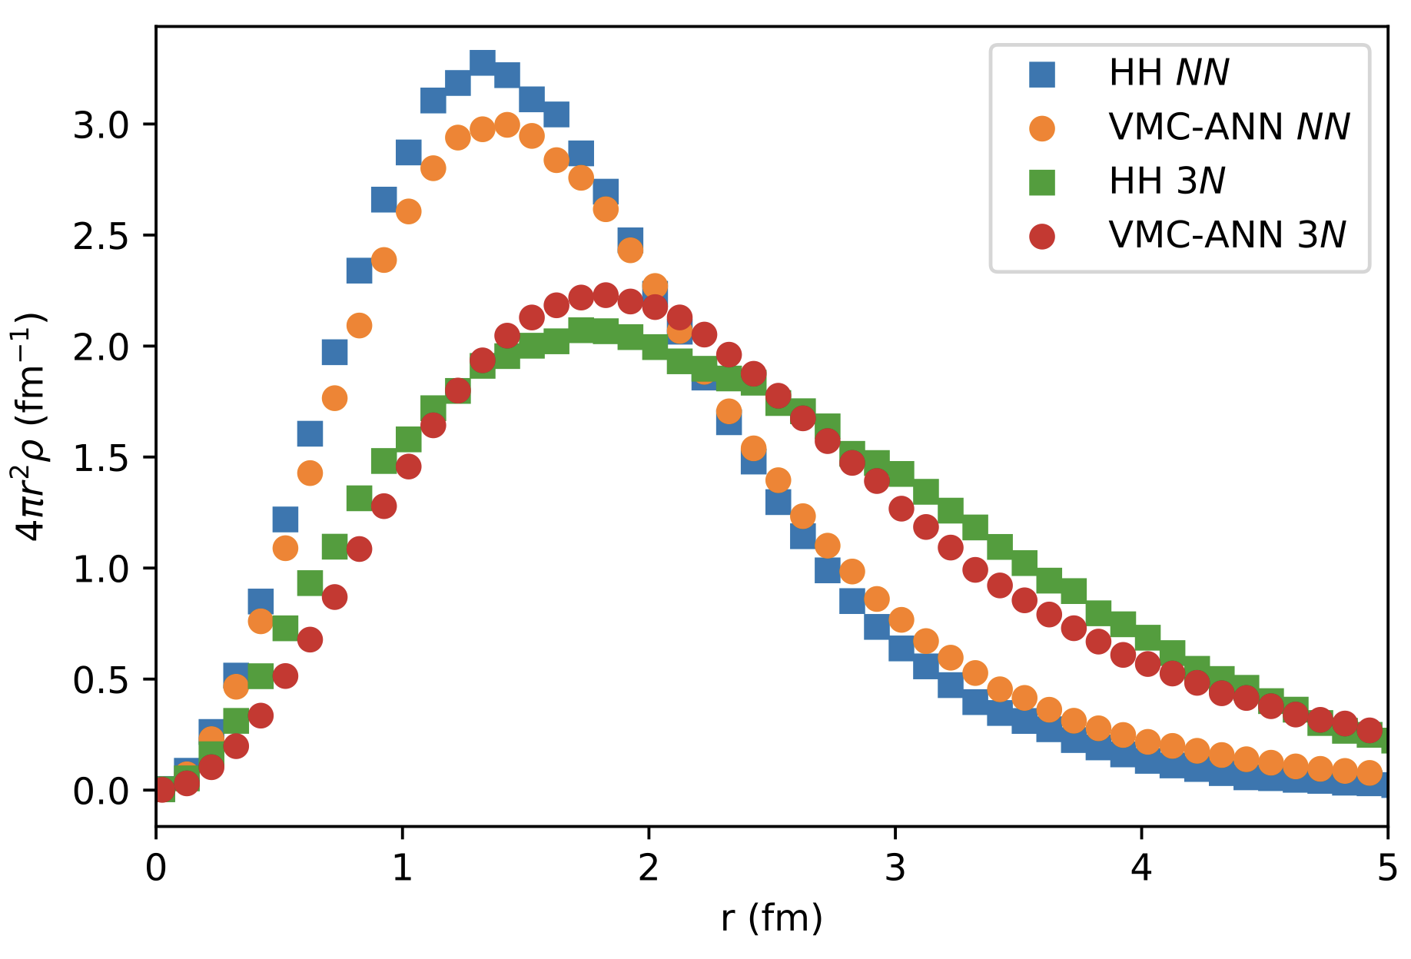
Variational Monte Carlo calculations of A ≤ 6 nuclei with Artificial Neural Networks, Adams et al., Phys. Rev. Lett. 127, 022502 (2021); Gnech et al. Few Body Systems 63, 7 (2022) (⇒ talk by A. Lovato)
Leading order pionless EFT NN+NNN Hamiltonian
point-nucleon density of ⁶Li
The spin-isospin dependent ANN variational wave function outperforms the routinely employed two- and three-body Jastrow parametrization of the correlation function.

Slide 10
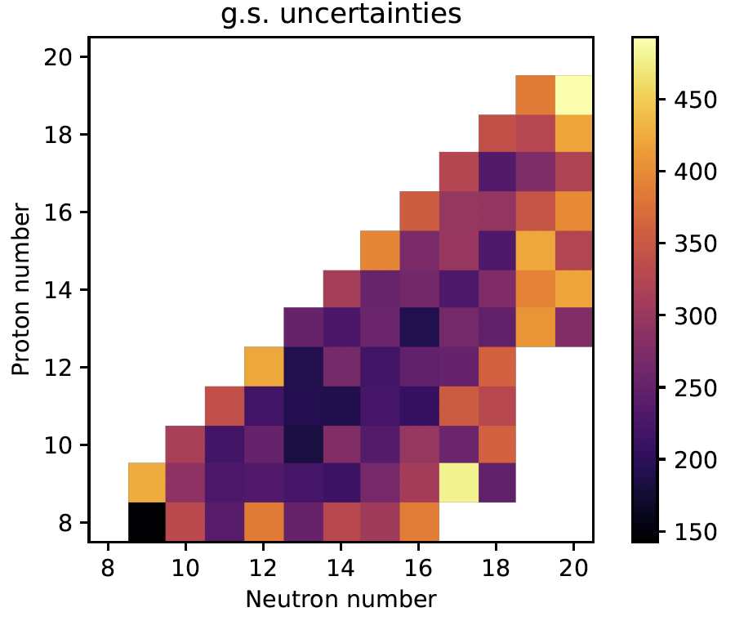
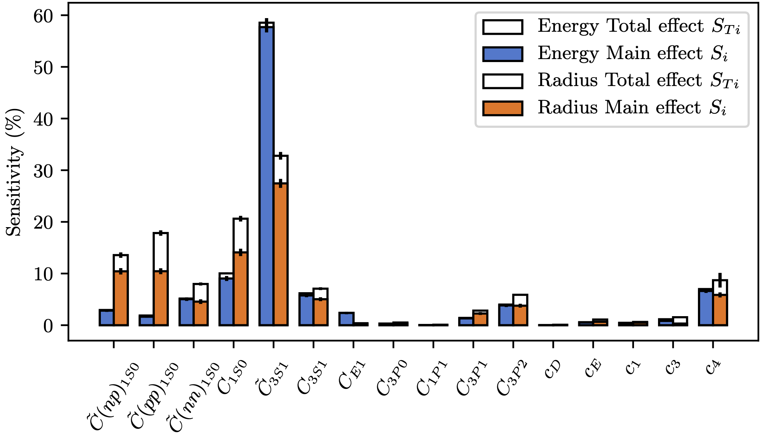
Sensitivity studies, model calibration
Identify key data to constraint models; Understanding model structure
Ekström and Hagen
PRL 123, 252501 (2019)
Fox et al.
PRC 101, 054308 (2020)
NNLO chiral-EFT Hamiltonian
Shell-model matrix elements
⇒ talk by A. Ekström

Slide 11
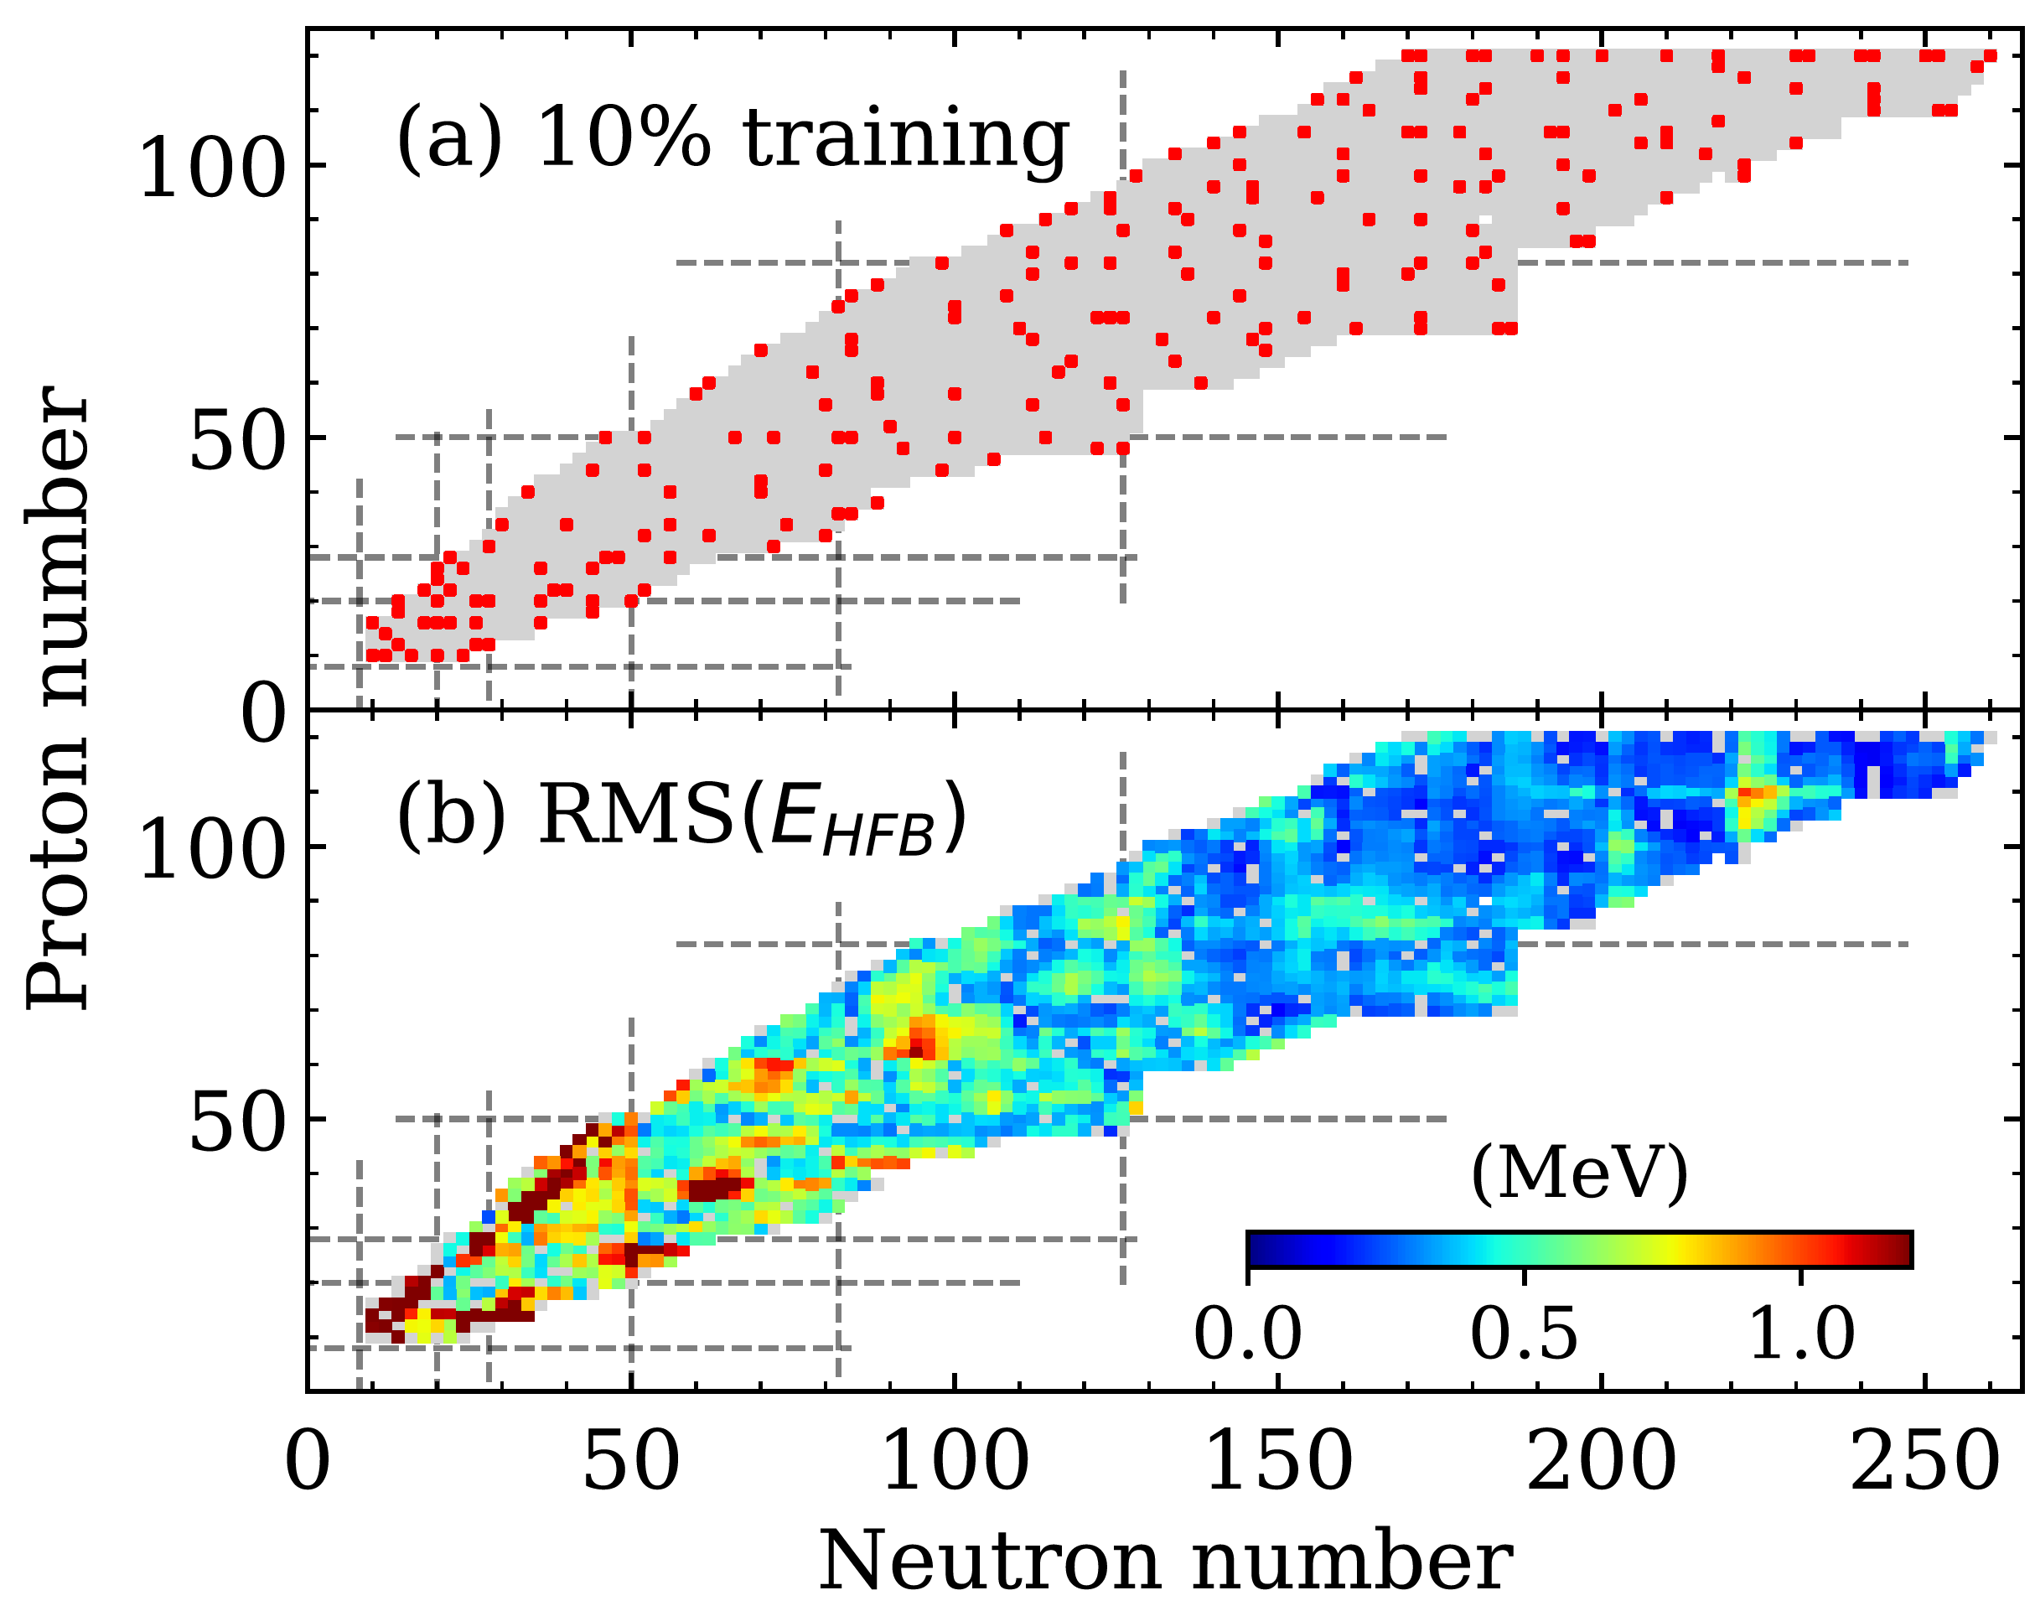
DFT emulator with artificial neural networks
Lasseri et al., Phys. Rev. Lett. 124, 162502 (2020)
The database nuclei (grey). Nuclei included
in the 10% training dataset obtained by the active learning are marked (dots).
The root mean square deviation between the total energy for the testing dataset calculated in DFT (EHFB) and with the committee of ANN.
⇒ talk by M. Verriere
⇒ talk by D. Lay
⇒ talks by P. Giuliani and D. Odell on reduced basis method applications to emulation

Slide 12
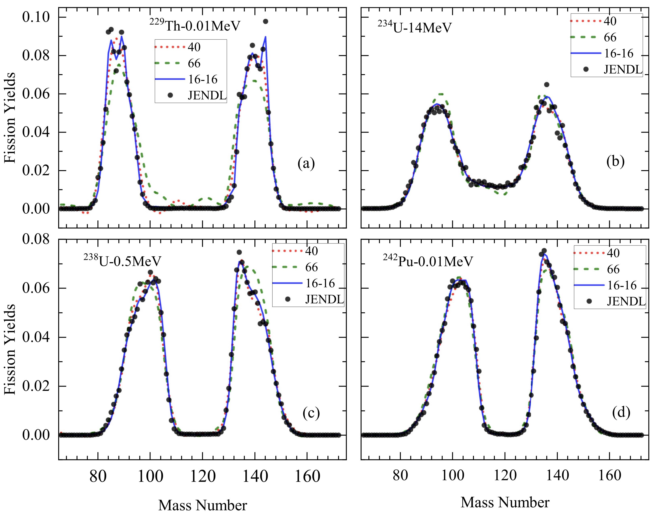
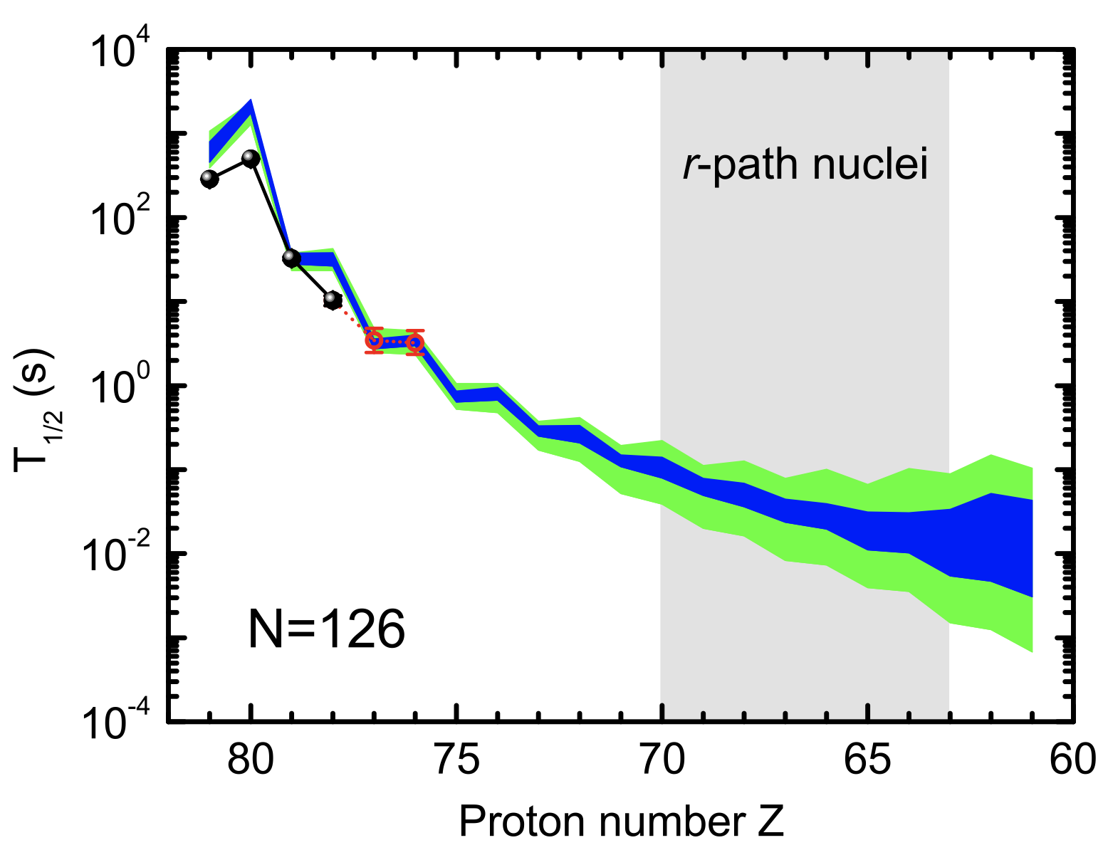
Machine learning for nuclear data mining
Optimizing multilayer Bayesian neural networks for evaluation of fission yields
Z.A Wand and J. Pei, Phys. Rev. C 104, 064608 (2021)
Predictions of nuclear β-decay half-lives with BNN and their impact on r-process nucleosynthesis, Z.M. Niu et al., Phys. Rev. C 99, 064307 (2019)
Predicting missing data
Model-based extrapolations

Slide 13
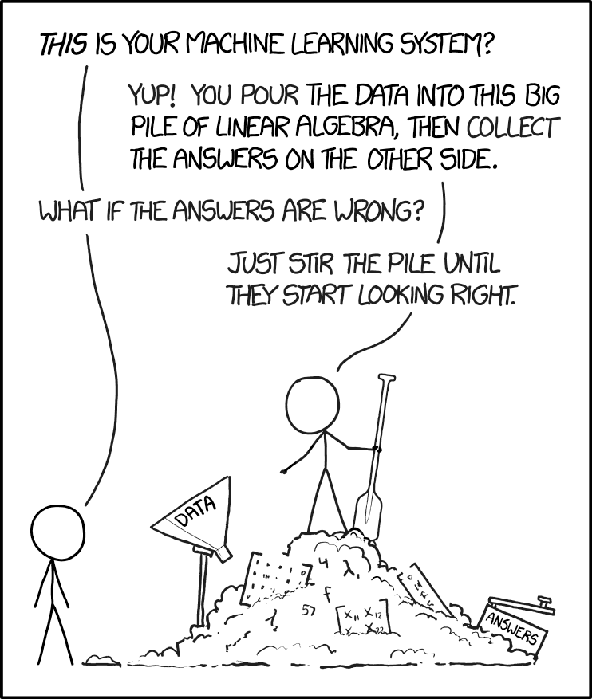
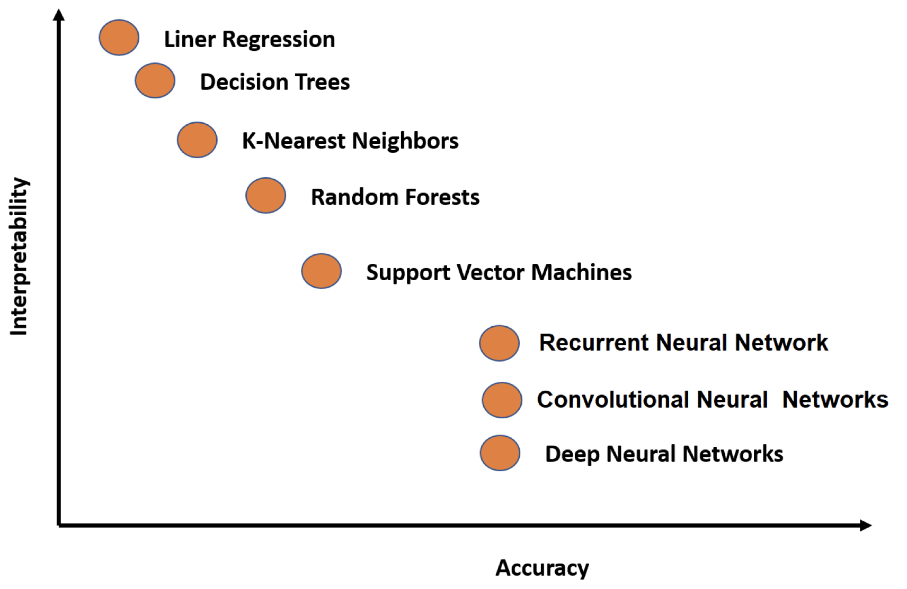
Extrapolations and Model Interpretability
Disadvantage of deep learning methods is their “black box” nature: the computationally-advanced methods by which these methods come up with the convolved output is not readily understandable. Kowsari et al. Information 10, 150 (2019); on text classification algorithms
Bayesian inference increases interpretability and accuracy!
https://xkcd.com/1838/
Information 10, 150 (2019)
⇒ Bayesian inference for nuclear modeling

Slide 14
Bayesian Machine Learning

Slide 15
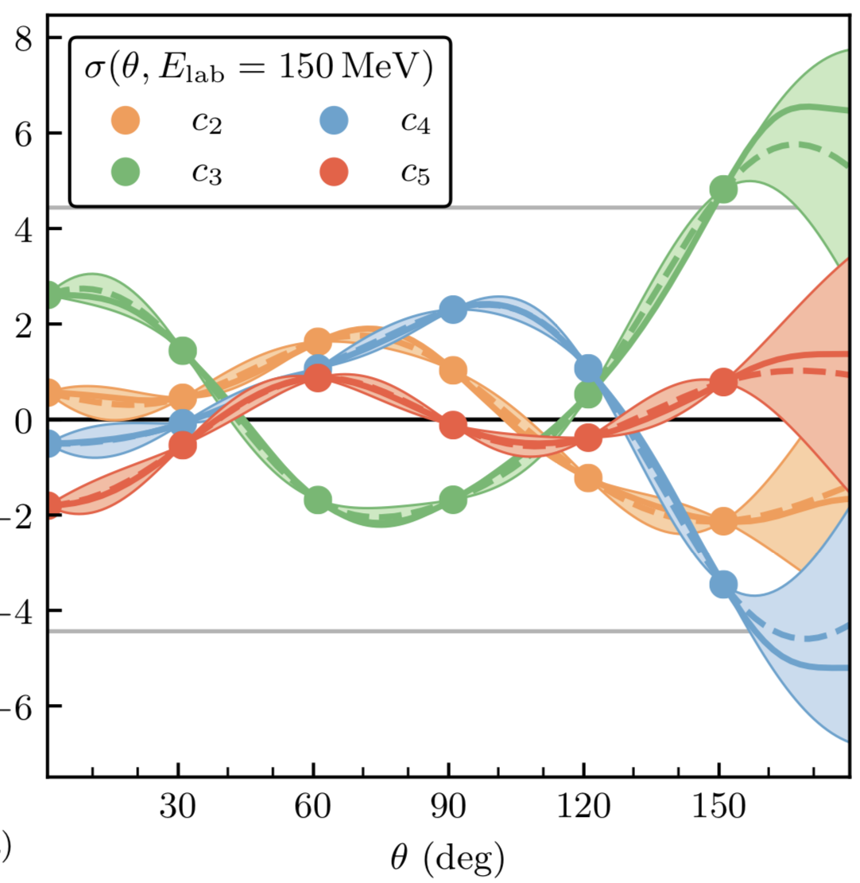
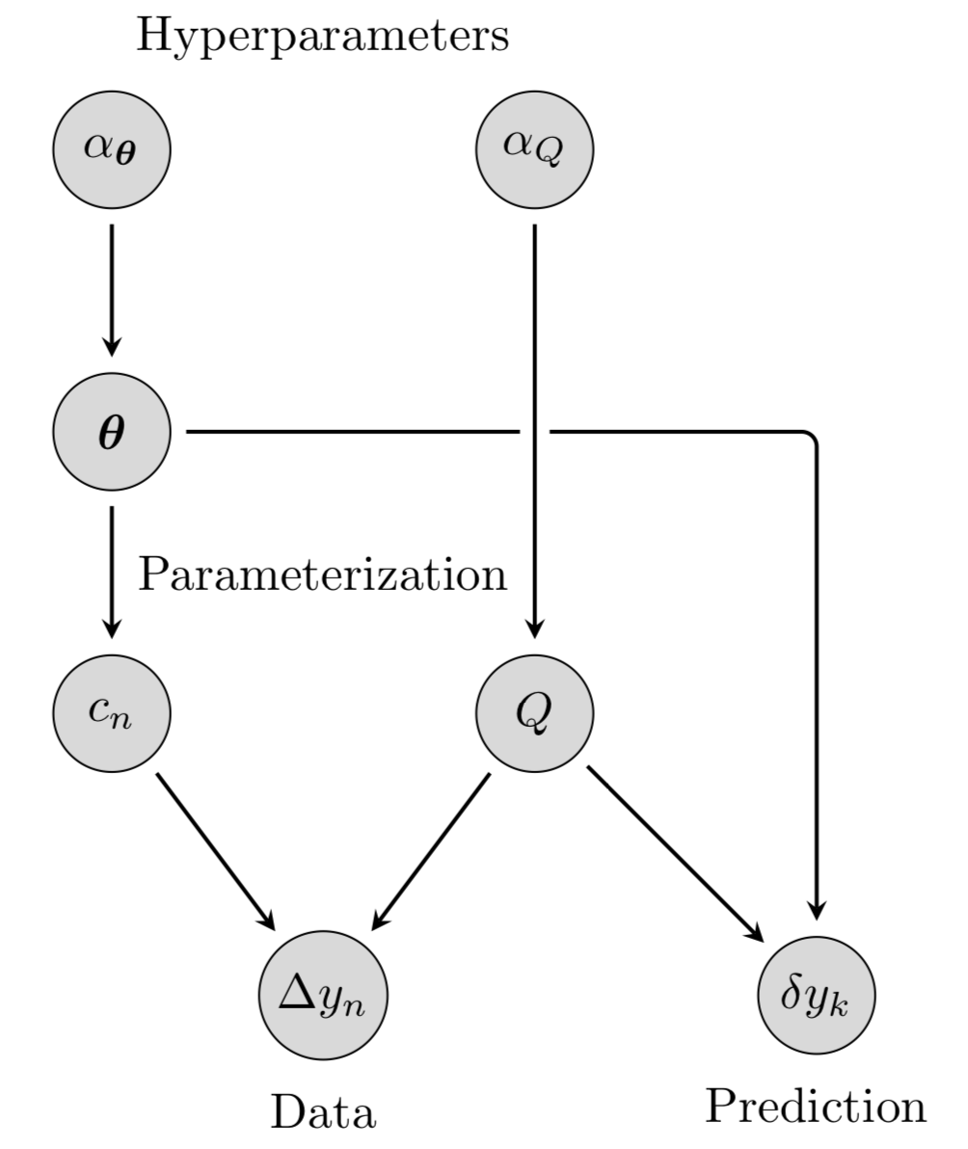
Bayesian GP model for Quantifying Correlated Truncation Errors in EFT
Melendez et al., Phys. Rev. C 100, 044001 (2019)
Differential NN cross section coefficients from the semilocal EKM potential
Bayesian network used
⇒ talk by D. Furnstahl

Slide 16
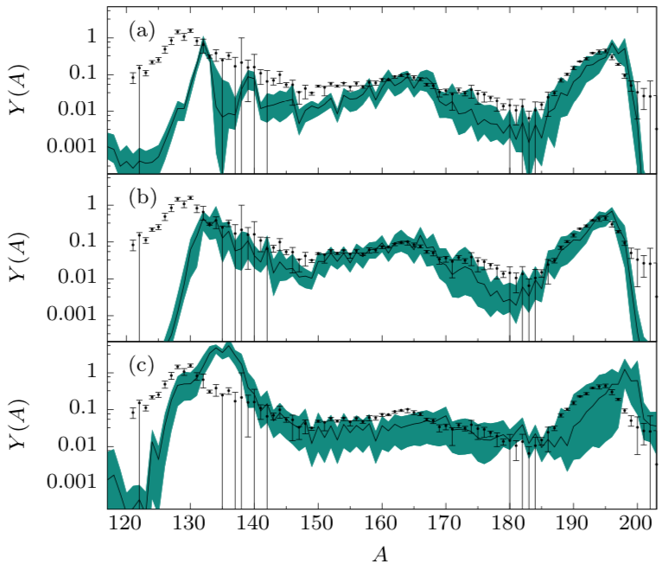
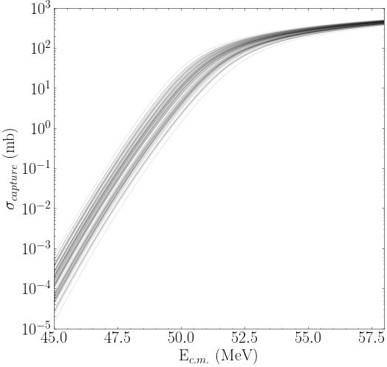
Parameter estimation: Quantified DFT
Sprouse et al.
Phys. Rev. C 101, 055803 (2020)
high-entropy
McDonnell et al.
Phys. Rev. Lett. 114, 122501 (2015)
low-entropy
r-process
modeling
fission recycling
Bivariate marginal estimates of the posterior distribution for the 12-dimensional DFT UNEDF₁ parameterization.
heavy-ion fusion
⇒ K. Godbey et al.
Phys. Rev. C 106, L051602 (2022)

Slide 17

Emulators for the nuclear many-body problem
Hu et al., Nature Phys. 18, 1196 (2022)
⇒ talk by Ch. Forssén
They explored 10⁹ different nuclear force parameterizations via history matching, confront them with data in select light nuclei and arrive at an importance-weighted ensemble of interactions
Nuclei from NN+NNN interactions: CC, IM-SRG, MBPT

Slide 18
Bayesian Model Averaging (BMA) or Bayesian Model Mixing (BMM) incorporate insights from different models into a unified prediction in a statistically rigorous way.
BMA: the total pdf is an average over pdf’s f individual models.
observable of interest
evidence dataset
model weight
model
The evidence dataset that is used to assess the aspects of model performance that are pertinent for predicting y* need not be the same as the dataset(s) used to calibrate the models. Ideally the data y_{ev} will be chosen because it is understood to be, or analyzed to be, a good proxy for the quantity of interest.
That performance is usually be addressed within the context of the model discrepancy δy_{th} of each model.
In the more advanced BMM, it is assumed that the total prediction is an average over predictions of individual models.
⇒ BAND Camp on Monday

Slide 19
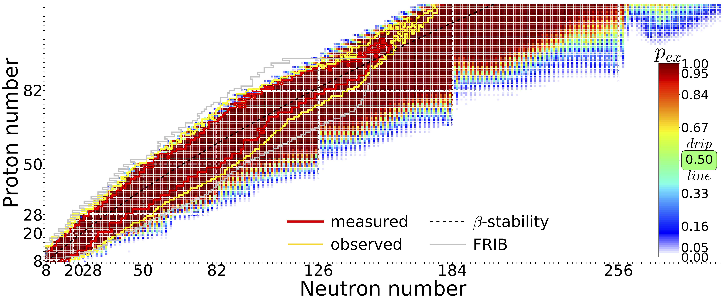
Quantified predictions based on current data and current theoretical knowledge (extrapolations are tough!)
L. Neufcourt at al , Phys. Rev. C 101, 044307 (2020)
Predictions made with 11 global mass model and Bayesian model averaging
More advanced Bayesian model mixing techniques on the horizon!
    Local model mixing
    Model orthogonalization
    Web-based mass interface (BMEX)
    Masses and covariances!

Slide 20
Many mass models based on machine learning!
See examples in Rev. Mod. Phys. Rev. Mod. Phys. 94, 031003 (2022)
Physically interpretable machine learning for nuclear masses, M. R. Mumpower et al., C Phys. Rev. C 106, L021301 (2022) - physically interpretable machine learning approach based on neural networks. (⇒ talk by A. E. Lovell)
Predicting nuclear masses with product-unit networks, B. Dellen et al., arXiv:2305.04675 (2023) (⇒ talk by B. Dellen)
Controlling extrapolations of nuclear properties with feature selection, R. Navarro Perez and N. Schunck, Phys. Lett. B833, 137336 (2022)
Uncertainty Quantification of Mass Models using Ensemble Bayesian Model Averaging, Y. Saito et al., arXiv:2305.01782 (2023)
Dataset limited, prone to overfitting, see Phys. Rev. C 98, 034318 (2018)
Notes:
Gaussian process is a stochastic process, such that every finite collection of those random variables has a multivariate normal distribution

Slide 21
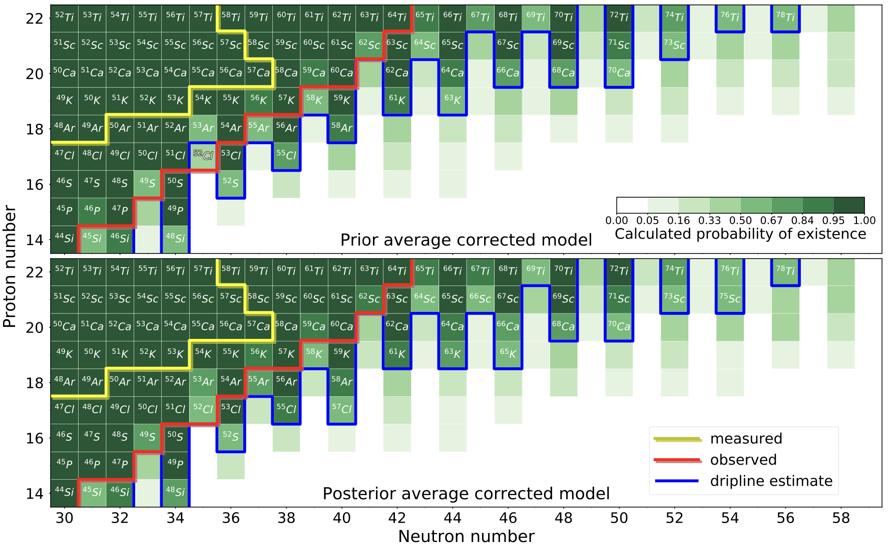
Existence experiments provide strong constraints
Discovery of ⁶⁰Ca, Tarasov et al. Phys. Rev. Lett. 121, 022501 (2018)
Bayesian model averaging, see L. Neufcourt et al., Phys. Rev. Lett. 122, 062502 (2019)
The impact of the discovery of ⁵²Cl, ⁵³Ar, and ⁴⁹S on drip-line predictions: the 2n drip line obtained with posterior weights generally extends by two neutron numbers for odd-Z chains.

Slide 22
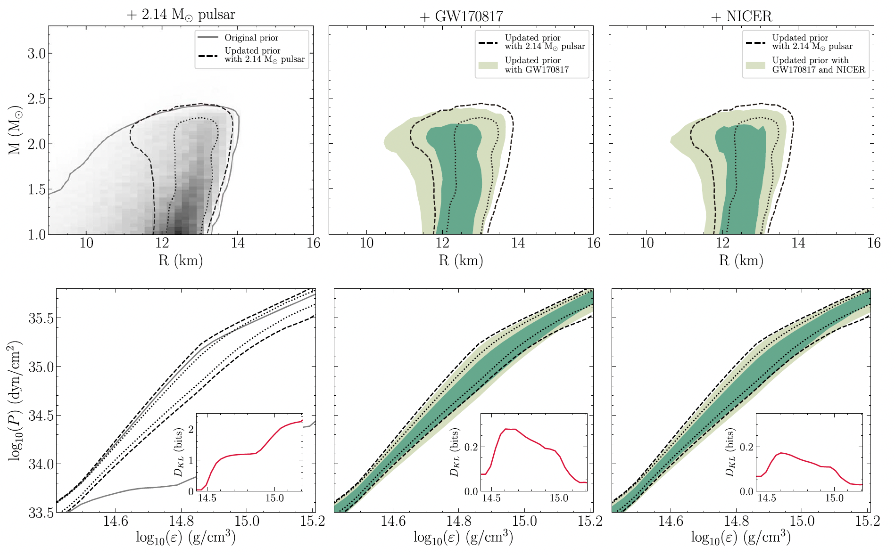
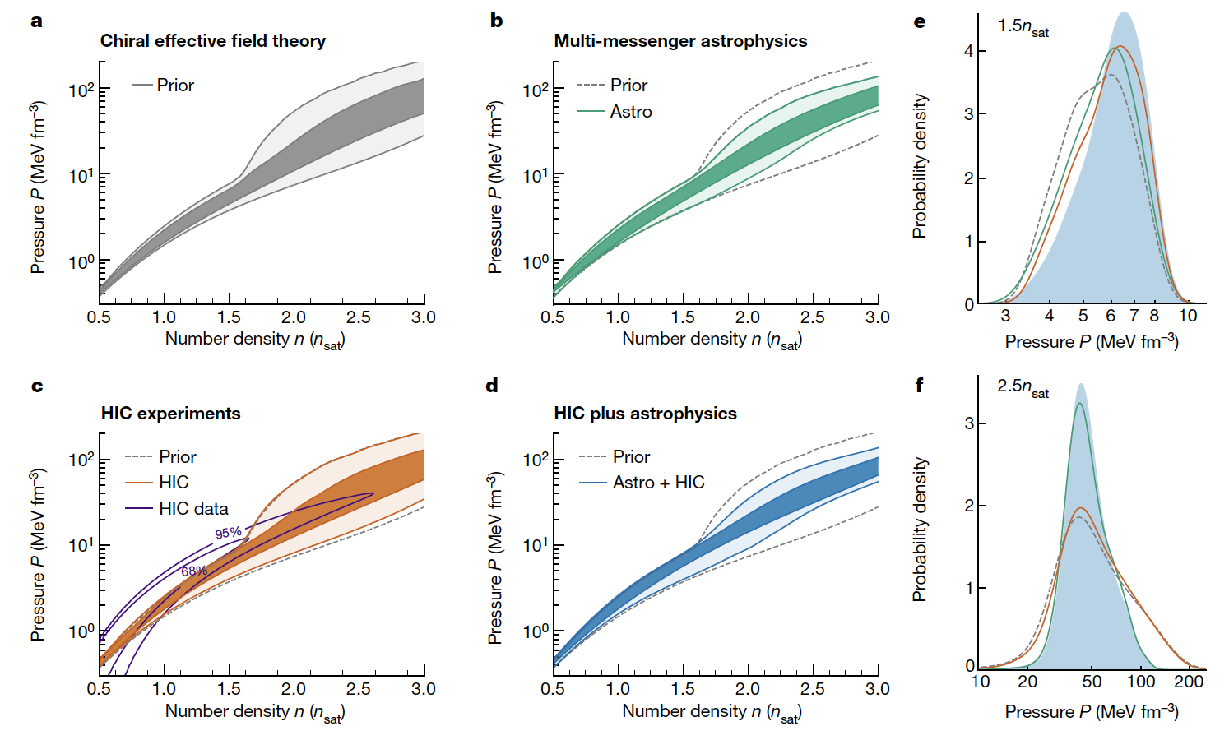
Equation of state of nuclear matter
Many studies combining nuclear data and astrophysical observations
G. Raaijmakers et al., Constraining the Dense Matter Equation of State with Joint Analysis of NICER and LIGO/Virgo Measurements, AJ Letters, 893, L21 (2020)
S. Huth et al. Constraining neutron-star matter with microscopic and macroscopic collisions, Nature 606, 276 (2022)
(ASY-EOS@GSI)

Slide 23
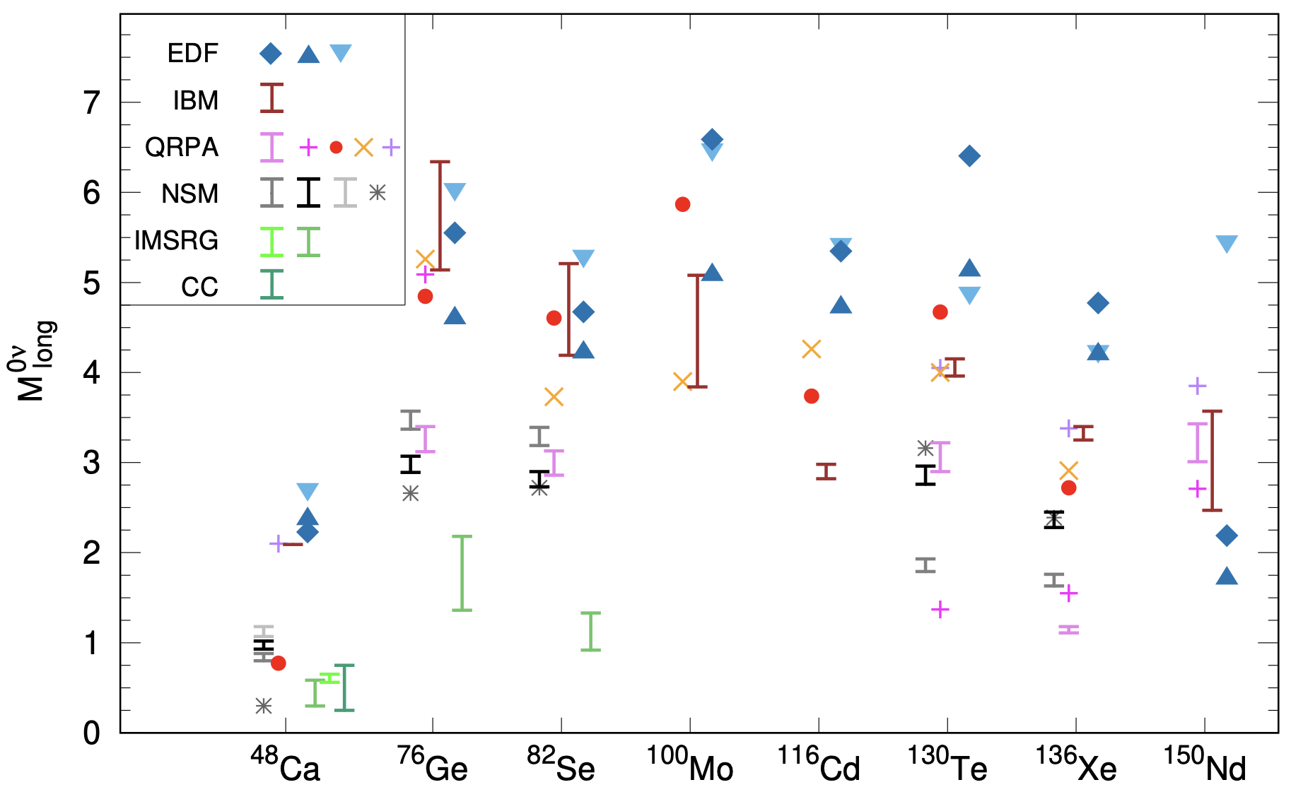
Current 0νββ predictions
“There is generally significant variation among different calculations of the nuclear matrix elements for a given isotope. For consideration of future experiments and their projected sensitivity it would be very desirable to reduce the uncertainty in these nuclear matrix elements.” (Neutrinoless Double Beta Decay NSAC Report 2014)
Towards Precise and Accurate Calculations of Neutrinoless Double-Beta Decay, V. Cirigliano et al.,
J. Phys. G 49, 120502 (2022)

Slide 24
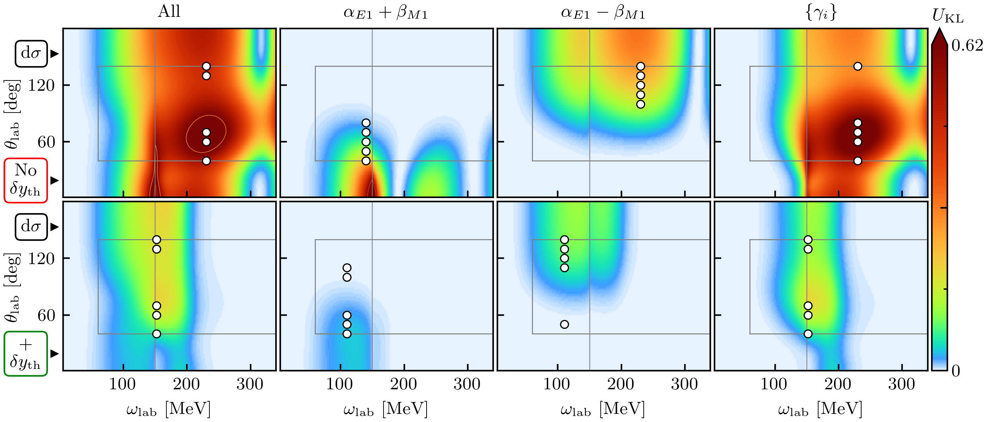
Experimental design
Beam time and compute cycles are expensive!
Bayesian experimental design provides a framework in which experiments can be designed using the best experimental and theoretical information available
The utility function is designed to encode the goals of the experiment and the constraints inherent in carrying it out.
Once the utility function and the possible designs have been specified, the optimal design is simply the scenario that maximizes the expected utility function over the domain of possible designs.
The expected utility of proton differential cross section measurements. The circles show the optimal design kinematics for five measurement points at the same energy but different angles.
Designing optimal experiments: An application to proton Compton scattering
J. A. Melendez et al., EPJA 57, 81(2021)
⇒ D. Furnstahl@BANDCamp

Slide 25
Summary
Great progress! Various machine learning approaches used in numerous applications.
Need for Uncertainty Quantification in nuclear physics theory. Much remains to be done.
To solve many complex problems in the field and facilitate discoveries, multidisciplinary efforts efforts are required involving scientists in nuclear physics, statistics, computational science, and applied math.
Congratulations and best wishes, John!

Slide 26
Backup

Slide 27
Model imperfections
The inclusion of a model discrepancy term in the analysis of data is known to be crucial for accurate parameter estimation
M.C. Kennedy and A. O’Hagan, J. Royal. Stat. Soc. B 63, 425 (2001);
Higdon et al., SIAM J. Sci. Comput. 26448–466 (2004)
model prediction
experimental
error (σ)
theory uncertainty
x: input space (e.g., Z,N)
discrepancy or residual
(can also be used to build emulators of expensive models)
Regular part of the residual represents missing physics
- a small number, if the model is good
Theory error contains systematic and statistical components
Refinements can be added based on our knowledge of trends (e.g. magic nuclei) ⇒ features
see L. Neufcourt at al., Phys. Rev. C 98, 034318 (2018)

Slide 28
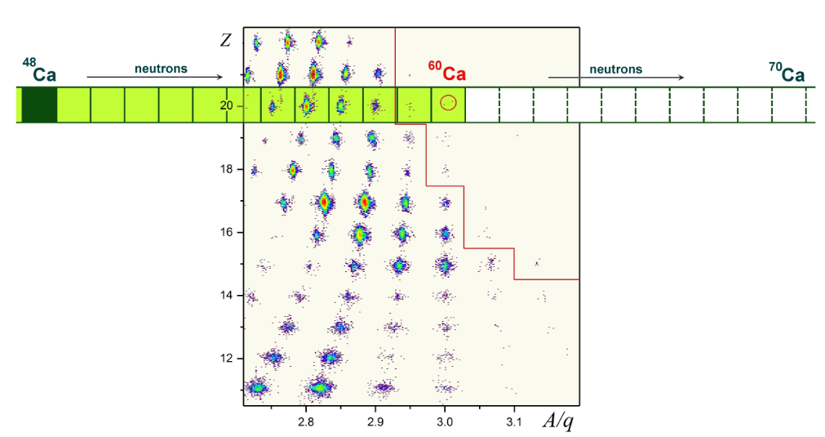
How many Ca nuclei exist?
Neufcourt et al.,Phys. Rev. Lett. 122, 062502 (2019)
Discovery of ⁶⁰Ca
O. Tarasov et al.
Phys. Rev. Lett. 121, 022501 (2018)
According to nuclear DFT, calcium isotopes are expected to be bound out to about ⁷⁰Ca
DFT
Phys. Scr. 2013, 014022 (2013)

Slide 29
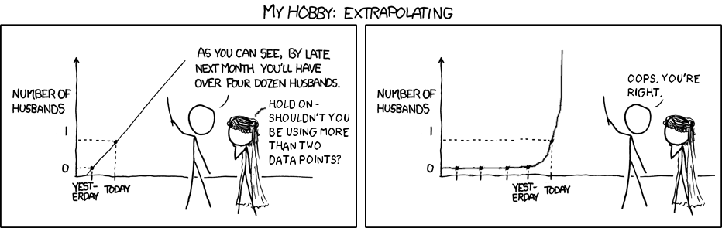
In many cases, nuclear input MUST involve massive extrapolations based on predicted quantities. And extrapolations are impossible tough.

Slide 30


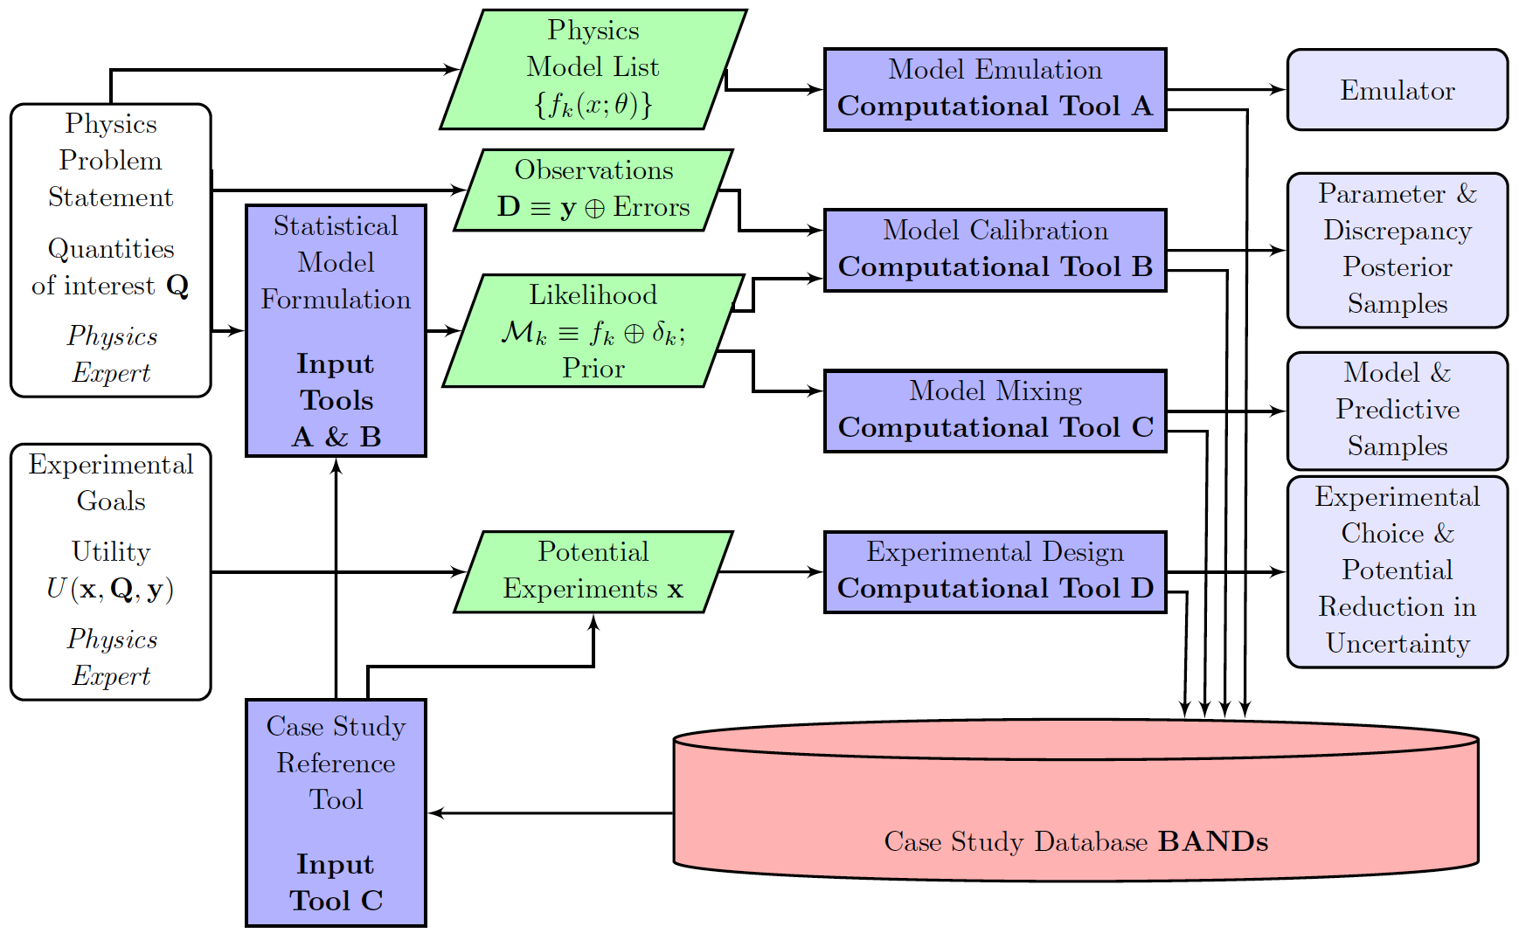
Ohio U.
Michigan State U.
Ohio State U.
Northwestern U.
Cyberinfrastructure for Sustained Scientific Innovation
Framework
https://bandframework.github.io
BAND Manifesto: D R Phillips et al. J. Phys. G 48, 072001 (2021)

