Slide 1


Uncertainty Quantification and Parameter Inference for Material Models Using a Bayesian Paradigm
Denielle Ricciardi*, Oksana Chkrebtii, Stephen Niezgoda
The Ohio State University
May 23, 2023
The Ohio State University
dericci@sandia.gov The Ohio State University

Slide 2
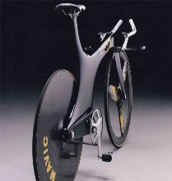
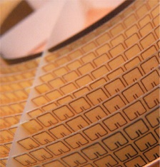

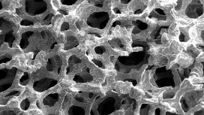
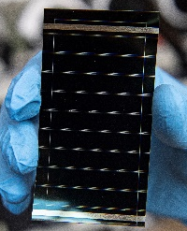


Materials Science Advancing Technology
Technology advancements enabled by the discovery and design of new materials
Wood, Jonathan [1]
Carl D. Millholland [3]
Dennis Schroeder [2]
Physics.org
The discovery and design of new materials is also often the bottleneck in advancing technology
Notes:
Materials science is important in the advancement of technology
Advancements in technology have largely been enabled by the discovery and design of new materials with specific properties
Metamaterial, Graphene, Willow Glass, Carbon fiber-reinforced plastics, Perovskite, Metal foam,
Flip side: bottleneck - due to the resource requirement to bring new materials to the market
In order to accelerate this process, there has been an emphasis on the integration of simulations to meet the demands of advancing technology.

Slide 3
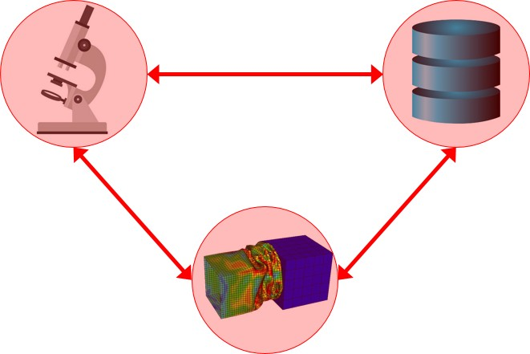
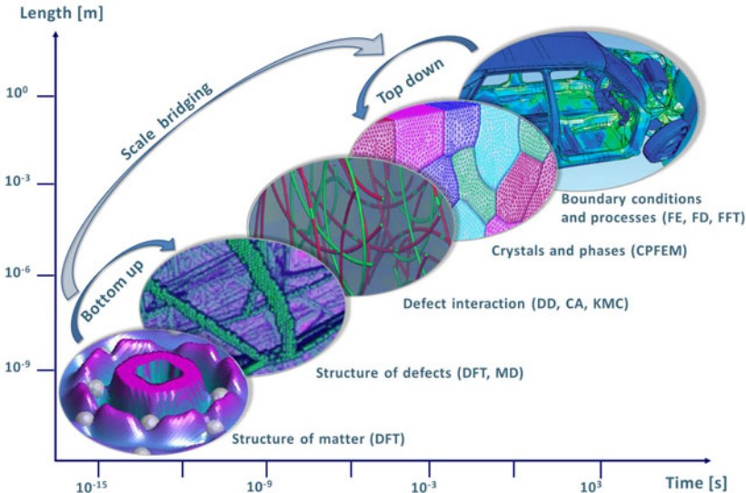
ICME for the Discovery and Design of New Materials
Integrated Computational Materials Engineering (ICME): Integration of materials information, experiment, and computational tools across length and timescales.
Processing ↔ Microstructure ↔ Properties ↔ Performance
Raabe, Dierk, et al. ”Multi-scale modeling in materials science and engineering.” (2009) [4].
Notes:
This has led to ICME , integrated computation materials engineering
Emphasis on simulation, integrated with databases and experiment to accelerate the design and discovery of new materials
reducing the number of repetitive and time-consuming experiments.
The aim is to use model linkages spanning multiple length and time scales to better account for mechanisms and phenomenon occurring at multiple levels which influence material behavior
This enables Processing to performance predictions and the inverse problem of determining which processing conditions are required to obtain specific material behaviors.

Slide 4
ICME for the Discovery and Design of New Materials
Integrated Computational Materials Engineering (ICME): Integration of materials information, experiment, and computational tools across length and timescales.
Processing ↔ Microstructure ↔ Properties ↔ Performance
Benefits
Model linkages account for mechanisms at various scales
Reduced cost of time and resources
Accelerated materials development
Challenge
Establishing a statistical design confidence from deterministic models
Raabe, Dierk, et al. ”Multi-scale modeling in materials science and engineering.” (2009) [4].
Notes:
Benefits of the ICME approach
Linked models across scales – help provide better understanding of processing → performance relationships for design in both directions
Challenges
Obtain statistical design confidence through simulations of the system, which is traditionally obtained through repetitive experimentation.
Need to be able to propagate uncertainty in model linkages

Slide 5
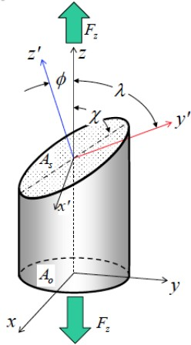
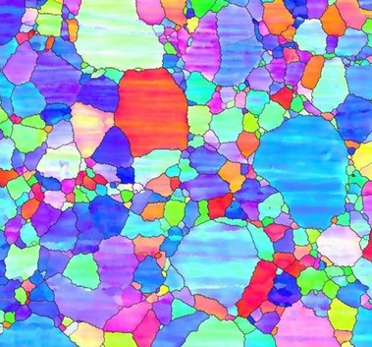
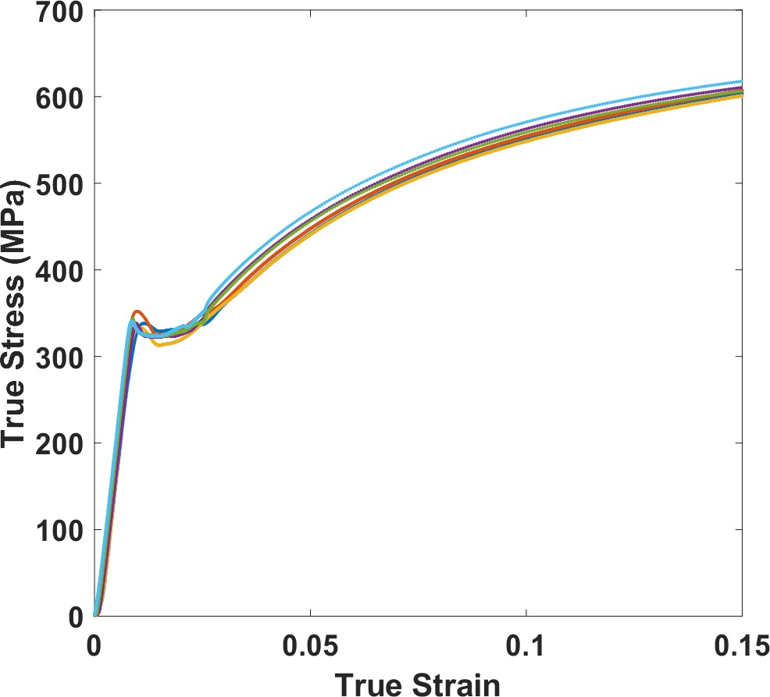
Sources of Uncertainty in Materials Modeling
Parameter uncertainty
Noisy/inconsistent experimental data
Model-form uncertainty
Sample to sample variability
  Microstructure dictates material behavior
  Randomness creates sample-to-sample variability
  Each sample has a unique true underlying property value due to its unique microstructure
  There is a single true underlying property of the material
Notes:
Deformation occurs in crystals by shearing on certain crystallographic planes that are preferentially oriented with respect to the applied force.
Orientation of grains influences deformation.
If you only measure one sample, you may not notice that sample-to-sample variability is present, but in many cases, it is there, and it very important to account for it

Slide 6
UQ for materials science and ICME
Principled approaches for UQ critical to reliably develop and deploy new and improved materials within the ICME paradigm.
Objective
Demonstrate a generalized framework for UQ for predictions of material behavior which considers various sources of uncertainty and is easily adaptable to important problems in materials modeling.
UQ
Bayesian inference
Sample-to-Sample Variability
Random Effects Model
Model Discrepancy
Gaussian Process
Exemplar Demonstration
Crystal Plasticity Modeling
Notes:
In MSE, UQ is critical to reliably develop and deploy new and improved materials and to determine appropriateness of new materials for design purposes.
To reliably meet the goals of ICME, advanced UQ needs to become integrated into the design process with appropriate rigor
Objective: address problem of quantifying uncertainty in a principled way for materials modeling. A generalized procedure is presented to make it more accessible and easily adaptable to various problems in MSE.

Slide 7
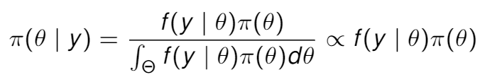
Bayesian formalism for statistical inference
Statistical Inference
The goal of recovering information about unknown components, or parameters, θ of a probability model from observed data, y, while accounting for associated uncertainty.
The Bayesian Paradigm for Inference
Directly defining and updating beliefs about unknown quantities conditionally on observed data
Markov Chain Monte Carlo
MCMC simulation methods are state of the art for generating approximate samples from the posterior distributions.
Notes:
MCMC
State-of-the-art methods to recover uncertainty information in posterior summaries is MCMC simulations
A Markov chain Monte Carlo (MCMC) approach is employed to construct a stochastic process whose stationary distribution matches the posterior of interest, allowing for approximate sampling and thus estimation of any posterior functionals used for model inversion.
As number of samples tends towards infinity, the Markov chain behaves approximately as a random sample from the posterior.

Slide 8





Statistical models for multiple studies/experiments
Overall Effect ($b_{0}$)
Sampling Error Distribution $N\left(0, σ^{2}\right)$
Between-Study Effect Distribution $N\left(0, τ^{2}\right)$
Sampling Deviation
Between-Study Deviation
Fixed Effect
Random Effects
Study A
Study A
$$y_{i}=b_{0}+e_{i}$$
Study B
Study B
$$y_{i}=b_{0}+s_{i}+ e_{i}$$
Study C
Study C
$$θ^{true}$$
$$θ^{true}$$
All studies share a common mean.
Deviations due to sampling variance
The means of the studies are distributed about the overall mean.
Deviations not strictly due to sampling variance
Nakagawa et. al [5]
Notes:
Bayesian paradigm for inference allows for a variety of models
Effects = model parameters
Fixed effects
single underlying true property value that underlies all experiments.
Any deviation seen experiment to experiment is solely due to sampling error.
Random effects
Data to no directly reflect the true universal underlying state of nature
There is some distribution which describes how the means of each study are scattered about the true value
The means are considered as random samples from the underlying process/distribution
Mean property value of each experiment does not reflect the true underlying state of nature but are distributed about it and considered as random samples from the underlying process/distribution.
goal is to estimate the mean of this distribution
Effect size: magnitude of $θ$
Fixed: same $θ$ – the magnitude or size of the effect is the same
simple example (our forward model much more complicated) – shows the structure of the model we are going to be using

Slide 9
Random Effects Model for UQ in Materials Science
Random Effects
Reflects the natural structure of a class of problems in materials modeling and simulation
In materials testing, it is not uncommon to see experimental deviations test-to-test which cannot be attributed strictly to sampling error.
Study A
Study B
$$y_{i}=b_{0}+s_{i}+ e_{i}$$
Study C
The means of the studies are distributed about the overall mean.
Deviations not strictly due to sampling variance

Slide 10
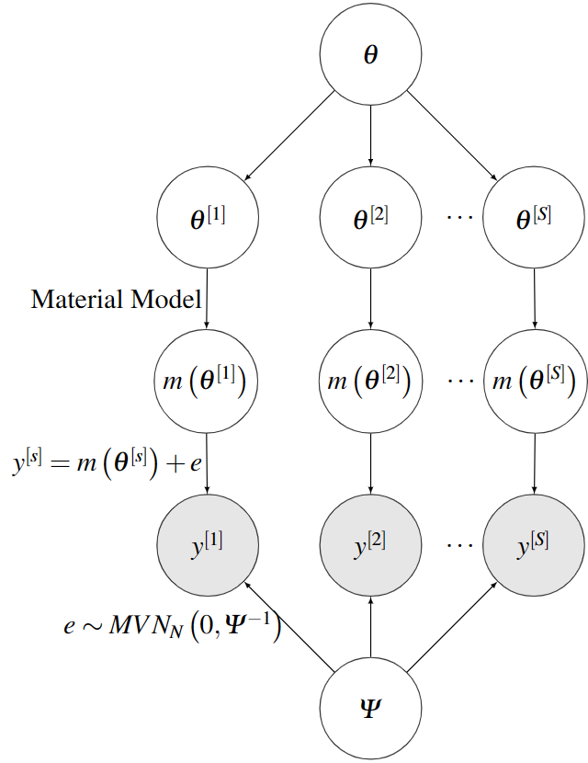
A hierarchical random effects model DAG
DAG: directed acyclic graph. Arrows → direction of conditional dependence
Effects
The ’true’ underlying state of nature, θ, is the overall effect.

Slide 11
A Hierarchical Random Effects Structure
DAG: directed acyclic graph. Arrows → direction of conditional dependence
Effects
The ’true’ underlying state of nature, θ, is the overall effect.
The data are collected from samples that, due to heterogeneity, have been generated under a different state, θ^{[s]}, which are random effects.

Slide 12
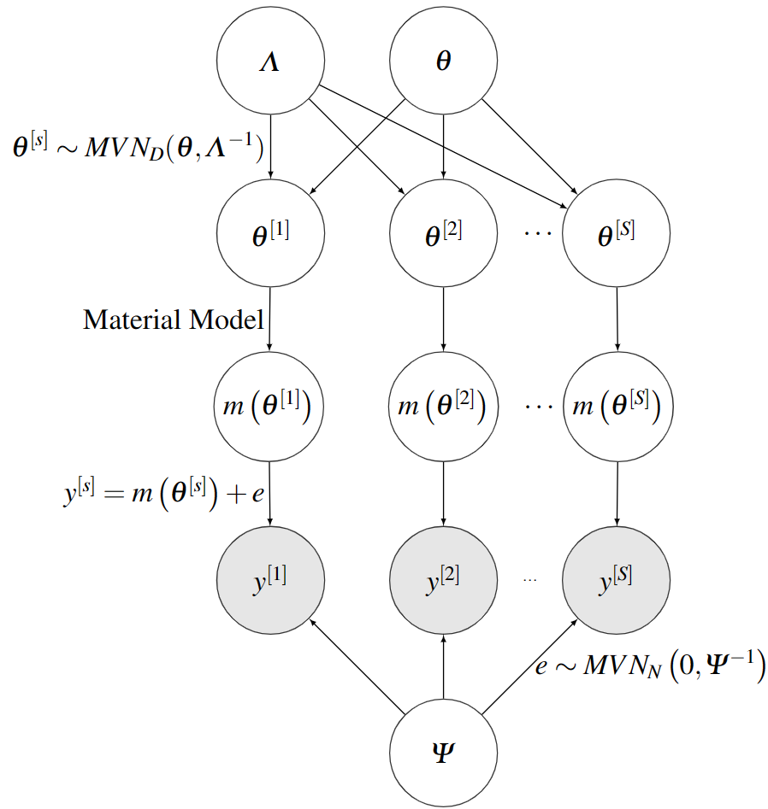
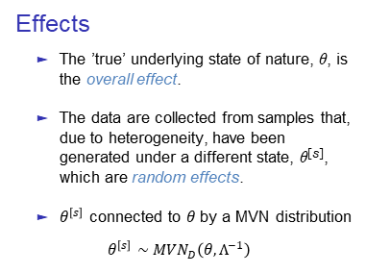
A Hierarchical Random Effects Structure
DAG: directed acyclic graph. Arrows → direction of conditional dependence
Effects
The ’true’ underlying state of nature, θ, is the overall effect.
The data are collected from samples that, due to heterogeneity, have been generated under a different state, θ^{[s]}, which are random effects.
$θ^{\left[s\right]}$ connected to $θ$ by a MVN distribution
  $$θ^{\left[s\right]}∼MVN_{D}\left(θ, Λ^{−1}\right)$$

Slide 13
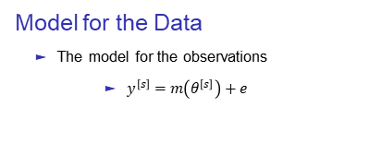
A Hierarchical Random Effects Structure
DAG: directed acyclic graph. Arrows → direction of conditional dependence
Model for the Data
The model for the observations
  $y^{\left[s\right]}=m\left(θ^{\left[s\right]}\right)+e$

Slide 14
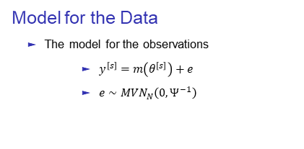
A Hierarchical Random Effects Structure
DAG: directed acyclic graph. Arrows → direction of conditional dependence
Model for the Data
The model for the observations
  $y^{\left[s\right]}=m\left(θ^{\left[s\right]}\right)+e$
  $e∼MVN_{N}\left(0, Ψ^{−1}\right)$

Slide 15
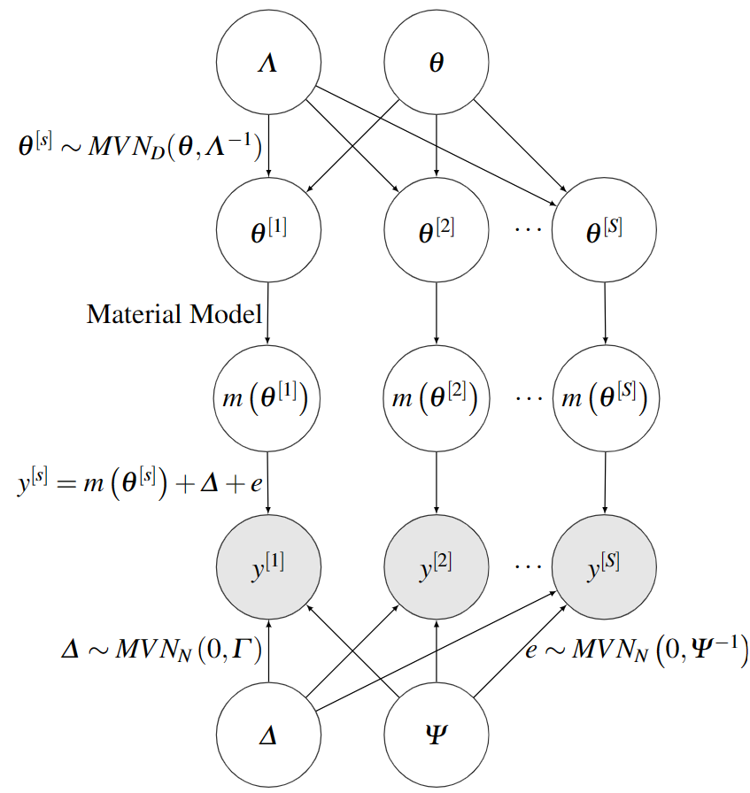
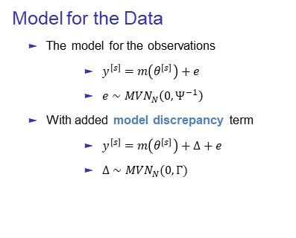
A Hierarchical Random Effects Structure
DAG: directed acyclic graph. Arrows → direction of conditional dependence
Model for the Data
The model for the observations
  $y^{\left[s\right]}=m\left(θ^{\left[s\right]}\right)+e$
  $e∼MVN_{N}\left(0, Ψ^{−1}\right)$
With added model discrepancy term
  $y^{\left[s\right]}=m\left(θ^{\left[s\right]}\right)+Δ+e$
  $Δ∼MVN_{N}(0, Γ)$

Slide 16
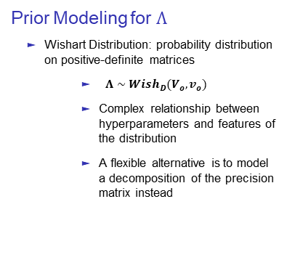
A Hierarchical Random Effects Structure
DAG: directed acyclic graph. Arrows → direction of conditional dependence
Prior Modeling for $Λ$
Wishart Distribution: probability distribution on positive-definite matrices
  $Λ∼Wish_{D}(V_{o},v_{o})$
  Complex relationship between hyperparameters and features of the distribution
  A flexible alternative is to model a decomposition of the precision matrix instead
Notes:
Wishart distribution, a probability distribution on positive-definite matrices
the Wishart prior is often restrictive due to the complex relationship between the hyperparameters and features of the distribution, which can introduce strong unintended prior information.
Some more flexible alternatives include modeling the components of a decomposition of the covariance matrix instead
To enable controlled modeling of the random effects precision, Λ, (i.e. maintaining flexibility in modeling the features of the distribution, such as the expected value and variance, while maintaining a non-informative nature), the parameter is decomposed into two components.

Slide 17
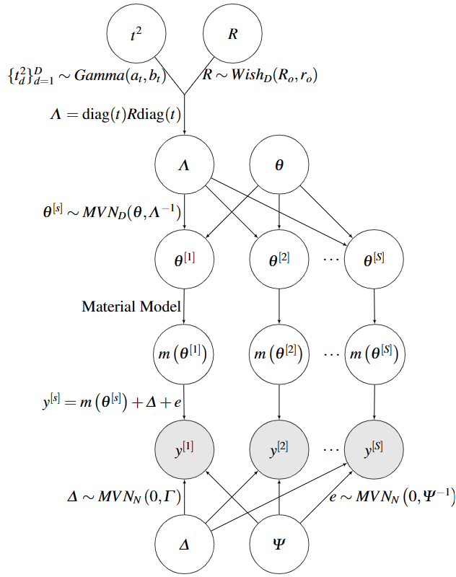
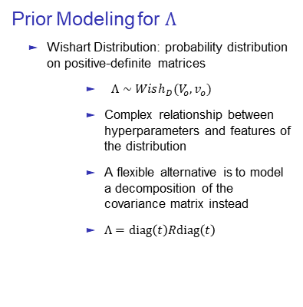
A Hierarchical Random Effects Structure
Prior Modeling for $Λ$
Wishart Distribution: probability distribution on positive-definite matrices
  $Λ∼Wish_{D}(V_{o},v_{o})$
  Complex relationship between hyperparameters and features of the distribution
  A flexible alternative is to model a decomposition of the covariance matrix instead
  $Λ=diag\left(t\right)Rdiag\left(t\right)$

Slide 18
Exemplar Problem: Crystal Plasticity
Crystal Plasticity (CP) Modeling: Used to predict mechanical behavior of polycrystalline materials such as the stress-strain response and texture evolution under specific modes of deformation.
CP models vary greatly in complexity
High-fidelity models appealing for scientific inquiry
  too expensive for UQ
Reduced-order, homogenized, mean-field models well-suited for UQ
Often have some systematic model discrepancy
Inference and prediction important in this setting

Slide 19
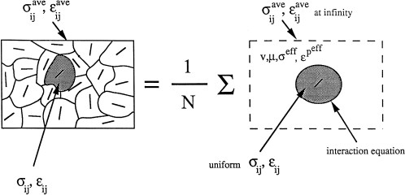
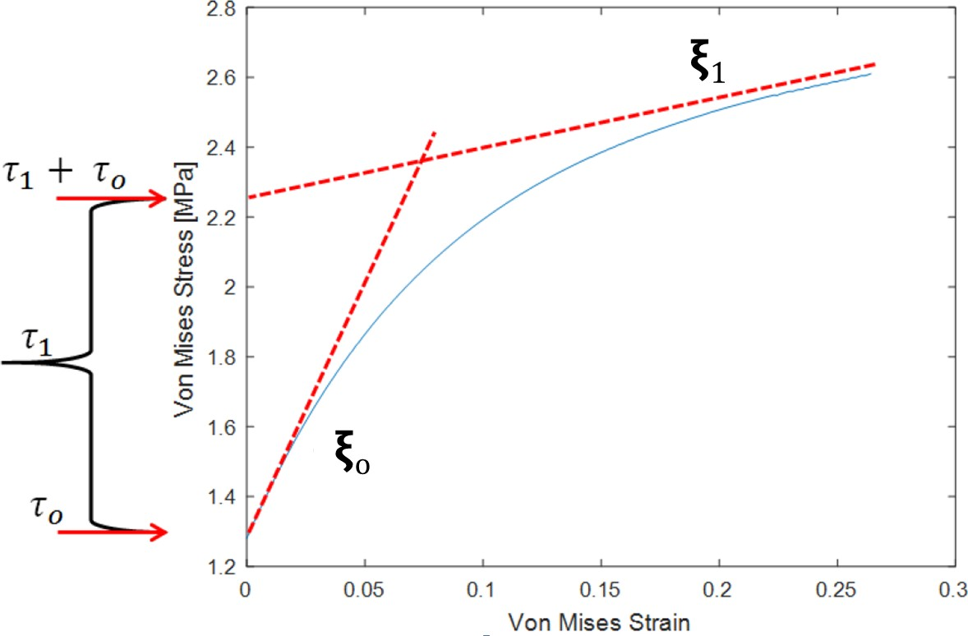

Phenomenological VPSC CP Model
Tome & Lebensohn [6]
The evolution of the CRSS with deformation is described in VPSC by the Voce Law
$${\hat{τ}}^{α}=τ_{0}^{α}+ \left(τ_{1}^{α}+ξ_{1}^{α}Γ\right)\left(1 −\exp\left\{−Γ\left|\frac{ξ_{0}^{α}}{τ_{1}^{α}}\right|\right\}\right)$$
Notes:
VPSC
Uses a mean-field solver and considers the plastic contribution to deformation due to externally applied stresses and strains – does not consider elastic strain
VPSC represents the polycrystal with volume fractions of crystal orientations (statistically representative grains)
Each SR grain is treated as an ellipsoidal inclusion within an infinite homogeneous effective medium (HEM) representing the polycrystal
VPSC considers local quantities within each grain --- stress, strain and plastic strain
The overall macroscopic quantities are an average of the local quantities of each SR grain.
Voce Hardening Law
As deformation occurs, this model uses the Voce hardening law to update the CRSS
CRSS - component of shear stress, resolved in the direction of slip, necessary to initiate slip in a grain.
Parameters: Initial hardening rate, asymptotic hardening rate, initial CRSS, and the back-extrapolated asymptotic CRSS
$Γ$: total accumulated shear over all the slip systems
The von Mises stress is used to predict yielding of materials under complex loading from the results of uniaxial tensile tests
Von Mises stress is a value used to determine if a given material will yield or fracture. It is mostly used for ductile materials, such as metals
Code developed at the Los Alamos National Laboratory by C.N. Tome and R.A. Lebensohn.
Phenomenological: Consistent with fundamental theory but not derived from first principles

Slide 20
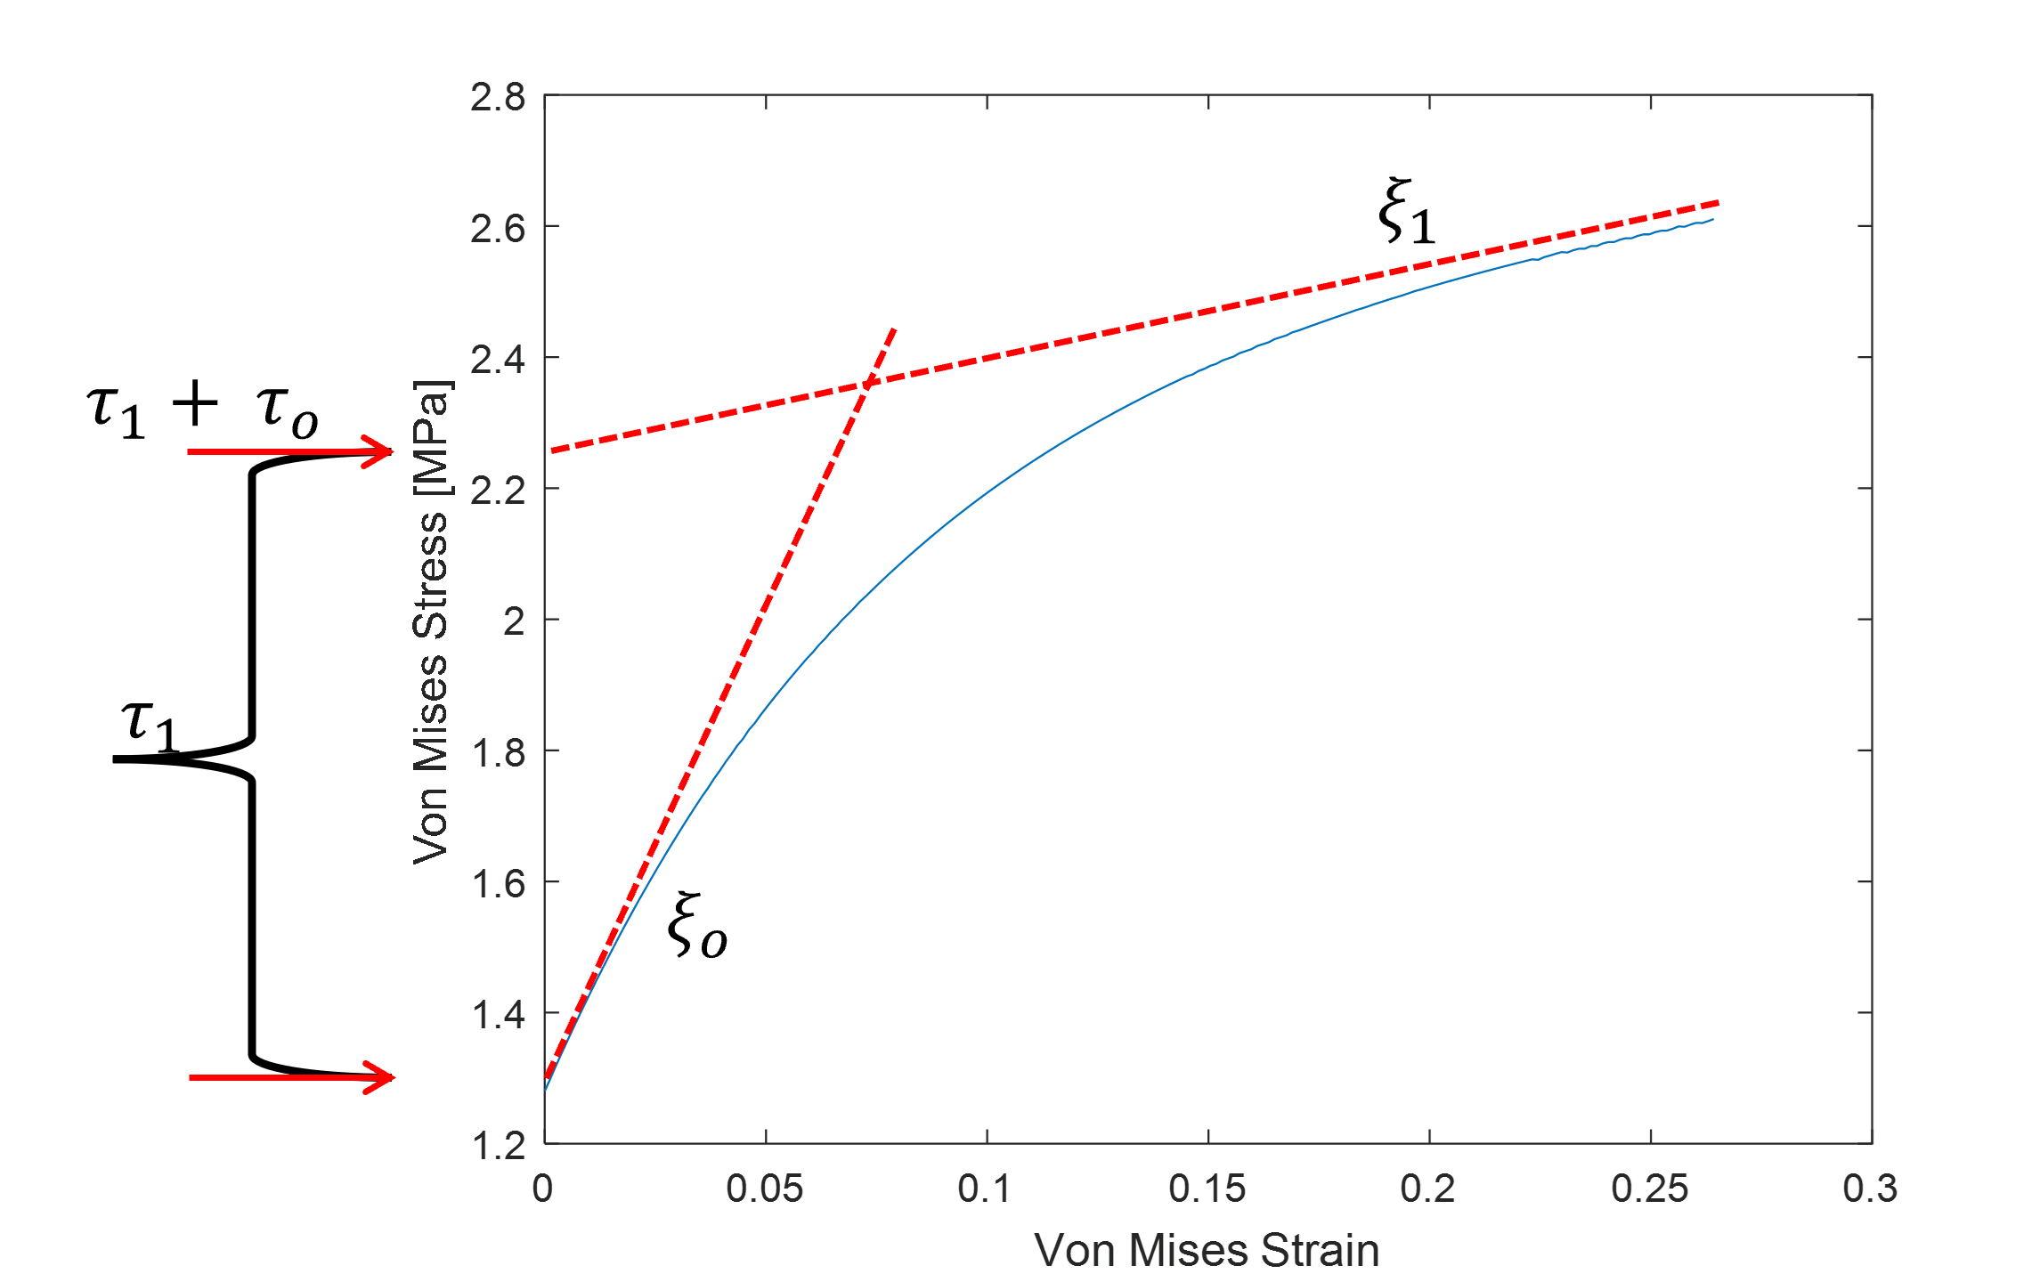
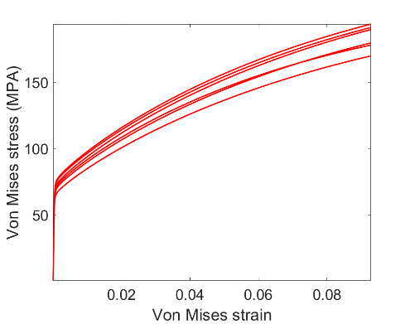
Inference Problem
Voce Parameters: θ := (τ₀, τ₁, ξ₀, ξ₁)
Constraints: C(θ) = (τ₀, τ₁, ξ₀ − ξ₁) > 0
mimic hardening behavior for the room-temperature deformation of copper
Simulated calibration data from the physics-based elasto-viscoplastic FFT model
VPSC – missing physics for the elastic region of deformation → model discrepancy
Notes:
Constraints: positive hardening rate which decreases monotonically with additional strain.
We make the simplifying assumption the testing error is small compared to sample-to-sample variability and should be approximately zero. Therefore, noise was not added to the simulated data. However, the statistical model still estimates the error precision term. The estimation of this term is used as a diagnostic tool since we know a priori the true value of the noise, assuming that the reduced-order model is correct.

Slide 21
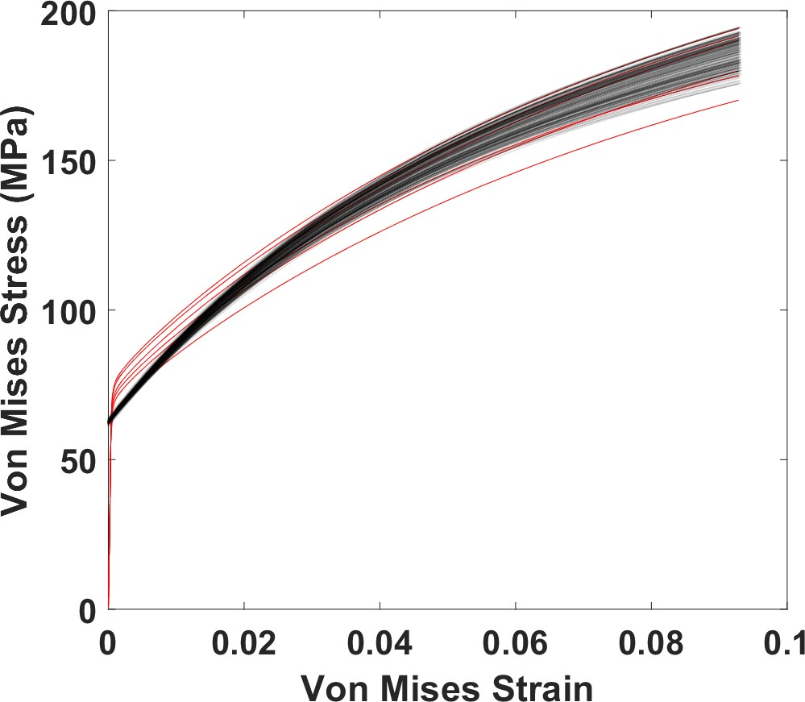

Importance of Accounting for Model Discrepancy
If model discrepancy ignored- bias is introduced in the inference and consequently in predictions
*Kennedy and O’Hagan (2001) [7] laid out a hierarchical framework for doing inference for reduced order models with discrepancy.
$$y=m\left(θ\right)+Δ+e$$
Analysis of the VPSC model with model discrepancy not accounted for.
Notes:
if model misfit ignored, bias will be induced in the parameter estimates and consequently the model trajectory
the posterior distribution centers around a ‘posterior best fit’ value which minimizes the mean residual error between the model output and the observations.
bias is particularly problematic when model parameters are not simply tuning parameters but whose values are of intrinsic interest and necessary for reliable prediction
(diffusivities, mobilities, defect energies, elastic constants)
The measured experimental response can be decomposed into three components: 1) the portion that is well-represented by the model, 2) the portion of the “true” material response not captured by the model due to discrepancy, 3) noise or measurement error

Slide 22
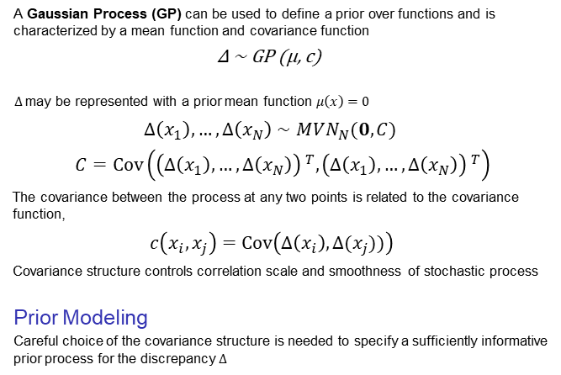
Gaussian Processes to Model Discrepancy
A Gaussian Process (GP) can be used to define a prior over functions and is characterized by a mean function and covariance function
∆ ∼ GP (µ, c)
$Δ$may be represented with a prior mean function $μ\left(x\right)=0$
$$Δ\left(x_{1}\right),…, Δ\left(x_{N}\right)∼MVN_{N}(0, C)$$
$C=Cov\left({\left(Δ\left(x_{1}\right), …, Δ\left(x_{N}\right)\right) }^{T}, {\left(Δ\left(x_{1}\right),…,Δ\left(x_{N}\right)\right) }^{T}\right)$
The covariance between the process at any two points is related to the covariance function,
$$c\left(x_{i}, x_{j}\right)=Cov\left(Δ\left(x_{i}\right), Δ(x_{j}))\right)$$
Covariance structure controls correlation scale and smoothness of stochastic process
Prior Modeling
Careful choice of the covariance structure is needed to specify a sufficiently informative prior process for the discrepancy $Δ$
Notes:
GP is a flexible model for modeling discrepancy
Stochastic process – collection of random variables
Can be used to define a prior distribution over functions, such as our discrepancy function
characterized by a mean function and a covariance function (Functional generalization of the multivariate Gaussian distribution)
It is often realistic to model the discrepancy as having prior mean function m(x) = 0 -- neutral and often reasonable assumption that the magnitude of the systematic deviation from the physical model across the domain is either close to zero or not known a-priori
In theory continuous: but any sub-collection of points have a jointly Gaussian distribution
C: The covariance between the process at all points.
Covariance structure controls the correlation scale and smoothness of the stochastic process → choose to be sufficiently informative for the prior

Slide 23
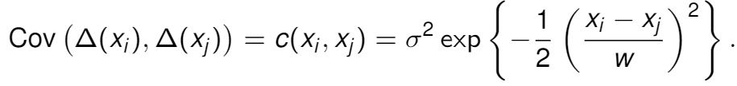
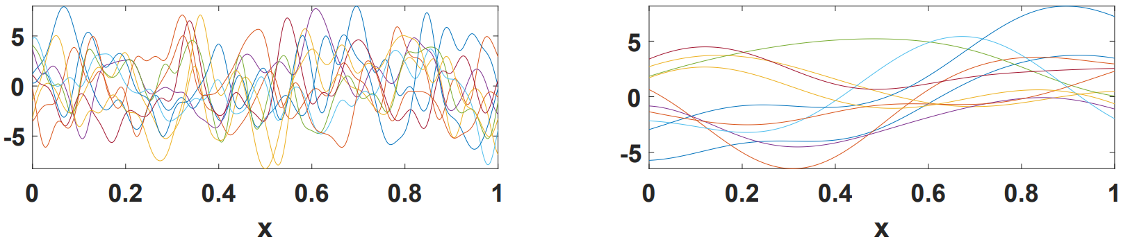
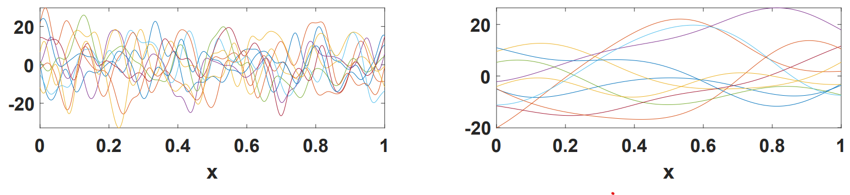
Prior Modeling of the Discrepancy
Example covariance function, the squared exponential,
Hyperparameters
Length scale, w , & variance, σ²
w = .025, σ² = 10
w = .25, σ² = 10
w = .025, σ² = 100
w = .25, σ² = 100
39
The Ohio State University
Notes:
Variance describes pointwise uncertainty. controls the pointwise variability of resulting sample paths.
a large variance - diffuse GP prior distribution
a smaller variance - tighter distribution appropriate when more prior information is available.
The length-scale parameter controls how dependence scales with the distance between nearby points.
Covariance structure controls the correlation scale and the smoothness of the stochastic process
Hyperparameters describe prior uncertainty about the unknown function – control pointwise variability of resulting sample paths
May also get bias and over-confidence if priors are too flexible

Slide 24
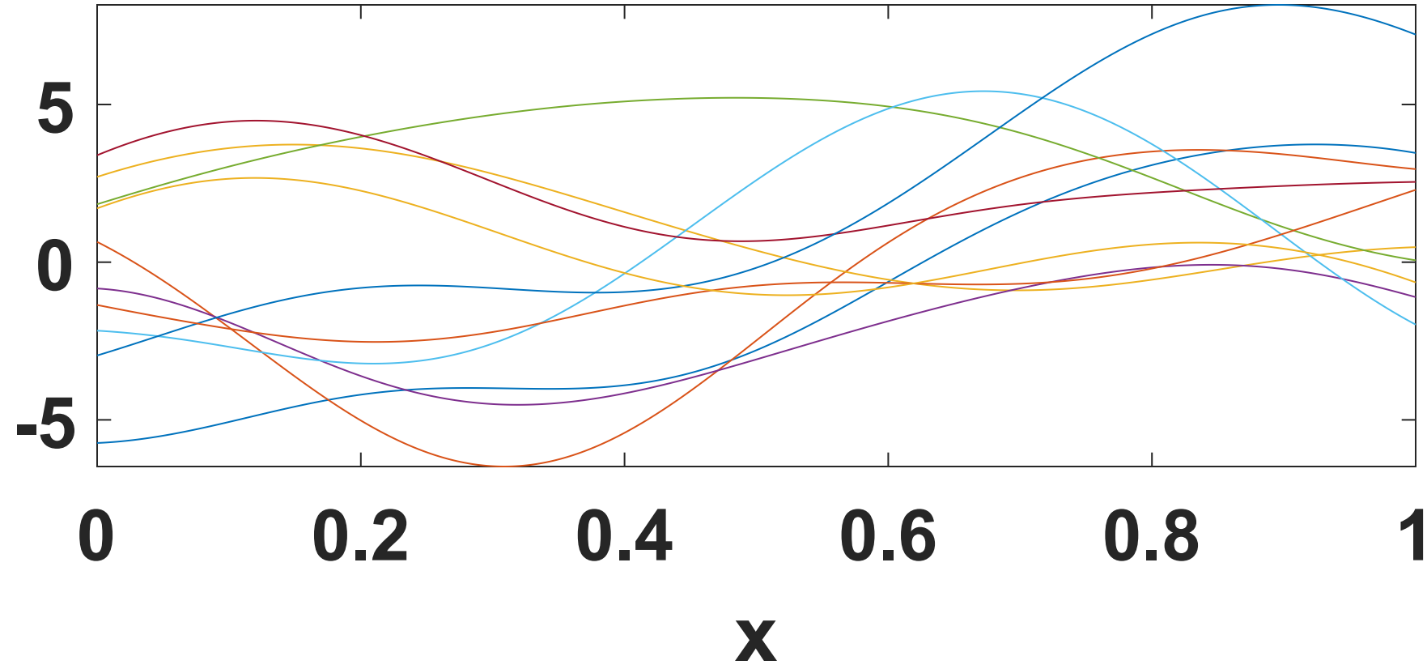
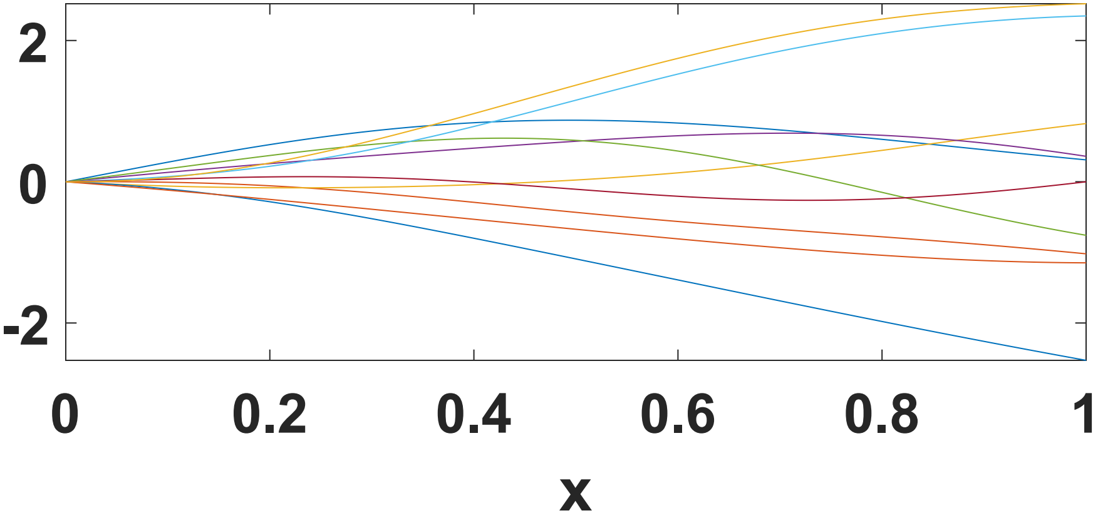
Prior Modeling of the Discrepancy
Example covariance function, the squared exponential,
Stationarity
Covariance function depends only on the distance between inputs and is independent of their relative location.
stationary non-stationary
39
The Ohio State University
Notes:
Stationary covariance function - depends only on the distance between the inputs and is independent of their relative location.
Non-stationary covariance models -allow for changes to the dependence structure across the input domain
The non-stationary figure: samples initially have a stronger dependence which decreases as we move away from 0

Slide 25
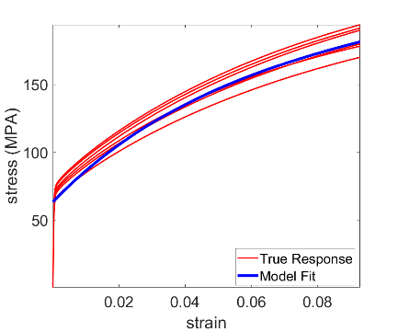
Discrepancy Prior for the VPSC CP Model
Prior knowledge about ∆
VPSC expected to capture the plastic region nearly perfectly and the elastic region not at all

Slide 26
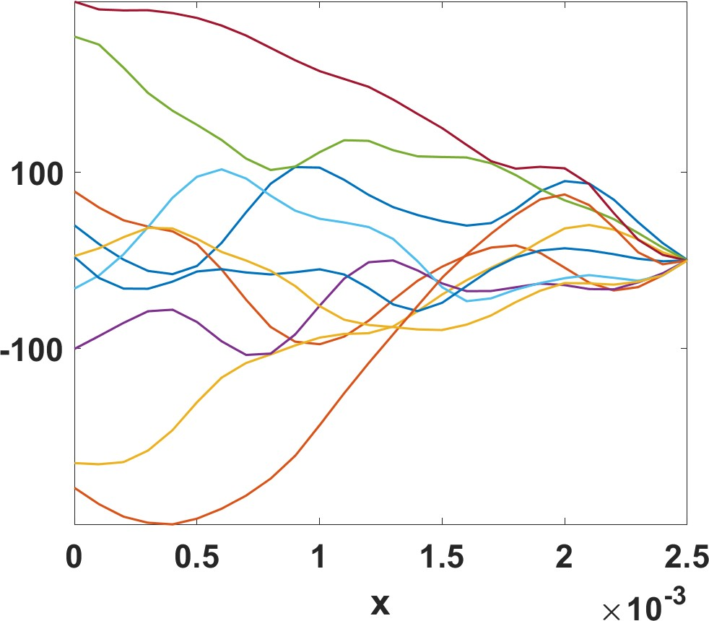
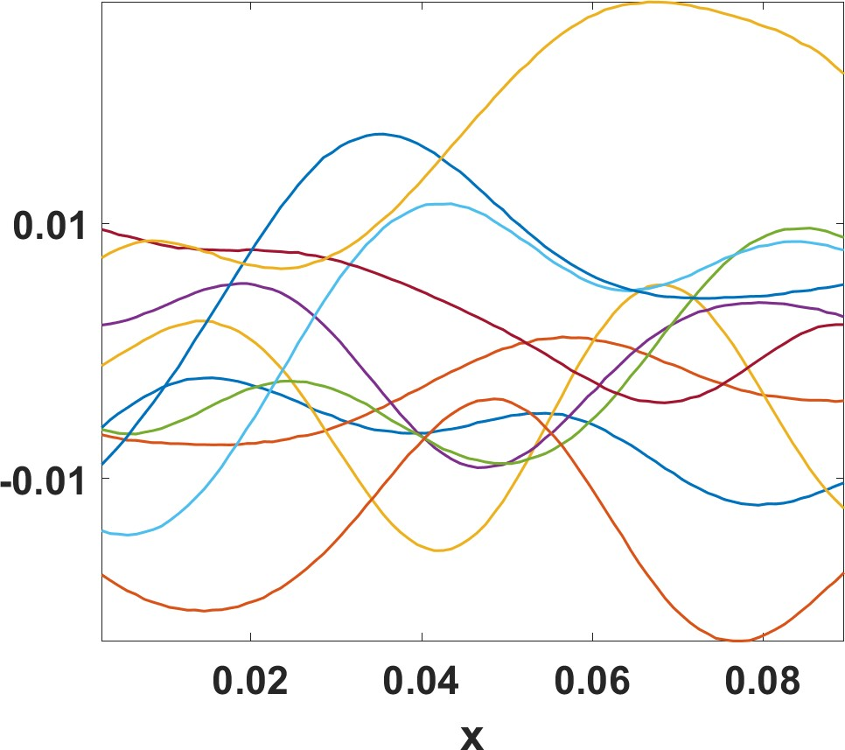
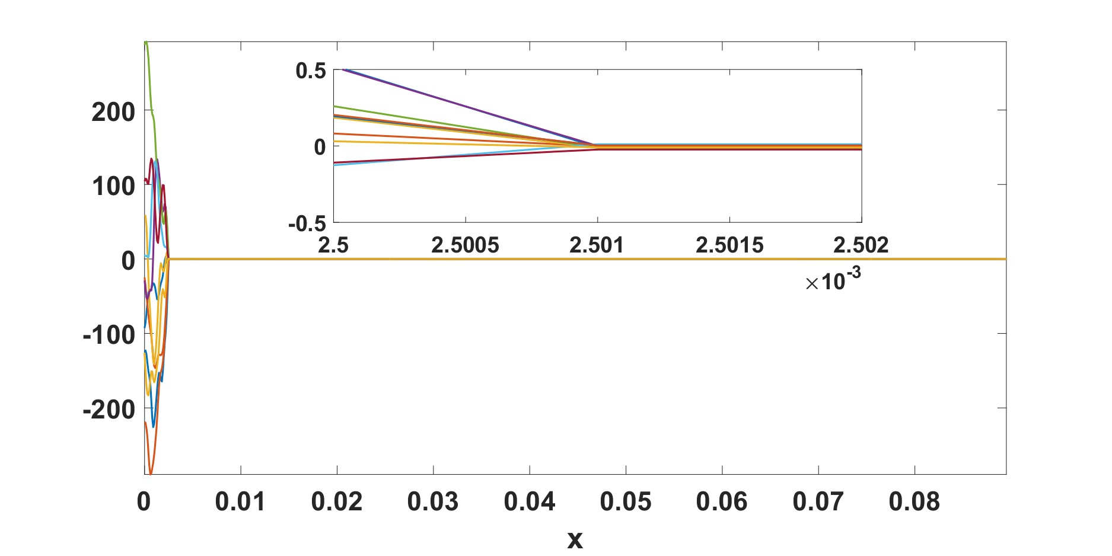
Discrepancy Prior for the VPSC CP Model
Prior knowledge about ∆
VPSC expected to capture the plastic region nearly perfectly and the elastic region not at all
Elastic
Plastic
Elastic Region
Model discrepancy is the greatest at x = 0 & decreases to 0 at the elastic-plastic transition
Constrained non-stationary covariance function
Plastic Region
Model discrepancy is expected to remain constant at nearly 0 for the plastic region
Stationary squared-exponential covariance function
Entire Domain
Notes:
Elastic region: A constrained non-stationary covariance function, c_{el} (xa, x_{b} ), is used with length scale w = 4 · 10⁻⁴.
Plastic region: stationary squared-exponential covariance function, w = .0009, σ² = .05.

Slide 27
Prior Modeling of $θ$
The degree to which the prior choice affects posterior uncertainty depends on
How informative the prior is
How much information the data contain about the unknown parameters

Slide 28

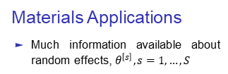
Prior Modeling of $θ$
Von Mises Stress (MPa)
150
100
$${\left\{y^{[s]}\right\} }_{s=1}^{S}$$
50
0.02 0.04 0.06
Von Mises Strain
0.08
Materials Applications
Much information available about random effects, $θ^{\left[s\right]}, s=1,…,S$

Slide 29
Prior Modeling of $θ$
Von Mises Stress (MPa)
150
100
$${\left\{y^{[s]}\right\} }_{s=1}^{S}$$
50
0.02 0.04 0.06
Von Mises Strain
0.08
Materials Applications
Much information available about random effects
Information propagated in hierarchy to θ is quite small

Slide 30
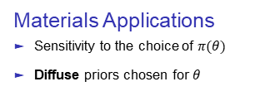
Prior Modeling of $θ$
Von Mises Stress (MPa)
150
100
$${\left\{y^{[s]}\right\} }_{s=1}^{S}$$
50
0.02 0.04 0.06
Von Mises Strain
0.08
Materials Applications
Sensitivity to the choice of $π(θ)$
Diffuse priors chosen for $θ$

Slide 31
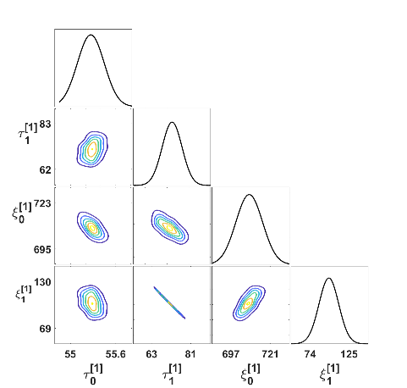
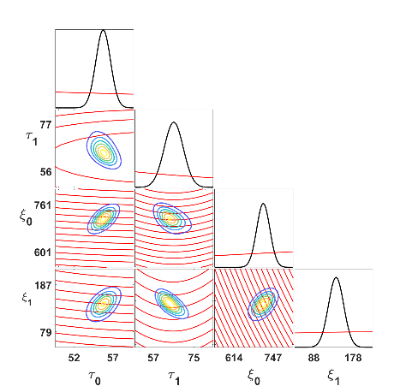
Bivariate Kernel Density Estimates
1.2 × 10⁵ samples produced, 2 × 10⁴ discarded as burn-in. Adaptive algorithm used to overcome high parameter correlations
Representative Random Effect
Overall Effect
Notes:
Priors more diffuse than the posterior contours → data informative
Following a posterior contour corresponds to a path in the parameter space where the posterior density remains unchanged
Suggest uni-modal approximately symmetric posterior densities and moderate to very strong posterior correlations between parameters
Posterior correlations do not necessarily imply direct physical relationships between parameters
Indicative of a trade-off relationship between parameters. A change in the parameters in the direction of the correlation is associated with a model output that remains relatively stable.

Slide 32
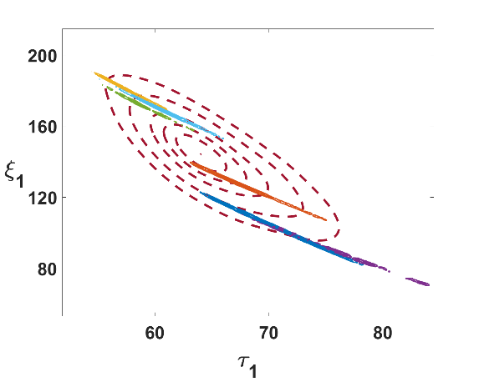
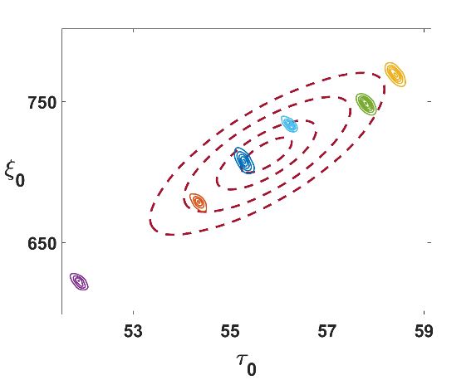
Marginal Posterior Contours
Insight: The highest reduction in uncertainty will be achieved by testing more samples rather than further trying to decrease the measurement noise for each single trajectory.
Notes:
Different correlations between random and overall effect is motivated by their different roles within in the hierarchical model
Contours of overall parameters - Interpreted as defining the distribution of the random effect
The posterior over the overall effects is quite diffuse relative to that of the individual random effects.
Rich calibration data provided direct information only about each individual random effect
Overall effect was only informed by the relatively small number and location of the random effects

Slide 33
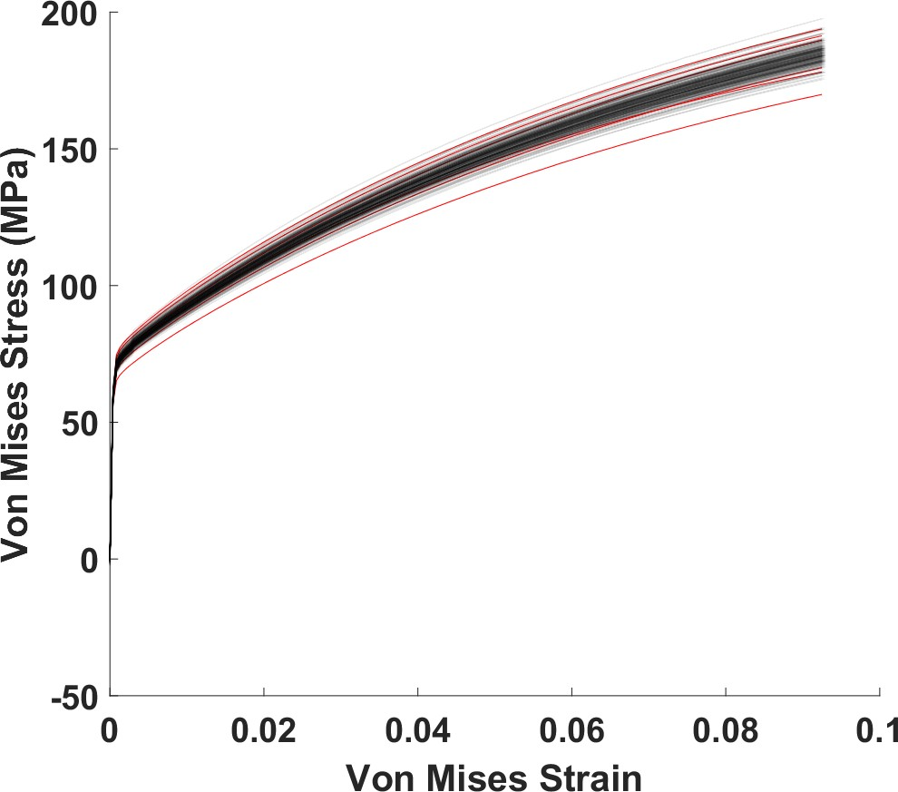
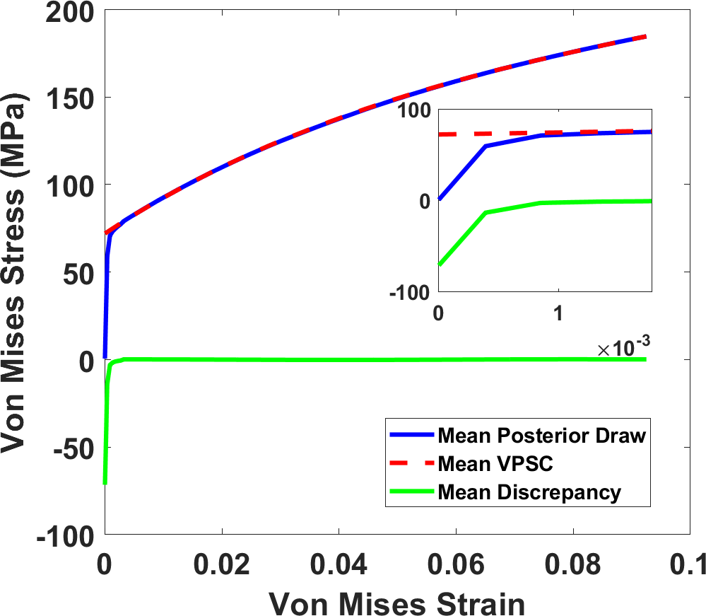


Posterior Uncertainty Propagated to Model Output
Assume discrepancy present
Assume discrepancy not present
The point-wise posterior mean, the VPSC model evaluated at the posterior mean parameter values and the mean discrepancy are shown with an inset showing the elastic region.
Notes:
The strong bias evident in the ‘no discrepancy’ analysis is not present when model misfit is accounted for.
This is a powerful tool in CP modeling. While the VPSC model is mean-field and missing certain physics – it can still be successfully calibrated to experimental data ‘as is’ by account for the missing physics in the model through the discrepancy term.
shows the pointwise posterior mean as well as its decomposition into the VPSC model evaluated at the expected value of the parameters and the mean discrepancy. Also included is an inset of the elastic region.

Slide 34
Summary
A framework for UQ for materials modeling was demonstrated in a CP example.
UQ accounting for:
Parameter uncertainty
Observation error
Sample-to-sample variability
Model discrepancy
Implications for ICME
Reliable use of fast reduced-order, phenomenological (etc.) models
True material properties are inferred from variable experimental data
Uncertainty can be propagated in model linkages for processing → performance predictions
Supports reliable design and discovery of new materials
Raabe [4].

Slide 35


Thank You
Ricciardi, Denielle E., Oksana A. Chkrebtii, and Stephen R. Niezgoda. "Uncertainty Quantification for Parameter Estimation and Response Prediction: Generalizing the Random Effects Bayesian Inferential Framework to Account for Material and Experimental Variability." Integrating Materials and Manufacturing Innovation 8 (2019): 273-293.
Ricciardi, Denielle E., Oksana A. Chkrebtii, and Stephen R. Niezgoda. "Uncertainty quantification accounting for model discrepancy within a random effects Bayesian framework." Integrating Materials and Manufacturing Innovation 9 (2020): 181-198.
(dericci@sandia.gov)

Slide 36
Cited Works
[1] Wood, Jonathan. "The top ten advances in materials science." Materials today 11.1-2 (2008): 40-45.
[2] Dennis Schroeder / National Renewable Energy Laboratory - https://www.energy.gov/eere/solar/perovskite-solar-cells, Public Domain, https://commons.wikimedia.org/w/index.php?curid=131749994
[3] Carl D. Millholland - Electrolyte Materials in Lithium-Ion Batteries - Advancing Materials (thermofisher.com)
[4] Dierk, et al. ”Multi-scale modeling in materials science and engineering.” (2009).
[5] Nakagawa, Shinichi, et al. "Meta-evaluation of meta-analysis: ten appraisal questions for biologists." BMC biology 15.1 (2017): 1-14.
[6] Tomé, C. N., and R. A. Lebensohn. "Visco-plastic self-consistent (vpsc)." Los Alamos National Laboratory (USA) and Universidad Nacional de Rosario (Argentina) 6 (2007).
[7] Kennedy, Marc C., and Anthony O'Hagan. "Bayesian calibration of computer models." Journal of the Royal Statistical Society: Series B (Statistical Methodology) 63.3 (2001): 425-464.

Slide 37
Supplemental Slide I: When to Include Discrepancy
Include when...
The model is missing physics, resulting in systematic discrepancy between the model output and the observations
There is strong prior knowledge about the misfit between the model and true process
Identifiability
∆ (x ) = ζ (x ) − m (x, θ) .
May exclude when...
No systematic discrepancy is expected
The model is flexible enough to fit the data
The model is empirical in nature, where parameters do not have physical significance since the parameter estimates will be strongly biased and HPIs may not cover the true parameter values
Notes:
The problem, called lack of identifiability in the statistical literature, results from the ability of different model components (in this case the discrepancy function and model parameters) to trade off in ways that can describe the data equally well.
When one of the model components is empirical (in this case the discrepancy), this lack of identifiability hinders our ability to obtain useful estimates of the physically meaningful model components.
One way to overcome lack of identifiability is by defining sufficiently informative prior models,

Slide 38
Supplemental Slide II: Modeling Discrepancy
Observations of the physical system,yn , at independent variable inputs,
x = {x₁, · · · , x_{N} }, are centered around some true value, ζ(xn ), with independent
Gaussian observation errors, en ,
yn = ζ(xn ) + en, n = 1, · · · , N.
Assume some model of the physical system, m(·), which accepts a vector of input parameters θ and is evaluated at variable inputs x = {x₁, · · · , x_{N} },
m (x, θ) .
We can link the model to the true system, by incorporating the discrepancy, ∆,
ζ(x) = m (x, θ) + ∆(x).
Relating the model to the observations:
yn = m (xn, θ) + ∆(xn ) + en,
n = 1, · · · , N

Slide 39
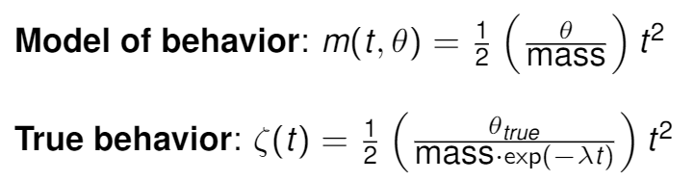
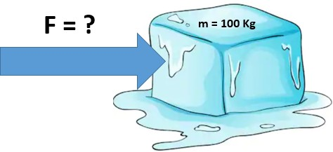
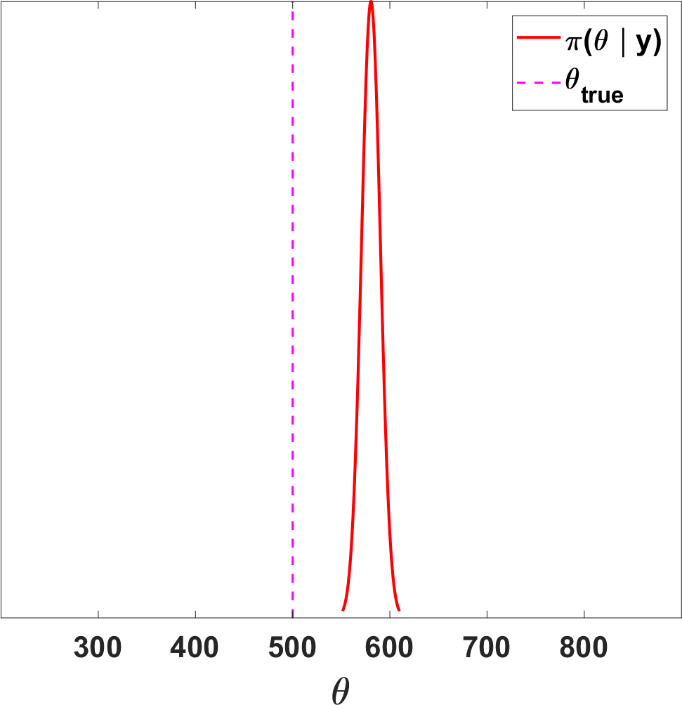
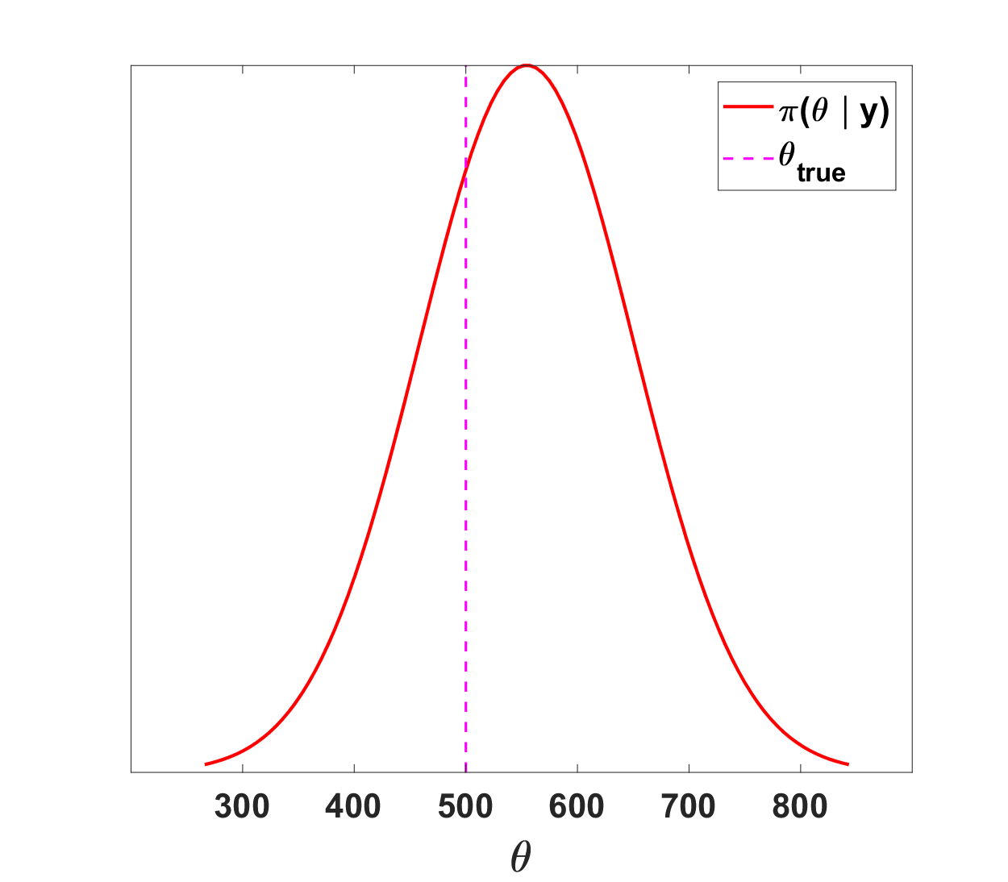
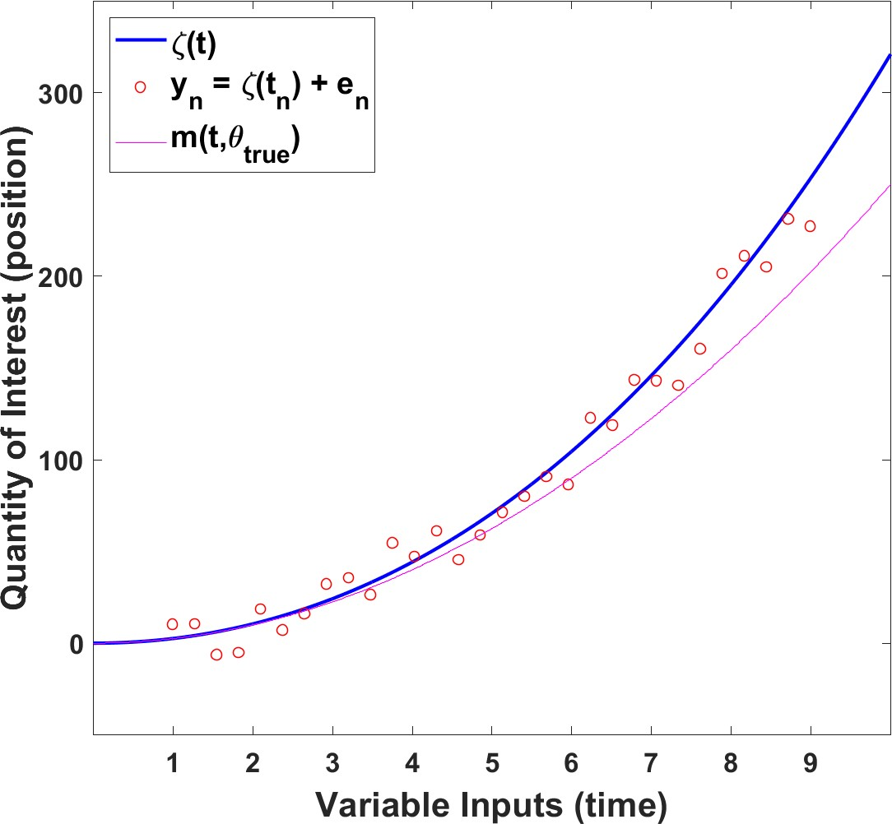
Supplemental Slide III: Toy Problem for Discrepancy
Toy Example for Discrepancy
No Discrepancy
With Discrepancy

Slide 40
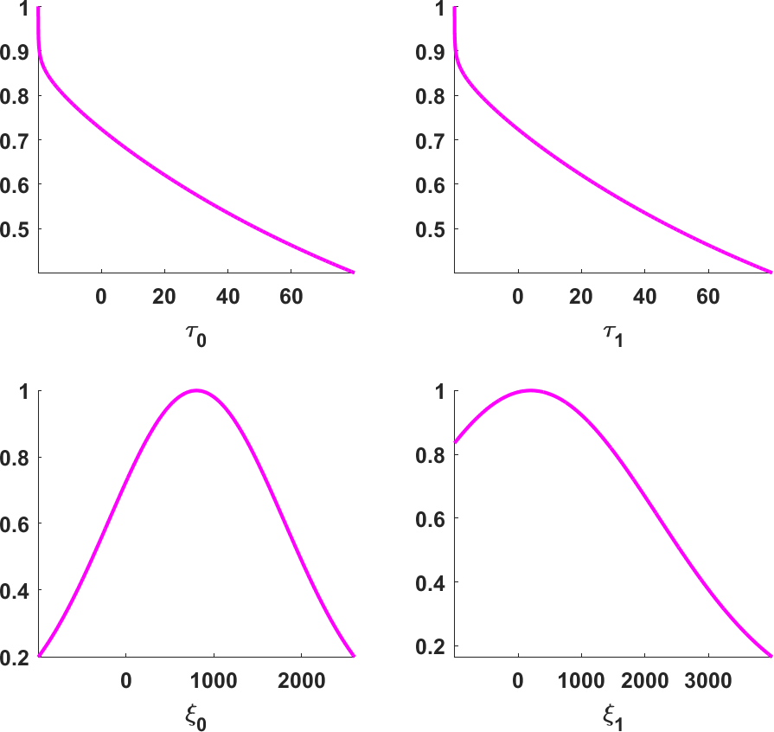
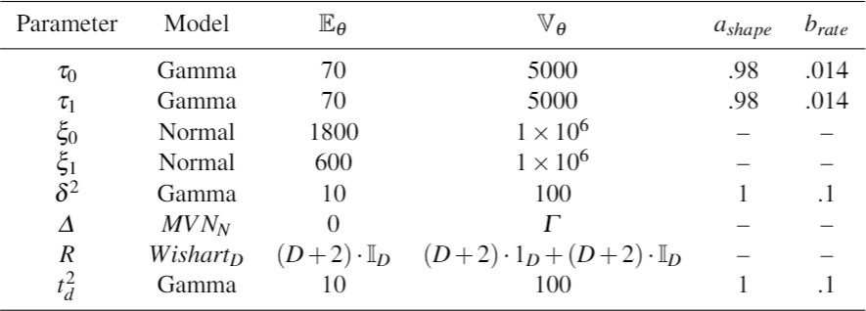
Supplemental Slide IV: Priors
Priors

Slide 41


Supplemental Slide V: Constitutive Model
$${\dot{ε}}^{p}={\sum_{α}{m^{α}{\dot{γ}}^{α}={\dot{γ}}_{0}\sum_{α}{m^{α}\left(\frac{m^{α} :σ^{α}}{τ_{0}^{α}}\right)}}}^{n}$$
$α$: slip systems
$τ_{0}$: initial threshold stress
$m$: Schmid tensor
${\dot{ε}}^{p}$: deviatoric plastic strain rate
$σ$: stress
${\dot{γ}}^{α}$: local shear rate on slip system $α$
${\dot{γ}}_{0}$: reference shear rate
$n$: rate-sensitivity exponent
Notes:
Describes the local behavior within each SR grain
Sum of the local behavior over the set of slip systems $α$ within each SR grain

Slide 42


Supplementary Slide VI: Inference and Prediction
Inference
Prediction

