Slide 1
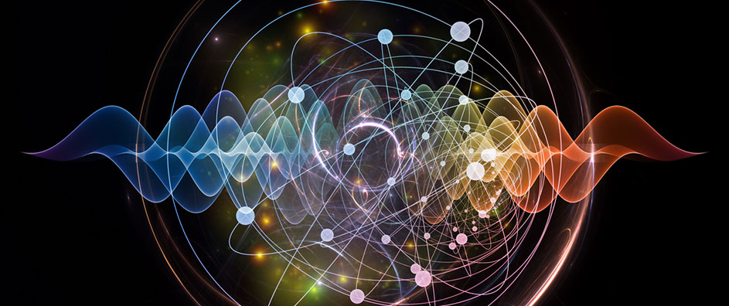


Generalized Coupled Vector Dark Energy Models
Gabriel Gómez
Fondecyt Postdoctoral Fellow
Departamento de Física, Universidad de Santiago de Chile
Third Workshop on Current Challenges in Cosmology Colombia 2023
Notes:
Let’s imagine the following: when you put inside a coconut ice cream and fruits you get some exotic. Something similar happens when you couple DM and DE. I do not if it taste good or not. let’s see if you wanna try.

Slide 2
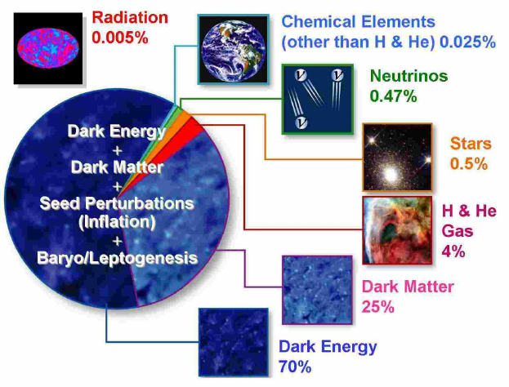
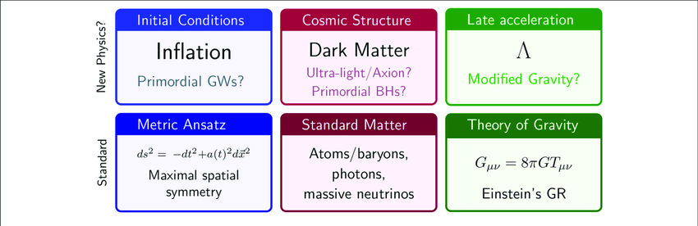

Slide 3
Interacting Dark Energy Models:
Notes:
Thought of the most general way of relating...

Slide 4

Interacting Dark Energy Models:
-Phenomenological interaction:
Notes:
Thought of the most general way of relating...

Slide 5

Interacting Dark Energy Models:
-Phenomenological interaction:
-Post-Friedmannian formalism:
Notes:
Thought of the most general way of relating...

Slide 6
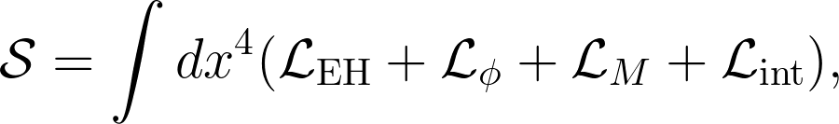

Interacting Dark Energy Models:
-Scalar-fluid theories:
Notes:
Thought of the most general way of relating...

Slide 7
Interacting Dark Energy Models:
-Scalar-fluid theories:
-Conformal and disformal coupling:
Notes:
Thought of the most general way of relating...

Slide 8
Interacting Dark Energy Models:
-Scalar-fluid theories:
-Conformal and disformal coupling:
Notes:
Thought of the most general way of relating...

Slide 9
What is the most general way of relating geometries of the same gravitational theory?
Notes:
Thought of the most general way of relating...

Slide 10
What is the most general way of relating geometries of the same gravitational theory?
-According to GR gravity and matter experience the same metric.

Slide 11

What is the most general way of relating geometries of the same gravitational theory?
-According to GR gravity and matter experience the same metric.
-Conformal/Disformal transformation(Bekenstein PRD. (1993))
Notes:
indeed, this is the question, bekenstein ask himself in 1993. He found the most general relation between the geometrical and physical sectors. It respects causality and the weak equivalence principle ( The WEP requires that all freely falling test-bodies follow the geodesics of the spacetime) so the WEP holds here. See https://arxiv.org/pdf/2103.08978.pdf. Quoting Bekenstein [42], the most general transformation between the two frames that ”respects the weak equivalence principle, ordinary notions of causality, and which is insensitive to a change of zero for the auxiliary scalar field” is the so called disformal transformation

Slide 12
What is the most general way of relating geometries of the same gravitational theory?
-According to GR gravity and matter experience the same metric.
-Conformal/Disformal transformation(Bekenstein PRD. (1993))

Slide 13
What is the most general way of relating geometries of the same gravitational theory?
-According to GR gravity and matter experience the same metric.
-Conformal/Disformal transformation(Bekenstein PRD. (1993))

Slide 14
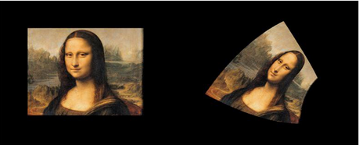
What is the most general way of relating geometries of the same gravitational theory?
-According to GR gravity and matter experience the same metric.
-Conformal/Disformal transformation(Bekenstein PRD. (1993))
-Different representations of the same theory:

Slide 15
What is the most general way of relating geometries of the same gravitational theory?
-According to GR gravity and matter experience the same metric.
-Conformal/Disformal transformation(Bekenstein PRD. (1993))
-Different representations of the same theory:
Jordan frame: fields and curvature couple directly, but matter only involves the metric.
Einstein frame: the gravitational Lagrangian has the Einstein-Hilbert form but the matter sector is affected by fields, which mediates an additional force.

Slide 16
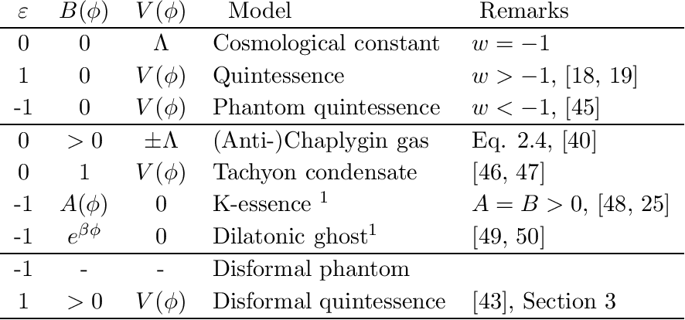
-Coupled scalar field models:
JCAP 1005 (2010) 038
Notes:
Thought of the most general way of relating...

Slide 17
-Coupled scalar field models:
JCAP 1005 (2010) 038
Notes:
Thought of the most general way of relating...

Slide 18

-Coupled Multi-Proca Vector Dark Energy:
Gómez & Rodríguez (PDU. 31 (2021) 100759)
arXiv:2004.06466 [gr-qc]
Notes:
in this work we assumed a different scenario. We imagine… but the vector sector which is part of the gravitational sector experiences a different metric.
Levi-Civita symbol which represents the structure constants of the SU(2) group.

Slide 19
-Coupled Multi-Proca Vector Dark Energy:
Gómez & Rodríguez (PDU. 31 (2021) 100759)
arXiv:2004.06466 [gr-qc]
Notes:
in this work we assumed a different scenario. We imagine… but the vector sector which is part of the gravitational sector experiences a different metric.
Levi-Civita symbol which represents the structure constants of the SU(2) group.

Slide 20
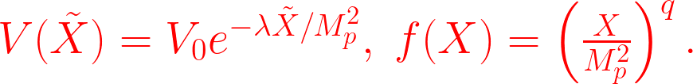
-Coupled Multi-Proca Vector Dark Energy:
Gómez & Rodríguez (PDU. 31 (2021) 100759)
arXiv:2004.06466 [gr-qc]
Notes:
in this work we assumed a different scenario. We imagine… but the vector sector which is part of the gravitational sector experiences a different metric.
Levi-Civita symbol which represents the structure constants of the SU(2) group.

Slide 21
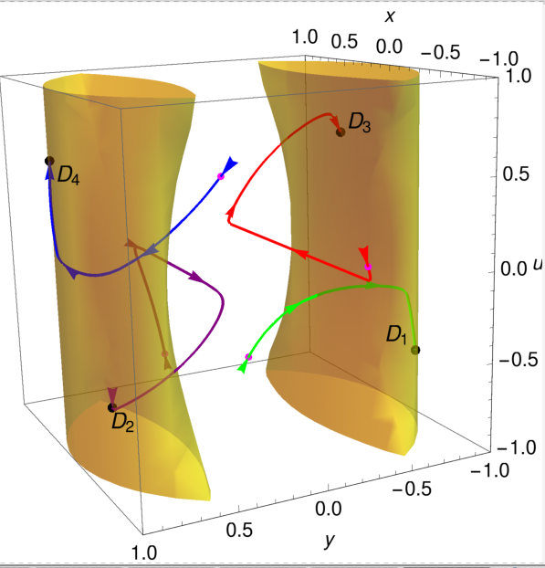
-Coupled Multi-Proca Vector Dark Energy:
Gómez & Rodríguez (PDU. 31 (2021) 100759)
Notes:
in this work we assumed a different scenario. We imagine… but the vector sector which is part of the gravitational sector experiences a different metric.
Levi-Civita symbol which represents the structure constants of the SU(2) group.

Slide 22
-Disformally coupled Vector Dark Energy:
Gómez (PRD 107 (2023) 12)
arXiv:2202.07027 [gr-qc]

Slide 23
-Disformally coupled Vector Dark Energy:
Vector disformal transformation:
Gómez (PRD 107 (2023) 12)
arXiv:2202.07027 [gr-qc]

Slide 24

-Disformally coupled Vector Dark Energy:
Vector disformal transformation:
Energy momentum tensor in both frames:

Slide 25

-Vector field equation of motion:
arXiv:2202.07027 [gr-qc]

Slide 26
-Vector field equation of motion:
arXiv:2202.07027 [gr-qc]

Slide 27

-Vector field equation of motion:
Interacting term:
Conservation law:

Slide 28
-Vector field equation of motion:
Interacting term:
Conservation law:

Slide 29

Concrete model:
arXiv:2202.07027 [gr-qc]

Slide 30
Concrete model:
arXiv:2202.07027 [gr-qc]

Slide 31


Concrete model:
It can be recast as:
arXiv:2202.07027 [gr-qc]

Slide 32
Intrinsic pathologies?
(2205.07784)

Slide 33
Intrinsic pathologies?
(2205.07784)
Ghost instabilities?
(2204.10868)

Slide 34
Breakdown of the theory?
(2301.02263)
Intrinsic pathologies?
(2205.07784)
Ghost instabilities?
(2204.10868)

Slide 35
A singularity problem?
(2204.11324)
Breakdown of the theory?
(2301.02263)
Intrinsic pathologies?
(2205.07784)
Ghost instabilities?
(2204.10868)

Slide 36
A singularity problem?
(2204.11324)
Breakdown of the theory?
(2301.02263)
The well-posedness of the Cauchy problem
(2207.00443)
Intrinsic pathologies?
(2205.07784)
Ghost instabilities?
(2204.10868)

Slide 37
Wave equation:
arXiv:2202.07027 [gr-qc]

Slide 38
Wave equation:
arXiv:2202.07027 [gr-qc]

Slide 39

Wave equation:
The Stueckelberg field:
arXiv:2202.07027 [gr-qc]

Slide 40
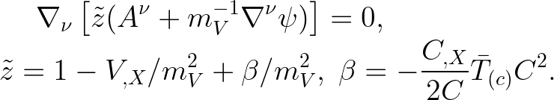
Wave equation:
The Stueckelberg field:
arXiv:2202.07027 [gr-qc]

Slide 41
arXiv:2202.07027 [gr-qc]

Slide 42

General conditions:
arXiv:2202.07027 [gr-qc]

Slide 43

General conditions:
Effective metric:
Notes:
there should be no changes in the signature of the metric

Slide 44

Cosmological Background:
arXiv:2202.07027 [gr-qc]

Slide 45
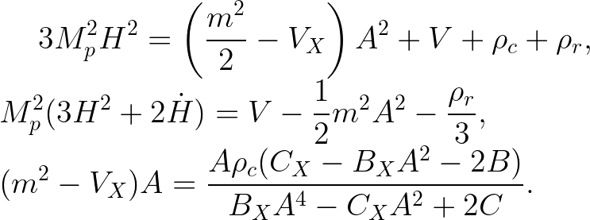
Cosmological Background:
arXiv:2202.07027 [gr-qc]

Slide 46

Cosmological Background:
Continuity equations:
arXiv:2202.07027 [gr-qc]

Slide 47
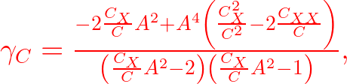
Cosmological Background:
Continuity equations:

Slide 48
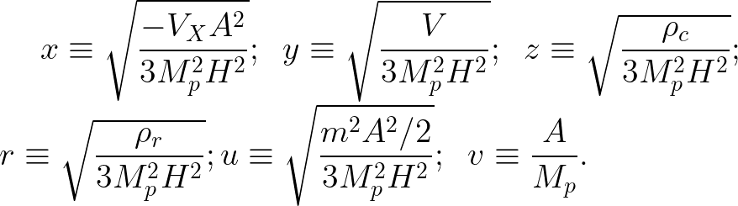
Dynamical system analysis:
arXiv:2202.07027 [gr-qc]

Slide 49
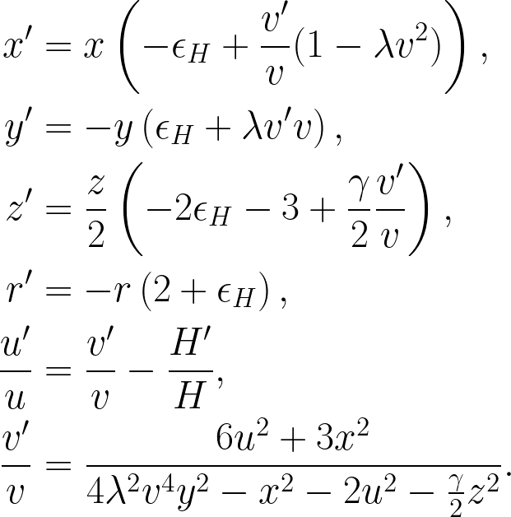
Dynamical system analysis:
Autonomous system

Slide 50


Conformal case:
Model 1:
Model 2:
arXiv:2202.07027 [gr-qc]

Slide 51


Conformal case:
Model 1:
Model 2:
arXiv:2202.07027 [gr-qc]

Slide 52
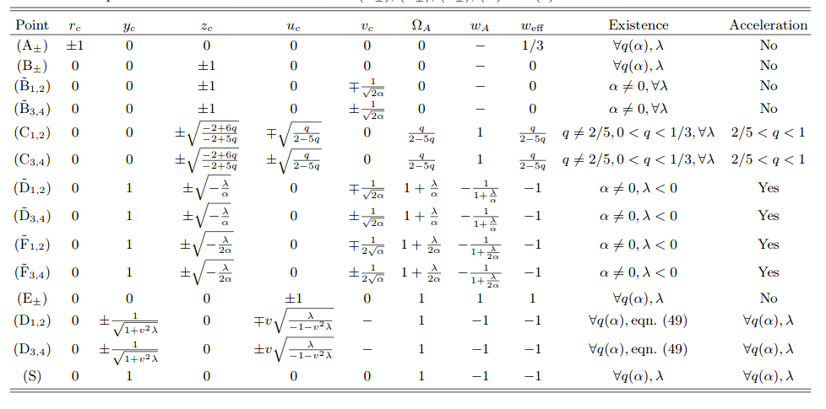
Conformal case:
Model 1:
Model 2:

Slide 53
Conformal case:
Model 1:
Model 2:

Slide 54
Conformal case:
Model 1:
Model 2:

Slide 55
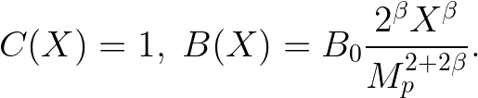
Disformal case:
arXiv:2202.07027 [gr-qc]

Slide 56

Disformal case:
arXiv:2202.07027 [gr-qc]

Slide 57
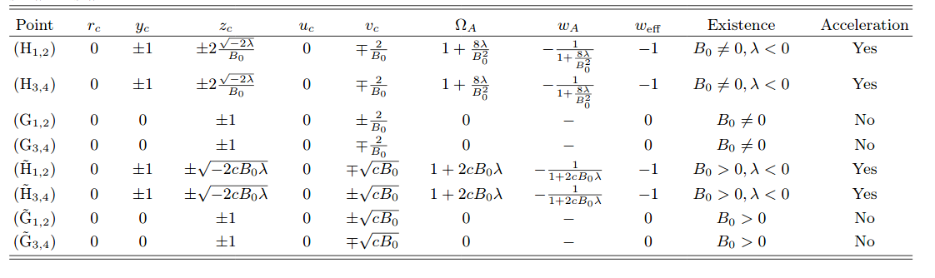
Disformal case:
arXiv:2202.07027 [gr-qc]

Slide 58
Disformal case:
arXiv:2202.07027 [gr-qc]

Slide 59
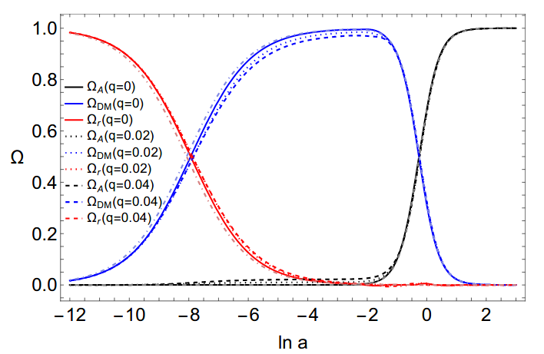
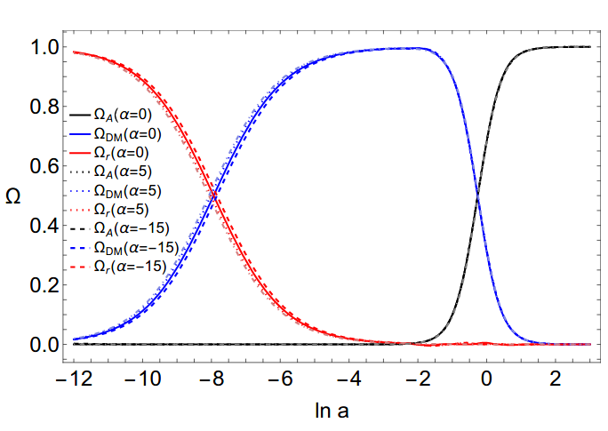
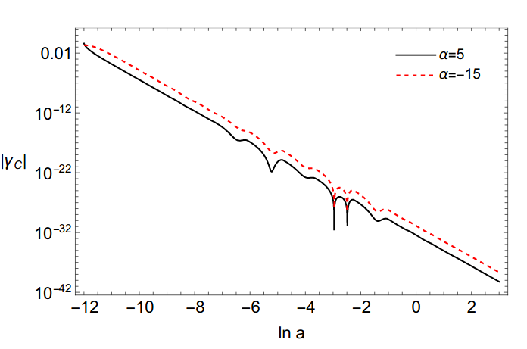
Cosmological evolution: conformal case
-

Slide 60
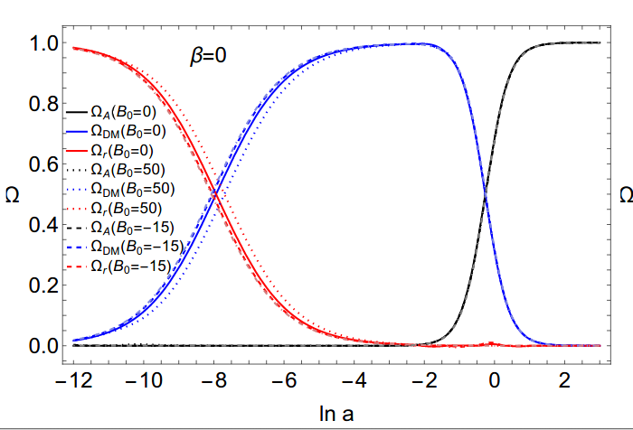
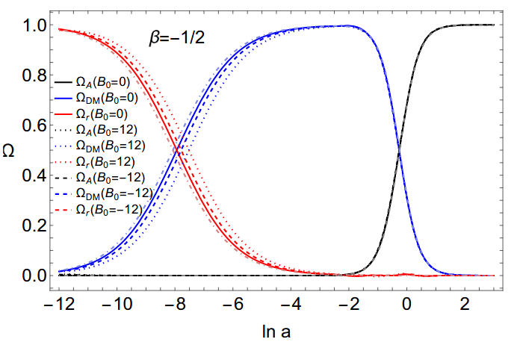
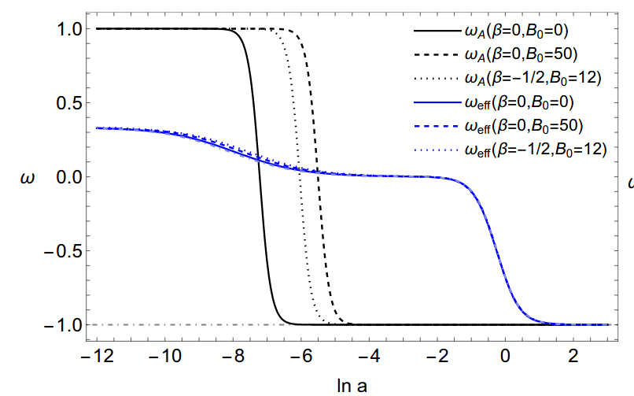
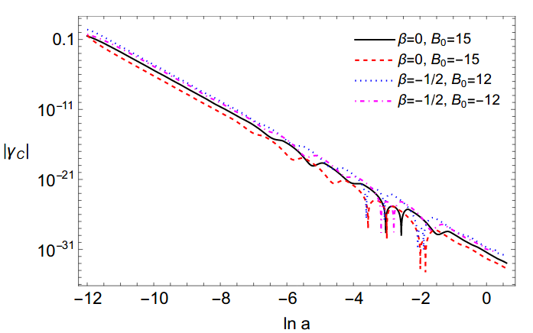
Cosmological evolution: disformal case
-

Slide 61

Summary and perspectives:
Notes:
we have proposed a novel recipe...

Slide 62
Summary and perspectives:
-It is possible to build coupled vector dark energy models by DT.
Notes:
we have proposed a novel recipe...

Slide 63
Summary and perspectives:
-It is possible to build coupled vector dark energy models by DT.
-The resulting theory can be healthy: ghost free instabilities.
Notes:
we have proposed a novel recipe...

Slide 64
Summary and perspectives:
-It is possible to build coupled vector dark energy models by DT.
-The resulting theory can be healthy: ghost free instabilities.
-Study disformal couplings for spatial vector fields: Muti-fields, non-Abelian vector fields.
Notes:
we have proposed a novel recipe...

Slide 65
Summary and perspectives:
-It is possible to build coupled vector dark energy models by DT.
-The resulting theory can be healthy: ghost free instabilities.
-Study disformal couplings for spatial vector fields: Muti-fields, non-Abelian vector fields.
-Several critical points arise in comparison to the standard quintessence case, leading to new interesting cosmological solutions: scaling solutions and stable attractor points.
Notes:
we have proposed a novel recipe...

Slide 66
Summary and perspectives:
-It is possible to build coupled vector dark energy models by DT.
-The resulting theory can be healthy: ghost free instabilities.
-Study disformal couplings for spatial vector fields: Muti-fields, non-Abelian vector fields.
-Several critical points arise in comparison to the standard quintessence case, leading to new interesting cosmological solutions: scaling solutions and stable attractor points.
-The disformal coupling affects the early and late-time universe, leaving some imprints that can be contrasted with observational data at different redshifts.
Notes:
we have proposed a novel recipe...

Slide 67
Summary and perspectives:
-It is possible to build coupled vector dark energy models by DT.
-The resulting theory can be healthy: ghost free instabilities.
-Study disformal couplings for spatial vector fields: Muti-fields, non-Abelian vector fields.
-Several critical points arise in comparison to the standard quintessence case, leading to new interesting cosmological solutions: scaling solutions and stable attractor points.
-The disformal coupling affects the early and late-time universe, leaving some imprints that can be contrasted with observational data at different redshifts.
-Constrain the background dynamics, number counts, the growth rate and the redshift-space distortion.
Notes:
we have proposed a novel recipe...

Slide 68
Summary and perspectives:
-It is possible to build coupled vector dark energy models by DT.
-The resulting theory can be healthy: ghost free instabilities.
-Study disformal couplings for spatial vector fields: Muti-fields, non-Abelian vector fields.
-Several critical points arise in comparison to the standard quintessence case, leading to new interesting cosmological solutions: scaling solutions and stable attractor points.
-The disformal coupling affects the early and late-time universe, leaving some imprints that can be contrasted with observational data at different redshifts.
-Constrain the background dynamics, number counts, the growth rate and the redshift-space distortion.
-Suppression of the growth factor? What about the current tensions?
Notes:
we have proposed a novel recipe...

Slide 69

Thank you!

