Slide 1

Neutrino masses at two-loop in multi-component dark matter Z5 model
Brallan Taborda
Adviser: Óscar Zapata
Universidad de Antioquia
Facultad de Ciencias Exactas y Naturales
Instituto de Física
1

Slide 2
Content
Motivation
The model
Results
Conclusions

Slide 3
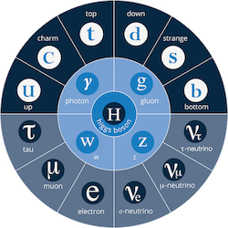
Standard Model
1.Motivation
Has to be modified!

Slide 4



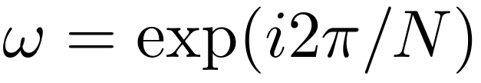
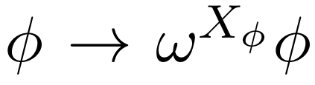
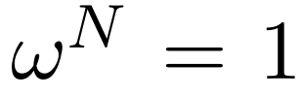
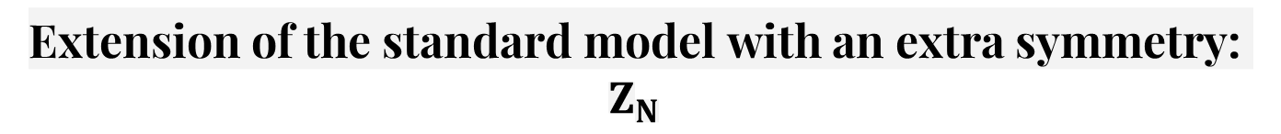
Extension of the standard model with an extra symmetry: $Z_{N}$
4

Slide 5
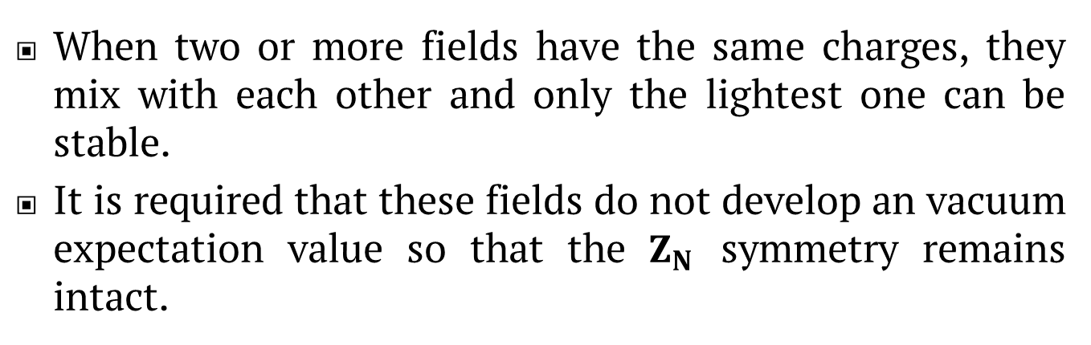
Extension of the standard model with an extra symmetry: $Z_{N}$
When two or more fields have the same charges, they mix with each other and only the lightest one can be stable.
It is required that these fields do not develop an vacuum expectation value so that the $Z_{N}$ symmetry remains intact.
5

Slide 6
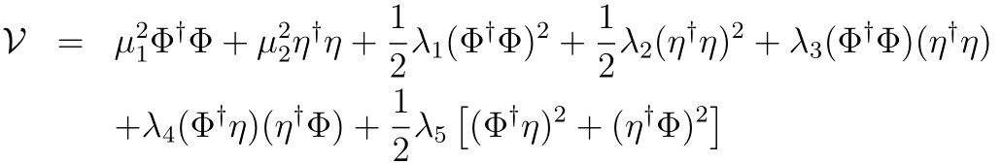

Example: Seesaw ${(Z}_{2})$
Scalar sector:
Fermion sector:

Slide 7
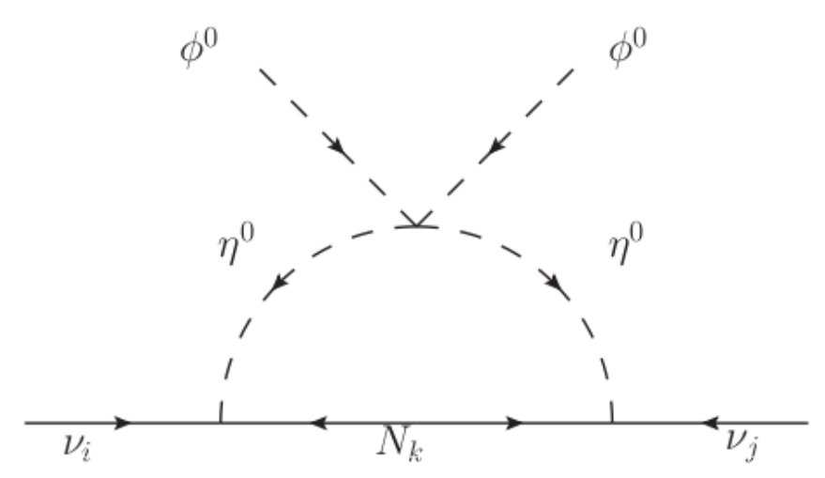
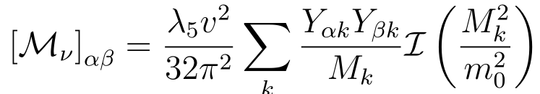
Example: Seesaw ${(Z}_{2})$
Neutrino mass:
Mechanism for generating neutrino masses to a loop

Slide 8

Multi-component Dark matter
2. The model
Dark matter can be thought of as being composed of several species of particles, each contributing a fraction of the relic density that is observed, and the $Z_{N}$ symmetry allows stabilizing several particles in order to reach this type of scenario.

Slide 9
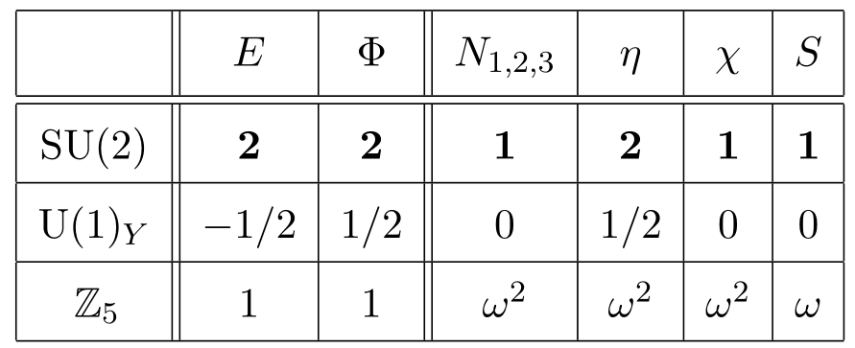
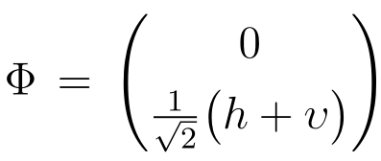
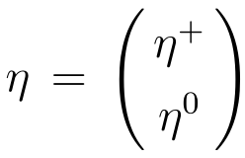
$Z_{5}$ Model (Shu-Yu Ho, Takashi Toma, Koji Tsumura)
Charges assignment

Slide 10
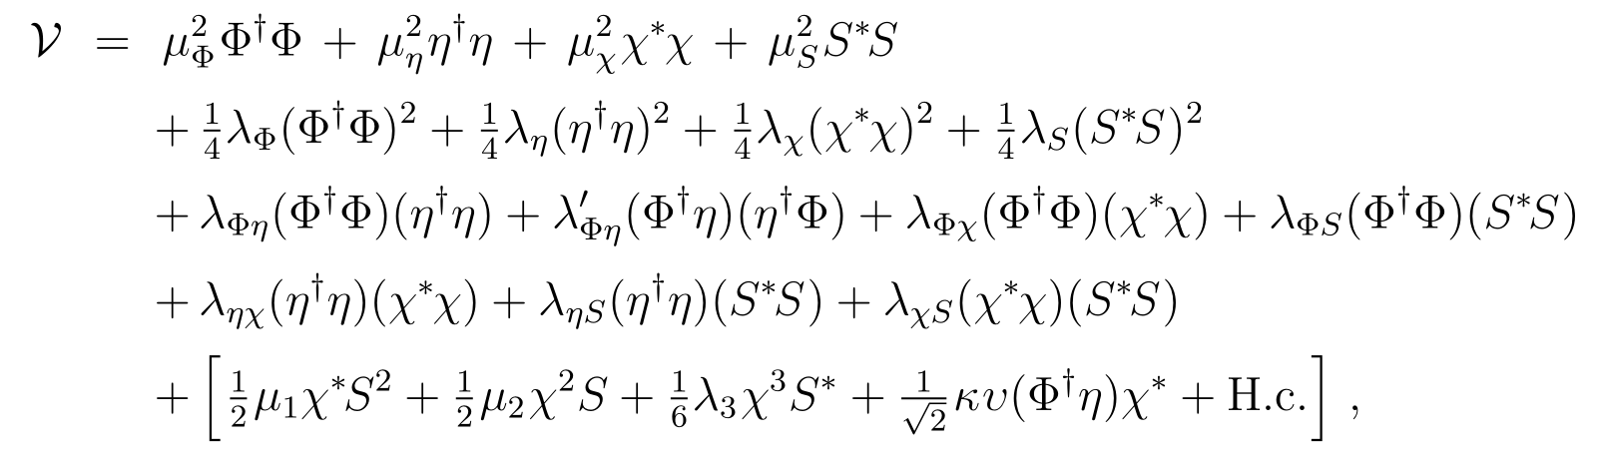
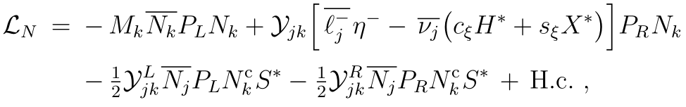
$Z_{5}$ Model (Shu-Yu Ho, Takashi Toma, Koji Tsumura)

Slide 11
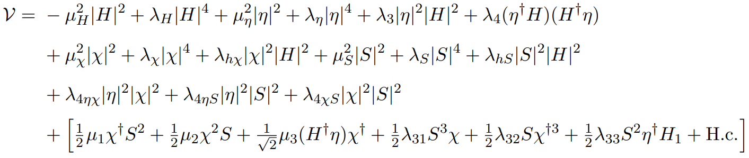

Our $Z_{5}$ Model

Slide 12
Comparation
Their:
Our:

Slide 13
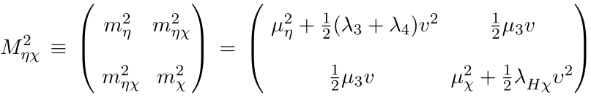
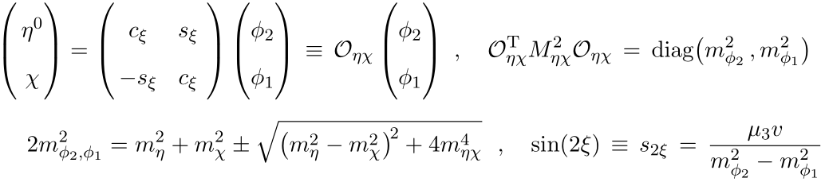
Our $Z_{5}$ Model
Diagonalizing:

Slide 14

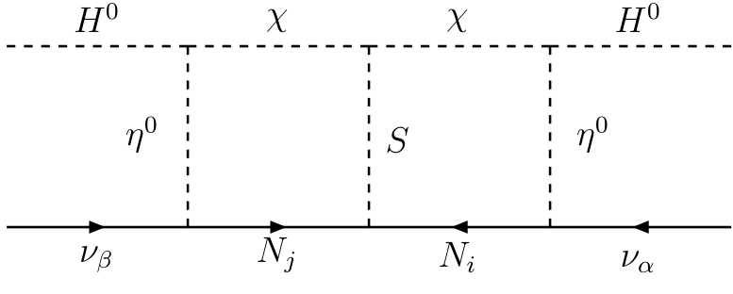

$Z_{5}$ Model
Feynman diagram for the generation of neutrino mass in two loops

Slide 15


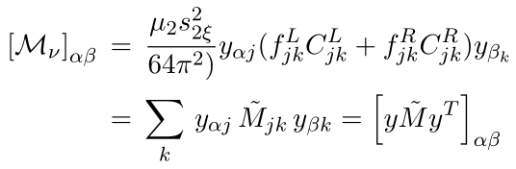

$Z_{5}$ Model
neutrino mass matrix:

Slide 16
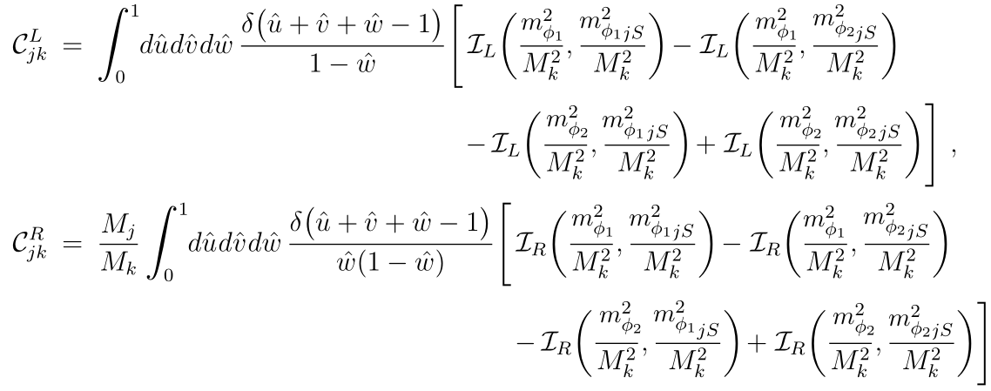
$Z_{5}$ Model

Slide 17
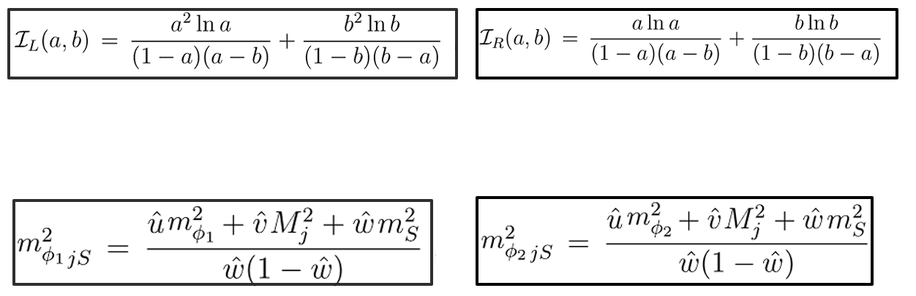
$Z_{5}$ Model

Slide 18
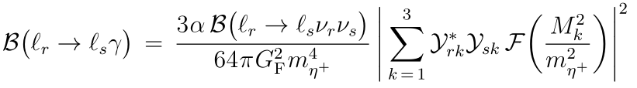


$Z_{5}$ Model
The flavor-changing radiative decay:

Slide 19
3. Results

Slide 20


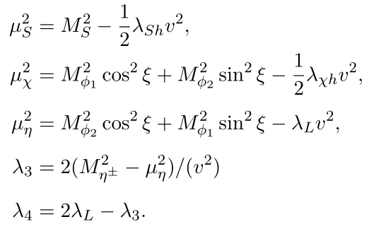




$$Parameters$$
To be fixed:
Dependent parameters:
Mass ratios:

Slide 21
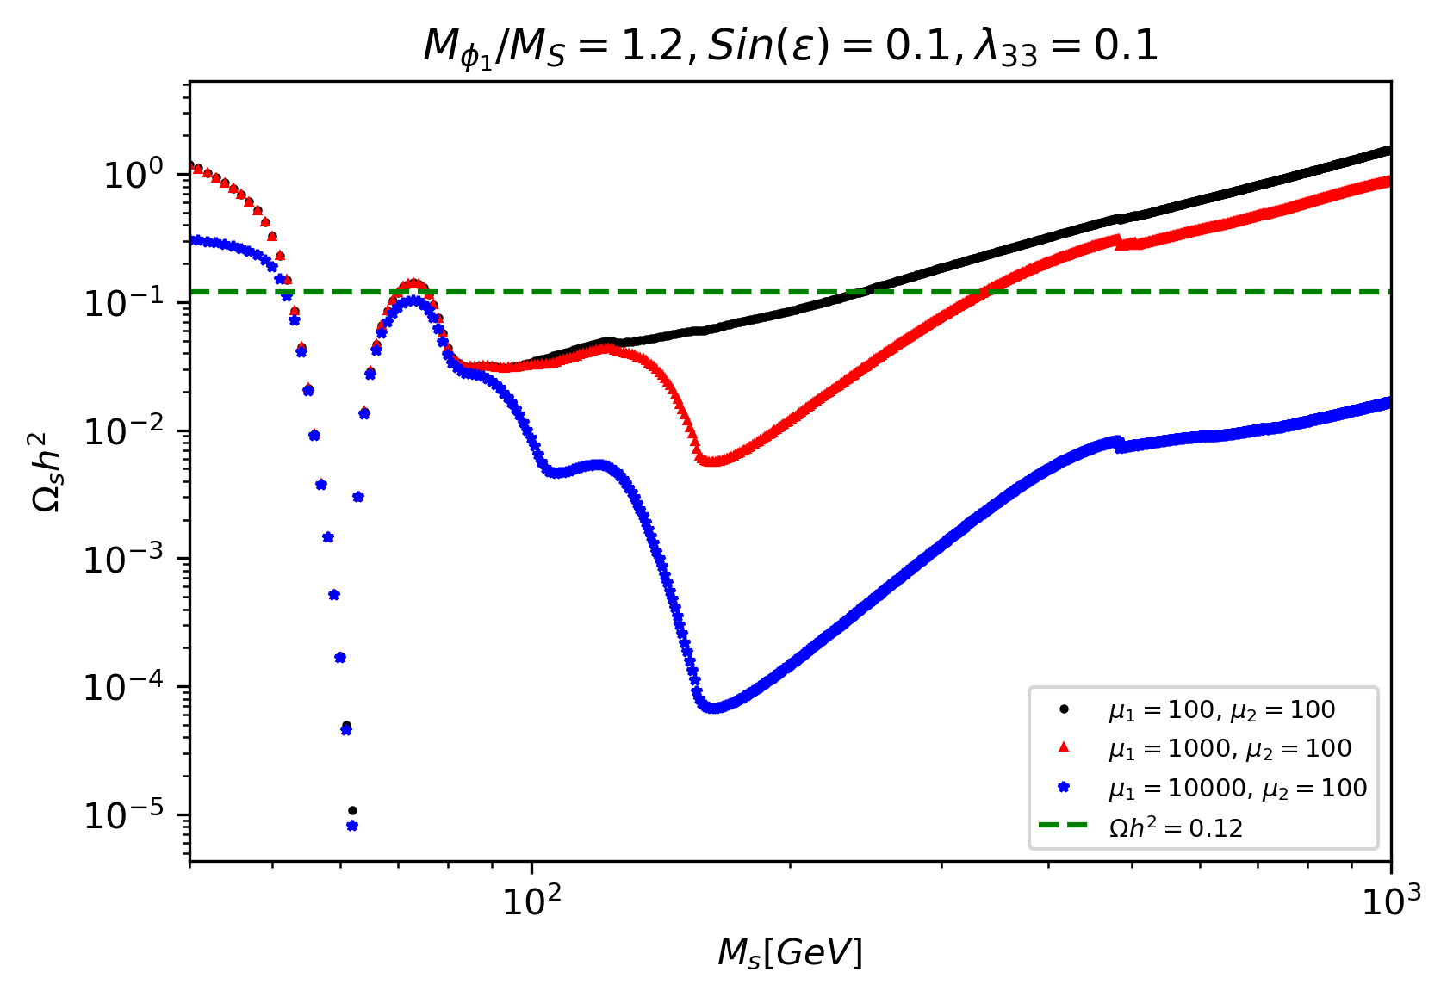
Relic density of particle S as a function of its mass

Slide 22
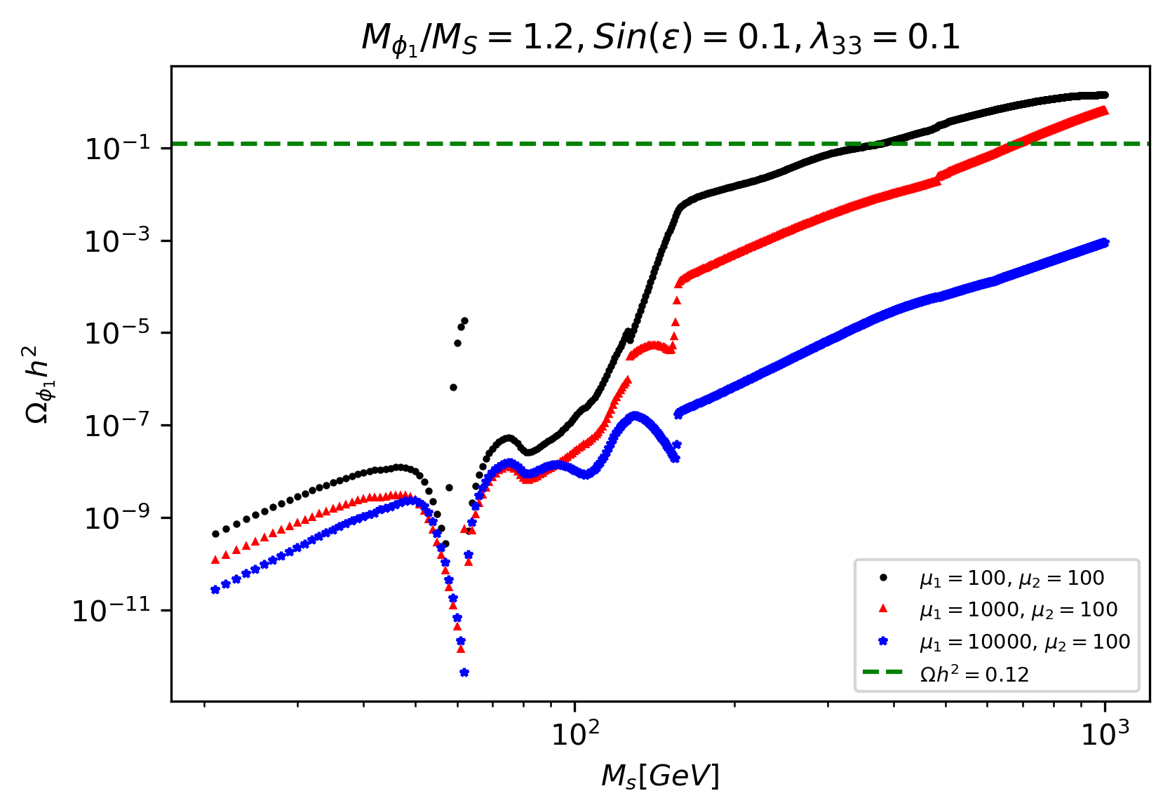
Relic density of particle Ф₁ as a function of the particle S mass

Slide 23
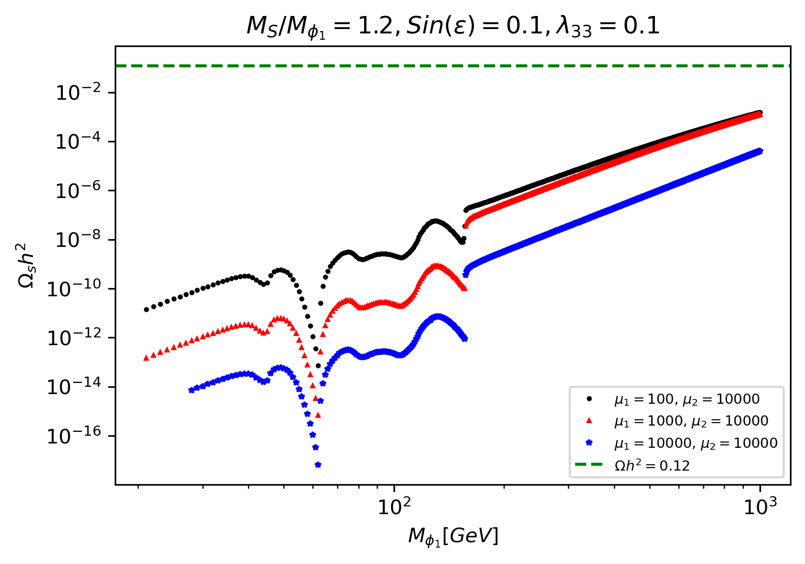
Relic density of particle S as a function of particle Ф₁ mass

Slide 24
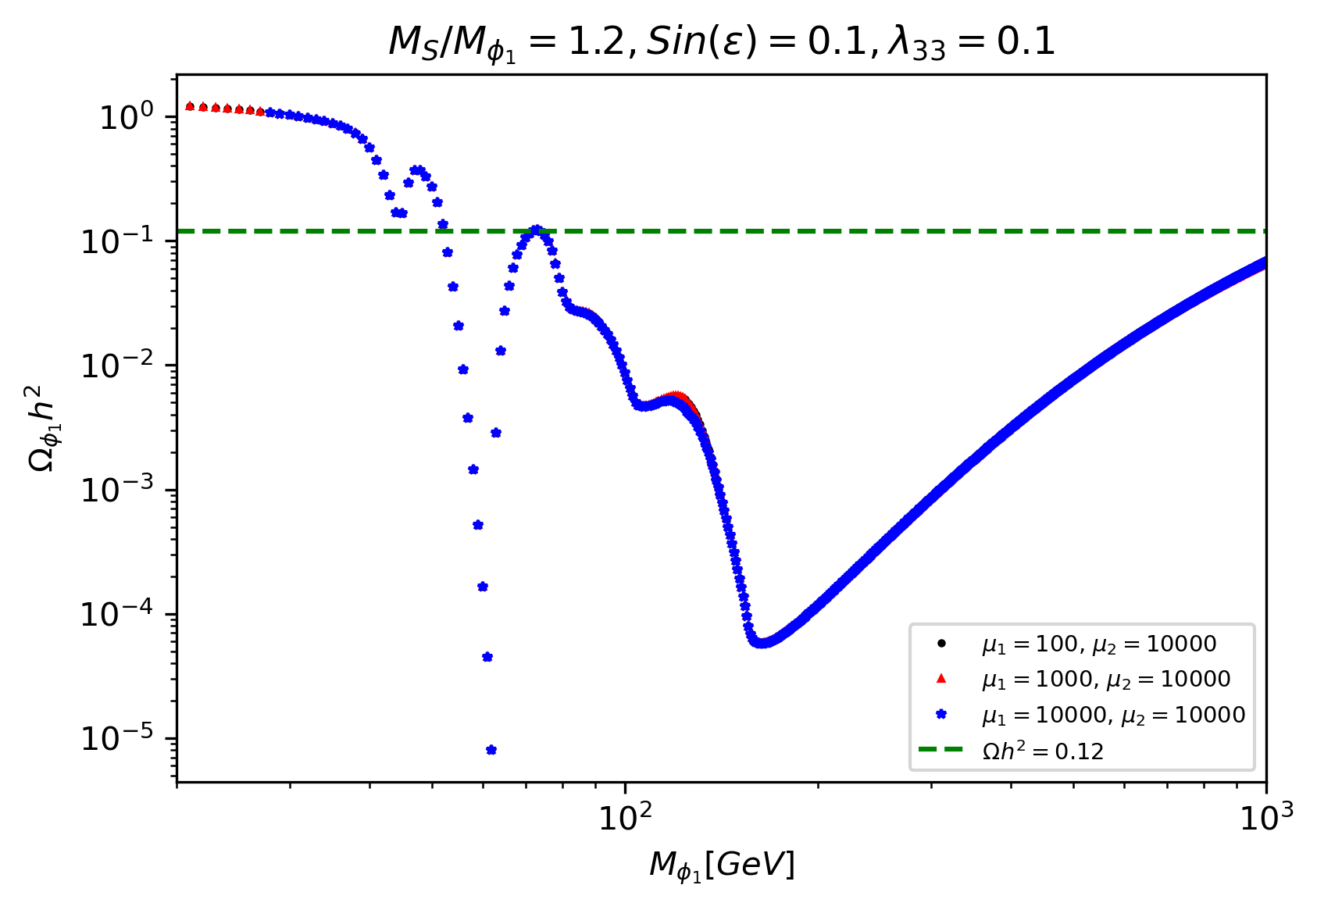
Relic density of particle Ф₁ as a function of its mass

Slide 25
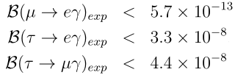
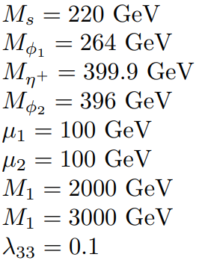
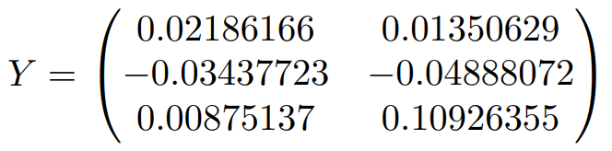
Yukawa Matrix

Slide 26

4. Conclusions
-We found that it is possible to satisfy the dark matter relic abundance with the model.
-Generating the neutrino masses falls under the responsibility of DM.
-The stability of the DM is guaranteed by the $Z_{5}$ symmetry.
-It is achievable to fulfill the LFV constraints and the dark matter relic abundance.

Slide 27
Thanks!

Slide 28
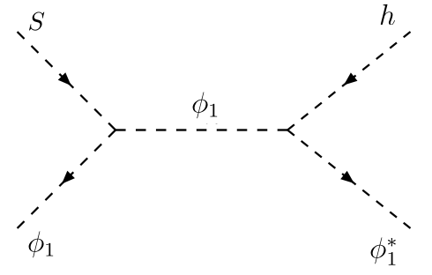
Relevant Dark matter semi-annihilation process

