Slide 1
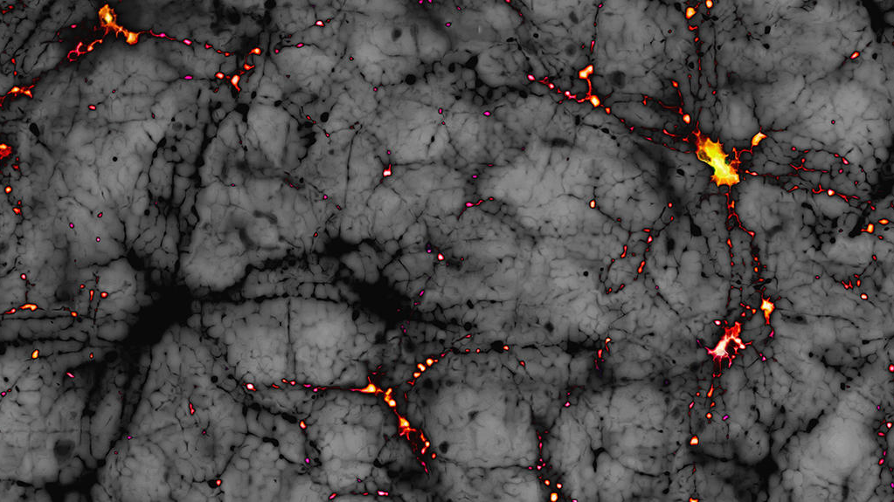


Dark Matter production in non-standard cosmologies
Valentina Franco Velásquez
Advisors: Óscar Zapata and Nicolás Bernal
Villa de Leyva, 2022.
Image taken from: https://news.cnrs.fr/articles/dark-matter-elusive-as-ever

Slide 2
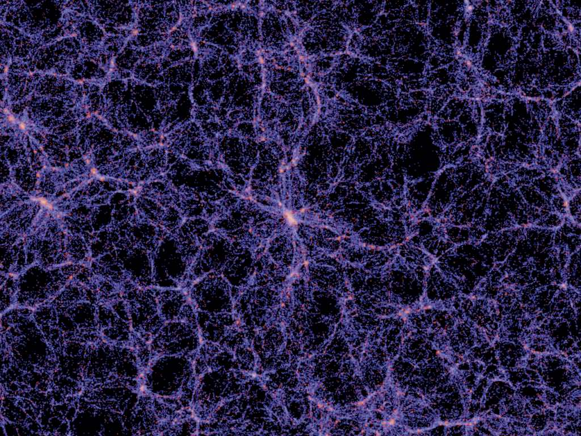
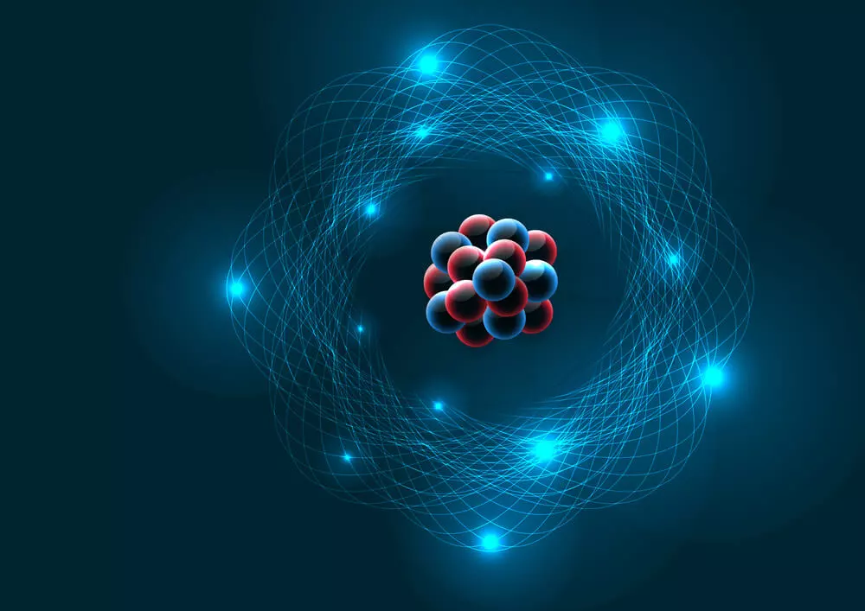
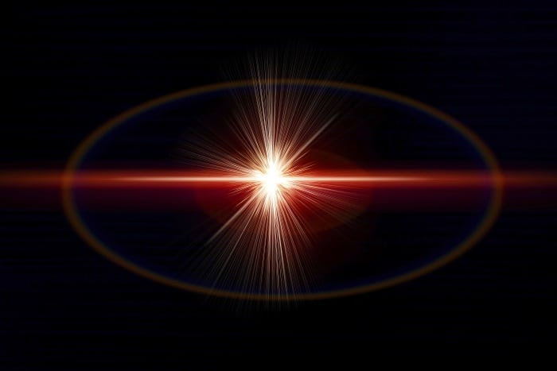


Standard cosmology
‘The simplest model that provides a reasonably good account of several properties of the universe’
Wikipedia, The Free Encyclopedia [3]
Our standard model corresponds to the $ΛCDM$ model in which the universe has three main components:
$Λ$ + CDM + Matter
Cosmological constant
Cold Dark Matter
Barionic matter.
Cosmological constant
Matter
Radiation
1/7

Slide 3
Standard cosmology
‘The simplest model that provides a reasonably good account of several properties of the universe’
Wikipedia, The Free Encyclopedia [3]
Our standard model corresponds to the $ΛCDM$ model in which the universe has three main components:
Possess problems
$Λ$ + CDM + Matter
Cosmological constant
Cold Dark Matter
Barionic matter.
Cosmological constant
Matter
Radiation
1/7

Slide 4
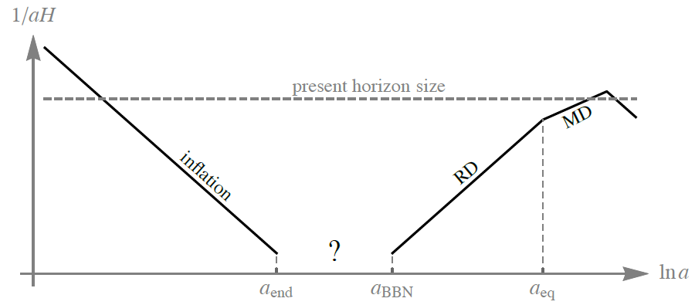

Non-Standard cosmology
‘Any physical cosmological model of the universe that is proposed as an alternative to the current standard model of cosmology’
Wikipedia, The Free Encyclopedia [4]
In this research project we are interested in models in which some stage in the history of the early universe is modified.
$$∼1 s$$
Figure 1. Gap in our knowledge of the early universe. Figure adapted from [5].
2/7

Slide 5
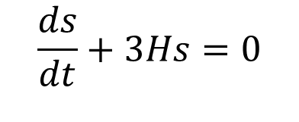
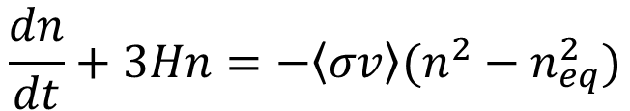
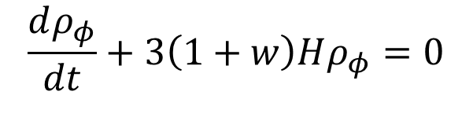
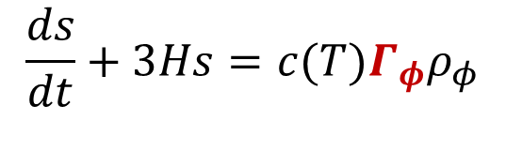
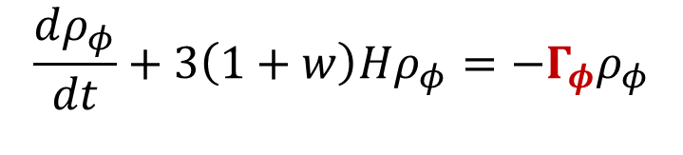
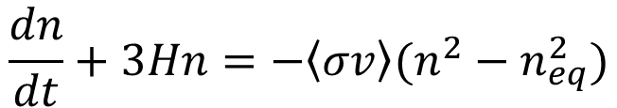
Standard to Non-Standard Cosmology
Decoupled system of Boltzmann differential equations.
Coupled system of Boltzmann differential equations.
$$\frac{dρ_{φ}}{dt}+3\left(1+w\right)Hρ_{φ}=0$$
$$\frac{dρ_{φ}}{dt}+3\left(1+w\right)Hρ_{φ}=−Γ_{φ}ρ_{φ}$$
$$\frac{ds}{dt}+3Hs=0$$
$$\frac{ds}{dt}+3Hs=c(T)Γ_{φ}ρ_{φ}$$
$$\frac{dn}{dt}+3Hn=−\left\langle σv\right\rangle (n^{2}−n_{eq}^{2})$$
$$\frac{dn}{dt}+3Hn=−\left\langle σv\right\rangle (n^{2}−n_{eq}^{2})$$
Thermal production of Dark Matter
3/7

Slide 6
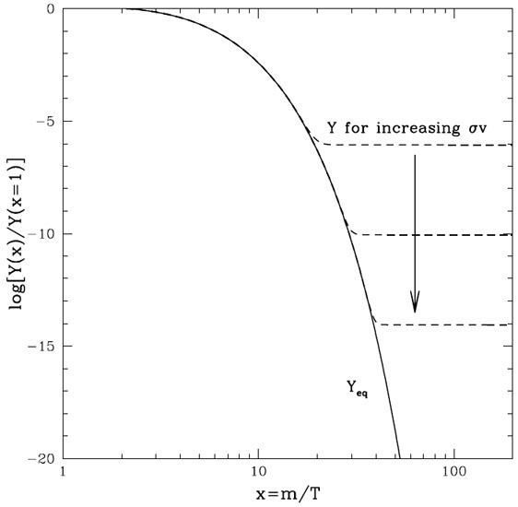
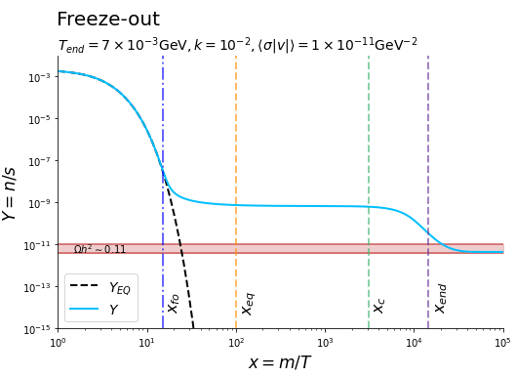

Standard to Non-Standard Cosmology
$$w=0; Γ_{φ}=Cte$$
Figura 3. WIMP freeze-out in a standard cosmology. Image taken from [6].
Figura 4. WIMP freeze-out in a non-standard cosmology. Figure reproduced from [1].
4/7

Slide 7

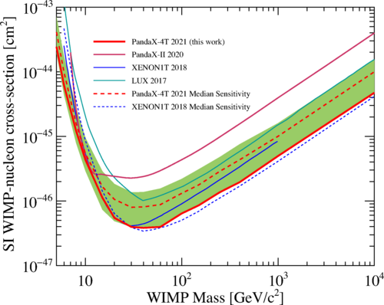
Dark Matter candidates
Save the WIMP!
$$\left\langle σv\right\rangle = 3.8×{10}^{−47} cm^{2}∼1×{10}^{−19}{GeV}^{−2}$$
Figure 2. Upper limits for WIMP cross sections from selected experiments as reported by PandaX in 2021. Figure taken from [9].
5/7

Slide 8
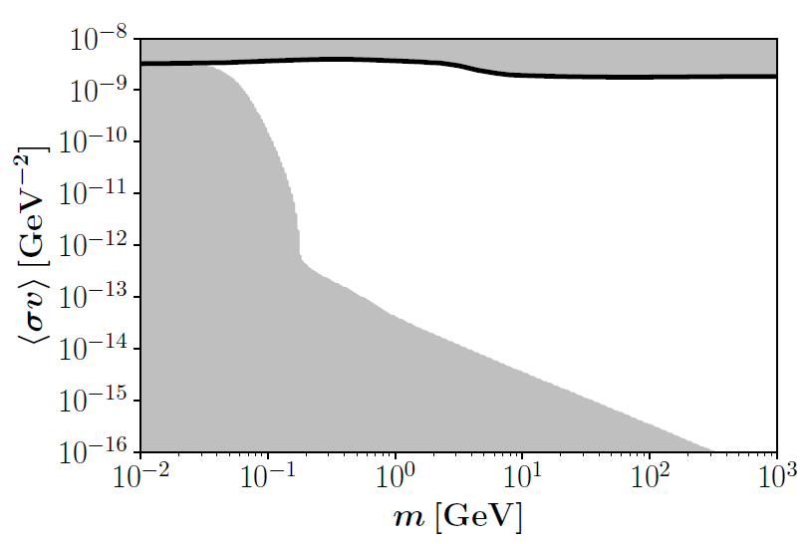
Non-Standard Cosmology
P. Arias et al., Reconstructing non-standard cosmologies with dark matter, 2019.
Figura 5. Parameter space (in white) that could reproduce the observed DM abundance via the WIMP mechanism with non-standard cosmologies.
6/7

Slide 9
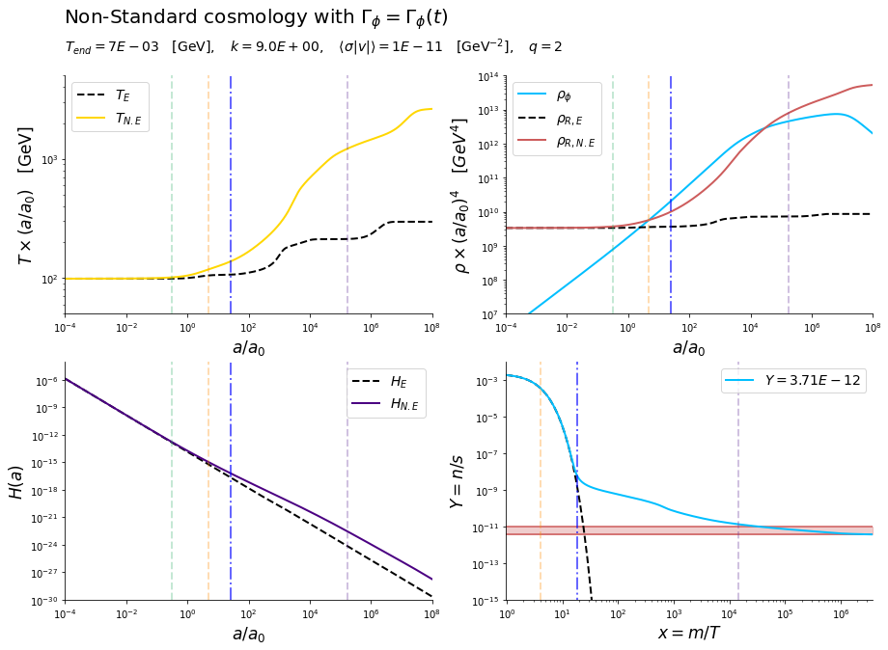
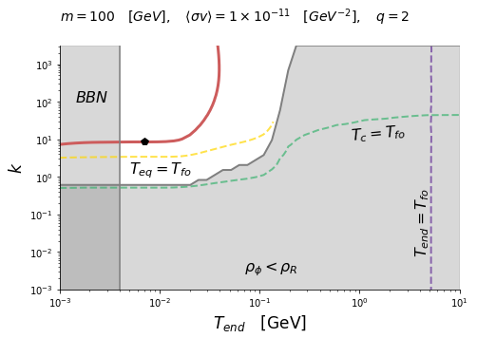




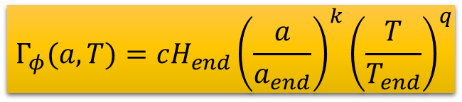





My research project
$$Γ_{φ}(a,T)=cH_{end}{\left(\frac{a}{a_{end}}\right)}^{k}{\left(\frac{T}{T_{end}}\right)}^{q}$$
Scale factor
$$x_{eq}$$
$$x_{c}$$
$$x_{fo}$$
$$x_{end}$$
k = 0; q = 2
Parametrization implemented in Barman, N. et al., Ultraviolet freeze-in with a time-dependent inflaton decay, 2022.
$$x_{eq}$$
$$x_{c}$$
$$x_{fo}$$
$$x_{end}$$
$$x_{eq}$$
$$x_{c}$$
$$x_{fo}$$
$$x_{end}$$
$$x_{c}$$
$$x_{fo}$$
$$x_{end}$$
7/7

Slide 10



Slide 11

References
[1] P. Arias, N. Bernal, A. Herrera, and C. Maldonado, Reconstructing non-standard cosmologies with dark matter, Journal of Cosmology and Astroparticle Physics 2019 (10), 047-047.
[2] R. T. Co, E. Gonzalez, and K. Harigaya, Increasing temperature toward the completion of reheating, Journal of Cosmology and Astroparticle Physics 2020 (11), 038–038.
[3] Wikipedia contributors, Lambda-cdm model — Wikipedia, the free encyclopedia (2022), [Online; accessed 28-November-2022].
[4] Wikipedia contributors, Non-standard cosmology — Wikipedia, the free encyclopedia (2022), [Online; accessed 28-November-2022].

Slide 12
References
[5] R. Allahverdi, M. A. Amin, A. Berlin, N. Bernal, C. T. Byrnes, M. S. Delos, A. L. Erickcek, M. Escudero, D. G. Figueroa, K. Freese, and et al., The first three seconds: a review of possible expansion histories of the early universe, The Open Journal of Astrophysics 4, 10.21105/astro.2006.16182 (2021).
[6] Chatterjee, Chayan & Majumdar, Debasish & Chatterjee, Suchetana. (2019). Dark Matter Self Interactions and its Impact on Large Scale Structures.
[7] B. Barman, N. Bernal, Y. Xu, and O. Zapata, Ultraviolet freeze-in with a time-dependent inflaton decay (2022).
[8] Wikipedia contributors, Weakly interacting massive particle — Wikipedia, the free encyclopedia (2022), [Online; accessed 29-November-2022].

