Slide 1

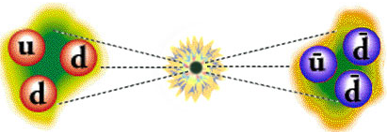
Raby Fest Conference • UMD • October 20-21, 2022
Prospects of Neutron
Oscillation Search
Yuri Kamyshkov/ University of Tennessee
email: kamyshkov@utk.edu

Slide 2
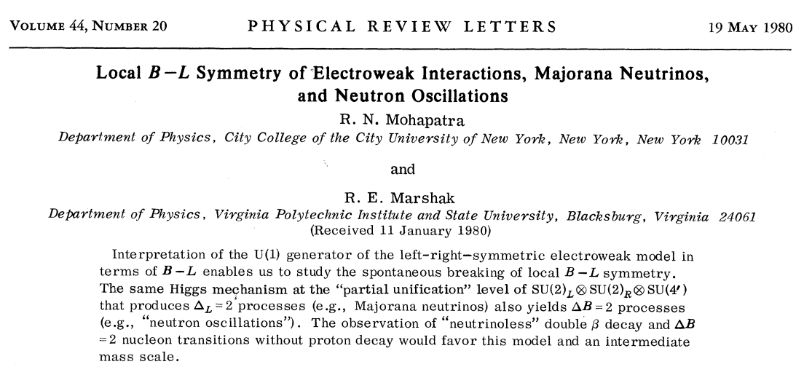
I am grateful to Rabi for his
impact on my scientific life.

Slide 3
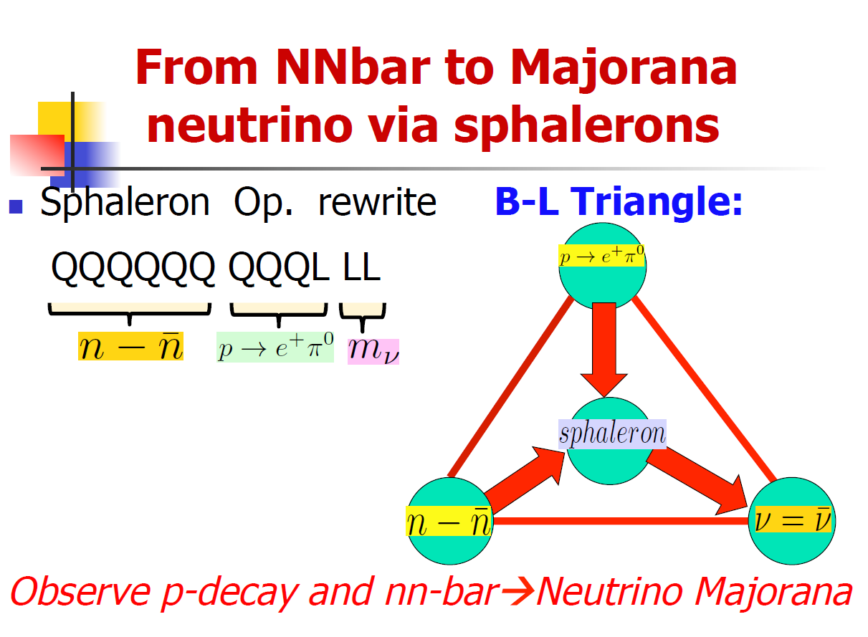
R. Mohapatra 2014

Slide 4

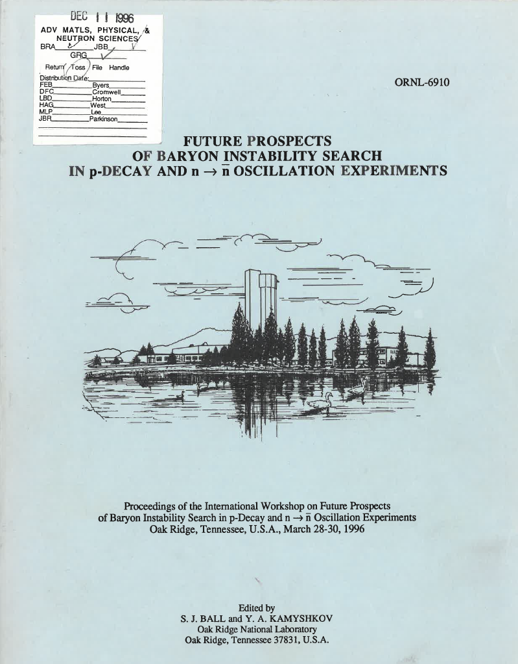
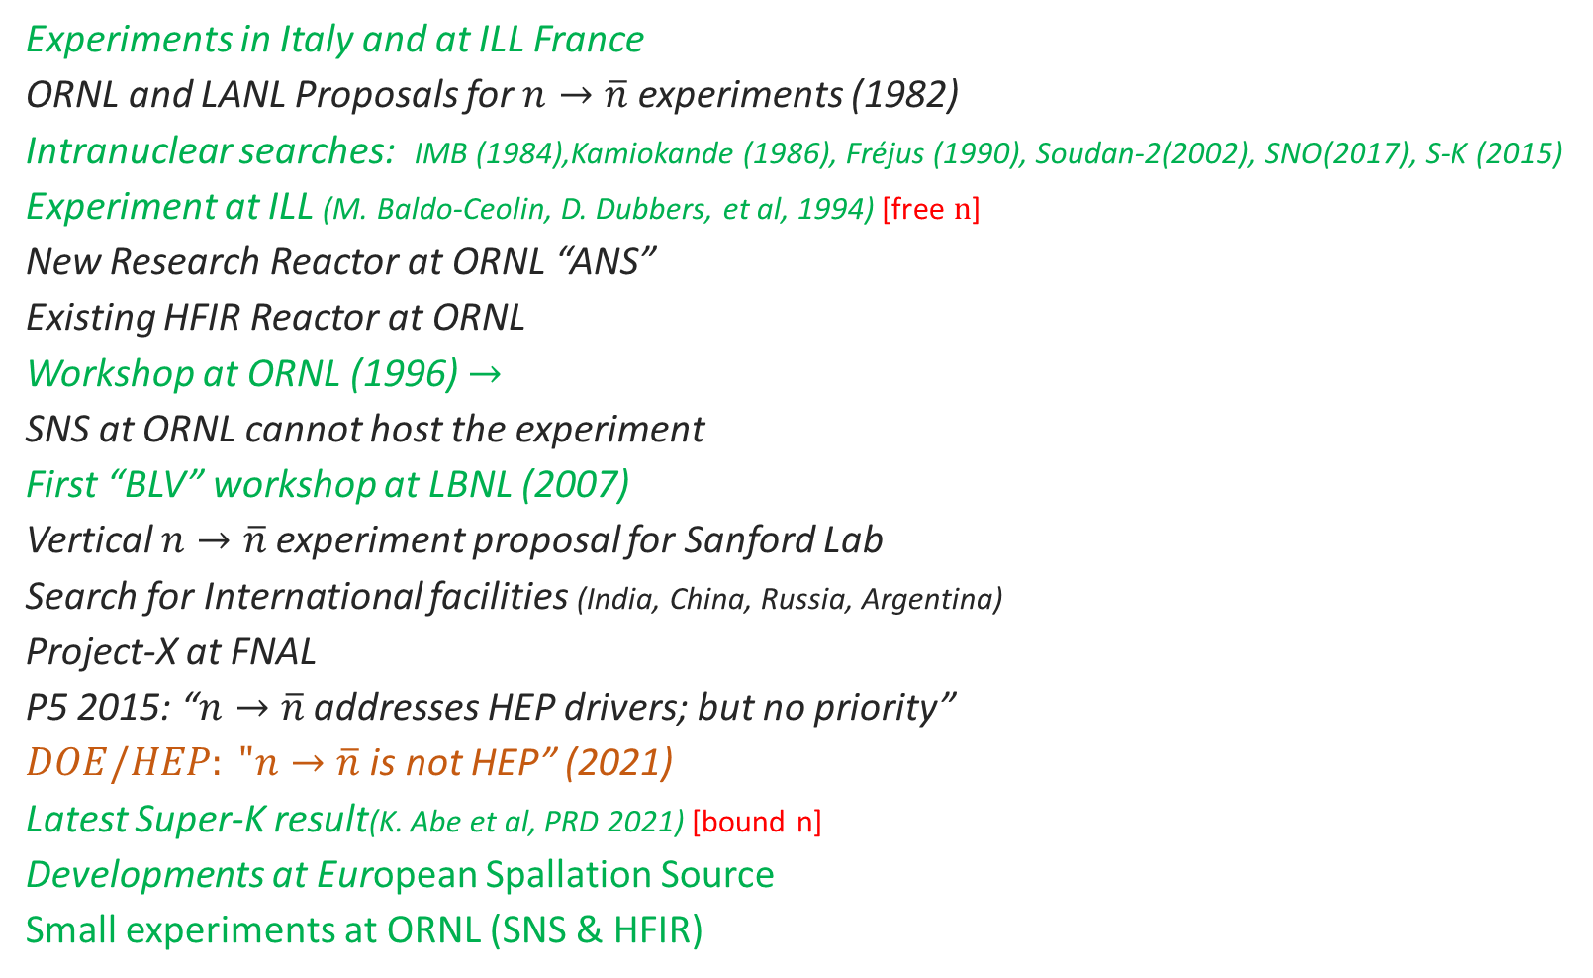

1980
Short history of $n→\overline{n}$ experiments
Experiments in Italy and at ILL France
ORNL and LANL Proposals for $n→\overline{n}$ experiments (1982)
Intranuclear searches: IMB (1984),Kamiokande (1986), Fréjus (1990), Soudan-2(2002), SNO(2017), S-K (2015)
Experiment at ILL (M. Baldo-Ceolin, D. Dubbers, et al, 1994) [free $n$]
New Research Reactor at ORNL “ANS”
Existing HFIR Reactor at ORNL
Workshop at ORNL (1996) $→$
SNS at ORNL cannot host the experiment
First “BLV” workshop at LBNL (2007)
Vertical $n→\overline{n}$experiment proposal for Sanford Lab
Search for International facilities (India, China, Russia, Argentina)
Project-X at FNAL
P5 2015: “$n→\overline{n}$ addresses HEP drivers; but no priority”
$DOE/HEP: "n→\overline{n}$ is not HEP” (2021)
Latest Super-K result(K. Abe et al, PRD 2021) [bound n]
Developments at European Spallation Source
Small experiments at ORNL (SNS & HFIR)
2022

Slide 5
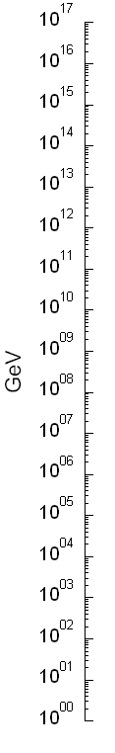
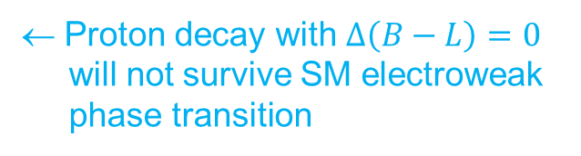
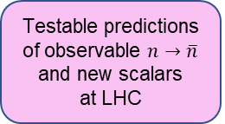
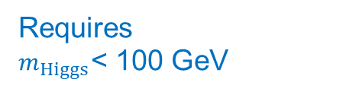
Baryogenesis Models
ΔB=1, ΔL=1; B−L=0
← Proton decay with $∆\left(B−L\right)=0$
will not survive SM electroweak
phase transition
GUT models
Proton decay
Heavy Majorana
neutrino
ΔL=2; B−L≠0
Leptogenesis model is very
difficult or impossible to test
Leptogenesis
Requires
$m_{Higgs}$< 100 GeV
Electroweak
sphaleron
phase transition
B−L=0
B+L≠0
Electroweak
Baryogenesis
Post-Sphaleron
Baryogenesis
LHC
ΔB=2; B–L≠0
BAU
washed out
BAU
generated
Excluded
in MSSM
Existing N-Nbar will erase all preexisting B
Testable predictions of observable $n→\overline{n}$
and new scalars
at LHC
K. Babu, B. Dev, E. Fortes,
R. Mohapatra, PRD 87
(2013) 115019

Slide 6
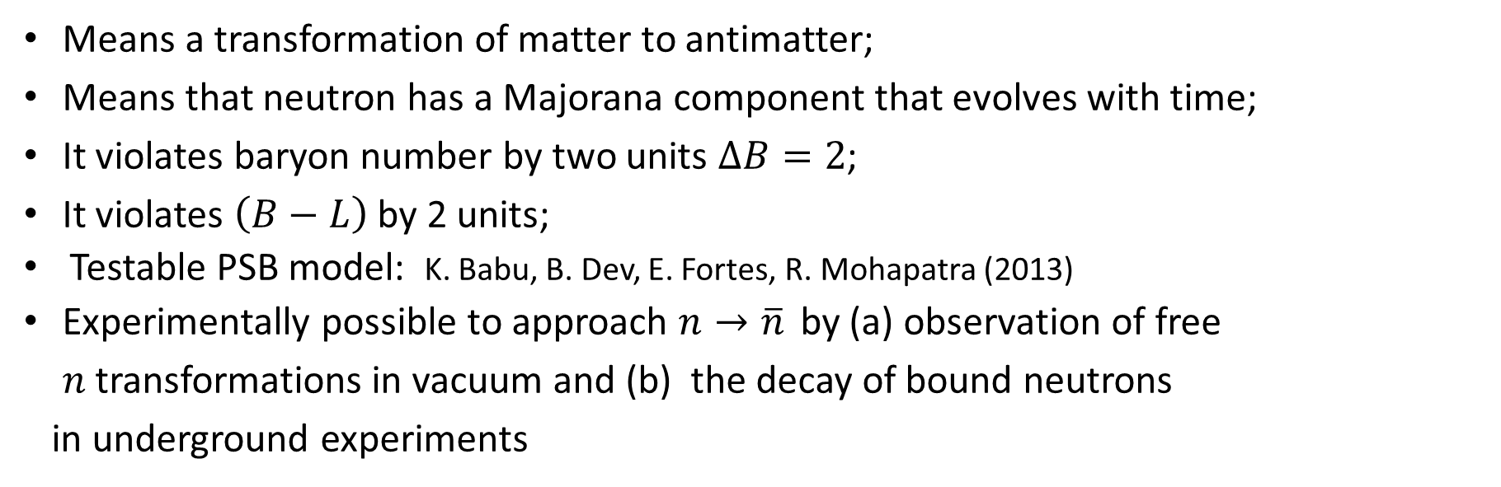
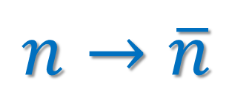
$$n→\overline{n}$$
Means a transformation of matter to antimatter;
Means that neutron has a Majorana component that evolves with time;
It violates baryon number by two units $∆B=2$;
It violates $\left(B−L\right)$ by 2 units;
Testable PSB model: K. Babu, B. Dev, E. Fortes, R. Mohapatra (2013)
Experimentally possible to approach $n→\overline{n}$ by (a) observation of free $n$transformations in vacuum and (b) the decay of bound neutrons
in underground experiments
Recent reviews “Neutron-Antineutron Oscillations: Theoretical Status and Experimental Prospects”,
D. Phillips + 57 authors, Physics Reports, Volume 612 (2016) https://arxiv.org/abs/1410.1100 and
“New high-sensitivity searched …”, A. Addazi + 90 authors https://arxiv.org/abs/2006.04907 (2020)
Both reviews are with essential Rabi’s contributions

Slide 7
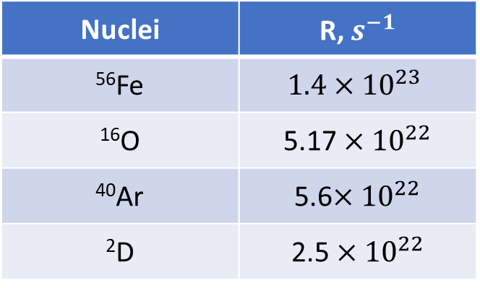
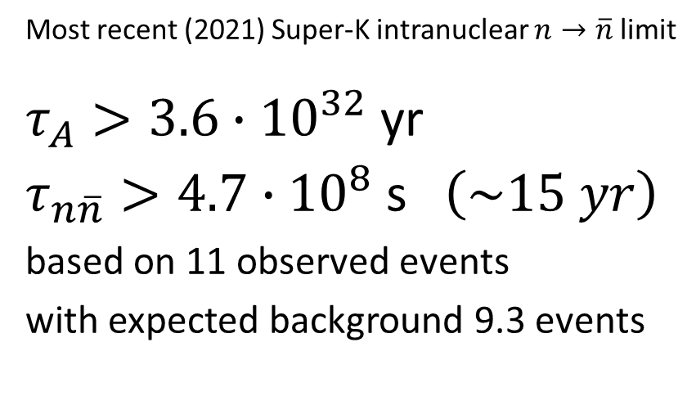
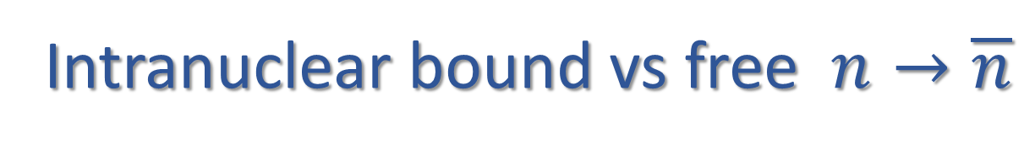
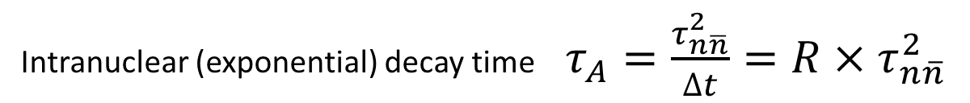
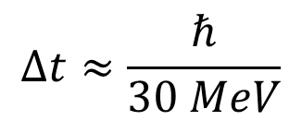
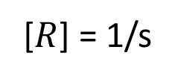
Intranuclear bound vs free $n→\overline{n}$
Intranuclear (exponential) decay time $τ_{A}=\frac{τ_{n\overline{n}}^{2}}{∆t}=R×τ_{n\overline{n}}^{2}$
[$R$] = 1/s
$$∆t≈\frac{ℏ}{30 MeV}$$
Known nuclear suppression
factors from nuclear theory
Most recent (2021) Super-K intranuclear $n→\overline{n}$limit
$τ_{A}>3.6∙{10}^{32}$ yr
$τ_{n\overline{n}}>4.7∙{10}^{8} \text{s}$ $\left(\sim 15 yr\right)$
based on 11 observed events
with expected background 9.3 events
Nuclei | R, $s^{−1}$
⁵⁶Fe | $$1.4×{10}^{23}$$
¹⁶O | 5.17 $×{10}^{22}$
⁴⁰Ar | 5.6$×{10}^{22}$
²D | 2.5 $×{10}^{22}$

Slide 8
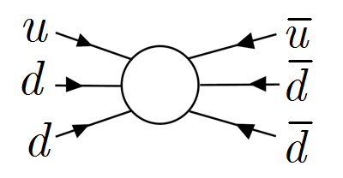
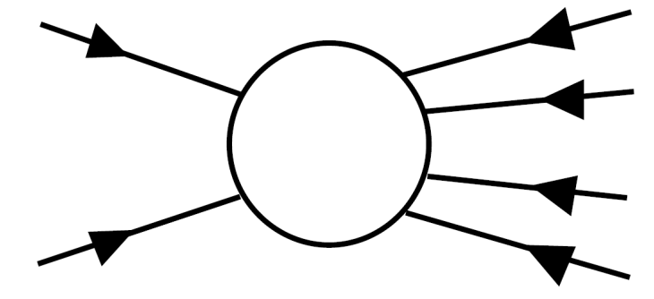


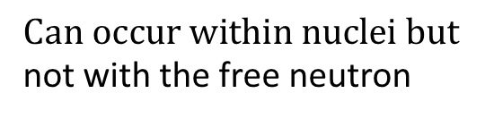
Nuclear suppression factor R can be calculated with $±15\%$ by nuclear theory
e. g. J. Barrow et al., https://arxiv.org/abs/1906.02833 (2020)
Some of my colleagues insist that free and bound $n→\overline{n}$ are two different processes
For example
S. Raby (2010)
$$n→\overline{n}$$
$$cross−symmetry channel$$
$$Can occur within nuclei but$$
not with the free neutron

Slide 9
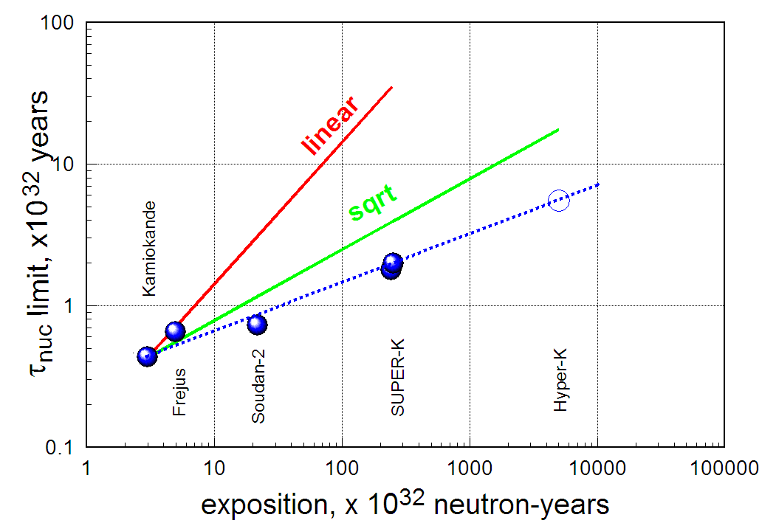
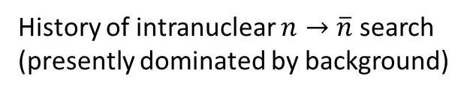
90% CL
History of intranuclear $n→\overline{n}$search
(presently dominated by background)
11/9.3
24/24.1
2015
SUPER-K
2021
2015 plot

Slide 10
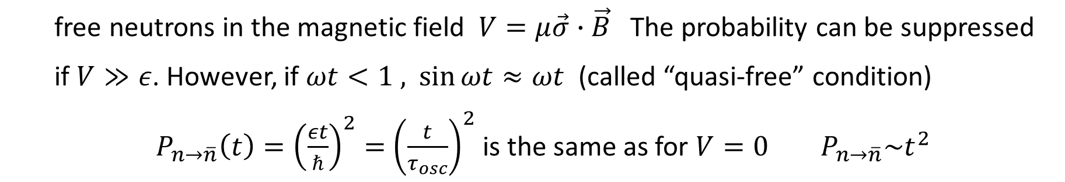
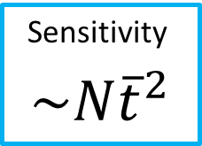
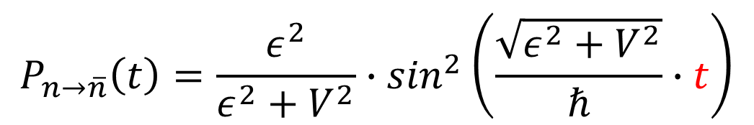

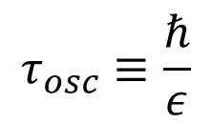
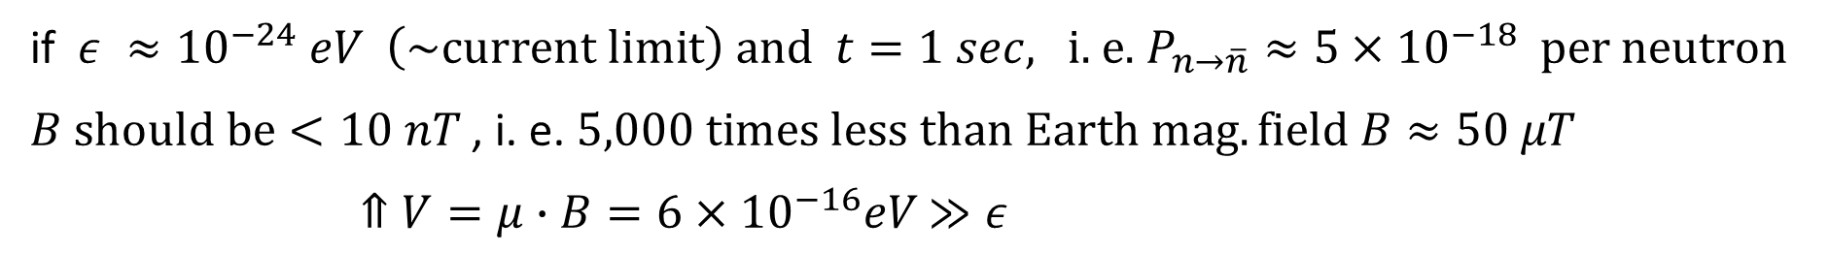
Free beam of neutrons in vacuum
$$τ_{osc}≡\frac{ℏ}{ε}$$
$$P_{n→\overline{n}}\left(t\right)=\frac{ε^{2}}{ε^{2}+V^{2}}∙\sin^{2}\left(\frac{\sqrt{ε^{2}+V^{2}}}{ℏ}∙t\right)$$
- oscillation time
$t$ - time of free neutron flight
free neutrons in the magnetic field $V=μ\vec{σ}∙\vec{B}$ The probability can be suppressed
if $V≫ε$. However, if $ωt<1 ,$ $\sin{ωt≈ωt}$ (called “quasi-free” condition)
$P_{n→\overline{n}}\left(t\right)={\left(\frac{εt}{ℏ}\right)}^{2}=$ ${\left(\frac{t}{τ_{osc}}\right)}^{2}$ is the same as for $V=0$ $P_{n→\overline{n}}\sim t^{2}$
Sensitivity
$$\sim N{\overline{t}}^{2}$$
if $ε ≈{10}^{−24} eV \left(\sim current limit\right) and t=1 sec,$ i. e. $P_{n→\overline{n}}≈5×{10}^{−18}$ per neutron
$B should be<10 nT$ , i. e. $5,000 times less than Earth mag. field B≈50 μT$
$⇑V=μ∙B=6×{10}^{−16}eV$ $≫ε$

Slide 11
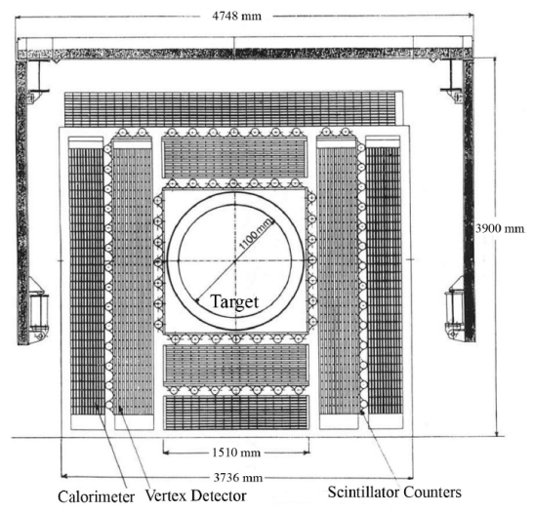
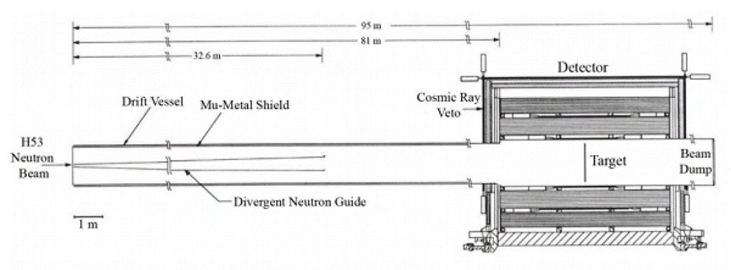
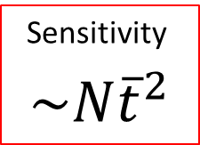
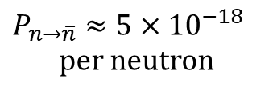
N-Nbar search experiment with free neutrons
at ILL/Grenoble reactor in 89-91 by Heidelberg-ILL-Padova-Pavia Collaboration
M. Baldo-Ceolin et al., Z. Phys., C63 (1994) 409
Top view
Sensitivity
$$\sim N{\overline{t}}^{2}$$
Overall detector
efficiency ~ 50%.
Running time was
1 year.
$$P_{n→\overline{n}}≈5×{10}^{−18}$$
per neutron
τ_{free} > 0.86×10⁸ s

Slide 12
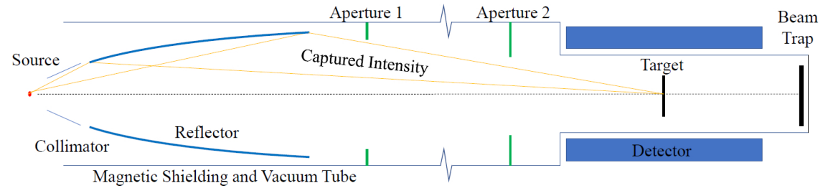

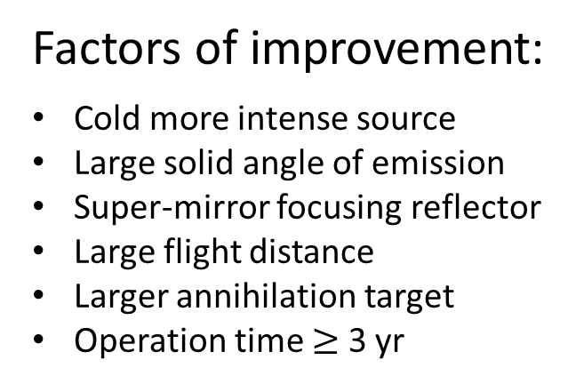
Schematically ESS $n→\overline{n}$ experiment will be configured similar to ILL
ILL type backgroundless detector
Factors of improvement:
Cold more intense source
Large solid angle of emission
Super-mirror focusing reflector
Large flight distance
Larger annihilation target
Operation time $≥$ 3 yr
$$→Large increase N{\overline{t}}^{2}$$

Slide 13

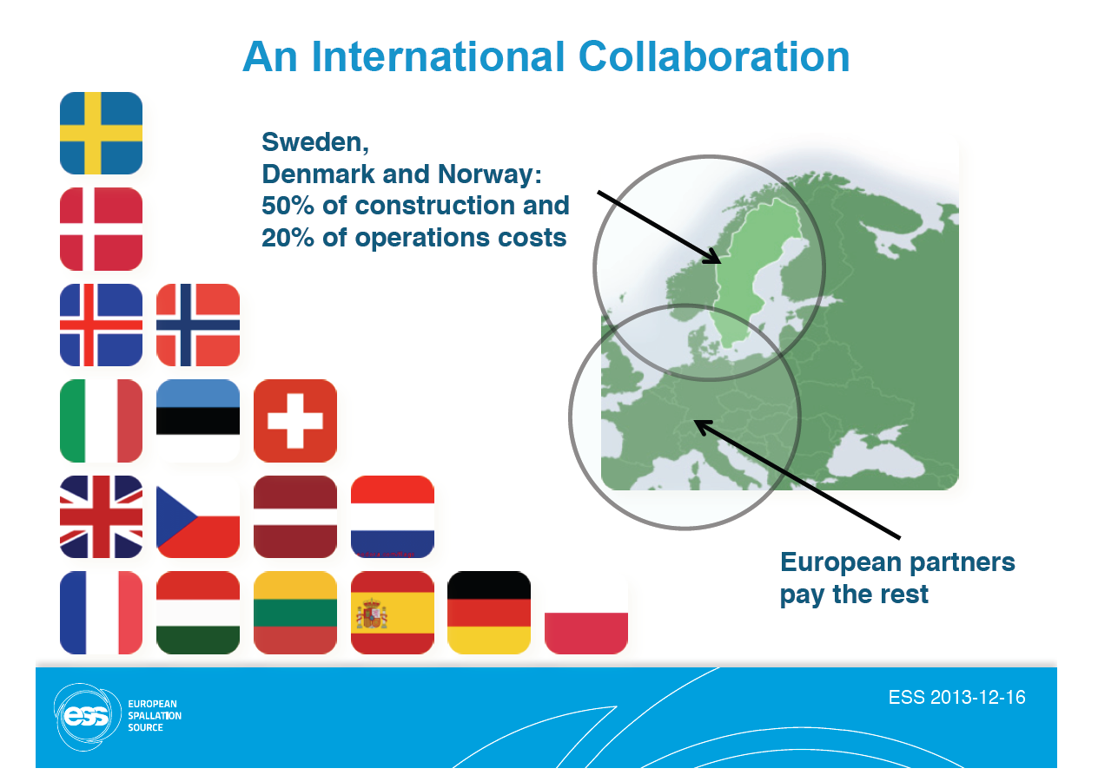
13

Slide 14
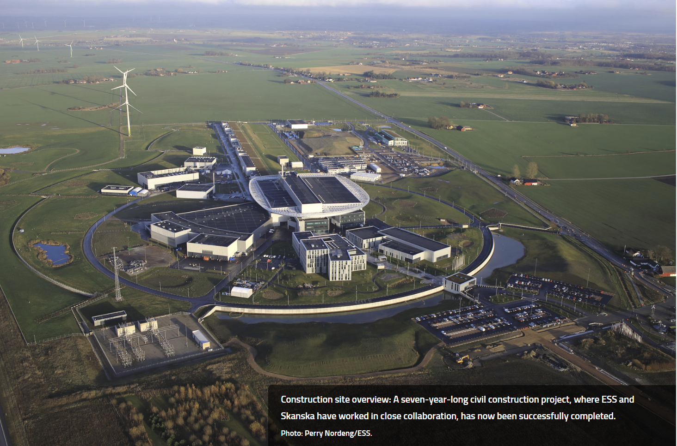
14 Hz 3 ms proton pulses
0.8 GeV/2MW
Future NNbar beamline

Slide 15
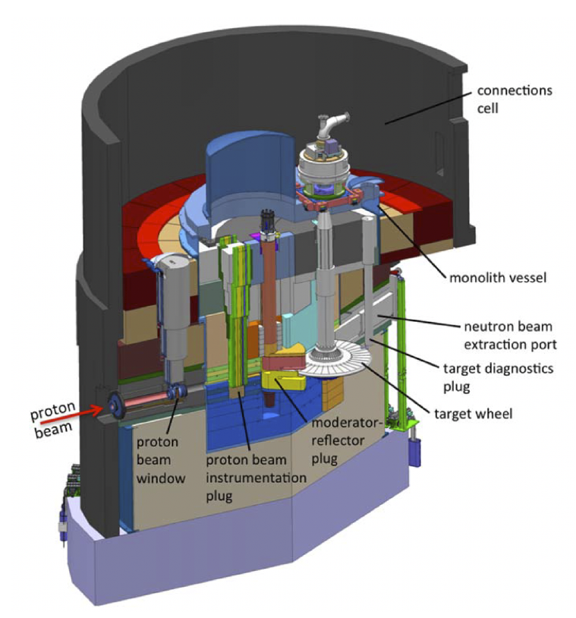
Spallation source ESS
Proton beam 0.8 GeV (1-st stage) 2026-2035 , 2 MW
Proton beam 2.0 GeV (2-nd stage) > 2035, 5 MW

Slide 16
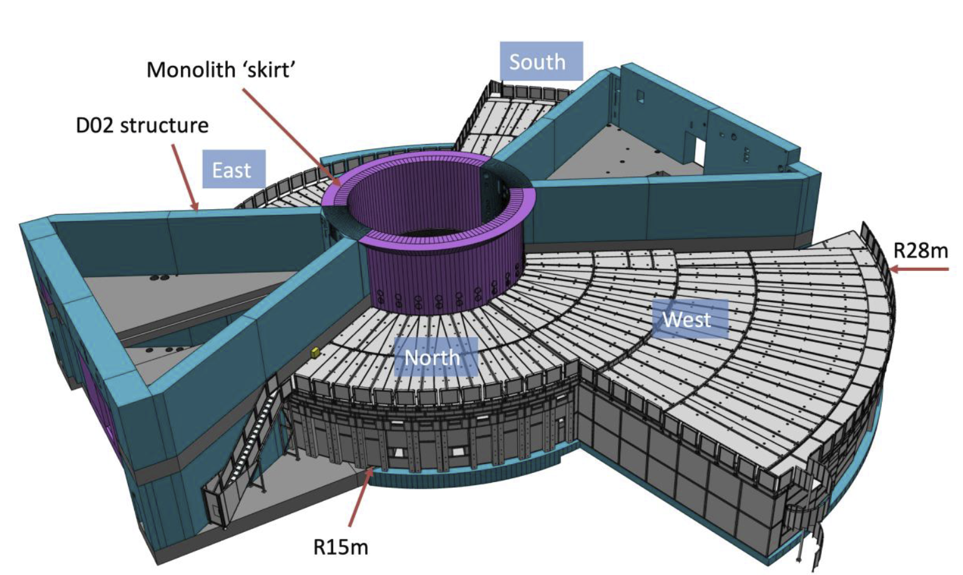
P
N-Nbar

Slide 17





Large Beam Port and special LD₂
moderator are constructed by ESS
in anticipation of NNbar experiment
Upper LH₂ moderator
Operational > 2026 $→$
$←$ High brightness
Operational > 2035 $→$
$←$ Colder, high intensity
Lower $LD2$ moderator

Slide 18
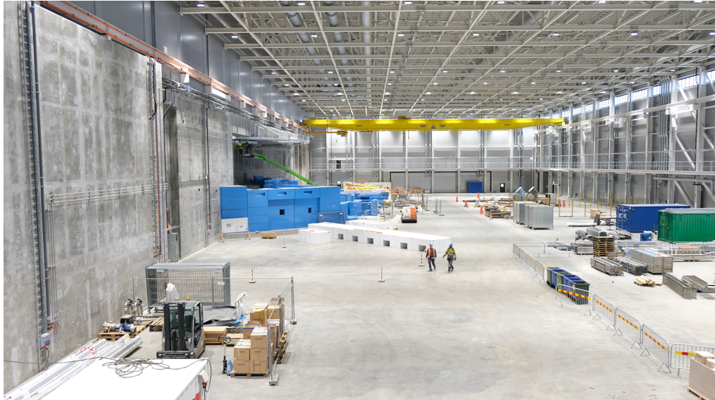
ESS North-West experimental hall in June 2022

Slide 19
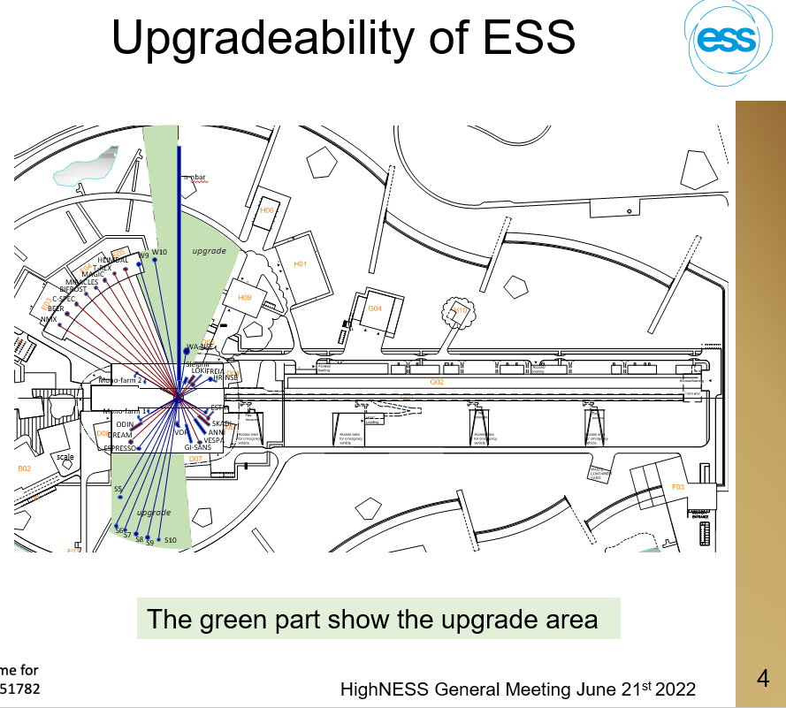

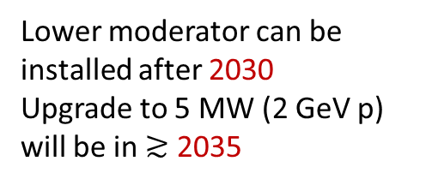
Initially planned for 5 MW
ESS will start in 2026 producing
cold neutrons at 2 MW with
0.8 GeV LINAC
14 Hz operation with 3 ms
Proton pulses and with upper
cold moderator operation will
start in 2026-2027
Lower moderator can be
installed after 2030
Upgrade to 5 MW (2 GeV p)
will be in $≳$ 2035
Unique possibility for designing
NNbar experiment together with the
design of the source and beamline.

Slide 20


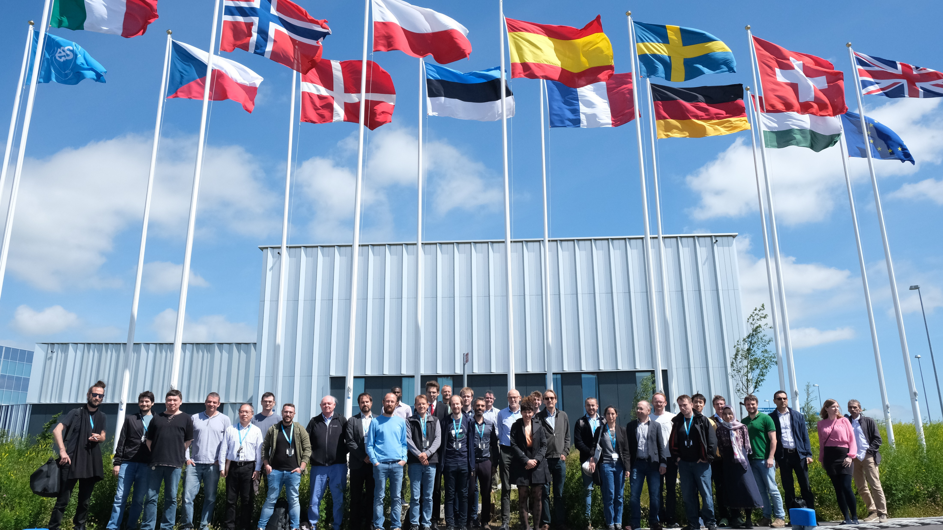
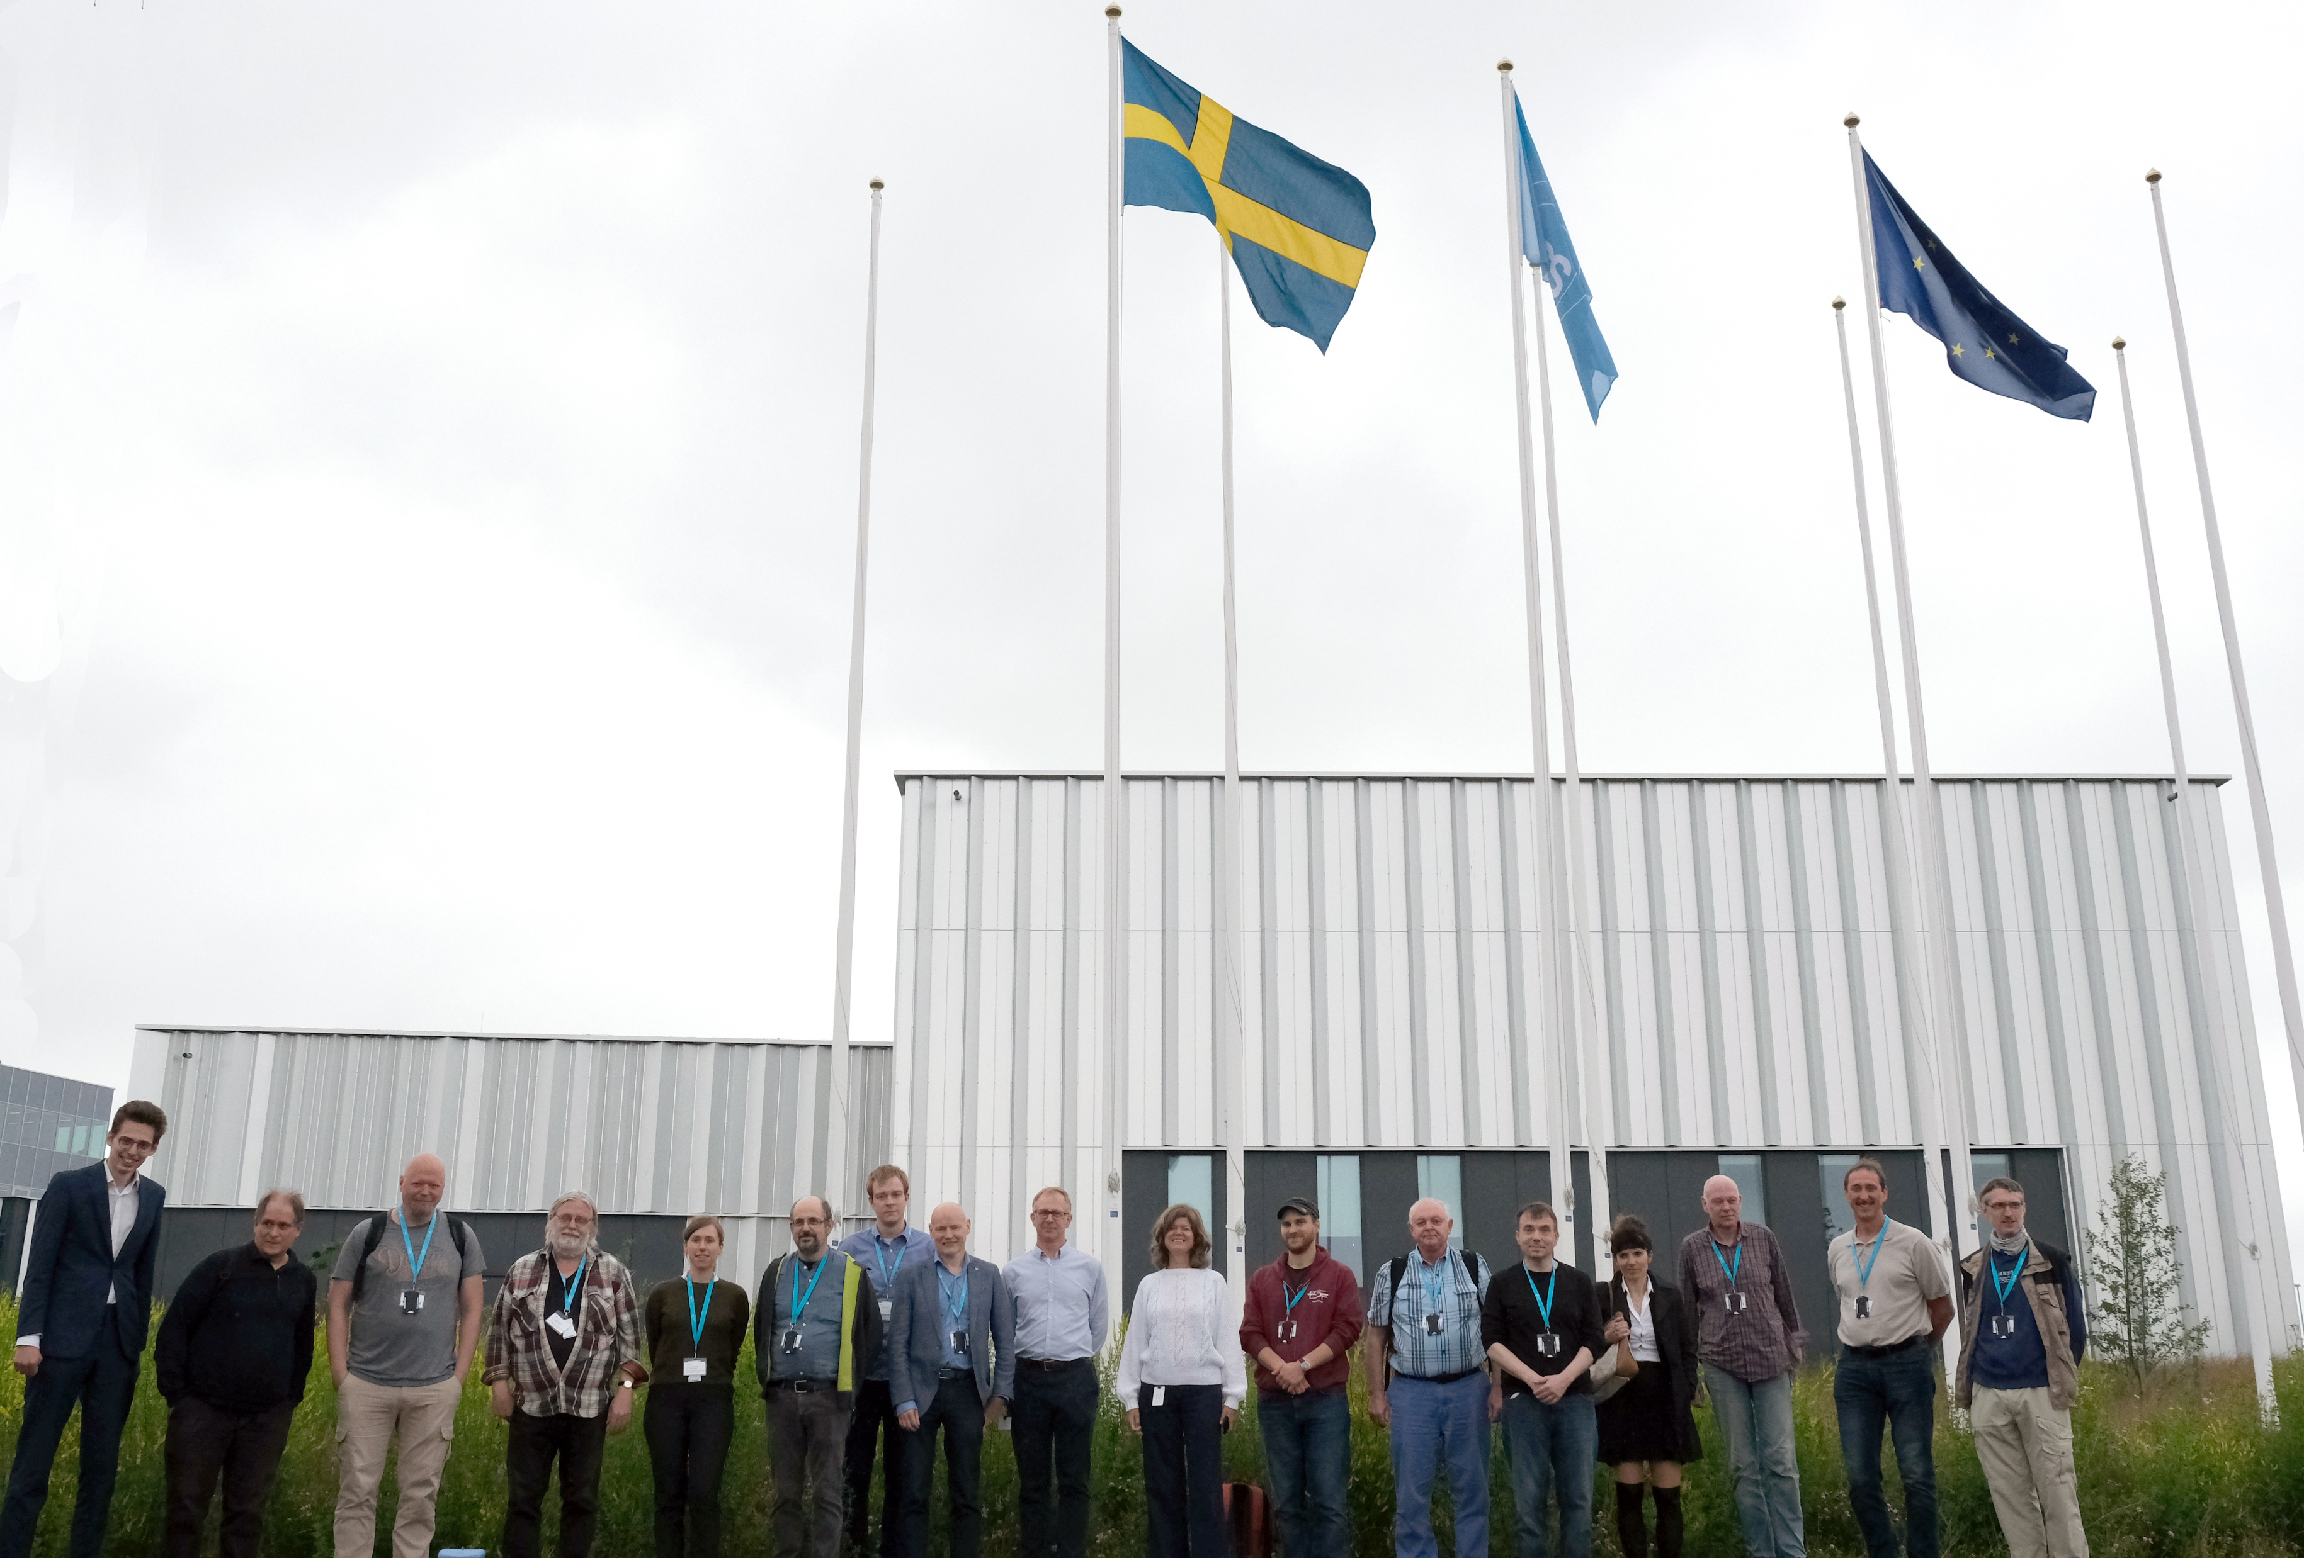
HighNESS Collaboration meeting
at ESS • Lund • 21-22 June 2022
NNbar Collaboration sub-group meeting
at ESS • Lund • 23 June 2022
Highness/ESS Design Project develops lower LD₂
Cold Source and beamline for NNbar
NNbar Collaboration has several working groups on the
detector study, prototypes construction/test, neutronics,
shielding, simulations, mag. field, and recently on project
Engineering.

Slide 21
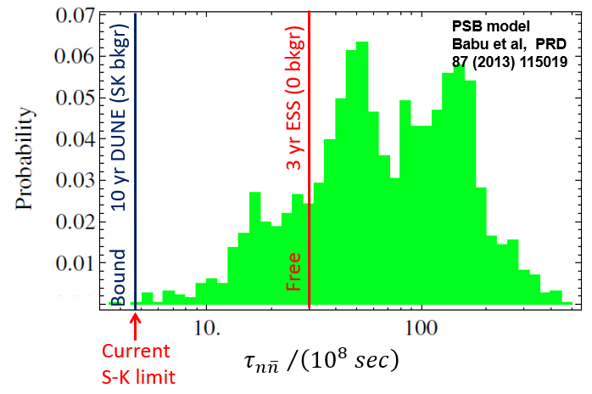
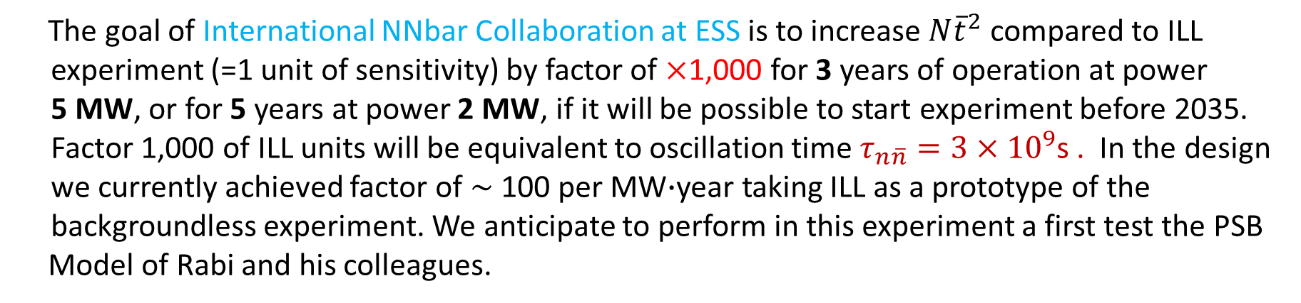
The goal of International NNbar Collaboration at ESS is to increase $N{\overline{t}}^{2}$ compared to ILL
experiment (=1 unit of sensitivity) by factor of $×$1,000 for 3 years of operation at power
5 MW, or for 5 years at power 2 MW, if it will be possible to start experiment before 2035.
Factor 1,000 of ILL units will be equivalent to oscillation time $τ_{n\overline{n}}=3×{10}^{9}$s . In the design
we currently achieved factor of $\sim$ 100 per MW$∙$year taking ILL as a prototype of the
backgroundless experiment. We anticipate to perform in this experiment a first test the PSB
Model of Rabi and his colleagues.

Slide 22
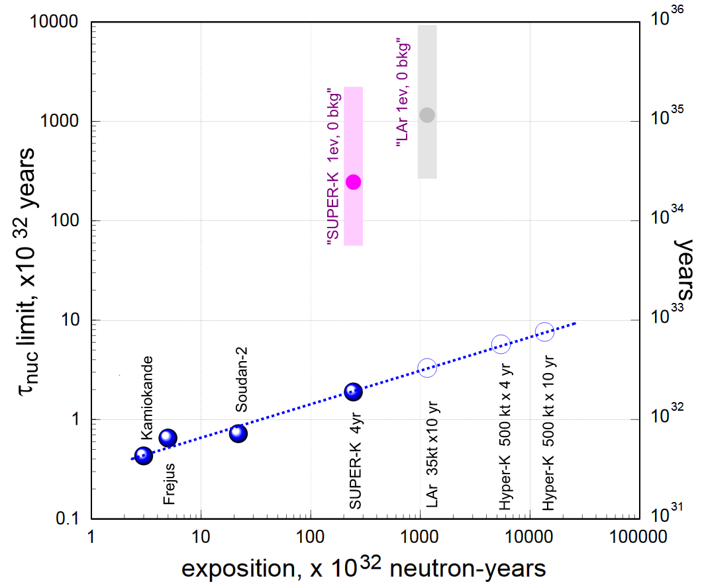
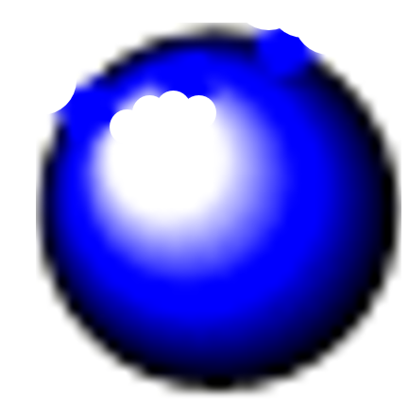




Prospects of intranuclear n-nbar search are background dependent
Hypothetical assumption
of big underground
backgroundless
detectors
If we believe in nuclear
suppression theory for
bound to free relation
ESS 3-yr goal for $\sim$2035
Discovery
Limit
$$τ_{A}=R×τ_{n\overline{n}}^{2}$$
Demonstrated
backgrounds
S-K 16 yr
Lar 35kt $×10 yr$
Current ILL limit
$$exposure× {10}^{32} neutron∙years$$
11 candidate events and 9.3 events background – best S-K result 2021 (0.37 kt-yr)
DUNE experiment will not be backgroundless (Josh Barrow, UT PhD thesis, 2021)

Slide 23
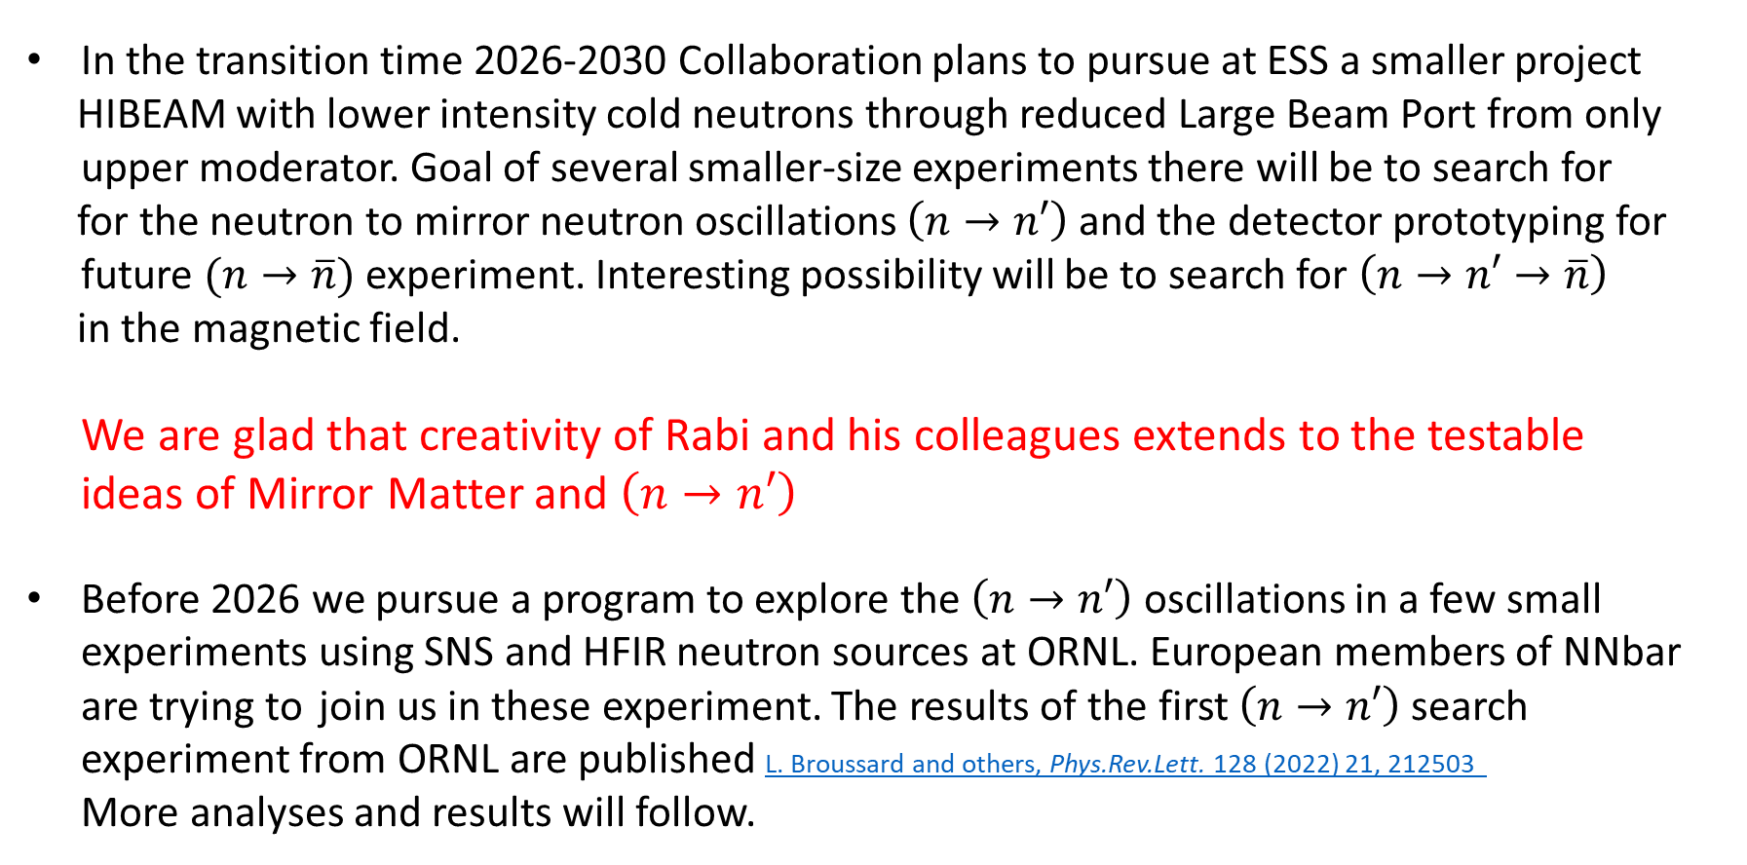
In the transition time 2026-2030 Collaboration plans to pursue at ESS a smaller project
HIBEAM with lower intensity cold neutrons through reduced Large Beam Port from only
upper moderator. Goal of several smaller-size experiments there will be to search for
for the neutron to mirror neutron oscillations $\left(n→n′\right)$and the detector prototyping for
future $(n→\overline{n})$ experiment. Interesting possibility will be to search for $\left(n→n′→\overline{n}\right)$
in the magnetic field.
We are glad that creativity of Rabi and his colleagues extends to the testable
ideas of Mirror Matter and $\left(n→n′\right)$
Before 2026 we pursue a program to explore the $\left(n→n′\right)$ oscillations in a few small
experiments using SNS and HFIR neutron sources at ORNL. European members of NNbar
are trying to join us in these experiment. The results of the first $\left(n→n′\right)$search
experiment from ORNL are published L. Broussard and others, Phys.Rev.Lett. 128 (2022) 21, 212503
More analyses and results will follow.

Slide 24
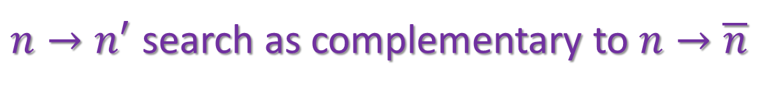
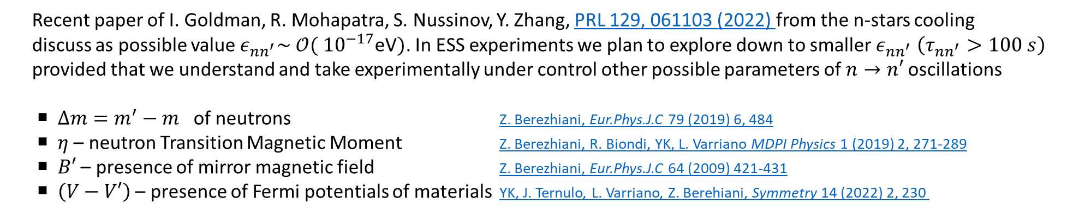
$n→n^{′}$search as complementary to $n→\overline{n}$
$n→\overline{n}$ is described by propagation of eigenstates $\left(\begin{matrix}m+μσB & ε_{n\overline{n}} \\ ε_{n\overline{n}} & m−μσB\end{matrix}\right)\left(\begin{matrix}n \\ \overline{n}\end{matrix}\right)$
More effects can be present for $n→n′$ $\left(\begin{matrix}m+V+μσB & ε_{nn^{′}}+ησB+η′σB′ \\ ε_{nn^{′}}+ησB+η′σB′ & m^{′}+V^{′}+μ′σB′\end{matrix}\right)\left(\begin{matrix}n \\ n′\end{matrix}\right)$
Recent paper of I. Goldman, R. Mohapatra, S. Nussinov, Y. Zhang, PRL 129, 061103 (2022) from the n-stars cooling
discuss as possible value $ε_{nn^{′}}\sim$ $𝒪($ ${10}^{−17}$eV$)$. In ESS experiments we plan to explore down to smaller $ε_{nn^{′}}$ $\left(τ_{nn^{′}}>100 s\right)$
provided that we understand and take experimentally under control other possible parameters of $n→n′$oscillations
○ $∆m=m^{′}−m$ of neutrons Z. Berezhiani, Eur.Phys.J.C 79 (2019) 6, 484
○ $η$ – neutron Transition Magnetic Moment Z. Berezhiani, R. Biondi, YK, L. Varriano MDPI Physics 1 (2019) 2, 271-289
○ $B′$ – presence of mirror magnetic field Z. Berezhiani, Eur.Phys.J.C 64 (2009) 421-431
○ $\left(V−V′\right)$ – presence of Fermi potentials of materials YK, J. Ternulo, L. Varriano, Z. Berehiani, Symmetry 14 (2022) 2, 230

Slide 25
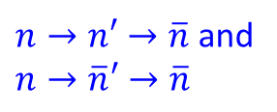





$n→\overline{n}$ transformation through mirror states in the presence of magnetic field
Z. Berezhiani, Eur.Phys.J.C 81 (2021) 1, 33
$$\left(\begin{matrix}\begin{matrix}E & ε \\ ε & E\end{matrix} & \begin{matrix}α & β \\ β & α\end{matrix} \\ \begin{matrix}α & β \\ β & α\end{matrix} & \begin{matrix}E & ε \\ ε & E\end{matrix}\end{matrix}\right)\left(\begin{matrix}\begin{matrix}n \\ \overline{n}\end{matrix} \\ \begin{matrix}n′ \\ \overline{n}′\end{matrix}\end{matrix}\right)$$
$$\left(\begin{matrix}n \\ \overline{n}\end{matrix}\right)↔\left(\begin{matrix}n′ \\ \overline{n}′\end{matrix}\right)$$
More general view:
$$P_{n\overline{n}}=ε^{2}t^{2}+16α^{2}β^{2}t^{4}$$
In vacuum, in the absence
of magnetic fields
“Conventional”
$$n→\overline{n}$$
$n→n′→\overline{n}$ and
$$n→\overline{n}′→\overline{n}$$
We can imagine that $ϵ≪α,β$and the mirror magnetic field $B′$ is present.
Then ILL $n→\overline{n}$ limit will not determine the real values of $αβ$.
One will need to tune $B$in order to compensate suppression due to $B^{′}.$
In the resonance $B=B′$ probability $P_{n\overline{n}}\sim {𝒪(10}^{−10})$ is not excluded.
This can be testable at ESS.

Slide 26

$\text{The} n$ - oscillations allow a range of new experiments at ORNL$→$ ESS
inspired by your Theories and addressing BSM physics of observation
of baryon number violation by 2 $\left(n→\overline{n}\right)$ or 1 units $\left(n→n′\right),$ the
mechanism of baryogenesis (PSB), and the nature of Dark Matter $\left(n′\right)$
We are building Collaboration including Europe, Japan, and US. Currently 5 US senior
scientists (UT, NCSU, IU, Columbia, ORNL) are participating in the project. No support
yet from funding agencies. ORNL, as specialized neutron Lab, is interested to participate.
In Europe we are hoping that Swedish Funding Agencies will sponsor HIBEAM and NNbar
as a substantial Sweden contribution to the science at ESS.
As emissary of NNbar-HIBEAM-${NN}^{′}$ORNL Collaboration I appeal
to the experimentalists in your institutions – join us
Rabi will continue work with us on the neutron oscillation search !
$∗$ I am grateful to the Stockholm University and Swedish Research Council, who are supporting my travel to Rabi Fest

