Slide 1
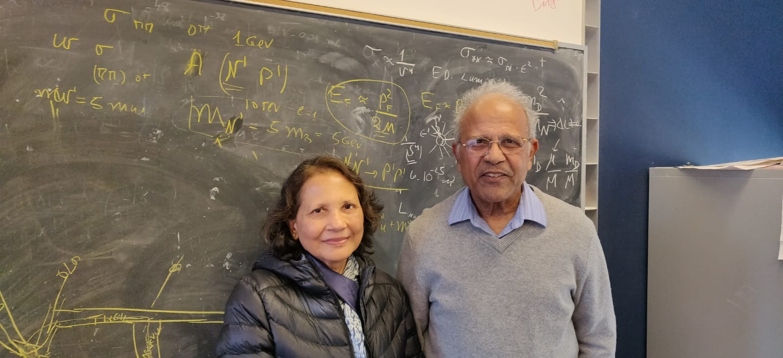
Manju Mohapatra

Slide 2
I want to thank you all from the bottom of my heart for celebrating Rabi. This is his celebration, but his students, postdocs, colleagues and collaborators have become a part of my life’s journey as well.
At any given point, I knew who Rabi’s students were because he loved to talk about them, and I had the opportunity to meet most of them. He often talked about his collaborators. Outside of home, that was his life, and slowly, I realized that they were incorporated into my life also through his talking.

Slide 3
Over a period of fifty years, I’m more familiar with Rabi’s physics community than in the community I’ve lived in. Some of the friendships became lasting. Gustavo and Salwa, Riccardo and Gabriella, Manfred and Roswita-these are friends whose houses we have visited multiple times. I fondly remember Goran, Dada and their daughter Natasha visiting us. In fact, my friendship with Mu-Chun and Michael formed when we were visiting Munich. I’ve met Antonio, Qaisar, Bhaskar and lots of Rabi’s other collaborators at various conferences. I’m not a physicist. Yet, physics has its own language in creating bonds.

Slide 4
Here at Maryland, each and everyone of you have a special place in our hearts. Wally, Jim, Jogesh, Raman, Chacko, Kaustubh, Babu, Haibo, Bhupal and their families, and the people who are not in Rabi’s group, are like family to us. In fact, everyone in this room, in some context or other- Rabi has told me about you. I’m really fortunate to meet you all. It has been an honor to be a part of this community.
I’m married to Rabi for more than fifty years. Yet, it is so touching to hear your kind words about him, his contributions not only to physics but to the finer aspects to be humane. Thank you all again.
By the way, this talk is a surprise for Rabi. With the help of Bhupal, Kaustubh and Ravi, I could manage to sneak it in.

