Slide 1
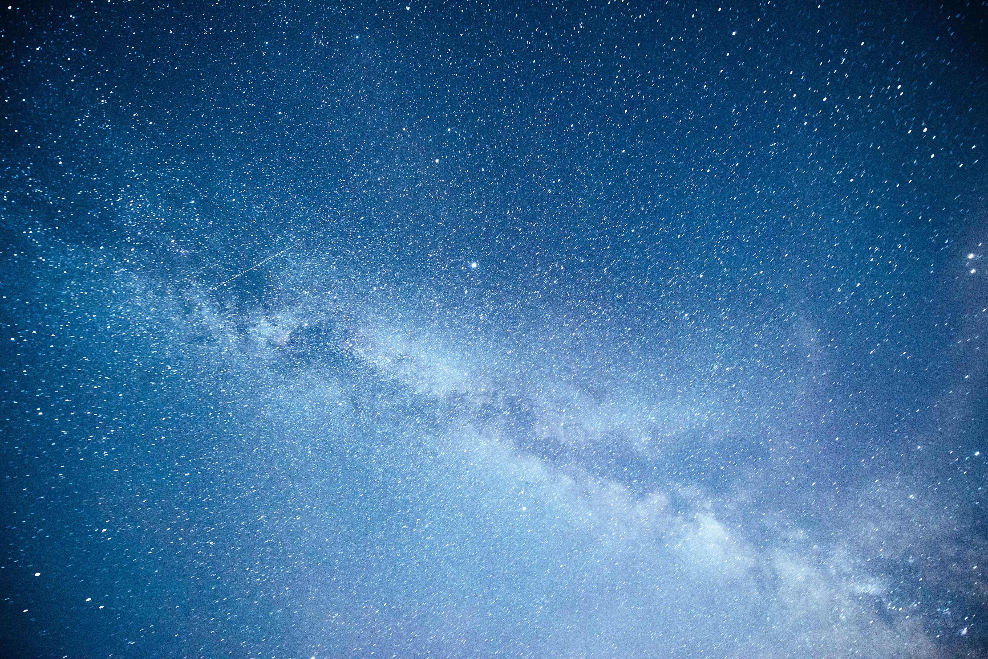



Leptophilic Z' model: Hubble tension and CMB constraints
Juan Arcila*, Andrés Castillo**, Héctor Hortua*, Leonardo Castañeda*
*Grupo de Gravitación y Cosmología, Universidad Nacional de Colombia
**Universidad Sergio Arboleda
CoCo 2o2o

Slide 2
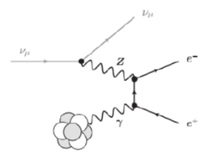





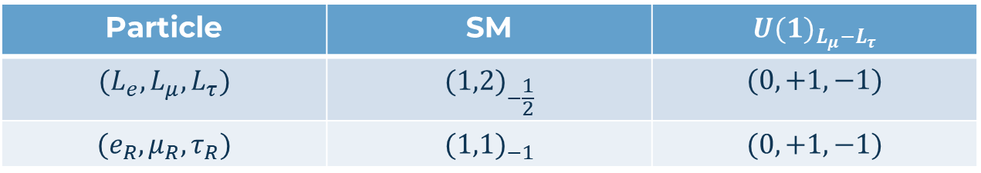






motivation and model building
Particle | SM | $${U(1)}_{L_{μ}−L_{τ}}$$
$$(L_{e},L_{μ},L_{τ})$$ | $${(1,2)}_{−\frac{1}{2}}$$ | $$(0,+1,−1)$$
$$(e_{R},μ_{R},τ_{R})$$ | $${(1,1)}_{−1}$$ | $$(0,+1,−1)$$
$$\sum_{α}{\left[2{\left(Q_{α}^{L}\right)}^{3}−{\left(Q_{α}^{R}\right)}^{3}\right]}−\sum_{N}{Q_{N}^{3}}=0$$
$${U(1)}_{Z′}^{3}$$
$$υ_{μ}$$
$$υ_{μ}$$
$$υ_{μ}$$
$$υ_{μ}$$
$$Z^{′}$$
$$τ^{−}$$
$$Z^{′}$$
$$μ^{−}$$
$$τ^{+}$$
$$μ^{+}$$

Slide 3
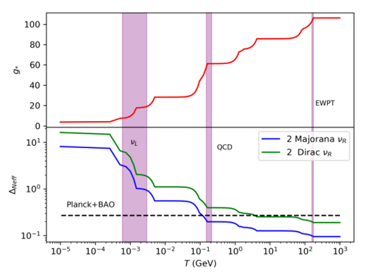

Δ$N_{eff}$ induced by Right-handed neutrinos
[1]
[2]

Slide 4
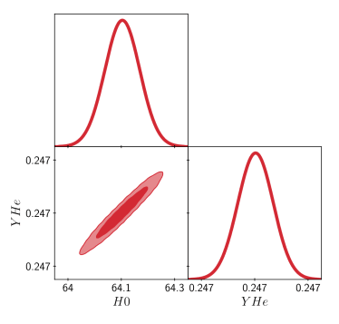
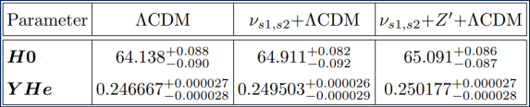
Effects of the model on the Hubble parameter
[3]

Slide 5
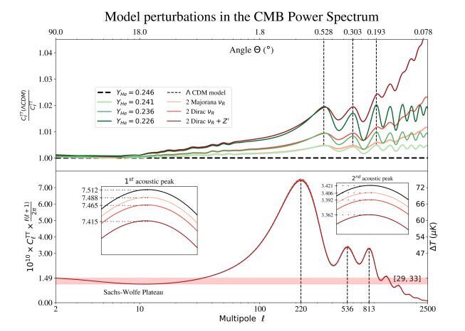
[5]
[4]

Slide 6


Conclusions
Deviations up to 2% from ΛCDM in the angular scales of approximately 0193°, 0.303°, 0.528°
Even number of Dirac neutrinos ruled out due to the experimental uncertainty reported for $N_{eff}$
$H_{0}$ parameter is modified by up to approximately 1.5%, getting closer to local astrophysics measurements

Slide 7


REMARKS and future work
How the massive regime of $ν_{R}$ impacts the Hubble parameter and the CMB matter-power spectrum?
The contribution of Z’ to ${ΔN}_{eff}$has to be extended to other accessible regions in the parameters’ space
It is expected that the effects of these model can be observed in LSST measurements, such as weak-lensing

Slide 8
references
Heeck J, Phys. Lett. B739 (2014) 256-262
N. Aghnaim et al. (Planck Collaboration), Planck 2018 Results. VI. Cosmological Parameters, arXiv: 1807.06209.
Audren, B., Lesgourgues, J., Benabed, K., & Prunet, S. (2013). J. Cosmol. Astropart. Phys, 2(001), 1210-7183
Diego Blas, Julien Lesgourgues, and Thomas Tram. Journal of Cosmology and Astroparticle Physics, 2011(07):034, 2011.
Sergei Bashinsky and Uros Seljak. Physical Review D, 69(8):083002, 2004
Thank you for your time

