Slide 1



Simulation of a Water Cherenkov Detector Response to the Background of Cosmic Rays at Pamplona Norte de Santander altitude (2300 m a.s.l.)for the LAGO Collaboration
Heidar Marcel Parada Villamizar
Undergraduate Physics Student
Co-Author: Mauricio Suárez Durán, Dr.
Department of Physics and Geology
University of Pamplona
1

Slide 2

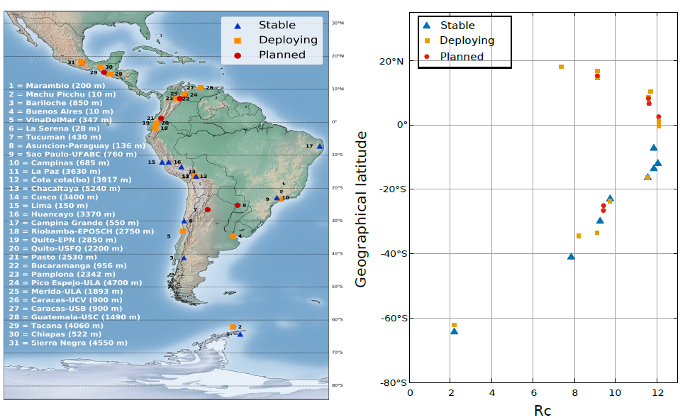
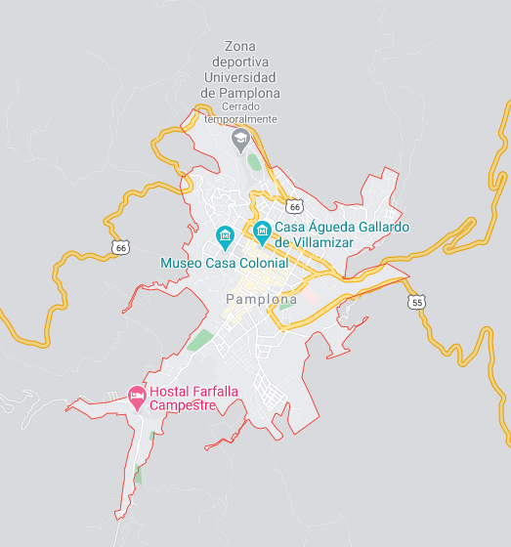
El Latin American Giant Observatory (LAGO)
2

Slide 3
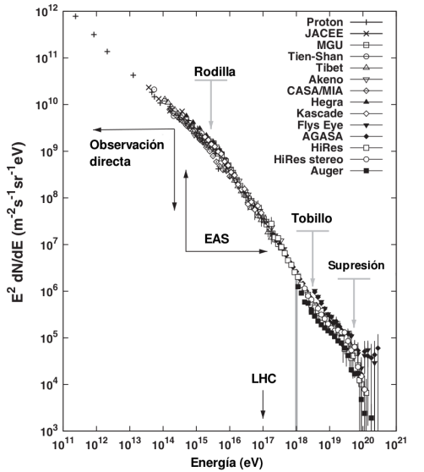
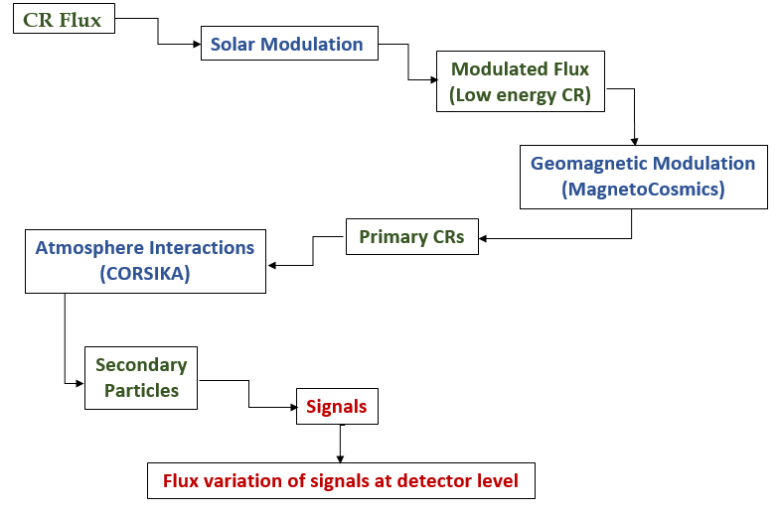
METHODOLOGY
Cosmic Ray Spectrum [1]
[1] Durán, M. S. (2015). Modulación de rayos cósmicos secundarios a nivel del suelo por cambios en el campo geomagnético (Doctoral dissertation, Tesis maestrıa, Universidad Industrial de Santander). Pg. 8
3

Slide 4
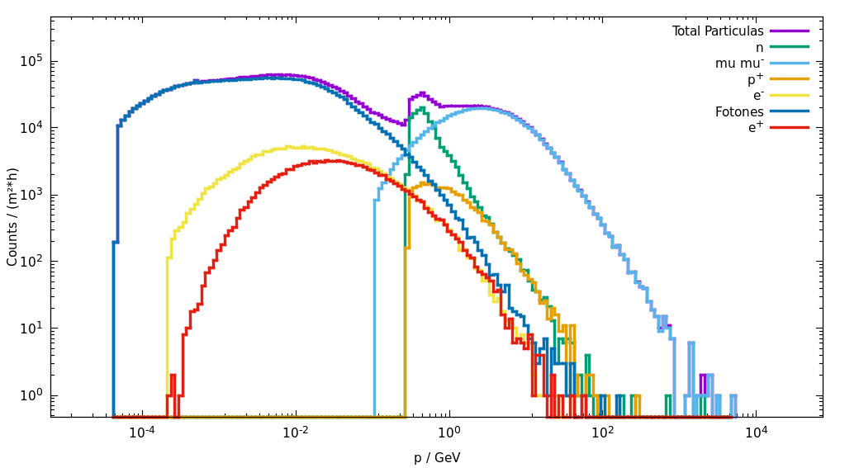
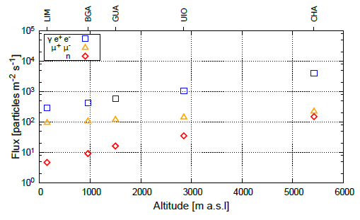
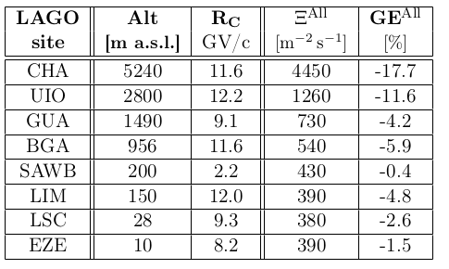
Preliminary Results
Photons: 1128,03 /(m^2*s)
Muons: 149,85 /(m^2*s)
Neutrons: 40,58 /(m^2*s)
[2]
[2]
[2] Sarmiento-Cano, C., Suárez-Durán, M., Calderón-Ardila, R., Vásquez-Ramírez, A., Jaimes-Motta, A., Dasso, S., ... & Asorey, H. (2020). Performance of the LAGO water Cherenkov detectors to cosmic ray flux. arXiv preprint arXiv:2010.14591. Pg. 6
4

Slide 5
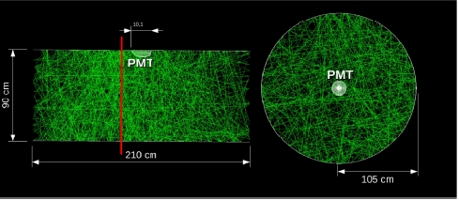
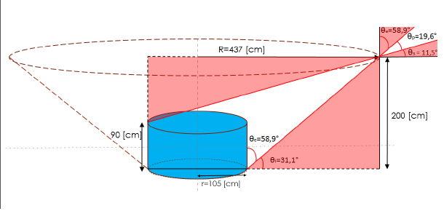
Preliminary Results
R=45cm; ; A=90cm; C=0.75
[3]
[3]
[
5
[3] Jaimes Motta, A. E. (2018). Estimacion De La Respuesta De Un Detector Cherenkov De Agua Al Fondo De Rayos Cosmicos En Bucaramanga (956 M SNM) (Doctoral dissertation, Universidad Industrial de Santander, Escuela de Física). Pg. 33, 39

Slide 6


THANKS
6

