Slide 1




Anisotropic Einstein Yang-Mills Higgs Dark Energy
Anisotropic Einstein Yang-Mills Higgs Dark Energy
J. Bayron O. Quintana
César A. Valenzuela-Toledo
Miguel A. Álvarez
Yeinzon Rodríguez
John Bayron Orjuela Quintana

Slide 2

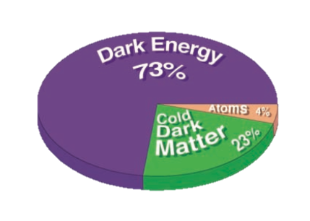
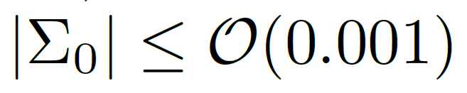
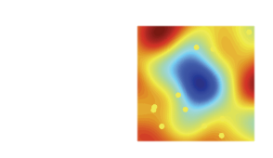
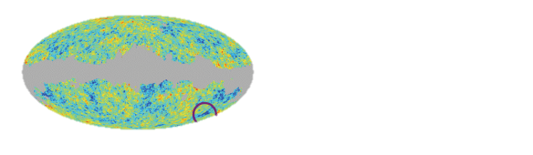
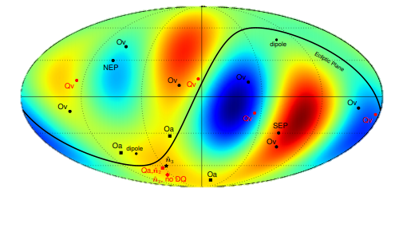
The Problems
1
ArXiv: 1510.07929 (Schwarz et al), 1012.5596 (Campanelli et al), 1802.04251 (Amirhashchi et al)

Slide 3
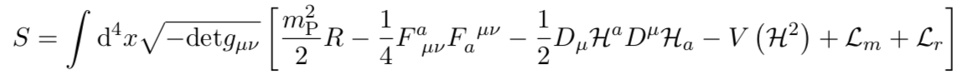
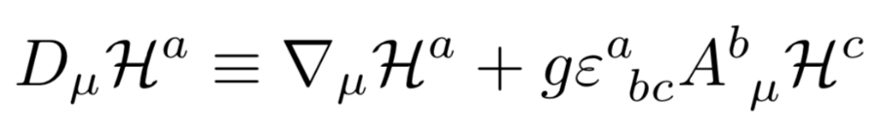
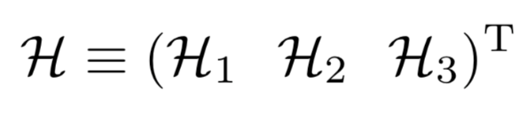
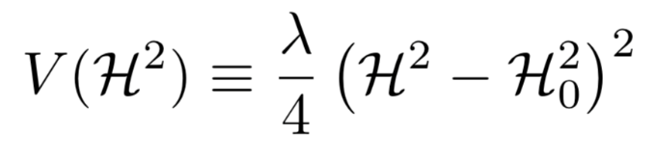
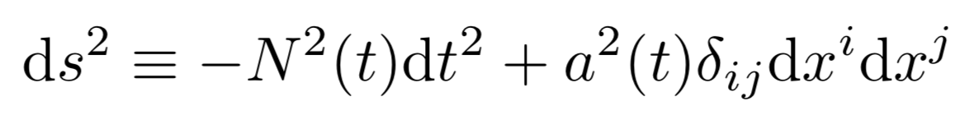
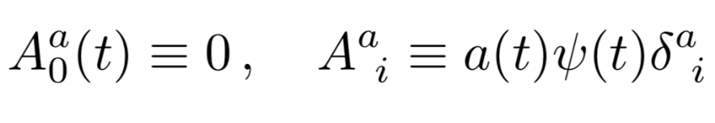
2
The Antecedents
Action
Covariant derivative
Mexican Hat Potential
FLRW Universe $→$ Homogeneous and Isotropic
Cosmic Triad
1508.04576 (Rinaldi).

Slide 4

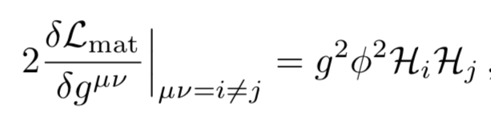
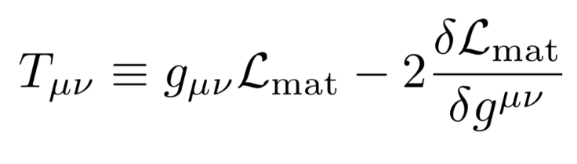
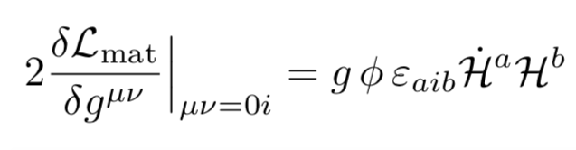

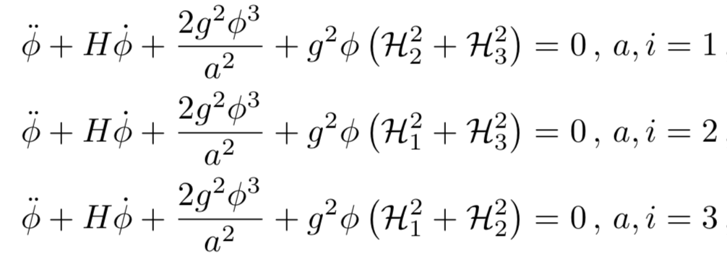
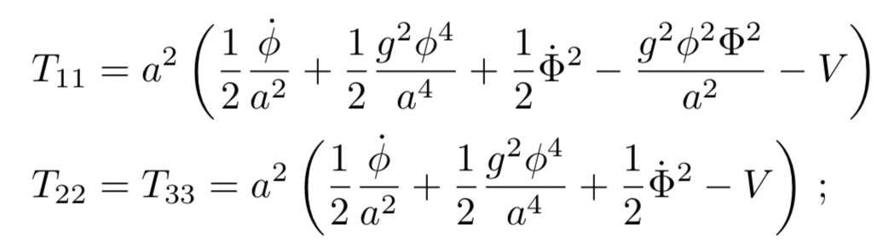
3
The Inconsistencies
Anisotropic Stress
Momentum Density
Different Behaviours

Slide 5
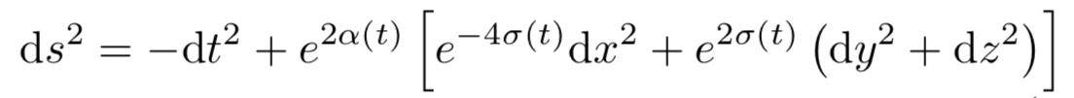

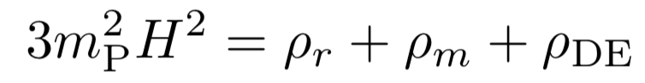
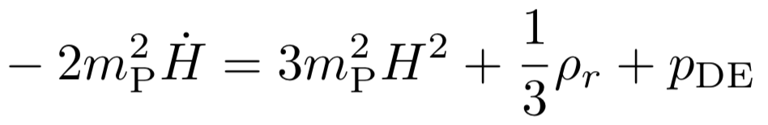


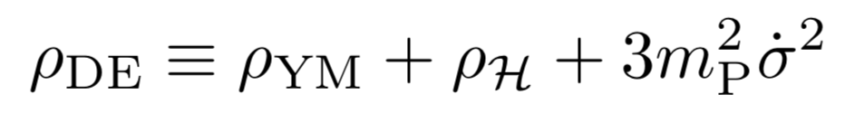
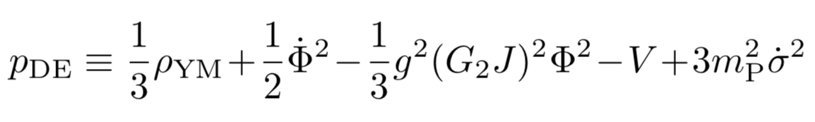
4
The Proposal
Bianchi-I
Dynamics

Slide 6
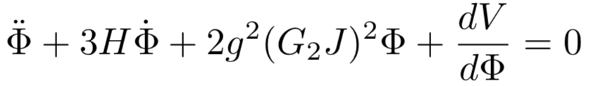
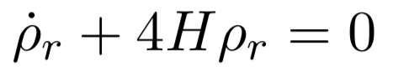
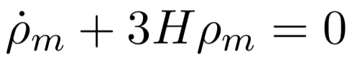
5
Equations of Motion
Equations of Motion
Continuity Equations

Slide 7
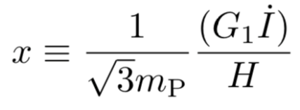
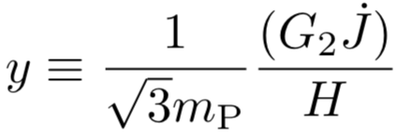
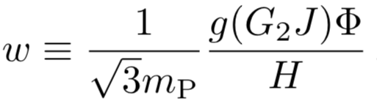
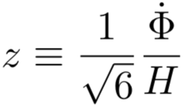
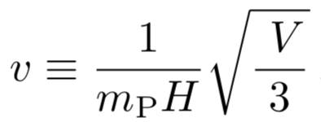
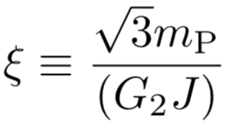
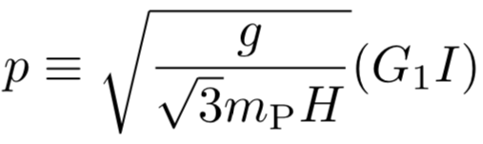
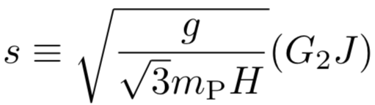
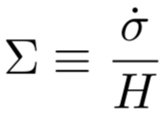
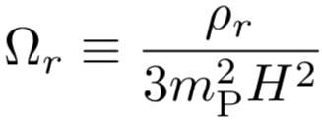
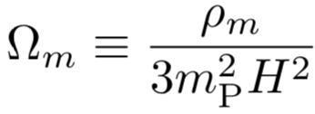
Dynamical System
6
Normalized Expansion Variables:
Fixed Points
Radiation - Saddle
Matter - Saddle
DE Attractor

Slide 8
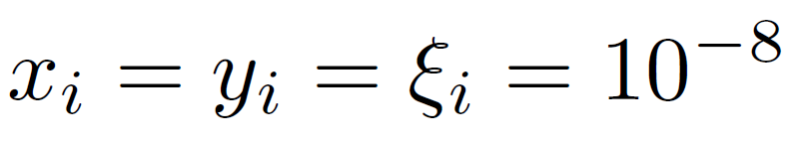
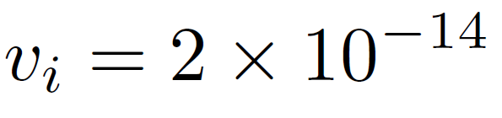
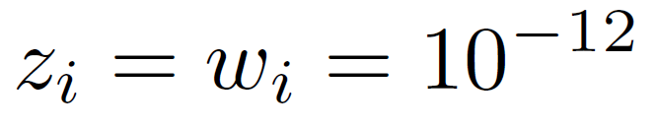
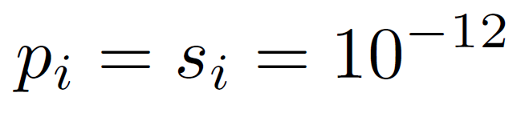
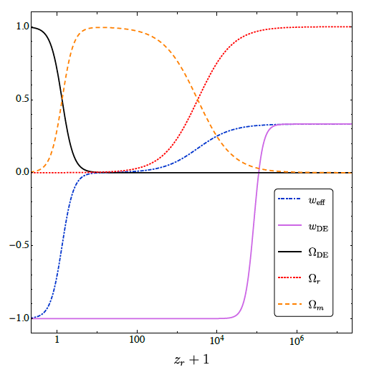
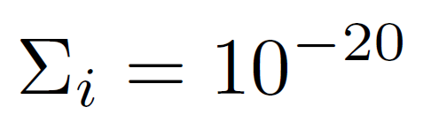
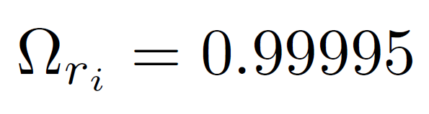
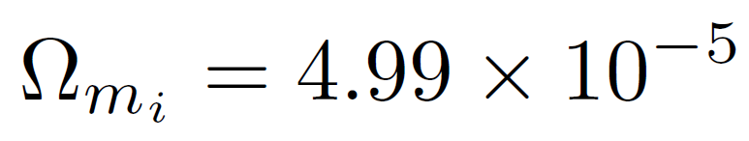

Numerical Analysis
7
FALTA GRAFICA RADIACION.
Initial Conditions
$$z_{r}≅6.566×10^{7}$$

Slide 9
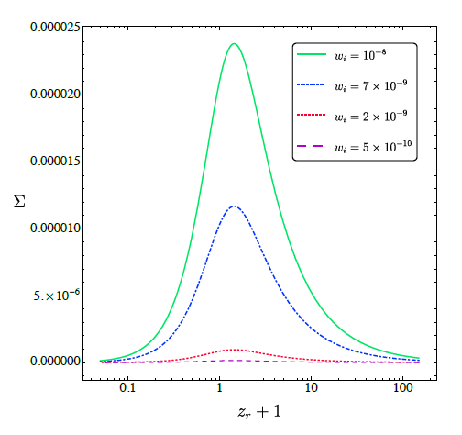
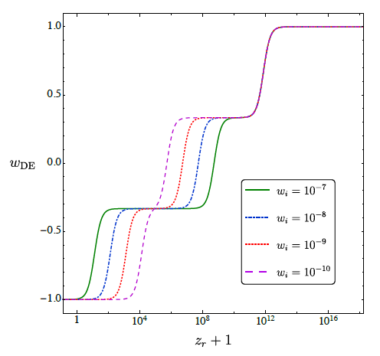
Anisotropy
Equation of State
8
Positive Eigenvalue
Effective Attractor!!!

Slide 10
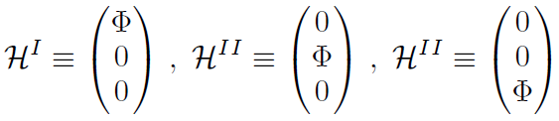









The “Higgs Triad”
9
Inspired in the “Cosmic Triad”
$$ℋ^{III}$$
$$ℋ^{III}$$
$$+$$
$$+$$
$$=$$
$$ℋ^{II}$$
$$ℋ^{II}$$
$$ℋ^{I}$$
$$ℋ^{I}$$

Slide 11

Conclusions
10
The reduced theory worked out in 1508.04576 (Rinaldi) is inconsistent with FLRW.
The anisotropic EYMH theory in $SO(3)$ reproduces the right expansión history.
Isotropic dark energy domination is the only attractor point.
The Universe can be anisotropic today.
The Universe can have hair although
it will lose it in the future.
The EYMH model can be compatible with FLRW $→$ “Higgs Triad”
Further details: 2006.14016 (Orjuela-Quintana et al)… Soonly available in JCAP.

Slide 12

Thank you!!!

