Slide 1
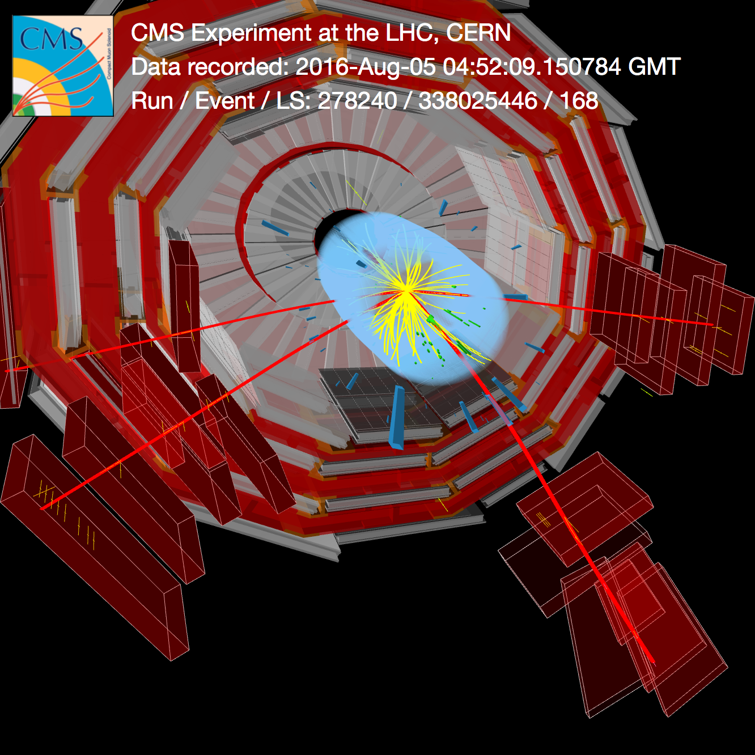

CMS RUN II HIGHLIGHTS
C. AVILA, UNIANDES

Slide 2

TALK OUTLINE
Introduction
2. Status of CMS Experiment
CMS Performance 2015-2018, 13 TeV
3. Highlights of run II Measurements, 13 TeV
Higgs Physics Results
Few BSM searches
( other three talks in this workshop covering other important topics:
- Searches for exotic signatures with the ATLAS detector: Gabriela Navarro
- Heavy favor physics in CMS: Jhovanny Mejia
- Searches for DM at the LHC: Andreas Albert)
4. Prospects for HL-LHC
5. Summary and conclusions

Slide 3
1. INTRODUCTION

Slide 4
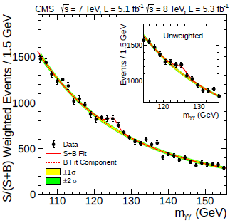
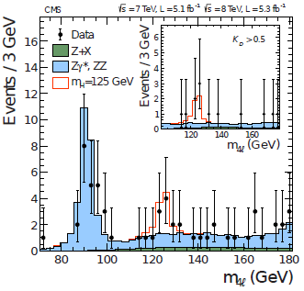
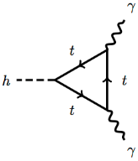

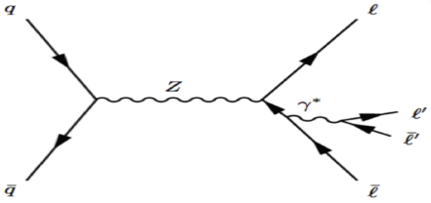
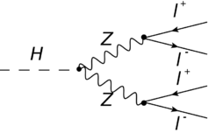
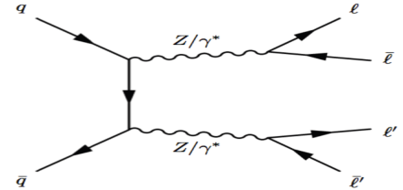
MAIN ACHIEVEMENT OF LHC RUN I : HIGGS BOSON DISCOVERY
H→ γγ
H→ZZ→4l (4μ, 2e2μ,4e)
Phys. Lett. B 716 (2012) 30
Discovery announced on July 4 2012 with ~ 10 fb⁻¹ of data.
Main Discovery channels: Full final states reconstructed.
Full kinematics info very important to reduce backgrounds.

Slide 5

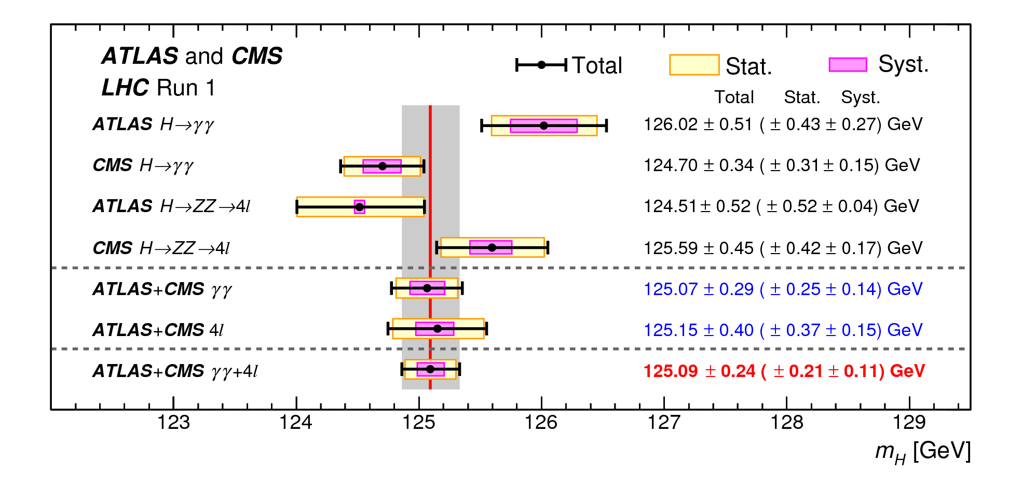
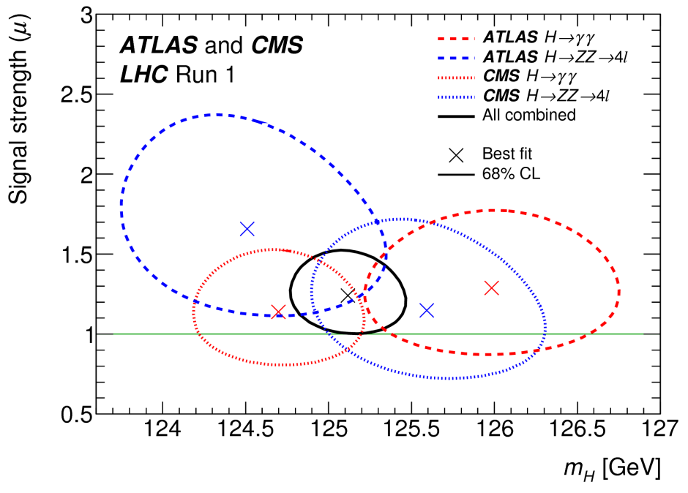
RUN I MASS MEASUREMENT
Combined measurement of ATLAS + CMS ( H→ γγ , H→ZZ )
Phys. Rev. Lett. 114 (2015) 191803
(H→ZZ->4l )_{ATLAS}
(H→ZZ->4l )_{CMS}
(H→γγ)_{CMS}
(H→γγ)_{ATLAS}
m_{H}=125.09±0.21±0.11 GeV
0.19 % Uncertainty, dominated by statistics

Slide 6
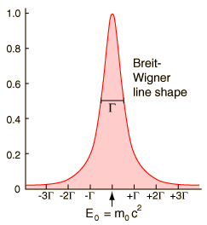
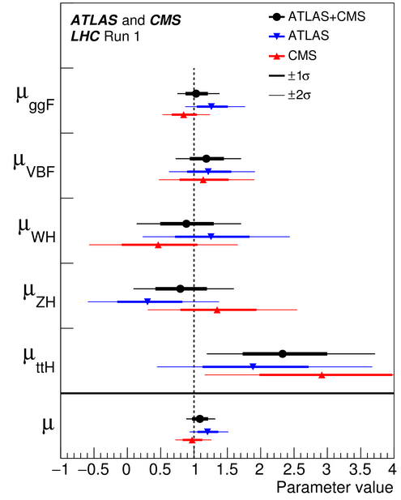
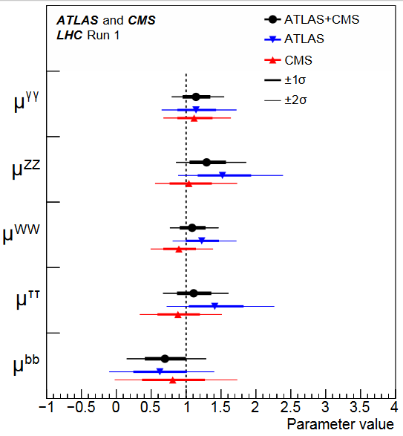
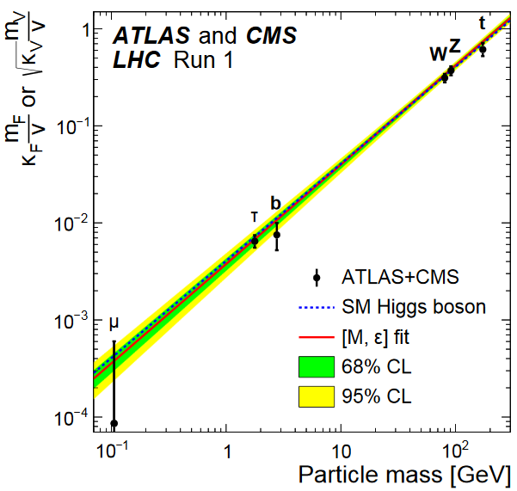
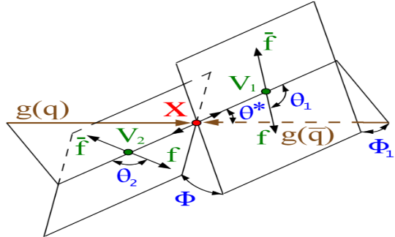

OTHER HIGGS PROPERTIES MEASURED WITH RUN I DATA
Higgs width (Γ_{H}SM ~ 4 MeV) from on-shell/off-Shell ZZ and WW production, combined ( JHEP 09 (2016) 051 ):
Lifetime (τ_{H,SM} = 16 x 10⁻⁸ fs) (Phys. Rev. D 92, 072010 (2015) ):
Signal strength : $μ=\frac{σ}{σ_{SM}}$ (JHEP 08 (2016) 045 )
Higss couplings (JHEP 08 (2016) 045 ):
SPIN-Parity (Phys. Rev. D 92, 012004 (2015) )
Γ_{H}< 13 (26) MeV at 95% CL
τ_{Η}<1.9x10⁻¹³ s 95% CL
μ_{PRODUCTION}
μ _{DECAY}
Data are compatible with 0⁺ within ~ 1σ

Slide 7
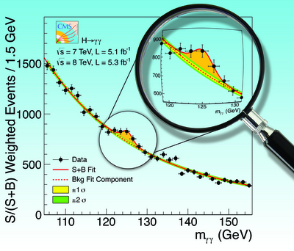
RUN I MEASUREMENTS OF HIGGS PROPERTIES
1. Mass ⎫
2. Width – Lifetime ⎫
3. Signal Strength ⎫
HIGGS PROFILE
AT LHC RUN I (~25 fb⁻¹)
4. Couplings ⎫
5. Spin – Parity ⎫
Fully compatible with SM, within uncertainties
All particles predicted by the SM are now experimentally confirmed.
Great success of the SM!
SM HIGGS

Slide 8
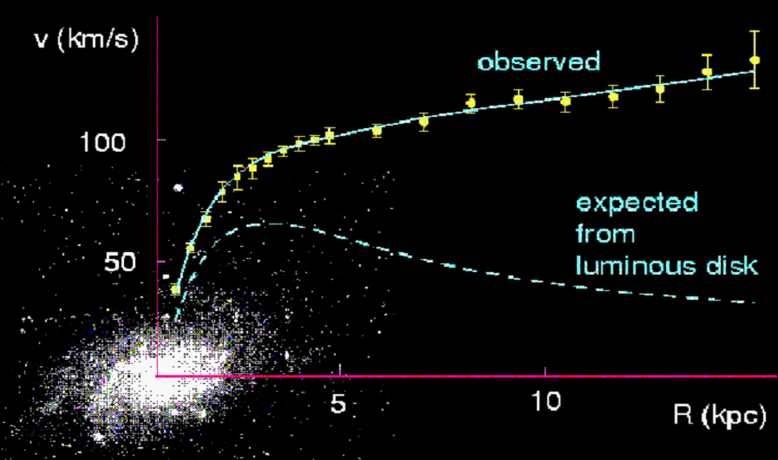
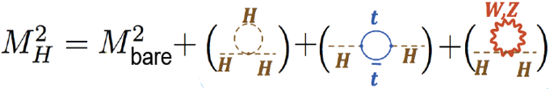
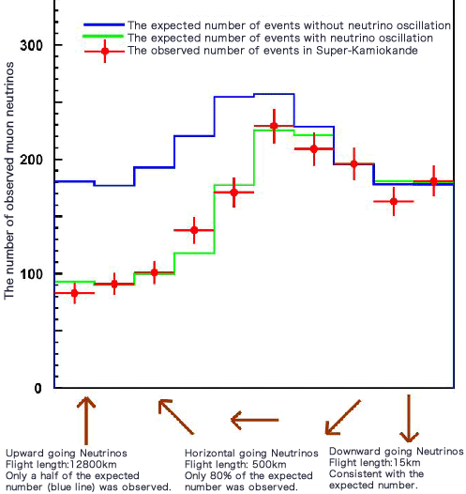
Despite all its success, the SM cannot be the complete story:
SM does not explain dark matter
Hierarchy problem: Loop corrections
to the Higgs Mass
SM does not explain mass of neutrinos
SM does not include gravity

Slide 9
MAIN GOAL OF THE LHC EXPERIMENTS: SEARCH FOR BSM PHYSICS
Strong physics motivation to search for signs of BSM at the TeV scale accesible to the LHC (natural SUSY, WIMP miracle, composite Higgs, etc.)
No clear guidance on the parameter space to search for. (i.e. MSSM has 124 unknown parameters → Huge parameter space).
LOOK FOR DEVIATIONS OF PRECISE SM PREDICTIONS
PRECISION MEASUREMENTS OF HIGGS PROPERTIES
SEARCH FOR BSM PHYSICS
DIRECT SEARCHES OF NEW PARTICLES AND FORCES

Slide 10
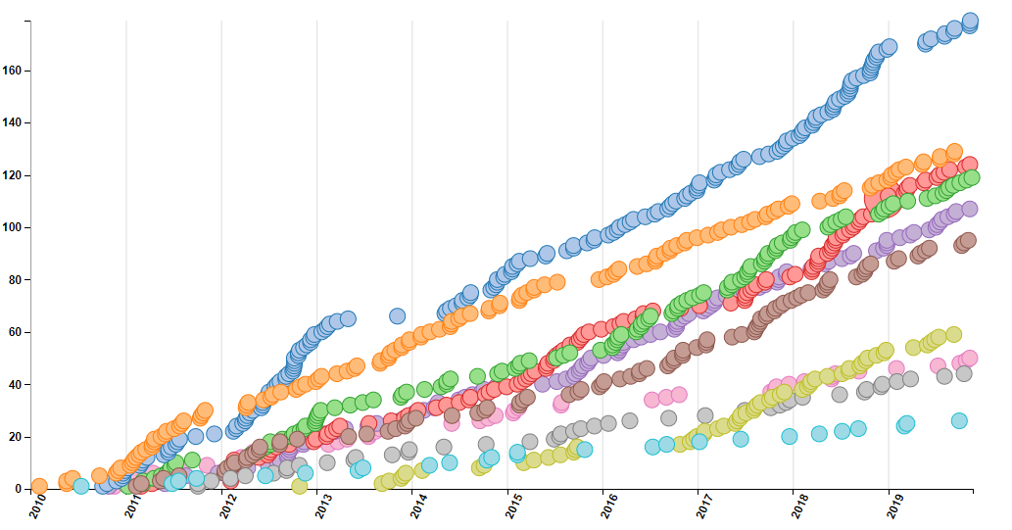
FOCUS OF THIS TALK:
CMS PUBLICATIONS
# CMS COLLIDER DATA PUBLICATIONS AS OF NOV-2019
More tan 934 publications as of november 29 2019. Imposible to sumarize all results in one single talk.
This talk summarizes some recent results on:
- Higgs Physics
- Searches : SUSY and Exotica
Three other talks in COMHEP 4, covering other topics:
- Searches for exo signls with ATLAS det.
- Heavy Flavor Physics
- Searches for DM at the LHC
EXOTICA
SM
HIGGS
SUSY
TOP
HEAVY
IONS
B2G
B
QCD
DP

Slide 11
2. STATUS OF CMS EXPERIMENT

Slide 12
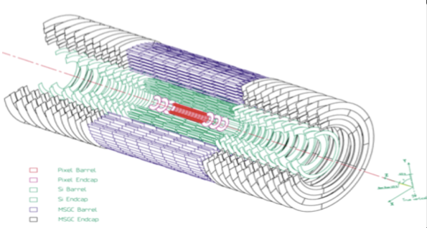
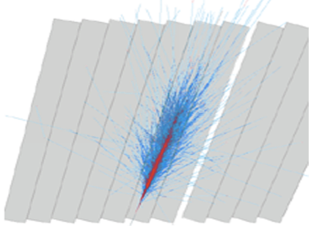
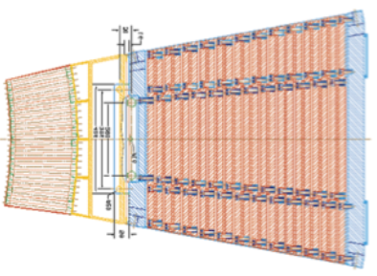
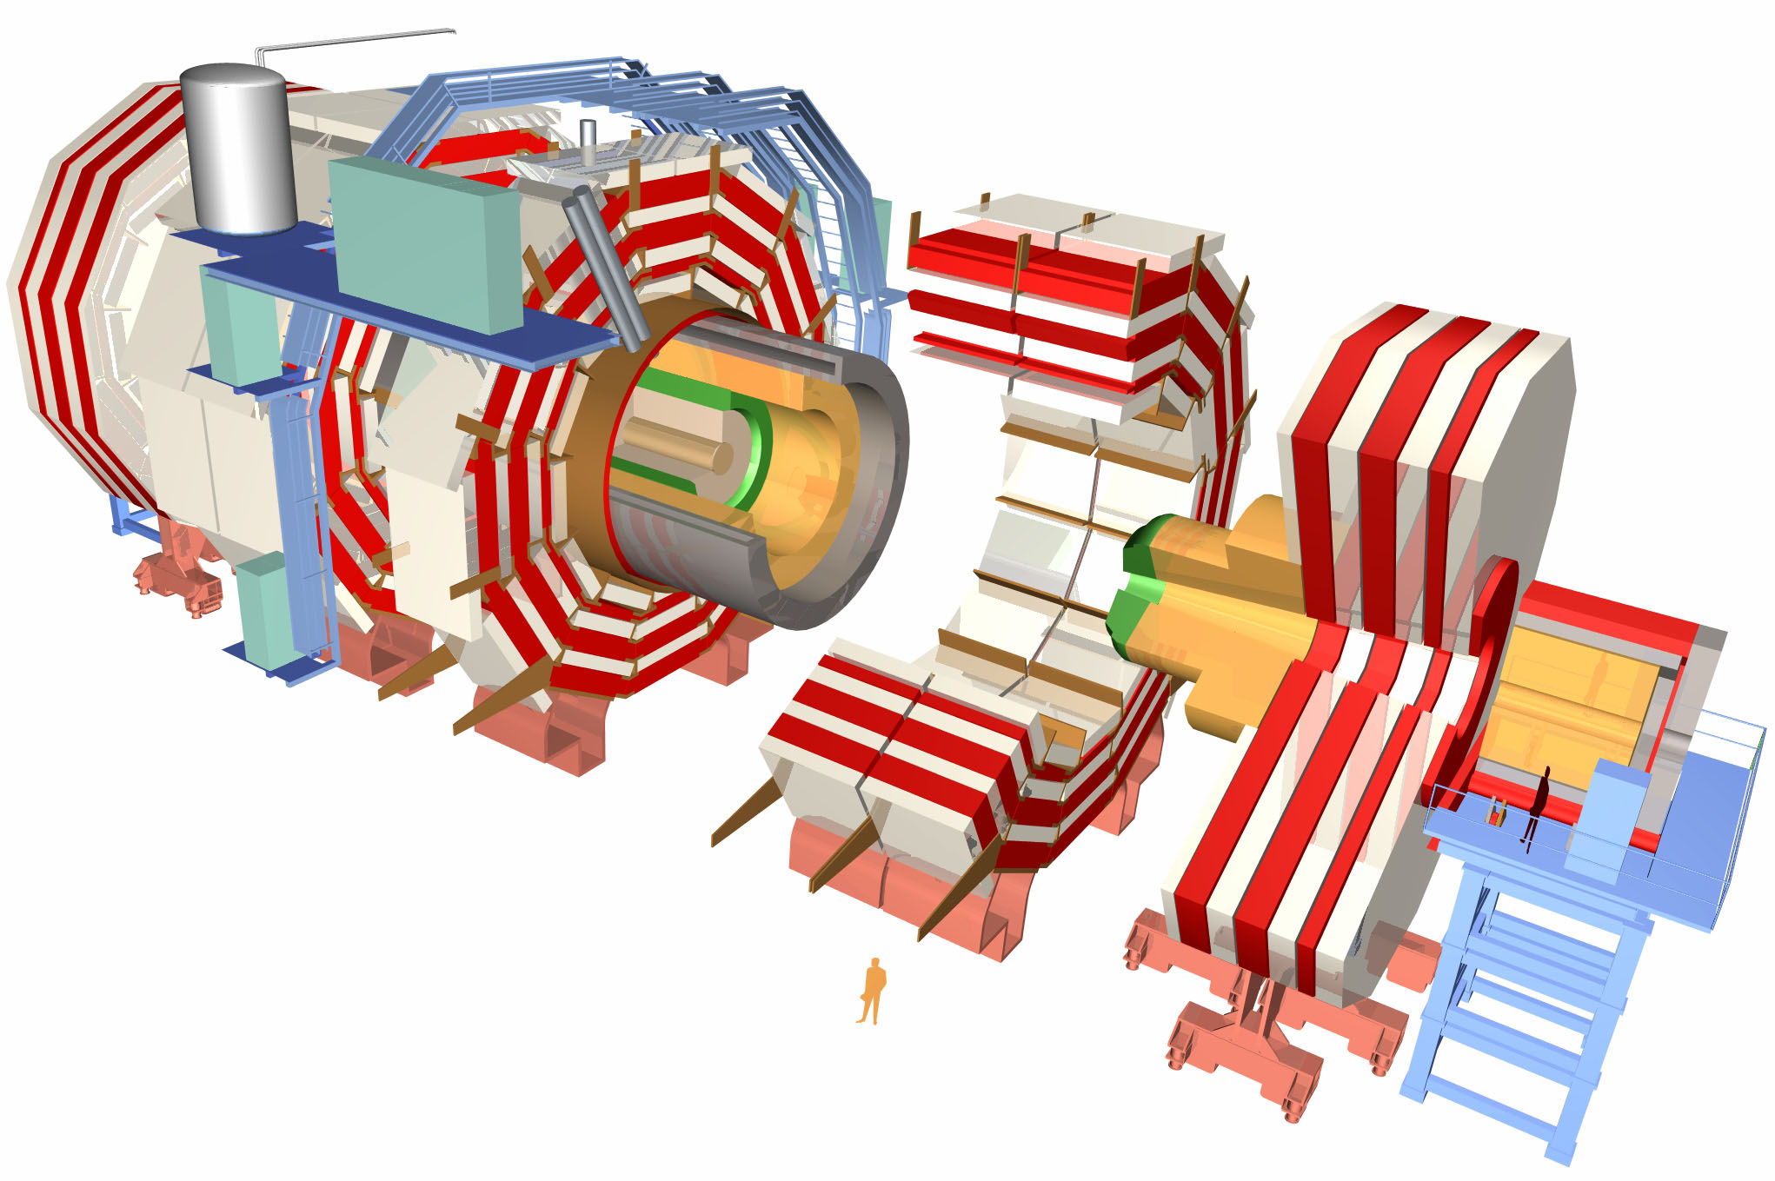
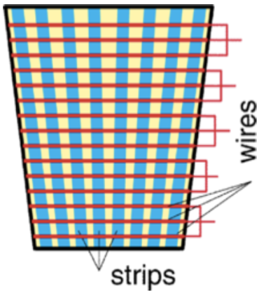
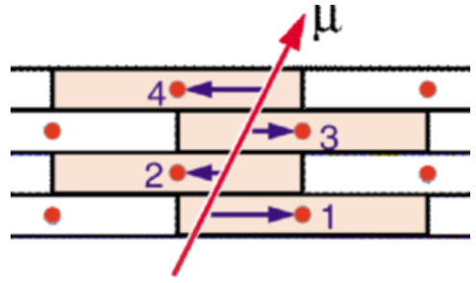
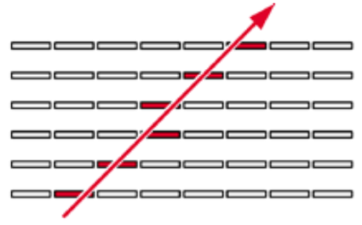
PbWO₄
Silicon Tracker
Electromagetic
calorimeter
Hadronic calorimeter
Superconducting
Solenoid
Iron Yoke
Muon barrel
chambers
RPC´s, CSC´s
Muon endcap
chambers
DT´s
RPC´s

Slide 13
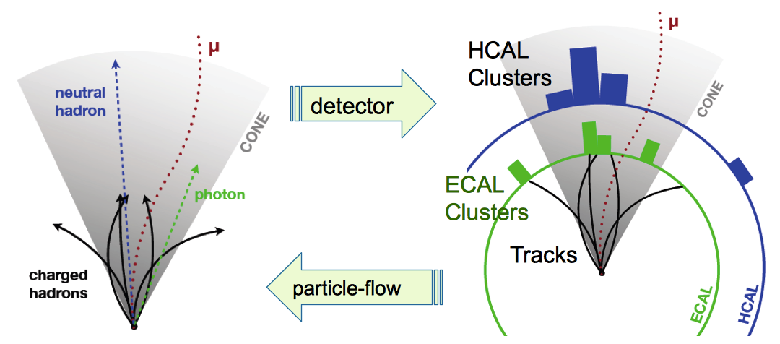
Particle Flow
Combine info from all subsystems to generate a list of reconstructed particles to descrcibe the entire event
Find μ´s and remove
Find e´s and remove
Find charged hadrons and remove
Find photons and remove
Find neutral hadrons and remove
A large B field, good calorimeter granularity and high resolution tracking are needed for efficient PF.
  e,μ,γ, charged and neutral hadrons
    Used in the event as a list of generated particles in the event.
    Used to reconstruct jets, taus, missing energy, isolation and identification of particles in multiple proton-proton collisions.
Notes:
13

Slide 14
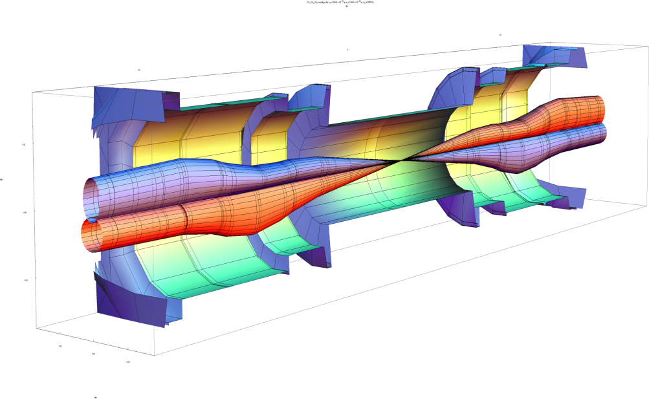
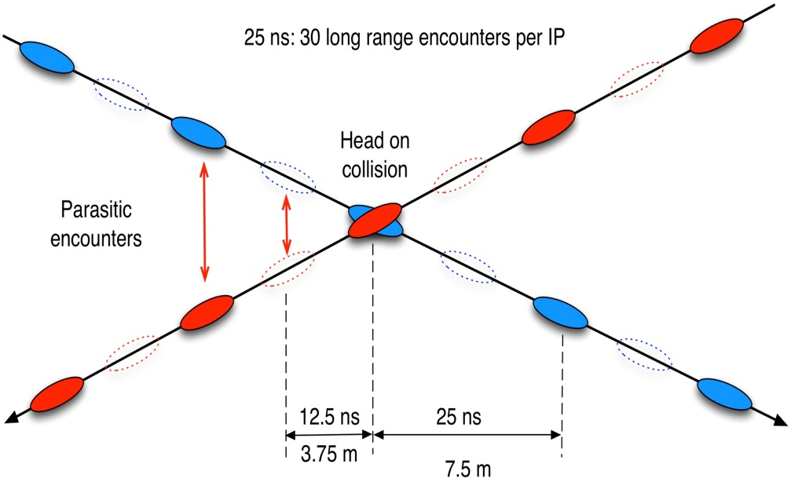
Achieving High Luminosity
f_{rev} is determined by accelerator radius = 11246 HZ for LHC
Increase number of bunches, n_{b}, in the accelerator, 2808 for LHC
Increase number of protons in the bunches, N₁, N_{2,} ~10¹¹
Minimize the beam size at the collision point,
Improve geometric factor F ( beam offsets and crossing angles)
Improve machine efficiency : reduce dead time between beam injection, etc.

Slide 15
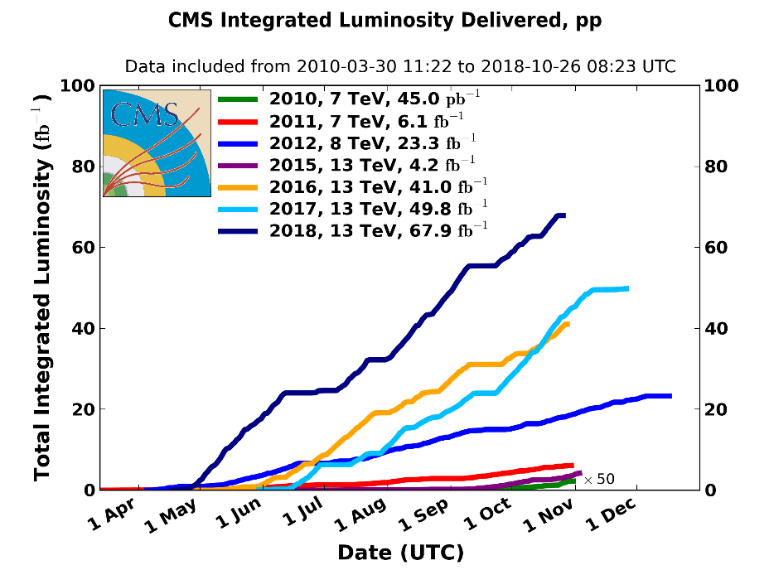
LHC PERFORMANCE
3 years of sustained high luminosity at 13 TeV
>50% of the time in stable operation
2018 maximum peak luminosity ~2x10³⁴ cm⁻² s⁻¹ with mean pileup ~ 38
→ twice the design lumi.
Rapid turn-around between fills (5 hours typical, ~2 hours record)
L_{RUN II} ~ 159fb⁻¹
L_{RUN I} ~ 30fb⁻¹

Slide 16
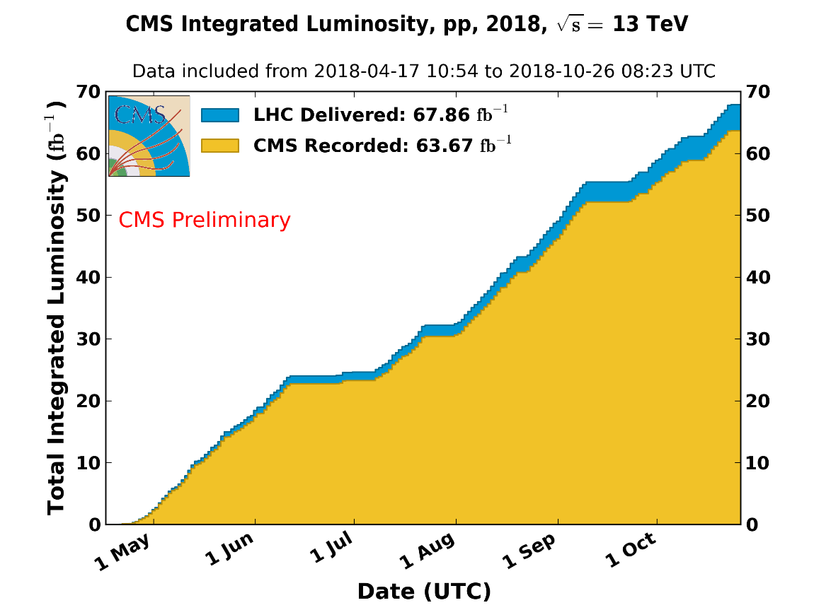
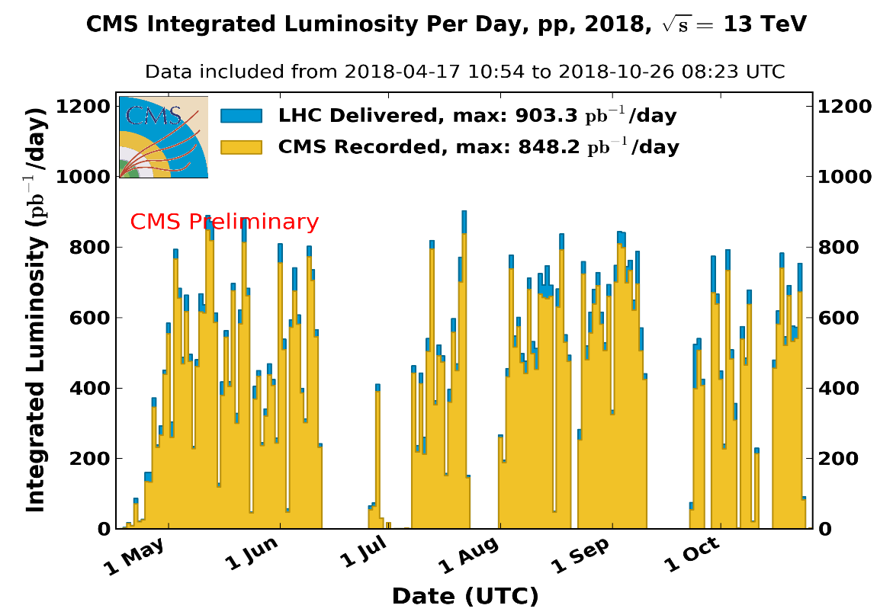
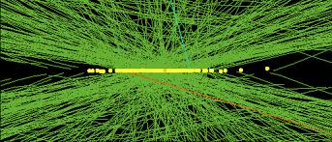
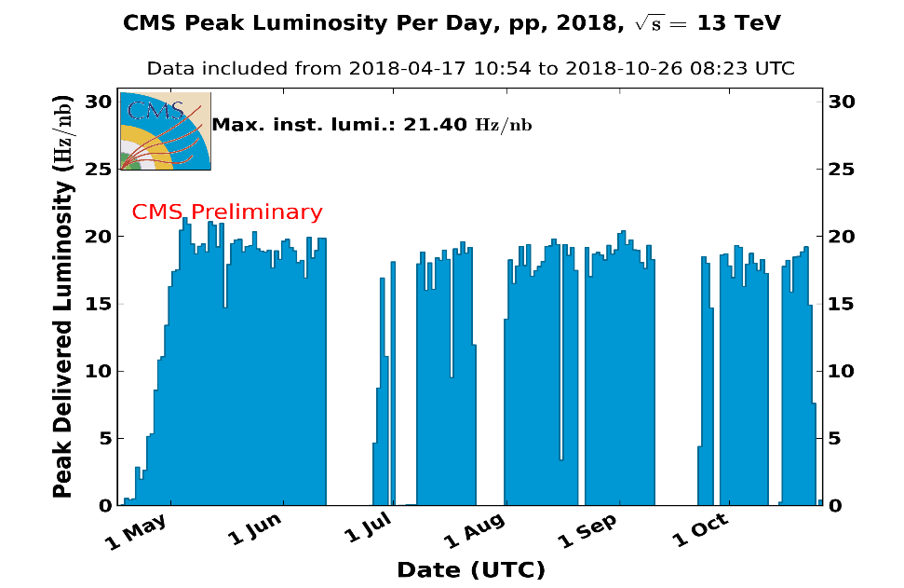
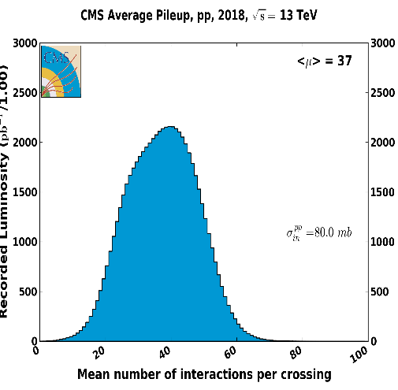
CMS LUMINOSITY
94% EFFICIENCY
CMS could record 0.8 fb⁻¹ in a single day.
Mean pileup
37 pp collisions/B-xing
Peak lumi ~ 1.8x10³⁴ cm⁻²s⁻¹

Slide 17
3. PHYSICS RESULTS AT 13 TeV
Higgs Physics Results

Slide 18
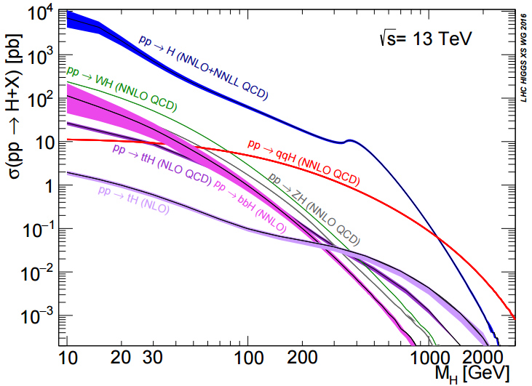
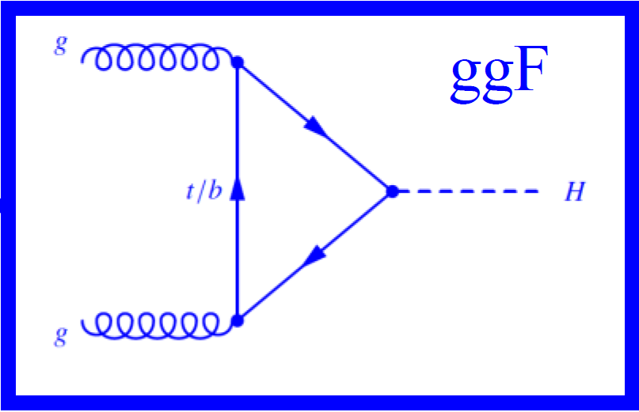
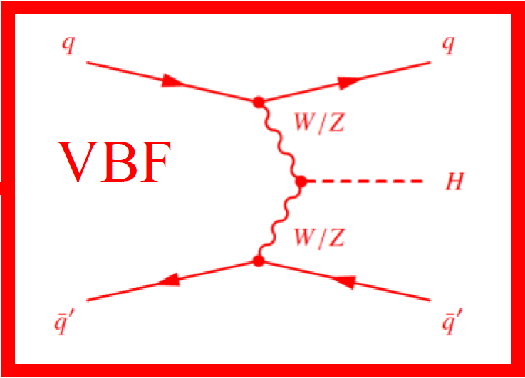
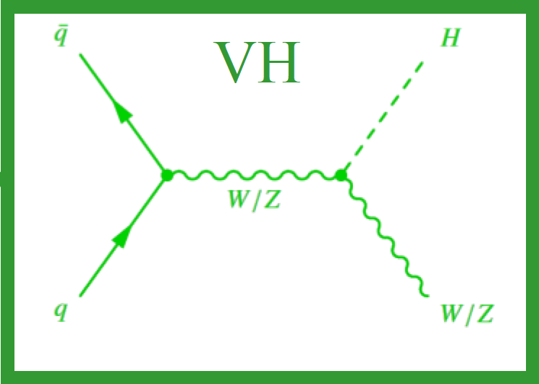
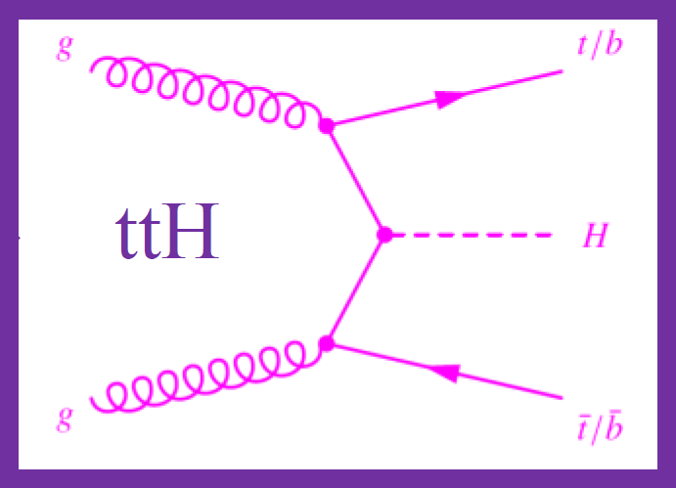
SM HIGGS CROSS SECTIONS
arXiv:1307.1347v2
~87%
~7%
~4%
~2%
m_{H} = 125 GeV

Slide 19
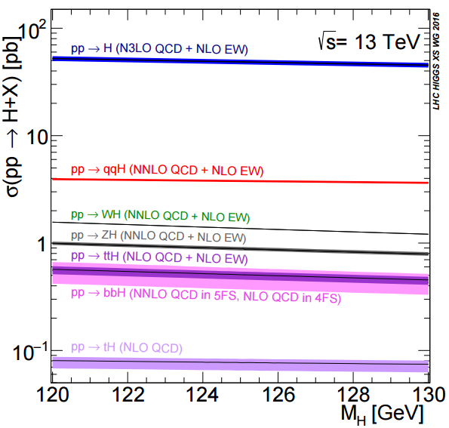
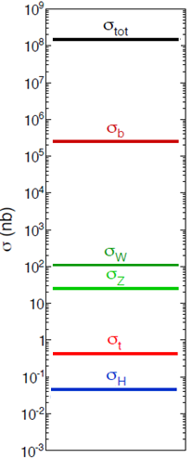
SM HIGGS CROSS SECTIONS
pp x-sections
σ=48.6 pb
2 Higgs produced every 10⁹
pp collisions
σ=3.75 pb
σ=1.38 pb
L_{RUN} _{II} = 150 fb⁻¹
~ 8.5 M Higgs
produced in RUN II
σ=0.87 pb
σ=0.51 pb
σ=0.49 pb
σ=0.07 pb
~0.5 M Higgs produced in Run I, L= 25 fb⁻¹
m_{H} = 125 GeV

Slide 20
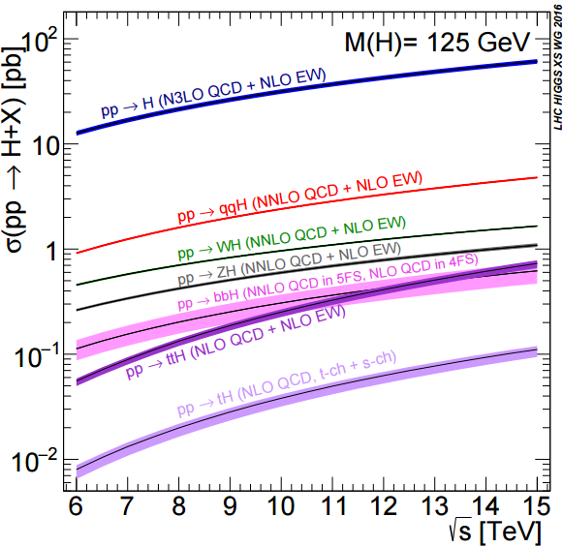
HIGSS CROSS SECTIONS VS ENERGY
process | σ[pb] 8 TeV | σ[pb] 13 TeV | ratio
ggF | 19.3 | 48.6 | 2.5
VBF | 1.58 | 3.75 | 2.4
WH | 0.705 | 1.38 | 2.0
ZH | 0.415 | 0.870 | 2.1
ttH | 0.129 | 0.509 | 3.9
bbH | 0.204 | 0.488 | 2.4
63% increase in energy→
>200% increase in cross section
RUN I (2011-2012)
RUN II (2015-2018)

Slide 21
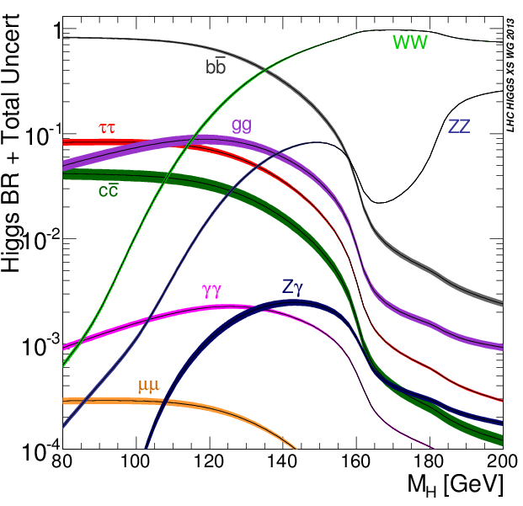
SM HIGGS DECAYS
m_{H}= 125 GeV
arXiv:1307.1347v2
Decay | BR(%)
H→bb | 57.7
H→WW | 21.5
H→ττ | 6.3
H→ZZ | 2.6
H→ γγ | 0.23
H→ Zγ | 0.15
H→μμ | 0.02
H→gg | 8.6
H→cc | 2.9
H→ss | 0.02
Main
Decay
Channels
H→ γγ
H→ZZ
H→WW
H→ττ
H →bb
H→ Zγ
H→μμ
m_{H}= 125 GeV

Slide 22
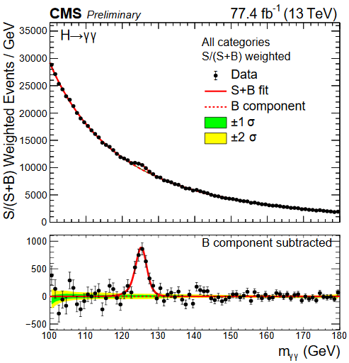
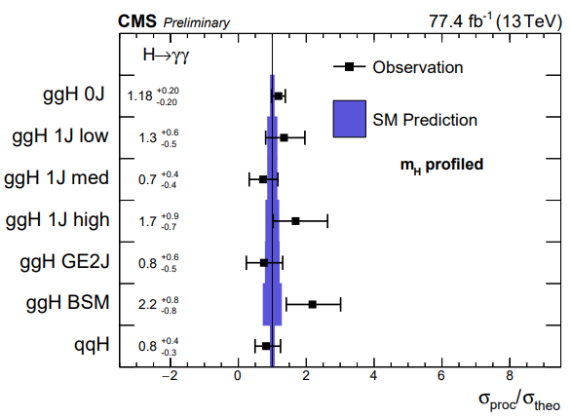
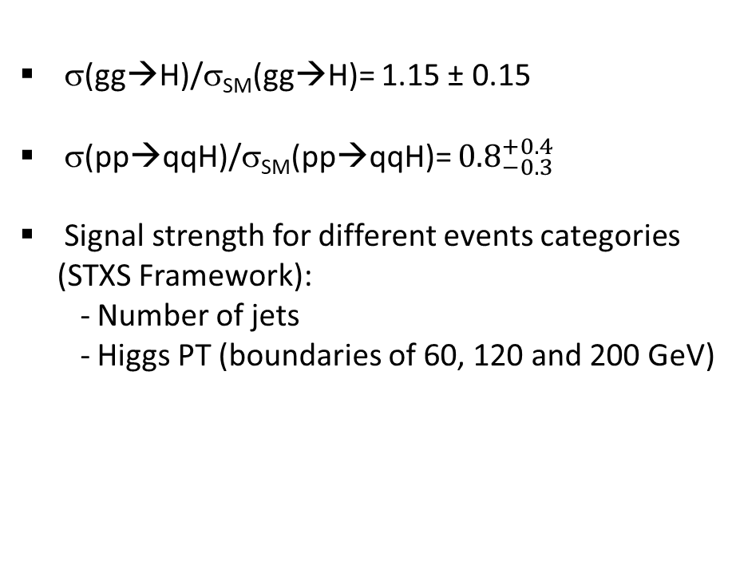
H→ γγ
CMS PAS HIG-18-029
σ(gg→H)/σ_{SM}(gg→H)= 1.15 ± 0.15
σ(pp→qqH)/σ_{SM}(pp→qqH)= ${0.8}_{−0.3}^{+0.4}$
Signal strength for different events categories (STXS Framework):
- Number of jets
- Higgs PT (boundaries of 60, 120 and 200 GeV)

Slide 23
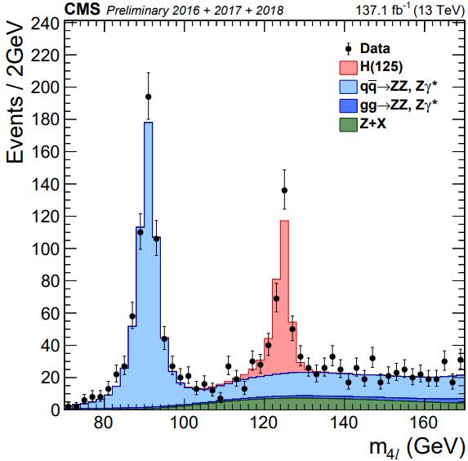
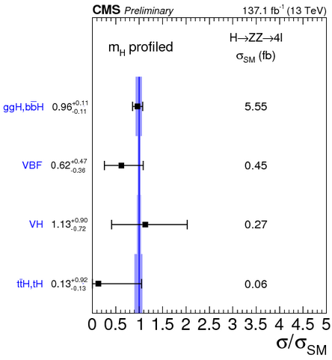




H→ZZ→4l (4μ, 2e2μ,4e)
CMS-PAS-HIG-19-001
Strategy:
Extract signal strength for each category
Combine in terms of production channel
Combine for inclusive result
$σ_{fid}={2.73}_{−0.22}^{+0.23}{\left(stat\right)}_{−0.19}^{+0.24}\left(syst.\right)$ fb
$σ_{SM}^{fid}=2.76±0.14$ fb
$μ={0.94}_{−0.07}^{+0.07}{(stat)}_{−0.07 (stat)}^{+0.08}$

Slide 24







Recent Discovery : ttH
PRL 120 (2018) 231801
ttH observed with run I (7 TeV+ 8 TeV) + 2016 (13 TeV) data
H→ WW, H→ ZZ, H→ ττ, H→bb, H→ γγ combined together to maximize sensitivity
Background prediction based on data (control regions) if possible
Reduction of backgrounds using multivariate analyses (MVAs)
first confirmation of the tree-level coupling of the Higgs boson to top quarks
Important way to access yt (t Yukawa coupling): top quarks not produced in Higgs decay because of their mass
$$μ={1.26}_{−0.36}^{+0.31}$$

Slide 25



Recent Discovery : (V)H→ bb
PRL 121 (2018) 121801
It has the biggest branching fraction but huge QCD backgrounds (~10³ times the signal in this mass region) → Choose a weak interaction production mode to reduce hadronic backgrounds (QCD multijet, top).
Advantage of VH: clear signature due to additional V (using 0, 1 or 2 leptons + 2 b jets)

Slide 26



(V)H→ bb : COMBINATION OF RUN I AND RUN II DATA
VH(bb) from 2016/17 at 13 TeV, 77.2 fb⁻¹
  Significance: 4.4 σ obs (4.2 exp)
VH(bb) including also 7 and 8 TeV
  Significance: 4.8 σ obs (4.9 exp)
Including new results and all published data from Run 1 and Run 2
  Run 1:
    ttH(bb): 5 fb⁻¹(8 TeV) + 19.8 fb⁻¹ (13 TeV)
    VBF, H→bb: 19.8 fb⁻¹ (8 TeV)
    VH, H→ bb, 5 fb⁻1 (8 TeV) + 19.8 fb⁻¹ (13 TeV)
  Run 2:
    ttH(bb), leptonic channels (2016)
    ttH(bb), hadronic channels
    Boosted ggH, H→ bb (2016)
    VH, H→bb (2016 + 2017)
$$μ= {1.04}_{−0.19}^{+0.20}$$
5.6 (5.5) σ observed (expected) for all H→bb

Slide 27



H → μ⁺μ⁻
CMS-HIG-17-019
Best chance at measuring a coupling to a second generation fermion, although branching fraction (BR) ~ 2.2x10⁻⁴, about 10% of γγ.
CMS has looked for this in 7, 8, and 13 TeV (2016 only) data
Current 95% CL upper limit on BR is
5.7x10⁻⁴, 2.64 X BR_{SM} (observed) vs 2.08 X BR_{SM} (expected).

Slide 28






HIGGS BOSON PAIR PRODUCTION
PRL 122 (2019) 121803
Access to the Higgs boson trilinear coupling can be obtained by measuring the production of pairs of Higgs bosons (HH) at the LHC.
$σ_{HH}^{SM}≈33.5 fb$
signal
Background
Constraining coupling modifier $κ_{λ}=λ_{HHH}/λ_{SM}$
Not yet close to SM sensitivity, limited by statistics.
Most sensitive channel (CMS): bbγγ despite low BR=0.13%
→ Combine several channels (bbγγ + bbττ+bbbb+bbVV) to become more sensitive

Slide 29
3. PHYSICS RESULTS AT 13 TeV
Few BSM searches

Slide 30




Why to searh for supersymmetry?
It solves many of the SM problems, among them:
SUSY SOLUTION:
Increase the SM particle spectra
1. SM Higgs Mass Hierarchy problem:
2. Unification of gauge couplings :
3. Dark Matter:
In R parity conserved models: LSP is the DM candidate particle. In most of RPC models:
|${\tilde{χ}}_{1}^{0}$> =|DM>=|WIMP>
SUSY particles produced in pairs
$$R={\left(−1\right)}^{3\left(B−L\right)+2S}=\left\{\begin{matrix}+1 for SM particle \\ −1 for SUSY particle\end{matrix}\right.$$
arxiv:9709356
MSSM is the supersymmetric extension of the SM with minimal number of particle states = twice SM # particles + extended Higgs sector. SUSY partners for gauge bosons mix as charginos (${\tilde{χ}}_{1}^{±}$, ${\tilde{χ}}_{2}^{±}$ ) and neutralinos (${\tilde{χ}}_{i}^{0}, i=1,..,4)$

Slide 31

SUSY CROSS SECTIONS
Strong-production channels
• copious production at hadron colliders
• MET-based generic channels
Third-generation sparticles
• naturalness ➜mass of O(<TeV)
• lighter than other squarks
Electroweak production
• coloured spartners too heavy
• direct gaugino/slepton production
• relevant for dark matter searches
RPC or RPV
• RPC ⇒ more leptons/jets and less MET
• RPV → prompt or delayed LSP decay

Slide 32




Data interpretation Frameworks
A major difficulty with the MSSM:
Huge parameter space: 124 parameters
arXiv:1908.09672
LHC DM W.G.
Two possibilities to overcome this issue:
Efective Field Theories
Simplified Models
SIMPLIFIED MODELS (Adopted for LHC searches):
Emphasize features of a broad set of models
Drives phenomenolgy for model independent searches
Usually concéntrate in one specific decay chain:
EFECTIVE FIELD THEORIES
Contact interaction between SM and DM particles
Few parameters
Model independent searches
Valid only for Q² << M_{mediator}
→ Issue for LHC

Slide 33
Typical SUSY Search
• Signal region (SR)
▫ may be single-bin (“cut & count”) or multibin
▫ optimised for best discovery in targeted productioon/decay mode
▫ to cover different mass hierarchies ➜few SRs for each final state
• Data-driven background estimate
▫ irreducible backgrounds estimated using control region (CR) data as a
constraint and Monte Carlo to extrapolate from CR to SR
▫ reducible background (fake/non-isolated leptons, MET from jet
mis-measurement) from data
▫ validation regions (VR) to check background estimate method and
CR→SR variable modelling
• Likelihood fit of data in SRs and CRs
▫ hypothesis testing of signal models ➜95% CL cross-section upper limits
▫ background versus data ➜model-independent upper limits at 95% CL

Slide 34





JHEP (2019) 2019: 244
Squarks & gluinos: 0L + jets + MET
• Events with no isolated lepton (e/μ) in the final state
-→ rely on high MET and hadronic activity.
• Various strategies:
multibin SRs: shape of jet-related variables,
e.g. $m_{eff}=\sum_{jets}{P_{T}^{j}}$
b) Boosted Decision Tree (BDT) trained against SM
c) split events into two pseudojets and compute MT2(j1; j2)
d) use MHT = $\left\|−\sum_{jets}{{\vec{P}}_{T}^{j}}\right\|$
CMS-PAS-SUS-19-005

Slide 35




Same-sign 2 Leptons & 3 Leptons
Targets leptonic decay signals (including R-parity violation)
▫ limited SM (irreducible) same-sign lepton backgrounds
▫ reducible detector backgrounds non negligible:
fake/non-prompt leptons, electron charge
flip, ... ➜estimated from data
CMS-PAS-SUS-19-008

Slide 36






Stop searches
Different analysis strategies depending on the mass difference : $Δm=m_{\tilde{t}}−m_{χ_{1}^{0}}$
Compressed regions studied with ISR jet.
OVERLAID CONTOURS ARE FROM DIFFERENT PROCESSES

Slide 37




VBF Electroweakinos
VBF selection: jet candidates with the following requirements
large eta separation
in opposite hemispheres
large dijet invariant mass
CMS SUSY Results
VBF topology suffers from smaller cross sections, but benefits from lower contamination from SM backgrounds.
Region under exploration:
Δm =m(${\tilde{χ}}_{1}^{±}/{\tilde{χ}}_{2}^{0}$)-m(${\tilde{χ}}_{1}^{0}$)= 1 – 50 GeV

Slide 38


High Mass e⁺e⁻ Resonance Search
CMS PAS EXO-18-006
2017 dielectrons
2017 dielectrons + 2016 dimuons
Exclusion limits for some models already ~ 4-5 TeV

Slide 39
4. PROSPECTS FOR HL-LHC

Slide 40

CMS PHASE II UPGRADE

Slide 41



MIP Precision Timing Detector
VBF H → ττ in 200 p-p collisions
Time of flight precision ≃ 30 ps, ∣η∣< 3, p_{T} > 0.7 GeV “Provide a factor 4-5 effective pile-up reduction”
  ~ 15% merged vertices reduce to ≃ 1.5%
  Low pileup track purity of vertices recovered
All showers timed to 30 ps in calorimeters

Slide 42
MAIN ASPECTS OF CMS PHASE II -UPGRADE
Goal: Be as efficient, and with low background/fake-rate, at 200-250 pileup as we are today, with extended acceptance and new capabilities
Tracker is AGAIN ALL SILICON but now with much higher granularity, and extends to |η| =4, >2 billion pixels and strips
Tracking information in “L1 track-trigger”
  Tracker is designed to enable finding of all tracks with P_{T}>~2 GeV in under 4 μs for use in the lowest level trigger
High Granularity Endcap Calorimeters
  Sampling of EM-showers every ~1λ_{rad} (28 samples) with small silicon pixels and then every ~0.35λ_{abs} (24 samples) with combination of silicon pixels and scintillator to map full 3-dimensional development of all showers (~6M channels in all)
Precision timing of all objects, including single charged tracks, provides a 4th dimension to CMS object reconstruction to combat pileup (~200K sensors in barrel section)

Slide 43
The LHC Luminosity Plan
We are in the middle of LS2
5%

Slide 44
CONCLUSIONS AND OUTLOOK
Great performance of the accelerator and the CMS experiment during run II (2015-2018).
The LS2, in parallel to the upgrade of the detector, allows to complete the analyses of the run II data.
The LHC will be running in 2021 at 14 TeV with higher luminosity.
Even if we do not have signs of any BSM signal yet. We are optimistic that it will reveal at some point with higher luminosity. So far, we have recorded only 5% of the full lumi expected at the LHC.
How a BSM signal might reveals is a mistery: A striking signal might show up in a single channel or may appear in several channels emerging slowly over large backgrounds. BSM might appear in channels we have been looking for long time, or perhaps with signatures we are still not looking at or triggering on.
BSM physics is still puzlling us, but that is what Physicists most enjoy: Finding answers to the puzles of nature. So the futures is bright for physicist: Plenty of work to do.

Slide 45

ADVERTISEMENT
http://fisicaconvocatoriasp.uniandes.edu.co
https://fisica.uniandes.edu.co/

Slide 46
Thanks !

Slide 47
BACKUP SLIDES

Slide 48


$t\overline{t}$ CROSS SECTIONS
CMS: 835 ± 33 pb
Theory: 816 ± 42 pb
At 13 TeV
Top pair rate is > 10 Hz, enabling us to address much more precise questions
Single, double, and triple differential cross sections
Rare (FCNC) decays
CP violation (a beginning)
Width and more complex methods for measuring the mass
----------------------------------------------------
Top pair production at 13 TeV CM energy is mainly (80%) produced by gluons, providing important information on the gluon distribution at relatively high x_{F}, up to ~0.25
Factory | Quark | Cross Section (nb) | Luminosity (cm-²s⁻¹)
B (KEKb) | Bottom | 1.15 (Y(4S)) | 2.11x10³⁴
LHC | Top | 0.82 (incl t-t) | 2.01x10³⁴

Slide 49



SINGLE TOP CROSS SECTIONS
13 TeV
t-channel ~220 pb
s-channel~ 10pb
tW channel ~70 pb
Not seen at LHC

Slide 50


TOP QUARK MASS
172.34 ±0.20 (stat+JSF)±0.76 (syst) GeV
Alternative methods are not as accurate now, but will become so and we hope the one or more will have ultimately more favorable systematics

Slide 51




RUN I HIGGS WIDTH LIMIT
From off-shell ZZ production
Phys. Lett. B 736 (2014) 64
H→ZZ→4l , H→2l2ν, (l=e,μ),
Breit-Wigner production gg→H→ZZ:
Dominant backgrounds:
On-peak (105.6<m_{4l} <140.6 GeV) and off-peak cross sections (m_{4l} > 220 GeV):
Must include interference between gg→H→ZZ and gg→Box→ZZ
K-factor of gg→ZZ not well known, assume the same as signal and add a sytematic uncertainty.
This method is a SM-model-dependent interpretation of the off-shell/on-shell ratio
Γ_{H}< 22 MeV at 95% CL

Slide 52




RUN I HIGGS WIDTH LIMIT
From off-shell WW production
H→WW→ eνμν
JHEP 09 (2016) 051
. Worst mass resolution thanH→ZZ but higher BR
. Same procedure as H→ZZ→4l, (l=e,μ) is followed.
Γ_{H}< 26 MeV at 95% CL
Dominant backgrounds:
Combination of ZZ and WW channels:
Γ_{H}< 13 (26) MeV at 95% CL

Slide 53





RUN I HIGGS LIFETIME & WIDTH LIMITS
H→ZZ→4l , (l=e,μ),
Phys. Rev. D 92, 072010 (2015)
τ_{H,SM} = 16 x 10⁻⁸ fs, beyond instrumental precision,
we can stablish an upper limit.
Lifetime derived from flight distance in the CMS detector:
= displacement vector between
H production vertex and decay
Γ_{H} obtained from off-shell production technique + Anomalous H→VV couplings.
τ_{Η}<1.9x10⁻¹³ s 95% CL
Effective cross section fraction:
Γ_{Η} < 26 MeV for f_{ΛQ}=0
Γ_{Η} < 46 MeV with f_{ΛQ} unconstrained
At 95% CL.

Slide 54




RUN I SIGNAL STRENGTH, μ=σ/σ_{SM}
EPJ C 75 (2015) 212
μ = 1.00 ± 0.09 (stat.) ± 0.08 (theory) ± 0.07 (syst. )
Syst. Uncertainty < theory uncertainty

Slide 55

RUN I SIGNAL STRENGTH, μ=σ/σ_{SM}
Combined measurement of ATLAS + CMS
JHEP 08 (2016) 045
μ_{PRODUCTION}
μ _{DECAY}
M_{H} assumed to be 125.09 (ATLAS+CMS combination)
Assume a single SM Higgs state
Uncertainty is dominated by theoretical uncertainty in σ_{ggH}

Slide 56



RUN I COUPLING TESTS
EPJ C 75 (2015) 212
v = 246.2 GeV

Slide 57



RUN I HIGGS COUPLINGS
Combined measurement of ATLAS + CMS
JHEP 08 (2016) 045
• Two relevant frameworks
1) |κV| < 1 (same sign for κΖ and κW ) + BBSM>0
2) BBSM = 0
Upper limit at 95% CL
On BBSM:
BBSM<0.34

Slide 58
HIGGS COUPLINGS
EPJ C 75 (2015) 212
All signals observed are assumed to come from a single state (J^{PC}=0⁺⁺) with mass of ~125 GeV.
Zero width approximation is used:
Scaling factors κ_{i} are defined to test deviations from SM: ; ;
PC=Production Channel ; DC=Decay Channel ; ; = SM value of total width
DIFFERENT STUDIES:
Test of Custodial Symmetry: λ_{WZ}=κ_{W}/κ_{Z}
Scaling of vector boson and fermion couplings: κ_{V}= κ_{W} = κ_{Z} ; κ_{f} = κ_{t} = κ_{b} = κ_{τ}
Assimetries in Fermion couplings: λ_{du}=κ_{d}/κ_{u} ; κ_{u} =κ_{t} =κ_{c} ; κ_{d}= κ_{b}= κ_{s} = κ_{τ} = κ_{μ} ; λ_{lq}=κ_{l}/κ_{q}
Scaling of couplings with SM masses: σggH, Γgg, Γγγ are functions of κ_{W} , κ_{Z} , κ_{t} , κ_{b} , κ_{τ} , κ_{μ}
M, ε Model: ;

Slide 59

SPIN-PARITY
Phys. Rev. D 89 092207 (2014)
Phys. Rev. D 92, 012004 (2015)
Non-zero Spin → correlation of kinematic distributions of production and decay.
H→WW, ZZ, γγ useful to study spin-parity of the Higgs.
H→ZZ→4l :
4l system is fully reconstructed (8 observables)
Use MELA approach.
H→WW→lν lν:
2 observables sensitive to X(J^{P}): m_{ll} , M_{T}
H→γγ :
J=1 forbidden (Landau-Yang Theorem)
cosθ* is the only sensitive variable of J^{P} at leading order

Slide 60


RUN I SPIN-PARITY
Phys. Rev. D 89 092207 (2014)
Phys. Rev. D 92, 012004 (2015)
J^{P}=0⁻, 1⁺, 1⁻ excluded at 99.9% CL
Ten J^{P}=2 models excluded at 99% CL
Data are compatible with 0⁺ within ~ 1σ

