Slide 1
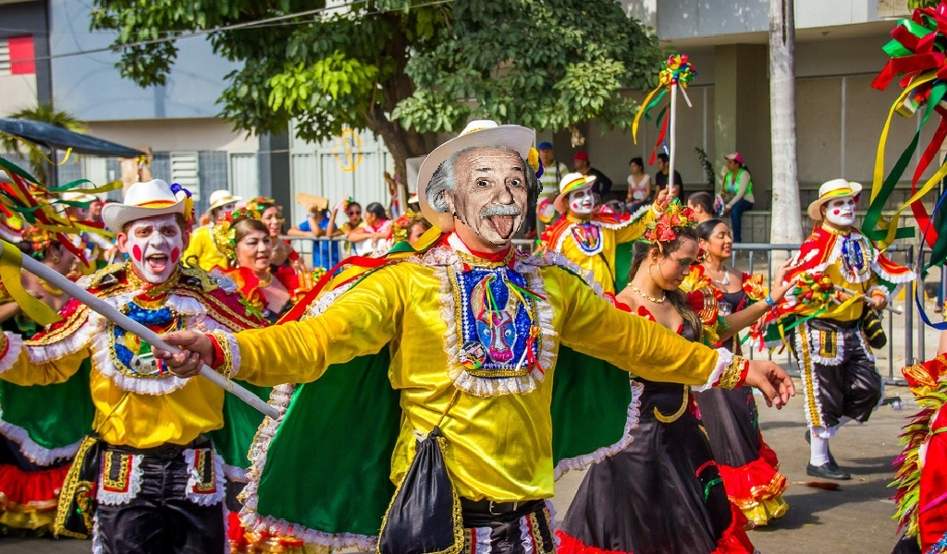



NOvA LATEST RESULTS
Barranquilla – Dec. 3rd 2019
Enrique Arrieta Díaz
Universidad del Magdalena
For the NOvA Collaboration
Notes:
12/2/2019
1
1

Slide 2
OUTLINE
The NOvA Collaboration
Introduction to neutrino oscillations
NOvA overview
NOvA latest results
  Neutrinos + antineutrinos
12/03/2019
E. Arrieta Díaz, NOvA @ COMHEP
2
Notes:
12/2/2019
2
2

Slide 3
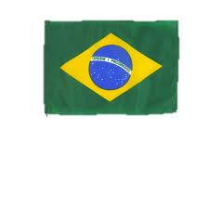
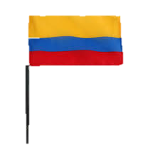
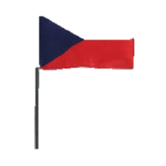
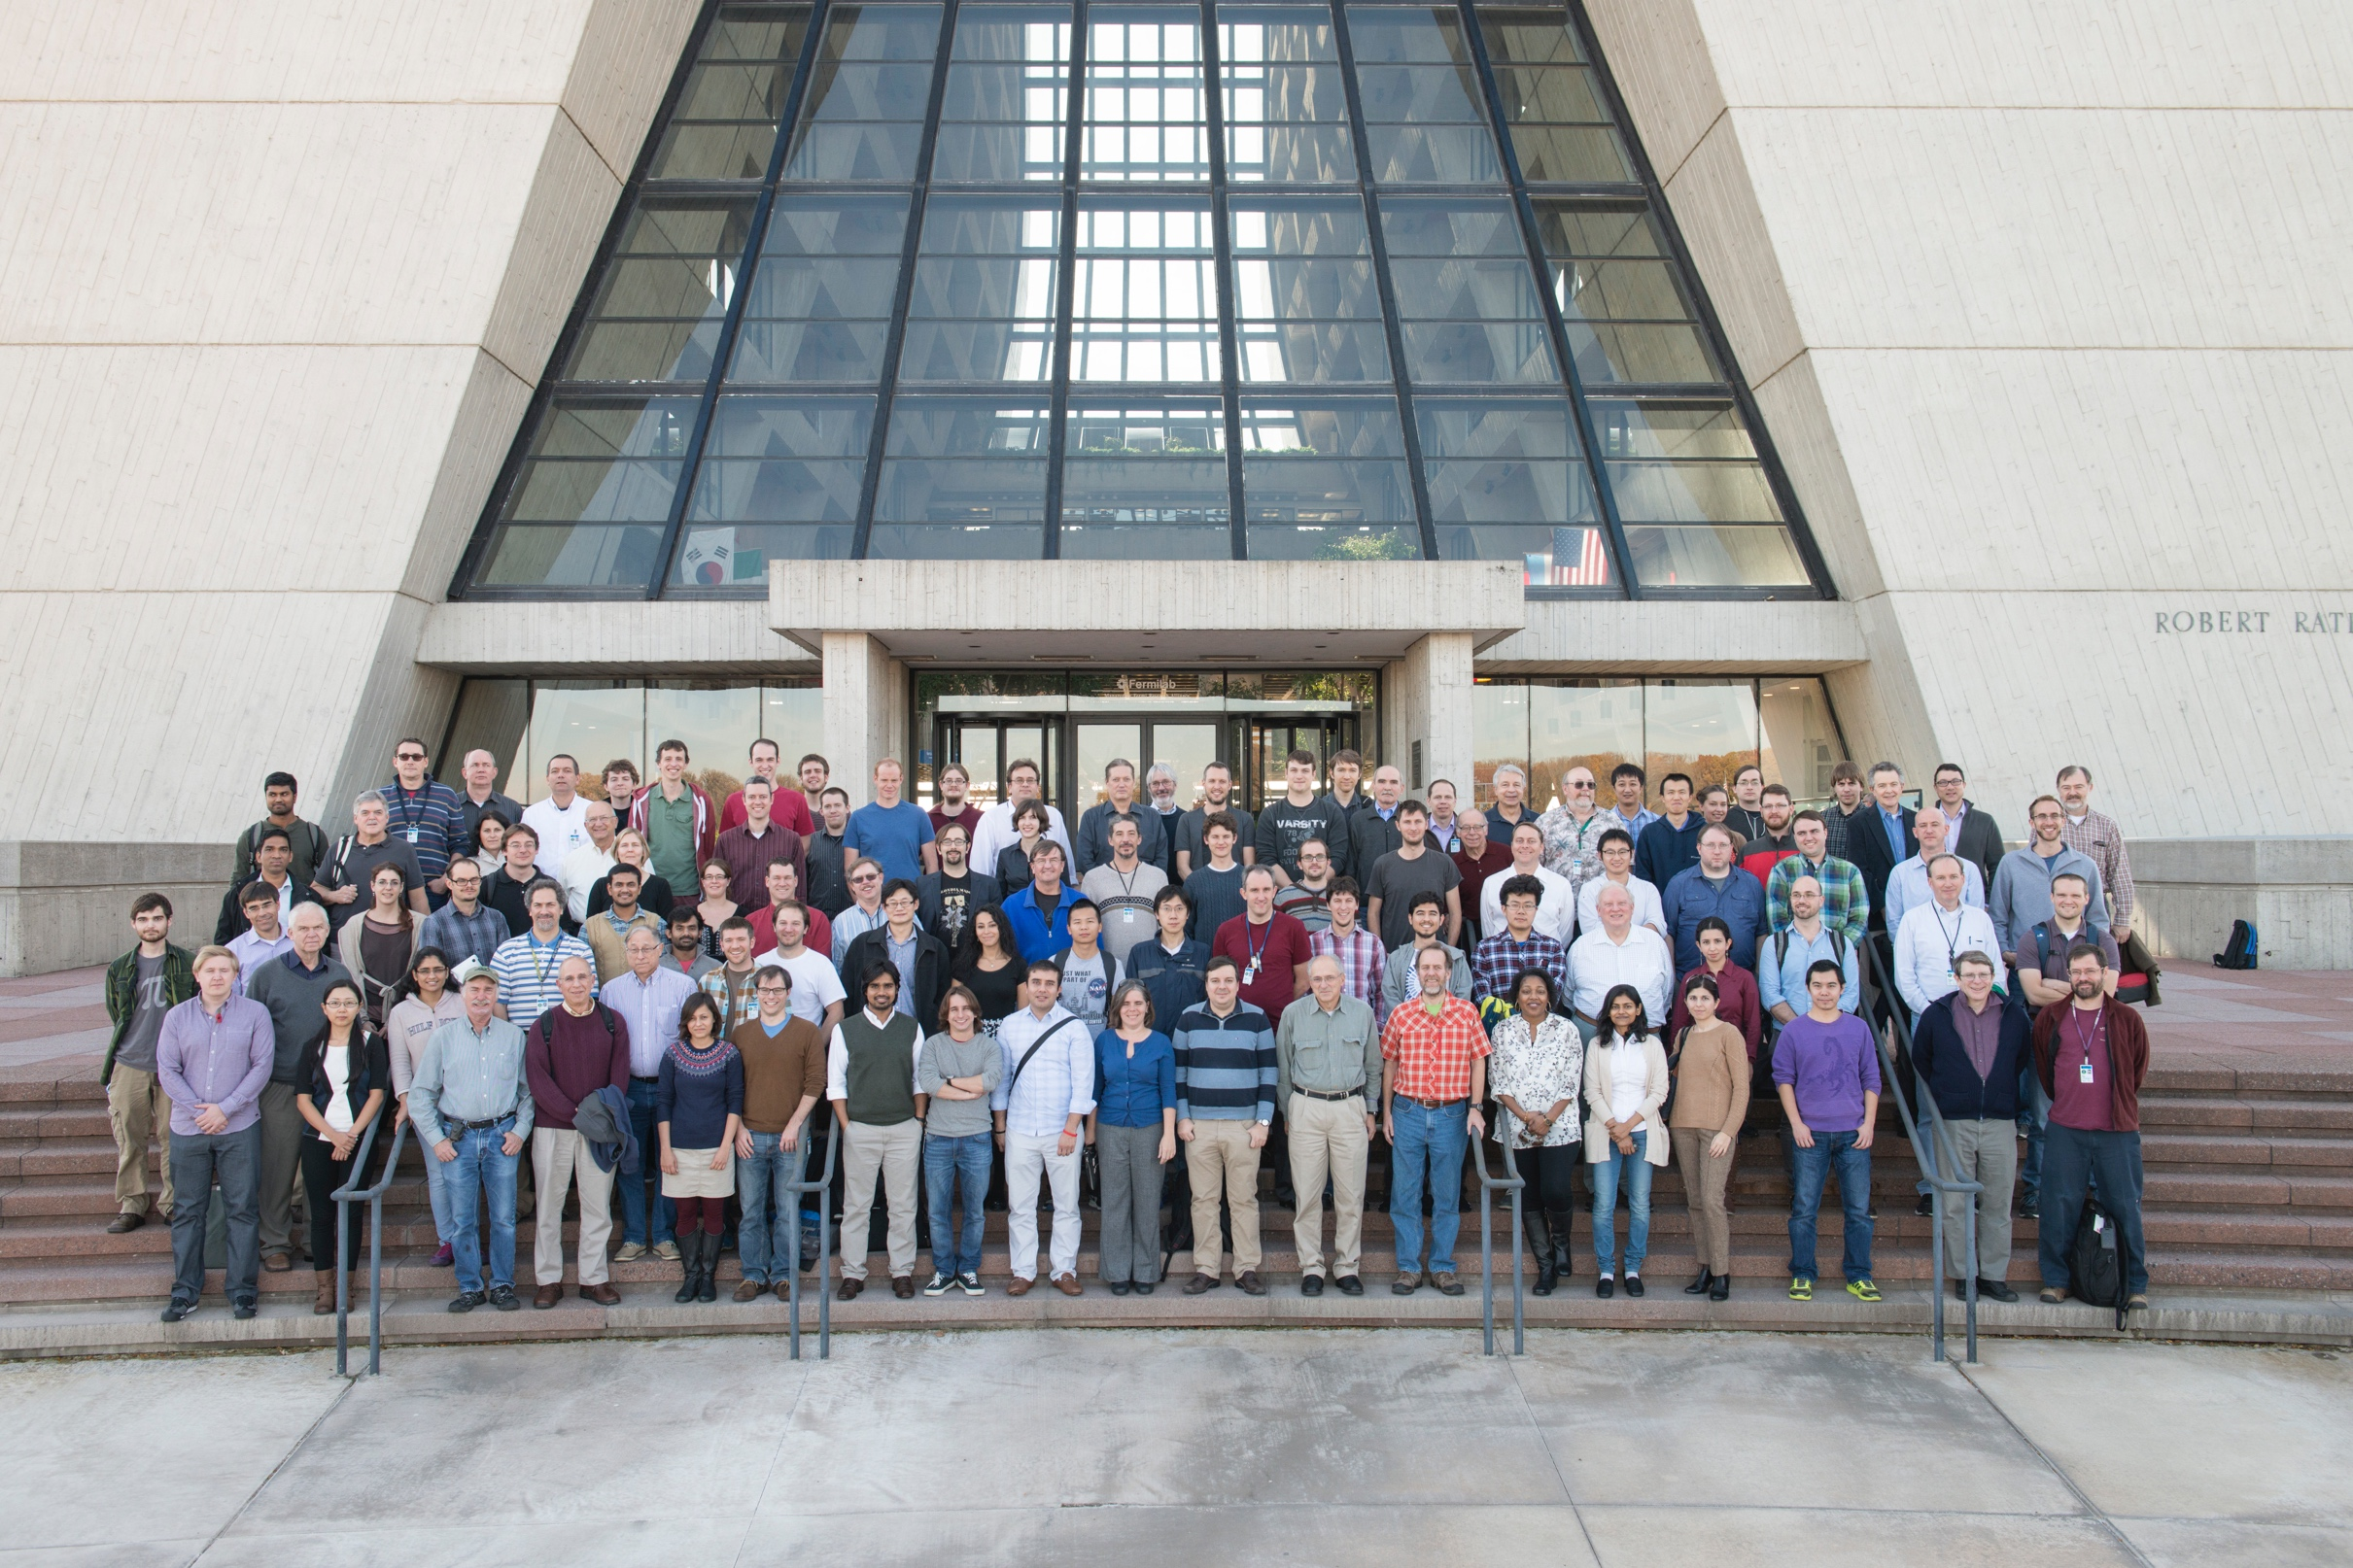




NOvA
Collaboration
NuMI Off-axis ν_{e} Appearance, NOvA
Headquarters @ Fermilab
250+ members
51 Institutions from:
12/03/2019
E. Arrieta Díaz, NOvA @ COMHEP
3
Notes:
12/3/2019
3
3

Slide 4
NOvA
Physics Program
NOvA has an extensive physics program
Two main goals related to oscillations
  Establish the neutrino mass hierarchy (3σ)
  Measure the δ CP phase (2,3σ)
Cross section program with near detector
Sterile neutrinos
Supernova neutrinos
Exotics: Magnetic monopoles, neutrino magnetic moment, dark matter & more
12/03/2019
E. Arrieta Díaz, NOvA @ COMHEP
4
Notes:
12/3/2019
4
4

Slide 5

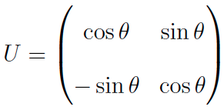
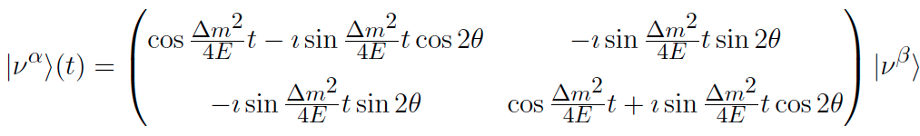




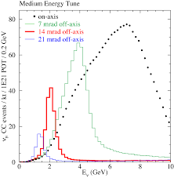



NEUTRINO PHYSICS
Oscillations
Easiest case: oscillation amongst two states (good approximation)
Oscillation amongst $ν_{μ} \& ν_{e}$:
Probability
Baseline = 810 km
Energy = 2 GeV
Maximum of Probability
12/03/2019
E. Arrieta Díaz, NOvA @ COMHEP
5
Notes:
12/2/2019
5
5

Slide 6
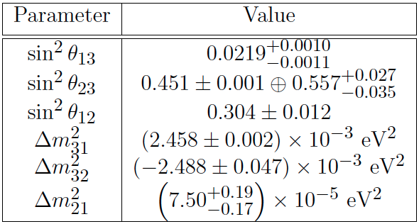
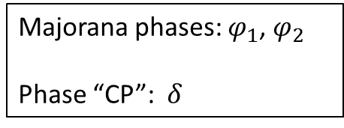
NEUTRINO PHYSICS
Oscillations
Parameters
Measured
Yet – to – be measured
Majorana phases: $φ_{1}$, $φ_{2}$
Phase “CP”: $δ$
Direct violation of CP symmetry in the lepton sector?
Which octant?
To – Do List
12/03/2019
E. Arrieta Díaz, NOvA @ COMHEP
6
Notes:
12/2/2019
6
6

Slide 7



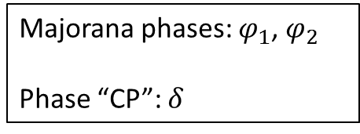
NEUTRINO PHYSICS
Oscillations
Parameters
Measured
Yet – to – be measured
Majorana phases: $φ_{1}$, $φ_{2}$
Phase “CP”: $δ$
Asymmetry:
To – Do List
12/03/2019
E. Arrieta Díaz, NOvA @ COMHEP
7
Notes:
12/2/2019
7
7

Slide 8
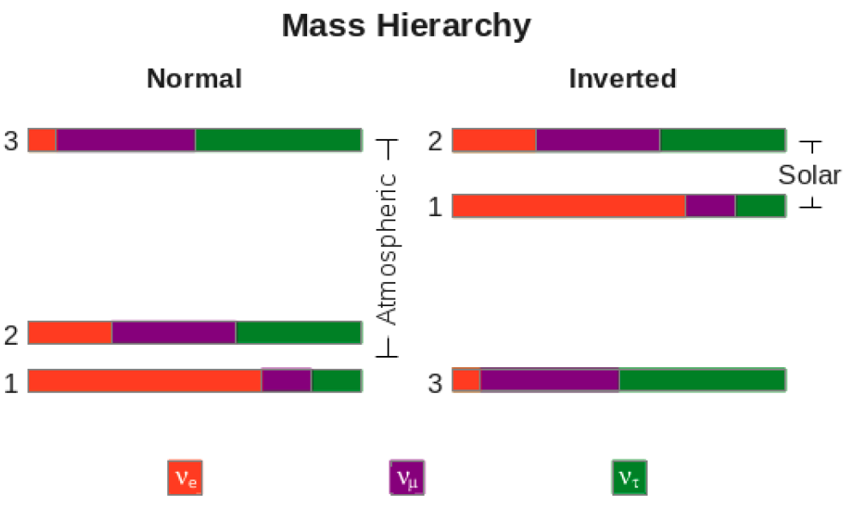
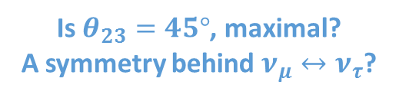
NEUTRINO PHYSICS
Oscillations
Parameters
Measured
Yet-to-be measured
Majorana phases: ϕ1, ϕ2
Phase “CP”: δ
Is $θ_{23}=45°$, maximal?
A symmetry behind $ν_{μ}↔ν_{τ}$?
To – Do List
12/03/2019
E. Arrieta Díaz, NOvA @ COMHEP
8
Notes:
12/2/2019
8
8

Slide 9
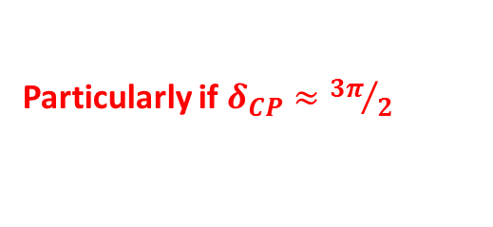
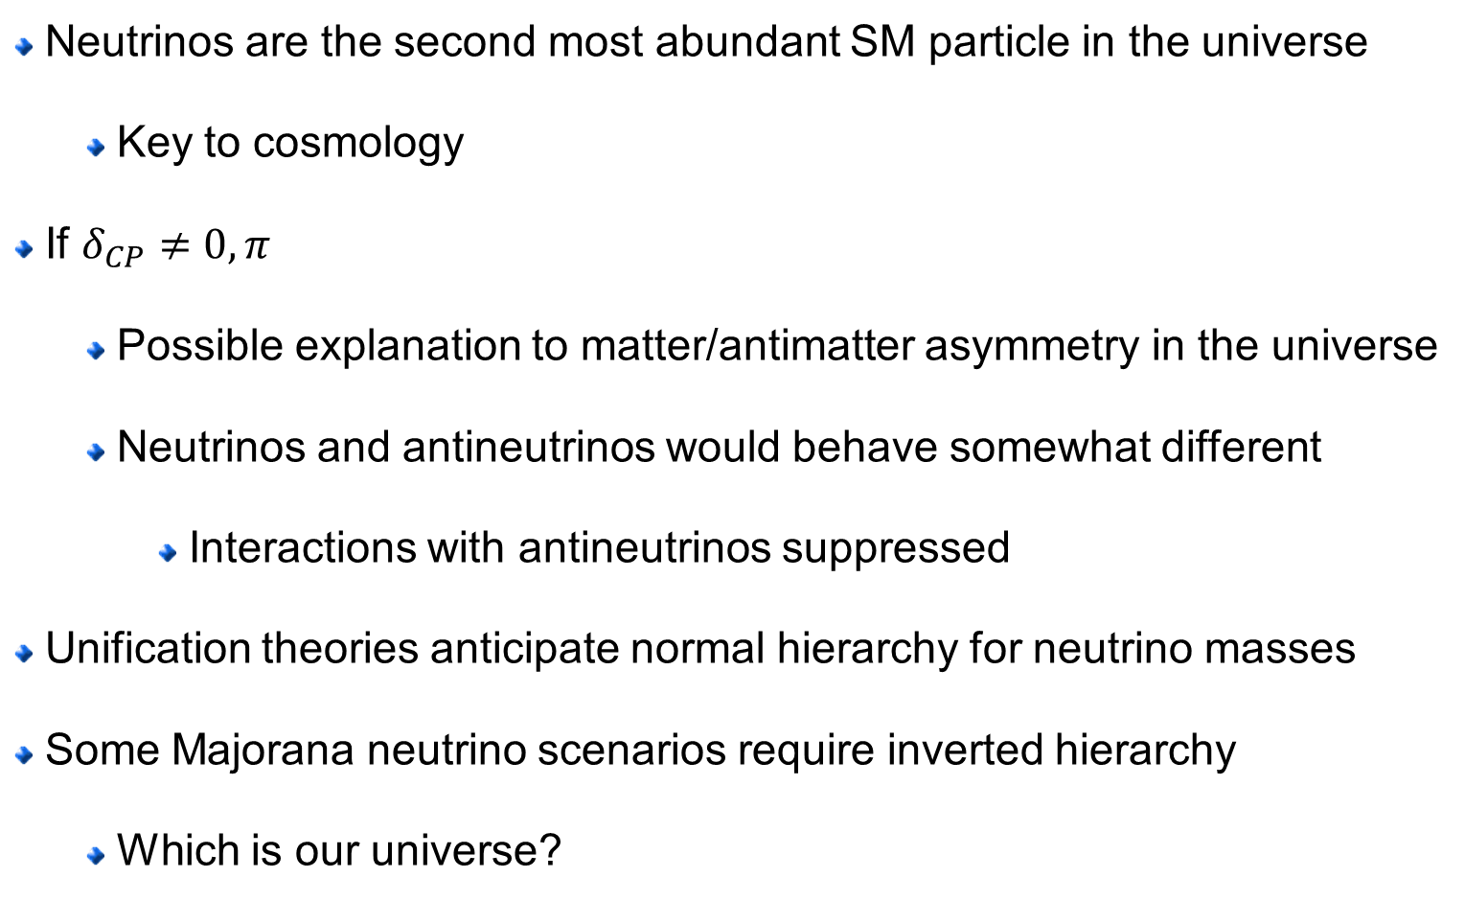
NEUTRINO PHYSICS
Relevance
Neutrinos are the second most abundant SM particle in the universe
  Key to cosmology
If $δ_{CP}≠0, π$
  Possible explanation to matter/antimatter asymmetry in the universe
  Neutrinos and antineutrinos would behave somewhat different
    Interactions with antineutrinos suppressed
Unification theories anticipate normal hierarchy for neutrino masses
Some Majorana neutrino scenarios require inverted hierarchy
  Which is our universe?
Particularly if $δ_{CP}≈{3π}/2$
Neutrinos at the heart of HEP
12/03/2019
E. Arrieta Díaz, NOvA @ COMHEP
9
Notes:
12/2/2019
9
9

Slide 10
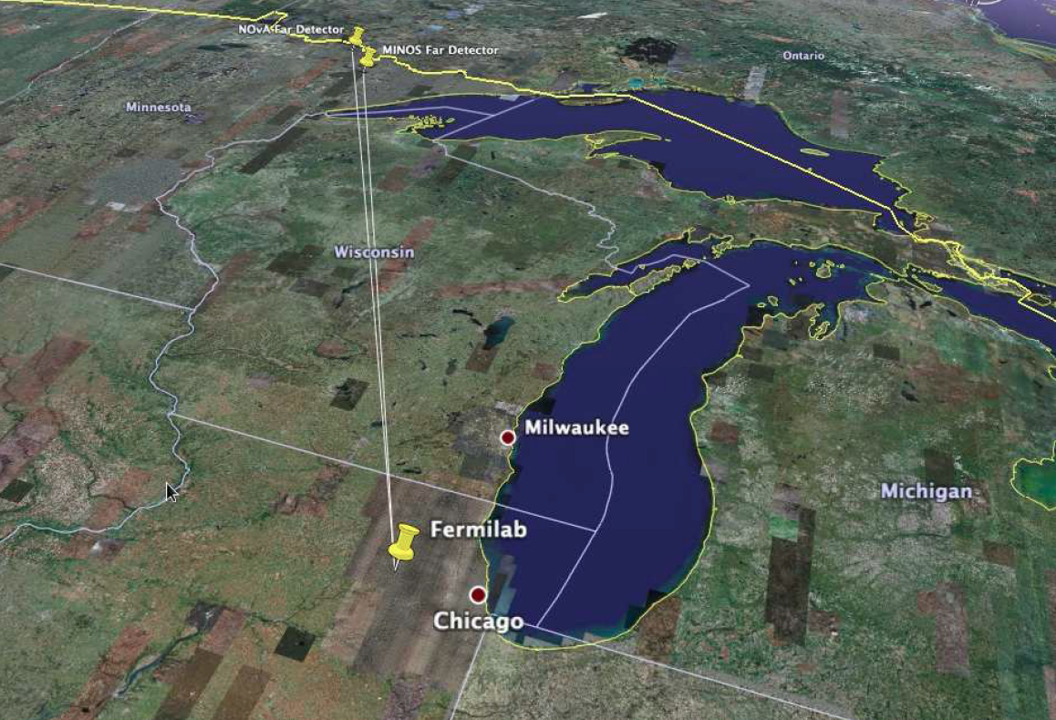

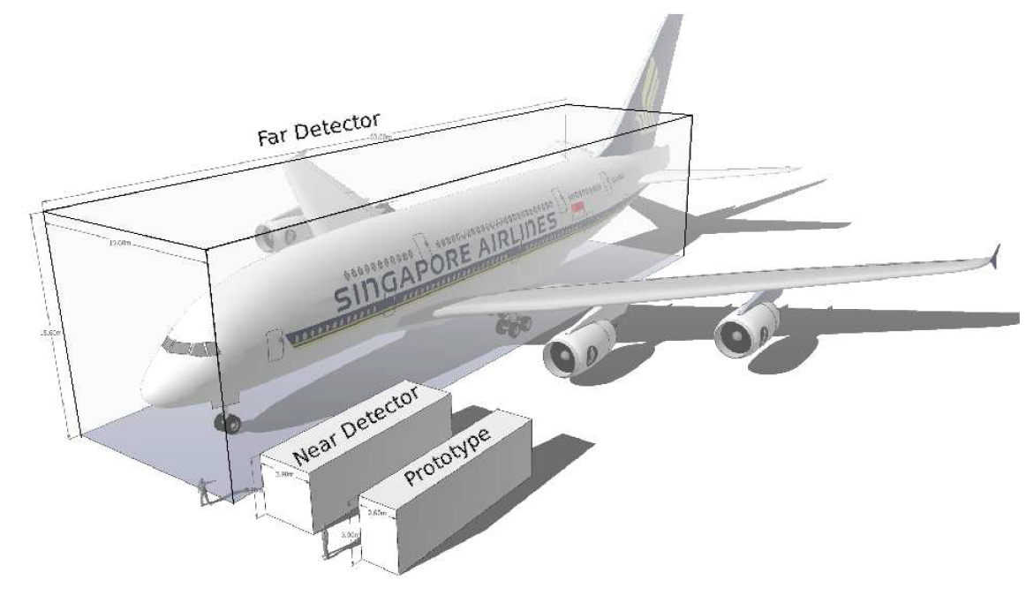
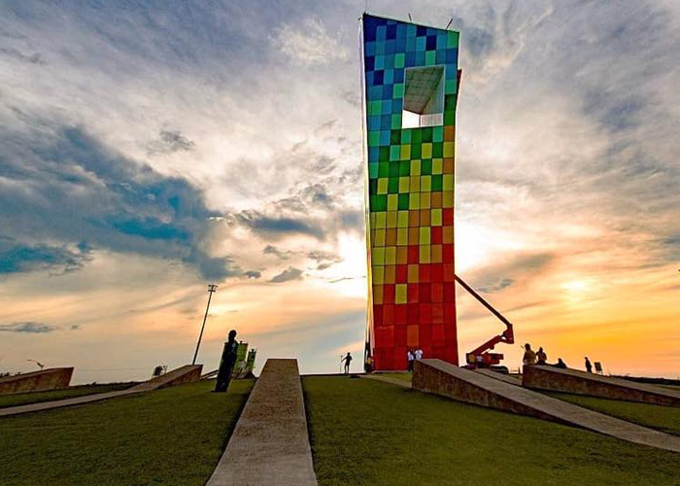
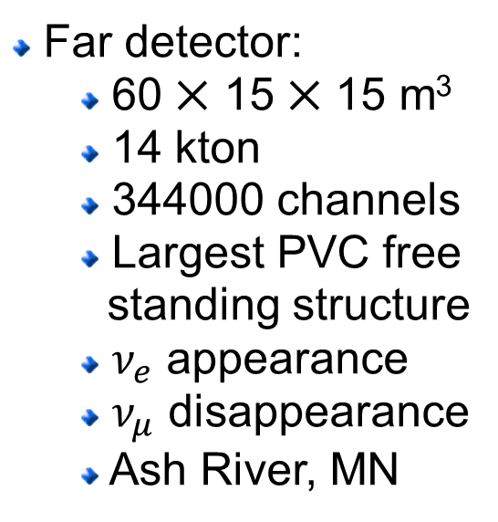
NOvA DETECTORS
Far Detector
Far detector:
  60 ⨉ 15 ⨉ 15 m³
  14 kton
  344000 channels
  Largest PVC free
  standing structure
  $ν_{e}$ appearance
  $ν_{μ}$ disappearance
  Ash River, MN
810 km
Airbus A380
15 m
15 m
60 m
45 m
12/03/2019
E. Arrieta Díaz, NOvA @ COMHEP
10
Notes:
12/2/2019
10
10

Slide 11
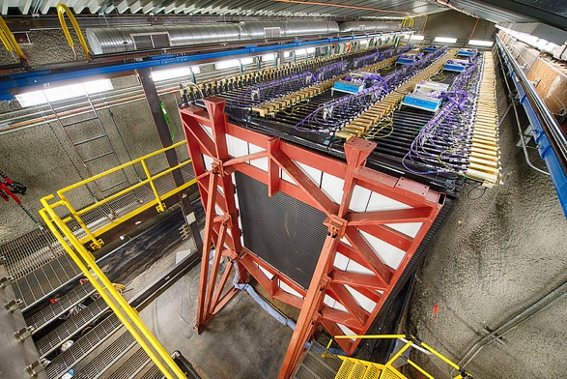
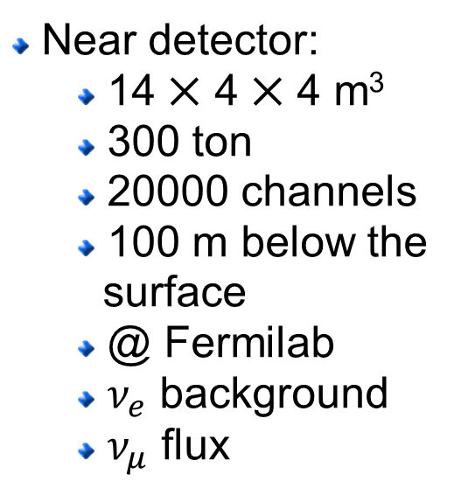
NOvA DETECTORS
Near Detector
Near detector:
  14 ⨉ 4 ⨉ 4 m³
  300 ton
  20000 channels
  100 m below the
  surface
  @ Fermilab
  $ν_{e}$ background
  $ν_{μ}$ flux
175 m
Airbus A380
12/03/2019
E. Arrieta Díaz, NOvA @ COMHEP
11
Notes:
12/2/2019
11
11

Slide 12
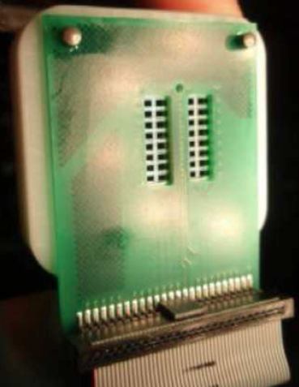
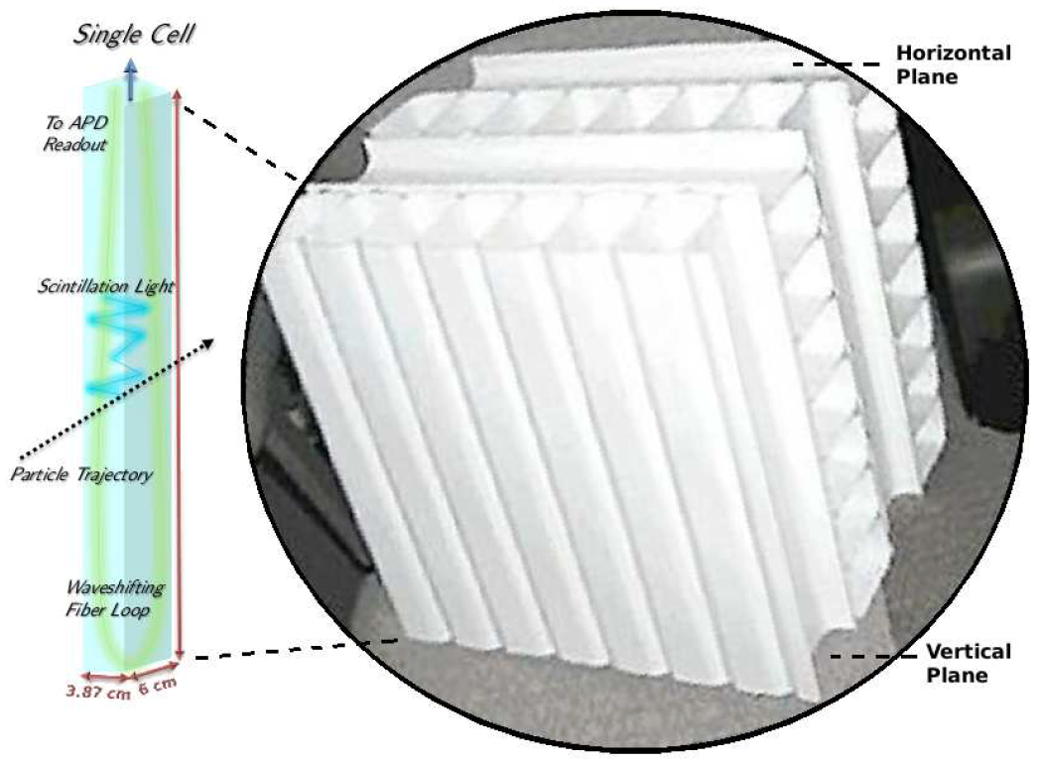
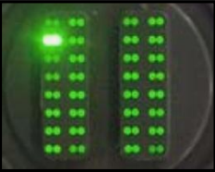
NOvA DETECTORS
Composition
Avalanche Photo Diodes, APD
High quantum efficiency
-15°C
32 channels, pixels
Mineral Oil
Pseudocumene (5%)
67% active material
0.17 X₀ per plane
PVC
The detectors are identical except for their size, to minimize systematic uncertainties
12/03/2019
E. Arrieta Díaz, NOvA @ COMHEP
12
Notes:
12/2/2019
12
12

Slide 13
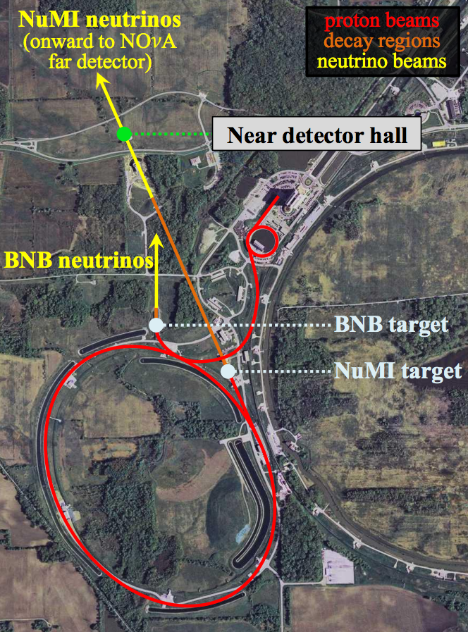
NOvA BEAM
NuMI
Booster Ring
Fermilab accelerates protons up
to 120 GeV with the Main Injector
There is a Neutrinos from Main
Injector (NuMI) beam
Main Injector
12/03/2019
E. Arrieta Díaz, NOvA @ COMHEP
13
Notes:
12/2/2019
13
13

Slide 14
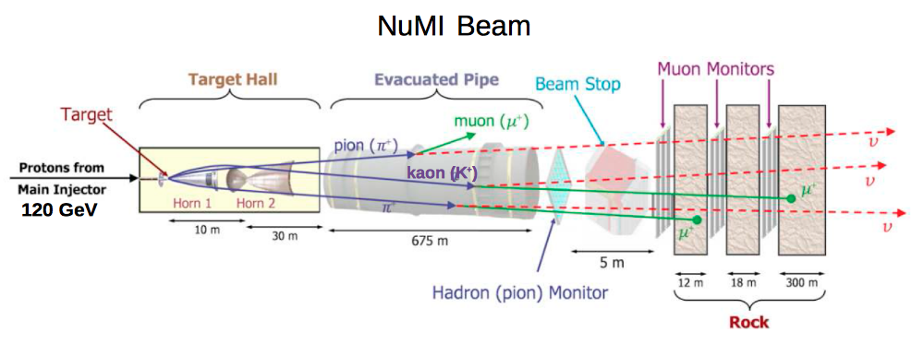
NOvA BEAM
NuMI
Booster Ring
Beam pulse every ~1.5 sec
~10¹³ protons/pulse
Fermilab accelerates protons up
to 120 GeV with the Main Injector
There is a Neutrinos from Main
Injector (NuMI) beam
Main Injector
12/03/2019
E. Arrieta Díaz, NOvA @ COMHEP
14
Notes:
12/2/2019
14
14

Slide 15
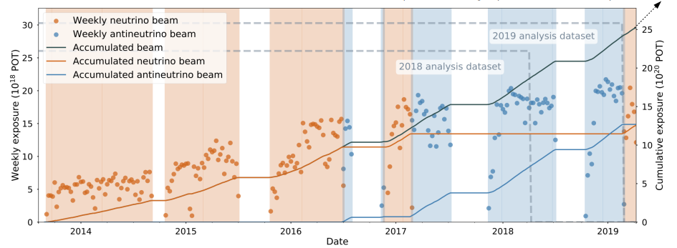
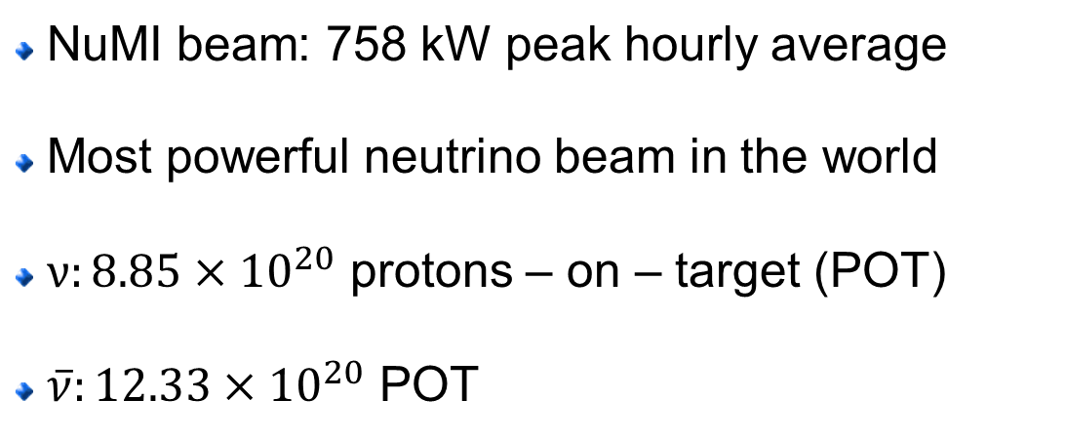
NOvA BEAM
NuMI
NuMI beam: 758 kW peak hourly average
Most powerful neutrino beam in the world
$ν:8.85×{10}^{20}$ protons – on – target (POT)
$\overline{ν}:12.33×{10}^{20}$ POT
12/03/2019
E. Arrieta Díaz, NOvA @ COMHEP
15
Notes:
12/2/2019
15
15

Slide 16
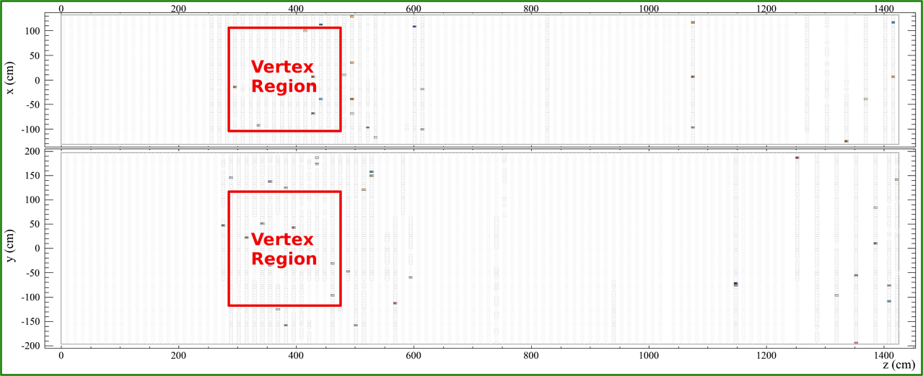
NOvA DETECTORS
Layout
Side view
Top view
Side view
Beam direction
12/03/2019
E. Arrieta Díaz, NOvA @ COMHEP
16
Notes:
12/2/2019
16
16

Slide 17
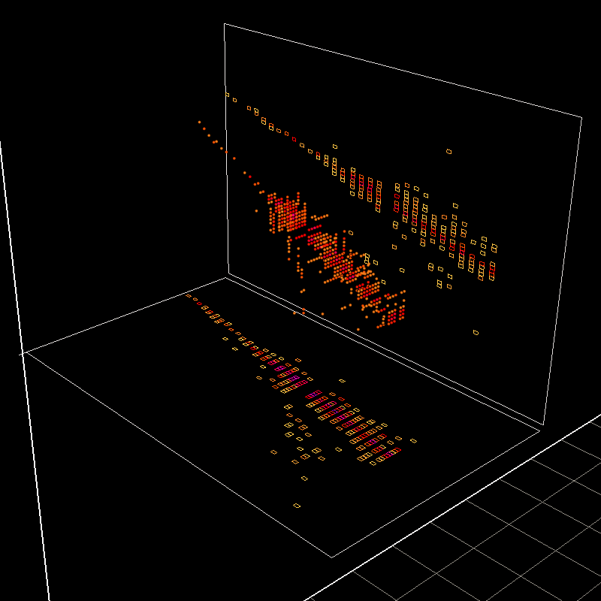
NOvA DETECTORS
Layout
Side view
Top view
Side view
Beam direction
Top view
First 3D event
May 21st 2013
12/03/2019
E. Arrieta Díaz, NOvA @ COMHEP
17
Notes:
12/2/2019
17
17

Slide 18
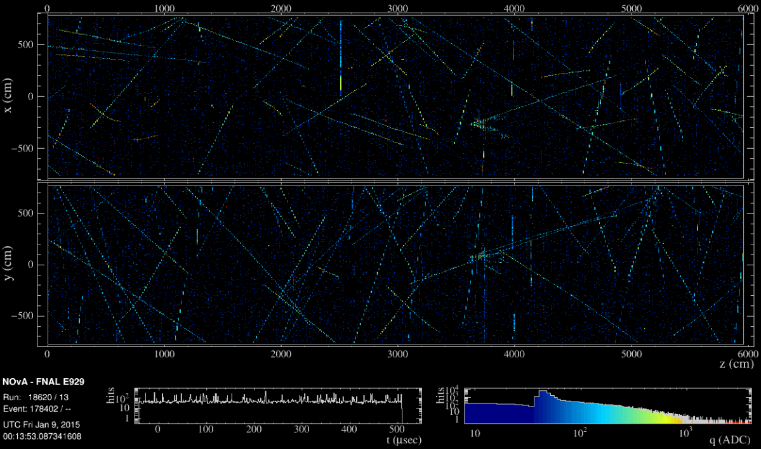
NOvA DETECTORS
Event Display
150 kHz of Cosmic rays
Far Detector (FD)
550 μsec exposure for FD
Charge (energy) deposition
12/03/2019
E. Arrieta Díaz, NOvA @ COMHEP
18
Notes:
12/2/2019
18
18

Slide 19
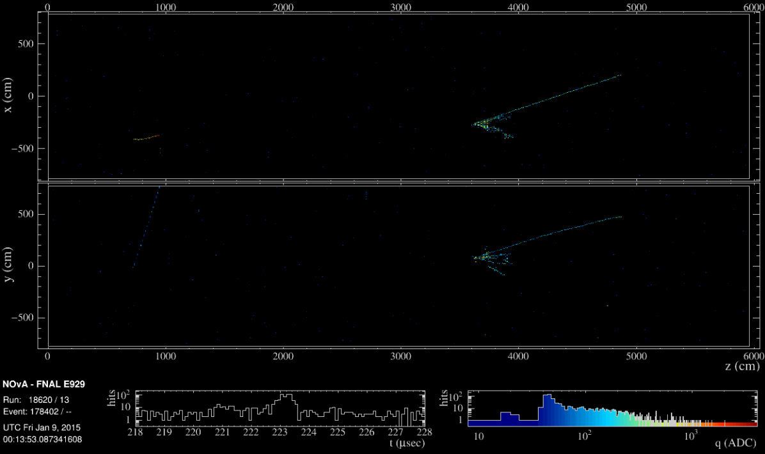
NOvA DETECTORS
Event Display
Time-zoom on 10 μsec interval during NuMI beam pulse
12/03/2019
E. Arrieta Díaz, NOvA @ COMHEP
19
Notes:
12/2/2019
19
19

Slide 20
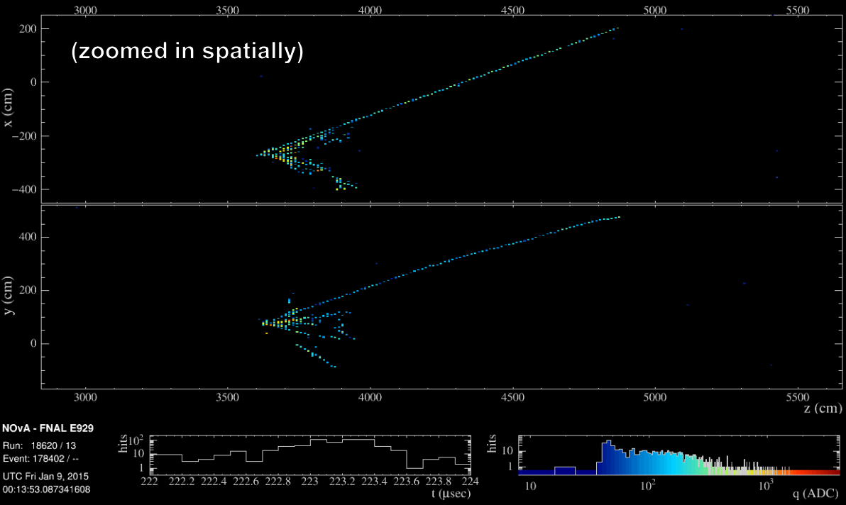
NOvA DETECTORS
Event Display
Close-up of neutrino interaction in the far detector
12/03/2019
E. Arrieta Díaz, NOvA @ COMHEP
20
Notes:
12/2/2019
20
20

Slide 21
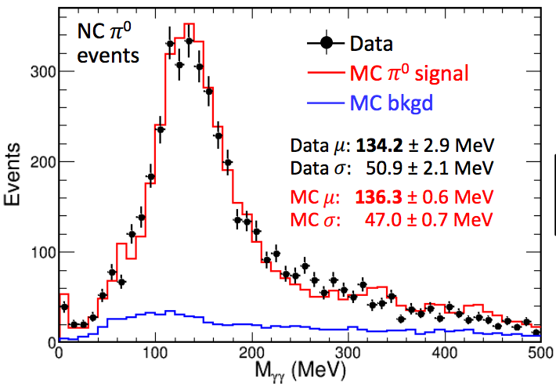
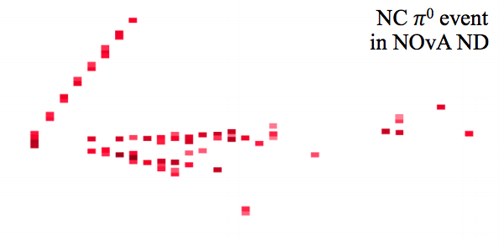
NOvA DETECTORS
Calibration
π⁰ invariant mass
Checks to energy scale:
  Hadronic shower hits
  Michael electron energy from muon
  decays
  Bremsstrahlung energy
  Muon dE/dX
All within 5% agreement
12/03/2019
E. Arrieta Díaz, NOvA @ COMHEP
21
Notes:
12/2/2019
21
21

Slide 22
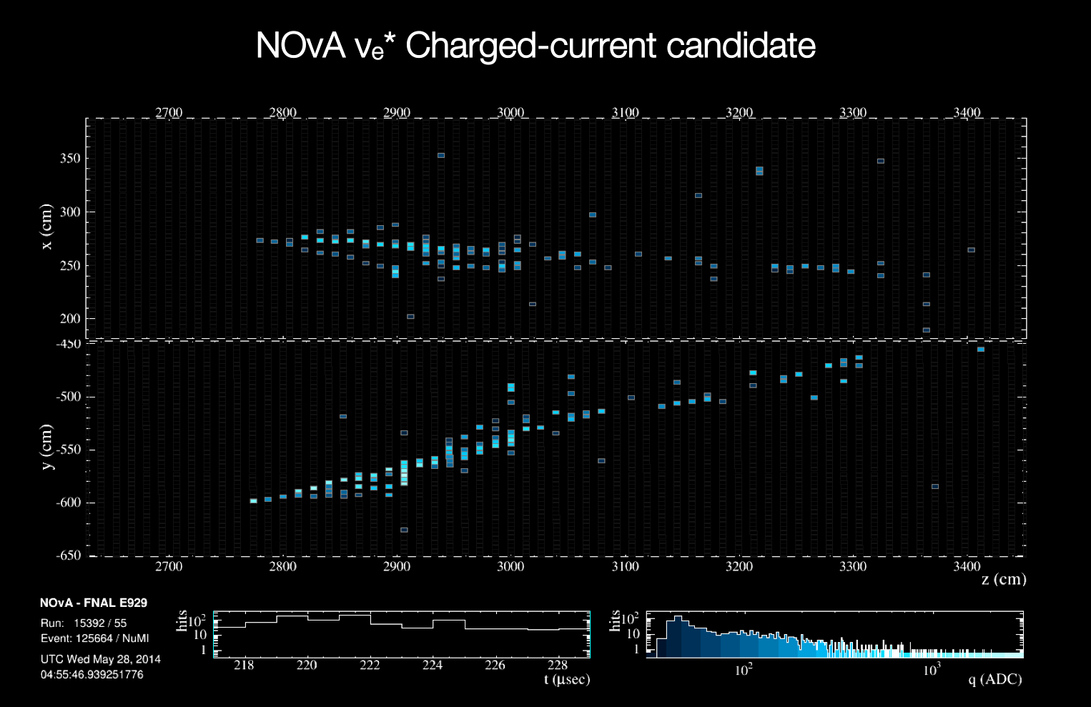
ANALYSIS
Event Selection
What are we looking for?
Fuzzy energy depositions:
Electromagnetic shower
12/03/2019
E. Arrieta Díaz, NOvA @ COMHEP
22
Notes:
12/2/2019
22
22

Slide 23
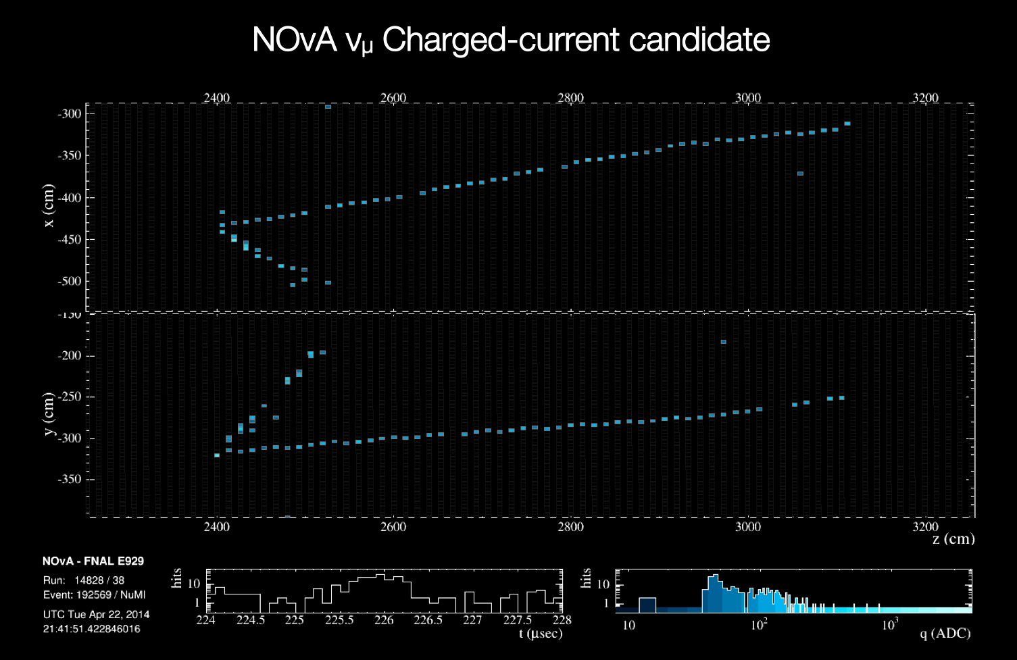
ANALYSIS
Event Selection
What are we looking for?
Track-like energy depositions:
Muon
12/03/2019
E. Arrieta Díaz, NOvA @ COMHEP
23
Notes:
12/2/2019
23
23

Slide 24
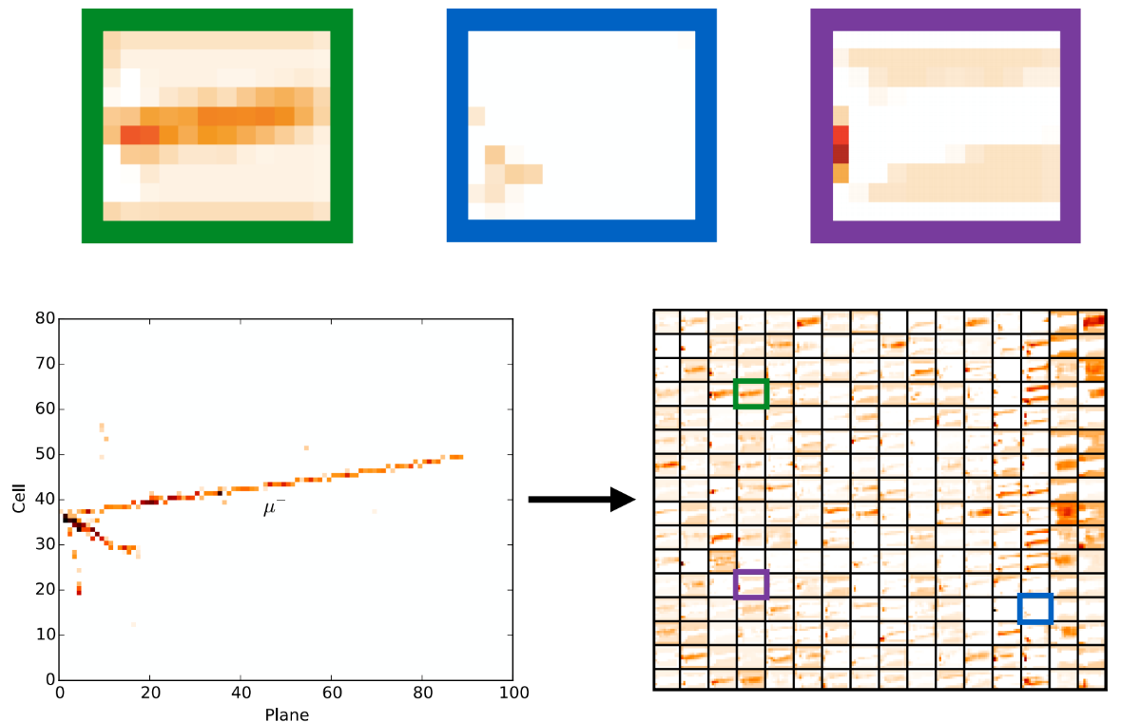
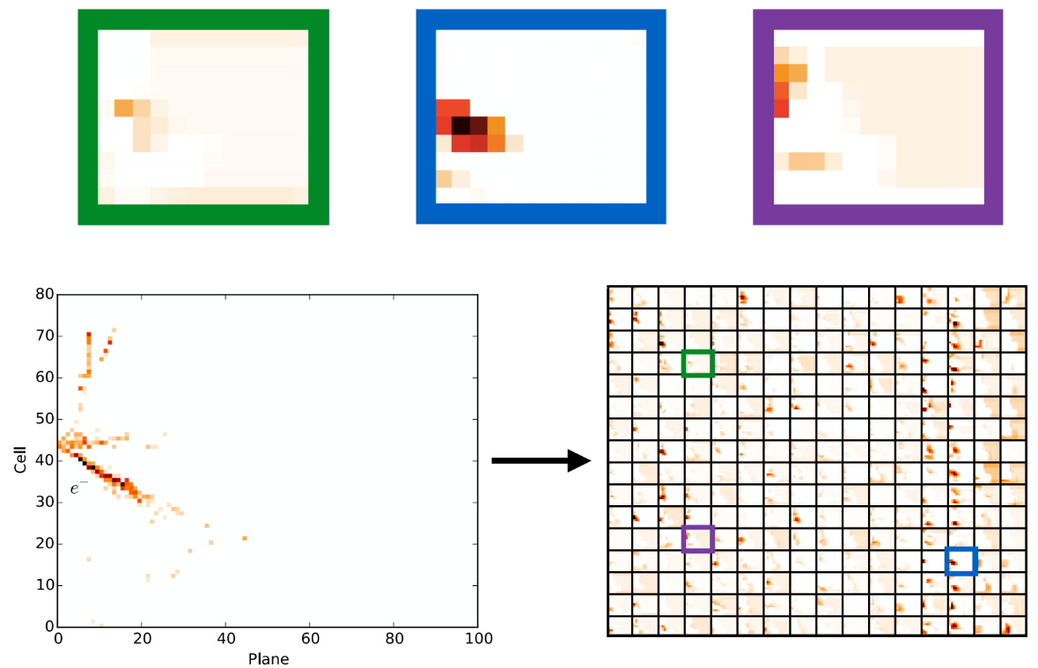
ANALYSIS
Event Selection
Recent advancements in the fields of deep learning and computer vision
allow for a new event selection technique
A Convolutional Visual Network (CVN) uses as input calibrated hit maps
Abstract features are extracted from transformations applied to series of
processed images
The CVN uses the abstract features to classify events
The technique improves the sensitivity: equivalent to 30% more exposure
Muon
Shower
A. Aurisiano et. al., JINST 11, P09001 (2016)
12/03/2019
E. Arrieta Díaz, NOvA @ COMHEP
24
Notes:
12/2/2019
24
24

Slide 25
ANALYSIS
Event Selection
Recent advancements in the fields of deep learning and computer vision
allow for a new event selection technique
A Convolutional Visual Network (CVN) uses as input calibrated hit maps
Abstract features are extracted from transformations applied to series of
processed images
The CVN uses the abstract features to classify events
The technique improves the sensitivity: equivalent to 30% more exposure
Each square is a convolution of the
event image
Features maps
A. Aurisiano et. al., JINST 11, P09001 (2016)
12/03/2019
E. Arrieta Díaz, NOvA @ COMHEP
25
Notes:
12/2/2019
25
25

Slide 26
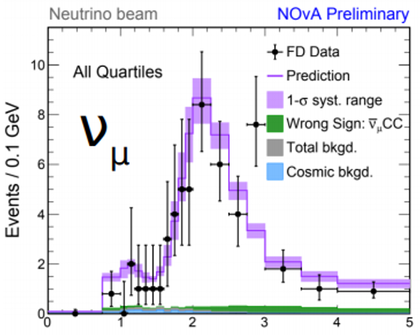
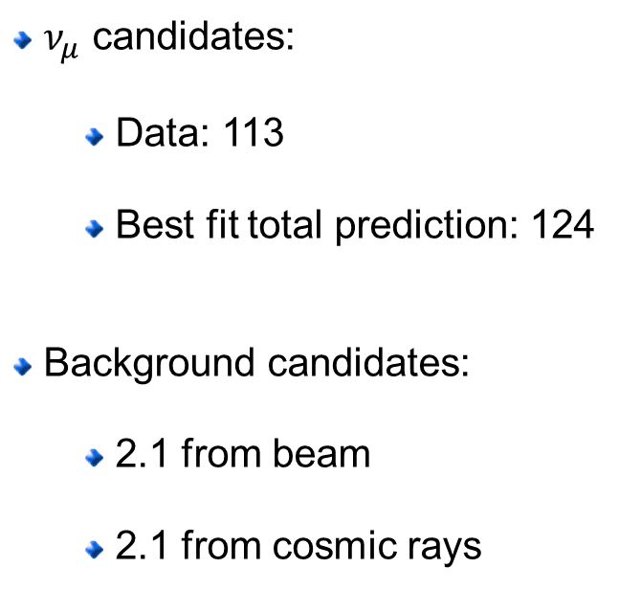
FD ANALYSIS
ν_{μ} Disappearance
ν_{μ} CC FD energy spectrum
$ν_{μ}$ candidates:
  Data: 113
  Best fit total prediction: 124
Background candidates:
  2.1 from beam
  2.1 from cosmic rays
Reconstructed Neutrino Energy (GeV)
ν_{μ} Disappearance observation!
12/03/2019
E. Arrieta Díaz, NOvA @ COMHEP
26
Notes:
12/2/2019
26
26

Slide 27
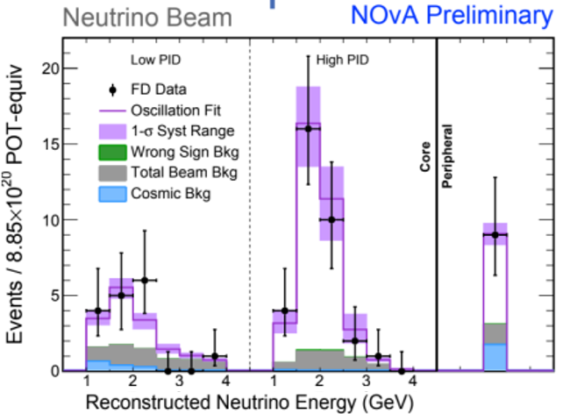

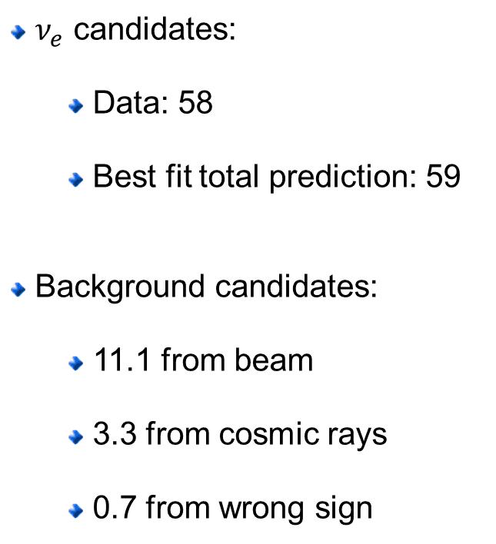

FD ANALYSIS
ν_{ε} Appearance
$ν_{e}$ CC FD energy spectrum
$ν_{e}$ candidates:
  Data: 58
  Best fit total prediction: 59
Background candidates:
  11.1 from beam
  3.3 from cosmic rays
  0.7 from wrong sign
$ν_{e}$ Appearance observation!
12/03/2019
E. Arrieta Díaz, NOvA @ COMHEP
27
Notes:
12/2/2019
27
27

Slide 28
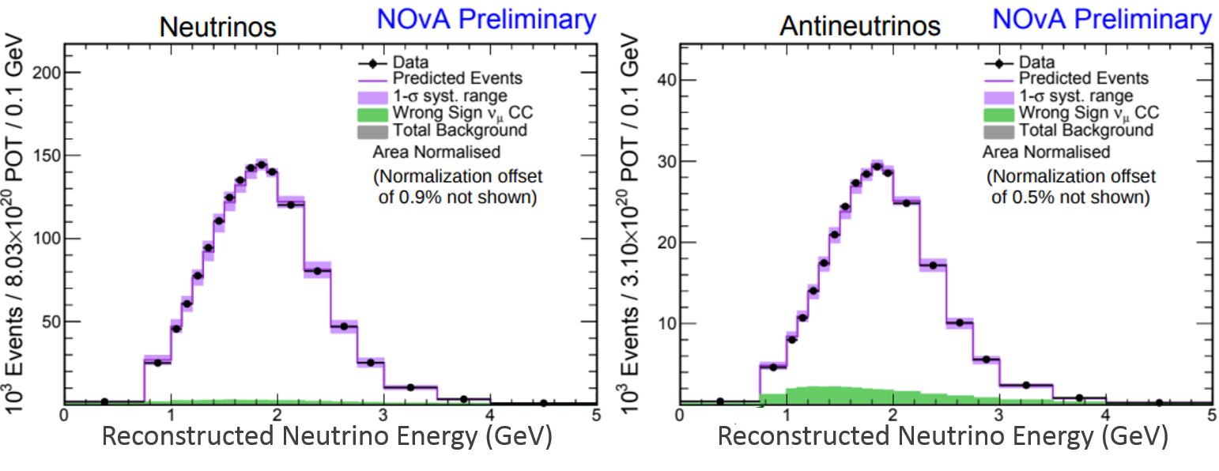

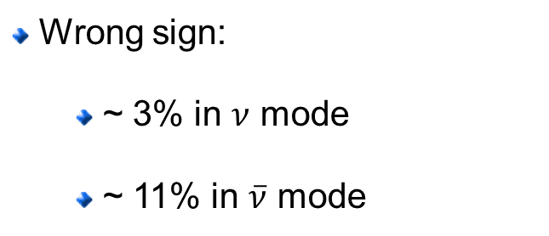
3 - FLAVOR ANALYSIS
Near Detector
$ν_{μ}$ vs ${\overline{ν}}_{μ}$ energy spectrum
Wrong sign:
  ~ 3% in $ν$ mode
  ~ 11% in $\overline{ν}$ mode
12/03/2019
E. Arrieta Díaz, NOvA @ COMHEP
28
Notes:
12/2/2019
28
28

Slide 29
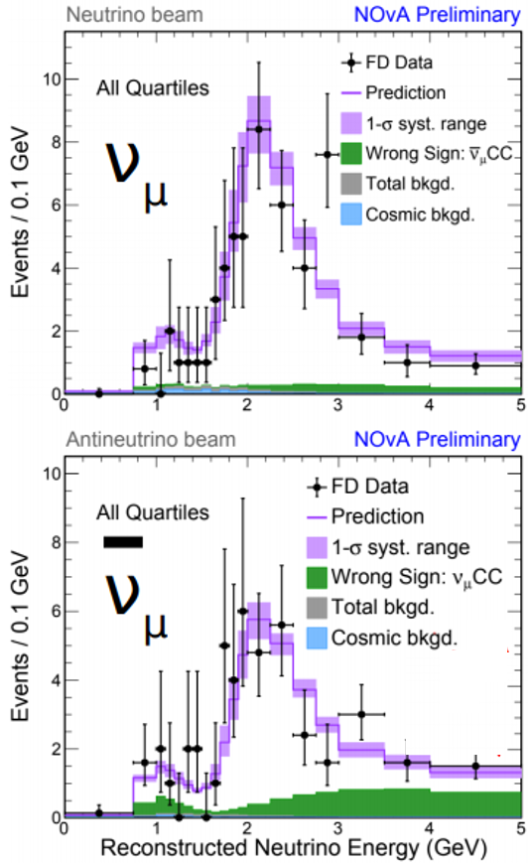
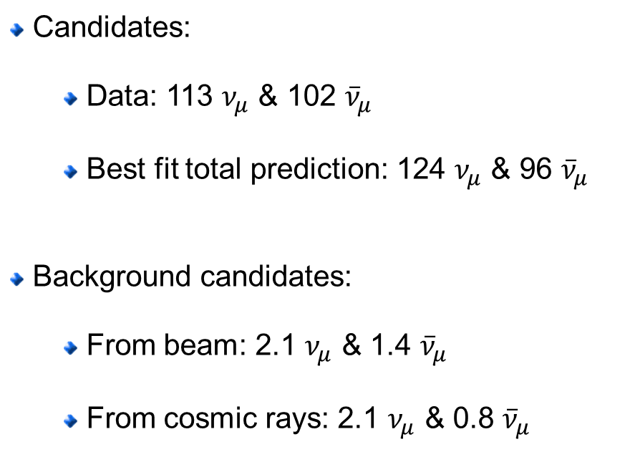
3 - FLAVOR ANALYSIS
Far Detector
$ν_{μ}$ vs ${\overline{ν}}_{μ}$ energy spectrum
Candidates:
  Data: 113 $ν_{μ}$ & 102 ${\overline{ν}}_{μ}$
  Best fit total prediction: 124 $ν_{μ}$ & 96 ${\overline{ν}}_{μ}$
Background candidates:
  From beam: 2.1 $ν_{μ}$ & 1.4 ${\overline{ν}}_{μ}$
  From cosmic rays: 2.1 $ν_{μ}$ & 0.8 ${\overline{ν}}_{μ}$
12/03/2019
E. Arrieta Díaz, NOvA @ COMHEP
29
Notes:
12/2/2019
29
29

Slide 30
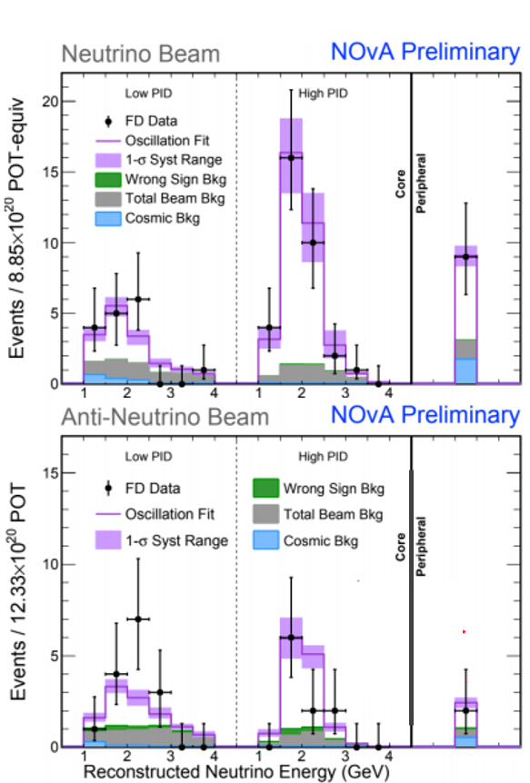


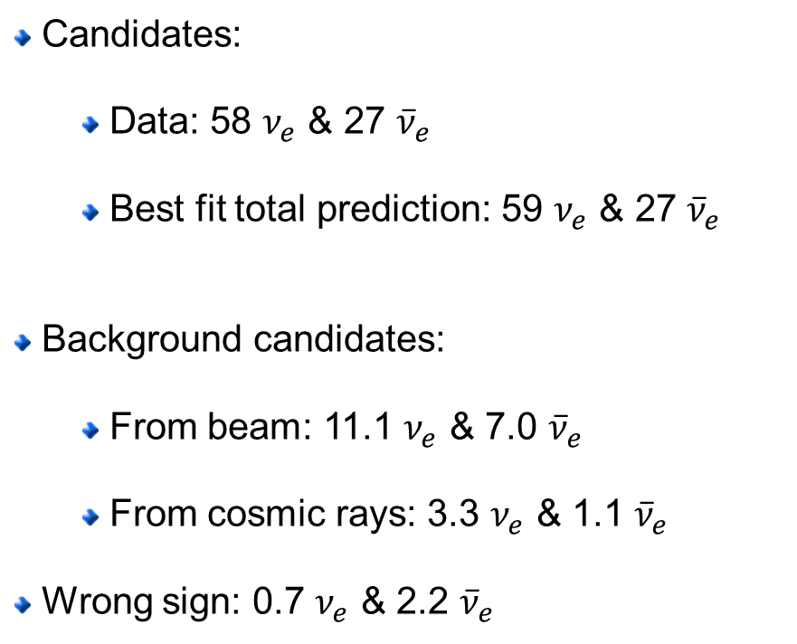
3 - FLAVOR ANALYSIS
Far Detector
$ν_{e}$ vs ${\overline{ν}}_{e}$ energy spectrum
Candidates:
  Data: 58 $ν_{e}$ & 27 ${\overline{ν}}_{e}$
  Best fit total prediction: 59 $ν_{e}$ & 27 ${\overline{ν}}_{e}$
Background candidates:
  From beam: 11.1 $ν_{e}$ & 7.0 ${\overline{ν}}_{e}$
  From cosmic rays: 3.3 $ν_{e}$ & 1.1 ${\overline{ν}}_{e}$
Wrong sign: 0.7 $ν_{e}$ & 2.2 ${\overline{ν}}_{e}$
$4.4σ$ evidence for ${\overline{ν}}_{e}$ appearence!
12/03/2019
E. Arrieta Díaz, NOvA @ COMHEP
30
Notes:
12/2/2019
30
30

Slide 31
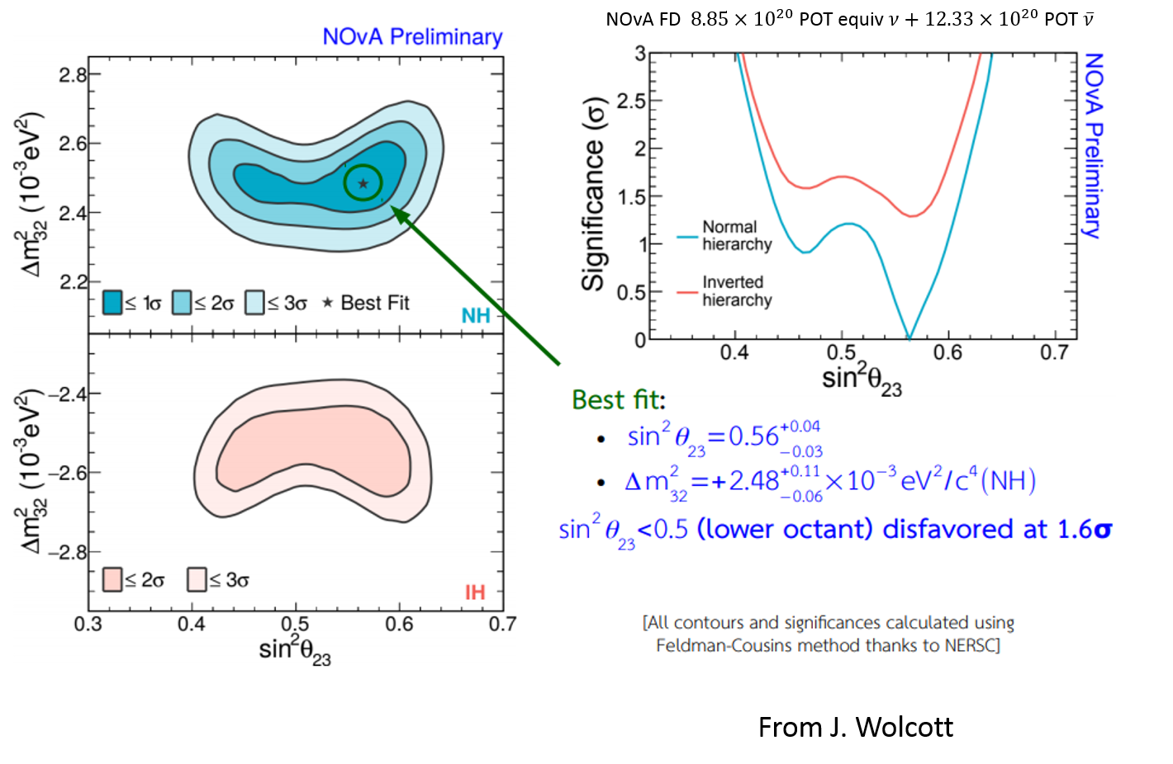

3 - FLAVOR ANALYSIS
Results
$\sin^{2}θ_{23}=0.5$ disfavored at $1.2σ$
12/03/2019
E. Arrieta Díaz, NOvA @ COMHEP
31
Notes:
12/2/2019
31
31

Slide 32

3 - FLAVOR ANALYSIS
Results
Compare various reported results
12/03/2019
E. Arrieta Díaz, NOvA @ COMHEP
32
Notes:
12/2/2019
32
32

Slide 33


3 - FLAVOR ANALYSIS
Results
Best fit:
  $Δm_{32}^{2}={2.48}_{−0.06}^{+0.11}×{10}^{−3}{{eV}^{2}}/{c^{4}}$ (NH)
  $\sin^{2}θ_{23}={0.56}_{−0.03}^{+0.04}$
  $δ_{CP}={0.0}_{−0.4}^{+1.3}π$
12/03/2019
E. Arrieta Díaz, NOvA @ COMHEP
33
Notes:
12/2/2019
33
33

Slide 34



3 - FLAVOR ANALYSIS
Results
Best fit:
  $Δm_{32}^{2}={2.48}_{−0.06}^{+0.11}×{10}^{−3}{{eV}^{2}}/{c^{4}}$ (NH)
  $\sin^{2}θ_{23}={0.56}_{−0.03}^{+0.04}$
  $δ_{CP}={0.0}_{−0.4}^{+1.3}π$
12/03/2019
E. Arrieta Díaz, NOvA @ COMHEP
34
Notes:
12/2/2019
34
34

Slide 35


3 - FLAVOR ANALYSIS
Results
Preferred at $1.9σ$
NH & Upper Octant:
  All values of $δ$ allowed at $1.1σ$
IH:
  $δ=\frac{π}{2}$ ruled out beyond $4σ$
12/03/2019
E. Arrieta Díaz, NOvA @ COMHEP
35
Notes:
12/2/2019
35
35

Slide 36


NOvA
What’s Next?
Same amount of data in both beam modes
  Up until 2025
With favorable parameters
  Sensitivity to hierarchy up to 3 – 5$σ$
  Sensitivity to CP violation beyond 2$σ$
Expected improvements from:
  Test beam
    Detector response model
  Simulation
    GENIE 3.0 cross sections
12/03/2019
E. Arrieta Díaz, NOvA @ COMHEP
36
Notes:
12/2/2019
36
36

Slide 37


SUMMARY
With $ν:8.85×{10}^{20}$ POT & $\overline{ν}:12.33×{10}^{20}$ POT
  $4.4σ$ evidence for ${\overline{ν}}_{e}$ appearance
  $1.6σ$ preference for $θ_{23}$ in upper octant
  $1.9σ$preference for the Normal Hierarchy
NOvA running through 2025
  Possible 3 - 5$σ$ to mass hierarchy
  Potential sensitivity to CP violation beyond $2σ$
  Improvement to systematic
    Test beam
    Cross sections from the neutrino community
Latest results here: arXiv:1906.04907
Maximal mixing disfavored at $1.2σ$
Key to cosmology
Phys. Rev. Lett. 123, 151803
12/03/2019
E. Arrieta Díaz, NOvA @ COMHEP
37
Notes:
12/3/2019
37
37

Slide 38
THANK YOU!
earrieta@unimagdalena.edu.co
12/03/2019
E. Arrieta Díaz, NOvA @ COMHEP
38
Notes:
12/2/2019
38
38

Slide 39
Suplements
12/03/2019
E. Arrieta Díaz, NOvA @ COMHEP
39
Notes:
12/3/2019
39
39

Slide 40
ANALYSIS
Event Selection
Cosmic background rejection
12/03/2019
E. Arrieta Díaz, NOvA @ COMHEP
40
Notes:
12/3/2019
40
40

Slide 41

ANALYSIS
Event Selection
Cosmic background rejection
No beam
12/03/2019
E. Arrieta Díaz, NOvA @ COMHEP
41
Notes:
12/3/2019
41
41

Slide 42
ND ANALYSIS
ν_{μ} Disappearance
For the muon neutrino disappearance
analysis NOvA uses mainly the energy
deposition profiles of muons to identify
them
The sought signal is a primary muon
coming from a charge current interaction
between a muon neutrino and target
nucleon/nucleus
  A muon identification algorithm is
  used
The background to this signal are:
  Neutral current interactions
  Beam electron neutrino interactions
  Also beam anti-muons (not rejected
  by the algorithm)
Muon ID > 0.75: is a moun!
Example
12/03/2019
E. Arrieta Díaz, NOvA @ COMHEP
42
Notes:
12/3/2019
42
42

Slide 43


ND ANALYSIS
ν_{μ} Disappearance
ND 98.4% beam purity
Excellent agreement between data & MC
range
)
θ_{z}
Beam
Muon energy from range
12/03/2019
E. Arrieta Díaz, NOvA @ COMHEP
43
Notes:
12/3/2019
43
43

Slide 44


ND ANALYSIS
ν_{μ} Disappearance
Hadronic energy shower from calorimetry
E_{ν} = E_{had} + E_{muon}
Excellent agreement between data & MC
range
Beam
Hadronic Shower
Reconstructed Neutrino Energy (GeV)
12/03/2019
E. Arrieta Díaz, NOvA @ COMHEP
44
Notes:
12/3/2019
44
44

