Slide 1
bayesian treatment of distance errors in the cosmic distance ladder
Germán Chaparro Molano
UNIVERSIDAD ECCI, COLOMBIA

Slide 2
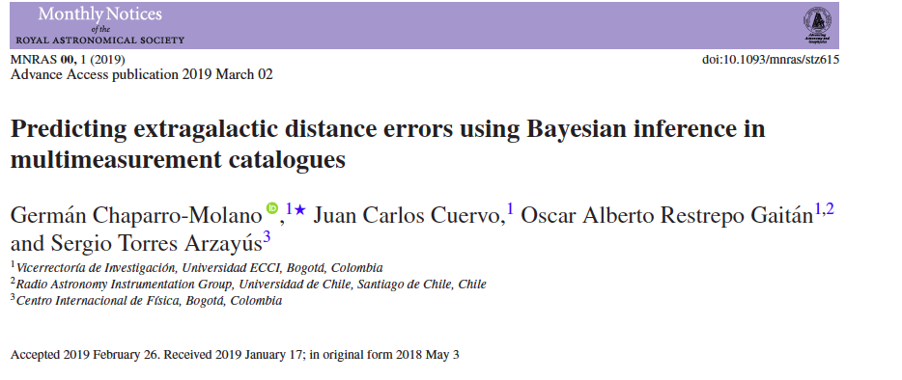
Chaparro Molano+2019 astro-ph:1805.02578
https://github.com/saint-germain/errorprediction

Slide 3
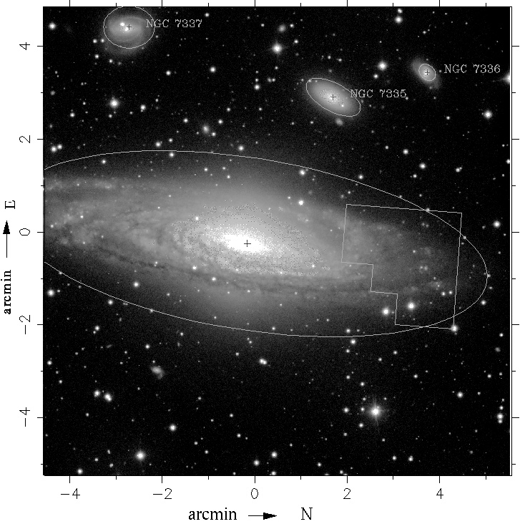
NGC 7331 (Group)
Hughes et al 1998

Slide 4
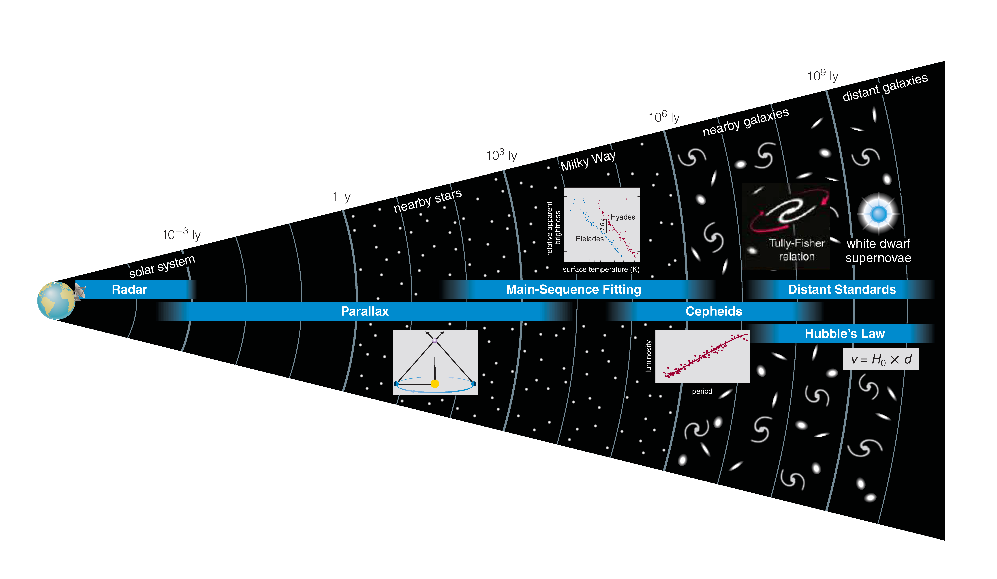
The Cosmic Distance Ladder
From The Essential Cosmic Perspective, 6th Ed., Bennet+2012

Slide 5
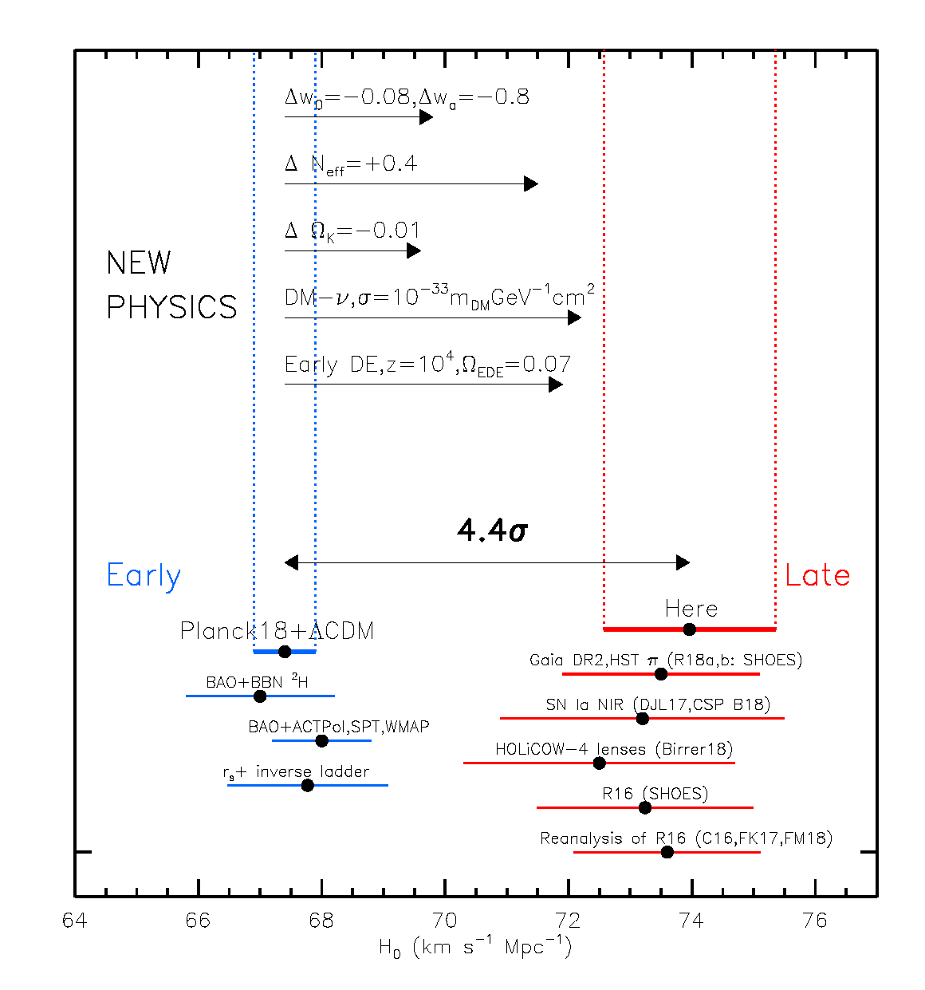
Riess et al 2019

Slide 6
Redshift-Independent Extragalactic Distance Catalogs
NED-D (NASA/IPAC)
  ~300k measurements for ~180k galaxies
HyperLEDA A007 (Lyon/SAO)
  ~12k measurements for ~4000 galaxies
Cosmicflows-3 (Tully+2016)
  ~10k galaxies w/ up to 4 distance methods ea.

Slide 7
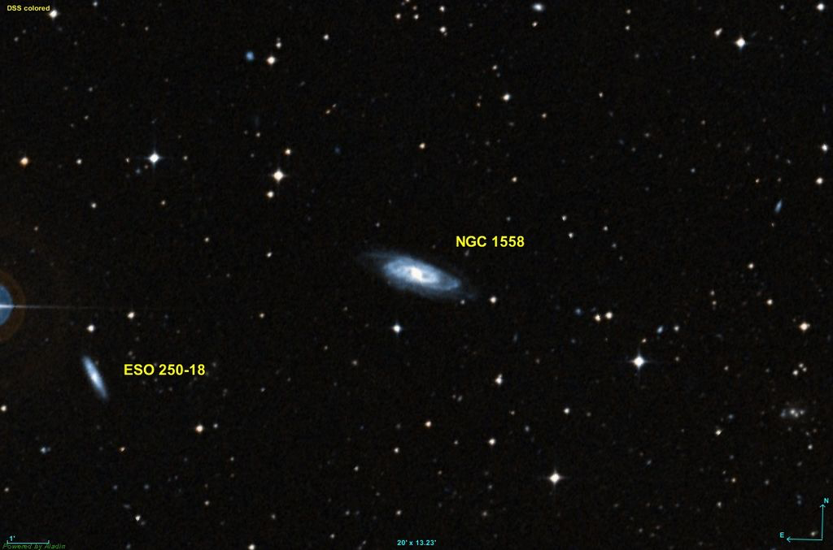
NGC 1558

Slide 8
NGC 1558
Distance modulus | Distance modulus error | Distance (Mpc) | Distance error (Mpc) | Method | Year
34.12 | 0.32 | 67 | 10 | Tully-Fisher | 1992
34.2 | 0.32 | 69 | 10 | Tully-Fisher | 1992
33.92 | 0.43 | 61 | 12 | Tully-Fisher | 1997
34.15 | 0.43 | 68 | 13 | Tully-Fisher | 1997
34.25 | 0.43 | 71 | 14 | Tully-Fisher | 1997
33.88 | 0.8 | 60 | 22 | IRAS | 1997
33.99 | 0.07 | 63 | 2 | Sosies | 2002
33.86 | 0.46 | 59 | 13 | Tully-Fisher | 2007
33.88 | 0.47 | 60 | 13 | Tully-Fisher | 2007
33.98 | 0.4 | 63 | 12 | Tully-Fisher | 2007
33.99 | 0.45 | 63 | 13 | Tully-Fisher | 2007
29.08 | 0.36 | 7 | 1 | Tully-Fisher | 2009
33.95 | 0.29 | 62 | 8 | Tully-Fisher | 2009
34.12 | 0.27 | 67 | 8 | Tully-Fisher | 2009
34.16 | 0.2 | 68 | 6 | Tully-Fisher | 2013
NED-D: A Master List of Redshift-Independent Extragalactic Distances
https://ned.ipac.caltech.edu/Library/Distances/

Slide 9
NGC 1558
“Frequentist” methods:
P: Propagation of errors (Cosmicflows-3, Tully et al 2016)
Q: Quadrature sum of P error and weighted stdev (to account for spread between measurements)
σ_{P} = 1.6 Mpc
σ_{Q} = 22 Mpc

Slide 10
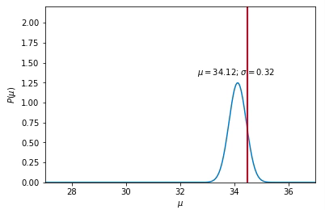
NGC 1558
Distance modulus | Distance modulus error
34.12 | 0.32
34.2 | 0.32
33.92 | 0.43
34.15 | 0.43
34.25 | 0.43
33.88 | 0.8
33.99 | 0.07
33.86 | 0.46
33.88 | 0.47
33.98 | 0.4
33.99 | 0.45
29.08 | 0.36
33.95 | 0.29
34.12 | 0.27
34.16 | 0.2
NED-D: A Master List of Redshift-Independent Extragalactic Distances
https://ned.ipac.caltech.edu/Library/Distances/

Slide 11
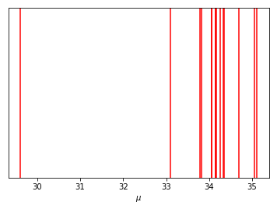
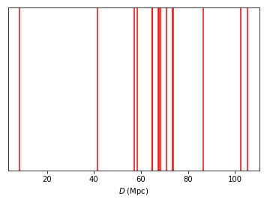
NGC 1558
Distance modulus | Distance modulus error
34.12 | 0.32
34.2 | 0.32
33.92 | 0.43
34.15 | 0.43
34.25 | 0.43
33.88 | 0.8
33.99 | 0.07
33.86 | 0.46
33.88 | 0.47
33.98 | 0.4
33.99 | 0.45
29.08 | 0.36
33.95 | 0.29
34.12 | 0.27
34.16 | 0.2

Slide 12
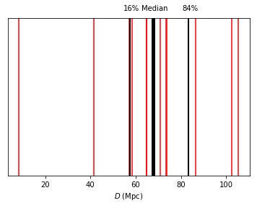
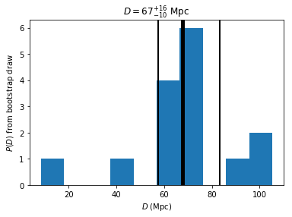
NGC 1558

Slide 13
NGC 1558
“Frequentist” methods:
P: Propagation of errors (Cosmicflows-3, Tully et al 2016)
Q: Quadrature sum of P error and weighted stdev (to account for spread between measurements)
σ_{P} = 1.6 Mpc
σ_{Q} = 22 Mpc
Proposed (bootstrap + robust)
H: Half-distance between the 84th and 16th percentiles
M: Median Absolute Deviation (outlier-proof)
σ_{H} = 11 Mpc
σ_{M} = 8 Mpc
If outliers did not affect uncertainty, then H=M
If P and/or Q are good measures of spread, then P and or Q=H

Slide 14
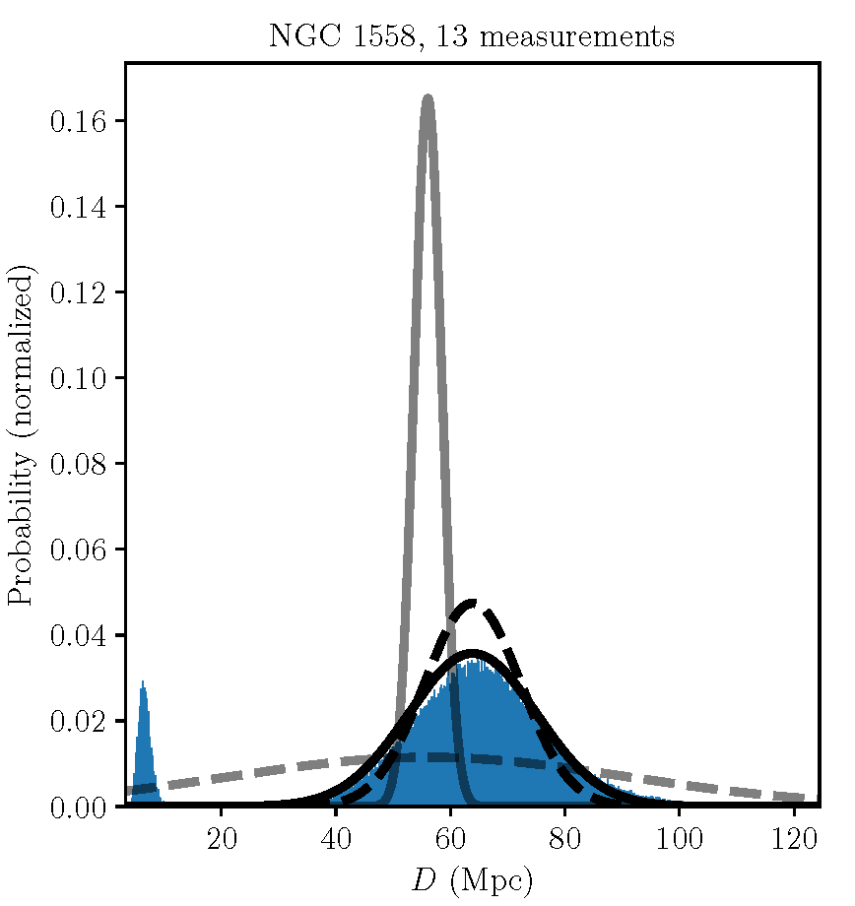
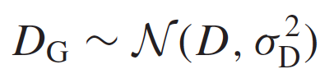
Chaparro Molano+2019 – astro-ph:1805.02578

Slide 15
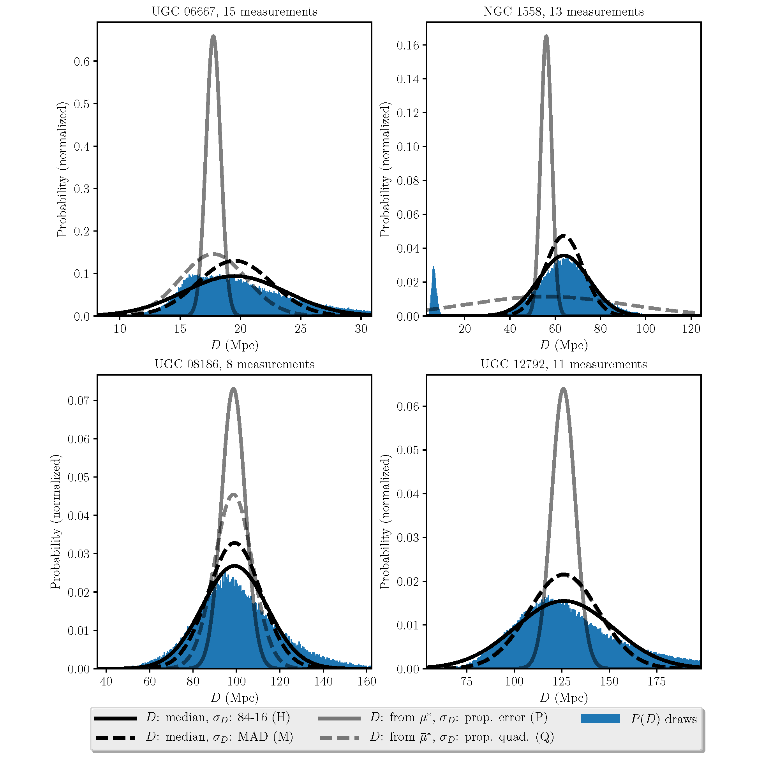
Chaparro Molano+2019 – astro-ph:1805.02578

Slide 16
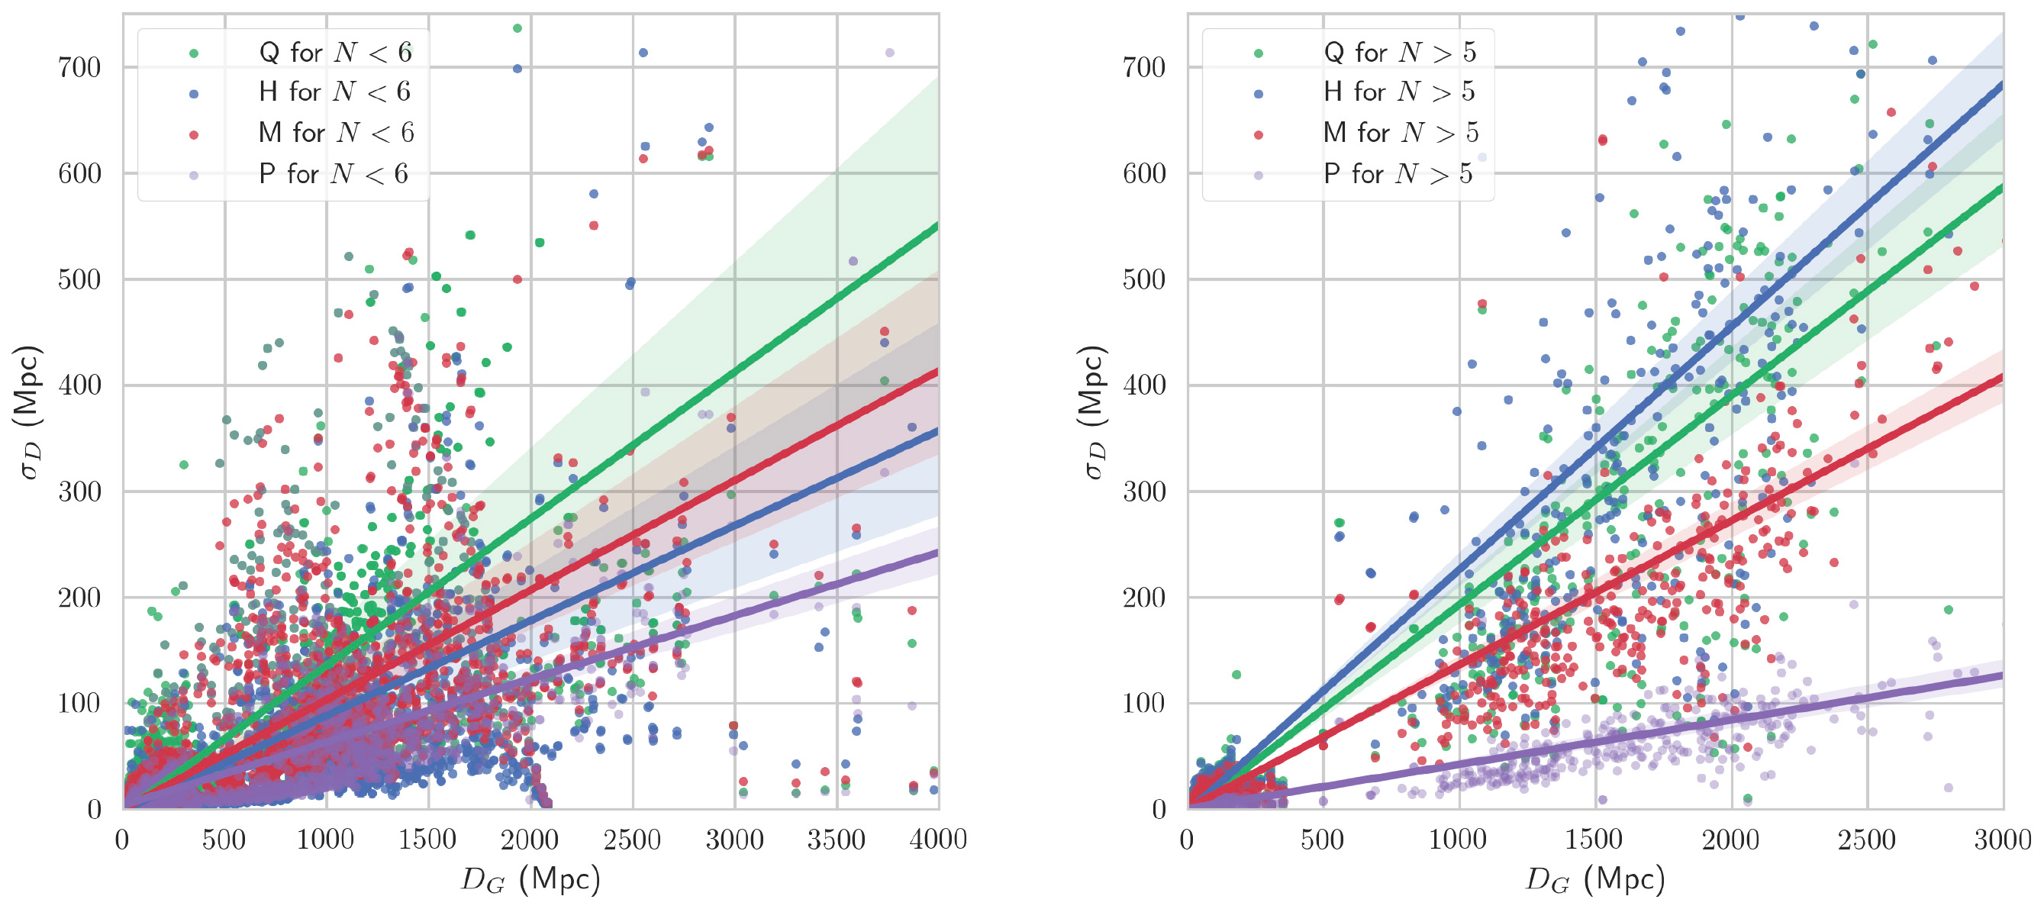
Errors in NED-D Extragalactic Distances
Few measurements
More than a few measurements
Chaparro Molano+2019 – astro-ph:1805.02578

Slide 17
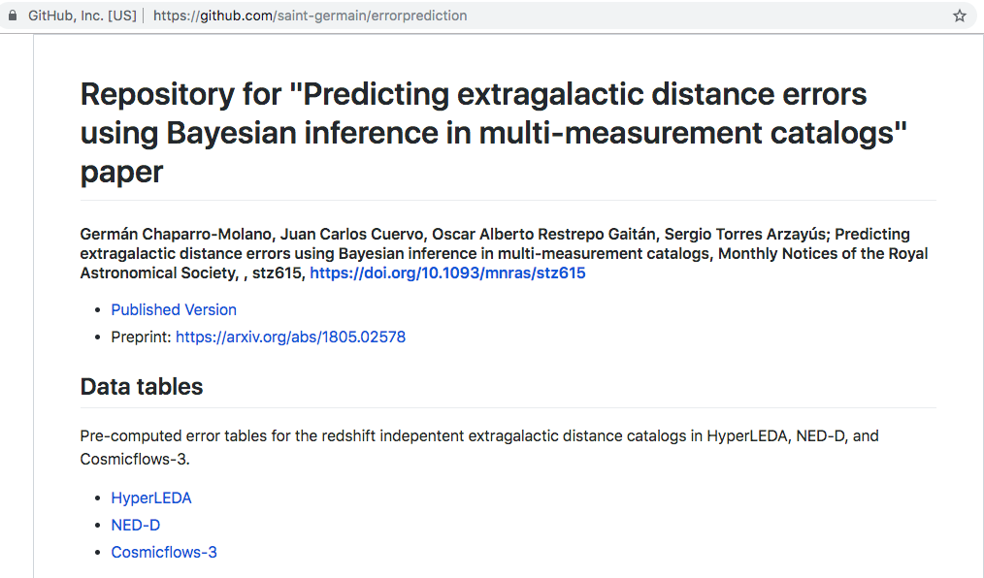
Pre-Computed Error Tables

Slide 18

M87
NED-D:
  115 measurements
  M-error = 1.6 Mpc
HyperLEDA:
  5 measurements
  M-error = 1.2 Mpc
EHT Collab+2019
  3 measurements
  Error = ~1 Mpc

Slide 19
When to use each error table
Comprehensive distances: NED-D
Comprehensive distances, calibrated: HyperLEDA
Latest, most trustworthy distances: Cosmicflows-3

Slide 20
Unknown Unknowns
Missing errors galore!
NED-D (NASA/IPAC)
  ~12k measurements without reported errors
  ~1k galaxies without reported TFR errors
HyperLEDA A007 (Lyon/SAO)
  ~1000 measurements without reported errors
  ~200 galaxies without reported TFR errors

Slide 21
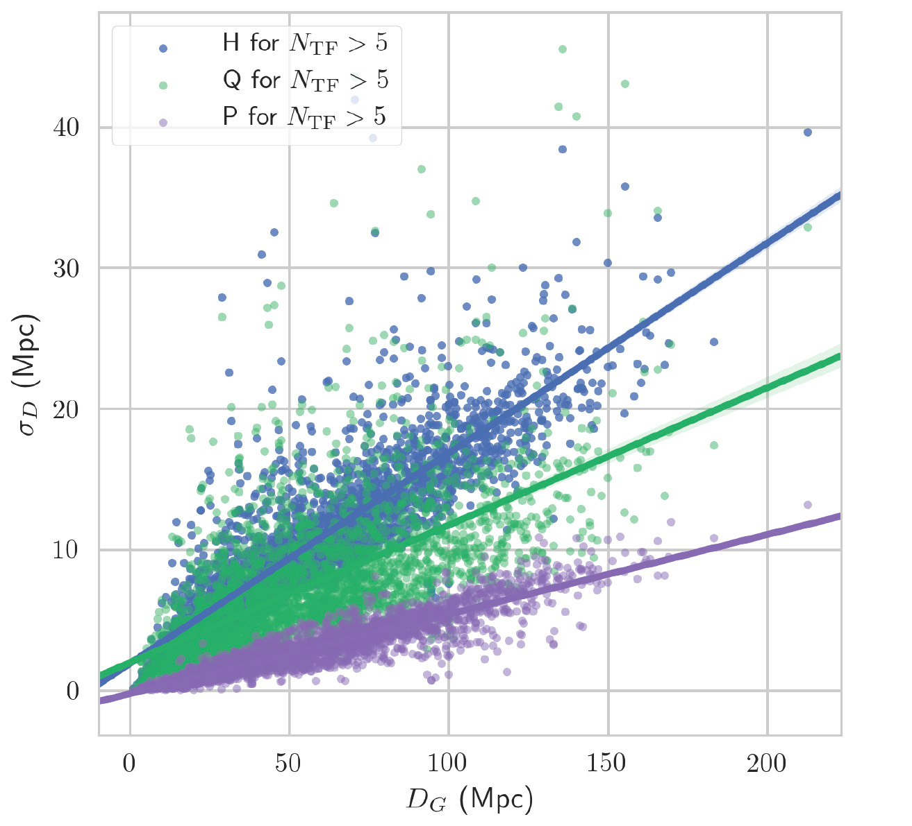
Tully-Fisher Errors in NED-D Extragalactic Distances
Can we extract information on the systematics of the TFR method?
Can we predict missing errors from these systematics?
Chaparro Molano+2019 – astro-ph:1805.02578

Slide 22
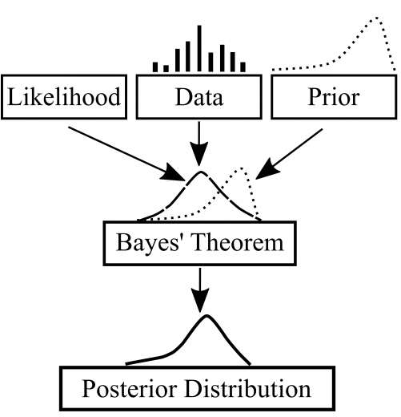
Bayesian Inference

Slide 23
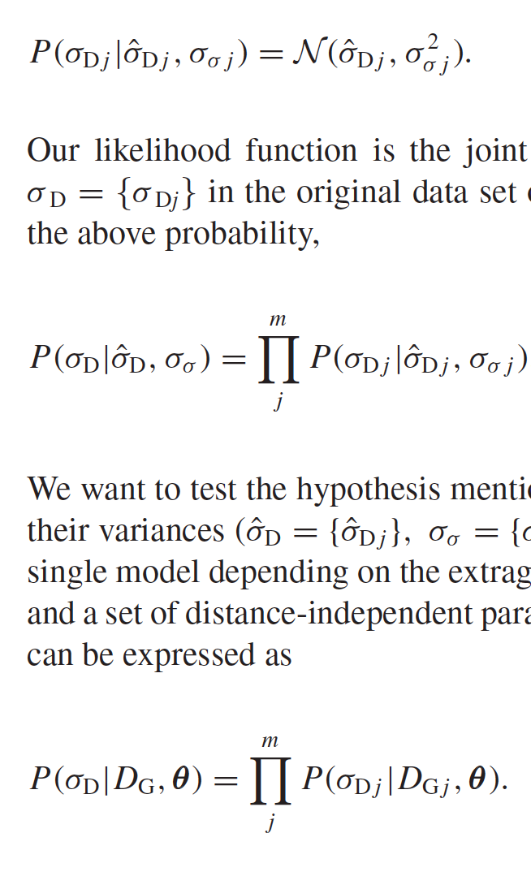

Building a Bayesian Predictive Model
Distance Errors take Normally Distributed Values
Likelihood = Probability that all distance errors in a dataset are generated by a Gaussian
Test whether distance errors can be estimated from D_{G} under a single model depending on a few parameters (θ )
Posterior can be estimated up to a constant (get values for θ given the D_{G}data)
Chaparro Molano+2019 – astro-ph:1805.02578

Slide 24
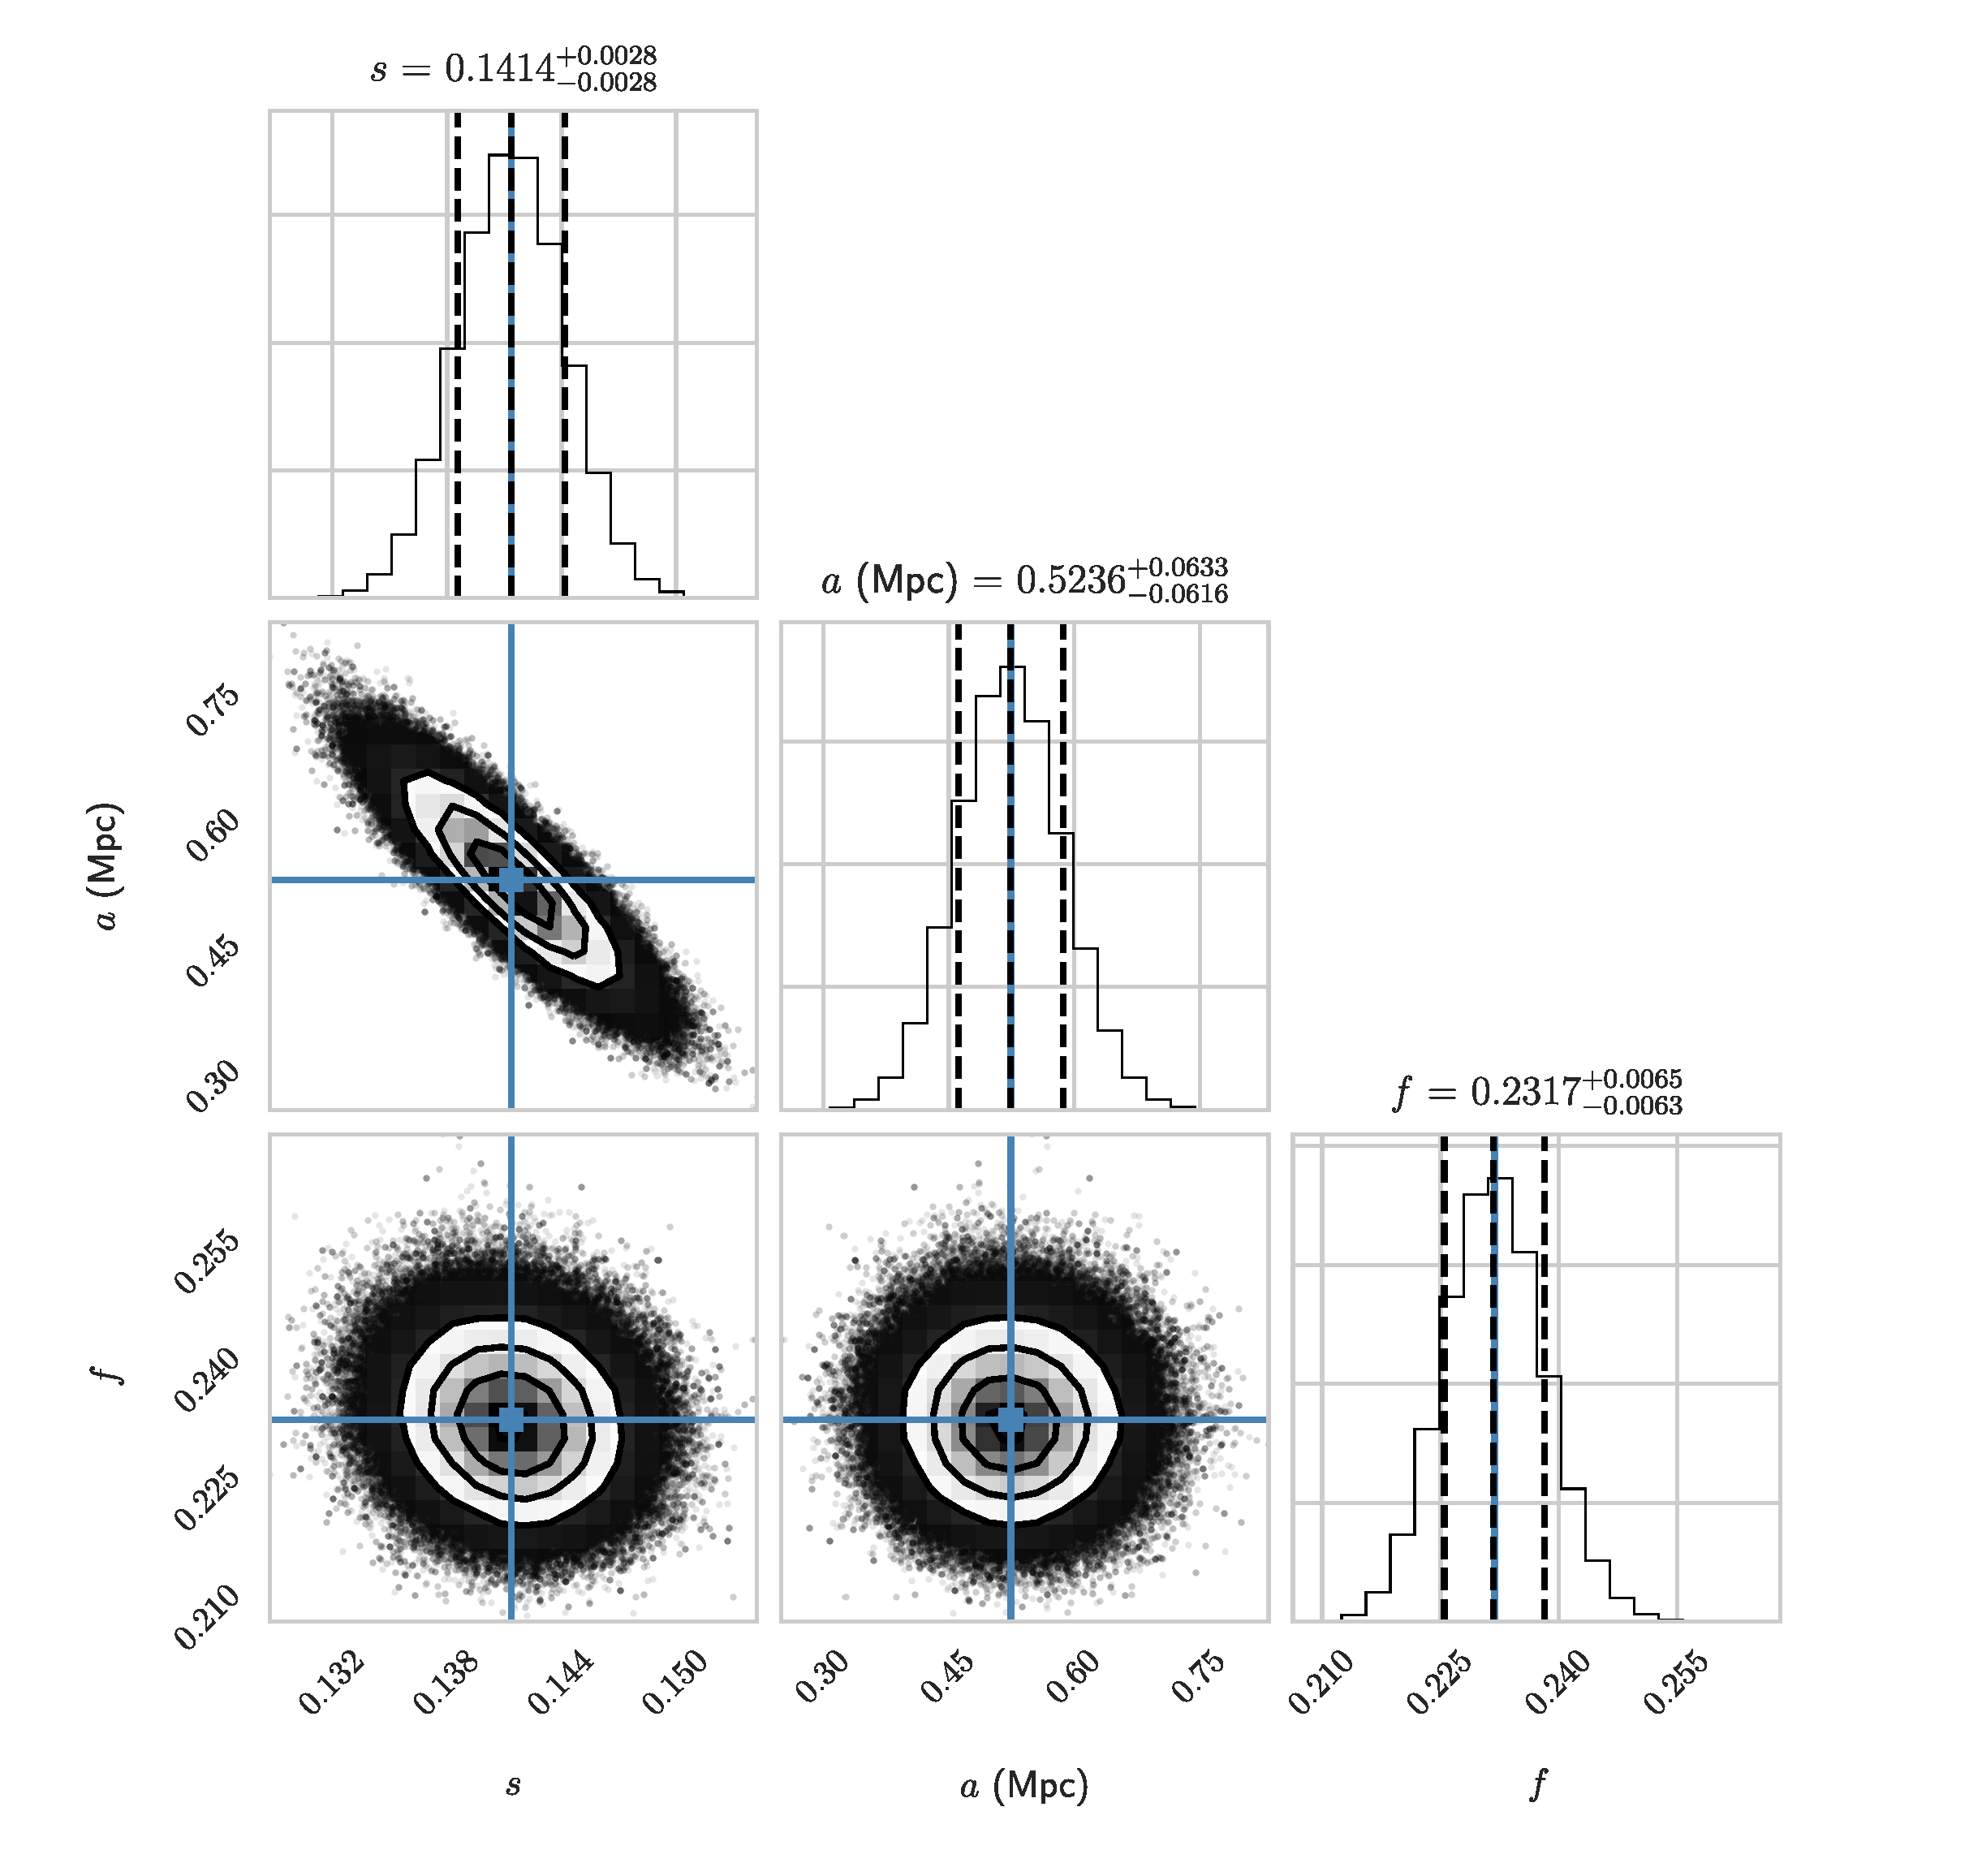


Sampling the Posterior
emcee
Affine Invariant
MCMC Ensemble Sampler
(Foreman-Mackey 2012)
Chaparro Molano+2019 – astro-ph:1805.02578

Slide 25
Sampling the Posterior
“Essentially, all models are wrong, but some are useful.” (Box & Draper 1987)
emcee
Affine Invariant
MCMC Ensemble Sampler
(Foreman-Mackey 2012)
Chaparro Molano+2019 – astro-ph:1805.02578

Slide 26
Posterior Predictive Checks
Chaparro Molano+2019 – astro-ph:1805.02578

Slide 27
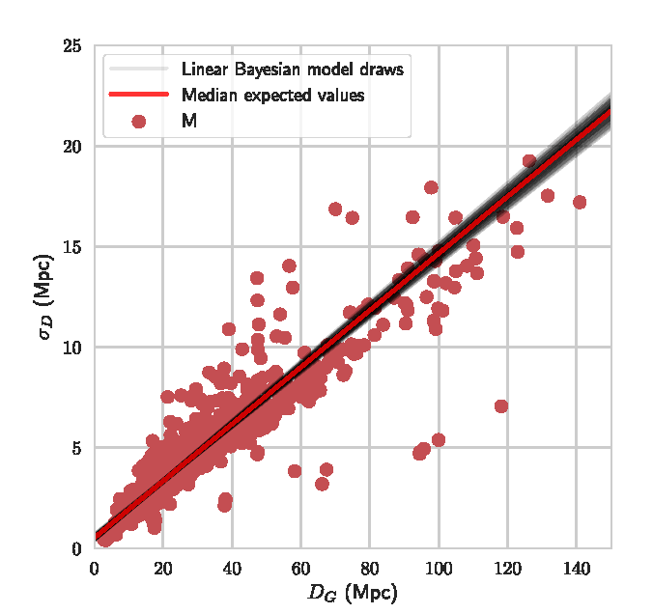
Posterior Predictive Checks
Take samples from MCMC walkers
Chaparro Molano+2019 – astro-ph:1805.02578

Slide 28

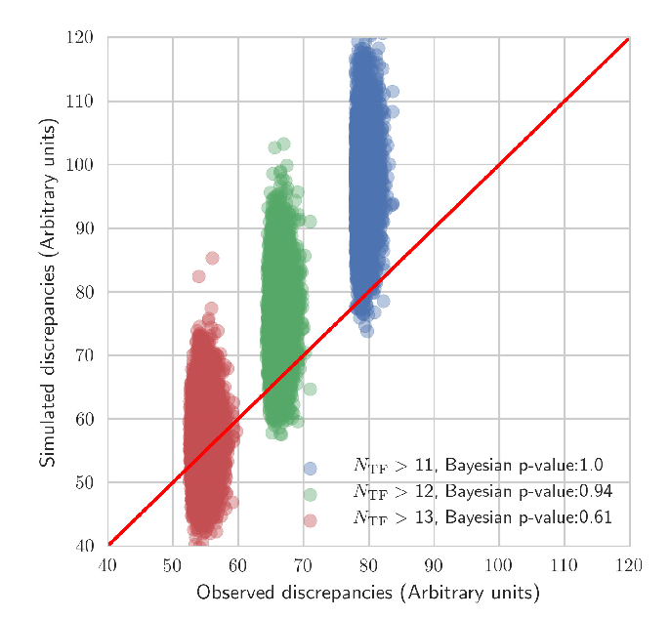
Model Comparison: Discrepancy Measure
(Gelman+1996, Gelman 2003)
Discrepancy between Data and Expected Values (from model)
For each MCMC draw θ_{k}:
Generate synthetic data (from model)
Calculate discrepancies for observed and synthetic data
Compare observed and synthetic discrepancies
Get a Bayesian “p-value” = ratio of ‘draws when the observed discrepancies are larger than the synthetic discrepancies’ to ‘total draws’
Chaparro Molano+2019 – astro-ph:1805.02578

Slide 29
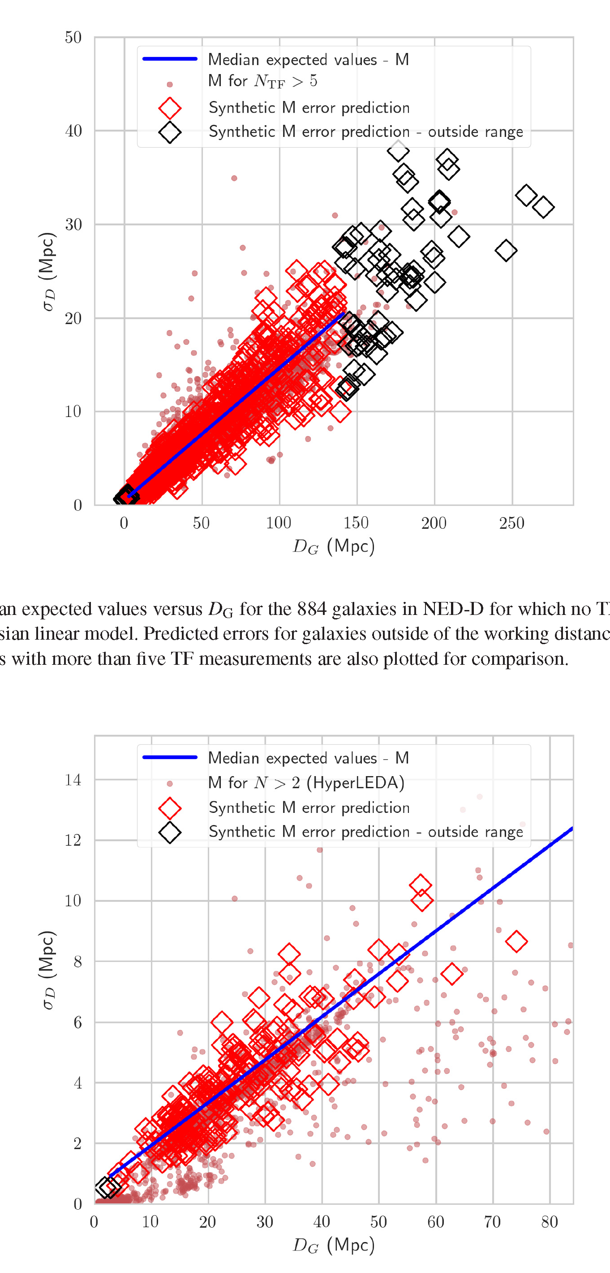
Prediction of Missing Errors
Predictions for 1k galaxies
in NED-D
Chaparro Molano+2019 – astro-ph:1805.02578

Slide 30
Prediction of Missing Errors
Predictions for 1k galaxies
in NED-D
Predictions for 200 galaxies
in HyperLEDA
Chaparro Molano+2019 – astro-ph:1805.02578

Slide 31
Prediction of Missing Errors
Unexpectedly good agreement!
HyperLEDA data never entered
our predictive model!
Predictions for 1k galaxies
in NED-D
Predictions for 200 galaxies
in HyperLEDA
Chaparro Molano+2019 – astro-ph:1805.02578

Slide 32
Summary
We report error data tables using the robust (H, M) and frequentist (P, Q) methods for NED-D, HyperLEDA, and Cosmicflows-3, along with the 16th, 50th, and 84th percentiles of the bootstrap sampled distance distribution for each galaxy.
These error tables should be a fundamental tool for future precision cosmology, catalog-wide studies.
We create a Bayesian predictive model for TFR distance errors in the NED-D catalogue and we use it to predict missing errors for 884 galaxies.
This predictive model was independently validated against HyperLEDA for 203 galaxies with missing TFR distance errors.
We want to advocate for the use of discrepancy measures for Bayesian model checking, as it checks the model’s ability to reproduce observed data scatter.

Slide 33
Error data tables, code, posterior samples at:
https://github.com/saint-germain/errorprediction

Slide 34
Riess et al. (2019) report Ho = 74 km/s/Mpc (distance ladder method). Planck (2018) reports Ho = 67 (cosmological).
Difference ok 5.8 Km/s/Mpc is (> ~ 3-sigma)

Slide 35
