Slide 1




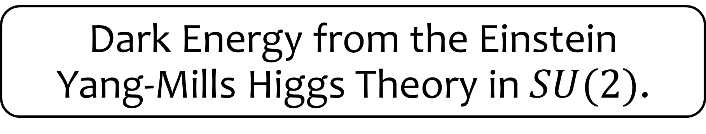
Dark Energy from the Einstein
Yang-Mills Higgs Theory in $SU(2)$.
J. Bayron O. Quintana
César A. Valenzuela-Toledo
Miguel A. Álvarez
Yeinzon Rodríguez

Slide 2

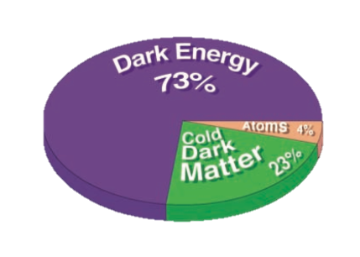

What is our Universe made of?

Slide 3

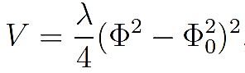




EYMH Theory in $SU\left(2\right).$
Action
Covariant derivative
Mexican Hat Potential
FLRW Universe $→$ Homogeneous and Isotropic
Cosmic Triad
M. Rinaldi, Class. Quantum Grav. 32, 045002 (2015).

Slide 4
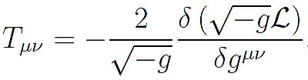



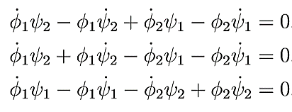





Energy Tensor
Contribution of the Scalar Field
Solution? $→$ Endless
What?!
Excellent!!!
Unitary Gauge

Slide 5




Field Equations.
Friedmann Equations
Equation for the Higgs Field
Equation for the Gauge Field

Slide 6
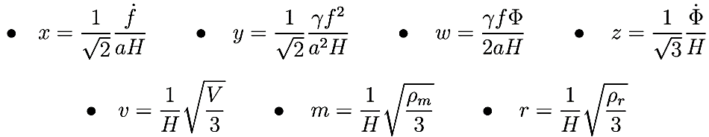
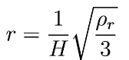
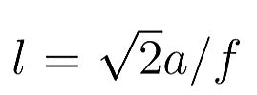
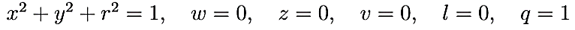
Dynamical System
Normalized Expansion Variables:
Fixed Points
Kination
Radiation
Matter
Transition
Dark Energy

Slide 7



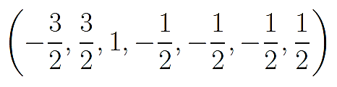


Stability Analysis.
FALTA GRAFICA RADIACION.
Jacobian
Kination
Repeller
Radiation
Saddle
Matter
Saddle
Transition
Saddle - Inconsistent
Dark Energy
Attractor!!!

Slide 8
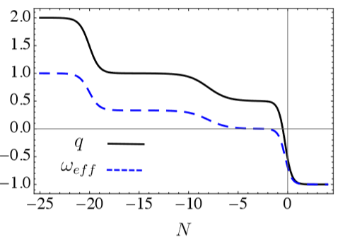
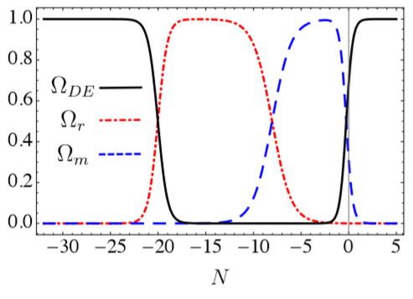

Evolution of the Deceleration Parameter and the Effective State Equation:
The final stage of the Universe is characterized by a negative state equation.
Evolution of the Density Parameters:
The first stage is the domination of the kinetic energy of $Φ$, passes through radiation and matter eras, eventually it reaches the dark energy stage which is an attractor. The Universe is condemned to suffer accelerated expansion.

Slide 9

Conclusions.
The EYMH theory in $SU(2)$ can reproduce the domination epochs of the Universe.
A specific form for the gauge and Higgs fields is needed in order to get a theory consistent with an isotropic Universe.
The dynamical system analysis reveals that dark energy domination is the only attractor point.
The dark energy is kept thanks to the gauge field which is “pushing up” the Higgs field preventing it to fall to its vaccum.

Slide 10

Thank you!!!

