Slide 1


Analytic Approximations for the Velocity Suppression of Dark Matter Capture
Jillian Paulin, Cosmin Ilie
Colgate University
This Photo by Unknown Author is licensed under CC BY-SA

Slide 2

Introduction
Dark Matter (DM)– one of the biggest mysteries in modern astrophysics & cosmology
Indirect detection of DM with astrophysical objects is an important discovery method
Impact of relative stellar velocity to DM halo on DM capture rates
This presentation is based on our paper: C. Ilie and J. Paulin, ApJ (in press) arXiv:2107.00675
  Accessible via the QR code
Outline:
  DM Capture
  DM Distributions
  Suppression Factor
  Bounds on DM-nucleon cross section

Slide 3
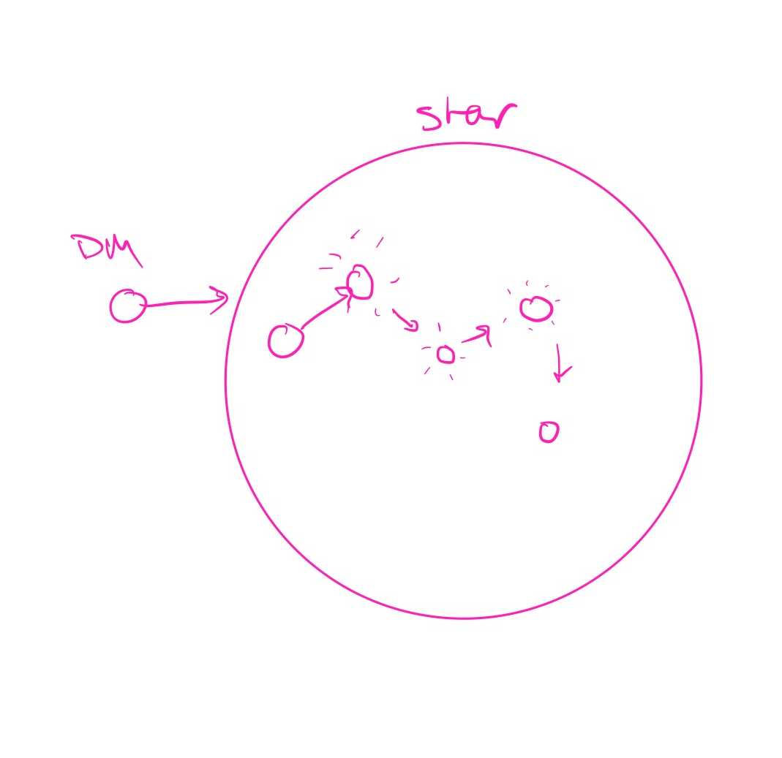
Dark Matter Capture: Conceptual Picture
DM scatters off nuclei & loses energy with each collision
DM is captured once the DM velocity falls below the escape velocity of the capturing object

Slide 4


Dark matter Capture
Stellar radius
Prob. For N collisions
DM Distribution
Prob. DM particle falls below v_{esc}
The total capture rate: the sum of the capture rate after N scatters
The focus for this project is the effect of altering the DM distribution

Slide 5



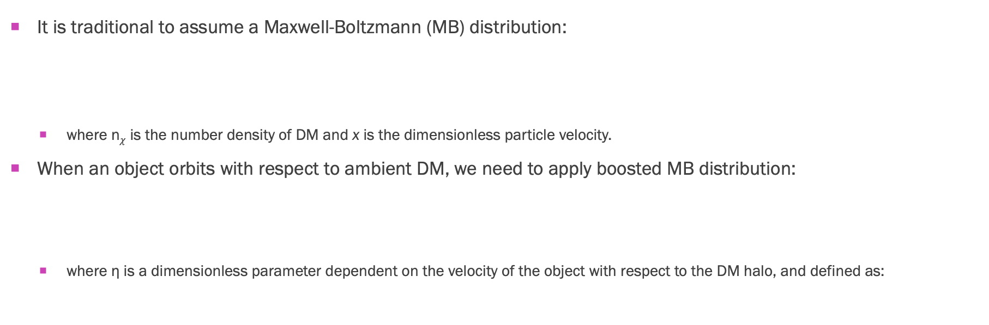
Dark matter Velocity Distribution
It is traditional to assume a Maxwell-Boltzmann (MB) distribution:
  where n$χ$ is the number density of DM and x is the dimensionless particle velocity.
When an object orbits with respect to ambient DM, we need to apply boosted MB distribution:
  where η is a dimensionless parameter dependent on the velocity of the object with respect to the DM halo, and defined as:
Stellar velocity
Average DM velocity

Slide 6
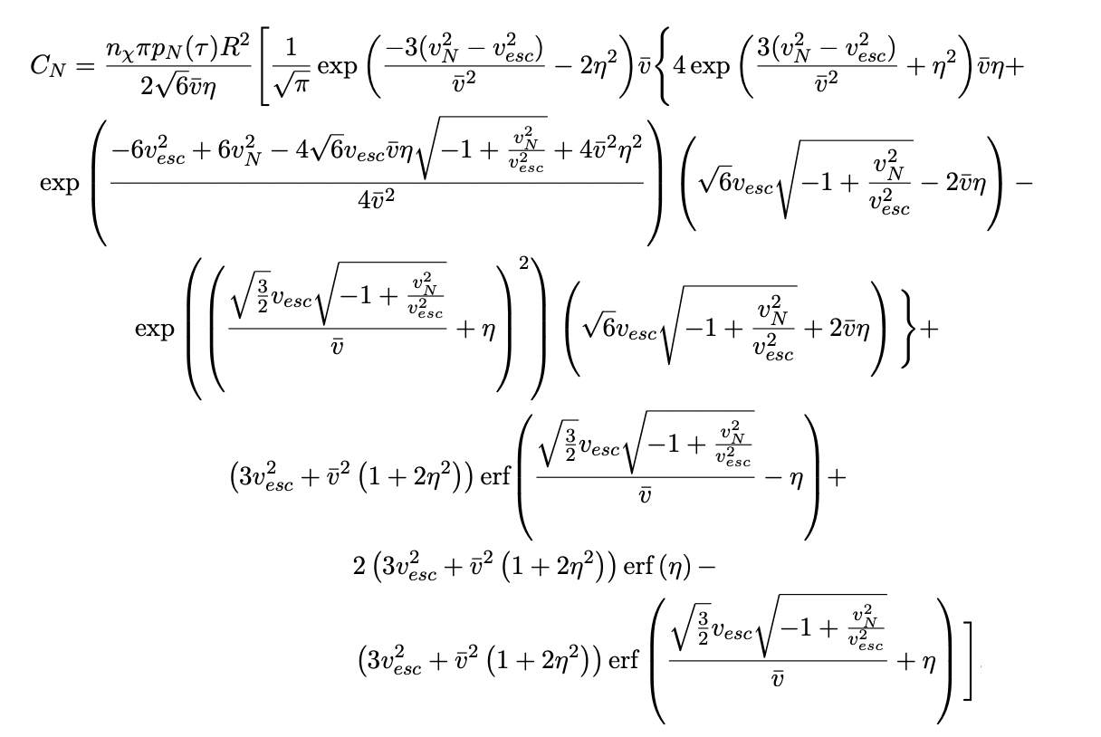
Total Capture Rate: With Boosted Distribution
In contrast:

Slide 7


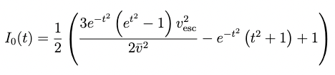

Analytic suppression Factor
The following is a useful closed form solution for the suppression factor:
where:

Slide 8
Suppression Factor for the sun
single scatter
multiscatter
single scatter
multiscatter

Slide 9
Suppression of the Total Capture Rate

Slide 10

What about the earliest stars?
Pop III stars:
  Theoretical class of stars
  Only contain H and He
  Redshifts z=10-50 (universe was approx. 200 million yrs old)
  1 or a few (due to fragmentation) per DM halo (halo mass ~ 10⁵-10⁶ M☉)
  Masses up to ~1000 M☉
  Very interesting candidates to constrain DM properties

Slide 11
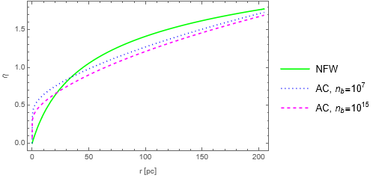
Dark Matter Halo Profiles
Notes:
Pick one nb for AC

Slide 12
Suppression factor for Pop III Stars
single scatter
multiscatter

Slide 13
Bounds on the DM-Nucleon Cross Section

Slide 14
Conclusions
Stellar velocity has a negligible impact on DM constraints from Pop III stars
Stellar velocity has a more significant impact for more local objects where η is higher
We have developed useful analytic formulae which are applicable in a variety of astrophysical contexts
We plan to study exoplanets and brown dwarfs next, in which we may account for the objects’ velocities using the given formulae. We plan to also explore the effects of DM evaporation in such objects.

Slide 15
Acknowledgements
Thank you to the other past & present members of the Dark Matter research team at Colgate University for your thoughtful discussions: Cosmin Ilie, Caleb Levy, Jacob Pilawa, Saiyang Zhang, Ian Bania, Madison Markham, Ellie Humphreys
Funding for this project was provided by the Justus ‘43 and Jayne Schlichting Fund and the Colgate University Research Council student wage grant.

Slide 16

Questions?
Email: jpaulin@colgate.edu cilie@colgate.edu

