Slide 1



Memory-triggered supernova neutrino detection
Mainak Mukhopadhyay
Department of Physics,
Arizona State University (ASU)
XV International Conference on interconnections between
Particle Physics and Cosmology (PPC 2022)
Washington University, St. Louis
June 08, 2022

Slide 2
Based on
The neutrino gravitational memory from a core collapse supernova: phenomenology and physics potential
MM, C. Cardona, C. Lunardini
JCAP 07 (2021) 055 (arXiv: 2105.05862).
Memory-triggered supernova neutrino detection
MM, Z. Lin, C. Lunardini
Submitted to PRL (arXiv: 2110.14657)
June 08, 2022
Memory-triggered SN neutrino detection
Mainak Mukhopadhyay

Slide 3
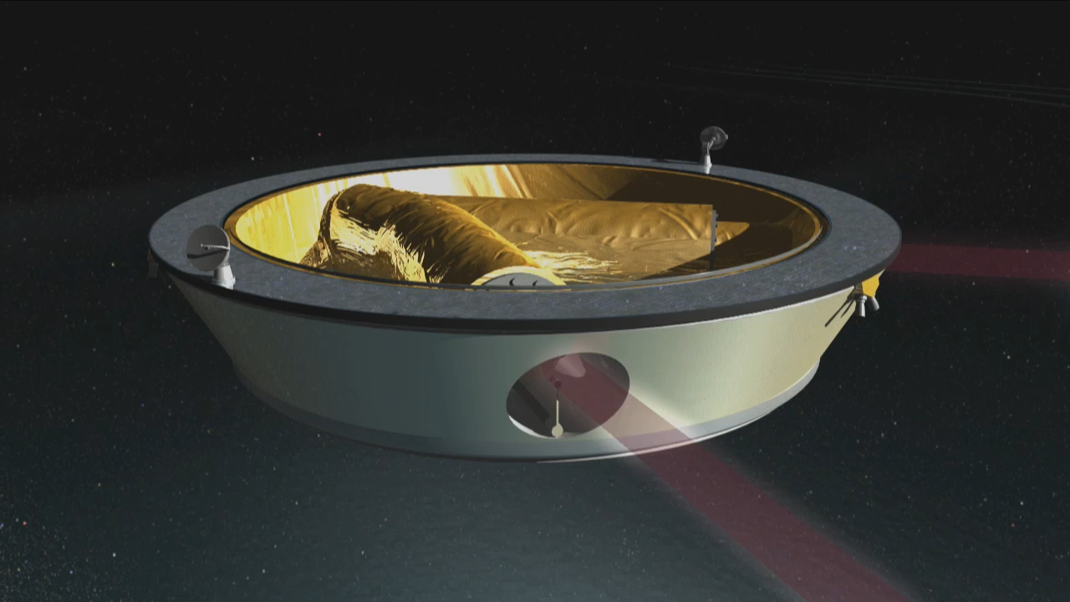
What is Gravitational Wave (GW) memory?
The Laser Interferometer Space Antenna (LISA)
Animation Credits: Chris Meaney and NASA
June 08, 2022
Memory-triggered SN neutrino detection
Mainak Mukhopadhyay

Slide 4
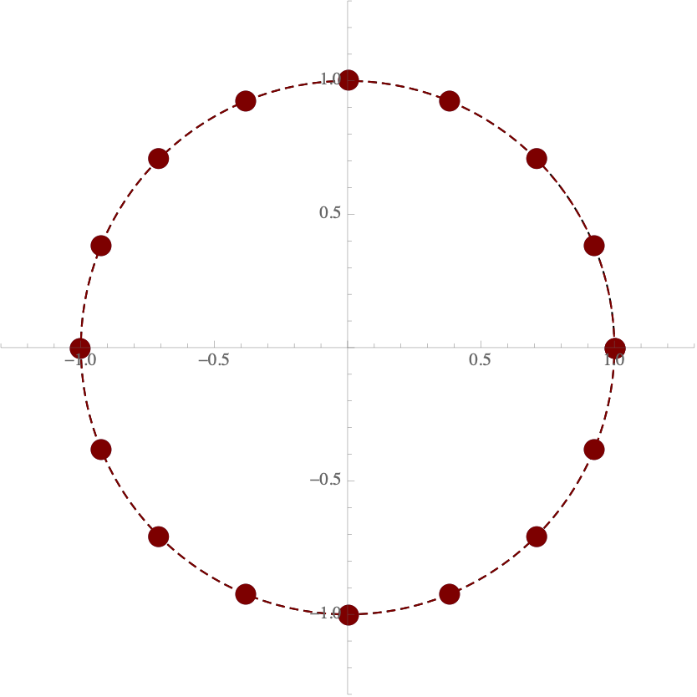
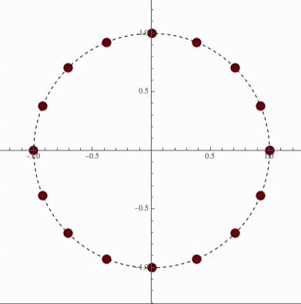
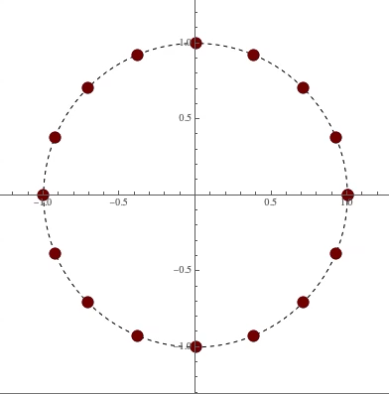
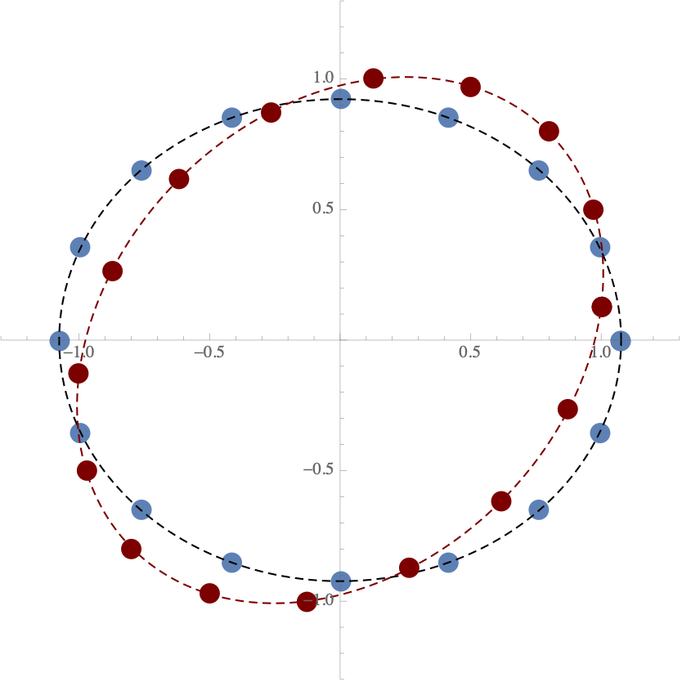
What is Gravitational Wave (GW) memory?
Before Passage of GW
GW passing through a detector say LISA
After the GW has passed
Without memory
With memory
: ’+’ Polarization
: ’x’ Polarization
GW is propagating perpendicular to the screen
Animation Credits: Joel Frederico
June 08, 2022
Memory-triggered SN neutrino detection
Mainak Mukhopadhyay

Slide 5
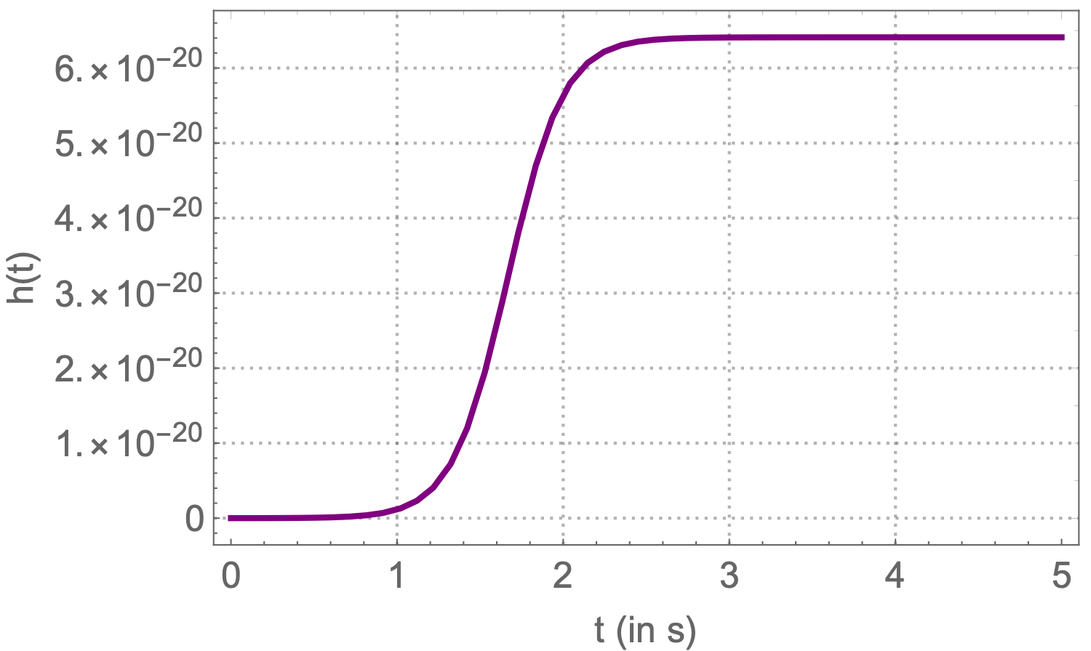
What is Gravitational Wave (GW) memory?
Causes:
Gravitationally unbound systems:
Anisotropic emission of energy (mass/radiation)
The gravitational wave strain h(t) remains at a non-zero value
Permanent distortion of the local space-time metric
M. Favata, The gravitational-wave memory effect, Class. Quant. Grav. 27 (2010) 084036
June 08, 2022
Memory-triggered SN neutrino detection
Mainak Mukhopadhyay

Slide 6
What is Gravitational Wave (GW) memory?
Causes:
Gravitationally unbound systems:
Anisotropic emission of energy (mass/radiation)
The gravitational wave strain h(t) remains at a non-zero value
Permanent distortion of the local space-time metric
The GW memory has never been observed!
Need:
A very powerful emitter
Anisotropy
Detectors in the frequency
regimes of interest
M. Favata, The gravitational-wave memory effect, Class. Quant. Grav. 27 (2010) 084036
June 08, 2022
Memory-triggered SN neutrino detection
Mainak Mukhopadhyay

Slide 7
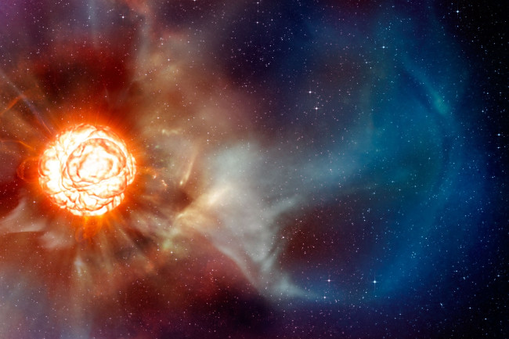
An Ideal Candidate: Core-collapse Supernova (CCSN)
Total energy as neutrinos :
Anisotropy :
Neutrino emission timescale :
$Δt∼O(10\text{s})→\text{sub-Hz scale}$
$$E_{total}∼3×{10}^{53}\text{ergs}∼(99\%)$$
$$α∼{10}^{-3}-{10}^{-2}$$
Credits: European Southern Observatory, L. Calçada
June 08, 2022
Memory-triggered SN neutrino detection
Mainak Mukhopadhyay

Slide 8
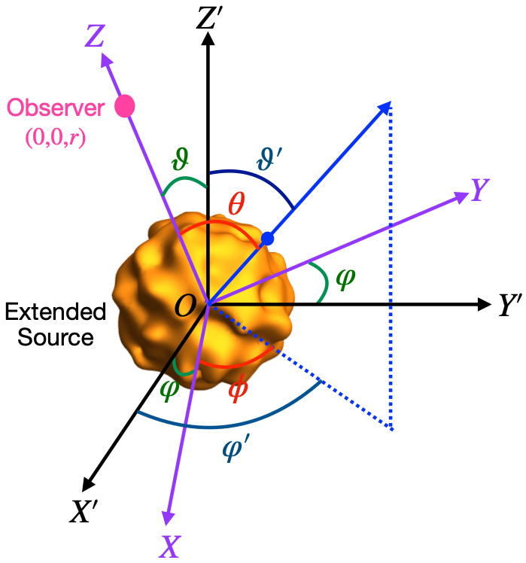
Phenomenological Model: Formalism
Begin with Einstein’s field equation:
$$R_{μν}-\frac{1}{2}Rg_{μν}=-8πGT_{μν}$$
Invoke weak field approximation (since we are very far away from the source $r→∞$)
$$g_{μν}=η_{μν}+h_{μν}$$
$$α(t)=\frac{1}{L_{ν}(t)}∫_{4π}dΩ^{′}Ψ(ϑ^{′},φ^{′})\frac{dL_{ν}(Ω^{′},t)}{dΩ^{′}}$$
Small perturbation
Angular dependence put together in anisotropy parameter
Black Box….
(Calculations in progress)
$$h_{TT}^{xx}=h(t)=\frac{2G}{rc^{4}}∫_{-∞}^{t-r/c}dt^{′}L_{ν}(t^{′})α(t^{′})$$
Change of separation for two free-falling masses
$$δl_{j}=\frac{1}{2}h_{jk}^{TT}l^{k}$$
Epstein, Astrophys. J. 223 (1978) 565
E. Mueller and H.T. Janka, AAP 317 (1997) 140
June 08, 2022
Memory-triggered SN neutrino detection
Mainak Mukhopadhyay

Slide 9
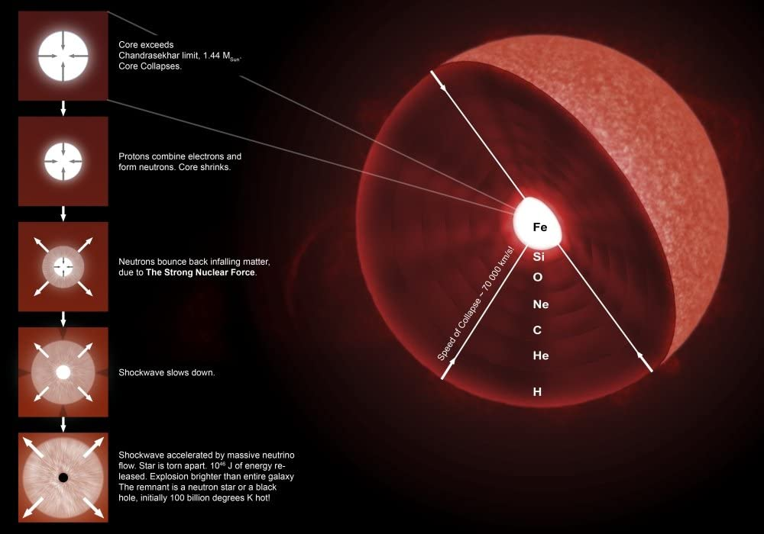
Supernova (SN) neutrinos - Review
Also see: Prof. Alex Friedland’s talk
CCSN: death of a massive (>10 $M_{sun}$) star
Red or Blue supergiants: advanced stages of
nuclear burning
Fe core: Fusion turns off: loss of pressure
Core collapses
Collapsed core: very dense (nuclear densities):
Incompressible
Infalling matter bounces off:
Shockwave produced
Star explodes: Supernova
Neutron star forming collapse (NSFC)
Shockwave re-energized
Shockwave stalls
Failed Supernova
Black hole forming collapse (BHFC)
Shockwave dies down
Credits: https://images-na.ssl-images-amazon.com/images/I/61yf26rpIXL._AC_SL1000_.jpg
June 08, 2022
Memory-triggered SN neutrino detection
Mainak Mukhopadhyay

Slide 10
Supernova (SN) neutrinos - Review
CCSN: death of a massive (>10 $M_{sun}$) star
Red or Blue supergiants: advanced stages of
nuclear burning
Fe core: Fusion turns off: loss of pressure
Core collapses
Collapsed core: very dense (nuclear densities):
Incompressible
Infalling matter bounces off:
Shockwave produced
Neutrinos emitted right after the collapse:
collapsed core cools
Shockwave stalled: accelerated by neutrinos
Star explodes: Supernova
Giunti and Kim. Fundamentals of Neutrino Physics and Astrophysics (2007)
Janka, Langanke, Marek and Martinez-Pinedo, et.al. Phys. Rept., 442:38–74, (2007)
June 08, 2022
Memory-triggered SN neutrino detection
Mainak Mukhopadhyay

Slide 11
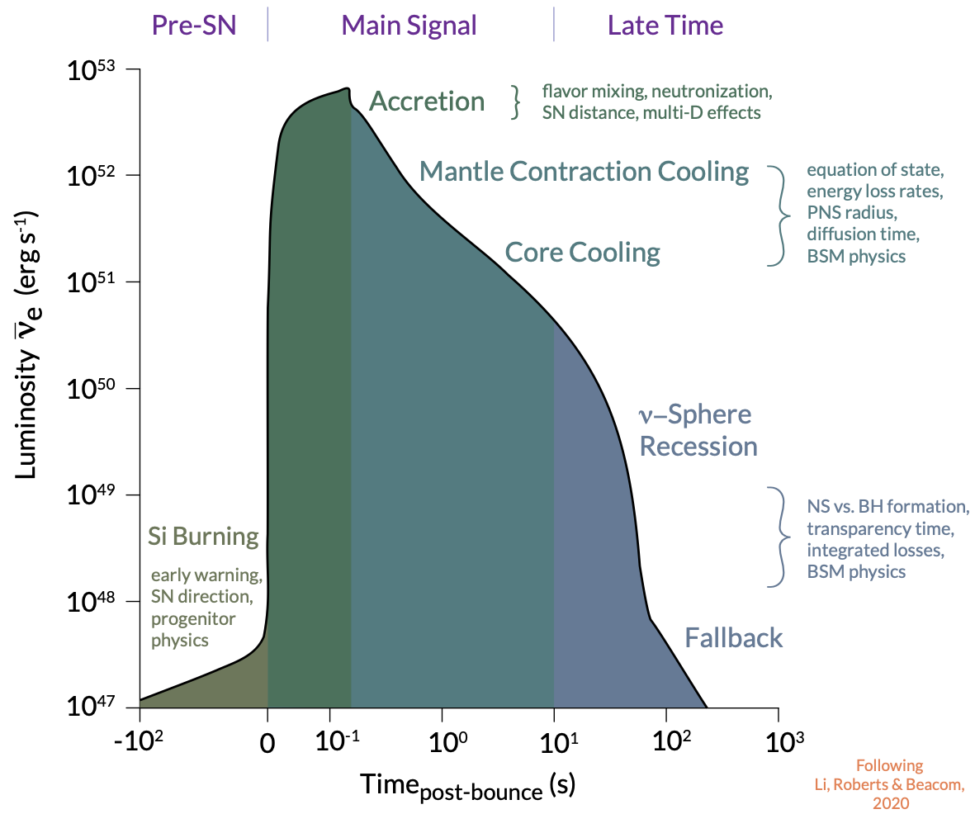
SN neutrino emission phases
c
c
c
c
c
c
Neutrino burst: $∼O(10\text{s})$
Accretion phase: t ~ 0.003 - 0.5 s
Cooling phase: t ~ 0.5 - 10 s
Graphics by: Frank Timmes
June 08, 2022
Memory-triggered SN neutrino detection
Mainak Mukhopadhyay

Slide 12
Anisotropy Parameter
c
Anisotropy develops during accretion phase, due to:
Convection
SASI (Standing Accretion Shock Instability)
c
c
c
c
c
Neutrino burst: $∼O(10\text{s})$
Accretion phase: t ~ 0.003 - 0.5 s
Cooling phase: t ~ 0.5 - 10 s
Graphics by: Frank Timmes
June 08, 2022
Memory-triggered SN neutrino detection
Mainak Mukhopadhyay

Slide 13
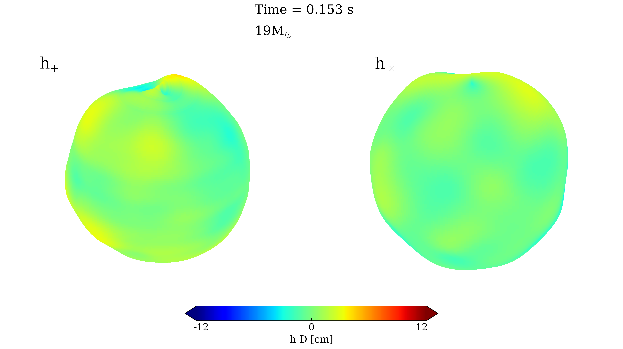
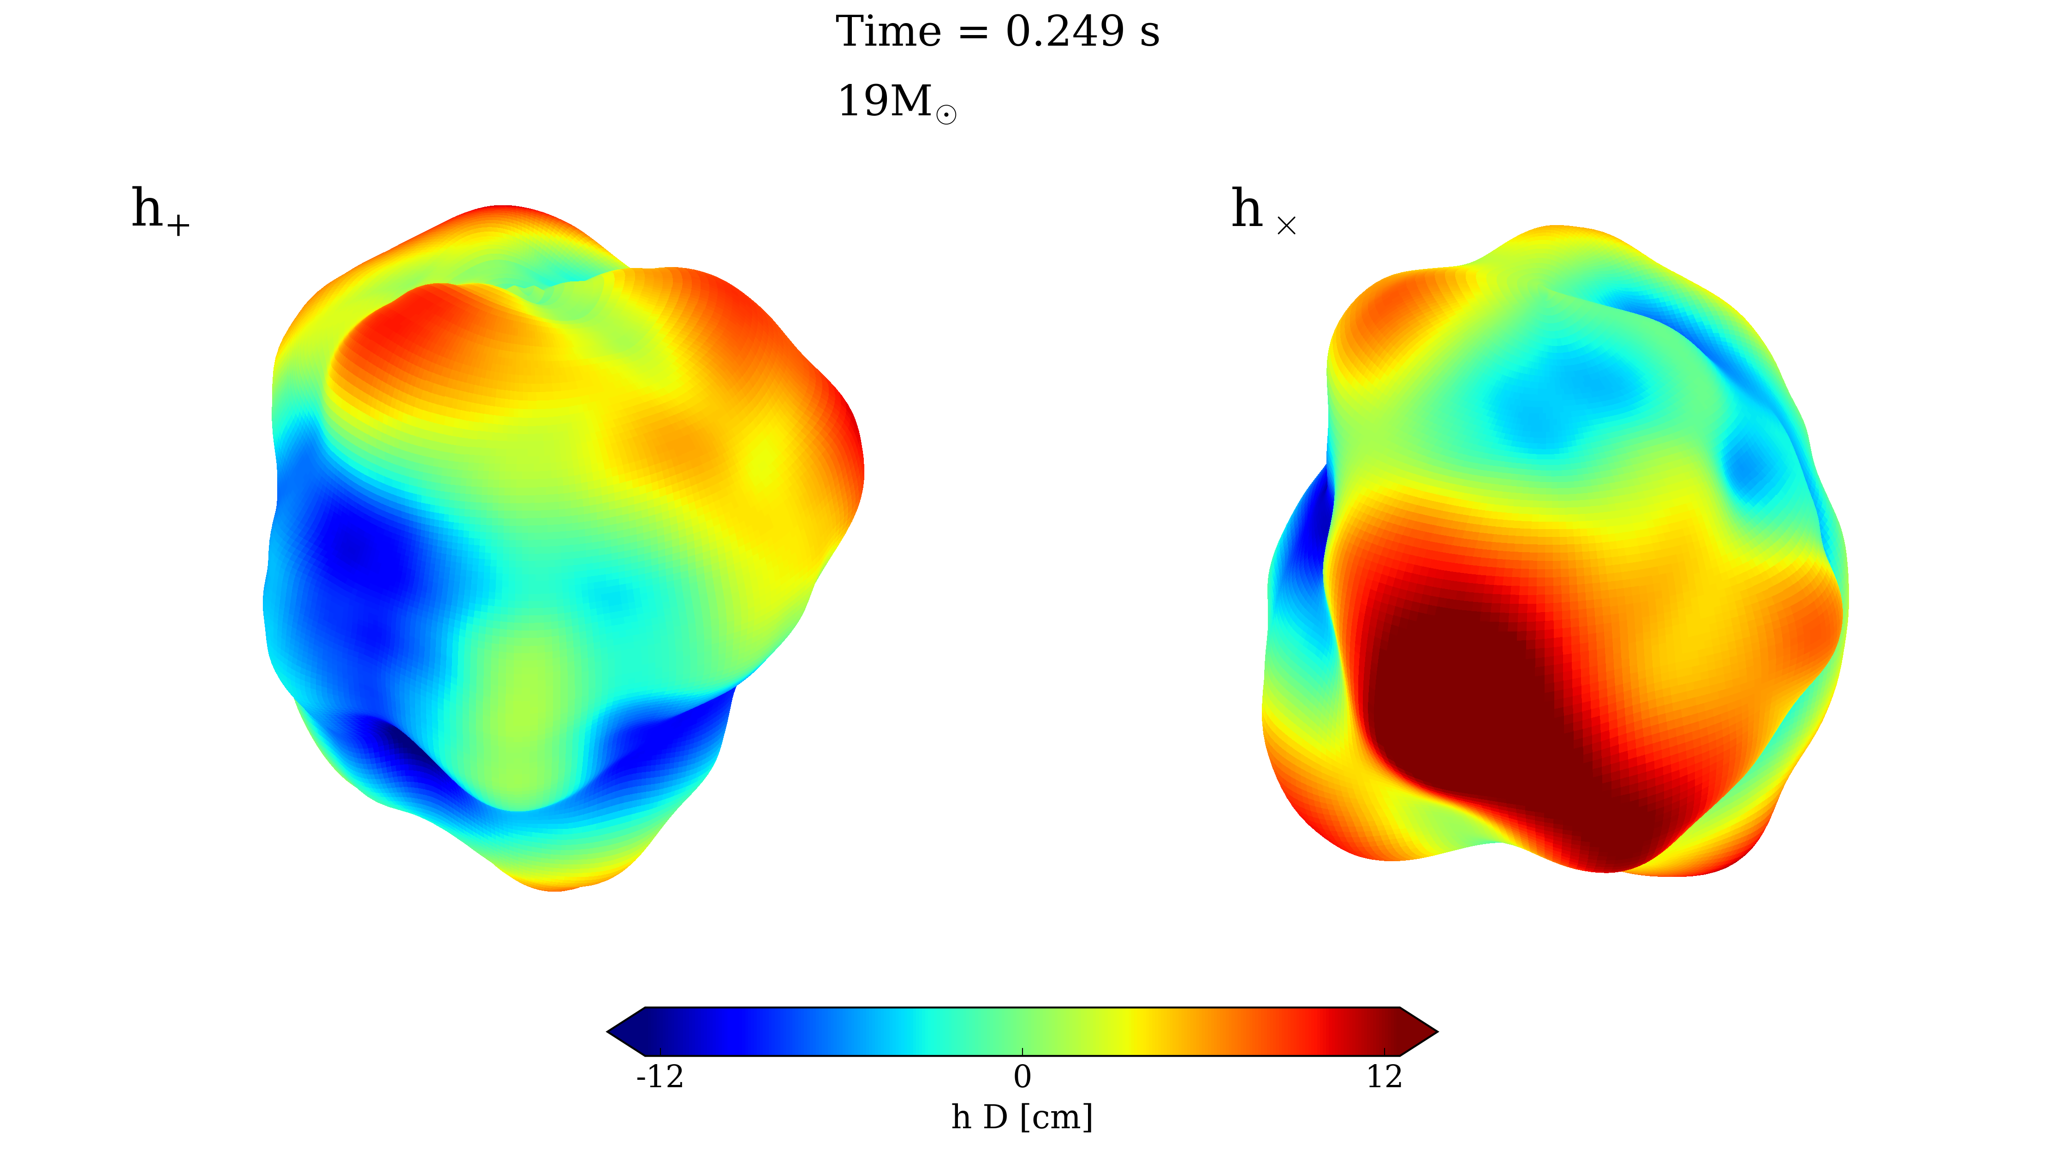
Anisotropy Parameter
Vartanyan and Burrows, Astrophys. J. 901 (2020) 108.
June 08, 2022
Memory-triggered SN neutrino detection
Mainak Mukhopadhyay

Slide 14
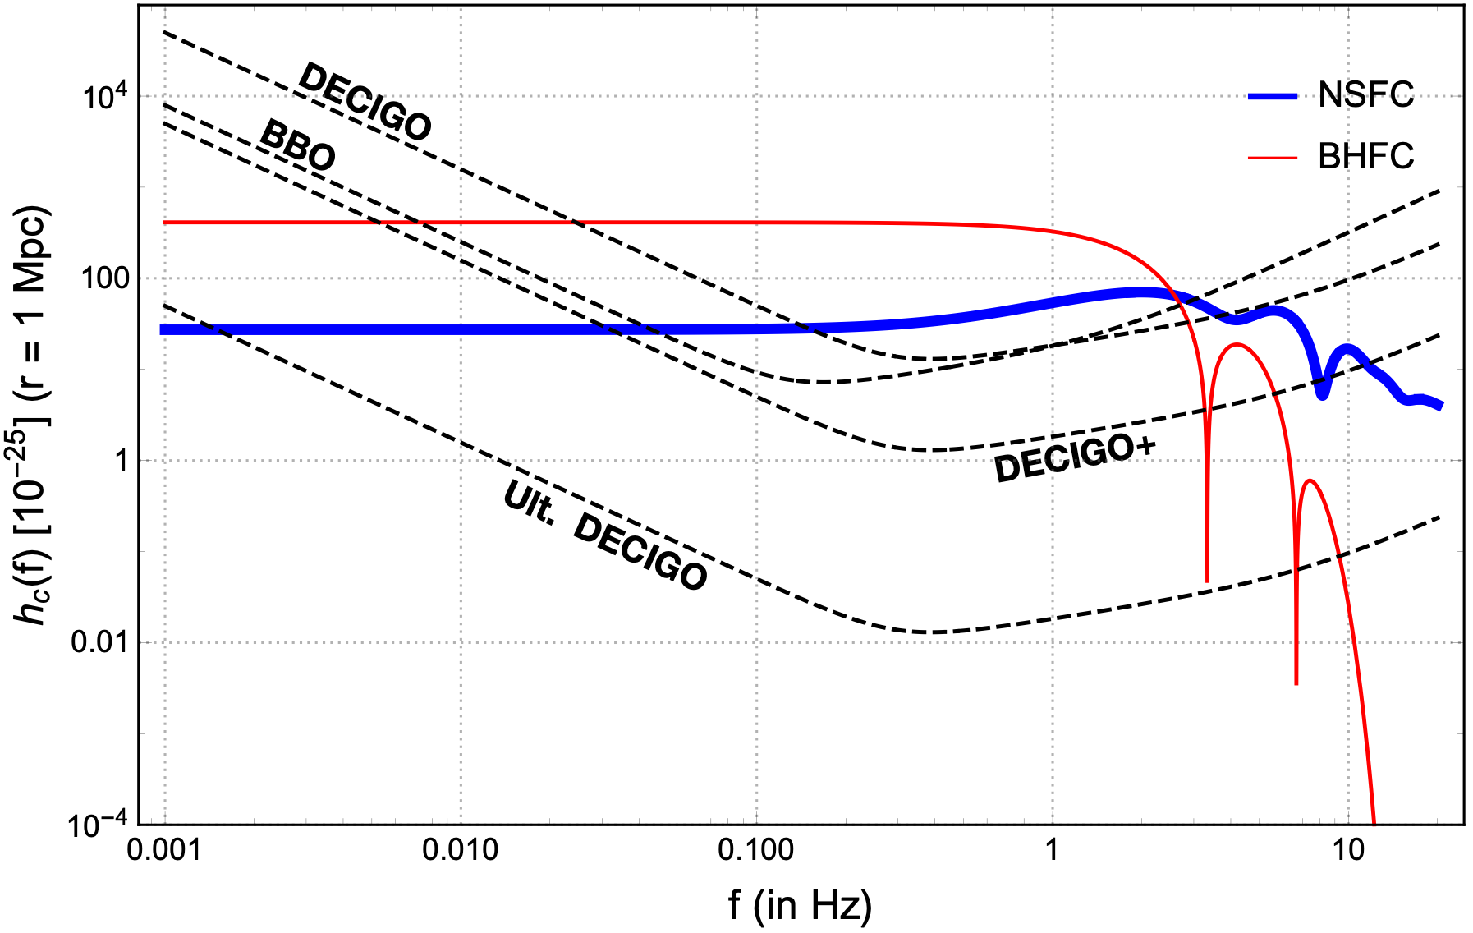
Characteristic strain (r = 1 Mpc)
Will be detectable up to $O(1)\text{Mpc}-O(10)\text{Mpc}$
June 08, 2022
Memory-triggered SN neutrino detection
Mainak Mukhopadhyay

Slide 15
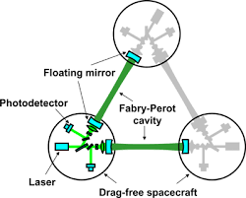
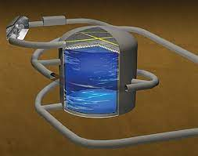
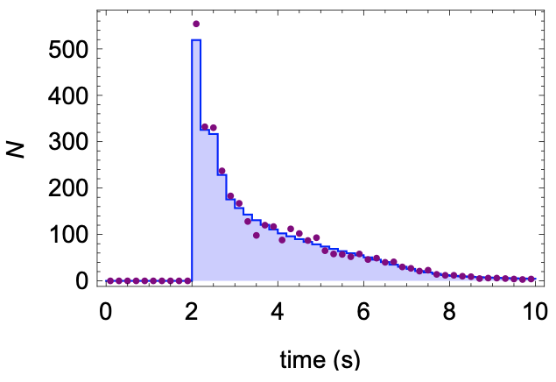
The idea
DECIGO
HyperK
Neutrino GW
Memory
in the GW detector
Neutrinos in the neutrino detector
June 08, 2022
Memory-triggered SN neutrino detection
Mainak Mukhopadhyay

Slide 16
The idea
Neutrino GW
Memory
in the GW detector
Neutrinos in the neutrino detector
1 signal
event
$$Δt=10\text{s}$$
1 signal
event
Neutrino detector
data
$$t_{4}$$
$$t_{5}$$
$$t_{2}$$
1
2
3
4
5
t/yr
$$t_{1}$$
$$t_{3}$$
$$Δt$$
$$Δt$$
$$Δt$$
$$Δt$$
$$Δt$$
June 08, 2022
Memory-triggered SN neutrino detection
Mainak Mukhopadhyay

Slide 17
Motivation for memory-triggered search
Neutrino
events
High
statistics
Low
statistics
$$\{$$
$$\{$$
DSNB
~ Gpc
~ kpc
~ Mpc
CCSN
rate
~ 0.01/yr
~ 1/yr
Fig. Motivation: John Beacom, TAUP, Munich, Germany, Sept 2011
June 08, 2022
Memory-triggered SN neutrino detection
Mainak Mukhopadhyay

Slide 18
Motivation for memory-triggered search
Neutrino
events
High
statistics
Low
statistics
$$\{$$
$$\{$$
DSNB
~ Gpc
~ kpc
$∼O(10)-O(100)$Mpc
CCSN
rate
~ 0.01/yr
~ 1/yr
$∼O(10)-O(100)$neutrinos/Mt/decade
Fig. Motivation: John Beacom, TAUP, Munich, Germany, Sept 2011
June 08, 2022
Memory-triggered SN neutrino detection
Mainak Mukhopadhyay

Slide 19

Motivations for triggered-searches
WHY?
Deliver a local sample of neutrino events from CCSNe:
Population averaged energy, luminosity
Comparison with DSNB (diffuse supernova neutrino background) or Galactic CCSNe
Understanding SN populations including NSFC and BHFC
and much more….
June 08, 2022
Memory-triggered SN neutrino detection
Mainak Mukhopadhyay

Slide 20

Motivations for triggered-searches
WHY?
Deliver a local sample of neutrino events from CCSNe:
Population averaged energy, luminosity
Comparison with DSNB (diffuse supernova neutrino background) or Galactic CCSNe
Understanding SN populations including NSFC and BHFC
and much more….
CHALLENGES:
CCSNe in immediate neighborhood are extremely rare
Limited distance ~ 1-3 Mpc to have significant statistics
June 08, 2022
Memory-triggered SN neutrino detection
Mainak Mukhopadhyay

Slide 21
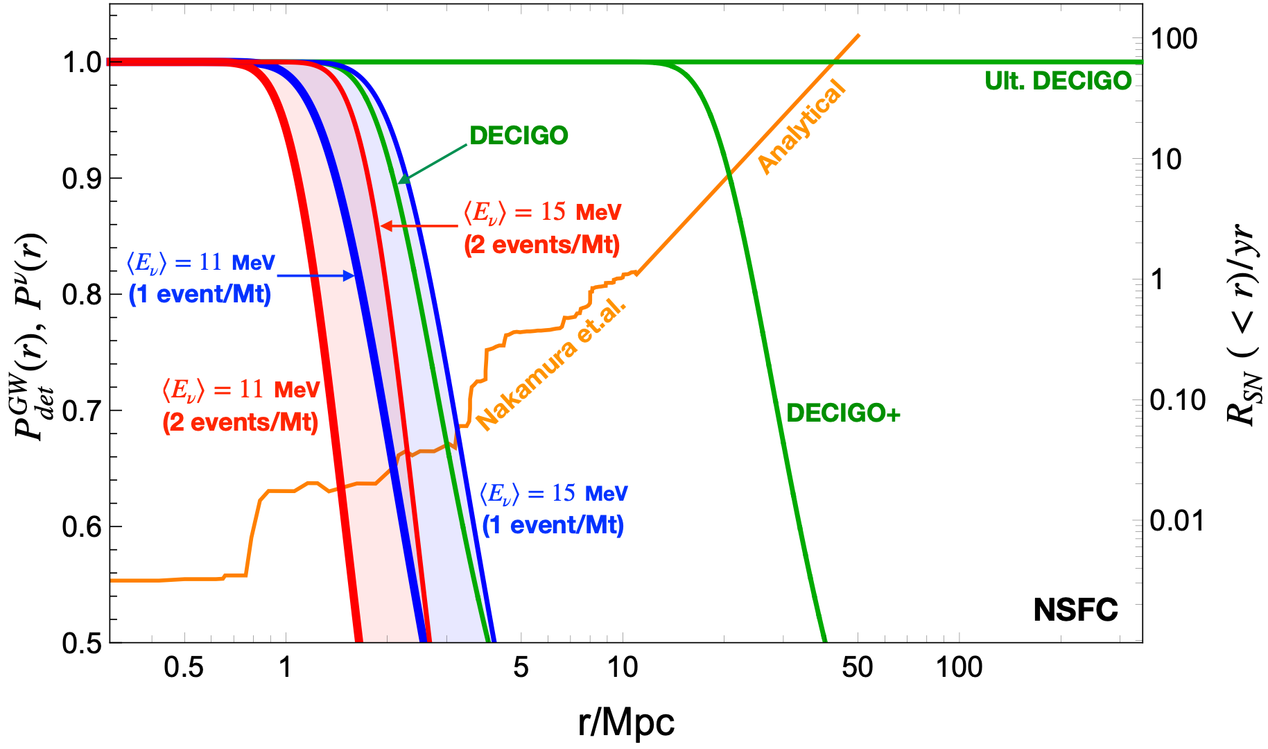
Detection probabilities and CCSN rates
June 08, 2022
Memory-triggered SN neutrino detection
Mainak Mukhopadhyay

Slide 22
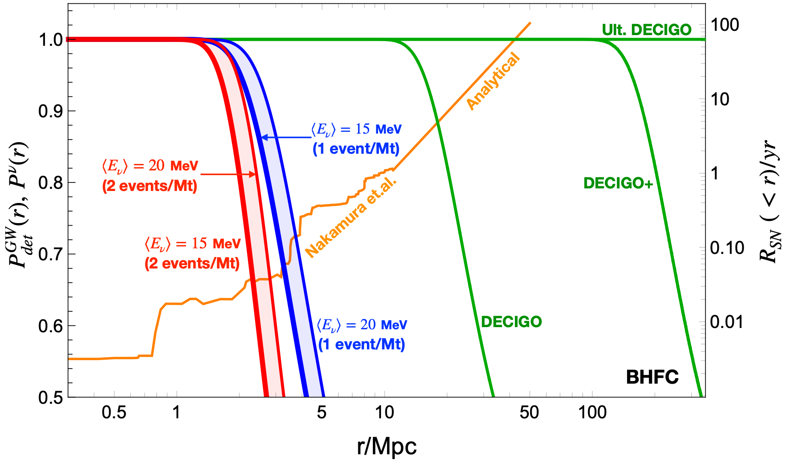
Detection probabilities and CCSN rates
June 08, 2022
Memory-triggered SN neutrino detection
Mainak Mukhopadhyay

Slide 23
Recipe in brief
Predicted number of neutrino events
in detector from a CCSN in the galaxy j
CCSN rate in the galaxy j
Detector running
time
$$N_{ν}^{trig}(D)=ΔT\underset{j,r_{j}<D}{∑}R_{j}N(r_{j})P_{det}^{GW}(r_{j})$$
Total number of
memory-triggered
neutrino events from all CCSNe
within a distance D
Probability of detecting the memory from a CCSN in the galaxy j
Distance to the galaxy j
Index of the galaxy, j=1,2,….
June 08, 2022
Memory-triggered SN neutrino detection
Mainak Mukhopadhyay

Slide 24
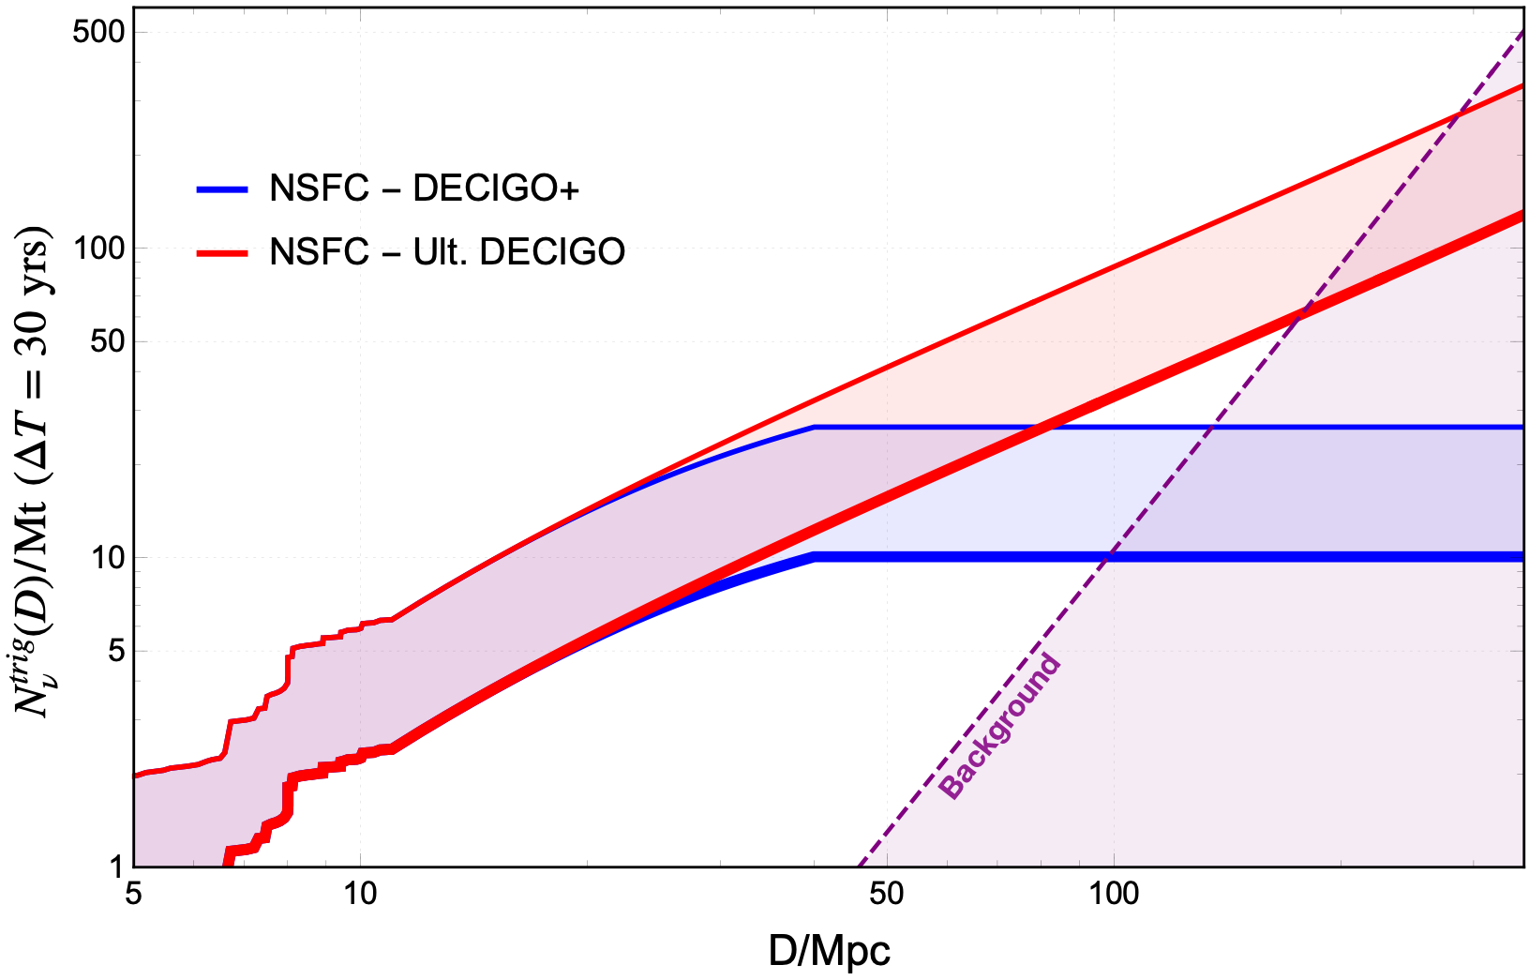
Results: Events and background - NSFC
Untriggered backgrounds would be orders of magnitude higher!
June 08, 2022
Memory-triggered SN neutrino detection
Mainak Mukhopadhyay

Slide 25
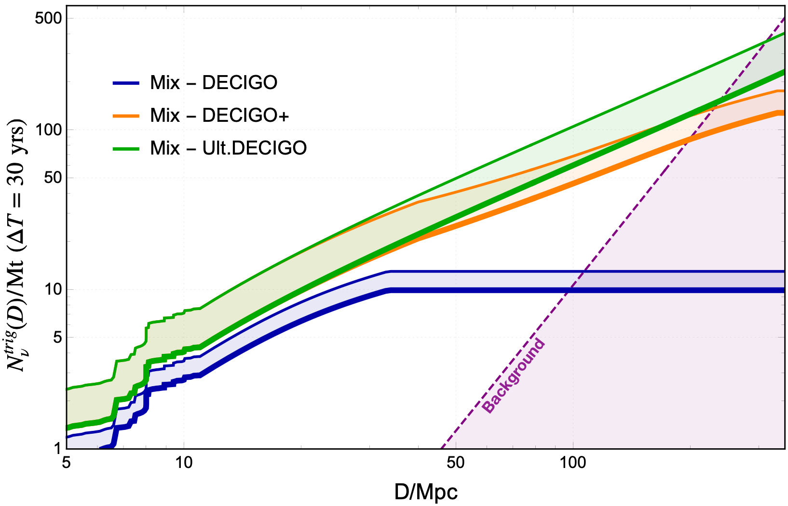
Results: Events and background - Mix
60% NSFC + 40% BHFC
Untriggered backgrounds would be orders of magnitude higher!
June 08, 2022
Memory-triggered SN neutrino detection
Mainak Mukhopadhyay

Slide 26
Takeaways
A new multi messenger approach to CCSNe: neutrino GW memory enables time-triggered search of supernova neutrinos.
Could be realized in a few decades: upcoming deci-Hz GW interferometers and megaton scale neutrino detectors.
Will help in performing various statistical studies on the clean sample of neutrinos collected, giving further insights and information about SN neutrinos, NSFC, BHFC, etc. in the local Universe.
For example, DECIGO+ will allow robust time triggers for supernovae at distances D ∼ 40 − 300 Mpc, resulting in a nearly background-free sample of ∼ 3 − 70 neutrino events per Mt per decade of operation.
June 08, 2022
Memory-triggered SN neutrino detection
Mainak Mukhopadhyay

Slide 27
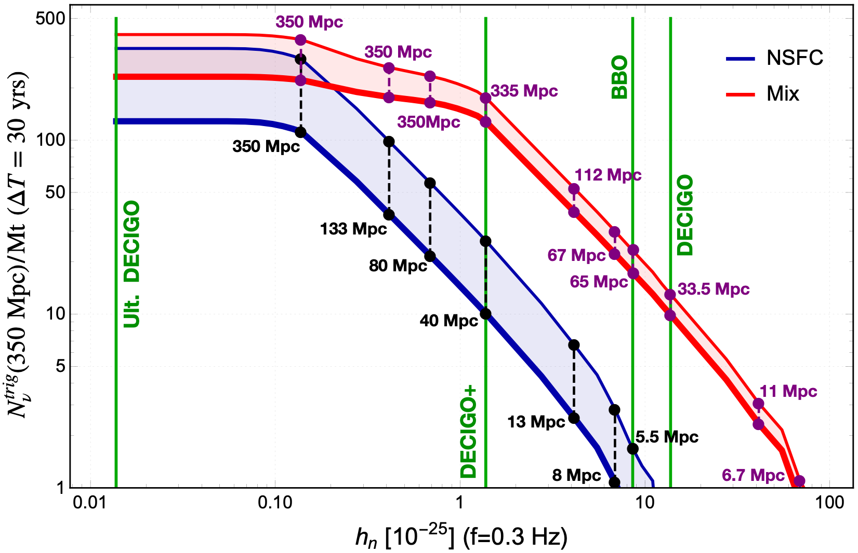
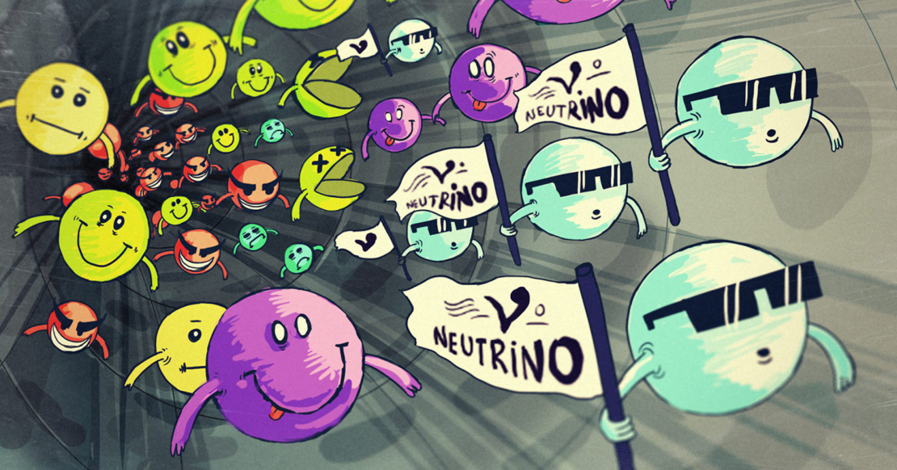
Team Neutrino reporting from a core-collapse supernova!
Thank You!
June 08, 2022
Memory-triggered SN neutrino detection
Mainak Mukhopadhyay

Slide 28
Backup
June 08, 2022
Memory-triggered SN neutrino detection
Mainak Mukhopadhyay

Slide 29
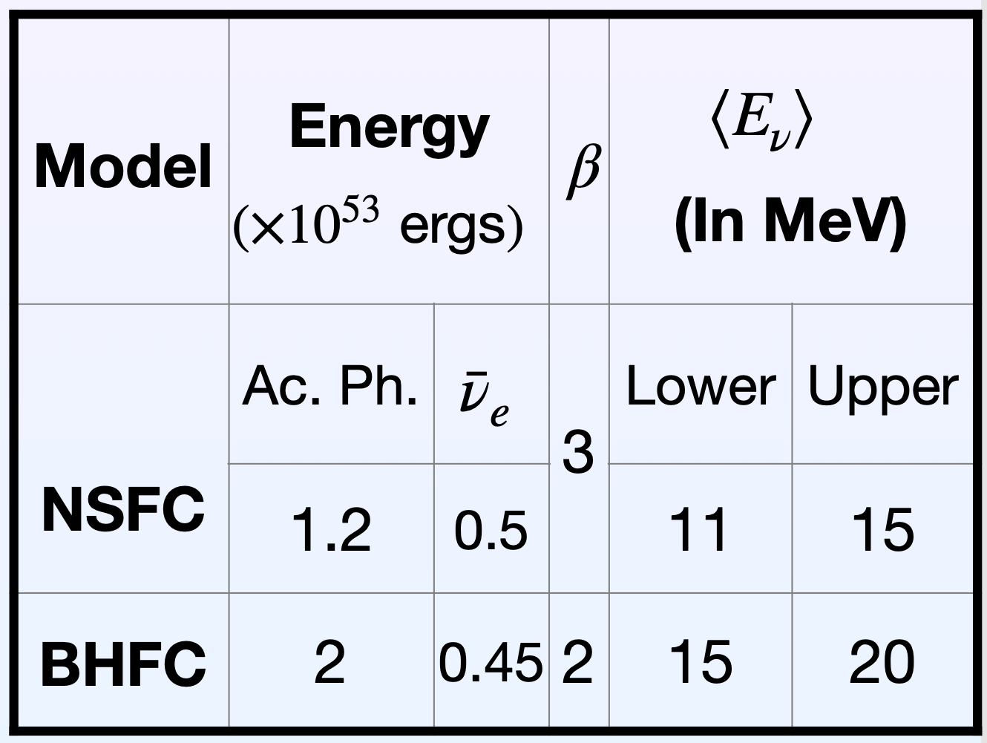
Neutrino flux parameters
June 08, 2022
Memory-triggered SN neutrino detection
Mainak Mukhopadhyay

Slide 30
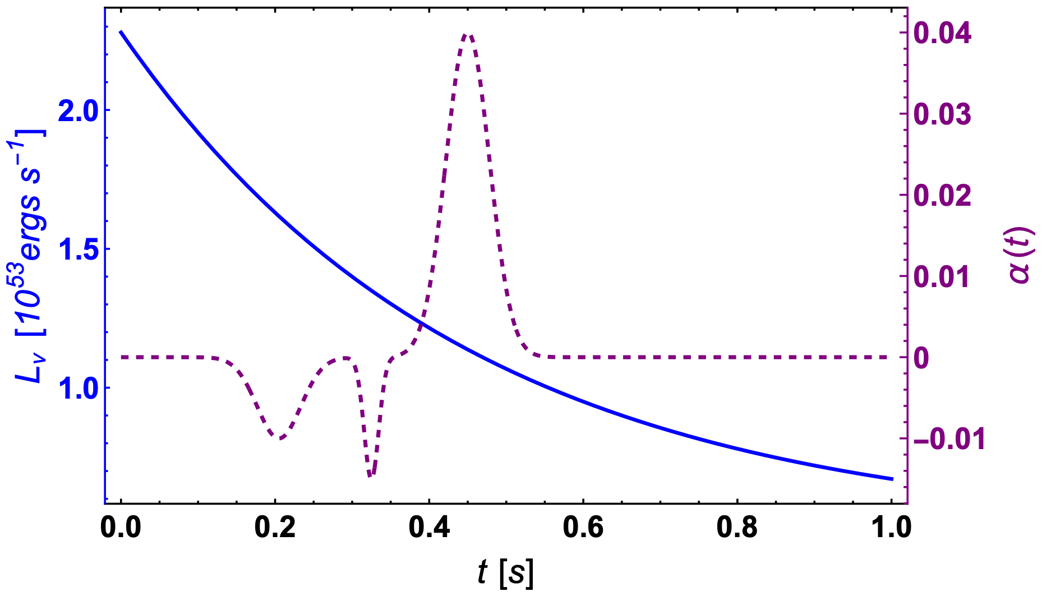
Models: NSFC
NSFC
June 08, 2022
Memory-triggered SN neutrino detection
Mainak Mukhopadhyay

Slide 31
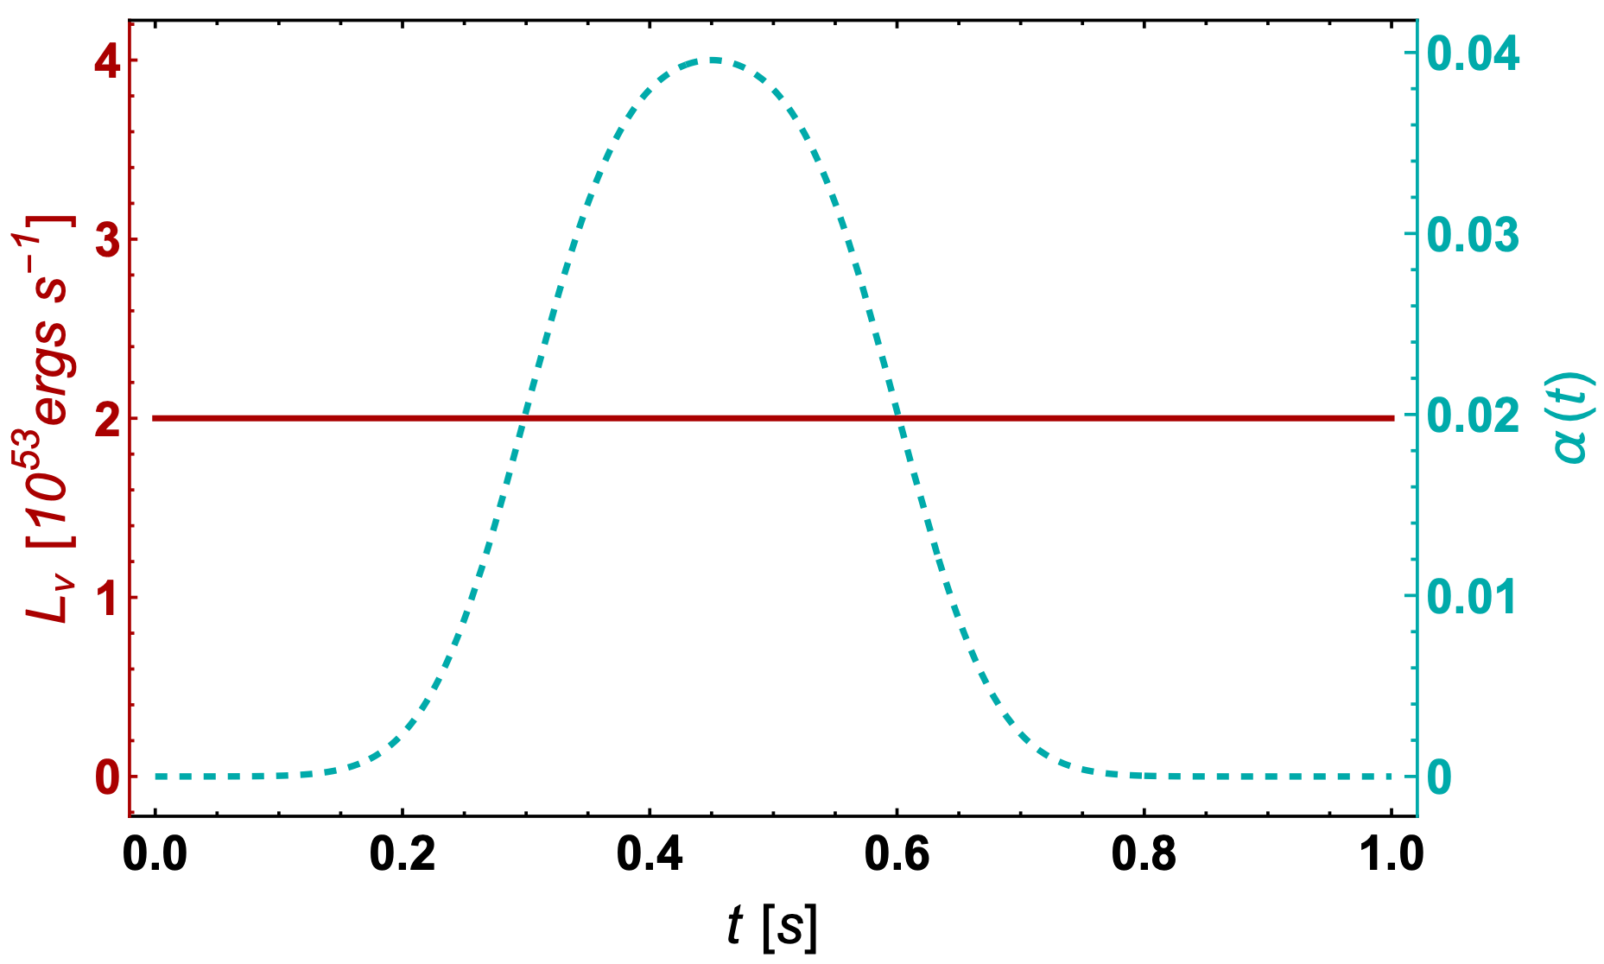
Models: BHFC
BHFC
June 08, 2022
Memory-triggered SN neutrino detection
Mainak Mukhopadhyay

Slide 32
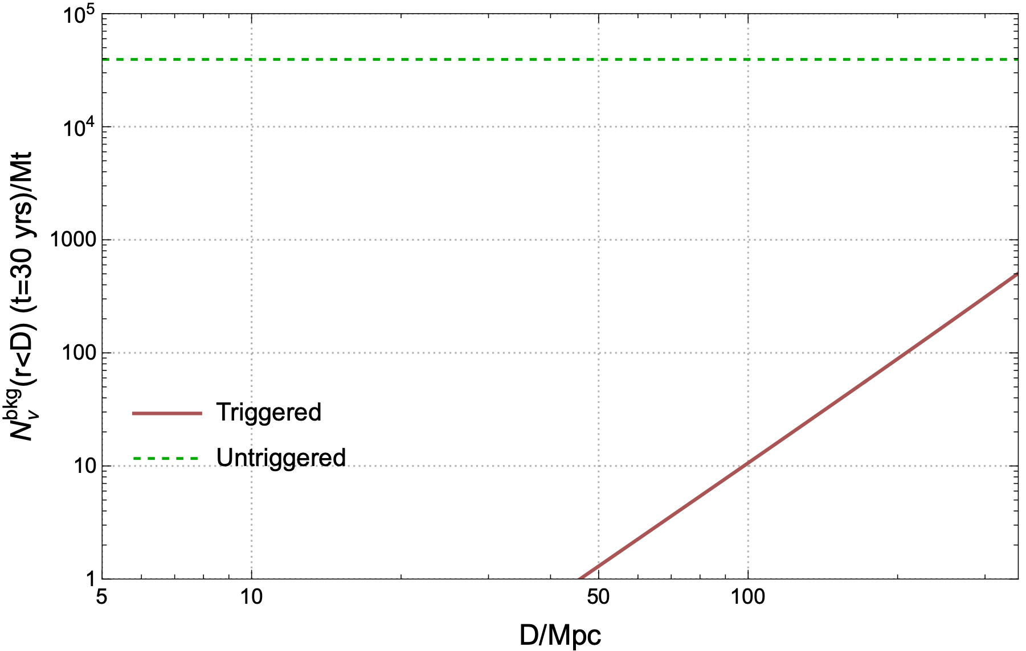
Comparison of backgrounds
$$∼O({10}^{2})$$
June 08, 2022
Memory-triggered SN neutrino detection
Mainak Mukhopadhyay

Slide 33
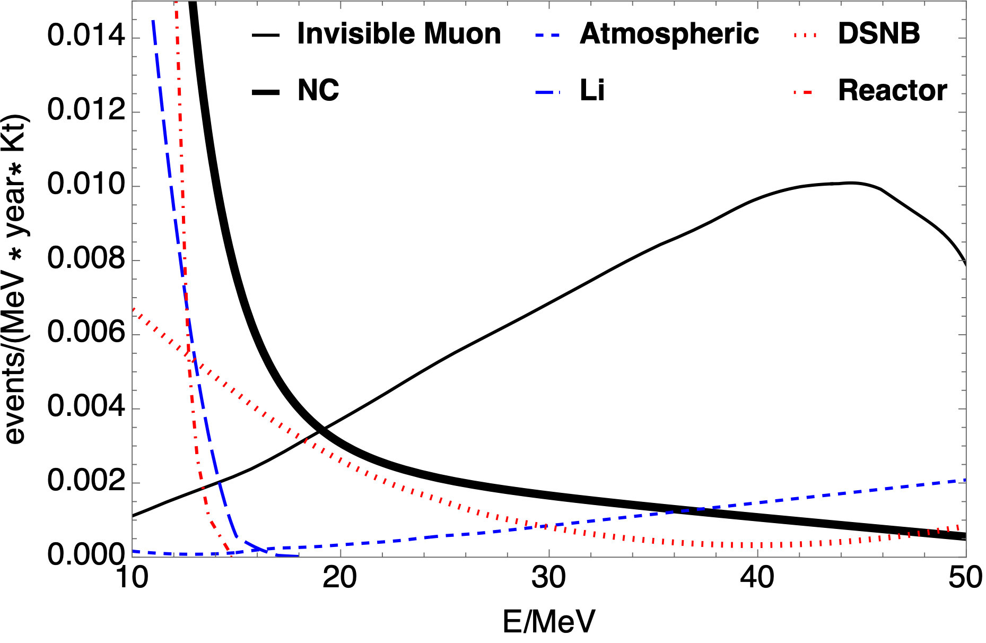
Individual backgrounds in HyperK (with Gd)
June 08, 2022
Memory-triggered SN neutrino detection
Mainak Mukhopadhyay

Slide 34
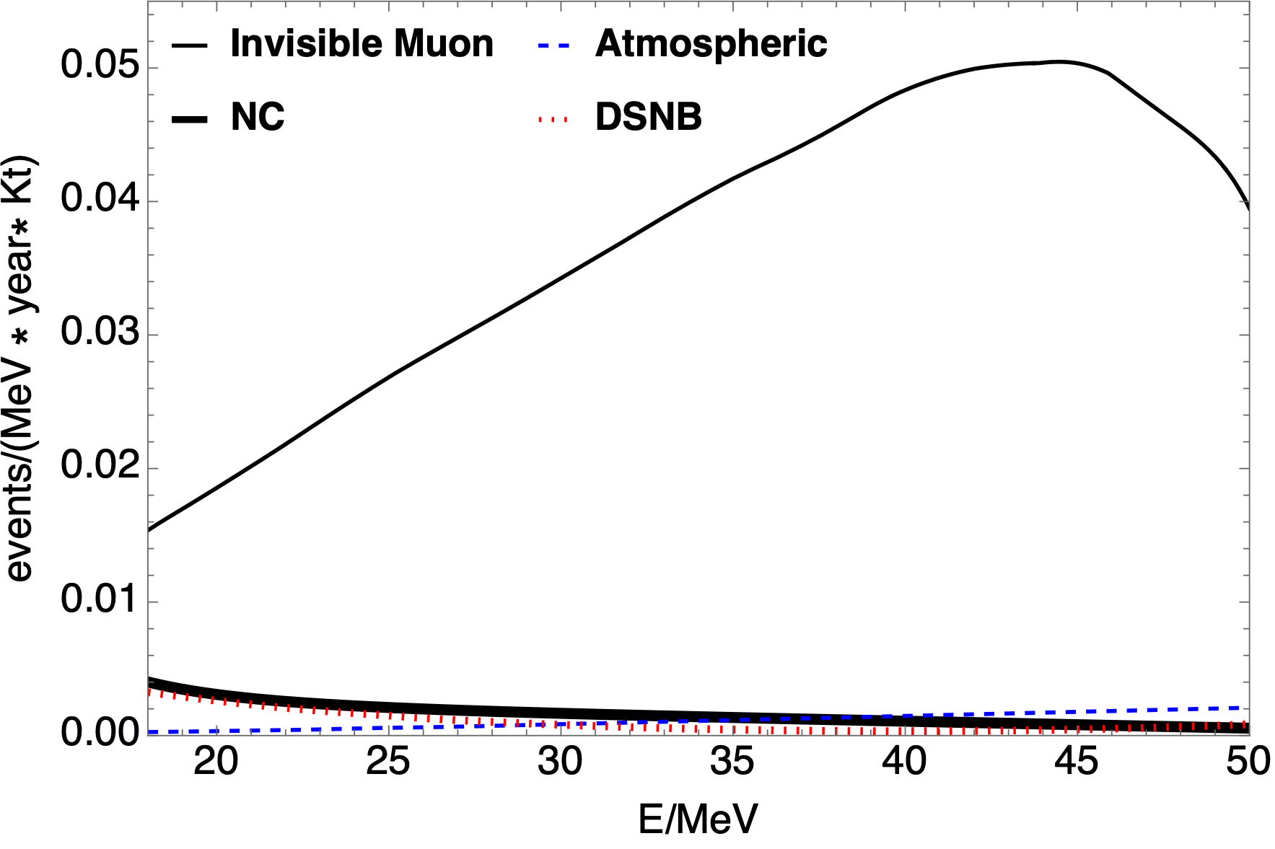
Individual backgrounds in HyperK (without Gd)
June 08, 2022
Memory-triggered SN neutrino detection
Mainak Mukhopadhyay

Slide 35
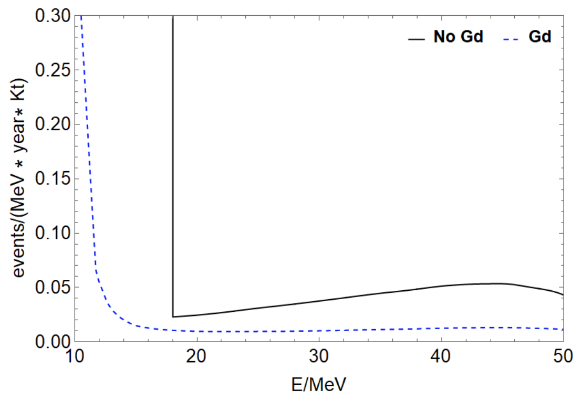
()
Total Background in HyperK
June 08, 2022
Memory-triggered SN neutrino detection
Mainak Mukhopadhyay

Slide 36
Overview: For GW experimental groups
June 08, 2022
Memory-triggered SN neutrino detection
Mainak Mukhopadhyay

Slide 37
What is Gravitational Wave (GW) memory?
Neutrino physics
Gravitational wave physics
Neutrino Gravitational memory effect
June 08, 2022
Memory-triggered SN neutrino detection
Mainak Mukhopadhyay

Slide 38
Phenomenological Model: Ingredients
Luminosity $L_{ν}(t)$ :
$$L_{ν}(t)=λ+βexp(-χt)$$
Anisotropy parameter $α(t)$ :
$$α(t)=κ+\overset{N}{\underset{j=1}{∑}}ξ_{j}exp(-\frac{(t-γ_{j})^{2}}{2σ_{j}^{2}})$$
$$h_{TT}^{xx}=h(t)=\frac{2G}{rc^{4}}∫_{-∞}^{t-r/c}dt^{′}L_{ν}(t^{′})α(t^{′})$$
$$h(t)=\overset{N}{\underset{j=1}{∑}}\{[h_{1j}(erf(ρ_{j}τ_{1j})+erf(ρ_{j}(t-τ_{1j})))]+[h_{2j}(erf(ρ_{j}τ_{2j})+erf(ρ_{j}(t-τ_{2j})))]\}+[h_{3}(\frac{β}{χ}(1-exp(-tχ))+λt)]$$
Effective parameters from $L_{ν}(t)$ and $α(t)$: $h_{1j},ρ_{j},τ_{1j},h_{2j},τ_{2j},h_{3}$
June 08, 2022
Memory-triggered SN neutrino detection
Mainak Mukhopadhyay

Slide 39
Phenomenological Model: Ingredients
Luminosity $L_{ν}(t)$ :
$$L_{ν}(t)=λ+βexp(-χt)$$
Anisotropy parameter $α(t)$ :
$$α(t)=κ+\overset{N}{\underset{j=1}{∑}}ξ_{j}exp(-\frac{(t-γ_{j})^{2}}{2σ_{j}^{2}})$$
$$h_{TT}^{xx}=h(t)=\frac{2G}{rc^{4}}∫_{-∞}^{t-r/c}dt^{′}L_{ν}(t^{′})α(t^{′})$$
$$h(t)=\overset{N}{\underset{j=1}{∑}}\{[h_{1j}(erf(ρ_{j}τ_{1j})+erf(ρ_{j}(t-τ_{1j})))]+[h_{2j}(erf(ρ_{j}τ_{2j})+erf(ρ_{j}(t-τ_{2j})))]\}+[h_{3}(\frac{β}{χ}(1-exp(-tχ))+λt)]$$
Effective parameters from $L_{ν}(t)$ and $α(t)$: $h_{1j},ρ_{j},τ_{1j},h_{2j},τ_{2j},h_{3}$
In frequency space,
$$\overset{˜}{h}(f)=\overset{N}{\underset{j=1}{∑}}[(h_{1j}\frac{i}{πf}exp(\frac{-π^{2}f^{2}}{ρ_{j}^{2}})exp(i2πfτ_{1j}))+(h_{2j}\frac{i}{πf}exp(\frac{-π^{2}f^{2}}{ρ_{j}^{2}})exp(i2πfτ_{2j}))]+(\sqrt{2π}h_{3}\frac{β}{χ}(\frac{1}{i2πf}-\frac{1}{-χ+i2πf}))$$
Characteristic strain $h_{c}(f)$ :
$$h_{c}(f)=2f|\overset{˜}{h}(f)|$$
Helps in computing the signal to noise ratio (SNR) and compare the signal to the sensitivity curve of the detector.
Dimensionless quantity.
June 08, 2022
Memory-triggered SN neutrino detection
Mainak Mukhopadhyay

Slide 40
Recipe in brief
$$N_{ν}^{trig}(D)=ΔT\underset{j,r_{j}<D}{∑}R_{j}N(r_{j})P_{det}^{GW}(r_{j})$$
Neutrino detectors:
Water Cherenkov detectors
Main channel: IBD
Quasi thermal emission spectra - mean energy
Flux at earth - depends on distance and emission spectra
Calculate number of events in detector from a CCSN - depends on distance
Rate of CCSN (how many such events):
Use calculated rate of CCSNe below 11 Mpc (local volume)
Analytical rate beyond 11 Mpc using cosmic SFR, Salpeter IMF….
GW detectors:
Calculate SNR - depends on distance to source
Calculate probability of detection given a fixed false alarm probability - depends on SNR
June 08, 2022
Memory-triggered SN neutrino detection
Mainak Mukhopadhyay

Slide 41
References
Theory :
Zel’dovich and Polnarev, Sov. Astron. 18 (1974) 17.
Braginskii. And Thorne, Nature 327 (1987) 123.
Epstein, Astrophys. J. 223 (1978) 565.
M. Favata, The gravitational-wave memory effect, Class. Quant. Grav. 27 (2010) 084036
Phenomenology of neutrino memory :
Sago, Ioka, Nakamura and Yamazaki, Phys. Rev. D 70 (2004) 104012.
Suwa and Murase, Physical Review D 80 (2009).
Li, Fuller and Kishimoto, Phys. Rev. D 98 (2018) 023002.
Numerical Simulations :
Burrows and Hayes, Phys. Rev. Lett. 76 (1996) 352.
Mueller and Janka, AAP 317 (1997) 140.
Kotake, Ohnishi and Yamada, The Astrophysical Journal 655 (2007) 406.
Kotake, Iwakami, Ohnishi and Yamada, Astrophys. J. 704 (2009) 951.
Muller, Janka and Wongwathanarat, Astron. Astrophysik. J. 537 (2012) A63.
Yakunin et al., Phys. Rev. D 92 (2015) 084040.
Vartanyan and Burrows, Astrophys. J. 901 (2020) 108.
Picture Credits: Stephane Andre
June 08, 2022
Memory-triggered SN neutrino detection
Mainak Mukhopadhyay

