Slide 1
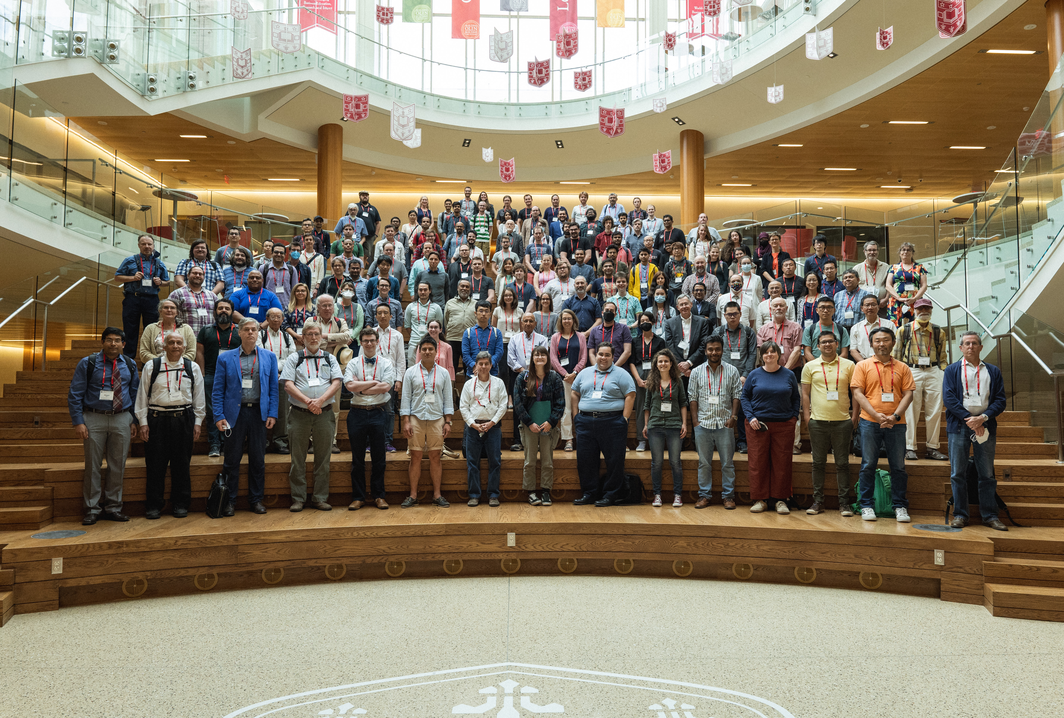
PPC 2022
Washington University in St. Louis
June 6-10, 2022

Slide 2
Statistics
168 registered participants from five (six) continents.
~40 postdocs and ~50 students.
49 plenary talks, 84 parallel talks and one public lecture.
And uncountable cups of coffee.

Slide 3
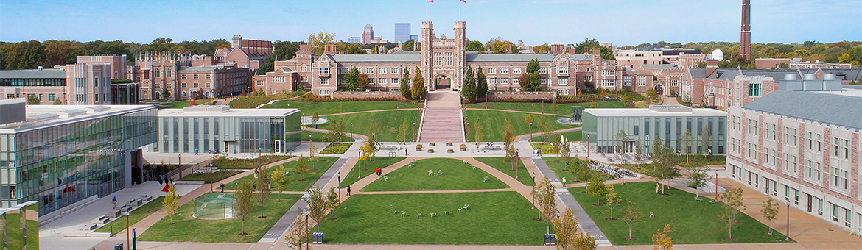



Thanks to our Sponsors

Slide 4
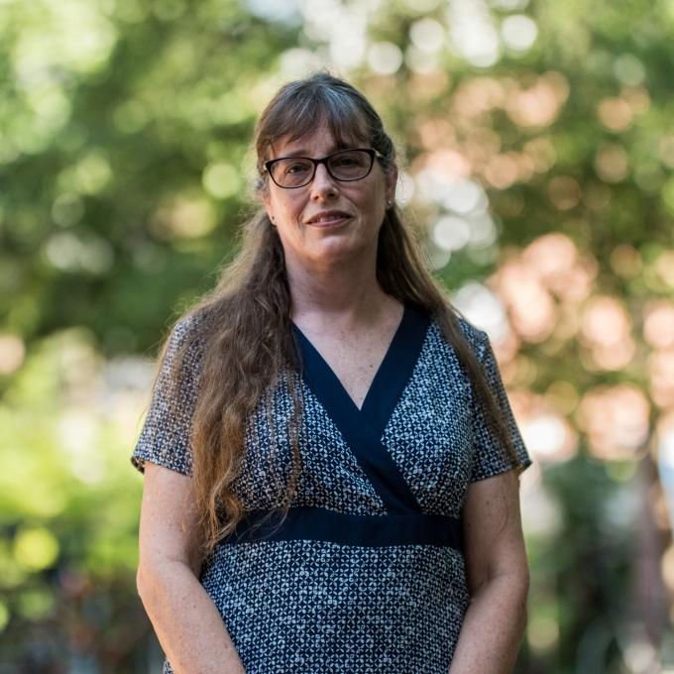
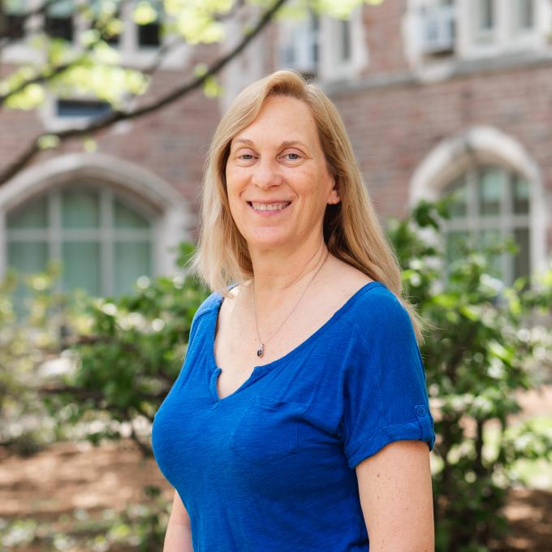
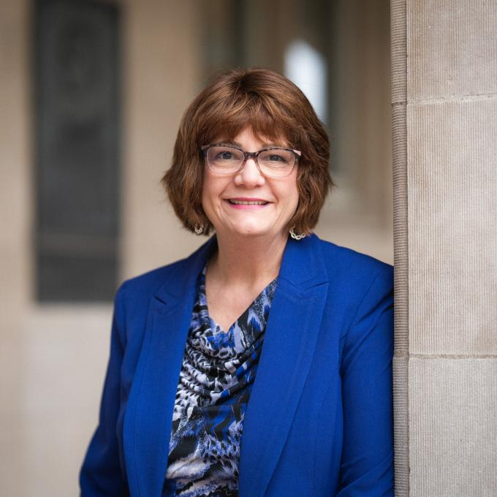
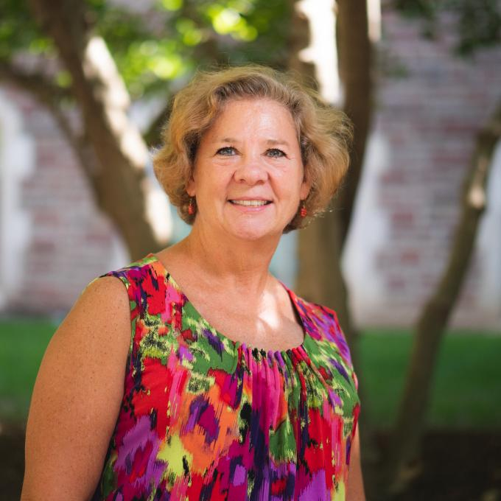
Thanks to our Awesome Staff
Sarah Akin
Alison Verbeck
Jan Foster
Mary Sullivan

Slide 5
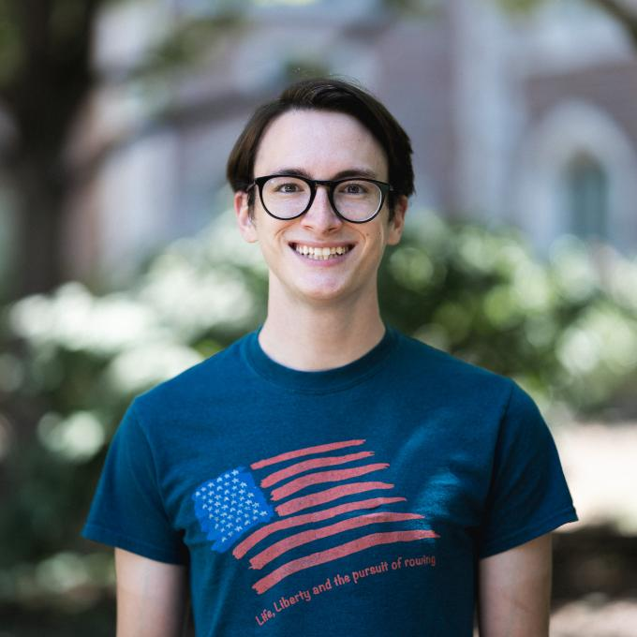
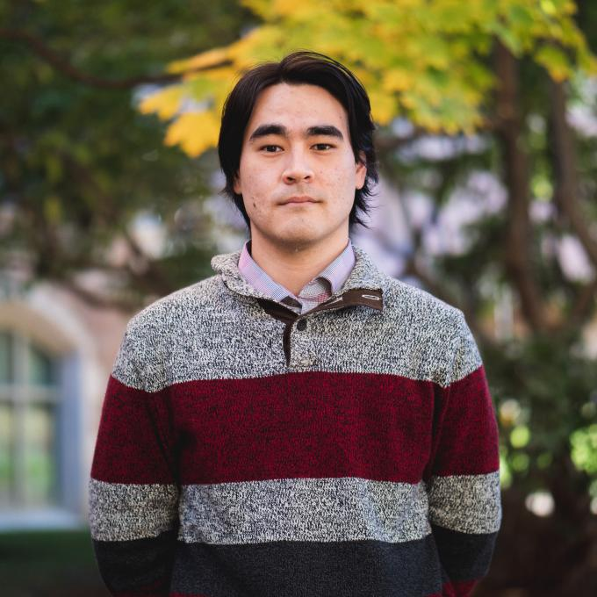
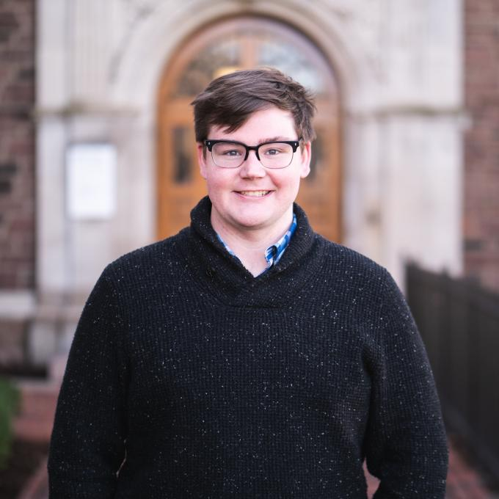
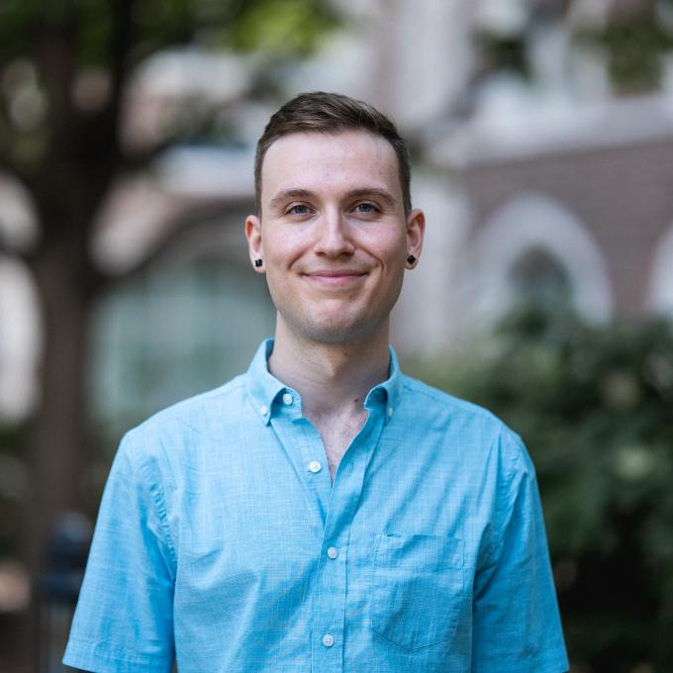
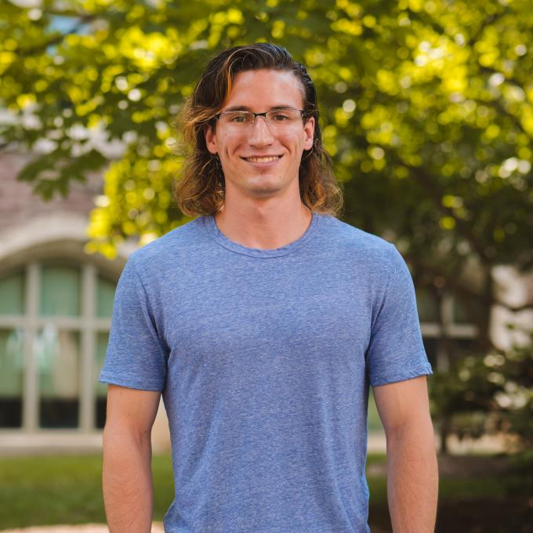
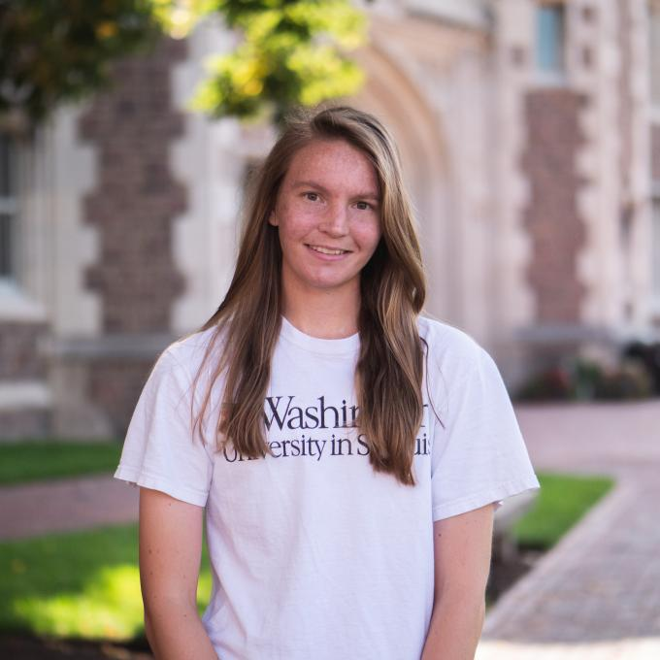
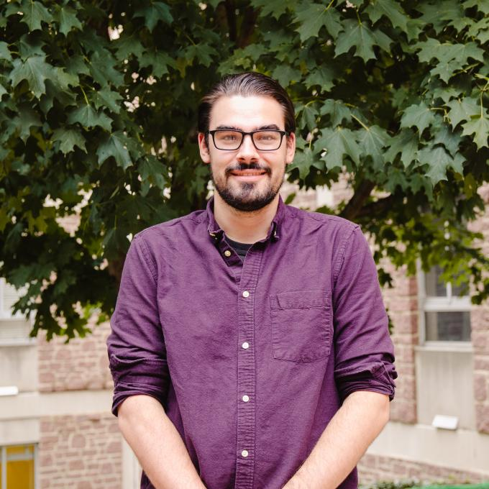
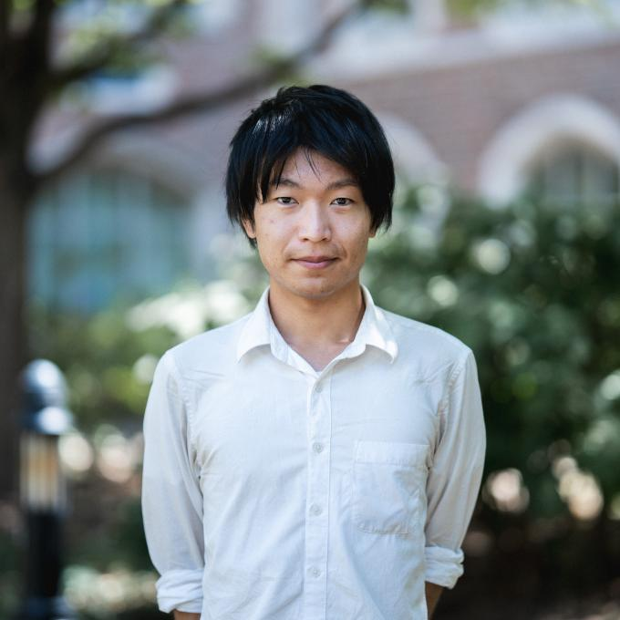
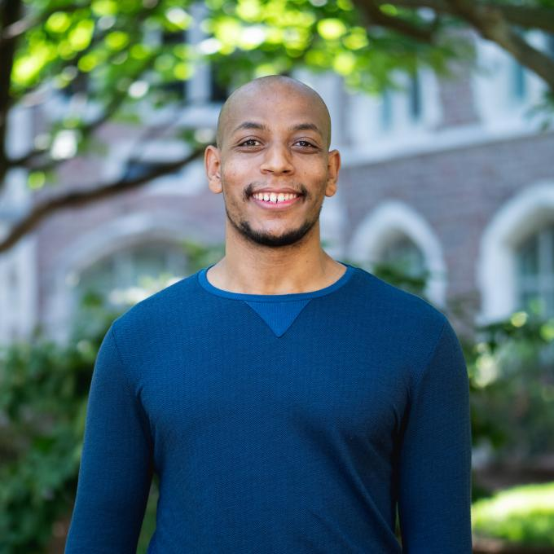
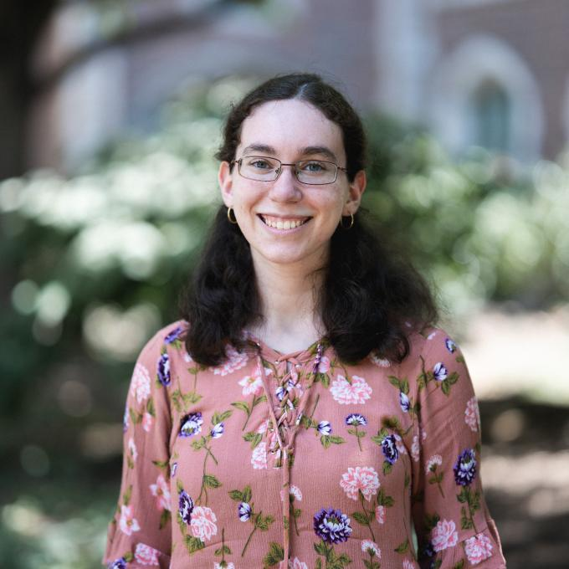
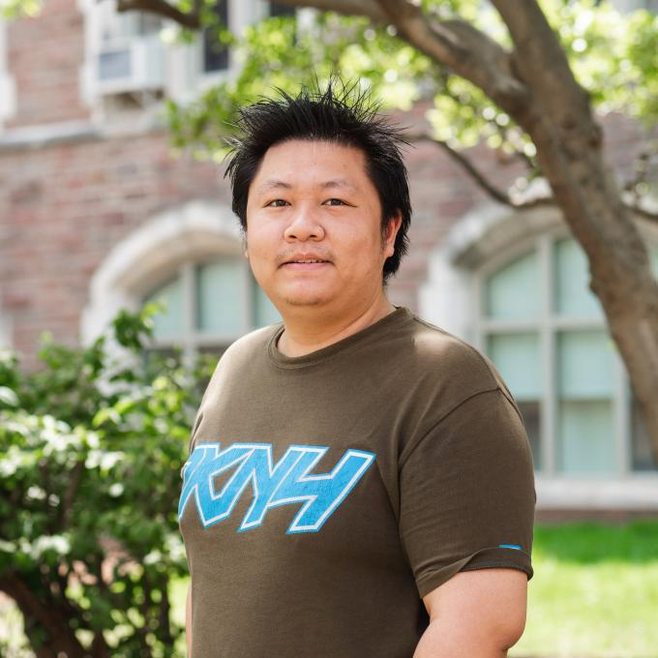
Thanks to the Student Volunteers
Liam Brodie
Jason Bub
Matt Carney
Will Charles
Dawson Huth
Cesiley King
Garrett King
Takuya Okawa
Tekeba Olbema
Pazit Rabinowitz
Fang Xu

Slide 6
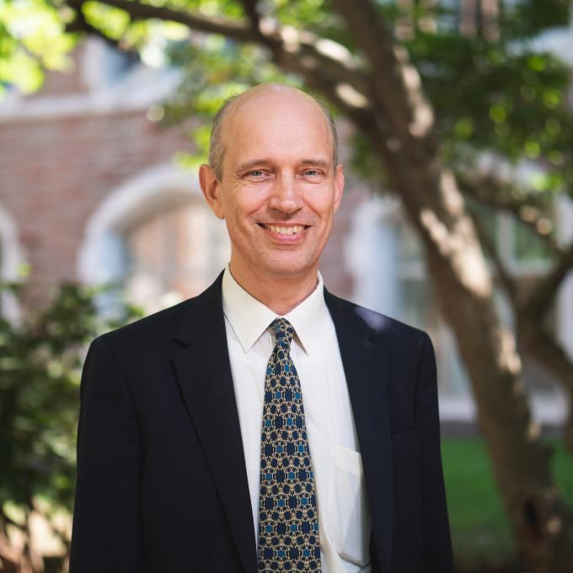
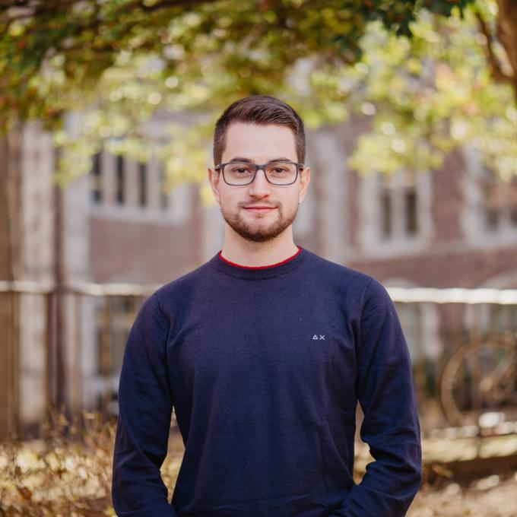
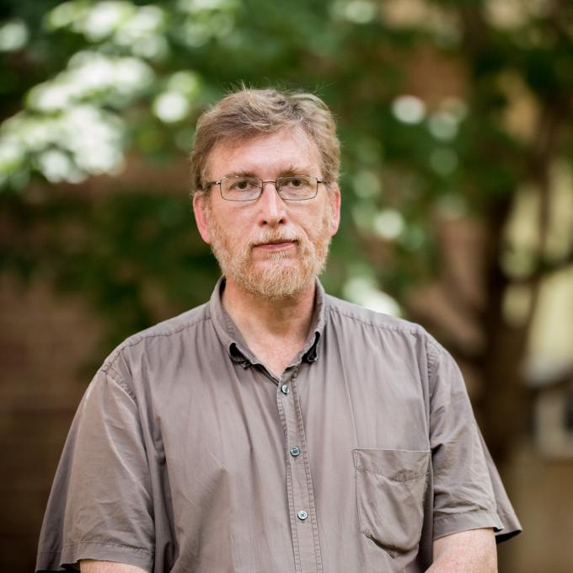
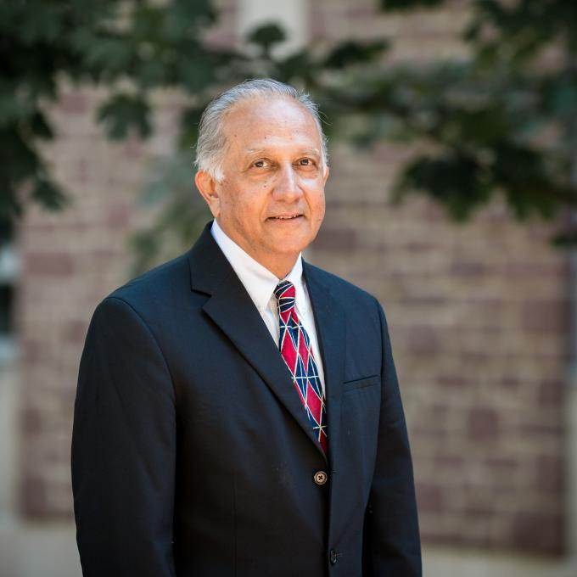
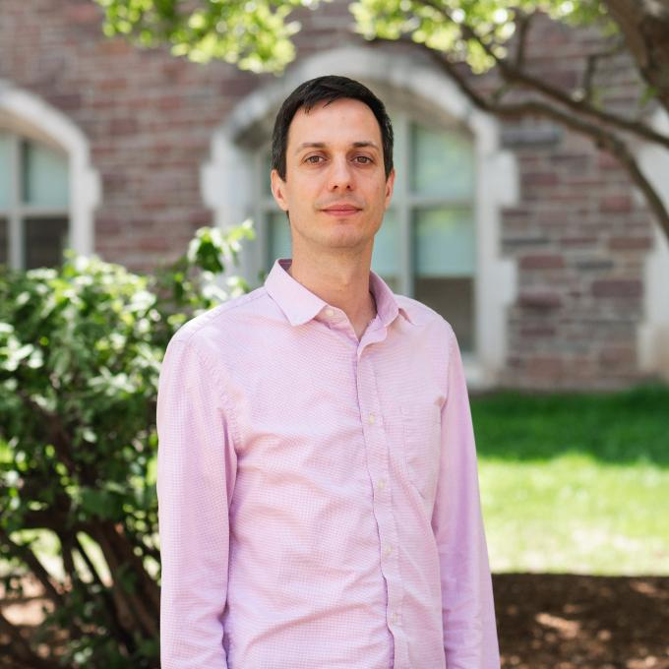
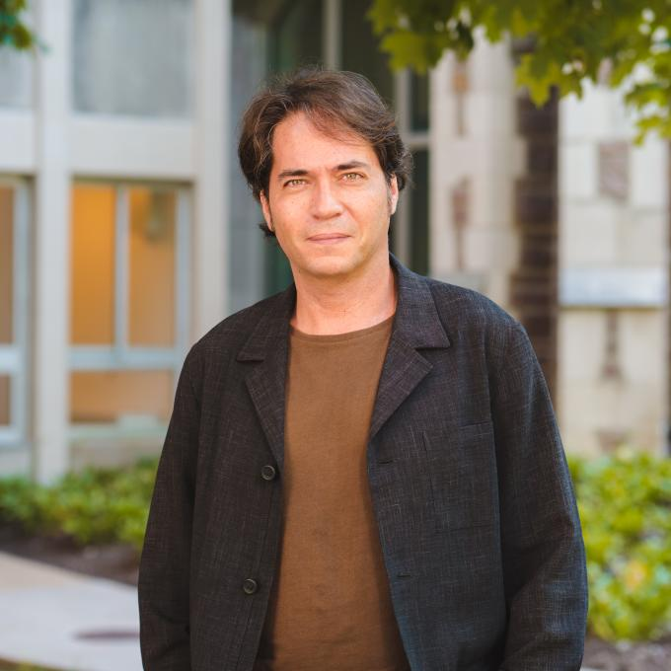
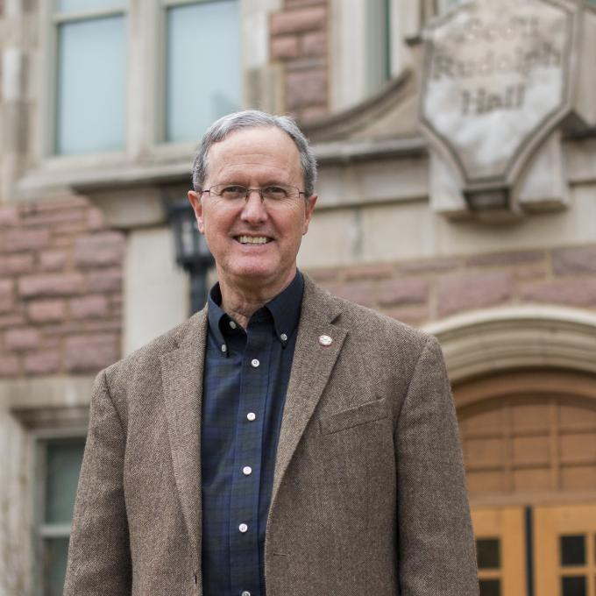
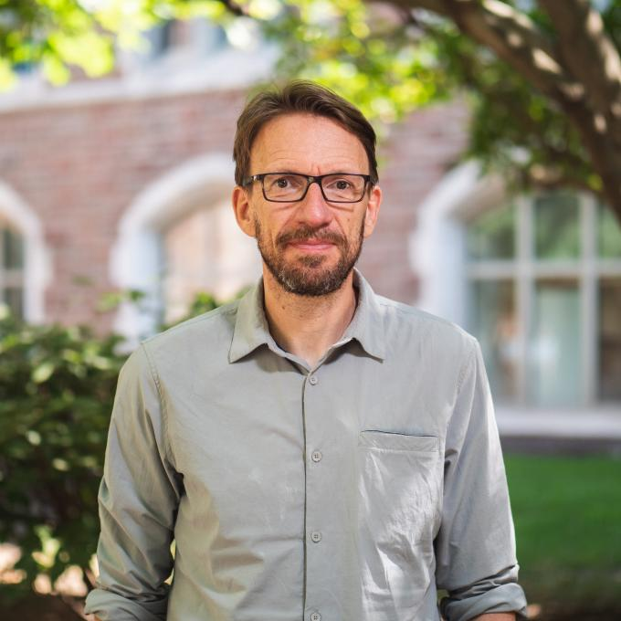
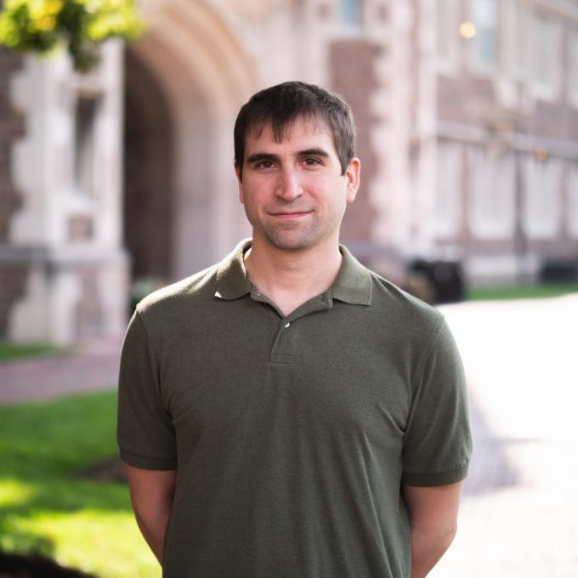
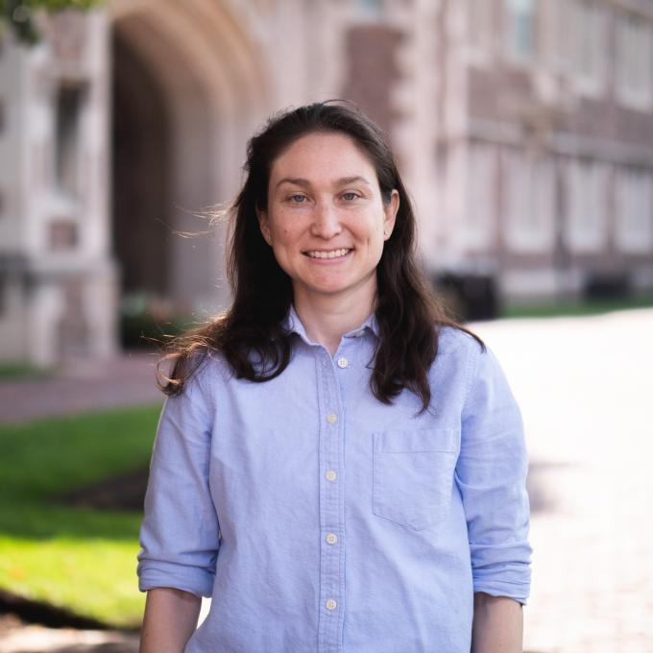
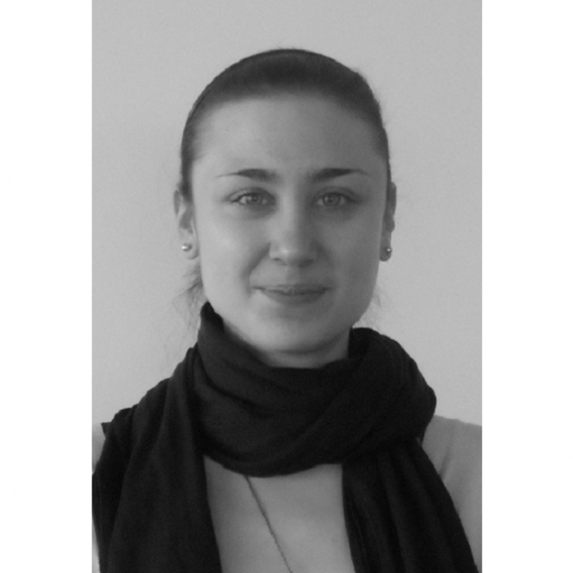
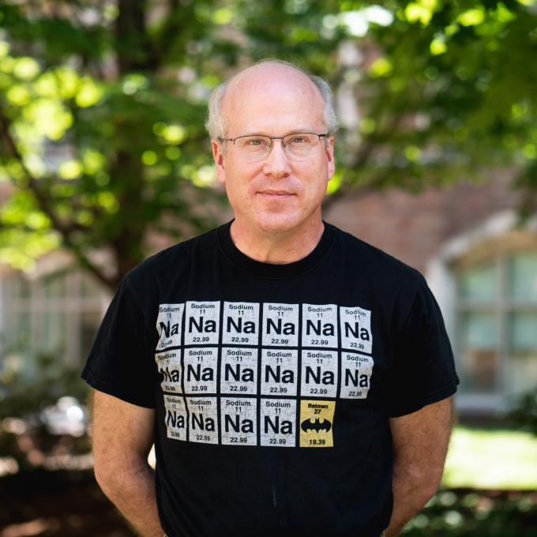
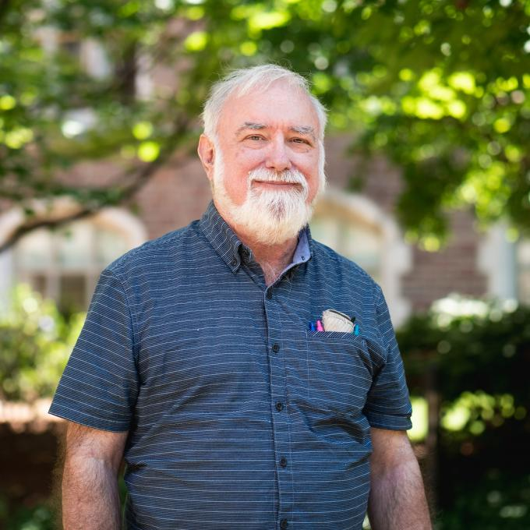
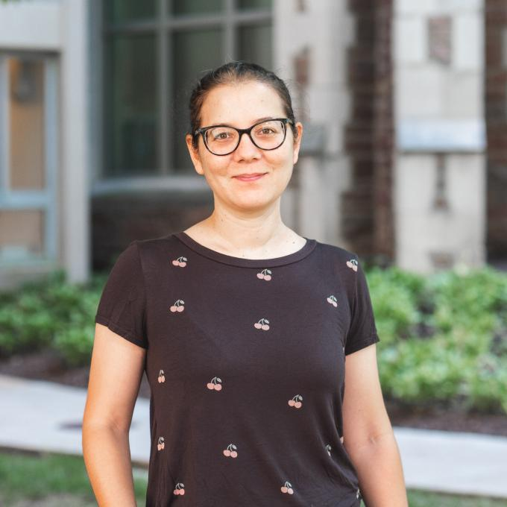
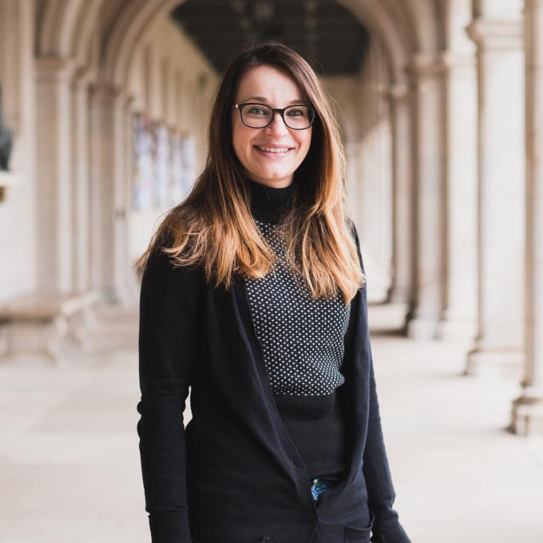
Thanks to the LOC Colleagues
Mark Alford
Lorenzo Andreoli
Jim Buckley
Ramanath Cowsik
Manel Errando
Francesc Ferrer
Brad Joliff
Henric Krawczynski
Jim Mertens
Johanna Nagy
Andrina Nicola
Mike Nowak
Mike Ogilvie
Saori Pastore
Maria Piarulli

Slide 7
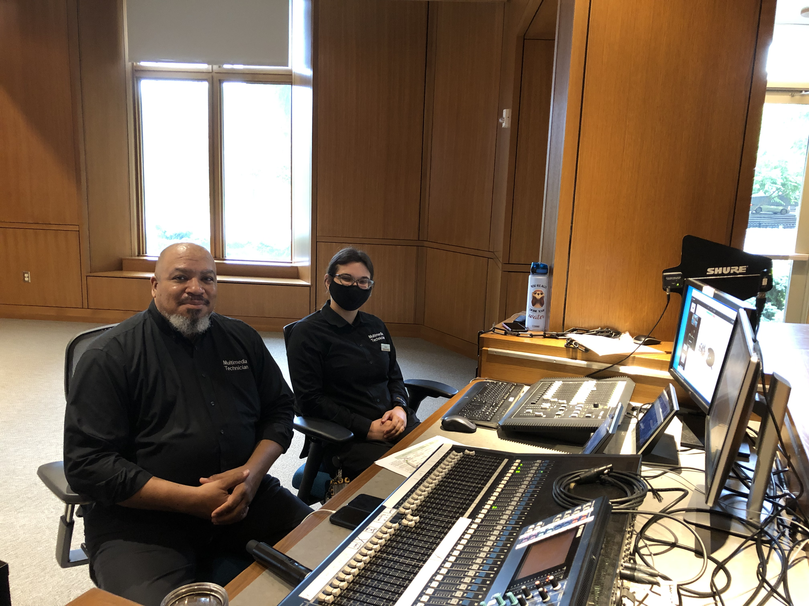
Thanks to the Technicians
Curtis, Megan and Eddie

Slide 8


Slide 9
PPC 2023
Past PPCs:
  PPC 2022: Washington University, St. Louis, USA
  PPC 2021: University of Oklahoma, Norman, Oklahoma
  PPC 2019: Universidad de los Andes, Cartagena, Colombia.
  PPC 2018: University of Zürich, Zurich, Switzerland
  PPC 2017: Texas A&M University, Corpus Christi, Texas
  PPC 2016: ICTP-SAIFR / IFT-UNESP, São Paulo, Brazil
  PPC 2015: Center for Theoretical Underground Physics and Related Areas (CETUP*), Deadwood, South Dakota
  PPC 2014: University of Guanajuato, Leon, Mexico
  PPC 2013: Center for Theoretical Underground Physics and Related Areas (CETUP*), Deadwood, South Dakota
  PPC 2012: Institute of Advanced Studies (KIAS) Seoul, South Korea
  PPC 2011: European Organization for Nuclear Research (CERN) Geneva, Switzerland
  PPC 2010: National University of Torino, Torino, Italy
  PPC 2009: University of Oklahoma, Norman, Oklahoma
  PPC 2008: University of New Mexico, Albuquerque, New Mexico
  PPC 2007: Texas A&M University, College Station, Texas
PPC 2023 is still looking for a host.
If you want to do, please contact
  Bhaskar Dutta (dutta@tamu.edu)
  Teruki Kamon (kamon@tamu.edu)

Slide 10


