Slide 1
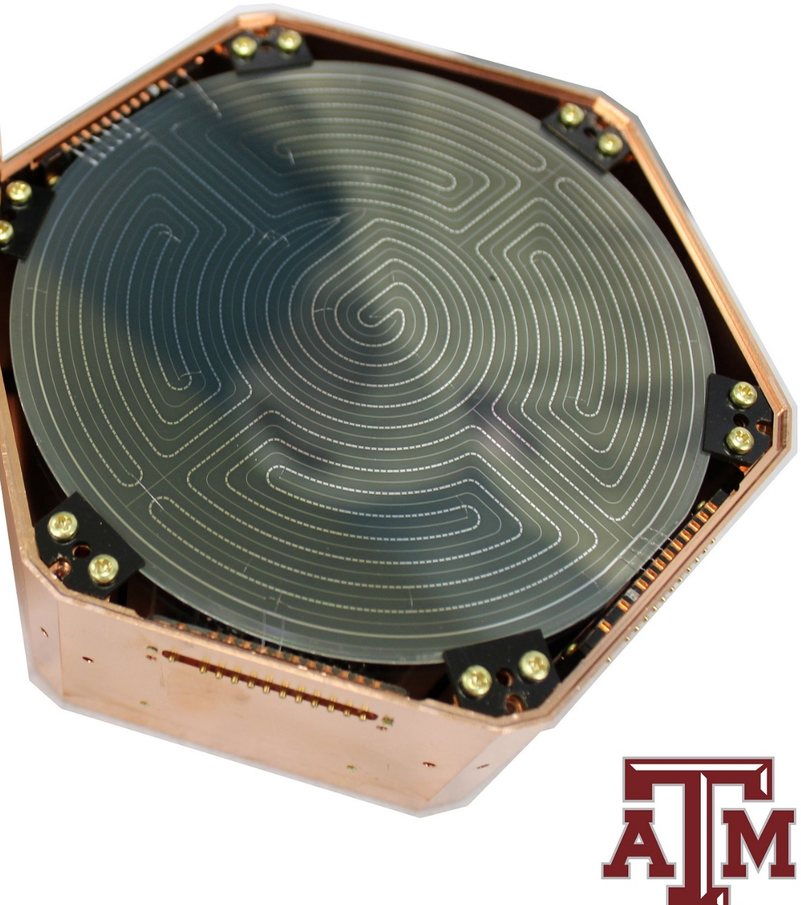
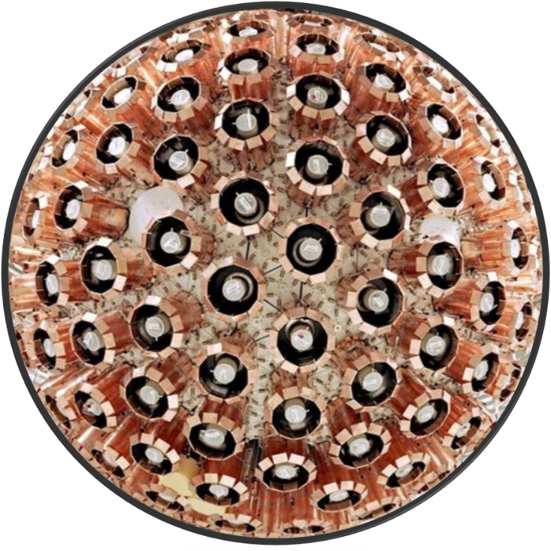
m
Dark Matter Direct Detection Searches
Dr. Rupak Mahapatra, Texas A&M

Slide 2
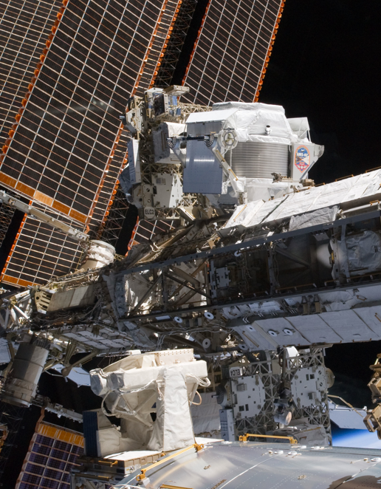
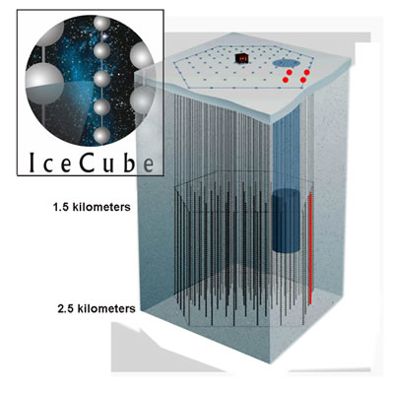
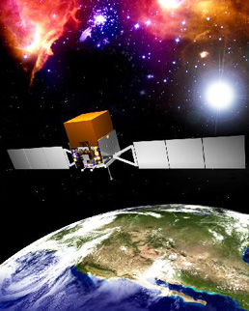
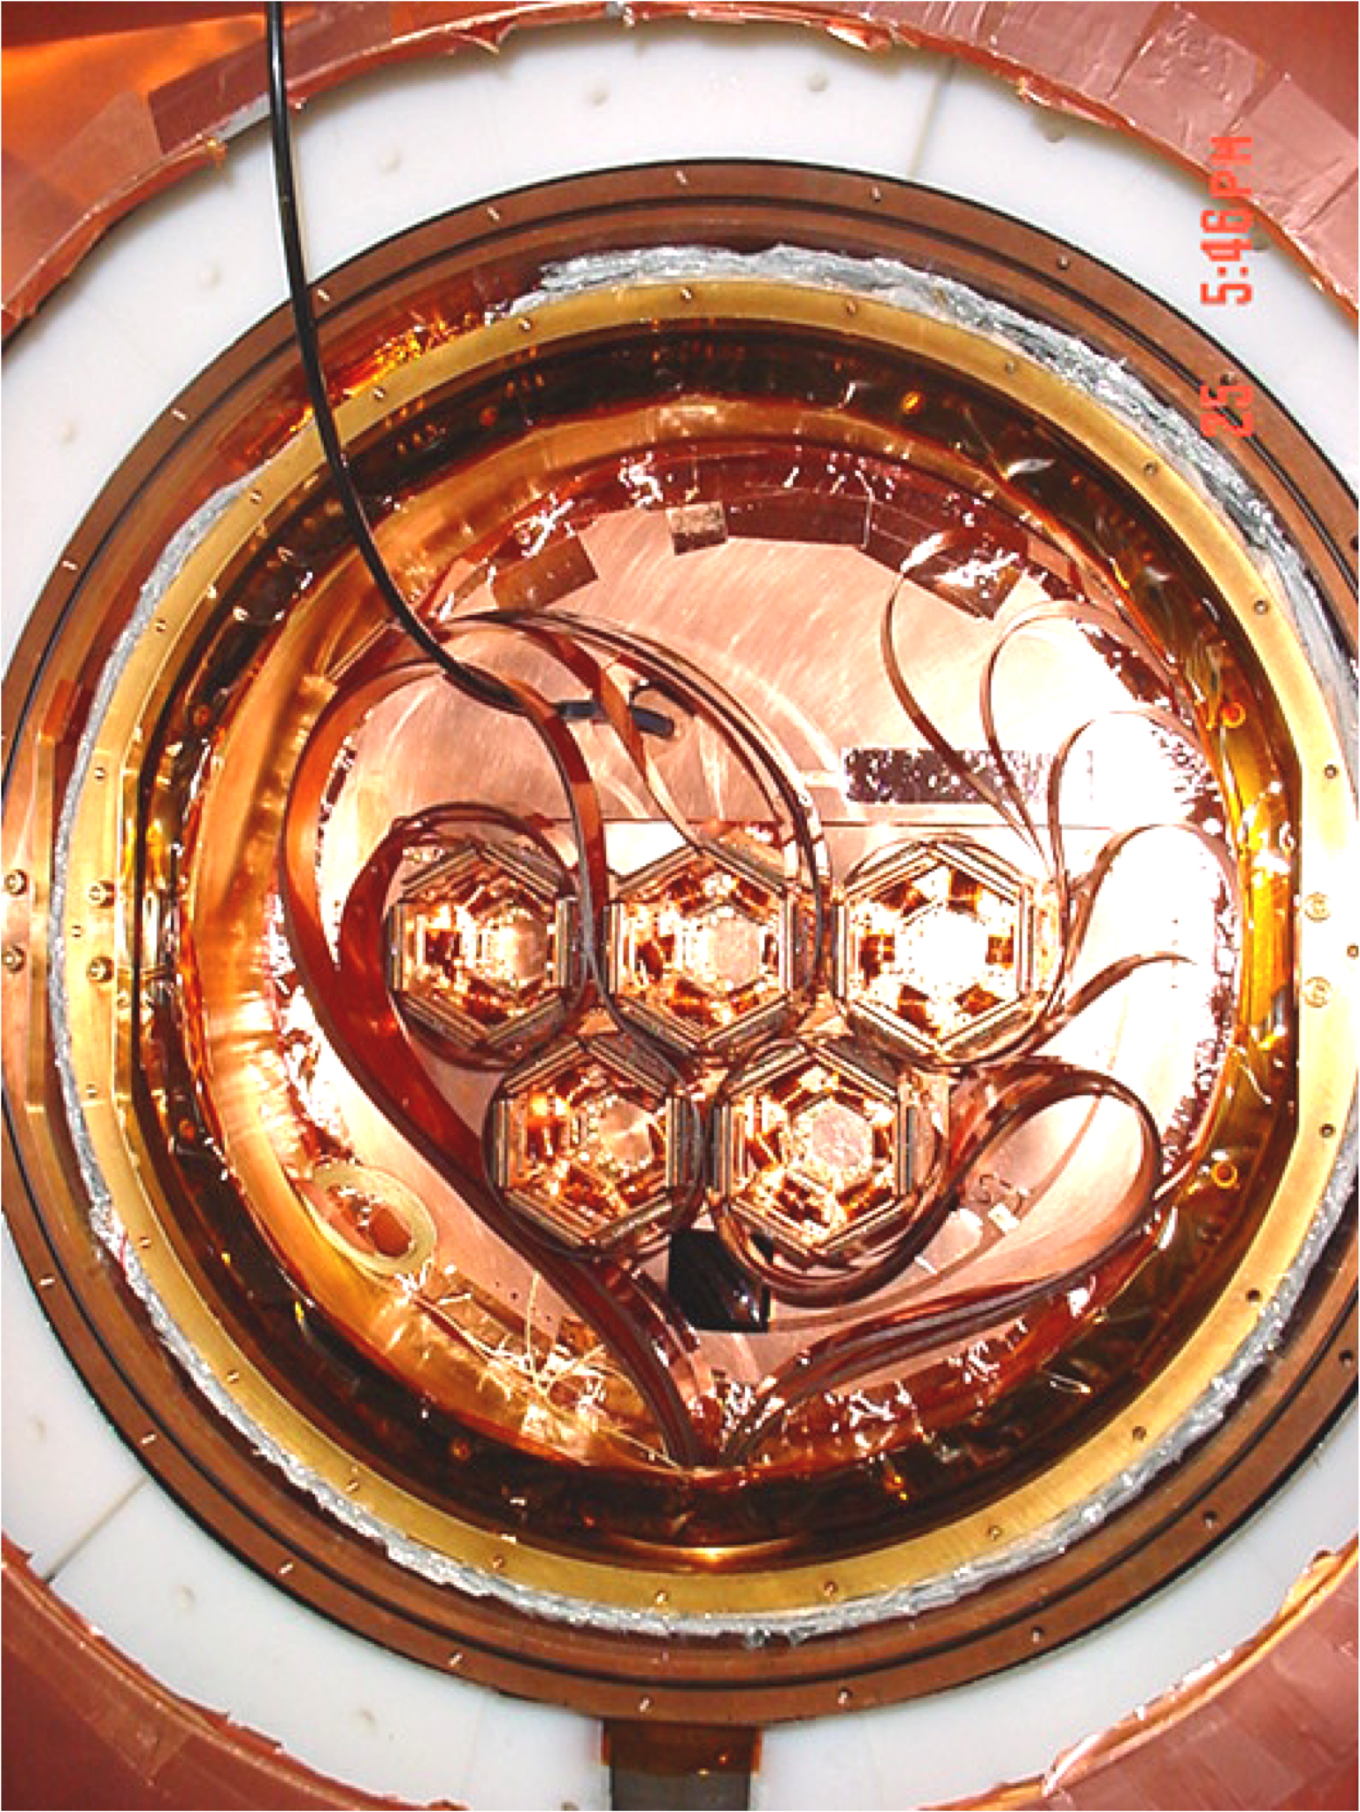
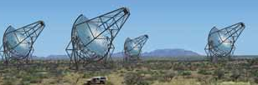
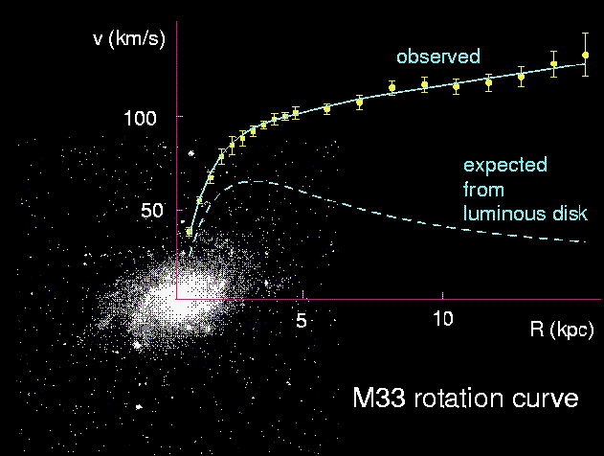
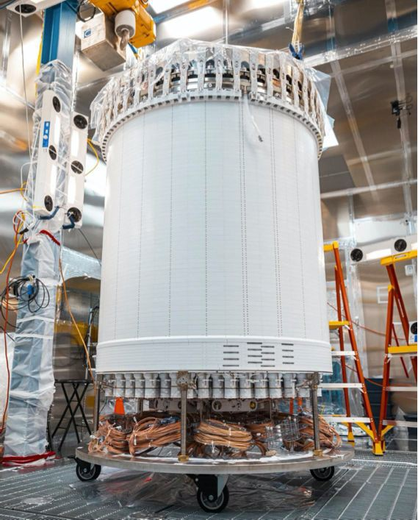
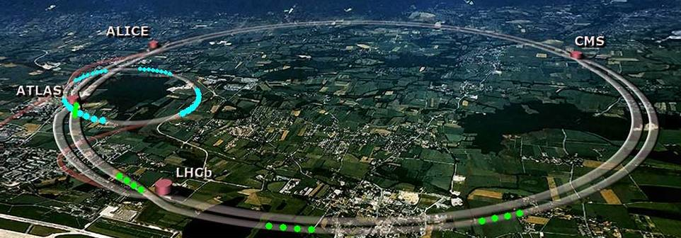
The Hunt
AMS
FERMI
Break It
SuperCDMS
HESS, VERITAS, HAWC
FERMI, Pamela, ATTIC
Shake It
Direct Detection
Annihilation in Cosmos
LZ
Make It
LHC
2
Notes:
Paolo Zuccon
There are multiple ways in which we hope to see signatures of WIMPs
look for WIMPs in the cosmos
produce them yourself.
CDMS is a terrestrial experiment, that hopes to observe the scattering of relic WIMPS off of ordinary matter.
cartoon shows how a WIMP inside a detector. Backgrounds primarily scatter off electrons. So to observe WIMPs directly, one hopes to observe the nuclear recoil

Slide 3
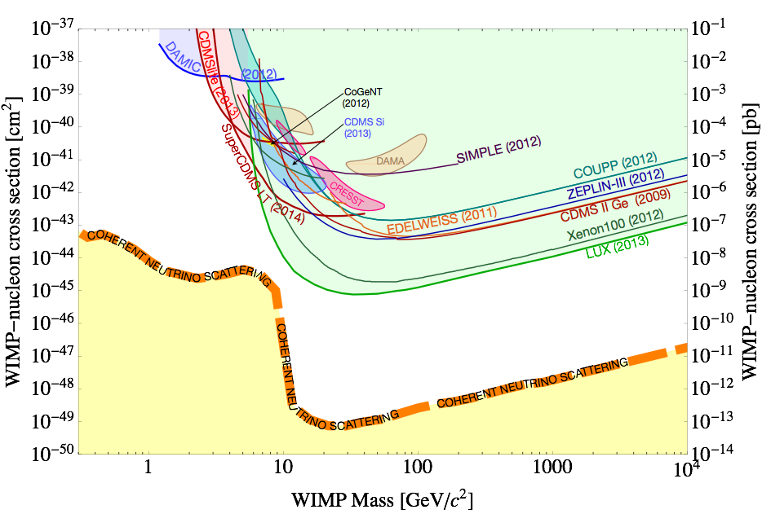
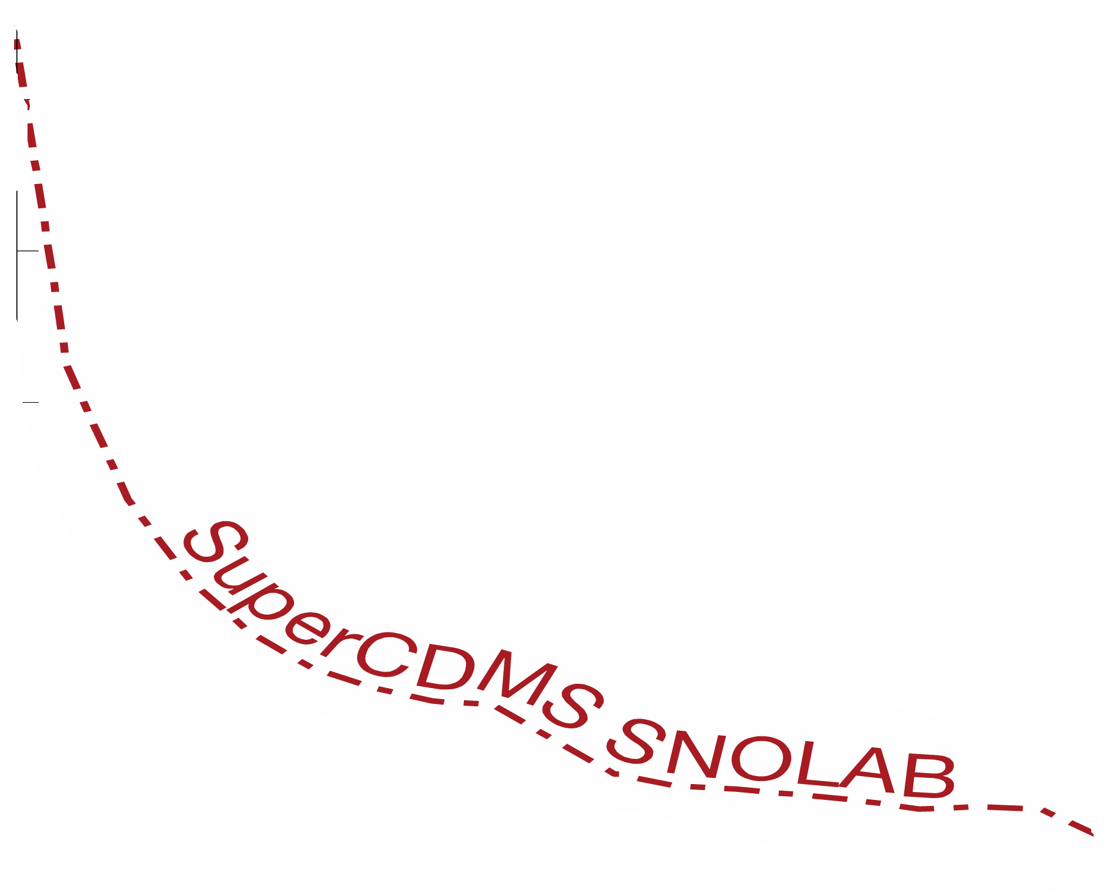
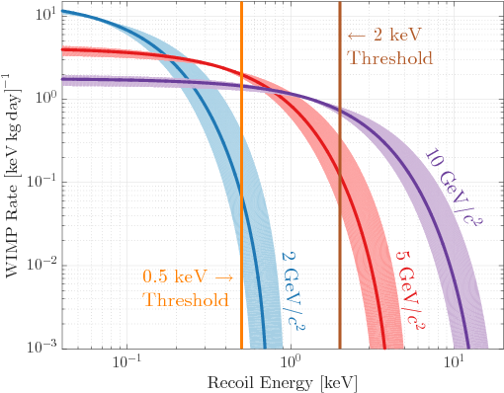
The Direct Detection Hunting Ground
E_{R}≈ μ² v²/m_{Ge}≈ 10 keV
Rate = N φ σ
χ₀
v/c =β ≅ 10⁻⁴
Ge
v/c =β ≅ 10⁻⁴
Coherence across nuclei gives A² boost
Low-threshold detector with <1 ct/kg/year
Challenging Background reduction and rejection
Background

Slide 4
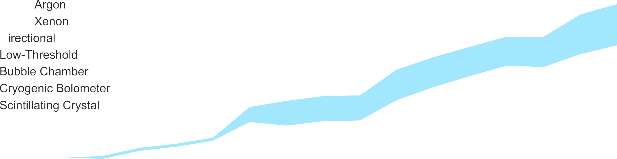
















# of researchers in this field increased by ~10 times in the last 20 years
5
Detector sensitivity improved by 5 orders of magnitude in the last 20 years

Slide 5
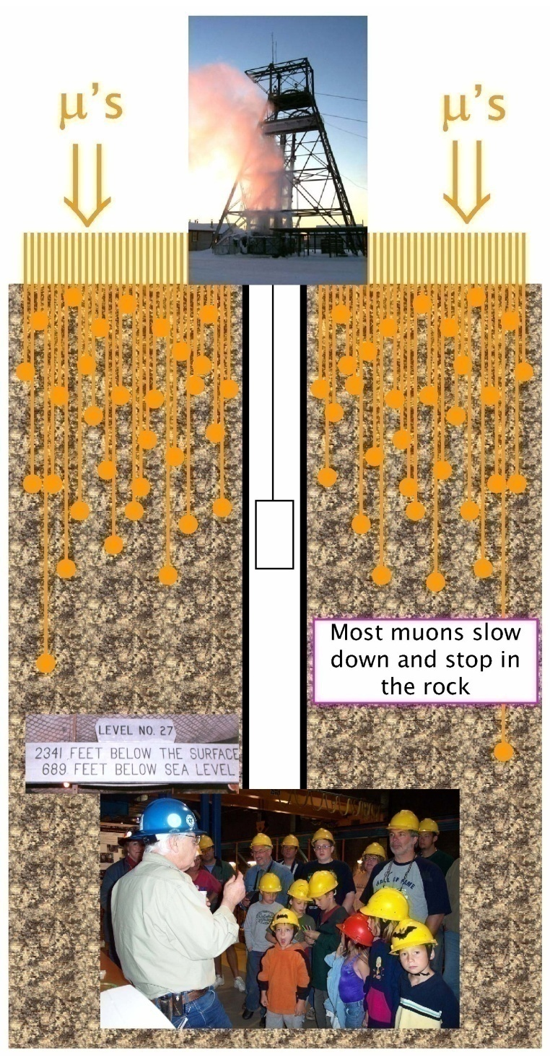
Underground Facilities

Slide 6
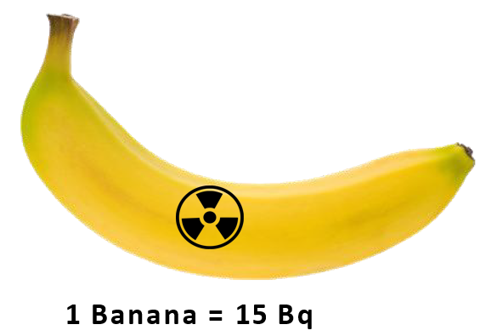
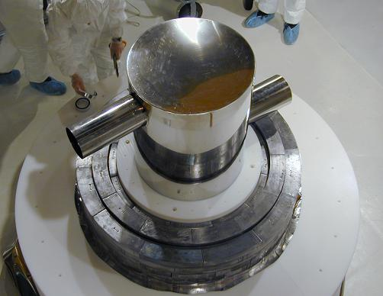
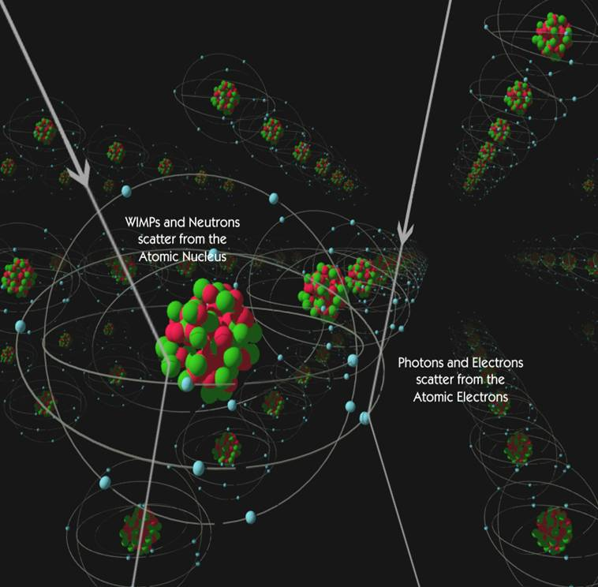
Background: Reduce and Reject
Current experiments: <1 millionth of a banana!
Reduce through shielding, material selection and reject through detector technology
Still often face unforeseen backgrounds that require new ways to reduce/reject
χ₀
γ
Earth as a shield from cosmic radiation
Passive Shielding: poly (N) and lead (γ)
Active Shielding (scintillators)

Slide 7
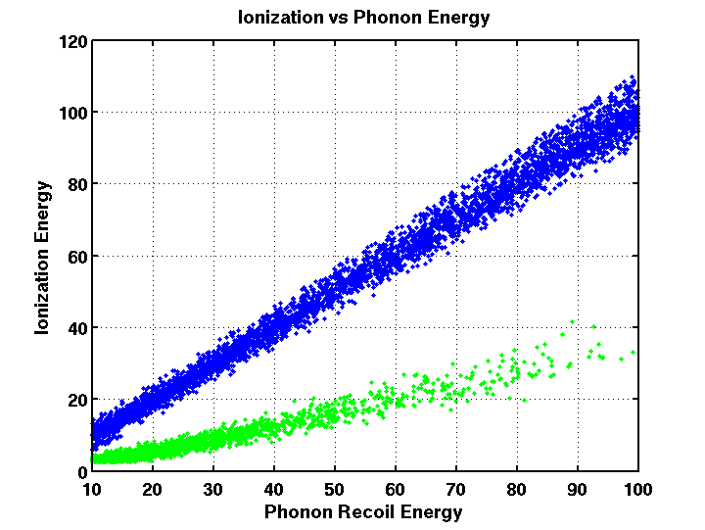
Detector Signal
Electron Recoil
SENSEI
Ionization Energy
eV, ε=20%
Nuclear Recoil
LZ, XENONnT, PANDAX, DARKSIDE
SuperCDMS, EDELWEISS
ionization
Q
Phonon (True) Energy
L
scintillation
H
phonons
keV, ε=1-10%
meV, ε=100%
DAMA, DEAP, XMASS, COSINE
PICO
CRESST III, TESSERACT
Notes:
Electron-ion pair creation in gas/liquid takes 2 orders of magnitude higher energy than electron-hole pair creation in semiconductors – so much higher ionization signal. Phonons have maximum energy of 60 meV in Si. Superconductors with band gaps of meV, where cooper pairs are broken. So, phonons can easily be used by superconducting sensors.

Slide 8


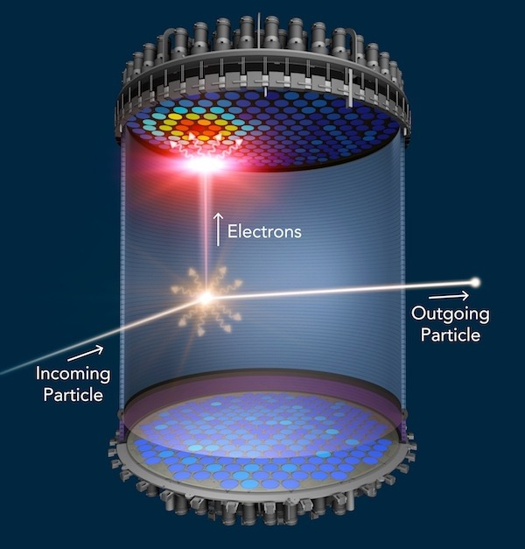
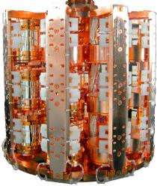
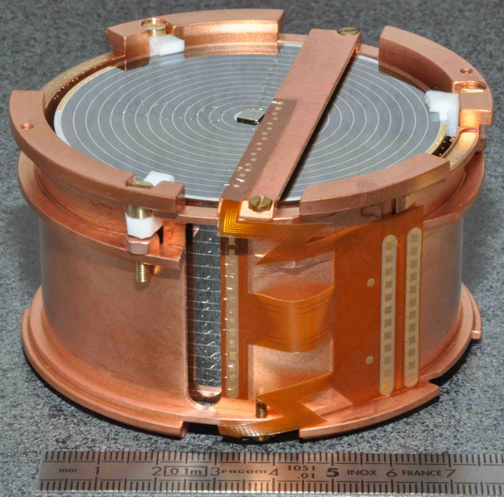
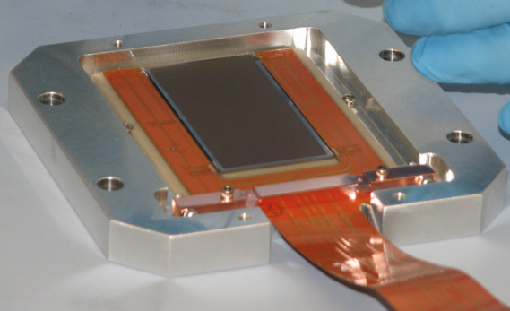
Leading Direct Detection Experiments
DarkSide
SuperCDMS
Cryogenic Semiconductor Detectors: (mK) SuperCDMS, CRESST, EDELWEISS; (77K) SENSEI
CRESST
EDELWEISS
SENSEI
SuperCDMS, CRESST

Slide 9
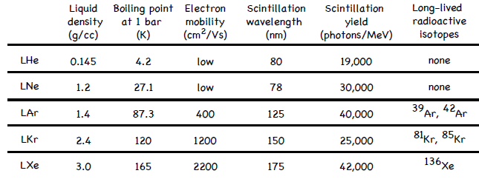
Noble Liquid Scintillators
M = 5 GeV/c², σ = 1e-42 cm²
χ χ-n
10⁴
Rate [Events/Ton/Year] > E
th
Xe (A=131)
Ge (A=73)
Ar (A=40) Ne (A=20)
-
10
3
Most noble gases can be used for detectors and such prototypes have been demonstrated to work
-
-
-
10²
10
1
0
1
2
3
4
5
6 7 8 9 10
Nuclear Recoil Threshold [keV ]
nr

Slide 10
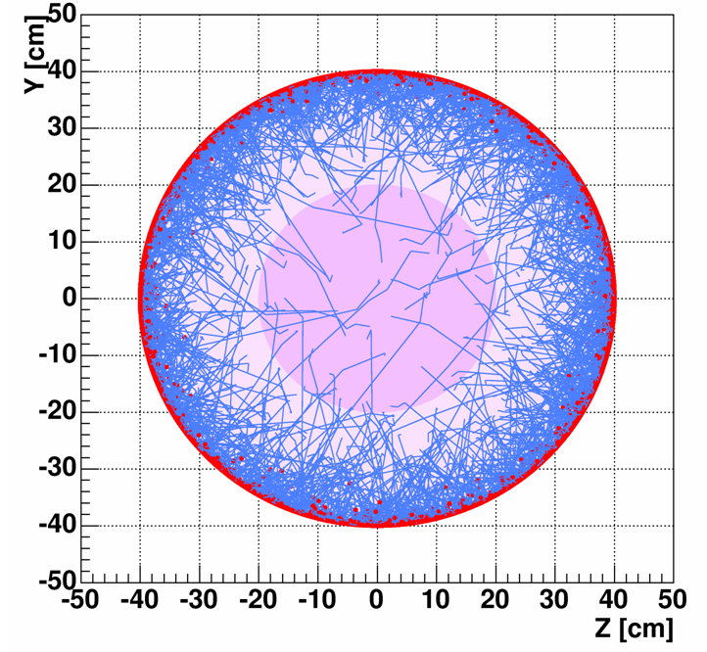
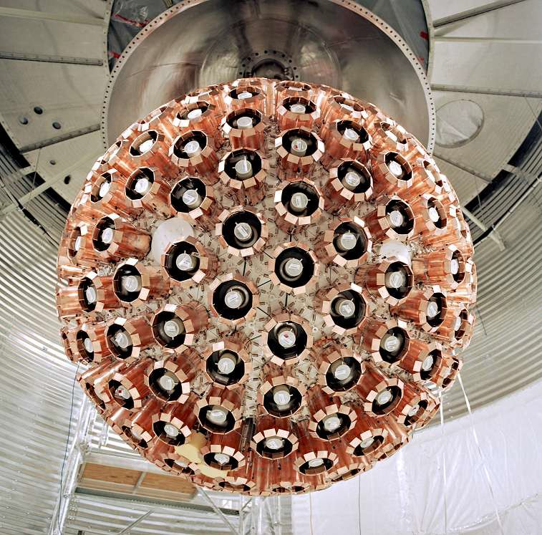
Single Phase Noble Liquid (Xe/Ar)
Shelf Shielding, Easier cryogenics (160K/80K) and no-self absorption of scintillation light
Single Phase Detector
DEAP @ SNOLAB
XMASS @ Kamioka
Simple design
PSD-based ER/NR discrimination in Argon

Slide 11
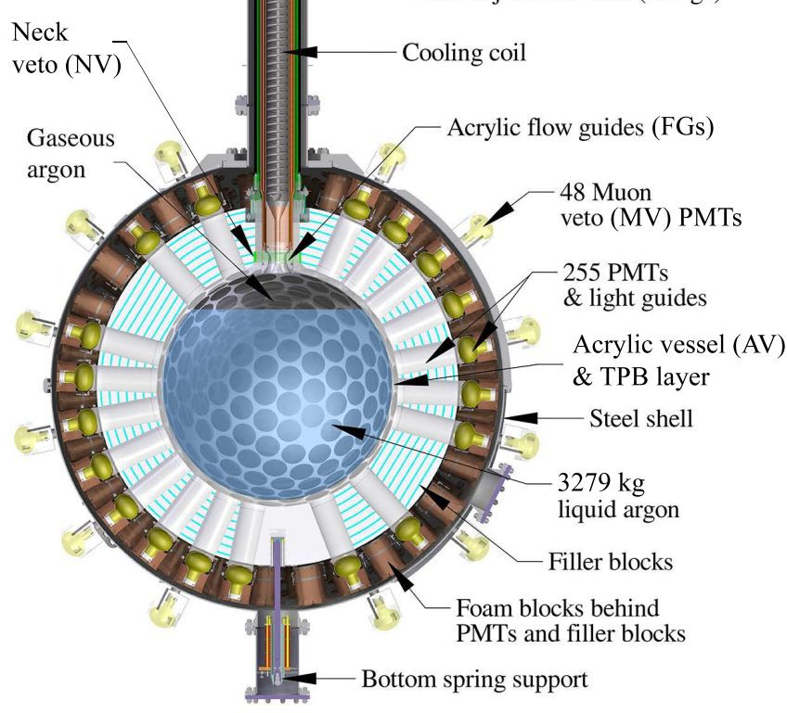
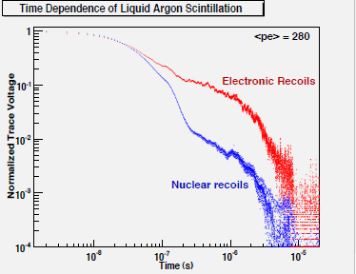
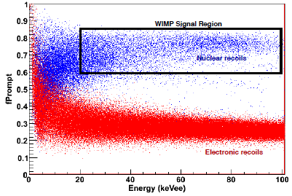
DEAP Liquid Argon @SNOLAB
Searches for nuclear recoils (10 - 100 keV)
Ar singlet (~7ns) vs. triplet (~1.6μs) decays
  ER cause relatively more triplet
  NR cause relatively more singlets
Use pulse shape discrimination (PSD)

Slide 12
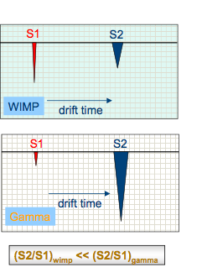
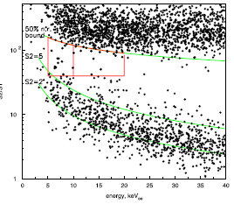
Dual Phase Noble Liquid (Xenon/Ar)
Prompt scintillation (S1) from recoil. Delayed S2 from drifted ionization
Nuclear recoil has reduced ionization ⇒ Lower S2 than Electron recoil
S2/S1
S1

Slide 13
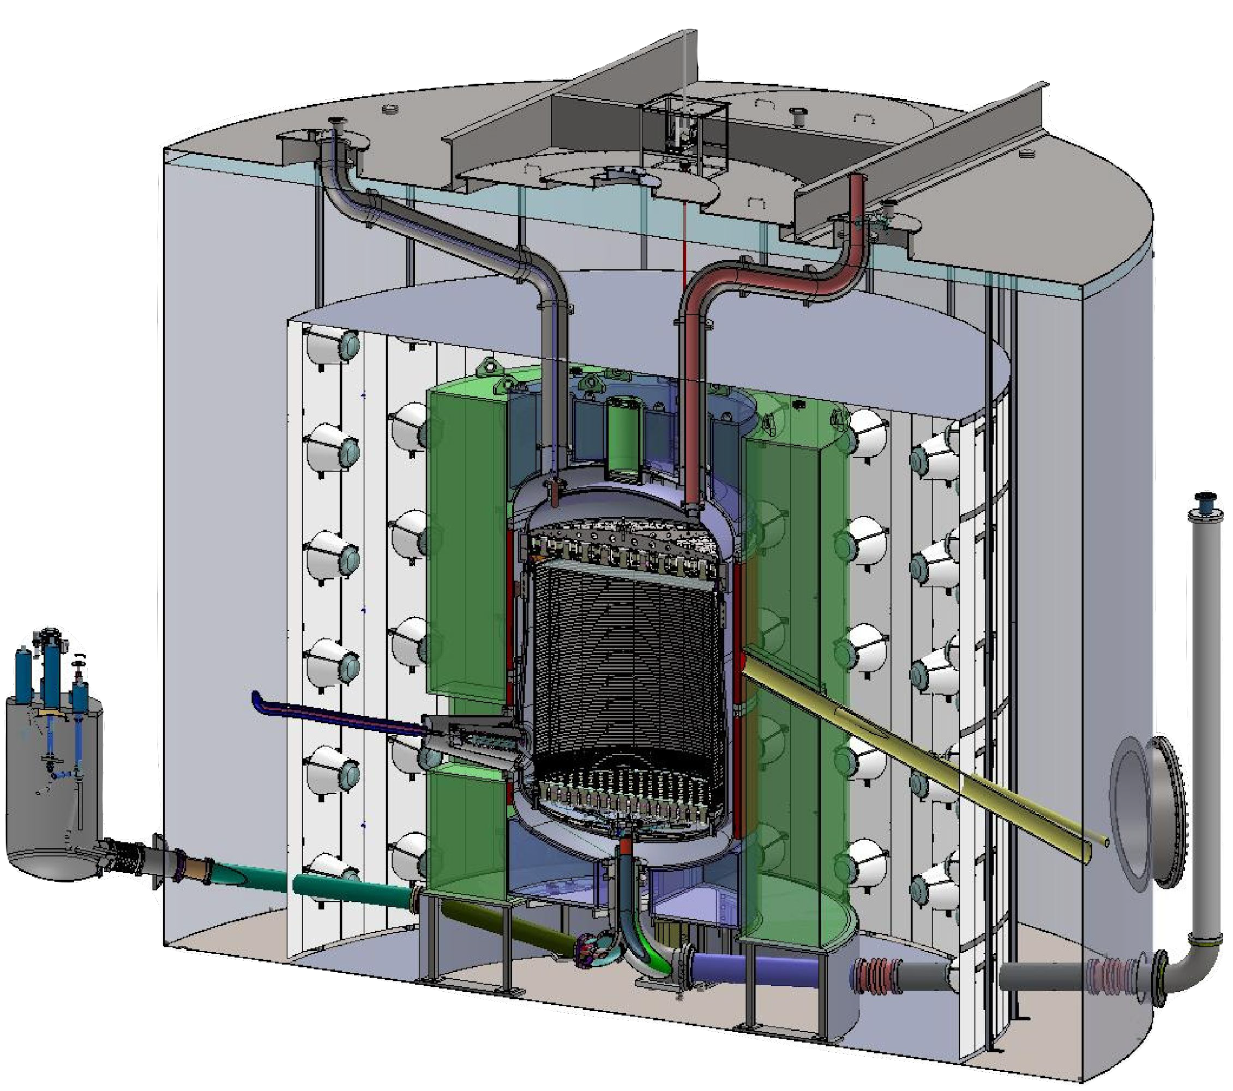





The LZ Detector
Water shield:
230 t DI water
Instrumented
LXe target:
7t LXe TPC
40x LUX
Outer Detector:
17 t Gd-LS
120 PMTs
New in LZ
6 m
TPC
1.5 m
1.5 m
LXe “skin” region:
Veto MeV γ
New in LZ
7.6 m

Slide 14
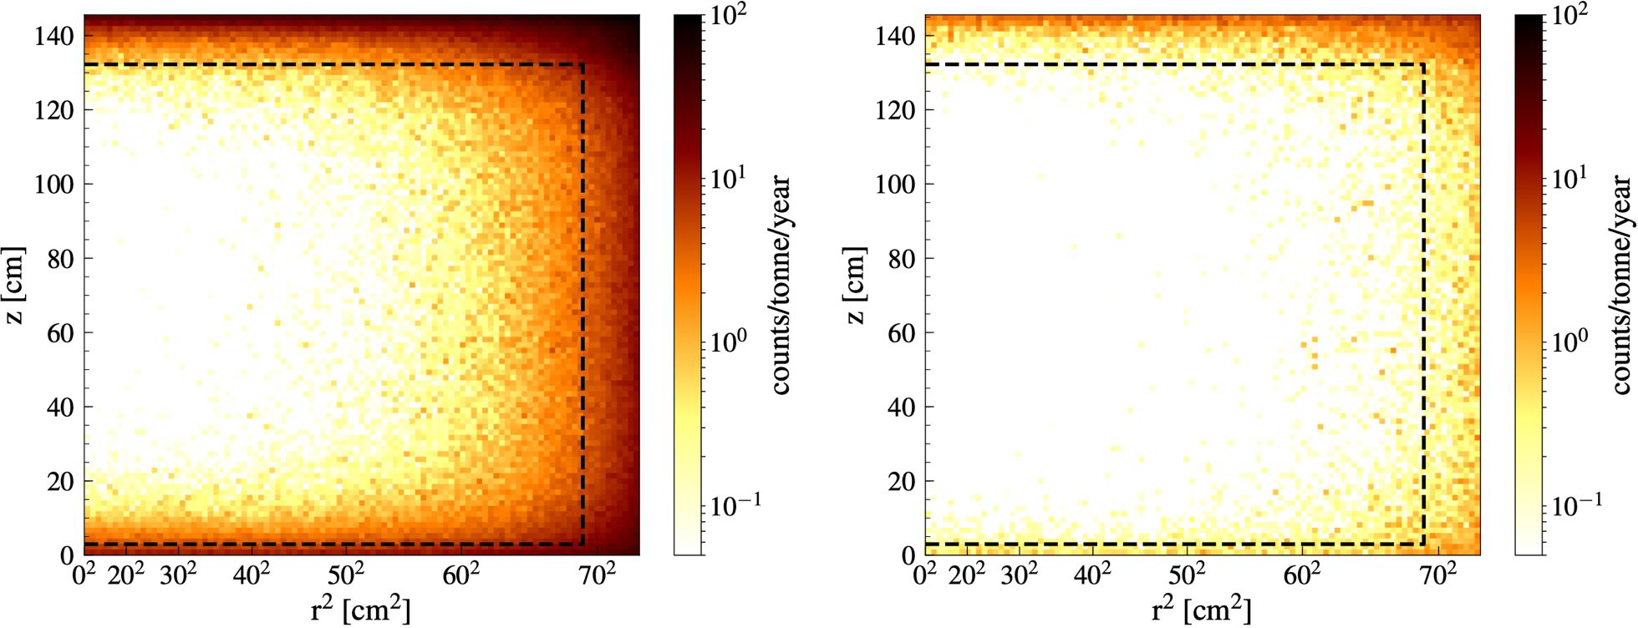
Anticoincidence cuts with veto detectors
Fiducial Volume
Fiducial Volume
No veto cuts After skin + OD Veto cuts
Single scatter NR events in 6-30 keV, relevant to a 40 GeV/c² WIMP
10x reduction in backgrounds in the 5.6 tonne fiducial volume in 1000 live days

Slide 15
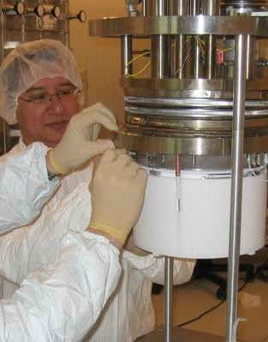
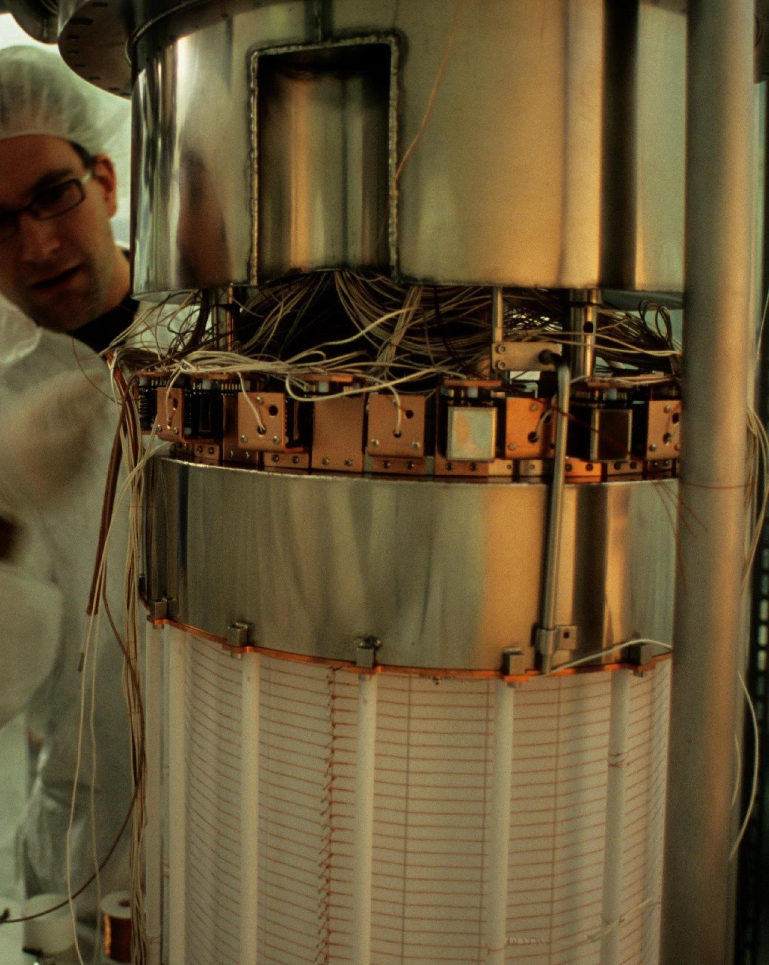
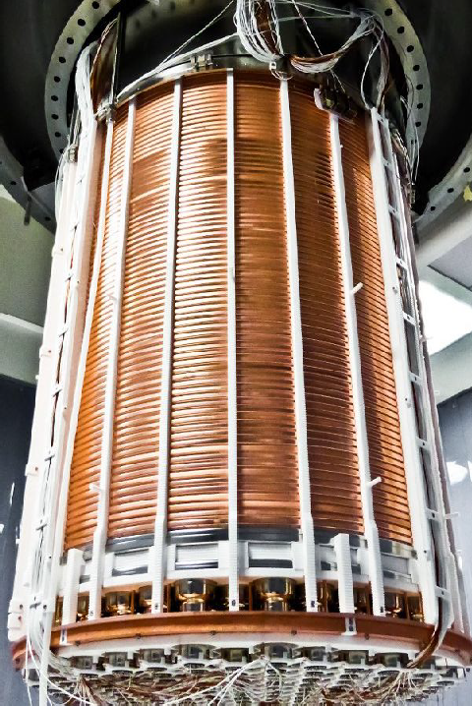
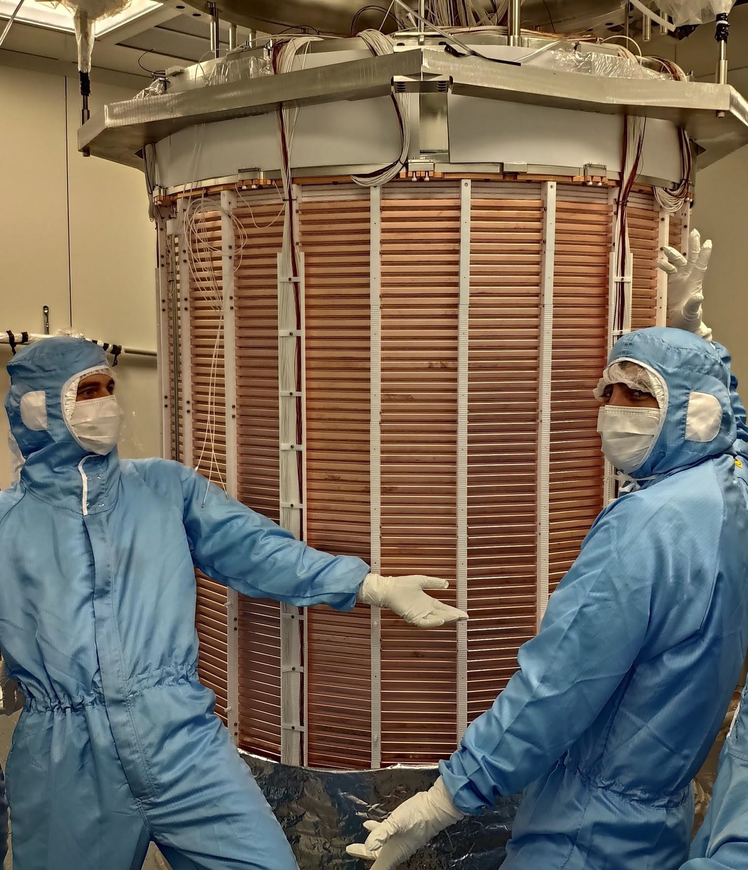
The XENONnT Program
Xenon10
Xenon100
XENON1T
XENONnT
14 kg Xe
2005-2007
62 kg Xe
2008-2016
2 T Xe
2012-2018
5.9 T Xe 2019-2020

Slide 16

XENONnT
Sharing a lot of infrastructure with
Xenon1T, very fast upgrade cycle
Notable improvements:
  Fiducial volume: 4T
  Very low ER background (⅙ compared to XENON1T)
  Low neutrons backgrounds (1 evt/ 20t yr. exposure)

Slide 17
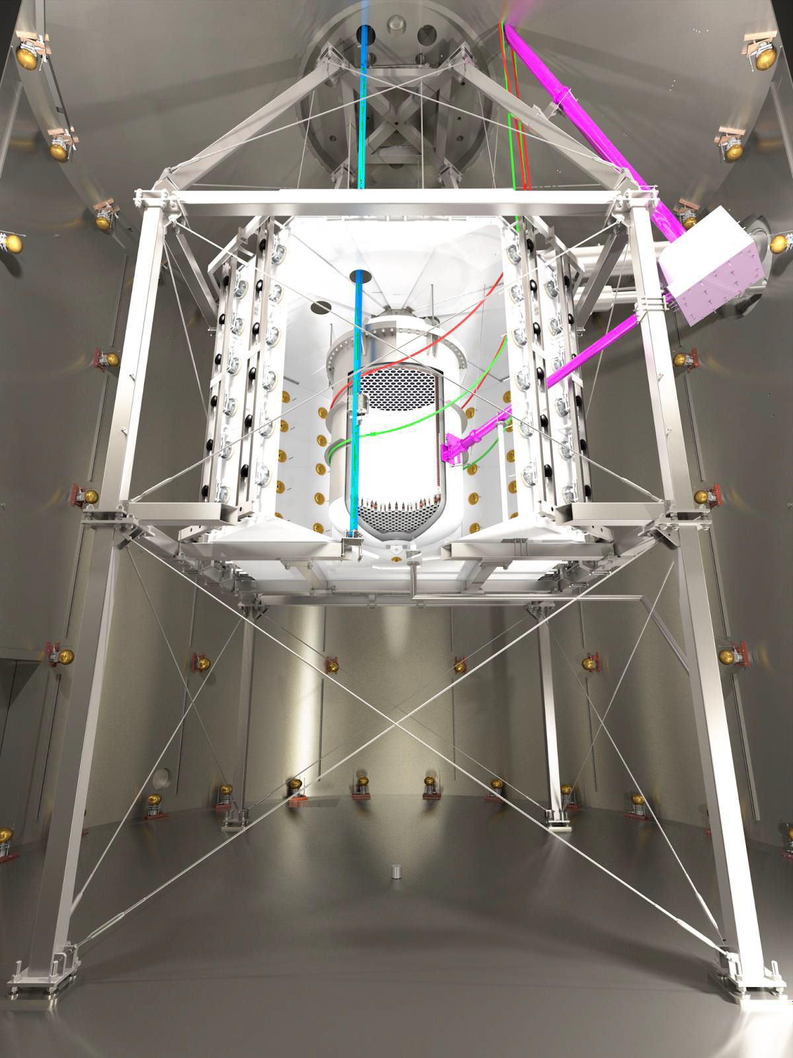
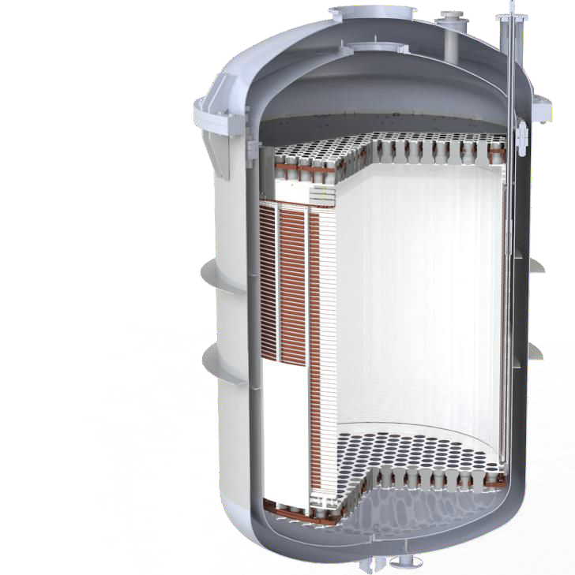


XENONnT
Active Xe mass 2t → 5.9t (3x)
Drift length 1m → 1.5m (1.5x)
PMTs 248 → 494 (2x)
The larger a detector the higher the purity needs to be
  Strict radioassay program
  Rn emanation: 4.2 µBq/kg (simulated, 1/3 of XENON1T )
Improved support system:
  Calibration system,
  Gd-water neutron veto (87%) eff
Goal: <1 event/ (20t x year)
https://arxiv.org/abs/2112.05629

Slide 18

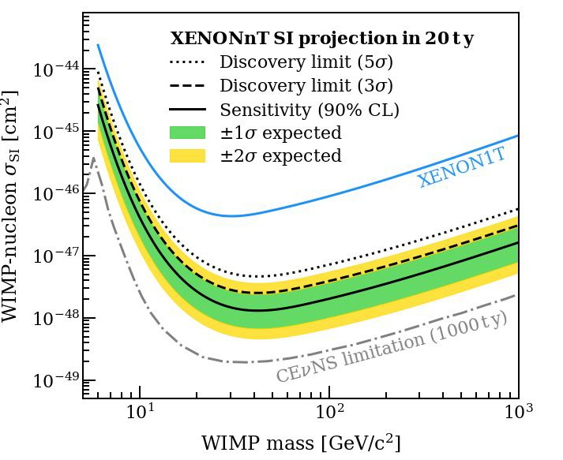
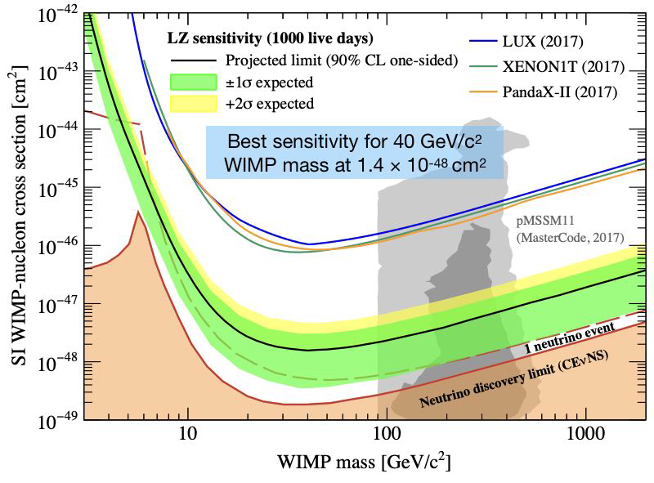
Projected Sensitivities
●
●
1.4×10⁻⁴⁸ cm² @ 50 GeV/c²
1.4×10⁻⁴⁸ cm² @ 40 GeV/c²
Actual ²²²Rn and neutron rates will be of large impact ultimatively

Slide 19

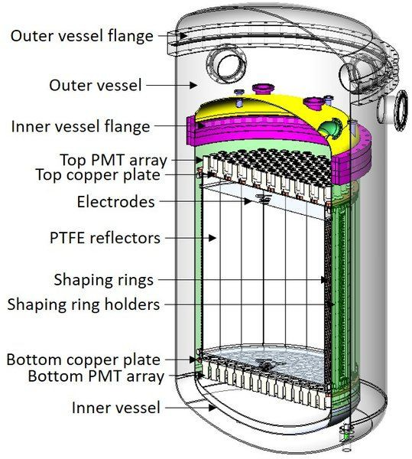
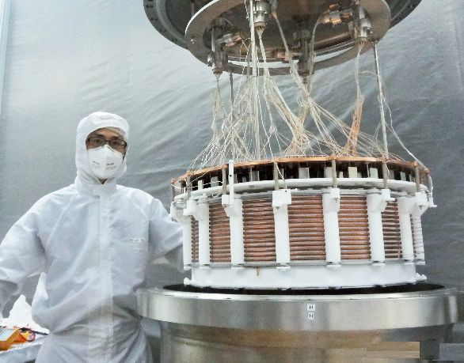
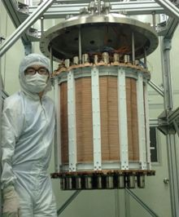
The PANDAX Program
Located in the China Jinping Underground Laboratory (CJPL)
5.7T of Xe, Fiducial: 3.7T inside DI water shield
PandaX-4T impressive performance with small team
PandaX = Particle and Astrophysical Xenon Experiments
Phase I: 120 kg DM
2009-2014
Phase II: 500 kg DM
2014-2017
PandaX-4T: multi-ton DM
2020-

Slide 20
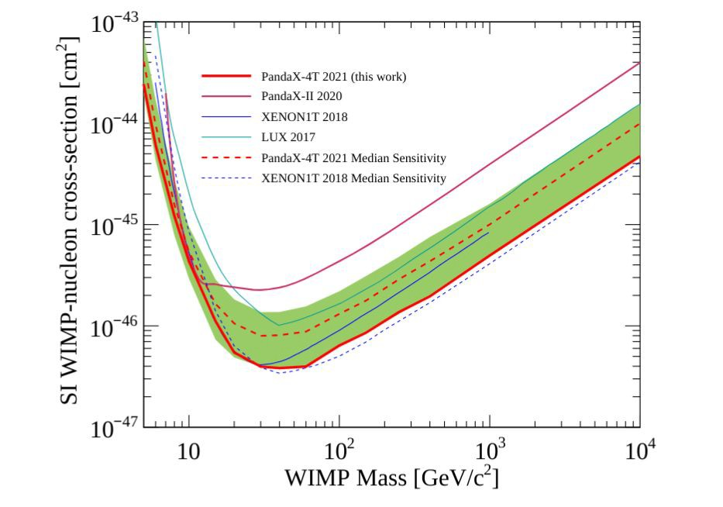
PandaX Limits
20

Slide 21
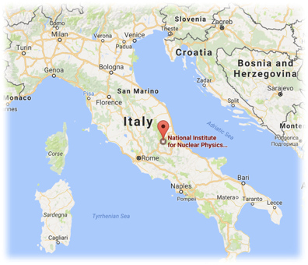
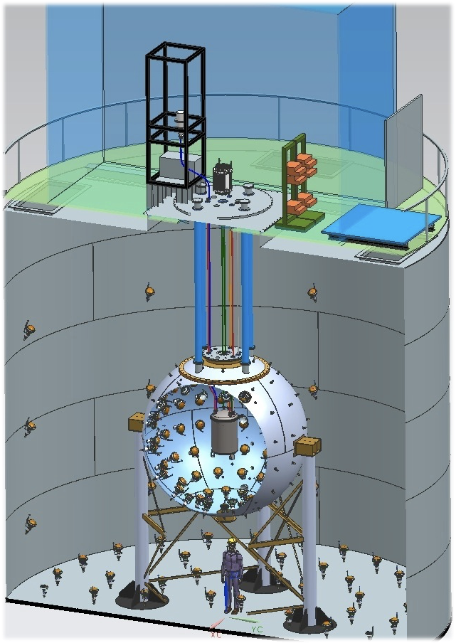




DarkSide-50
Radon-free (Rn levels < 5 mBq/m³) Assembly Clean Room
1,000-tonne Water Cherenkov Cosmic Ray Veto
30-tonne Liquid Scintillator Neutron and γ’s Veto
Veto efficiency > 99.1%
Inner detector TPC
filled with 150 kg of liquid Underground Ar

Slide 22
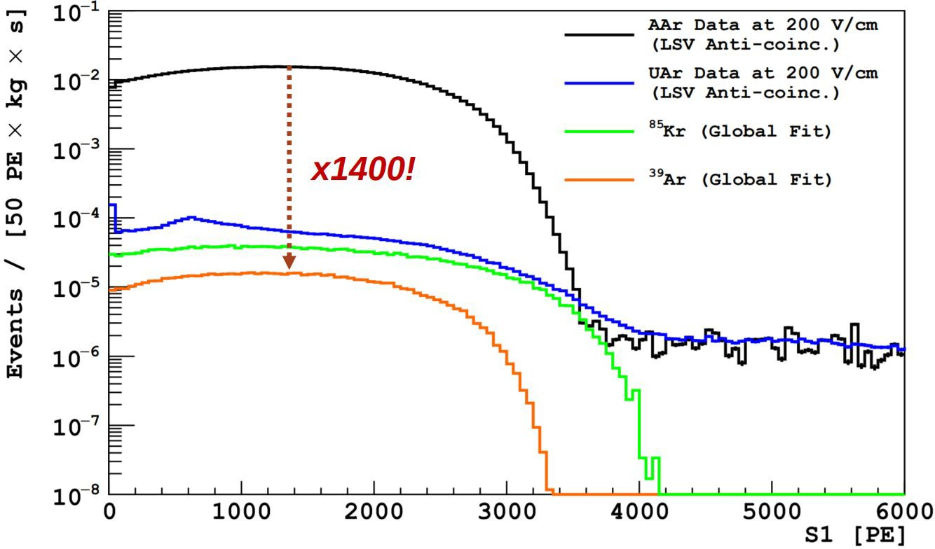
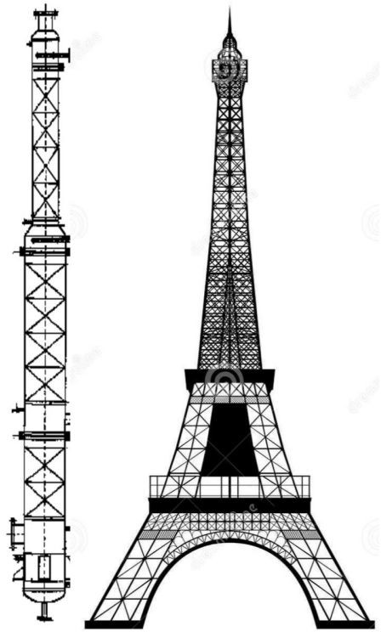
Why Underground Ar?
⁴⁰Ar is the most abundant noble gas in the atmosphere
Much less expensive than Xe plus PSD, but cosmogenic ³⁹Ar production limits the size of detectors due to pile-up: 1Bq/kg, 269 yr half-life
Source underground Ar depleted in ³⁹Ar, and purify via cryogenic distillation
Urania: UA extraction plant in CO. Same source as DS-50
Aria: Huge cryogenic distillation column in Sardinia, Italy
  Process O (1 t/day) with 10³ reduction of all chemical impurities
  Isotopically separate ³⁹Ar from ⁴⁰Ar

Slide 23
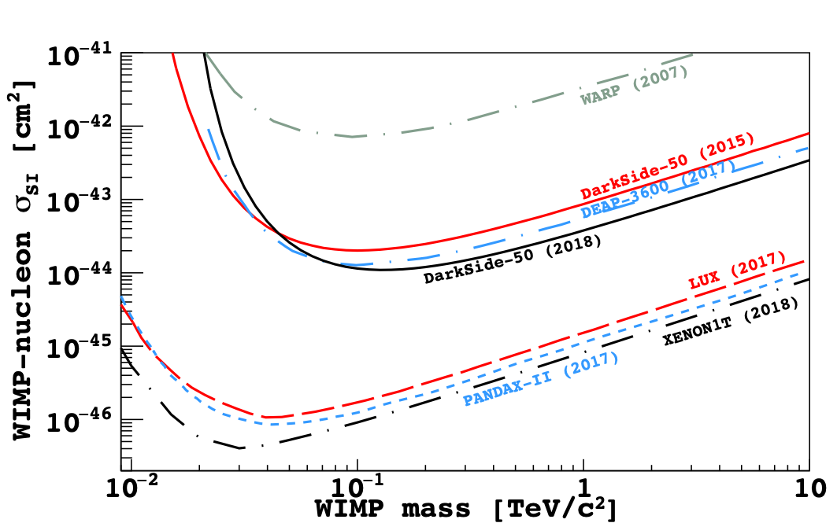


540-day Blind Analysis Result
Strong Pulse Shape Discrimination!!
No BG in the Search Region
WIMP Search Region
Pulse Shape Discrimination
0 Event
Phys. Rev. D 98 102006 (2018)

Slide 24

Future Argon Program
Global Argon Dark Matter Collaboration (GADMC), merger of DEAP-3600, MiniCLEAN, ArDM & DarkSide-50
DarkSide-20k
  Sealed acrylic dual phase TPC filled with ~ 50 tonnes UAr
  2% Gd doped acrylic panels as neutron veto detector
  Membrane cryostat filled with
~700 tonnes Atmospheric Argon (AAr);
  SiPMs as photosensors:
8280 channels for TPC
~3000 channels for Veto;
DarkSide-20k 50 T LAr

Slide 25
Cryogenic Detectors

Slide 26

Cryogenic Dark Matter Search: The Big Picture
Cryogenically cooled Ge/Si detectors with photo-lithographically patterned Transition Edge Sensors for excellent energy and position resolution
40mK
Demonstrated two decades of leading WIMP search limits with excellent low-background performance
Phonon
Nucleus
Ionization
Background
Signal
χ⁰
v/c ≈ 10⁻³ (Galactic)
Mc² ≈ 50 - 500 GeV)
Passive Shielding (Pb, poly, depth)
Active Shielding (muon veto shield)
X-Y-Z Position from Phonon Pulse Timing

Slide 27



Anatomy of an event
Ionization Energy
Electron Recoil
Q inner
Q outer
Nuclear Recoil
Phonon Energy (Recoil)
-3V
Hot charge carriers (3eV/pair)
h⁺
e⁻
0V
Quasi-diffusive THz phonons
Sensor A
Sensor B
Sensor C
Sensor D
Ballistic Neganov-Luke phonons
Ballistic low-frequency phonons
Total Phonons = Direct Phonons + Luke Phonons

Slide 28


Phonon Sensors
Quasi-particle assisted athermal phonon sensors provide much faster μs timing than ms timing from thermal phonon sensors like used in EDELWEISS/CRESST
1 μm TES
Al Collector
W Transition Edge Sensor (TES)
Cooper Pair
Al
ΔR
R₀
ΔT
Ge or Si
T₀
phonons
Athermal phonons are collected by superconducting Al fins (Δ=~meV), creating quasi particles that are then trapped by the W Transition Edge Sensors (TES), held in equilibrium between Normal and Super Conducting temp. SQUIDs measure current small change through sharp ΔR/ΔT

Slide 29


Detector Technology Developed for SuperCDMS
iZIP Detector with ionization and phonon sensors for ER/NR discrimination (>keV)
First SNOLAB Ge iZIP (fabricated at TAMU)
https://arxiv.org/pdf/1610.00006.pdf
Phonon
Ionization
High Voltage Detector with NTL gain. Give up discrimination in favor of low threshold (~100eV).
First SNOLAB Si HV (fabricated at TAMU)

Slide 30



Improved SNOLAB Detectors
Larger voltage bias
More position info
Lower Tc for better phonon resolution
Resolution few e-h pair for HV det.
A major advantage of modular detectors: Provides the ability to develop breakthrough detector technologies that can be rapidly deployed in the same experiment, unlike monolithic detectors like LZ/XENON/DARKSIDE that have a longer development lifecycle for each detector

Slide 31




SuperCDMS experiment design
DCRC boards
15 mK
E-tank
Detector
tower
Seismic platform
C-Stem (cold) is stem for heat conduction to a dilution refrigerator
E-tank is the vacuum bulkhead where the detector readout boards (DCRCs) connect
Detector
housing
Shielding:
Cu cans
Inner neutron shield
Pb gamma shield
Outer neutron shield
E-Stem (electronic) carries signals out from the detectors
8

Slide 32






Dark Matter Searches: A broadband approach
Traditional Nuclear Recoil | iZIP, Background free | >5 GeV
Low Threshold Nuclear Recoil | iZIP, limited discrimination | >1 GeV
HV mode | HV, no discrimination | 0.3 - 10 GeV
Electron recoil | HV, no discrimination | 0.5 MeV - 10 GeV
Absorption (Dark Photons, ALPs) | HV, no discrimination | 1 eV - 500 keV
All major Dark Matter direct detection experiments have rich detector and DAQ systems that allows for rich multi-physics searches with analysis optimized for each search

Slide 33
Sub-GeV Dark Matter Electron Recoils
Need to look at electron signals
  Electrons emitted as a secondary process (Migdal, Bremsstrahlung)
  Dark matter interacts with electrons
Require: detect down to a few or even single electrons
Reducing the “few-electron” background to improve sensitivity
Existing large experiments (LUX/LZ, DarkSide, XENON, SuperCDMS) can perform simultaneous search while searching for heavy WIMPs
Smaller target experiments: DAMIC, SENSEI aim to achieve very low single-to-few electron background

Slide 34





SuperCDMS installation in progress
Seismic Platform
Component deliveries to SNOLAB by the construction project
Plan | Status
Seismic Platform | Installed
3T Gantry Crane | Installed
Radon Reduction System | Installed
Cleanroom | Installed
DAQ | Installed
Computing | Offsite, data transferred to SLAC and others
Calibration | Preparing to ship
Readout Electronics | Complete
Dilution Refrigerator | Received from vendor
Shielding | Received from vendor
Detector Towers | Scheduling The Work
SNOBOX | In Development
Shielding
Radon Reduction
System
Calibration
Dilution Refrigerator
Plan is to start commissioning run in 2023!

Slide 35





SuperCDMS installation in progress
Inner lead and
Seismic platform polyethylene shield
Hardware
Radon filter system
Chilled waterloop
Calibration system
Plan is to start commissioning run in 2023!

Slide 36

SNOLAB Upgrades to Reach Neutrino Floor
Lower
Threshold
More exposure,
Lower Backgrounds

Slide 37



Single-e sensitive HVeV Detector (gram -scale)
Single-e sensitivity has been demonstrated at gram-scale (1cm²x4mm) Si detector. Run 1 at Stanford and Run 2 at Northwestern provided world leading low-mass sensitivity
Phys. Rev. D 102, 091101(R)

Slide 38





Hybrid HV Detector
⁵⁵Fe
Main idea: Monolithic detector with a LV and a HV side – LV to measure primary phonons like iZIP and HV to measure NTL phonons. Do it without significant NTL pollution from HV to LV. ~100gm
²⁴¹Am
Charge transport from LV region to HV almost 100%
Discrimination improves at low energies due to the Lindhard suppression of NR ionization. Funded by DOE for DM and CEνNS searches
Phonon-mediated High-voltage Detector with Background Rejection for Low-mass Dark Matter and Reactor Coherent Neutrino Scattering Experiments: https://inspirehep.net/literature/1802528

Slide 39



Low-Threshold Ge Detector inside Fully Hermetic Ge Shielding
  3He + 32Si (β-decay in bulk)
Ge Activation
Surface Betas
Surface 206Pb
Neutrons
CNS
Last SuperCDMS Soudan result limited by surface Radon decays, where the NR was detected in the detector with the α escaping
Ge 3”x1” G15
Inner Ge detector surrounded by Ge active veto reduces Compton by 10x and eliminates all surface decays from Radon and other radioactive contaminants on crystal, copper housing
Ge 3”x1” G22

Slide 40

The CRESST Experient
Latest results of CRESST-III’s search for sub-GeV/c² dark matter
10 CRESST-III modules installed (23.6 gm)
Jul 2016 – Feb 2018 run
lowest nuclear recoil threshold: 30.6 eV
[arXiv:1904.00498]
reflective and scintillating housing
block-shaped target crystal (with TES)
light detector (with TES)
instrumented CaWO₄ sticks (with holding clamps and TES)
Detector design optimized for low-mass dark matter:
24g detectors with detection threshold of 𝟏𝟎𝟎 𝐞𝐕
crystal with low total background of ≈ 3 DRU
veto against surface related background
Signal time-scale ms, compared to us in SuperCDMS
Measured heat pulses
SQUID output, V
0.3
0.25
SQUID output [V]
Δ𝑇 = ^{Δ𝐸}
0.2
𝐶
0.15
0.1
0.05
0
−20
0
20
40
60
80 100
time, ms

Slide 41

Detector Response
Latest results of CRESST-III’s search for sub-GeV/c² dark matter
Light yield=light signal/phonon signal
e⁻/γ
Discrimination between
electron recoils,
i.e. dominant radioactive background
nuclear recoils,
i.e. potential DM signal
α O
Ca
W
Energy / keV

Slide 42

Exclusion limit
Latest results of CRESST-III’s search for sub-GeV/c² dark matter
Experimental range
extended down to 160 MeV/c²

Slide 43








The SENSEI Experiment
2017
Demonstrate sub-electron resolution
2018
DM search with proto-SENSEI (0.1 g) at surface
2019
DM search with proto-SENSEI at MINOS (230
m.w.e.)
2020
DM search with science-grade (~2 g) at MINOS
Ongoing
DM search with 100 g of science-grade CCDs at SNOLAB (6000
m.w.e)

Slide 44


Skipper-CCD
The skipper-CCD is a modification of the output stage of a CCD (Janesik et al-1990). It allows for multiple non-destructive readout of the charge in a pixel.
The noise on each pixel can be optimized as needed.This allows an optimization between readout time and noise
44

Slide 45


2020 SENSEI Result (world leading)
Rates:
•
•
1e- = 450 ev/g-day (1.6 10⁻⁴ e/pix/day) 2e- = 2.4 ev/g-day
Phys. Rev. Lett. 125, 171802 – Published 20 October 2020
₁₀-27
₁₀-28
₁₀-29
₁₀-30
₁₀-31
₁₀-32
₁₀-33
₁₀-34
₁₀-35
₁₀-36
₁₀-37
₁₀-38
₁₀-39
₁₀-40
₁₀-28
DarkSide50
-29
XENON100
10
₁₀-30
₁₀-31
₁₀-32
protoSENSEI@Surface
protoSENSEI@Surface
CDMS-HVeV
er_{e} [cm²]
CDMS-HVeV
er_{e} [cm²]
DAMIC
EDELWEISS
protoSENSEI@MINOS
DAMIC-SNOLAB
₁₀-33
₁₀-34
₁₀-35
₁₀-36
XENON100
protoSENSEI@MINOS
EDELWEISS
DarkSide50
Solar reflection
XENONlT
electron-only
XENONlO
SENSEI@MINOS
XENONl0
SENSEI@MINOS
DM-e scattering
F_{DM}=(am_{e}/q)²
DM-e scattering
Benchmark
Freeze-in
F_{DM}=1
Models
XENONlT
₁₀-37
1
10
m_{x} [MeV]
10²
10³
9
1
10
m_{x} [MeV]
10²
10³

Slide 46







Nuclear Recoil Calibration
Nuclear recoil efficiency for ionization (SuperCDMS) and light (Xe, Ar) are measured using monochromatic neutrons combined with scatter setup
1.889 MeV protons with 2.5 MHz pulsing
LiF target used to generate 56 keV neutrons
Utilize 55.7 keV elastic scattering resonance in Si
EJ-301, EJ-309 scintillators

Slide 47

Coherent Neutrino Scattering: Connection to WIMPs
CEνNS process is yet to be discovered at a reactor
Integrated rate/kg-year
Background
Requirements: Low Threshold and Low-background. Majority of the current low-threshold DM searches have an equivalent CEνNS program that is rapidly helping understand detector response and unknown background
Recoil energy in eV

Slide 48


EXCESSive Challenges to Low-mass Dark Matter Searches
https://arxiv.org/abs/2202.05097

Slide 49

Sharp Increase in Background: Non-Ionizaiton
Lowered sub-keV thresholds among DM/CEνNS experiments reveal a new signal of unknown origin. Typically starting at energies below 1 keV, the signal rises exponentially towards lower energies.
The signal is observed in various experiments with different detector materials, sensors and holding structures, below and above ground, at different temperatures and background levels.

Slide 50

Sharp Increase in Background: Ionizaiton
An understanding of the observed background below 1 keV has a top priority for current low-threshold experiments, since this energy region is a crucial part of the DM/CENNS ROI
Uncovering the origin and whether it is a common effect among all the experiments, is a difficult task. Needs further collaborative work
Due to variations in the shape, rate and time dependence of the signal among experiments, detectors and measurements, a dark matter (DM) explanation seems unlikely.

Slide 51

Nature of the Background? ER? NR? IR leakage? Unknown effects?
Leading detector technologies with low-threshold particle discrimination on an event-by-event basis are trying to further investigate this phenomenon in R&D labs
Changes in crystal holder, vibrations, environmental noise, IR exposure being tried in non-discriminating detectors

Slide 52



DM Search Beyond the Neutrino Floor?
WIMP signal points to the direction of Cygnus. Direction to the Sun and Cygnus do not overlap during the year. Directionality can cleanly separate the WIMP from the Solar ν
Exploring directional semiconductor detector with known ν direction from a reactor core

Slide 53




Threshold Displacement Energy (TDE) Anisotropy:
Directional detection and NR discrimination
Expect two effects:
  If single electron ionization NR threshold angular is homomorphic to TDE we expect an event rate that varies as earth rotates w.r.t to DM wind.
  The energy stored in the defects will be missed in phonon signals.
For ionization detection The effect will lead to a rate modulation as a function of the earth angles wrt DM:
For phonon detection We expect a measurable distortion in the spectrum:
  The Blue spectrum without the defect effects
  The Orange with defects effect convolved
  The Green is the significance of the effect
  Diamond shows the best sensitivity to this defect missing energy effect
Detector R&D program to develop very low Tc sensors for extremely low background that can exploit this
F. Kadribasic et al., Phys. Rev. Lett. 120, 111301 (2018). [Arxiv: 1703.05371],
https://doi.org/10.48550/arXiv.2112.14495

Slide 54
Conclusions
Next generation experiments will be aiming to explore parameter space down to the neutrino floor, especially at higher WIMP masses
The low-mass WIMP parameter space is fertile for quick technical progress in thresholds and dramatic increases in discovery potential.
Broad program of Dark Matter searches beyond the nominal WIMPs. Strong detector and background synergy with Reactor CEνNS expts.
Serious background challenges remain for low-mass searches.
Many leading technologies are joining forces to build corresponding G3 detectors: Xe technologies (LZ and XENON), Ar (Darkside, DEAP)
There will be pleasant and unpleasant surprises and we may discover something different from what we set out to find!

