Slide 1


In collaboration with Suruj Jyoti Das, Abhijit Kumar Saha, Rome Samanta
Probing Miracle-less Dark Matter
via Gravitational Wave Spectral Shapes
Based on arXiv:2202.10474
Debasish Borah
Indian Institute of Technology Guwahati

Slide 2
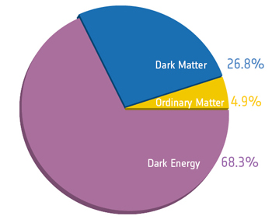
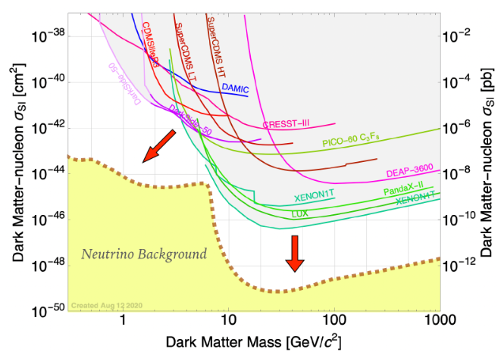
The motivation
The Standard Model (SM) has been very successful, but it does not have a particle dark matter (DM) candidate.
WIMPs, the popular DM has been extensively searched for, but no positive signatures yet.
It is motivating to consider scenarios, where DM interactions are weaker yet with complementary detection prospects.
2110.02359

Slide 3
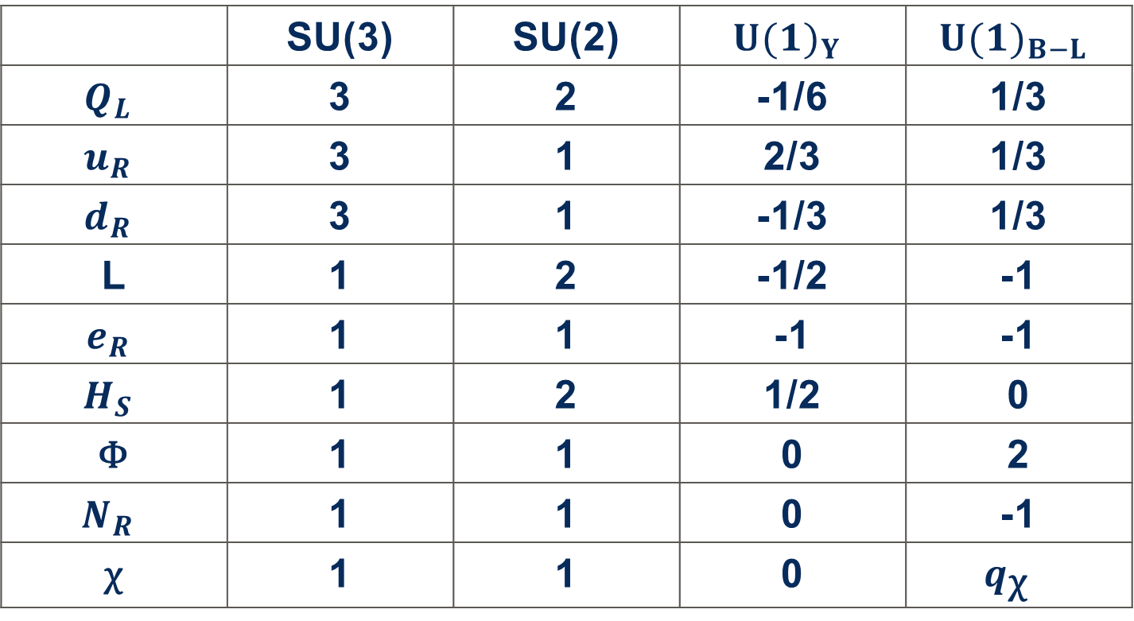
The FRAMEWORK
We consider a scenario where DM mediates with the SM via superheavy mediators: naturally leading to weaker DM interactions.
An Abelian gauge extended scenario can accommodate this possibility while ensuring DM stability simultaneously.
As an illustrative example, we consider gauged B-L extension of SM.
 | SU(3) | SU(2) | $${U(1)}_{Y}$$ | $${U(1)}_{B−L}$$
$$Q_{L}$$ | 3 | 2 | -1/6 | 1/3
$$u_{R}$$ | 3 | 1 | 2/3 | 1/3
$$d_{R}$$ | 3 | 1 | -1/3 | 1/3
L | 1 | 2 | -1/2 | -1
$$e_{R}$$ | 1 | 1 | -1 | -1
$$H_{S}$$ | 1 | 2 | 1/2 | 0
ϕ | 1 | 1 | 0 | 2
$$N_{R}$$ | 1 | 1 | 0 | -1
χ | 1 | 1 | 0 | $$q_{\text{χ} }$$
Anomaly Free
Vector-like
Davidson 1979, Mohapatra & Marshak 1980

Slide 4
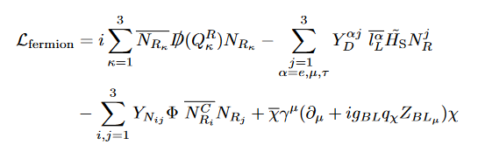
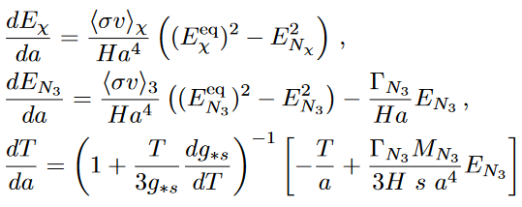
DM RELIC
DM is produced thermally and freezes out by virtue of B-L interactions.
DM gets thermally over-produced due to insuffic-ient annihilations media-ted by heavy B-L gauge boson.
Correct DM relic is obtain-ed via late entropy injecti-on due to decay of one of the right handed neutrinos (RHN).
Scherrer & Turner 1985

Slide 5
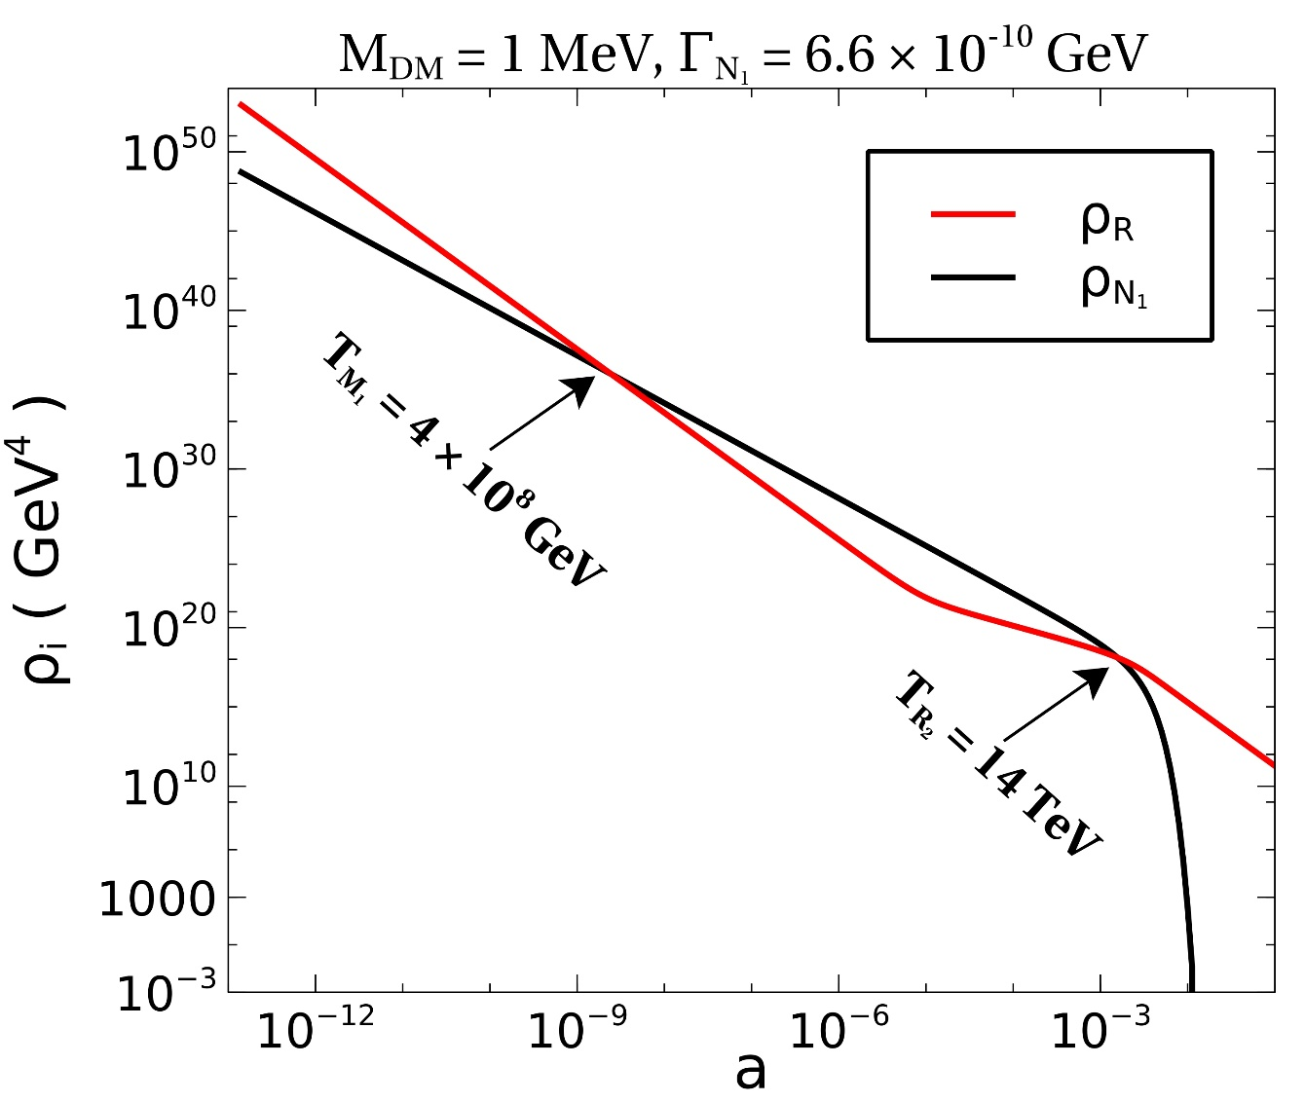
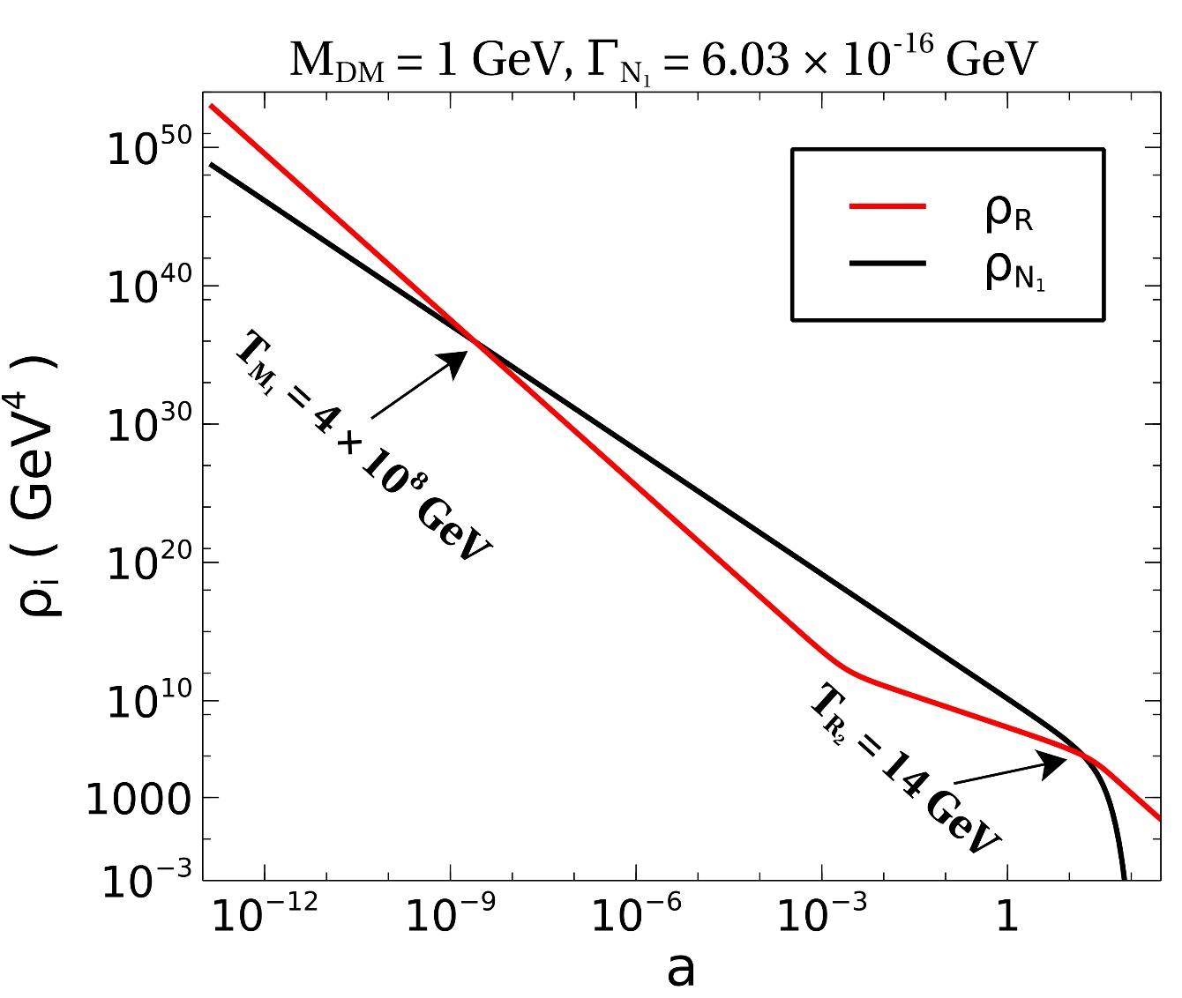
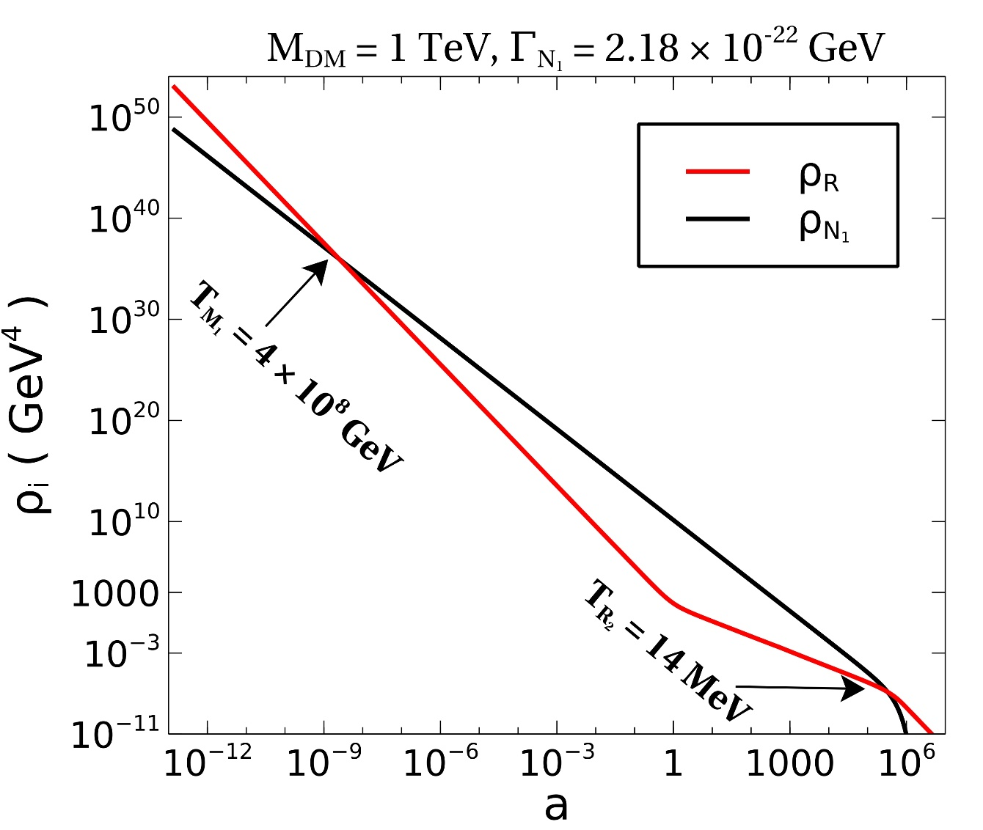
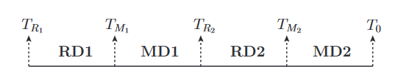
Naturally leads to non-standard
cosmological history with early matter
domination due to long-lived diluter

Slide 6
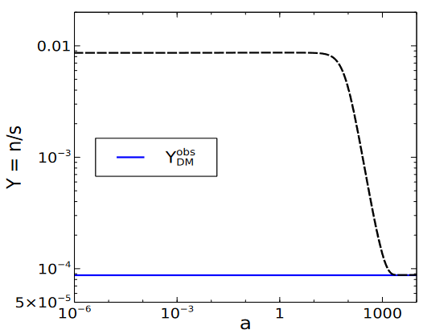
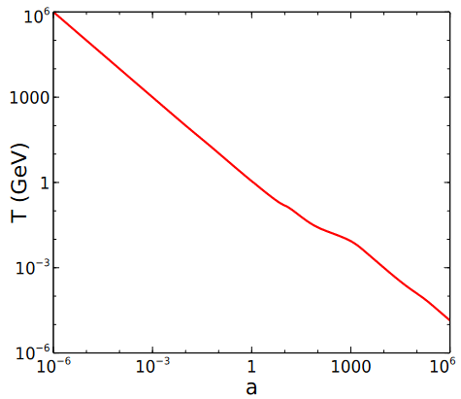
Thermally overproduced
Entropy dilution
Entropy injection

Slide 7
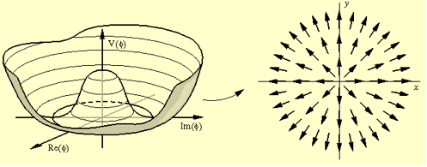
Cosmic Strings FROM U(1) breaking
Courtesy: http://www.ctc.cam.ac.uk
Spontaneous breaking of U(1) can produce cosmic strings (Nielsen, Olesen 1973; Kibble 1976) which can emit GW with a characteristic spectrum (LISA Cosmology WG, arxiv:1909.00819).
There have been some recent proposals to probe Superheavy DM which acquire mass from a high scale U(1) symmetry breaking using GW spectrum emitted from cosmic strings (see, for example, arxiv: 2107.13112).
However, the characteristic GW spectrum from cosmic strings can arise without DM too: need some stronger connection!

Slide 8
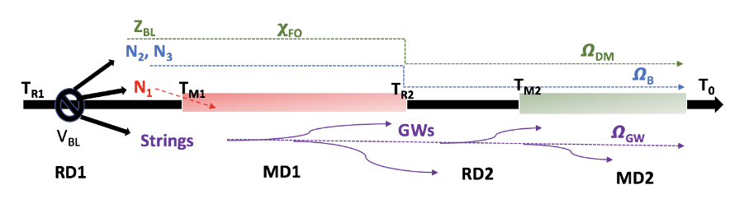
We, therefore, consider a scenario where the mechanism which guarantees correct DM abundance also leaves imprint on the GW spectrum generated by cosmic strings.
In our setup, late entropy release required for correct DM relic, causes distortions in GW spectral shapes generated by cosmic strings.

Slide 9

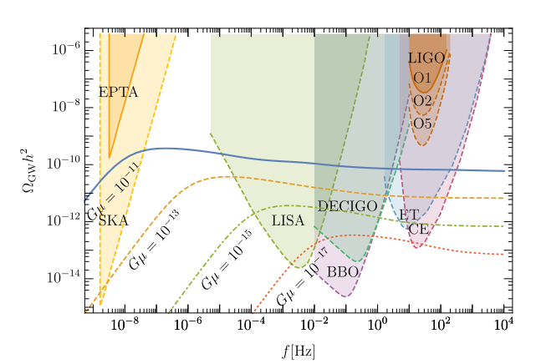
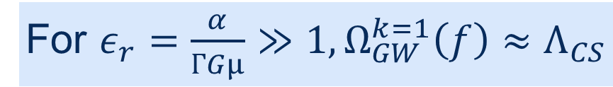
Characteristic gw sPECTRUM
From cosmic strings
For $ε_{r}=\frac{α}{ГGμ}≫1, Ω_{GW}^{k=1}\left(f\right)≈Λ_{CS}$
Arxiv: 1808.08968

Slide 10
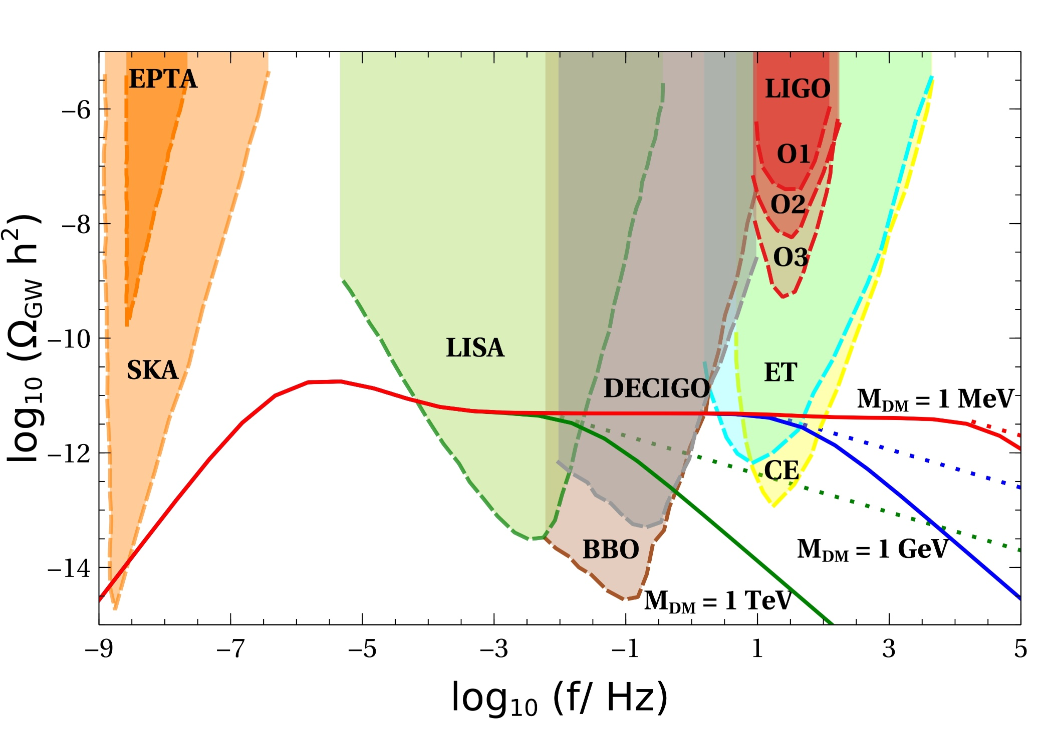

GW Spectrum with dm
DB, Das, Saha, Samanta’22

Slide 11
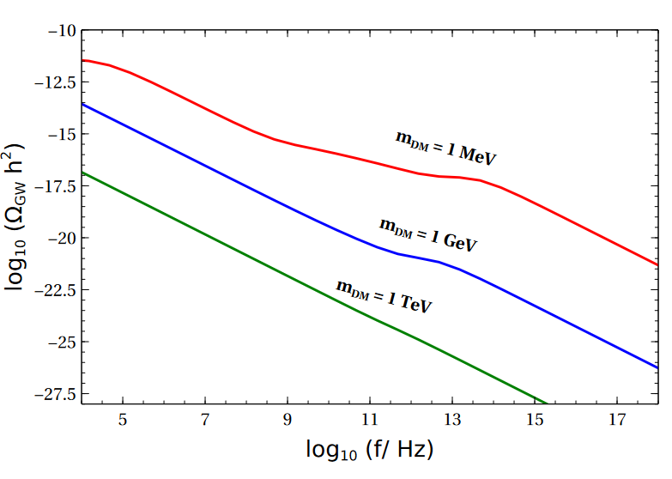
DB, Das, Saha, Samanta’22

Slide 12
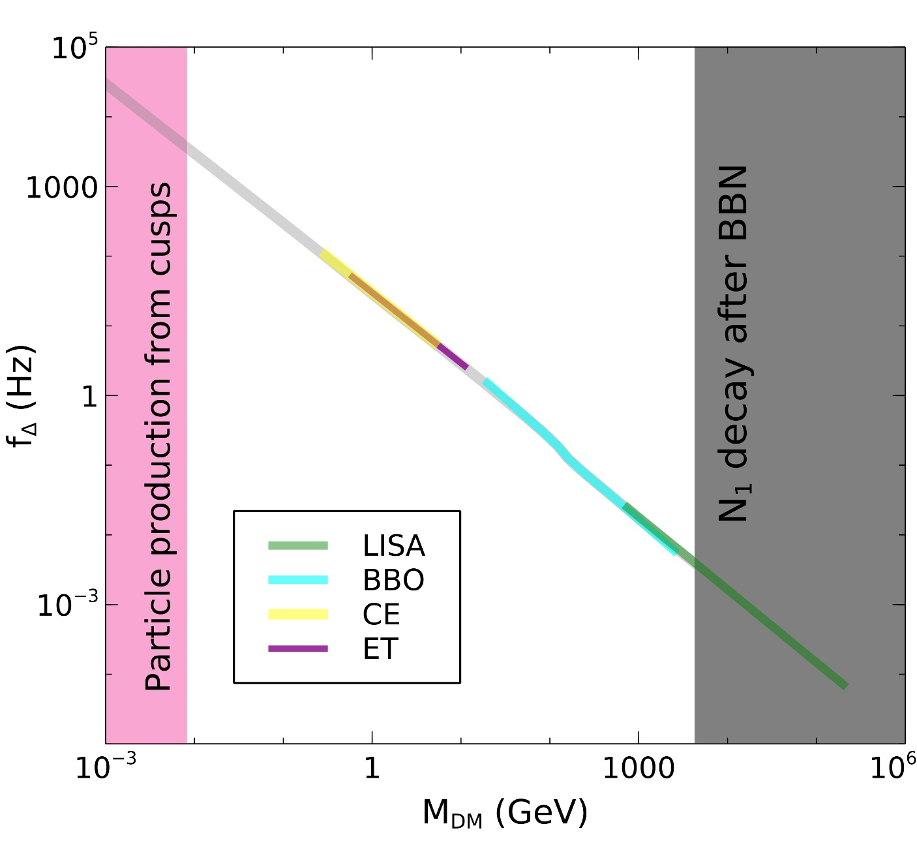
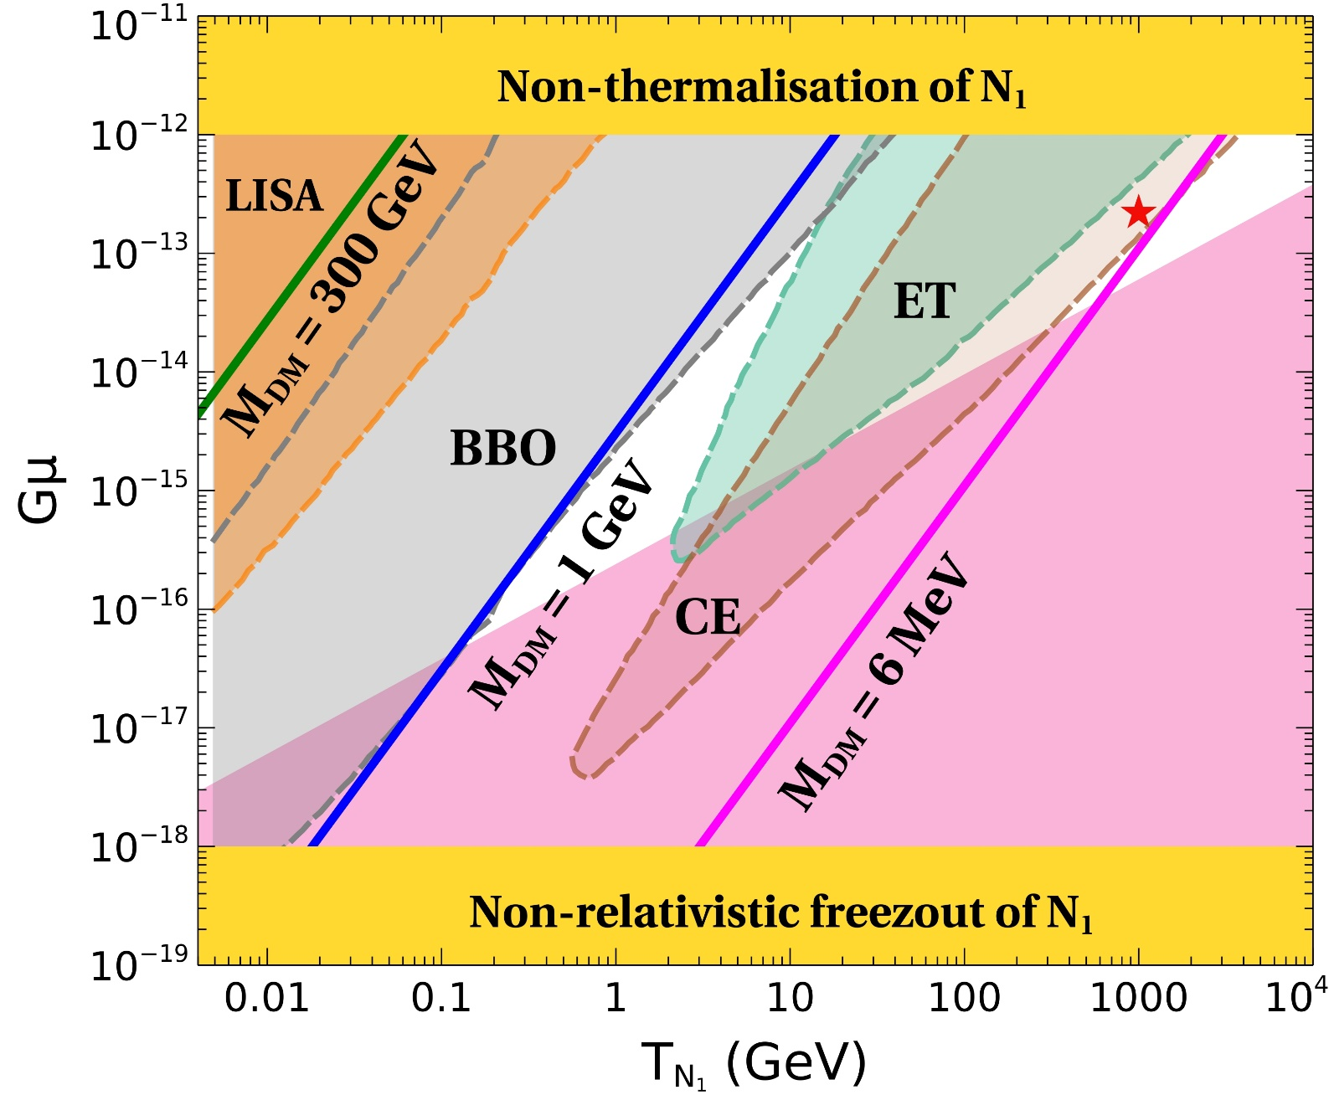
A benchmark consistent with successful leptogenesis.
DB, Das, Saha, Samanta’22
Arxiv: 2202.10474

Slide 13
Conclusion
Miracle-less WIMPs have weaker interaction rates which can be mediated by superheavy gauge bosons.
Thermally overproduced relic can be brought within limits via late entropy dilution. Gauged B-L model naturally accommodates this.
High scale B-L breaking can lead to observable GW background (with a scale invariant spectrum) from cosmic strings which form as a result of such symmetry breaking.
Early matter domination due to the diluter creates GW spectral distortions at high as well as low frequencies: one of which remain within near future experimental reach.
The model predicts vanishing lightest neutrino mass, can be falsified at tritium beta decay or neutrinoless double beta decay experiments.

Slide 14
Thank You For Your Attention

