Slide 1
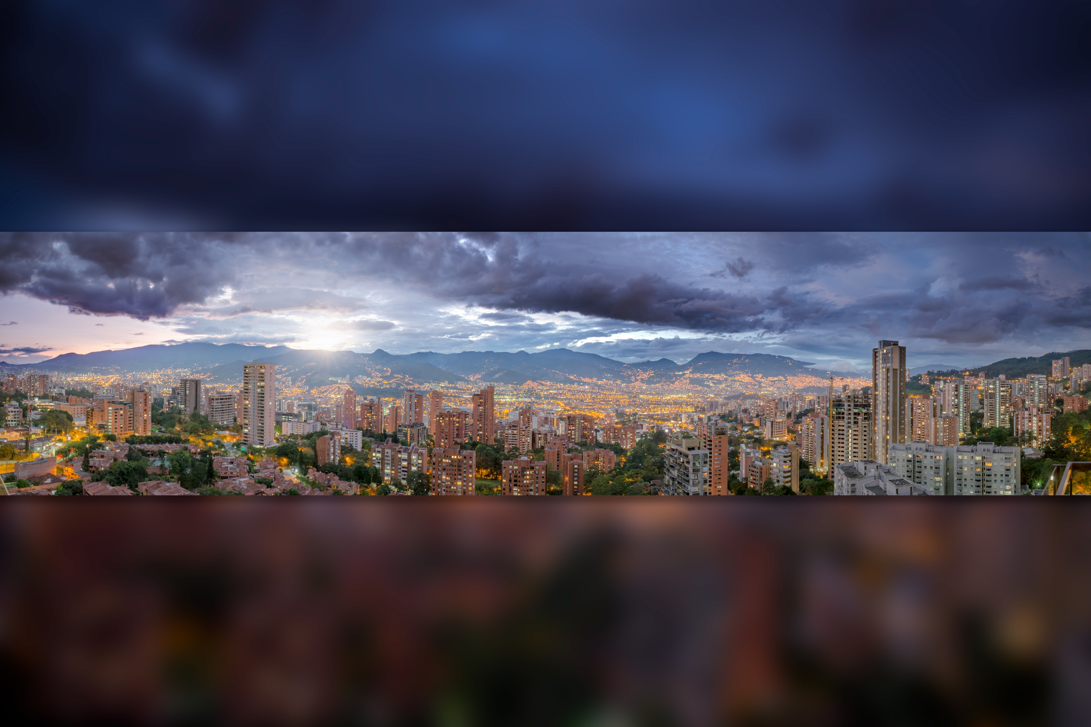


Neutrino Physics With NOvA
Enrique Arrieta Díaz
Southern Methodist University
For the NOvA Collaboration
COMHEP, Medellín – Nov. 29th 2016
By:JEN
Notes:
11/29/16
1
1

Slide 2
OUTLINE
Introduction to neutrino physics at Fermilab
Frontiers in particle physics
Intensity frontier & neutrino experiments at Fermilab
Neutrino physics with NOvA
NOvA overview
  Physics program
  Detectors
  Capabilities
NOvA results
11/29/2016
E. Arrieta Díaz, COMHEP
2
Notes:
11/29/16
2
2

Slide 3
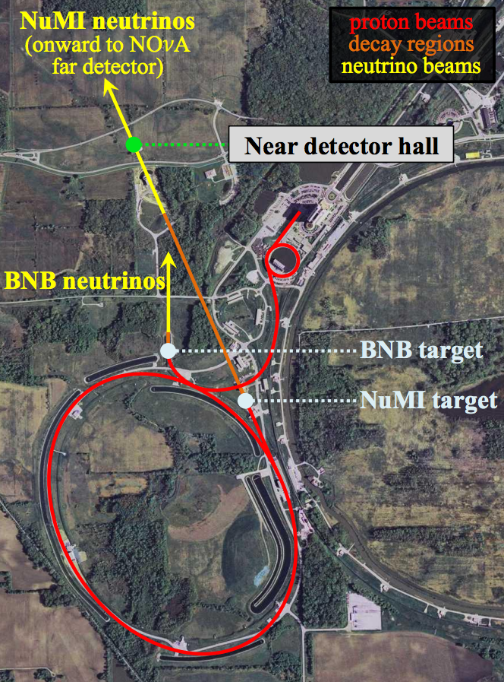
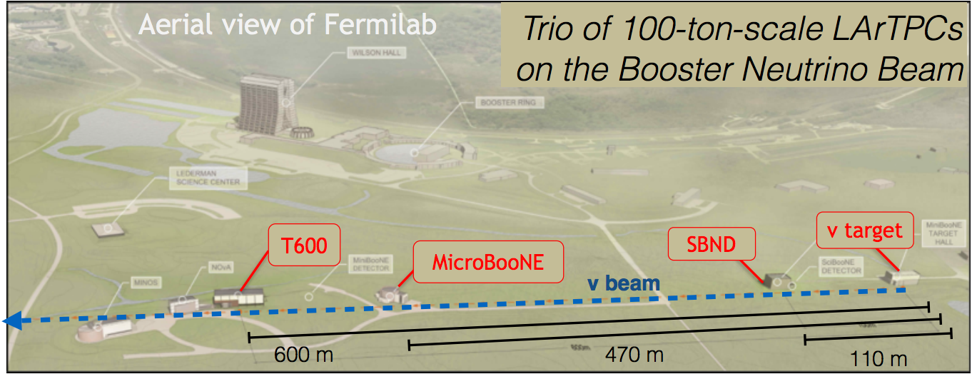
NEUTRINO PHYSICS
The Beams
Neutrino research requires a
neutrino source, a beam
Fermilab accelerates protons up
to 8 GeV with the Booster Ring
There is a Booster Neutrino
Beam (BNB)
Neutrino physics program with
the BNB
Booster Ring
Main Injector
11/29/2016
E. Arrieta Díaz, COMHEP
3
Notes:
11/29/16
3
3

Slide 4
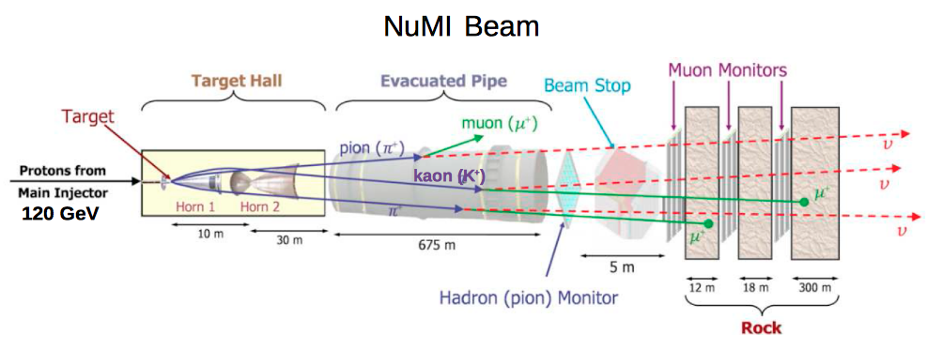
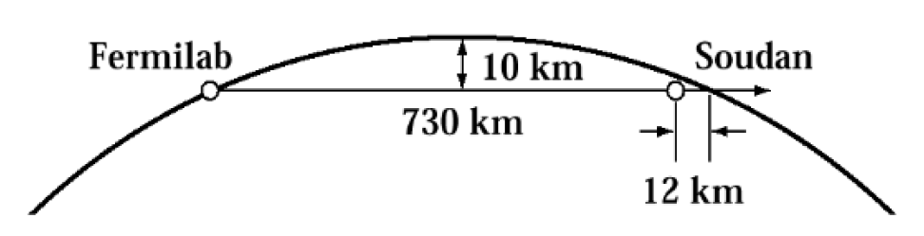
NEUTRINO PHYSICS
The Beams
Booster Ring
Beam pulse every ~2 sec
~10¹³ protons/pulse
Fermilab accelerates protons up
to 120 GeV with the Main Injector
There is a Neutrinos from Main
Injector (NuMI) beam
Main Injector
11/29/2016
E. Arrieta Díaz, COMHEP
4
Notes:
11/29/16
4
4

Slide 5
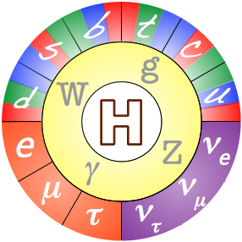
NEUTRINO PHYSICS
Standard Model
Bosons
Quarks: -1/3
Quarks: +2/3
Leptons: -1
Neutrinos: 0
All have non-zero masses
Massless
11/29/2016
E. Arrieta Díaz, COMHEP
5
Notes:
11/29/16
5
5

Slide 6
NEUTRINO PHYSICS
Standard Model
There are two bases
to describe neutrino
eigen states
Mass eigen states:
  ν₁, ν₂, ν₃
How do flavor eigen states evolve with time?
Flavor eigen states
11/29/2016
E. Arrieta Díaz, COMHEP
6
Notes:
11/29/16
6
6

Slide 7
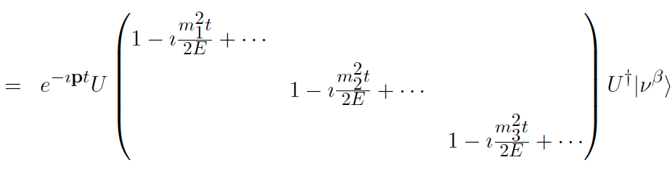

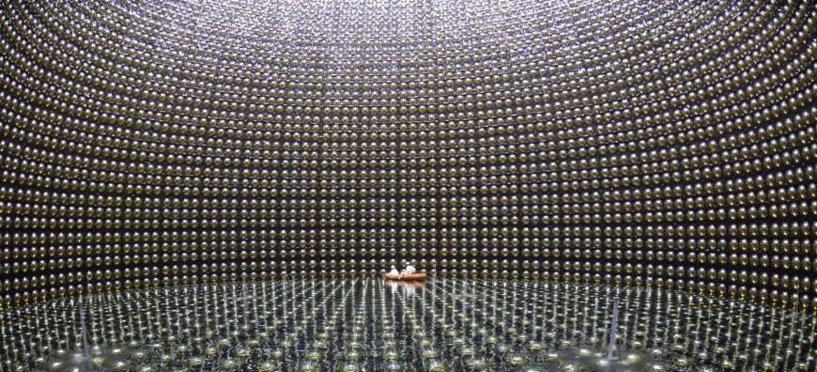
NEUTRINO PHYSICS
Oscillations
If the masses are different from zero: oscillations
There are two bases
to describe neutrino
eigen states
Mass eigen states:
  ν₁, ν₂, ν₃
Flavor eigen states
In 1998 Super Kamiokande (Japan) finds that neutrinos are massive
First evidence showing that the Standard Model needs an extension
Is state β the same state α?
11/29/2016
E. Arrieta Díaz, COMHEP
7
Notes:
11/29/16
7
7

Slide 8

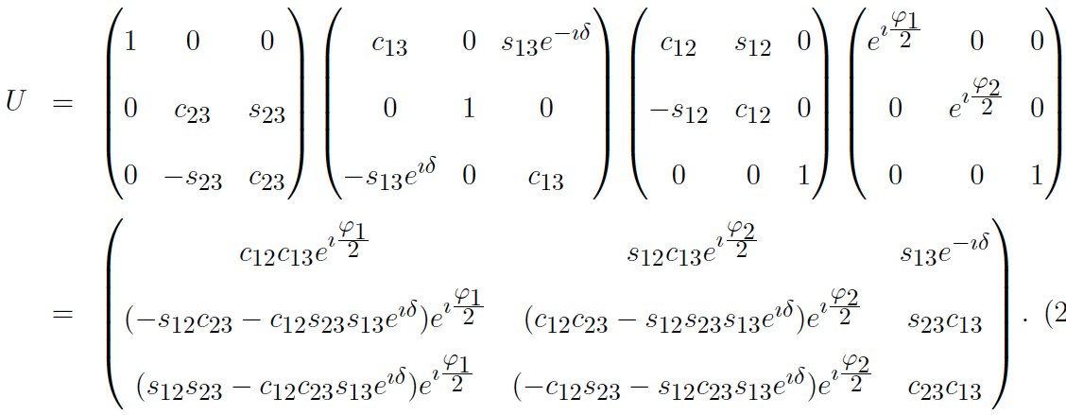
NEUTRINO PHYSICS
Oscillations
i: mass eigen values
α, β: flavor eigen values
Each matrix represents oscillation amongst two states
What happens if a neutrino type β propagates? When observed… Would it be: α = β?
s_{ij} ➔ sen θ_{ij}
c_{ij} ➔ cos θ_{ij}
ϕ, δ: phases
11/29/2016
E. Arrieta Díaz, COMHEP
8
Notes:
11/29/16
8
8

Slide 9

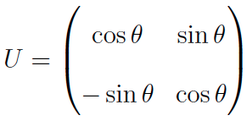
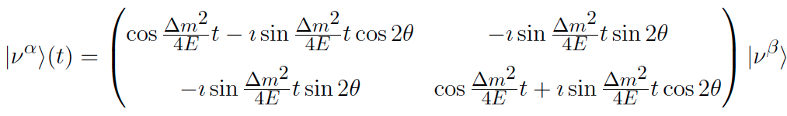






NEUTRINO PHYSICS
Oscillations
Easiest case: oscillation amongst two states (good approximation)
Oscillation amongst ν_{μ} & ν_{e}:
Probability
Maximum of Probability
11/29/2016
E. Arrieta Díaz, COMHEP
9
Notes:
11/29/16
9
9

Slide 10
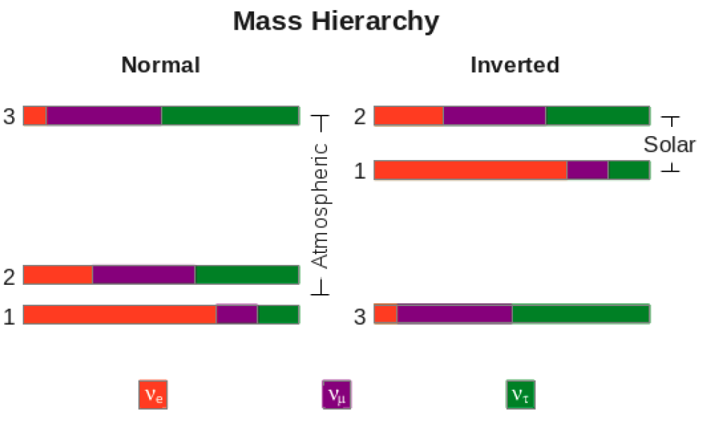
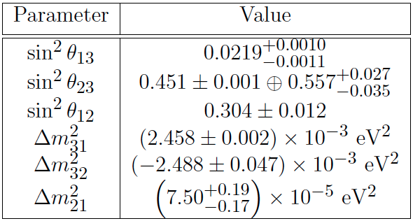




NEUTRINO PHYSICS
Oscillations
Parameters
Measured
Yet-to-be measured
Majorana phases: ϕ1, ϕ2
Phase “CP”: δ
➔
Asymmetry:
Which octant?
Confirmation from accelerators
Program
11/29/2016
E. Arrieta Díaz, COMHEP
10
Notes:
11/29/16
10
10

Slide 11
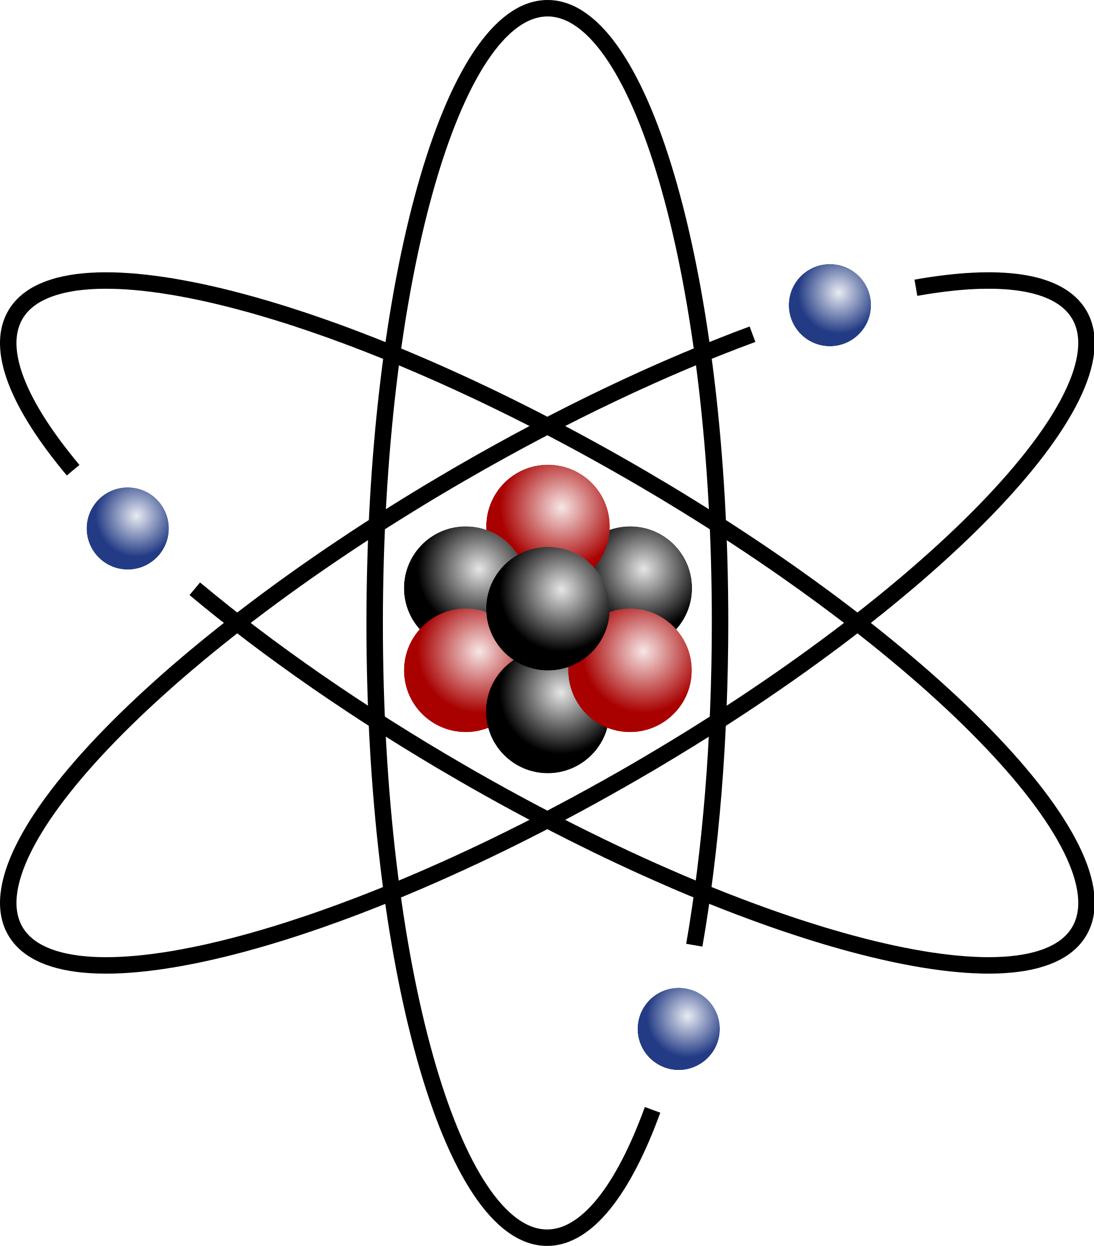

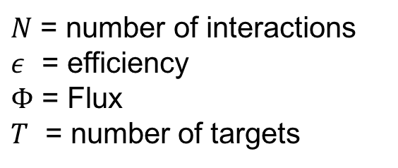
NEUTRINO PHYSICS
Cross Section
Cross sections are a measure of how frequent an interaction is
  Some precision measurements are currently doable
  Oscillation experiments require these measurements for low
  uncertainty results
Only recently experiments are able to lower uncertainties to ⩽ 10%
Cross section, :
$$σ=\frac{N}{εΦT}$$
$N$ = number of interactions
$ε$ = efficiency
$Φ$ = Flux
$T$ = number of targets
lepton
Neutrino
Target
11/29/2016
E. Arrieta Díaz, COMHEP
11
Notes:
11/29/16
11
11

Slide 12
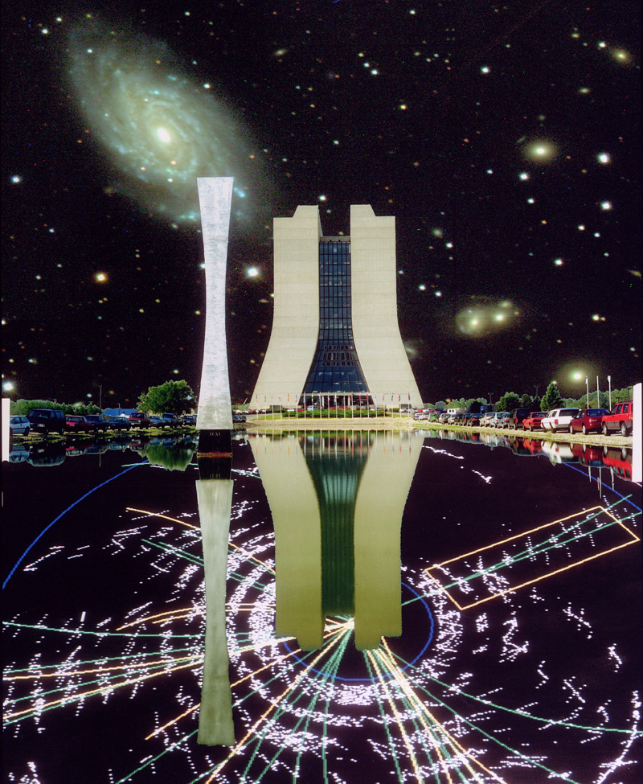




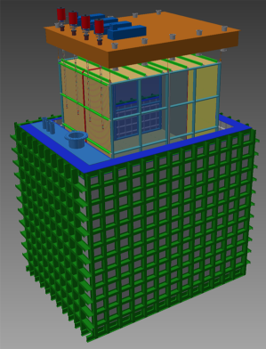
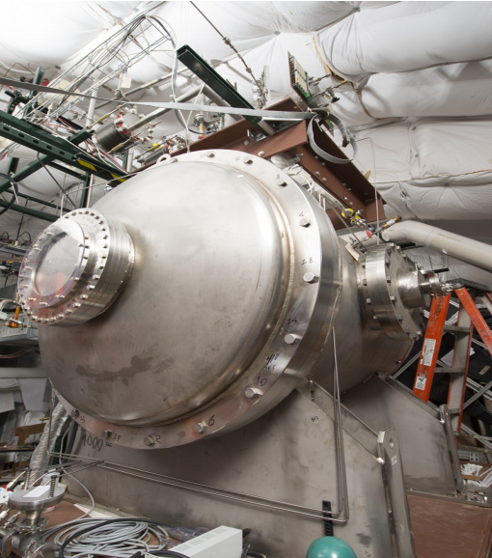


FRONTIERS
Intensity
Is home of neutrinos in the American continent
Frontiers
Cosmological
Intensity
Energy
Dark Energy
Dark Matter
Cosmic Rays
Gamma Rays
Others
Fermilab
Neutrinos
Charged Leptons
Others
CERN
LHC
Higgs Boson
Super Symmetry
Extra Dimensions
11/29/2016
E. Arrieta Díaz, COMHEP
12
Notes:
11/29/16
12
12

Slide 13
NEUTRINOS @ FNAL
Experiments
Cross Section measurements:
  MINERvA
  NOvA (Near detector)
  MicroBooNE
Oscillations
  Long base-line
    NOvA
    MINOS+
    DUNE
  Short base-line
    MicroBooNE
    SBND
LArIAT:
Liquid Argon time projection chamber In A Testbeam
11/29/2016
E. Arrieta Díaz, COMHEP
13
Notes:
11/29/16
13
13

Slide 14
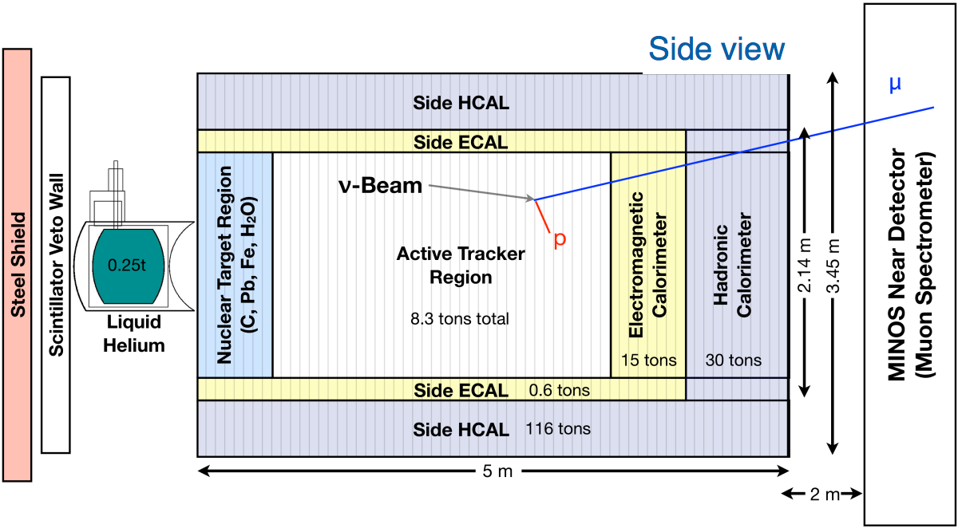
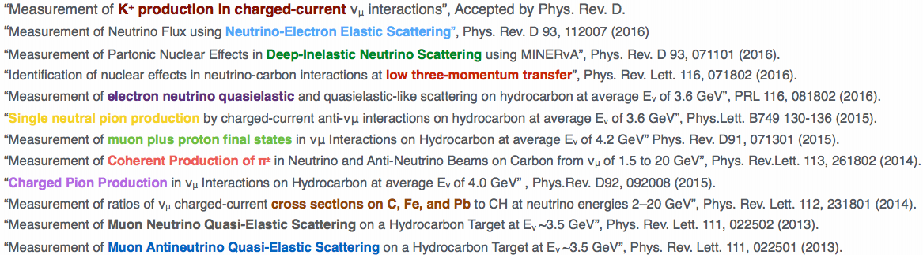
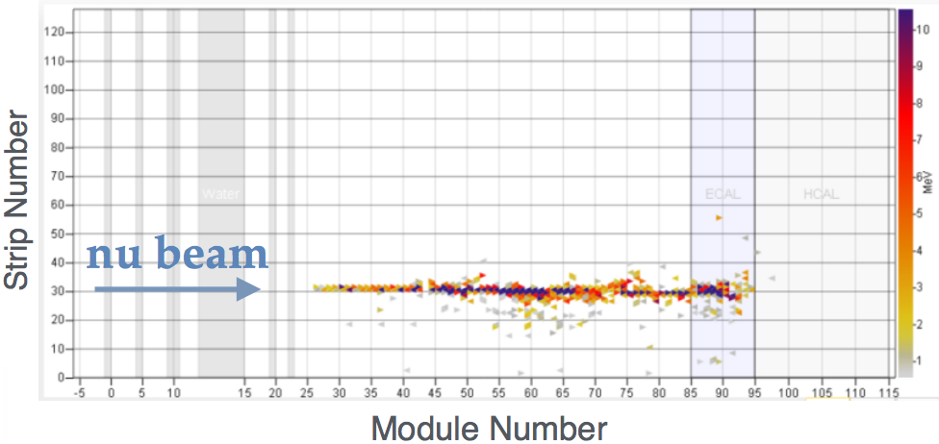
NEUTRINOS @ FNAL
Experiments
Cross Section measurements:
  MINERvA
  NOvA (Near detector)
  MicroBooNE
Oscillations
  Long base-line
    NOvA
    MINOS+
    DUNE
  Short base-line
    MicroBooNE
    SBND
Main Injector Neutrino Experiment for ν-A
Thanks to Laura Fields
11/29/2016
E. Arrieta Díaz, COMHEP
14
Notes:
11/29/16
14
14

Slide 15
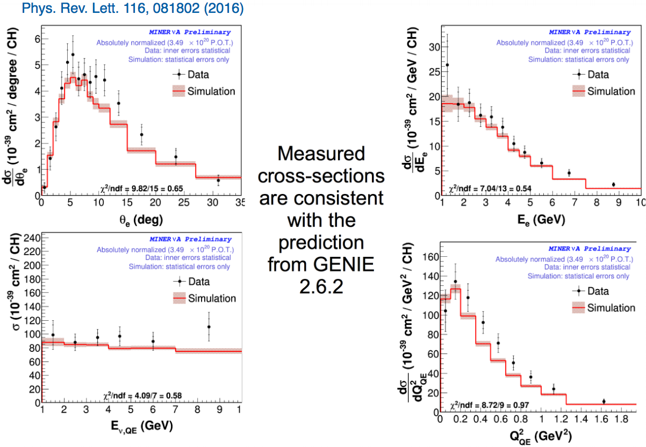
NEUTRINOS @ FNAL
Experiments
Thanks to Laura Fields
11/29/2016
E. Arrieta Díaz, COMHEP
15
Notes:
11/29/16
15
15

Slide 16
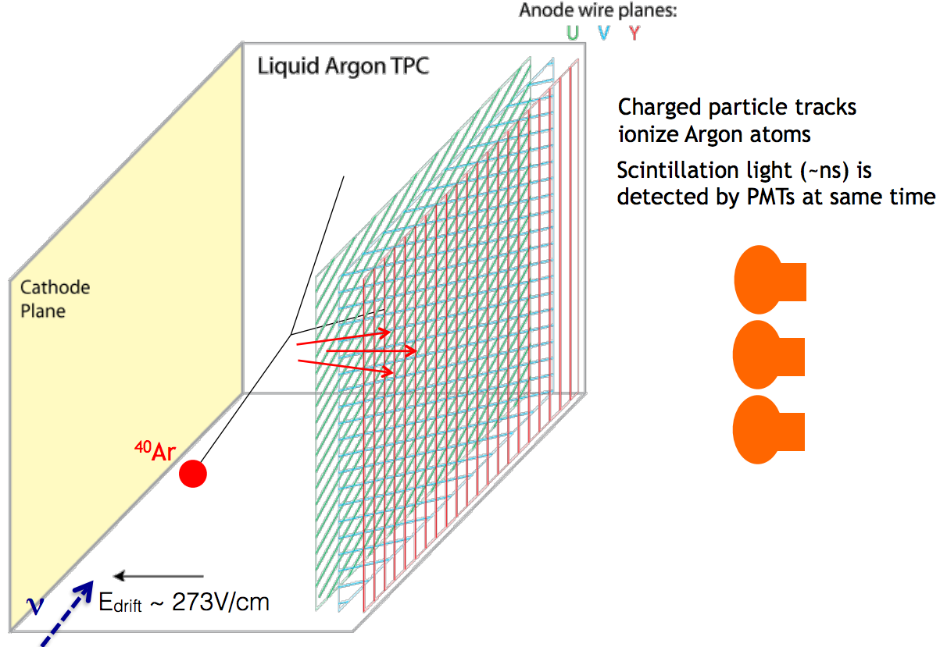
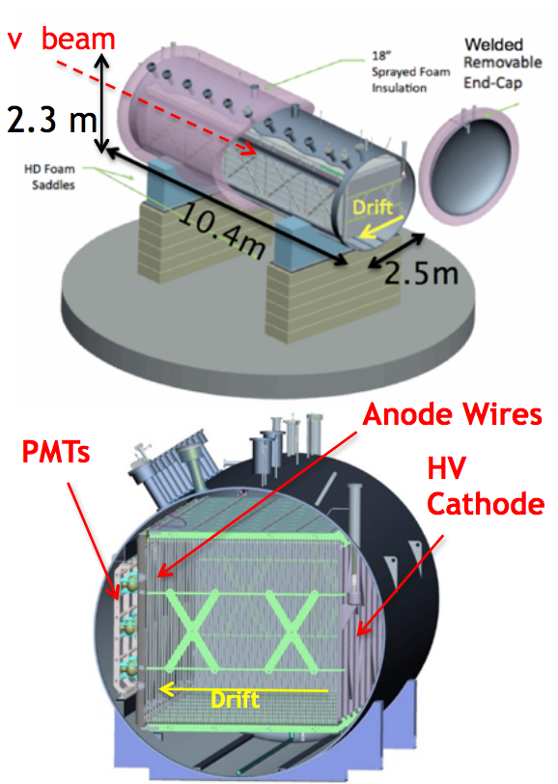
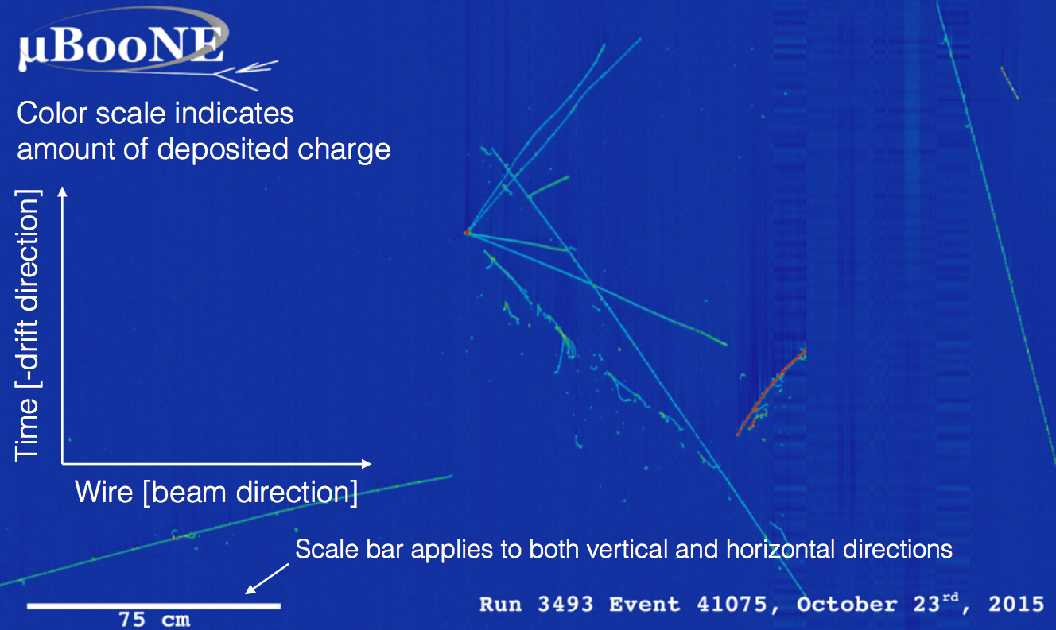
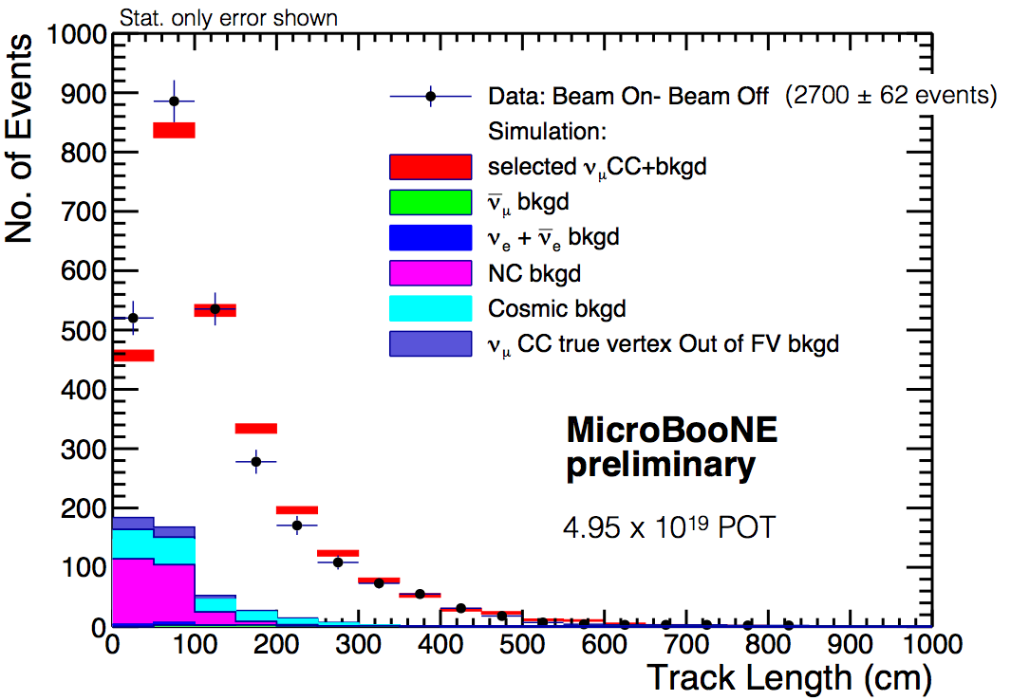
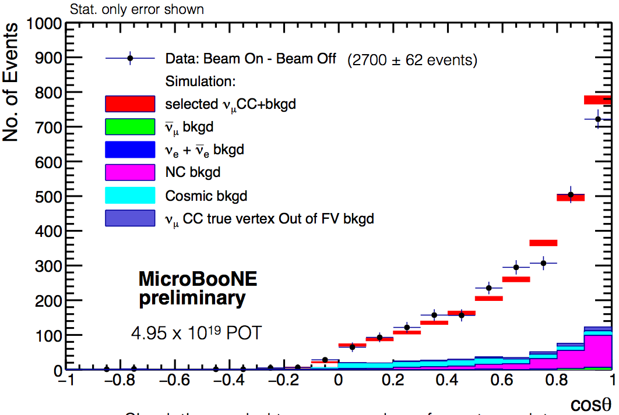
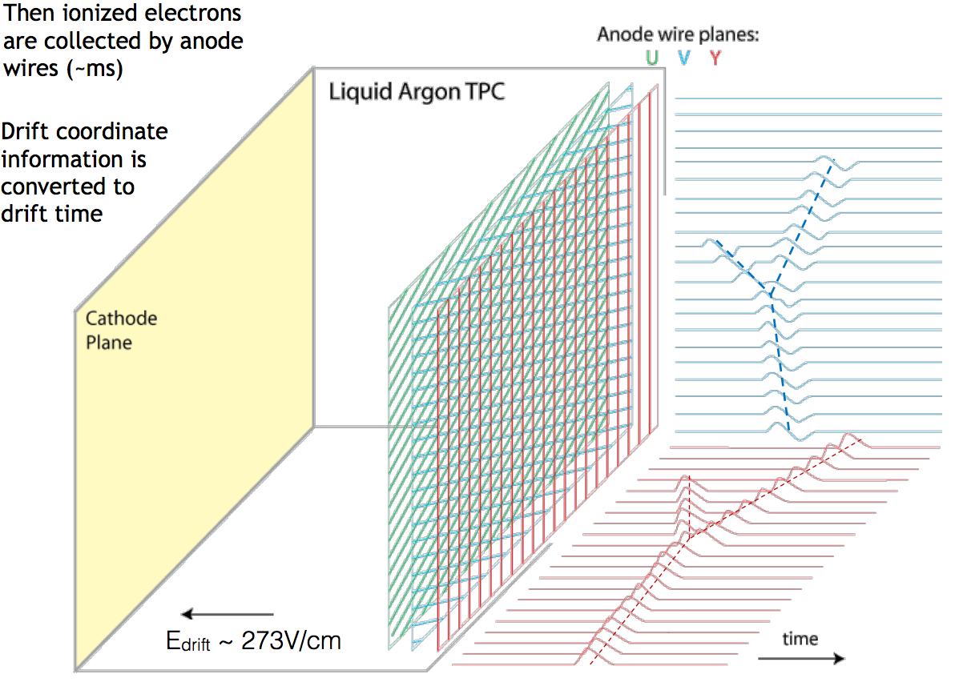
NEUTRINOS @ FNAL
Experiments
Cross Section measurements:
  Minerva
  NOvA (Near detector)
  MicroBooNE
Oscillations
  Long base-line
    NOvA
    MINOS+
    DUNE
  ν_{μ} CC inclusive
  ν_{μ} CC π⁰
Booster Neutrino Experiment
Thanks to Mathew Toups
11/29/2016
E. Arrieta Díaz, COMHEP
16
Notes:
11/29/16
16
16

Slide 17
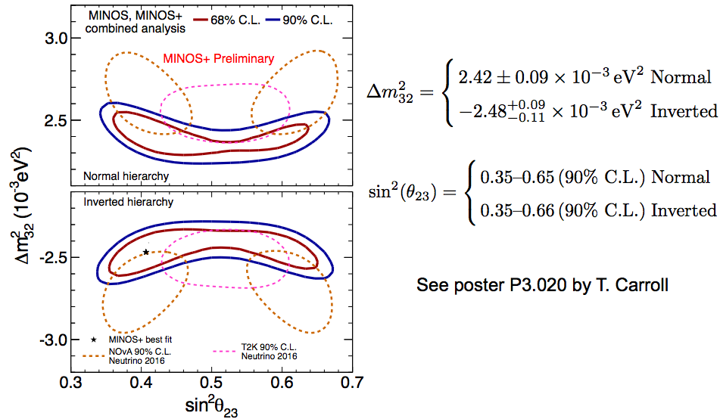
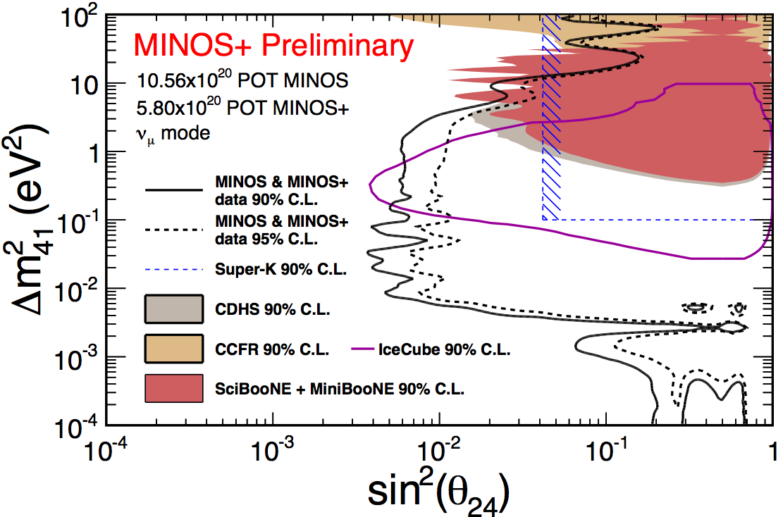
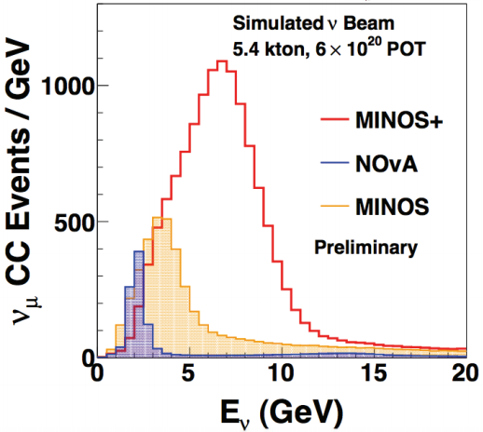
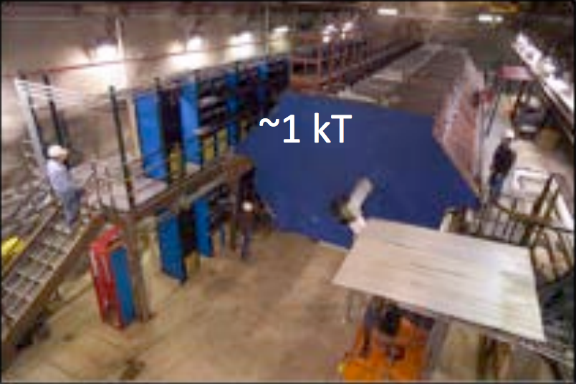
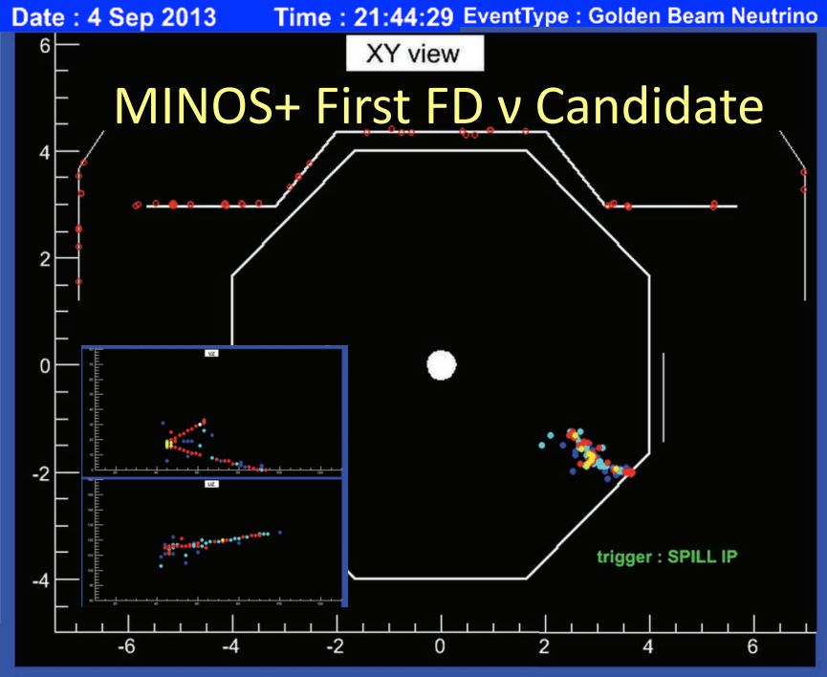
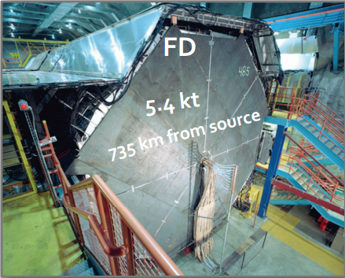
NEUTRINOS @ FNAL
Experiments
Oscillations
  Long base-line
    MINOS+
    DUNE
    NOvA
ND
At Fermilab
Main Injector Neutrino OScillations
Physics goals:
  Precision neutrino oscillation measurements
  Searches for sterile neutrinos
  Non-standard interactions
  Large extra dimentions
Norther Minnesota
In the Soudan Mine
Null results fo far
Thanks to Justin Evans & Alex Sousa
11/29/2016
E. Arrieta Díaz, COMHEP
17
Notes:
11/29/16
17
17

Slide 18
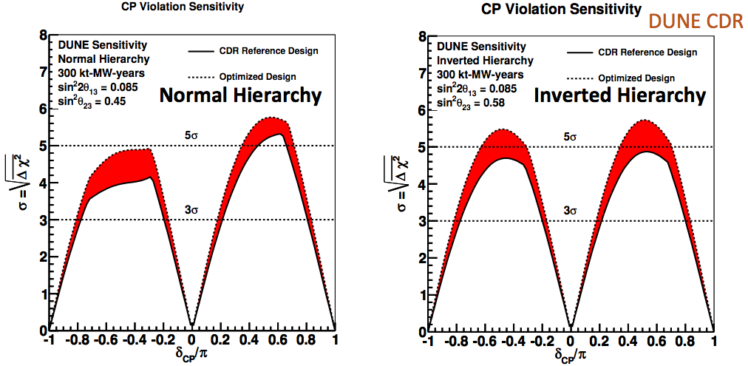
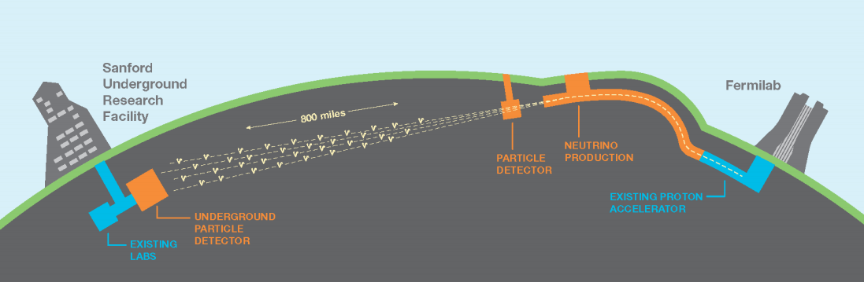
NEUTRINOS @ FNAL
Experiments
  Physics program:
    Neutrinos Oscillations
    Proton Decay
    Supernova neutrinos
    Exotics
Oscillations
  Long base-line
    DUNE
    DUNE
  Short base-line
    MicroBooNE
    SBND
  Deep Underground Neutrino Experiment
  Will use the Long Base-line Neutrino Facility (LBNF)
  Most intense neutrino beam ever
South Dakota
Beam power: 2.4 MW
40 kton LArTPC
Prototype detectors, CERN: 2018
20 kton operations 2024
Thanks to Jon Urheim
11/29/2016
E. Arrieta Díaz, COMHEP
18
Notes:
11/29/16
18
18

Slide 19



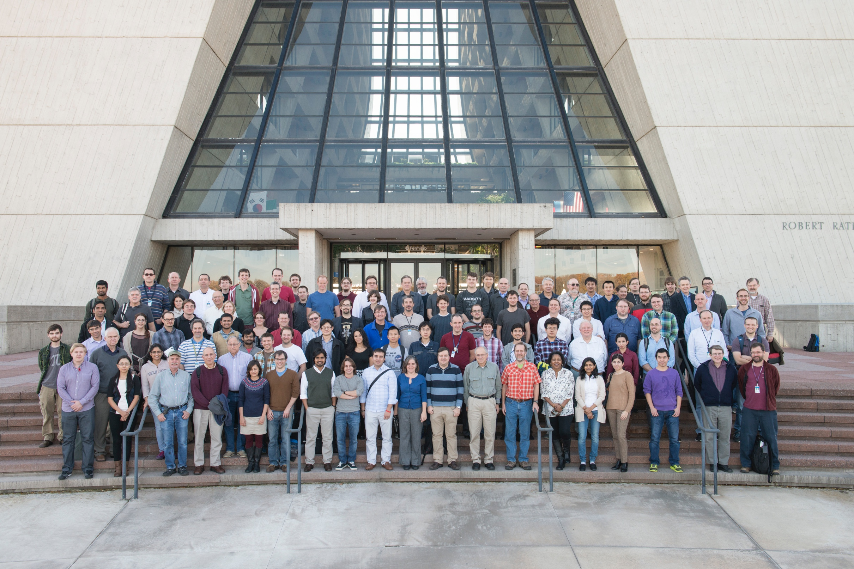




NOvA
Collaboration
NuMI Off-axis ν_{e} Appearance, NOvA
Headquarters @ Fermilab
220+ members
20+ Institutions from:
11/29/2016
E. Arrieta Díaz, COMHEP
19
Notes:
11/29/16
19
19

Slide 20
NOvA
Physics Program
NOvA has an extensive physics program
Two main goals related to oscillations
  Establish the neutrino mass hierarchy (3σ)
  Measure the δ CP phase (2,3σ)
Cross section program with near detector
Sterile neutrinos
Supernova neutrinos
Exotics: Magnetic monopoles, neutrino magnetic moment, dark matter & more
11/29/2016
E. Arrieta Díaz, COMHEP
20
Notes:
11/29/16
20
20

Slide 21
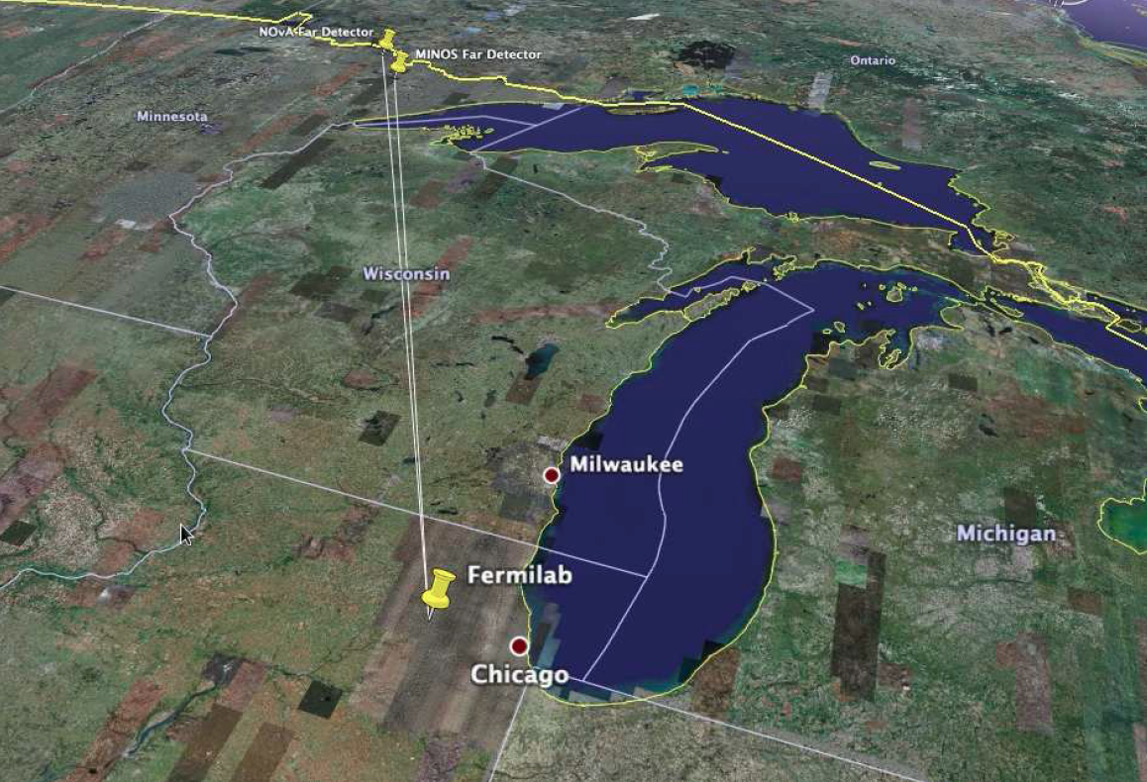
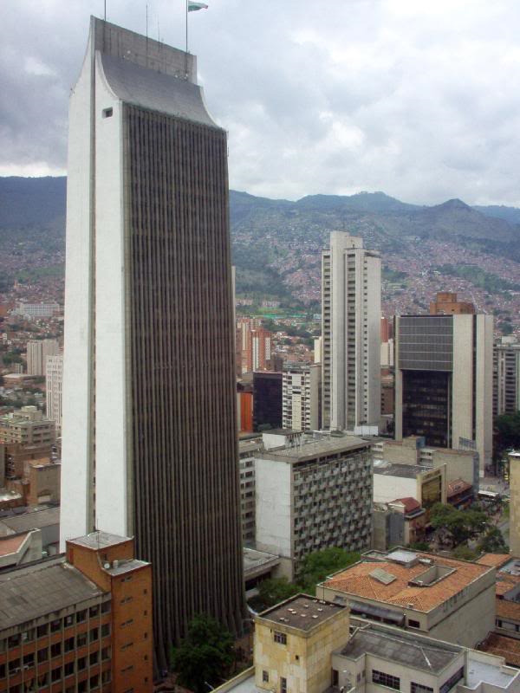

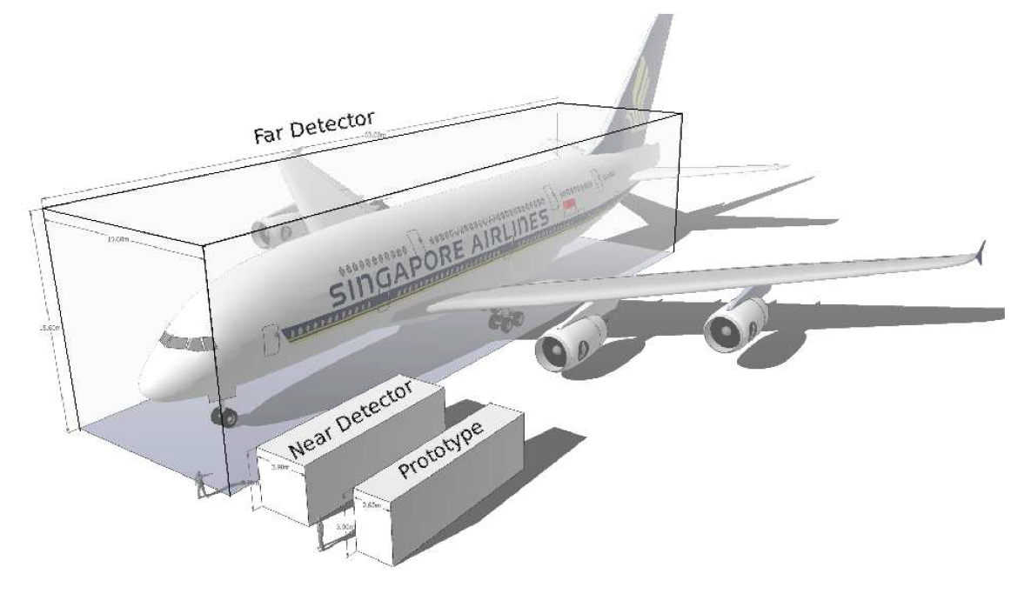
NOvA DETECTORS
Far Detector
Far detector:
  60 ⨉ 15 ⨉ 15 m³
  14 kton
  344000 channels
  Largest PVC free
  standing structure
  ν_{e} appearance
  ν_{μ} disappearance
  Ash River, MN
810 km
175 m
Airbus A380
15 m
15 m
60 m
11/29/2016
E. Arrieta Díaz, COMHEP
21
Notes:
11/29/16
21
21

Slide 22
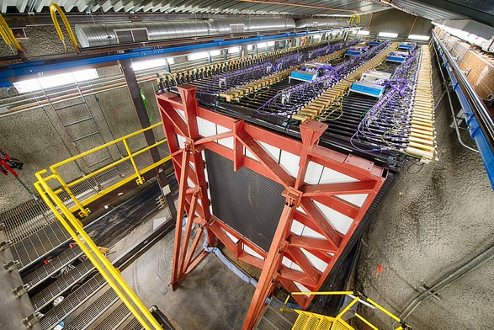
NOvA DETECTORS
Near Detector
Near detector:
  14 ⨉ 4 ⨉ 4 m³
  300 ton
  20000 channels
  100 m below the
  surface
  @ Fermilab
  ν_{e} background
  ν_{μ} flux
175 m
Airbus A380
11/29/2016
E. Arrieta Díaz, COMHEP
22
Notes:
11/29/16
22
22

Slide 23
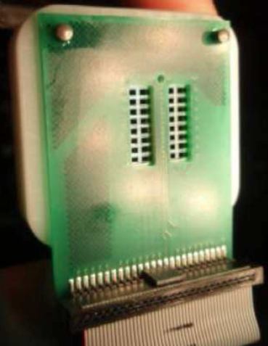
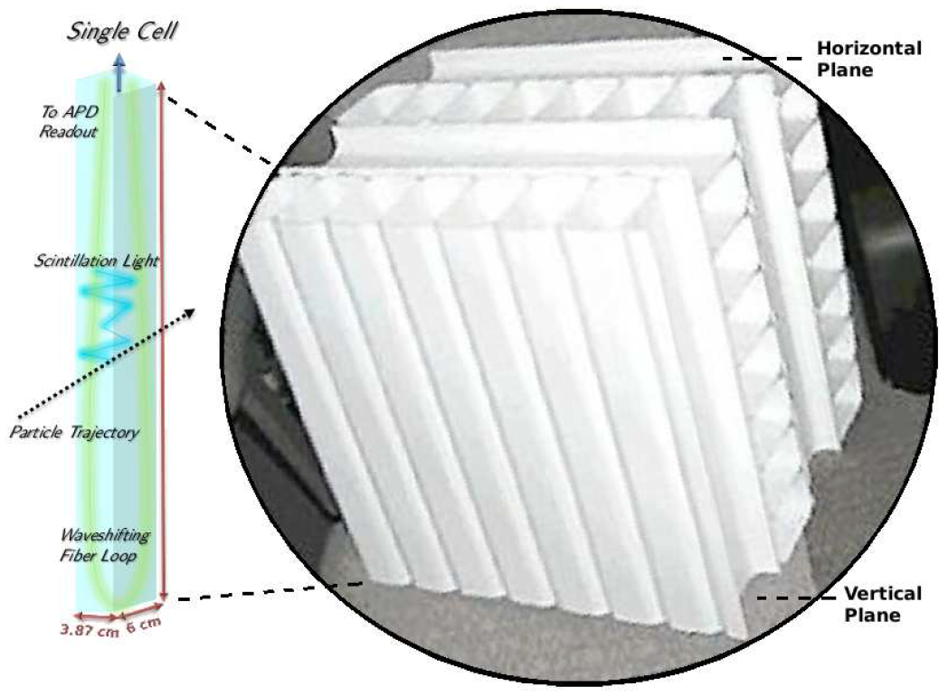
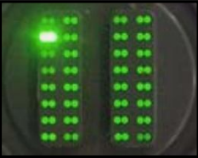
NOvA DETECTORS
Composition
Avalanche Photo Diodes, APD
High quantum efficiency
-15°C
32 channels, pixels
Mineral Oil
Pseudocumene (5%)
67% active material
0.17 X₀ per plane
PVC
The detectors are identical except for their size, to minimize systematic uncertainties
11/29/2016
E. Arrieta Díaz, COMHEP
23
Notes:
11/29/16
23
23

Slide 24
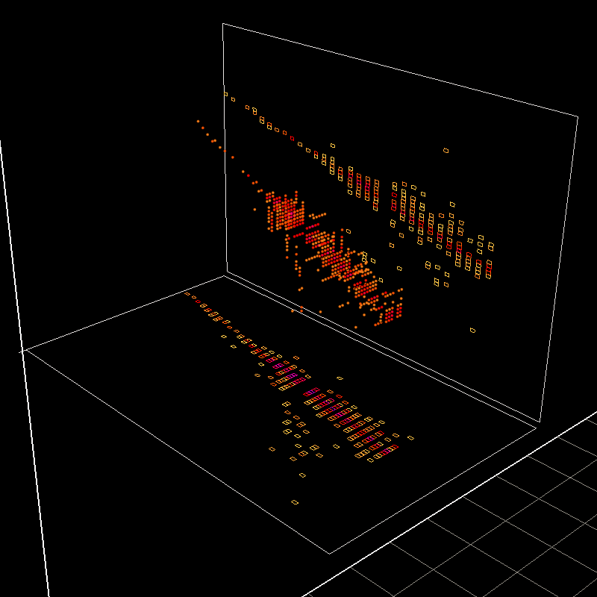
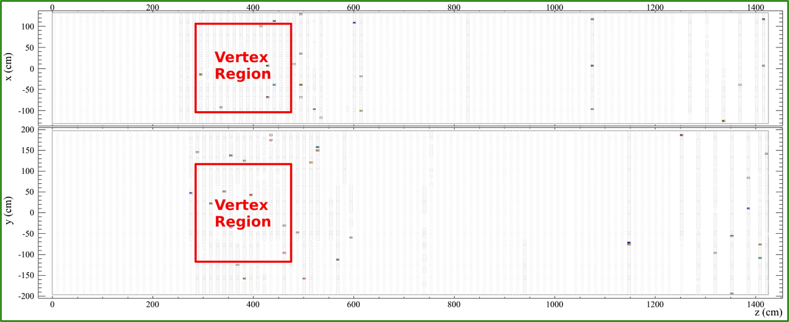
NOvA DETECTORS
Layout
Side view
Top view
Side view
Beam direction
Top view
First 3D event
May 21st 2013
11/29/2016
E. Arrieta Díaz, COMHEP
24
Notes:
11/29/16
24
24

Slide 25
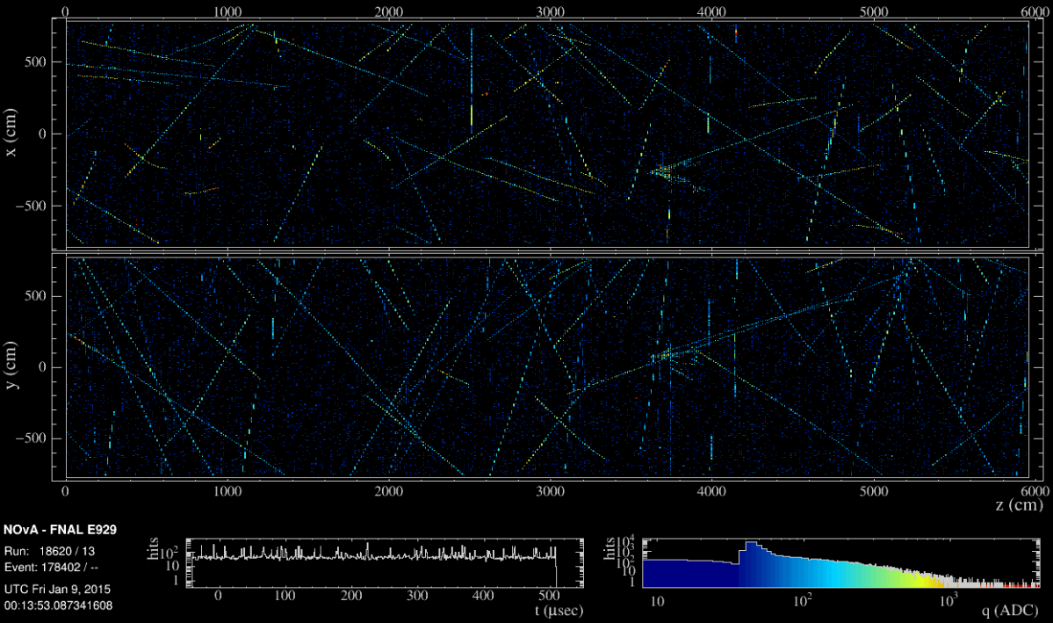
NOvA DETECTORS
Event Display
150 kHz of Cosmic rays
Far Detector (FD)
550 μsec exposure for FD
Charge (energy) deposition
11/29/2016
E. Arrieta Díaz, COMHEP
25
Notes:
11/29/16
25
25

Slide 26
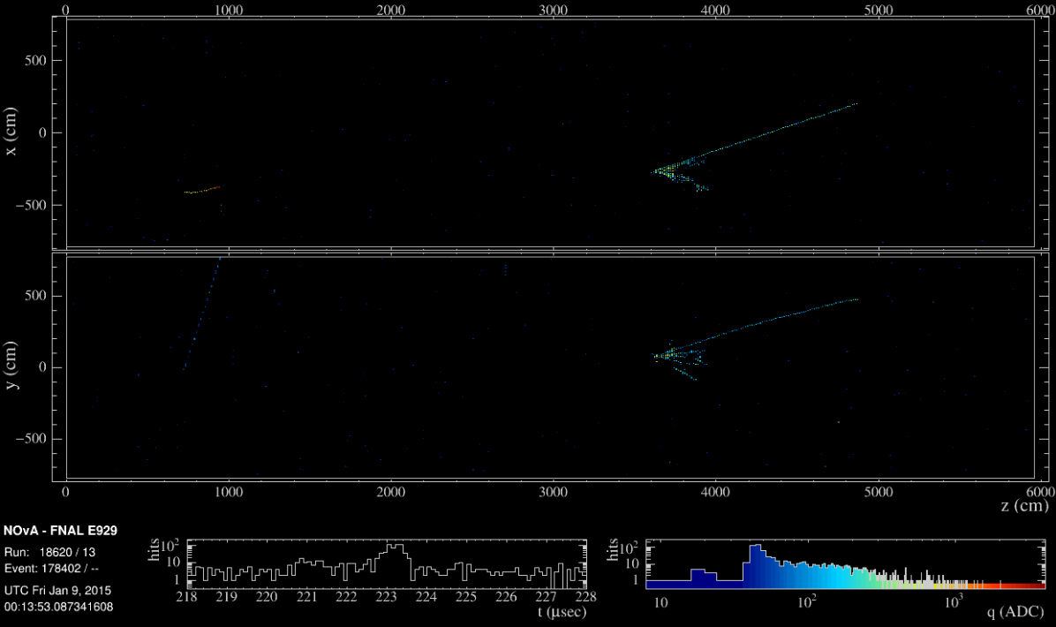
NOvA DETECTORS
Event Display
Time-zoom on 10 μsec interval during NuMI beam pulse
11/29/2016
E. Arrieta Díaz, COMHEP
26
Notes:
11/29/16
26
26

Slide 27
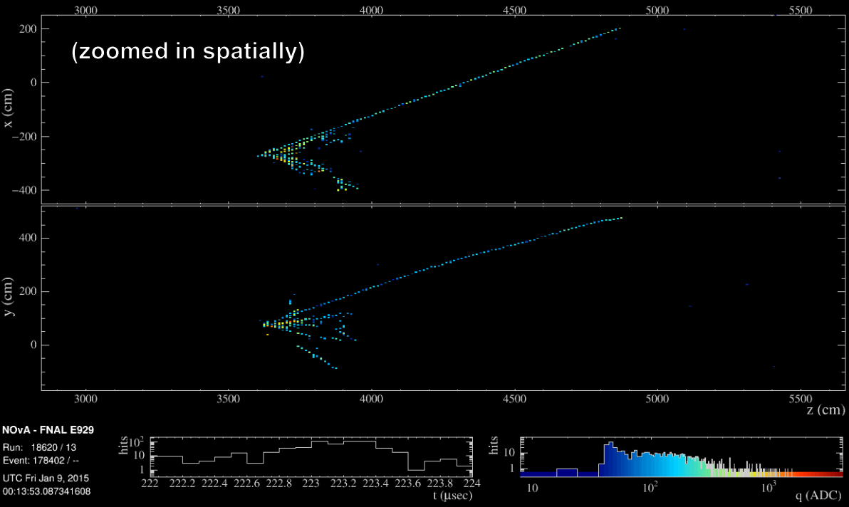
NOvA DETECTORS
Event Display
Close-up of neutrino interaction in the far detector
11/29/2016
E. Arrieta Díaz, COMHEP
27
Notes:
11/29/16
27
27

Slide 28



NOvA DETECTORS
Calibration
Stopping muons provide absolute energy
scale (dE/dX)
Attenuation in the wavelength shifting
fiber
Energy deposition of a muon crossing the far end ~40 PE
11/29/2016
E. Arrieta Díaz, COMHEP
28
Notes:
11/29/16
28
28

Slide 29


NOvA DETECTORS
Calibration
π⁰ invariant mass
Checks to energy scale:
  Hadronic shower hits
  Michael electron energy from muon
  decays
  Bremsstrahlung energy
  Muon dE/dX
All within 5% agreement
11/29/2016
E. Arrieta Díaz, COMHEP
29
Notes:
11/29/16
29
29

Slide 30

ANALYSIS
Event Selection
What are we looking for?
Fuzzy energy depositions:
Electromagnetic shower
11/29/2016
E. Arrieta Díaz, COMHEP
30
Notes:
11/29/16
30
30

Slide 31

ANALYSIS
Event Selection
What are we looking for?
Track-like energy depositions:
Muon
11/29/2016
E. Arrieta Díaz, COMHEP
31
Notes:
11/29/16
31
31

Slide 32


ANALYSIS
Event Selection
Recent advancements in the fields of deep learning and computer vision
allow for a new event selection technique
A Convolutional Visual Network (CVN) uses as input calibrated hit maps
Abstract features are extracted from transformations applied to series of
processed images
The CVN uses the abstract features to classify events
The technique improves the sensitivity: equivalent to 30% more exposure
Each square is a convolution of the
event image
Features maps
Muon
Shower
A. Aurisiano et. al., JINST 11, P09001 (2016)
11/29/2016
E. Arrieta Díaz, COMHEP
32
Notes:
11/29/16
32
32

Slide 33
ANALYSIS
ν_{μ} Disappearance
For the muon neutrino disappearance
analysis NOvA uses mainly the energy
deposition profiles of muons to identify
them
The sought signal is a primary muon
coming from a charge current interaction
between a muon neutrino and target
nucleon/nucleus
  A muon identification algorithm is
  used
The background to this signal are:
  Neutral current interactions
  Beam electron neutrino interactions
  Also beam anti-muons (not rejected
  by the algorithm)
Muon ID > 0.75: is a moun!
11/29/2016
E. Arrieta Díaz, COMHEP
33
Notes:
11/29/16
33
33

Slide 34

ANALYSIS
ν_{μ} Disappearance
Cosmic background rejection
No beam
11/29/2016
E. Arrieta Díaz, COMHEP
34
Notes:
11/29/16
34
34

Slide 35


ND ANALYSIS
ν_{μ} Disappearance
ND 98.4% beam purity
Excellent agreement between data & MC
range
)
θ_{z}
Beam
Muon energy from range
11/29/2016
E. Arrieta Díaz, COMHEP
35
Notes:
11/29/16
35
35

Slide 36


ND ANALYSIS
ν_{μ} Disappearance
Hadronic energy shower from calorimetry
E_{ν} = E_{had} + E_{muon}
Excellent agreement between data & MC
range
Beam
Hadronic Shower
11/29/2016
E. Arrieta Díaz, COMHEP
36
Notes:
11/29/16
36
36

Slide 37




FD ANALYSIS
ν_{μ} Disappearance
ν_{μ} CC FD candidate events distributions
11/29/2016
E. Arrieta Díaz, COMHEP
37
Notes:
11/29/16
37
37

Slide 38


FD ANALYSIS
ν_{μ} Disappearance
ν_{μ} CC FD energy spectrum
Background candidates:
  3.7 from beam
  2.9 from cosmic rays
Oscillation fit from:
  $∆m_{32}^{2}{ \& θ}_{23}$
473 ± 30 expected events
from ND prediction
: 75 selected events
ν_{μ} Disappearance observation!
11/29/2016
E. Arrieta Díaz, COMHEP
38
Notes:
11/29/16
38
38

Slide 39


FD ANALYSIS
ν_{μ} Disappearance
Non-maximal mixing favored at 2.5σ C. L.
Normal hierarchy case:
  ${∆m}_{32}^{2}=(2.67±0.12)×{10}^{−3}$ eV²
  sin² θ₂₃ = ${0.40}_{−0.02}^{+0.03} { (0.63}_{−0.03}^{+0.02})$
Top systematic:
  Energy calibration (now)
  Hadronic modeling (before)
Analysis upgrades under current
development, e.g. energy
resolution & event selection
4.5% uncertainty, MINOS 3.8%
11/29/2016
E. Arrieta Díaz, COMHEP
39
Notes:
11/29/16
39
39

Slide 40



ANALYSIS
ν_{e} Appearance
ν_{μ} CC sample constrains:
  The intrinsic ν_{e} CC (3% adjustment
  to simulation)
  The ν_{e} CC signal (2%)
33 ν_{e} CC candidates (±5%)
  Includes 8.2 candidates (±10%) from
  background (independent from
  oscillation parameters)
~17 to 42 predicted
ν_{e} CC candidates
(depending on oscillation parameters)
11/29/2016
E. Arrieta Díaz, COMHEP
40
Notes:
11/29/16
40
40

Slide 41

ANALYSIS
Oscillations
Single neutrino energy and baseline per ellipse
Normal hierarchy (NH)
Inverted hierarchy (IH)
If sin² θ₂₃ > 0.5:
  Most challenging case
If NH & sin² θ₂₃ < 0.5:
  Anti-neutrinos run is key to
  close on δ_{cp}
Cartoon
11/29/2016
E. Arrieta Díaz, COMHEP
41
Notes:
11/29/16
41
41

Slide 42


ANALYSIS
Oscillations
NH/IH & sin² θ₂₃ > 0.5:
  Allowed at 1σ
sin² θ₂₃ < 0.5:
  NH allowed at 1σ
  IH rejected at 3σ for δ_{cp} ~ π/2
  Global best fit: δ_{cp} = 1.49π
Best fit NH/IH: Δχ² = 0.47
11/29/2016
E. Arrieta Díaz, COMHEP
42
Notes:
11/29/16
42
42

Slide 43





NOvA PHYSICS
Coming Soon
Cross Section Studies
Simulation
Awaiting for a Supernova…
11/29/2016
E. Arrieta Díaz, COMHEP
43
Notes:
11/29/16
43
43

Slide 44
CONCLUSION
The Intensity Frontier is a global effort to measure all terms of the oscillation matrix
NOvA operates better that initially expected
NOvA confirmed ν_{e} appearance (>8σ)
NOvA favors Normal Hierarchy and maximal (δ_{cp} = 3π/2) CP violation
NOvA anti-neutrinos run next Spring will aid reducing uncertainty on oscillation parameters
NOvA favors non-maximal value of sin² θ₂₃
NOvA found no evidence of Sterile Neutrinos so far
Much more to come, stay tuned!
11/29/2016
E. Arrieta Díaz, COMHEP
44
Notes:
11/29/16
44
44

Slide 45

THANK YOU!
earrietadiaz@smu.edu
11/29/2016
E. Arrieta Díaz, COMHEP
45
Notes:
11/29/16
45
45

