Slide 1


DEMA LAB
Design, Engineering and Manufacturing Laboratory
SAPHIR - UTFSM
SAPHIR Annual Research Meeting 2024
January 2024
Eng. Rafael Mena Fredes
Prof. Eng. Rafael Mena Yanssen

Slide 2
INDEX
Fundaments
How?
Capabilities
Questions

Slide 3
The Task
Take problems and requierements from science, society and industry. Develop through a design process prototypes for equipment and machinery that solve this problems.
Why.
  The neccesity of research centers and industry to develop quality prototypes.
  The oportunity of use the knowledge available in the academy and industrial aplications and applied it in novel ideas and scientific development.
  The neccesity of technical documentation and information of former develpments of aplications (R&D)
  Generate a communication bridge between high-tech science, university and industry.

Slide 4
How?
Clear and structured design process.
Mechanical Engineering application.
Manufacturing Capabilities.
Measurements and quality control.
A place for people.

Slide 5
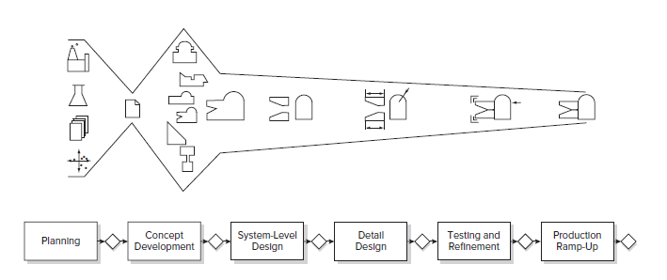
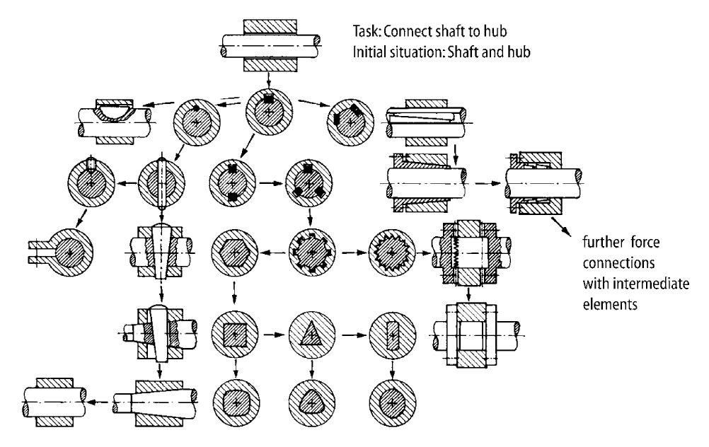
Design
Requirement list.
  Wishes.
  Requirements.
  Restrictions.
  Budget.
  Time
Conceptual design.
  Exploration of possible solutions.
Embodiment design.
  Definition of dimensions.
  Integration of subsystems.
Detail design.
  Pre-production revisions.
  Technical drawings preparation.
GROW OF AVAILABLE INFORMATION

Slide 6
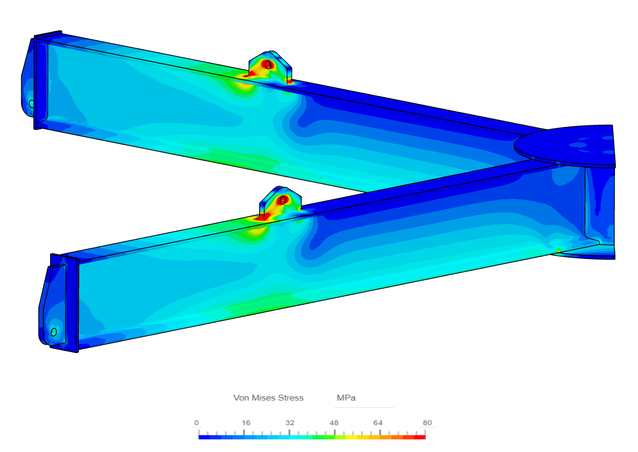
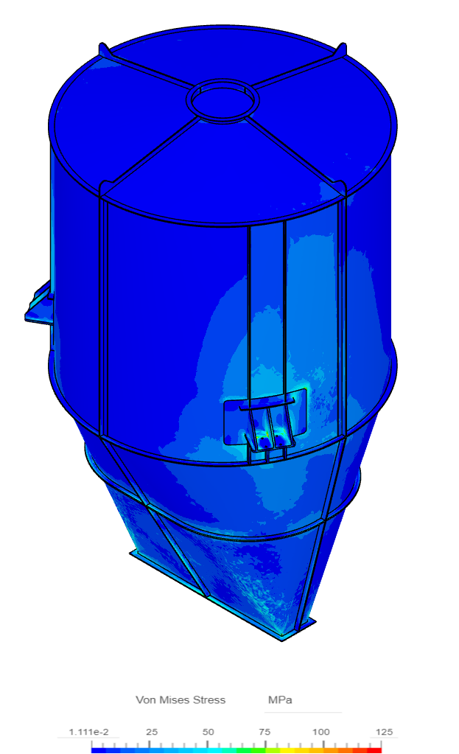
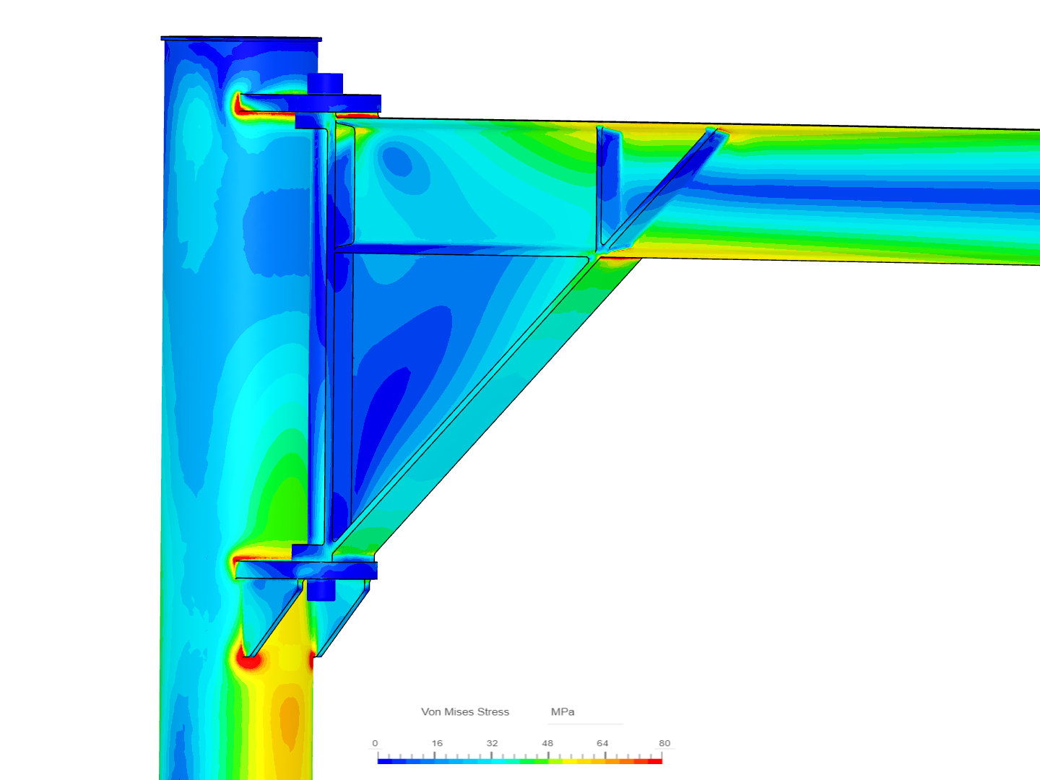
Mechanical Engineering
Design and calculations of machine structures.
  Finite element analysis.
    Stress.
    Deformations.
    Load capacity.
    Bodies interaction.
    Different materials.
      Composites.
      Fragile nature.
      Elastic or plastic.
Design and calculation of machine elements.

Slide 7
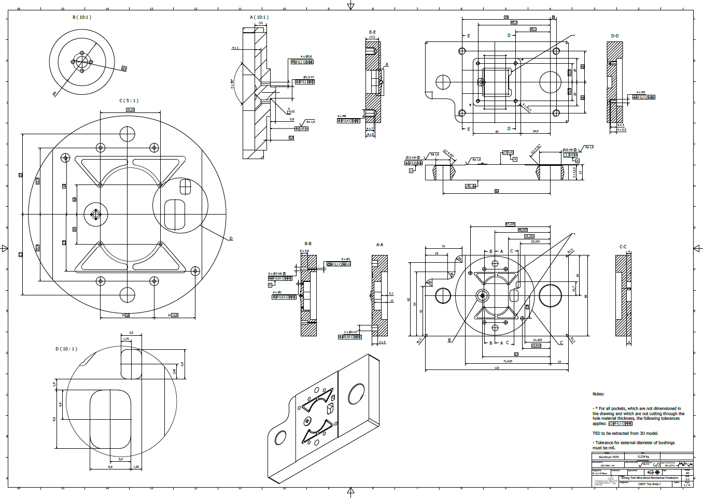
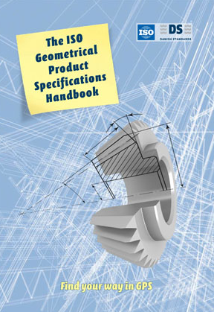
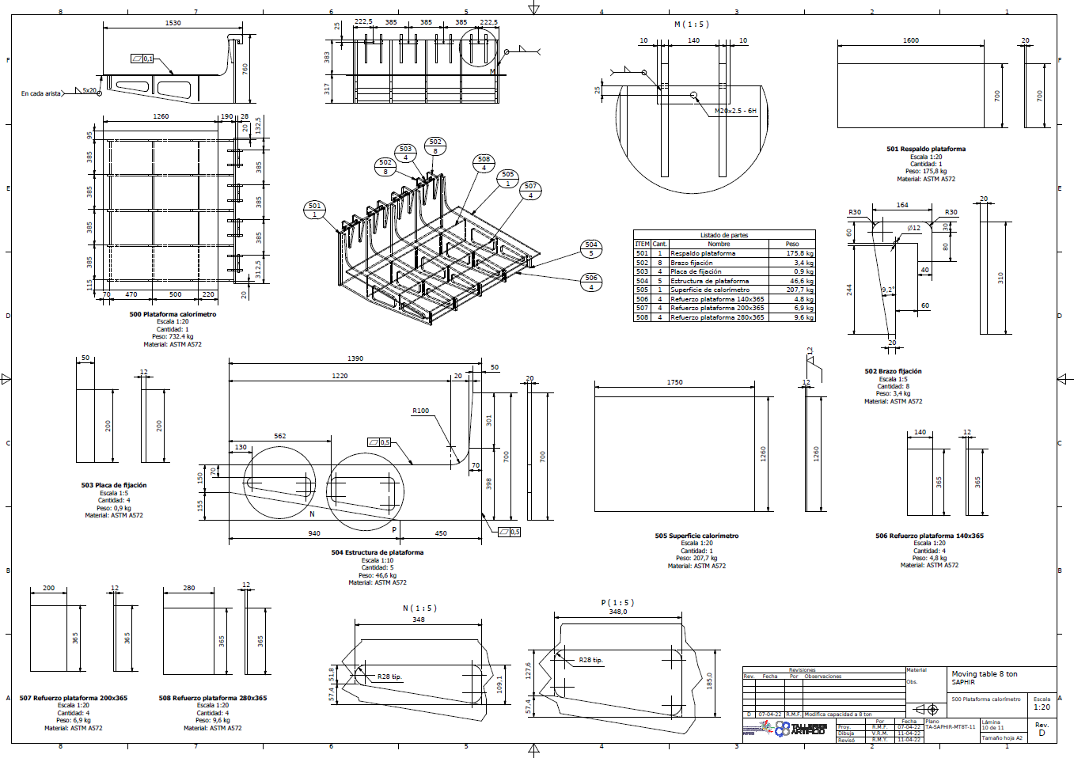
Mechanical Engineering
Design and calculation of power transmissions.
  Shafts.
  Bearings.
  Gears.
  Pulleys.
  Etc.
Design of process.
Elaboration of technical drawings– International Standard
  ISO GPS Standards.
  Quotations.
  Technical discussions.
  Reports.
  Archive/Versions.

Slide 8
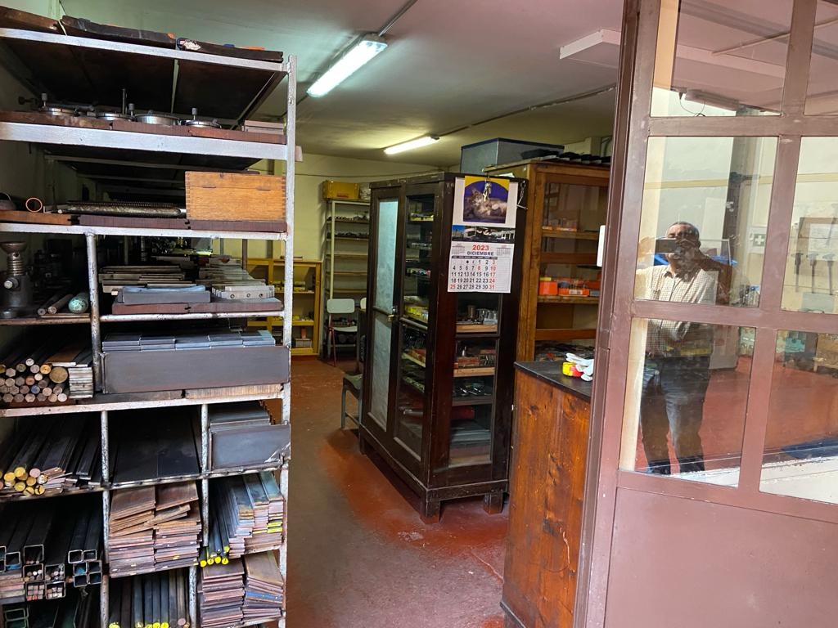
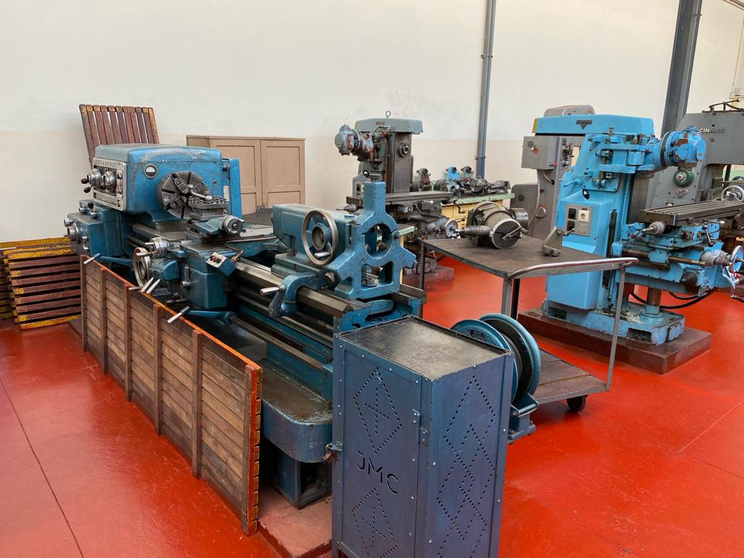
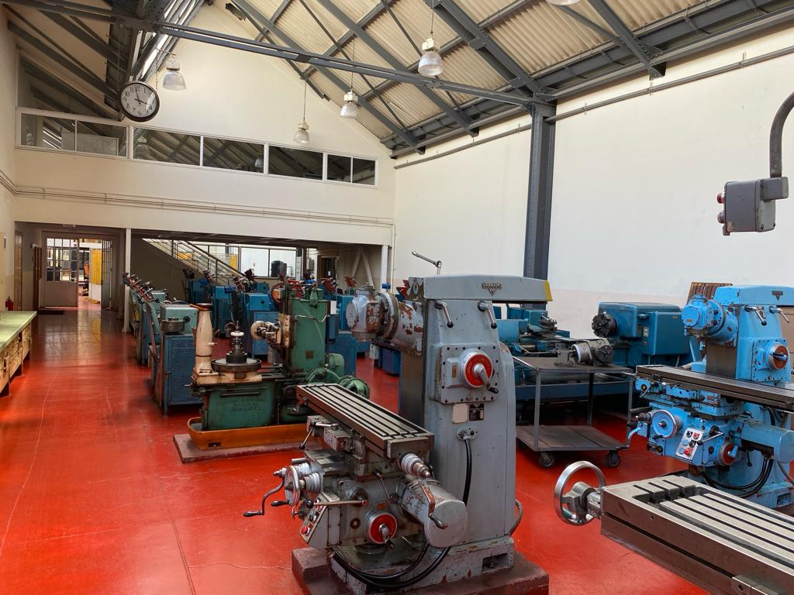
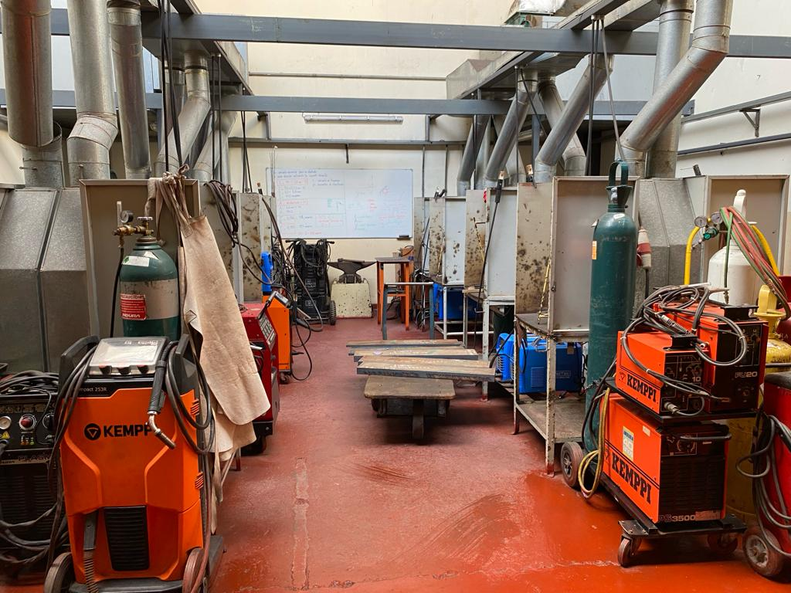
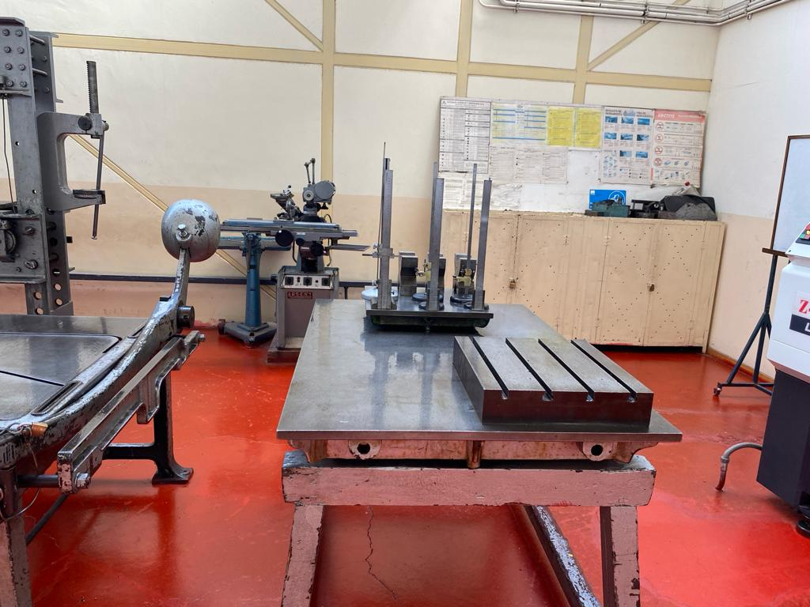
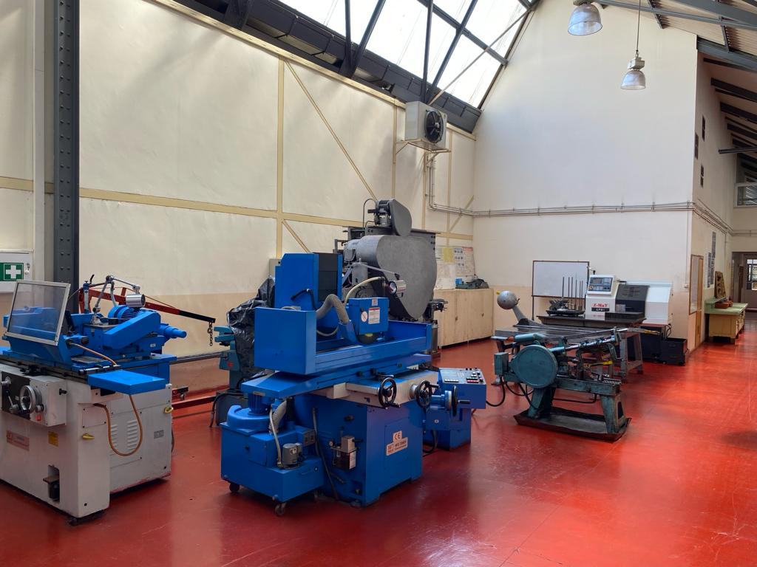
Manufacturing Capabilities
Laboratorio Taller Metalmecánico
Machine tools, machining process and manufacturing laboratory
- Lathes, Mills, Plane grinder, Cylindrical grinder, Drills, Saws.
- Electric arc weld, MIG and TIG.

Slide 9
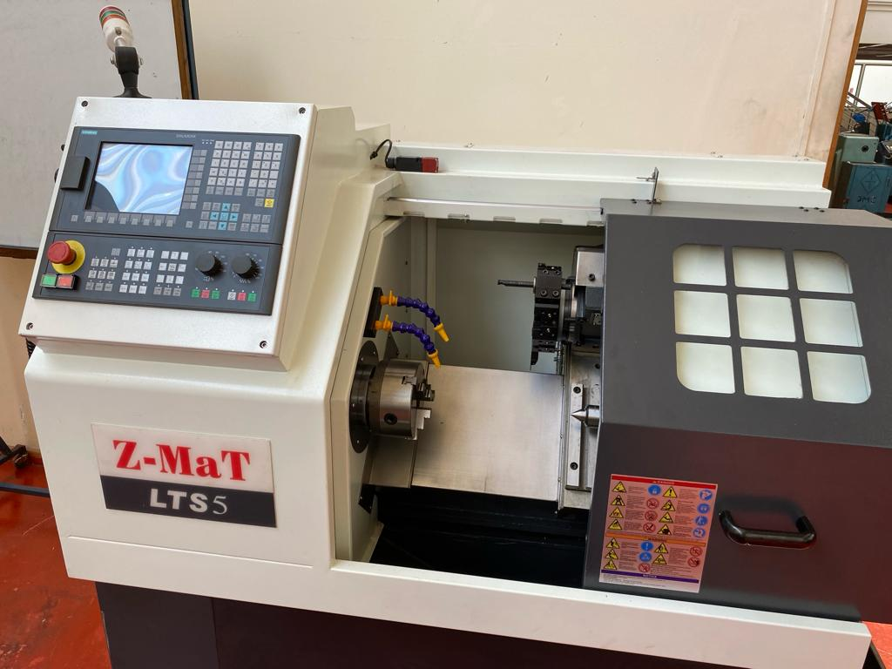
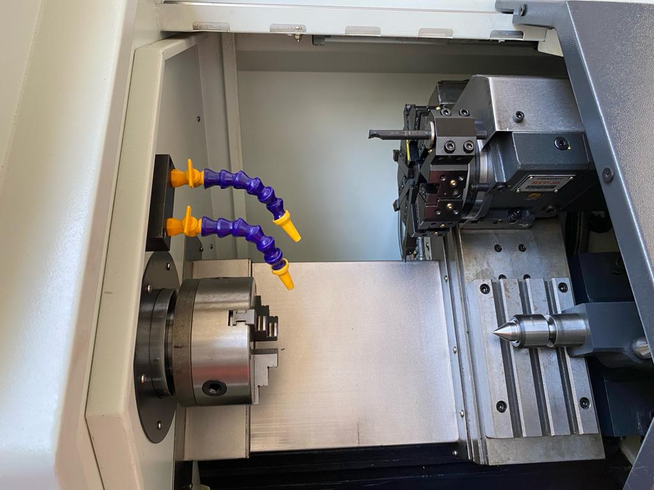
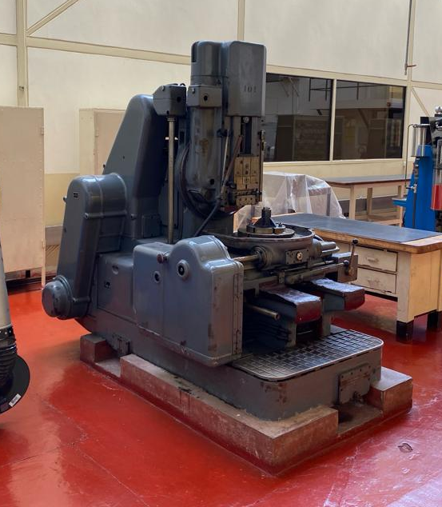
Manufacturing Capabilities
Laboratorio Taller Metalmecánico
- Gear profile generator.
- CNC Lathe.

Slide 10
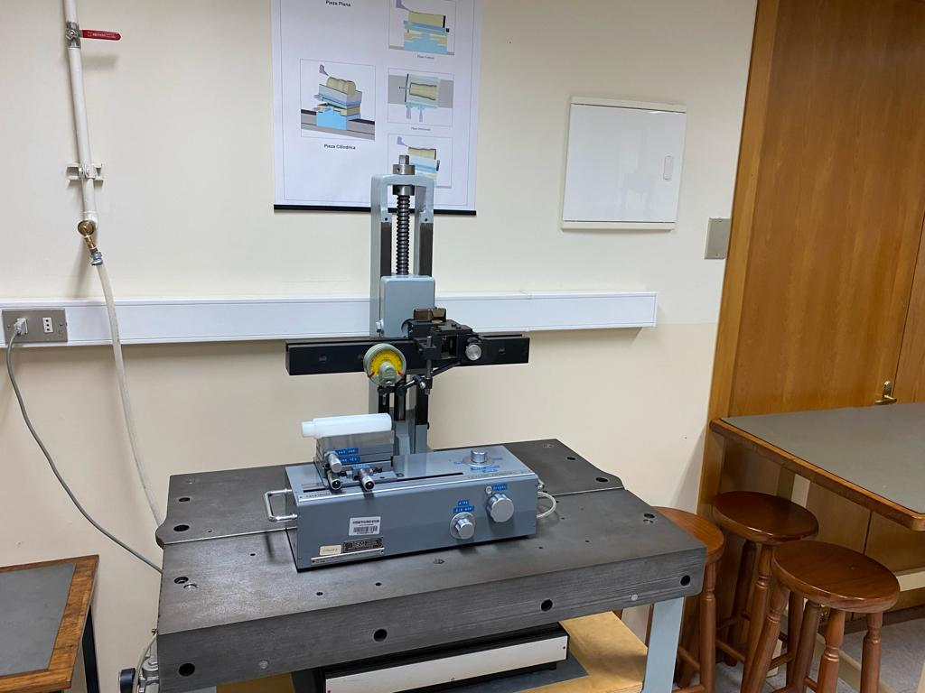
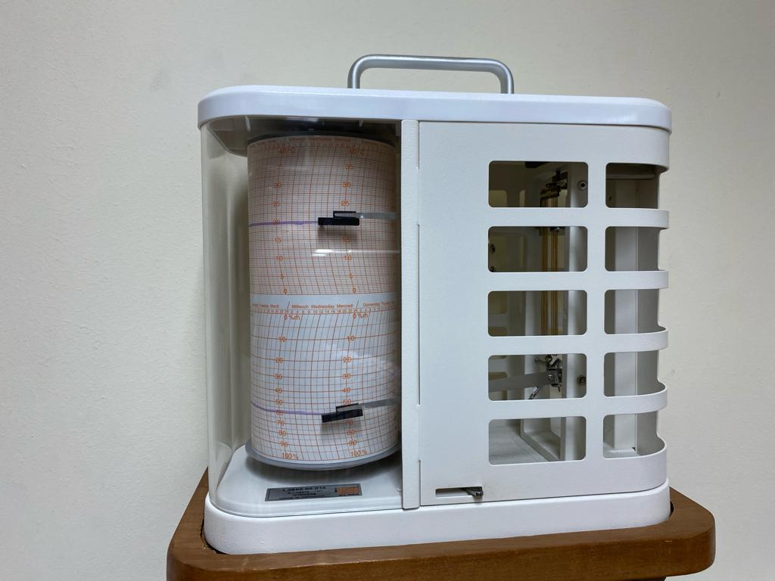
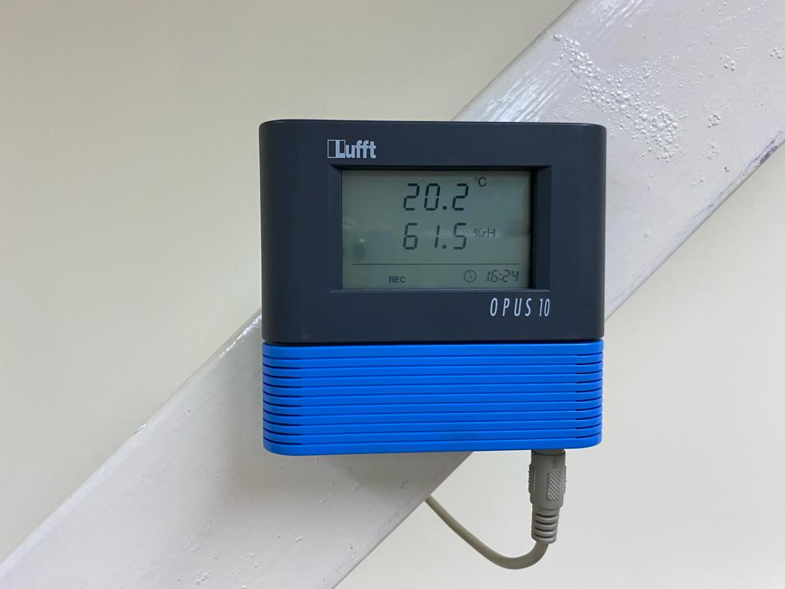
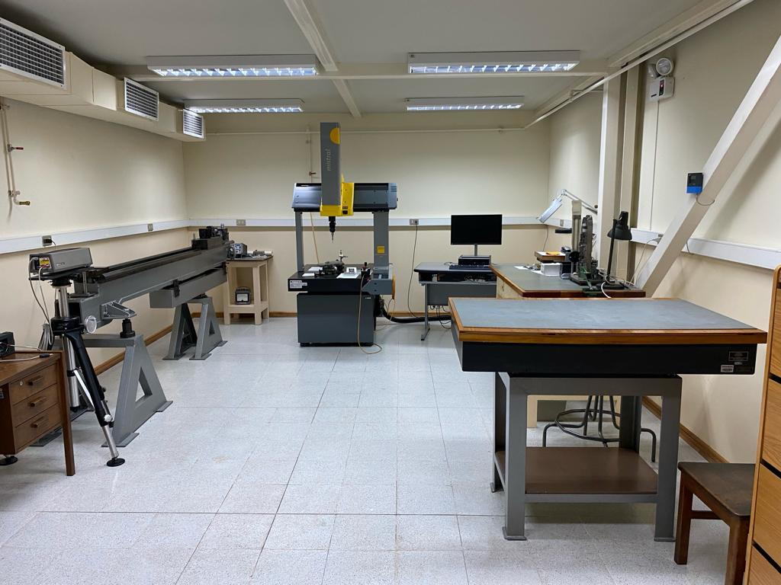
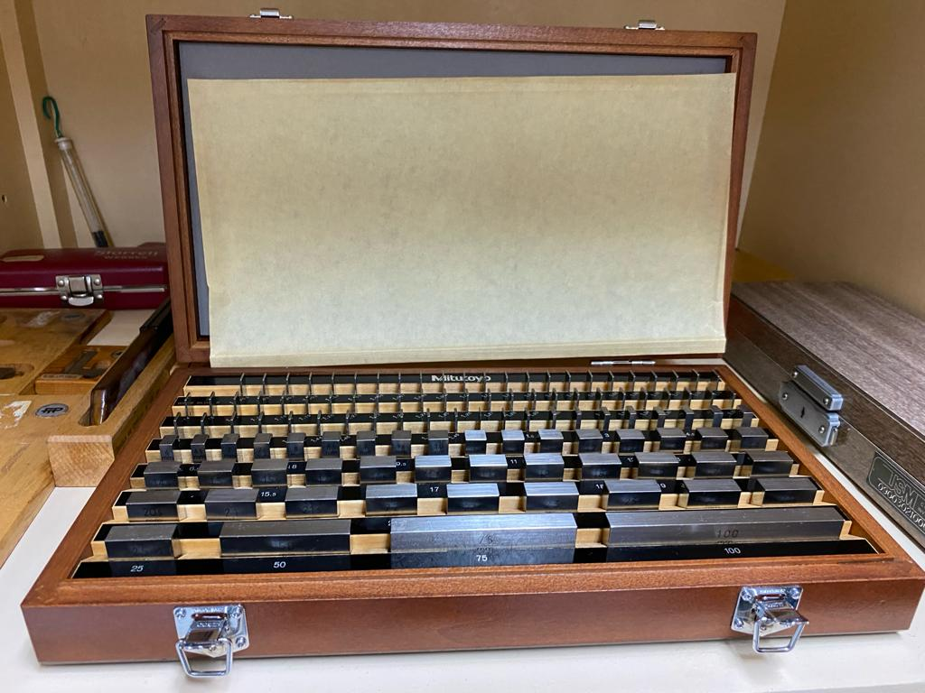
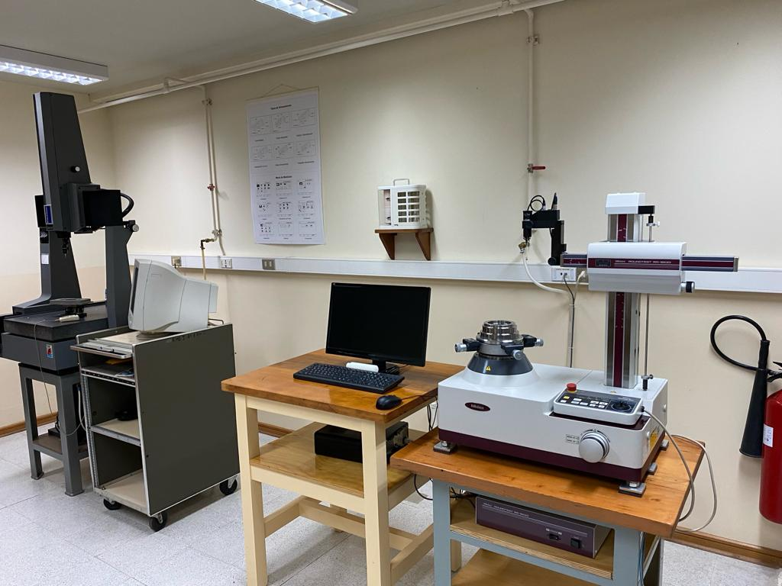
Measurements and quality control
Laboratorio de mediciones y automatización.
CONTROLLED ENVIROMENT ROOM
Micrometers.
Dial comparators.
Gear measurement.
Roughness measurement.
Workshop microscope.
3 axis measurement machine.
Roundness measurement machine.
Rectitude measurement machine.
Calibration gauges.
Profile projector.

Slide 11
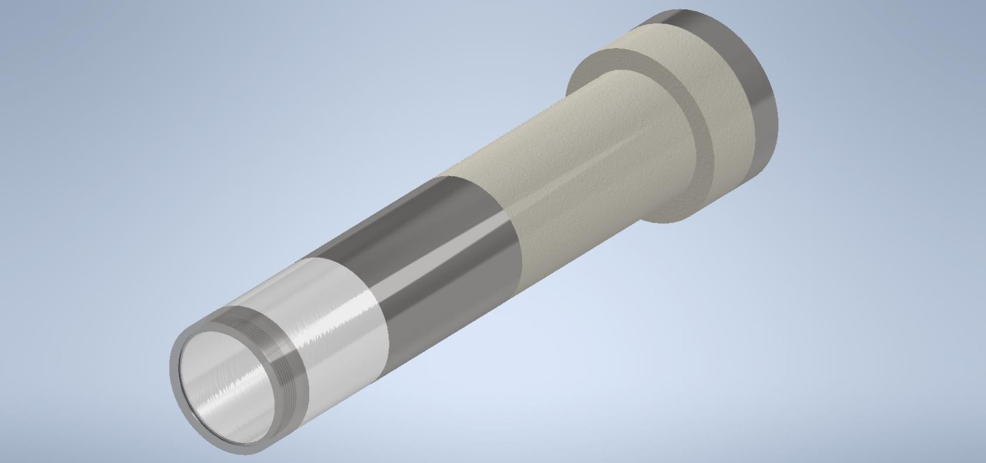
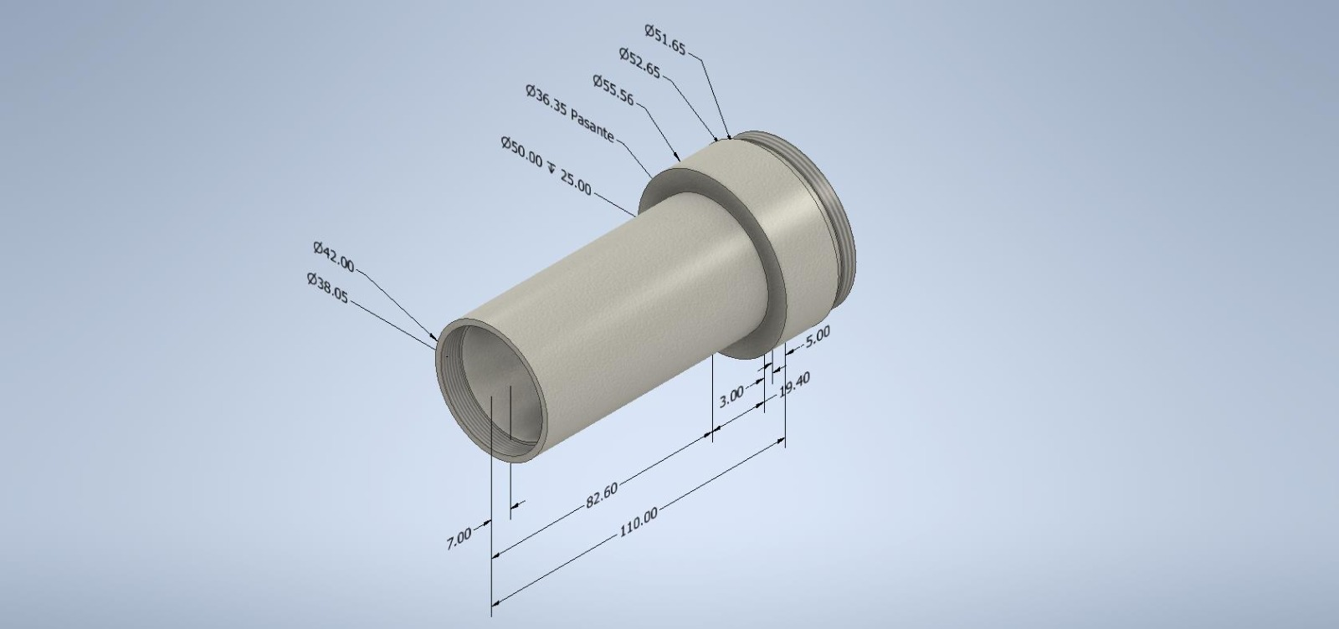
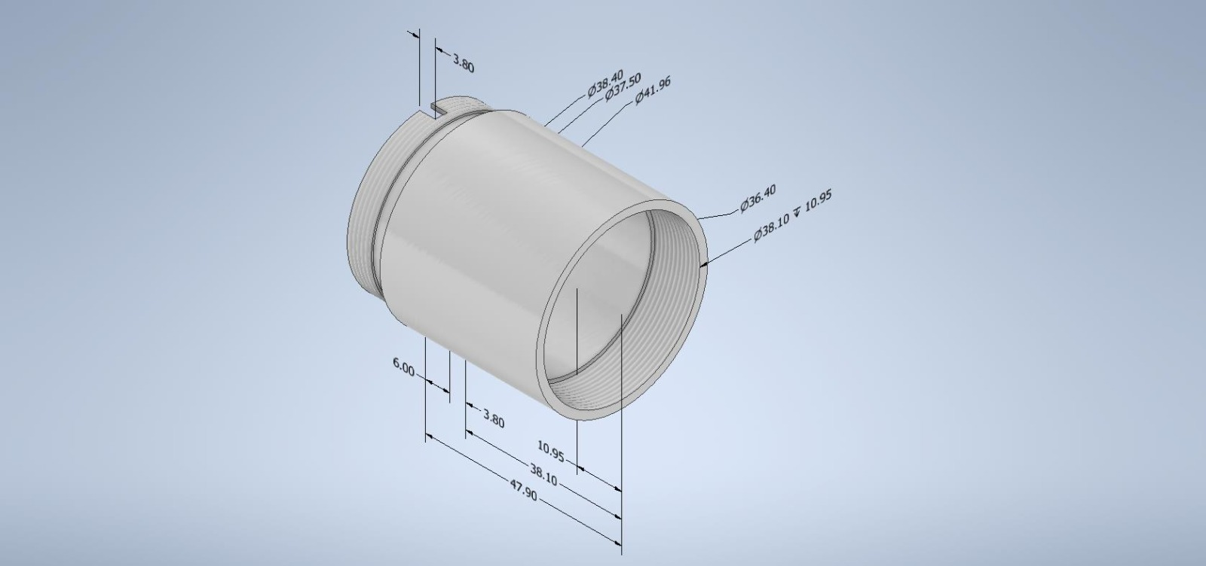
Measurements and quality control
Laboratorio de mediciones y automatización.
PHOTON MULTIPLIER MECHANICAL HARDWARE
Measurements.
3D drawings.

Slide 12
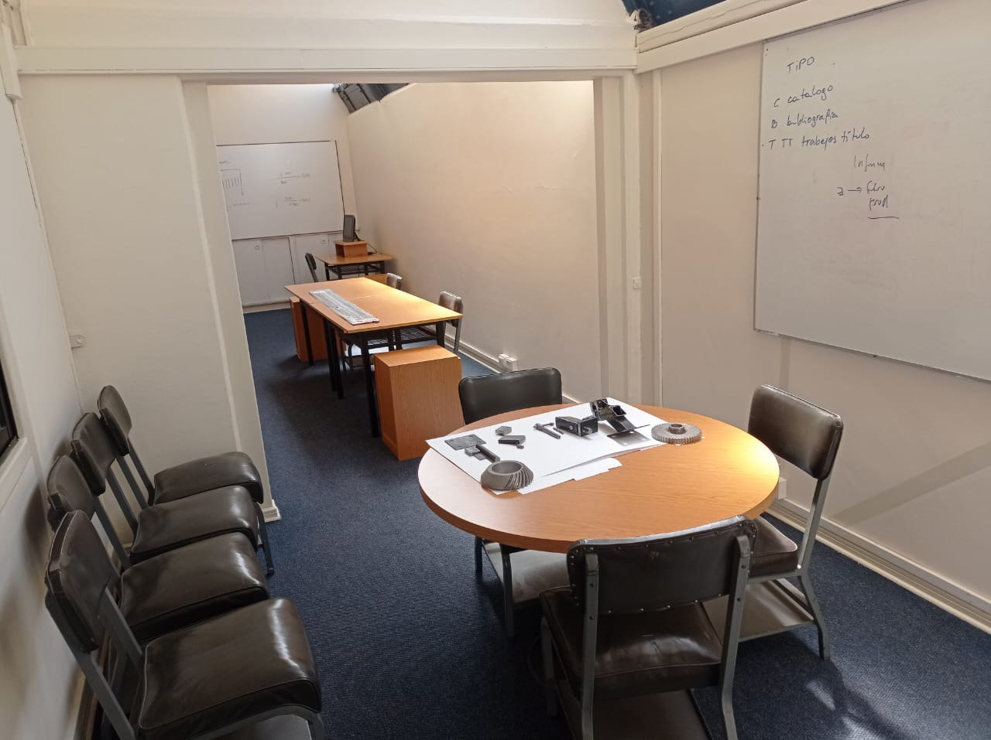
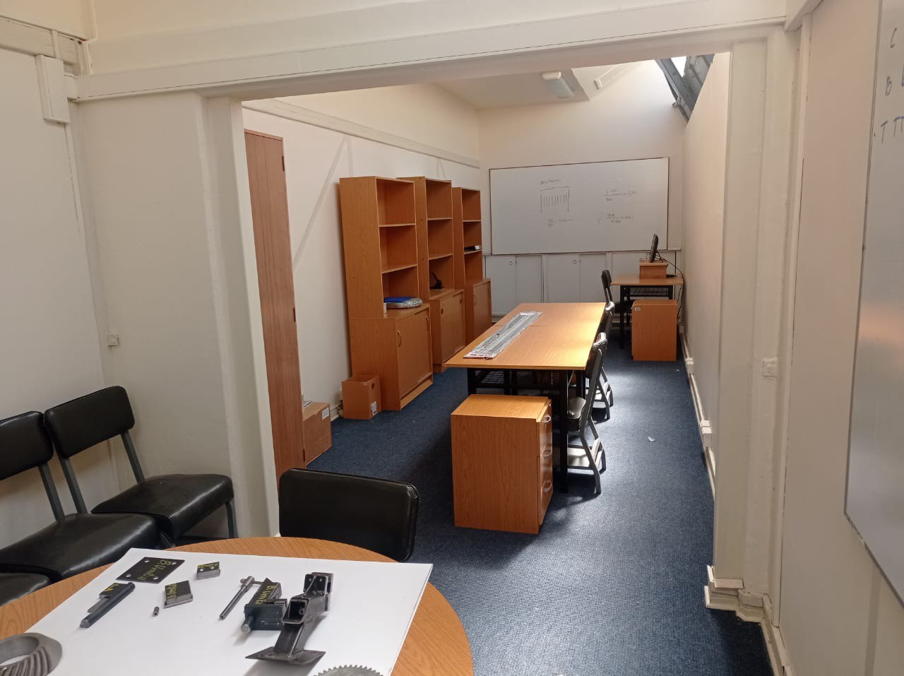
Design and Engineering
Laboratorio Taller Metalmecánico
DESIGN AND ENGINEERING OFFICE
Technical conversations.
Project planning and following.
Place of work for engineers and technicians.

Slide 13
A place for people
DEMA LAB SAPHIR-UTFSM
A place for students
A place for technology integration.
Specific knowledge.
Lot of hours of work.
Lot of motivation, responsibility and commitment.
Young people and very experienced people.
Great opportunity to prepare young professionals.

