Slide 1
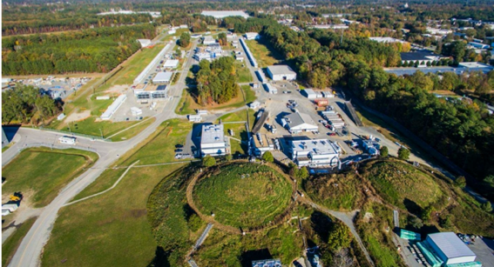
Science at Jefferson Lab – Tomorrow and Today
Cynthia Keppel
9th International Conference on High Energy Particle and Nuclear Physics in the LHC Era
Universidad Tecnica Federico Santa Maria
Valparaiso, Chile
January 6-10, 2025

Slide 2

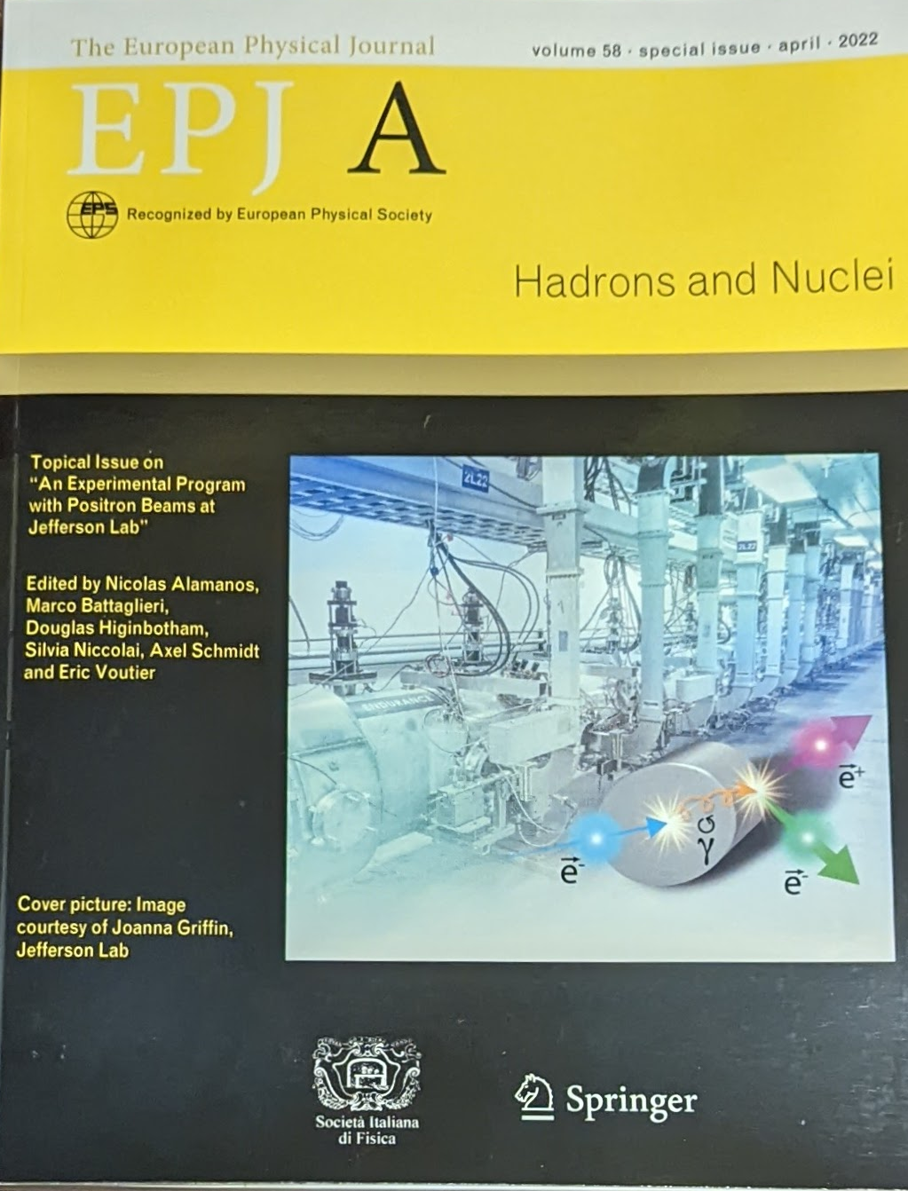
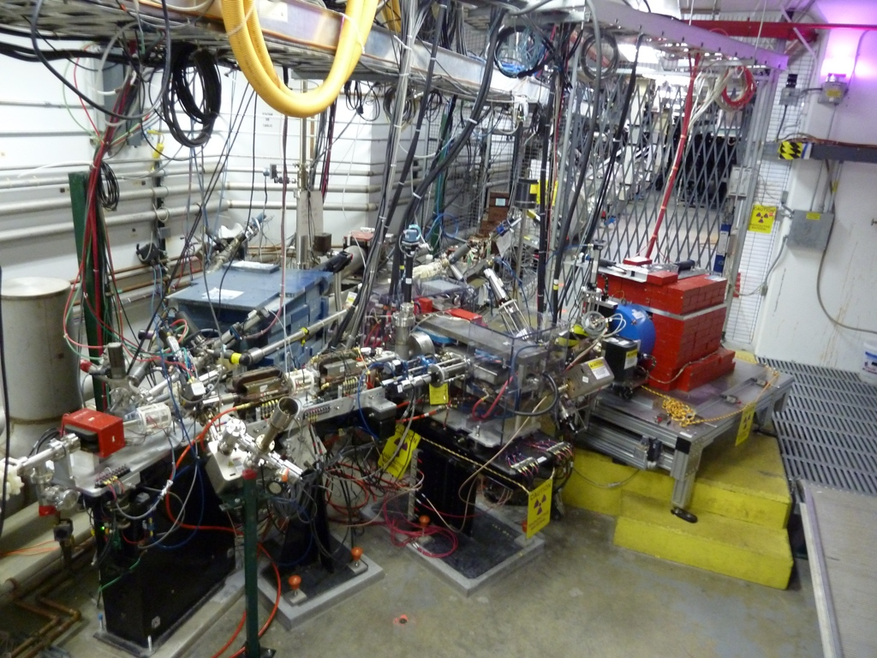
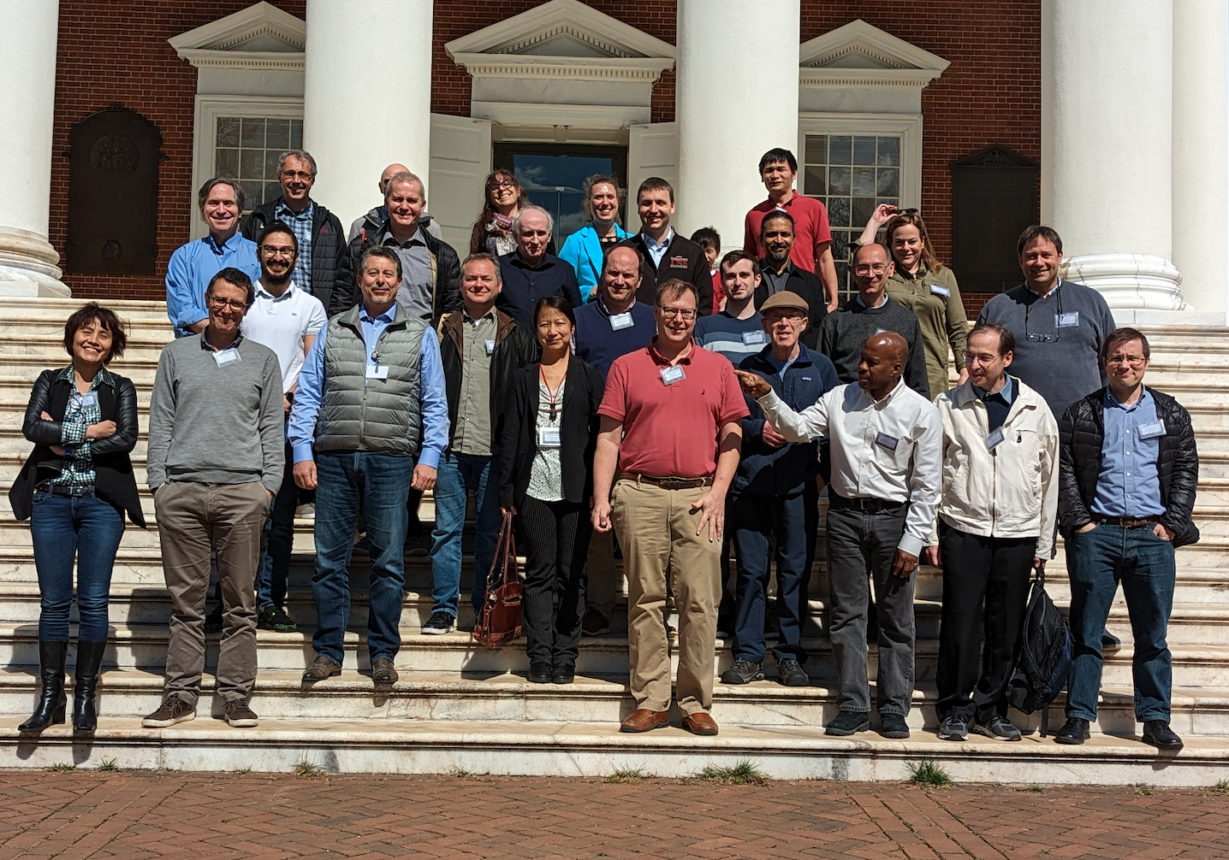


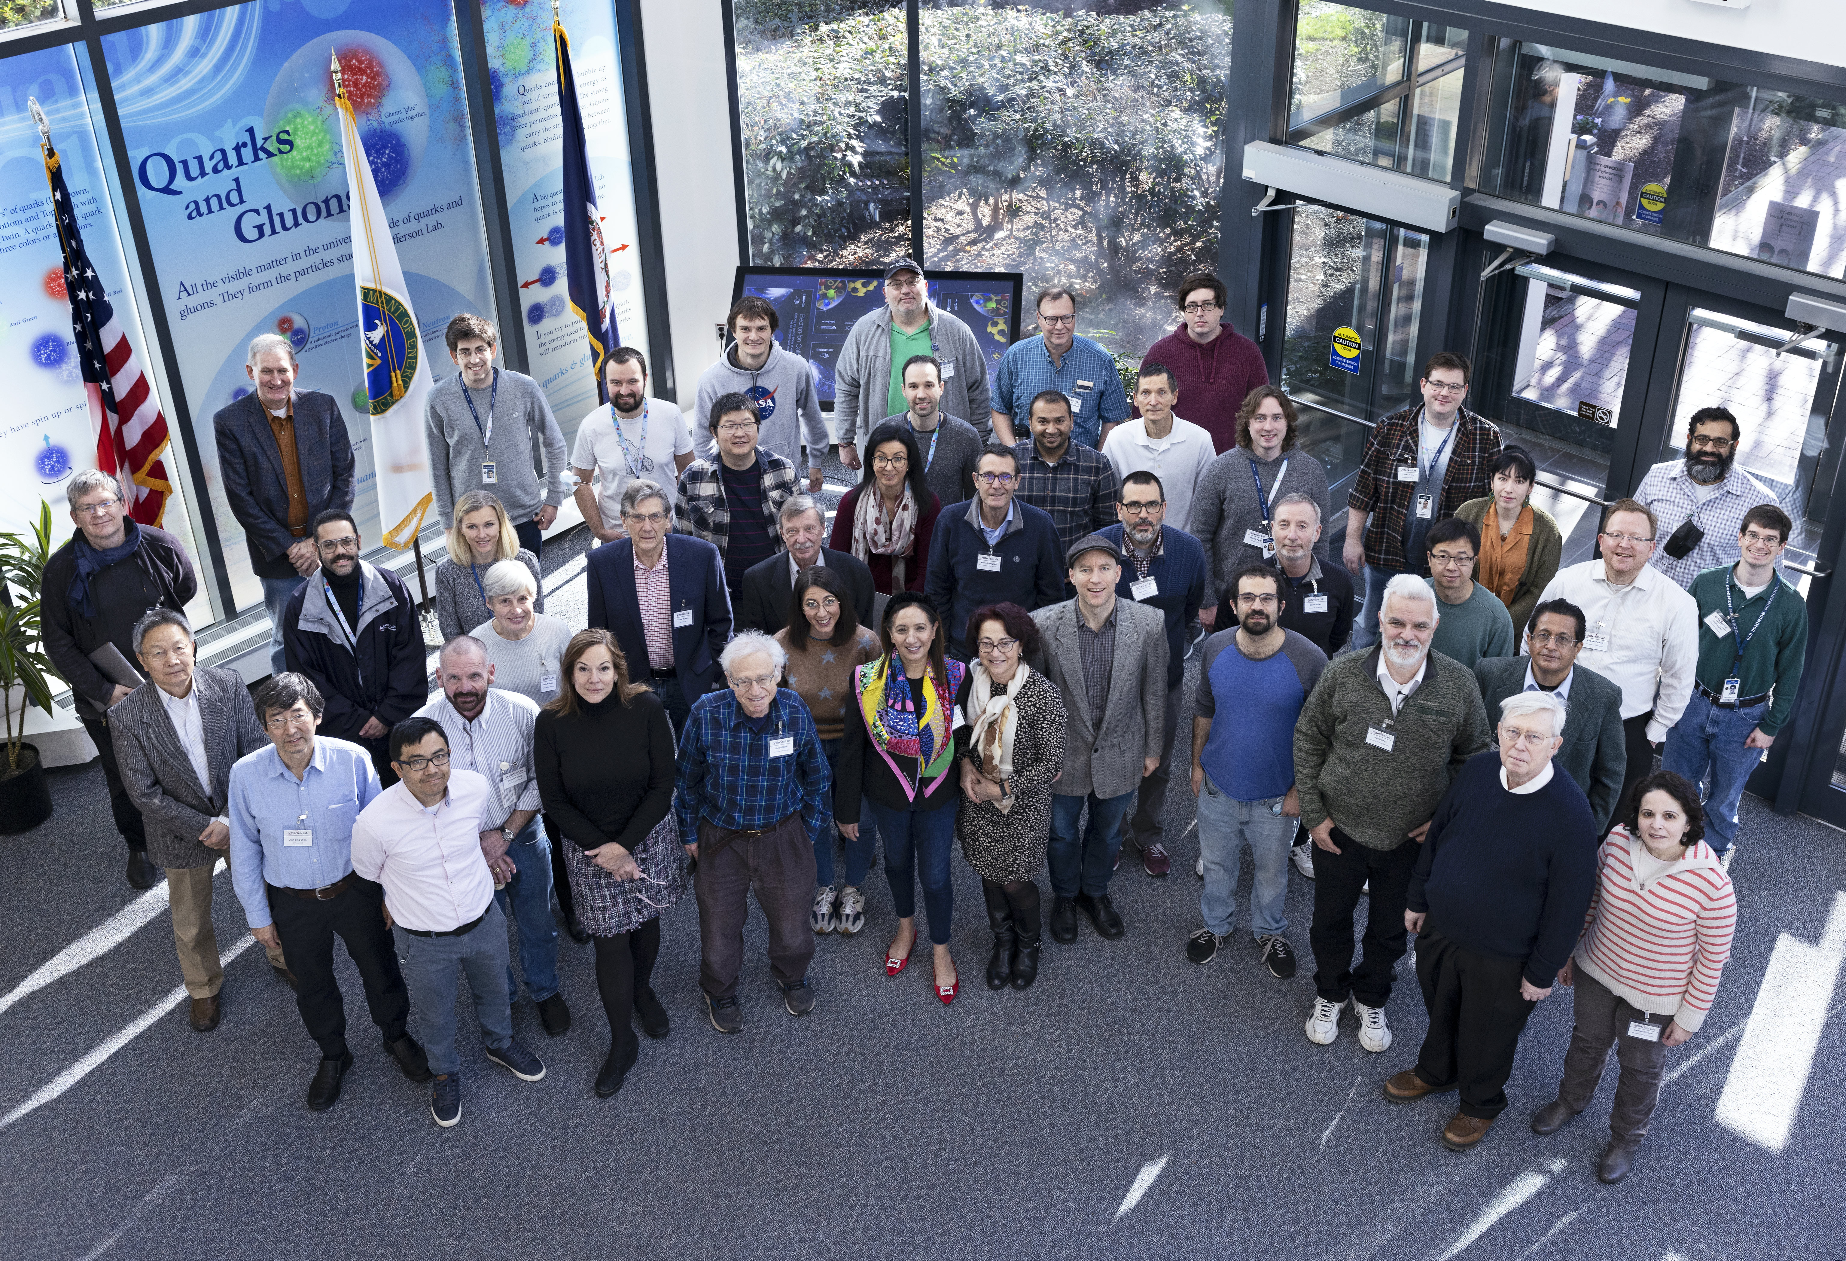
Science at the Luminosity Frontier: Jefferson Lab Upgrade Development
Topical issue on An Experimental Program with Positron Beams at Jefferson Lab
Eur. Phys. J. A 58 (2022) 3, 45
Strong Interaction Physics at the Luminosity
Frontier with 22 GeV Electrons at JLab
Eur. Phys. J.A 60 (2024) 9, 173
Many workshops along the way
2012-16 PEPPo demonstrates 82% e+ polarization
2009 1st dedicated workshop
Broad community interest in this science

Slide 3

The combined positron to 22 GeV GeV upgrade is a rather new opportunity at Jefferson Lab….
The community did a lot of work (science workshops, accelerator studies, cost estimating, profile development,…) to quickly prepare for the US Long Range Plan for Nuclear Science
- Critical just to be mentioned favorably!
“To investigate the other XYZP states, higher beam energy is required; the tetraquark candidate Z_{c} states would Z_{c} be copiously produced at a high-luminosity, fixed-target electron machine operating above 20 GeV.”
“The role of two-photon exchange can
be determined by measurements using a positron
beam, which could be realized at Jefferson Lab with
a modest accelerator upgrade.”
“The staged upgrade plan for CEBAF foresees...[]…an energy upgrade of CEBAF to more than 20 GeV….. exciting new technology could enable a cost-effective method to double the energy of CEBAF, allowing wider kinematic reach for nucleon femtography studies in the existing tunnels and with no new cryomodules required.”

Slide 4
Jefferson Lab Accelerator PHASED Upgrade
A staged upgrade program at the luminosity frontier (up to 10³⁹ e-N /cm²/ s), capitalizing on novel accelerator science and technology
Phase 1: Polarized positrons in a former Free Electron Laser (“LERF”) with transport to CEBAF (proposed 12 GeV science program)
Phase 2: Recirculating injector energy upgrade to 650 MeV electrons
Replace one set of arcs on each side with new FFA permanent magnet arcs to upgrade to 22 GeV – no new RF needed! No new cryomodules needed!
123 MeV e⁺ and 650 MeV e⁻

Slide 5
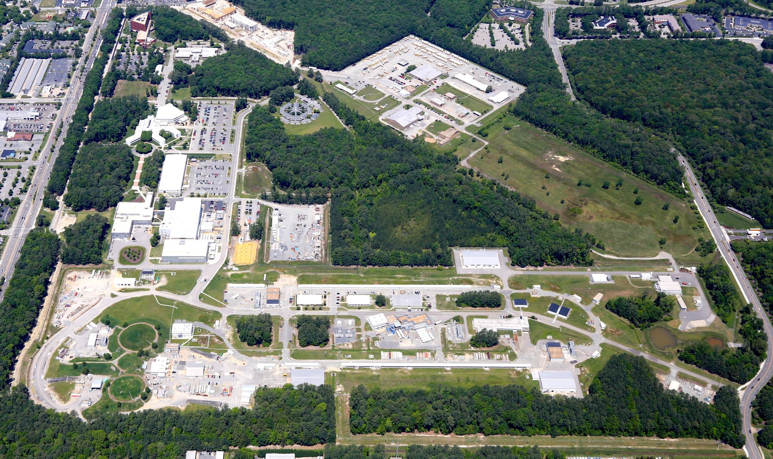
12 GeV Ce⁺BAF: Polarized Positron Beams
Machine Parameter | Electrons | Positrons
Hall Multiplicity | 4 | 1 or 2
Energy (ABC/D) | 11/12 GeV | 11/12 GeV
Beam Repetition | 249.5/499 MHz | 249.5/499 MHz
Duty Factor | 100% cw | 100% cw
Unpolarized Intensity | 170 µA | > 1 µA
Polarized Intensity | 170 µA | > 50 nA
Beam Polarization | > 85% | > 60%
Fast/Slow Helicity Reversal | 1920 Hz/Yes | 1920 Hz/Yes

Slide 6
(c1) Approved Positron Science program
6 Experiments, 10+ LOIs, even more ideas!
Approved 210 days Hall B & 202 days in Hall C for 357 total PAC days
(PAC day = two calendar day)
The JLab Positron Working Group offers review for new experimental proposals.

Slide 7
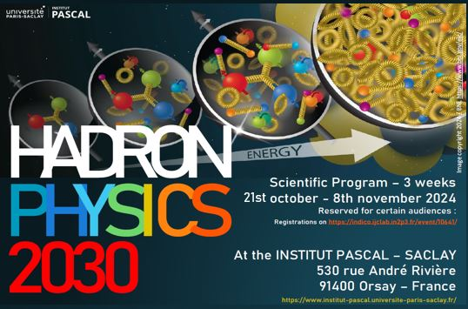
  https://indico.ijclab.in2p3.fr/event/10641/

Slide 8
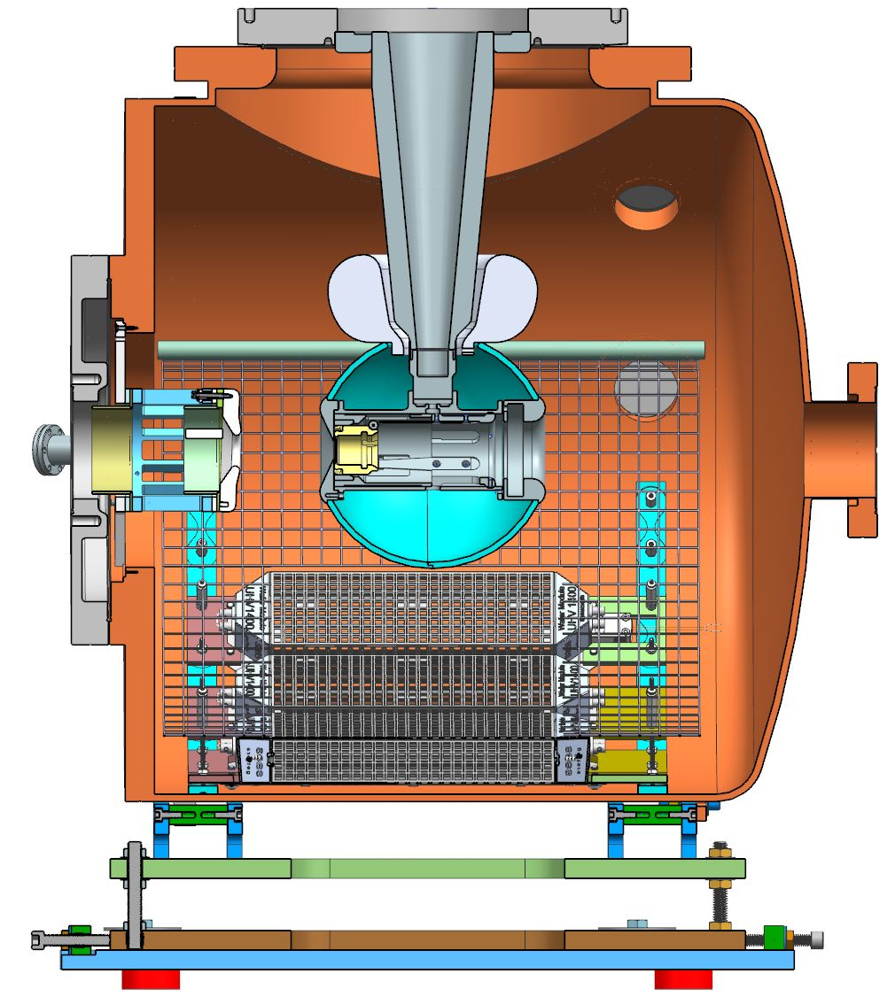
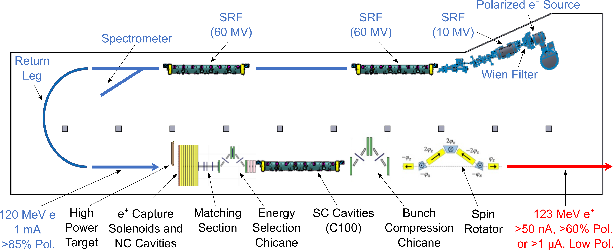
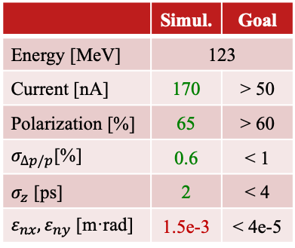
Pol. e⁺ Injector Critical Risk Areas mA e‒ Source, High Power Targets, Capture Cavity
Conceptual Development
Improve design of e⁺ injector
Develop pCDR
High current e‒ source
(<10 mA @ 10 MeV)
Up to 90% polarization
Long life time
M. Bruker, IPAC’24, MOPC52
JLab LDRD “A high-intensity, polarized-beam prototype photogun for the Ce⁺BAF positron source”,
PI: M. Bruker, proposal awarded,
FY25-FY26
Scheme of e⁺ Injector at LERF
S. Habet, PhD Thesis, Dec 2023
 | Simul. | Goal
Energy [MeV] | 123
Current [nA] | 170 | > 50
Polarization [%] | 65 | > 60
$σ_{∆p/p}$[%] | 0.6 | < 1
$σ_{z}$ [ps] | 2 | < 4
$ε_{nx},ε_{ny}$ [m·rad] | 1.5e-3 | < 4e-5
Target Test Area

Slide 9
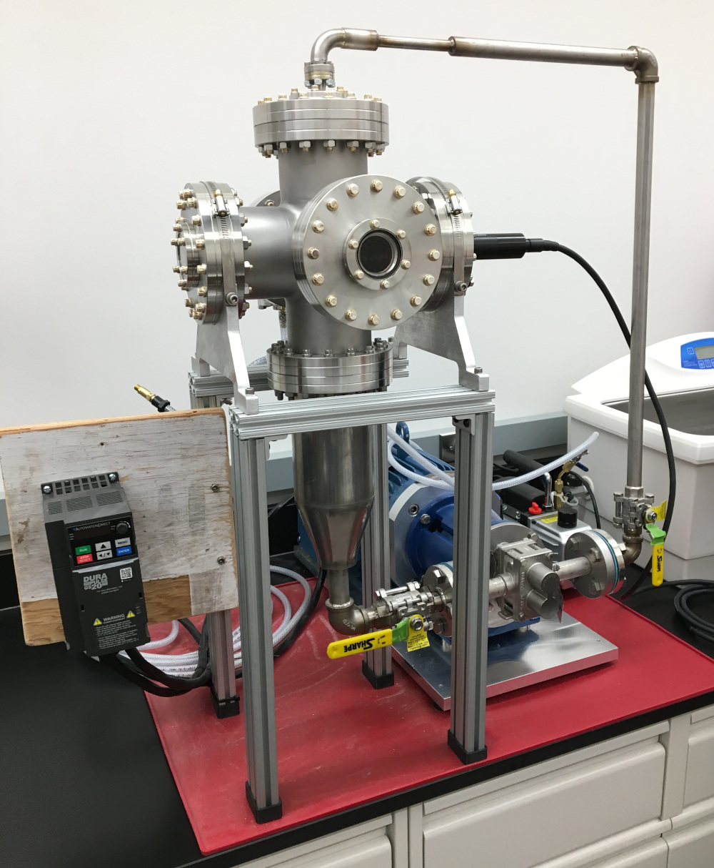
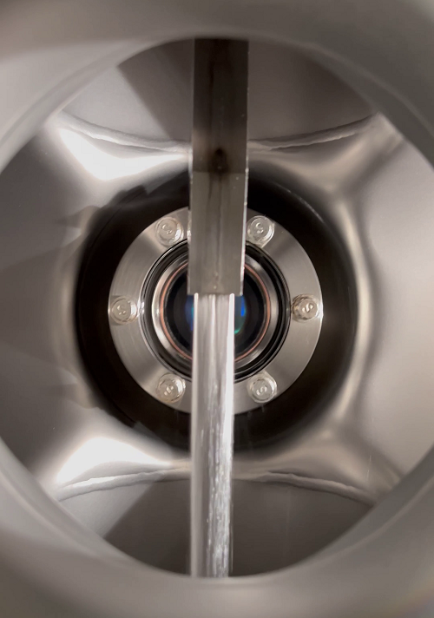
Development and Test of Liquid Metal Targets
Two target concepts are considered
Solid high-Z target (i.e. tungsten)
⇒ next slide
Liquid metal targets (GaInSn, PbBi)
Prototype of GaInSn Test Stand (Xelera)
Example of GaInSn jet
with speed ~8 m/s
Liquid-metal jet inside chamber
Laser doppler velocimeter
Liquid Metal Targets are developed by Xelera Research LLC
DOE Small Business Innovation Research (SBIR) Phase 2, Oct 2024 – Sep 2026
Planned test of GaInSn target at JLab with up to 10 mA @ 10 MeV e‒ beam
Liquid PbBi target is proposed for future for drive e‒ beam with 1 mA @ 120 MeV
Gear pump
N. Taylor et al.,
IPAC’24, TUPC83
Pump VFD
GaInSn reservoir

Slide 10
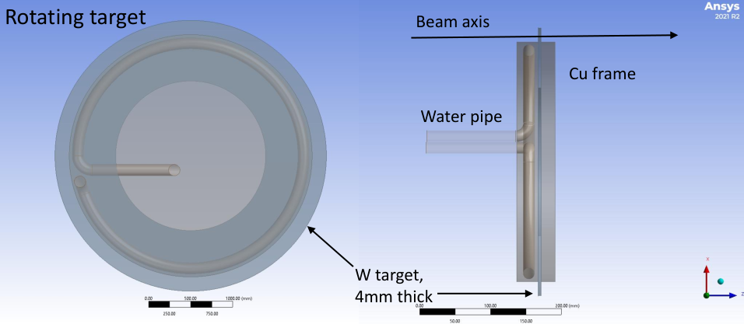
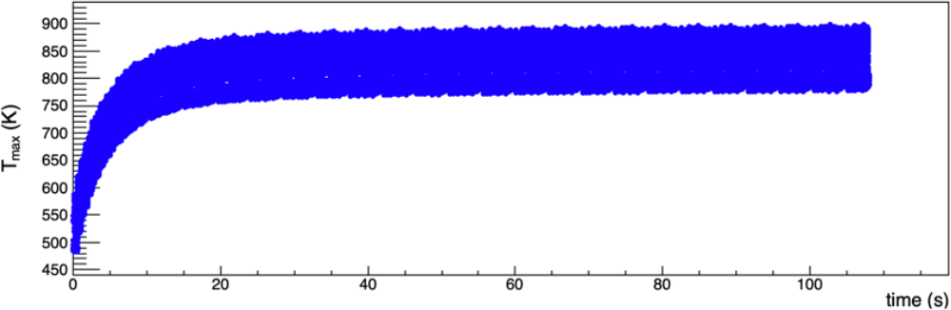
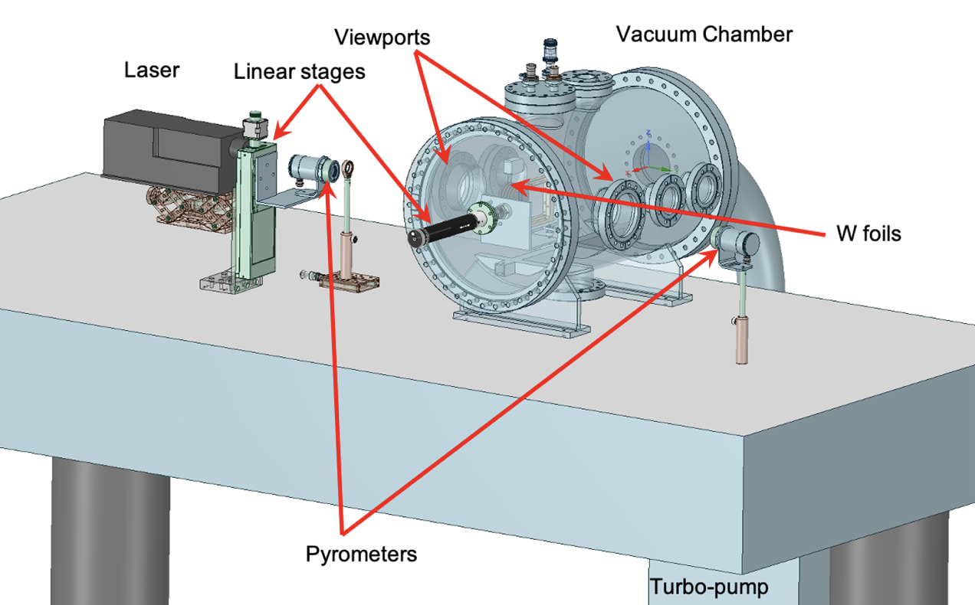
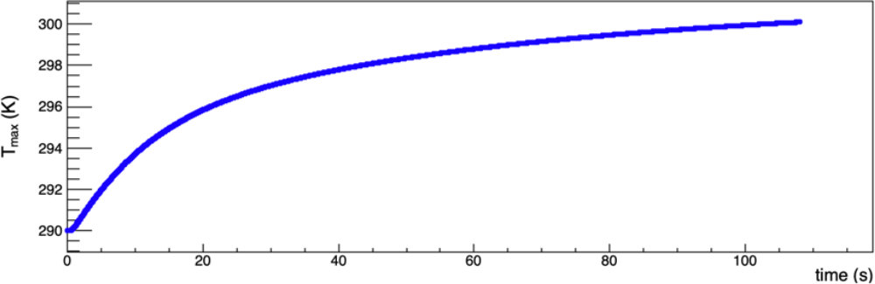
Concept of Tungsten Target, CFD Simulations, Prototype Testing (S. Covrig)
Design goal: target should be able to take 1 mA, 120 MeV CW e‒ beam current and have a lifetime of 6 months (or longer)
Focus on assessing with CFD solid high-Z targets (tungsten, W-alloys, etc.)
Implemented full time-dependent CFD simulations
Initial calculations have shown that the rotating W target
(4mm thickness, 10 Hz rot. frequency, >30 cm diameter)
can take 20 kW beam power and peak target temperature T_{max} < 1000 K
Started looking at target engineering, radiological issues, shielding
Tungsten Target Test
DOE FY2024 R&D for Next Generation Nuclear Physics Accelerator Facilities (funded, FY25-FY26)
Max T of Tungsten vs Time
Max T of Cooling Water vs Time

Slide 11
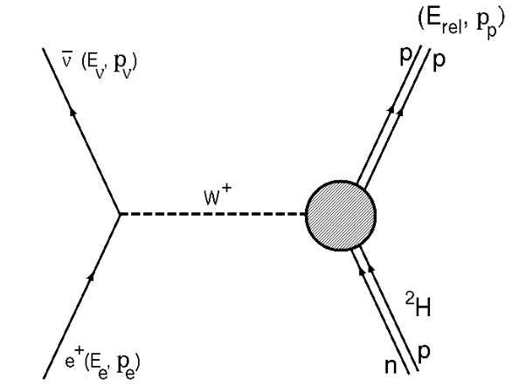
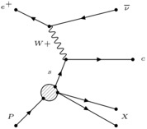
Positrons open the door to understanding a range of physics that can’t be accessed with electrons alone.
Beam charge asymmetries
  Two-photon exchange
  Deeply Virtual Compton Scattering
Annihilation processes
  Light dark matter searches
Charged-current processes
  Inverse beta-decay
  Access strangeness with charm-tagging
  Charged lepton flavor violation
  Axial Form Factor
Along with many
other new ideas!

Slide 12
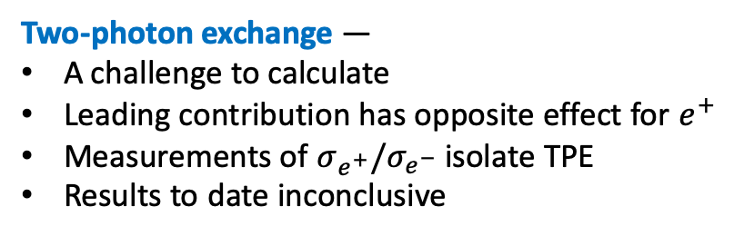

Two-photon exchange may be the cause of the proton form factor discrepancy.
Two-photon exchange —
A challenge to calculate
Leading contribution has opposite effect for $e^{+}$
Measurements of $σ_{e^{+}}/σ_{e^{−}}$ isolate TPE
Results to date inconclusive
Accessible with JLab 12 GeV
$$\frac{σ_{e^{+}p}}{σ_{e^{−}p}}$$
Requires precision measurements

Slide 13
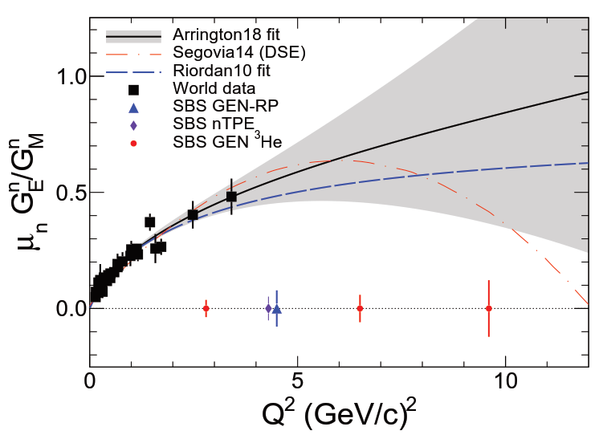
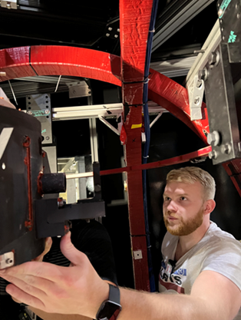
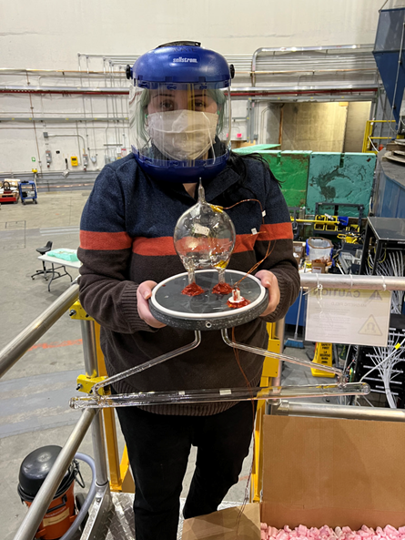
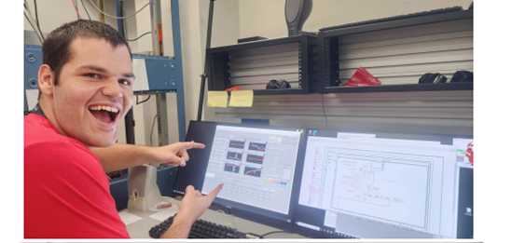
Hall A Today
Just completed Neutron Electric Form Factor Experiments
(part of the SBS program)
60cm long polarized helium cell at 50% polarization at 45 uA
Highest Figure-of-merit ever achieved!
6 graduate students on the experiment.
This experiment will clearly differentiate between fundamental approaches to QCD.
Hunter is excited about the first NMR measurement
Gary is installing target oven
Kate with the 3He target cell
Currently installing GEp (to start early 2025)

Slide 14
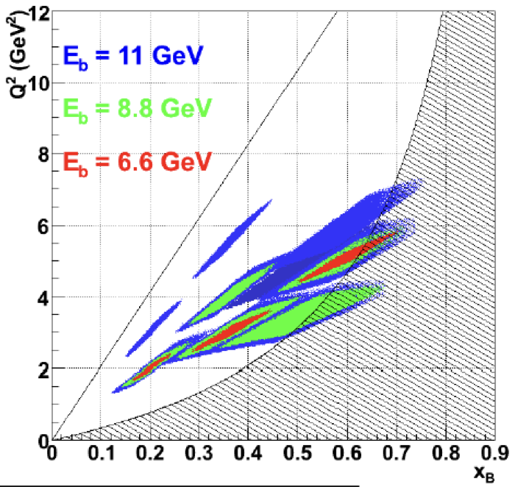
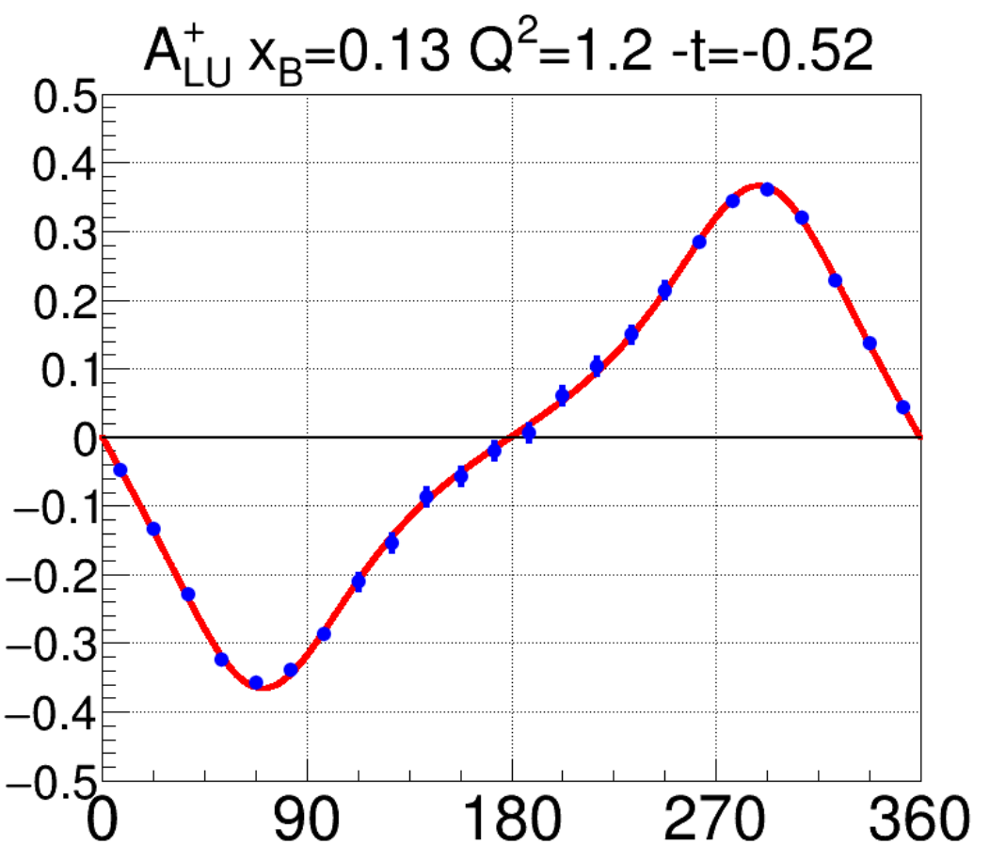
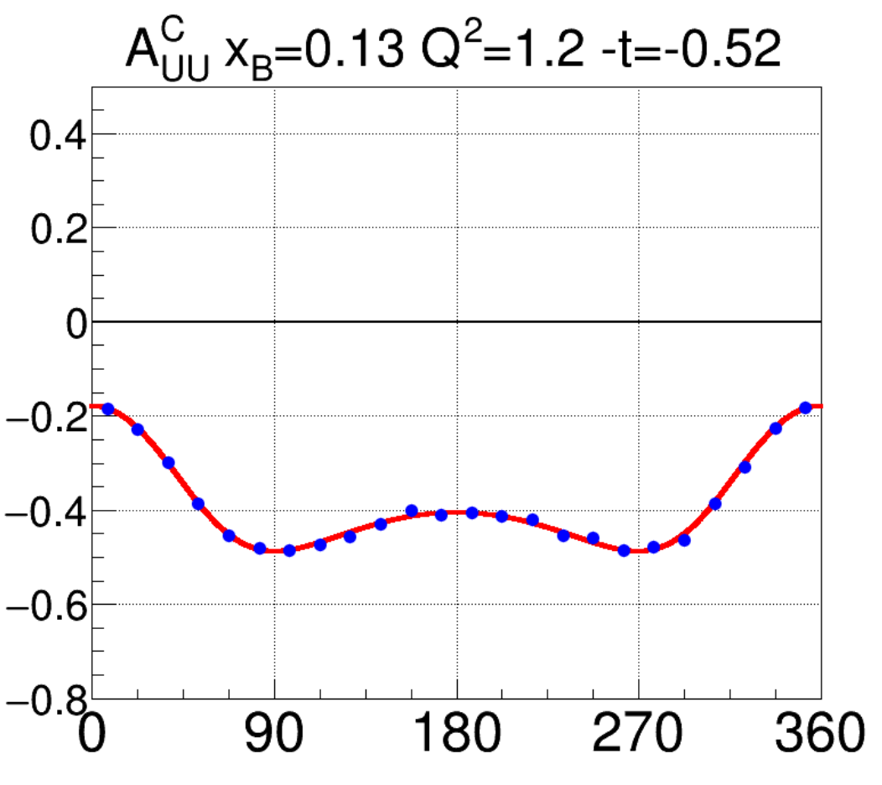
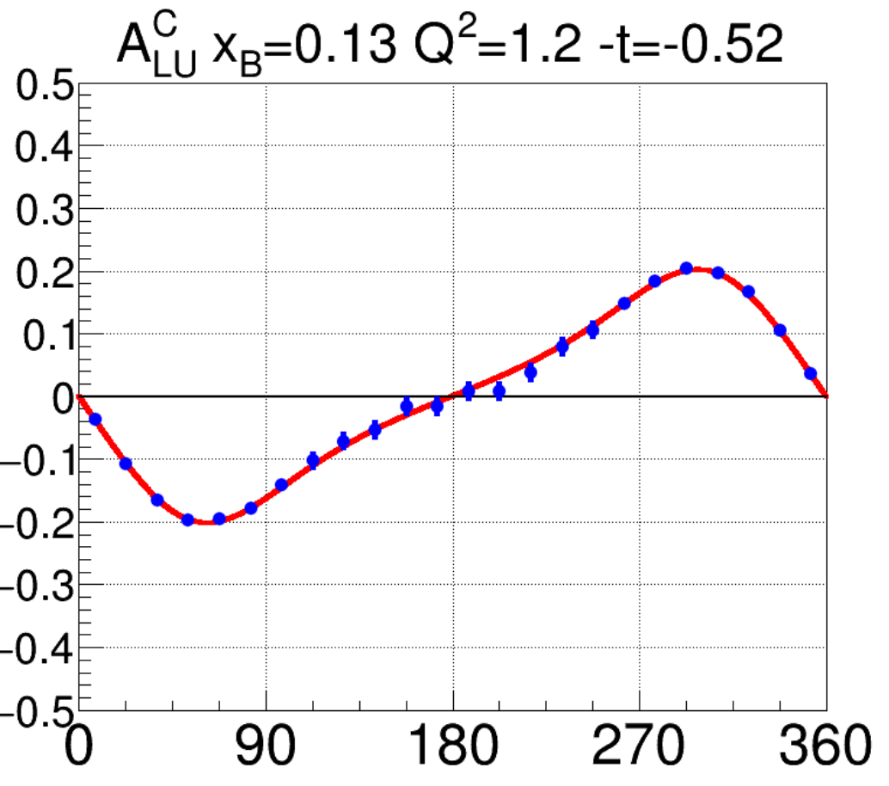
Polarized positrons are an excellent tool for separating DVCS from background
Lepton beams of opposite charge separate Interference from DVCS
Lepton beams of opposite helicity separate spin (in)dependent contributions
Clean isolation of DVCS, constraints on GPDs
Positron data would dramatically improve GPD global fits.
10
Anticipated Reach
Q² (GeV²)
t
t
2
Anticipated precision
for beam charge/spin asymmetries
0.8
0.1
x_{B}
JLab Today: Pioneering mechanical properties of the Nucleon via GPDs (Gravitational Form Factors, Pressure Distribution, Gluonic Radius,…!)

Slide 15
Strong Interaction Physics at the Luminosity Frontier with 22 GeV Electrons at JLab
Eur. Phys. J. A 60 (2024) 9, 173
140+ pages, ~450 authors with many powerful experiments using existing or planned equipment - just a few examples….

Slide 16
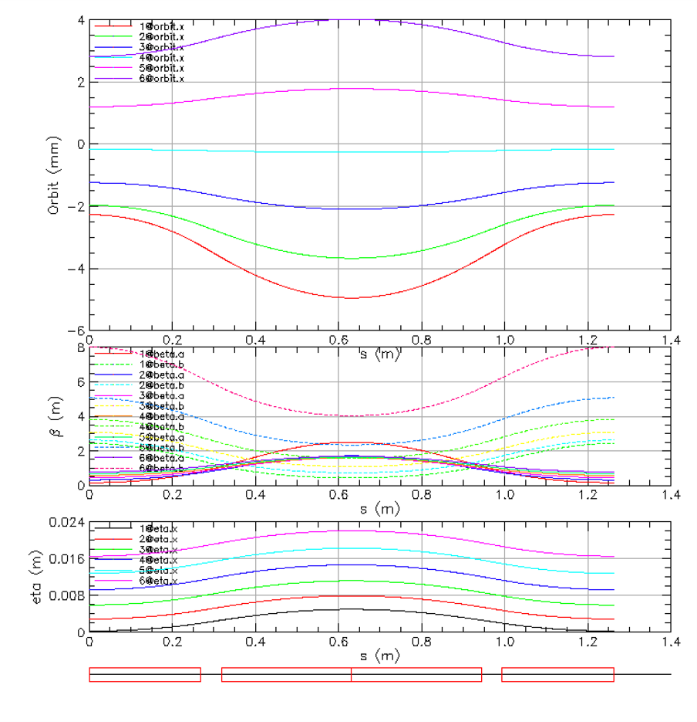
Compact FFA Cell – How Does it Work?
Large momentum acceptance FFA (Fixed Field, Alternating Gradient) cell is configured with combined function permanent magnets capable of transporting multiple energy beams through the same string of magnets (six beams with energies spanning a factor of two)
BD
BD
Focusing Magnet BF
G_{F}= -41.13 T/m
L_{QF}= 1.67 m
B_{F}= -0.812 T
BF
12 cm
1 T
50 T/m
13 cm
Closely spaced orbits for all six beams (~ 1 cm)
Extremally low dispersion (a few mm) in a combined function lattice – virtue of FFA technology
Self similar beta functions for different energy beams
Arc composed of 75 cells, L_{cell} = 3.15 m
BD
BF
BD

Slide 17

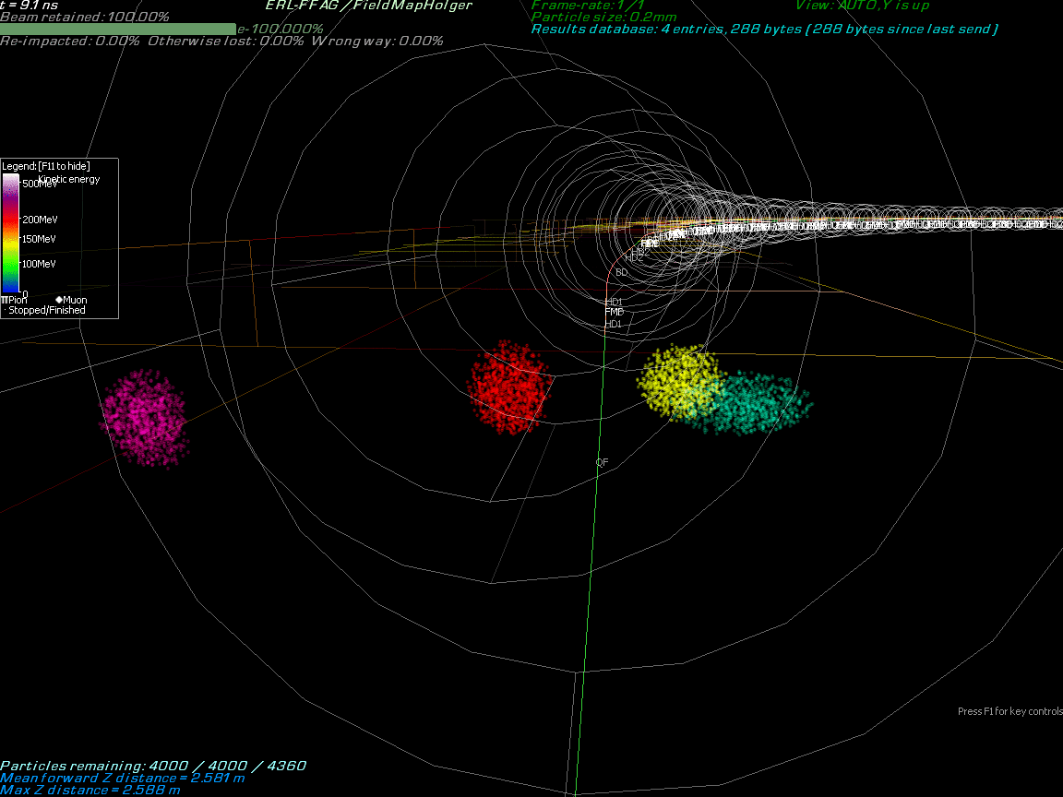
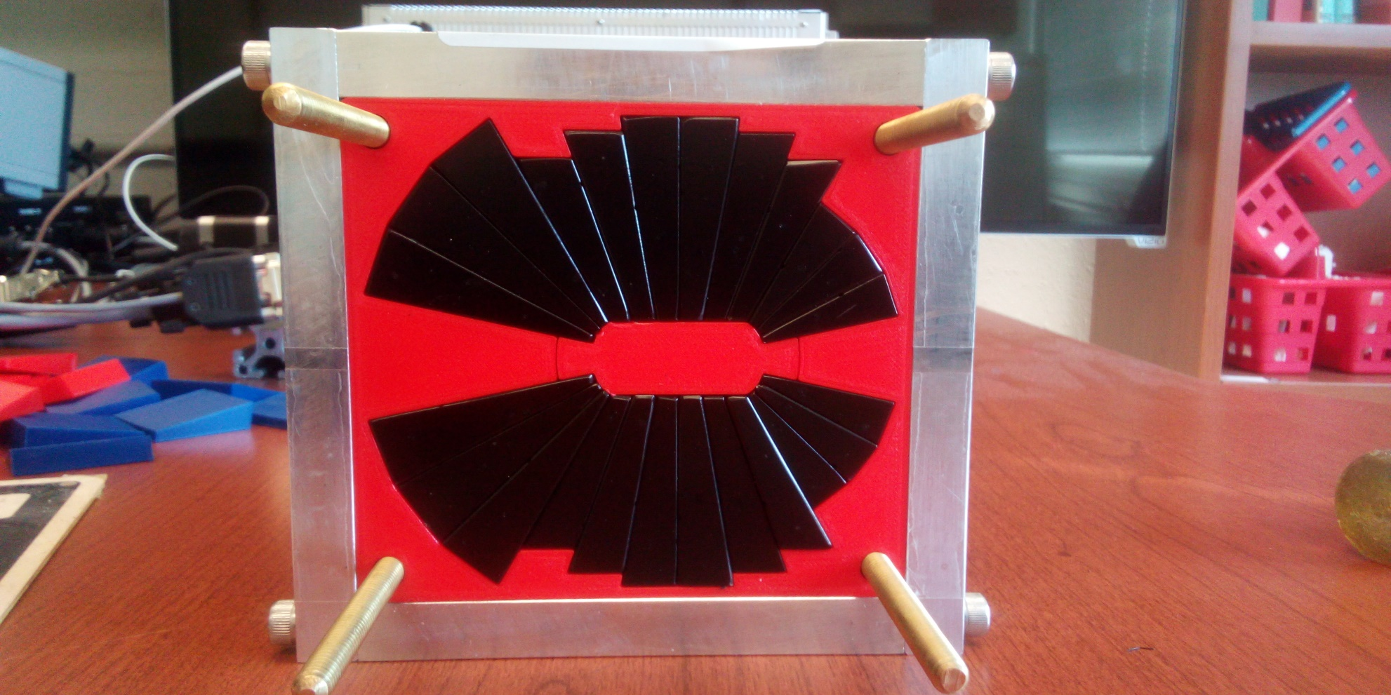
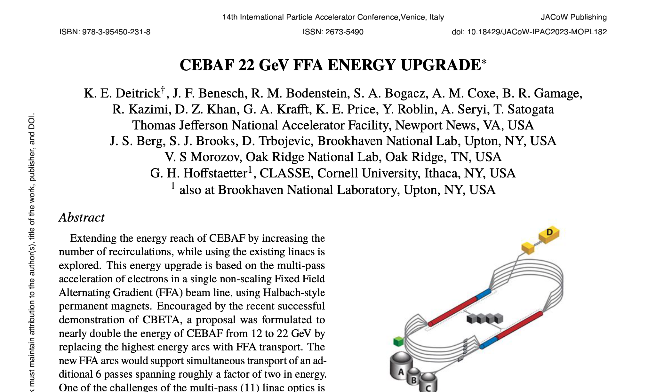
Multi-Energy Beam Dynamics in FFA Arc
2019-2022 the first multi-turn SRF ERL (150 MeV)
Scaling to higher energy at Jlab…
Stephen Brooks, BNL
A prototype open midplane BF magnet was built and evaluated for mechanical integrity. Magnetic measurement confirmed a robust design with >1.5 Tesla in good field region, 10⁻³ field accuracy. JLab radiation resilience tests in CEBAF began October 2023.

Slide 18
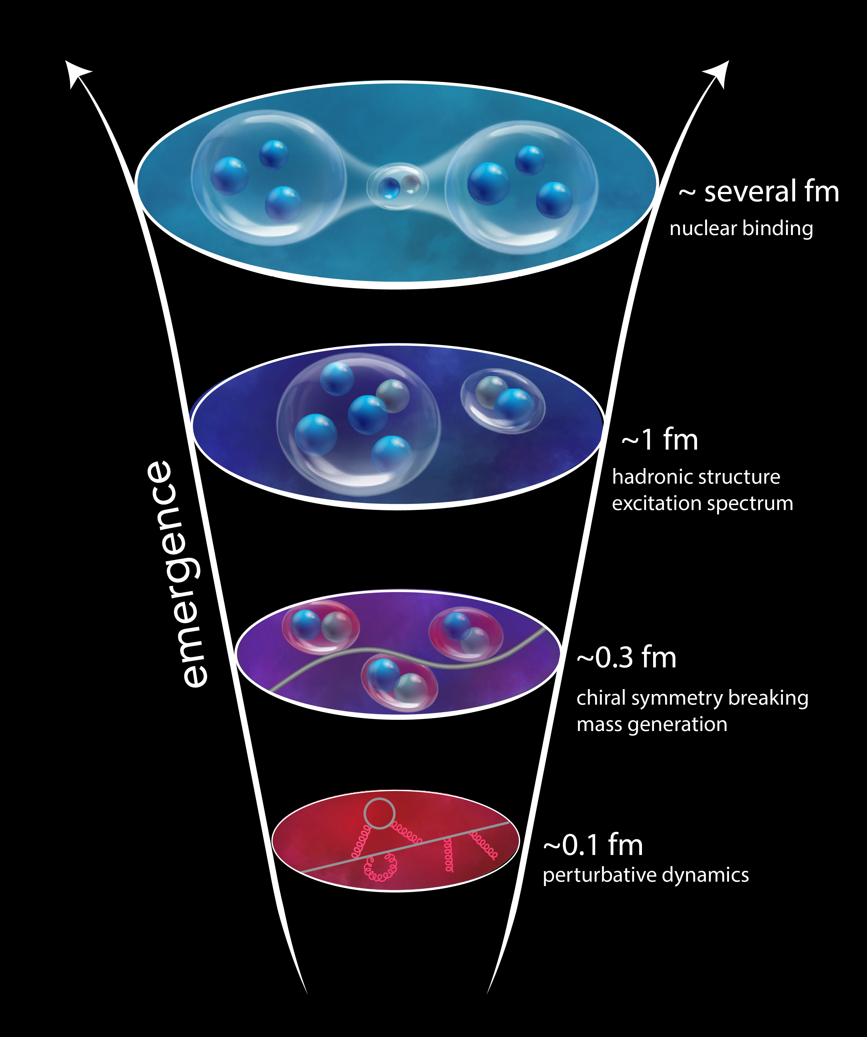
Why CEBAF @ 22 GeV?
“The ability to reduce everything to simple fundamental laws does not imply the ability to start from those laws and reconstruct the universe.” -- More is Different, P. W. Anderson [Science 177, 393 (1972)]
In this landmark paper P.W. Anderson established complexity as a fundamentally important subject of inquiry. He highlighted profound limitations of reductionist approaches in understanding nature’s complexity, and he set in motion new lines of investigation that have led to, for instance, condensed matter physics and systems biology.
Levels at which complex processes occur require our close and careful attention: understanding the dynamics at a given level often requires more than simply being able to characterize the dynamics at lower levels. Complexity is fundamentally important in its own right.

Slide 19
Why CEBAF @ 22 GeV?
Studying the Complexity in Quantum Chromodynamics
Need to understand strong interaction dynamics at multiple levels, from asymptotically free fundamental quark and gluon constituents to
the structure of (bound) nucleons, to
nucleon-nucleon interactions, and to
the nuclear medium
Understanding the dynamics at each level is a complex, non-pQCD problem which demands different approaches and measurements to access multiple observables across multiple scales

Slide 20
What a 22 GeV Upgrade Brings
A NEW territory to explore ➜ cross the critical threshold into the region where cc states can be produced in large quantities, and with additional light quark degrees of freedom
A BRIDGE between JLab @ 12 GeV and EIC ➜ testing and validation of QCD from lower to higher energy, through multiple phenomena, and with high precision
A BETTER insight into our current program ➜ enhancement of the phase space

Slide 21
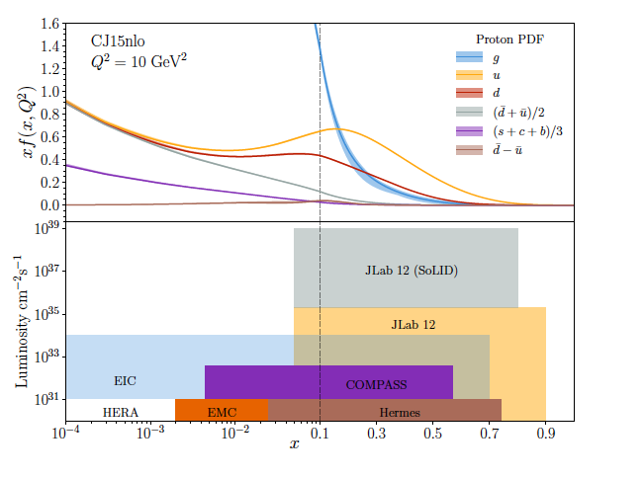
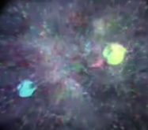
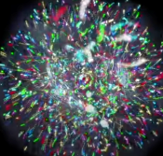
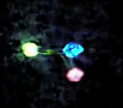
JLab 12 to 22 GeV:
Probing Nucleon Valence Structure at High Luminosity
Partonic structure in the valence region defines the hadron
Baryon number, charge, flavor content, total spin, …
Large x, low Q² PDFs evolve to low x, high Q² via pQCD, extract shape and strength from data
Precision measurements (2D,3D) in the valence regime requiring high luminosity are the purview of JLab, providing overlap with EIC
into the low x region
Probability Distribution
Probability Distribution
JLab 22
Luminosity (cm⁻²s⁻¹)
2030s-2040s
Fraction of nucleon momentum
Physics with CEBAF at 12 GeV and Future Opportunities
Prog. Part. Nucl. Phys. 127 (2022) 103985

Slide 22
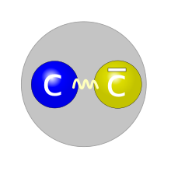
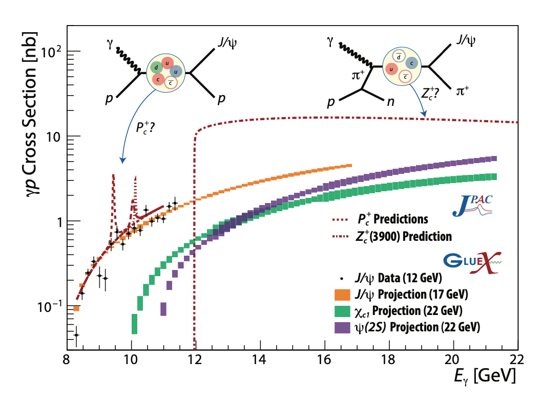
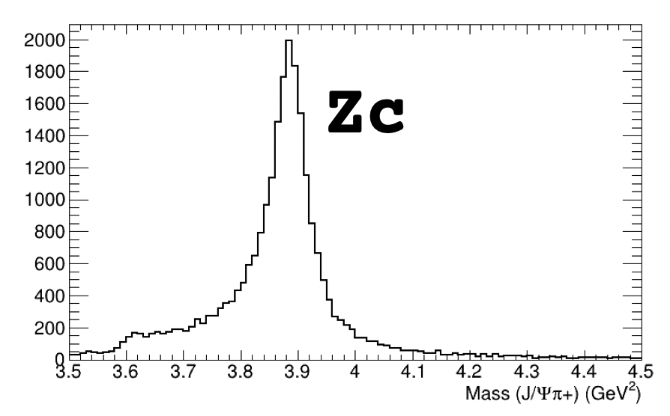
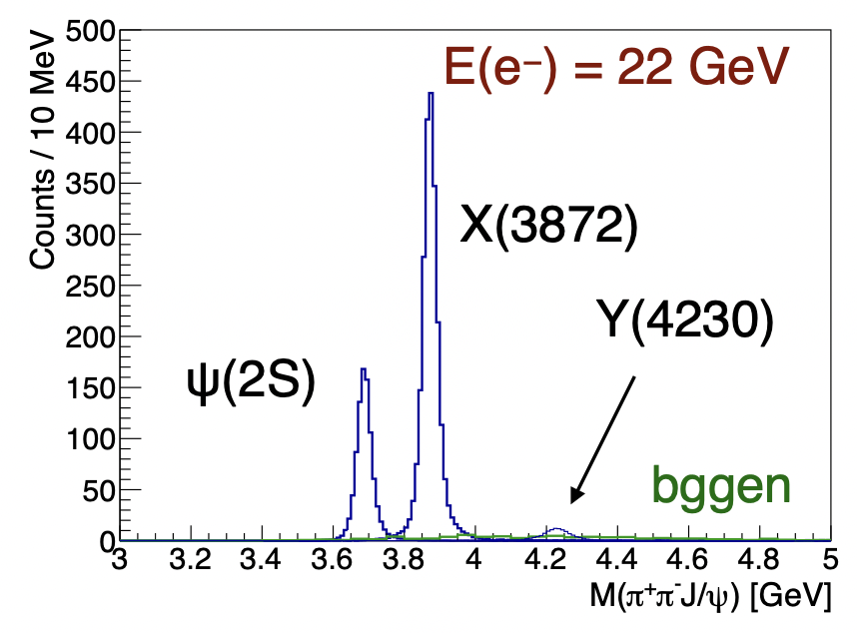
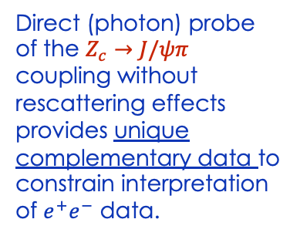

Spectroscopy of Exotic States with charm
Photoproduction of hadrons with charm quarks: a new tool for discovery in QCD
➜ a unique method to probe the gluonic structure of the proton
➜ potentially decisive information about the nature of some 5-quark and 4-quark candidates
Tetraquark candidates, XYZ states, observed in B decays, e⁺e⁻ colliders but their internal structure is not yet understood
Never direcly produced using γ/lepton beams ➞ Polarized photoproduction alternative mechanism to study such states
Direct (photon) probe of the $Z_{c}→J/ψπ$ coupling without rescattering effects provides unique complementary data to constrain interpretation of $e^{+}e^{−}$ data.
Initial simulations demonstrate the capabilities of the existing detectors to measure these reactions
$$γp→Jψπ^{+}n$$
Thresholds crossed and t range opens up at higher energy

Slide 23
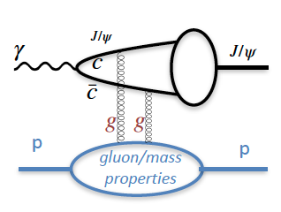
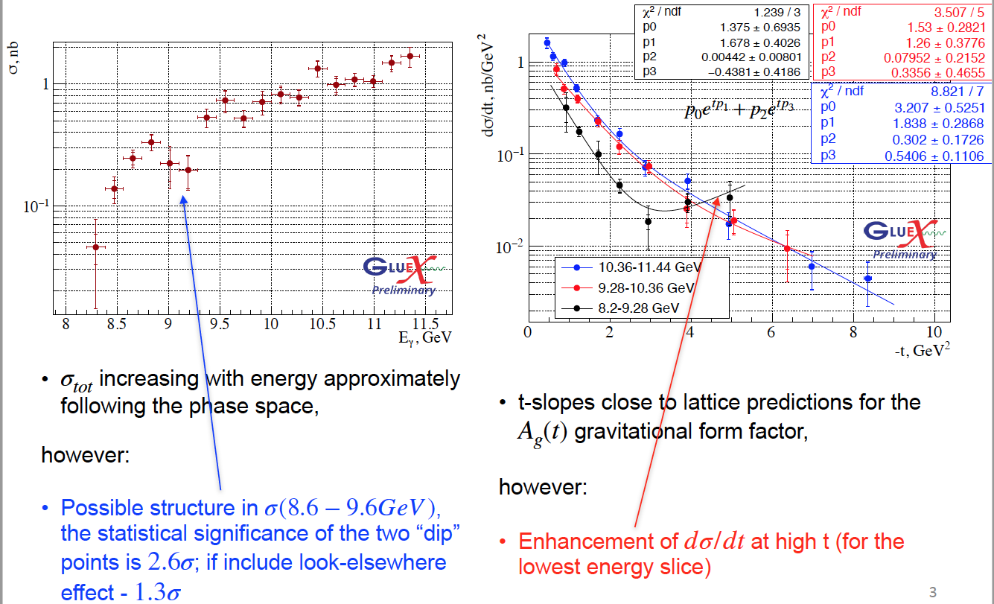
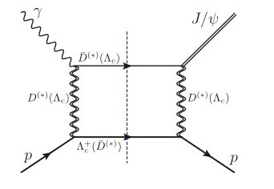
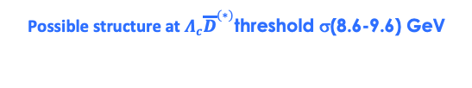
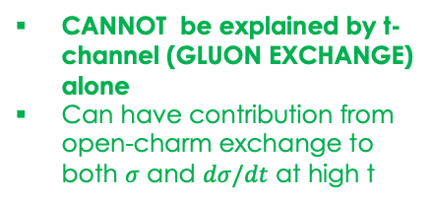
J/ψ photoproduction near threshold
Used to study important aspects of the gluon structure of the proton
gluon GPD, gravitational FF
mass radius of the proton,
anomalous contribution to the proton mass.
..based on some assumptions (mainly 2-g exchange)
Possible structure at $Λ_{c}{\overline{D}}^{(∗)}$threshold σ(8.6-9.6) GeV
CANNOT be explained by t-channel (GLUON EXCHANGE) alone
Can have contribution from open-charm exchange to both $σ$ and $dσ/dt$ at high t
Enhancement of dσ/dt at high t for the lowest energy slice
Can we interpret this as a possible evidence for a s-channel resonance (?) Pc
23
Phys. Rev. C 108 (2023) 2, 025201

Slide 24
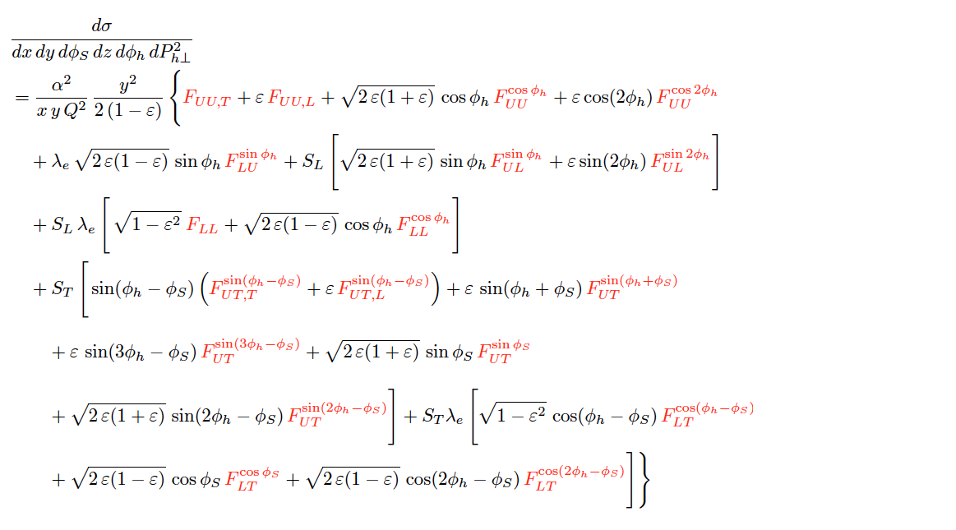
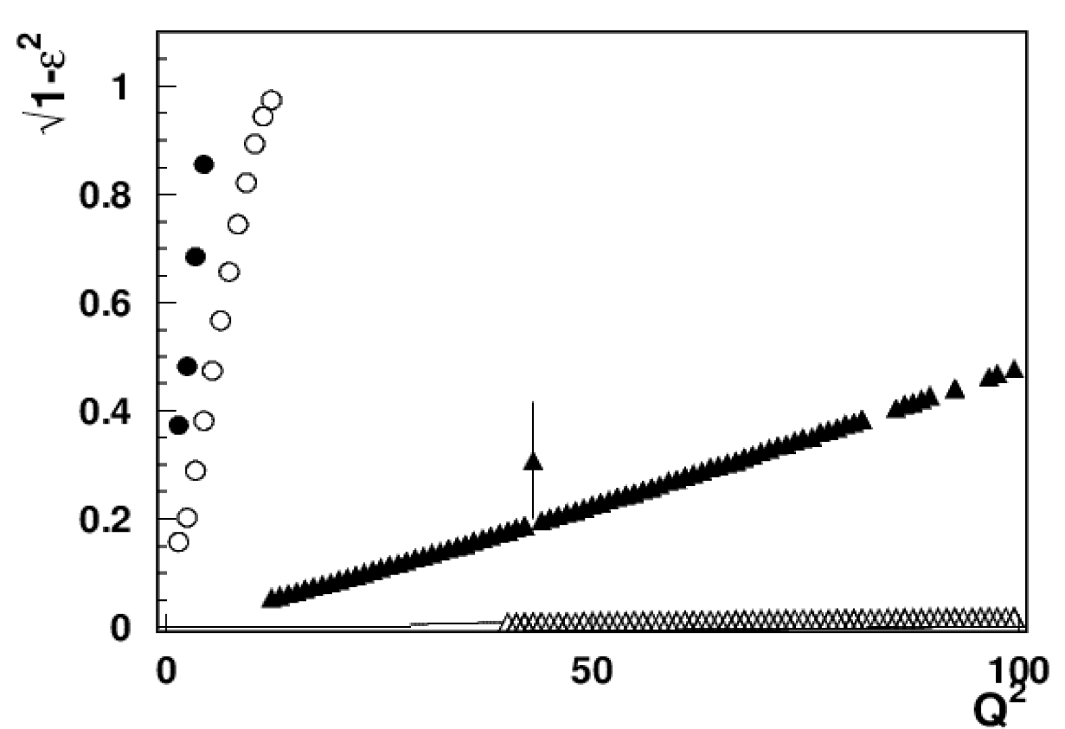
Nucleon Structure in 3D
SIDIS cross section
Separation of SFs highly non-trivial!
σ = f ( x , Q² , z , P_{T})
CLAS12
X=0.3
CLAS24
EIC 5x41
EIC 18x275
A combined 11, 22 GeV and EIC SIDIS program
will increase our ability to measure a variety of SIDIS SFs across an enhanced multidimensional phase space – the only way to test and validate our understanding and interpretation of SIDIS reactions.
24
24

Slide 25
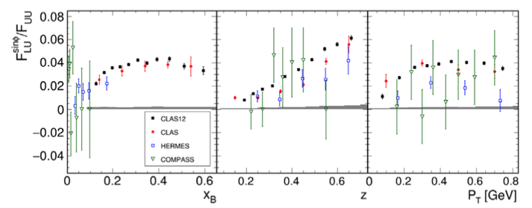
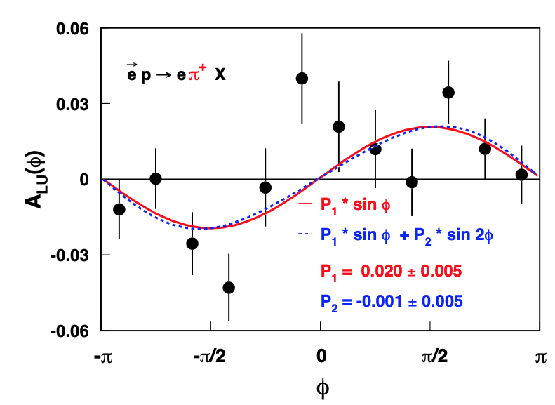


TMDs: High Statistics (i.e. Luminosity) Crucial!
ep→e’π+ X
HERMES - 1996-2000
JLab – CLAS12 1 day
Phys. Rev. Lett. 128, 062005 (2022). (2022)
F_{LU} contains information on quark- gluon correlations
Phys.Lett.B648:164-170,2007
QCD predicts only the Q² dependence
Studies of the Q² behavior requires high precision and multi-dimensional analysis

Slide 26

SIDIS Phase Space at 22 GeV
20
Expected uncertainties for SIDIS cross sections in 4D bins
P_{hT}
Significantly increase the kinematic range to validate/test the theory/phenomenology
Multi-dimensional coverage of P_{T} gives access to fine binning of all observables
Projections using the existing CLAS12 simulation/reconstruction chain for 100 days of running with L= 10³⁵ cm²s⁻¹
10⁻²
Q² (GeV²)
z_{h}
1
0
1
x

Slide 27


Spacial Structure & Mechanical Properties of the Proton
Form Factors: source of information on hadron structure
Gravitational FFs (GFFs) : describe how energy, spin, and various mechanical properties of hadrons are carried by q/g constituents.
GFF D(t): describes the pressure distribution in the nucleon. It is accessible through measurements of the Compton FFs measured in Deeply Virtual Compton Scattering
Simulation @ 22 GeV
data @ 6 GeV
A large -t range is required to perform the Fourier transform with controlled uncertainties ➜ high luminosity
➜
The 22 GeV beam energy is crucial to this program
22 GeV
27
27

Slide 28

Spacial Structure & Mechanical Properties of the Proton
Form Factors: source of information on hadron structure
Gravitational FFs (GFFs) : describe how energy, spin, and various mechanical properties of hadrons are carried by q/g constituents.
GFF D(t): describes the pressure distribution in the nucleon. It is accessible through measurements of the Compton FFs measured in Deeply Virtual Compton Scattering
Simulation @ 22 GeV
data @ 6 GeV
A large -t range is required to perform the Fourier transform with controlled uncertainties ➜ high luminosity
➜
The 22 GeV beam energy is crucial to this program
Double DVCS (DDVCS): e+p→e′ +(l+l−)+p, l=e or μ
NEVER been measured (very small cross section).➜ JLAB with high luminosity will be the only place to measure this reaction.
22 GeV
28
28

Slide 29


Unambiguous Access to Strange Quarks
Current Situation
Parity-violating DIS
di-muon production in neutrino-nucleus scattering – nuclear corrections introduce significant uncertainty
W and Z rapidity distributions
W+c production
Semi-inclusive K production: choice of fragmentation function negates inclusion in global fits
JLab12 Q² too low for PDF analysis
Parity-violating DIS allows strange contribution to be isolated from combined with p,n data
Valence regime provides strength and shape
Substantial improvement with a reduction in the uncertainty that can reach more than a factor two at large-x
LO
~100 days, 40 μA beam split between 40 cm D and H targets
Order of magnitude differences!
x
29

Slide 30


Partonic Structure of Mesons
Meson structure
Tagged deep inelastic scattering (TDIS) provides a mechanism to access the meson structure via the Sullivan process .
A cut of W² π > 1.04 GeV² (to avoid contributions from resonances in a pion analysis,) eliminates most of the data at 11 GeV.
At 22 GeV:
Available phase space significantly increased
➔ large improvement in the determination of the valence structure of the pion
➔ kin. coverage to smaller x_{π} region to probe the sea content of mesons
Overlap the existing π induced DY data
➔ test the universality of PDFs in the mid to large x_{π} region
➔ pion PDF predicted to be broader than the proton PDF
30
30

Slide 31



Anti-shadowing: solving a multi-decade puzzle
Small!
With a 22 GeV e- beam JLab can access the anti-shadowing region (x~0.1-0.3) at moderate Q²
Region extremely interesting, near-equally dominated by valence quarks, sea-quarks, and gluons → many many models!!
Anti-Shadowing is the least studied nuclear structure function effect experimentally – small effect requiring precision and high luminosity
  flavor dependence essentially uncharted
  spin dependence essentially uncharted (~50% differences in predictions)
  no tagged measurements
  no L/T separations
Theory predictions for polarized structure function A/D ratios
A rigorous testing ground between shadowing, EMC regimes – models and theory must describe ALL
31

Slide 32




QCD Confinement and Fundamental Symmetries
π⁰ Primakoff production off an electron target
Γ(π⁰ → γγ) can be predicted at ≈ 1% precision
Higher energy will allow for η’
The threshold for photo- or electroproduction of π⁰ off an electron target is 18 GeV
Stringent test of low-energy QCD
Primakoff production off nuclear target
A 22 GeV upgrade will greatly enhance the Primakoff experiments for more massive mesons off nuclear target
first Primakoff measurement of Γ(η′ → γγ) with ∼3.5% precision to study the U(1)A anomaly coupling to the gluon field,
improve the measurement of Γ(η → γγ) to a 2% accuracy to determine the light-quark mass ratio
32
32

Slide 33





MOLLER Scattering at Jefferson Lab – installation in a year!
δ(sin²θW) = ± 0.00023 (stat.) ± 0.00012 (syst.)
~ 0.1%
Unique (purely leptonic) new physics reach
Special opportunity with JLab high luminosity
Search for new flavor diagonal neutral currents
Look for tiny but measurable deviations from precisely calculable predictions for SM processes
Only e-e measurement: SLAC E158
A_{new}
MOLLER Reach
Unique discovery space: beyond that of a 500 GeV lepton collider
Precursor to HiLumi LHC sin²θ_{W} – complementary precision electroweak physics
Impacts the current discrepancy on the W mass (Fermilab vs LHC)
JLab Measurements
MOLLER: improve QW(e) by a factor of 5

Slide 34
Upgrade Outlook
Understanding structure and dynamics in non-pQCD and the strong interaction is a complex problem requiring multiple observables using different approaches and measurements
The unique CEBAF capability to run experiments in the valence regime at the luminosity frontier provides a powerful tool
Proposals are being accepted by the Program Advisory Committee for positron science (6 approved and more to come!)
A very strong science case for an energy upgrade is emerging – come join the fun!
Polarized gluon distribution, standard model tests, longitudinal/transverse separations, hadron formation in nuclei, meson form factors, probing the light quark sea,……. and more!
34
34

Slide 35


BDX and Secondary Beam Capability Behind Hall A
The Beam Dump Experiment (BDX) at Jefferson Laboratory (JLab) is an electron-beam thick- target experiment to search for Light Dark Matter (LDM) particles in the MeV-GeV mass range
Muons and neutrinos that penetrate the shielding form high-intensity secondary beams.
(M. Battaglieri et al., Secondary Beams at High-Intensity Electron Accelerator Facilities, Instruments 8, 1 (2024), https://doi.org/10.3390/instruments8010001.)
Is this a new JLab (HEP) Physics program? Look for ‘BDX and Beyond’ workshop being planned at JLab for this Summer!

Slide 36
Thank you!
Thank you for listening, and thanks also to the scientific community working on developing this exciting science!
36

Slide 37
More info!
37

Slide 38

Notional CEBAF & upgrade schedule (FY24 – FY42)
Accelerator and engineering team have worked up an early schedule and cost estimate – in revision
  Schedule assumptions based on a notional timing of when funds might be available (near EIC ramp down based on EIC V3 profile)
  For completeness, Moller and SoLID (part of 12 GeV program) are shown; positron source development also shown

Slide 39


Polarized Structure Functions and α_{s}
Extend the precision and kinematic reach of polarized structure functions
Bjorken Sum Rule
A₁^{n}
The strong coupling constant is a key parameter of the Standard Model
Its current uncertainty is the least precise among all fundamental couplings
α_{s}
Q
1
Q²

Slide 40


Nuclear Dynamics at Extreme Conditions
The dynamics of the nuclear repulsive core is still poorly understood
A 22 GeV upgrade will provide reach to the nuclear forces dominated by nuclear repulsion
Superfast Quarks
The high Q² reach will allow
  the suppression of quasi-elastic contributions,
  the first-ever study of nuclear DIS structure function at Bjorken x > 1.2 (r∼ 0.5 fm,)
Exploring Deuteron at Very Large Internal Momenta (> 800 MeV/c – non-nucleonic & hidden color components)
non-relativistic theory reproduces data up to pm ∼ 0.7 GeV/c
no model reproduces data (non-nucleonic degrees of freedom?, quarks?) pm > 0.7 GeV/c
40
40

Slide 41


Bound 3 Quark Structure of N∗s and Emergence of Mass
Continuum Schwinger Method
  QCD equations of motion for q/g fields reveal existence of dressed q/g with momentum-dependent masses.
Dressed gluons
Dressed quarks
p _{quark} (GeV)
Q² evolution of the γvpN* electrocouplings could offer an insight into hadron mass generation and the emergence of the N* structure from QCD
15-20%
40-50%
>80%
6 GeV
12 GeV
22 GeV
Simulations indicate JLab22 is the only foreseeable facility to extend these measurements up to 30 GeV²
Q² range(<35 GeV²) where the dominant portion of hadron mass is expected to be generated
41
41

