Slide 1

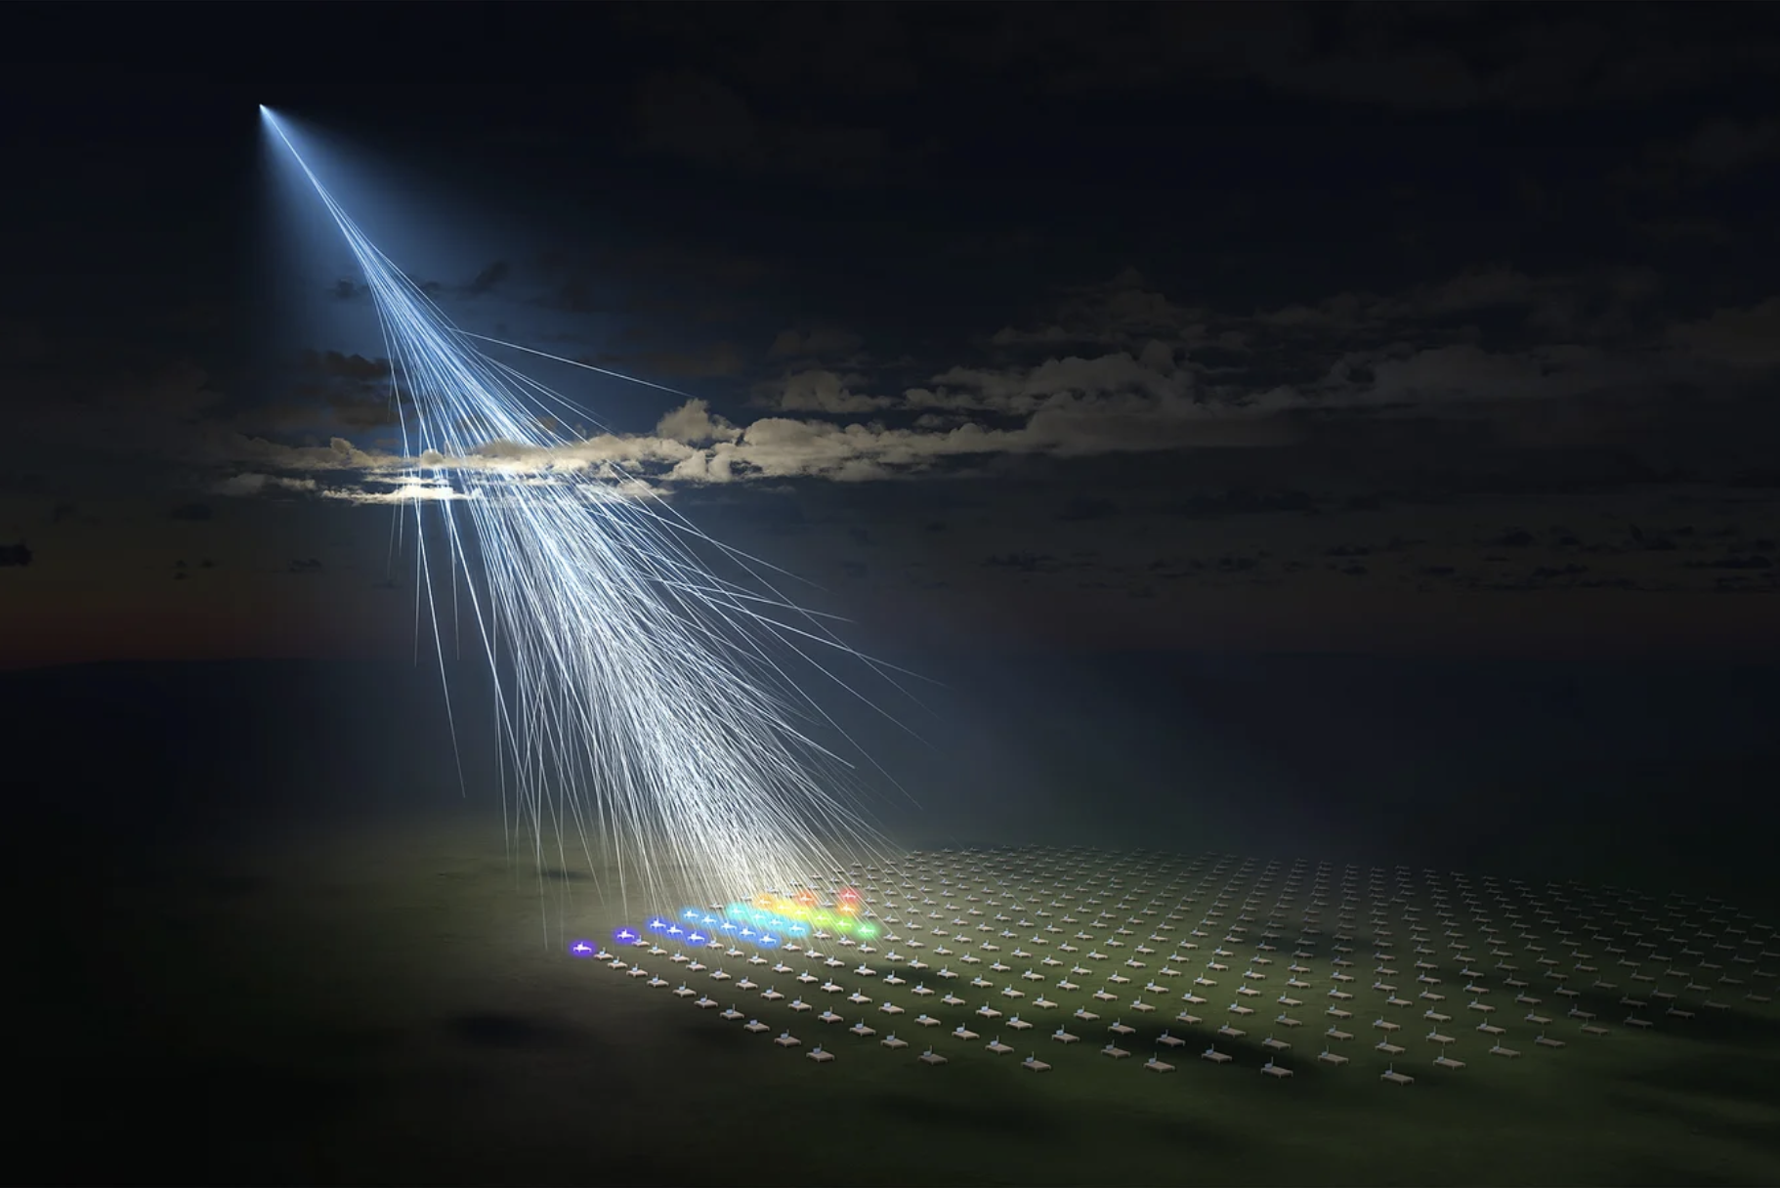



Osaka Metropolitan University/L-INSIGHT, Kyoto University/Ryuunosuke Takeshige.
CONDOR
Observatory Project
Thursday 9th, January 2025
9th International Conference on High Energy Particle and Nuclear Physics in the LHC Era. Valparaíso, Chile
Authors: Raquel Pezoa, Sebastián Tapia, Nicolás Viaux, Gonzalo Muñoz, Constanza Valdivieso, Luis Navarro.
Notes:
Hay que agregar logo

Slide 2
01
02
03
CONDOR Observatory
CORSIKA
Technology, materials, detection, etc.
Extensive air showers simulations and particles spatio-temporal distributions.
04
Machine Learning
Current advances
Angular reconstruction and particles classification.
On-site testing, data acquisition boards, simulations, predictions.
1

Slide 3
CONDOR
01
CONDOR: The world's highest-altitude observatory for cosmic and gamma rays.
2

Slide 4
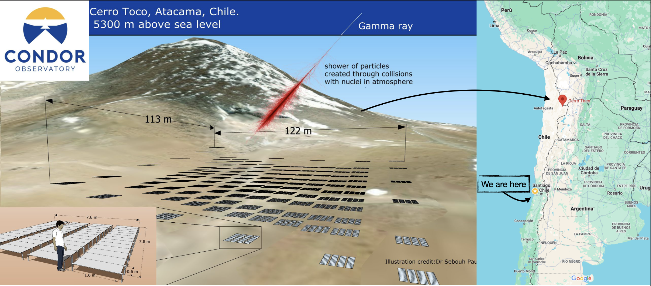
CONDOR (COmpact Network of Detectors with Orbital Range)
3

Slide 5
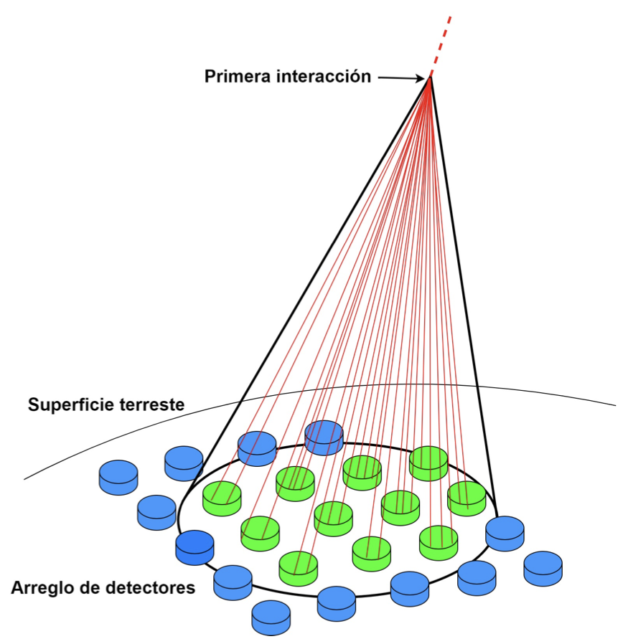
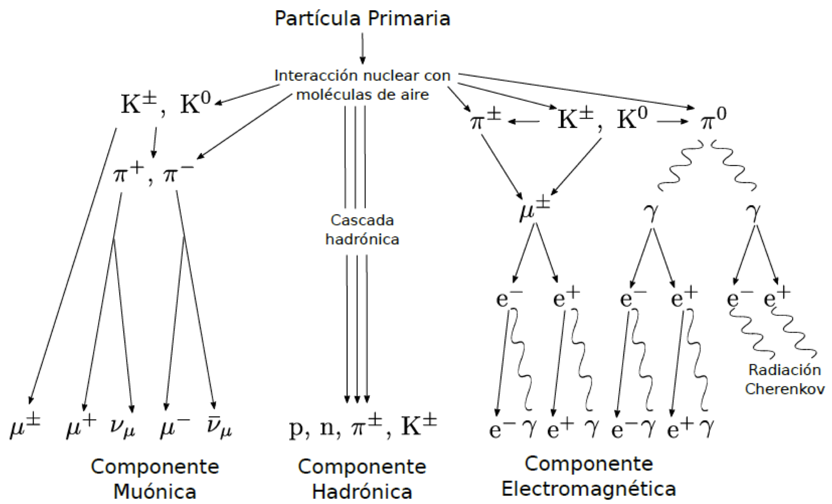
Cosmic and Gamma Rays
This rays interact with the atmosphere producing particles showers.
Atmosphere
Primary Particle
First interaction
Nuclear interaction with the atmosphere
Hadronic Cascade
Earth’s surface
Muonic
Component
Hadronic
Component
Electromagnetic
Component
Detectors array
4

Slide 6
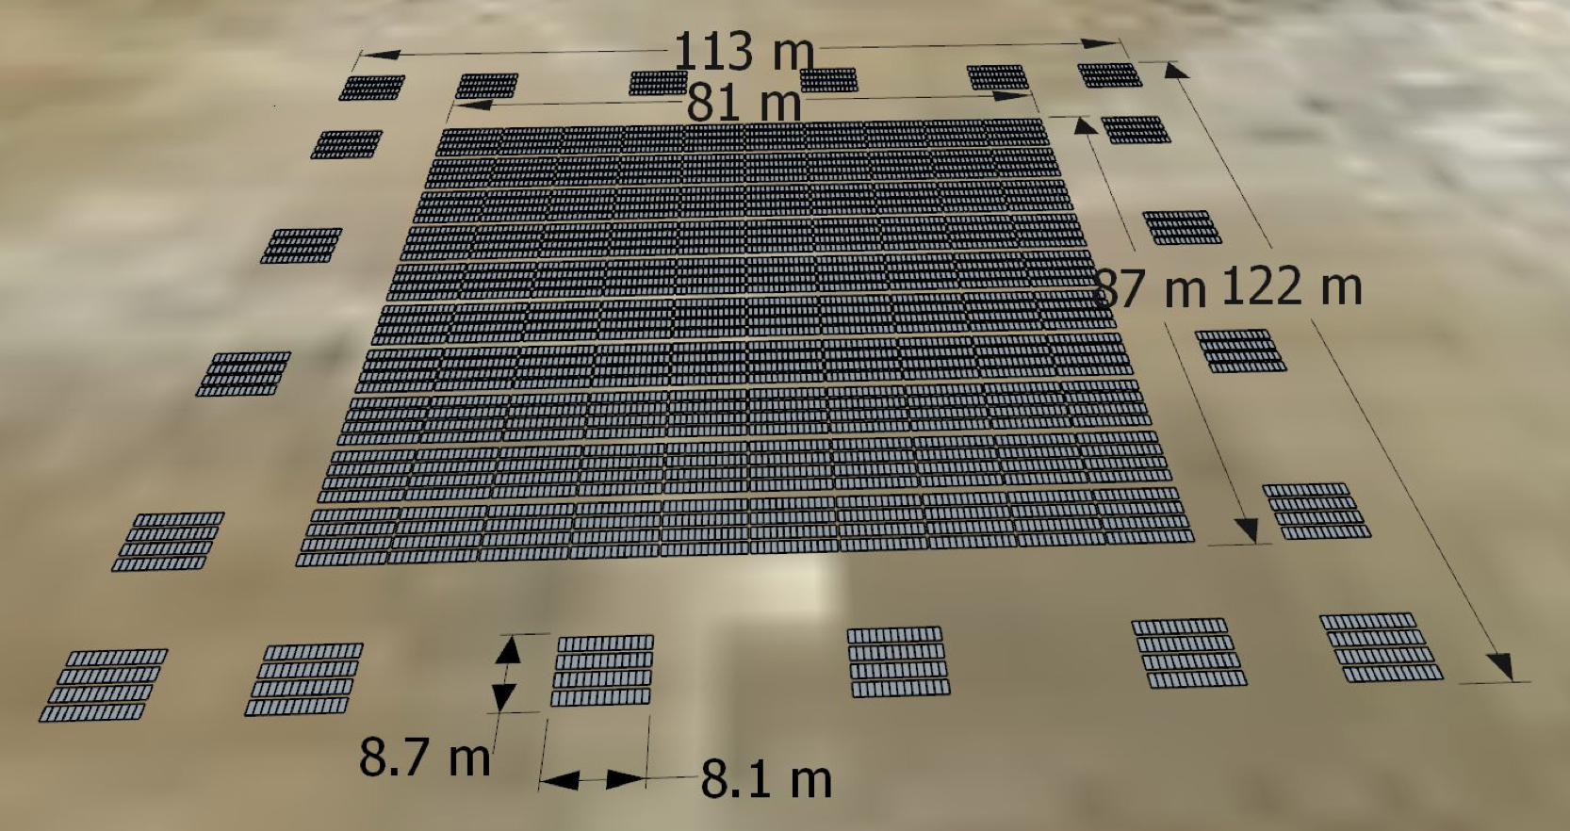
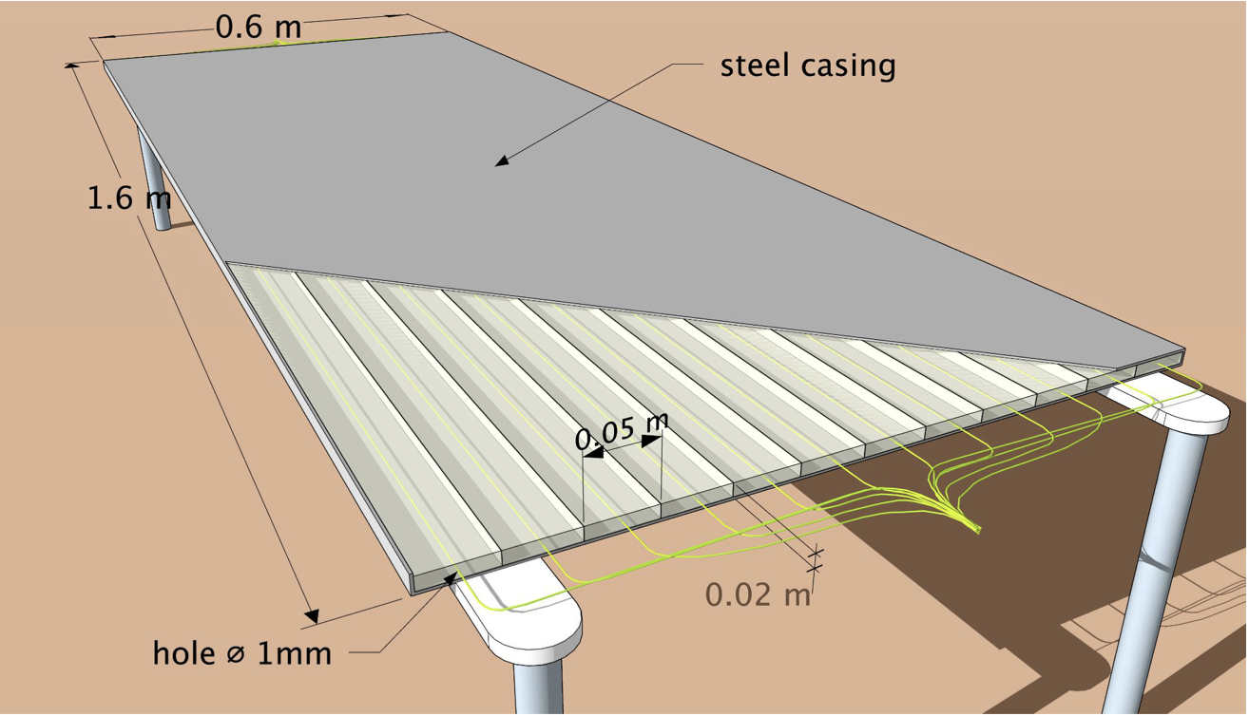
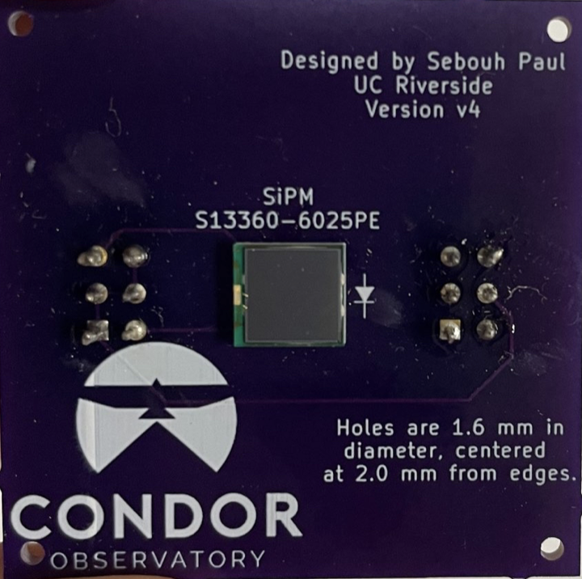
How do we detect Cosmic Rays?
Detectors Array
Detector module
Plastic Scintillator + Wave-length shifting fiber + Light sensors (SiPM)
5
CONDOR will consist of a total of 5200 detectors in the central array and 1040 in the peripheral array.

Slide 7
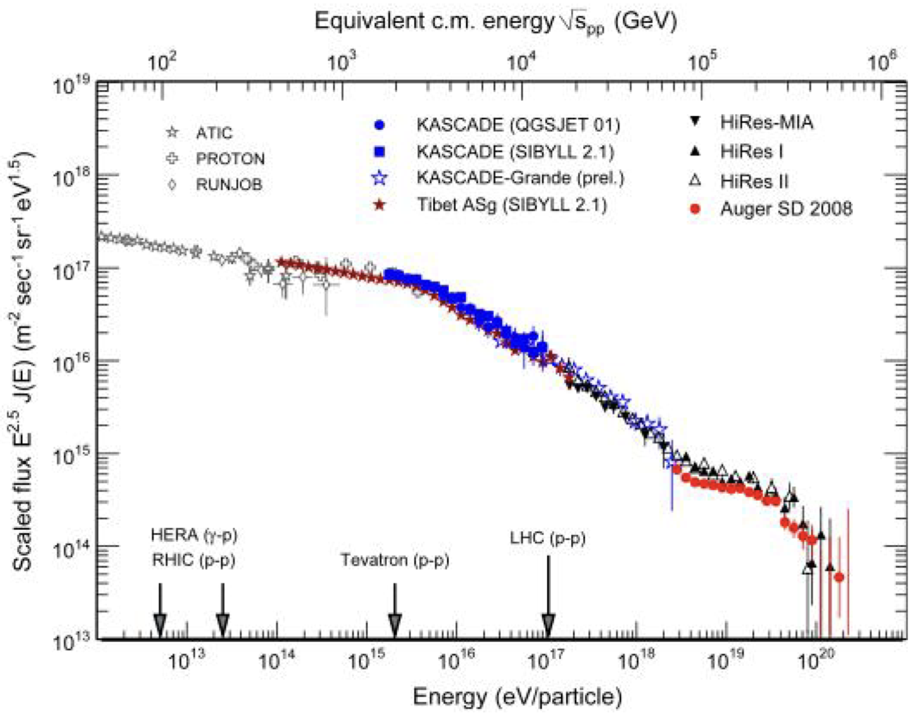

CONDOR Objectives
CONDOR will be a bridge between ground-based measurements and those made with satellites and balloons, opening a new window to study the universe and our sun.
The scientific program of CONDOR includes:
Gamma rays in the GeV-TeV scale, covering transient phenomena such as gamma-ray bursts.
Solar astronomy with multiple probes.
Beyond the Standard Model.
CONDORRange
6

Slide 8
CONDOR
02
CORSIKA: A software for particles showers simulations
7

Slide 9
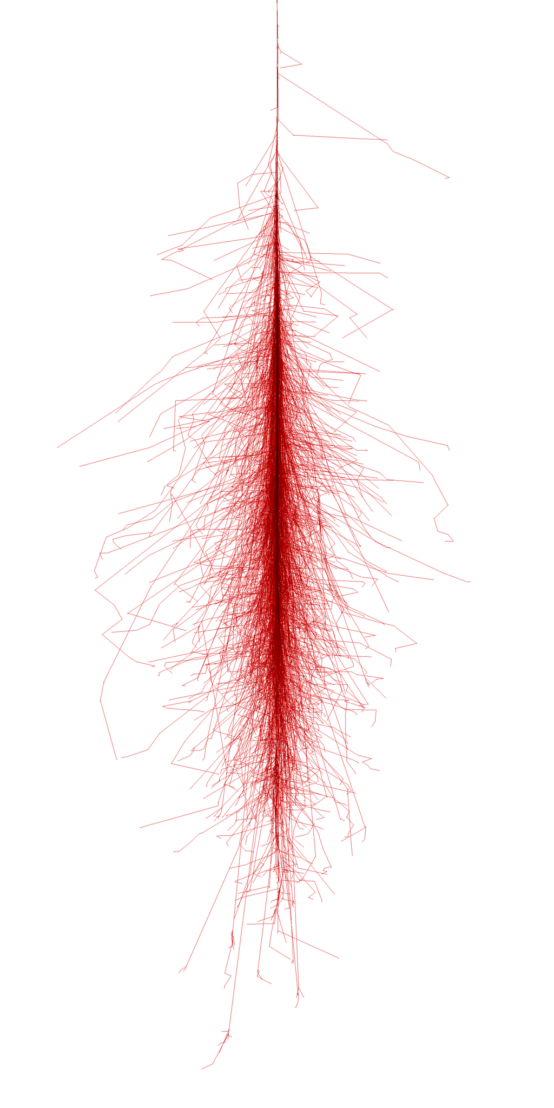
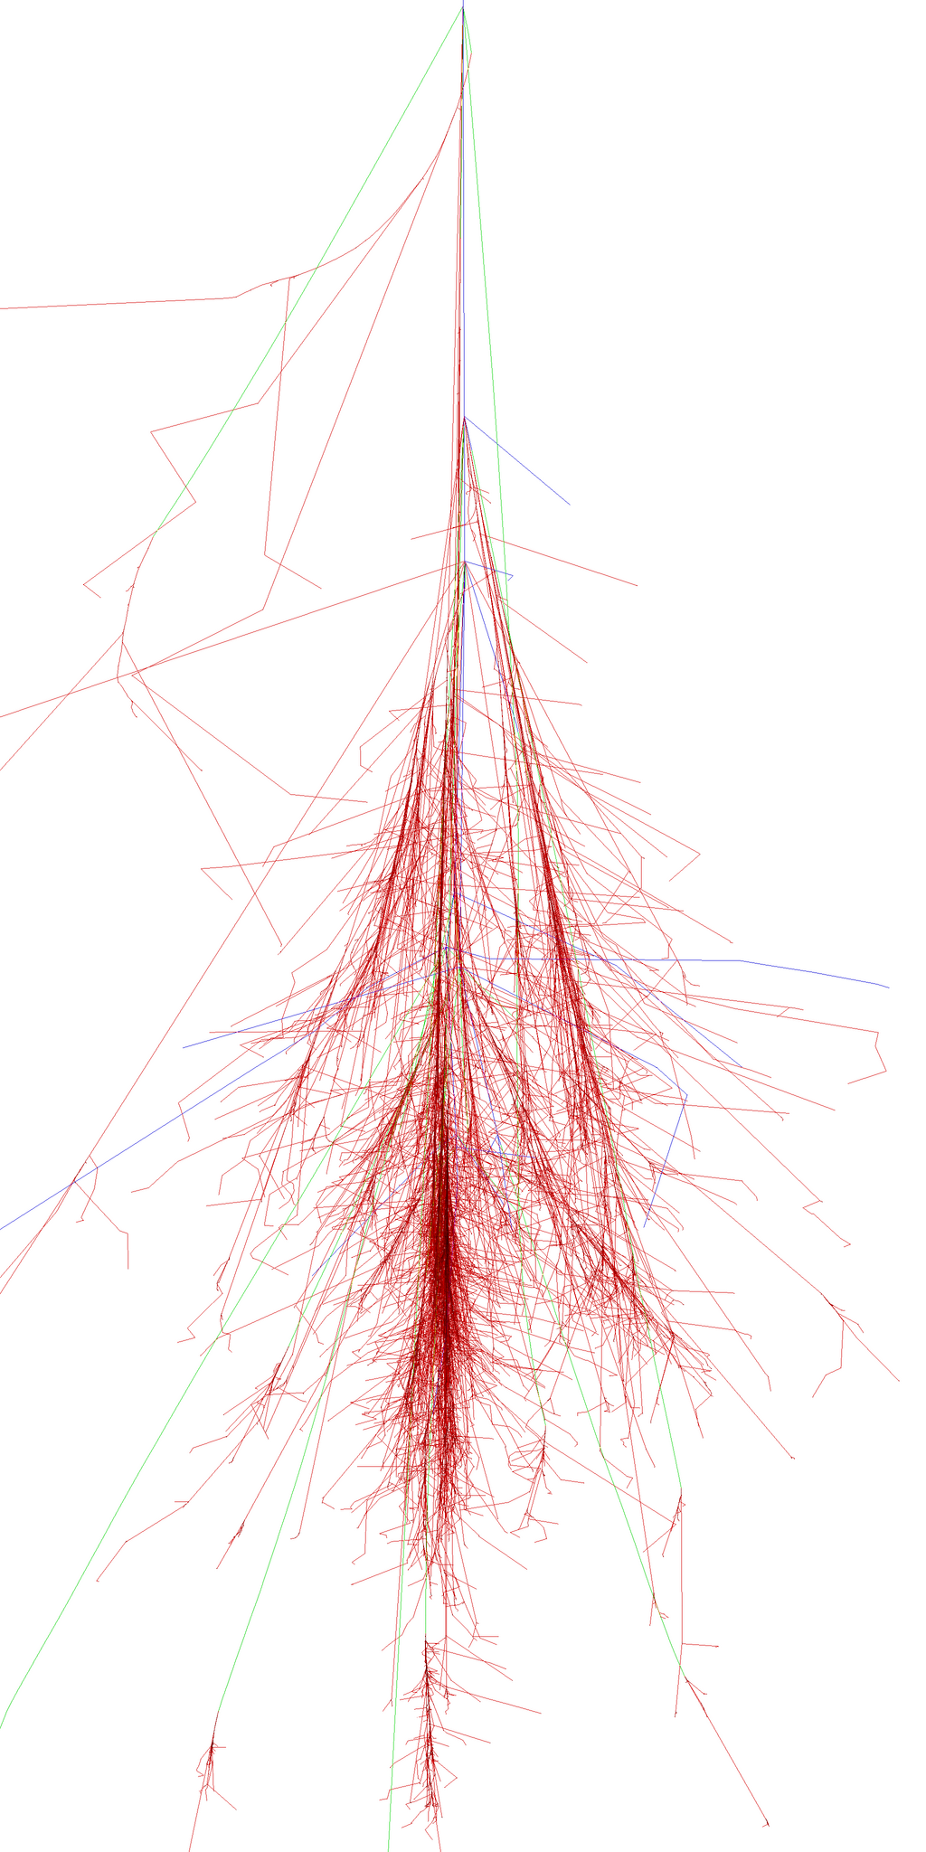
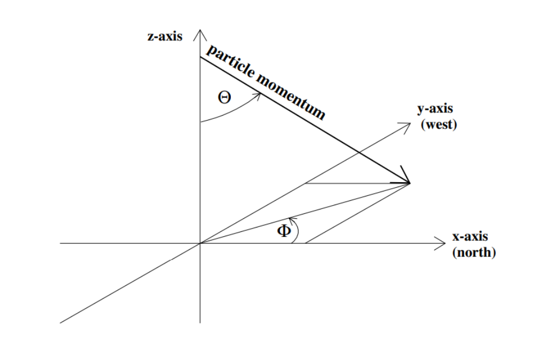
Extensive Air Showers (EAS) simulations
Detailed EAS simulations, with information on energy, spatial and temporal distribution of particles, etc.
https://www.iap.kit.edu/corsika.
CORSIKA Reference System
Gamma Ray
(50 GeV Photon)
Cosmic Ray
(100 GeV Proton)
8

Slide 10
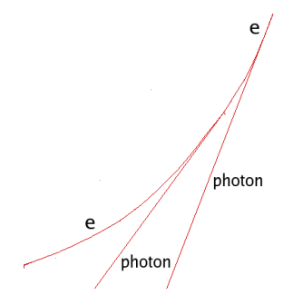
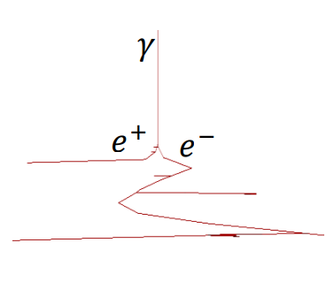
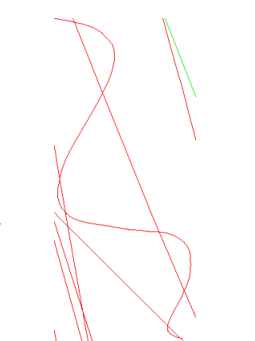
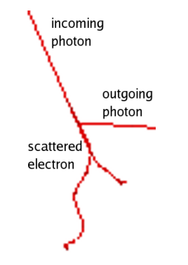
Some CORSIKA Particles Interactions
Bremmstrahlung
Pair Production
Magnetic Deflection
Compton Scattering
9

Slide 11
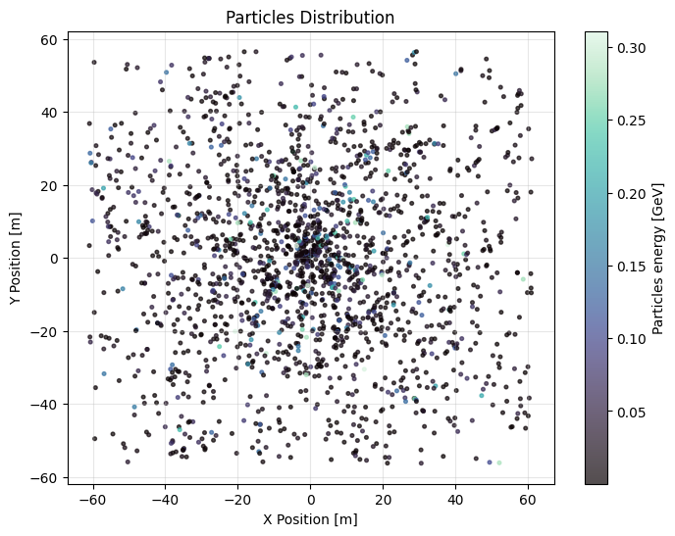
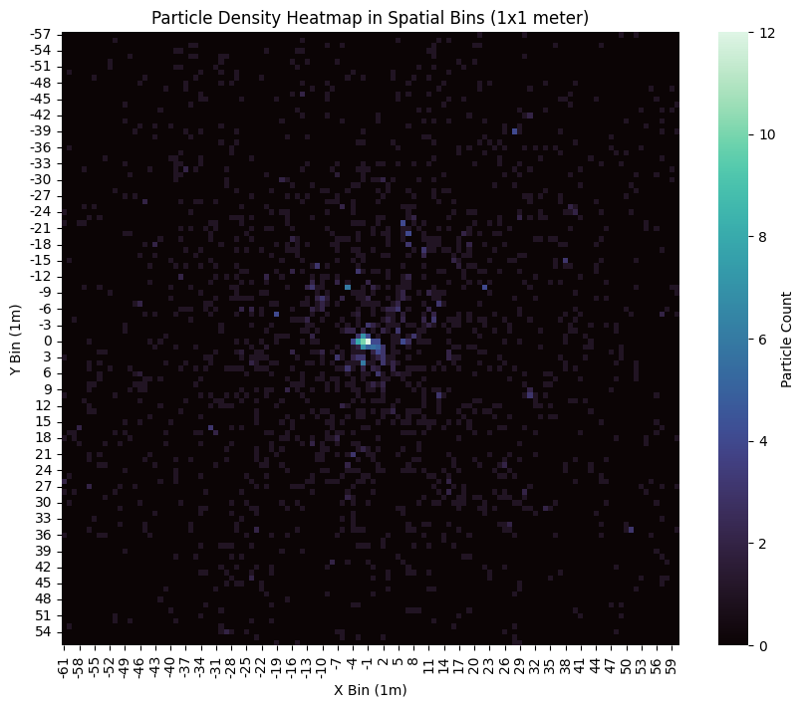
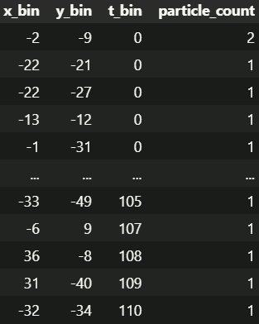
EAS Data
0° Zenith Angle 1E3 GeV Primary Photon
Particle spatial density
Particle “hits” per squared meter, time integrated
Particles Spatial Distributions
Limited at CONDOR’s detector array
(113 x 122 squared meters area)
10

Slide 12
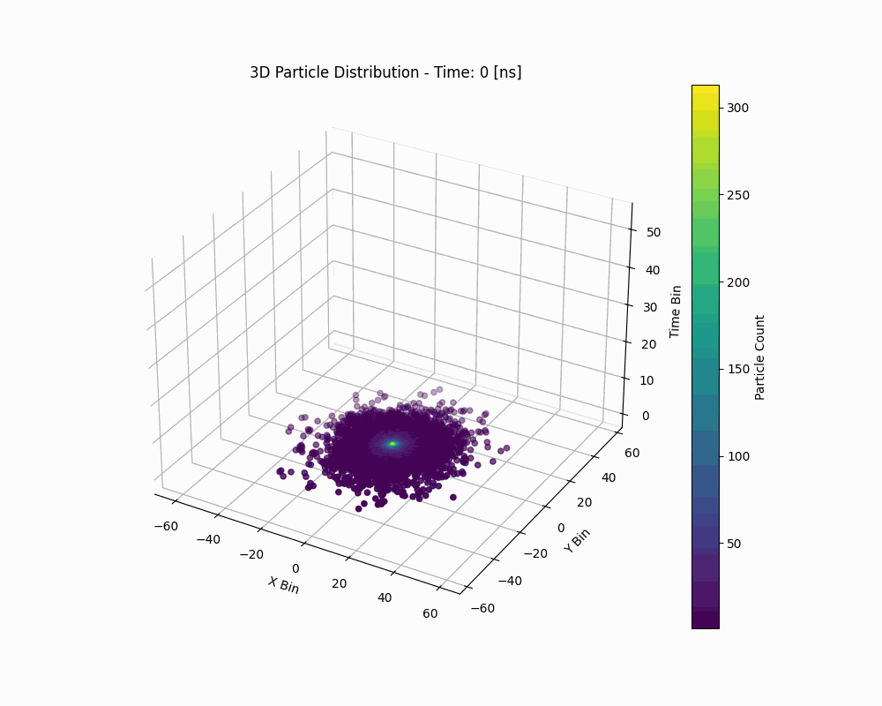
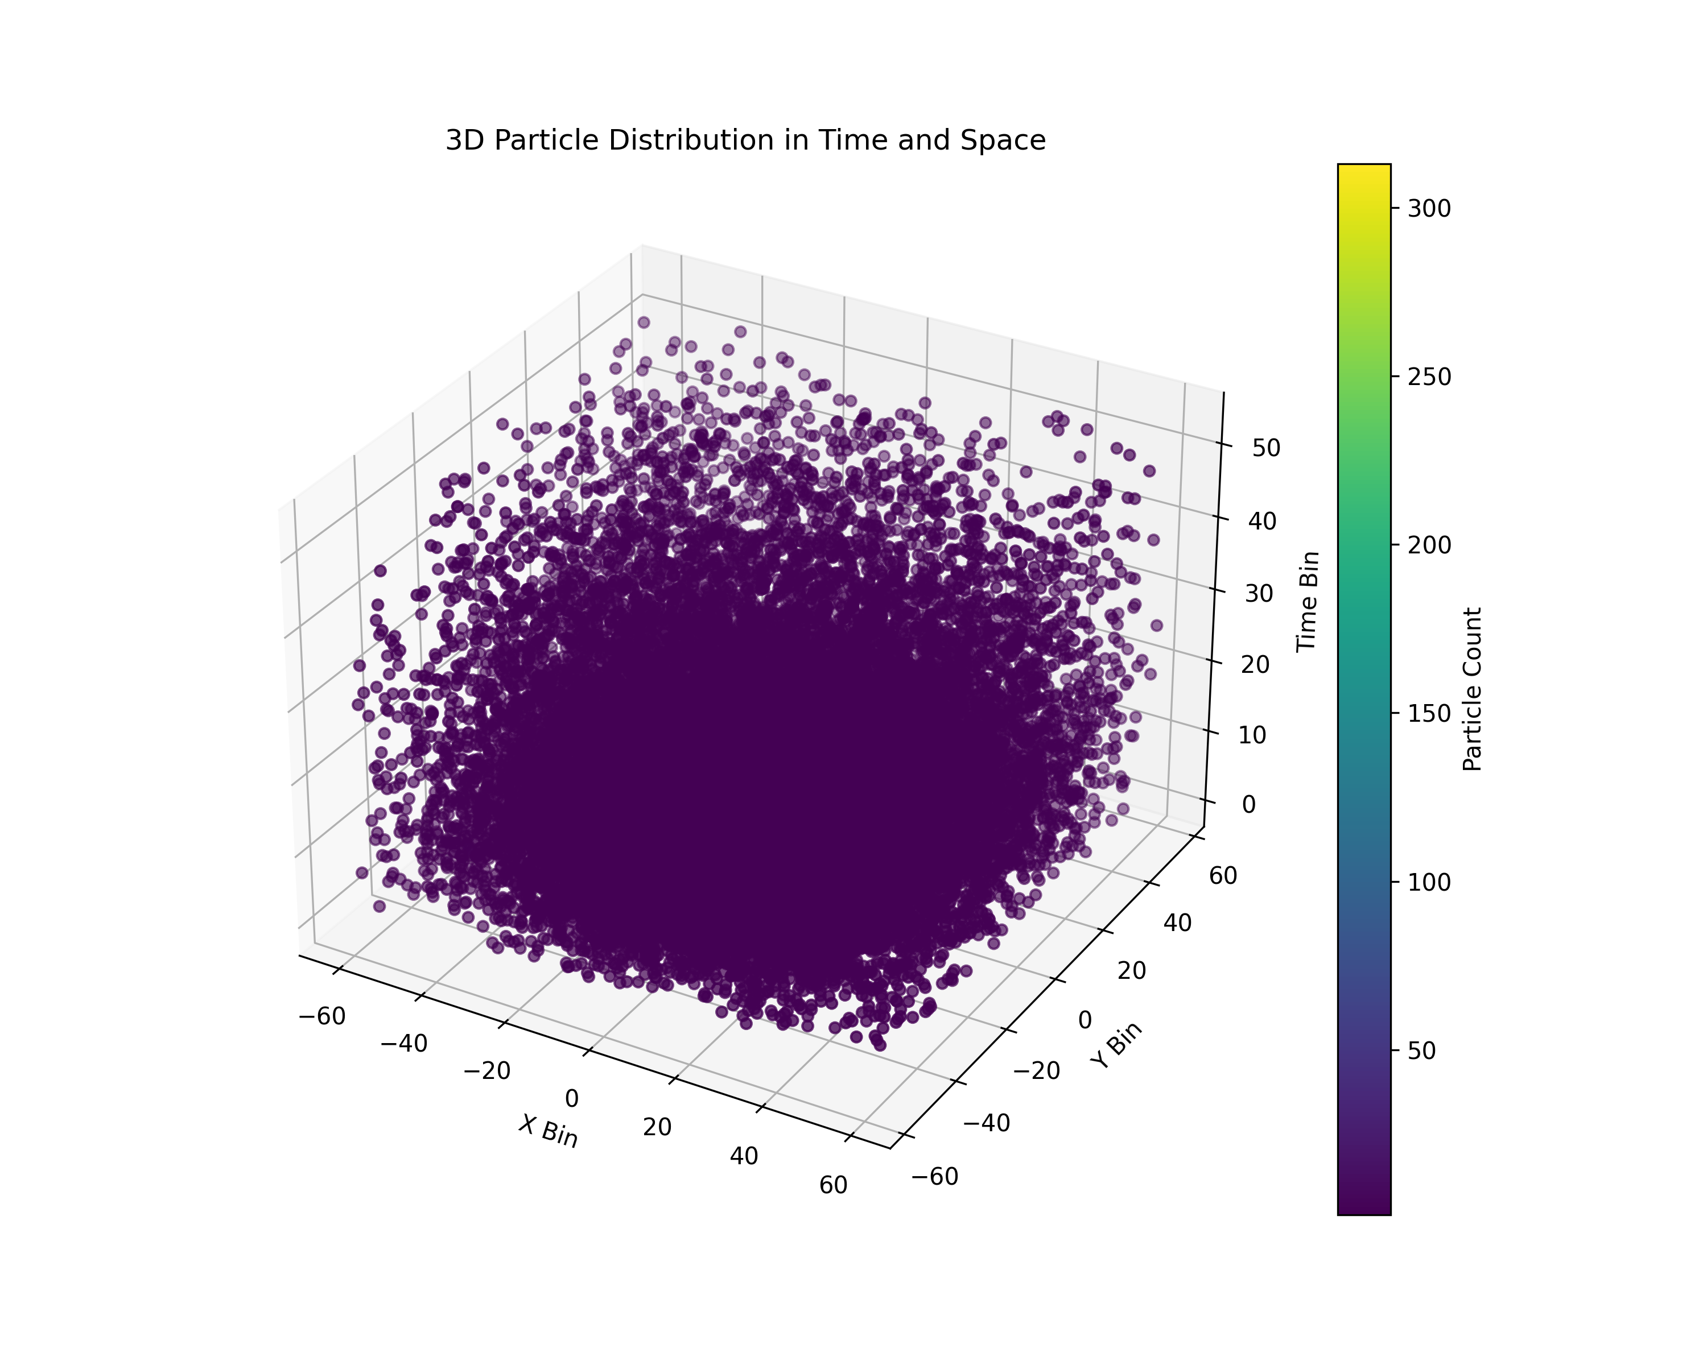
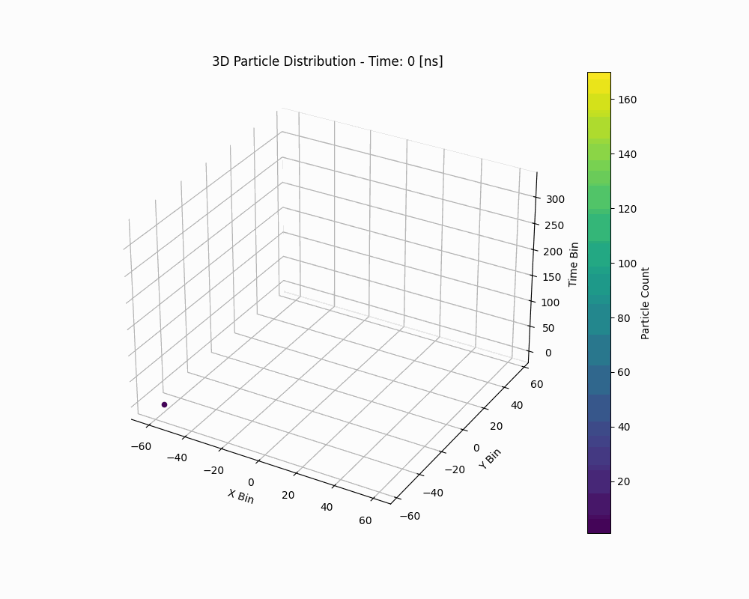
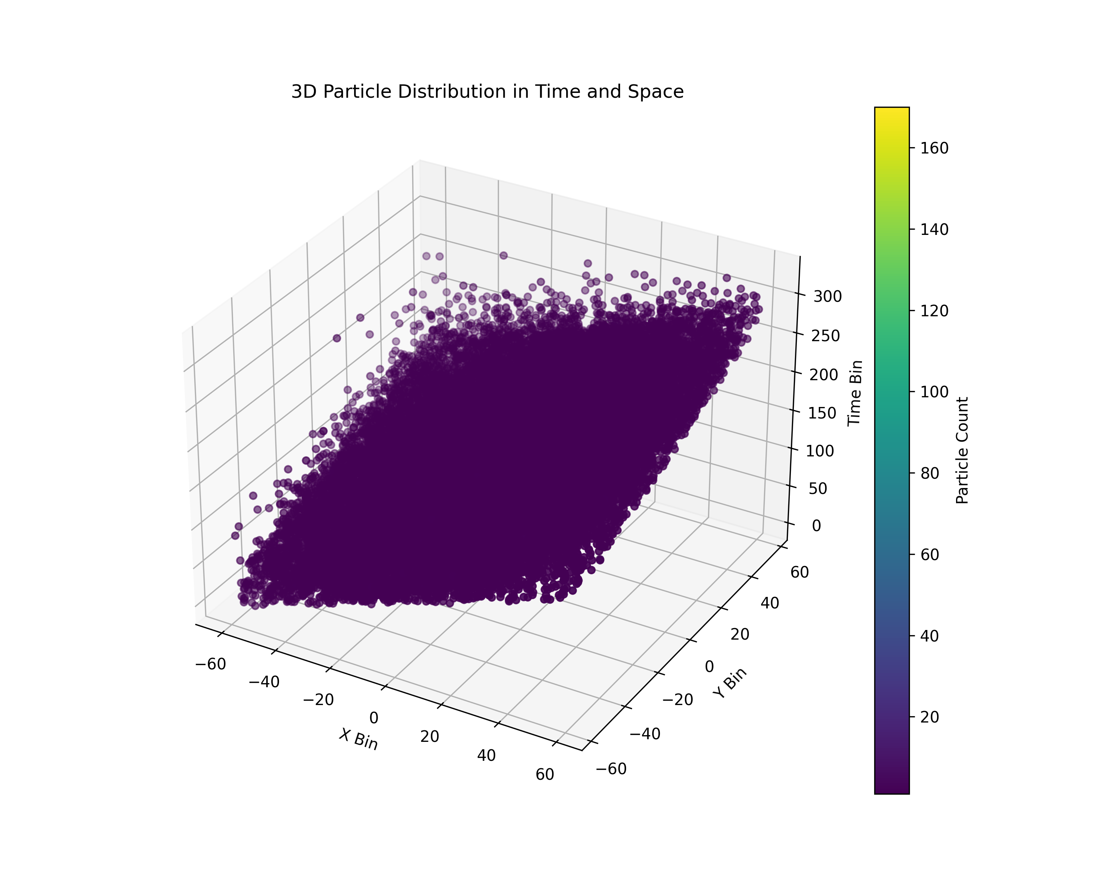
${10}^{5}$ [GeV] Proton CR Spatio-Temporal Distributions
0°
30°
11

Slide 13
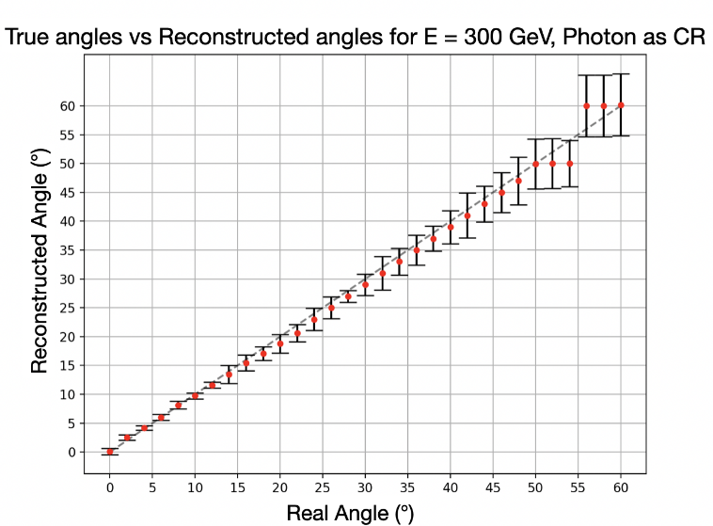
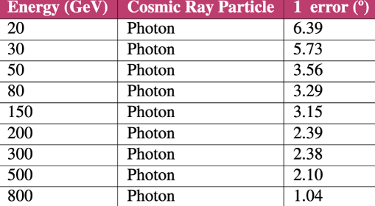
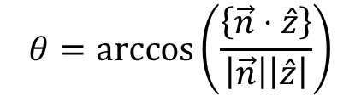
Angular Reconstruction – Angle Fit
$$θ=\arccos\left(\frac{\left\{\vec{n}⋅\hat{z}\right\}}{\left|\vec{n}\right|\left|\hat{z}\right|}\right)$$
12
See “Angle reconstruction for Cosmic Rays at CONDOR Observatory.” by Constanza Valdivieso.

Slide 14
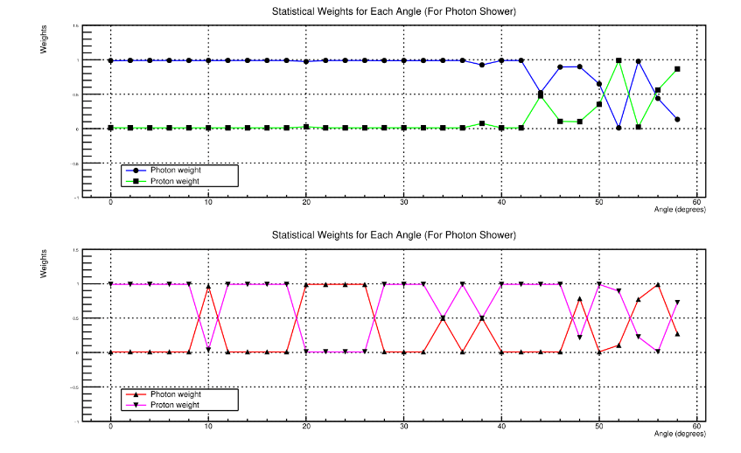
Particle Classification
High-statistics MonteCarlo algorithm tagger for classifying unknown showers at an energy of 300 GeV.
Gamma Ray
Photon
Cosmic Ray
Proton
13
See “Tagger System: Particle Identification for Cosmic Rays at the CONDOR Observatory.” by Gonzalo Muñoz.

Slide 15
03
Machine Learning
Angular Reconstruction.
14

Slide 16
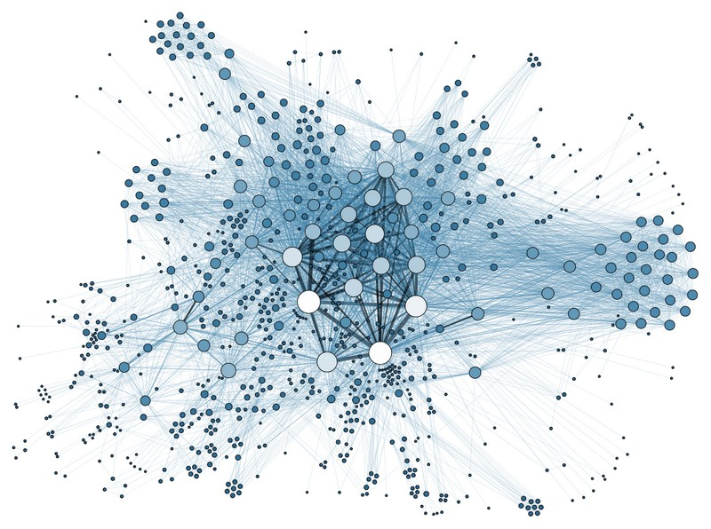
Large amount of Particle Data
Complex data due to volume, complex characteristics
Complex algorithms are needed
Machine Learning
15

Slide 17
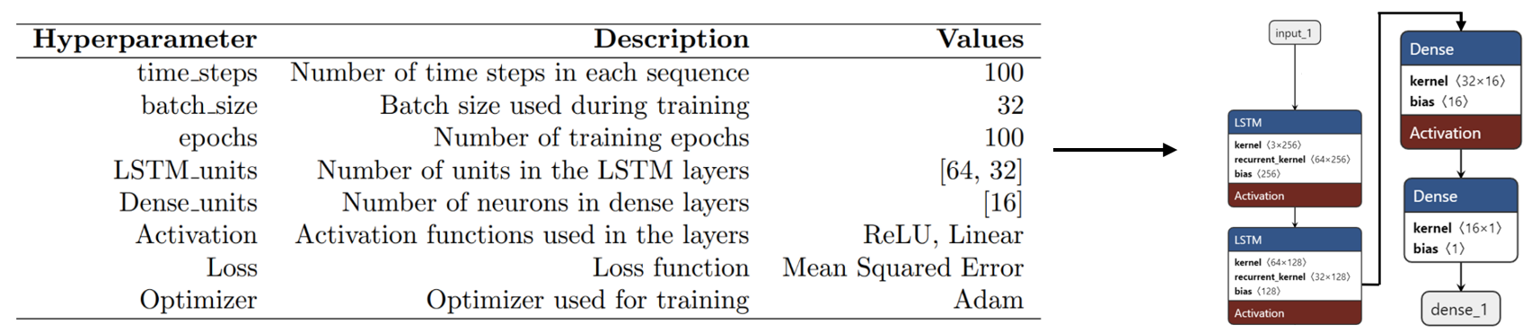
Long Short-Term Memory (LSTM) Model
Type of recurrent neural network (RNN) specifically designed to handle sequential data and learn temporal or spatial patterns within those sequences.
Each sequence represents the behavior of particle showers over a specific time window.
16
See “Cosmic Ray Simulations for CONDOR Observatory and Angular Reconstruction via Machine Learning.” by Luis Navarro.

Slide 18
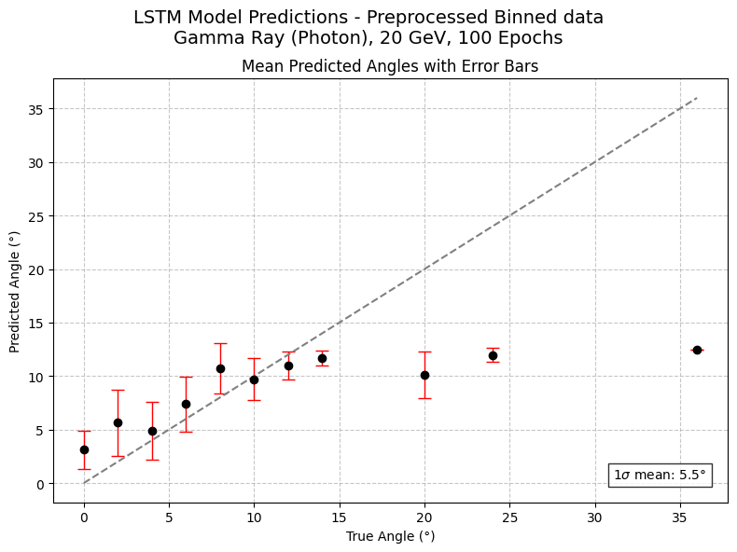
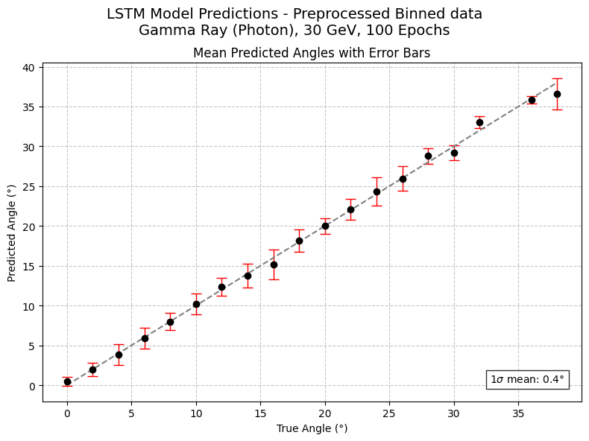
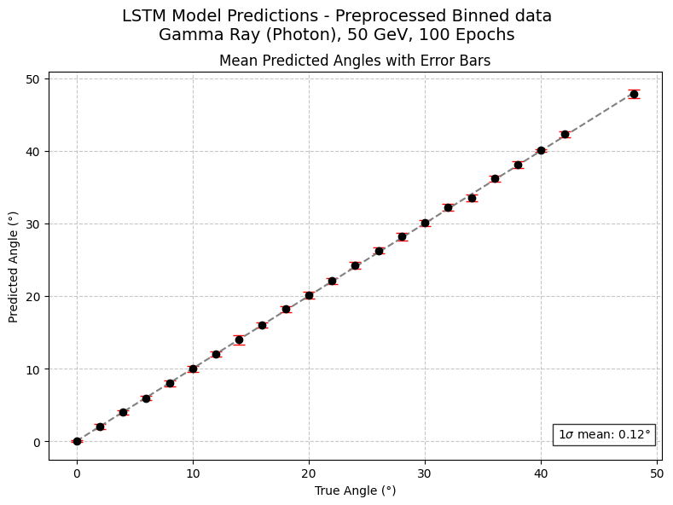
Angular Reconstruction – ML
(Photon – Gamma Ray)
20 [GeV]
30 [GeV]
50 [GeV]
17
See “Cosmic Ray Simulations for CONDOR Observatory and Angular Reconstruction via Machine Learning.” by Luis Navarro.

Slide 19
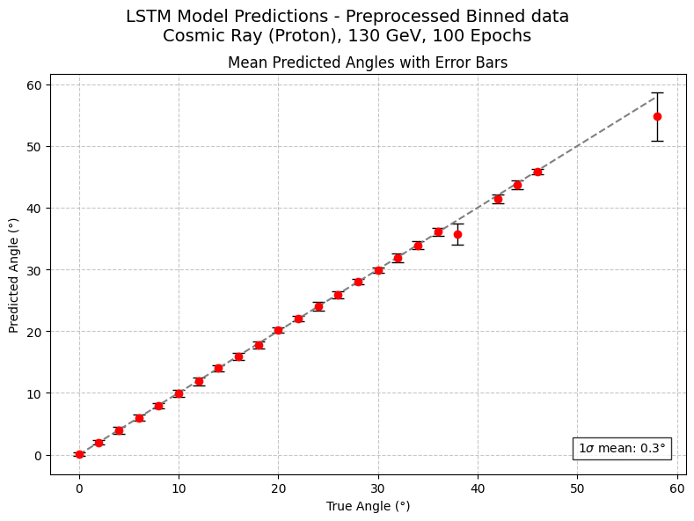
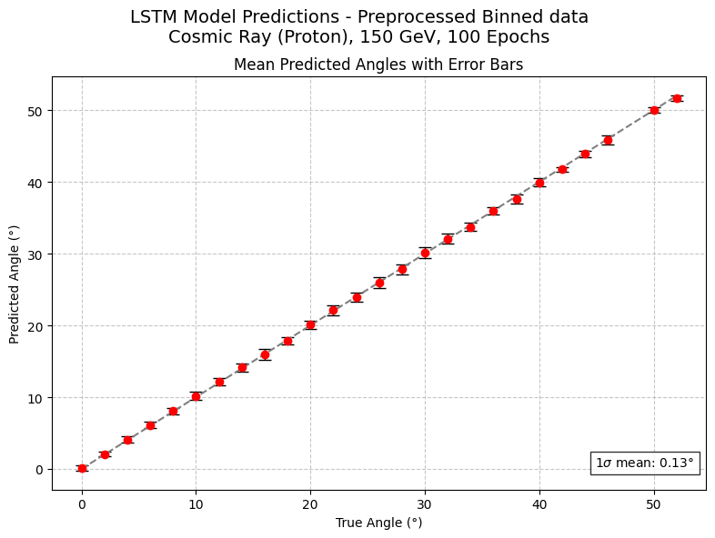
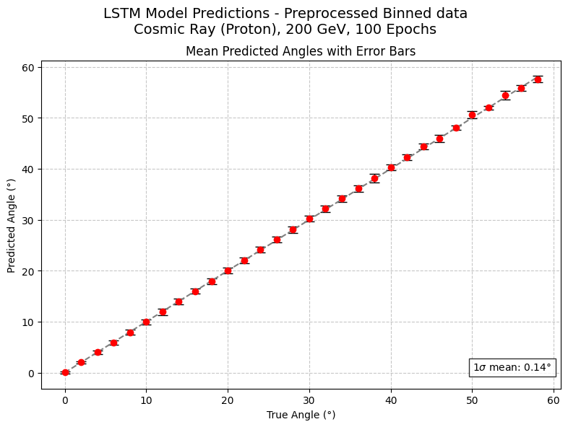
Angular Reconstruction – ML
(Proton – Cosmic Ray)
130 [GeV]
150 [GeV]
200 [GeV]
18
See “Cosmic Ray Simulations for CONDOR Observatory and Angular Reconstruction via Machine Learning.” by Luis Navarro.

Slide 20
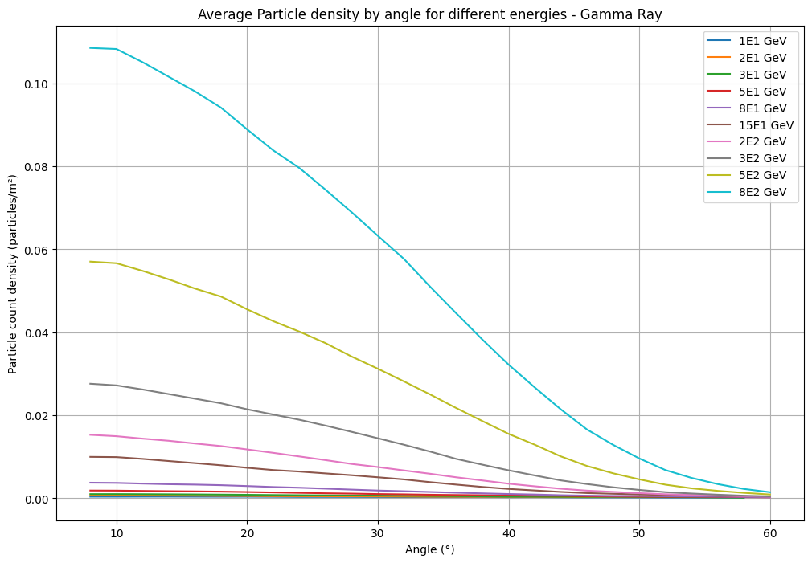
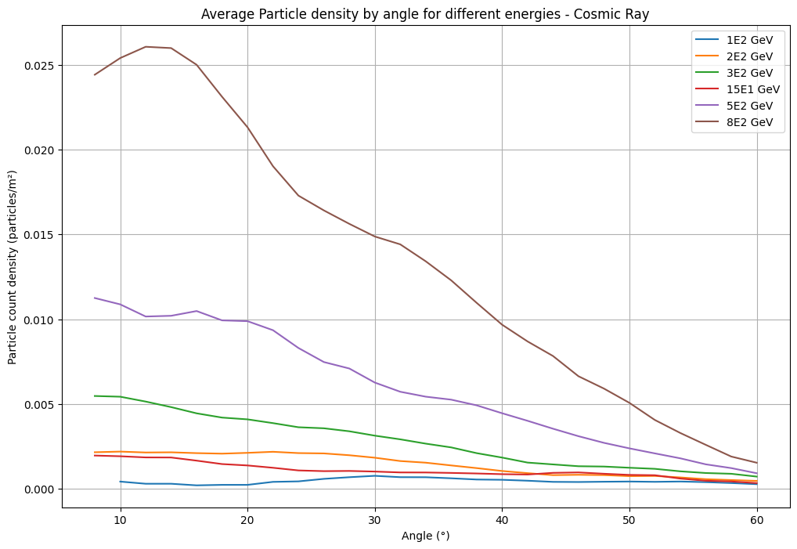
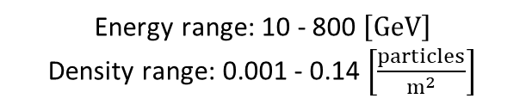
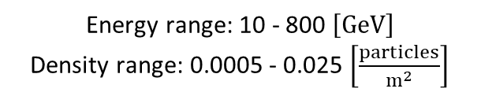
Particle Density by angle per energy
Gamma Ray – Primary Photon
Cosmic Ray - Primary Proton
Energy range: 10 - 800 $\left[GeV\right]$
Density range: 0.001 - 0.14 $\left[\frac{particles}{m^{2}}\right]$
Energy range: 10 - 800 $\left[GeV\right]$
Density range: 0.0005 - 0.025 $\left[\frac{particles}{m^{2}}\right]$
19

Slide 21
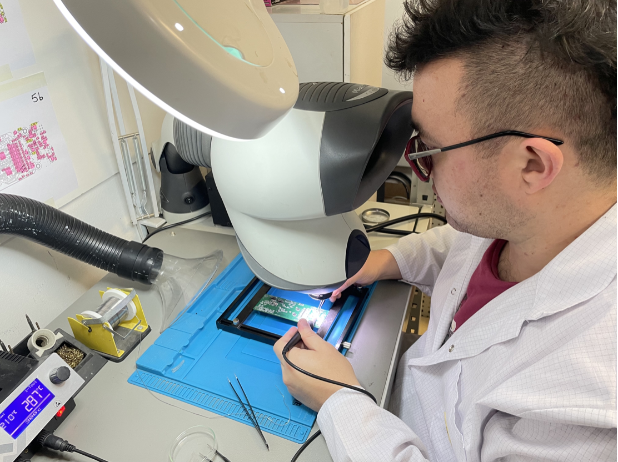
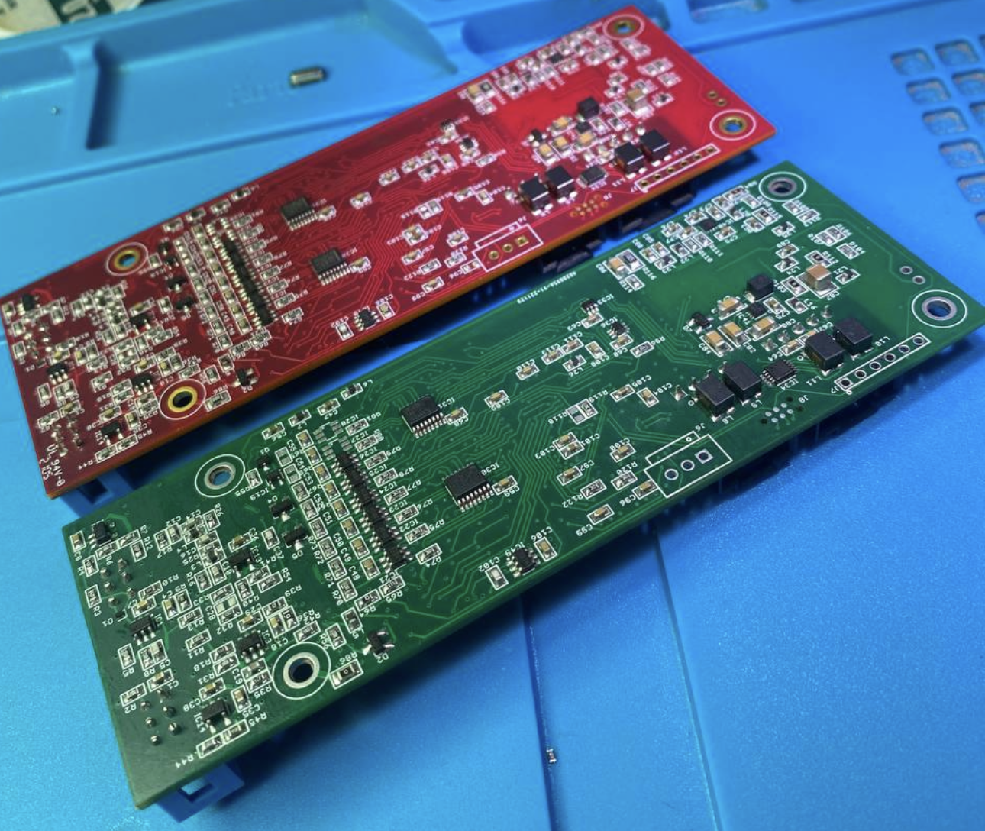
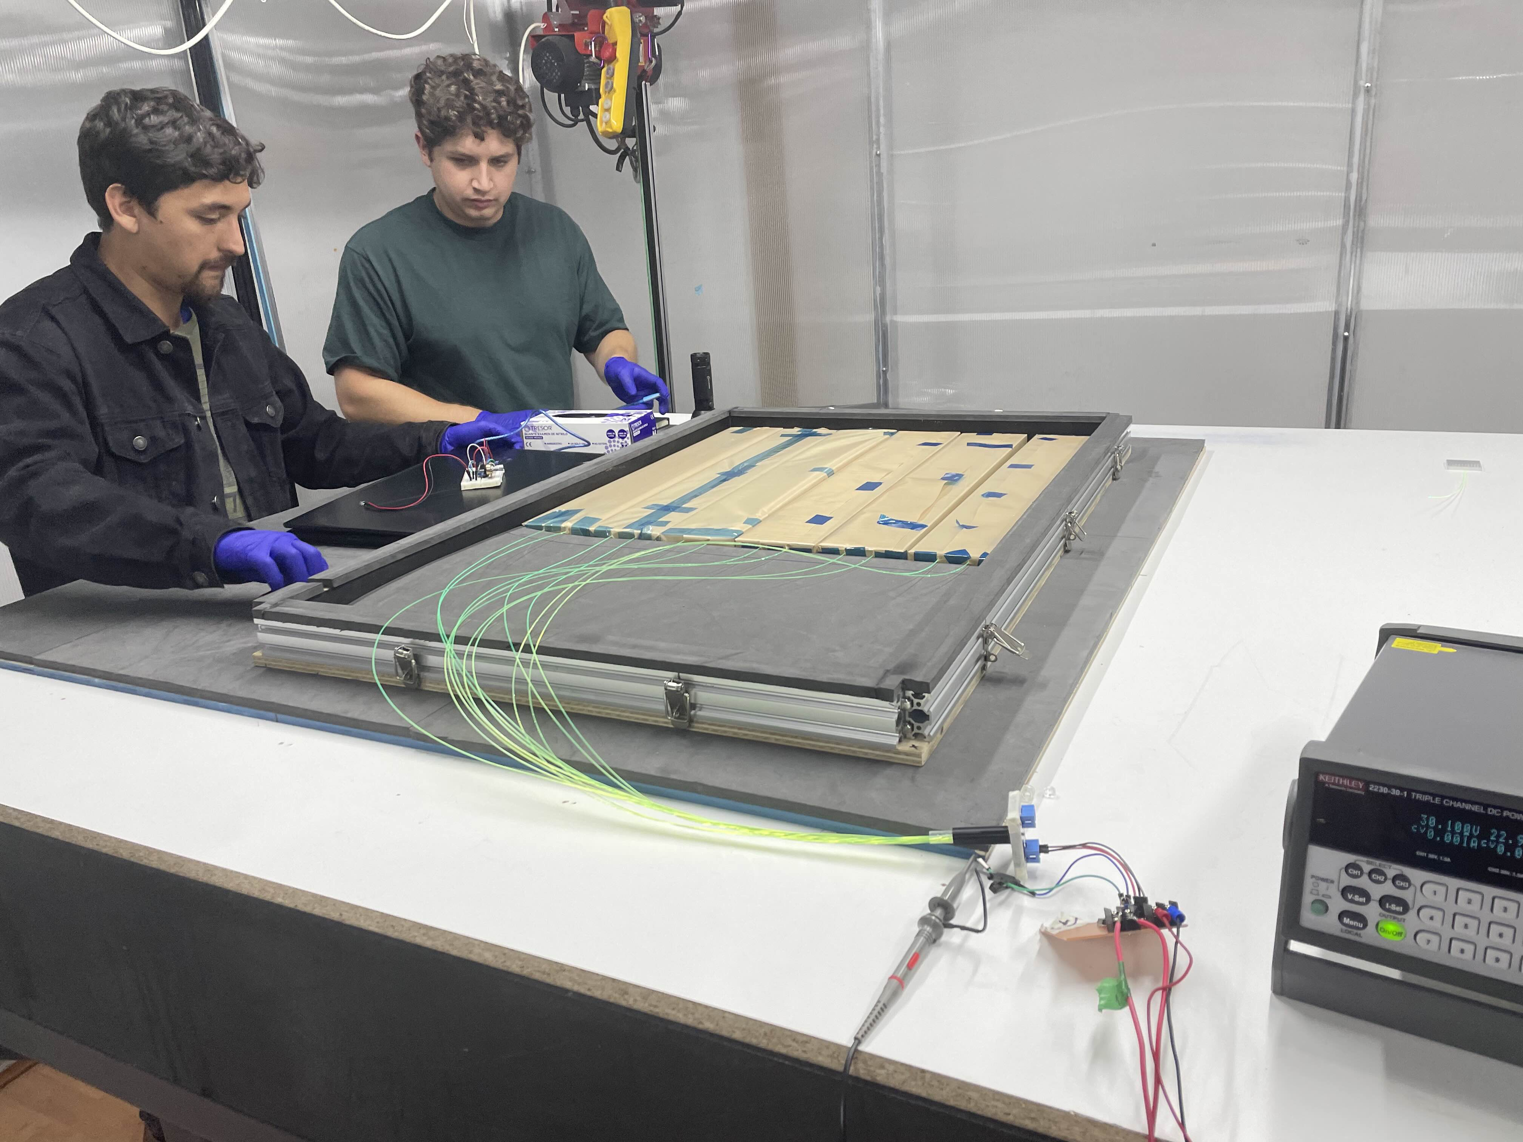
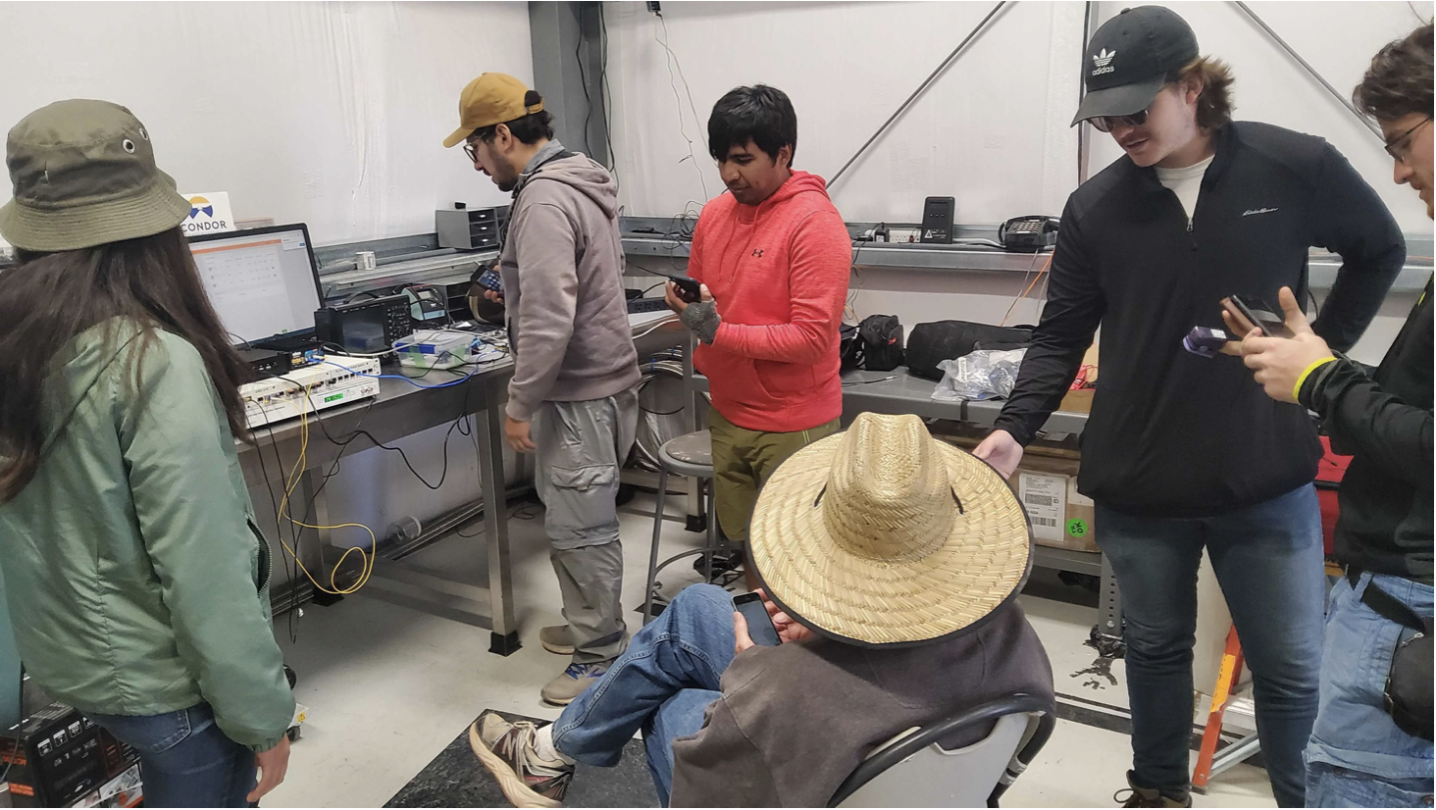
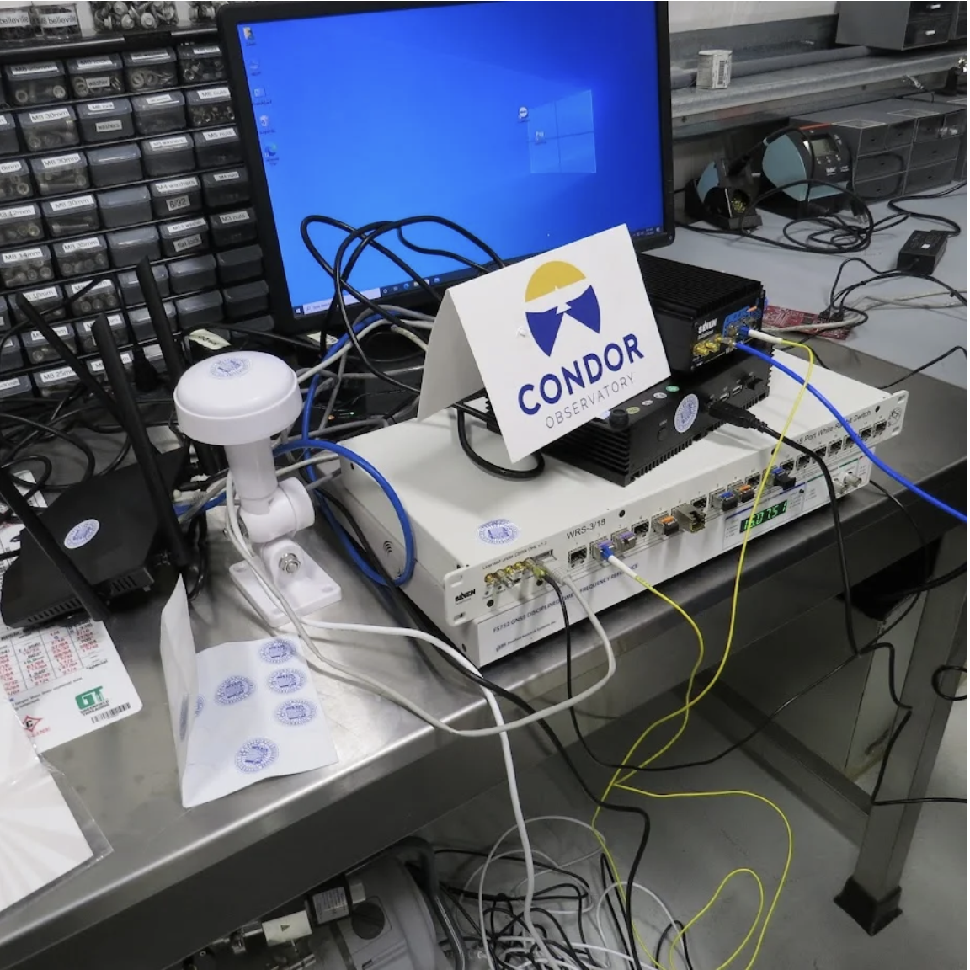
Where are we now?
Producing data acquisition board
Synchronization studies
More models, more predictions.
20

Slide 22
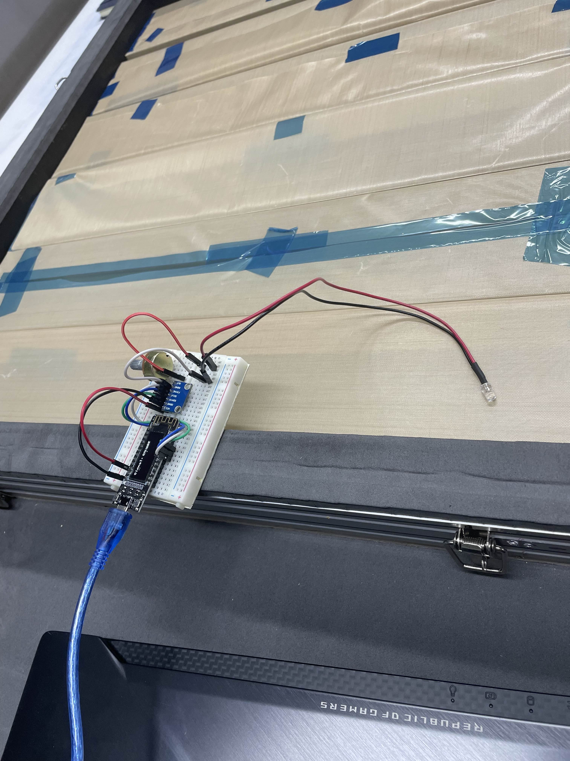
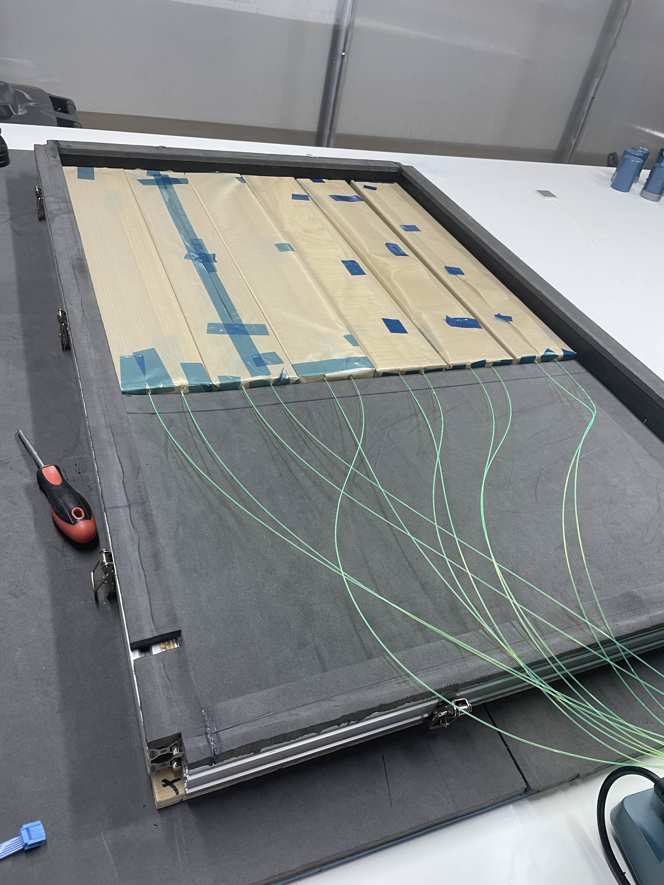
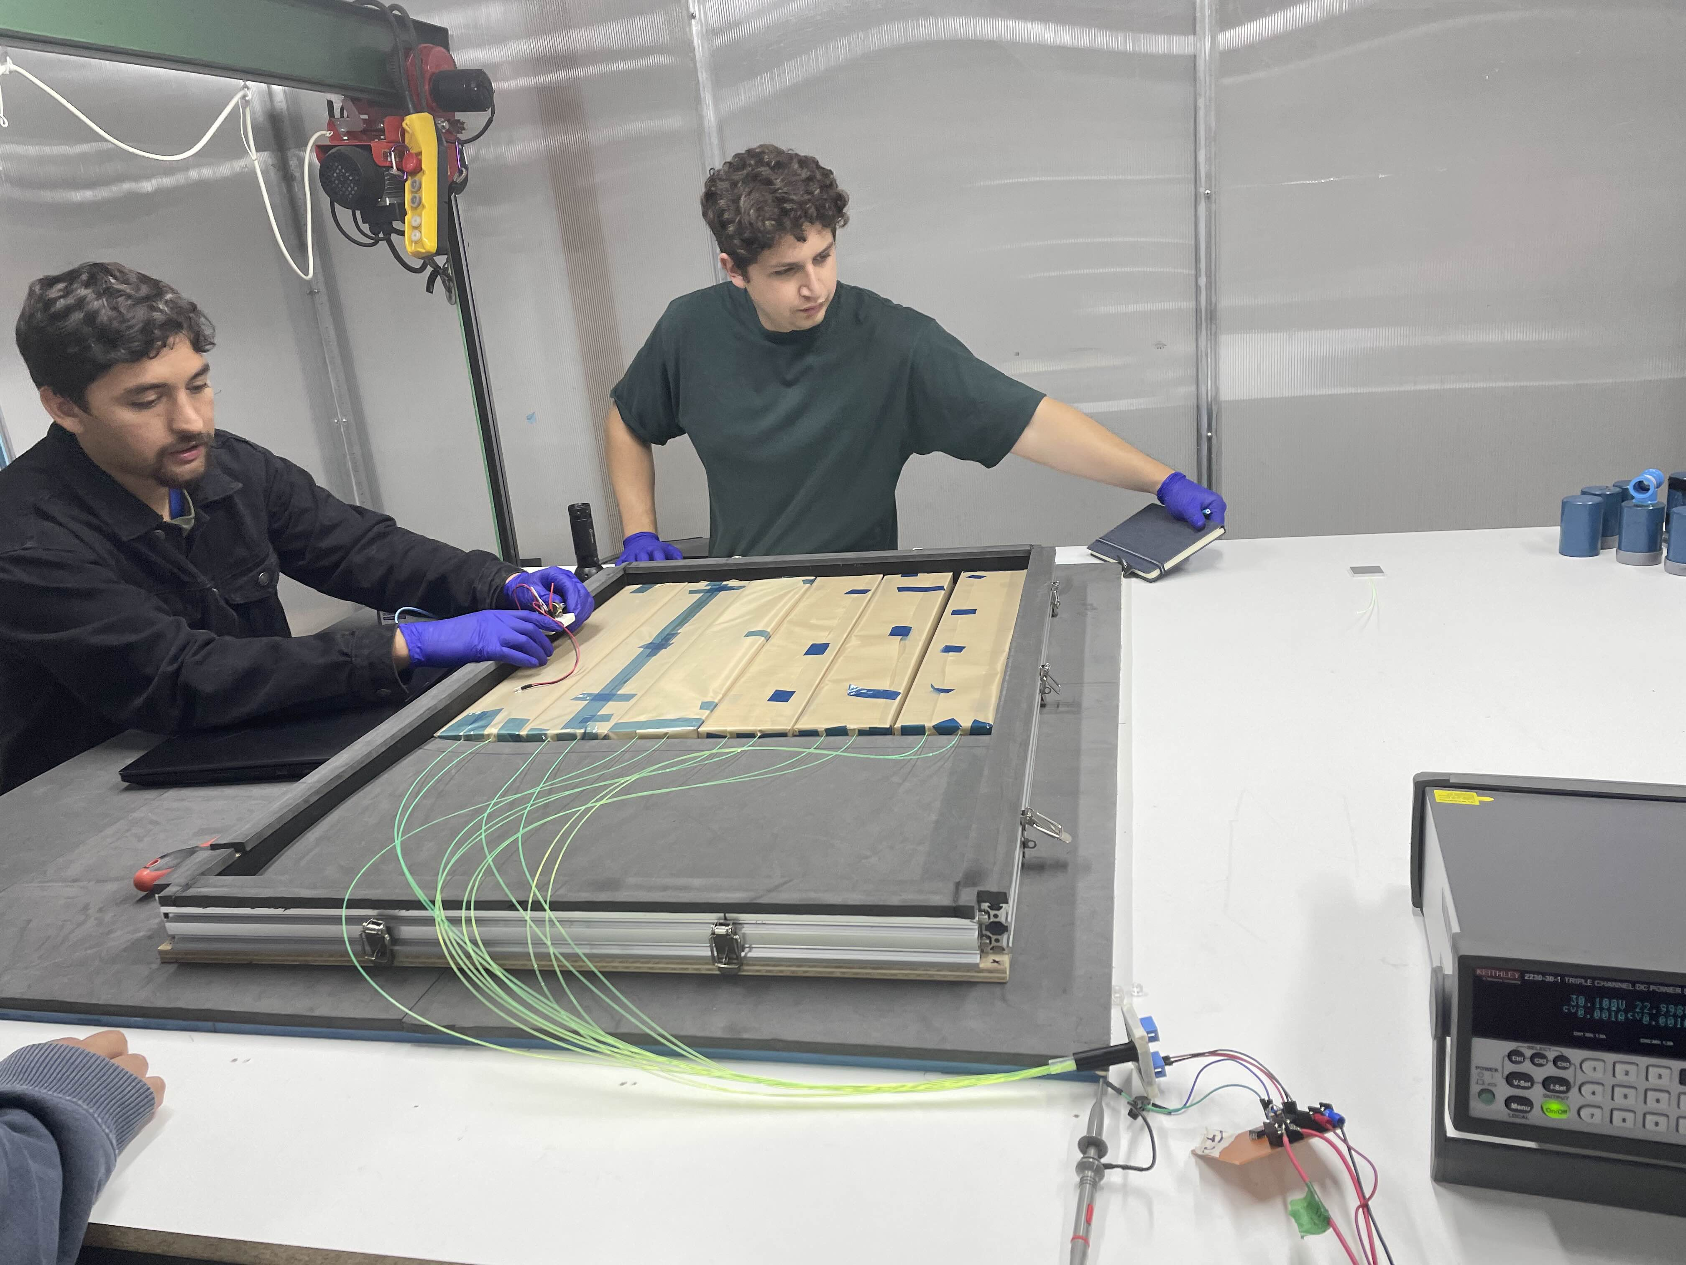
Where are we now?
On-site testing (Cerro Toco, Atacama).
Building module prototypes
21

Slide 23




Thanks!
Questions?
All the authors acknowledge the financial support from ANID PIA/APOYO AFB230003 and Proyectos Internos de Investigación Multidisciplinarios USM 2024 PI_M_24_02.

