Slide 1
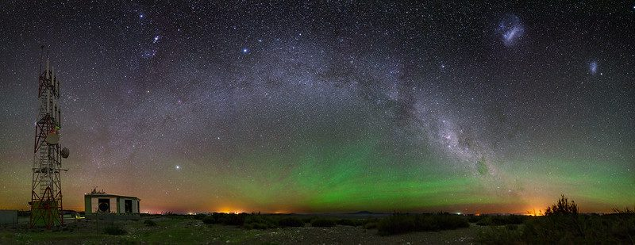


The Pierre Auger Observatory
Latest Results and Prospects
Fernando Catalani
for the Pierre Auger Collaboration
EEL - Universidade de São Paulo, Brazil

Slide 2
OUTLINE
Introduction
Pierre Auger Observatory
Selected Results
AugerPrime

Slide 3
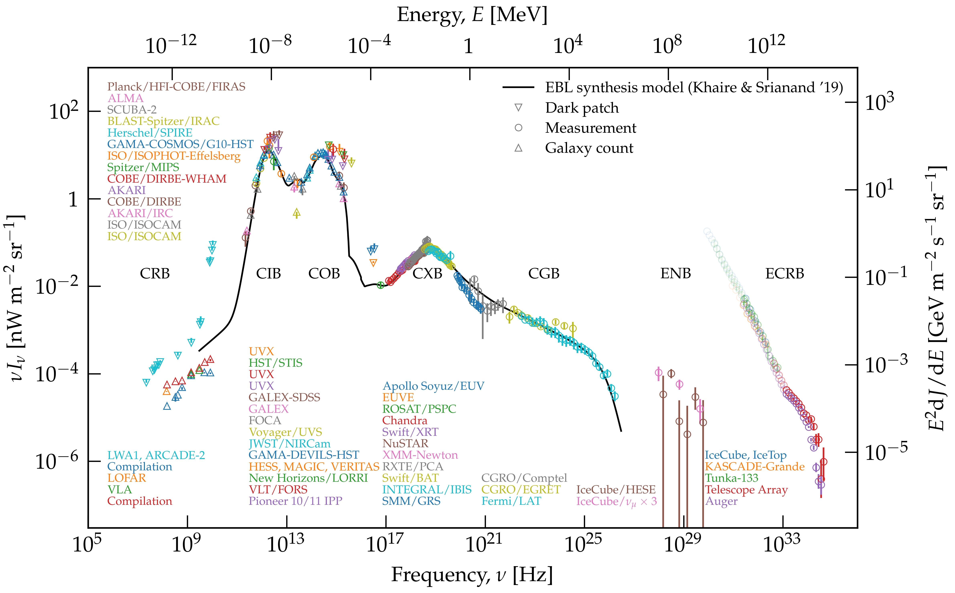
Multi-messenger Spectrum of the universe
Graphic by J. Biteau

Slide 4
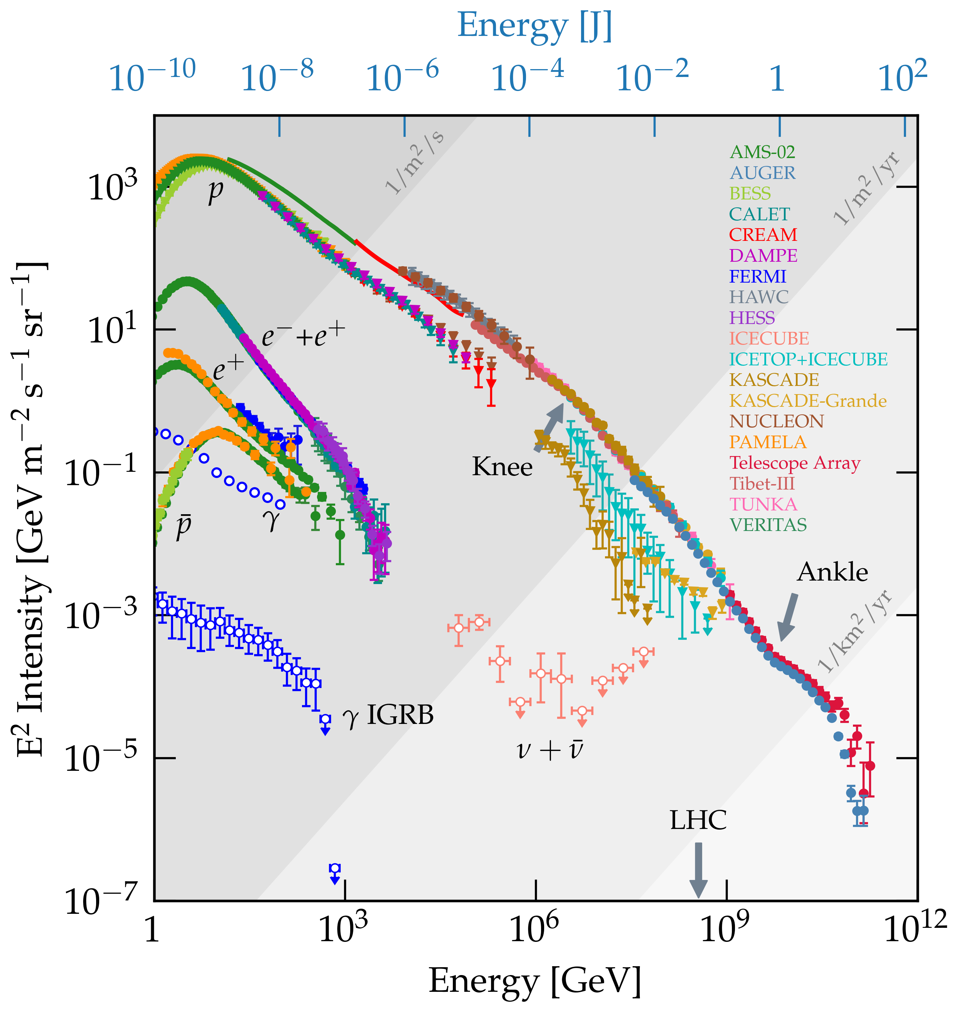
Ultra High Energy Cosmic Rays (UHECR) Spectrum
Galactic Extragalactic
Graphic by C. Evoli

Slide 5
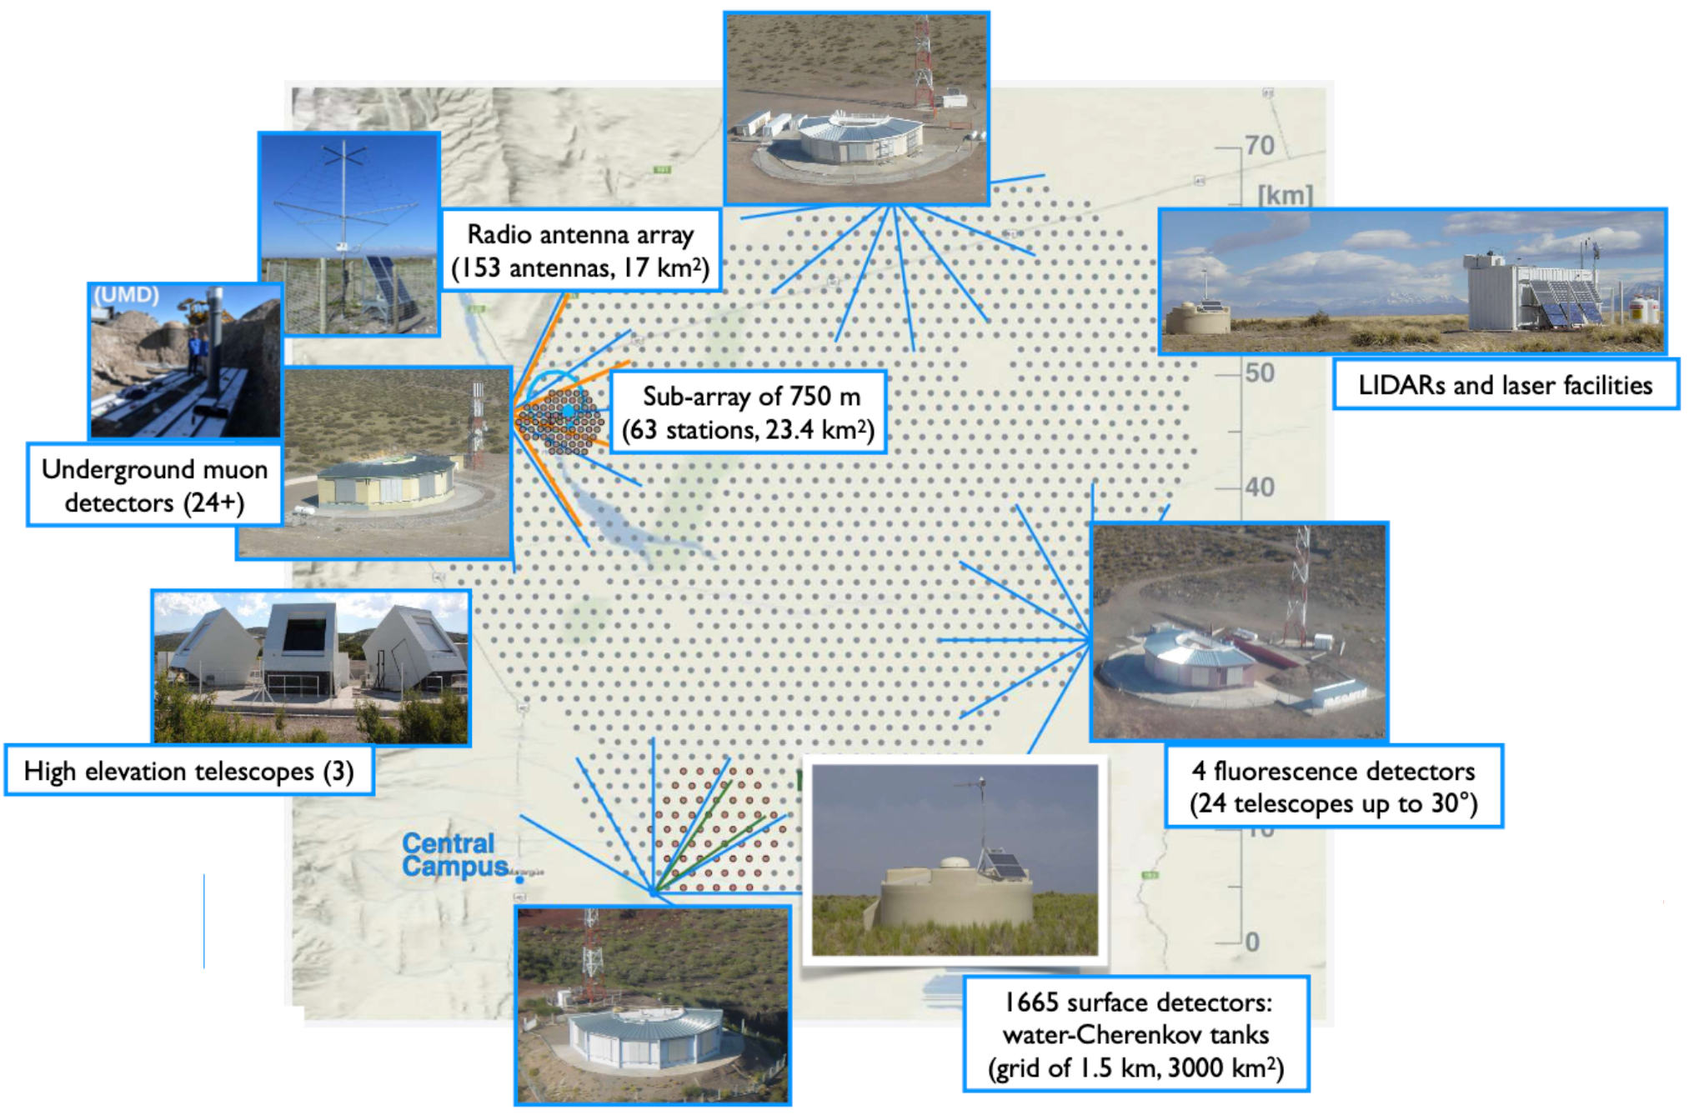
1665 Water-Cherenkov stations
SD1500 : 1600, 1.5 km grid;
SD750: 61, 750 m grid
SD433: 19, 433 m grid
4 Fluorescence sites
24 telescopes, 1-30⁰ FoV
3 High Elevation Telescopes,
30-60º FoV
Engineering arrays
AERA: 153 radio antennas
UMD: 24 underground muon detectors
The Pierre Auger Observatory
Geolocalization: (−69.0° longitude, −35.4° latitude )
The Pierre Auger Observatory
Total area 3000 km²

Slide 6
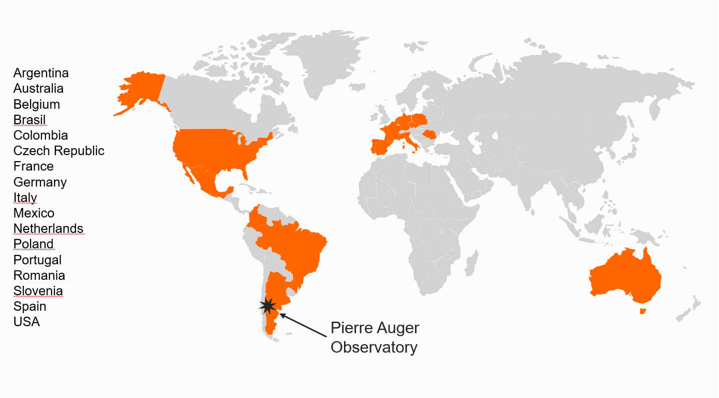
International collaboration of 17 Countries,
98 institutions and more than 400 scientists

Slide 7
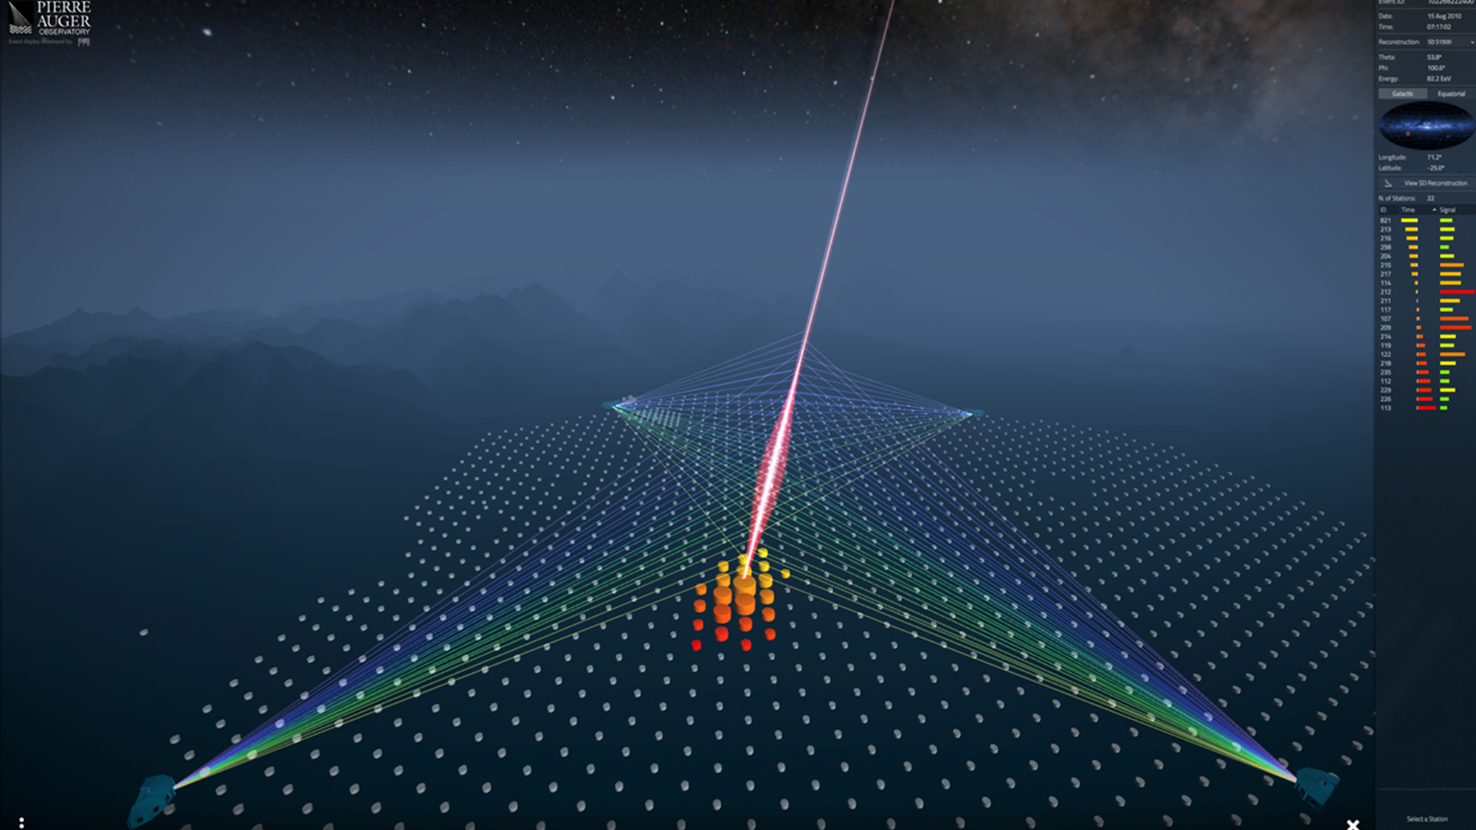
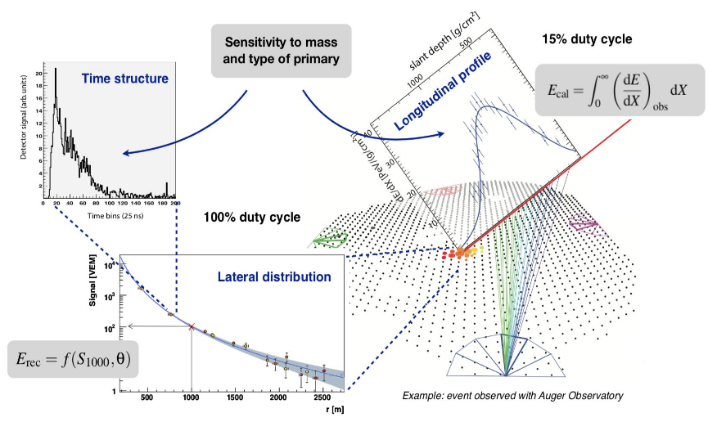
Air Shower Observables (Hybrid Detection)
FD energy resolution ~ 8%
Systematic uncertainty 14%
Fluorescence Detector (FD):
Calorimetric energy measurement.
Surface Detector (SD):
Sensitive to both eletromagnetic and muonic componentes
Hybrid events:
Data driven calibration

Slide 8
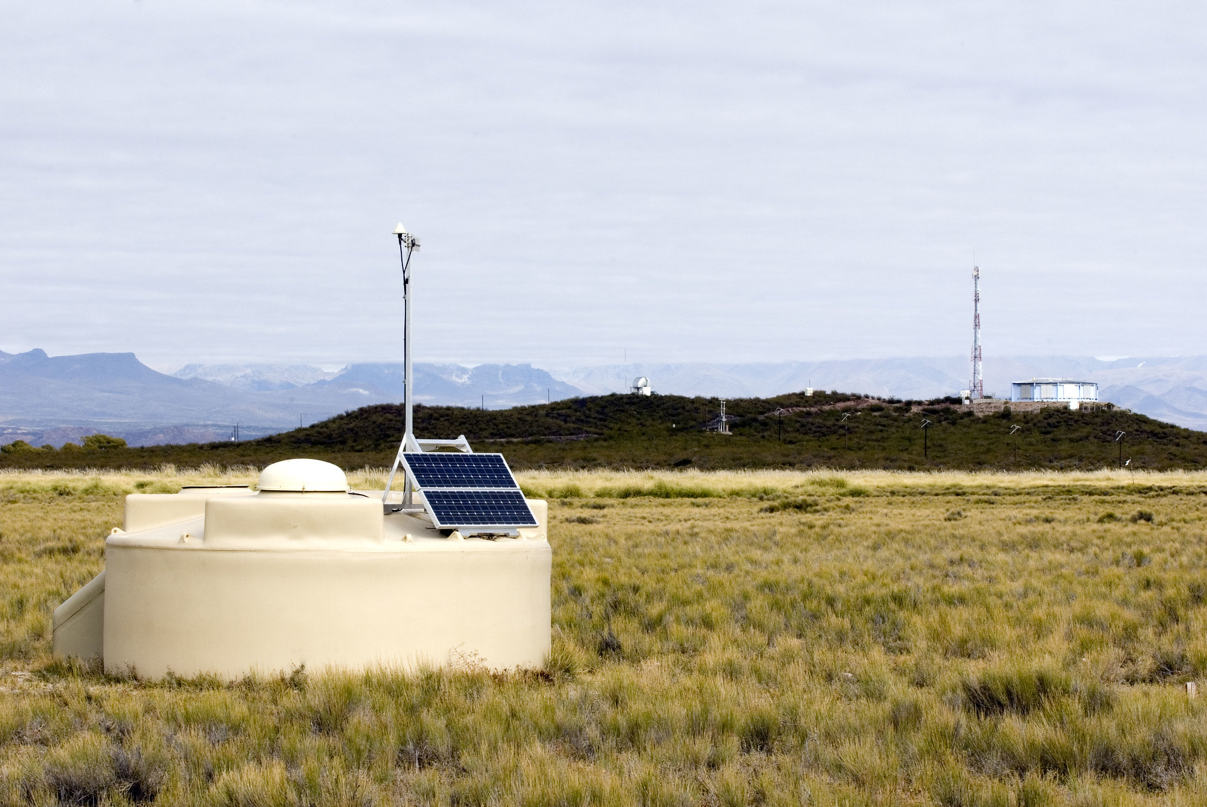
Selected Results

Slide 9
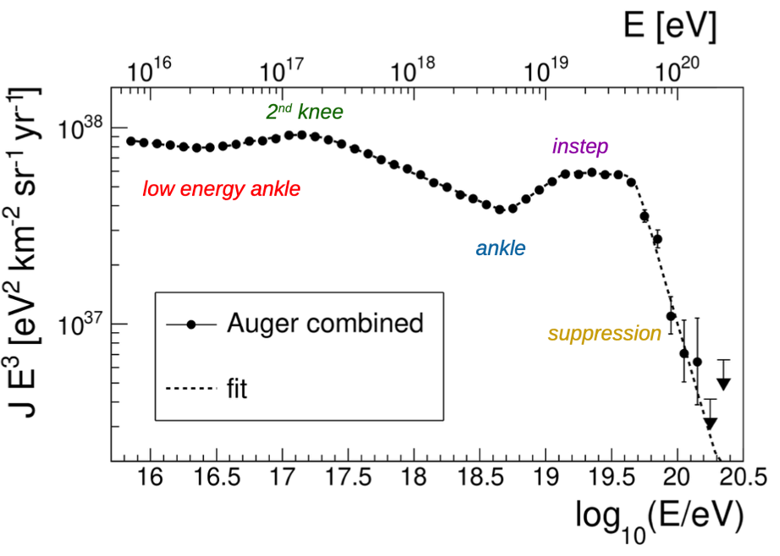
UHECR energy spectrum
Largest available exposure:
>80,000 km2 sr yr, >920,000 events
Independent of any assumptions on the primary mass composition or hadronic physics
● Strong suppression
at ~ 5 10¹⁹ eV
● New feature “instep”
at ~ 10¹⁹ eV
● Ankle at ~ 5 10¹⁸ eV
● 2nd knee at ~ 2 10¹⁷ eV
Auger Coll., Phys.Rev.D102 (2020) 062005
Auger Coll., Phys.Rev.Lett. 125 (2020) 121106
Auger Coll., Eur. Phys. J. C 81 (2021) 966

Slide 10
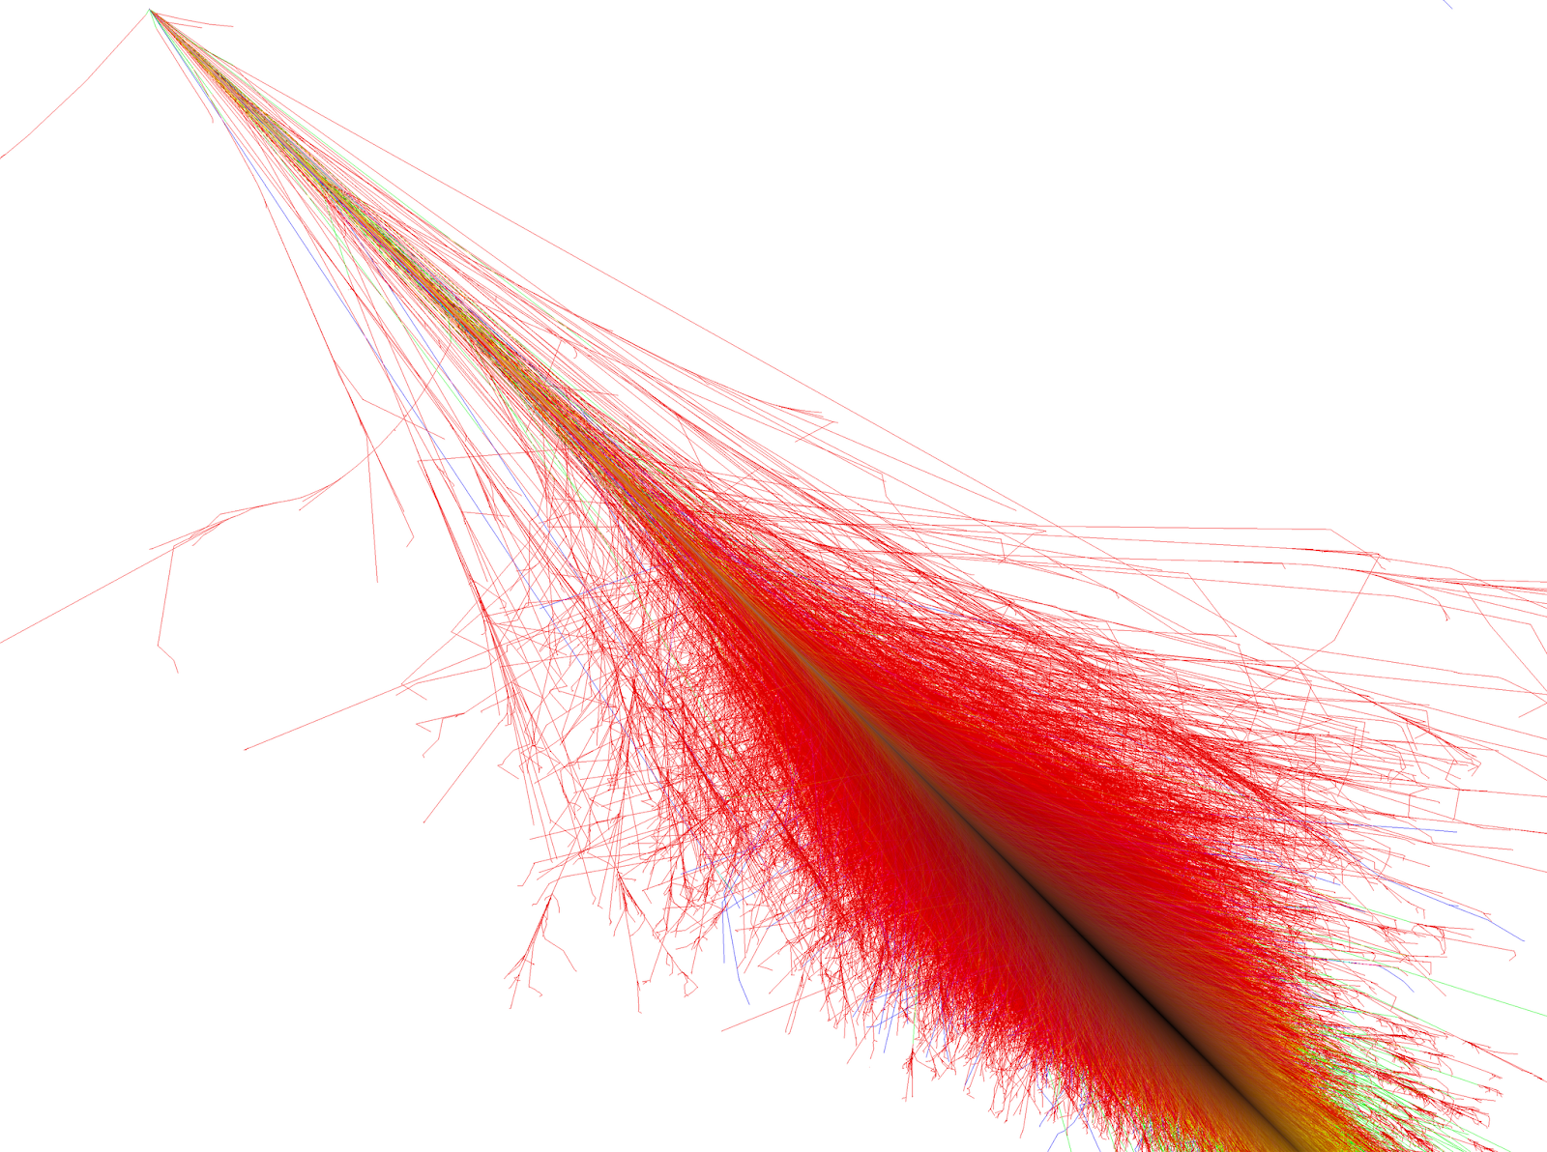
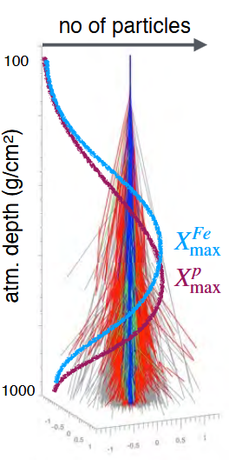

Mass Composition Results
The position of shower maximum X_{max} is the most accurate mass estimator
$$X_{max}∝D.ln\left(E/{{A.E}_{0}}\right)$$
Credit: Ralph Engel / Karl-Heinz Kampert

Slide 11
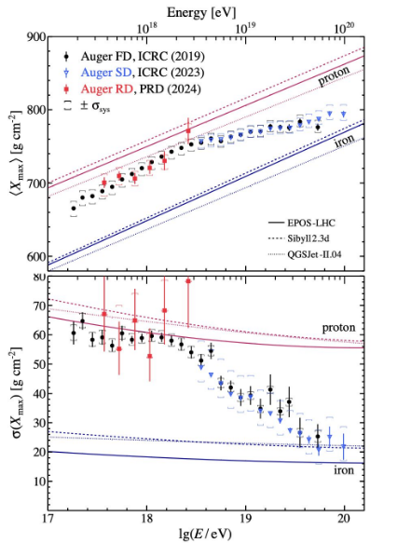
Consistent results from 3 different air shower measurements:
‣FD ( longitudinal profile)
‣SD ( temporal and lateral distributions)
‣ RD (radio detector)
Interpretation in terms of A is dependent on LHC-tuned hadronic interaction models.
Mass Composition Results
The <X_{max} > shows composition becoming lighter up to ~2 .10¹⁸ eV and heavier above this energy.
The σ (X_{max}) at the highest energy indicates a purer and heavier composition: excluding a large fraction of protons.
Flux suppression most likely due to a superposition of maximum injection energy and propagation energy losses, constraining photo-pion production (GZK cutoff) from non dominance of protons at all energies.

Slide 12
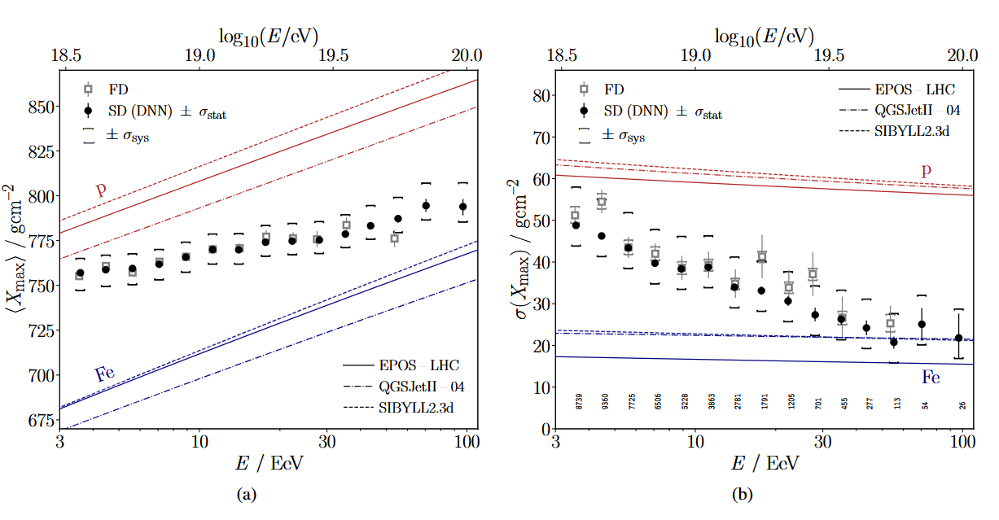
Mass Composition
(SD-based DNN analysis)
Event-by-event X_{max} estimation using SD data and custom-designed deep neural networks (DNN).
50000+ SD events up to 10²⁰ eV (10-fold increase of statistics with respect to FD data).
Results in agreement with FD.

Slide 13
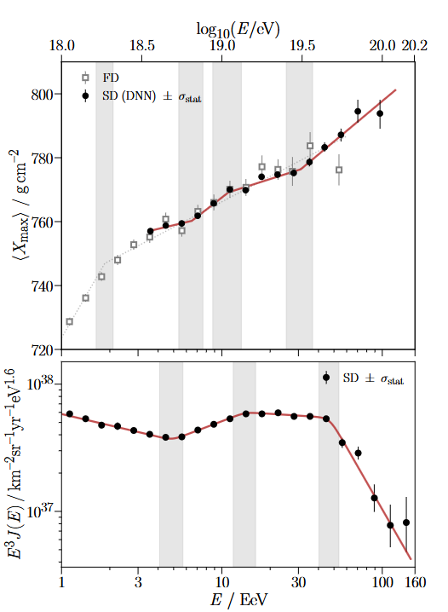

Mass Composition – SD based DNN
Evidence of a structure in Elongation Rate
Best described with a three-break model - incompatible with pure composition - Constant ER rejected at 4.4σ .
Positions of breaks in the elongation rate are observed to be in proximity of the ankle, instep and suppression features identified in the energy spectrum.
Confirmation that mass composition is lighter and mixed at lower energies, getting heavier and purer as the energy increase.
The red line indicates the elongation model found using the SD, and the dotted grey line using the FD.
Auger Coll., arXiv:2406.06315, arXiv:2406.06319 - accepted PRD, PRL

Slide 14
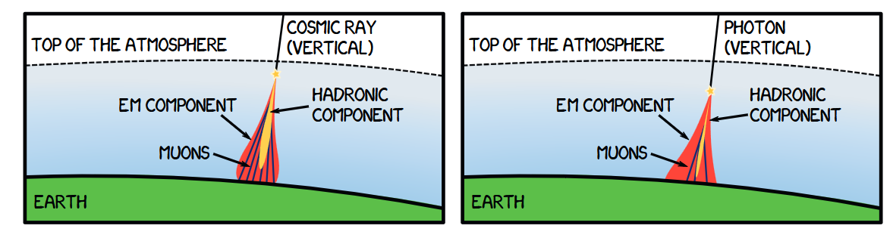
Multi-messenger searches
UHE Photon showers detection
Photons entering the Earth’s atmosphere can initiate extensive air showers, just like
charged cosmic rays – making indirect detection possible
Main challenge: distinguishing photon-induced air showers from the vast background of showers
initiated by cosmic protons and heavier nuclei
In a nutshell: Searching for UHE photons means looking for deeper (vertical) showers with fewer
muons

Slide 15
Neutrino shower detection
Candidates for neutrino showers are searched among nearly horizontal showers

Slide 16
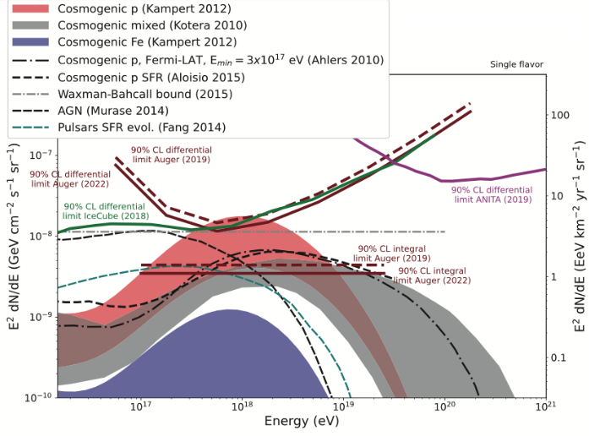
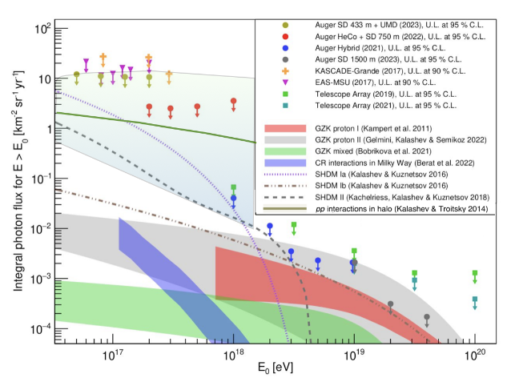
Multi-messenger searches: diffuse flux of Photons and Neutrinos
Four different measurements available
Auger Coll., JCAP 10 (2019) 022
Auger Coll., Phys. Rev. D 109, L081101 (2024)
Best sensitivity to UHE neutrinos slightly below 10¹⁸ eV, comparable to IceCube.
No candidades found.
Limits on point-like sources of neutrinos complement IceCube.
Starting to exclude proton-only accelerating sources scenarios
No primary photon observed.
Set the most stringent limits on the diffuse flux of UHE ɣs over ~ 4 order of magnitude in energy
Auger Coll, Phys. Rev. D 110 (2024)
Auger Coll., JCAP 05 (2023) 021
Auger Coll., ApJ 933 (2022) 125

Slide 17
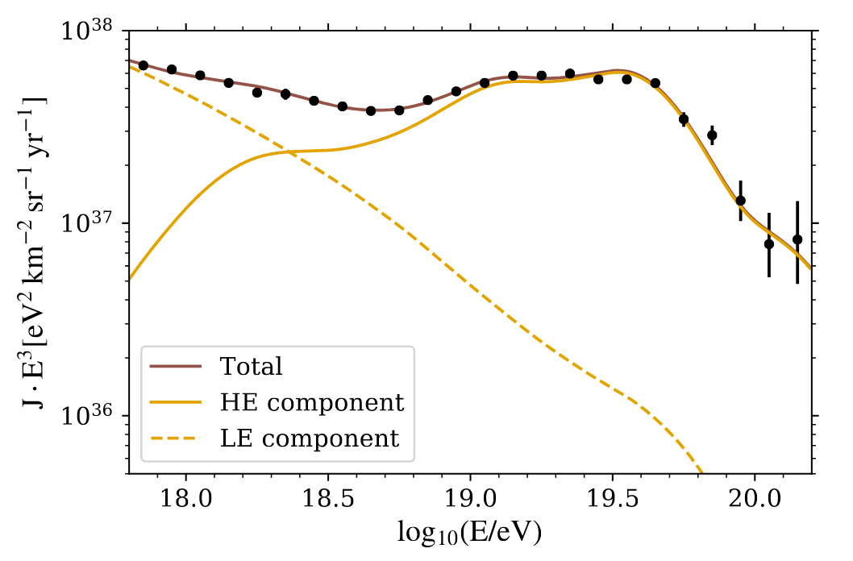
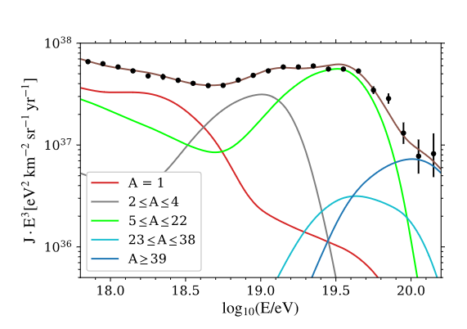
Astrophysical Scenarios
The energy spectrum and composition data allow to constrain astrophysical scenarios for the UHECR sources
Best description of the energy spectrum and composition data:
2 populations of EG identical sources, uniformly distributed
Power law injected energy spectrum + rigidity cutoff
Only propagation effects considered
1 - High Energy (HE) component with a mixed composition, hard spectrum and a low rigidity cutoff.
2- Low Energy (LE) component with a soft spectrum and a mix of protons and intermediate mass nuclei with unconstrained rigidity cutoff.
Ankle (~5 EeV): Interplay between the two populations
Instep (~ 10 EeV): interplay between He and CNO primary masses
absence of cosmogenic 𝝂 and γ + low cutoff
Indication for a suppression mainly due to exhaustion of the sources

Slide 18
Anisotropy studies

Slide 19
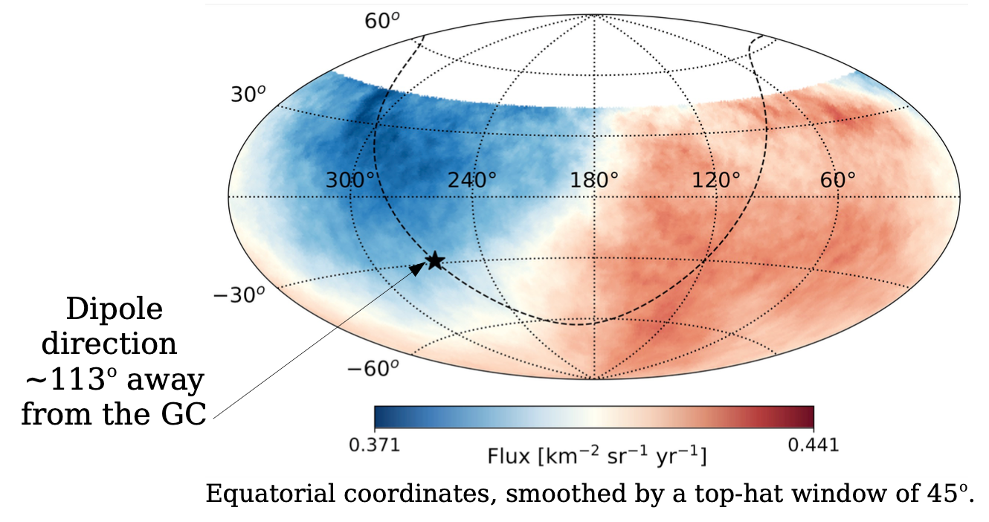
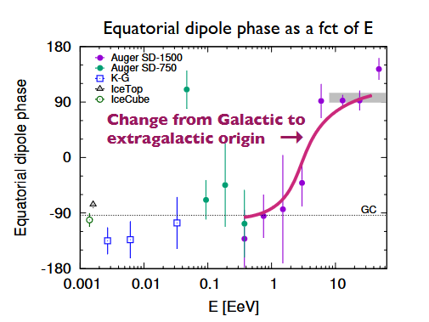
Large scale anisotropy
Extremely large exposure (θ<80º )
123,000 km2 sr yr
Auger Coll., Science 357 (2017) 1266
Auger Coll., Ap J. 868 (2018) 4
Observation of dipolar anisotropy for E≳8 10¹⁸ eV
Significance 6.8σ above 8 EeV, 5.7σ at E=8-16 EeV.
Dipole direction ~113º away from the Galactic Center: Extragalactic origin of UHECR above 8 EeV .

Slide 20
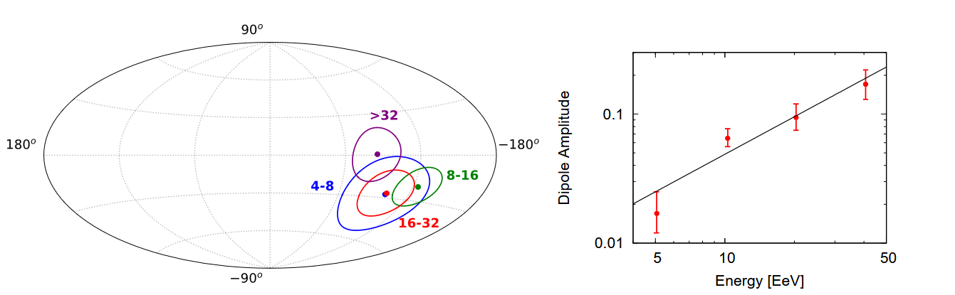
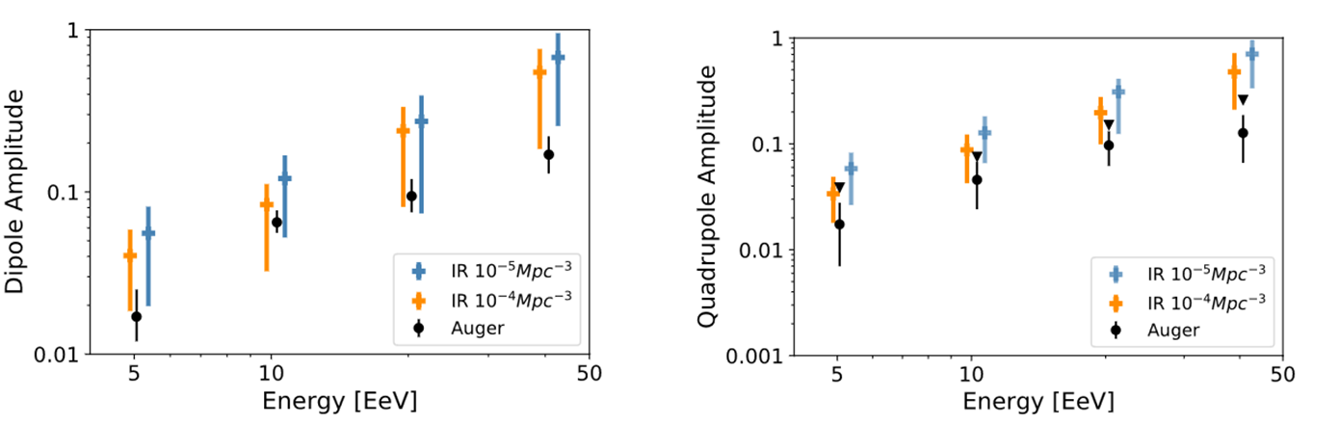
Large scale anisotropy – Evolution with energy
The observed anisotropy and its evolution with energy is well described as a signature of the Local Large Structure (LLS) distribution of matter.
Complex interplay between Source distribution, mass composition and magnetic fields deflections.
Map with the directions of the 3D dipole. The contours: contain the 68% CL.
Spectrum and composition of CRs emitted according to Auger best fit model.
Sources distributed following IR galaxies in 2MASS with different densities up to 120 Mpc (uniformly distributed beyond).
Propagation take into account.
Deflections in the galactic magnetic field from Jansson & Farrar 2012
Compatible with data for densities 10⁻⁴ and 10⁻⁵ Mpc⁻³
Auger Coll. ApJ. 976 (2024) 48

Slide 21
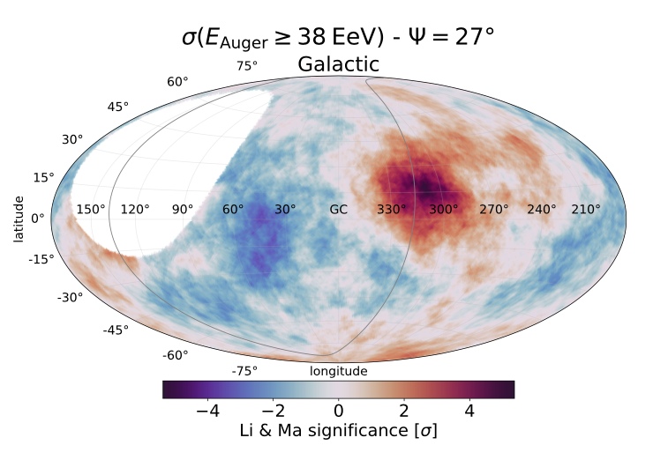
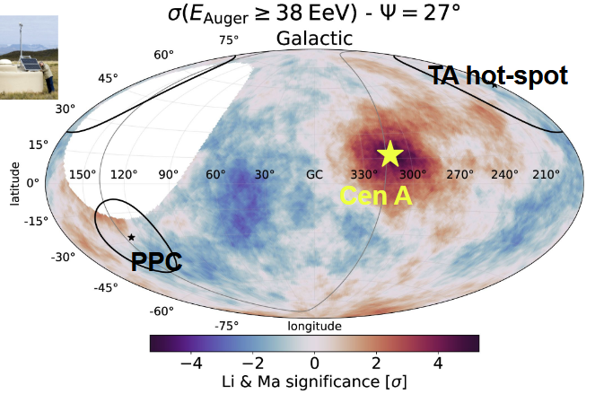
Small and Intermediate angular scale
1. Search for overdensities and correlation with structures
Scan in energy and in top-hat radius
Centaurus region: 4.0σ significance at E_{th}=38 EeV at top-hat radius ψ=27º
With the current growth, the excess could reach 5𝜎 by the end of 2025.
2 . catalog-based search
Unbinned maximum likelihood method - two free parameters: the Fisher search radius Θ and the signal fraction. The energy scan in steps of 1 EeV between 32 EeV and 80 EeV.
The catalogs (and their flux proxies):
“all galaxies (IR)” from 2MRS (K-band),
“starbursts galaxies (radio)” based on Lunardini+19 (1.4 GHz),
“all AGNs (X-rays)” from Swift-BAT (14-195 keV)
“jetted AGNs (𝛾-rays)” from Fermi 3FHL (𝐸 > 10 GeV).
➡All models capture an overdensity in Centaurus region (CenA, NGC4945, M83)
Excesses claimed by TA coll. not confirmed by Auger

Slide 22
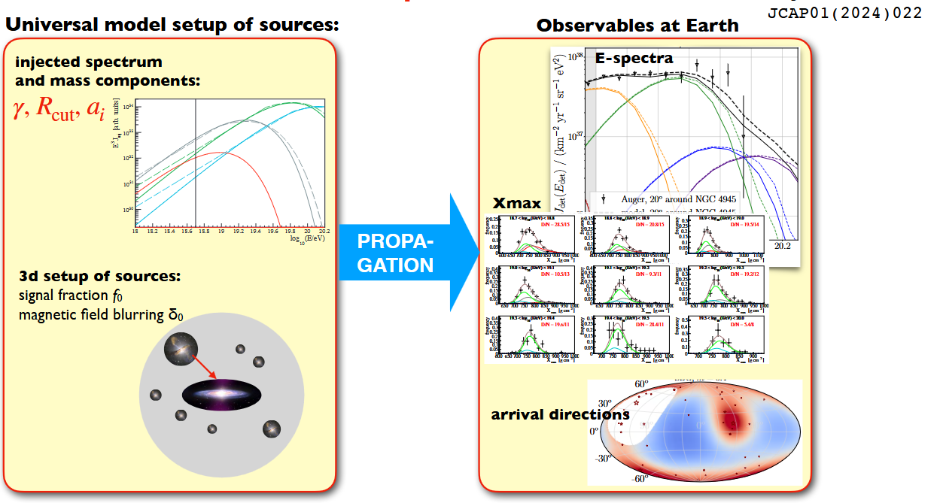
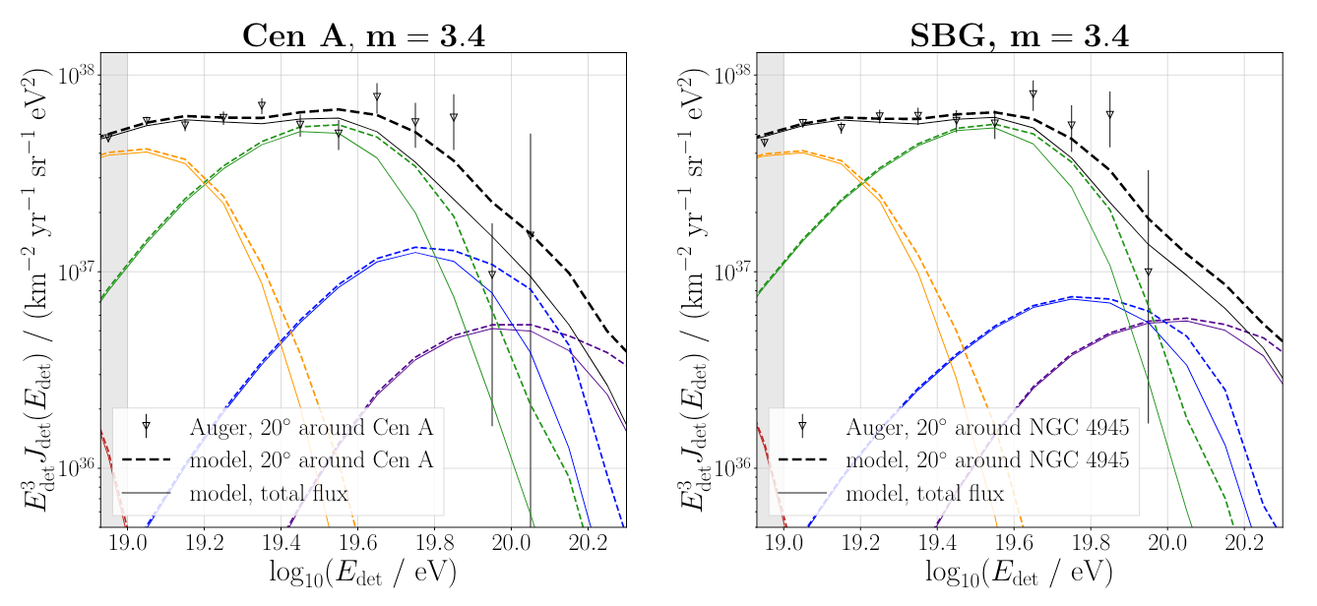
Astrophysical interpretation
(energy spectrum+mass composition+arrival directions)
Result of likelihood fit to measured E-spectrum, Composition, and arrival directions, including signal fraction (f₀) from individual catalog sources and blurring angle (δ) due to EG magnetic fields as free parameters.
Data best described by a starburst galaxy model with hard spectral index model with signal fraction f₀ ~ 20% and blurring δ~20º at 40 EeV for a particle with rigidity of 10 EV, N-dominated hard injection spectra.
Significance of SBG model ~4.5σ, contribution of Centaurus A dominant (~80%)
ɣ-AGN sources disfavoured

Slide 23
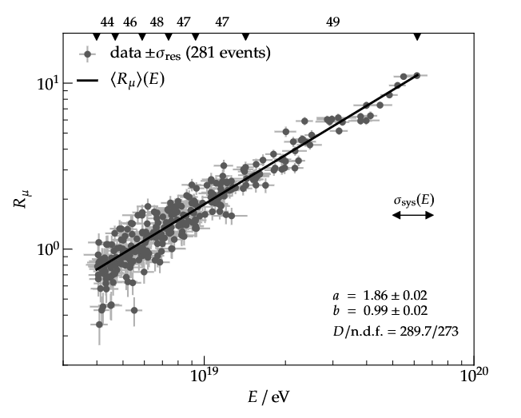
The Muon puzzle
Auger Coll., PRD91 (2015)
Eur.Phys.J.C 80 (2020) 8
Phys.Rev.Lett. 126 (2021) 15
Measurement of the EAS muon content:
Using hybrid inclined showers:
Performing a likelihood fit including all reconstruction uncertainties (detector, energy)
Direct measurement (vertical showers) : Underground Muon Detector (UMD) – Lower energy: 2 × 10¹⁷ - 2 × 10¹⁸ EV
Muon excess present both at lower and higher energies
All this measurements suggest heavier primary masses compared to X_{max} data, leading to what's known as the 'Muon Puzzle'.

Slide 24
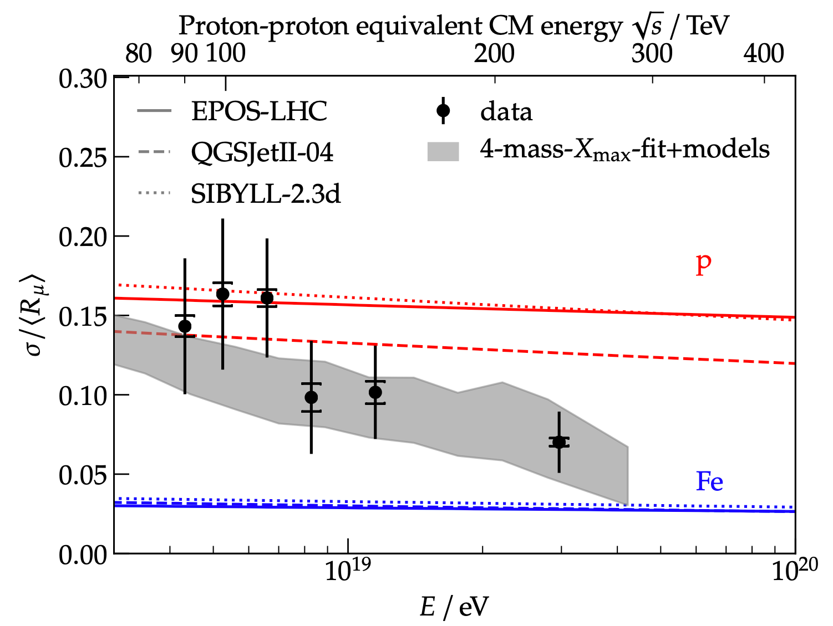
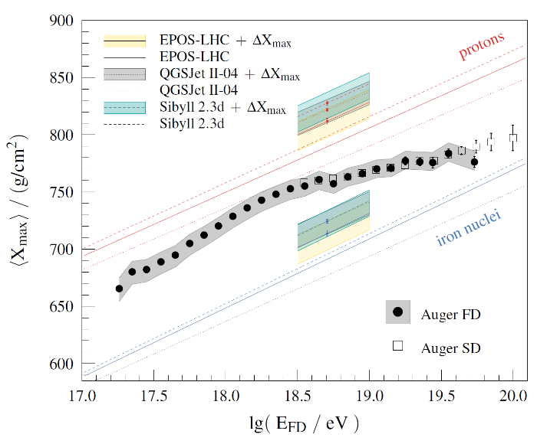
The Muon puzzle
Phys.Rev.Lett. 126 (2021) 15
The Pierre Auger Collaboration, Phys. Rev. D 109 (2024)
Discrepancy of muon number (20–30%), but not in relative shower-to-shower fluctuations
70% of fluctuations are from first interaction (Phys. Lett. B 784 (2018).
Most likely Scenario: Discrepancy due to small effect accumulating during shower development.
SD+FD indicates the predctions of Xmax for all models need a 20-50 g/cm² shift to deeper values and the hadronic signal should be increased by about 15% to 25% (at SD) suggesting that UHECR primary mass can be heavier than current models predict, indicating tension between Auger data and hadronic interactions models. Further studies are necessary.

Slide 25
To solve open problems we need
composition enhanced anisotropies measurements
AugerPrime

Slide 26
AugerPrime : The second phase of the PAO
Radio Detector (RD):
Measure radio emission of showers in atmosphere (30-80 MHz)
Enhance the detection of Inclined air showers
Surface Scintillator Detector (SSD):
Measure mass composition in combination with the WCD
Disentangling different components of shower possible with multi-parametric analyses
Underground Muon Detector (UMD):
Directly measure muon component of LE showers
Enhance photon/hadron discrimination
New electronics (UUB) will enhance the sensitivity of triggers to electromagnetic signals

Slide 27
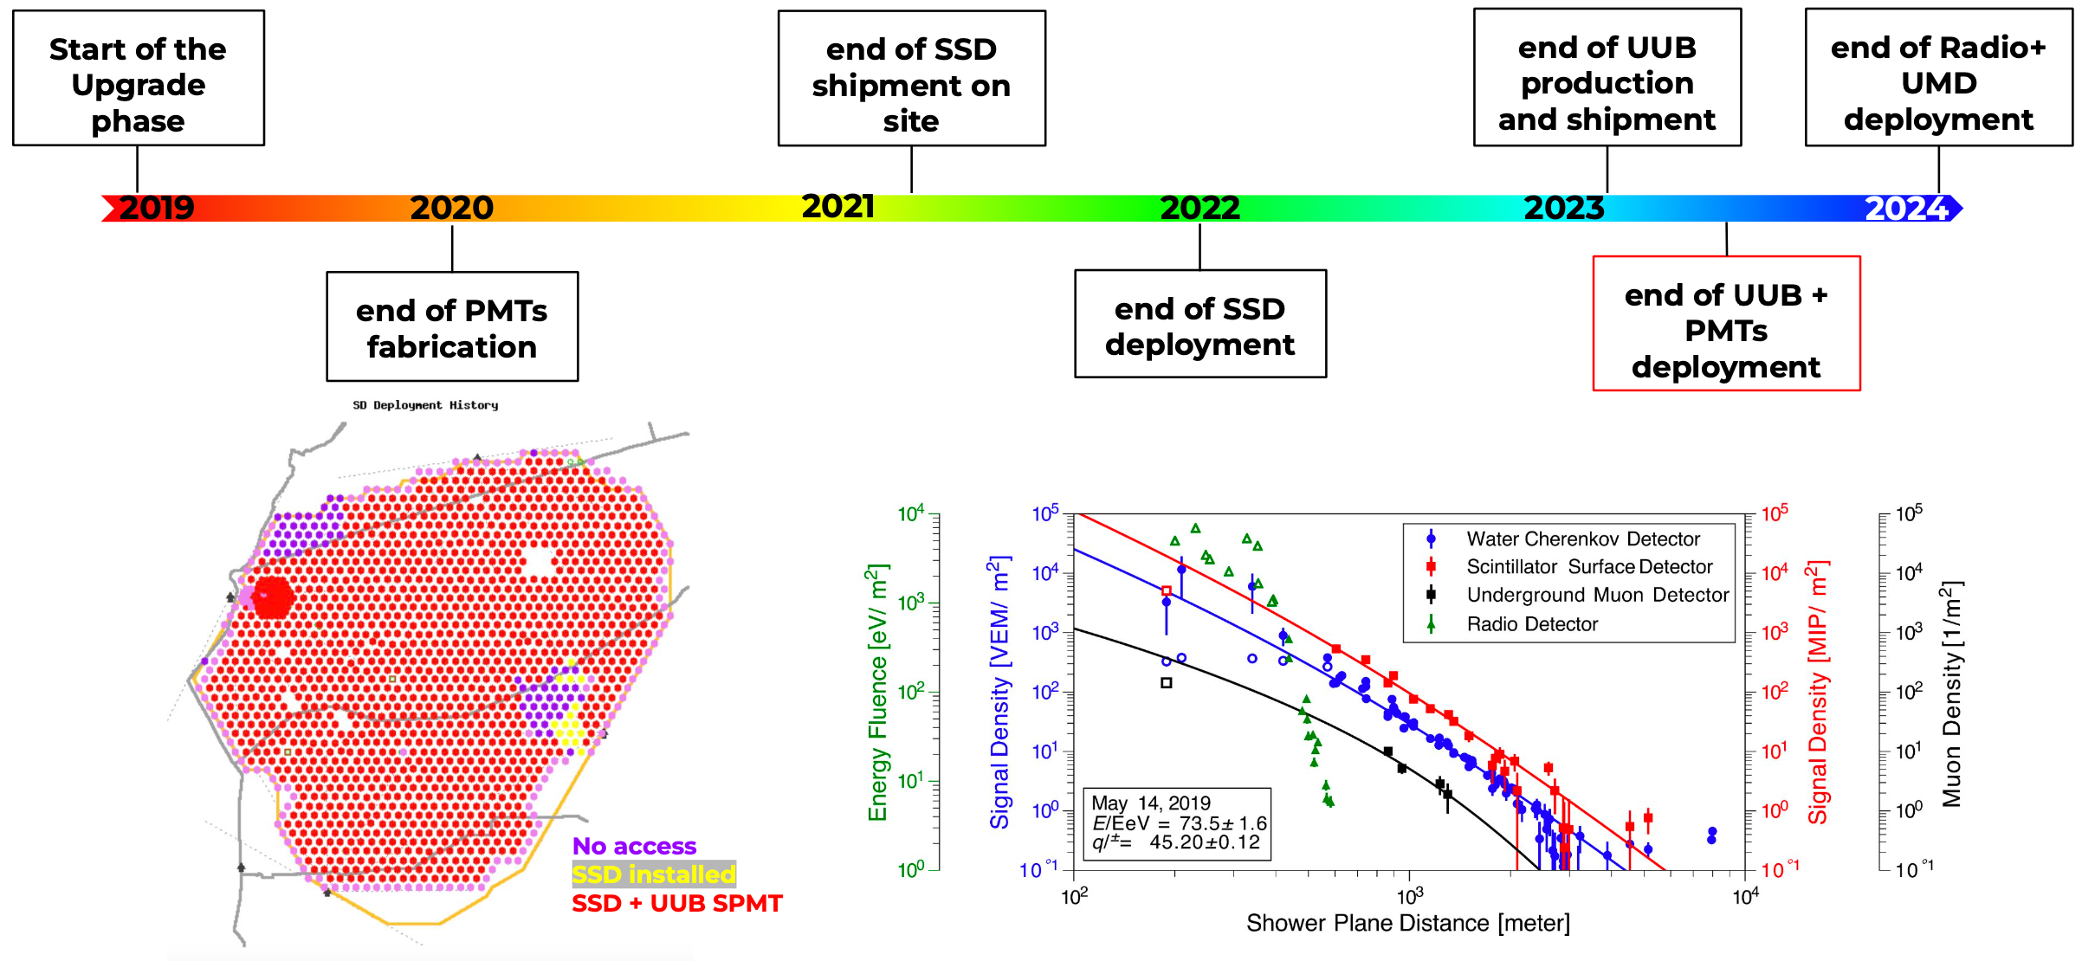
AugerPrime

Slide 28
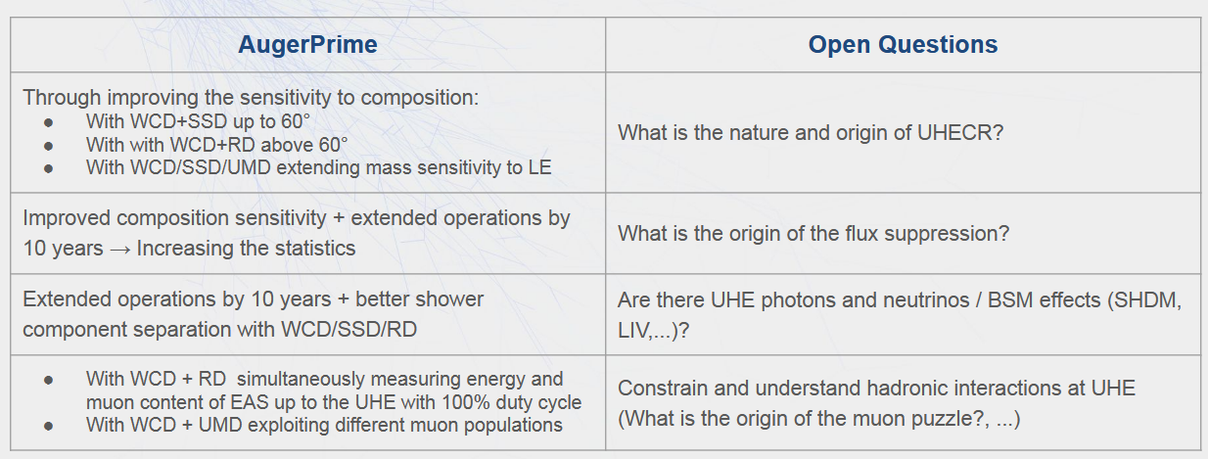

Slide 29

Thank You!

Slide 30
Backup slides

Slide 31
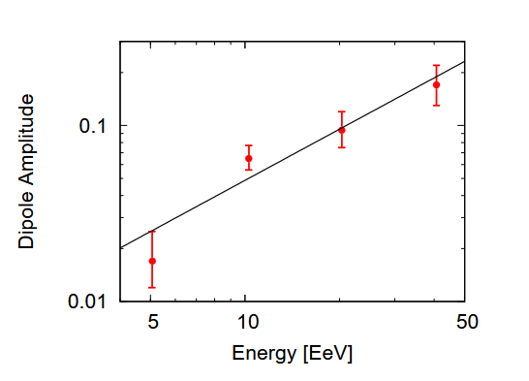
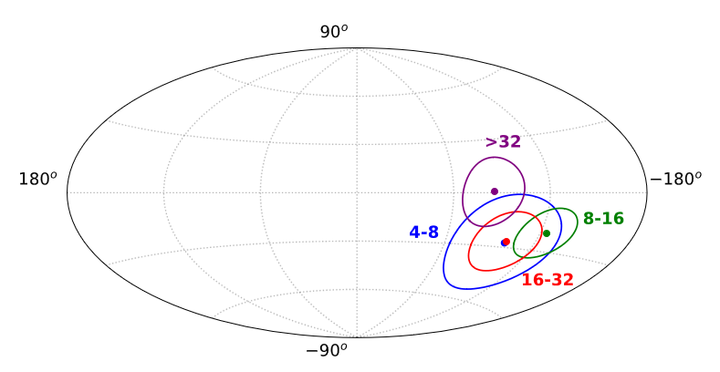
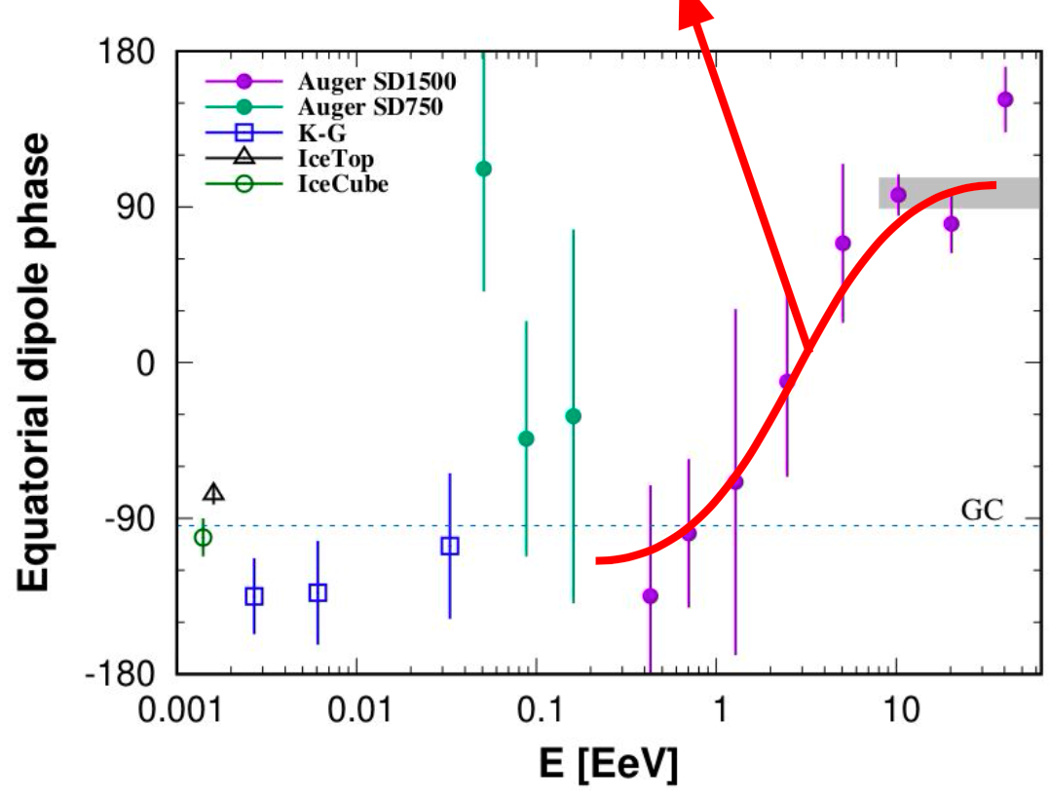
(a) Map with the directions of the 3D dipole for different energy bins, in Galactic coordinates. The contours of
equal probability per unit solid angle, marginalized over the dipole amplitude, that contain the 68% CL range are shown. (b)
The evolution of the dipole amplitude with energy, for the four energy bins considered (4-8, 8-16, 16-32, ≥ 32) EeV.

Slide 32
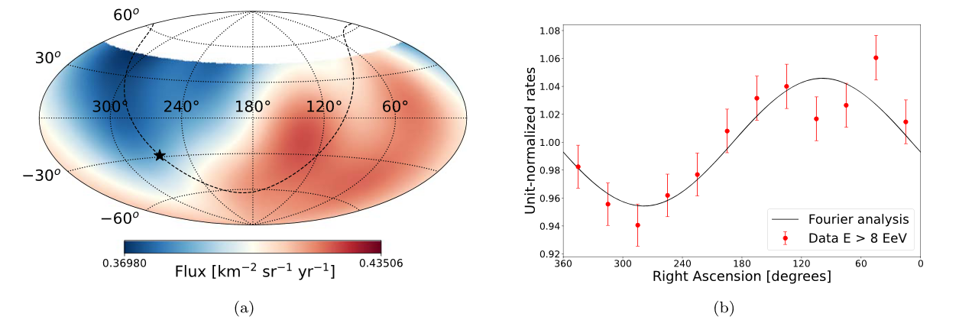

Slide 33
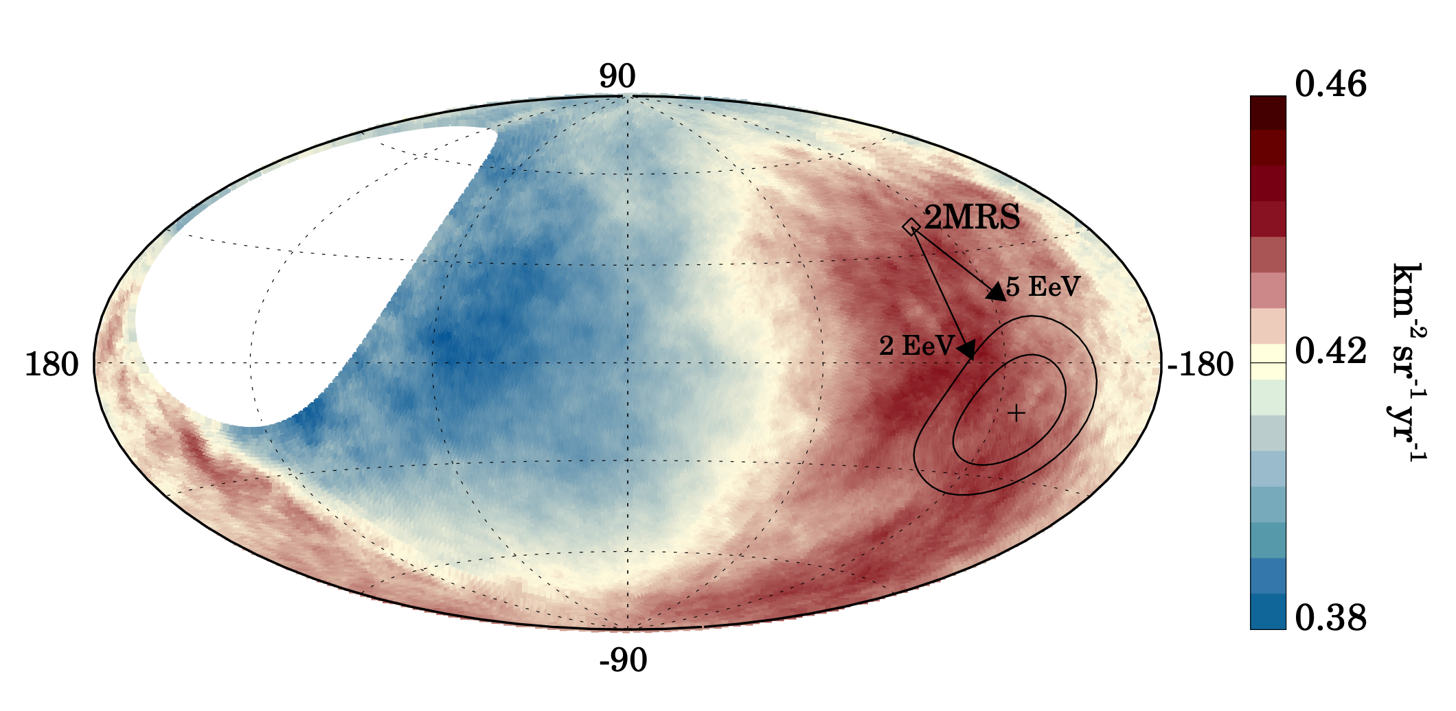

Slide 34
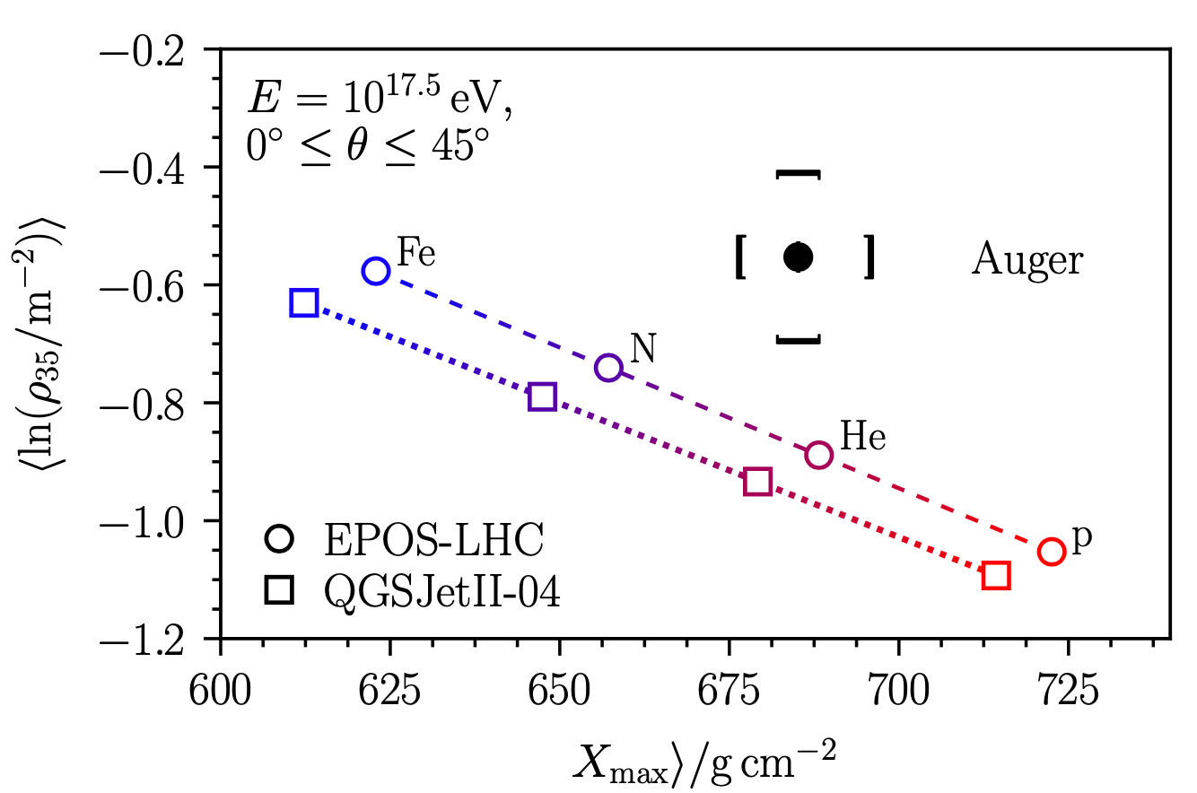

Slide 35
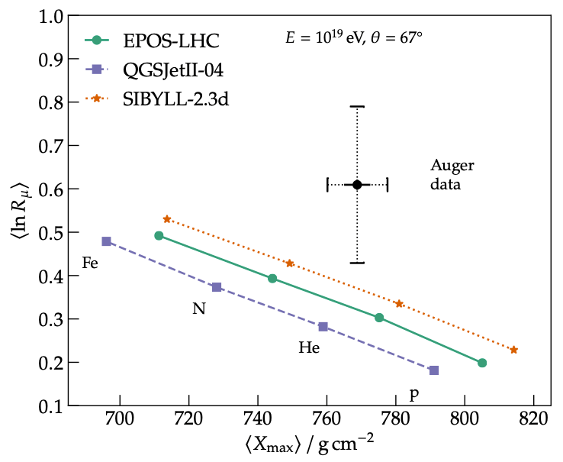

Slide 36
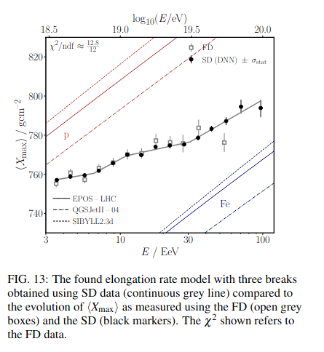

Slide 37
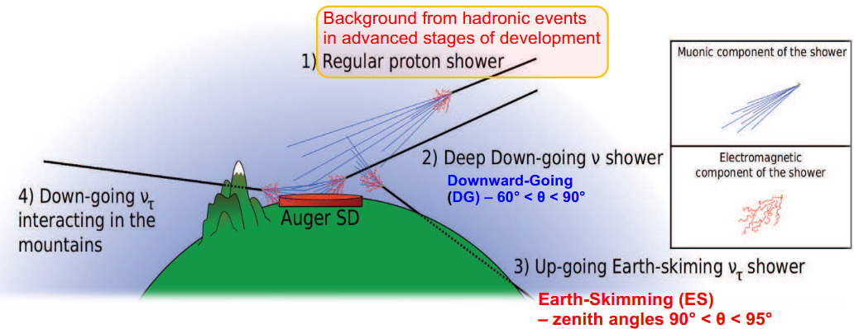

Slide 38
Searches for a diffuse (i.e., direction-independent, unresolved) flux of photons
Different energy ranges using data from different detector systems:
Above 10¹⁹ eV: 1500 m SD array
10¹⁸ to 10¹⁹ eV: FD + 1500 m SD array (hybrid data)
2 × 10¹⁷ to 10¹⁸ eV: HEAT/Coihueco + 750 m SD array (hybrid data)
Below 2 × 10¹⁷ eV (down to tens of PeV): 433 m SD array + UMD;

Slide 39
results of the blind search for overdensities over the exposed sky.
For this, we do a scan in energy in steps of 1 EeV between 32 EeV and 80 EeV and a scan in the top-hat search radius with steps of 1◦ between 1◦ and 30◦.
Furthermore, there are indications, at the ∼4𝜎 significance level, of anisotropies at intermediate angular scales, which are obtained when comparing the arrival directions against the distribution of potential sources from astrophysical catalogs, in particular that of nearby starburst galaxies, and around the Centaurus region.
A promising energy range to look for angular correlation between cosmic rays of extragalactic origin and their sources is at the highest energies, above few tens of EeV (1 EeV 1018 eV). Despite the flux of these particles being extremely low, the area of 3;000km2 covered at the Pierre Auger Observatory, and the 17-year data-taking period of the Phase 1 of its operations, have enabled us to measure the arrival directions of more than 2,600 ultra-high energy cosmic rays above 32EeV.
The data set, the largest available at such energies from an integrated exposure of 122;000 km2 sr yr, and search it for anisotropies over the 3.4π steradians covered with the Observatory. Evidence for a deviation in excess of isotropy at intermediate angular scale, with 15 Gaussian spread or 25 top-hat radius, is obtained at the 4σ significance level for cosmic-ray energies above 40 EeV.

Slide 40
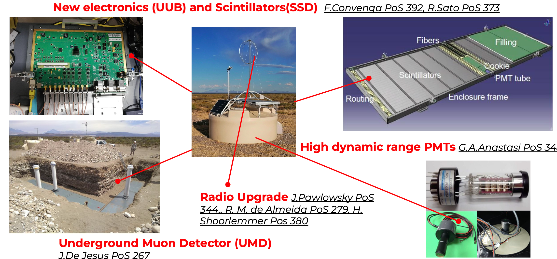
AugerPrime
WCD/SSD/RD can collect multi-hybrid events with a 100% duty cycle
Separation of shower components can be obtained
• by WCD/SSD for events up to ~600
• by WCD/RD for inclined events >600
• by WCD/SSD/UMD extending the mass sensitivity to the lower energies and
improving the photons/hadrons discrimination
• With UUB we will enhance the sensitivity of triggers to electromagnetic signals

