Slide 1
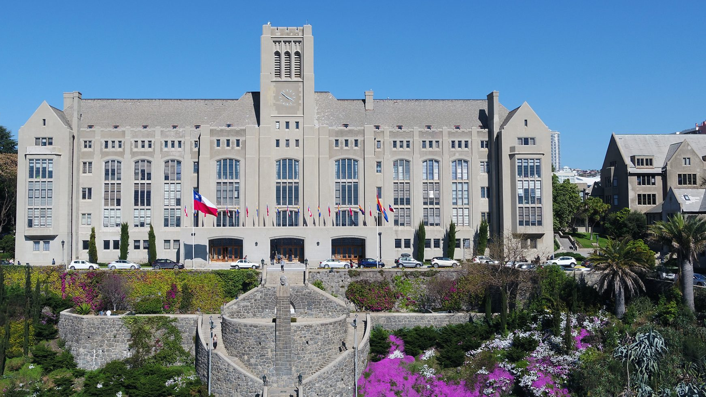
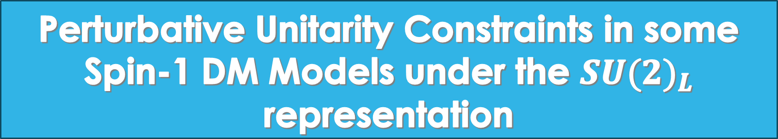
Perturbative Unitarity Constraints in some Spin-1 DM Models under the ${SU(2)}_{L}$ representation
Speaker: Gonzalo Benítez-Irarrázabal

Slide 2

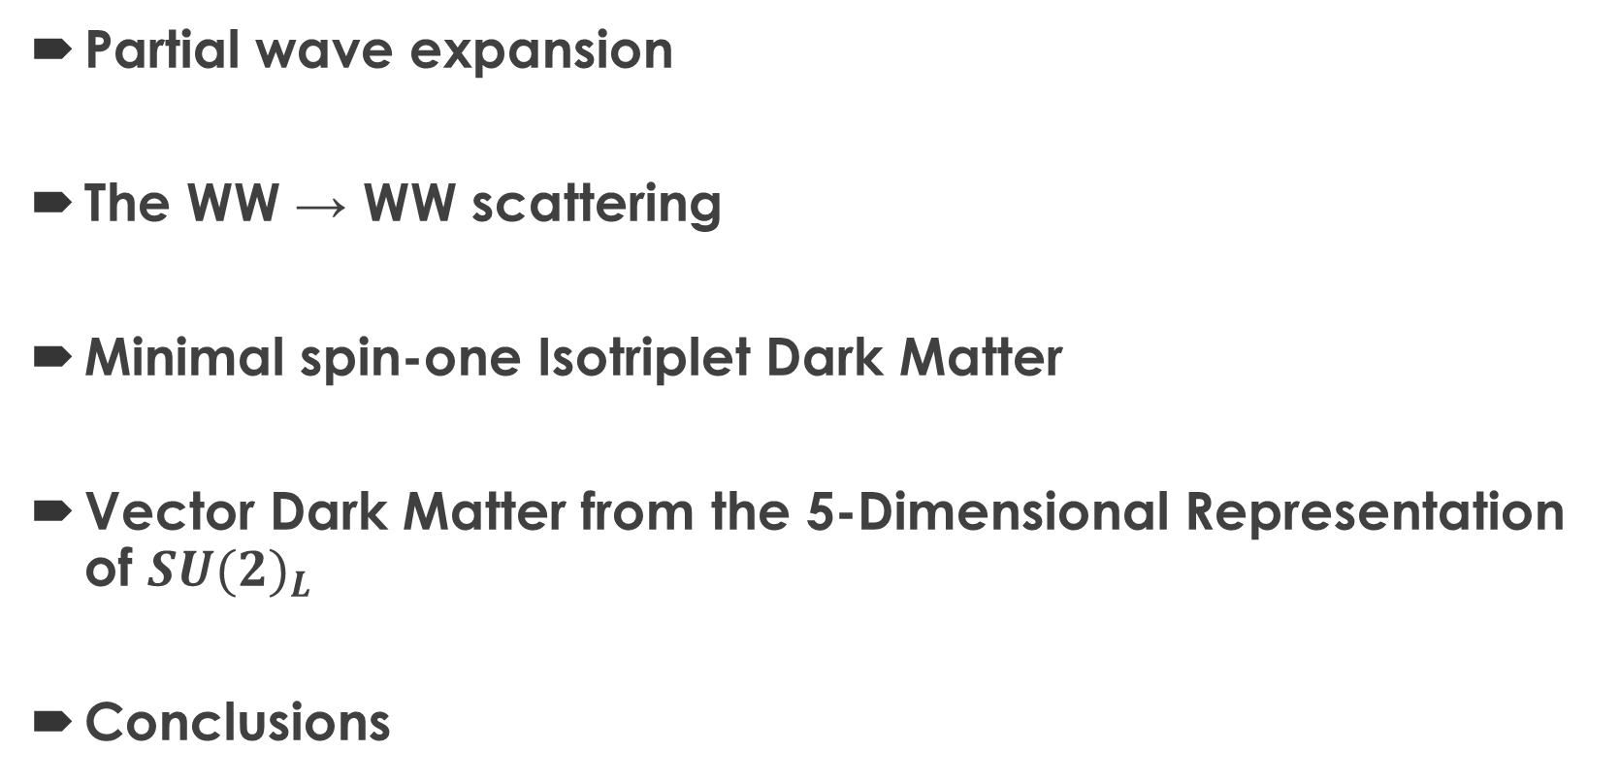
Outline
Partial wave expansion
The WW → WW scattering
Minimal spin-one Isotriplet Dark Matter
Vector Dark Matter from the 5-Dimensional Representation of ${SU(2)}_{L}$
Conclusions

Slide 3
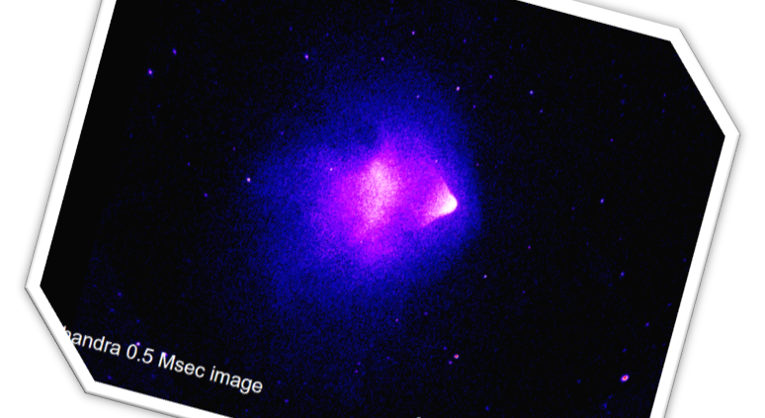
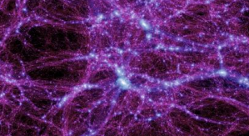
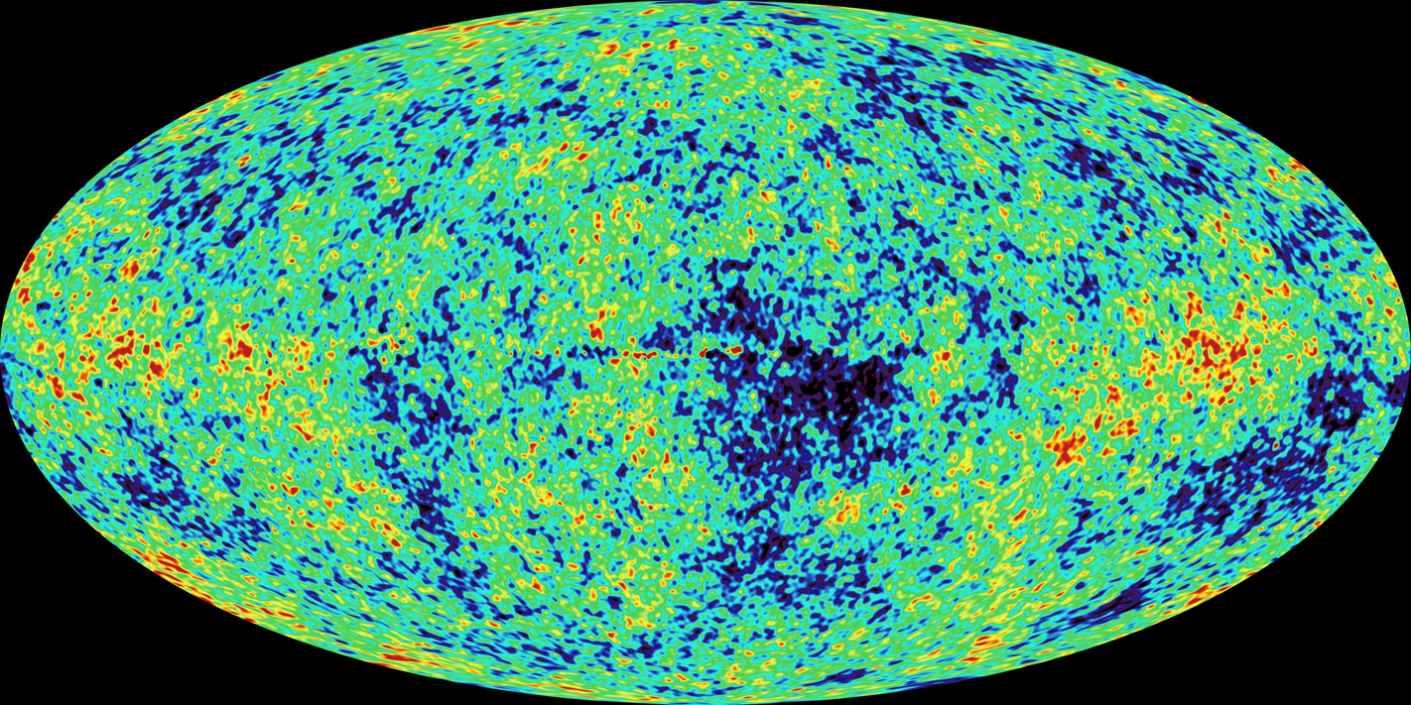
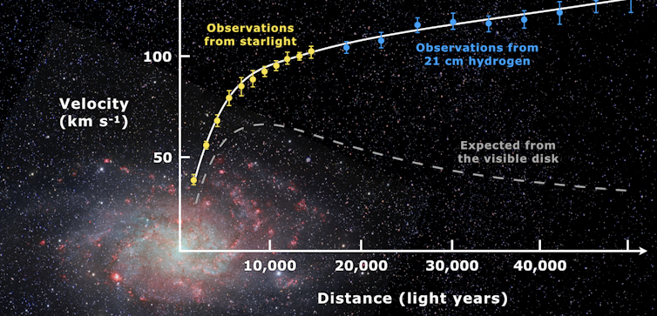
WIMP’s

Slide 4


Motivations
There are many kinds of WIMP’s.
The spin of the Dark Matter is not constrained.
There is no particular reason to avoid a spin-1 Dark Matter candidate.
Also introducing massive vector fields induce unitarity violation.
However, the unitarity violation is “manageable” and this anaylsis reduce the parameter space of the model.

Slide 5
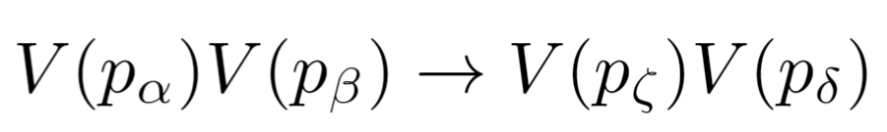
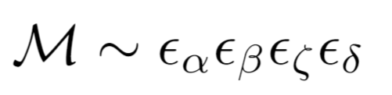

Slide 7
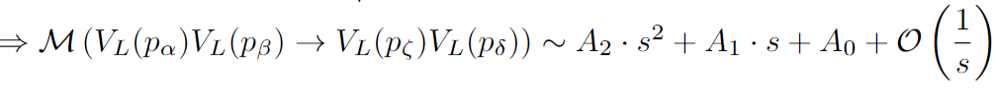

Slide 8


Slide 9
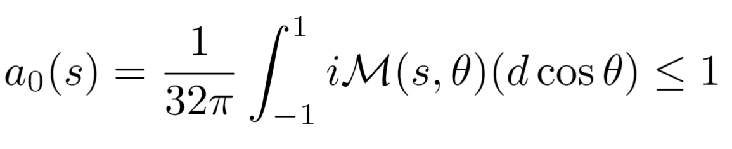
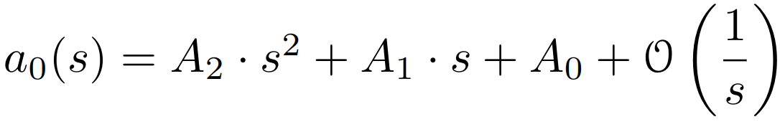

Slide 11


Slide 12
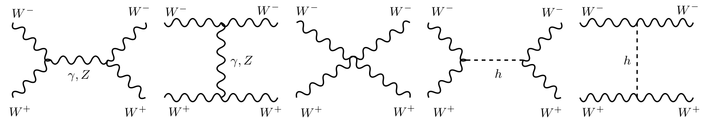

WW$→$WW scattering

Slide 13
WW$→$WW scattering
This channels induce problems at high energy

Slide 14
WW$→$WW scattering
This channels induce problems at high energy
Does the Higgs boson fix this problem?

Slide 15
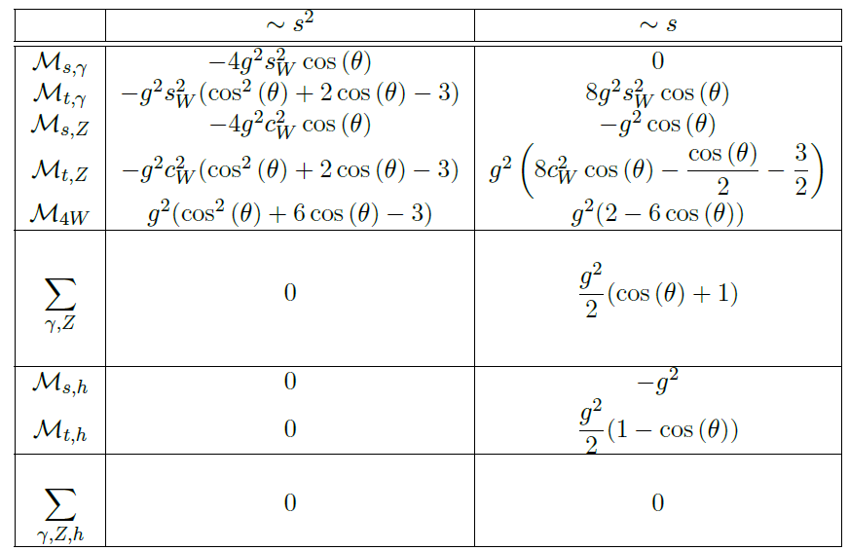

Slide 17
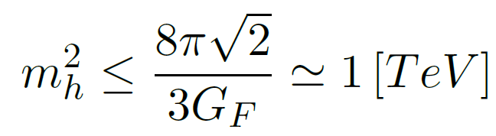
(*) B. W. Lee, C. Quigg, and H. B. Thacker, “Weak Interactions at Very High-Energies: The Role of the
Higgs Boson Mass,”

Slide 18

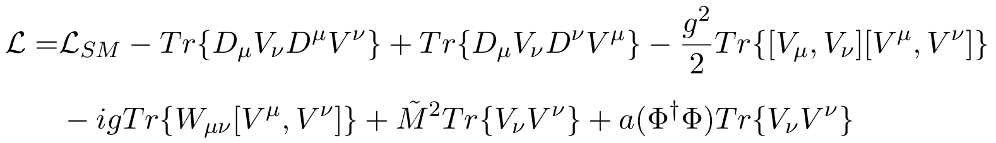
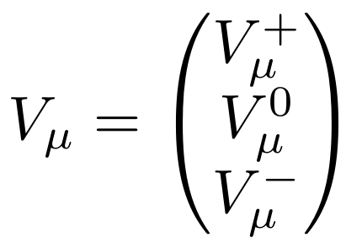
Minimal spin-one Isotriplet Dark Matter

Slide 19



Minimal spin-one Isotriplet Dark Matter

Slide 20
Minimal spin-one Isotriplet Dark Matter
DM
candidate
→ Stable
→ Neutral EM charge

Slide 21


$V^{+}V^{−}→V^{+}V^{−}$ scattering

Slide 22
$V^{+}V^{−}→V^{+}V^{−}$ scattering

Slide 23
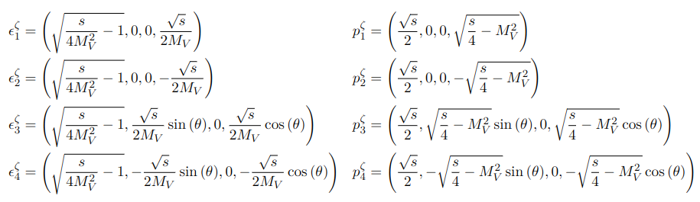
$V^{+}V^{−}→V^{+}V^{−}$ scattering

Slide 24
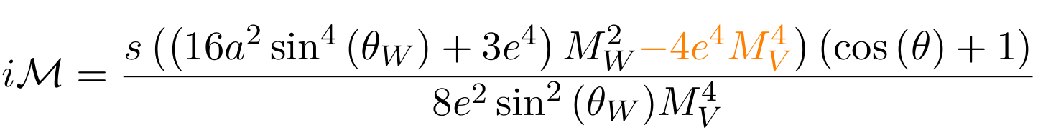

Slide 25
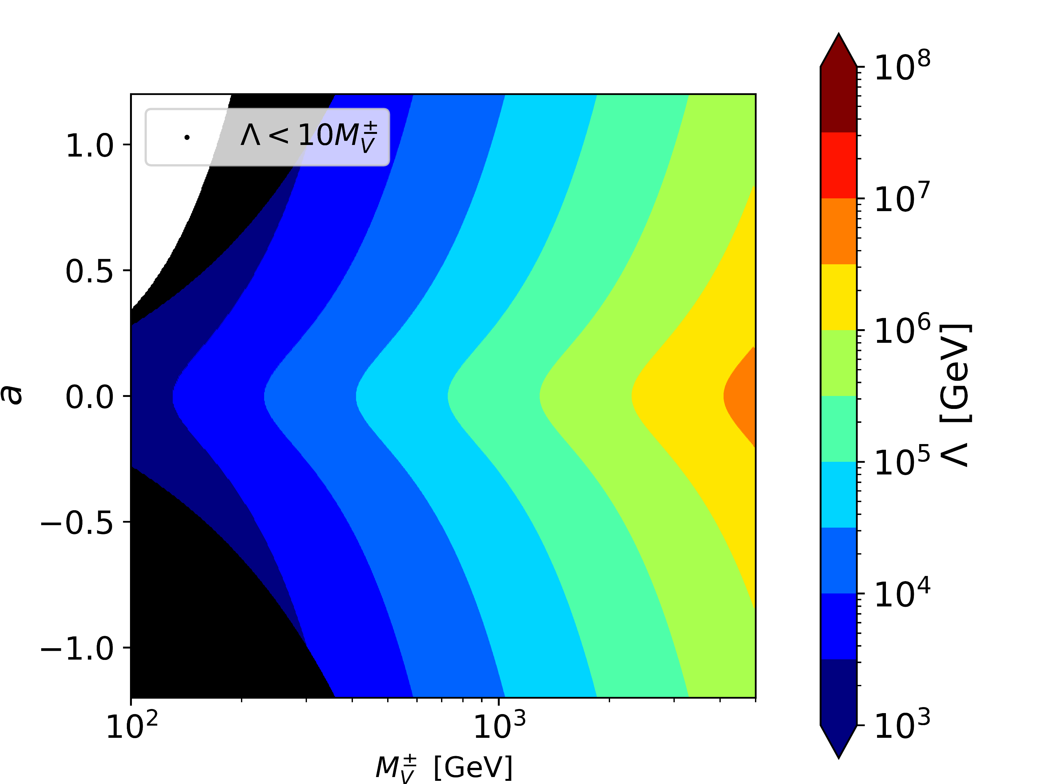
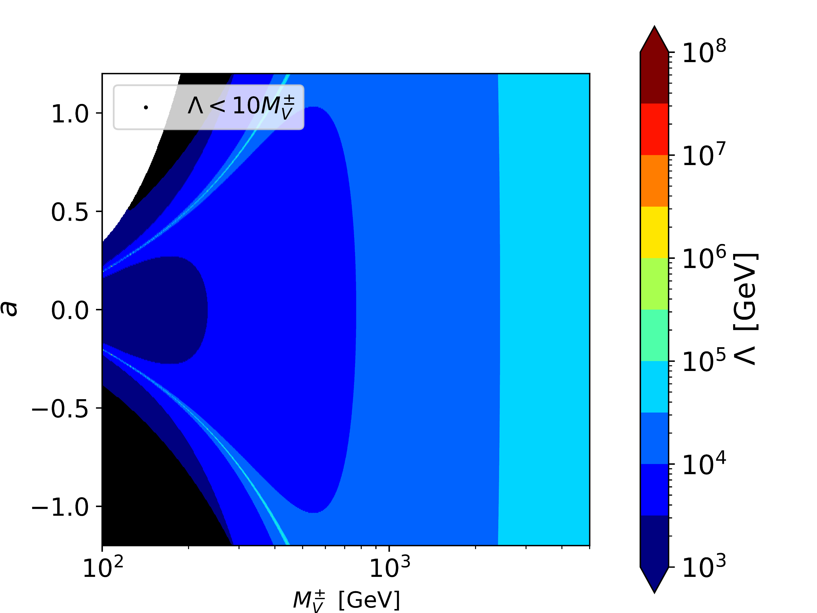
Using the approximation
Without the approximation

Slide 26
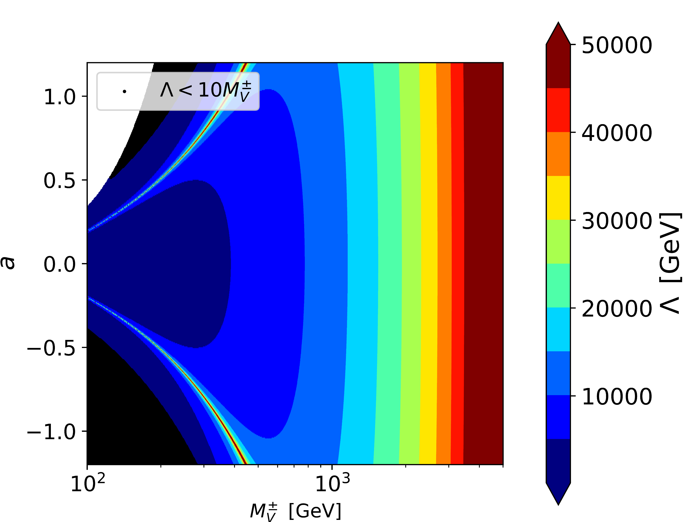

Slide 27
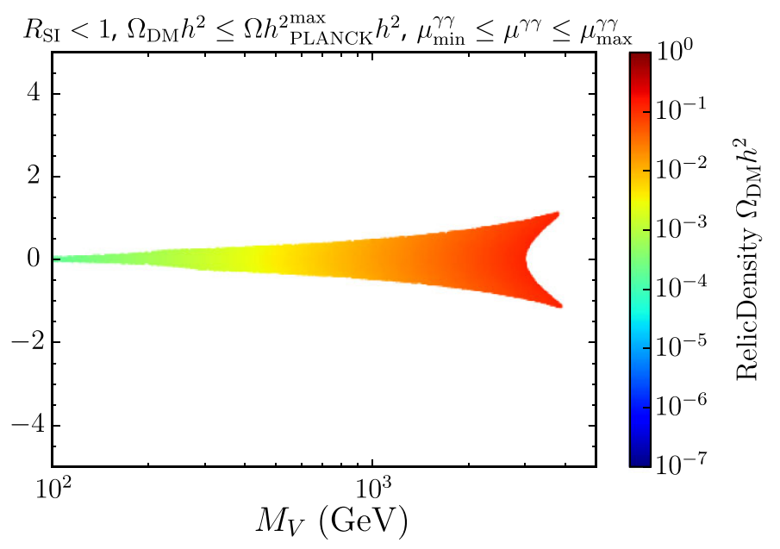
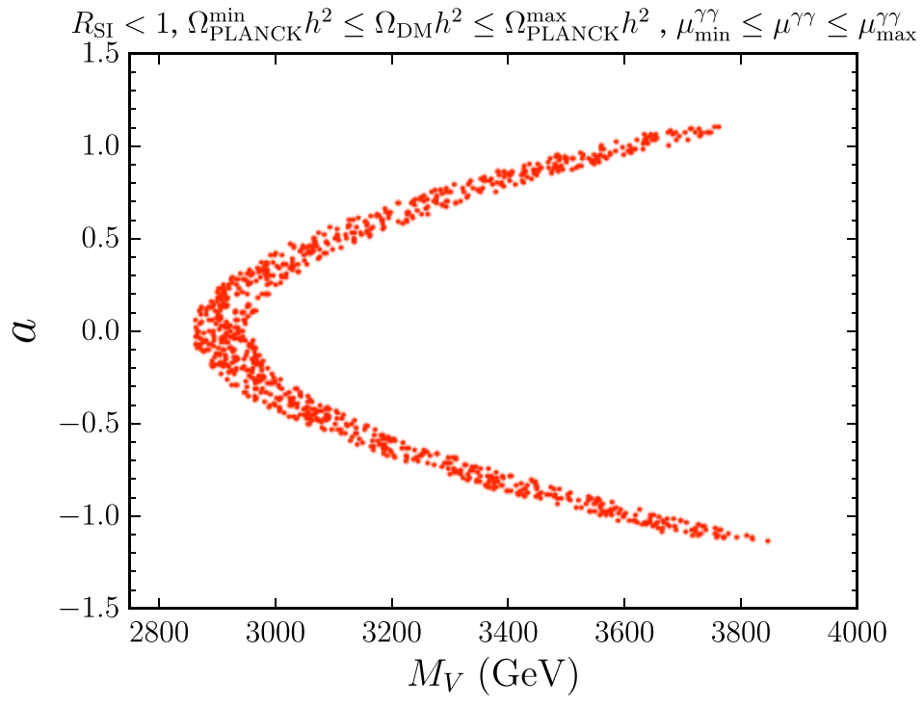


Slide 28
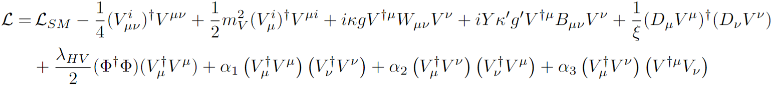
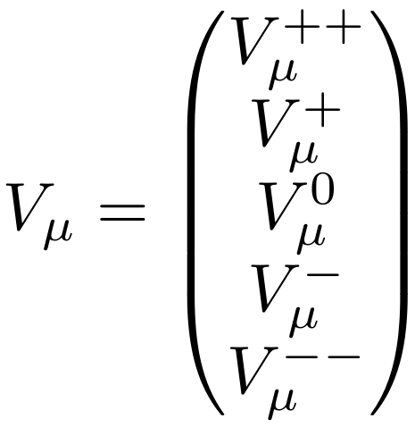
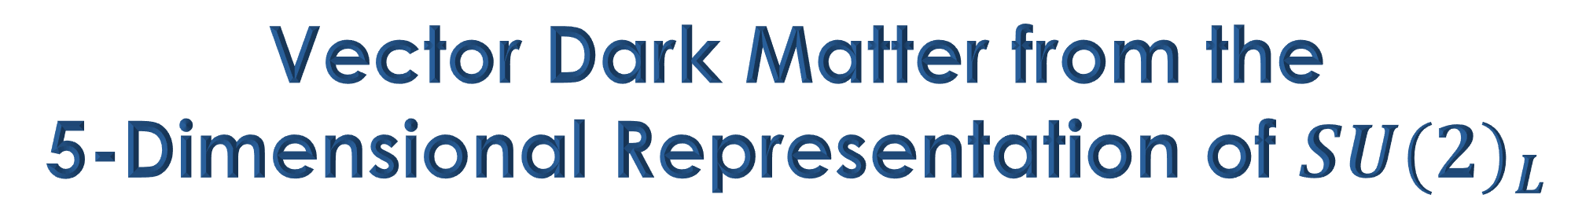
Vector Dark Matter from the
5-Dimensional Representation of ${SU(2)}_{L}$

Slide 29




Vector Dark Matter from the
5-Dimensional Representation of ${SU(2)}_{L}$

Slide 30

Vector Dark Matter from the
5-Dimensional Representation of ${SU(2)}_{L}$
DM
candidate
→ Stable
→ Neutral EM charge

Slide 31
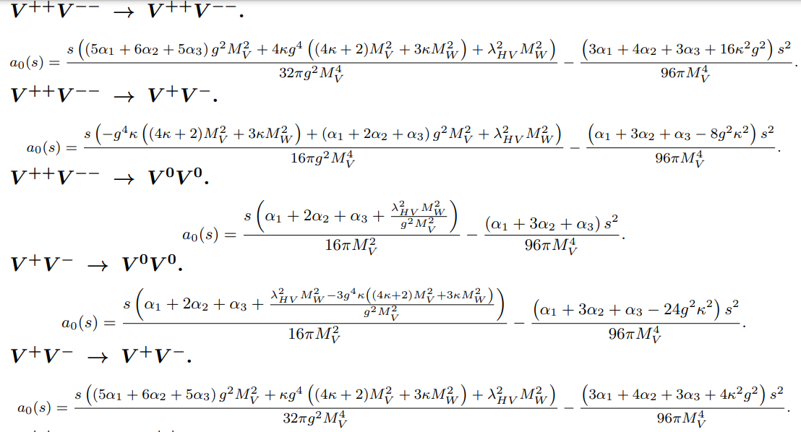

Slide 32


Slide 33
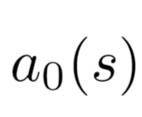

in every VV $→$VV scattering

Slide 34
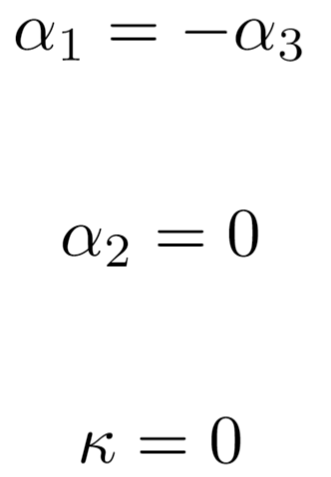
in every VV $→$VV scattering

Slide 35
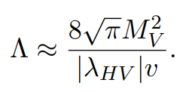
in every VV $→$VV scattering

Slide 36
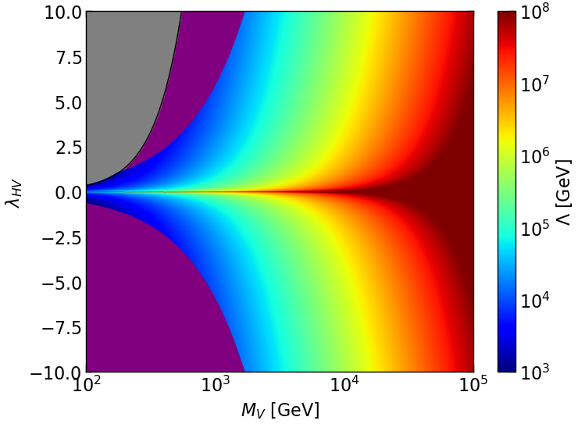

Slide 37
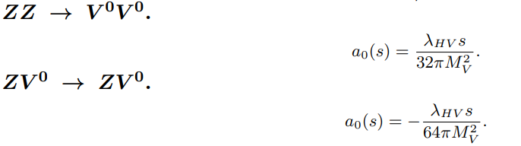
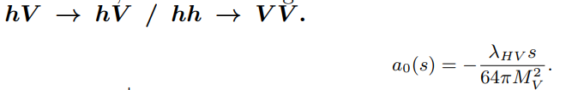

Slide 39
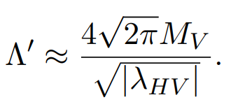
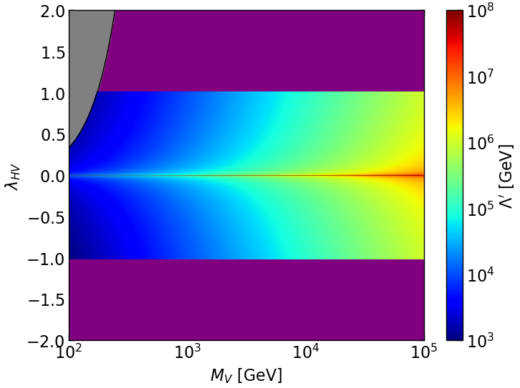

Slide 41
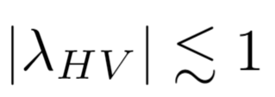

Slide 42

¿ ? This factor modifies the propagator

Slide 43
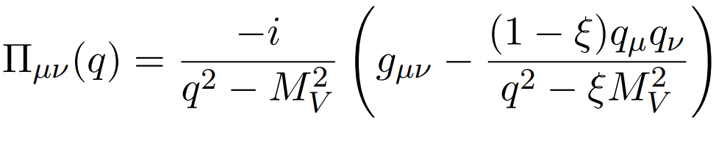

Slide 44
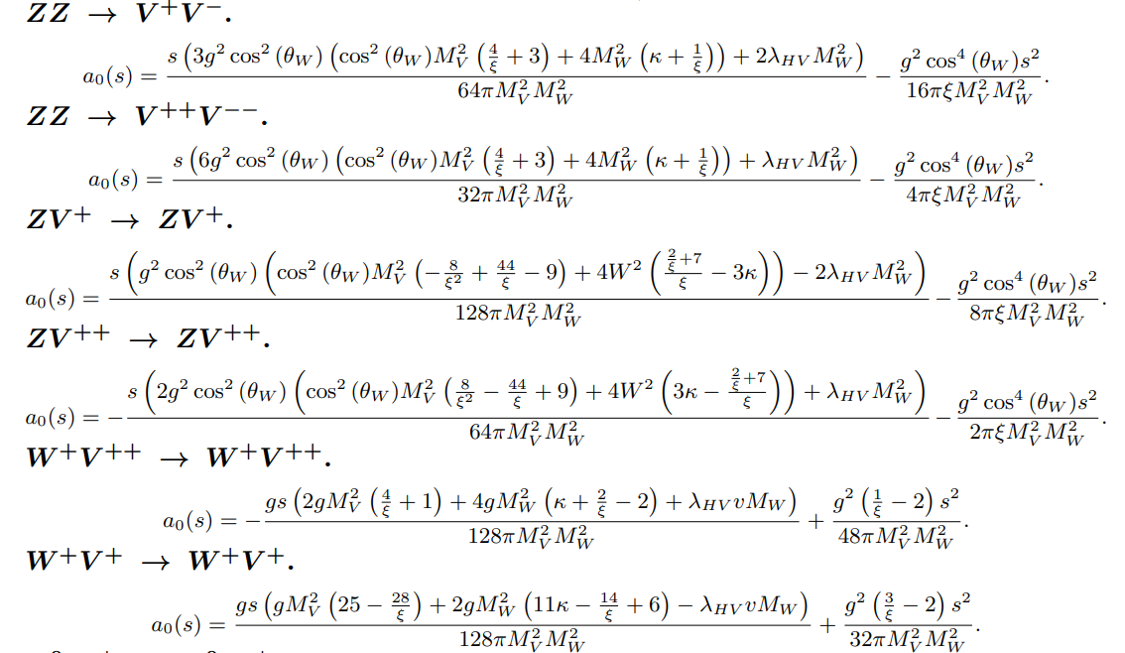

Slide 45


Slide 47
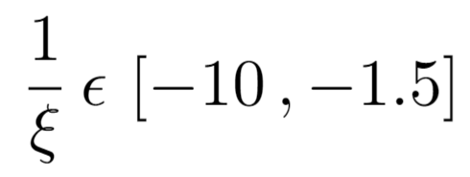

Slide 48
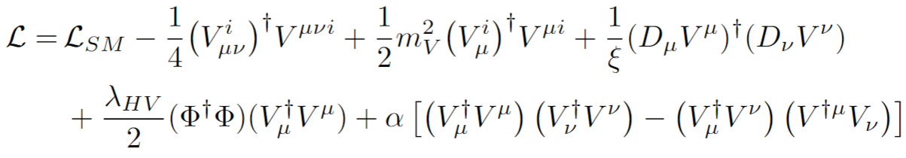
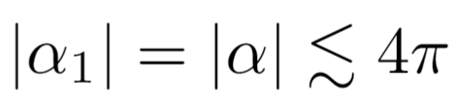

Slide 49

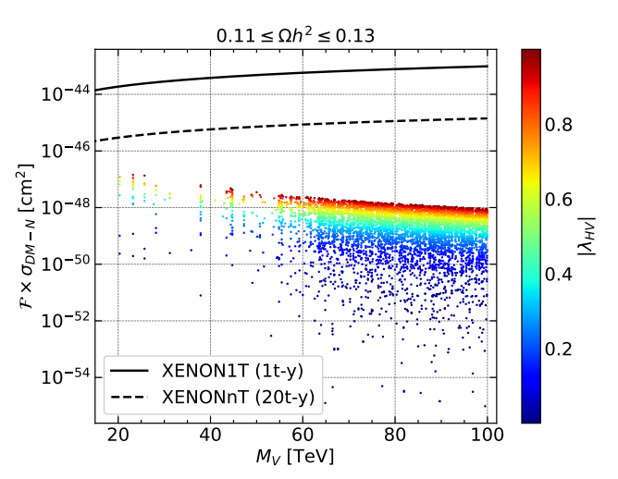
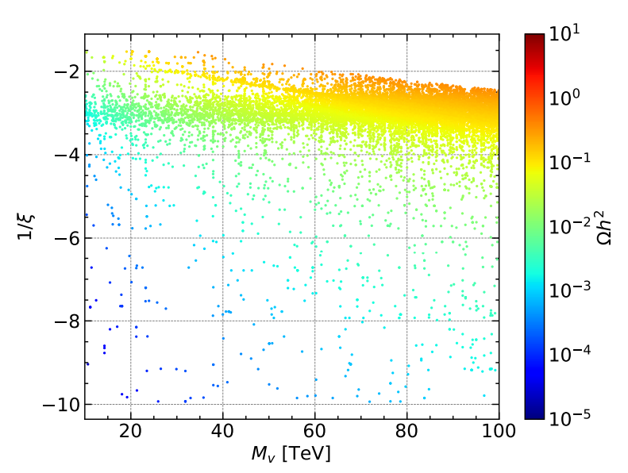
Phenomenological results

Slide 50
Summary
The parameter space is reduced.
We can use the approximation, but to be sure, it’s better use the exact polarization.
Coupling with the Higgs Boson needs to be small.
In the Quintuplet case the final parameter space coming from the Unitarity Violation analysis “push” the mass of the vector at dozens of TeV in order to saturate the Relic Density. Also, Direct Detection and its future projections are avoid.

Slide 51



Acknowledgements

Slide 52







Thank you!

Slide 53
Backup

Slide 54
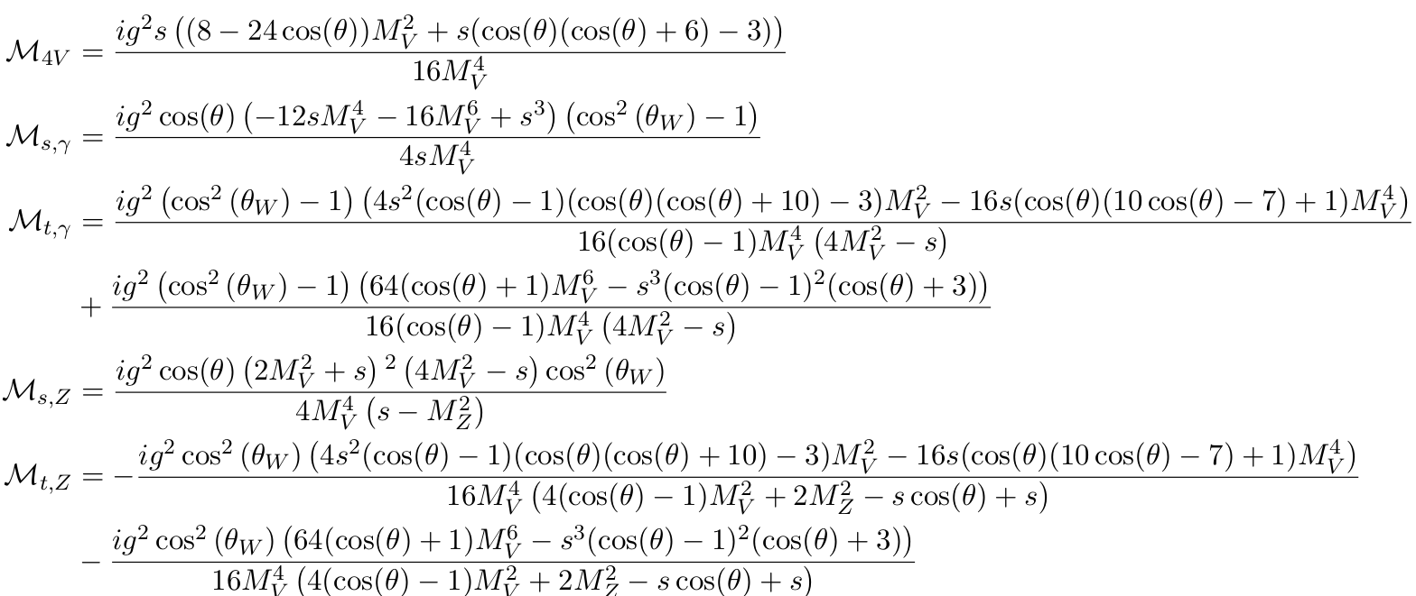
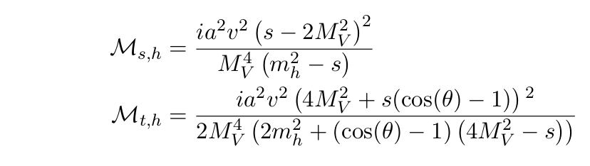
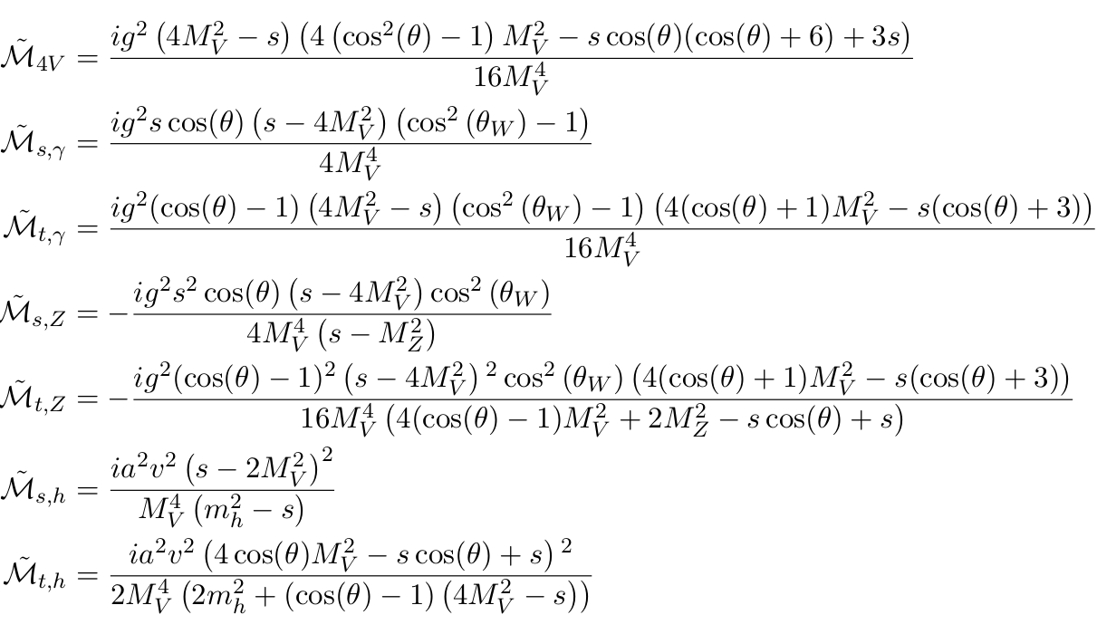

Slide 55
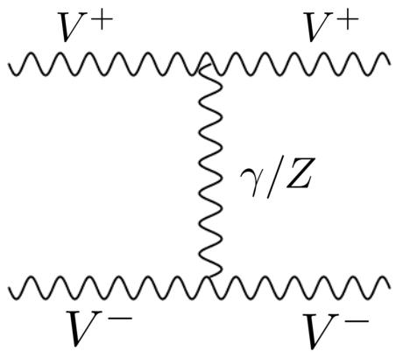
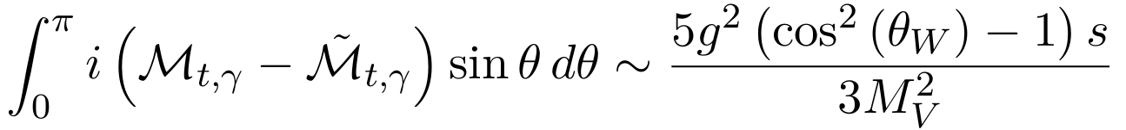
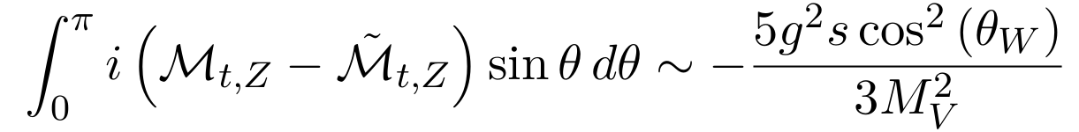



Slide 56


Slide 57


