Slide 1






ALICE Highlights
Jun Takahashi
for the ALICE collaboration

Slide 2
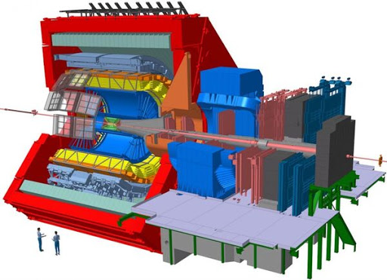





















ALICE: A Large Ion Collider Experiment

Slide 3
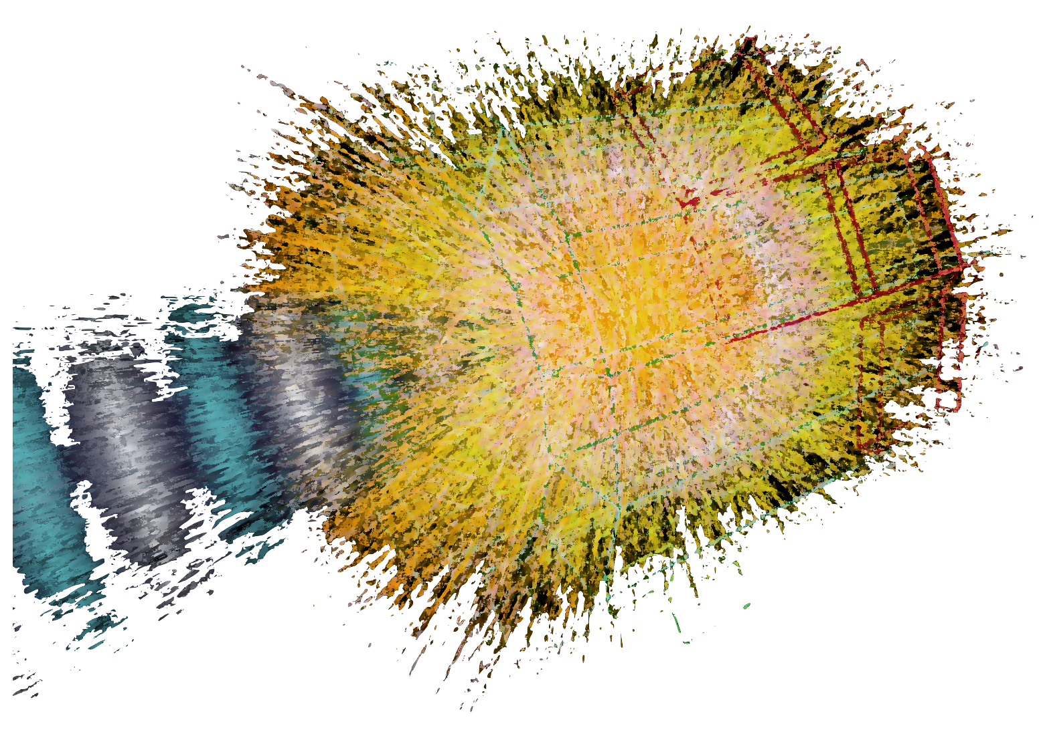



ALICE was specifically designed to study the strongly interacting quark-gluon plasma (sQGP).

Slide 4
Experimental investigation of QGP and QCD
2010-2012 2015-2018 2022-2024 2028-2030 2032-2034 2036-2039
Run I
LS1
Run 2
LS2
Run 3
LS3
Run 4
LS4
Run 5
LS5
Run 6
ALICE 1
ALICE 2
ALICE 2.1
ALICE 3
Top energy collisions:
13.6 TeV (pp)
8.16 TeV (p-Pb)
5.44 TeV (Xe-Xe)
5.36 TeV (Pb-Pb)

Slide 5
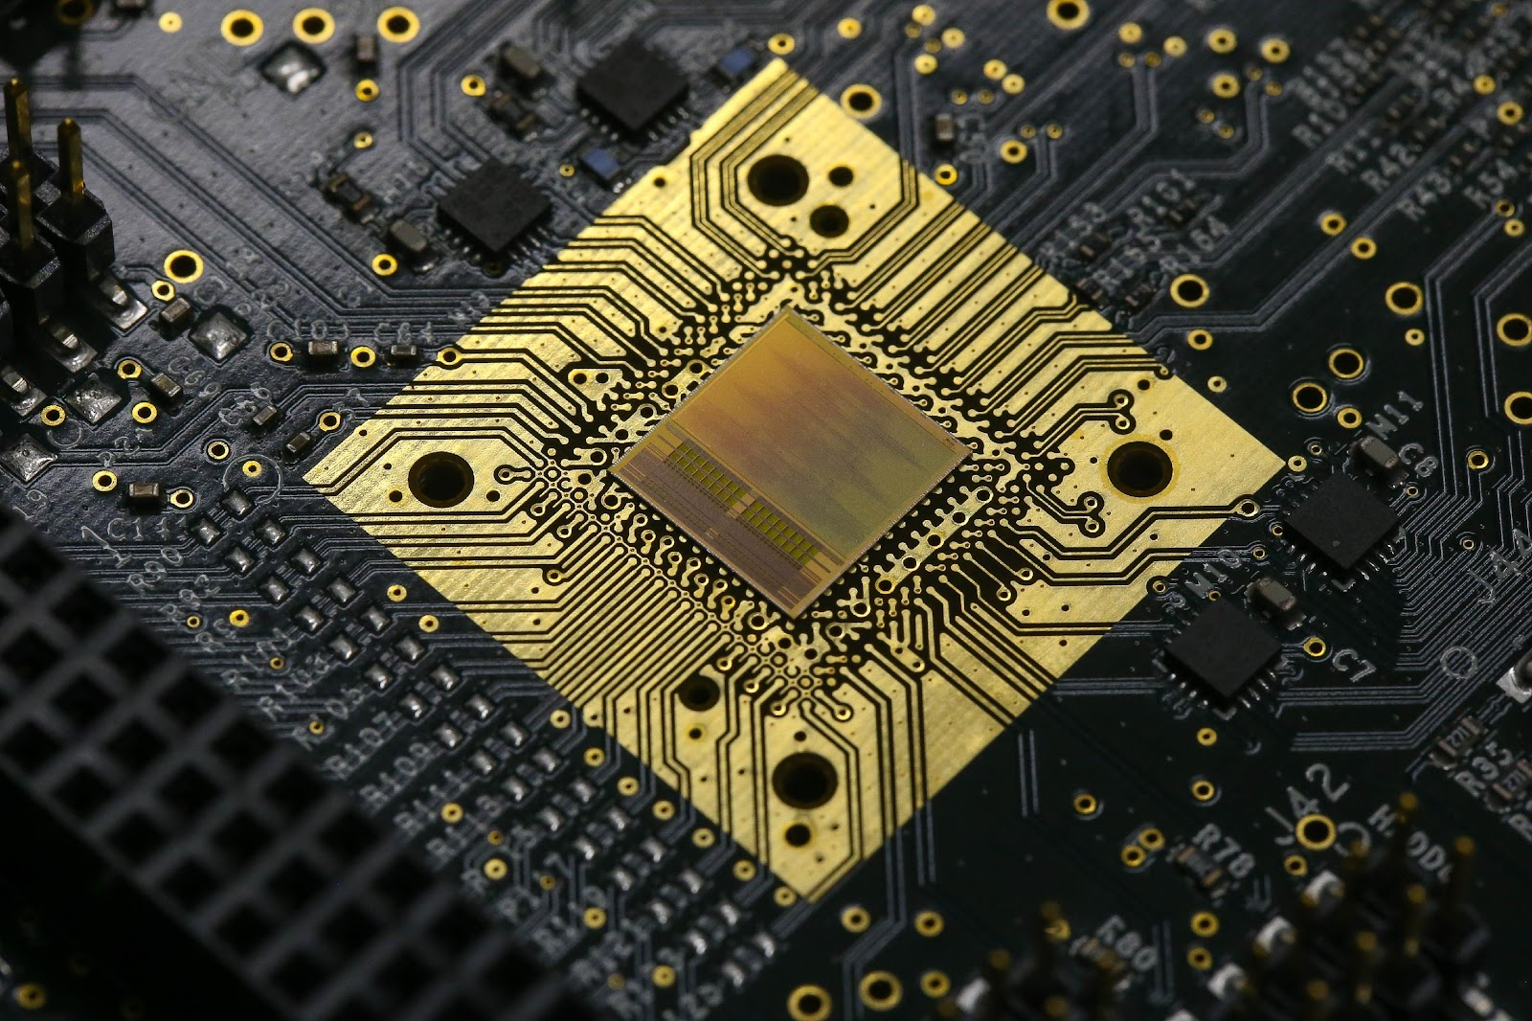
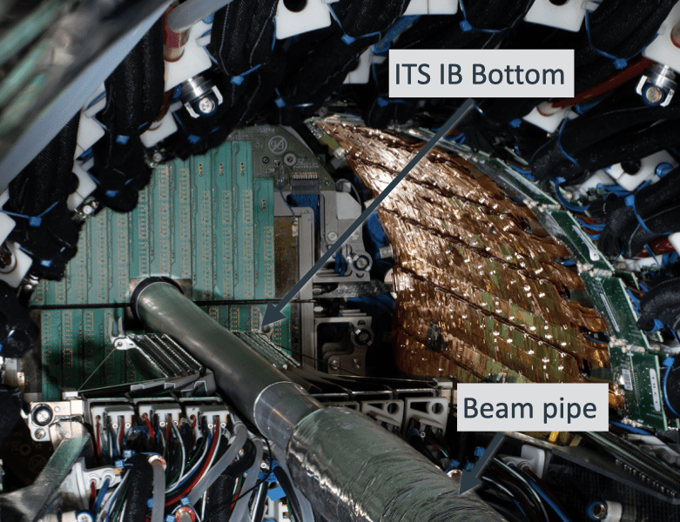
ALICE 2, improved for Run 3
Improved Tracking
ITS2 – 7 layers of fully Monolithic Pixel
Higher resolution
Closer to IP
Low mass
Higher rates:
TPC with continuous readout
MWPC replaced by GEMs
Upgraded fast electronics
SAMPA chip
32 input channels ASIC, made in CMOS 130nm technology
Combines analogic and digital functionalities in the same chip
Continuous readout
Other upgrades:
New Fast Interaction Trigger (FIT)
New Muon Forward Tracker (MFT)
New event processing farm

Slide 6
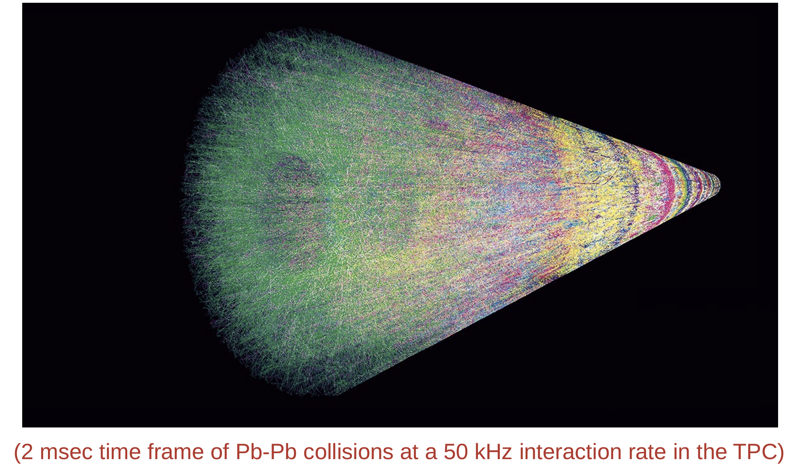
A better detector in Run 3
Full Online and Offline software upgrades (O2)

Slide 7




















































































































Probing the nuclear matter phase diagram

Slide 8
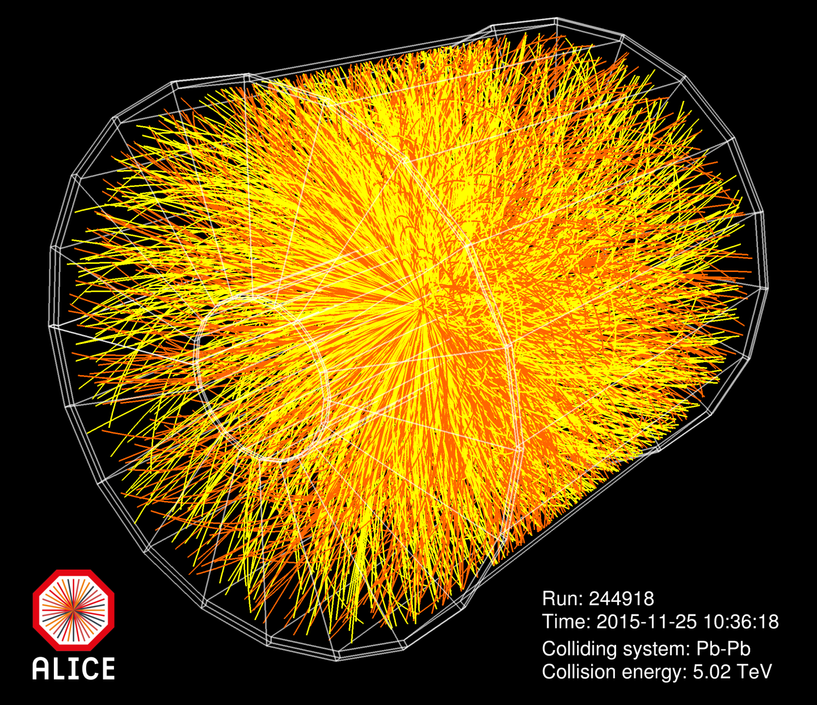








Slide 9
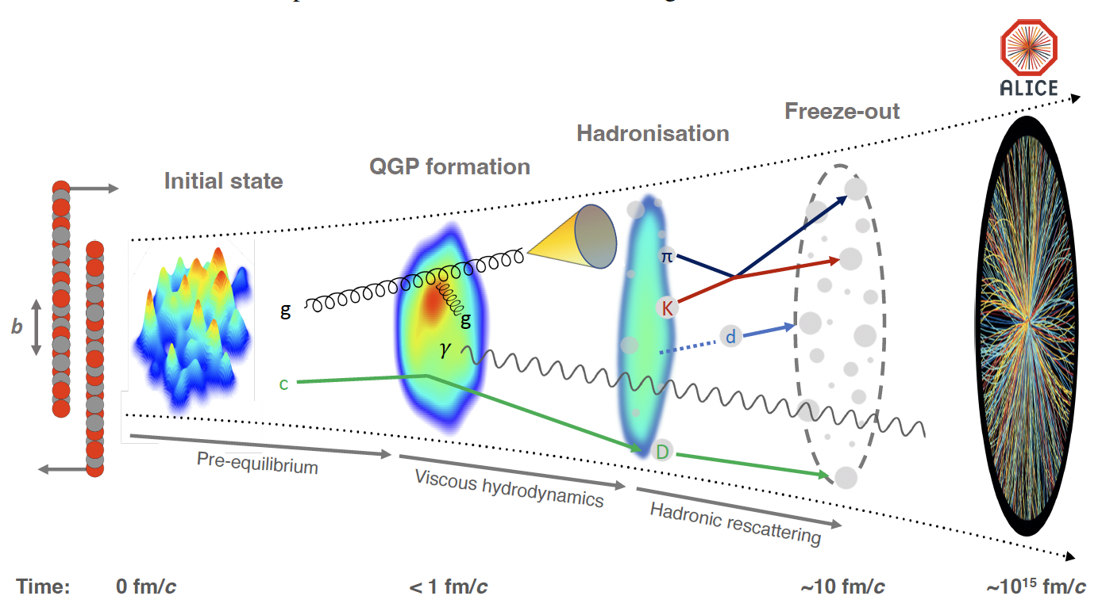
The standard model of heavy ion collisions
“The ALICE experiment: A journey through QCD”, Eur. Phys. J. C 84 (2024) 813
ALICE

Slide 10
Large amounts of particles produced
ALICE, Phys. Lett. B 772 (2017) 567-577
Charged particle pseudo-rapidity density
Central
Pb-Pb
Peripheral
Pb-Pb
ALICE can measure few tens of charged particles per unit of rapidity in peripheral heavy-ion collisions to few thousands in central heavy-ion collisions.

Slide 11
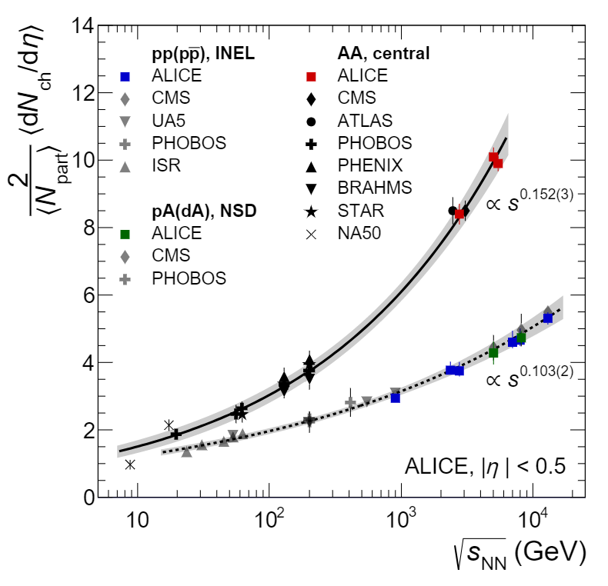
Heavy ion collisions are different from pp
Heavy-ion collisions are more efficient in transferring energy from beam- to mid- rapidity than pp
AA
pp, p-A
ALICE, Eur. Phys. J. C (2019) 79:307

Slide 12
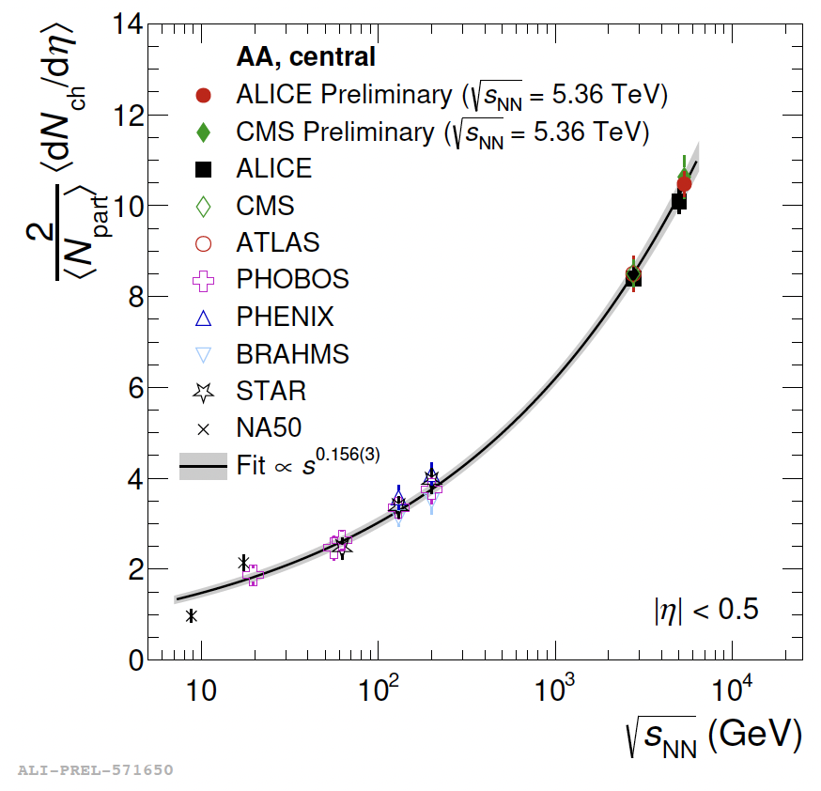
Heavy ion collisions are different from pp
Heavy-ion collisions are more efficient in transferring energy from beam- to mid- rapidity than pp
AA
pp, p-A
ALICE, Eur. Phys. J. C (2019) 79:307

Slide 13
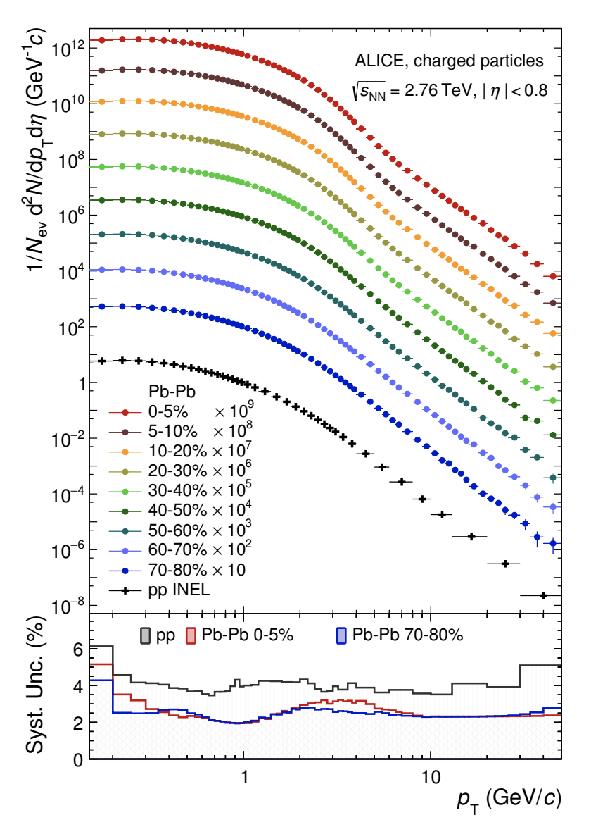


Different physics contribute to final spectra
Central collisions
High N_{ch}
Large and longer system.
Peripheral collisions
Small N_{ch}
Small number of binary collisions
Low p_{T} (< 2 GeV/c)
Particle spectra are described by a Boltzmann distribution → “thermal”, ~ exp(-1/k_{B}T)
“Bulk” dominated by light flavor particles
Non-perturbative QCD regime
High p_{T} (> 8-10 GeV/c)
Particle spectra described by a power law
Dominated by parton fragmentation (jets)
Perturbative QCD regime
ALICE, JHEP 11 (2018) 013

Slide 14
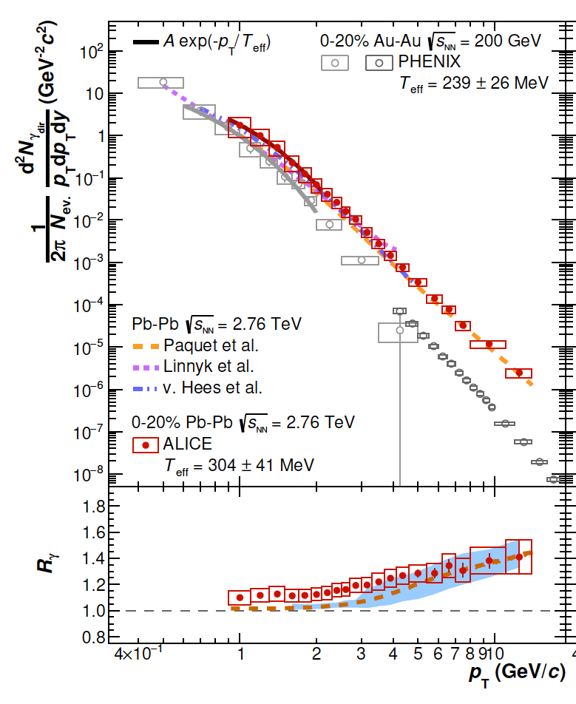
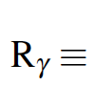

It’s Hot !!!
Direct photon spectra, thermal radiation from the medium.
Effective temperature is larger than the critical temperature and increases from RHIC to LHC.
ALICE, Eur. Phys. J. C 84 (2024) 813

Slide 15
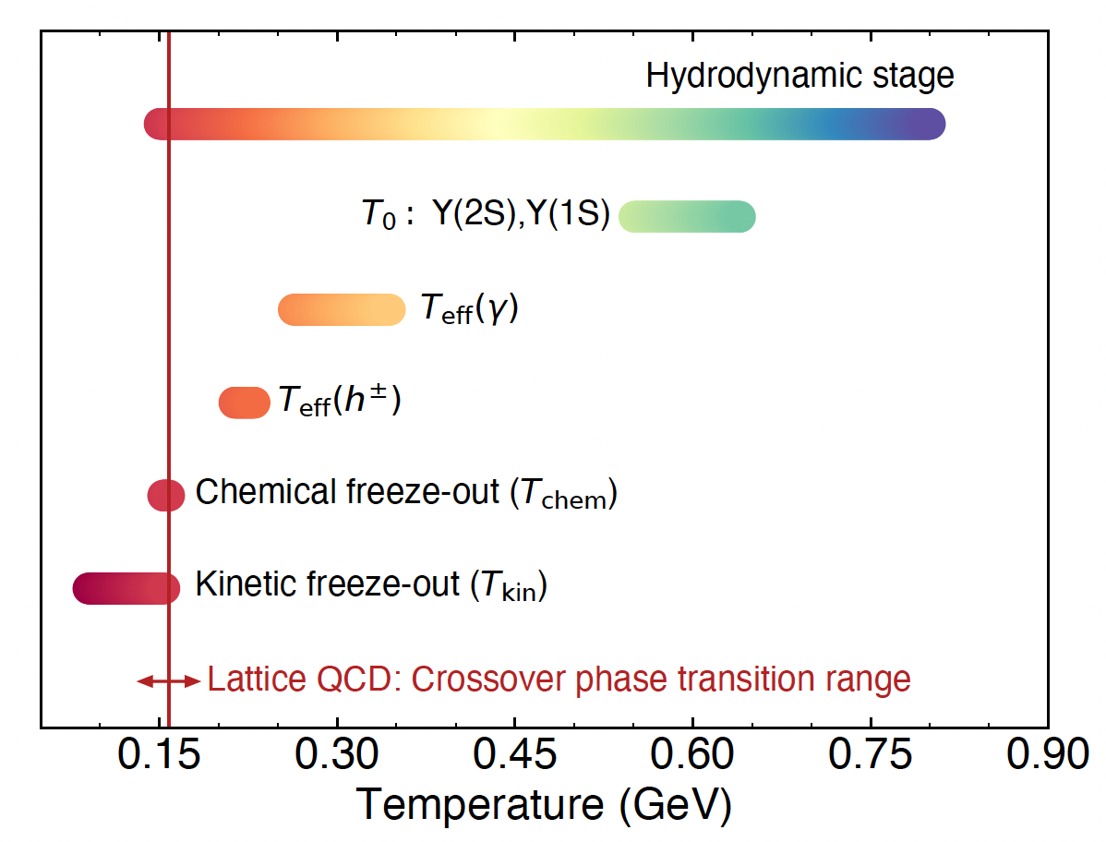
It’s Hot !!!
ALICE, Eur. Phys. J. C 84 (2024) 813
Effective temperature is larger than the critical temperature and increases from RHIC to LHC.
Of the order of a trillion Kelvin, ~10⁵ times hotter than the center of the Sun.

Slide 16
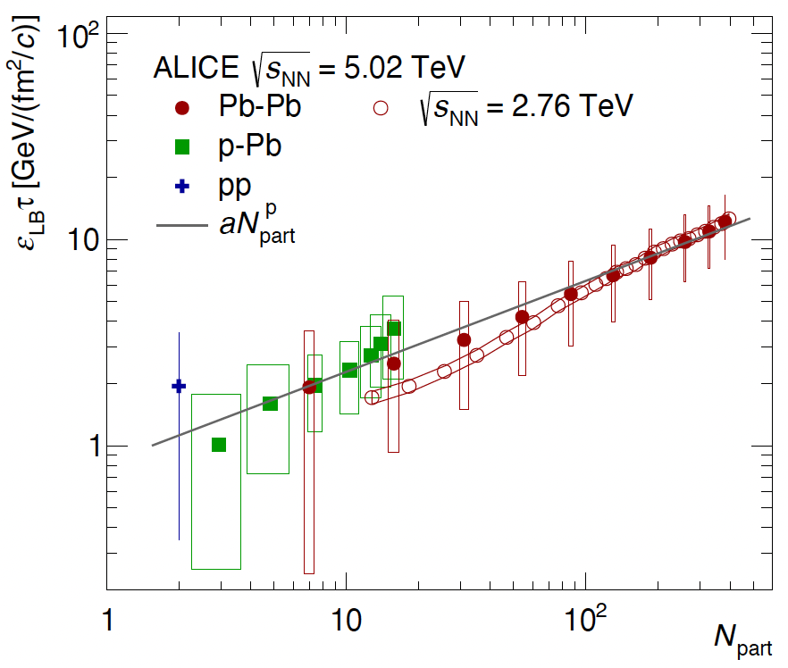
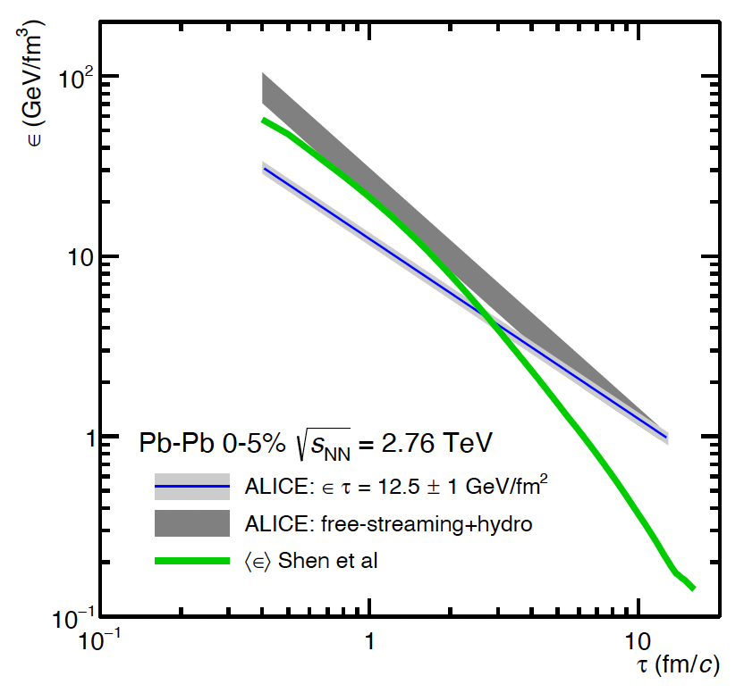
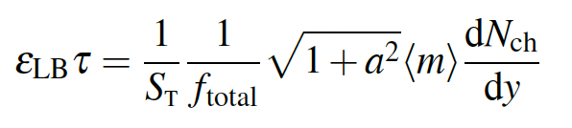
It’s dense !!!
ALICE, Eur. Phys. J. C 84 (2024) 813
LB: Lower Bound
S_{T}: Transverse size
f_{total}: fraction of charged to all
a: effective p_{T}/m
Energy density exceeds by more than a factor of 30 the critical energy density from lattice QCD in most central Pb–Pb collisions at the LHC.

Slide 17
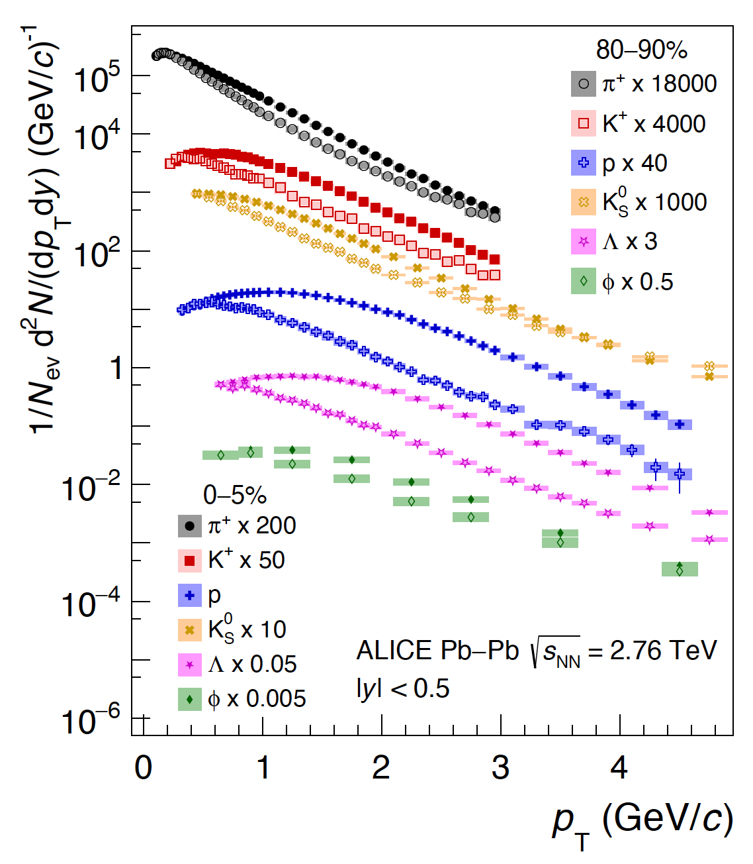
It’s rapidly expanding !!!
ALICE’s excellent PID provides identified particle spectra to low p_{T}.
ALICE, Eur. Phys. J. C 84 (2024) 813

Slide 18
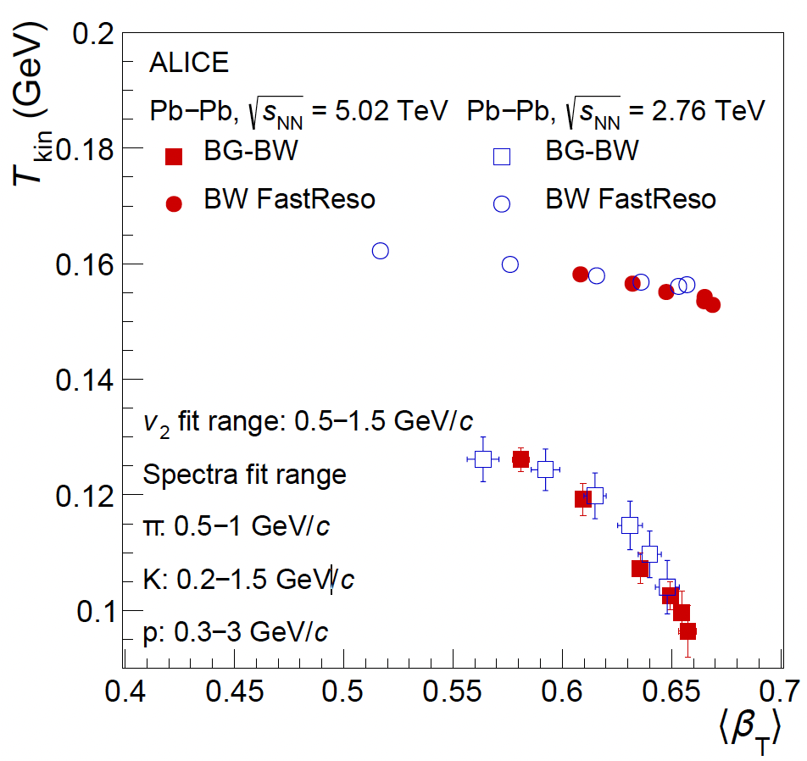
It’s rapidly expanding !!!
The radial flow velocities derived from p_{T} spectra approach ~70% of the speed of light.
ALICE, Eur. Phys. J. C 84 (2024) 813

Slide 19
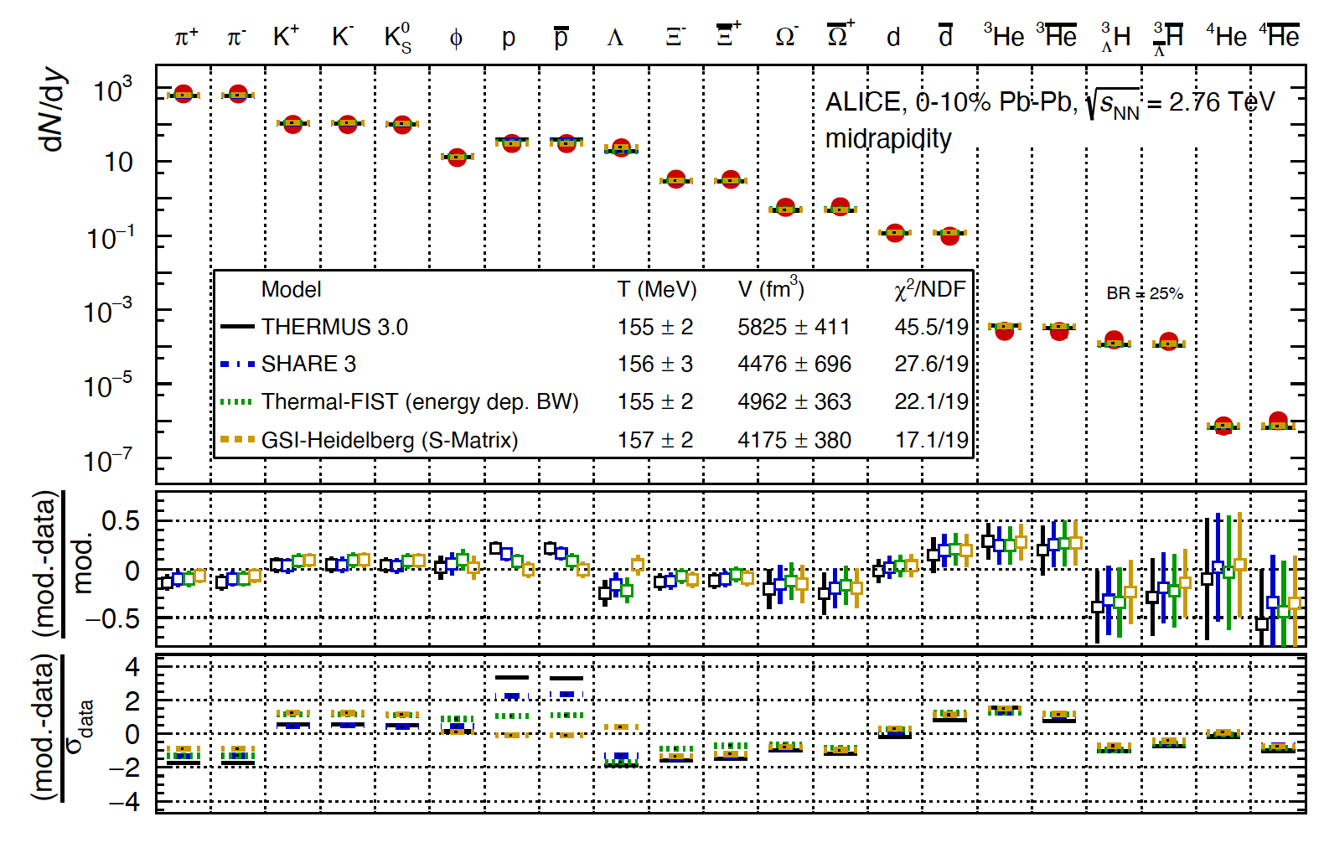
It’s equilibrated !!!
Particle abundances well described by statistical hadronization models, confirming the thermal nature of particle production.
ALICE, Eur. Phys. J. C 84 (2024) 813

Slide 20
It’s enhanced
Strangeness enhancement.
gluon fusion will enhance strangeness production in QGP.
Higher enhancement for Omegas than Lambdas.
ALICE, PLB 728 (2014) 216

Slide 21
It’s puzzling
Strangeness enhancement.
gluon fusion will enhance strangeness production in QGP.
Higher enhancement for Omegas than Lambdas.
Enhancement also in pp and p-Pb where originally QGP was not expected.
ALICE, Nature Phys. 13, (2017) 535
Hadrochemistry depends on final state N_{ch}, independent of colliding system and energy.
ALICE, PLB 728 (2014) 216

Slide 22
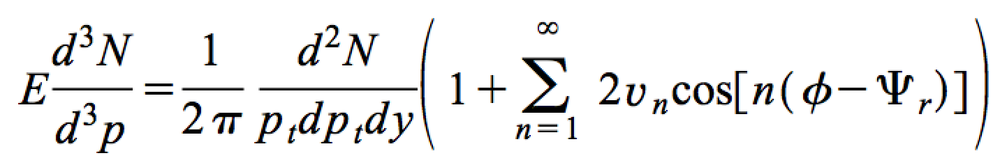
It’s hydrodynamic !!!!
ALICE, PRL 107(2011) 252301
Elliptic flow measurements show success of low viscosity relativistic hydrodynamics to describe the QGP evolution.

Slide 23
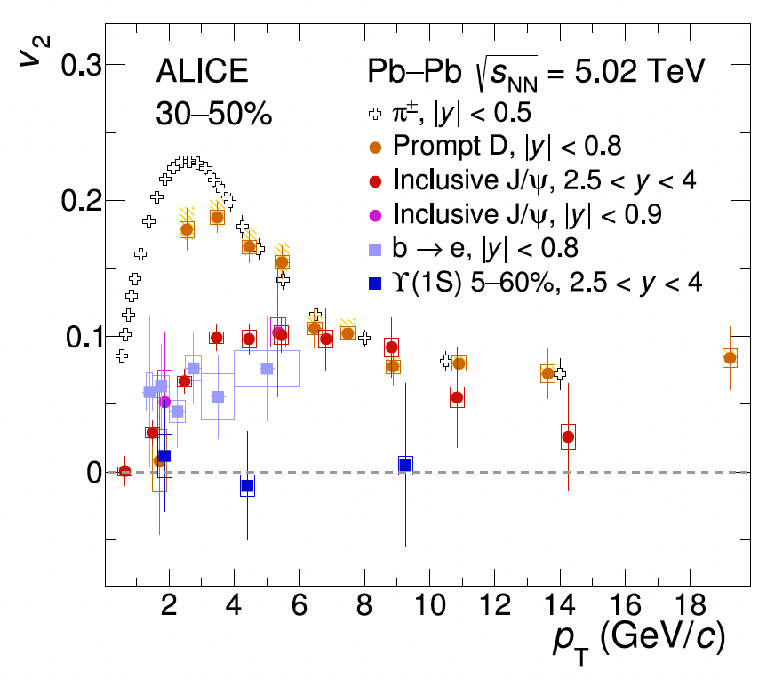
It’s Charming
Charm hadrons show anisotropic flow, suggesting that charm quarks are at least partly thermalized in the QGP.
Charm quarks partially thermalized means colored partons can move freely over larger distances than hadron scale.
ALICE, Eur. Phys. J. C 84 (2024) 813

Slide 24
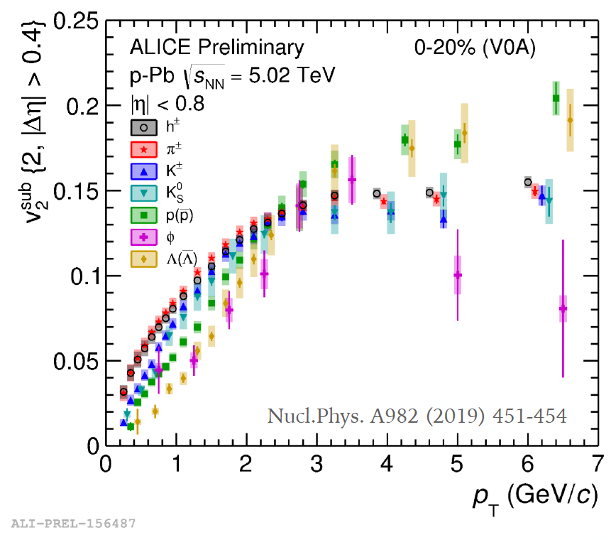
Collectivity in small systems
Small systems also showed collectivity signatures, similar to observed in Pb-Pb.
While hydrodynamic-like description
seems to be favored by data especially at high multiplicities, the effects of initial state effects from initial gluon momentum correlations may play an important role at low-N_{ch}.

Slide 25
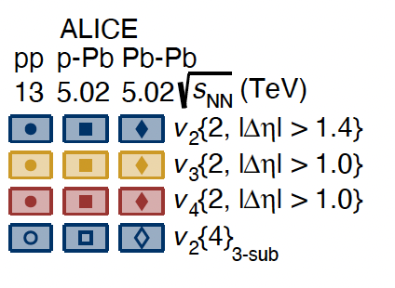
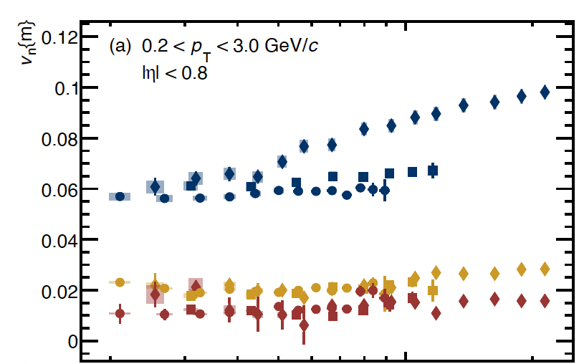

Small vs. large systems
ALICE, Eur. Phys. J. C 84 (2024) 813
v₂:
Pb-Pb: increase with N_{ch}.
pp & p-Pb: weak variation with N_{ch}.
Consistent with v₂ reflecting the system’s collective response to the initial geometry

Slide 26
Small vs. Large systems
ALICE, Eur. Phys. J. C 84 (2024) 813
v₂:
Pb-Pb: increase with N_{ch}.
pp & p-Pb: weak variation with N_{ch}.
Consistent with v₂ reflecting the system’s collective response to the initial geometry
v₃ and v₄:
similar and without significant dependence on N_{ch}.
higher harmonics originating from fluctuations.

Slide 27
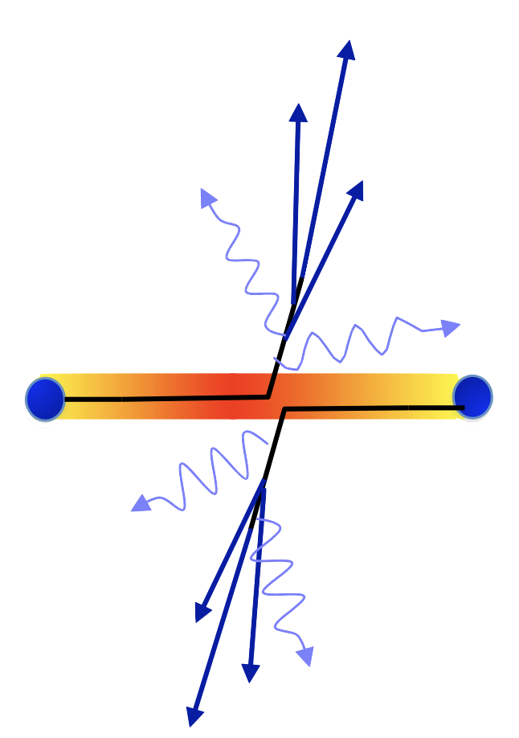
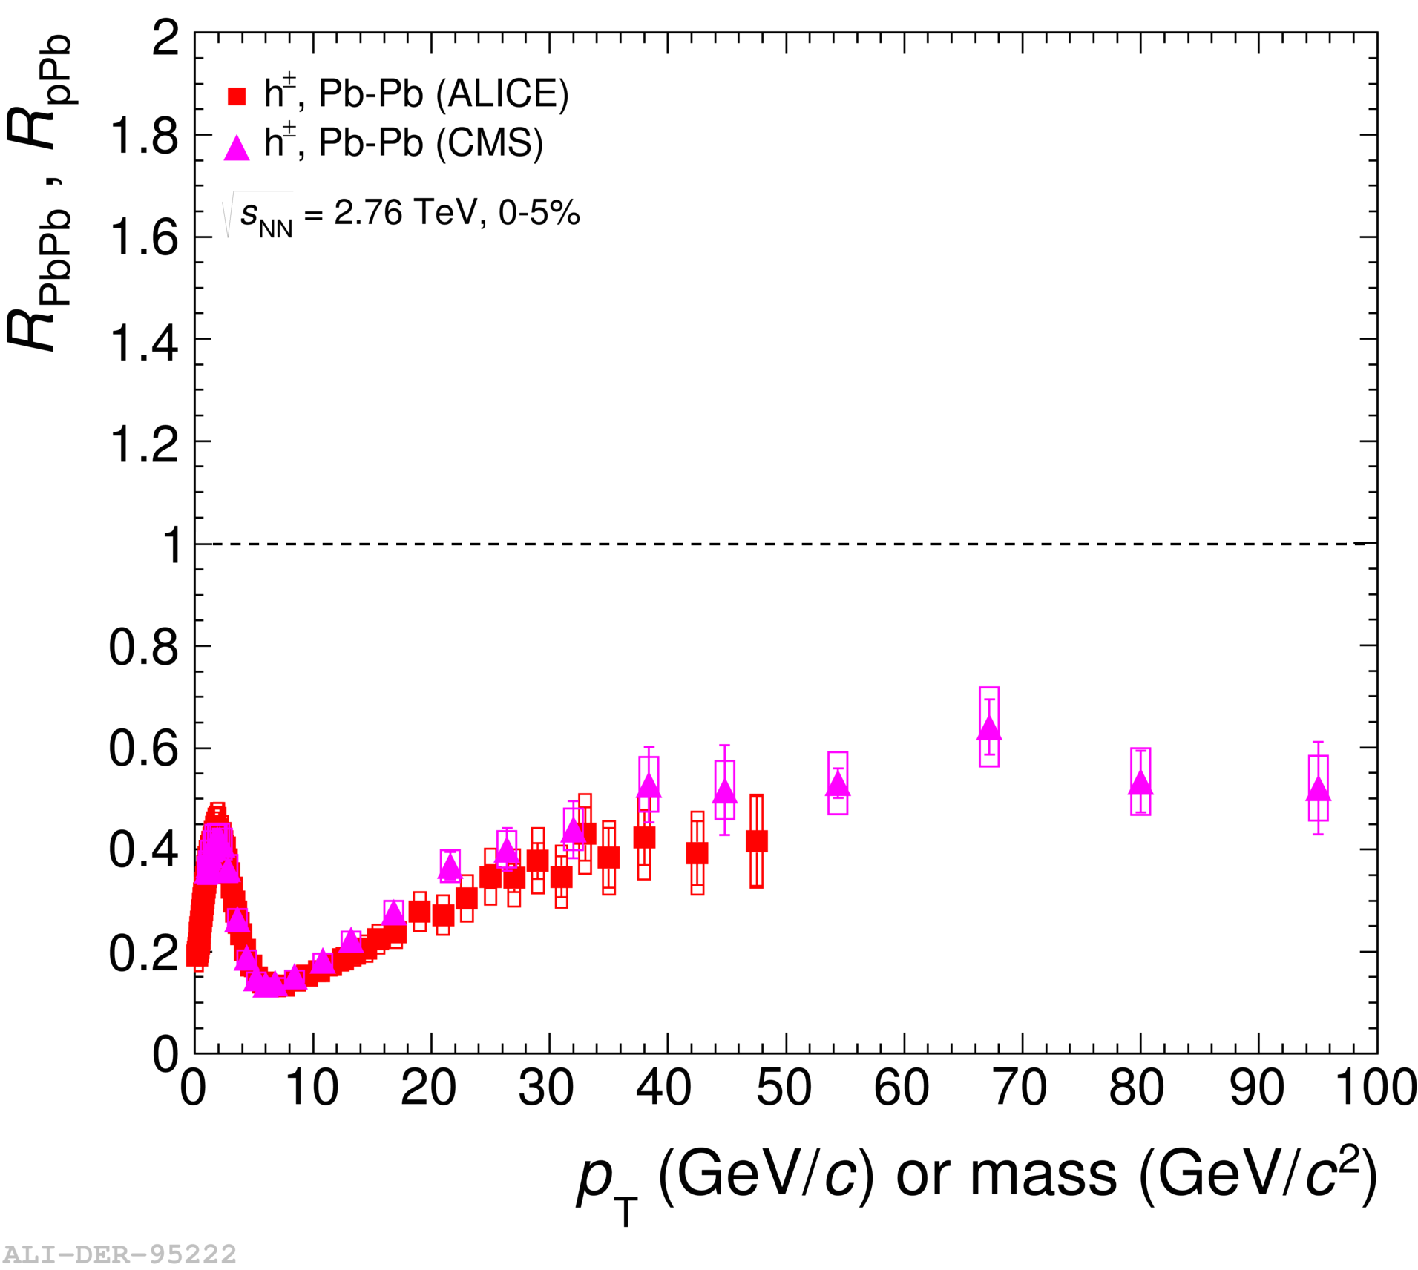
It’s strongly interacting
ALICE, EPJ C74 (2014) 3054
pQCD
R<1 “Soft”
Suppression
Parton energy loss to medium results in depletion of high-p_{T} hadrons.
Medium is highly opaque to colored probes.
Nuclear modification factor compares p_{T} spectra of AA with pp.

Slide 28
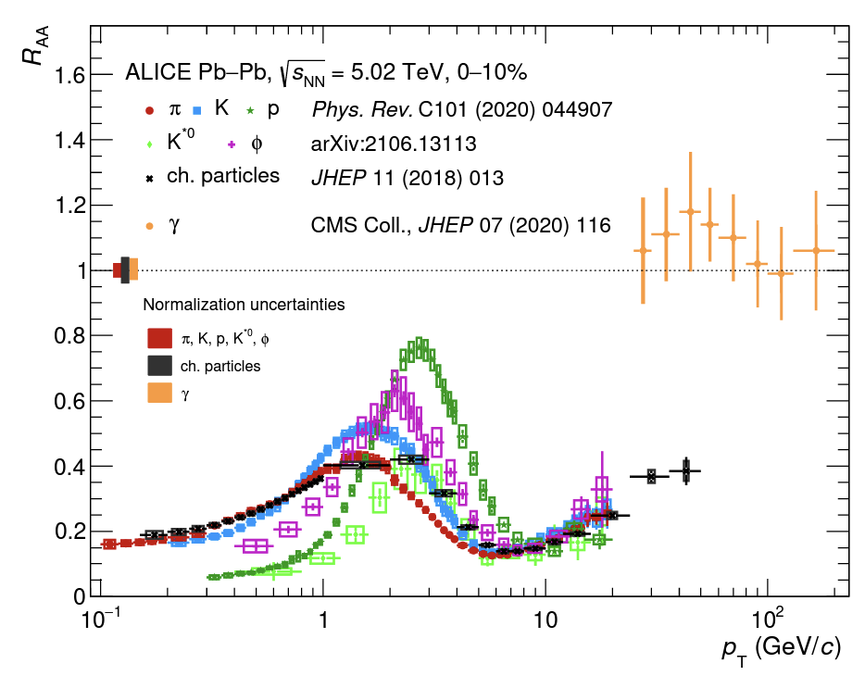
It’s strongly coupled QGP
ALICE, Eur. Phys. J. C 84 (2024) 813
Suppression same for a wide range of light flavor hadrons, evidence of jet quenching at partonic level.

Slide 29
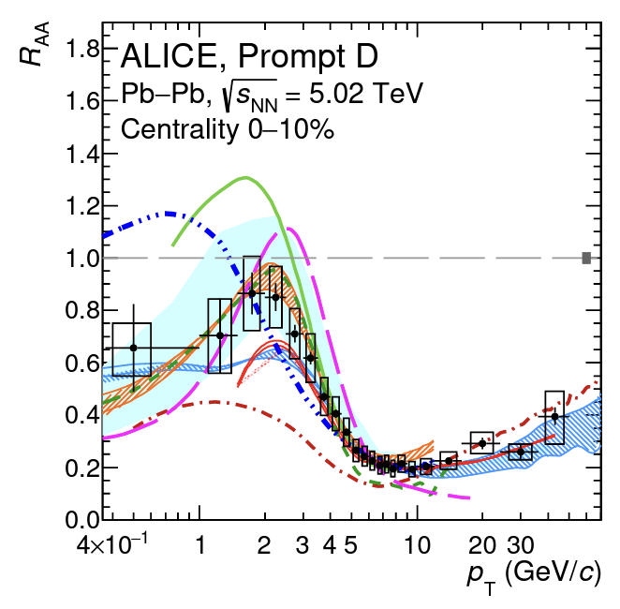
It’s strongly coupled QGP
ALICE, Eur. Phys. J. C 84 (2024) 813
Even hadrons with charm quarks loose energy in the QGP.

Slide 30
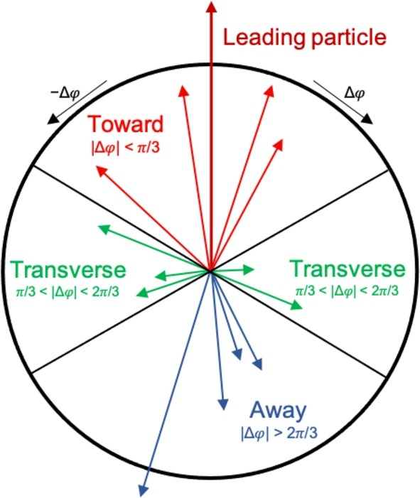
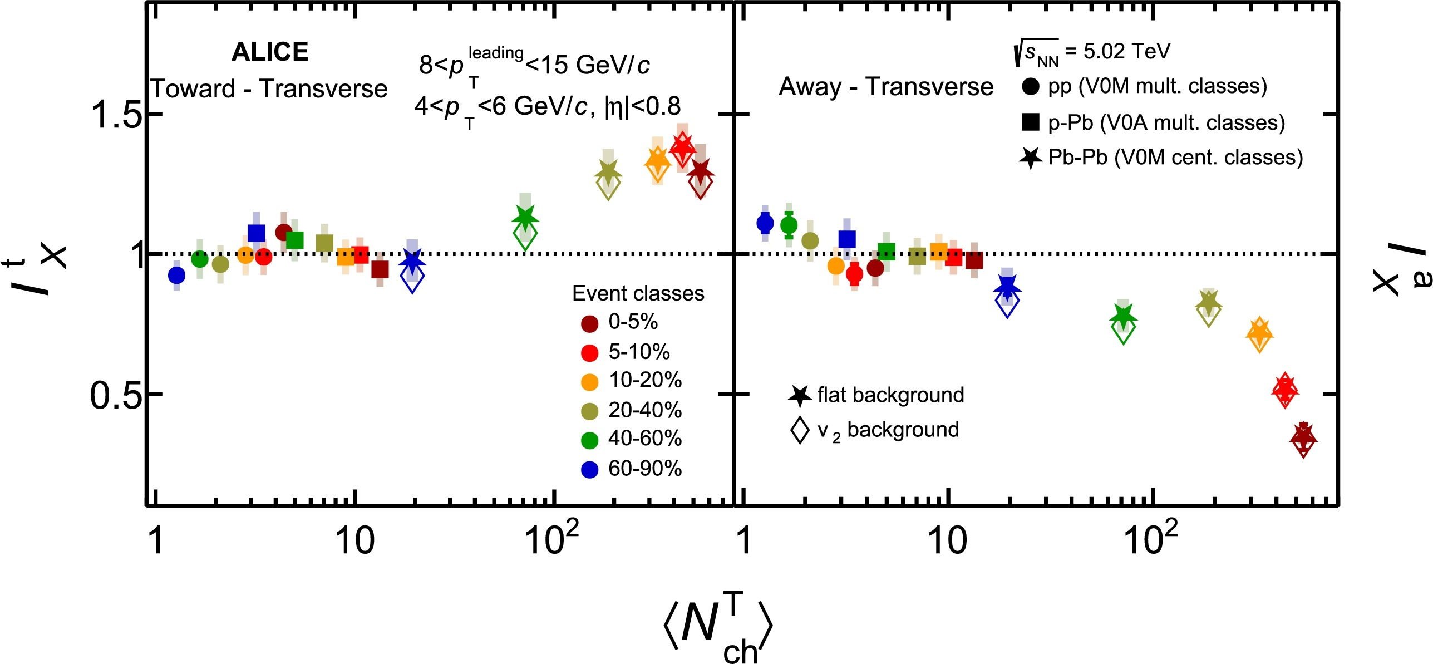
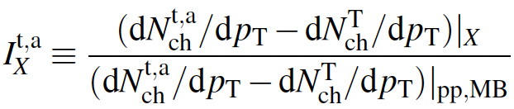
It’s not quenched in pp and p-Pb
ALICE, PLB 843 (2022) 137649
For now, no jet quenching effects are observed in pp and p–Pb collisions.

Slide 31
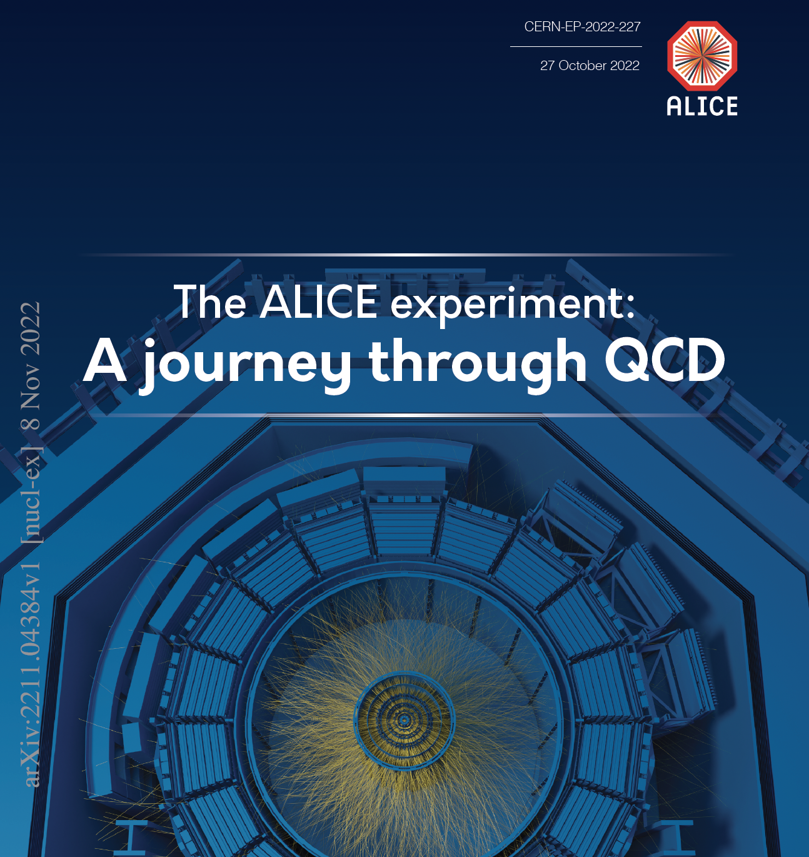
Much more results !!!!
ALICE results on Quarkonium
Martino Gagliardi
Tomorrow morning!!!!
ALICE, Eur. Phys. J. C 84 (2024) 813

Slide 32
The future

Slide 33
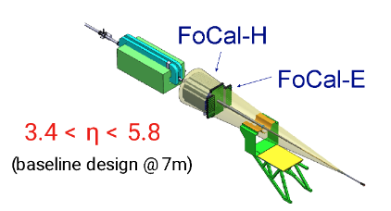
Upgrading the experiment
2010-2012 2015-2018 2022-2024 2028-2030 2032-2034 2036-2039
Run I
LS1
Run 2
LS2
Run 3
LS3
Run 4
LS4
Run 5
LS5
Run 6
We are here
ITS3 and FoCal
Forward Calorimeter (FoCal):
  Explore the small-x parton structure of nucleons and nuclei.
  Electromagnetic and hadronic calorimeters at the very forward region (3.4 < η < 5.8).

Slide 34
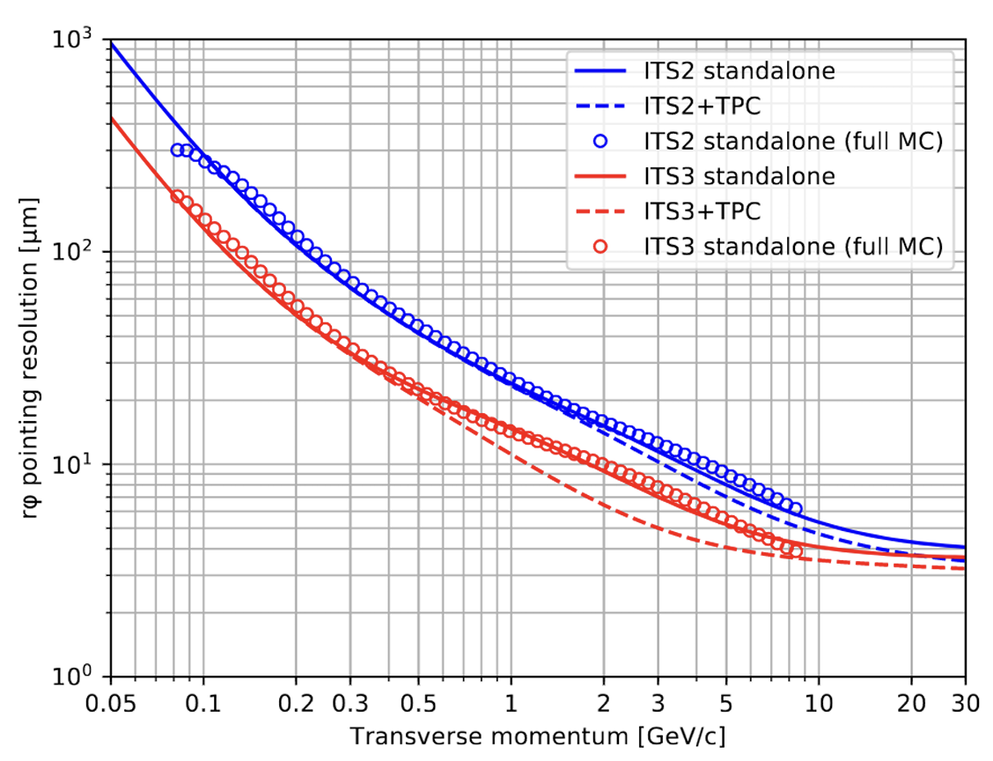
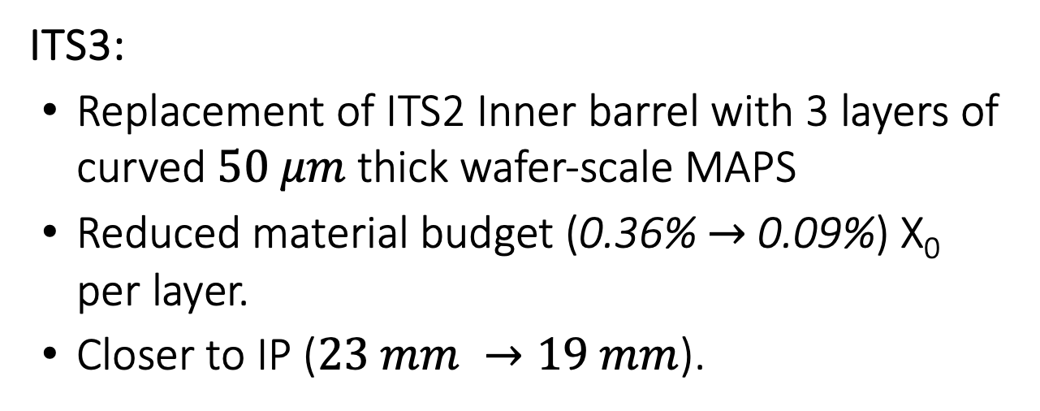
Upgrading the experiment
2010-2012 2015-2018 2022-2024 2028-2030 2032-2034 2036-2039
Run I
LS1
Run 2
LS2
Run 3
LS3
Run 4
LS4
Run 5
LS5
Run 6
We are here
ITS3 and FoCal
ALICE-PUBLIC-2018-013
ITS3:
  Replacement of ITS2 Inner barrel with 3 layers of curved $50 μm$ thick wafer-scale MAPS
  Reduced material budget (0.36% $→$ 0.09%) X₀ per layer.
  Closer to IP ($23 mm →19 mm$).

Slide 35
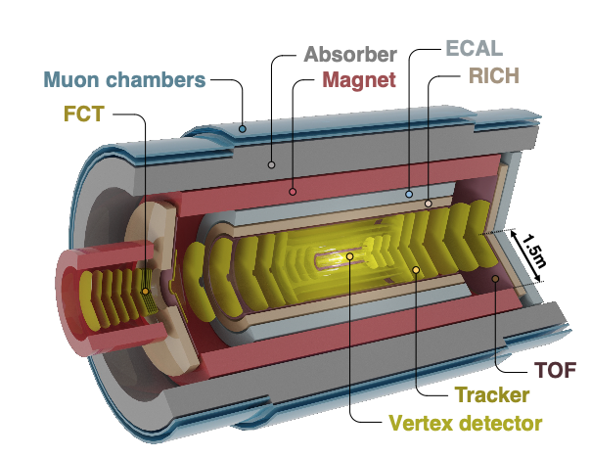
ALICE 3
ALICE 3: a whole new dedicated HI detector!
LHCb upgrade II
2010-2012 2015-2018 2022-2024 2028-2030 2032-2034 2036-2039
Run I
LS1
Run 2
LS2
Run 3
LS3
Run 4
LS4
Run 5
LS5
Run 6
High luminosity LHC
We are here
ALICE 3 CERN-LHCC-2022-009
Compact all-Si tracker with high-resolution vertex detector.
minimal mass (essentially only sensor)
5 mm from beam (LHC aperture)
Superconducting magnet
Fast readout and online processing.
Physics focus:
low-p_{T} heavy-flavor precision measurement.
electromagnetic radiation from QGP
Multi-heavy-flavored hadrons

Slide 36
In summary
Data from Heavy-Ion collisions is the perfect lab to study QCD.
Large amount of data, new complex observables and precision measurements available,
It’s great!!!
Small systems shows QGP like behavior .
It’s puzzling, and it’s great !!!!
Run3, brings exciting better data, with much more statistics.
It’s work, but it’s great !!!!
ALICE 2.1 & ALICE 3 upgrades !!!
It’s exciting, it’s the future !!!!

