Slide 1



Denys Yen Arrebato Villar, J. Zhao, P.B. Gossiaux, J. Aichelin
(Subatech, Nantes)
, T. Song, E. Bratkovskaya
(GSI Helmholtzzentrum für Schwerionenforschung, Darmstadt)
pp: PRC 96 014907
first results in AA:
2206.0130 (soon revised version)
J/ψ production in pp and
Heavy Ion Collisions
work in progress
8th International Conference on High Energy Physics in the LHC Era
Valparaiso, Chili January 9-13, 2023
1

Slide 2
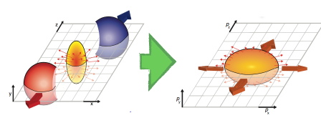


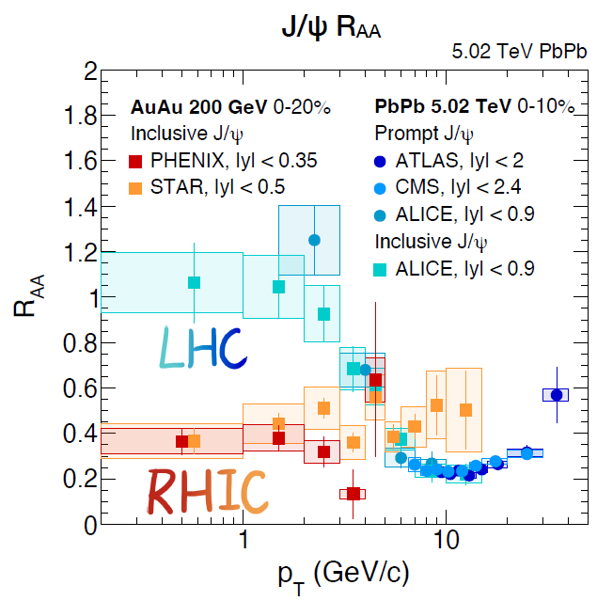
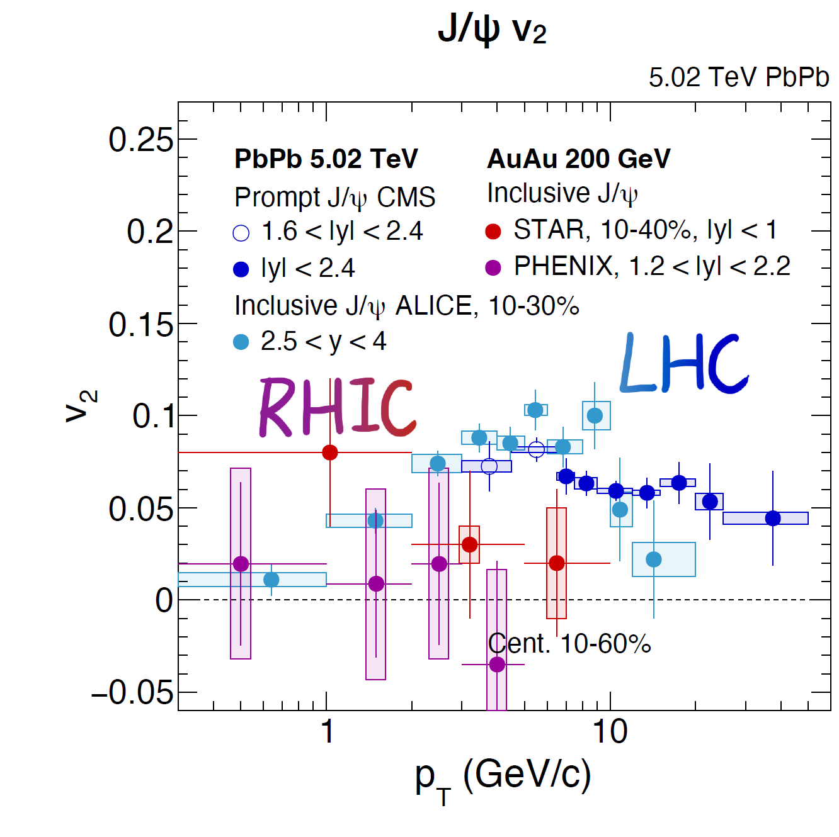
Why do we study J/ψ production in heavy-ion collisions?
J/ψ mesons
are a hard probe: tests quark gluon plasma from creation to hadronization
no consistent microscopical theory available yet
which are not understood yet
show quite different results for key observables at RHIC and LHC:

Slide 3
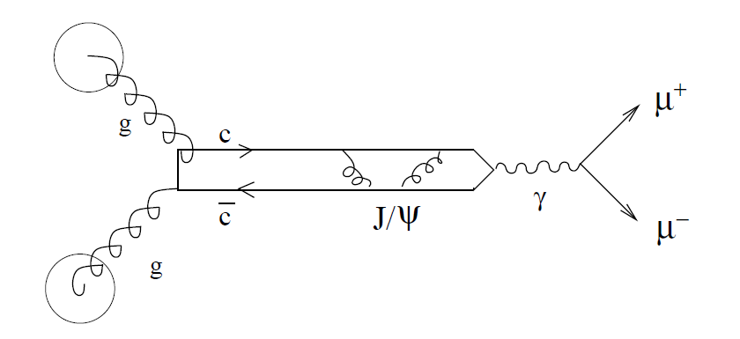
J/ψ production in p+p collisions
How to describe a composite object if perturbative QCD can only deal with
quarks and gluons
Need non perturbative input ➔ assumptions.
Our approach: Wigner density formalism (as successful at lower energies)
P
P
PYTHIA event generator
Wigner projection

Slide 4








Wigner Density Formalism
Interaction depends on relative coordinates only, -> plane wave of CM
Starting point: Wave function (w.f.) of the relative motion of state i:
w.f → density matrix
Fourier transform of density matrix in relative coord. → Wigner density of
(close to classical phase space density)
two body c cbar density matrix
pp: In momentum space given by PYTHIA (Innsbruck tune)
In coordinate space

Slide 5
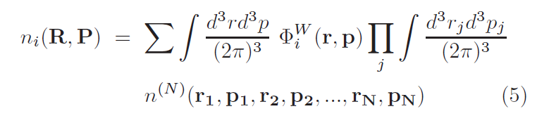
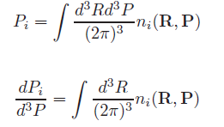
Wigner Density Formalism
If there are N c cbar pairs in the system the phase space density of states
Sum over all possible ccbar pairs after integration of the relative coordinates
Integration over all N-2 left particles.
Multiplicity of
Momentum distribution

Slide 6
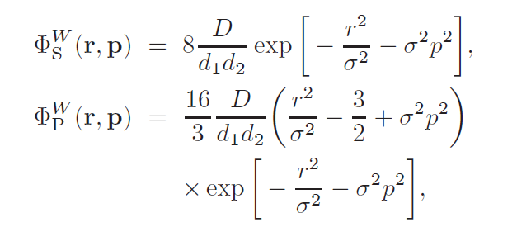

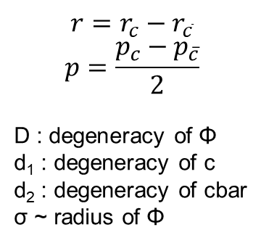
Wigner Density Formalism
The Wigner density of the state is different for S and P states
We choose the simplest possible parametrization
Where σ reproduces the rms radius of the vacuum c cbar state
$$r=r_{c}−r_{\overline{c}}$$
$$p=\frac{p_{c}−p_{\overline{c}}}{2}$$
D : degeneracy of Φ
d₁ : degeneracy of c
d₂ : degeneracy of cbar
σ ~ radius of Φ
$$Φ=J/ψ\left(1S\right), χ_{c}\left(1P\right), { ψ}^{′}\left(2S\right)$$

Slide 7
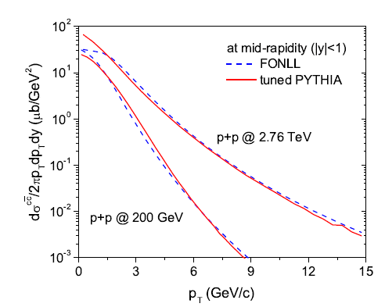
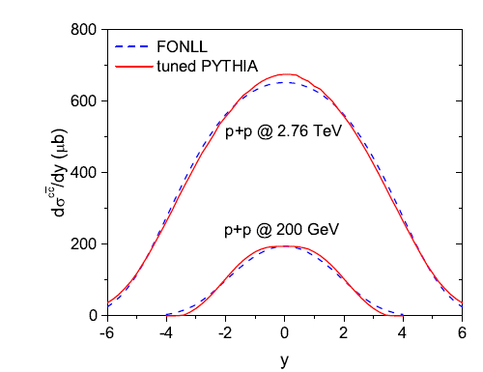
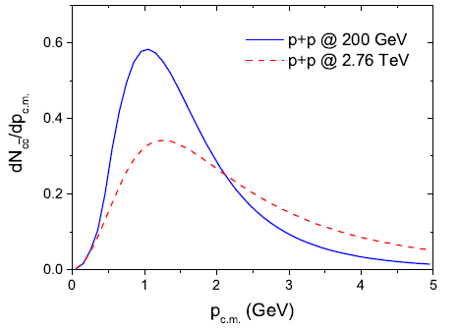
Wigner Density Formalism
The (Innsbruck) tuned PYTHIA reproduces FONLL calculations
but in addition it keeps the ccbar correlation (not known in FONLL)
Distribution of
charm quarks
agrees
but quite different relative momenta
at RHIC and LHC
Tuned Pythia:
distribution
of p_{rel} in c.m.

Slide 8
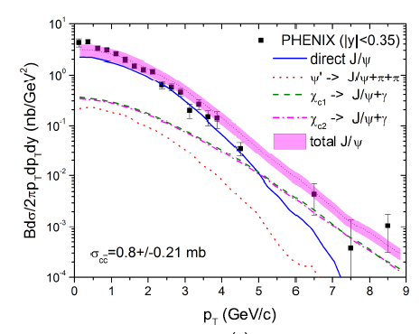
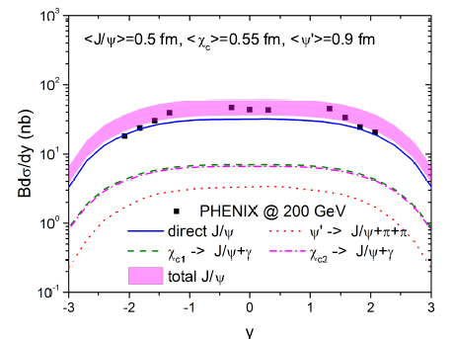
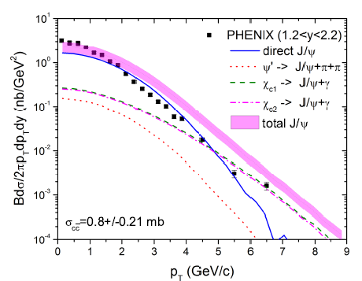
pp: comparison with Phenix data
Good agreement for
rapidity spectra
pt spectra at |y| < 0.35
pt spectra at 1.25 < |y| < 2.2
Feeding at RHIC not very important

Slide 9
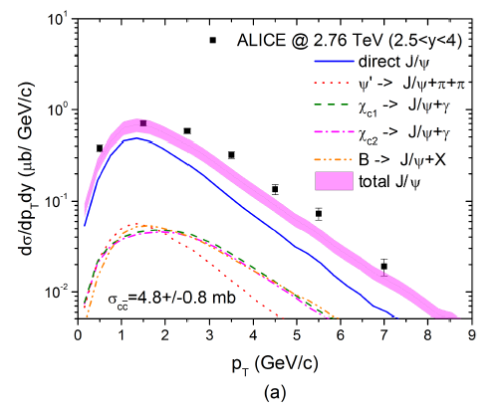
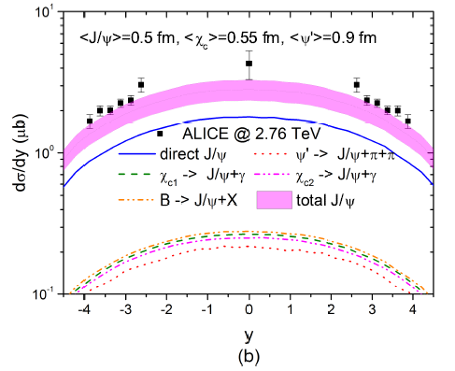
pp: comparison with ALICE data
same charmonia radii as at RHIC
Important contribution of feeding
The observed J/ψ data in pp at RHIC and LHC can be well described by Wigner dens.

Slide 10
AA collisions

Slide 11
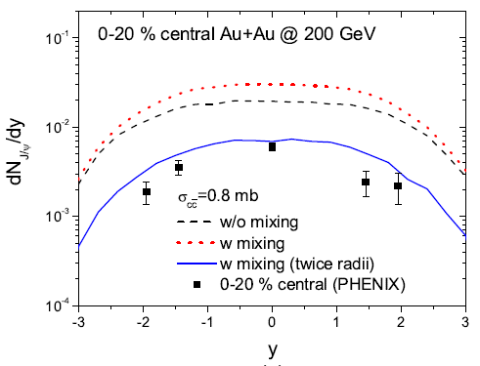
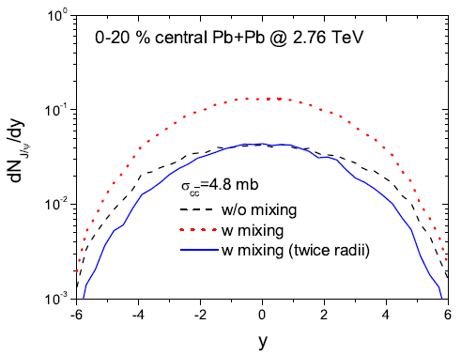
AA: without any QGP
Without the formation of a QGP we expect a (large) enhancement of the
J/ψ production because c and cbar from different vertices can form a J/ψ.
enhancement 46% enhancement 270%
but experiments show suppression
Reason: J/ψ production in HI collisions is a very complex process

Slide 12
Complexity of heavy quark physics in HI reactions
Hadronisation of light quarks:
Cross over or phase transition (statistical physics, nonpert. QCD)
Hadronic interactions (hadron physics)
2) Evolution of the QGP (transport theory, EoS from lattice gauge theory)
2) Interaction of heavy quarks with plasma constituents, LPM, pQCD, transport theory
D/B formation at the boundary of QGP
fragmentation or coalescence (pQCD)
QGP
3)Quarkonia formation in QGP (finite temp QCD, pQCD)
(
1) (hard) production of heavy quarks in initial NN collisions (generalized parton distribution fcts, pQCD, FONLL)
hadrons

Slide 13
The different processes which influences the J/ψ yield
Creation of heavy quarks (shadowing)
J/ψ are first unstable in the quark gluon plasma and are created later
c and cbar interact with the QGP
c and cbar interact among themselves (<-lattice QCD)
If QGP arrives at the dissociation temperature T_{diss} , stable J/ψ are possible
J/ψ creation ends when the QGP hadronizes
J/ψ can be further suppressed or created by hadronic interaction
(task for the future -> Torres-Rincon)
There are in addition J/ψ from the corona (do not pass the QGP)
The model we developed follows the time evolution of all c and cbar quarks
Is based, as our pp calculation, on the Wigner density formalism
assumes that
all c and cbar interact with the medium as those observed finally as D-mesons
all c and cbar interact among themselves
uses EPOS2 to describe the expanding QGP

Slide 14
HQ interactions with the QGP Phys.Rev.C 78 (2008) 014904
The interaction between HQ and q and g is described by Born type diagrams
q/g is randomly chosen from a Fermi/Bose distribution with the hydro cell temperature
coupling constant and infrared screening are input
If t is small (<<T) : Born has to be replaced by a hard thermal loop (HTL) approach
For t>T Born approximation is (almost) ok
(Braaten and Thoma PRD441298,2625) for QED:
Energy loss indep. of the artificial scale t* which separates the regimes
Extension to QCD (PRC78:014904)
Peshier 0801.0595
based on universality constraint of Dokshitzer
κ ≈ 0.2

Slide 15
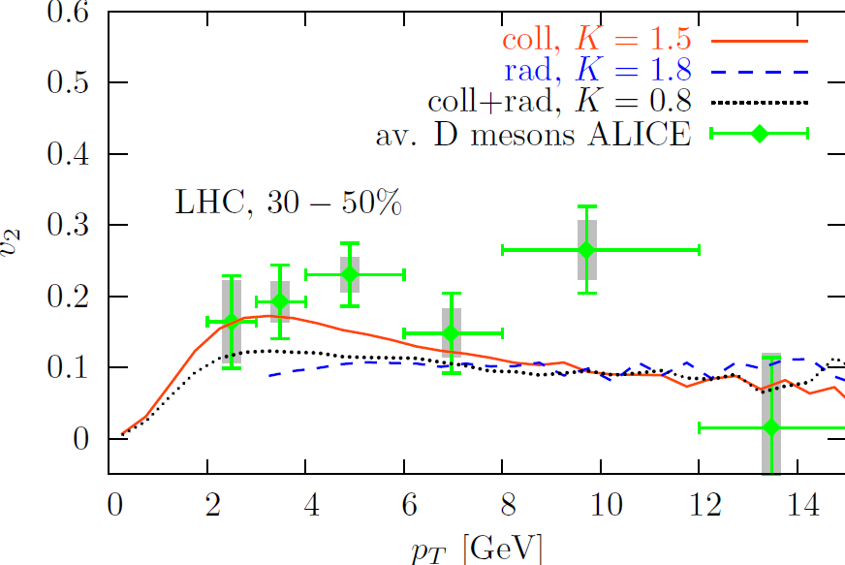
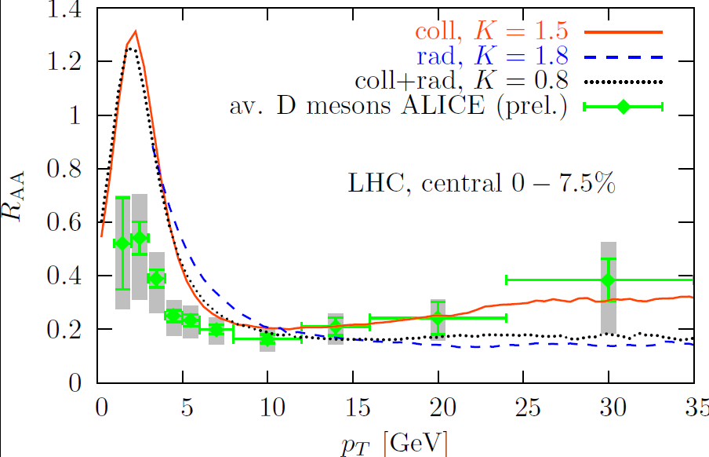
v₂ tests the late stage of the expansion
D meson results
Energy loss tests the initial phase of the expansion
3 options : Collisions only K factor = 1.5
Collision and radiation K = 0.8
Radiation only K= 1.8
R_{AA} and v₂ for coll and
coll + radiative give about the same result
b much more suppressed

Slide 16







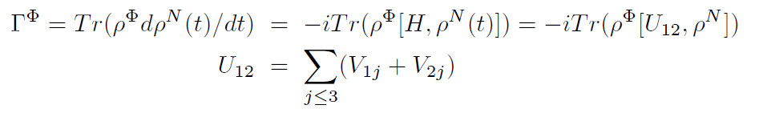
J/ψ creation in heavy ion collisions
Starting point: von Neumann equation for the density matrix of all particles
with
gives the probability that at time t the state Φ is produced:
This is the solution if we could calculate the quantal
In our semiclassical approach (correlations are lost) preferable to calculate the rate
For time independent :

Slide 17

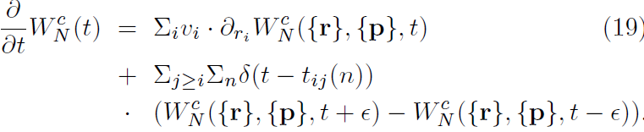
J/ψ creation in heavy ion collisions
Heavy ion studies (BUU,QMD,PHSD) have shown that we obtain very
satisfying results if we assume
W = <W^{classic} >
We assume in addition that heavy quarks and QGP partons interact
by collisions only
with

Slide 18

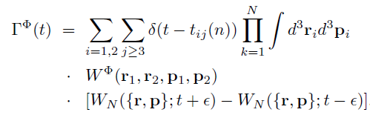
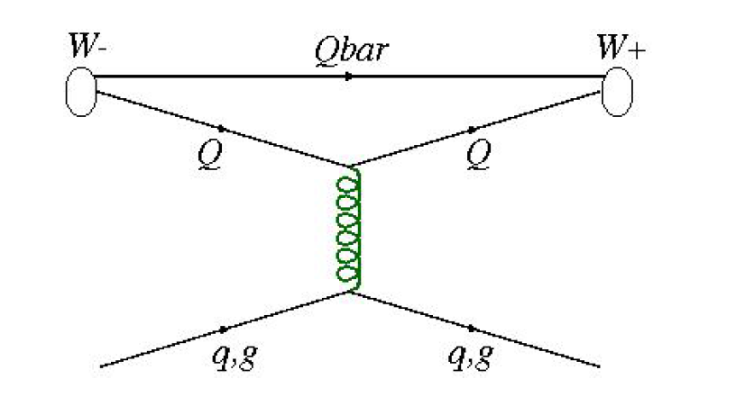
J/ψ creation in heavy ion collisions
If the collisions are point like in time and if is time independent :
t-ε
t+ε
QGP parton

Slide 19
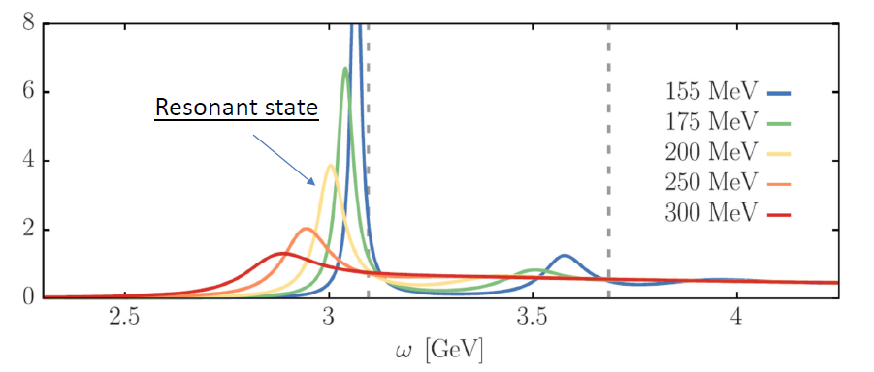
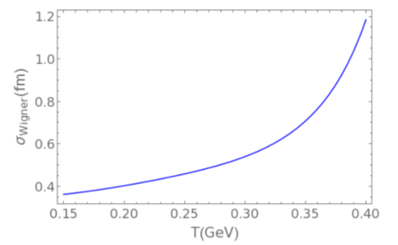
J/ψ creation in heavy ion collisions
Lattice calc: In an expanding QGP depends
on the temperature and hence on time
Parametrization of the lattice results (Lafferty and Rothkopf PRD 101,056010)
σ_{wigner} =2/3 <r²>
R. Katz, thesis
This creates an additional rate, called local rate.

Slide 20




Local Rate
Lattice : J/ψ wavefct is a function of the local QGP temperature
The QGP temperature decreases during the expansion
→ J/ψ wavefct becomes time dependent
creates for T<T _{diss} =400 MeV a local J/ψ prod. rate
=
Total J/ψ multiplicity at time t is then given by
For t →∞ P(t) is the observable J/ψ multiplicity

Slide 21




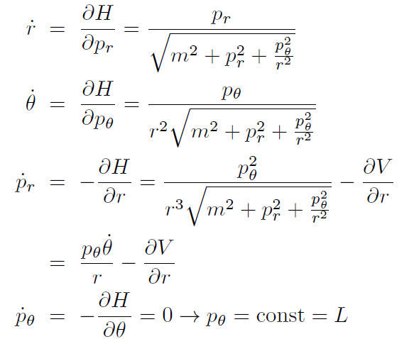
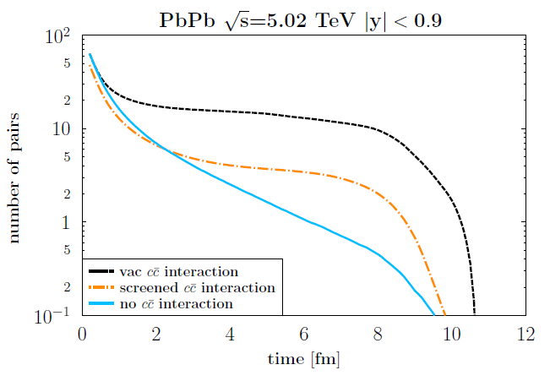
Interaction of c and cbar in the QGP
V(r) = attractive potential between c and cbar (PRD101,056010)
We work in leading order in
Time evolution equation:
position and momentum of each
c cbar pair evolve according to
these equations
c cbar pairs with Δr < 1fm

Slide 22
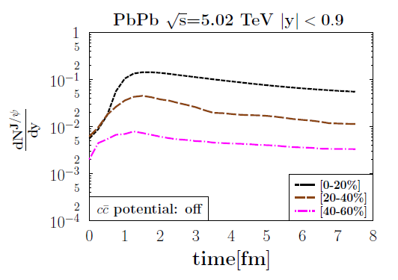
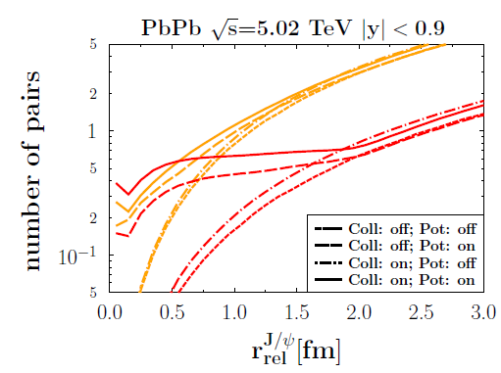
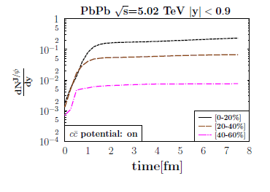
Consequences of the c cbar Interaction
Qq and Qg collisions shift p_{T} spectra
to lower values
(as for D mesons)
QQbar potential interaction increases
the production rate
ccbar potential off
t=4fm/c
ccbar potential on
t=8fm/c

Slide 23
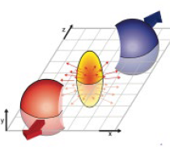
Influence of the Corona
Standard hydrodynamical calculations (EPOS 2) show two classes of particles
of initially produced particles:
Core particles which become part of QGP
Corona particles from the surface of the interaction zone
(energy density too low, no collision after production → like pp)
importent for high pt and for v2
Confirmed by centrality dependence of multiplicity
For elementary particles it is easy to define corona and core particle
For J/ψ mesons we use working description:
Corona J/ψ are those where none of its constituents suffers from a momentum
change of q > q_{thres} . Larger q would destroy a J/ψ.

Slide 24
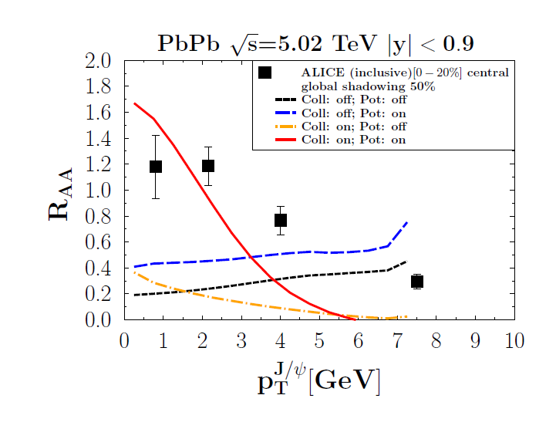
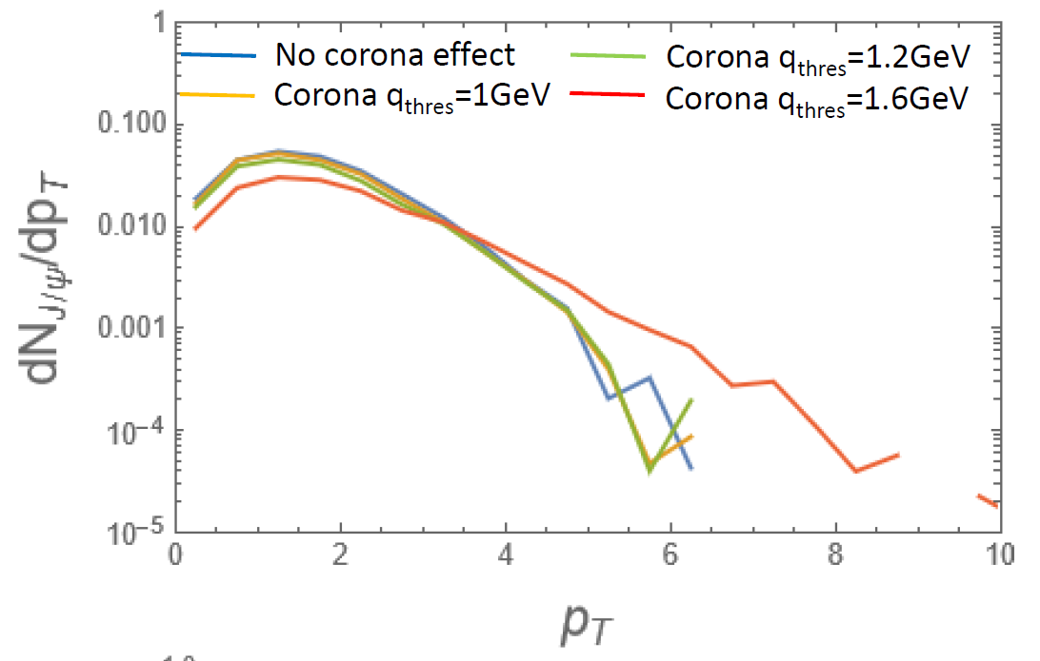
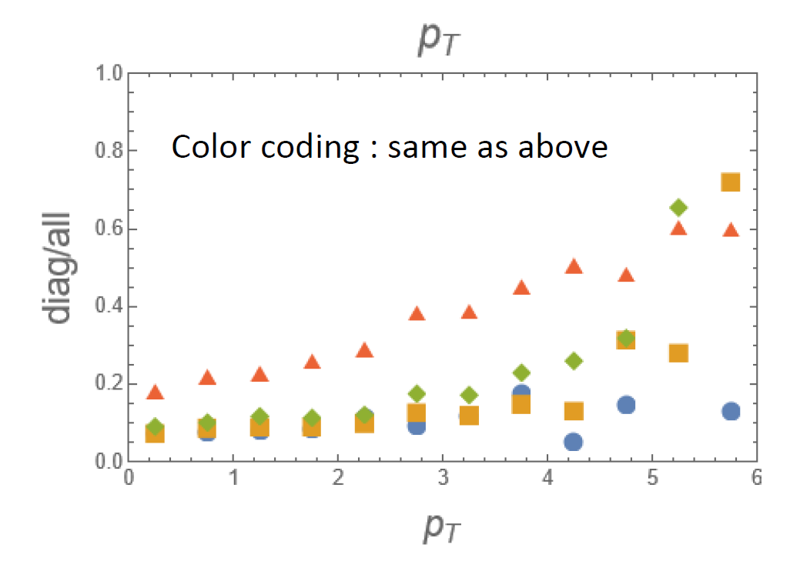
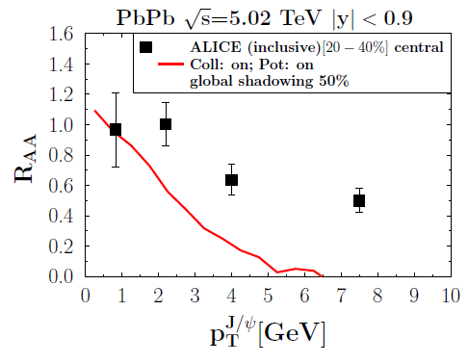
Comparison with ALICE data
[0-20%] no corona influence of the corona
[20-40%] no corona
Caution: excited state decay, b decay and hadronic rescattering not in yet
.

Slide 25
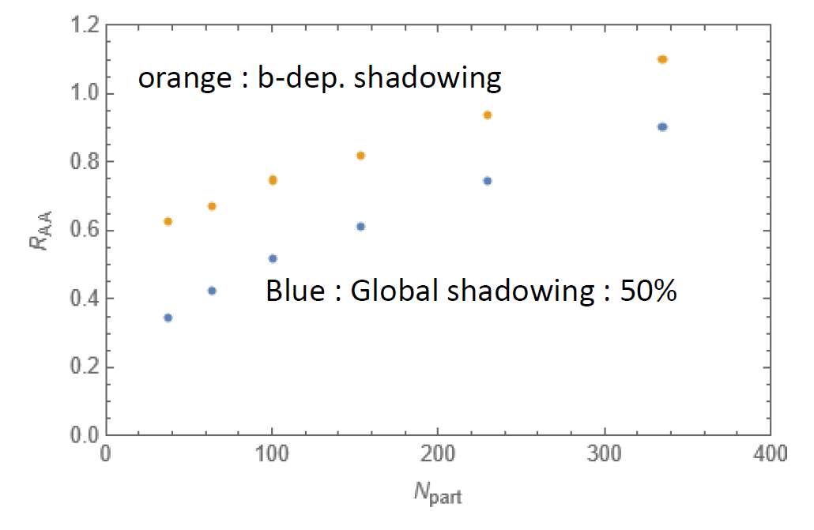
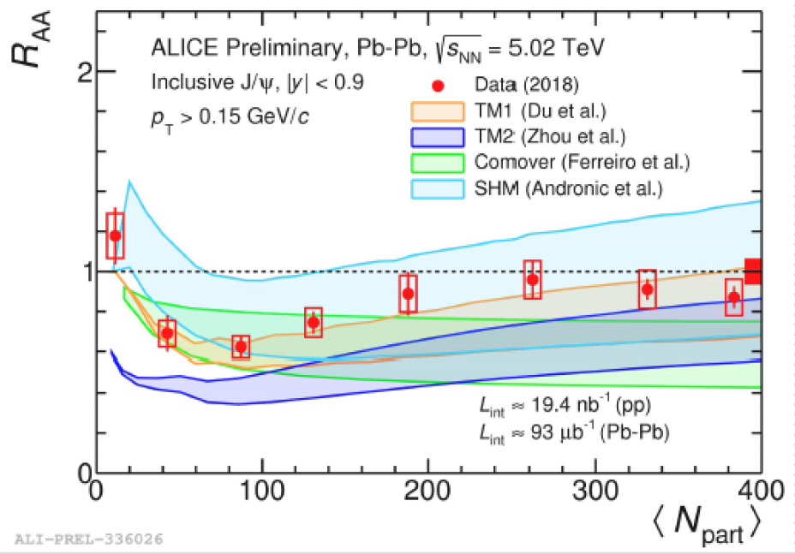
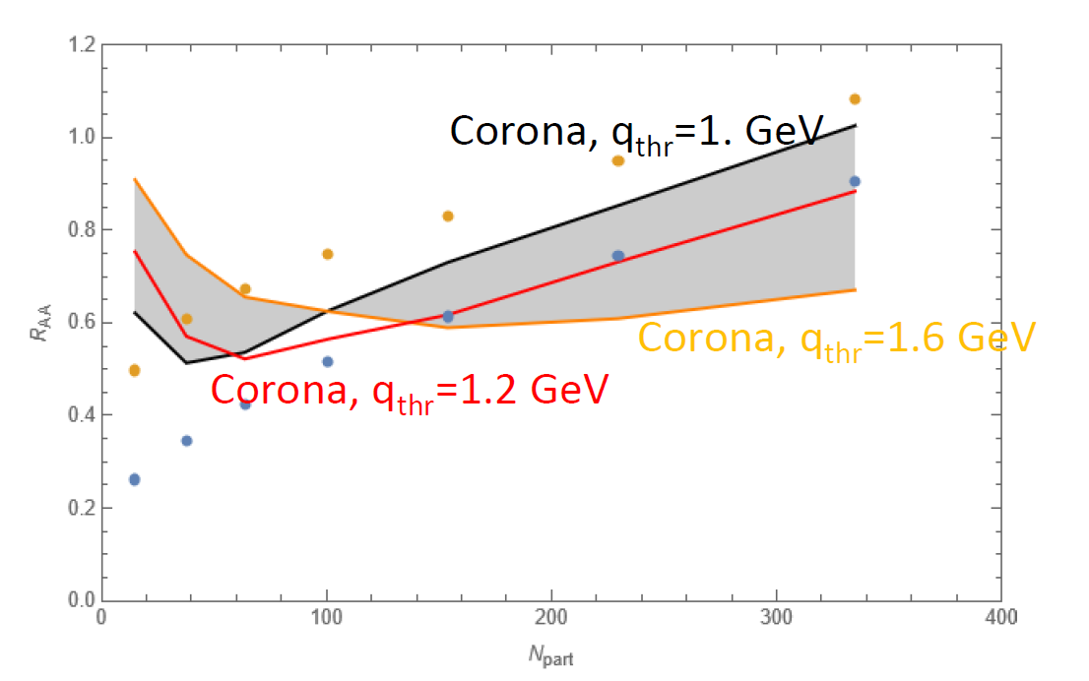
Comparison with ALICE data
Corona J/ψ bring
R_{AA} close to one for
peripheral reactions
the participant dependence
close to data
No corona

Slide 26
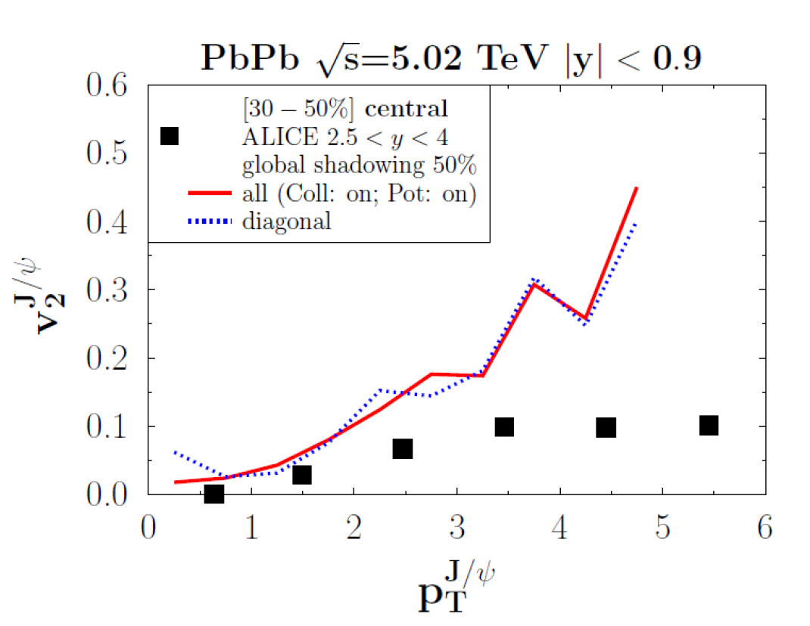
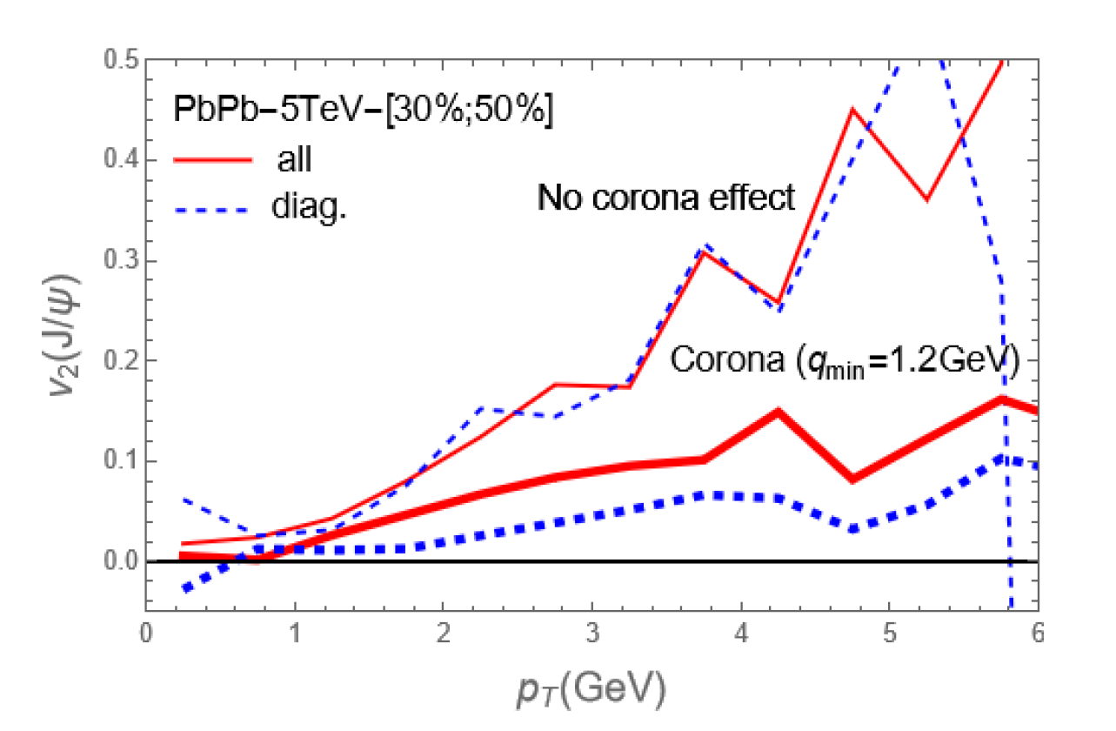
Comparison with ALICE data
[30-50%] [30-50%]
No corona
Corona J/ψ
bring v₂ closer
to the experimental values
create difference between
diagonal and off-diagonal
caution:
comparison of mid and forward rapidities

Slide 27
Summary
New microscopic approach which follows each c and cbar from creation until detection as J/ψ
(no rate equation, no Fokker Planck eq., no thermal assumptions)
c and cbar are created in initial hard collisions (controlled by pp data)
when entering the QGP J/ψ become unstable
c and cbar interact by potential interaction (lattice potential)
c and cbar interact by collisions with q,g from QGP
when T < T_{diss} = 400 MeV J/ψ can be formed (and later destroyed)
described by Wigner density formalism (as in pp)
Including corona J/, preliminary results agree reasonably with ALICE data for R_{AA} as well as for v₂ .
The later production (over) compensates the expected multiplicity
increase (with respect to pp) due to c and cbar from different vertices
Has many common features with open quantum system approach (however bottom up)
Outlook; a lot remains to be done.
Follow the color structure, excited states
Relativistic kinematics, J/ψ interaction in the hadronic expansion
Collisions of preformed J/ψ (r < interaction range) with QGP partons (dipole cross section)

Slide 28







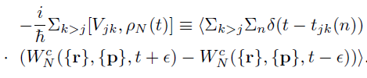




Our approach and open quantum systems
Von Neuman eq.
Prob. to find quarkonium with
Quarkonium rate:
Interaction: coll. heavy quarks – partons:
yields
Lindblad eq. (open quantum systems) in the quantal Brownian motion regime
Miura, Akamatsu , 2205.15551

Slide 29

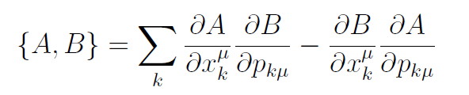


new description of c and cbar potential interaction
Not used in the present calculation
Extension to a real relativistic two body kinematics:
Energy and time constraints reduce 8 dim → 6+1 dim phase space
energy constraints generalized Poisson brackets
which gives the time evolution equations
to know what the dot means we need time fixations to the system time 
where U is the center of mass velocity
for details: Marty et al. PRC87,034912

Slide 30

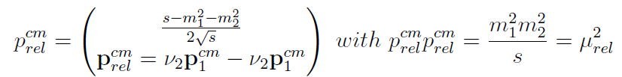


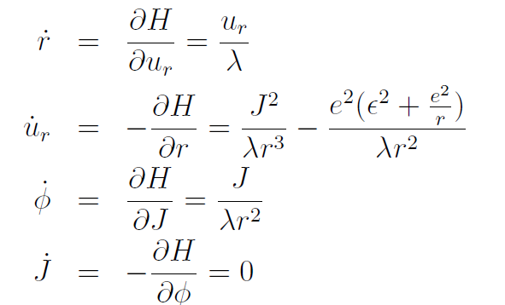
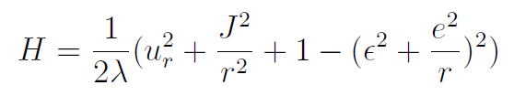
new description of c and cbar potential interaction
Fiziev and Todorov (PRD63,104007)
approximation which allows for a separation of CM and relative motion
H can be rewritten (for Coulomb) with the time evolution eqs.
J: angular momentum
: const

