Slide 1



Model-based and Learning-based Computational Methods: Closing the Gap
DANCE Workshop
Rice University
October 28, 2019
Waheed U. Bajwa
Department of Electrical and Computer Engineering
Department of Statistics
Rutgers University–New Brunswick
http://www.inspirelab.us

Slide 2

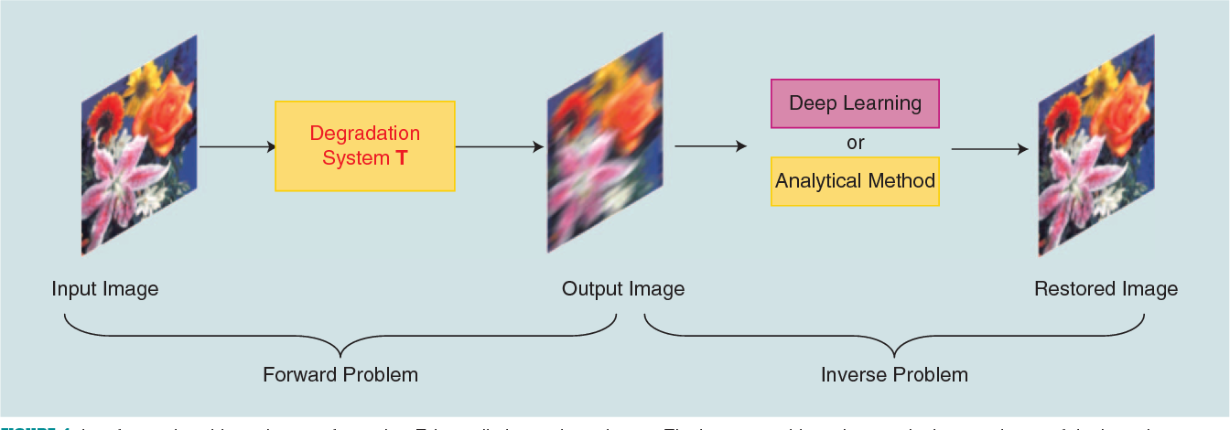
Research Theme 1: Inverse Problems
(Physical) Cause
Mathematical model / Physical theory
Measured data
Image: “Using Deep Neural Networks for Inverse Problems in Imaging: Beyond Analytical Methods”

Slide 3
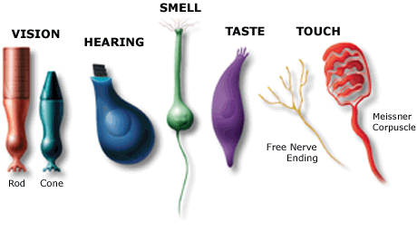
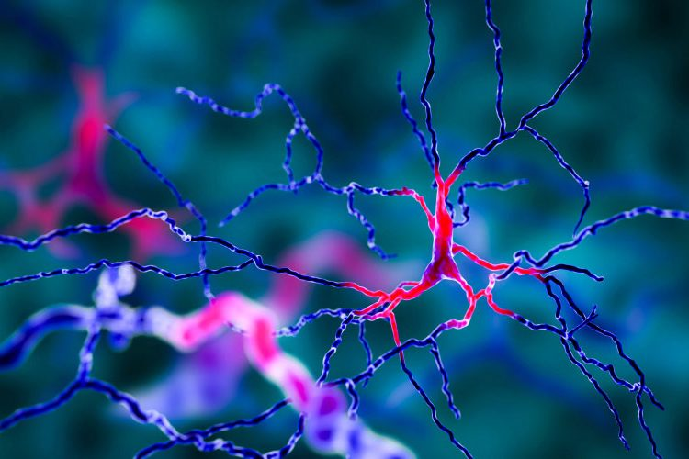
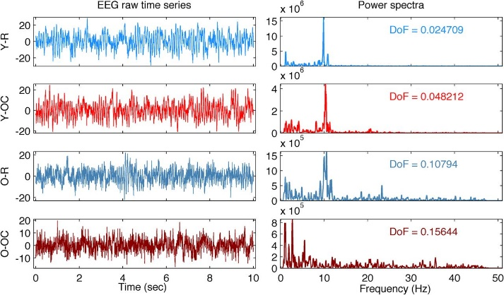
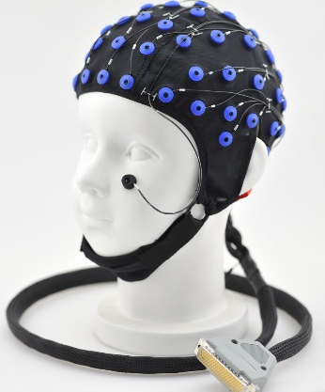
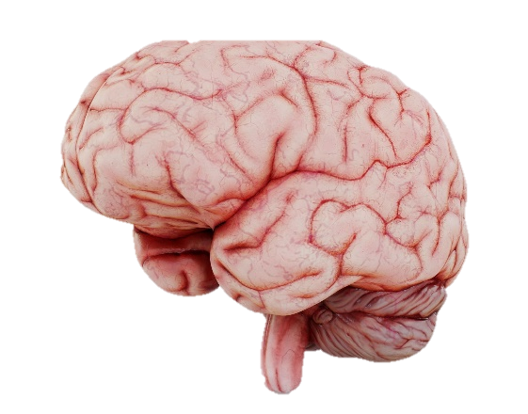
Inverse Problems: Parallels with Dark Matter Direct Detection
Cause
Multichannel Time-series Data
Mathematical Model
Images taken from Google Images

Slide 4
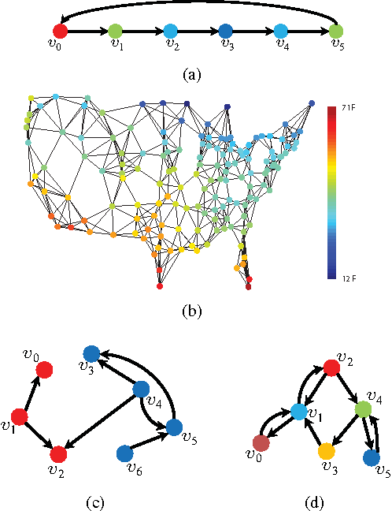
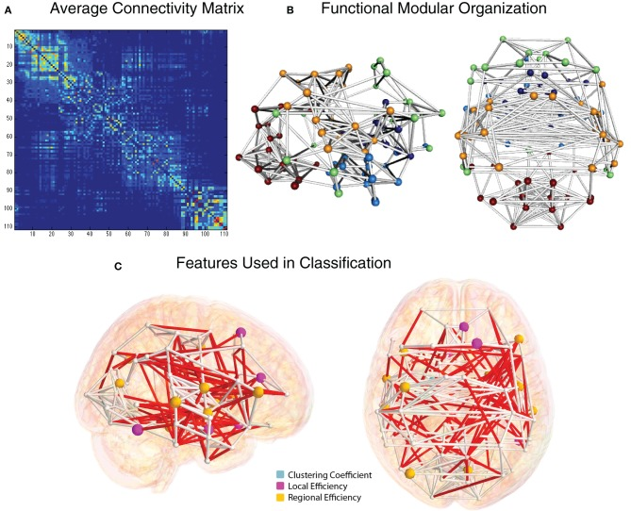
Research Theme 2: Non-Euclidean Data
Left image: “Big Data Analysis with Signal Processing on Graphs: Representation and processing of massive data sets with irregular structure”; Right image: “Insights into multimodal imaging classification of ADHD”

Slide 5
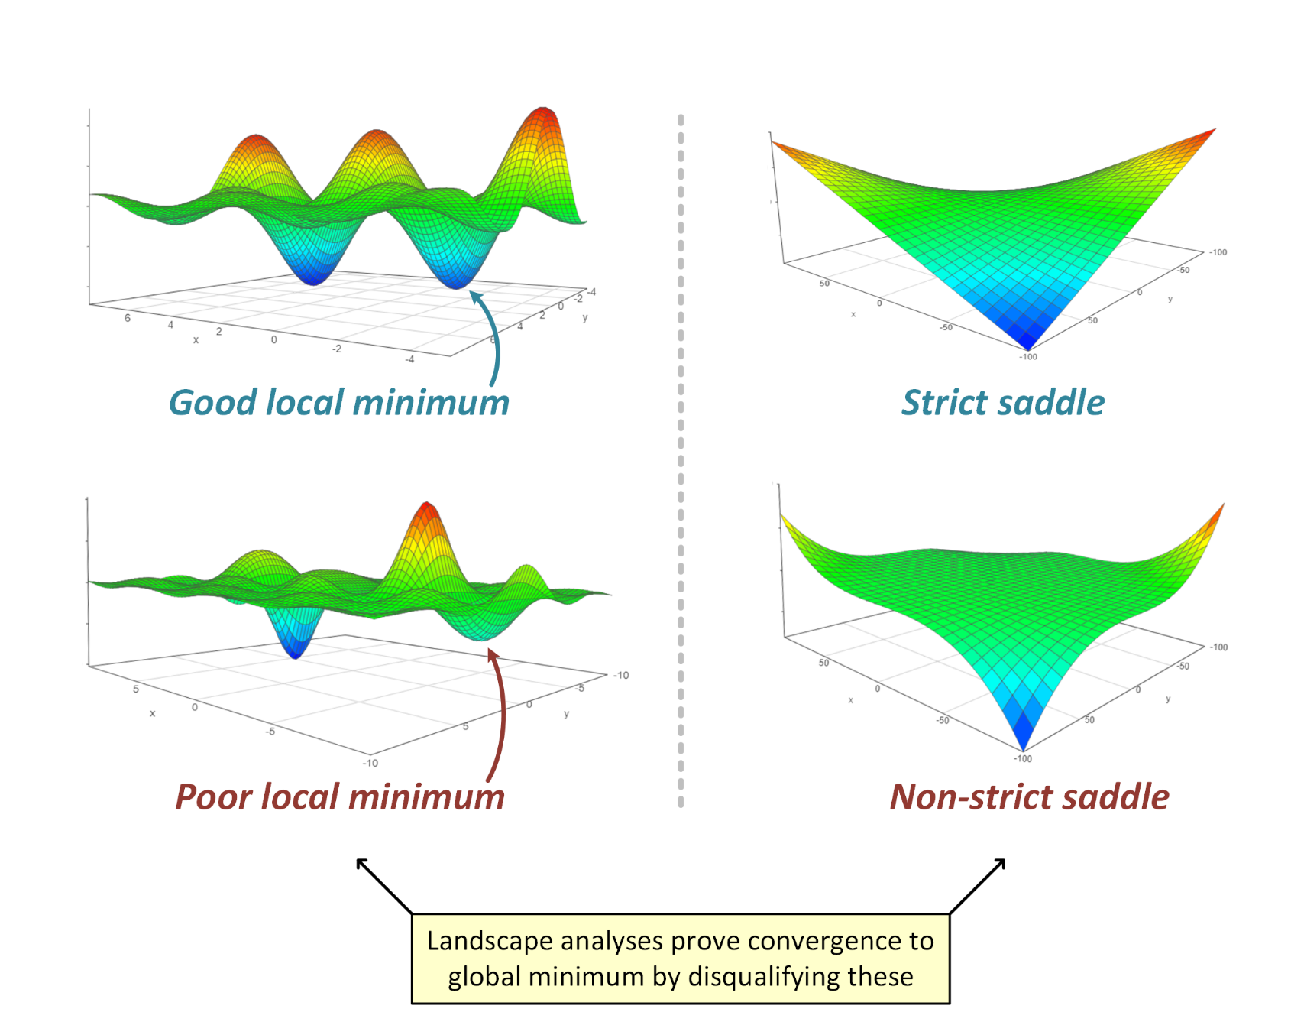
Research Theme 3: Understanding Optimization Landscapes
Off the Convex Path Blog: https://www.offconvex.org/2018/11/07/optimization-beyond-landscape/

Slide 6
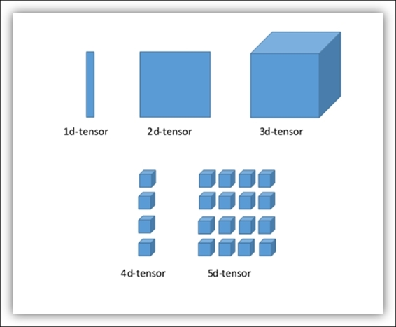
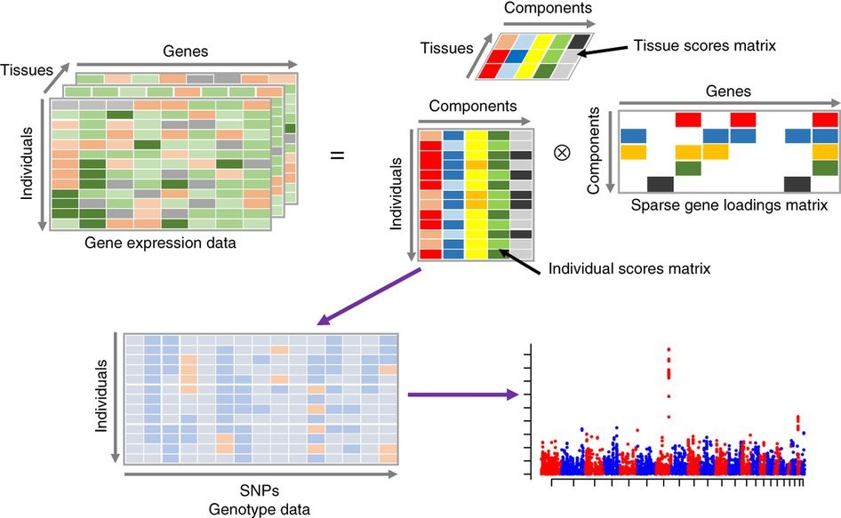
Research Theme 4: Multidimensional Data
Images taken from Google Images

Slide 7
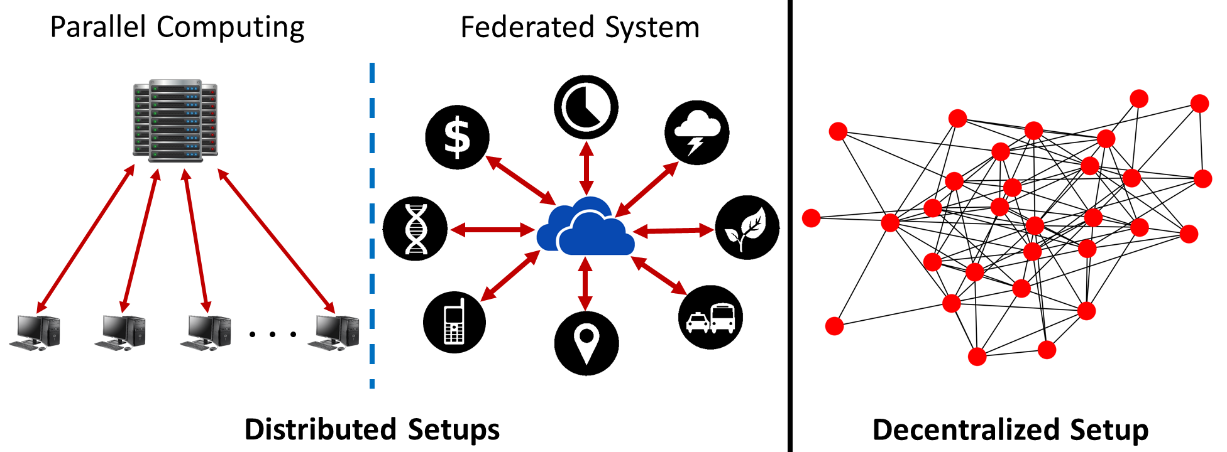
Research Theme 5: Distributed Machine Learning

