Slide 1
Muon-Ion Collider at BNL
Christoph Montag, BNL
1st Muon-Ion Collider Workshop
Rice University
December 13 – 15, 2023

Slide 2
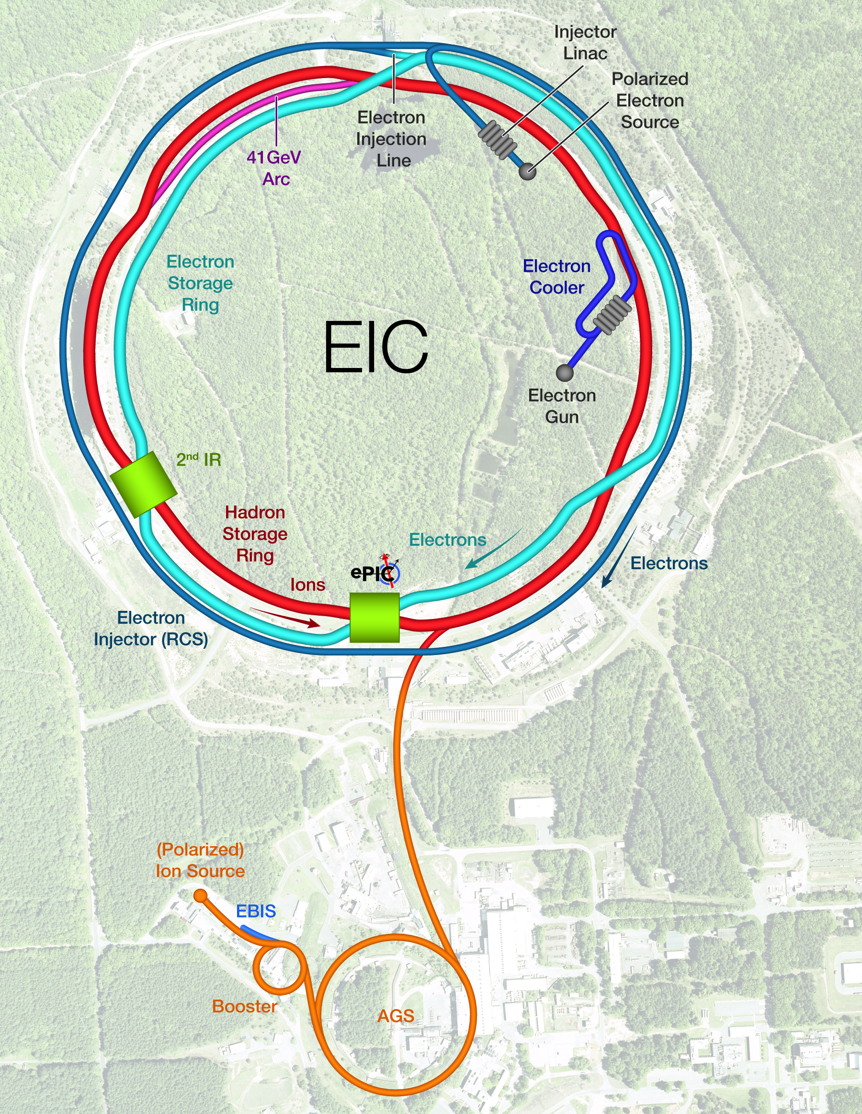
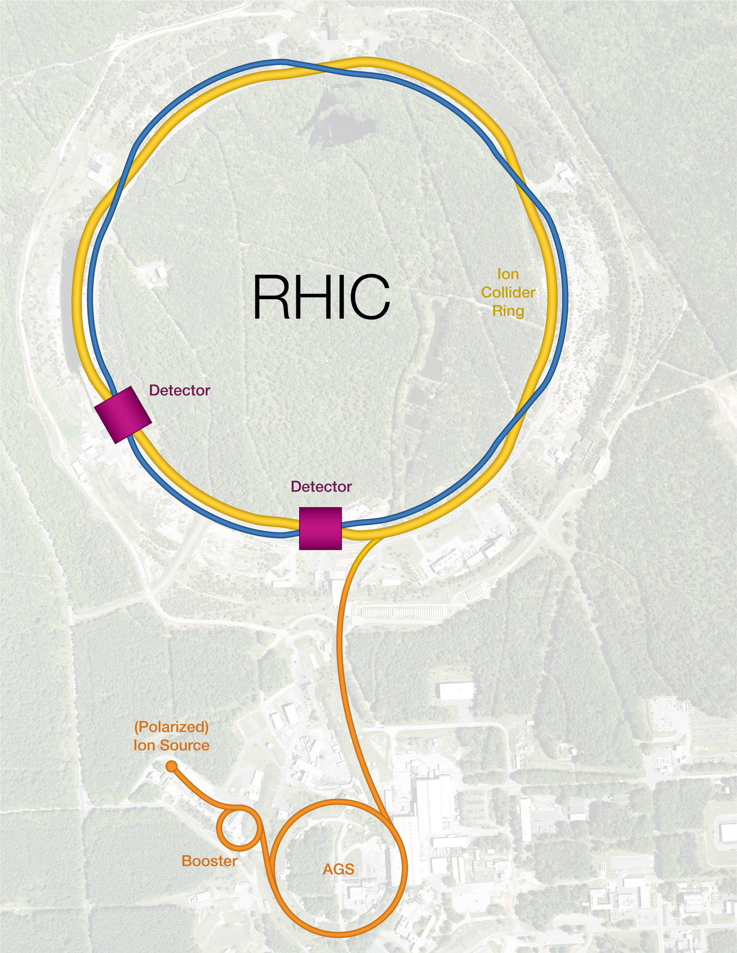
EIC Facility layout
Hadron Storage Ring comprised of “Blue” and “Yellow” RHIC arcs
Layout breaks RHIC symmetry
Retaining RHIC injector chain
Strong Hadron Cooling in IR12
Electron complex to be installed in existing RHIC tunnel – cost effective

Slide 3
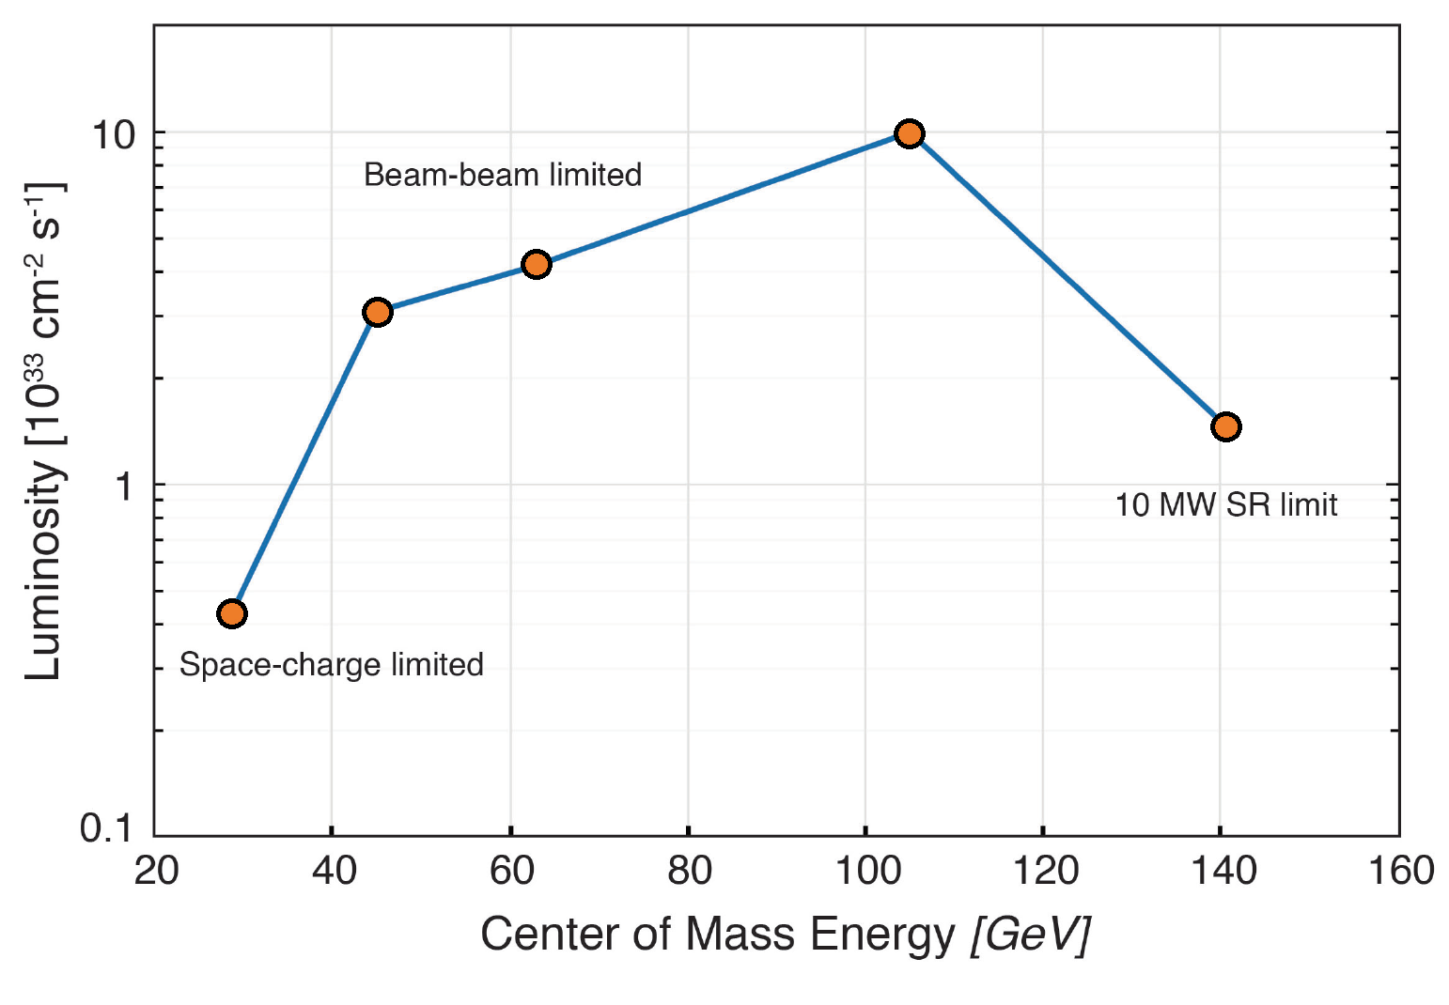
EIC e-p Luminosity versus Center-of-Mass Energy
Electron-nucleon luminosities in e-A collisions are similar within a factor of 2 to 3

Slide 4
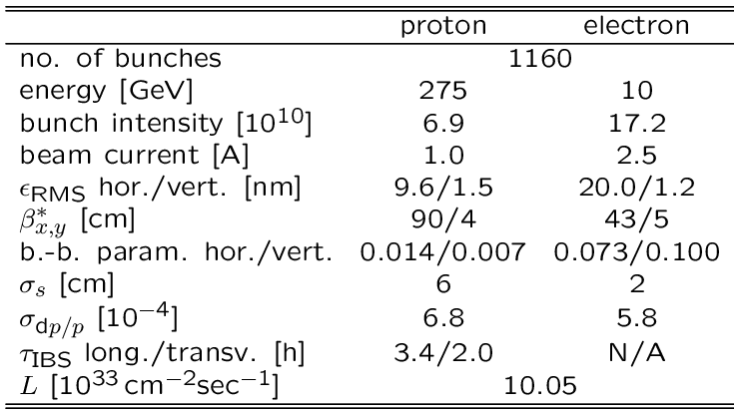
EIC Parameters for Highest e-p Luminosity
Hadron beam parameters similar to present RHIC, but ”flat” beams with an emittance ratio of $\frac{ε_{y}}{ε_{x}}=0.1$and many more bunches
2 hour IBS growth time requires Strong Hadron Cooling
Electron beam parameters resemble a B-Factory
Now, let’s replace the electron ring with a muon ring

Slide 5
Muon Collider Facility Overview
Front end: capture muons, convert to bunch train
Cooling: reduce emittance, combine into one bunch
Acceleration: increase energy
Collider ring

Slide 6
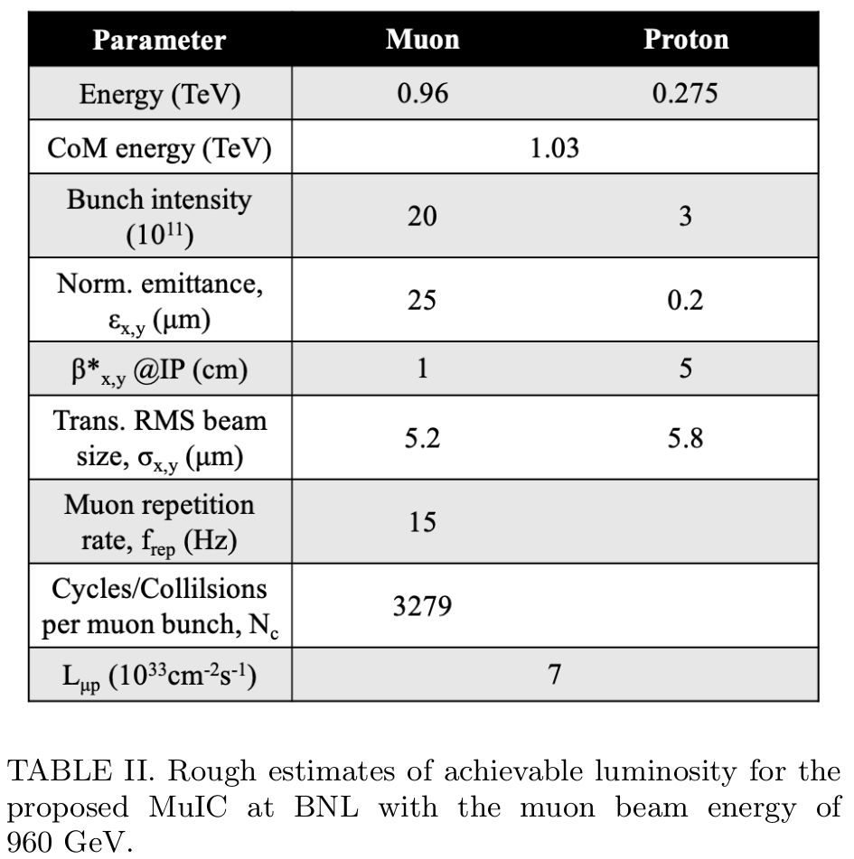
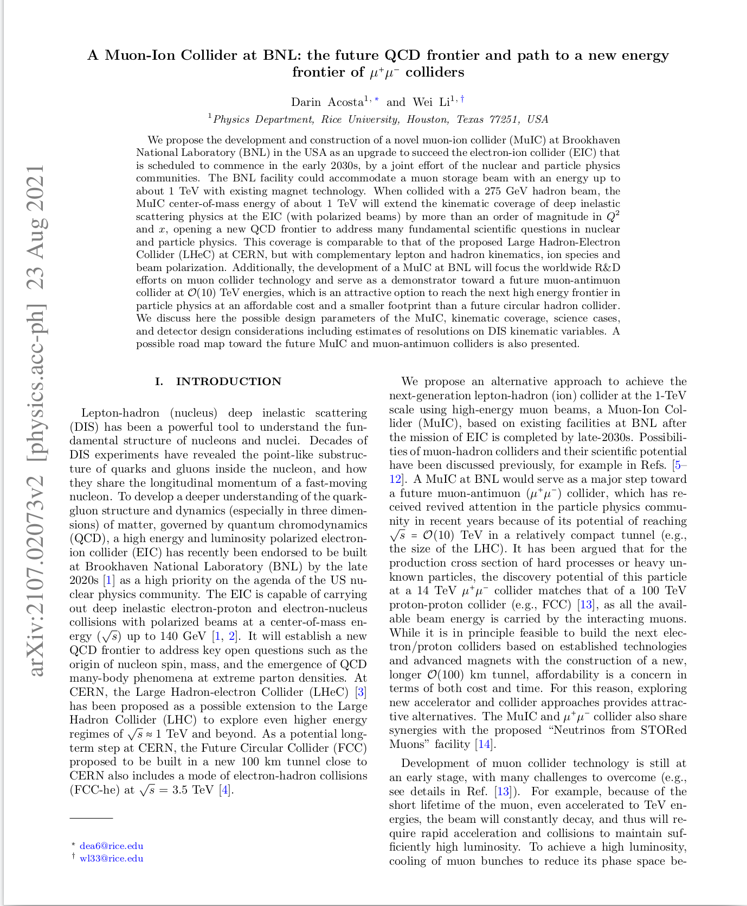
MUIC Parameters
Parameters taken from Acosta, Li paper

Slide 7
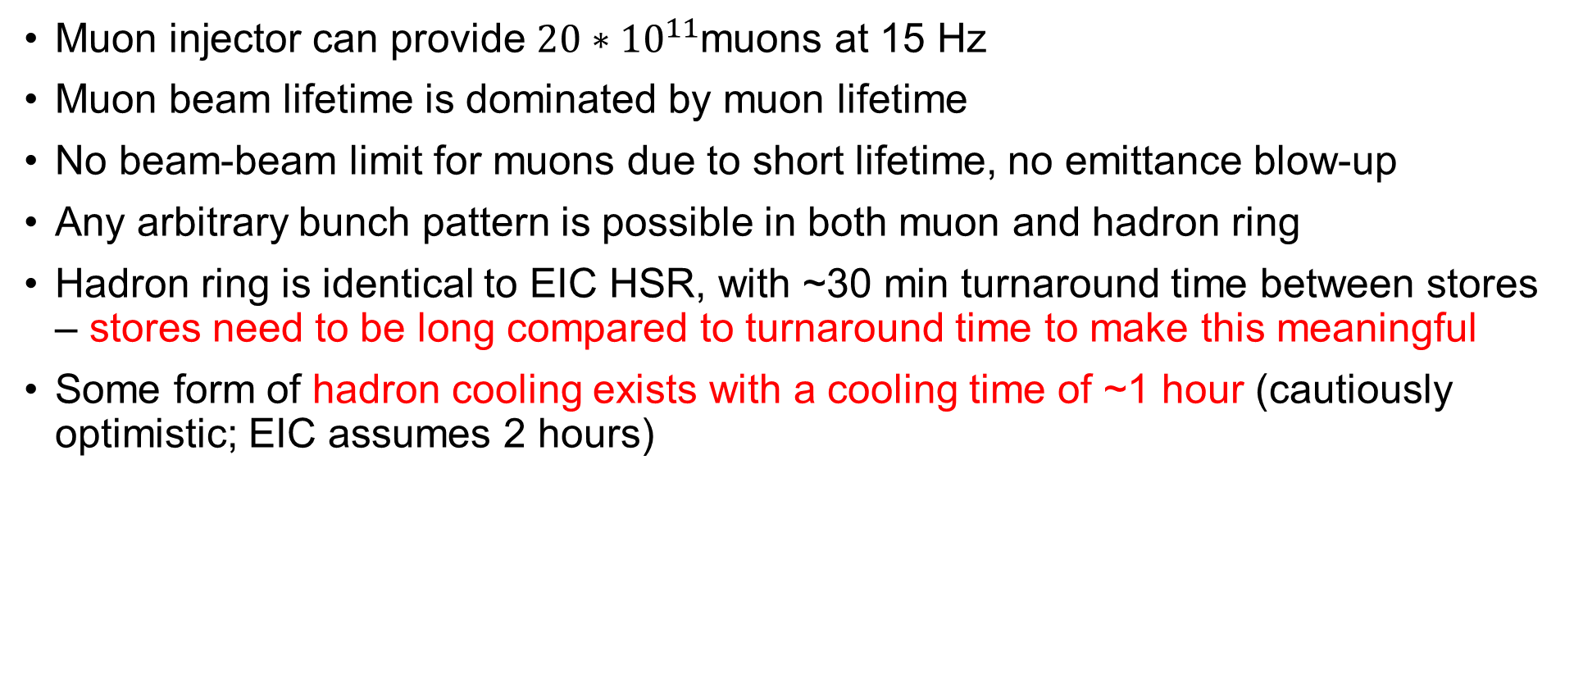
Assumptions
Muon injector can provide ${20∗10}^{11}$muons at 15 Hz
Muon beam lifetime is dominated by muon lifetime
No beam-beam limit for muons due to short lifetime, no emittance blow-up
Any arbitrary bunch pattern is possible in both muon and hadron ring
Hadron ring is identical to EIC HSR, with ~30 min turnaround time between stores – stores need to be long compared to turnaround time to make this meaningful
Some form of hadron cooling exists with a cooling time of ~1 hour (cautiously optimistic; EIC assumes 2 hours)

Slide 8
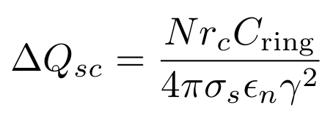

Space Charge
Space charge tune shift:
Reasonable limit for protons: Δ$Q_{sc}$= 0.01
MUIC: Δ$Q_{sc}$= 0.12
Remedy: reduce $N_{p}$ by factor ~12
Consequence: luminosity drops by factor 12, to 6*${10}^{32}{cm}^{−2}\sec^{−1}$

Slide 9

Intrabeam Scattering
Horizontal proton emittance growth time with proposed numbers from paper: ~30 seconds (EIC HSR: 2 hours)
Growth rate scales linearly with bunch intensity, so we have to lower the proton bunch intensity by a factor 240 to get to 2 hours
That’s another factor 20 on top of the space charge reduction (previous slide)
Luminosity drops to 3*${10}^{31}{cm}^{−2}\sec^{−1}$

Slide 10
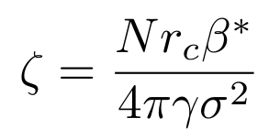
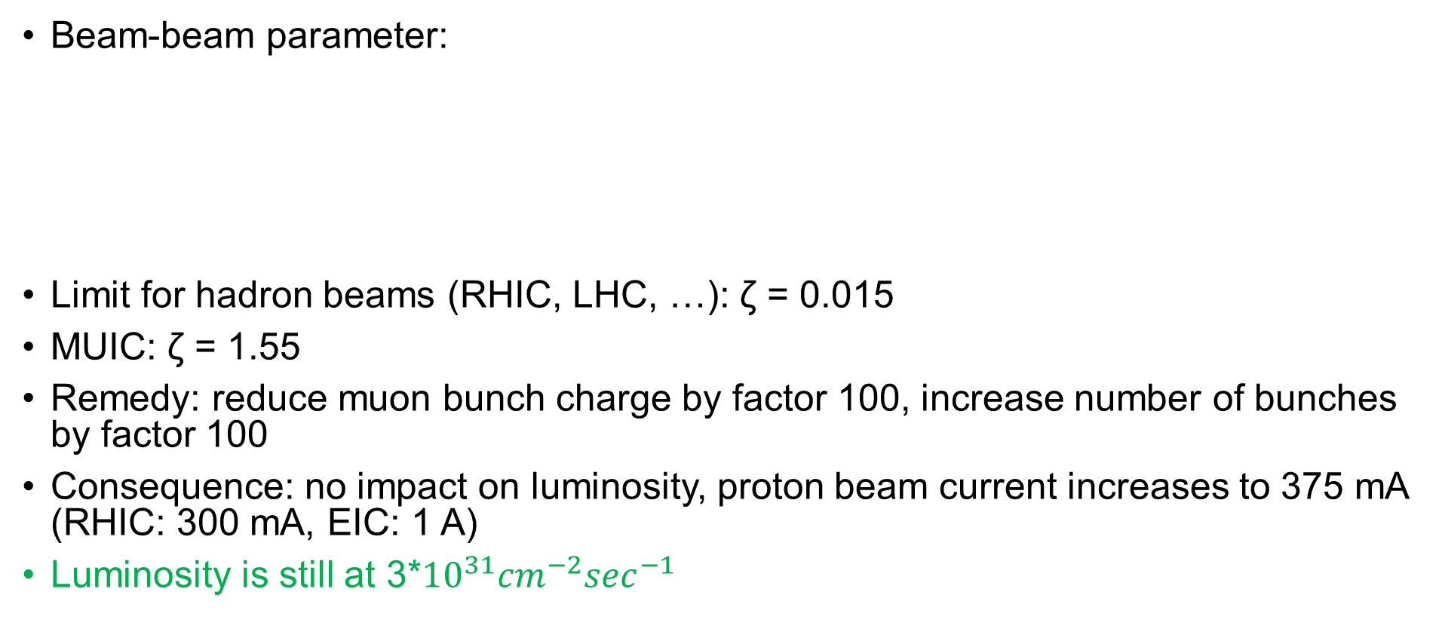
Beam-beam
Beam-beam parameter:
Limit for hadron beams (RHIC, LHC, …): ζ = 0.015
MUIC: ζ = 1.55
Remedy: reduce muon bunch charge by factor 100, increase number of bunches by factor 100
Consequence: no impact on luminosity, proton beam current increases to 375 mA (RHIC: 300 mA, EIC: 1 A)
Luminosity is still at 3*${10}^{31}{cm}^{−2}\sec^{−1}$

Slide 11
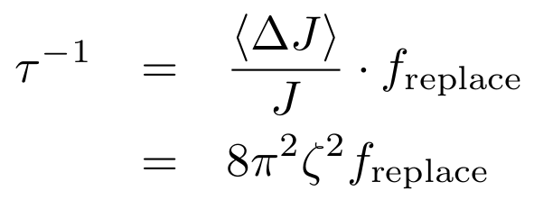
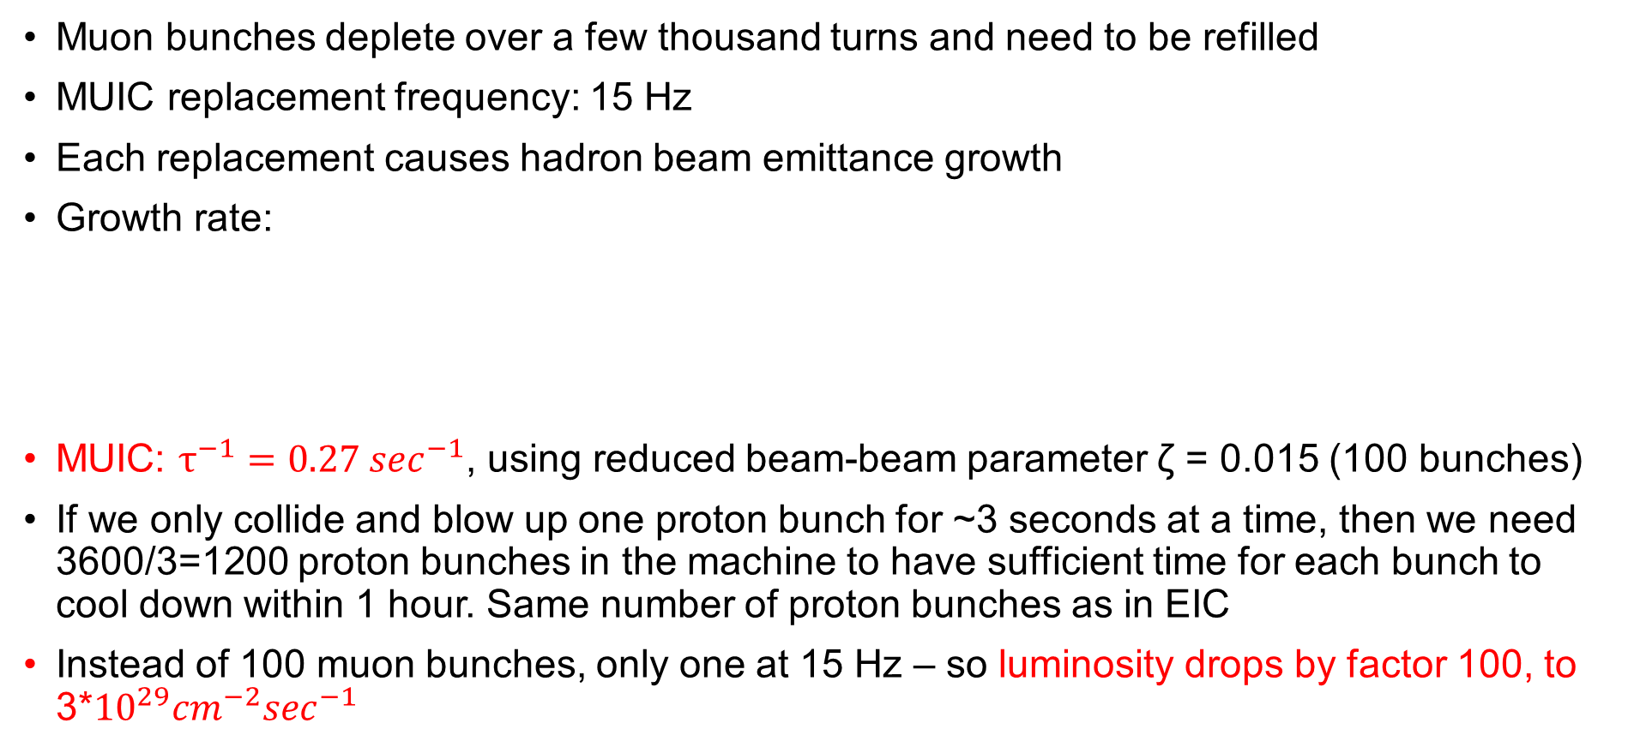
Muon replacement
Muon bunches deplete over a few thousand turns and need to be refilled
MUIC replacement frequency: 15 Hz
Each replacement causes hadron beam emittance growth
Growth rate:
MUIC: $τ^{−1}=0.27 \sec^{−1}$, using reduced beam-beam parameter ζ = 0.015 (100 bunches)
If we only collide and blow up one proton bunch for ~3 seconds at a time, then we need 3600/3=1200 proton bunches in the machine to have sufficient time for each bunch to cool down within 1 hour. Same number of proton bunches as in EIC
Instead of 100 muon bunches, only one at 15 Hz – so luminosity drops by factor 100, to 3*${10}^{29}{cm}^{−2}\sec^{−1}$

Slide 12
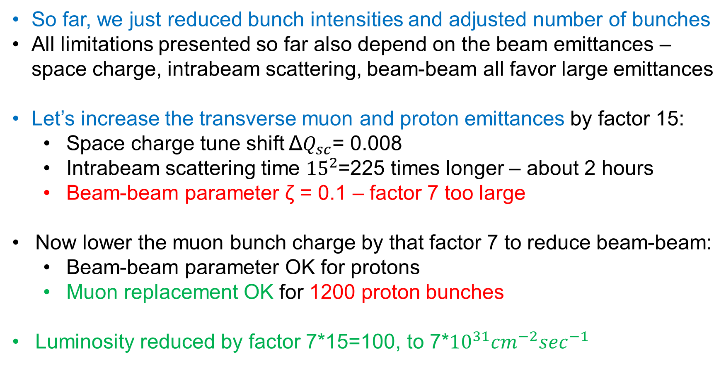
Alternative Approach
So far, we just reduced bunch intensities and adjusted number of bunches
All limitations presented so far also depend on the beam emittances – space charge, intrabeam scattering, beam-beam all favor large emittances
Let’s increase the transverse muon and proton emittances by factor 15:
  Space charge tune shift Δ$Q_{sc}$= 0.008
  Intrabeam scattering time ${15}^{2}$=225 times longer – about 2 hours
  Beam-beam parameter ζ = 0.1 – factor 7 too large
Now lower the muon bunch charge by that factor 7 to reduce beam-beam:
  Beam-beam parameter OK for protons
  Muon replacement OK for 1200 proton bunches
Luminosity reduced by factor 7*15=100, to 7*${10}^{31}{cm}^{−2}\sec^{−1}$

Slide 13
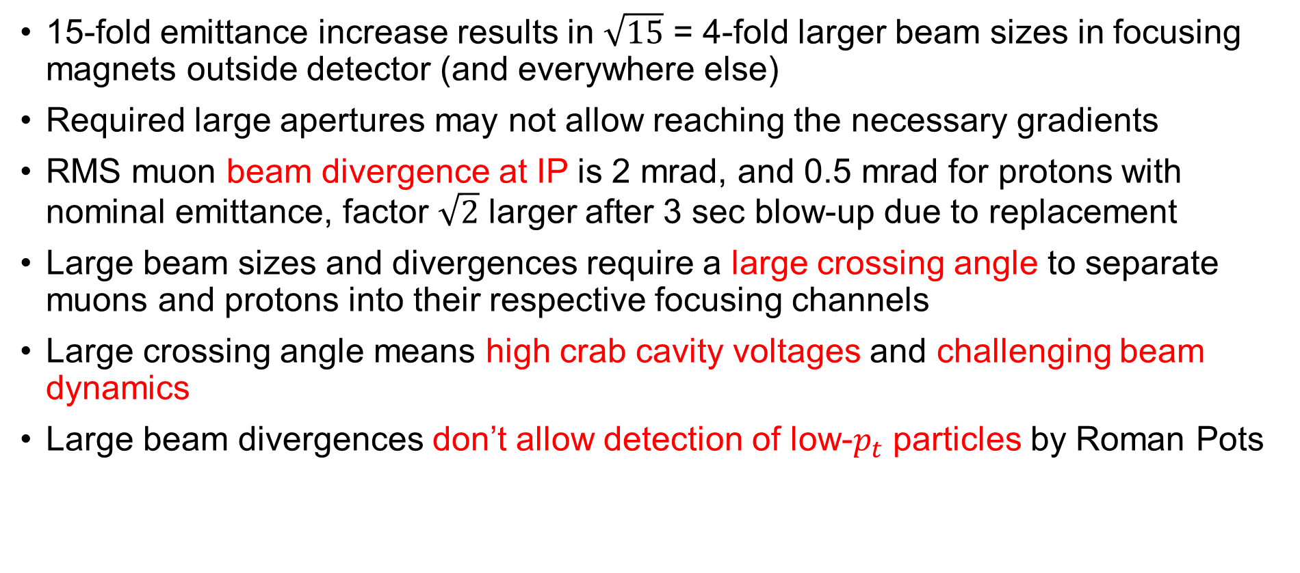
Challenges and Downsides
15-fold emittance increase results in $\sqrt{15}$ = 4-fold larger beam sizes in focusing magnets outside detector (and everywhere else)
Required large apertures may not allow reaching the necessary gradients
RMS muon beam divergence at IP is 2 mrad, and 0.5 mrad for protons with nominal emittance, factor $\sqrt{2}$ larger after 3 sec blow-up due to replacement
Large beam sizes and divergences require a large crossing angle to separate muons and protons into their respective focusing channels
Large crossing angle means high crab cavity voltages and challenging beam dynamics
Large beam divergences don’t allow detection of low-$p_{t}$ particles by Roman Pots

Slide 14
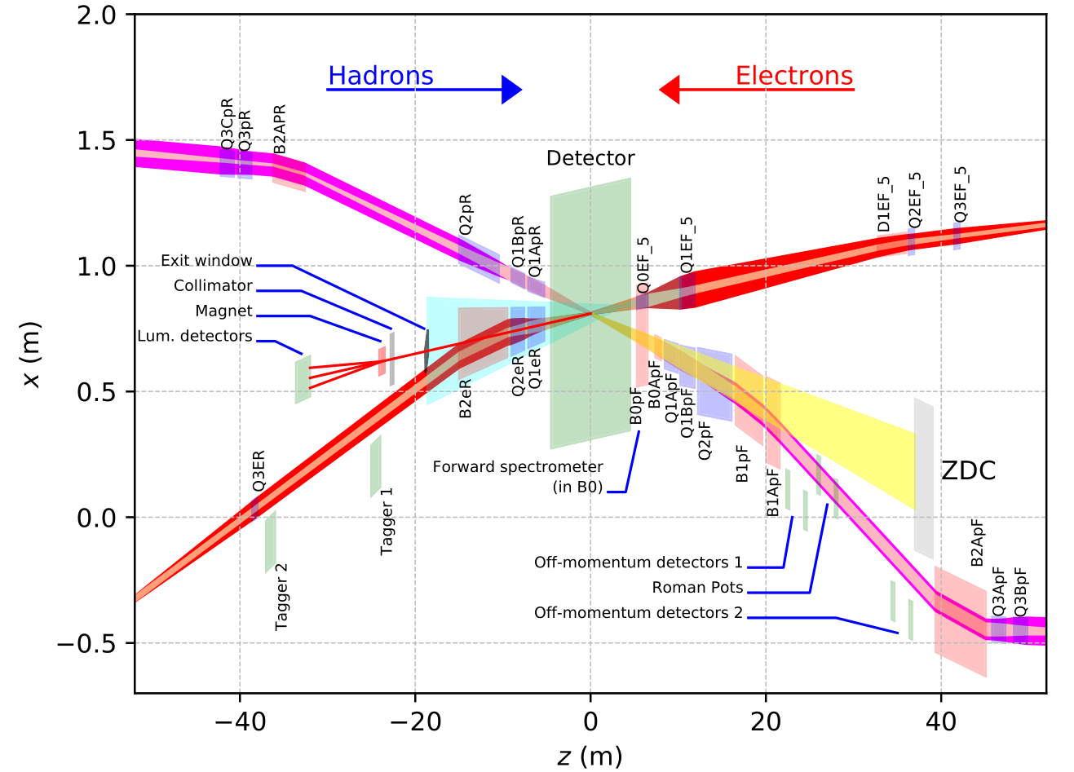
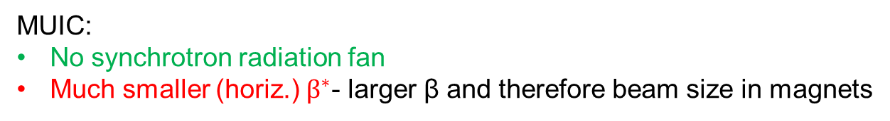
EIC Inner IR Layout
High luminosity:
  Small β* for high luminosity
  Limited IR chromaticity contributions
  Large final focus quadrupole aperture
  Physics requirements:
  Large detector acceptance for forward-scattered particles, and safe passing of synchrotron radiation fan – even larger magnet apertures
  Forward spectrometer
  No machine elements within +/- 4.5m from the IP
  Space for luminosity detector, neutron detector, “Roman Pots”
Multi-stage separation:
Electrons from protons – 25mrad crossing angle
Protons from neutrons – separator dipole
Electrons from Bethe-Heitler photons for luminosity monitoring – separator dipole
MUIC:
No synchrotron radiation fan
Much smaller (horiz.) $β^{∗}$- larger β and therefore beam size in magnets

Slide 15
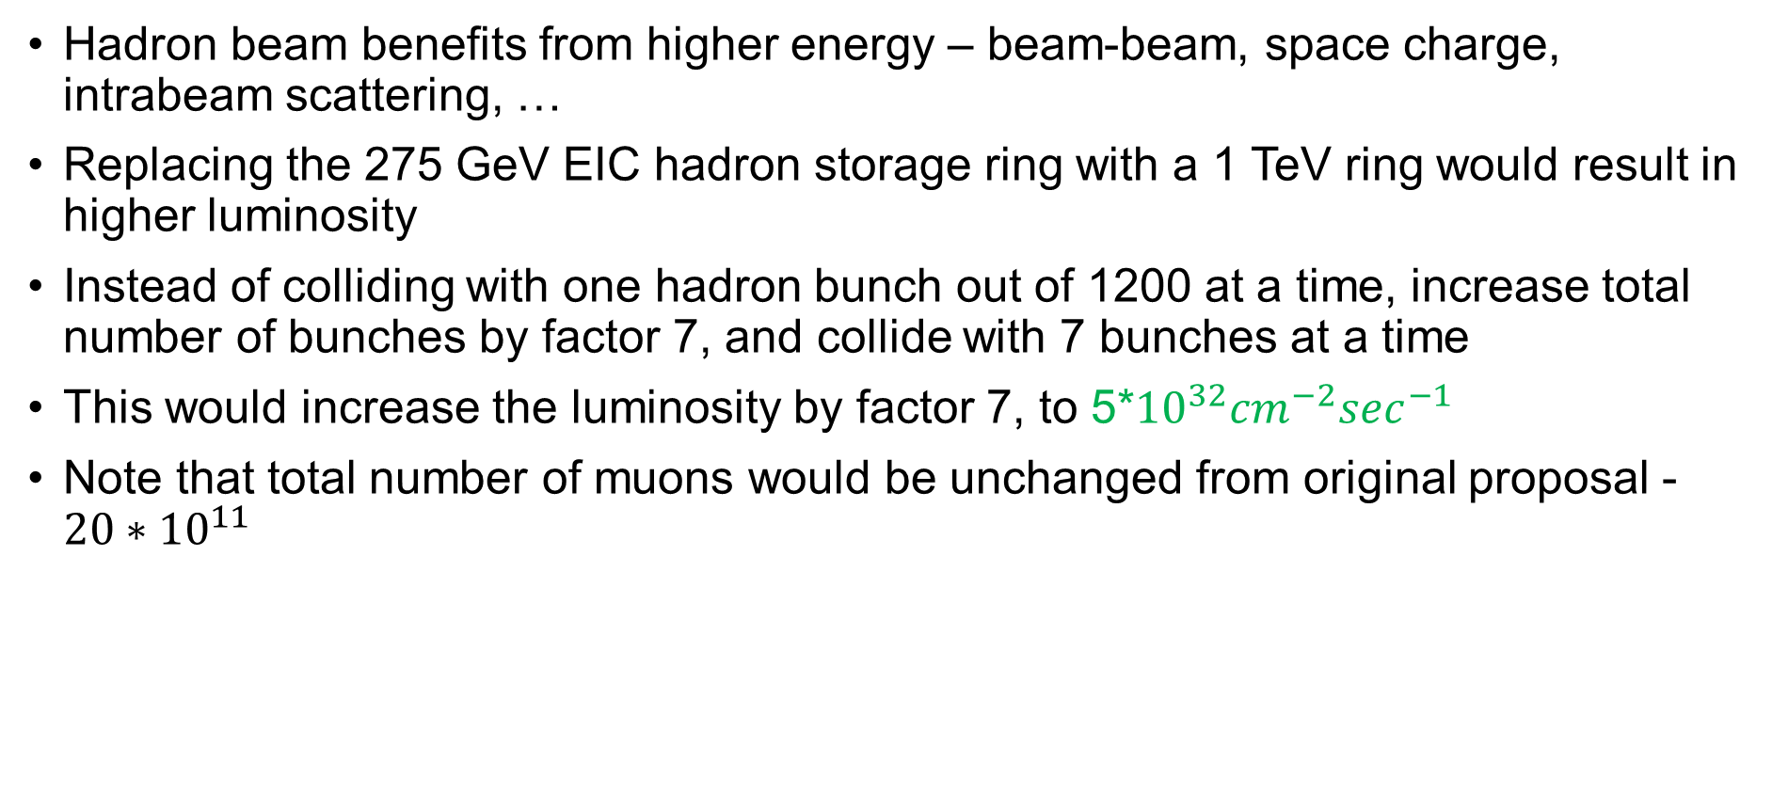
“Staging”
Hadron beam benefits from higher energy – beam-beam, space charge, intrabeam scattering, …
Replacing the 275 GeV EIC hadron storage ring with a 1 TeV ring would result in higher luminosity
Instead of colliding with one hadron bunch out of 1200 at a time, increase total number of bunches by factor 7, and collide with 7 bunches at a time
This would increase the luminosity by factor 7, to 5*${10}^{32}{cm}^{−2}\sec^{−1}$
Note that total number of muons would be unchanged from original proposal - ${20∗10}^{11}$

Slide 16
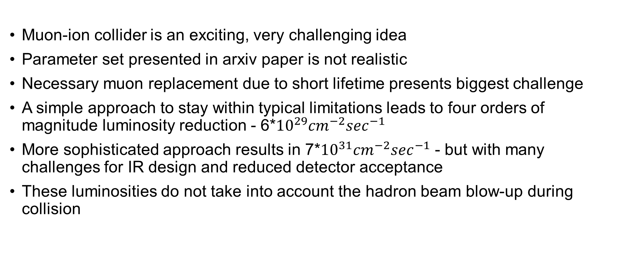
Summary
Muon-ion collider is an exciting, very challenging idea
Parameter set presented in arxiv paper is not realistic
Necessary muon replacement due to short lifetime presents biggest challenge
A simple approach to stay within typical limitations leads to four orders of magnitude luminosity reduction - 6*${10}^{29}{cm}^{−2}\sec^{−1}$
More sophisticated approach results in 7*${10}^{31}{cm}^{−2}\sec^{−1}$ - but with many challenges for IR design and reduced detector acceptance
These luminosities do not take into account the hadron beam blow-up during collision

